Slide 1

Machine learning, digital twins and atomistic simulations for t-o-f INS
Olivier Delaire ª, Aiden Sable ª, Xing He ª, Bander Linjawi ª, Andrei Savici ^{b}, Jiao Lin ^{b}, Fahima Islam ^{b}, Garrett Granroth ^{b}, Daniel Pajerowski ^{b}, Douglas Abernathy ^{b}
ªDuke University, Durham NC, USA ,
^{b}Oak Ridge National Laboratory, Oak Ridge TN, USA
DTU Mcstas workshop July 2025

Slide 2
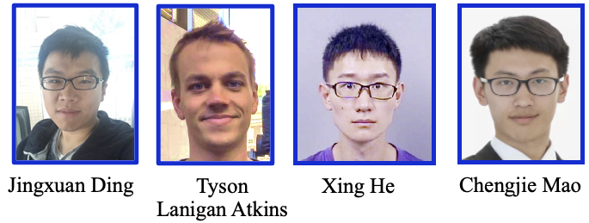
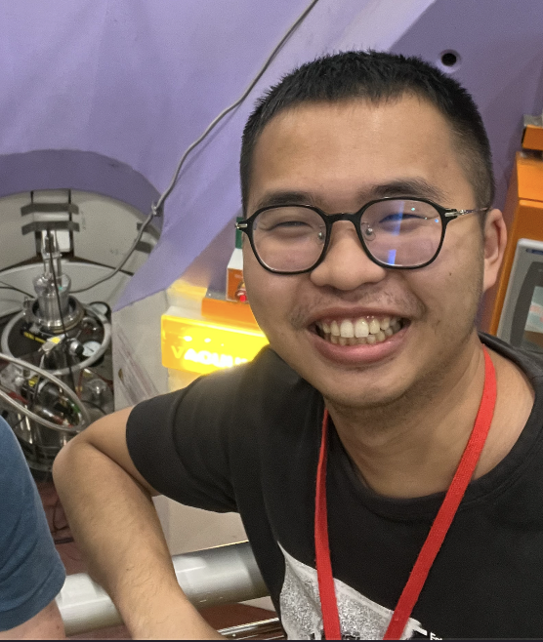
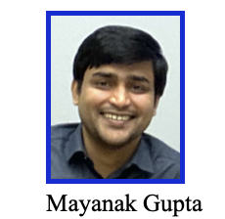






Acknowledgements
Ph.D.
students
Bander Linjawi,
Tyler Wilson,
Patrick Postec,
Aiden Sable,
Kevin Clelland,
Tingguang Li,
Wenda Si
Hung-Min Lin
Postdocs
Argonne National Lab: M. Krogstad, R. Osborn, S. Rosenkranz, D.-Y. Chung, Z. Hood, A. Said, A. Alatas,
Oak Ridge National Lab: D.M. Pajerowski, D.L. Abernathy, T. Hong, F. Ye, Y, Liu, S. Chi, L. Boatner, J. Lin, A. Savici
Ross Stewart (ISIS); Fanni Juranyi (PSI)
W. Zeier (U. Münster); L. Nazar (U. Waterloo);
M. Kanatzidis (Northwestern); Hui Wang (Louisville)
Jie Ma (Shanghai Jiao Tong); Qingyong Ren (CSNS)
Niuchang Ouyang
J. Niedziela
D. Bansal
Funding: DOE Office of Science, Basic Energy Sciences
National Science Foundation,
Duke Energy Initiative
Argonne National
Laboratory

Slide 3


Spectra beyond phonon quasiparticles
harmonic phonons: 𝛅 -functions on dispersions
$$E=ℏω\left(\text{q}\right)$$
strong disorder and anharmonicity:
- complex spectral functions
- no-longer well-defined quasiparticles
Strongly Perturbed:
strong renormalization,
complex spectra (eg. satellites),
quasi-elastic from damped fluctuations
Harmonic:
delta functions
Weakly Perturbed:
damped harmonic oscillators
Lorentzian-like, shifted
$\text{δ}(E−ℏω\left(\text{q}\right)$)
E
E
E
E
Q
Q
Q
Q
Q₀
Q₀
Q₀
Q₀
PbTe, SnTe:
Nature Materials 10, 614 (2011)
PRL 112, 175501 (2014)
Superionics:
Nature Physics 15, 73 (2019)
PNAS 117, 3930 (2020)

Slide 4
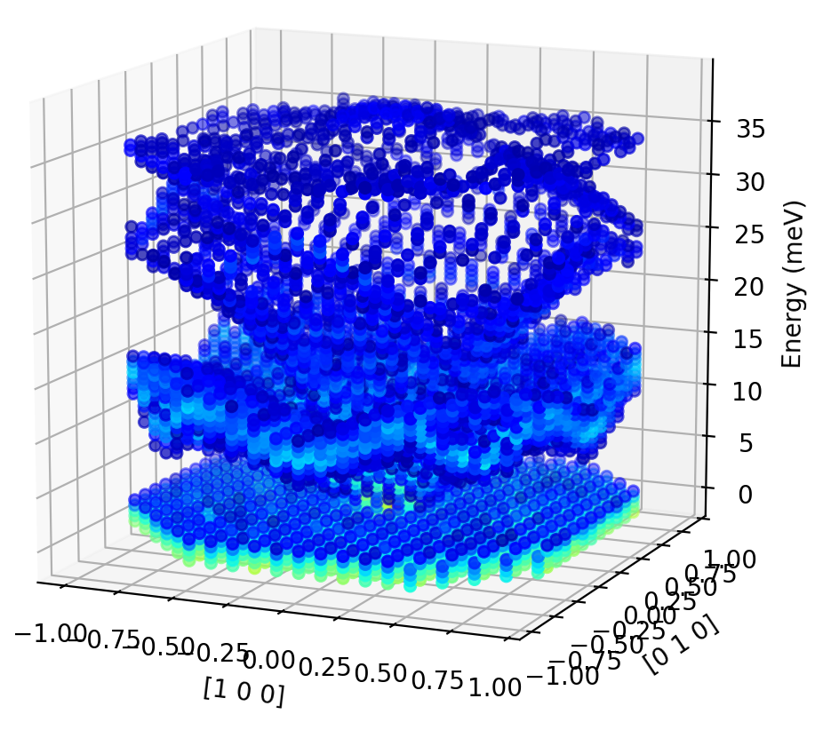
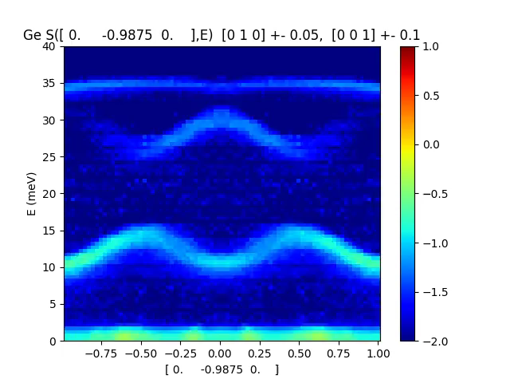
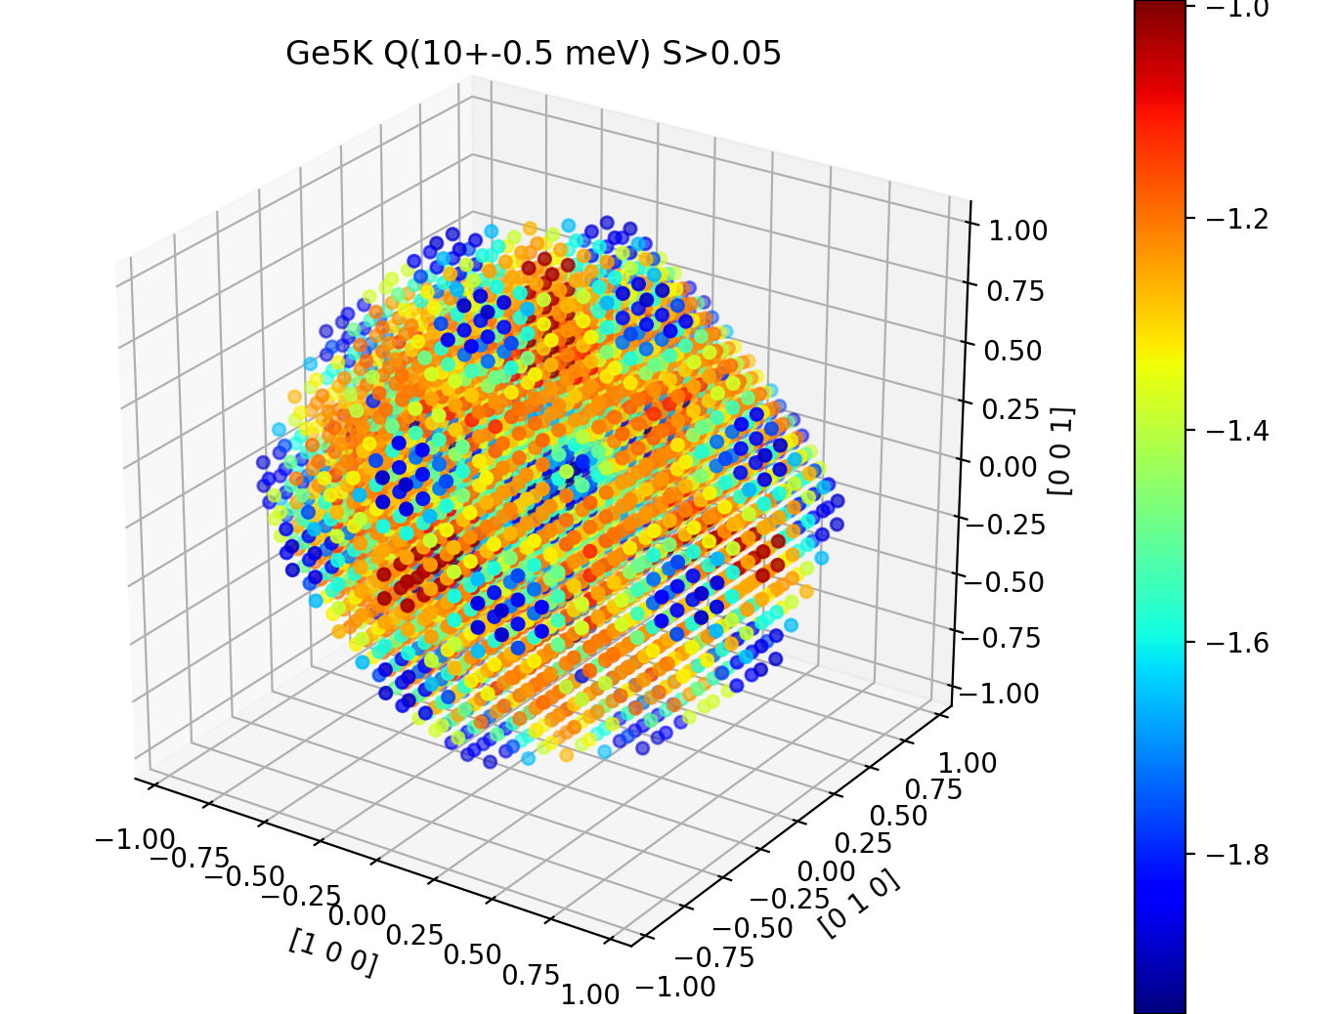
Big data from time-of-flight INS
Dynamical structure factor S(Q,E) in Ge crystal at T=5K from ARCS @ SNS
Energy transfer, E
Wave vector transfer, Q

Slide 5

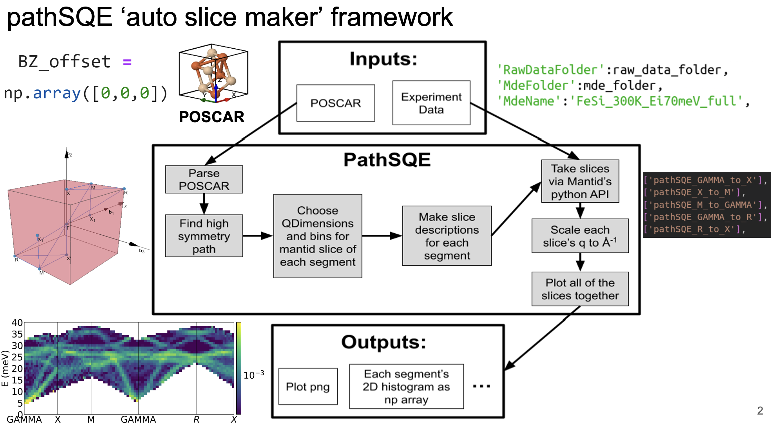
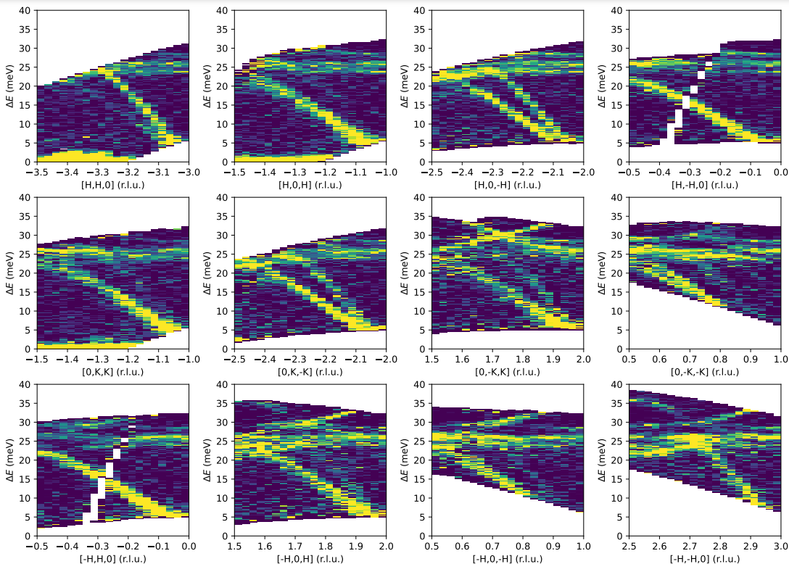
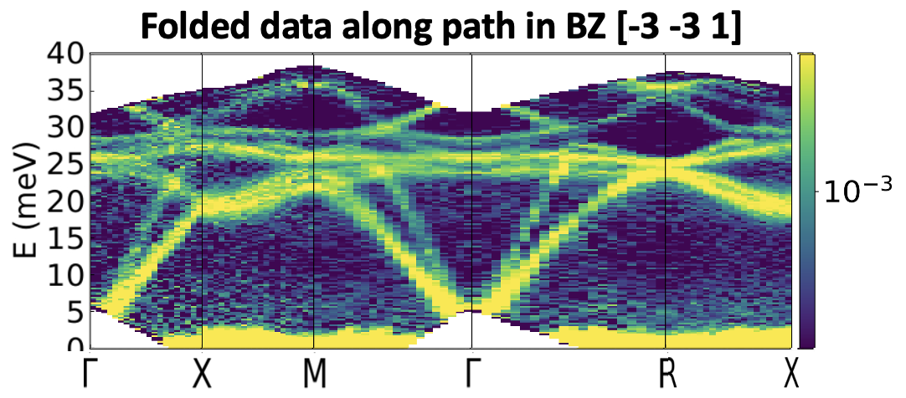
pathSQE: workflow overview
Efficient, Mantid-compatible framework
Data normalization and errors properly handled
Extensive data visualization and coupled simulations
Aiden Sable
BZ [-3 -3 1] Page 3: All M-𝚪 segments

Slide 6
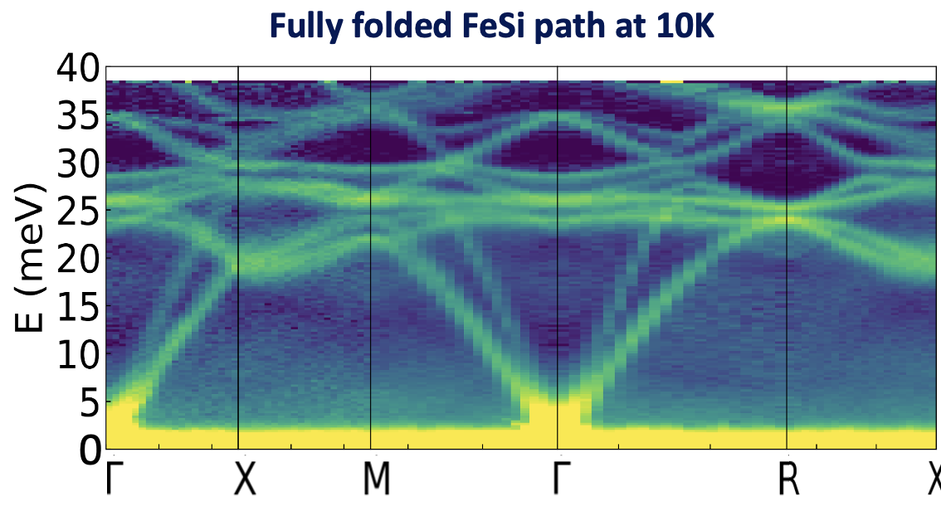
pathSQE: workflow overview
Aiden Sable
Efficient, Mantid-compatible framework
Data normalization and errors properly handled
Extensive data visualization and coupled simulations

Slide 7
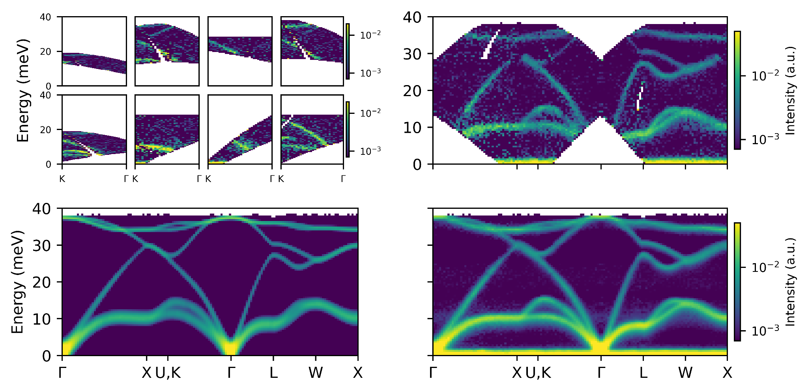
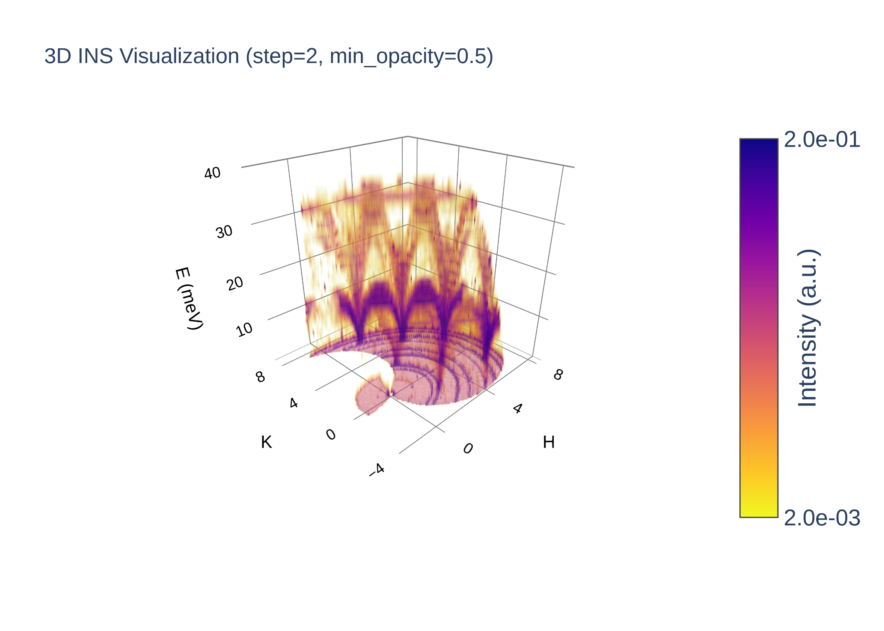

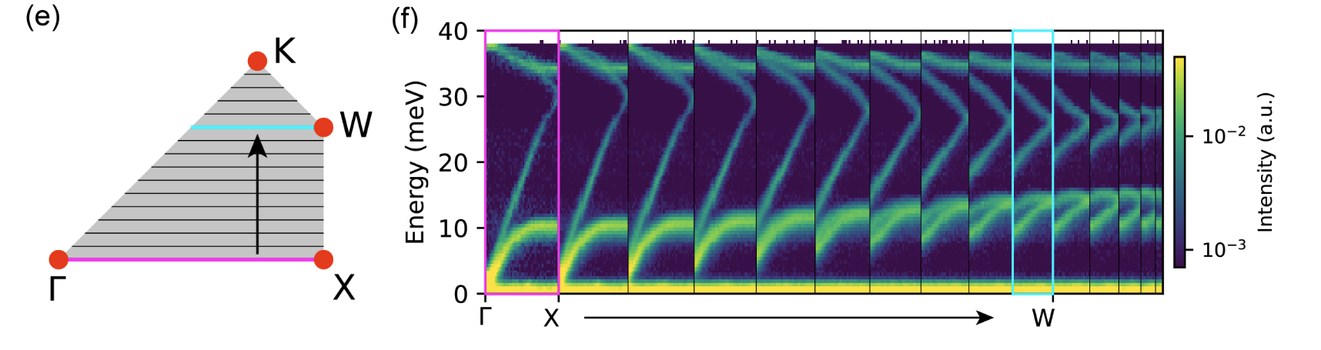
Ge ARCS data processing with pathSQE
Expt.

Slide 8
INS data processing, comparison with DFT
Single-crystal Ge phonons dataset (INS vs DFT)
INS
DFT
Expt.
Sim.

Slide 9
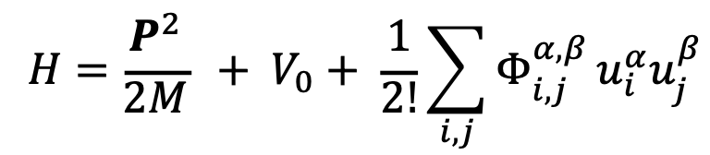
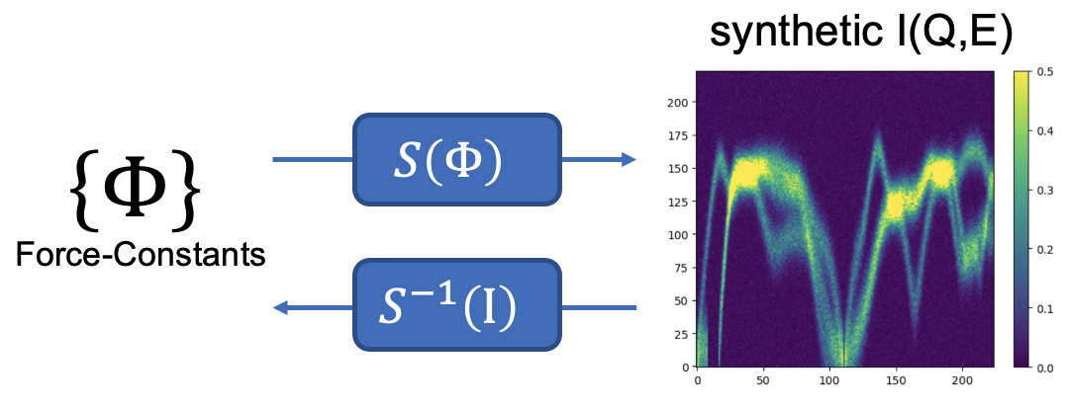
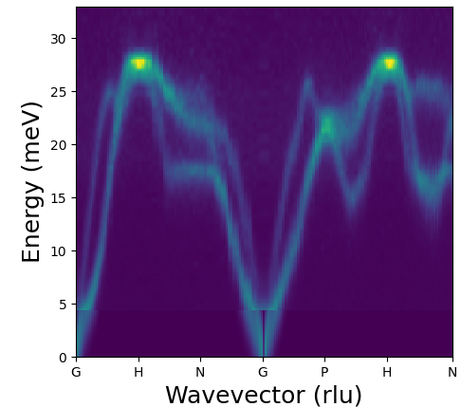
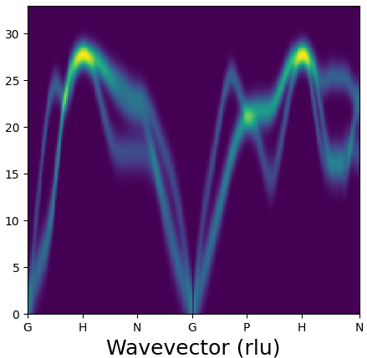
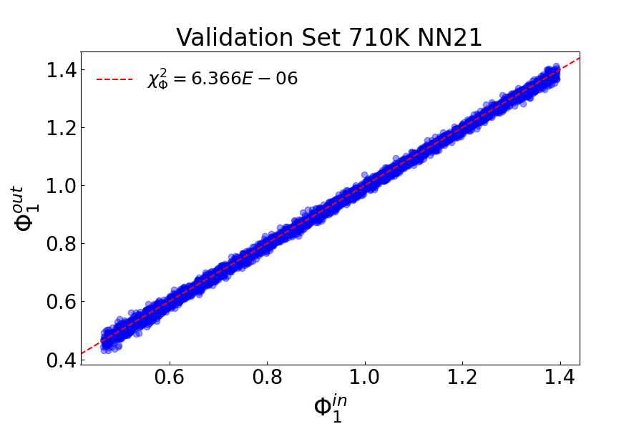

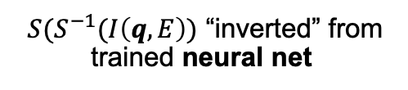
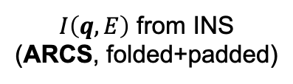
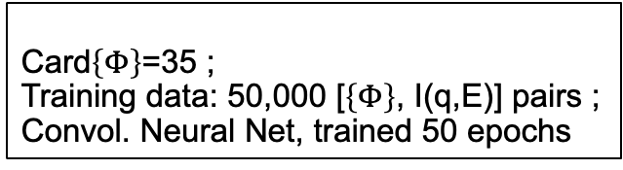
Machine learning for lattice dynamics model inversion based on INS data
Parameterized
Hamiltonian
$$\left\{Φ\right\}$$
Card$\left\{Φ\right\}$=35 ;
Training data: 50,000 [$\left\{Φ\right\}$, I(q,E)] pairs ;
Convol. Neural Net, trained 50 epochs
$I\left(q,E\right)$ from INS
(ARCS, folded+padded)
$S(S^{−1}(I\left(q,E\right))$ “inverted” from
trained neural net
validation, NN21

Slide 10
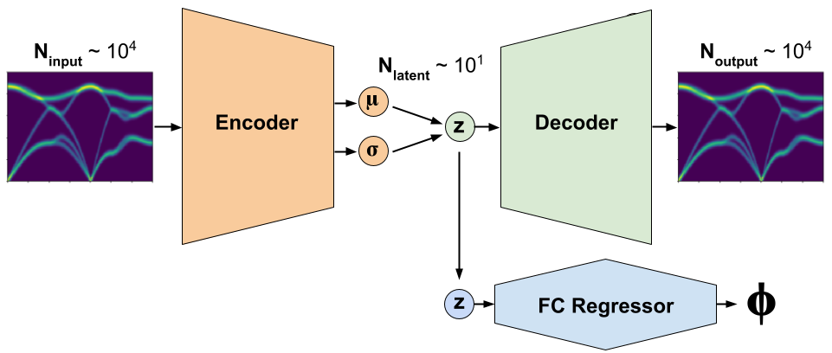
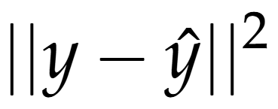
VAE model architecture for FC inversion from I(q,E) spectra
VAE dual-objective loss function
Note: Grid search optimization identified well-performing hyperparameters:
N_{lat} = 20, w_{KLdiv} = 1e-6L
FC Reg MSE loss on FC predictions

Slide 11
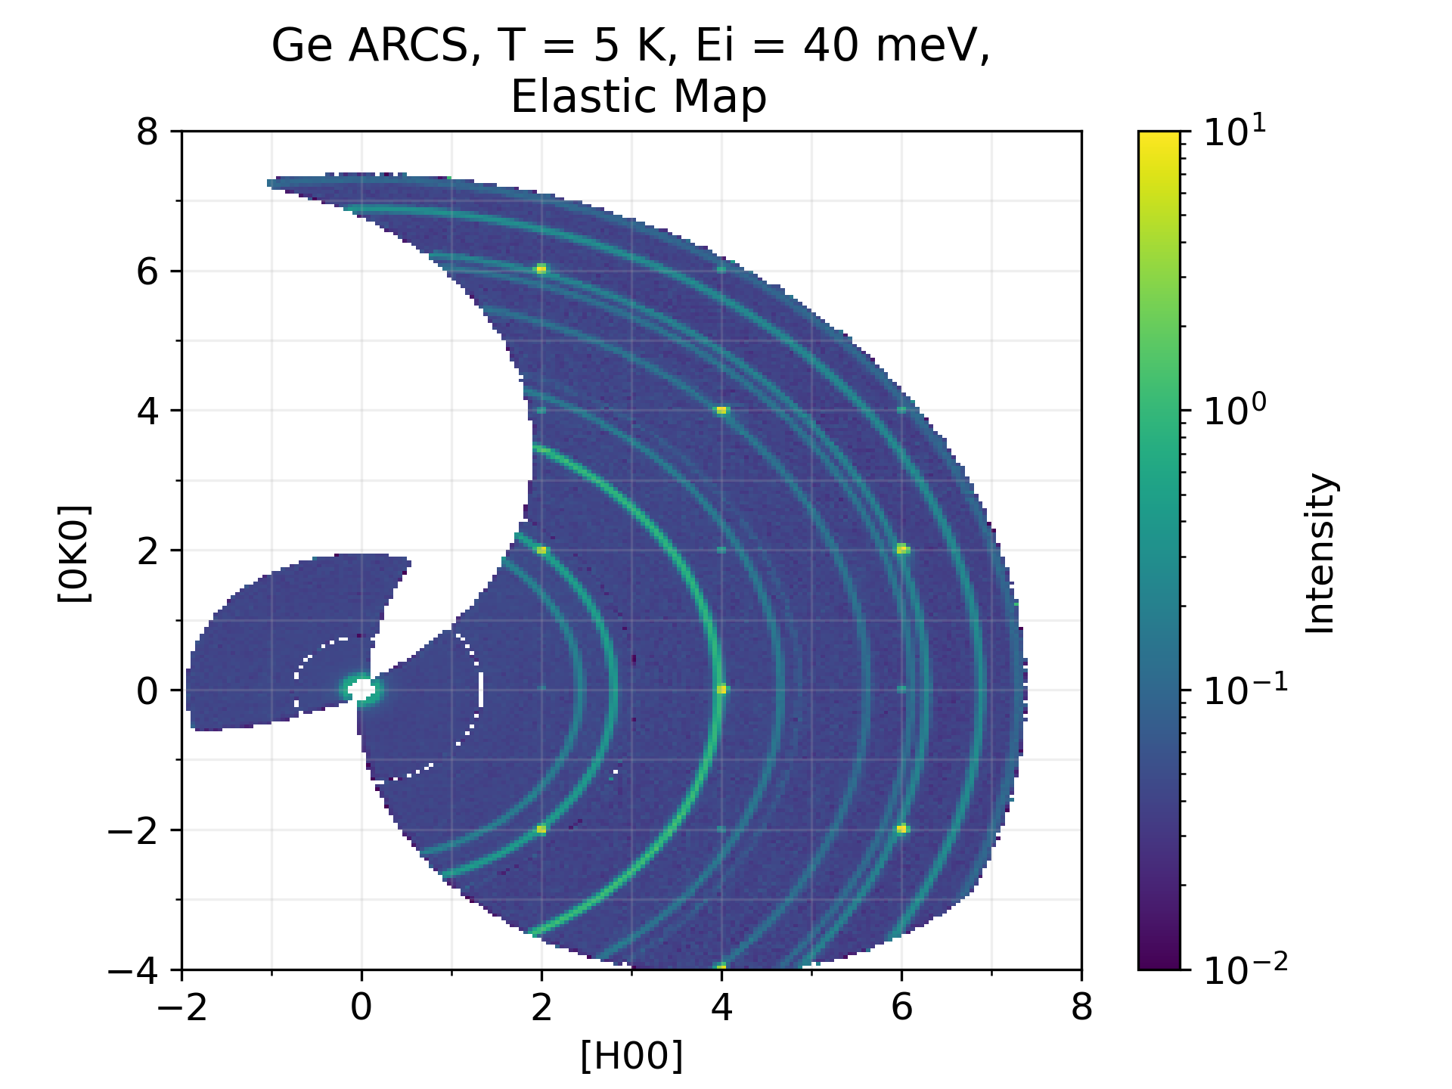
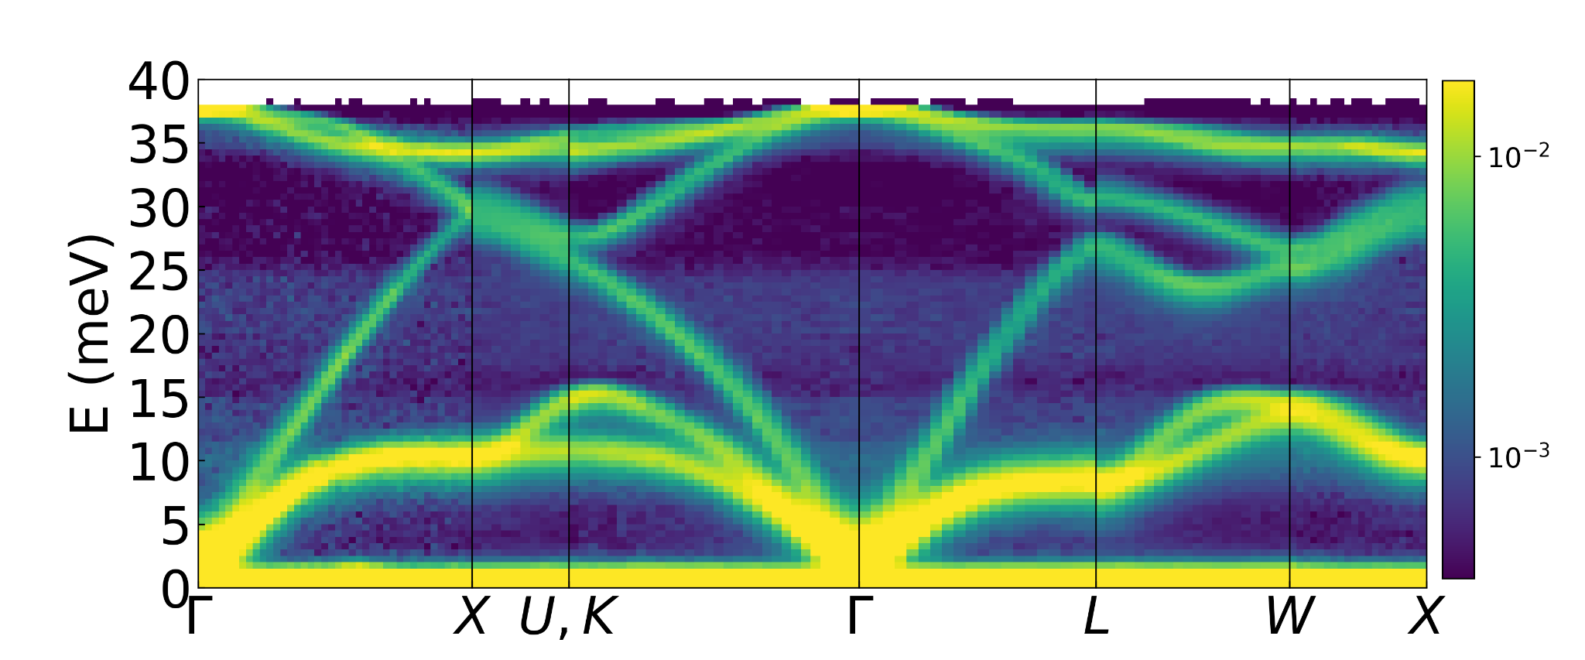
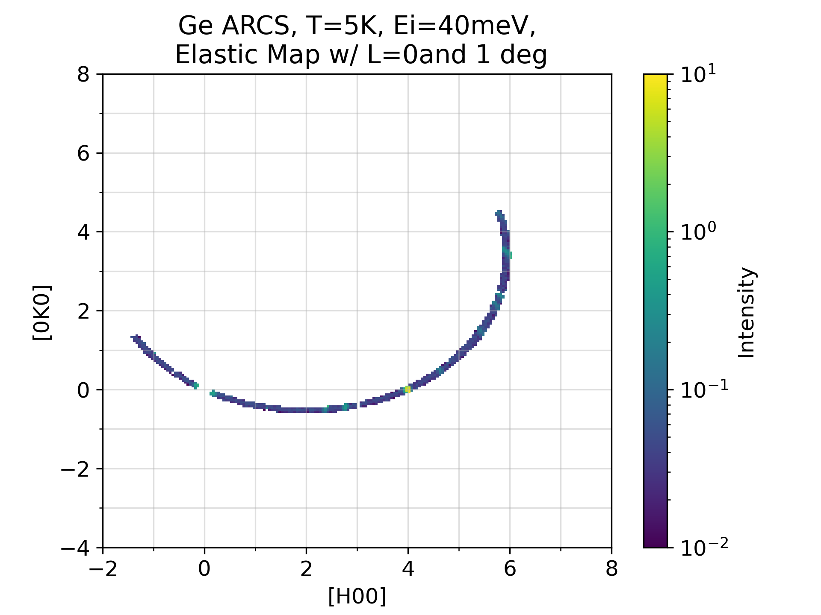
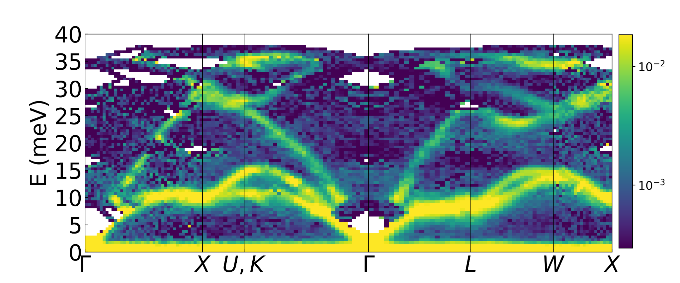

Ongoing work: model inversion on less data
90° rotation, 3 hours
ɸ
✅
Which orientations to choose?
→ Potential for experiment optimization / steering
1° rotation, 2 mins
ɸ
✅
(!)

Slide 12
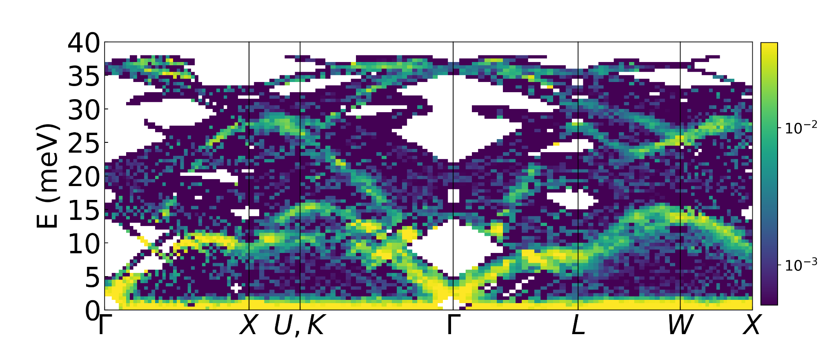
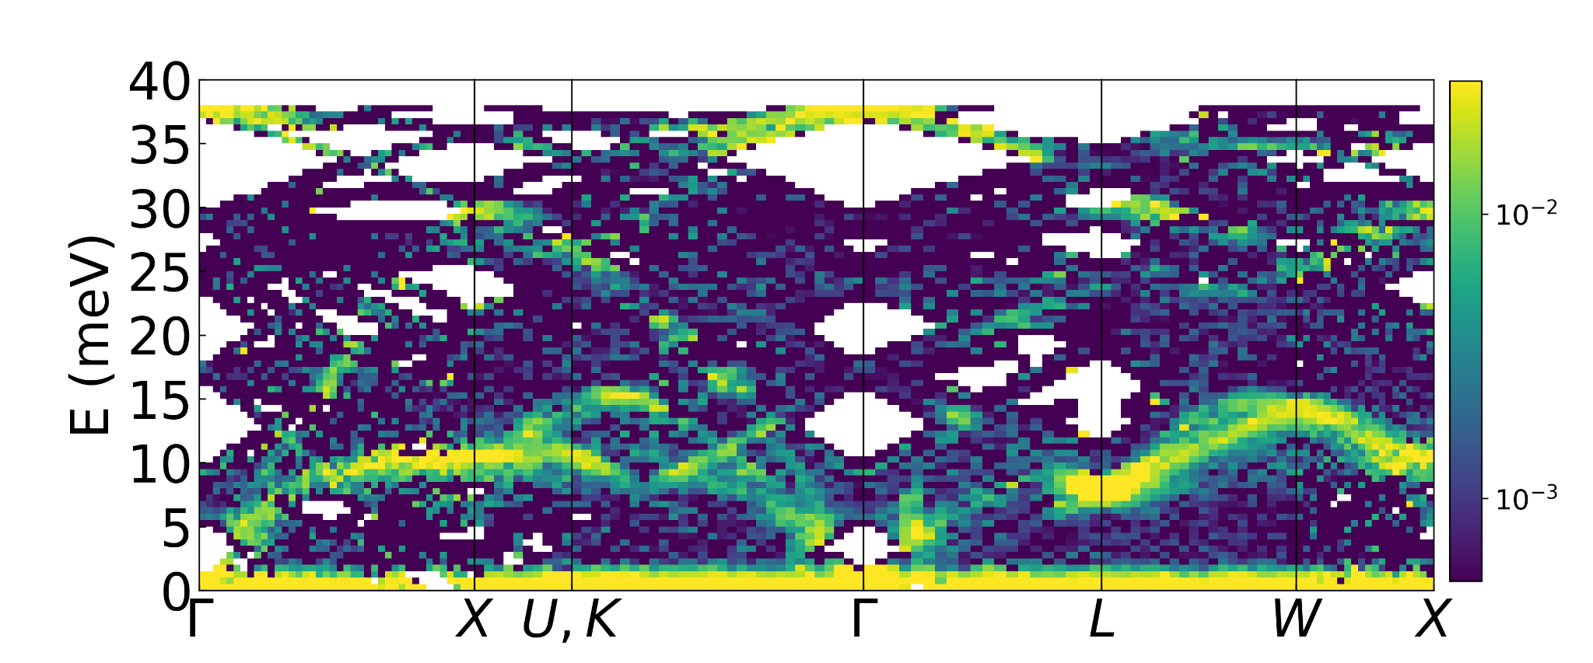
Ongoing work: model inversion on less data
ꞷ = 42°
ꞷ = 75°

Slide 13
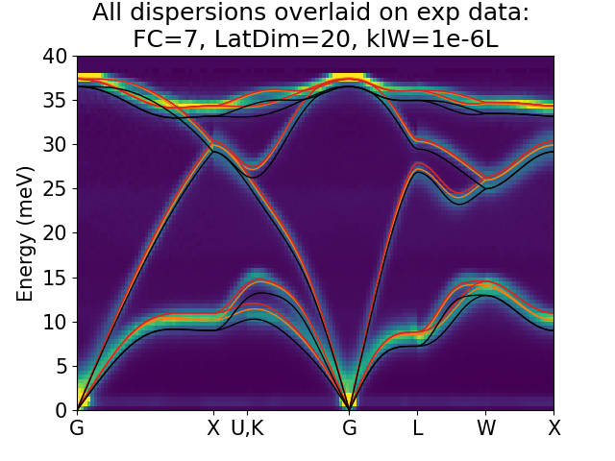
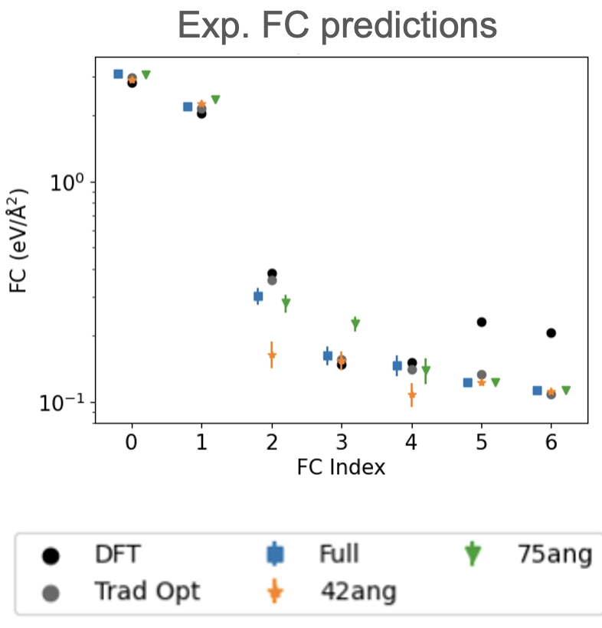
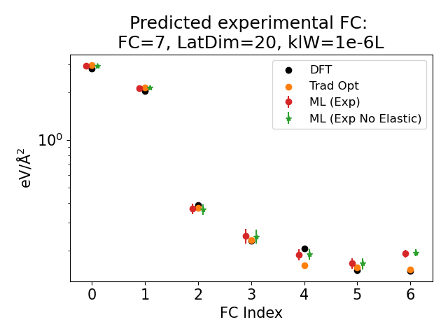
ML FC capture experimental dynamics better than DFT FC

Slide 14
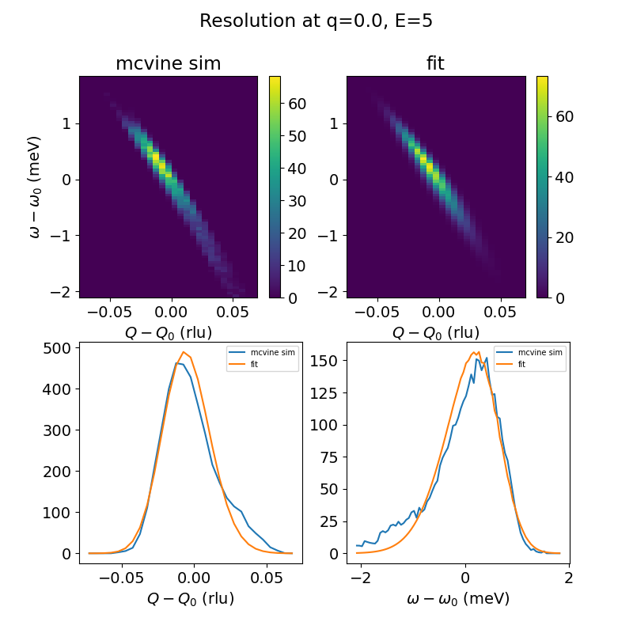
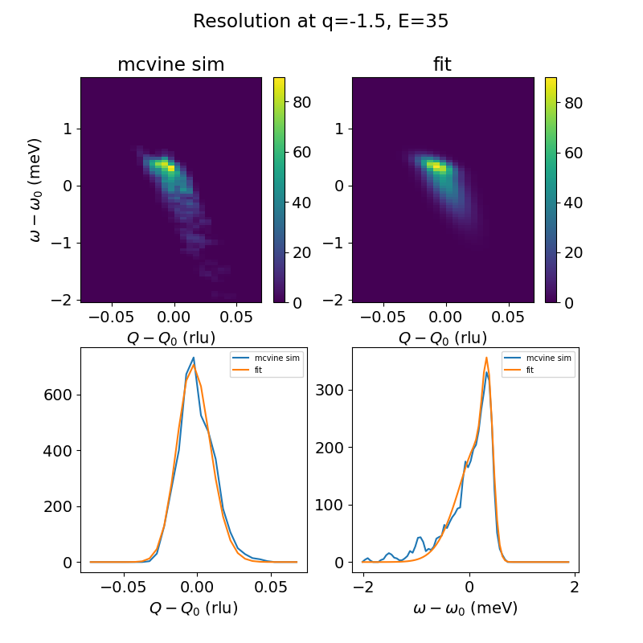
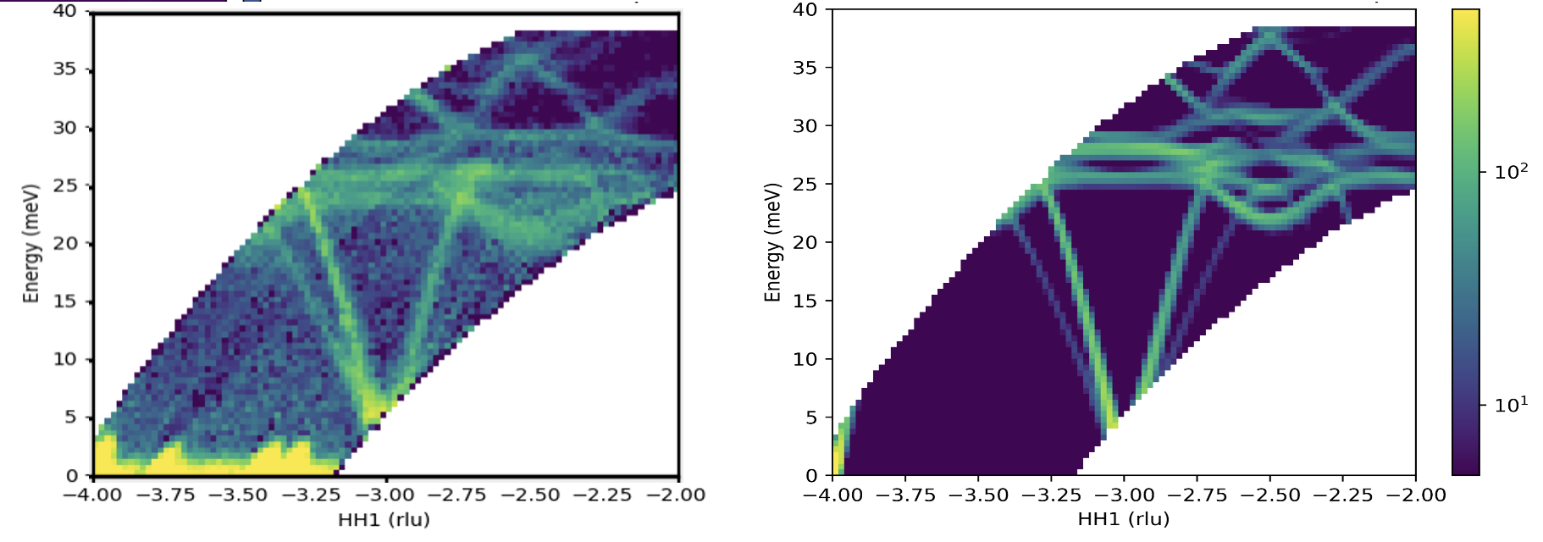
Ongoing work: t-o-f resolution
(w/ Fahima Islam, Garrett Granroth)
McVine resolution modeling → intrinsic linewidths, INS deblurring for FC inversion
Quantitative comparisons to simulation results (w/ Niuchang Ouyang)
ARCS at SNS

Slide 15
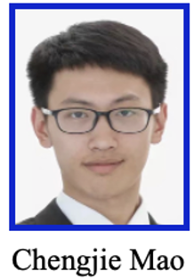
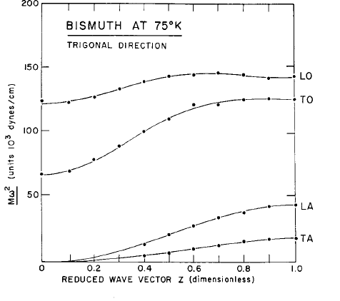
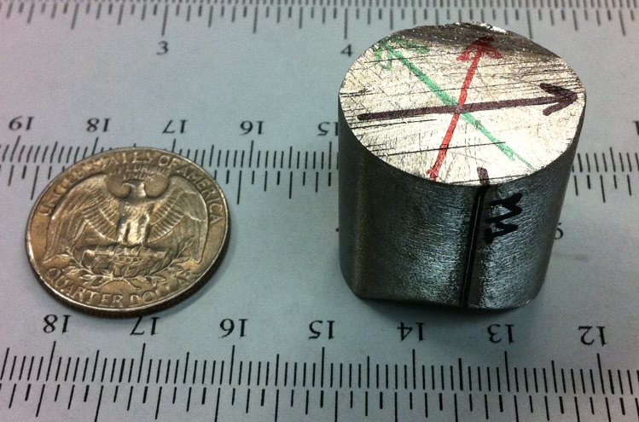
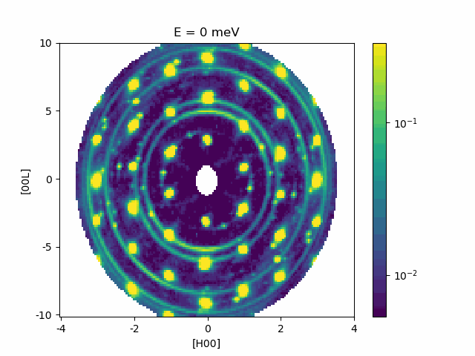
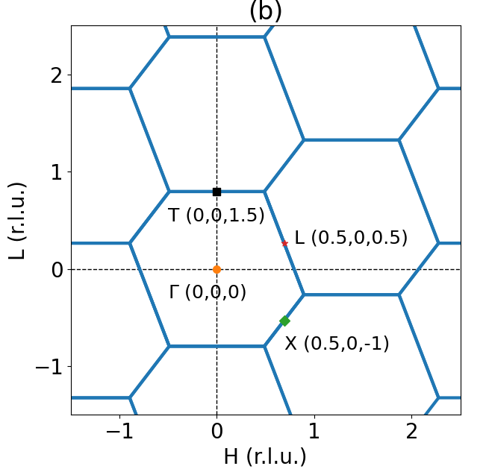
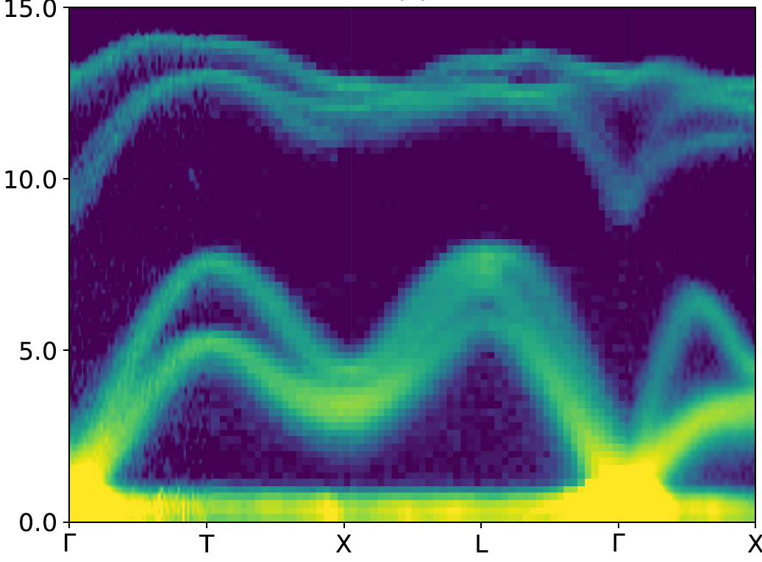

High-resolution phonon energies and linewidths in bismuth
Bi: no mass disorder (single isotope)
Purely coherent neutron cross section
Large crystal of high quality
Bi single crystal with 107g mass
Mosaic < 0.27°
Bi INS data from TAS (1964)
(H0L) reciprocal plane
CNCS 20meV data visualization (~6h scan)
INS (CNCS) T=2K, Ei=20meV folded in high symmetry directions (36 BZ in H0L planes)
[1] Yanell J., et al., IBM Journal of Research and development. 8, 234-240(1964)
Notes:
Disperion energy unit

Slide 16
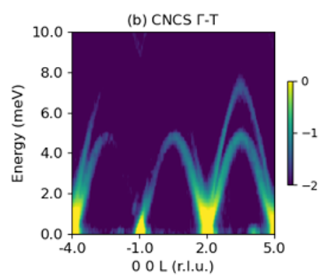
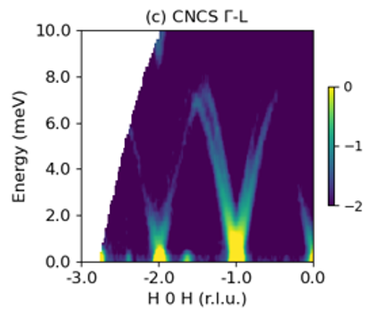
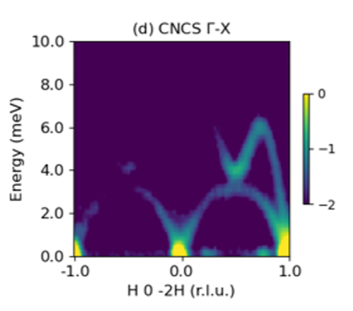
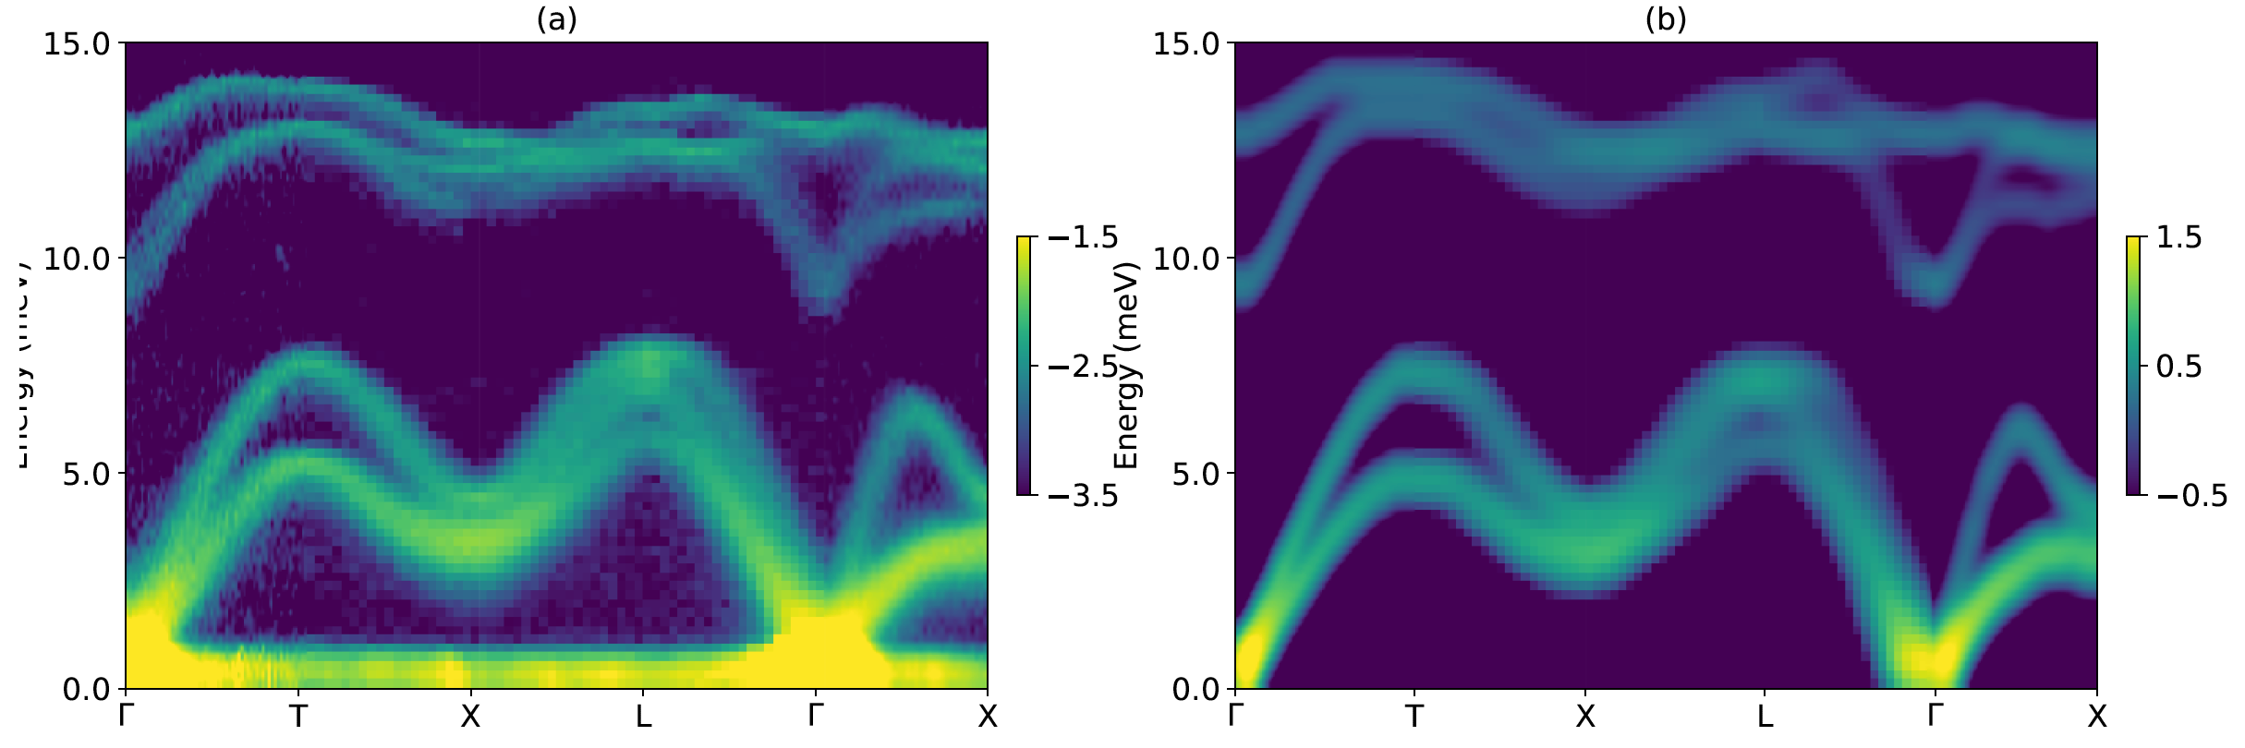
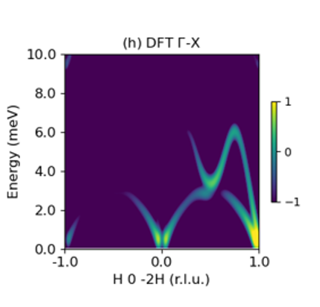
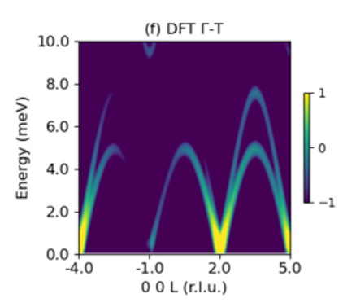
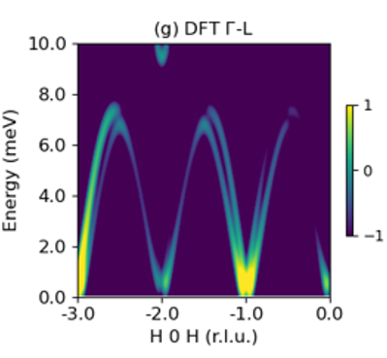
Comparison between INS and DFT
Bismuth INS intensity for S(Q,E) in good agreement with DFT harmonic simulations (requires including spin-orbit coupling)
(INS at 300K, CNCS, Ei = 12meV)
Notes:
Animate the slices

Slide 17
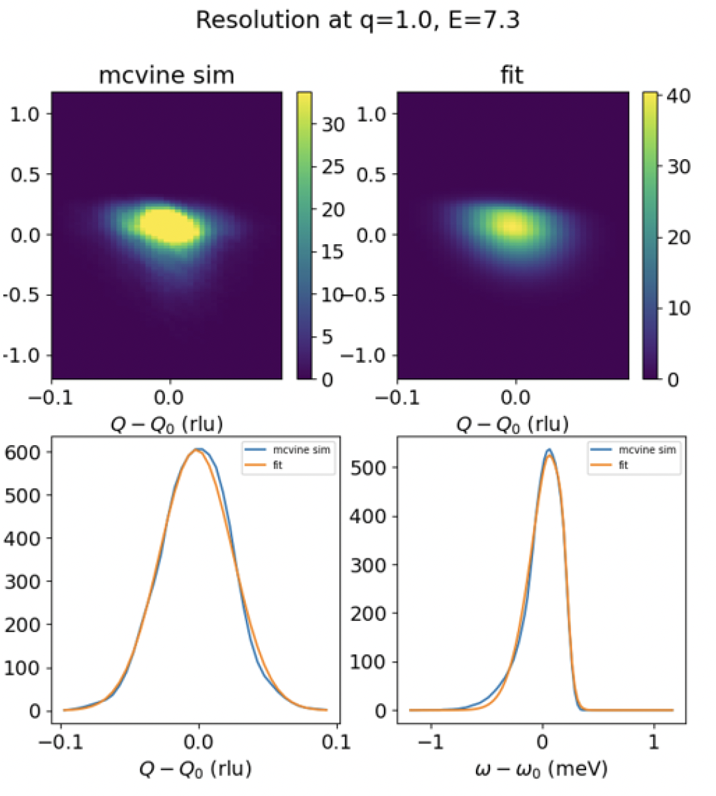
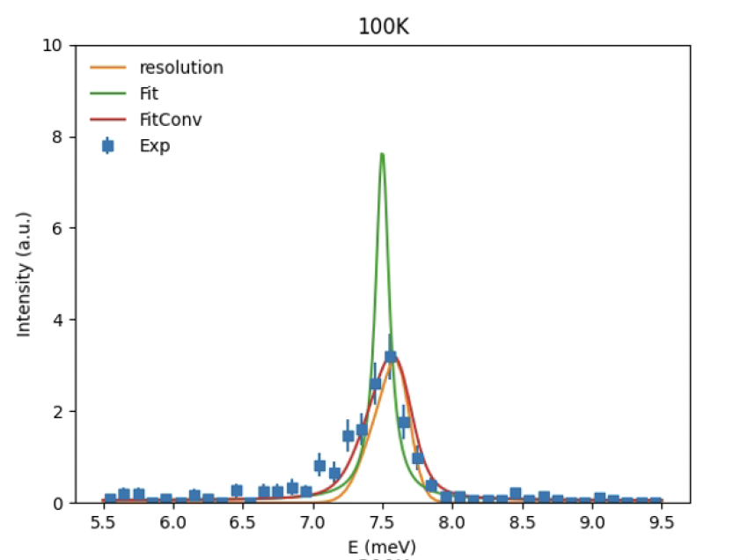

Monte Carlo resolution for t-o-f INS
McVine resolution modeling → intrinsic linewidths
CNCS at SNS

Slide 18

Monte Carlo resolution: intrinsic linewidths
McVine resolution modeling → intrinsic linewidths
Quantitative comparison to simulations of linewidths from anharmonic scattering

Slide 19



First-principles simulations including finite temperature and disorder: AIMD and MLMD
Phys. Chem. Chem. Phys., 2022, 24, 18361
Gordon Bell Prize 2020
J. Chem. Phys. 159, 054801 (2023)
https://doi.org/10.1063/5.0155600
Additional ML surrogate potentials:
Neuro-evolution potential
https://gpumd.org/
Gaussian approximation potential
https://github.com/libatoms/QUIP
Moment tensor potential
https://mlip.skoltech.ru/download/

Slide 20






ML for materials simulations: MLIPs
DeePMD neural net potential trained on VASP AIMD
AIMD trajectories at set of T’s
MD in LAMMPS

Slide 21





MLMD: predict S(Q,E) including full anharmonicity
phonon broadening in Cu argyrodite
50K
150K
300K
450K
600K
Strong phonon broadening starting at low T, hope to check with CNCS / AMATERAS

Slide 22



Liquid-like dynamics in crystalline Li₆PS₅Cl
Nature Physics 21, 118 (2025)
Excess spectral weight on warming reveals Li⁺ stochastic motions at low frequency
(similar to INM’s in liquids)
DOS shape, $g(E)$ vs $E$, evolves from quadratic (solid-like) to linear (liquid-like)

Slide 23


Comparing QENS measurements and MLMD simulations
Nanosecond duration MD trajectories → match BASIS resolution (~3.5μeV)
Measured and simulated QENS spectrum
Chudley-Elliot fits of measured and simulated QENS spectrum
QENS
vs
MLMD

Slide 24

Subset of ML Force Fields from Materials Project
https://matbench-discovery.materialsproject.org/

Slide 25


















Ge dispersion from 14 MLFFs
DFT Results

Slide 26

FC domain from ensemble of universal MLFFs

Slide 27
Conclusions
ToF INS resolution needs to be systematically simulated to correct measured excitation linewidths
4D ToF INS datasets can benefit from folding and automated slicing (ideally updated with live events)
AI/ML can transform experimental and simulation workflows
Need AI to steer experiments and inform/refine sample models
Many exciting opportunities to work together!

Slide 28
Extra Slides

Slide 29
Simulation inference and
latent space analysis

Slide 30


Reconstructions are accurate across simulated test set
Most dissimilar test spectra to assess performance across FC phase space
Input
Recon.
Input
Recon.
Input
Recon.

Slide 31


15k-D spectra are accurately represented with 11-D encodings

Slide 32

High-fidelity FC predictions on simulated test data

Slide 33

Active latents nonlinearly encode to underlying FC
Mutual Information: a non-linear measure of the statistical dependence between two random variables
Difference between the entropy of one variable and its conditional entropy given the other variable.
Entropy: uncertainty or randomness of a random variable
Conditional Entropy: uncertainty of one variable given the knowledge of another

Slide 34




Semantic grouping in latent space mirrors physical interactions
UMAP (Uniform Manifold Approximation and Projection): unsupervised ML for non-linear dimensionality reduction
Known for preserving both local and global structures

