Slide 1
Simulating diffractive optics for neutron techniques
Advanced computer simulations methods for neutron scattering instruments
Mano raj Dhanalakshmi Veeraraj
ICNS 2025

Slide 2
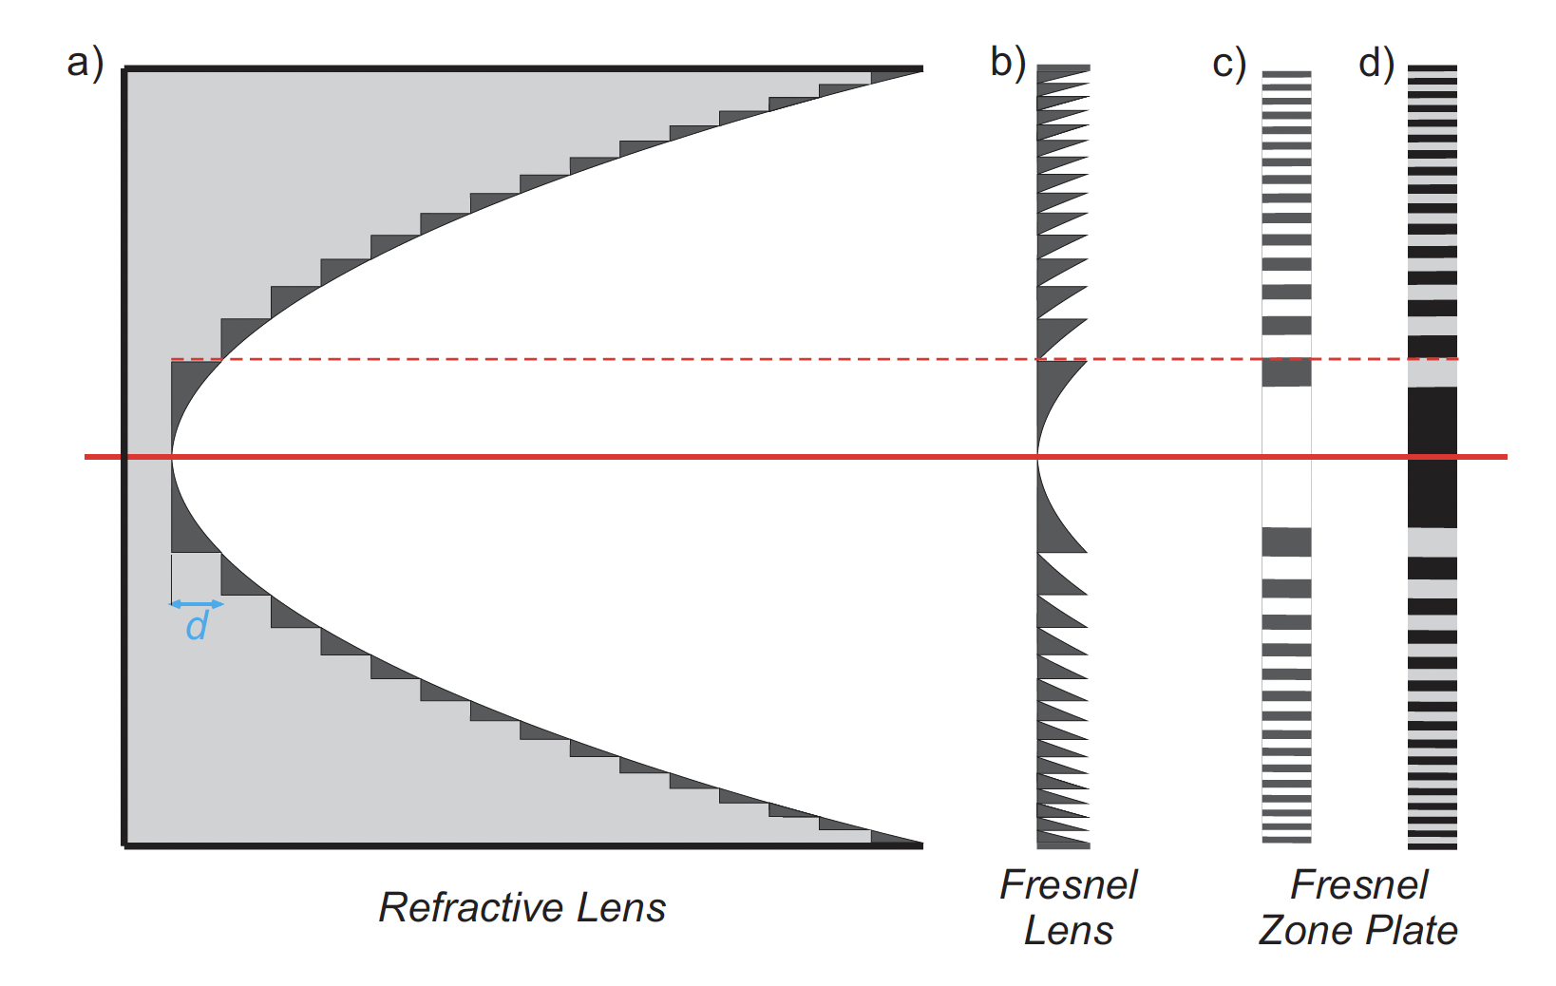
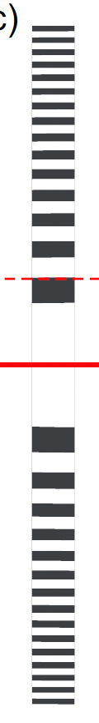
Fresnel zone plate (FZP)
Refractive index of hard X-rays and cold neutrons are similar n = 1-δ-iβ < 1
Refractive lens
Fresnel lens
Amplitude
zone plate
Phase
zone plate

Slide 3
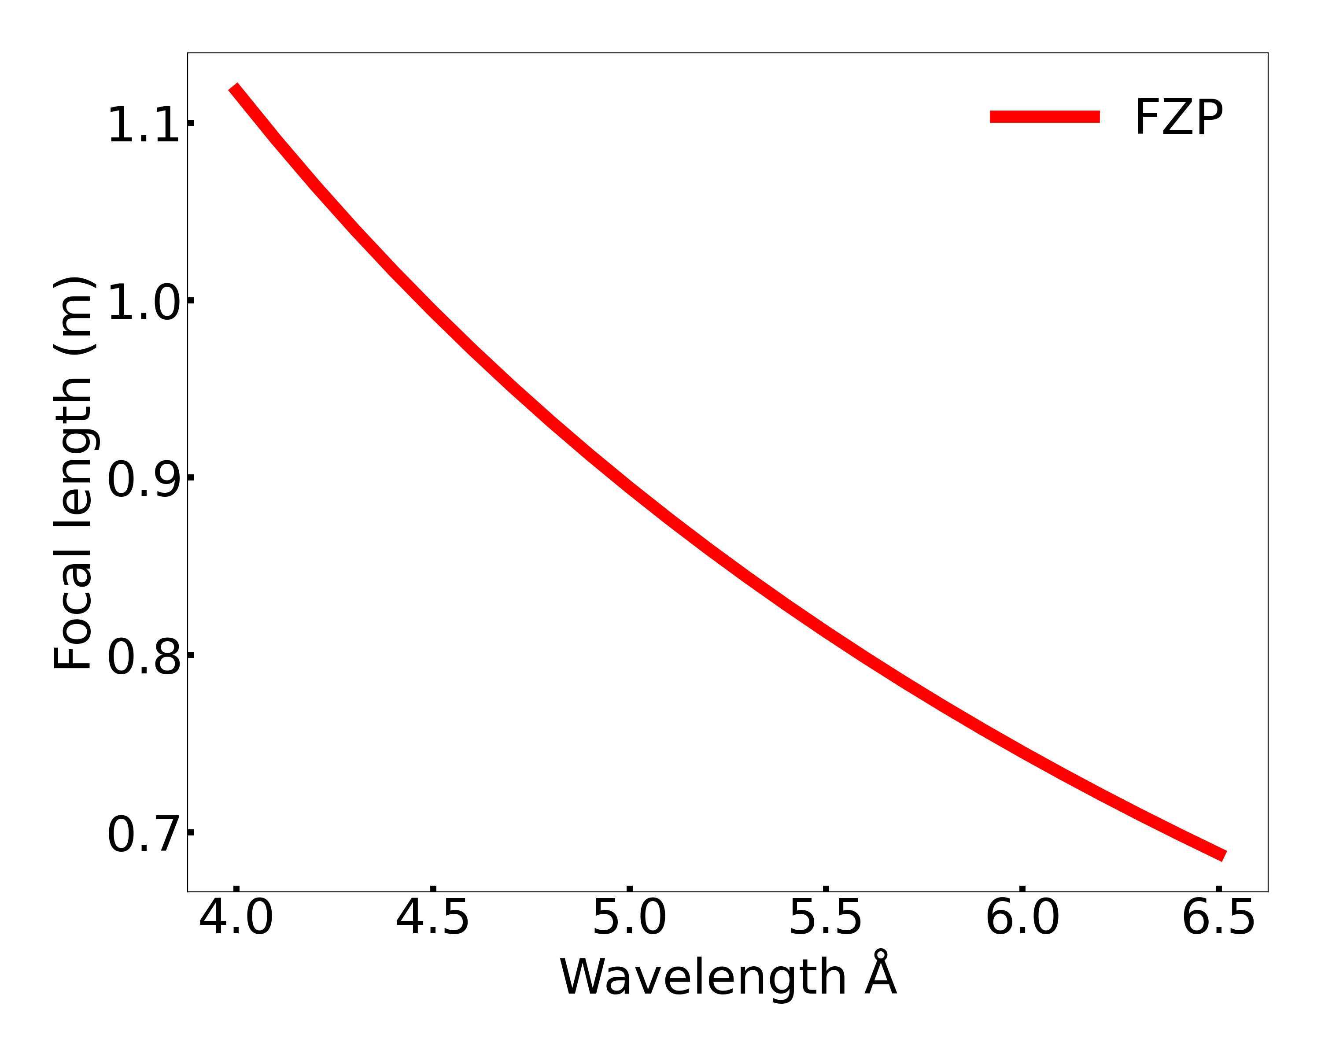
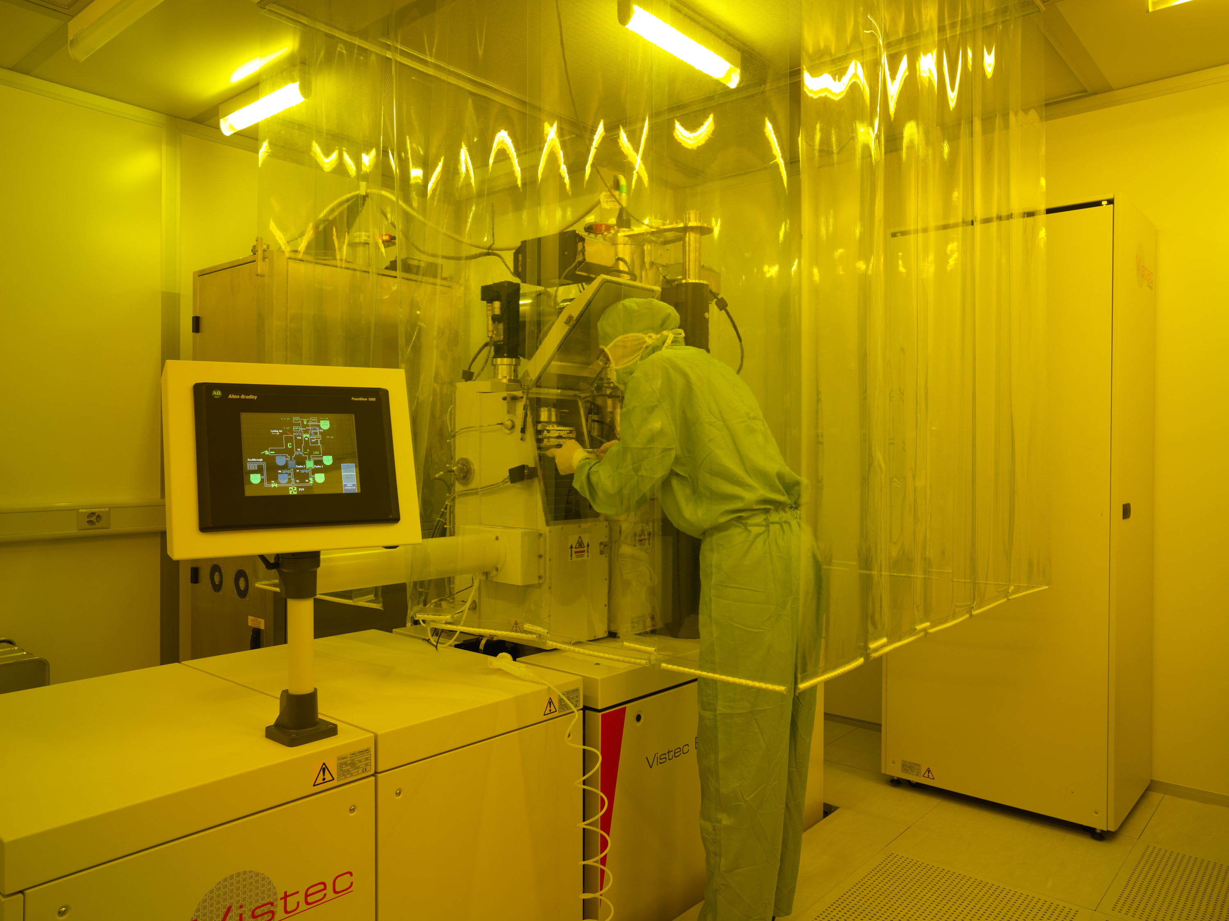
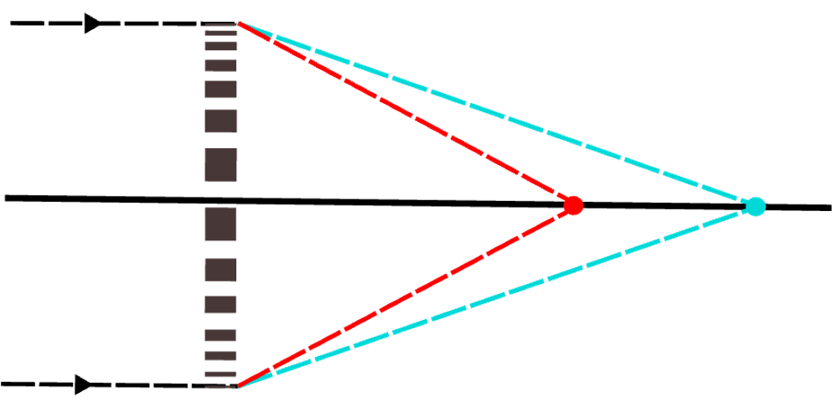
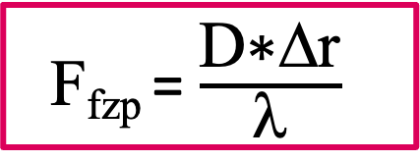
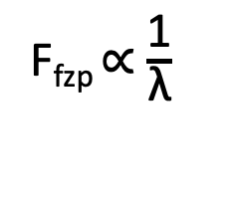
Fresnel zone plate (FZP)
Refractive index of hard X-rays and cold neutrons are similar n = 1-δ-iβ < 1
F_{fzp} ∝ $\frac{\text{1}}{\text{λ}}$
Neutrons
F_{fzp} = $\frac{\text{D}\text{∗}\text{D}\text{r}}{\text{l}}$
Highly chromatic
Can be fabricated by e-beam lithography
Kearney, et al. (1980)
Altissimo, et al. (2004)
Dhanalakshmi Veeraraj, M.r., et al (2025)

Slide 4
SEM images of a Nickel FZP

Slide 5
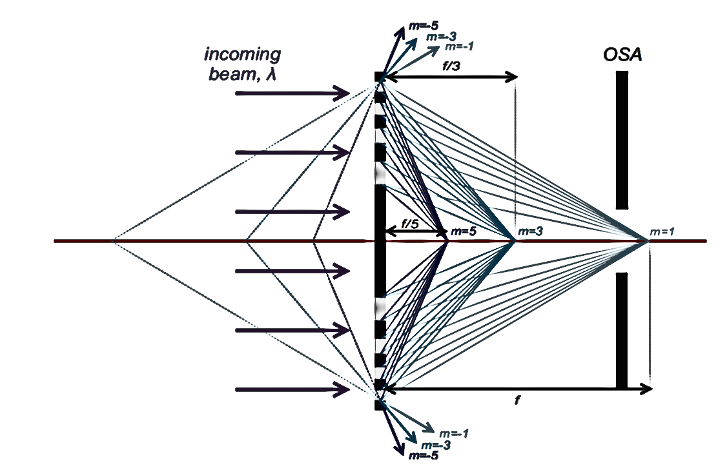
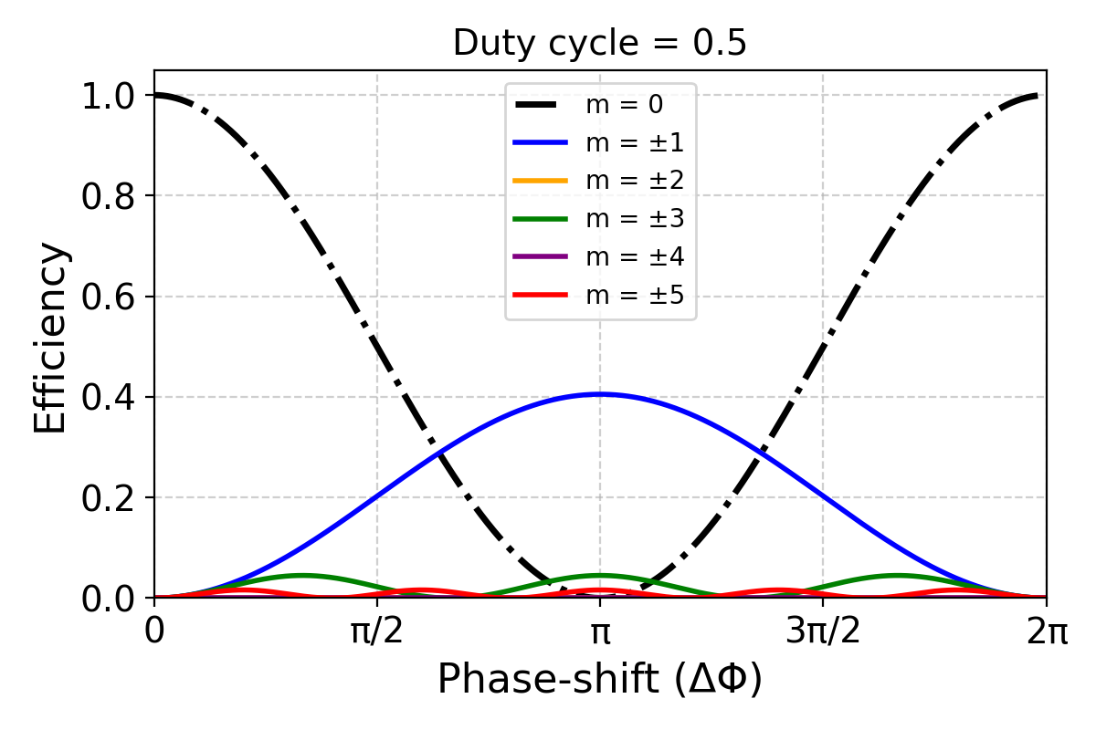
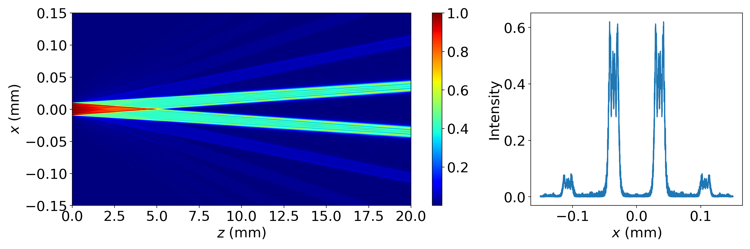
Understanding diffraction efficiency
When the duty cycle is 0.5
ΔΤ
p
1st order
0th order
-1st order
incoming radiation
Diffraction grating

Slide 6
FZP fabrication challenges
Quite challenging to get,
Small outer-zone widths (<100s of nm) AND tall structures (> 2 um)
High aspect ratio nano structures
Perfect 50% duty cycle

Slide 7
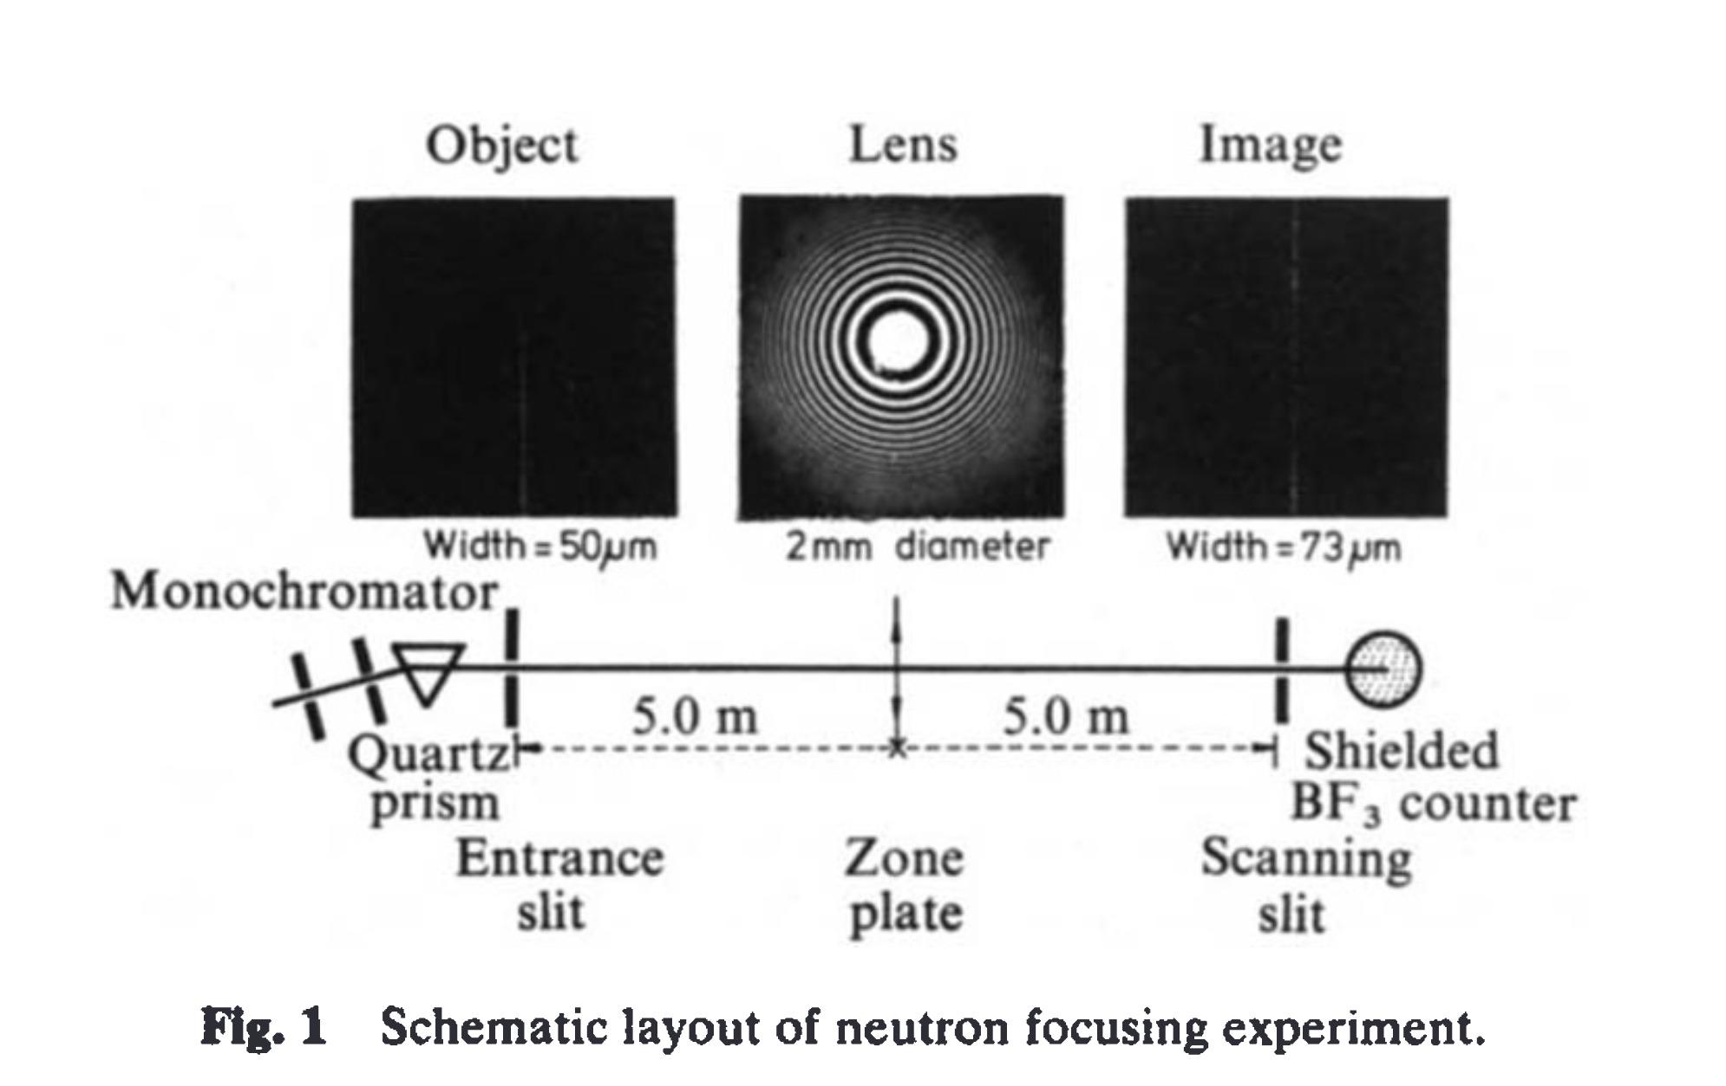

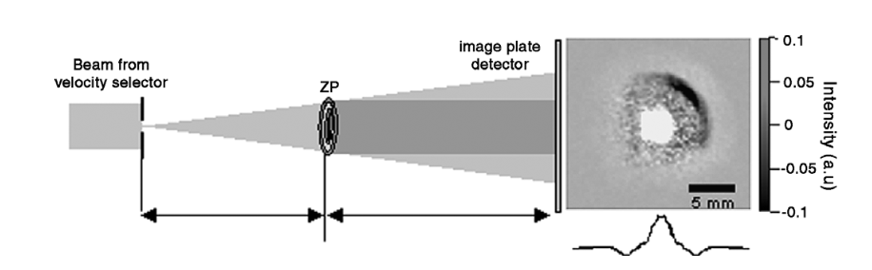
Soooo…. Neutron zoneplates
Kearney, et al. (1980)
Altissimo, et al. (2004)
Me 🙋🏻, et al. (2025)

Slide 8
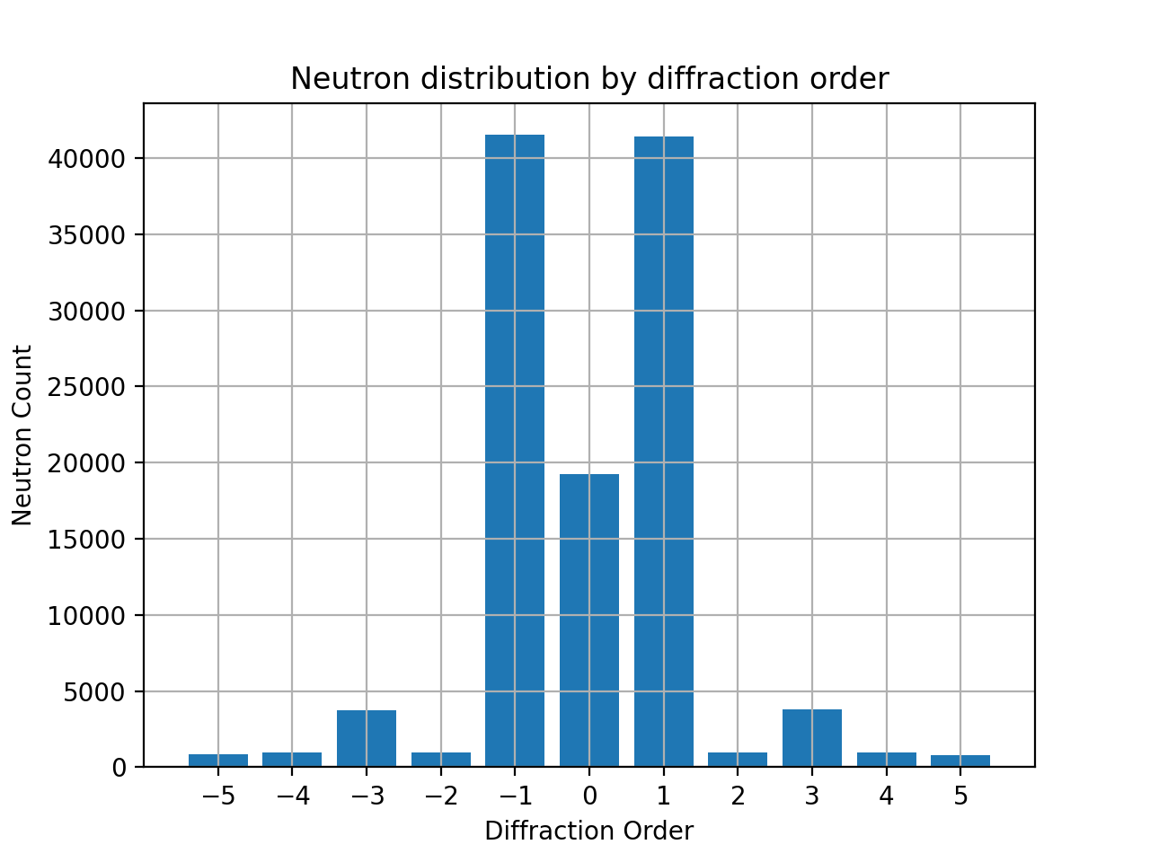
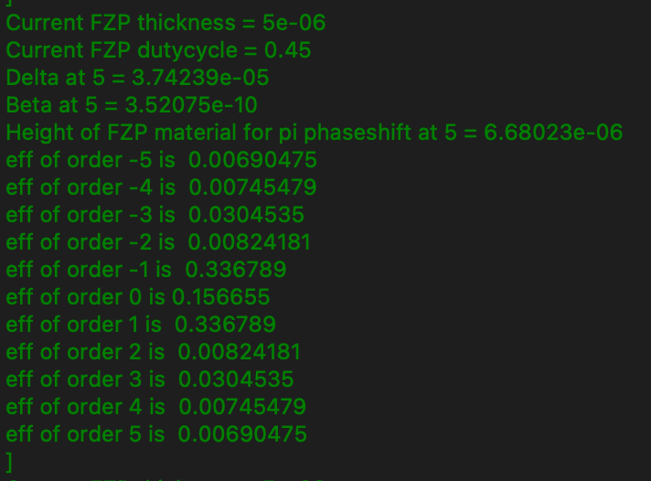
New improved FZP component
def FZP_simple(rad, dr, bs0rad, sigma_abs, sigma_inc, sigma_coh, rho,thickness, gamma, order, eta):
Included in McStas 3.5.32
Nice simple approximation
Handles efficiency as if it is an absorption FZP
def FZP_mod (rad, dr, bs0rad, sigma_abs, sigma_inc, sigma_coh, rho, thickness, gamma,lambda0):
Handles efficiency as if it is a binary phase FZP
Imperfections can be included
Soon available to public

Slide 9
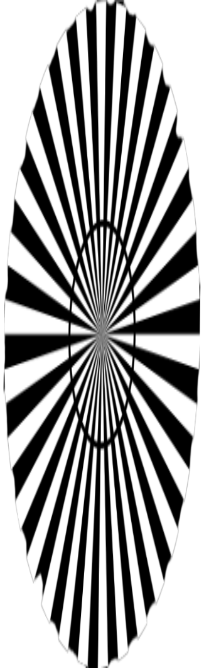
Instrument setup
PSD_monitor
Slit
Slit
Fzp_mod
Mask
Source_simple
0.88 m
6.6 m
Scheme of a neutron microscope
• Magnification : ~ 7 X

Slide 10
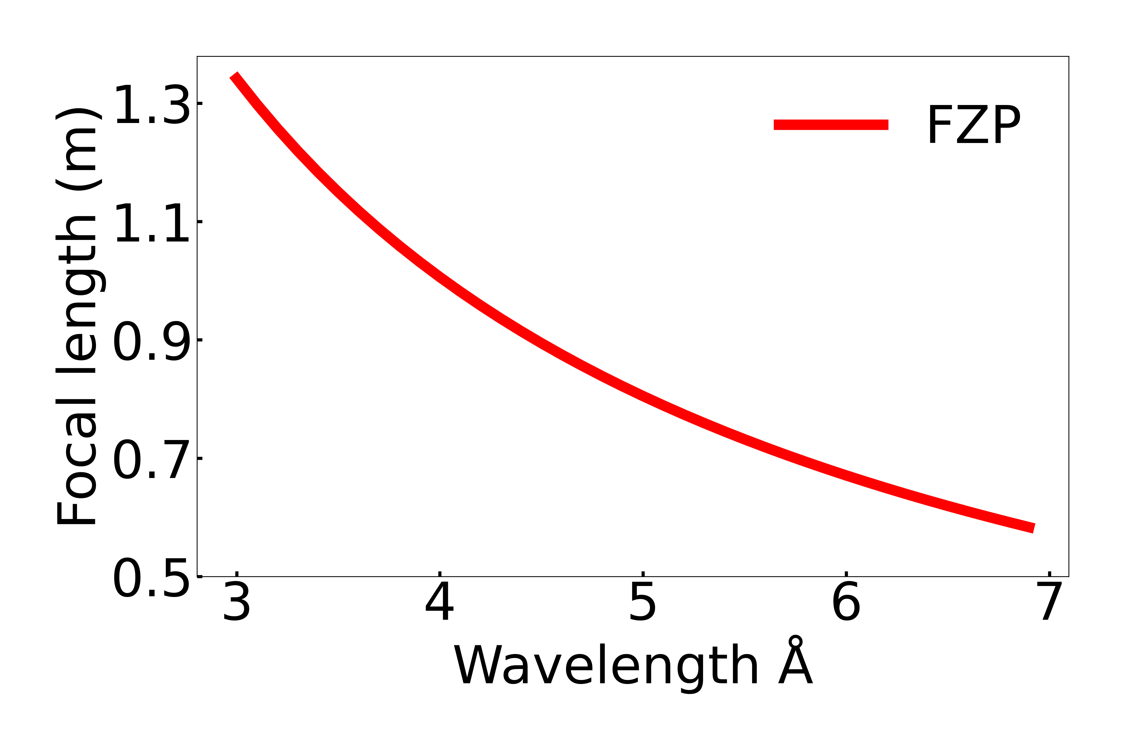
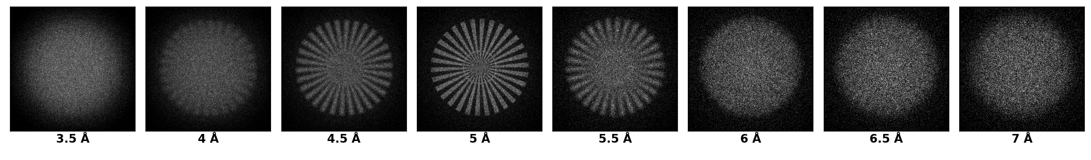
Instrument setup
PSD_monitor
Slit
Slit
Fzp_mod
Mask
Source_simple
0.88 m
6.6 m
Scheme of a neutron microscope
• Δλ/λ : 0.15
• Magnification : ~ 7 X
Highly chromatic
Not suitable for broad band imaging
Simulated magnified images:
star30.png

Slide 11
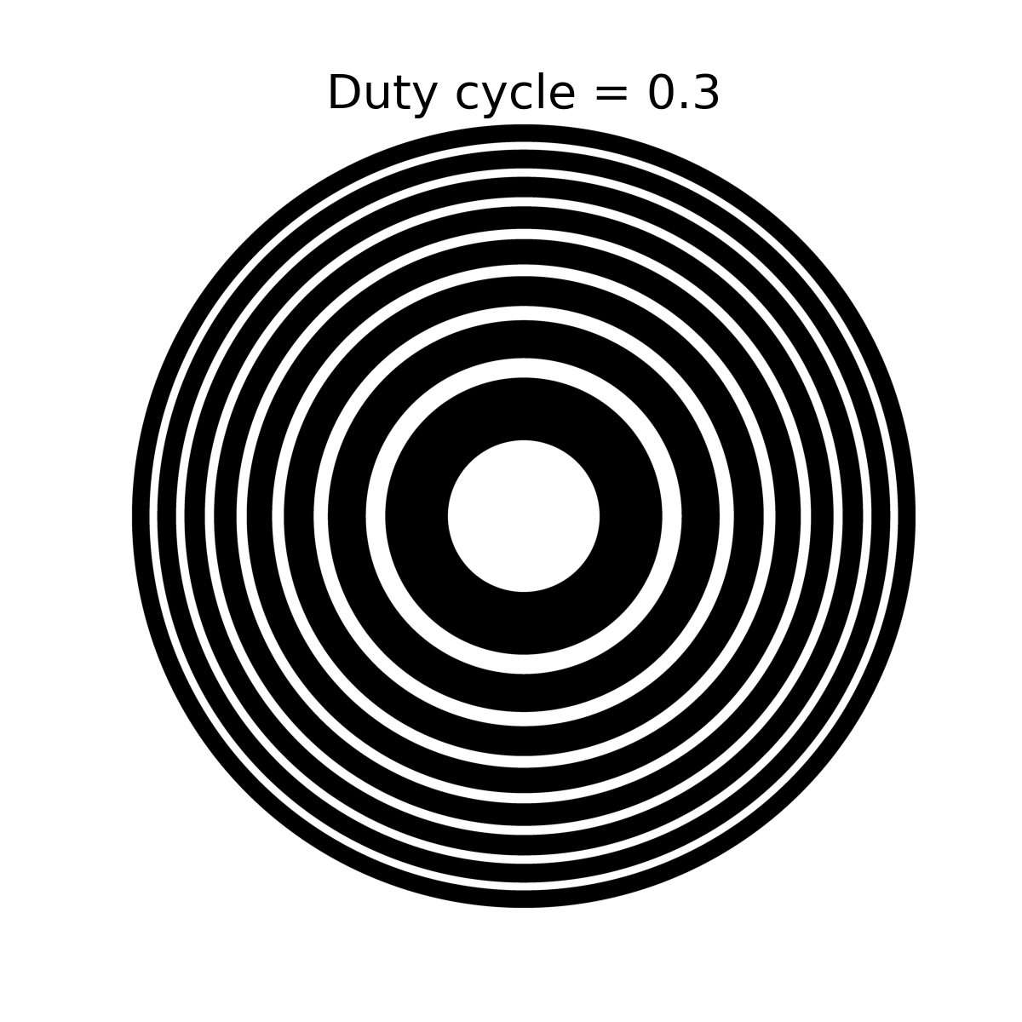
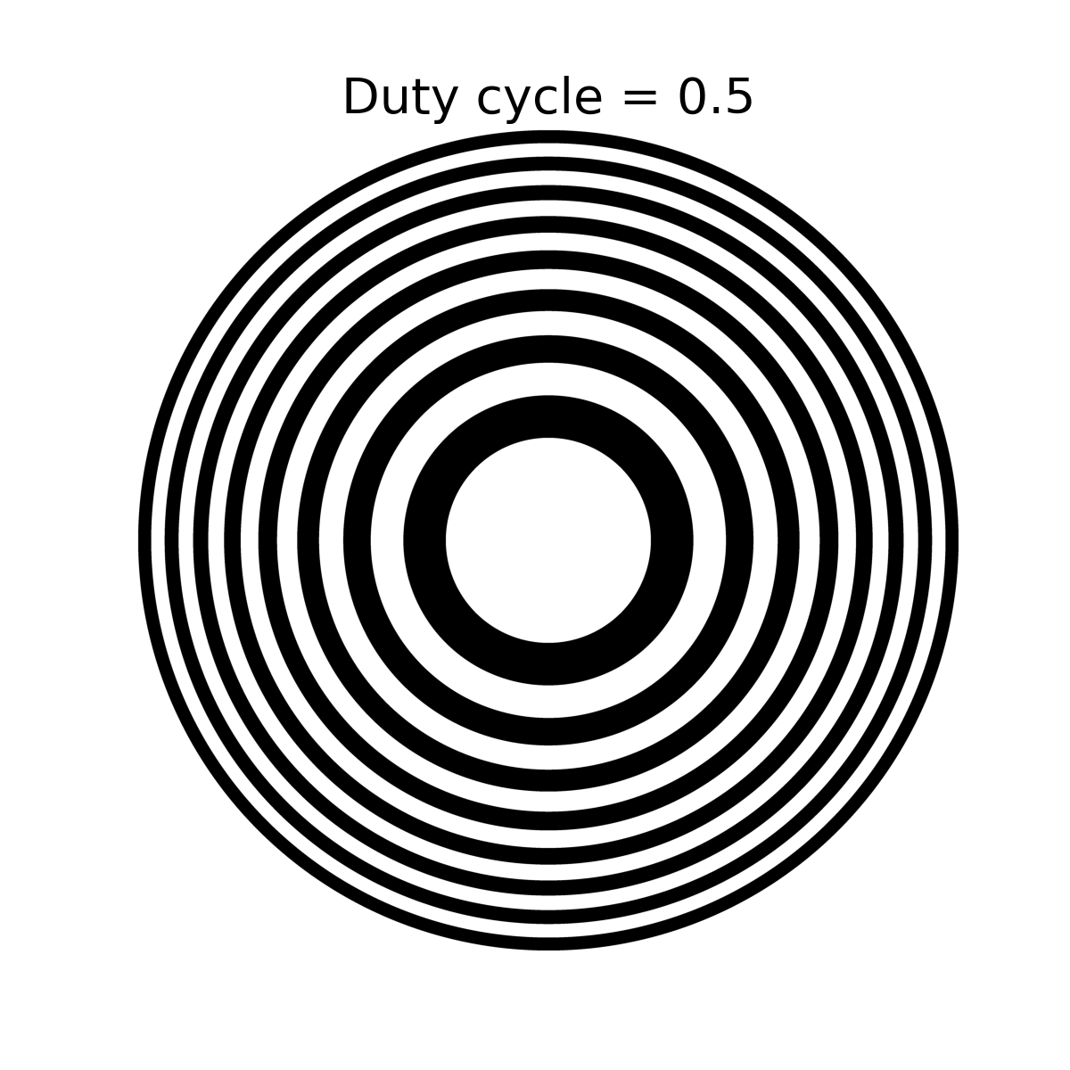
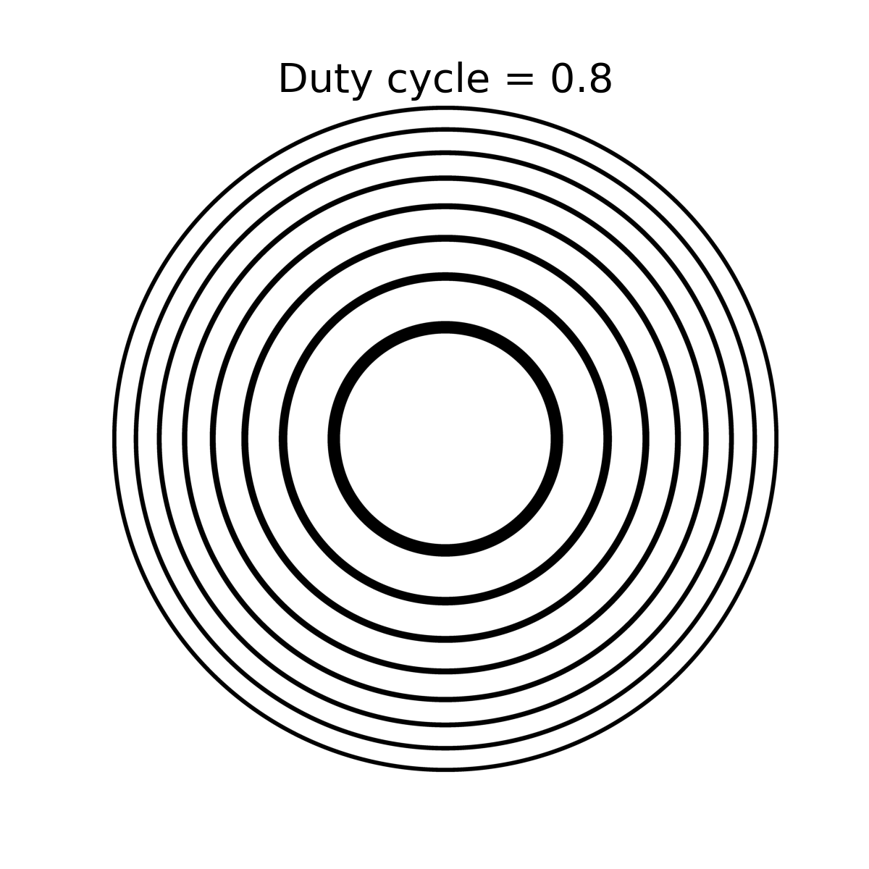
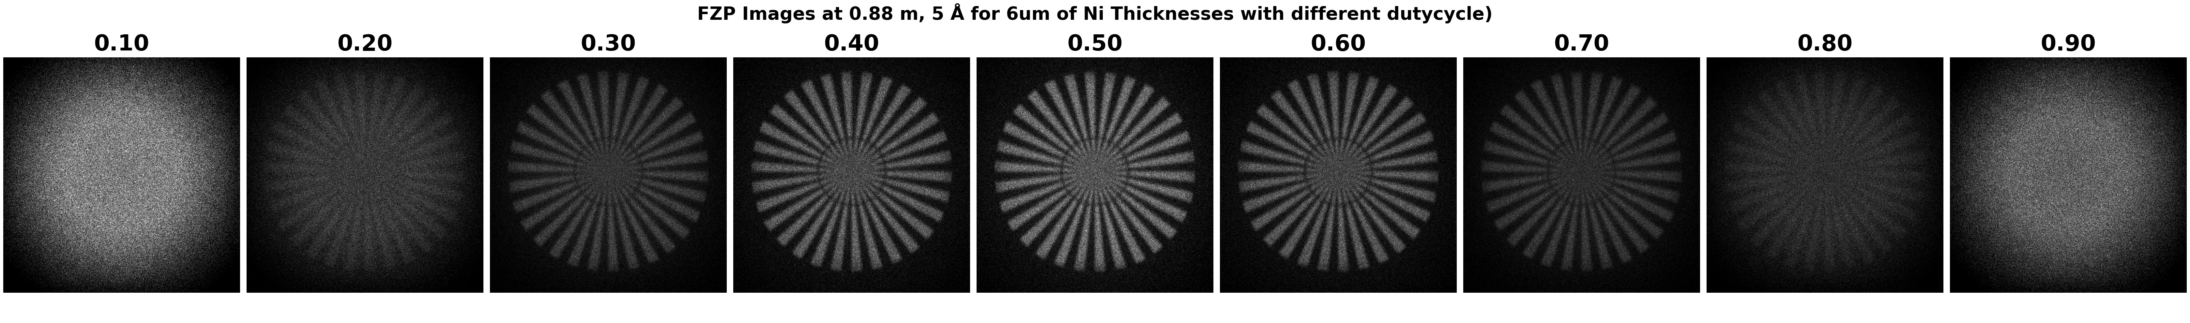
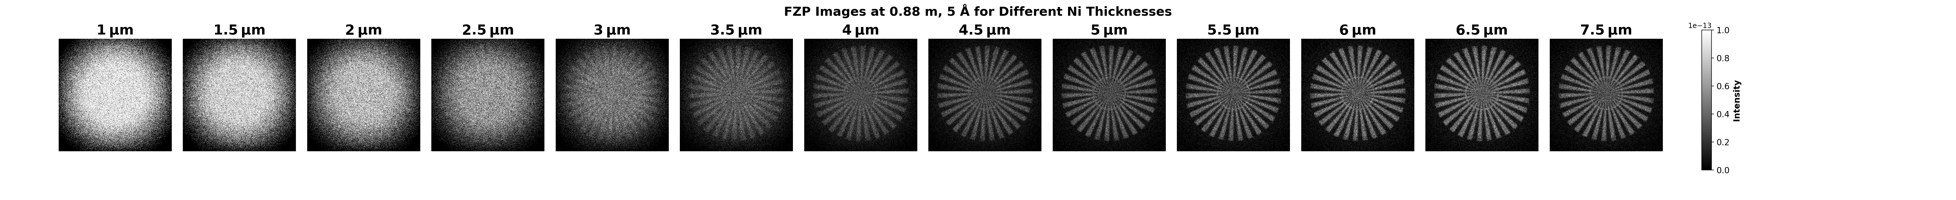
Is sensitive to duty cycle
More close to reality
Is sensitive to thickness of material

Slide 12
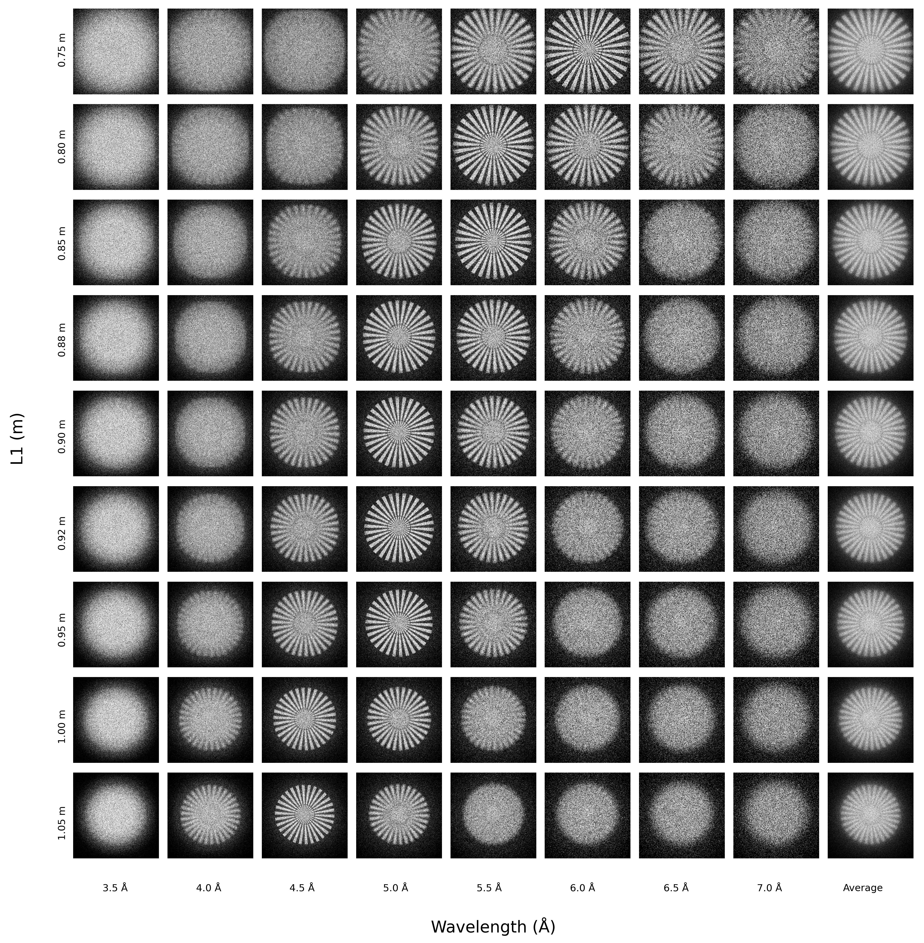
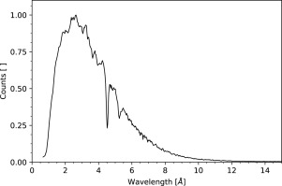

Slide 13
Instrument setup
PSD_monitor
Slit
Slit
Fzp_mod
Mask
Source_simple
0.88 m
6.6 m
Scheme of a neutron microscope
• Δλ/λ : 0.15
• Magnification : ~ 7 X
Highly chromatic
Not suitable for broad band imaging

Slide 14
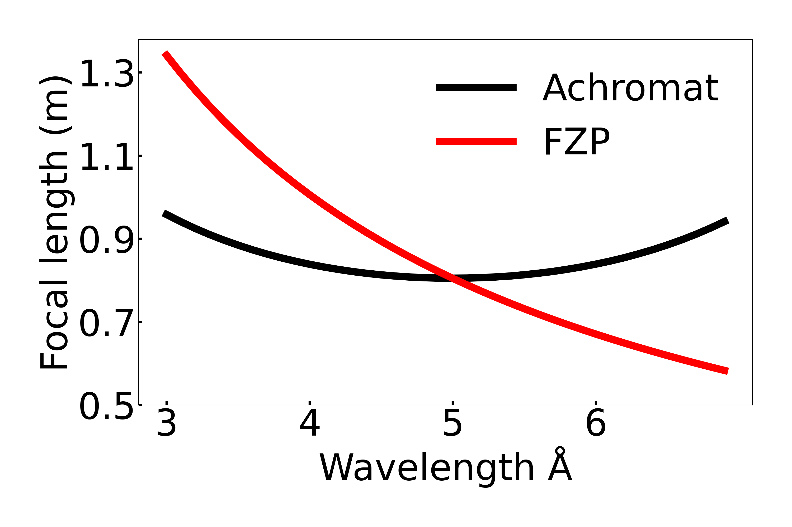
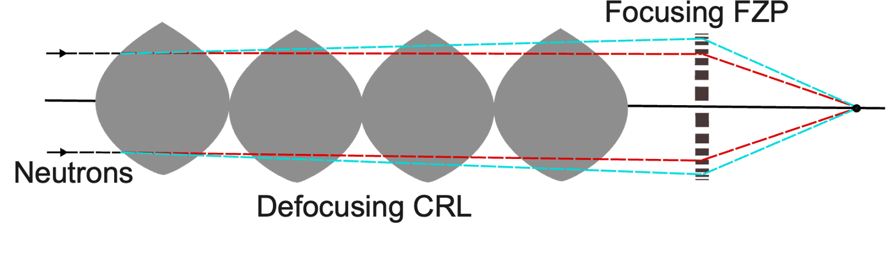
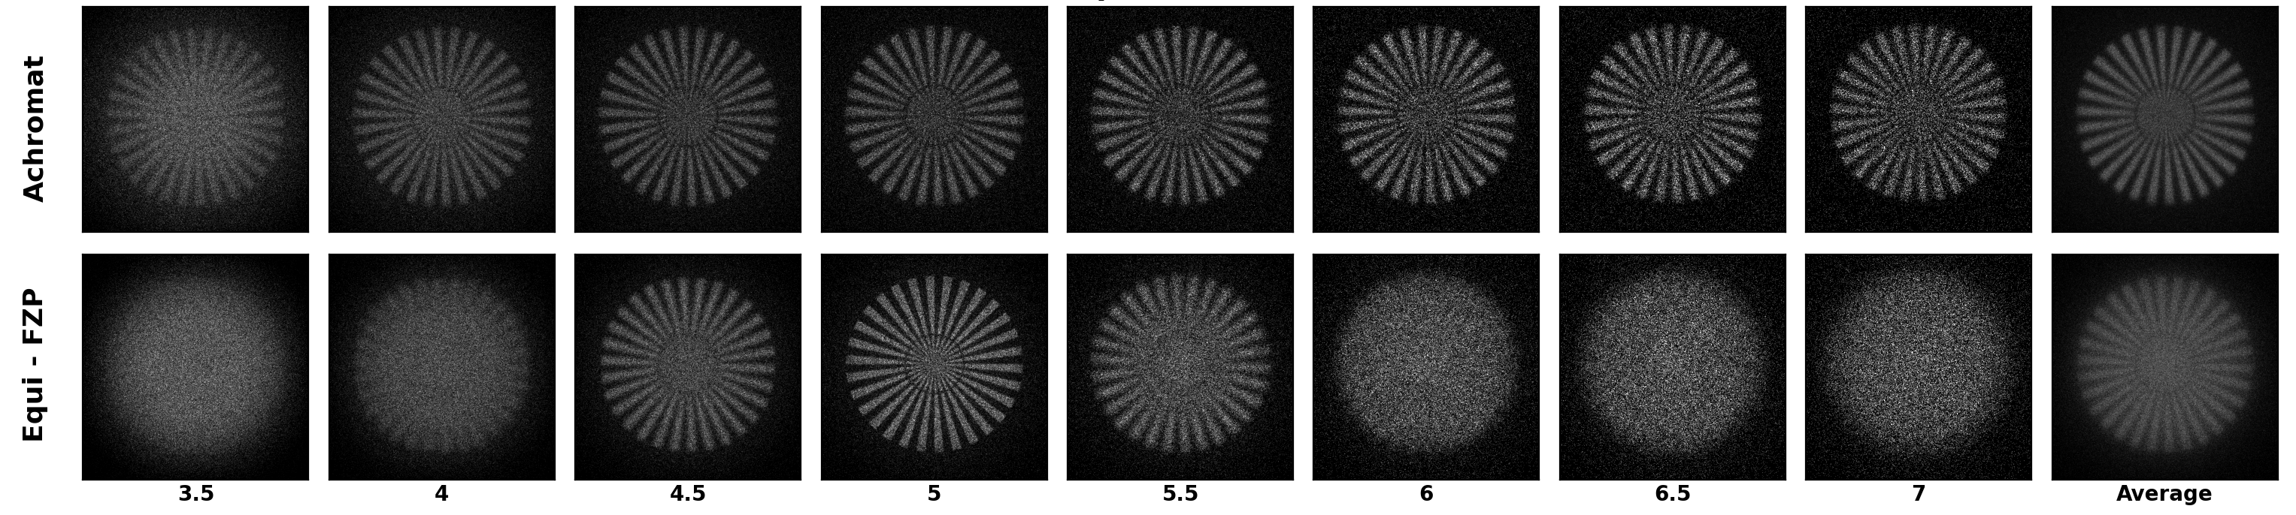
A Neutron Achromat
Suitable as an objective lens imaging with broadband radiation
Hybrid optic by combining individual optics with opposite dispersive power
Achromat condition :: F_{rl}= -2* F_{fzp}
λ_{design} = 5 Å
Lens aperture = 1.4 mm
F_{achromat} = 0.8 m
F_{equi- FZP} = 0.8 m
Kubec, A. et al. (2022)
Sanli, U. T. et al. (2023)
Simulated data

Slide 15
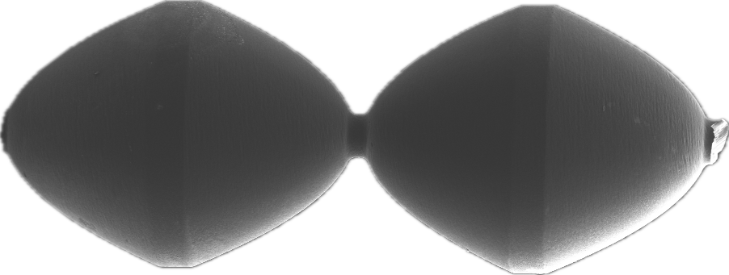
Aspect ratio: 41
SEM of the Ni FZP
300 μm
Image of the Diamond CRL
SEM image of the Diamond CRL

Slide 16
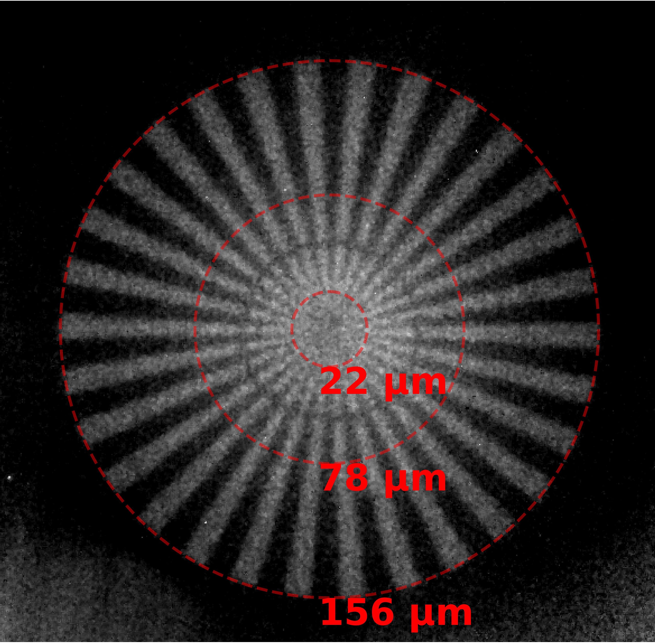
Experimental data: NeXT, ILL
Experimental data
Matches very well with the simulations
🥳😁
We have an achromatic neutron objective lens
• F_{Achromat} at 5Å : 0.8 m
• Lens aperture : 1.4 mm
• Magnification : 6.67 X
• Exposure time : 60 minutes
• Wavelength : 5 Å
• Δλ/λ : 0.15
• Field of view : 5 mm
• ~20 µm structures resolved
McStas was a huge part
Benchmarking
Troubleshooting
Expectation management
0.5 mm
High resolution magnified neutron image

Slide 17
Thanks for your attention Questions ??? Comments??
Laboratory for X-ray Nanoscience and Technologies (LXN), PSI
Di Qu
Silas Strebel
Hui-Yuan Chen
Peng Qi
Konstantins Jefimovs
Joan Vila-Comamala
Christian David
Laboratory for Neutron Scattering and Imaging, PSI
Markus Strobl
Joachim Kohlbrecher, SANS1
Anders Kaestner, ICON
Matteo Busi, BOA
Large scale structures, NeXT beamline, ILL
Alessandro tengattini
Lukas helfen
Anna fedrigo
300 nm

Slide 18
