Slide 1

Simulating Diffraction in bent crystals

Slide 2

Overview
Cross section of a Type 1 crystal
Understanding that we have an issue
Monte Carlo Intermission
Sampling the time
Validation setups
Results
Discussion & Conclusion

Slide 3
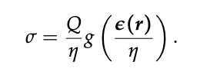
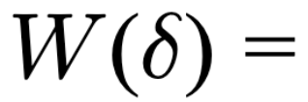
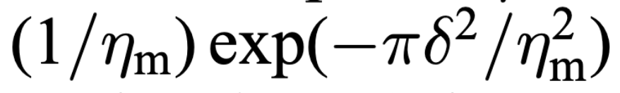
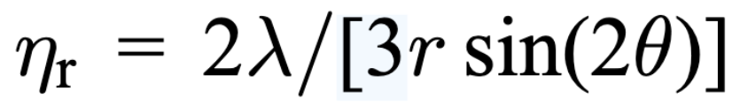

Scattering cross section of a Type 1 Crystal
Type 1 crystals are crystals with a small crystallite domain size compared to their mosaic spread.
$η_{m}≫η_{r}$
$η_{m}$ is width of the mosaic spread. For gaussian:
$η_{r}$ is the crystallite width:
Lefmann, K., J. T. Tuoriniemi, K. K. Nummila, and A. Metz. “Neutron Thermometry on Polarized Silver Nuclei at Sub-Microkelvin Spin Temperatures.” Zeitschrift Für Physik B Condensed Matter 102, no. 4 (December 1, 1997): 439–47. https://doi.org/10.1007/s002570050309.

Slide 4
Understanding the issue
Cross section relies on the mosaicity distribution
But the Bragg condition changes throughout the crystal.
So we can’t just sample a place and probability through the crystal, as an exponential function.

Slide 5

Understanding the issue – how to fix it
Given a rotation of the chosen crystal domain,
there is only one point of Bragg reflection, in the
Path throughout the crystal (to the 1st order).
Sampling the distribution can therefore become
sampling the point of reflection.

Slide 6
Monte Carlo Intermission
Before equations, what do I mean by sampling? Two ways:
Accept/reject
Inversion transformation sampling

Slide 7
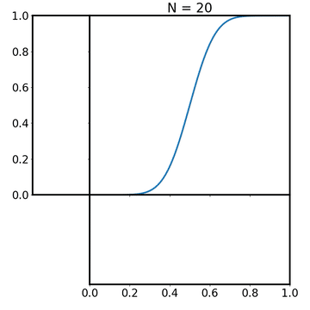
Monte Carlo Intermission
Before equations, what do I mean by sampling? Two ways:
Accept/reject
Inversion transformation sampling
By Davidjessop - Own work, CC BY-SA 4.0, https://commons.wikimedia.org/w/index.php?curid=100369573

Slide 8
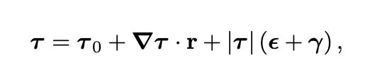


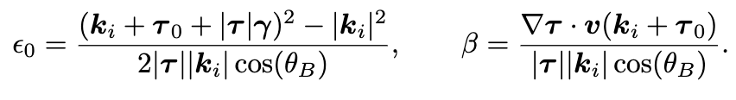
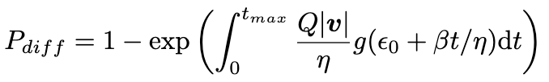
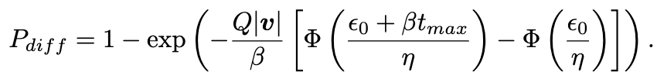
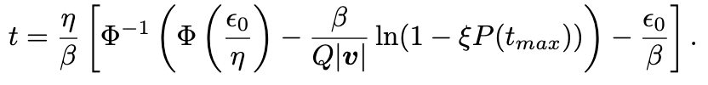

Sampling the time
Describe $ε$ as a function of Bragg condition:
Leads to:
Meaning the Diffracting power is:
Allowing us to sample the time by:
Šaroun, Jan. “Random-Walk Algorithm for the Simulation of Neutron Diffraction in Deformed Mosaic Crystals.” Nuclear Instruments and Methods in Physics Research Section A: Accelerators, Spectrometers, Detectors and Associated Equipment 529, no. 1–3 (August 2004): 162–65. https://doi.org/10.1016/j.nima.2004.04.197.

Slide 9
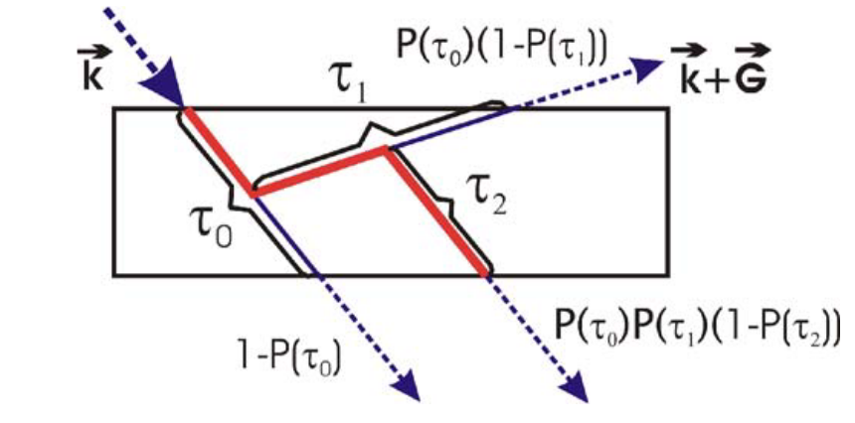
Absorption , primary extinction and multiple reflections
Monochromator_Bent includes Absorption through exponential multiplied onto weight.
Primary extinction is accounted for in the same way
Multiple reflections are done by repeating the algorithm:
Figure: Šaroun, Jan. “Random-Walk Algorithm for the Simulation of Neutron Diffraction in Deformed Mosaic Crystals.” Nuclear Instruments and Methods in Physics Research Section A: Accelerators, Spectrometers, Detectors and Associated Equipment 529, no. 1–3 (August 2004): 162–65. https://doi.org/10.1016/j.nima.2004.04.197.
Absorption: Freund, Andreas K. “Cross-Sections of Materials Used as Neutron Monochromators and Filters.” Nuclear Instruments and Methods in Physics Research 213, no. 2 (August 1, 1983): 495–501. https://doi.org/10.1016/0167-5087(83)90447-7.
Primary extinction: Bacon, G. E., and R. D. Lowde. “Secondary Extinction and Neutron Crystallography.” Acta Crystallographica 1, no. 6 (1948): 303–14. https://doi.org/10.1107/S0365110X48000831.

Slide 10
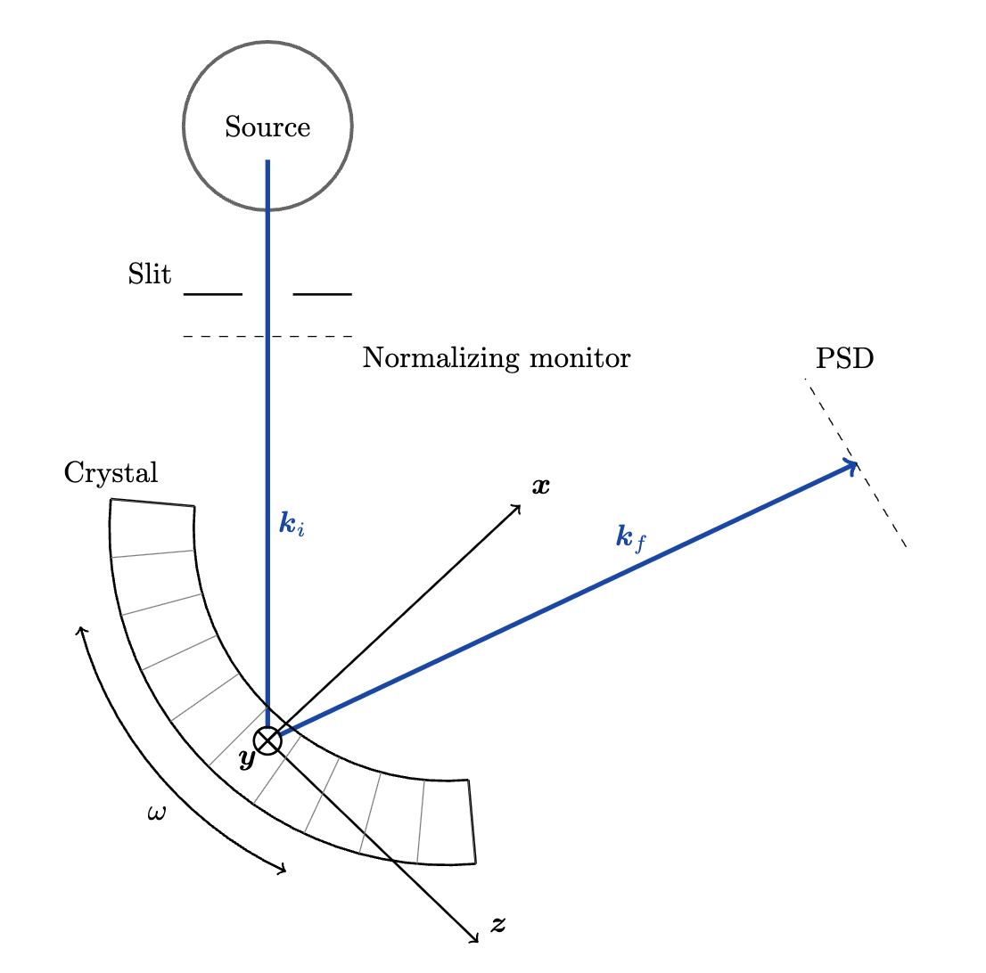
Validation setup
Spatial distribution and
Rocking curve

Slide 11
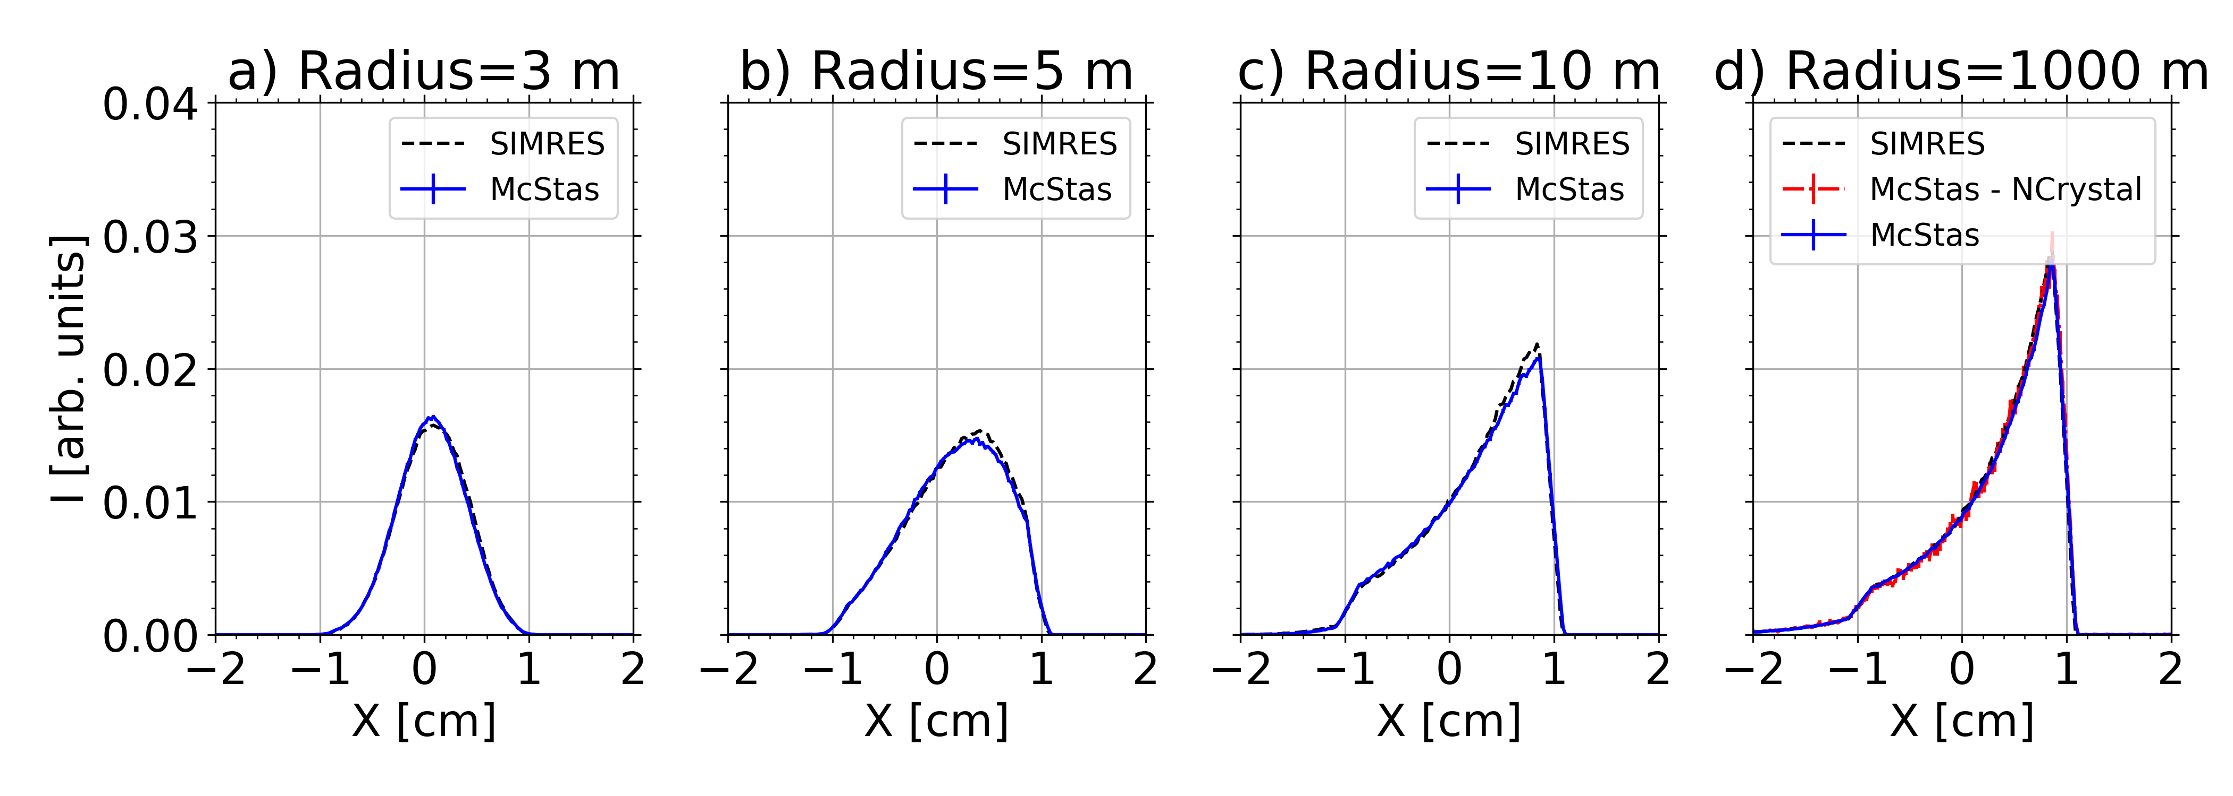
Results Spatial distribution

Slide 12
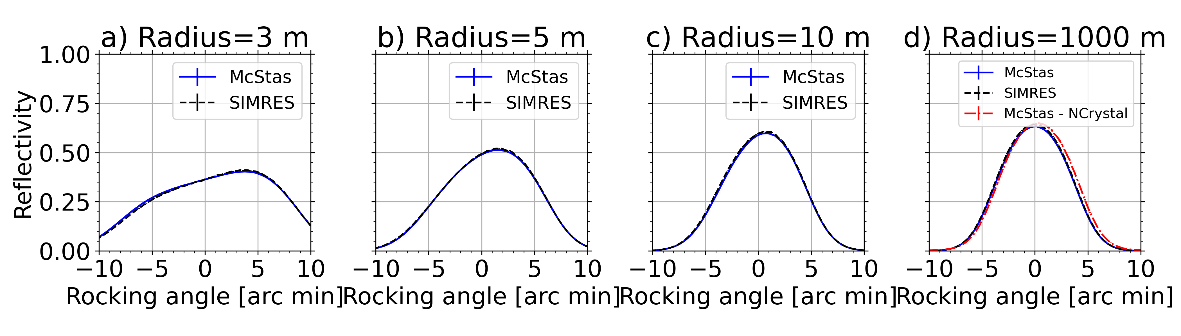
Results rocking curve

Slide 13
Conclusion
Successful comparison to SIMRES and Ncrystal
It also runs a little faster than Ncrystal (1 minute vs 1.4 minutes in like setups)
Monochromator_Bent simulates diffraction off of a crystal with a mechanical cylindrical bending. The reciprocal lattice vector is assumed normal to the surface but can have a cut in the horizontal plane.
We are looking in to adding support for making an alternative component that allows for more parameters for each crystal.

Slide 14
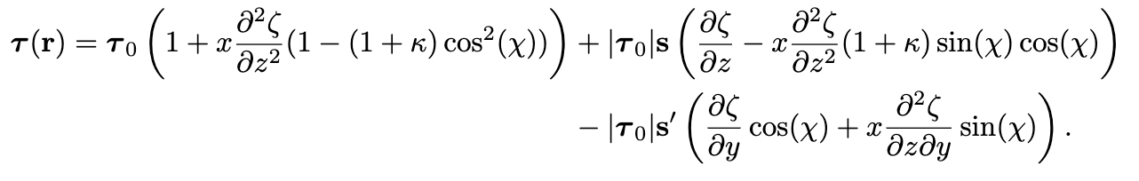
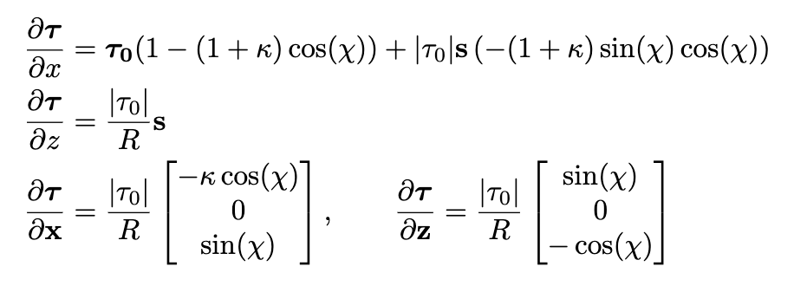
Appendix A:
Equations
From Popovici:
Our derivations:

