Slide 1
Overview of Accelerator
SAR4
Ciprian Plostinar

Slide 2
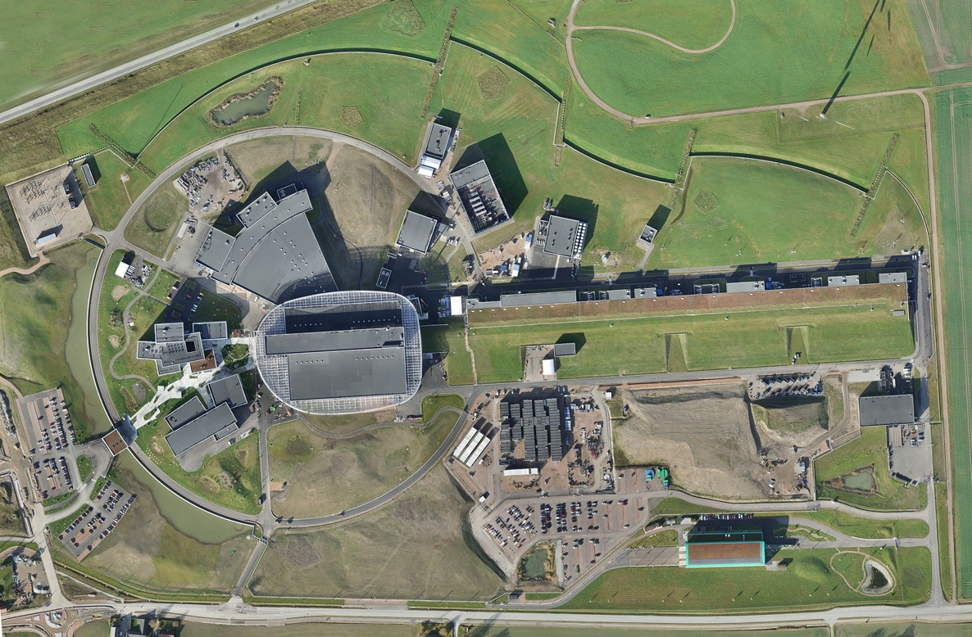
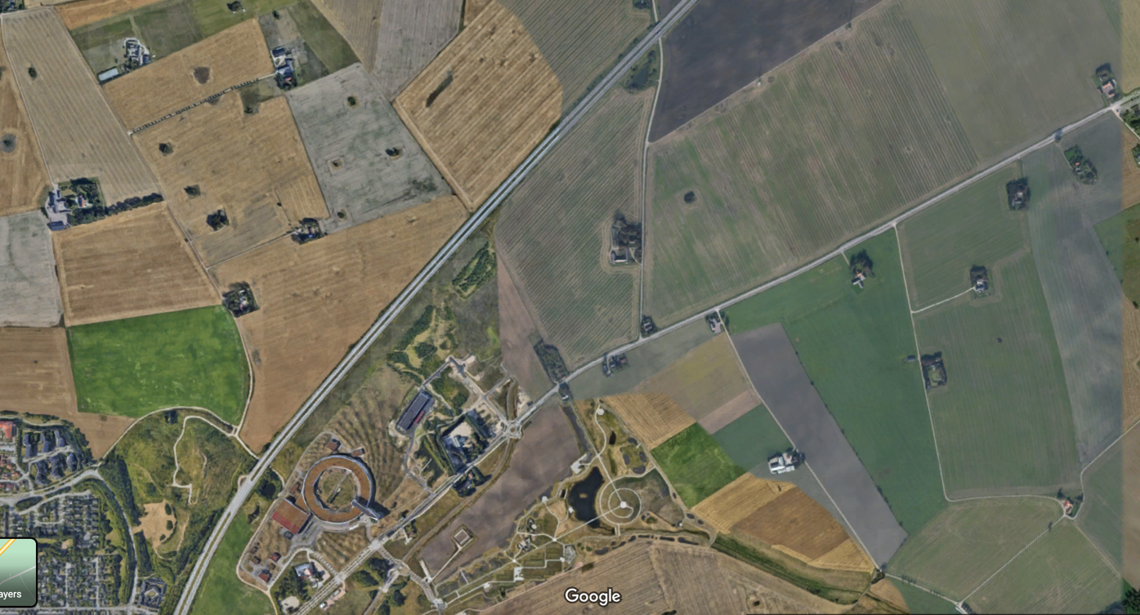
We’ve Built An Accelerator
ESS Site

Slide 3
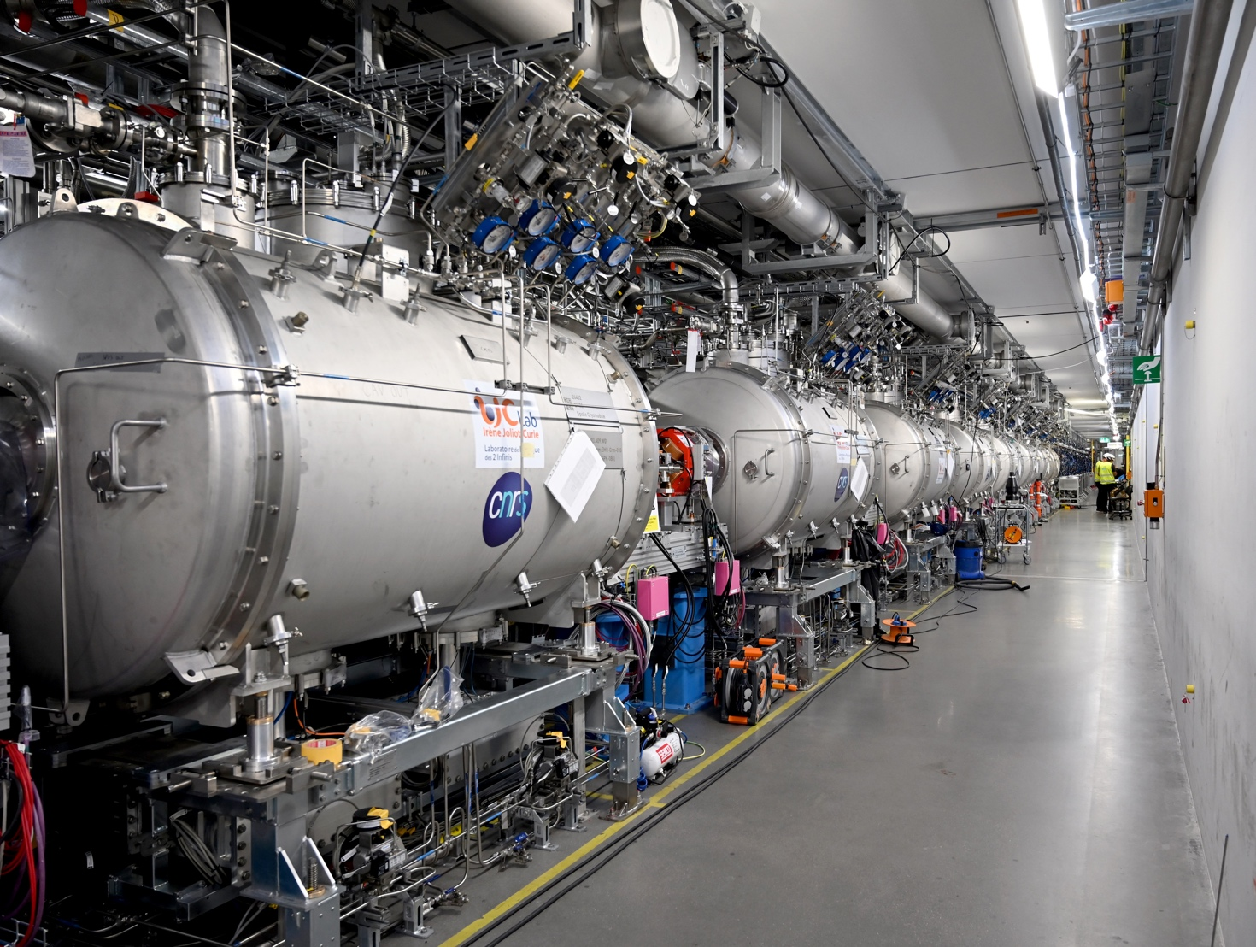
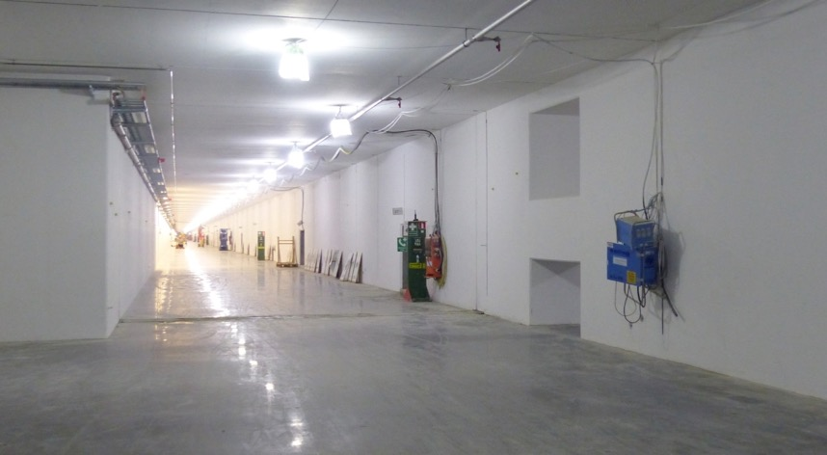
We’ve Built An Accelerator
G01

Slide 4
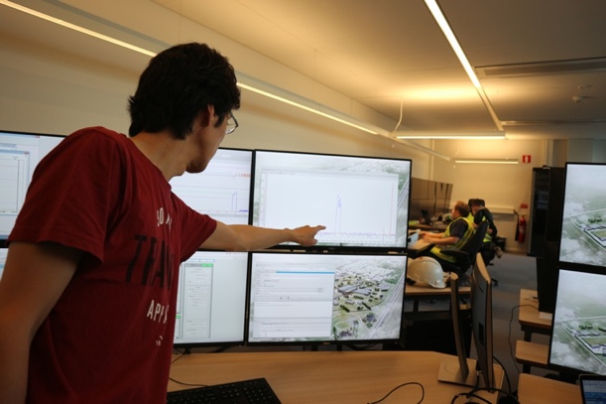
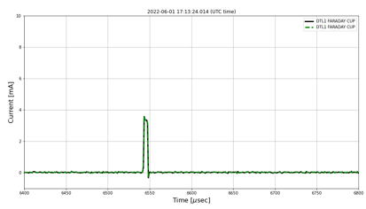
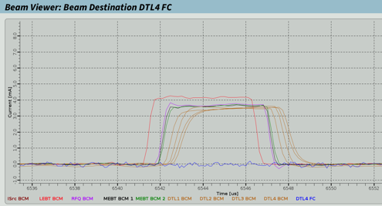
A Long Journey
ISrc to Beam on Target
SRR5
22 Sep, 2025
SRR1
SRR TS2
SRR2A
SRR2B
SRR3
SRR4
BOT
EOC
17 Jul, 2018
29 Aug, 2019
7 Sep, 2021
4 May, 2022
22 Mar, 2023
24 Feb, 2025
31 Oct, 2025
31 Dec, 2027
2018
2018
2019
2020
2021
2022
2023
2024
2025
2026
2027
2027
19 Sep, 2018
20 Apr, 2023
3 Oct, 2025
First Beam through the LEBT
First Beam through DTL4
Facility RBOT
1 Jun, 2022
11 Jul, 2025
First Beam through DTL1
ACC RBOT
26 Nov, 2021
First Beam through the RFQ
Beam: ISrc->LEBT
Beam: ISrc->LEBT->RFQ->MEBT
Beam: ISrc->LEBT->RFQ->MEBT->DTL1
Beam: ISrc->LEBT->RFQ->MEBT->DTL1->DTL4
19 Sep, 2018
26 Nov, 2021
1 Jun, 2022
20 Apr, 2023

Slide 5
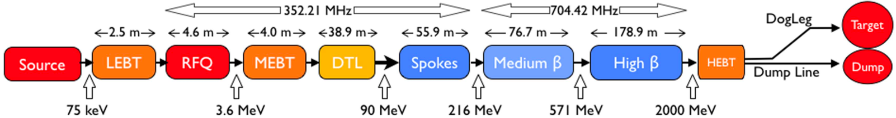
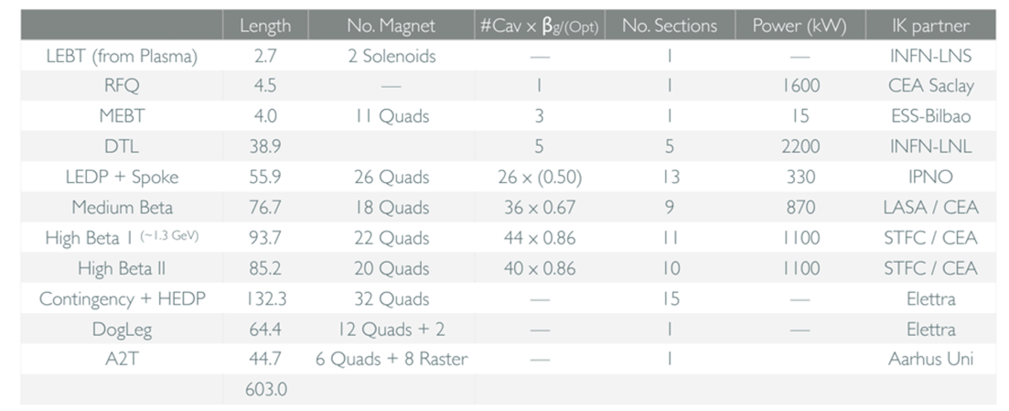
ESS Accelerator
Overview
FC
Insertable stop
Parameter | Value
Ave power (design) [MW] | 5
Max energy (design) [MeV] | 2000
Peak current [mA] | 62.5
Pulse length [ms] | 2.86
Rep rate [Hz] | 14
Duty factor [%] | 4
RF freq [MHz] | 352.21/704.42

Slide 6
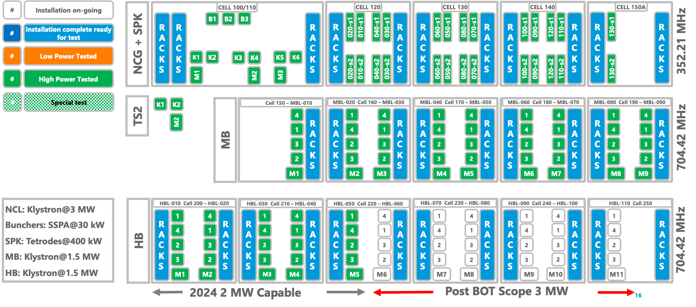
Machine Configuration
Baseline

Slide 7

Machine Configuration
Baseline
ACCELERATOR
Operations
All BOD/BOT technical scope
MCR, WOO
ICS
Target
PSS, MPS, Controls, Software,
Etc.
Tuning Beam Dump
ESH&S
Licence
SRR4, OHS, RP, REMS, Training, Security, Etc.
SCL
Eng./Infra.
Everything else
Design & Engineering, Site support and services, IOM, IT, Etc.
Quality, Engineering Management, Admin, Etc.

Slide 8
ESS Accelerator Baseline Scope
BOD -> 2 MW
Target
BOD/BOT
ISrc
LEBT
RFQ
MEBT
DTL
SPK
MBL
HBL
HEBT
Dump
870 MeV
Target
5 MW
ISrc
LEBT
RFQ
MEBT
DTL
SPK
MBL
HBL
HEBT
Dump
75 keV
3.6 MeV
90 MeV
216 MeV
571 MeV
2000 MeV

Slide 9
Machine Configuration
Technical Baseline – ESS-5359878.9 – NCL

Slide 10
Machine Configuration
Technical Baseline – ESS-5359878.9 – SCL SPK

Slide 11
Machine Configuration
Technical Baseline – ESS-5359878.9 – SCL MBL

Slide 12
Machine Configuration
Technical Baseline – ESS-5359878.9 – SCL HBL

Slide 13
Machine Configuration
Technical Baseline – ESS-5359878.9 – HEBT

Slide 14
Machine Configuration
Technical Baseline – ESS-5359878.9 – DmpL

Slide 15
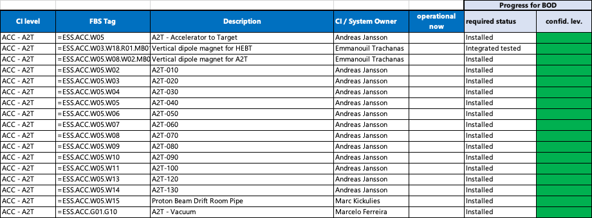
Machine Configuration
Technical Baseline – ESS-5359878.9 – A2T

Slide 16
Machine Configuration
Technical Baseline – ESS-5359878.9 – PSS/ODH

Slide 17
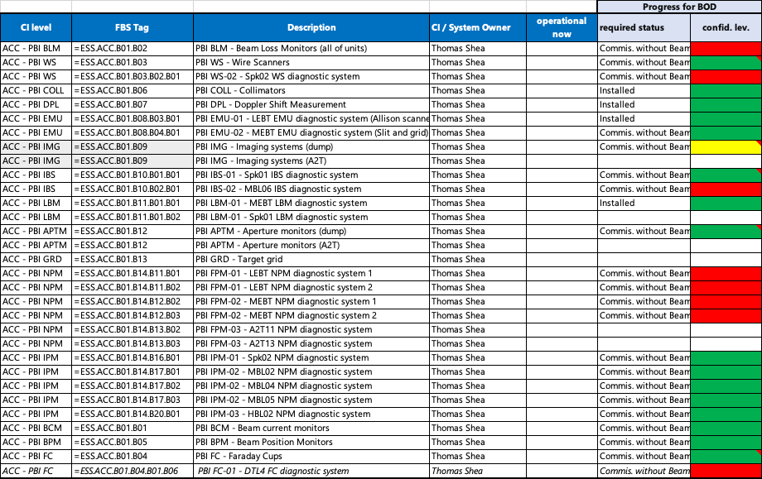
Machine Configuration
Technical Baseline – ESS-5359878.9 – BI

Slide 18
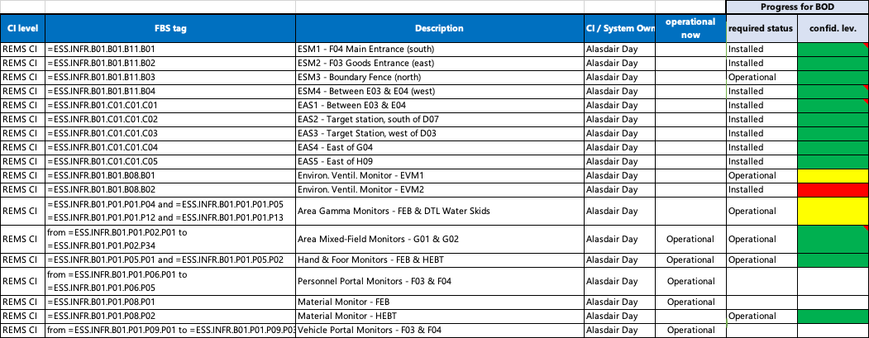
Machine Configuration
Technical Baseline – ESS-5359878.9 – REMS

Slide 19
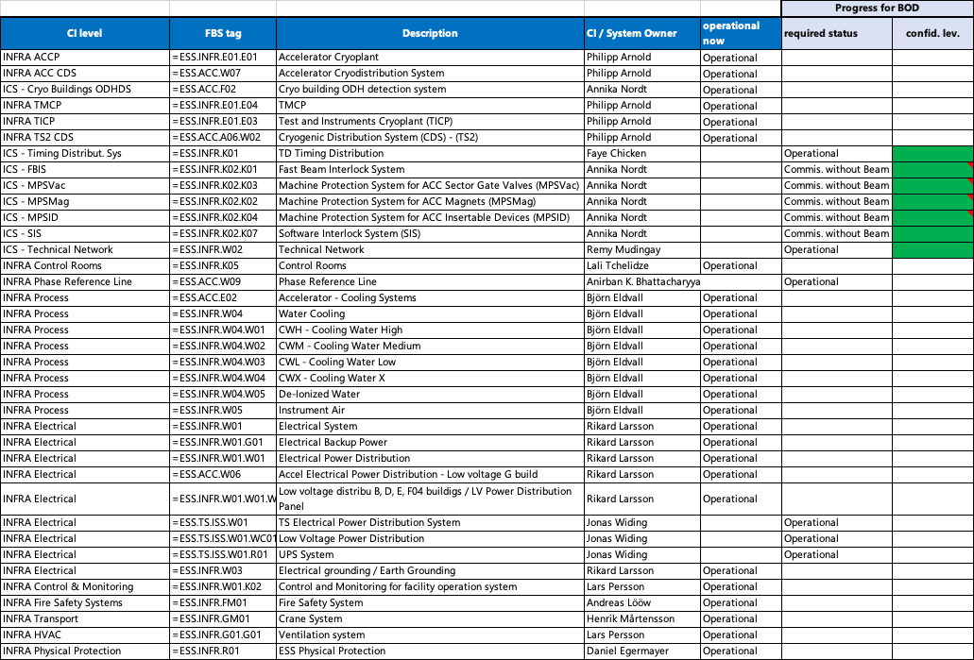
Machine Configuration
Technical Baseline – ESS-5359878.9 – Infra/Site

Slide 20
NCRs
35 In Progress

Slide 21
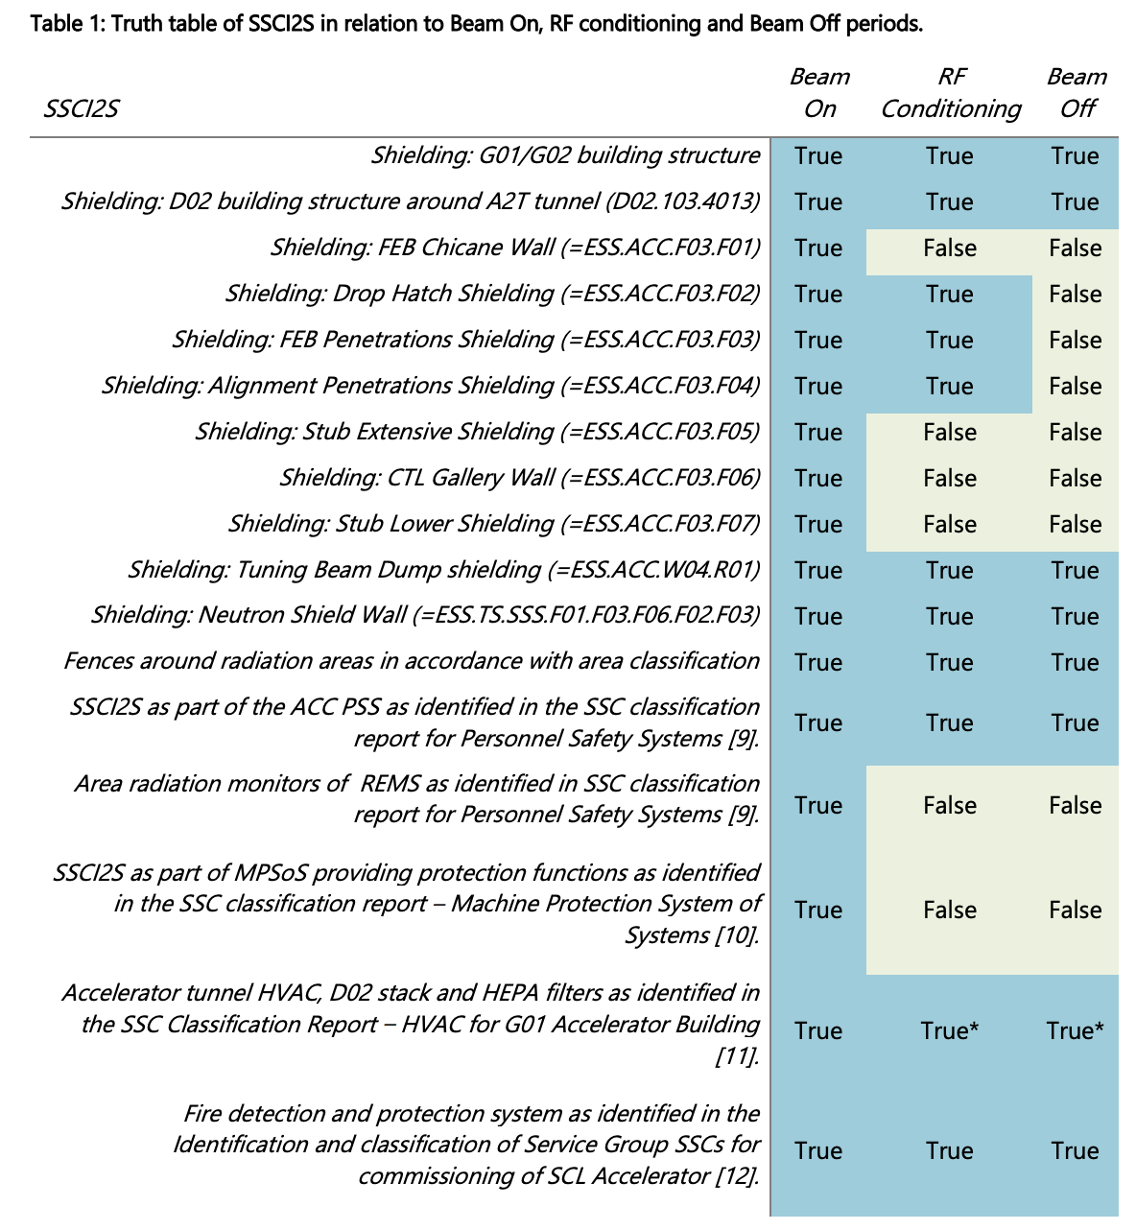
SSCI2S
See ESS-0357253.14 and ESS-5597859.1
  OLC revision 14 applies for BOD
    ESS-0357253.14
  SCL Licence applies for BOD
    PSAR: ESS-0000002 rev 22
  For BOT the INP licence will apply.
  Between the SCL submission and the INP submission, the analysis and our general licence strategy improved and many systems listed as SSCs for BOD are not listed for BOT.
  ESS-5597859.1 clarifies beyond the OLC what these systems are.
  We need to find a way to navigate this period while maintaining safety and meeting regulatory requirements.

Slide 22
SSCI2S
See ESS-0357253.14 and ESS-5597859.1

Slide 23
Essential CCRs
See ESS-1085626 ESS Facility Change Log

Slide 24
Energisation Status
See Joakim’s talk
  Many systems in ACC with temporary energisation.
  Effort ongoing to improve the documentation gap for permanent energisation.
  Not completed by SAR4, but progress has been made.

Slide 25
Safety
ACC Risk Index - ESS-3878402
  Since SAR3, NCL and SCL risk index files have been combined into a consolidated new risk index for the whole ACC.
  ESS-3878402.4 in review
  Probably needs a further revision before SRR4.
  The document needs to be continuously kept up to date.

Slide 26
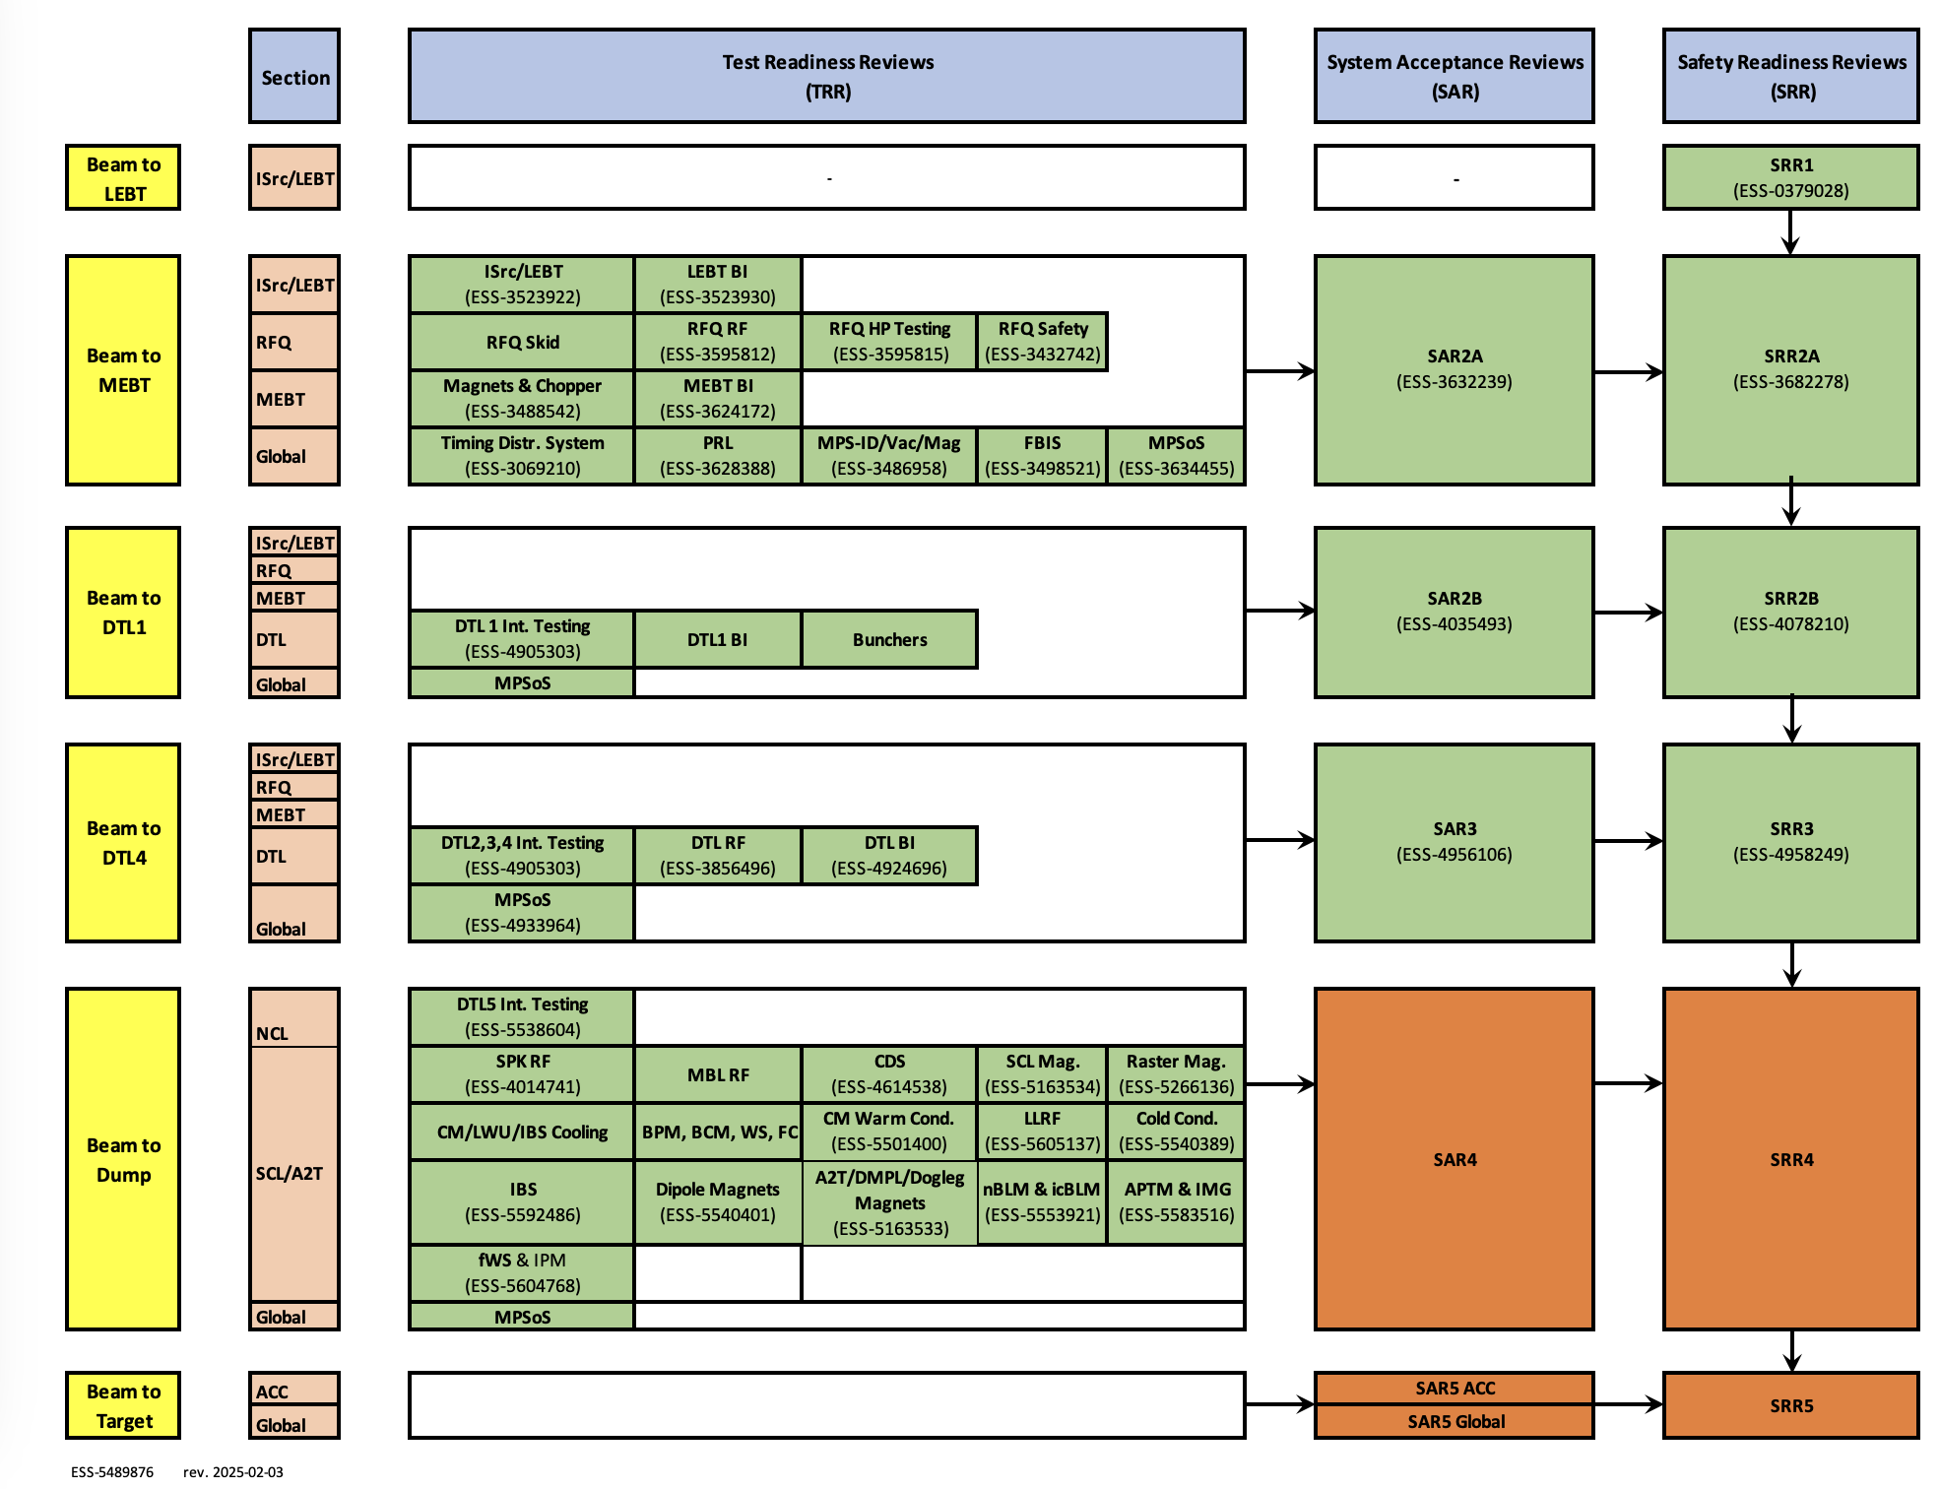
Roadmap to SRR4 - Reviews
ESS-5489876

Slide 27
Top Critical Path to ACC RBOT
Dec’24 Update
SAR4 Approved
SRR4 Approved
ACC RBOT
24 Feb '25
10 Mar '25
11 Jul '25
Dec
2025
Feb
Mar
Apr
May
Jun
Jul
Today
Holidays
17 Apr '25 - 21 Apr '25
Easter 2025
2 Jan '25 - 10 Jan '25
SPK-IBS Testing
13 Jan '25
MPS_ID-SPK_IBS Interface Verification
ACC Critical Path
(October 2024)
14 Jan '25 - 10 Feb '25
MPSoS ACC SIT
11 Feb '25 - 24 Feb '25
SAR4
24 Feb '25 - 10 Mar '25
SRR4
Beam Commissioning to Dump
11 Mar '25 - 19 May '25
30 Jun '25 - 11 Jul '25
ACC SAR5

Slide 28
Planning 2025 – Assuming Summer CM Installation
SAR4 Approved
SRR4 Approved
ACC RBOT
Facility RBOT
24 Feb '25
10 Mar '25
11 Jul '25
3 Oct '25
Jan
Feb
Mar
Apr
May
Jun
Jul
Aug
Sep
Oct
Nov
Dec
Today
Holidays
17 Apr '25 - 21 Apr '25
Easter 2025
21 Jul '25 - 8 Aug '25
Summer Maintenance 2025
11 Feb '25 - 24 Feb '25
SAR4
24 Feb '25 - 10 Mar '25
SRR4
Reviews
8 Sep '25 - 19 Sep '25
Facility SAR5
22 Sep '25 - 3 Oct '25
Facility SRR5
6 Oct '25 - 10 Oct '25
System Permit
13 Oct '25 - 17 Oct '25
Beam Authorisation
Commissioning Periods
Beam Commissioning to Dump
11 Mar '25 - 19 May '25
Beam Commissioning to Target
31 Oct '25 - 31 Dec '25
3 Feb '25 - 19 Sep '25
Cryo Controls
3 Feb '25 - 4 Jul '25
6 CM Testing @TS2
3 Feb '25 - 30 May '25
CM/Infra Installation Preparation
3 MW Scope
2 Jun '25 - 6 Jun '25
Linac Cryo Warmup
2 Jun '25 - 13 Jun '25
Linac RP Cooldown Period
16 Jun '25 - 19 Sep '25
CM Installation/Testing
22 Sep '25 - 26 Sep '25
Linac Cooldown
3 Feb '25 - 26 Dec '25
RF Systems Installation and Testing in G02

Slide 29
Beyond BOT
Dec’24 Update
BOD
Facility RBOT
BOT
EOC
17 Mar '25
3 Oct '25
31 Oct '25
31 Dec '27
2025
2026
2027
2028
Beam Commissioning to Dump
ACC, Target, NSS - Installation, Testing, Commissioning - Before BOT
Facility SAR5
Pre-BOT
Facility SRR5
Beam Commissioning to Dump after Facility RBOT
System Permit BOT
Beam Authorisation BOT
ACC Commissioning to Target + Test Beamline (post-BOT)
Hot Commissioning 1
Shutdown 1 (Instrument Install in Bunker)
Hot Commissioning 2
Shutdown 2 (Instrument Install in Bunker)
Post-BOT
Hot Commissioning 3
Shutdown 3 (Instrument Install in Bunker)
Users 1
Shutdown 4 (Instrument Install in Bunker + CM Install)
Recommissioning
Users 2

Slide 30
To BOD and Beyond!

