Slide 1
SAR 4 – Documentation/Configuration control
PRESENTED BY Joakim meyer

Slide 2
Agenda
1 Status of ESS Baseline Plan for SAR 4 (CIDL)
2 Technical Baseline
3 Structure System Component Important To Safety (SSCI2S) and Worker Radiation Safety Function
4 Backlog energization requests

Slide 3
Status of ESS Baseline Plan for SAR 4 (CIDL)
CIDLs that are not in released and correct state:
ESS CIDL – Work ongoing; will be done before SAR5
Accelerator CIDL, As-Verified, – Waiting on last parts of the shielding to be completed
ACC PSS CIDL, As-Operated, - Waiting on final test together with REMS; should be released before SRR4.
DTL CIDL, As-Verified, - Waiting on the verification of DTL5
Cooling Water Accelerator CIDL, As-Verified, - Waiting for the final mechanical documentation
BIS CIDL, As-Verified, – will be done during beam commissioning.
Baseline | Description
2A | As-Operated ACC DTL4
3A/1 | As-Designed ACC SCL (BoT)
3A/2 | As-Verified ACC SCL (BoT)
3A | As-Operated ACC SCL (BoT)

Slide 4
Status of ESS Baseline Report for SAR 4 (CIDL)
The Release report for the Facility configuration baseline for SAR 4 is available in ESS-5030919 Rev 3.
The report specifies the baseline scope with its changes and recorded quality assurance.
Found incomplete review reports and inconsistent change requests shall be assessed to be included as pre/post start items.
CDR reports not released (10 in preliminary)
TRR reports not released (3 in review, 1 in preliminary and 8 not documented)

Slide 5
Status of CCRs for SAR 4 (CIDL)
CCRs with unclear status tat may impact BoD comissoning
ESS-5540580 ACC PSS AMM Temporary Interface Bypass
ESS-5536384 Configuration Change of BCM Differential Pair Interlock
ESS-5238748 Water cooling for SPK-010 and MBL-060 LWU insertable beam stops
ESS-4747642 Install heat exchangers for CWM and CWH
ESS-5128250 Remove Need of Operator FBIS Rearm due to RFLPS inputs
ESS-4796032 Move PSS waveguide position in DTL-2
ESS-5092865 Modification of coupler outlet circuit for SPK, MBL and HBL
ESS-3481590 Configuration change for Beam Instrumentation systems in initial NCL phases

Slide 6
Reflection on documentation
Documentation is getting better and also the interaction with system owners.
Room for improvement:
Personally, I would expect some more System description.
We lack the relation between requirements and verification reports.
We miss some electical schematics, initiative is on going.
Also, most operation and maintenance manuals are not available as of yet, but this will be covered later at As-Operated baseline.

Slide 7
List of documents to be completed
Will be updated

Slide 8
2 Technical Baseline

Slide 9
AS-OPERATED
AS-VERIFIED
AS-DESIGNED
**Accelerator**
ISrc
LEBT
RFQ
MEBT
DTL1-4
**DTL5**
SPK
MBL
HBL
HEBT
DMPL
HBL6-21 RF Sys.
SPK2 WS-02 Diag.Sys. (See note)
HBL6-21 Modulator Sys.
SPK2 nBLM-06 Diag.Sys. for BoT
HBL6-21 Control Sys.
SPK4 nBLM-06 Diag.Sys. for BoT
HBL6-21 Cryomodules
SPK6 nBLM-06 Diag.Sys. for BoT
HBL10-17 ICBLM-09 Diag.Sys. for BoT
SPK8 nBLM-06 Diag.Sys. for BoT
HBL18-21 ICBLM-11 Diag.Sys. for BoT
LEBT FPM-01 Diag.Sys.
MEBT COLL-01 Diag.Sys. for BoT
SPK10 nBLM-06 Diag.Sys. for BoT
HBL11 nBLM-08 Diag.Sys. for BoT
HEBT1-5 ICBLM-11 Diag.Sys. for BoT
LEBT EMU-01 Diag.Sys.
MEBT LBM-01 Diag.Sys. for BoT
DTL1 FPM-04 Diag.Sys. For EOC
SPK12 nBLM-06 Diag.Sys. for BoT
MBL5 nBLM-07 Diag.Sys.
HBL1-21 VAC Thermocouple Sys.
HEBT6-16 ICBLM-13 Diag.Sys. for BoT
LEBT VAC Thermocouple Sys.
MEBT FPM-02 Diag.Sys. for BoT
DTL4 FC-01 Diag.Sys.
SPK1 LBM-01 Diag.Sys.
MBL6 IBS-02 Diag.Sys.
HBL6-21 VAC Vacuum Valves
HEBT17 nBLM-09 Diag.Sys. for BoT
DMPL5 IMG-01 Diag.Sys.
Notes:
“ACC As-Operated” has not yet been released yet due to remaining shielding verification reports.
“DTL As-Verified” has not yet been released due to the pending Verification Report.
=====================================================================================
LEBT FPM-01 Diag.Sys. – Marked as RED in the confidence rating, low priority due to focus on other critical devices
LEBT EMU-01 Diag.Sys. – Marked as “Installed @ BoD” in the confidence rating
LEBT VAC Thermocouple Sys. – Marked as "As-Designed" in the CIDL
MEBT COLL-01 Diag.Sys. – Marked as "As-Designed for BoT" in the CIDL
MEBT LBM-01 Diag.Sys. – Marked as “Installed @ BoD” in the confidence rating, and "As-Designed for BoT" in the CIDL
MEBT FPM-02 Diag.Sys. – Marked as RED in the confidence rating, low priority due to focus on other critical devices, and "As-Designed for BoT" in the CIDL
DTL1 FPM-04 Diag.Sys. – Marked as “Commis. With Beam @ EOC” in the confidence rating
DTL4 FC-01 Diag.Sys. – Marked as RED in the confidence rating, to be installed after BoD
SPK2 WS-02 Diag.Sys. – this WS on LWU SPK-020 is broken. It will be replaced only after BOD. But, it is still being tested fully and integrated into the MPS.
SPK2 nBLM-06 Diag.Sys. – Marked as "As-Designed for BoT" in the CIDL
SPK4 nBLM-06 Diag.Sys. – Marked as "As-Designed for BoT" in the CIDL
SPK6 nBLM-06 Diag.Sys. – Marked as "As-Designed for BoT" in the CIDL
SPK8 nBLM-06 Diag.Sys. – Marked as "As-Designed for BoT" in the CIDL
SPK10 nBLM-06 Diag.Sys. – Marked as "As-Designed for BoT" in the CIDL
SPK12 nBLM-06 Diag.Sys. – Marked as "As-Designed for BoT" in the CIDL
SPK1 LBM-01 Diag.Sys. – Marked as “Installed @ EOC” in the confidence rating due to supply chain issue as noted in CCR ESS-5264409
MBL5 nBLM-07 Diag.Sys. – Marked as "As-Designed" in the CIDL
MBL6 IBS-02 Diag.Sys. – Marked as RED in the confidence rating, to be installed after BoD, and "As-Designed" in the CIDL
HBL6-21 is beyond EOC as marked in the confidence rating and "As-Designed" in the CIDL
HEBT1-5 ICBLM-11 Diag.Sys. – Marked as "As-Designed for BoT" in the CIDL
HEBT6-16 ICBLM-13 Diag.Sys. – Marked as "As-Designed for BoT" in the CIDL
HEBT17 nBLM-09 Diag.Sys. – Marked as "As-Designed for BoT" in the CIDL
DMPL5 IMG-01 Diag.Sys. – Marked as "As-Designed " in the CIDL as confirmed by Johan Norin

Slide 10
AS-OPERATED
AS-VERIFIED
AS-DESIGNED
**ESS Facility**
ACC CDS
CWL
Control & Monitoring
ACCP
LVPD H&F Bldgs
Timing Distribution for NCL up to and including DTL4
Technical Network NCL up to and including MBL9
HVAC
**ACC PSS**
Temp. RW Storage
**CW ACC**
Fire Safety
(except F01)
**BIS**
Phase Reference Line
Electrical
Transport
CryoB ODHDS
ICS Comp. Infr.
LVPD G Bldgs
Physical Protection
ACC ODHDS
Instrument Air
LVPD D&E Bldgs
Site and INFR
CWH
LVPD B&F04 Bldgs
REMS
CWM
Electrical Grounding
Timing Distribution for DTL5 up to and including DMPL
Technical Network for HBL up to and including DMPL
Process
ACCP New Back-up Compressor
Some LVPD Panels
HVAC for H09
(but not relevant to SAR4/SRR4)
Notes:
“ESS Facility As-Operated” has not yet been released due to pending high-level ESS documentation.
“ACC PSS As-Operated” has not yet been released because it needs to be verified with REMS.
“BIS As-Operated” has not yet been released due to high verification dependency on other interfacing systems.
“CW ACC” has not yet been released due to pending mechanical documentation.

Slide 11
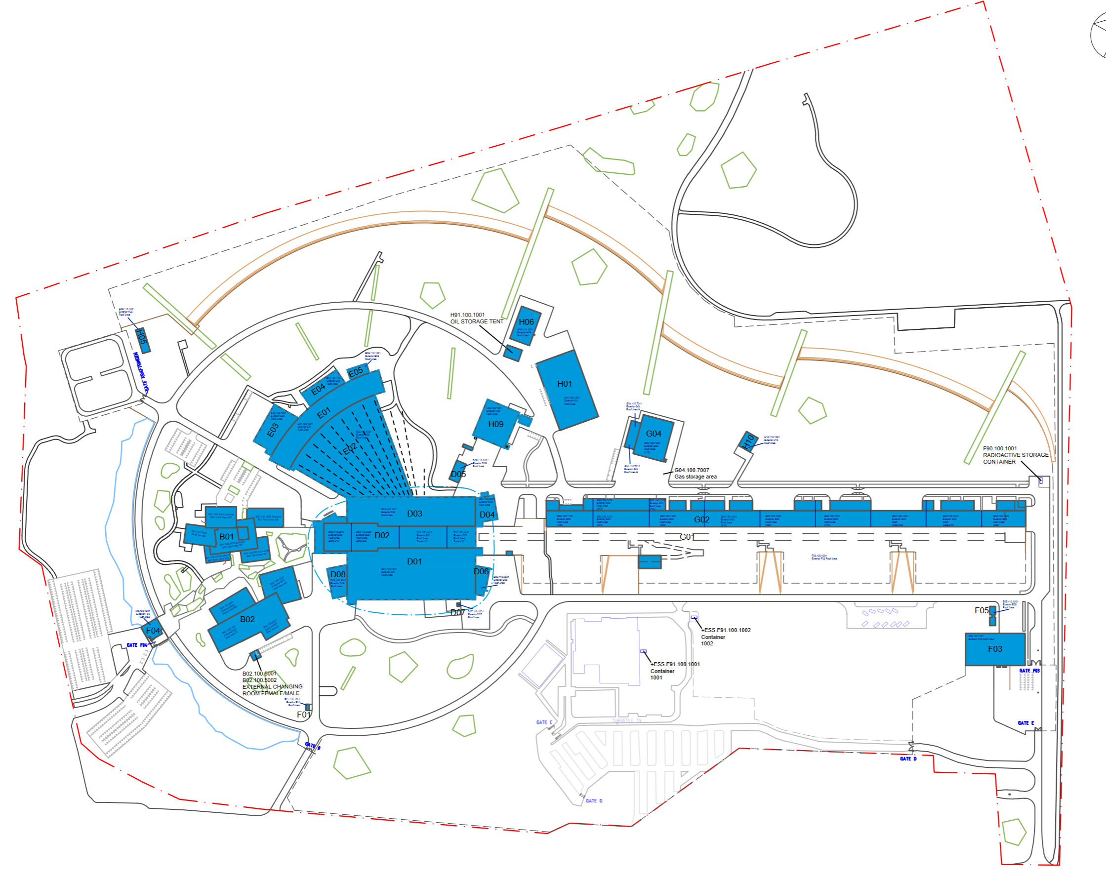
AS-BUILT
As-Built and Relevant to SAR4/SRR4
As-Built but not Relevant to SAR4/SRR4
E04
E05
E03
E01
E02
B01
D03
D04
D01
B02
D08

Slide 12
3 Structure System Component Important To Safety (SSCI2S) and Worker Radiation Safety Function

Slide 13
System Component Important To Safety and Worker Radiation Safety Function
CIDLs shall capture the SSCs, however, there are some discrepancies between the current CIDLs and SSCs noted in:
ESS-5597859 SSCI2S List for SAR4 and SRR4, (filter on “SAR 4” in column Q, and O for which CIDL it is included or not)
These are not included in the CIDL according to the document above:
Fast Interlock Module CS for RFQ, MEBT, SPK, MBL, HBL (parent nodes are included)
Interlock PLC CPU (added late to the CIDL)
Vacuum Sector Valves (only a few)
For INP, this list largely aligns with the INP baseline but some adjustment is necessary:
ESS-4911308 Extraction of FBS Tags from SSC Classification Reports and Lists

Slide 14
4 Backlog energization requests

Slide 15
Backlog energization requests
Backlog consist of 124 requests where the documentation has been missing
Of these 65 has been updated and are sent for new evaluation.

Slide 16
Finish presentation

