Slide 2
Maintenance & Periodic Inspection
SAR 4
PRESENTED BY ola nanzell

Slide 3
Introduction
The Asset and Maintenance Management (AMM) function is a centralized team who is system owner of EAM, managing the overall maintenance framework (through WoW Develop and Maintain Facility), and provide centralized support to set up periodic inspection & maintenance plans based on input from system owners.
This presentation aims to cover how ESS will implement the maintenance framework for SAR4 and SAR5

Slide 4
Periodic inspection and maintenance
As defined in ESS Maintenance Handbook (ESS-1162328)
ESS has an established maintenance program created and managed by the respective system owners with support and coordination by the Asset and Maintenance Management function in accordance with the “ESS Maintenance Handbook”, this document. The maintenance program consists of several deliverables that together enables the Work Coordination and Planning function to execute the program.
Deliverables that are required:
A maintenance schedule in the ESS maintenance management tool
This plan shall incorporate time (calendar time or run time) between planned maintenance activities
Classification of the equipment in scope of the plan, including criticality class and SSCI2S
A maintenance manual
If none is delivered from the vendor or In-Kind partner the template for Maintenance Manual shall be used. This template acts as a guide of what to include. Any areas in the template that is not applicable to a system shall be removed.
A risk assessment
Any required permits to perform the work

Slide 5
Pragmatic approach to periodic inspection and maintenance
Long term (gradual approach), each system must have a minimum of periodic inspection/maintenance documentation and possibility to track and follow up required maintenance activities (as defined in ESS Maintenance Handbook)
Pragmatic approach
SSCI2S, ATEX & ODH (documents, plans, records)
SSCs (pressurized directive, electrical safety) (1&2 can be validated in EAM)
Criticality class A items (operational critical)
Criticality class B items (important for operation)
4
3
SAR/SRR 4
SAR/SRR 5
3,4 – As we experience/learn from operations
1
2
2024
2025
2026
2027
2028

Slide 6
Status and Plan Forward
Towards SAR5
ESS has a lot of documentation that potentially covers periodic testing, inspection and maintenance. We need to (were applicable):
Connect documents to structures
Update with new information based on changes in how we work, re-designs or lessons learned from operating the system
Write maintenance manuals
Create preventive maintenance schedules that can be verified in alignment with OLC SSCI2S Periodic Maintenance Rules in EAM
This should be possible to verify through EAM by SAR5
Until then, each system owner is responsible to point out necessary plans and reports for periodic inspections and maintenance

Slide 7
Electrical Maintenance & Inspections
Status & way forward
Quality has developed a guide for maintenance that shall be considered for electrical installations
Many maintenance manuals that has been developed by the project teams cover these checks, albeit with different terminology
A draft project plan has been developed and will be implemented in alignment with the time axle on slide 5 (by SAR5)

Slide 8
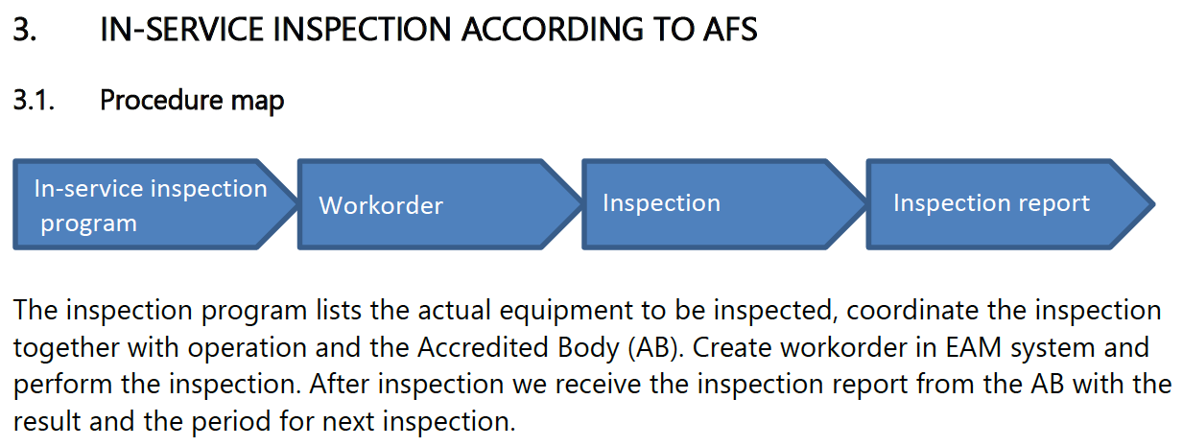
Pressurized Systems
Status & way forward
Systems have been identified and have maintenance plans in documents that needs to be checked and potentially updated
Maintenance schedules needs to be created in EAM
Third party inspection plans needs to be created in EAM (done by SAR5)
All third party inspections has been performed that are required this year, and we have the documentation for this (both in CHESS and with the accredited body) but it’s not tracked in EAM

Slide 9
Finish presentation

