Slide 1
Draft System Permit
SAR4
PRESENTED BY Yngve levinsen

Slide 2
Content
Draft scope definition of system permit for BOD
Overall status of operational readiness, including startup checklists.

Slide 3
What is the system permit
System permit marks start of an operational campaign (with radiological risks)
Declaration that systems are ready for the planned campaign
In particular SSCI2S
Facility configuration baseline readiness
The full review progress is completed, pre-start recommendations are addressed.
Systems operations and monitoring is now coordinated through MCR
Listing manuals & instructions, outstanding issues, tests, any missing systems, …
ESS-3682300 – currently rev 10 released Dec. 6th, for RF commissioning of SCL

Slide 4
Operational Limits and Conditions
ESS-0357253 rev. 14
Revision 14 valid for SCL License (Revision 17 current/INP submission).
Need to carefully review revisions of references, not all are (immediately) compatible in recent revision
Some additional documents will have two released versions while SCL license is used
From Ops side before SRR4
Updating old version of Handbook with “appropriate reference correction”
Updating procedures (flow-charts) for MCR staff in emergencies (SRR-79)

Slide 5
The Systems
All systems with a relevant SSCI2S for SCL commissioning (as per SCL license)
All systems included in current SCL RF commissioning permit (ESS-3682300 rev 10)
Additionally
Magnet systems and Power Supplies
Machine Protection System
Beam Diagnostics devices
Tuning Beam Dump

Slide 6
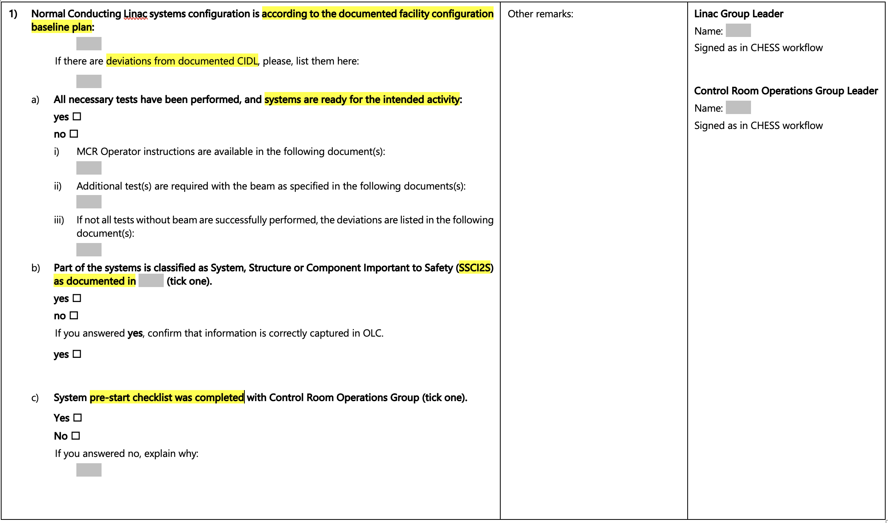
Template changes
Instead of listing FBS nodes we will add a CIDL reference for each system
A reference is needed which captures any SSCI2S for a system
Pre-start checklist should be completed together with CR Ops before signing system permit for most systems

Slide 7
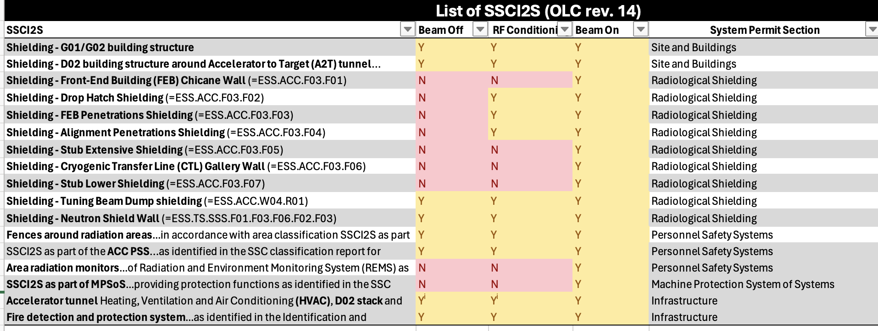
What SSCI2S are there?
See also Joakim’s presentation..
Explicitly in the OLC rev 14 directly, we have the table below
Then you crawl SSC classification reports, RSFs …
And we now have ESS-5597859 with just under 400 SSC listed (Thanks Ruji, Peter, Benjamin and others!)
SCL license SSCI2S as baseline -> CCR -> 2-stage safety review (if needed) -> What we rely on
CCR identified to need 2-stage review so far:
ESS-5584795 – Masking of BLMs

Slide 8
Pre-start checks status
See OPS Confluence page for scheduling
Checklist available in ESS-5513661
~1 hour meeting with sys rep, CR Ops rep, optionally ICS rep
Had meetings:
Cryo
Vacuum
RF
To be scheduled:
SRF
Skids
NCL cavities
NCL ISrc/iris
BI (BCM/BPM/FC)
Magnets & power supplies
Power systems & RFPS
Others?
Other BI?
IOM (CWS, HVAC, …)?
Timing?
Tuning Beam Dump?
For status&findings we refer to
system owners presentations

Slide 9
MCR Training Program
Modules, in progress
After BoD
After BoD
Completed
Completed
Completed
Completed
Completed
TBD
Start-up
W17
Big picture
W20
ACC HW
W21
ACC HW
TBD
TD HW
TBD
NSS HW
TBD/W35
Big Picture
W35
Admin
>BOD
< INP/SAR
ESS-5115994 – Training & Cert. Procedure
ESS-5505521 – Training programme details
THE TRAINING
Systematic approach
Experience based
Teach to learn, learn to teach
SSM-2500 considered fully implemented for what we need for SRR4
- Should add one seminar on TBD operations
Confluence page
Notes:
- This is the fourth week, and the last planned week before we start BoD
- Peo developed this extensive programme, we’ve come a long way since last year
- Programme is to teach how to operate, but also improve how we teach -> evaluation forms
- Some of the Big Picture content will come this week (e.g. MPS/PSS, cryo ops)
- Target, NSS will be postponed to after BoD- This week is what we call the “admin week”
- Thanks a lot to Arek and Benjamin for organising, together with great support from Kata!

Slide 10
The operator tools - summary
SRR-67
S&R functionality improvements
SDS in testing
RF Orchestration
Sequencer tool in testing
Fault Reporting Tool not in the state we would have preferred

Slide 11
The end

Slide 12
References
In no particular order..
ESS-0357253 – Operational Limits and Conditions
ESS-5359877 – Technical Excecution Baseline
ESS-2070708 – ESS Procedure for System Permit
ESS-0372700 – System permit template
ESS-3682300 – System Permit (the actual decision/active permit)
ESS-5597859 - SSCI2S List for SAR4 and SRR4
ESS-5513661 – MCR pre-start checklist
ESS-3821403 – Rules for Software Updates in Systems Supporting Accelerator
ESS-5115994 – ESS Procedure for Training and Certifying MCR Shift Leaders and Operators
ESS-5505521 – ESS Main Control Room Operators Training Programme
ESS-5584795 - Global Masking of ICBLMs and nBLMs from FBIS during Beam on Dump (BOD) Commissioning

Slide 13
Lesson’s learned summary
ESS-5590900
Consider clarifying scope of the system
Find a simpler way to list relevant systems
Consider sectionizing sign-off of the system permit.
Some systems were missed from system permit last time.
Clearer CIDL & SSCI2S relevance. CIDL release not linked to (all) commissioning stages
Allow time between finishing system tests and releasing CIDL
System permit is very much focused around OLC; other safety aspects are not well captured. Administrative measures were not included. WRSF needs to be captured for INP.
Too much focus on documentation
Lack of verified baseline uncovered issues still to be closed.

