Slide 1
Beam Commissioning Plan, Schedule, and Goals
Ryoichi Miyamoto (AD/BPBD/BP)
SAR4
2025-02-04

Slide 2
Outline
NCL commissioning recap
Priorities (goals) and plan
Schedule
Potentially open points
(Details in backup)

Slide 3
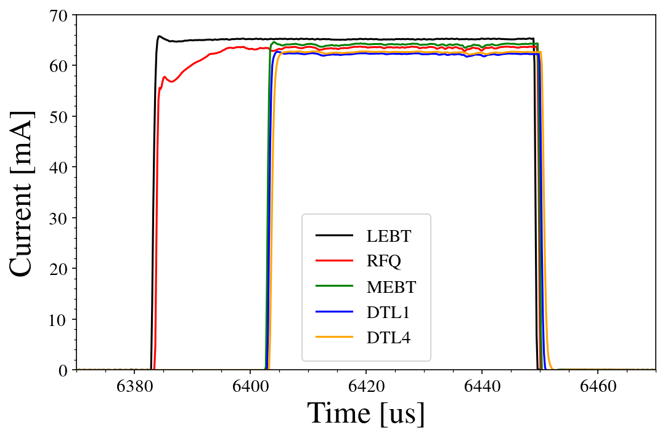
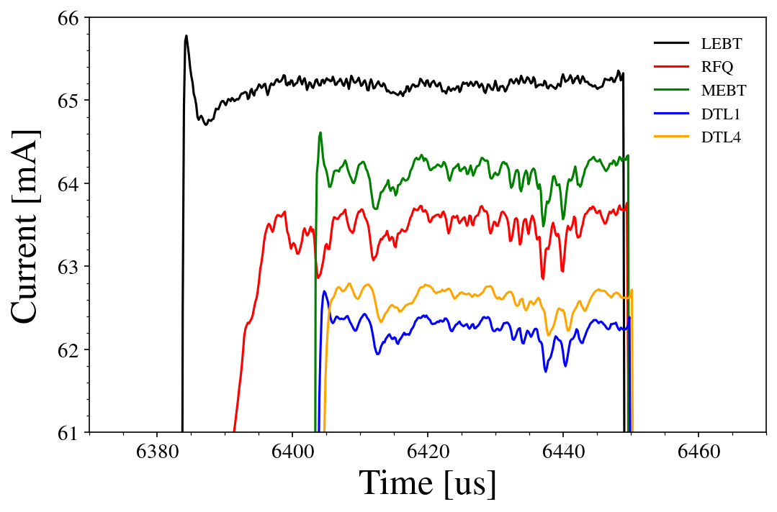
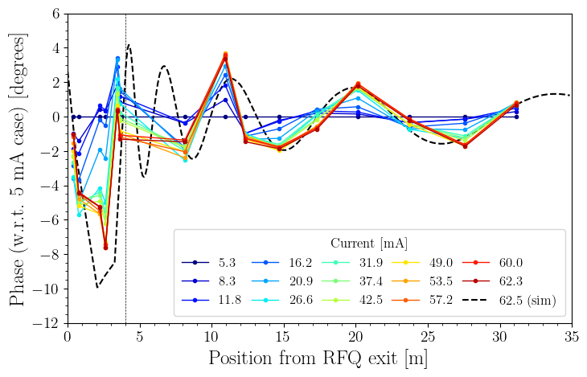
NCL commissioning recap (1): Beam physics
~74 MeV beam w/ 62 mA and 50 µs (at 0.2 Hz) to the DTL4 exit.
No loss expected in DTL2-5. Need to see what happens in SCL.
Further study needed for some points.
RFQ output phase/energy variation over current (iris).
DTL phase scan.
ISrc pulse stability over ~3 ms.
Emittance/profile measurements and model benchmarking.
(ESS-5112857 for more details.)

Slide 4
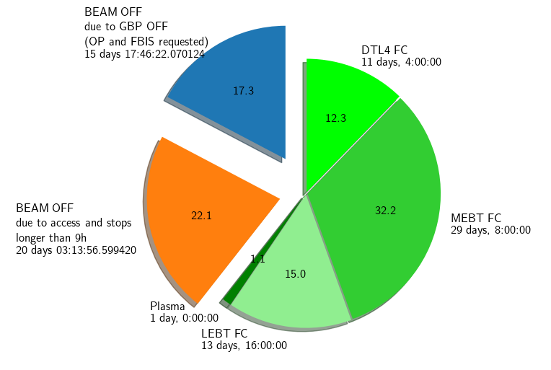
NCL commissioning recap (2): Operations
Schedule
2023-04-19 ~ 2023-07-14
86 days (58 working days)
Most of tests done during normal (sometimes extended) hours.
17 tests during off-hour shifts.
Coordination
First focused to establish probe to DTL4 (~10 days).
Afterwards parallel activities, coordinated in a weekly meeting.
Shifter Tool was introduced.
Room of improvement for planning of each test.
Same strategy for this commissioning.
Operations situations.
RF pulse length limited to ~300 µs.
14 Hz operation wasn’t possible.
Lost a lot of time for cavity re-conditioning.
The situation in the last few weeks was particularly bad due to loss of condition of the RFQ.
Courtesy of A. Gorzawski

Slide 5
Priorities (goals) and plan
Establish ~880 MeV probe to the dump.
Check critical systems (BCMs, BPMs, MPS).
Set all SC cavity phase/amp and debug/improve the tool/method.
Check polarities.
Test systems critical for higher power.
LLRF: feed-forward and pulse ramp-up.
Dump Imaging System.
BLMs.
Ramp-up beam pulse length and current to 50 µs and 62.5 mA.
Test profile monitors.
Test matching and loss mitigation.
(Improve operations: beam time, tools, procedures, ...)

Slide 6
Schedule overview
Week | 1 | 2 | 3 |  | 4 | 5 |  | 6 | 7 | 8 | 9 | 10
NCL recomm |  | Front-end retuning
 |  | MPS check
Probe to dump |  |  | SPK test and scan
 |  |  |  |  | MBL test and scan
 |  |  |  | DmpL Img and AptM test
 |  |  |  |  |  | MBL+HBL test and scan
 |  |  |  |  | DmpL |  | (DmpL Img and AptM test)
 |  |  |  |  |  |  | SCL BPM test, polarity check, and steering
RF/beam ramp-up | LLRF and RF pulse/rep ramp-up
 | Pulse/current ramp-up
Parallel activities | Differential protection test
 | BLM test
 | SCL PBI test
 | SCL BP
 | SCL trans. matching
 | NCL PBI test
 | NCL BP |  | NCL beam physics
Conservative assumption of ~3 hours per SC cavity for the initial check and phase/amp setting w/ the scan.

Slide 7
Modes and destinations
Scanned cavity | Min W [MeV] | MEBT-FC | DTL2-FC | SPK-IBS | Dump
Buncher1 | 3.6
Buncher2 | 3.6
Buncher3 | 3.6
DTL1 | 20 |  |  | F-comm, RF-test
DTL2 | 21 |  |  | F-comm, RF-test
DTL3 | 39
DTL4 | 57
DTL5 | 74
SPK | 90
MB+HB | 216
Forbidden modes during the cavity scans
We do cavity scan mostly w/ probe but may also use the fast-commissioning and RF-test.
Beam mode check of MPS is based on ESS-0377547, but there are more constraints based on energy.
Slow-tuning will be used only for the MEBT-FC and dump, until we have good measurements of activations.
RP monitors DTL2-FC and SPK-IBS.
14 Hz will be done mainly with fast-commissioning.
If the long-pulse verification is not used now, do we ever use it at its full extent?

Slide 8
What I want to know/communicate before starting beam
RF/cavity
Field limits and operation pulse length. How do we keep track the limits?
Strategy for ramp-up pulse length and how much time to allocate for conditioning?
If 2.86 ms is important for the initial OPs, should we prioritise conditioning over the current ramp-up?
Discussion ongoing for how to handle a bad pulse for LLRF learning.
Diagnostics
Mainly for BLMs and emittance/profile devices, we want to test which units, roughly when, and in which condition?
(For myself, feasibility of the controlled loss test.)
Protections
For the differential protection, do we do anything beyond testing functionality?
Dump protection
Do we use the limits in ESS-0034025 (interface requirements)? Analysis exists only for 5x5 mm RMS even for probe.
Do we keep the imaging exposed to the beam all the time?
(Requirements and use cases could have been communicated better. Something to think for BoT.)
Support and man-power (for scheduling)
Who’s taking shift when? Who’s coordinating?
Note, if the initial test and phase/amp setting indeed take ~3 hours for each cavity and if we only work regular hours, we have no time for the parallel activities.

Slide 9
Backup

Slide 10
Steps w/ details: Front-end
 | Mode | Destination | PBIs | Note
ISrc pulse check | N/A | LEBT-FC | ISrc-ACCT LEBT-FC | Check reproducibility of the ISrc pulse. (Can also check emittance.) (Start earlier?)
Iris (and sol1) scan | N/A | LEBT-FC | LEBT-FC | Check reproducibility of current adjustment with the iris (and sol1/ISrc).
Probe to MEBT-FC | Probe (RF test) | MEBT-FC | BCMs MEBT-BPMs | Establish probe transport to MEBT FC. Bunchers1-2 and Q5-7 off. Steering only for Q1-4.
Choppers check | Slow tuning | MEBT-FC | BCMs | Check timing and chopping of the choppers. Bunchers1-2 and Q5-7 off.
MPS/PBIs verifications Polarity checks |  | MEBT-FC
LEBT sol+steerer scan | Slow tuning | MEBT-FC | BCMs MEBT-BPMs | Check/set LEBT magnets for 62 mA. Bunchers1-2 and Q5-7 off. ~Full beam loss in RFQ. (RFQ voltage scan.)
LLRF check for RFQ
Buncher1-2 scan | Probe (RF test) | MEBT-FC | MEBT-BPMs | Check/set buncher1-2 amp and phase. Q5-Q7 powered.
Steering to MEBT-FC | Probe (RF test) | MEBT-FC | MEBT-BPMs | Steering w/ buncher1-2 and Q5-7.
Parallel tests to MEBT-FC |  | MEBT-FC

Slide 11
Steps w/ details: DTL
 | Mode | Destination | PBIs | Note
Buncher 3 scan | Probe (RF test) | DTL2-FC | MEBT-BPMs (DTL1-BPM1) | Check/set buncher3 amp and phase. Full beam loss in DTL1.
DTL1 transmission scan | Probe (RF test) | DTL2-FC | DTL1-BCM | Check/set roughly DTL1 amp and phase. Full beam loss in DTL1.
MPS/PBIs verifications Polarity checks |  | DTL2-FC
DTL1 steering | Probe (RF test) | DTL2-FC | DTL1 BPMs | Steering to DTL1 exit. The first half likely not well corrected.
DTL1 scan | Probe (RF test) | DTL2-FC | DTL1-2-BPMs | Check/set DTL1 amp and phase. Full beam loss in DTL1.
DTL2-4 scan | Probe (RF test) | SPK-IBS | DTL3-5-BPMs | Check/set DTL2-4 amp and phase.
DTL2-4 steering | Probe (RF test) | SPK-IBS | DTL3-5-BPMs | Steering to DTL4 exit.
MPS/PBIs verifications Polarity checks |  | SPK-IBS

Slide 12
Steps w/ details: SCL
 | Mode | Destination | PBIs | Note
DTL5+SPK1-13 scan | Probe (RF test) | Dump | SPK-BPMs | Check/set SPK1-13 amp and phase. Quads scaled. Debunching and potential full loss.
SPK14-26 scan | Probe (RF test) | Dump | SPK-BPMs (MBL-BPMs) | Check/set SPK14-26 amp and phase. Quads scaled. Debunching and potential full loss.
Steering to SPK exit | Probe (RF test) | Dump | SPK-BPMs | Steering.
MPS/PBIs verifications Polarity checks |  | Dump
MB1-36 scan | Probe (RF test) | Dump | MBL-BPMs (HBL-BPMs) | Check/set MB1-36 amp and phase. (Quads scaled.)
HB1-20 scan | Probe (RF test) | Dump | HBL-BPMs | Check/set HB1-20 amp and phase. (How many cavities in bunching mode?)
Steering to Dump | Probe (RF test) | Dump | MBL-HEBT-BPMs | Steering.
All parallel tests Shielding validation?

Slide 13
Beam physics key points
Majority of time spend on testing phase scan.
Setting right amp/phase is important for loss in SCL. (Plan to adjust amp too unlike SNS.)
Improving efficiency (and eventually automating) is important.
Steering is necessary but not demanding.
~0.5-1 mm level should be sufficient.
1-1 steering is fine in term of the steerer-BPM layout. (SVD should still help to identify bad pairs.)
Loss in SCL shouldn’t be very sensitive against transverse matching.
Excessive beta-beating should still be avoided.
Need measurements at multiple locations for model benchmarking.
The current and pulse length ramps will be done in gradual steps, while observing loss situation.
Loss detection mainly reply on BCMs during the beam-on-dump commissioning. Need to be careful with systematics.
Pay attention to the survey result in parallel.
No well-known receipt for loss mitigation for a proton linac.
The required level will be ~1E-7 in terms of fraction.
BLM thresholds often empirically set compared to activations.
We could only repeat basics, e.g., phase scan.
Adjusting the front-end could change the situation.

Slide 14
List of (selected) beam physics studies
SCL (probe to dump)
Phase scans
0.5-1 hr per cavity 82 cavities
Polarity checks
1 shift
Steering
0.5 shift
Dump-line optics
0.5 shift
SCL (parallel)
Current/pulse-length ramp
0.5-1 shift per step
5-10 steps in current, 2 steps in pulse length
Controlled loss tests
~10 min per period
59 periods (13+9+21+16)
Emittance reconstruction with dump imaging
0.5 shift
Matching w/ 3 wires
0.25 x 2 shift per station?
Energy recovery test
1 shift per scenario?
NCL
ISrc pulse flatness
1 shift
RFQ output variation vs. iris.
4 shifts?
DTL phase scan with external BPMs
1 shift
ISrc HV (and RFQ field) and optimization
1 shifts
Solenoids scan with a wider range
1 shift
...
List is not exclusive and not including system tests.
Durations are very rough estimations.
Often a test needs to be repeated.

Slide 15
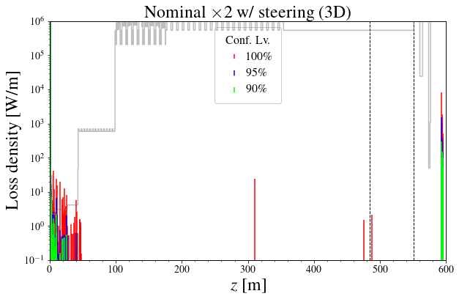
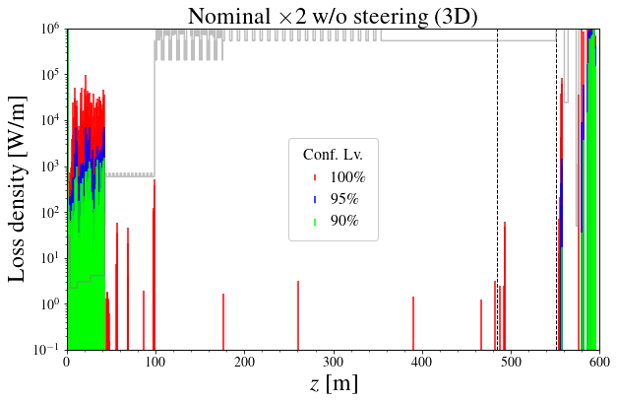
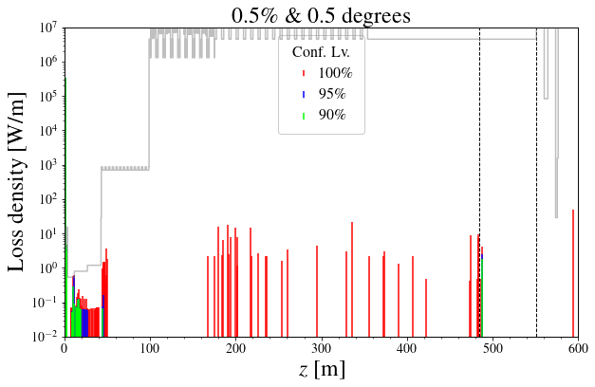
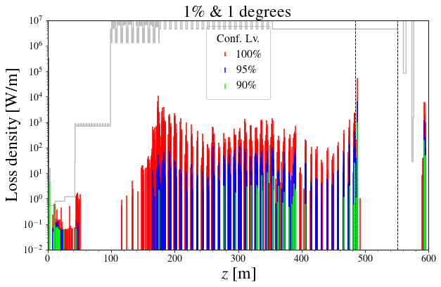
Beam loss simulations (confidence level losses)
Quad x2 w/ steering
Quad x2 w/o steering
Conditions:
x1-x2 of tolerances. (Defined to preserve emittance.)
Quad and cavity errors, separately .
100k particles x 100 runs.
Losses in SCL are not too sensitive against steering and transverse matching.
Losses in DTL and target area are sensitive against transverse errors.
Excessive beta-beating (hundreds of %) should be still avoided.
Losses in SCL are sensitive against longitudinal tuning.
Cav x1
Cav x2

