Slide 2
SCL Components: Cavities and Cryomodules
SAR-4
PRESENTED BY Cecilia MAIANO

Slide 3
1. Brief Scope description
In short
As simple as:
‘’Bring to operation cryomodules of SPK and ELL types with cavities capable of sustaining the RF fields as required by the nominal machine beam physics design, driven by an RF pulse allowing the acceleration of 2.85 ms beams at 14 Hz, and within the heat load budget allowed by the cryogenic system’’
This includes the whole workflow
component reception from the InKind contributors
SAT activities
Installation in the Linac
Technical commissioning
Handover with a clear envelope for the operational parameters and limits
Maintenance during operation of the facility.

Slide 4
2. Brief Status of Systems (1/2)
Scope for BOD is fullfilled
13 SPK Cryomodules (with 26 Double Spoke cavities)
9 MBL Cryomodules (with 36 Medium Beta elliptical cavities)
5 HBL Cryomodules (with 20 High Beta elliptical cavities)
are presently installed in the ESS Linac
Cryomodules have been successfully cooled, filled with LHe at 2K from ACCP
Cryogenic operation within the nominal HL budget has been achieved
All Cryomodules have passed SAT testing at FREIA (SPK) or TS2 (ELL)
Warm Coupler Conditioning was performed on all cavities
Cold Coupler Conditioning was performed on all* cavities
* HBL-040 Module could not be cold conditioned yet due to the modulator failure
Cavities are being tuned and brought to nominal performances (w/o beam)

Slide 5
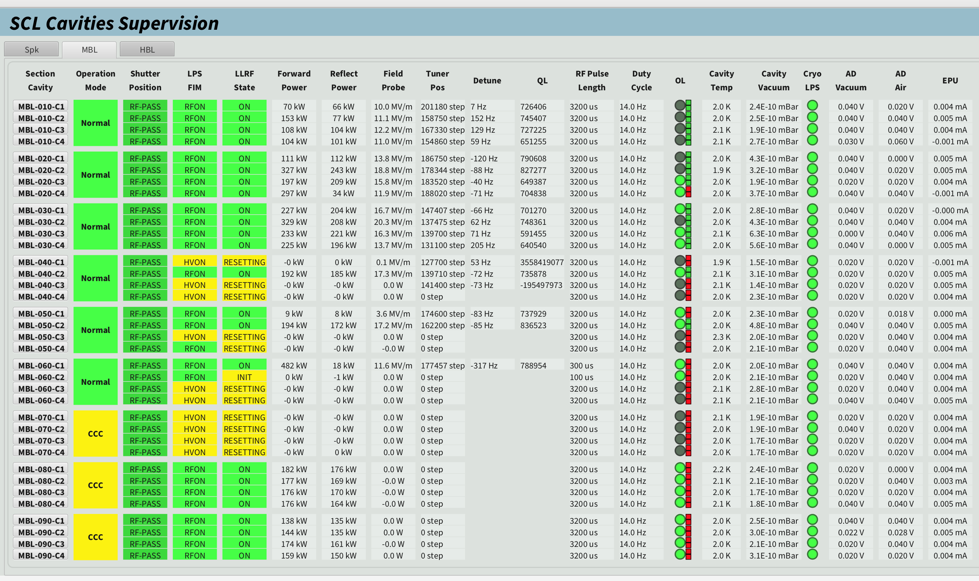
2. Brief Status of Systems (2/2)
MBL Systems being commissioned since January 16
As of January 30:
18 cavities tuned
15 cavities conditioned
(~4 CM equivalents)
Daily progress,
24/7 operation from MCR
Could be faster…
Maintenance Tuesdays
W6-7 Maintenance
Ready CM used for:
LLRF tuning
Beam procedures prep.
All other soaking in RF
but detuned

Slide 6
3. Status of documentation (1/3)
A few key documents in the CIDL
ESS.ACC.A03.AXX.W01 (XX 02 to 14, i.e. SPK-010 to SPK-130)
ESS.ACC.A04.AXX.W01.W01 (XX 02 to 10, i.e. MBL-010 to MBL-090)
ESS.ACC.A05.AXX.W01.W01 (XX 02 to 06, i.e. HBL-010 to HBL-050)

Slide 7
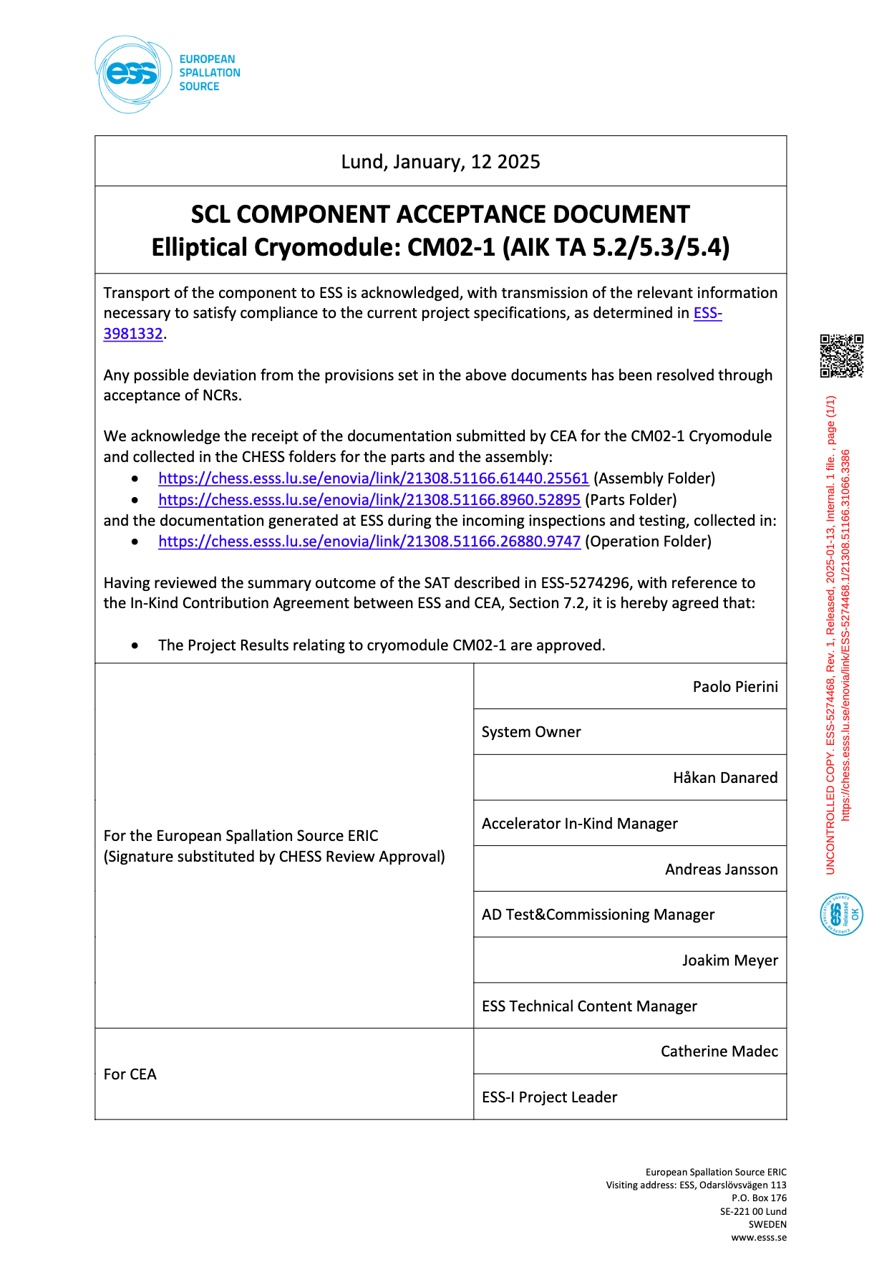
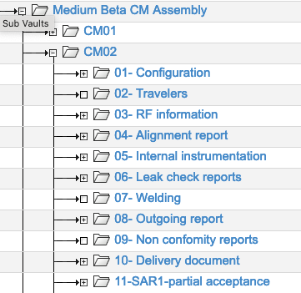
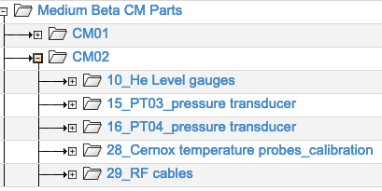
4. Status of documentation (2/3)
Huge documentation from IK, with TCM involvement
TA acceptance document acknowledge documentation transfer/per asset
~ 40 CHESS nodes
~ 30 CHESS nodes
Plus detailed documentation from sucontractors in restriced access areas
Plus design folders with drawings/CAD models for EPL/interfaces

Slide 8
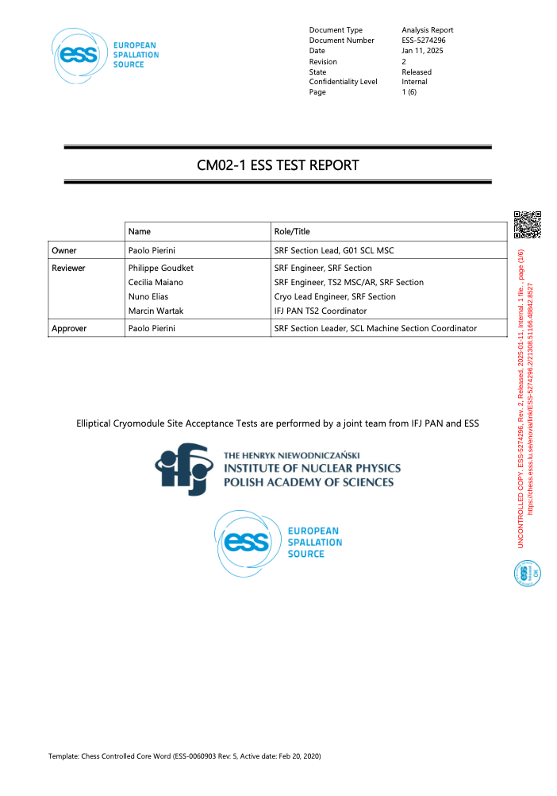
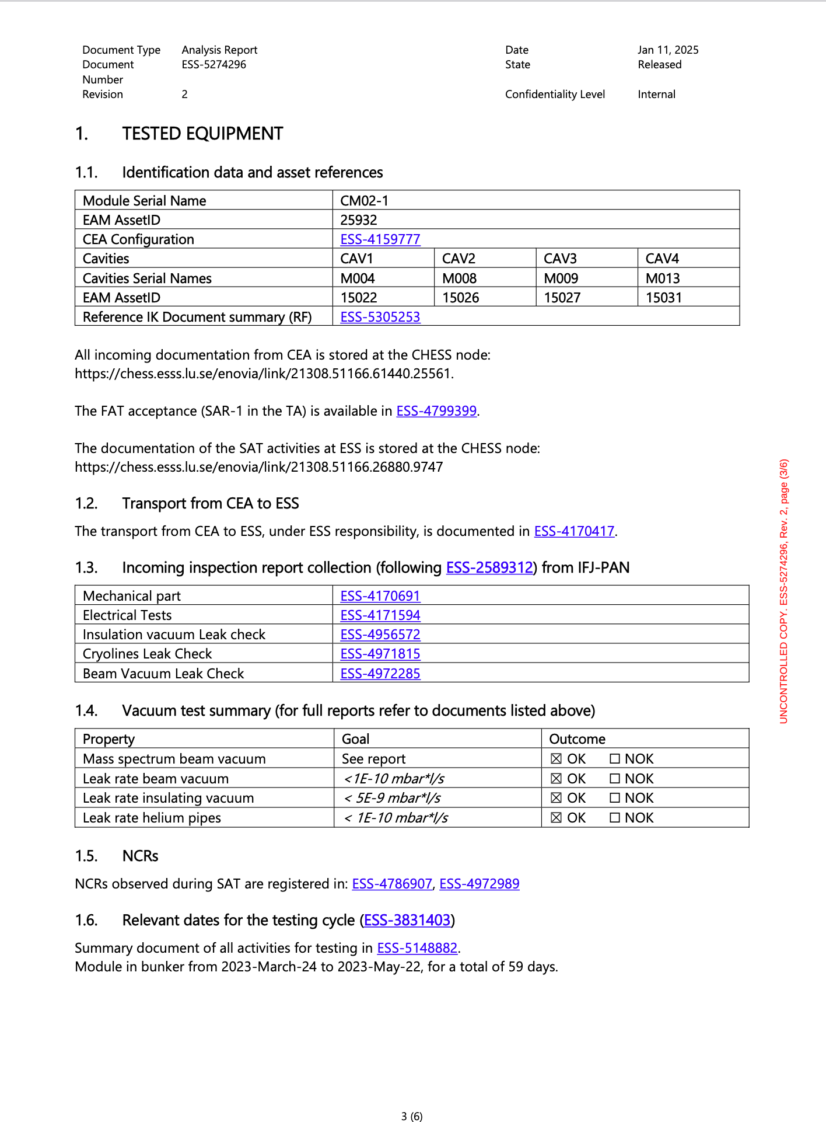
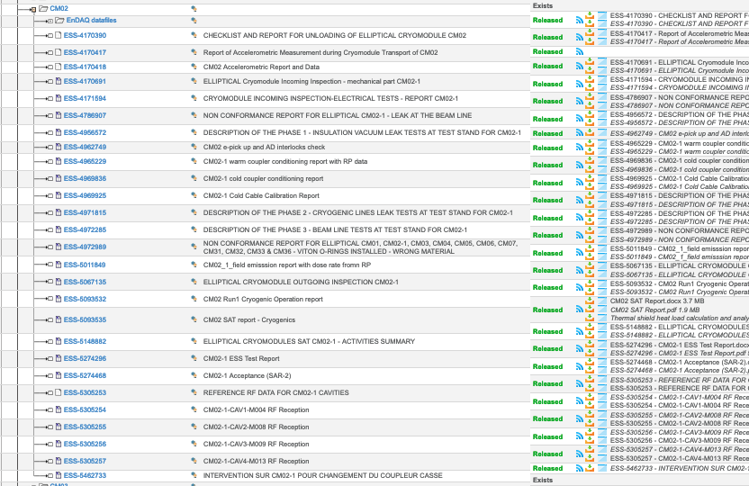
4. Status of documentation (3/3)
Huge documentation SAT in CHESS, with TCM involvement
SAT summary (in CIDL)
EAM Asset Identification
IK measurements
In reality an index for ~ 30 TS2 reports
Incoming checks:
Iso Vacuum
Cryopiping
Beamline vacuum
RF

Slide 9
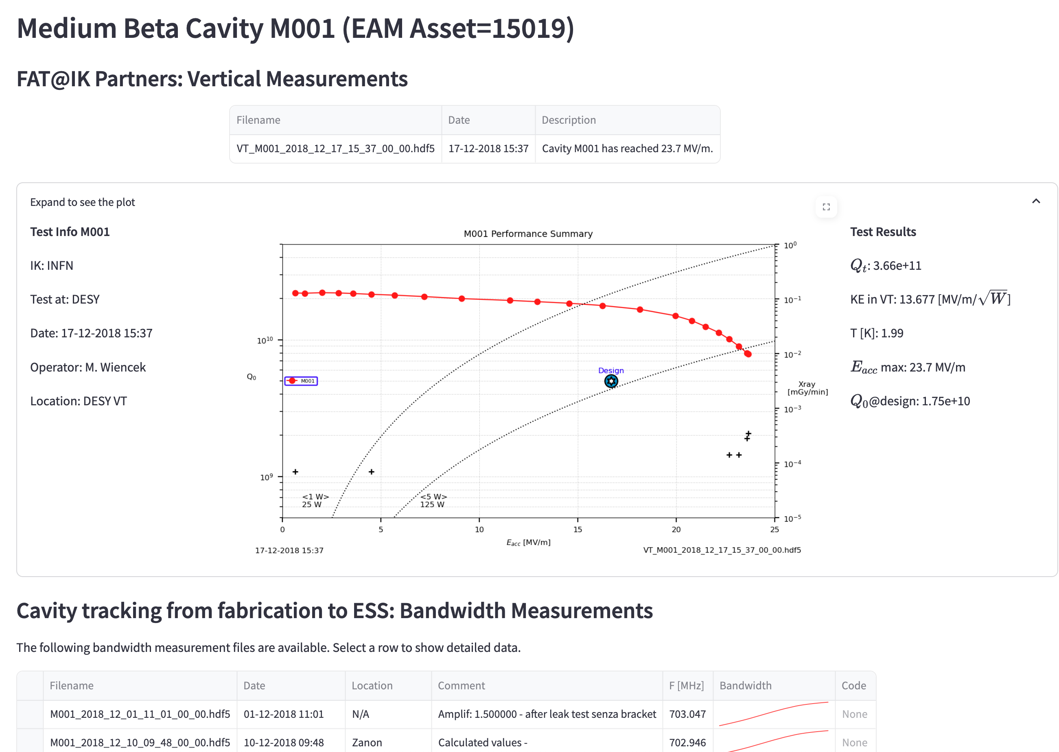
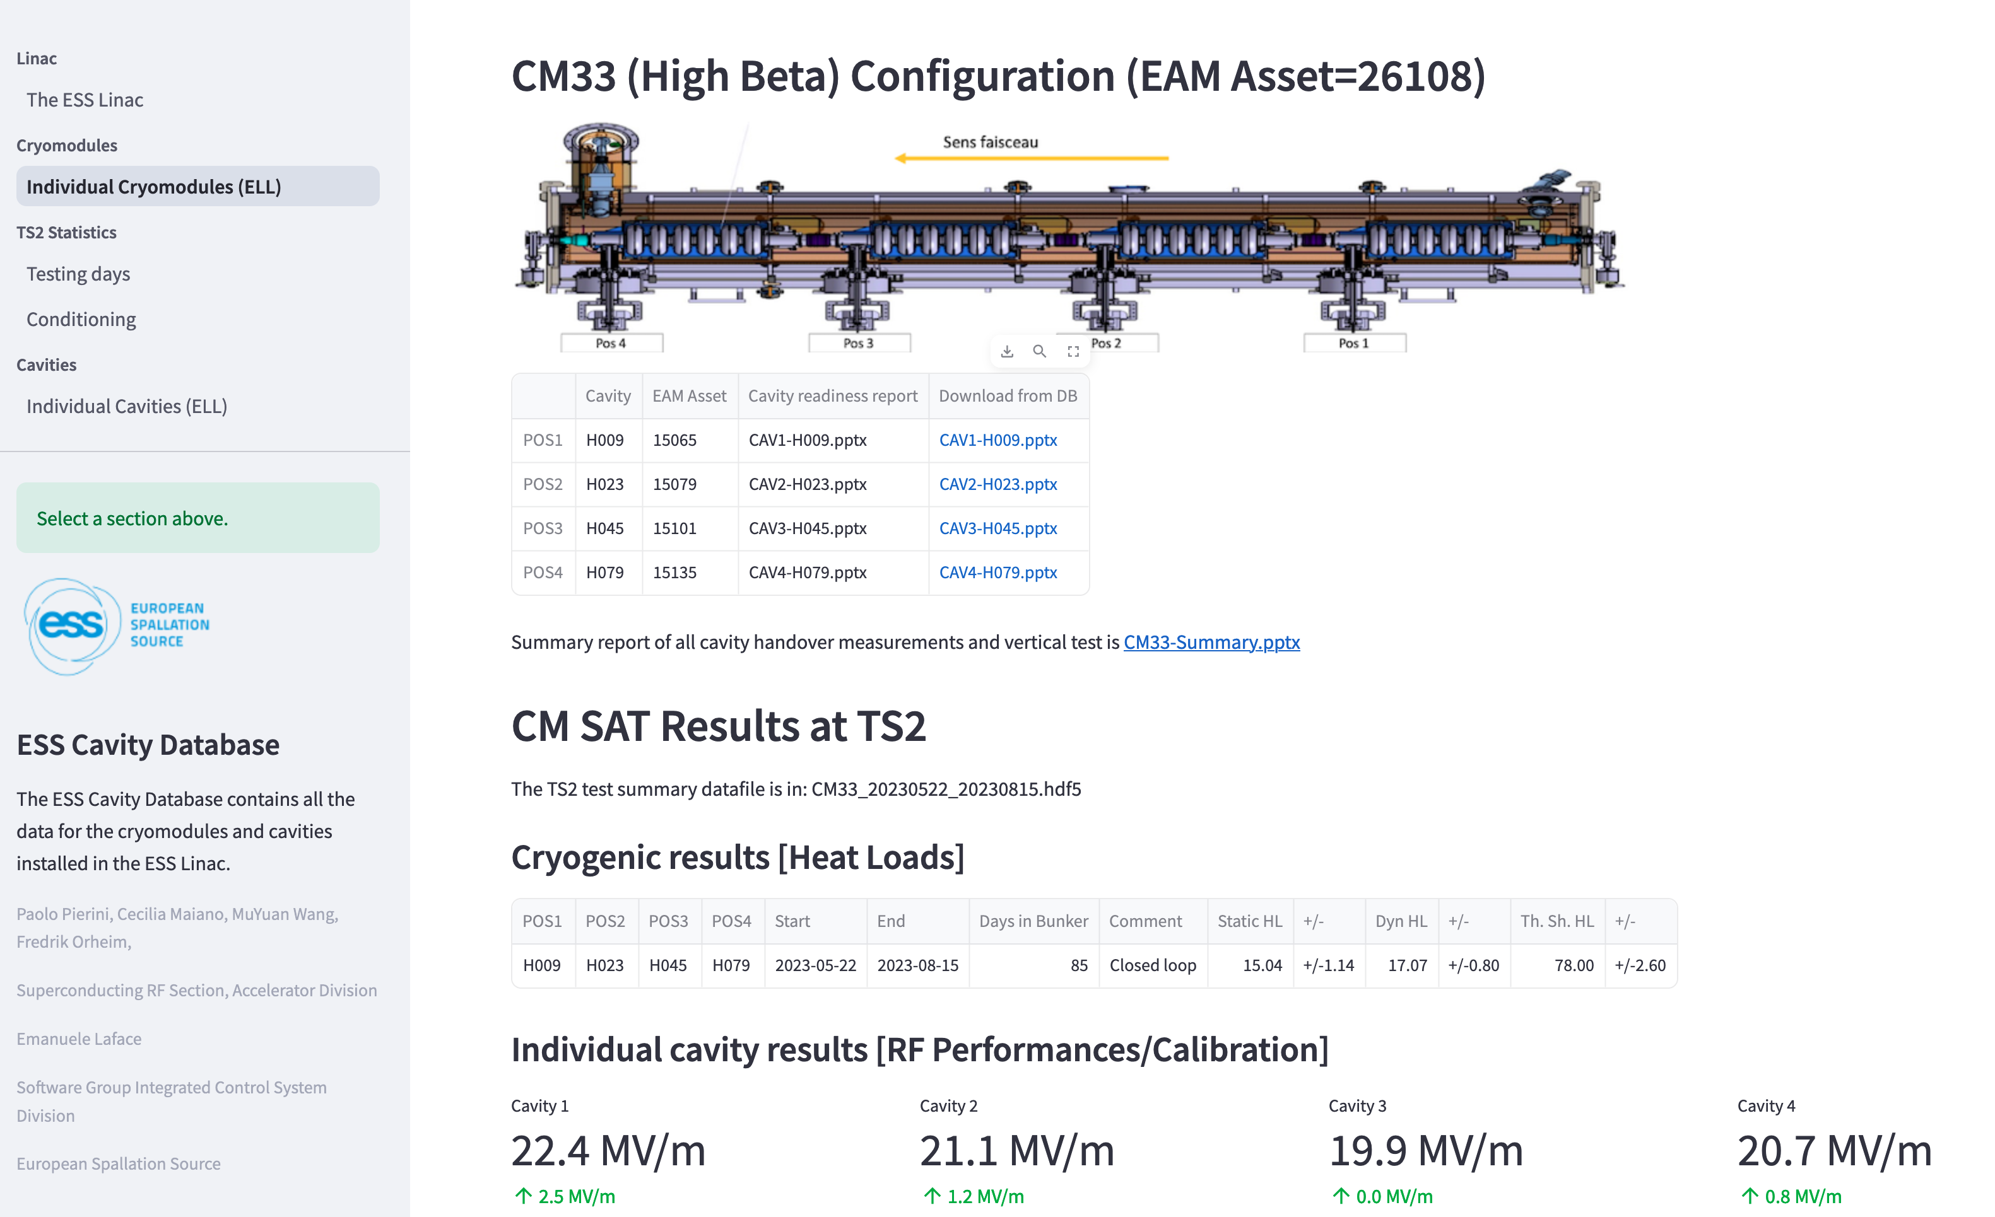
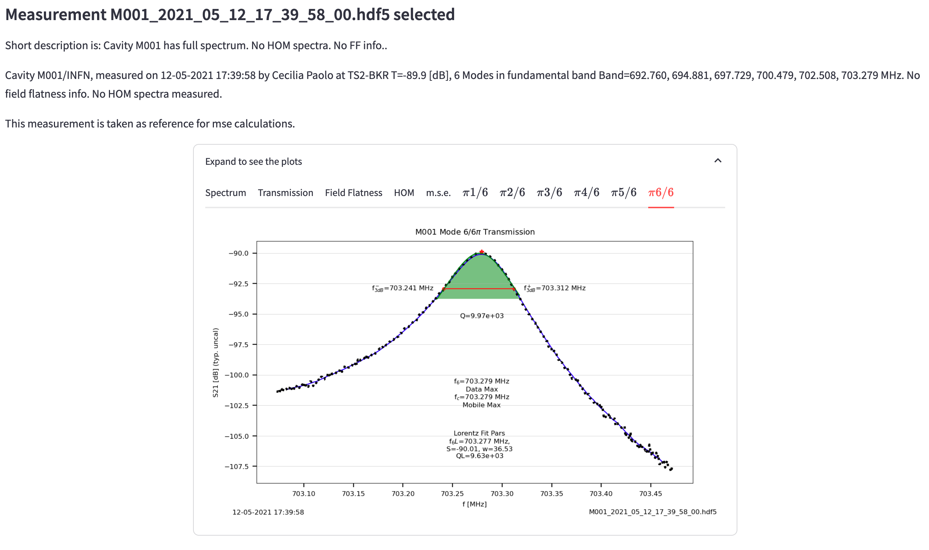
But more important than static CHESS…
Data is “live” and used daily during T&C: cm-database.cslab.esss.lu.se
In an internal webserver (self-developed)
“Technical stewardship”

Slide 10
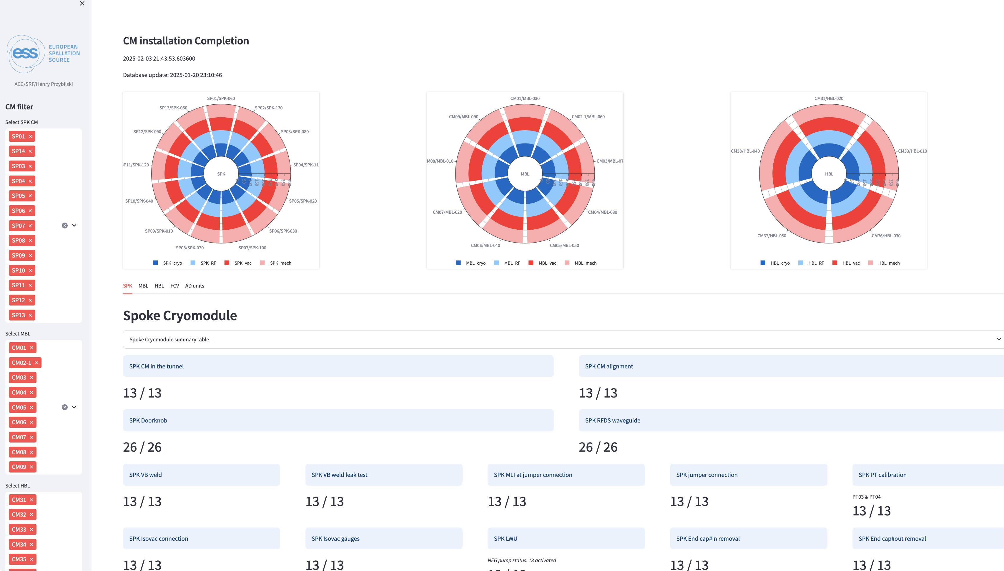
Exending to live installation tracking
Dashboard of installation tasks: cm-dashboard.cslab.esss.lu.se
13 SPK
9 MBL
5 HBL
Cryo task
RF task
Vacuum task
Mechanical task
Task completion
Connection to infra
Cabling
Instrument calibration
Test status

Slide 11
4. Know issues deemed OK to proceed
NONE

Slide 12
5. Open CCRs or NCRs
Nonconformity | Description
10428 | Alignment defect on CM44 | To be registered as permanent NCR | Minor
10427 | Inadequate cleanliness of cavity H001 | To be registered as permanent NCR | Minor
10415 | Weld imperfections in VLP line in CM06 | To be registered as permanent NCR | Minor
10181 | Weld NCR on HB CRM CM31 | To be registered as permanent NCR | Major? Inconsistency -> Minor
10180 | Weld NCR on HB CRM CM32 | To be registered as permanent NCR | Major? Inconsistency -> Minor
10179 | Weld NCR on HB CRM CM033 | To be registered as permanent NCR | Minor
10175 | Leaky component on cavity assembly | Cavity repaired by supplier, to close | Major
10174 | One cavity in CM does not reach ESS specifications | Raised by CEA during test at CEA. SAT test at TS2 achieved performance, to close | Major
10167 | Incorrect material on bolts and accessories | All fasteners exchanged at ESS with proper grade material, to close | Minor
10157 | Weld NCR on MB CRM CM07 | To be registered as permanent NCR | Minor
10136 | Welding defects in CM's diphasic line | To be registered as permanent NCR | Minor
Usually all information is provided in the NCR, as the request to make it a permanent NCR.

Slide 13
6. SSCI2S function
NONE

Slide 14
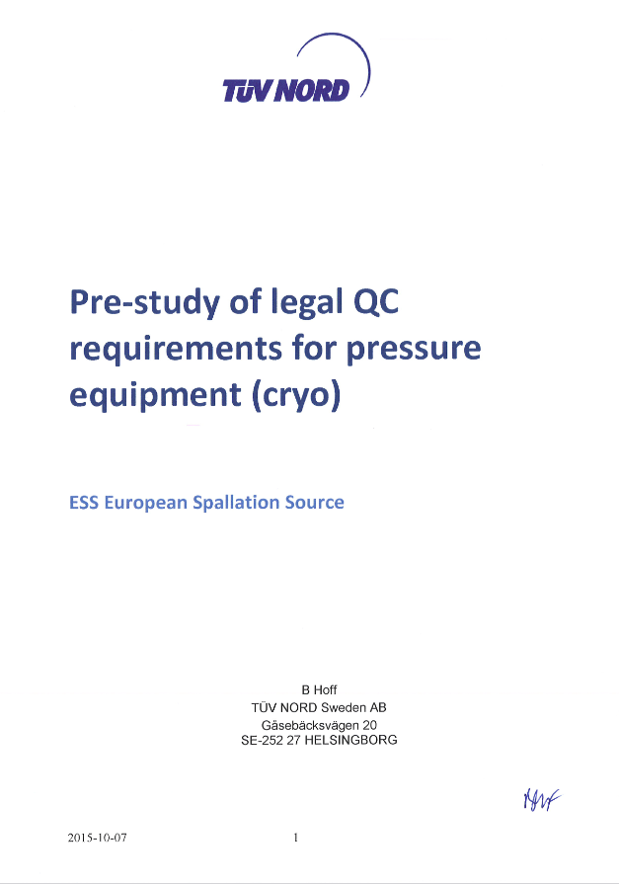
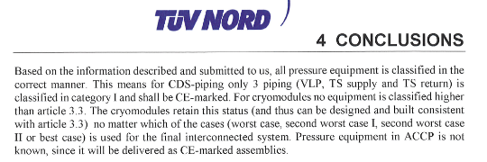
7. Applicable codes and compliance
IK delivery according to the pre-study performed in 2015, i.e. PED/SEP.
Fabrication following CODAP.
Integration in the full interconnected system -> Philipp

Slide 15
8. Tests needed with beam
Cavities are the devices responsible for beam acceleration…

Slide 16
9. Start up checklist? Any issues found?
Any phase of the CM workflow starts with checklists
Receiving inspection checklists
Testing checklists on several subcomponent (sensors/valves/heaters/tuners/…)
Checklist for protection functions (interlocks) before RF excitation for coupler or cavity conditioning
All are routinely performed and documented in the SAT and installation folders. Key documents are exposed in the CIDLs.
Issues may be found and resolved, as in any vertical integration activity…

Slide 17
11. Issues from reviews?
Not only TRR
None
TS2 Cryomodule TRR
TRR For the Warm Coupler Conditioning

