Slide 1
Magnets and Power Converters
PRESENTED BY Emmanouil TRACHANAS-ACCELERATOR ENGINEER-linac group
Dana Mackenzie- Electromechanical Technician-Power converters group

Slide 2
✓
✓
-Documentation & CIDLs Released ✓
-No Issues Detected.
-No NCRs.
-All Magnets-Applicable to SAR4 and BoD ✓
✓
-No specific Tests*
-In Progress
-Completed.

Slide 3
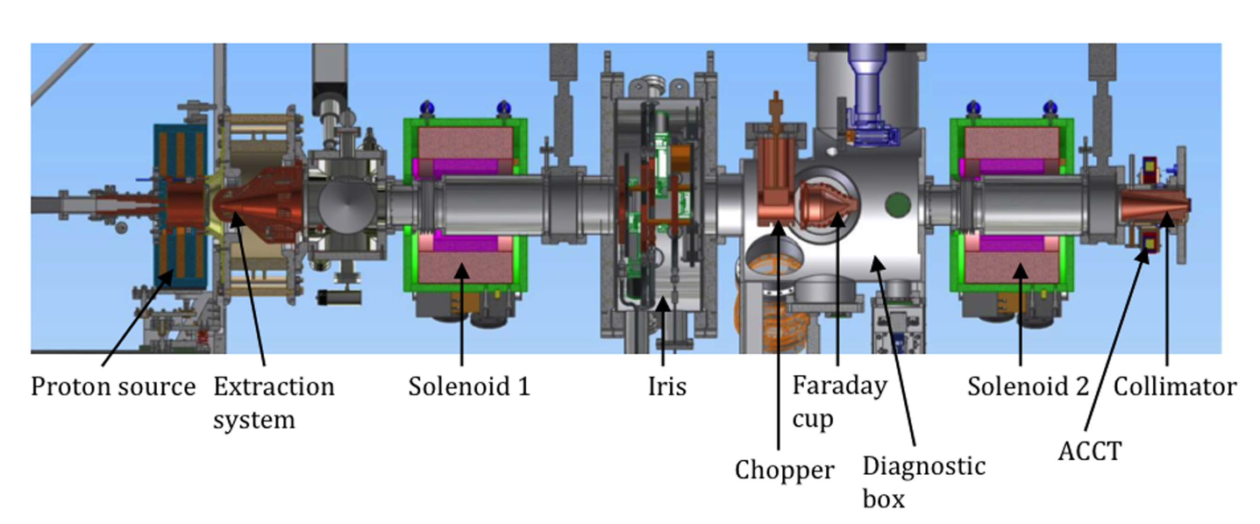
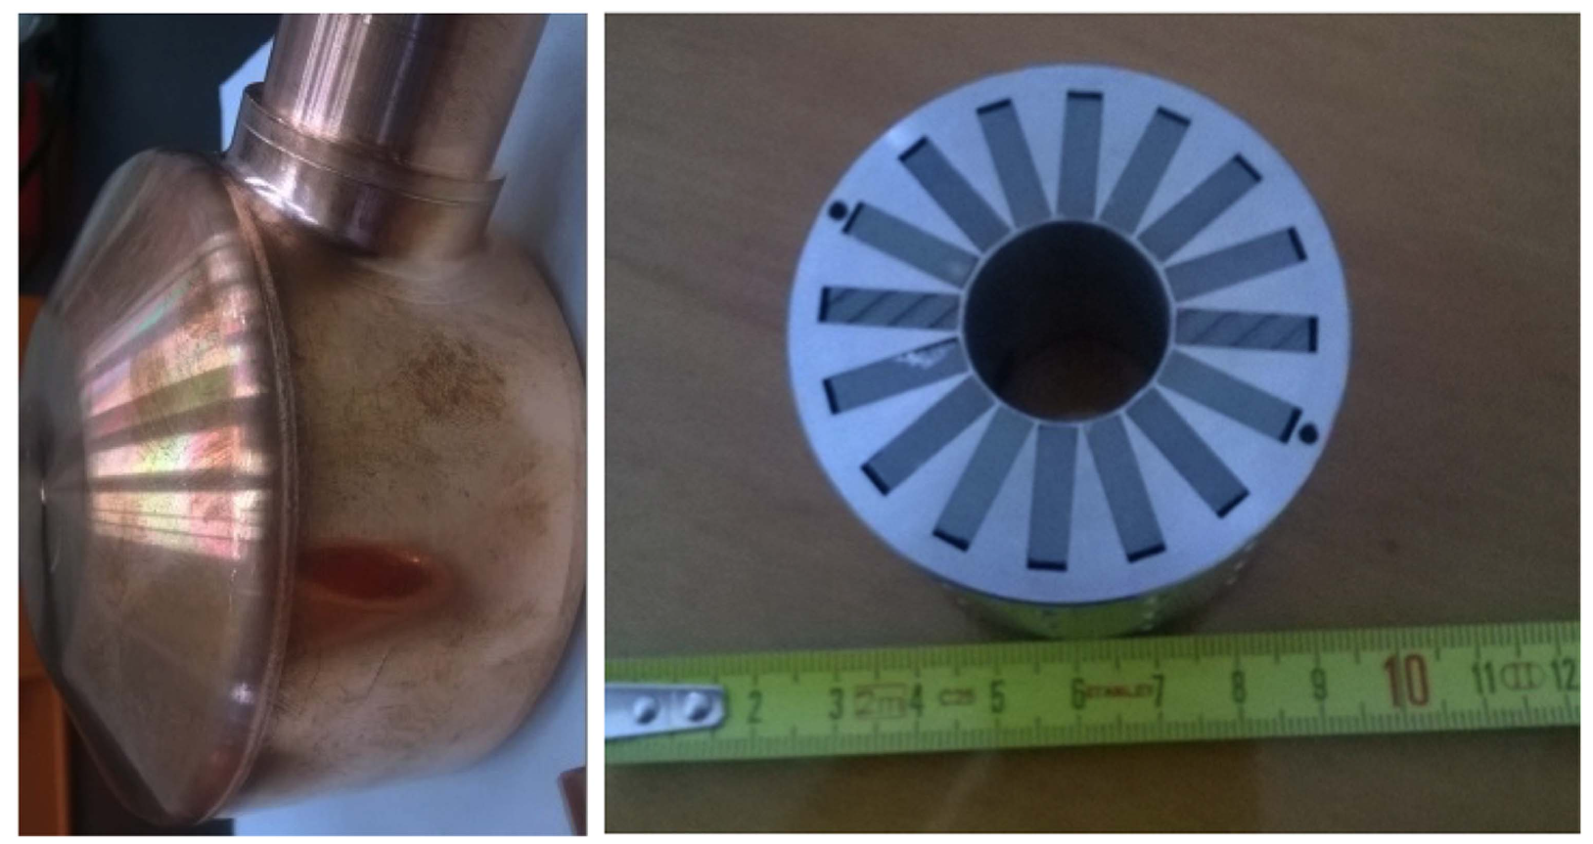
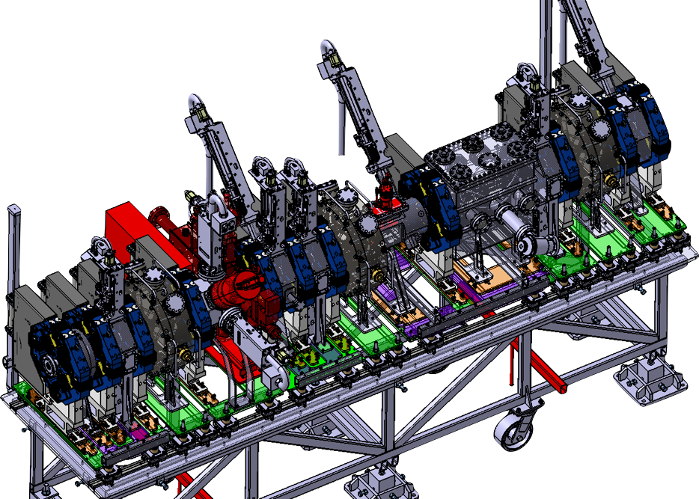
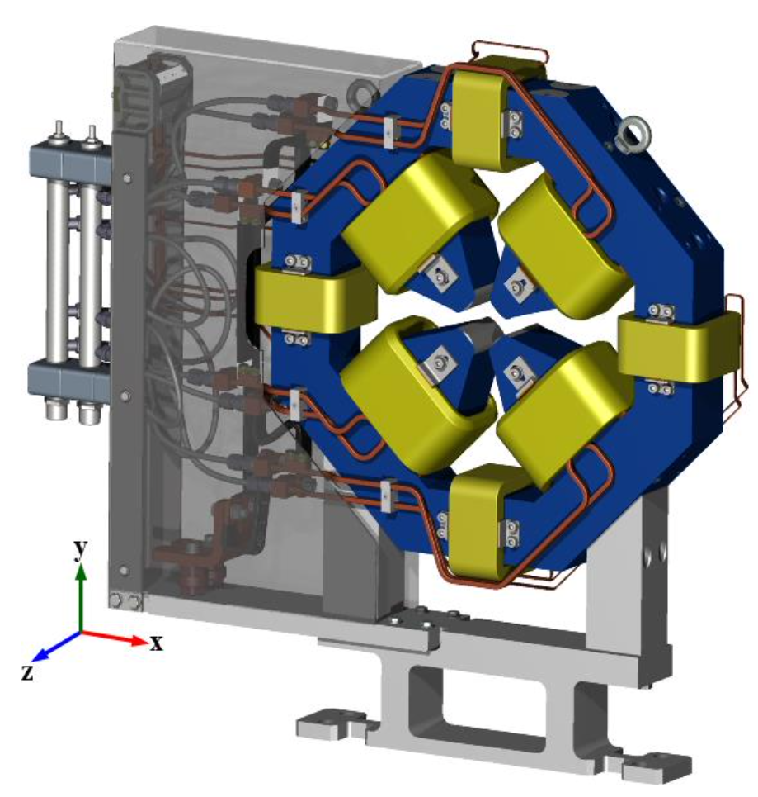
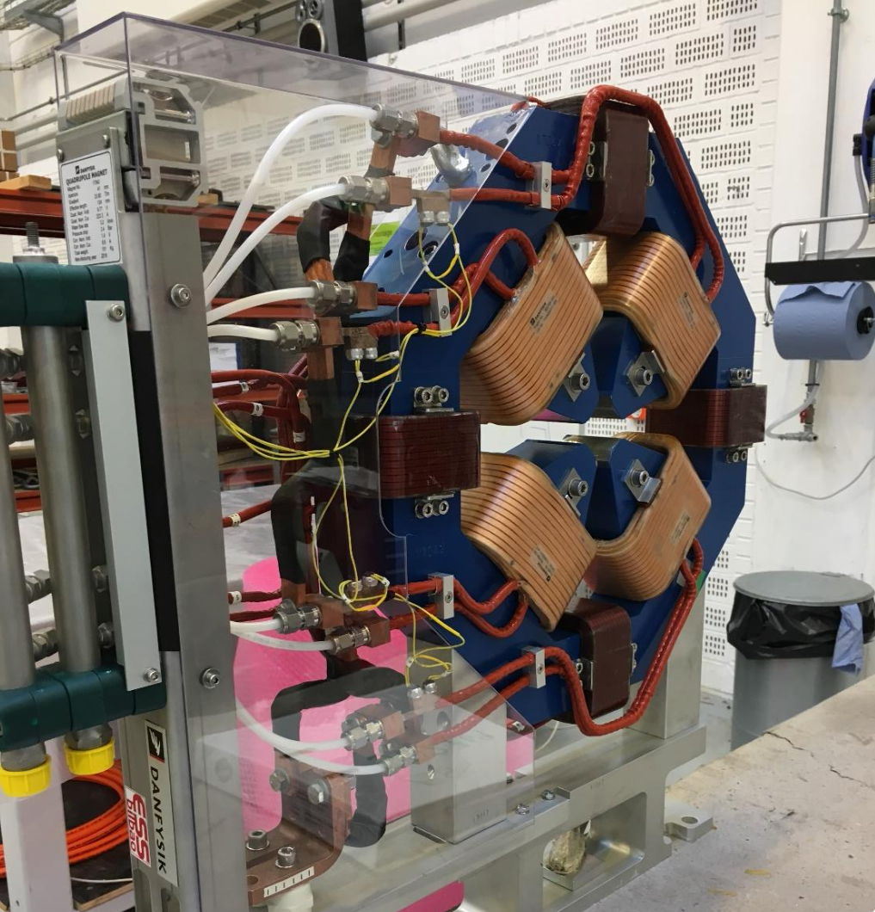
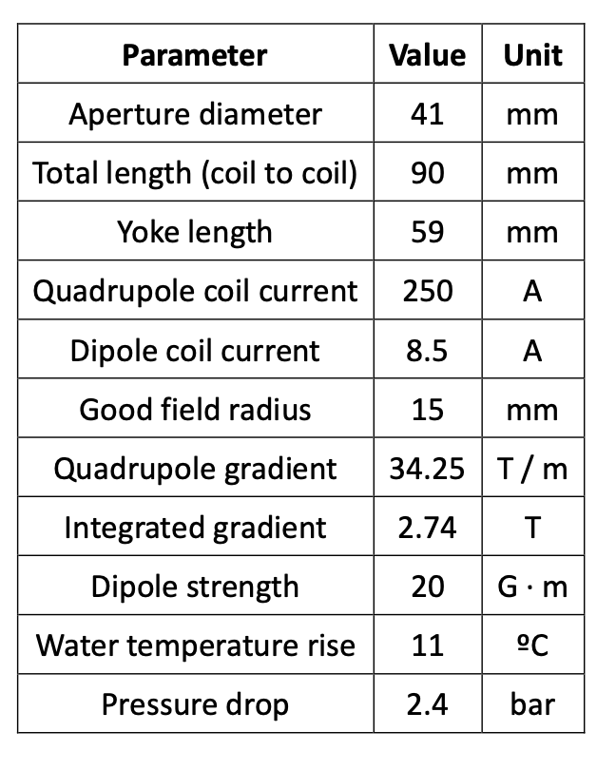
Magnet Systems-NCL
ISRC-LEBT- 3x Solenoids, 2x Solenoids with Embedded Steerers
DTL- 89 PMQs and 30 Steerers
Tank | PMQs | Steerers
1 | 31 | 12
2 | 18 | 6
3 | 15 | 4
4 | 13 | 4
5 | 12 | 4
MEBT- 11 Quadrupoles with Embedded Steerers

Slide 4
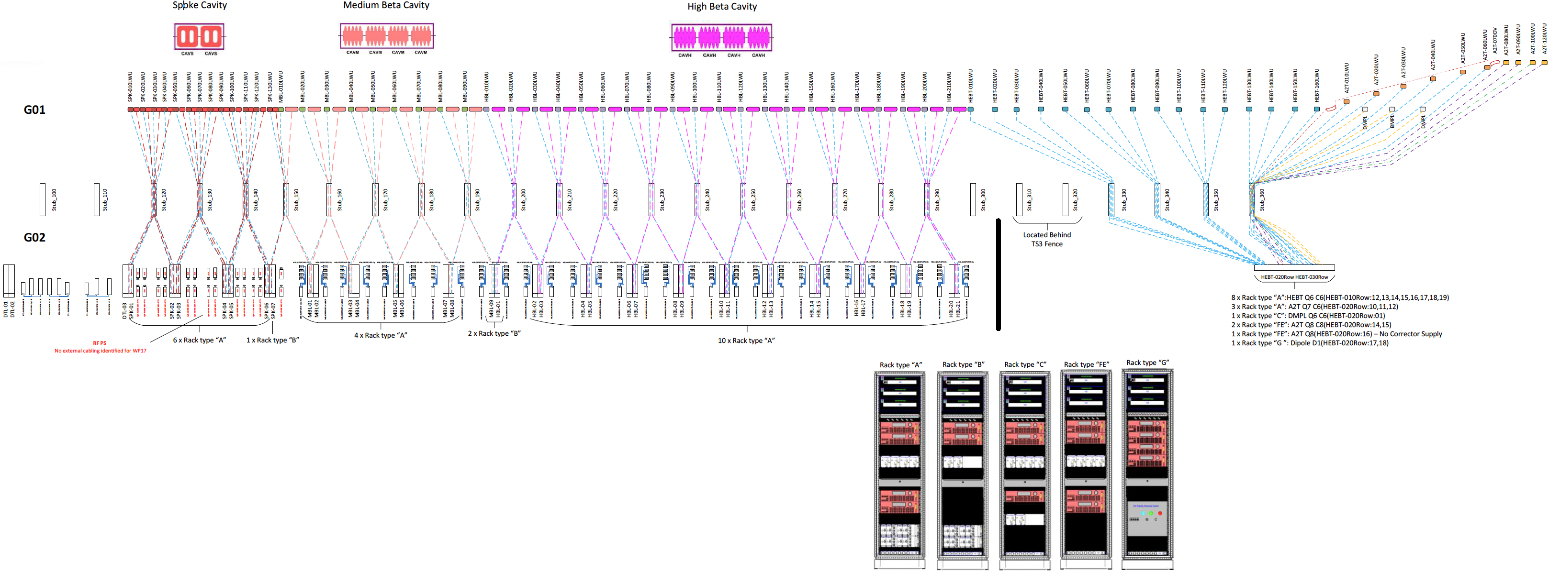
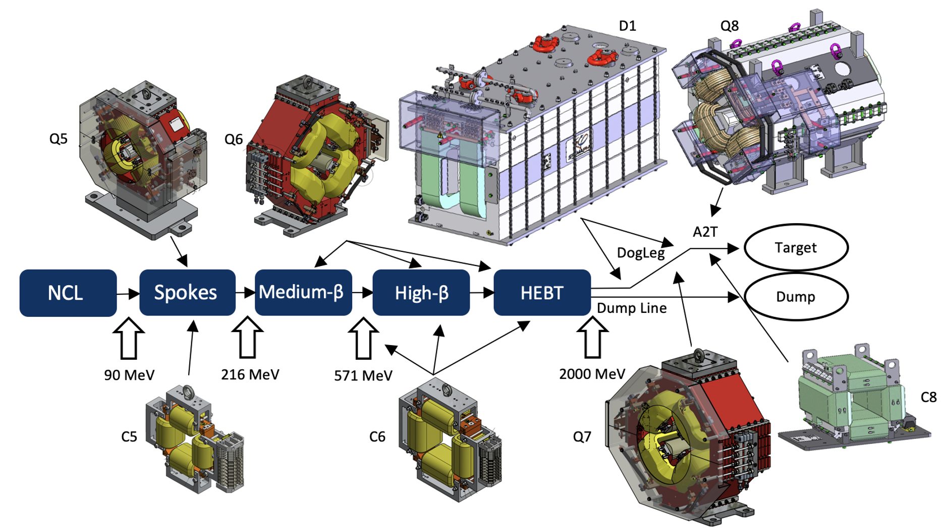
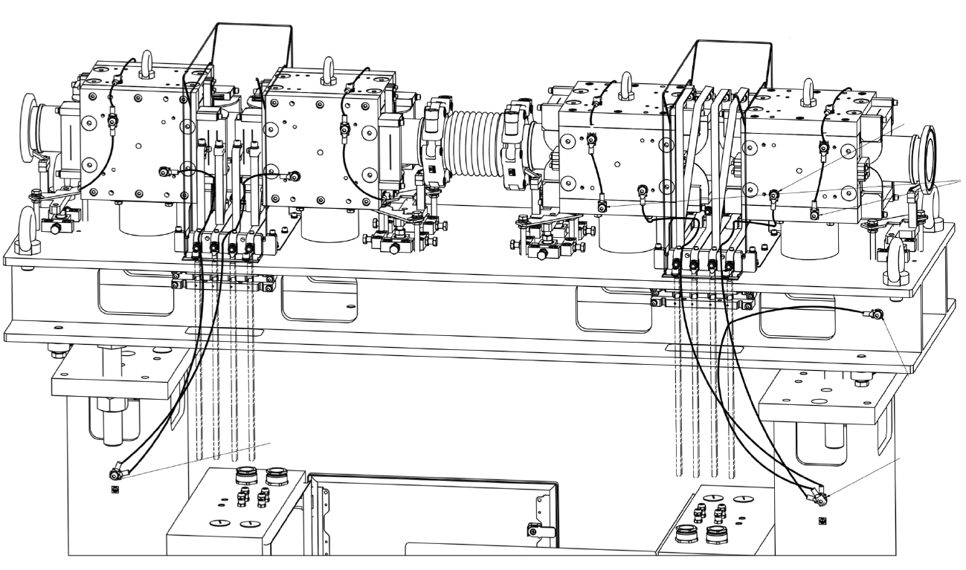
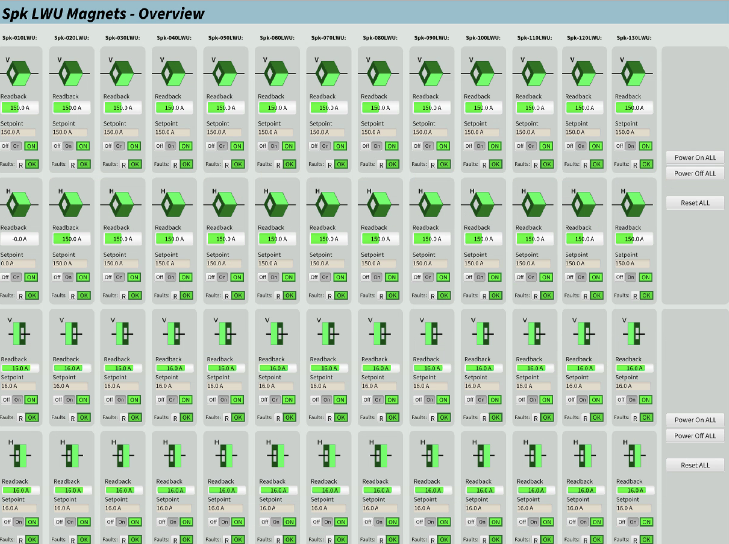
Magnet Systems-SCL

Slide 5
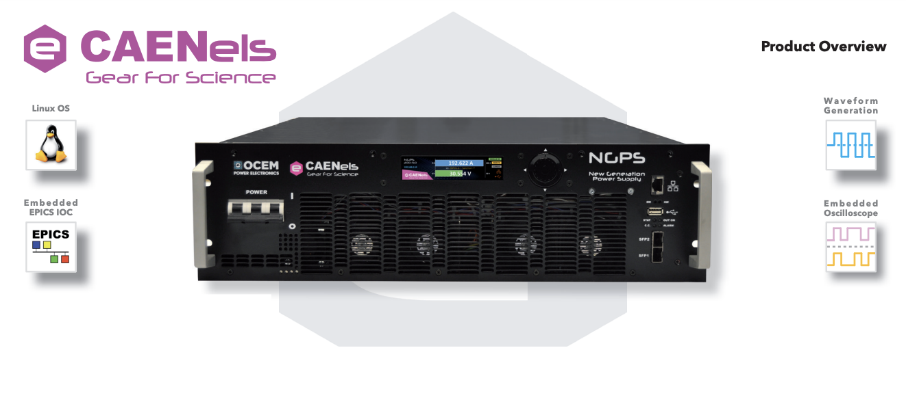
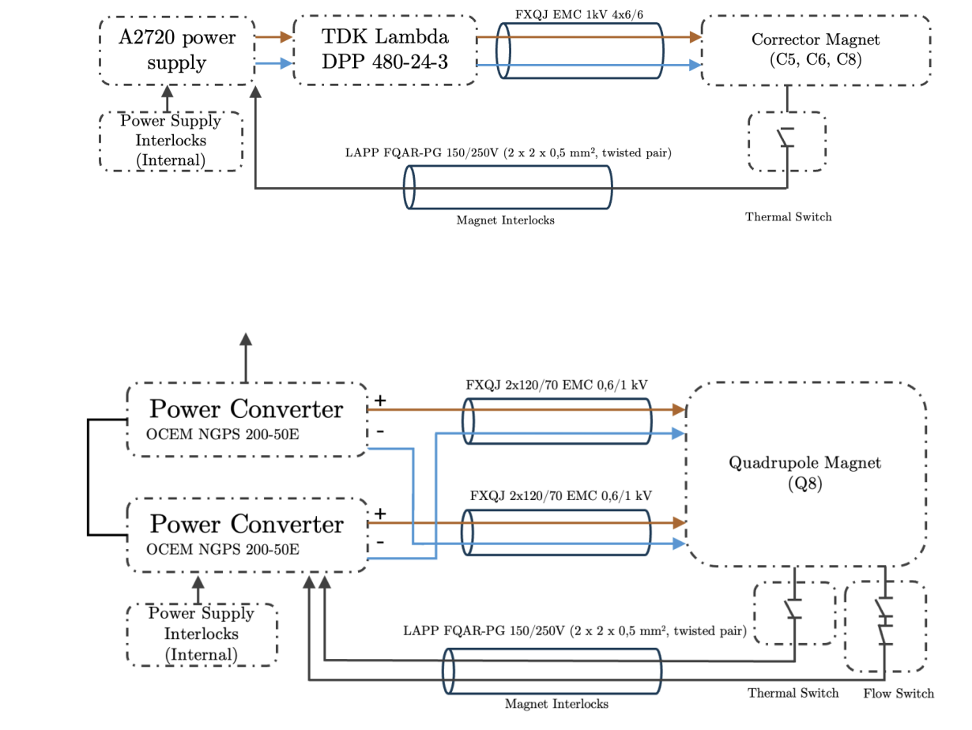
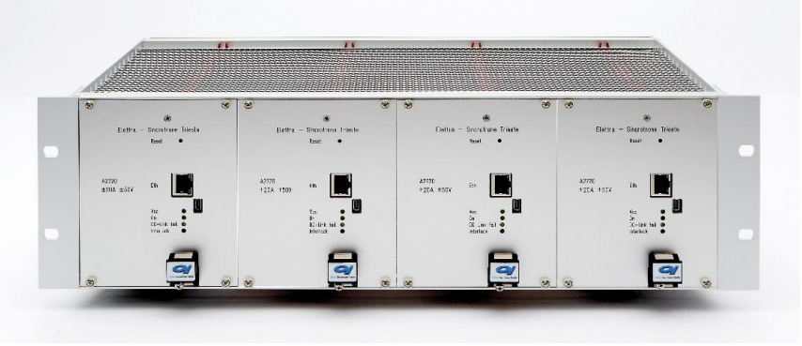
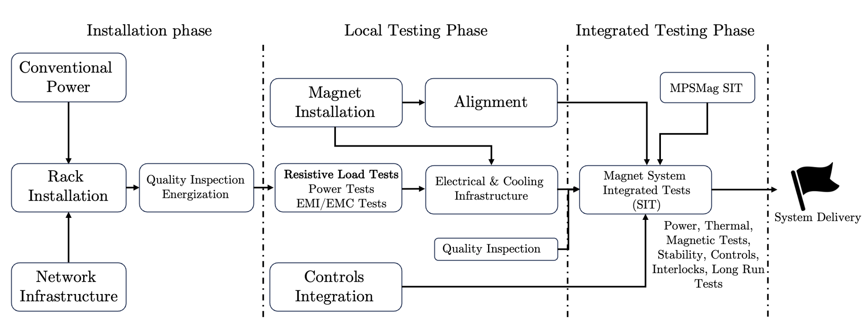
System Architecture

Slide 6
Scope-NCL & Correctors & Raster Magnets
MEBT
MEBT-010:BMD-QV-001 | =ESS.ACC.W02.W01.R03.MB01
MEBT-010:BMD-CH-001 | =ESS.ACC.W02.W01.R03.MB02
MEBT-010:BMD-CV-001 | =ESS.ACC.W02.W01.R03.MB03
MEBT-010:BMD-QH-002 | =ESS.ACC.W02.W01.R04.MB01
MEBT-010:BMD-CH-002 | =ESS.ACC.W02.W01.R04.MB02
MEBT-010:BMD-CV-002 | =ESS.ACC.W02.W01.R04.MB03
MEBT-010:BMD-QV-003 | =ESS.ACC.W02.W01.R05.MB01
MEBT-010:BMD-CH-003 | =ESS.ACC.W02.W01.R05.MB02
MEBT-010:BMD-CV-003 | =ESS.ACC.W02.W01.R05.MB03
MEBT-010:BMD-QH-004 | =ESS.ACC.W02.W01.R06.MB01
MEBT-010:BMD-CH-004 | =ESS.ACC.W02.W01.R06.MB02
MEBT-010:BMD-CV-004 | =ESS.ACC.W02.W01.R06.MB03
MEBT-010:BMD-QH-005 | =ESS.ACC.W02.W01.R07.MB01
MEBT-010:BMD-CH-005 | =ESS.ACC.W02.W01.R07.MB02
MEBT-010:BMD-CV-005 | =ESS.ACC.W02.W01.R07.MB03
MEBT-010:BMD-QV-006 | =ESS.ACC.W02.W01.R08.MB01
MEBT-010:BMD-CH-006 | =ESS.ACC.W02.W01.R08.MB02
MEBT-010:BMD-CV-006 | =ESS.ACC.W02.W01.R08.MB03
MEBT-010:BMD-QH-007 | =ESS.ACC.W02.W01.R09.MB01
MEBT-010:BMD-CH-007 | =ESS.ACC.W02.W01.R09.MB02
MEBT-010:BMD-CV-007 | =ESS.ACC.W02.W01.R09.MB03
MEBT-010:BMD-QV-008 | =ESS.ACC.W02.W01.R10.MB01
MEBT-010:BMD-CH-008 | =ESS.ACC.W02.W01.R10.MB02
MEBT-010:BMD-CV-008 | =ESS.ACC.W02.W01.R10.MB03
MEBT-010:BMD-QH-009 | =ESS.ACC.W02.W01.R11.MB01
MEBT-010:BMD-CH-009 | =ESS.ACC.W02.W01.R11.MB02
MEBT-010:BMD-CV-009 | =ESS.ACC.W02.W01.R11.MB03
MEBT-010:BMD-QV-010 | =ESS.ACC.W02.W01.R12.MB01
MEBT-010:BMD-CH-010 | =ESS.ACC.W02.W01.R12.MB02
MEBT-010:BMD-CV-010 | =ESS.ACC.W02.W01.R12.MB03
MEBT-010:BMD-QH-011 | =ESS.ACC.W02.W01.R13.MB01
MEBT-010:BMD-CH-011 | =ESS.ACC.W02.W01.R13.MB02
MEBT-010:BMD-CV-011 | =ESS.ACC.W02.W01.R13.MB03
SPK
HEBT
Spk-010LWU:BMD-CX-010 | =ESS.ACC.A03.A02.W02.MB01
Spk-020LWU:BMD-CX-010 | =ESS.ACC.A03.A03.W02.MB01
Spk-030LWU:BMD-CX-010 | =ESS.ACC.A03.A04.W02.MB01
Spk-040LWU:BMD-CX-010 | =ESS.ACC.A03.A05.W02.MB01
Spk-050LWU:BMD-CX-010 | =ESS.ACC.A03.A06.W02.MB01
Spk-060LWU:BMD-CX-010 | =ESS.ACC.A03.A07.W02.MB01
Spk-070LWU:BMD-CX-010 | =ESS.ACC.A03.A08.W02.MB01
Spk-080LWU:BMD-CX-010 | =ESS.ACC.A03.A09.W02.MB01
Spk-090LWU:BMD-CX-010 | =ESS.ACC.A03.A10.W02.MB01
Spk-100LWU:BMD-CX-010 | =ESS.ACC.A03.A11.W02.MB01
Spk-110LWU:BMD-CX-010 | =ESS.ACC.A03.A12.W02.MB01
Spk-120LWU:BMD-CX-010 | =ESS.ACC.A03.A13.W02.MB01
Spk-130LWU:BMD-CX-010 | =ESS.ACC.A03.A14.W02.MB01
HEBT-010LWU:BMD-CX-010 | =ESS.ACC.W03.W02.W02.MB01
HEBT-020LWU:BMD-CX-010 | =ESS.ACC.W03.W03.W02.MB01
HEBT-030LWU:BMD-CX-010 | =ESS.ACC.W03.W04.W02.MB01
HEBT-040LWU:BMD-CX-010 | =ESS.ACC.W03.W05.W02.MB01
HEBT-050LWU:BMD-CX-010 | =ESS.ACC.W03.W06.W02.MB01
HEBT-060LWU:BMD-CX-010 | =ESS.ACC.W03.W07.W02.MB01
HEBT-070LWU:BMD-CX-010 | =ESS.ACC.W03.W08.W02.MB01
HEBT-080LWU:BMD-CX-010 | =ESS.ACC.W03.W09.W02.MB01
HEBT-090LWU:BMD-CX-010 | =ESS.ACC.W03.W10.W02.MB01
HEBT-100LWU:BMD-CX-010 | =ESS.ACC.W03.W11.W02.MB01
HEBT-110LWU:BMD-CX-010 | =ESS.ACC.W03.W12.W02.MB01
HEBT-120LWU:BMD-CX-010 | =ESS.ACC.W03.W13.W02.MB01
HEBT-130LWU:BMD-CX-010 | =ESS.ACC.W03.W14.W02.MB01
HEBT-140LWU:BMD-CX-010 | =ESS.ACC.W03.W15.W02.MB01
HEBT-150LWU:BMD-CX-010 | =ESS.ACC.W03.W16.W02.MB01
HEBT-160LWU:BMD-CX-010 | =ESS.ACC.W03.W17.W02.MB01
MBL
MBL-010LWU:BMD-CX-010 | =ESS.ACC.A04.A02.W02.MB01
MBL-020LWU:BMD-CX-010 | =ESS.ACC.A04.A03.W02.MB01
MBL-030LWU:BMD-CX-010 | =ESS.ACC.A04.A04.W02.MB01
MBL-040LWU:BMD-CX-010 | =ESS.ACC.A04.A05.W02.MB01
MBL-050LWU:BMD-CX-010 | =ESS.ACC.A04.A06.W02.MB01
MBL-060LWU:BMD-CX-010 | =ESS.ACC.A04.A07.W02.MB01
MBL-070LWU:BMD-CX-010 | =ESS.ACC.A04.A08.W02.MB01
MBL-080LWU:BMD-CX-010 | =ESS.ACC.A04.A09.W02.MB01
MBL-090LWU:BMD-CX-010 | =ESS.ACC.A04.A10.W02.MB01
A2T/DumpLine/DogLeg
A2T-010LWU:BMD-CX-010 | =ESS.ACC.W05.W02.W02.MB01
A2T-020LWU:BMD-CX-010 | =ESS.ACC.W05.W03.W02.MB01
A2T-030LWU:BMD-CX-010 | =ESS.ACC.W05.W04.W02.MB01
A2T-040LWU:BMD-CX-010 | =ESS.ACC.W05.W05.W02.MB01
A2T-050LWU:BMD-CX-010 | =ESS.ACC.W05.W06.W02.MB01
A2T-060LWU:BMD-CX-010 | =ESS.ACC.W05.W07.W02.MB01
A2T-080Drf:BMD-CX-010 | =ESS.ACC.W05.W09.W02.MB01
A2T-100Drf:BMD-CX-010 | =ESS.ACC.W05.W11.W01.MB01
A2T-120Drf:BMD-CX-010 | =ESS.ACC.W05.W13.W01.MB01
A2T-130Drf:BMD-CX-010 | =ESS.ACC.W05.W14.W02.MB01
DmpL-010QC:BMD-CX-010 | =ESS.ACC.W04.W02.MB01
DmpL-020QC:BMD-CX-010 | =ESS.ACC.W04.W03.MB01
DmpL-030QC:BMD-CX-010 | =ESS.ACC.W04.W04.MB01
HBL
HBL-010LWU:BMD-CX-010 | =ESS.ACC.A05.A02.W02.MB01
HBL-020LWU:BMD-CX-010 | =ESS.ACC.A05.A03.W02.MB01
HBL-030LWU:BMD-CX-010 | =ESS.ACC.A05.A04.W02.MB01
HBL-040LWU:BMD-CX-010 | =ESS.ACC.A05.A05.W02.MB01
HBL-050LWU:BMD-CX-010 | =ESS.ACC.A05.A06.W02.MB01
HBL-060LWU:BMD-CX-010 | =ESS.ACC.A05.A07.W02.MB01
HBL-070LWU:BMD-CX-010 | =ESS.ACC.A05.A08.W02.MB01
HBL-080LWU:BMD-CX-010 | =ESS.ACC.A05.A09.W02.MB01
HBL-090LWU:BMD-CX-010 | =ESS.ACC.A05.A10.W02.MB01
HBL-100LWU:BMD-CX-010 | =ESS.ACC.A05.A11.W02.MB01
HBL-110LWU:BMD-CX-010 | =ESS.ACC.A05.A12.W02.MB01
HBL-120LWU:BMD-CX-010 | =ESS.ACC.A05.A13.W02.MB01
HBL-130LWU:BMD-CX-010 | =ESS.ACC.A05.A14.W02.MB01
HBL-140LWU:BMD-CX-010 | =ESS.ACC.A05.A15.W02.MB01
HBL-150LWU:BMD-CX-010 | =ESS.ACC.A05.A16.W02.MB01
HBL-160LWU:BMD-CX-010 | =ESS.ACC.A05.A17.W02.MB01
HBL-170LWU:BMD-CX-010 | =ESS.ACC.A05.A18.W02.MB01
HBL-180LWU:BMD-CX-010 | =ESS.ACC.A05.A19.W02.MB01
HBL-190LWU:BMD-CX-010 | =ESS.ACC.A05.A20.W02.MB01
HBL-200LWU:BMD-CX-010 | =ESS.ACC.A05.A21.W02.MB01
HBL-210LWU:BMD-CX-010 | =ESS.ACC.A05.A22.W02.MB01
DTL
ISRC & LEBT
Tank DTL-010 | =ESS.ACC.A02.A01.R01
Tank DTL-020 | =ESS.ACC.A02.A02.R01
Tank DTL-030 | =ESS.ACC.A02.A03.R01
Tank DTL-040 | =ESS.ACC.A02.A04.R01
Tank DTL-050 | =ESS.ACC.A02.A04.R01
ISrc-CS:PwrC-PSCoil-01 | =ESS.ACC.E01.E02.R01.TA01
ISrc-CS:PwrC-PSCoil-02 | =ESS.ACC.E01.E02.R01.TA02
ISrc-CS:PwrC-PSCoil-03 | =ESS.ACC.E01.E02.R01.TA03
LEBT-CS:BMD-Sol-01 | =ESS.ACC.W01.W02.MB01
LEBT-CS:BMD-Sol-02 | =ESS.ACC.W01.W02.MB02
Raster Magnets
A2T-100RSM | =ESS.ACC.W05.R01.R01
A2T-110RSM | =ESS.ACC.W05.R01.R02

Slide 7
Scope-Quadrupole & Dipole Magnets
HEBT
HEBT-010LWU:BMD-QH-010 | =ESS.ACC.W03.W02.W02.MB02
HEBT-010LWU:BMD-QV-010 | =ESS.ACC.W03.W02.W02.MB03
HEBT-020LWU:BMD-QH-010 | =ESS.ACC.W03.W03.W02.MB02
HEBT-020LWU:BMD-QV-010 | =ESS.ACC.W03.W03.W02.MB03
HEBT-030LWU:BMD-QH-010 | =ESS.ACC.W03.W04.W02.MB02
HEBT-030LWU:BMD-QV-010 | =ESS.ACC.W03.W04.W02.MB03
HEBT-040LWU:BMD-QH-010 | =ESS.ACC.W03.W05.W02.MB02
HEBT-040LWU:BMD-QV-010 | =ESS.ACC.W03.W05.W02.MB03
HEBT-050LWU:BMD-QH-010 | =ESS.ACC.W03.W06.W02.MB02
HEBT-050LWU:BMD-QV-010 | =ESS.ACC.W03.W06.W02.MB03
HEBT-060LWU:BMD-QH-010 | =ESS.ACC.W03.W07.W02.MB02
HEBT-060LWU:BMD-QV-010 | =ESS.ACC.W03.W07.W02.MB03
HEBT-070LWU:BMD-QH-010 | =ESS.ACC.W03.W08.W02.MB02
HEBT-070LWU:BMD-QV-010 | =ESS.ACC.W03.W08.W02.MB03
HEBT-080LWU:BMD-QH-010 | =ESS.ACC.W03.W09.W02.MB02
HEBT-080LWU:BMD-QV-010 | =ESS.ACC.W03.W09.W02.MB03
HEBT-090LWU:BMD-QH-010 | =ESS.ACC.W03.W10.W02.MB02
HEBT-090LWU:BMD-QV-010 | =ESS.ACC.W03.W10.W02.MB03
HEBT-100LWU:BMD-QH-010 | =ESS.ACC.W03.W11.W02.MB02
HEBT-100LWU:BMD-QV-010 | =ESS.ACC.W03.W11.W02.MB03
HEBT-110LWU:BMD-QH-010 | =ESS.ACC.W03.W12.W02.MB02
HEBT-110LWU:BMD-QV-010 | =ESS.ACC.W03.W12.W02.MB03
HEBT-120LWU:BMD-QH-010 | =ESS.ACC.W03.W13.W02.MB02
HEBT-120LWU:BMD-QV-010 | =ESS.ACC.W03.W13.W02.MB03
HEBT-130LWU:BMD-QH-010 | =ESS.ACC.W03.W14.W02.MB02
HEBT-130LWU:BMD-QV-010 | =ESS.ACC.W03.W14.W02.MB03
HEBT-140LWU:BMD-QH-010 | =ESS.ACC.W03.W15.W02.MB02
HEBT-140LWU:BMD-QV-010 | =ESS.ACC.W03.W15.W02.MB03
HEBT-150LWU:BMD-QH-010 | =ESS.ACC.W03.W16.W02.MB02
HEBT-150LWU:BMD-QV-010 | =ESS.ACC.W03.W16.W02.MB03
HEBT-160LWU:BMD-QH-010 | =ESS.ACC.W03.W17.W02.MB02
HEBT-160LWU:BMD-QV-010 | =ESS.ACC.W03.W17.W02.MB03
SPK
HBL
Spk-010LWU:BMD-QH-010 | =ESS.ACC.A03.A02.W02.MB02
Spk-010LWU:BMD-QV-010 | =ESS.ACC.A03.A02.W02.MB03
Spk-020LWU:BMD-QH-010 | =ESS.ACC.A03.A03.W02.MB02
Spk-020LWU:BMD-QV-010 | =ESS.ACC.A03.A03.W02.MB03
Spk-030LWU:BMD-QH-010 | =ESS.ACC.A03.A04.W02.MB02
Spk-030LWU:BMD-QV-010 | =ESS.ACC.A03.A04.W02.MB03
Spk-040LWU:BMD-QH-010 | =ESS.ACC.A03.A05.W02.MB02
Spk-040LWU:BMD-QV-010 | =ESS.ACC.A03.A05.W02.MB03
Spk-050LWU:BMD-QH-010 | =ESS.ACC.A03.A06.W02.MB02
Spk-050LWU:BMD-QV-010 | =ESS.ACC.A03.A06.W02.MB03
Spk-060LWU:BMD-QH-010 | =ESS.ACC.A03.A07.W02.MB02
Spk-060LWU:BMD-QV-010 | =ESS.ACC.A03.A07.W02.MB03
Spk-070LWU:BMD-QH-010 | =ESS.ACC.A03.A08.W02.MB02
Spk-070LWU:BMD-QV-010 | =ESS.ACC.A03.A08.W02.MB03
Spk-080LWU:BMD-QH-010 | =ESS.ACC.A03.A09.W02.MB02
Spk-080LWU:BMD-QV-010 | =ESS.ACC.A03.A09.W02.MB03
Spk-090LWU:BMD-QH-010 | =ESS.ACC.A03.A10.W02.MB02
Spk-090LWU:BMD-QV-010 | =ESS.ACC.A03.A10.W02.MB03
Spk-100LWU:BMD-QH-010 | =ESS.ACC.A03.A11.W02.MB02
Spk-100LWU:BMD-QV-010 | =ESS.ACC.A03.A11.W02.MB03
Spk-110LWU:BMD-QH-010 | =ESS.ACC.A03.A12.W02.MB02
Spk-110LWU:BMD-QV-010 | =ESS.ACC.A03.A12.W02.MB03
Spk-120LWU:BMD-QH-010 | =ESS.ACC.A03.A13.W02.MB02
Spk-120LWU:BMD-QV-010 | =ESS.ACC.A03.A13.W02.MB03
Spk-130LWU:BMD-QH-010 | =ESS.ACC.A03.A14.W02.MB02
Spk-130LWU:BMD-QV-010 | =ESS.ACC.A03.A14.W02.MB03
HBL-010LWU:BMD-QH-010 | =ESS.ACC.A05.A02.W02.MB02
HBL-010LWU:BMD-QV-010 | =ESS.ACC.A05.A02.W02.MB03
HBL-020LWU:BMD-QH-010 | =ESS.ACC.A05.A03.W02.MB02
HBL-020LWU:BMD-QV-010 | =ESS.ACC.A05.A03.W02.MB03
HBL-030LWU:BMD-QH-010 | =ESS.ACC.A05.A04.W02.MB02
HBL-030LWU:BMD-QV-010 | =ESS.ACC.A05.A04.W02.MB03
HBL-040LWU:BMD-QH-010 | =ESS.ACC.A05.A05.W02.MB02
HBL-040LWU:BMD-QV-010 | =ESS.ACC.A05.A05.W02.MB03
HBL-050LWU:BMD-QH-010 | =ESS.ACC.A05.A06.W02.MB02
HBL-050LWU:BMD-QV-010 | =ESS.ACC.A05.A06.W02.MB03
HBL-060LWU:BMD-QH-010 | =ESS.ACC.A05.A07.W02.MB02
HBL-060LWU:BMD-QV-010 | =ESS.ACC.A05.A07.W02.MB03
HBL-070LWU:BMD-QH-010 | =ESS.ACC.A05.A08.W02.MB02
HBL-070LWU:BMD-QV-010 | =ESS.ACC.A05.A08.W02.MB03
HBL-080LWU:BMD-QH-010 | =ESS.ACC.A05.A09.W02.MB02
HBL-080LWU:BMD-QV-010 | =ESS.ACC.A05.A09.W02.MB03
HBL-090LWU:BMD-QH-010 | =ESS.ACC.A05.A10.W02.MB02
HBL-090LWU:BMD-QV-010 | =ESS.ACC.A05.A10.W02.MB03
HBL-100LWU:BMD-QH-010 | =ESS.ACC.A05.A11.W02.MB02
HBL-100LWU:BMD-QV-010 | =ESS.ACC.A05.A11.W02.MB03
HBL-110LWU:BMD-QH-010 | =ESS.ACC.A05.A12.W02.MB02
HBL-110LWU:BMD-QV-010 | =ESS.ACC.A05.A12.W02.MB03
HBL-120LWU:BMD-QH-010 | =ESS.ACC.A05.A13.W02.MB02
HBL-120LWU:BMD-QV-010 | =ESS.ACC.A05.A13.W02.MB03
HBL-130LWU:BMD-QH-010 | =ESS.ACC.A05.A14.W02.MB02
HBL-130LWU:BMD-QV-010 | =ESS.ACC.A05.A14.W02.MB03
HBL-140LWU:BMD-QH-010 | =ESS.ACC.A05.A15.W02.MB02
HBL-140LWU:BMD-QV-010 | =ESS.ACC.A05.A15.W02.MB03
HBL-150LWU:BMD-QH-010 | =ESS.ACC.A05.A16.W02.MB02
HBL-150LWU:BMD-QV-010 | =ESS.ACC.A05.A16.W02.MB03
HBL-160LWU:BMD-QH-010 | =ESS.ACC.A05.A17.W02.MB02
HBL-160LWU:BMD-QV-010 | =ESS.ACC.A05.A17.W02.MB03
HBL-170LWU:BMD-QH-010 | =ESS.ACC.A05.A18.W02.MB02
HBL-170LWU:BMD-QV-010 | =ESS.ACC.A05.A18.W02.MB03
HBL-180LWU:BMD-QH-010 | =ESS.ACC.A05.A19.W02.MB02
HBL-180LWU:BMD-QV-010 | =ESS.ACC.A05.A19.W02.MB03
HBL-190LWU:BMD-QH-010 | =ESS.ACC.A05.A20.W02.MB02
HBL-190LWU:BMD-QV-010 | =ESS.ACC.A05.A20.W02.MB03
HBL-200LWU:BMD-QH-010 | =ESS.ACC.A05.A21.W02.MB02
HBL-200LWU:BMD-QV-010 | =ESS.ACC.A05.A21.W02.MB03
HBL-210LWU:BMD-QH-010 | =ESS.ACC.A05.A22.W02.MB02
HBL-210LWU:BMD-QV-010 | =ESS.ACC.A05.A22.W02.MB03
A2T/DumpLine/DogLeg
MBL
A2T-010LWU:BMD-QH-010 | =ESS.ACC.W05.W02.W02.MB02
A2T-010LWU:BMD-QV-010 | =ESS.ACC.W05.W02.W02.MB03
A2T-020LWU:BMD-QH-010 | =ESS.ACC.W05.W03.W02.MB02
A2T-020LWU:BMD-QV-010 | =ESS.ACC.W05.W03.W02.MB03
A2T-030LWU:BMD-QH-010 | =ESS.ACC.W05.W04.W02.MB02
A2T-030LWU:BMD-QV-010 | =ESS.ACC.W05.W04.W02.MB03
A2T-040LWU:BMD-QH-010 | =ESS.ACC.W05.W05.W02.MB02
A2T-040LWU:BMD-QV-010 | =ESS.ACC.W05.W05.W02.MB03
A2T-050LWU:BMD-QH-010 | =ESS.ACC.W05.W06.W02.MB02
A2T-050LWU:BMD-QV-010 | =ESS.ACC.W05.W06.W02.MB03
A2T-060LWU:BMD-QH-010 | =ESS.ACC.W05.W07.W02.MB02
A2T-060LWU:BMD-QV-010 | =ESS.ACC.W05.W07.W02.MB03
A2T-080LWU:BMD-QH-010 | =ESS.ACC.W05.W09.W02.MB02
A2T-080LWU:BMD-QV-010 | =ESS.ACC.W05.W09.W02.MB03
A2T-090LWU:BMD-QH-010 | =ESS.ACC.W05.W10.W02.MB02
A2T-090LWU:BMD-QV-010 | =ESS.ACC.W05.W10.W02.MB03
A2T-130LWU:BMD-QH-010 | =ESS.ACC.W05.W14.W02.MB02
A2T-130LWU:BMD-QV-010 | =ESS.ACC.W05.W14.W02.MB03
DmpL-010QC:BMD-QH-010 | =ESS.ACC.W04.W02.MB02
DmpL-020QC:BMD-QV-010 | =ESS.ACC.W04.W03.MB02
DmpL-030QC:BMD-QH-010 | =ESS.ACC.W04.W04.MB02
MBL-010LWU:BMD-QH-010 | =ESS.ACC.A04.A02.W02.MB02
MBL-010LWU:BMD-QV-010 | =ESS.ACC.A04.A02.W02.MB03
MBL-020LWU:BMD-QH-010 | =ESS.ACC.A04.A03.W02.MB02
MBL-020LWU:BMD-QV-010 | =ESS.ACC.A04.A03.W02.MB03
MBL-030LWU:BMD-QH-010 | =ESS.ACC.A04.A04.W02.MB02
MBL-030LWU:BMD-QV-010 | =ESS.ACC.A04.A04.W02.MB03
MBL-040LWU:BMD-QH-010 | =ESS.ACC.A04.A05.W02.MB02
MBL-040LWU:BMD-QV-010 | =ESS.ACC.A04.A05.W02.MB03
MBL-050LWU:BMD-QH-010 | =ESS.ACC.A04.A06.W02.MB02
MBL-050LWU:BMD-QV-010 | =ESS.ACC.A04.A06.W02.MB03
MBL-060LWU:BMD-QH-010 | =ESS.ACC.A04.A07.W02.MB02
MBL-060LWU:BMD-QV-010 | =ESS.ACC.A04.A07.W02.MB03
MBL-070LWU:BMD-QH-010 | =ESS.ACC.A04.A08.W02.MB02
MBL-070LWU:BMD-QV-010 | =ESS.ACC.A04.A08.W02.MB03
MBL-080LWU:BMD-QH-010 | =ESS.ACC.A04.A09.W02.MB02
MBL-080LWU:BMD-QV-010 | =ESS.ACC.A04.A09.W02.MB03
MBL-090LWU:BMD-QH-010 | =ESS.ACC.A04.A10.W02.MB02
MBL-090LWU:BMD-QV-010 | =ESS.ACC.A04.A10.W02.MB03
Bending Dipoles
BMS:BMD-DV-010 | =ESS.ACC.W03.W18.R01.MB01
BMS:BMD-DV-020 | =ESS.ACC.W05.W08.W02.MB01

Slide 8
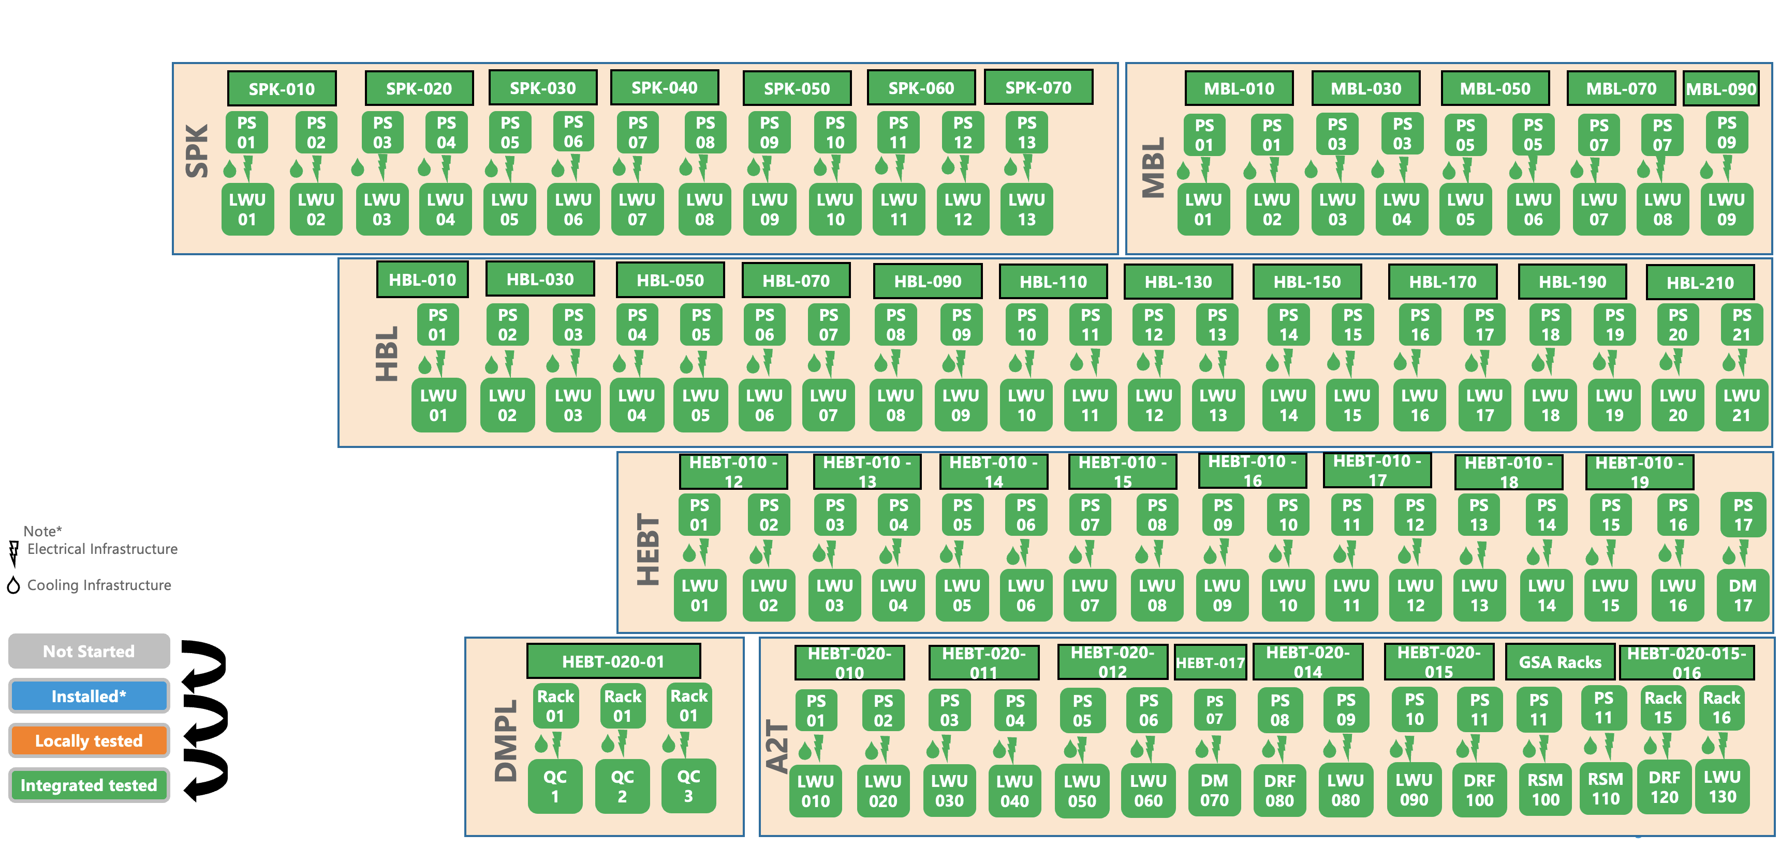
System Status
-Integrated Tests Completed- Full BoD/BoT Scope.
-MPS Interface Tests Completed.
-Magnets Long Run Tests for 400 Hours.

Slide 9
Requirements Documentation
-Released
1. ESS-0036939-Magnet Functional Requirements for Types C5, C6, C8, Q5, Q6, Q7, Q8 and D1
2. ESS-0036940- Magnet Interface Requirements for Types C5, C6, C8, Q5, Q6, Q7, Q8 and D1
Design Documentation
-Released
1. C5 System Design, 3D Model, FAT Reports, Magnetic Measurements: https://chess.esss.lu.se/enovia/link/21308.51166.35584.50656
2. C6 System Design, 3D Model, FAT Reports, Magnetic Measurements: https://chess.esss.lu.se/enovia/link/21308.51166.38656.59795
3. C8 System Design, 3D Model, FAT Reports, Magnetic Measurements: https://chess.esss.lu.se/enovia/link/21308.51166.33280.23352
4. Q5 System Design, 3D Model, FAT Reports, Magnetic Measurements: https://chess.esss.lu.se/enovia/link/21308.51166.64256.40621
5. Q6 System Design, 3D Model, FAT Reports, Magnetic Measurements: https://chess.esss.lu.se/enovia/link/21308.51166.18944.21202
6. Q7 System Design, 3D Model, FAT Reports, Magnetic Measurements: https://chess.esss.lu.se/enovia/link/21308.51166.10240.48462
Q8 System Design, 3D Model, FAT Reports, Magnetic Measurements: https://chess.esss.lu.se/enovia/link/21308.51166.33280.56467
Raster Magnets Design Documentation- https://chess.esss.lu.se/enovia/link/21308.51166.28673.2150
MEBT Magnets Design Documentation-https://chess.esss.lu.se/enovia/link/21308.51166.61184.36273
ISRC & LEBT Magnets Design Documentation- https://chess.esss.lu.se/enovia/link/21308.51166.9472.7818
MEBT Magnets PC SAT: https://chess.esss.lu.se/enovia/link/21308.51166.59648.36741
DTL Steerers:https://chess.esss.lu.se/enovia/link/21308.51166.21504.51905
DTL PMQs: https://chess.esss.lu.se/enovia/link/21308.51166.11776.22108

Slide 10
SAT & Installation & Energisation Documentation (2/2)-SCL
LWU Vacuum Acceptance Documentation (Vacuum Group):
Vacuum acceptance tests folder: https://chess.esss.lu.se/enovia/link/21308.51166.10752.15785
ESS-2069339- Guideline for Acceptance Tests of the Particle Free Linac Warm Units
Confluence page: https://confluence.esss.lu.se/pages/viewpage.action?pageId=64914873
Magnet Systems Acceptance & Installation Documentation (Linac Group)
ESS-4239660-Receiving Inspection Report LWU Magnets- Released
ESS-3062528-Electrical inspection LWU magnets- Delivery inspection of LWU magnets at RATS and Tunnel- Released
ESS-5446025-SPK Magnets Electrical Quality Inspection-Final inspection before integrated testing. - Released
ESS-5510171- Electrical inspection MBL LWU magnets in G01. - Released
ESS-5402205-Electrical inspection Magnets HBL - Released
ESS-4970029- Inspection of magnets HEBT-030-LWU and HEBT-040-LWU. - Released
ESS-5064501- Electrical installation inspection of HEBT LWU magnets in G01 prior to energization for testing. - Released
ESS-5165562- Electrical inspection of Magnets in Dumpline and A2T - Released
Electrical interface Schematics: https://chess.esss.lu.se/enovia/link/21308.51166.64512.28648- Released
Energisation Requests: https://chess.esss.lu.se/enovia/link/21308.51166.56064.25116 - Released
Rack circuit diagrams: https://chess.esss.lu.se/enovia/link/21308.51166.7936.43208 -Released- Rack Types
Connection diagrams: https://chess.esss.lu.se/enovia/link/21308.51166.6144.23552 -Released
Power Converters Group Documentation:
SAT Acceptance reports: https://chess.esss.lu.se/enovia/link/21308.51166.65025.928-Released
Rack Self Inspection: https://chess.esss.lu.se/enovia/link/21308.51166.30464.60533 - Released

Slide 11
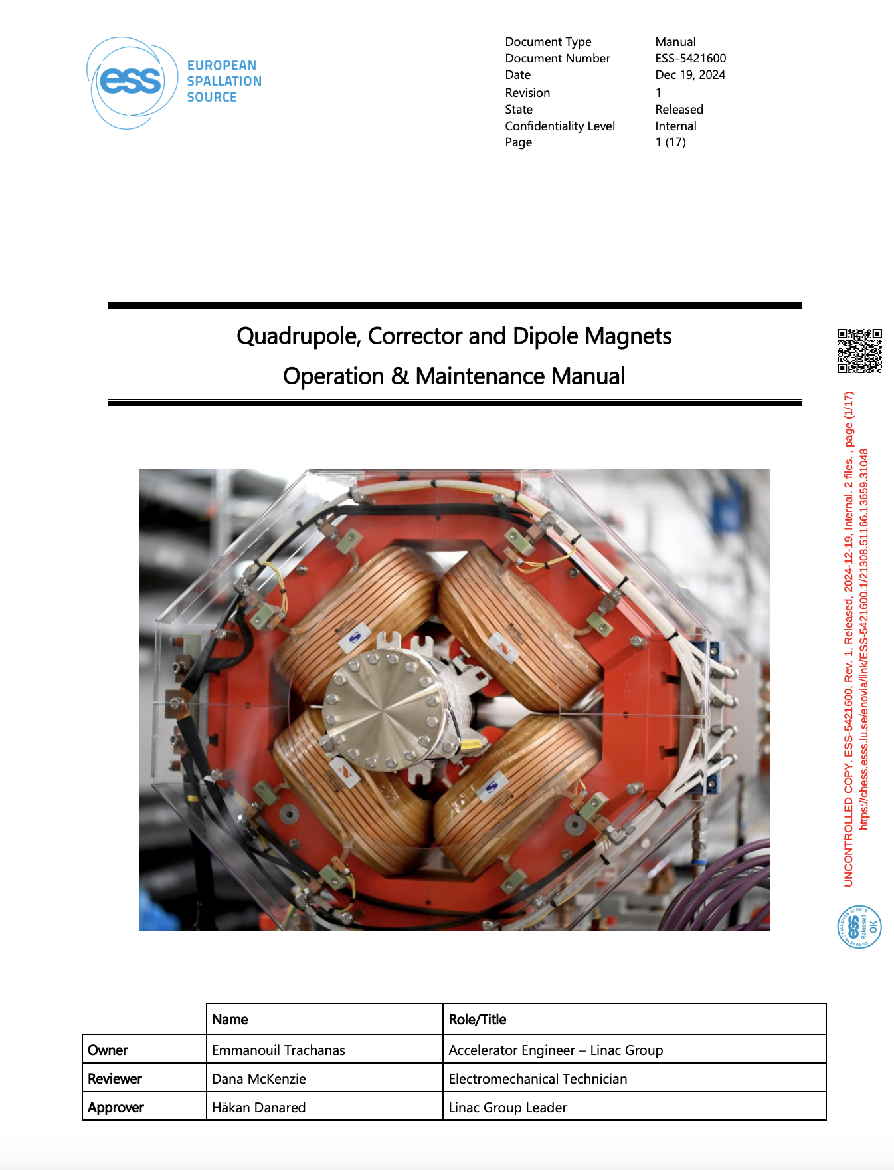
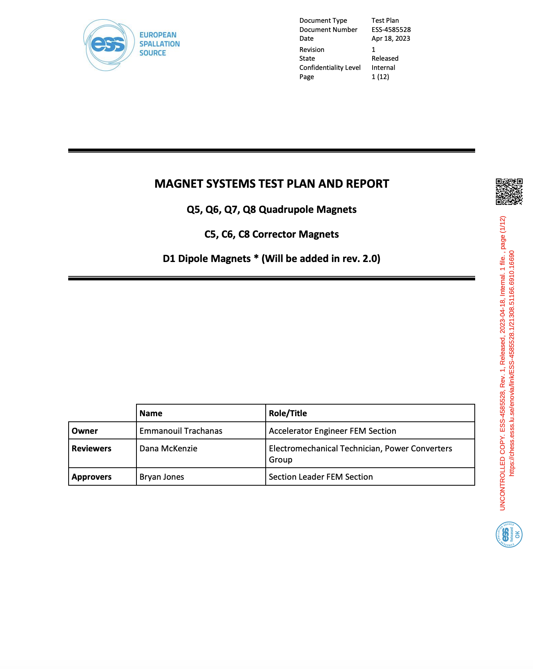
Test Plans & Maintenance Manuals
NCL:
ESS-1093283-ESS-Bilbao - Operation and service manual ESS MEBT Quadrupoles – Released
ESS-3069799-MEBT Magnets Testing plan and Report – Released
ESS-3077645-MEBT Verification and Validation Plan – Released
ESS-4867732-DTL Verification and Validation (V&V) plan – Released
ESS-3148851-Sorensen SGA 30X501D-2GAA LEBT Solenoid Test Procedure– Released
ESS-3148850-Ion Source Solenoid Coils Test Procedure and Report– Released
ESS-3148853-FAST PS 20-20-400 LEBT Steerer Test Procedure– Released
Local Testing Phase (SCL):
ESS-4164904-MPC Routine Test Template – Released
Test Reports: https://chess.esss.lu.se/enovia/link/21308.51166.13312.34632
ESS-4818003-Rack Type Test protocol– Released
Test Reports: https://chess.esss.lu.se/enovia/link/21308.51166.13312.34632
Integrated Testing Phase (SCL)
ESS-4585532-Raster Magnets Test Plan and Report– Released*
ESS-5507926-SPK LWUs Magnet Systems (Q5,C5) Test Report– Released
ESS-5507961-MBL LWUs Magnet Systems (Q6,C6) Test Report– Released
ESS-5507962-HBL LWUs Magnet Systems (Q6,C6) Test Report– Released
ESS-5507958-HEBT LWUs Magnet Systems (Q6,C6) Test Report– Released
ESS-5507966-DumpLine DogLeg A2T- LWUs Magnet Systems Test Report– Released
ESS-5584247-Dipole Magnet Systems (D1) Test Report– Released
ESS-5421600-Quadrupole, Corrector and Dipole Magnets Operation & Maintenance Manual– Released
ESS-XXXXXX-Raster Magnet Maintenance Manual-In Progress

Slide 12
Thank you !

