Slide 2
SAR4
Tuning Beam Dump
PRESENTED BY Siamak kianzad

Slide 3
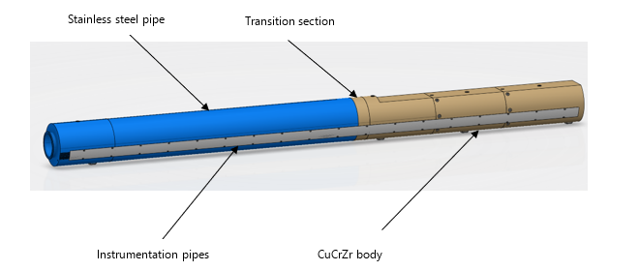
System Overview
Tuning Beam Dump Shielding
LBS: +ESS.G01.090.1002
FBS: =ESS.ACC.W04.R01.F01
Tuning Beam Dump System
LBS: +ESS.G01.090.1002
FBS: =ESS.ACC.W04.R01.R01
Notes:
Overall view of the communications.
We are aiming for selectivity between the different circulators. E.g. if one cable, com. module or local PLC fails, the other options should still be OK.
The weak spot in this setup is the dependency on the INFRA network to reach the back-up circulator and SERA compressor on the floor below.

Slide 4
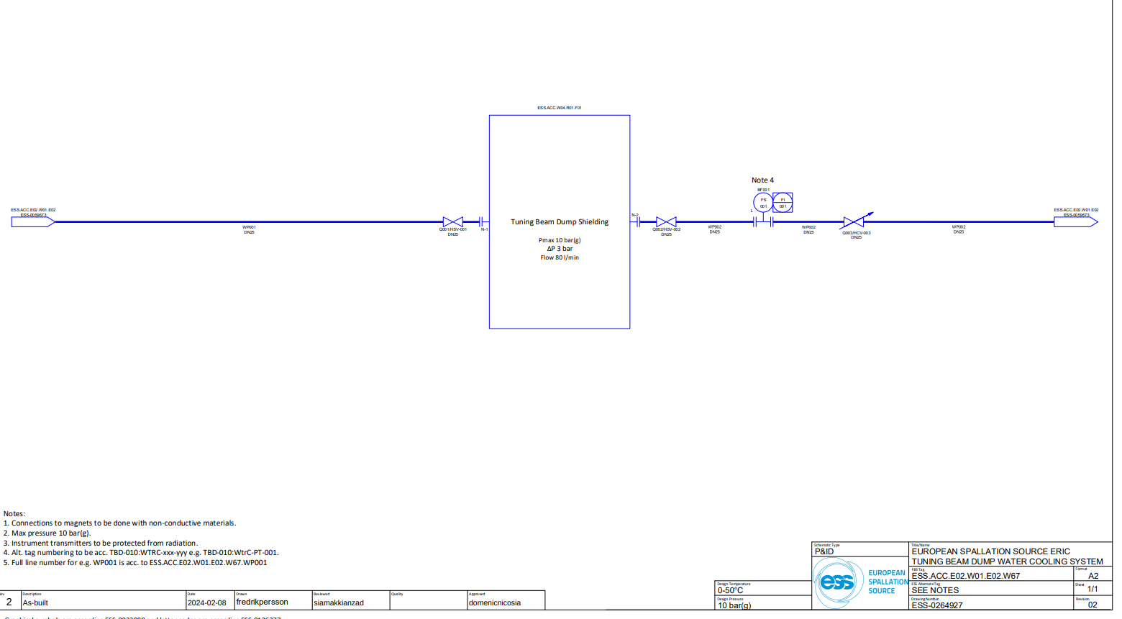
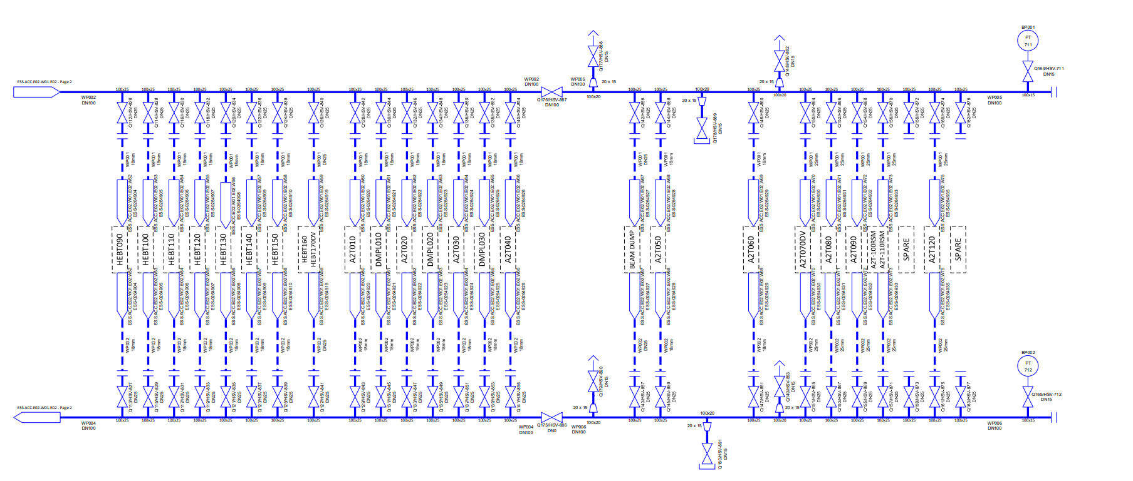
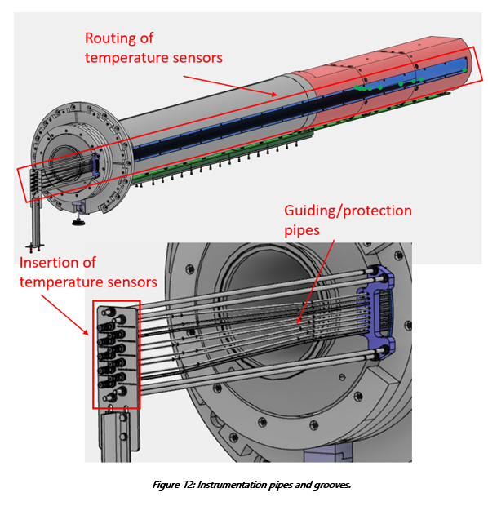
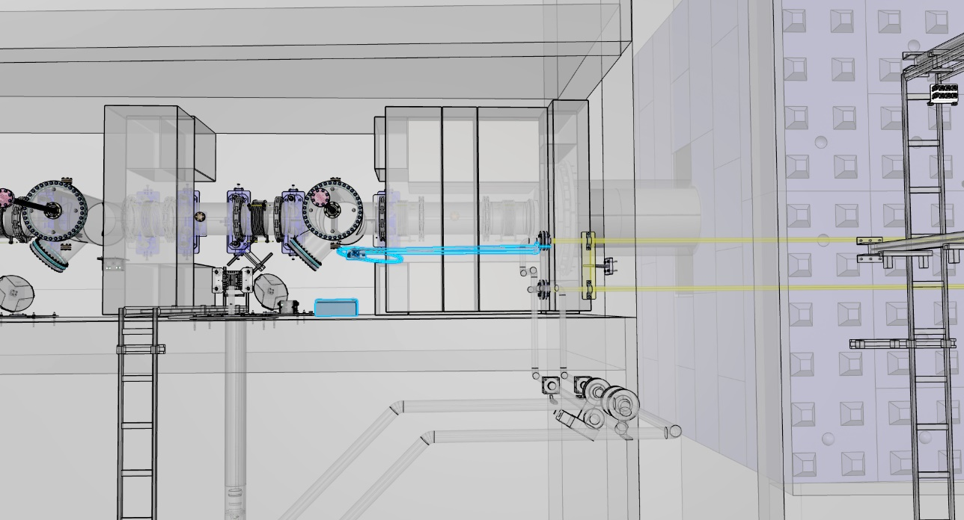
System Overview
Tuning Beam Dump
Water cooled, passive system
Temperature monitoring with 9 PT100 temperature sensors
Water level switch
Notes:
Overall view of the communications.
We are aiming for selectivity between the different circulators. E.g. if one cable, com. module or local PLC fails, the other options should still be OK.
The weak spot in this setup is the dependency on the INFRA network to reach the back-up circulator and SERA compressor on the floor below.

Slide 5
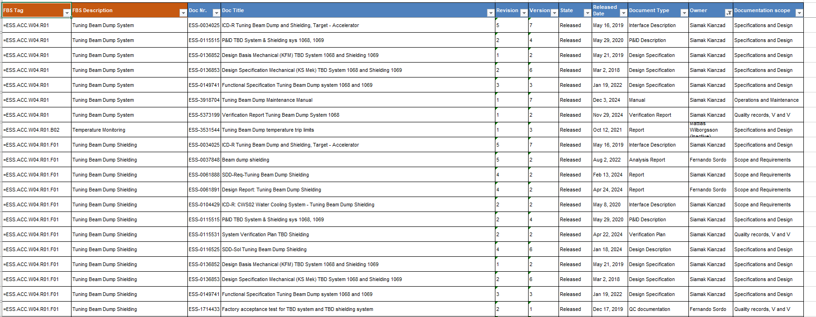
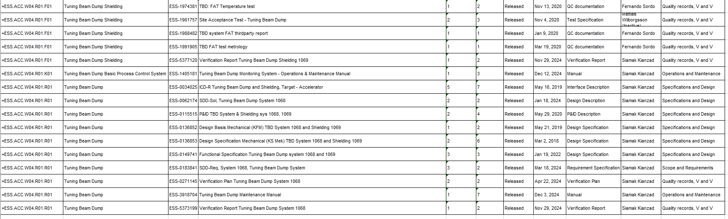
Documentation
Target Project CDR Approval form
  Tuning Beam Dump Shielding: ESS-0375295
  Tuning Beam Dump System: ESS-1790371
System Requirements Specification
  Tuning Beam Dump Shielding: ESS-0061888
  Tuning Beam Dump System: ESS-0183841
System Verification Report
  Tuning Beam Dump Shielding: ESS-5377120
  Tuning Beam Dump System: ESS-5373199
Maintenance Manual: ESS-3918704
Operations Manual: ESS-1405181
Final Installation Documentation: ESS-2491139 & ESS-4978139
CIDL DMPL OS-0000021
Notes:
Overall view of the communications.
We are aiming for selectivity between the different circulators. E.g. if one cable, com. module or local PLC fails, the other options should still be OK.
The weak spot in this setup is the dependency on the INFRA network to reach the back-up circulator and SERA compressor on the floor below.

Slide 6
Known issues
There are no known issues
Notes:
Overall view of the communications.
We are aiming for selectivity between the different circulators. E.g. if one cable, com. module or local PLC fails, the other options should still be OK.
The weak spot in this setup is the dependency on the INFRA network to reach the back-up circulator and SERA compressor on the floor below.

Slide 7
NCRs
No open NCRs
Notes:
Overall view of the communications.
We are aiming for selectivity between the different circulators. E.g. if one cable, com. module or local PLC fails, the other options should still be OK.
The weak spot in this setup is the dependency on the INFRA network to reach the back-up circulator and SERA compressor on the floor below.

Slide 8
Tests with Beam
The TBD system will not conduct any tests with beam. But the system will be used in the beam commissioning plan.
Notes:
Overall view of the communications.
We are aiming for selectivity between the different circulators. E.g. if one cable, com. module or local PLC fails, the other options should still be OK.
The weak spot in this setup is the dependency on the INFRA network to reach the back-up circulator and SERA compressor on the floor below.

Slide 9
Start-up checklist
Start-up checklist not yet performed
Meeting with operators/control room scheduled to 12/2
Notes:
Overall view of the communications.
We are aiming for selectivity between the different circulators. E.g. if one cable, com. module or local PLC fails, the other options should still be OK.
The weak spot in this setup is the dependency on the INFRA network to reach the back-up circulator and SERA compressor on the floor below.

Slide 10
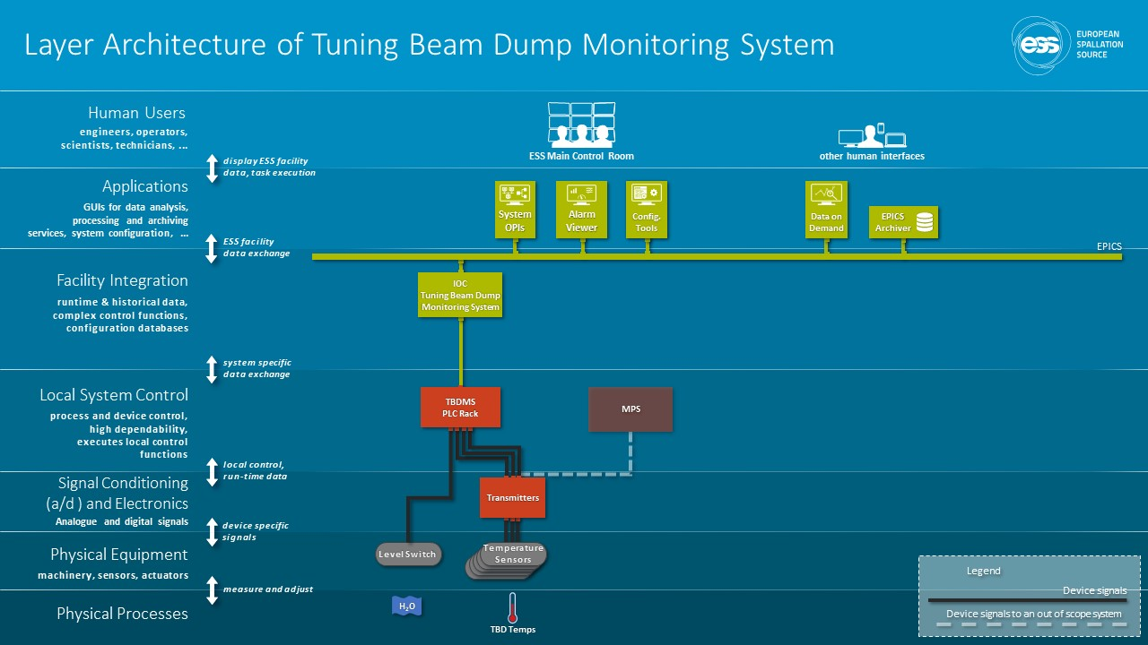
Notes:
Overall view of the communications.
We are aiming for selectivity between the different circulators. E.g. if one cable, com. module or local PLC fails, the other options should still be OK.
The weak spot in this setup is the dependency on the INFRA network to reach the back-up circulator and SERA compressor on the floor below.

Slide 11
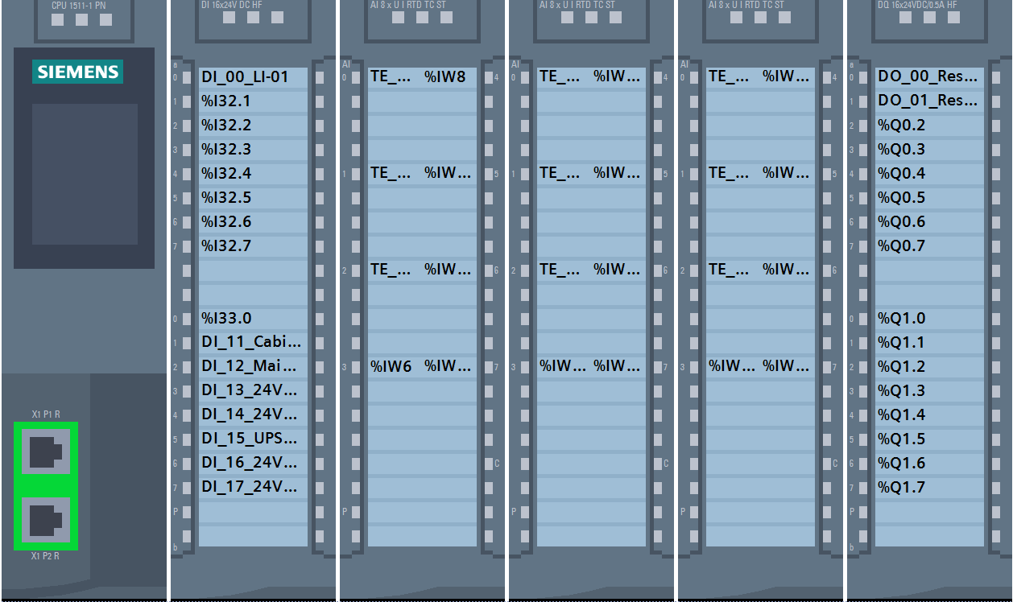

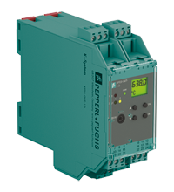
Control System Architecture
Hardware Overview
Warnings & Alarms
Each of the 9 temp sensors will issue a warning at an H1 limit, and an alarm at H2 limit.
In addition to the above a warning will be issued if not at least 8 out of 9 valid signals indicates lower than H2 limit.
Also an alarm will be issued if not at least 7 out of 9 valid signals indicates lower than H2 limit.
tbd-tbdmon-plc-001.tn.esss.lu.se
Technical Network
Controls-Target
MPS logic
tbd-tbdmon-ioc-001.tn.esss.lu.se
At least 4 out of 7 transmitters must presents a valid signal < H3, else beam-permit = False
IOC
MPS
X 7
X 2
A warning will be issued in the event of a high level in the Tuning Beam Dump cave
Level switch
Temp Transmitters
with MPS connection
Temp Transmitters
without MPS connection
Notes:
Overall view of the communications.
We are aiming for selectivity between the different circulators. E.g. if one cable, com. module or local PLC fails, the other options should still be OK.
The weak spot in this setup is the dependency on the INFRA network to reach the back-up circulator and SERA compressor on the floor below.

Slide 12
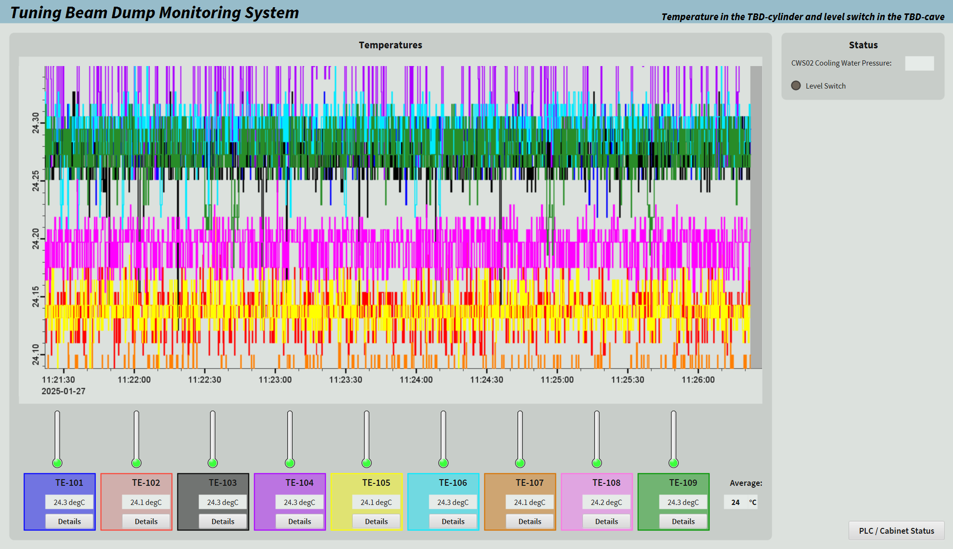
Operator Interface
Main.bob
Level switch indication
Chart of temperatures
Click to access faceplates
Average temperature reading
Click to access PLC-Cabinet.bob
Temperature
readings
Notes:
Overall view of the communications.
We are aiming for selectivity between the different circulators. E.g. if one cable, com. module or local PLC fails, the other options should still be OK.
The weak spot in this setup is the dependency on the INFRA network to reach the back-up circulator and SERA compressor on the floor below.

Slide 13
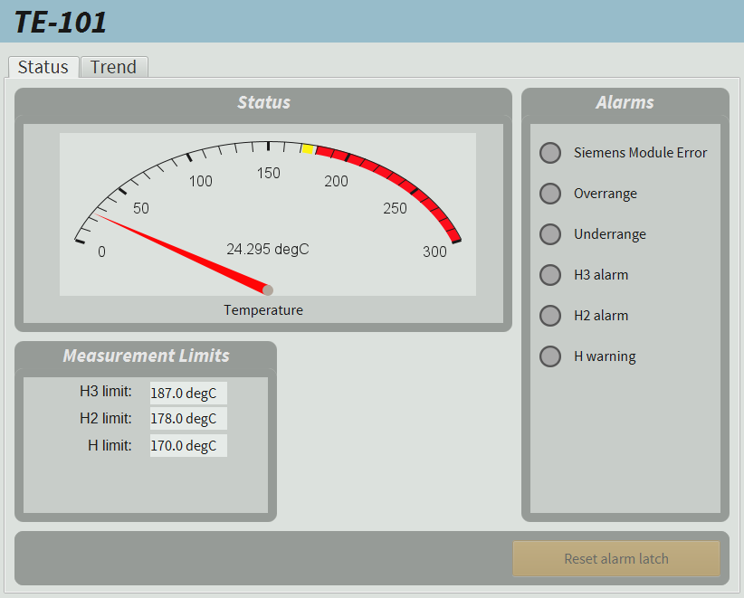
Operator Interface
Faceplates
Error indications
MPS limit
Alarm limit
Warning limit
Notes:
Overall view of the communications.
We are aiming for selectivity between the different circulators. E.g. if one cable, com. module or local PLC fails, the other options should still be OK.
The weak spot in this setup is the dependency on the INFRA network to reach the back-up circulator and SERA compressor on the floor below.

Slide 14
Thank You
Siamak kianzad

Slide 15
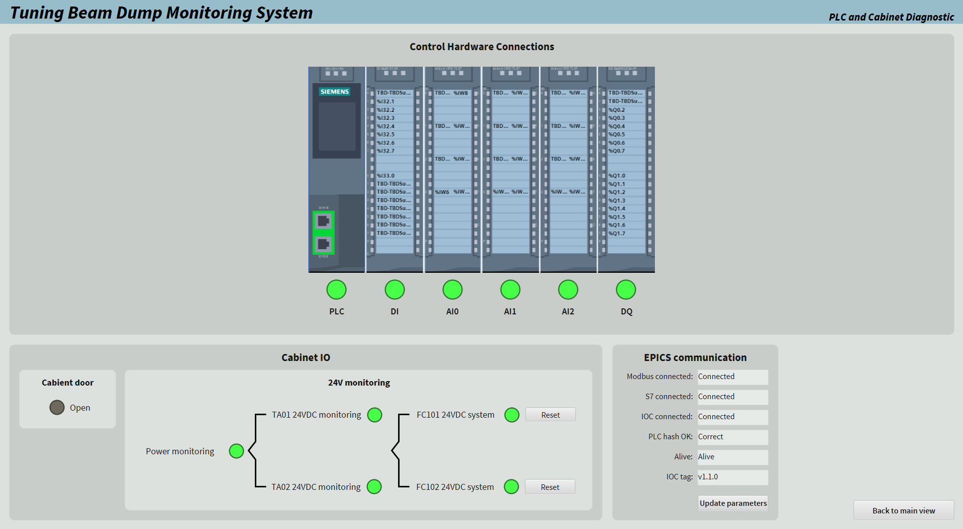
Operator Interface
PLC-Cabinet.bob
Click to reset electronic fuses
Update parameters upon a PLCfactory update
Click to access Main.bob
Notes:
Overall view of the communications.
We are aiming for selectivity between the different circulators. E.g. if one cable, com. module or local PLC fails, the other options should still be OK.
The weak spot in this setup is the dependency on the INFRA network to reach the back-up circulator and SERA compressor on the floor below.

