Slide 2
SAR4 – Phase Reference Line Accelerator Division RF Group
PRESENTED BY Anirban Krishna bhattacharyya, LLRF engineer

Slide 3
Agenda
1 Phase reference line (PRL) – location distribution
2 Status of the PRL System
3 Documentation
4 Operation and maintenance

Slide 4
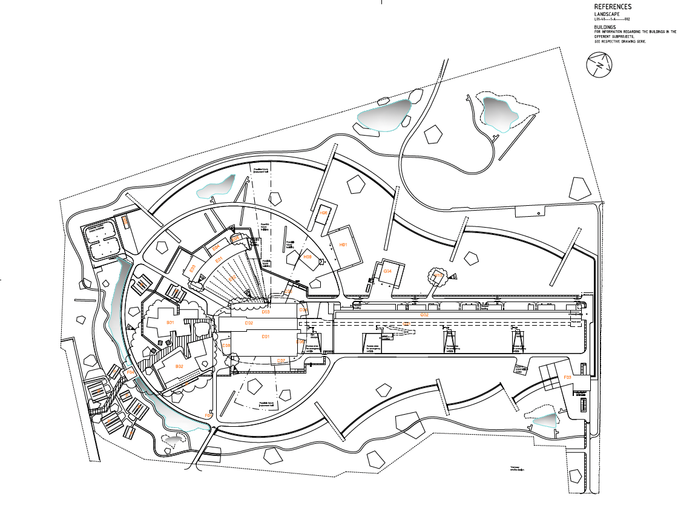
1. PRL – location distribution
Distributed all along B-01 ESS-1789532 – PRL schematic
All along B01

Slide 5
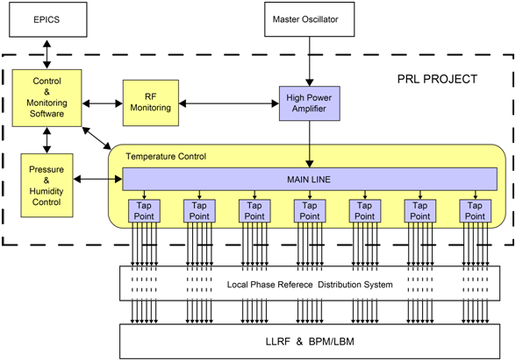
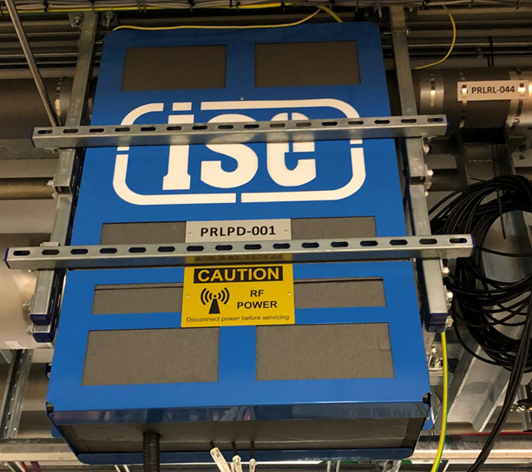
1.1 PRL
Functional Block Diagram
RF concept
58 tap points on coaxial rigid line

Slide 6
PRL Status
Component | Status
Gas system | Installed (permanent rack), long term leak checked
Temperature Control Box (Hardware) | Installed (permanent racks), network connected, tested
Temperature Control Box (IOC/Screens) | Deployed
Amplifier (Hardware) | Installed in racks
Amplifier (IOC/Screens) | OPI screens and IOC developed and running
Phase compensation unit (Hardware) | Installed
Phase compensation unit (IOC/Screens) | OPI screens developed and running.
PRL pipes, tap points, MO Power Divider | Installed in tunnel

Slide 7
PRL Status: Screens
From MEBT to Target : PRL operational (OPIs)

Slide 8
PRL Status: Signal
RFQ to HBL

Slide 9
2. Status of documentation
PRL CIDL
No CCRs or NCR
All recommendations from TRR were carried out

Slide 10
3. Operation and maintenance
Operation is continuous and no supervision is required
Spares are maintained
Phase reference signal is continuously monitored, and all failure indicators are available
Gas bottle is on lease, so replaced every 3 years
The gas system is maintained at 1.050 bar( absolute pressure) and controlled
All pvs are archived

Slide 11
Thanks!

