Slide 2
SAR4 - Machine Protection

Slide 3
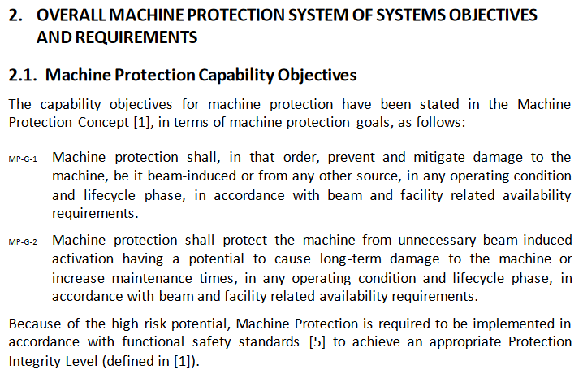
Machine Protection Context
Machine Protection -Systems requirements and architectural framework (ESS-0057251)

Slide 4
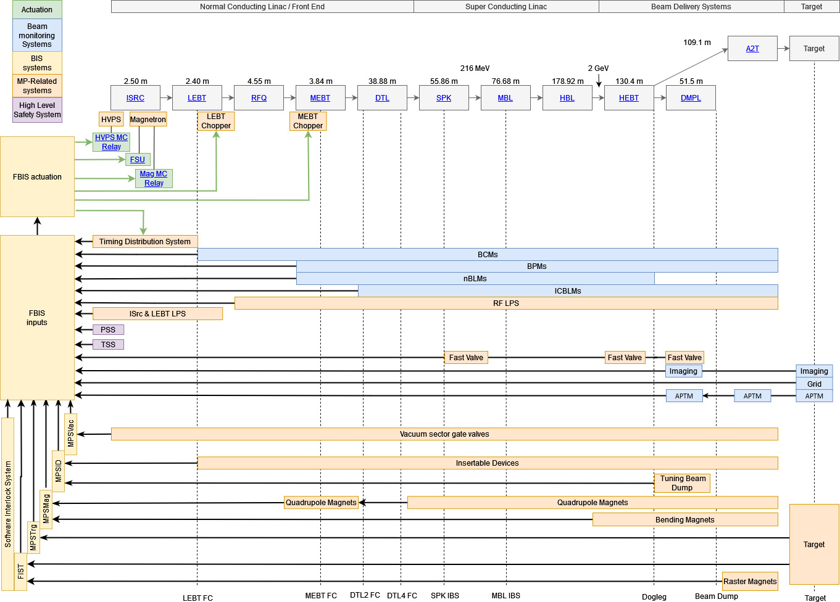
Machine Protection Context (BoD)
Layout and scope of Machine Protection Systems of Systems (MP-SoS)
19 Beam Current Monitors – 9 interfaces
98 Beam Position Monitors – 49 interfaces
60 nBLMs / 198 ICBLMs – 33/11 interfaces
91 RF Systems – 91 interfaces
3 Fast Valves – 3 interfaces
2 Imaging Systems – 2 interfaces
1 Aperture Monitor – 1 interface
74 Vacuum Sector Gate valves – 74 interfaces
28 Insertable devices – 28 interfaces
1 Tuning Beam Dump – 1 interface
150 Quadrupoles – 150 interfaces
2 Bending Magnets – 3 interfaces
1 Timing System - 1 interface
1 ACC PSS – 1 interface
1 Ion Source LPS – 1 interface
LEBT/MEBT Choppers – 2 interfaces
1 Ion Source HVPS – 1 interface
1 Magnetron PS and relay – 2 interfaces
1 Fast Shutdown Unit – 1 interface

Slide 5
Beam Interlock Systems and Status (BoD) CIDL (OS-0000037)
MPS System | MP Requ + ICDs (PSG) | PIL report (PSG) | SIT report (PSG) | CCRs / Comments
MPSMag | ✅ | ✅ | In Review ESS-3271572 | Status: MPSMag deployed and tested for BoT scope
MPSVac | ✅ | ✅ | In Review ESS-3271566 | Status: MPSVac deployed for BOT Scope, Tested for BoD scope CCR ESS-5548376 (1 HEBT valve removed - implemented), CCR ESS-4224098 (change due to reduced amount of CryoModules being installed implemented), CCR ESS-4965201 (addition 3 valves in A2T - implemented)
MPSID | ✅ | ✅ | In Review ESS-3271573 | Status: MPSID deployed for BOT Scope, Tested for BoD scope CCR ESS-5584078 (DTL4 FC deferred to BoT - implemented), CCR ESS-5584080 (MBL IBS deferred to BoT - implemented), CCR ESS-5264410 (reduced scope of IDs for BoD - implemented), CCR ESS-5152656 (deferral of BSM in MBL – on-going), CCR ESS-5264409 (removal of BSMs in MEBT and Spoke from BoT scope – on-going), CCR ESS-4790072 (removal of dumpline gammablocker – implemented) CCR ESS-5584795 (restricted long pulse verification for Tuning beam dump - implemented)
SIS | ✅ | ✅ | ❌ | Status: SIS is deployed (SRS Rev4), will be SIT tested whilst MP-SoS testing is ongoing
FBIS | ✅ | ✅ | ❌ | Status: FBIS deployed for BoT scope, Testing underway for BoD scope CCR ESS-5049523 (change of BCM interface to FBIS - implemented), CCR ESS-5536384 (change of differential BCM pairs – implemented on FBIS side), CCR ESS-5502997 (BCMs sending frequency instead of discrete BP – rejected by PSG), CCR ESS-5099753 (change of BPM interface to FBIS - implemented), CCR ESS-5584795 (BLMs deferred to BoT - implemented), CCR ESS-5161724 (addition of 2 imaging systems - implemented on FBIS side), CCR ESS-5075035 (FBIS-MPSxxx interface change - implemented), CCR ESS-5128250 (reduce number of RFLPS trips – on-going)

Slide 6
SSCI2S’s – MP-SoS Sensor Systems (BoD)
MP-SoS SSC Classification Report – ESS-4867744, rev 3
SSC Name | MP Requ + ICD (PSG) | PIL report (PSG) | Local Test Report (SO) | CCRs / Comments
APTM | ✅ | ❌ | ❌ | PIL report cannot be created - not enough system information is available (NCR will be created by PSG), no local test report available yet
IMG | ✅ | ❌ | ❌ | PIL report cannot be created - not enough system information is available (NCR will be created by PSG), no local test report available yet.
BCMs | ✅ | ✅ | ✅ | Open NCR 10344 – Differential Pairs (Implemented, Testing to be completed in SRR4 Commissioning)
BPMs | ✅ | ✅ | ✅
BLMs | ✅ | ✅ | ❌ | Removed from Scope in CCR ESS-5584795 (NCR will be created by PSG for the MP function), no local test report available yet.
RFLPS | ✅ | ✅ | ✅
Magnets | ✅ | ✅ | ✅ | Magnets for BoT scope deployed – including bending magnets – excluding raster magnets (not needed for BoD)
Vac valves | ✅ | ✅ | ✅
PBVIS | ✅ | ✅ | ✅
FCs | ✅ | ✅ | ✅ | CCR ESS-5584078 (DTL4 FC deferred to BoT - implemented)
IBSs | ✅ | ✅ | Spoke IBS in review
TBD | ✅ | ✅ | ✅

Slide 7
SSCI2S’s – MP-SoS Actuator Systems (BoD)
SSC Name | MP Requ + ICDs (PSG) | PIL report (PSG) | Local Test Report (SO) | CCRs / Comments
LEBT chopper | ✅ | ✅ | ✅
MEBT chopper | ✅ | ✅ | ✅
FSU | ✅ | ✅ | ✅
Ion Source | ✅ | ✅ | ✅

Slide 8
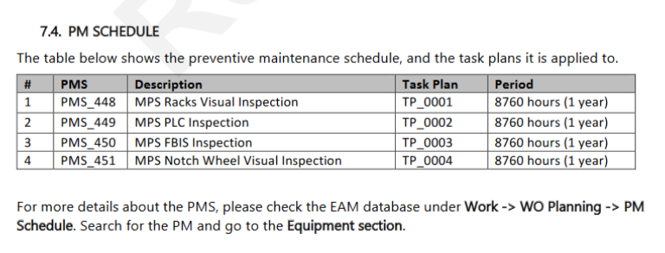
Maintenance for the Beam Interlock System
Maintenance requirements for the Beam Interlock System can be found in the
ESS-3178302 - Beam Interlock System (BIS) Maintenance Manual
https://chess.esss.lu.se/enovia/link/ESS-3178302.2/21308.51166.47790.38262
As all systems have been fully retested before SRR4, all systems are considered proof tested so no maintenance is required. Next revision of the manual will address the proof testing intervals and methods for interfacing systems as well as the BIS systems.

Slide 9
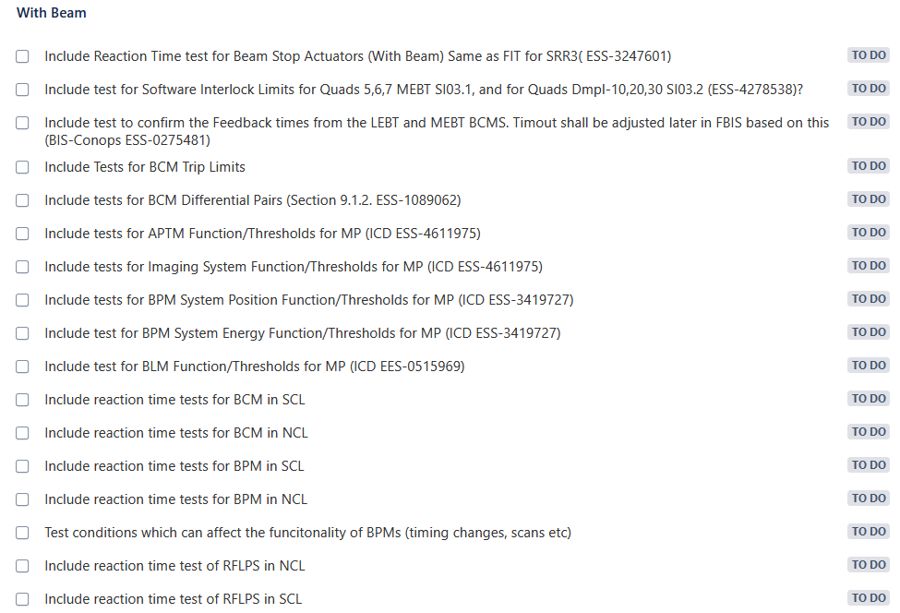
Tests Required with Beam Jira ICSMPS-3936

Slide 10
Previous issues / Recommendations
NSOI-165 – Solution implemented (will be tested in FIT)
LEBT Chopper should not be required for Plasma Conditioning
NSOI-168 – Solution implemented (will be tested in FIT)
Remove requirement of the LEBT gate valve for plasma conditioning
NSOI-209 – Solution implemented (will be tested in FIT)
NCL RF systems in MP-SoS: Interlock to Inhibit

Slide 11
Thanks, Questions?

