Slide 2
SAR4D - Accelerator Vacuum Group
PRESENTED BY marcelo juni ferreira, Vacuum group leader

Slide 3
Agenda
1 Vacuum Group – location distribution
2 Status of the Vacuum System
3 Approach to managing scope for reliable operation
4 Scope and associated requirements / functions
5 Projected labour resources
6 Projected non-labour resources
7 Benchmarking
8 Summary

Slide 4
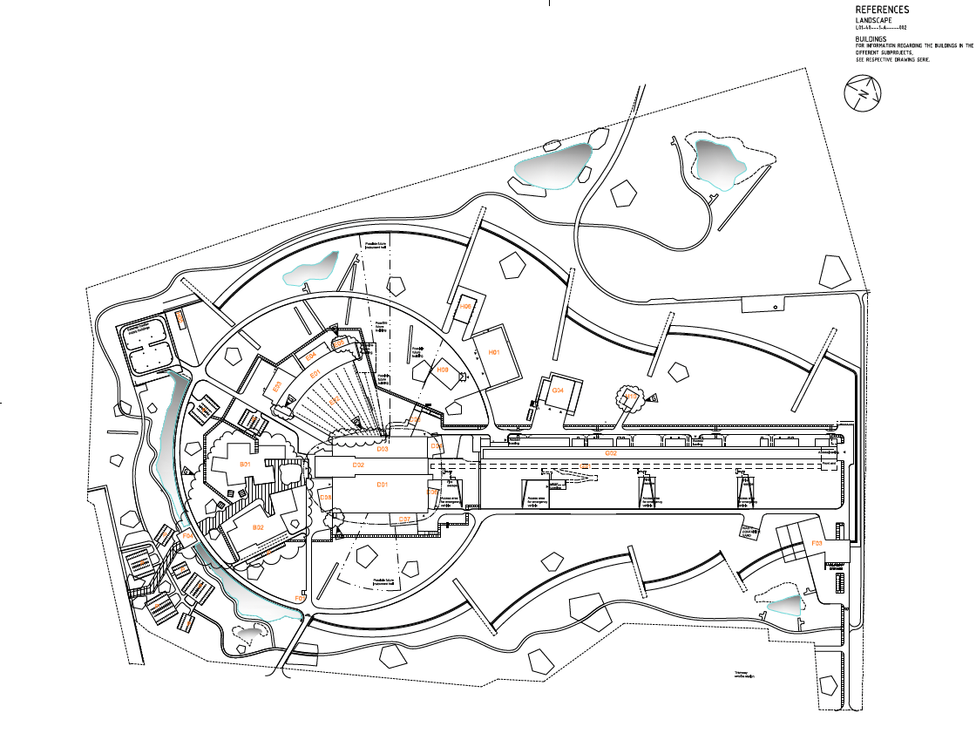
1. Vacuum Team – location distribution
Mission across the facility ESS-3192748 - Functional Description Vacuum
Vacuum area on Neutron Instruments hall:
Bunker (NG, choppers),
Neutron guides (MV),
Instruments (LV, MV, HV)
Sample environment.
Vacuum room on G02 (klystron gallery) Accelerator (including hardware from tunnel for maintenance):
Warm LINAC (HV),
Cold LINAC (HV, UHV, vacuum insulation Cryo, particle free assembling),
A2T + Tunning Dump + drift room (HV, UHV),
Vacuum system on Target building:
Monolith Vessel (HV),
PBW vessel (HV),
NBPI (He, water).
Vacuum Laboratories site wide support for all:
- Accelerator/Target/Instruments
- stand-alone vacuum systems.

Slide 5
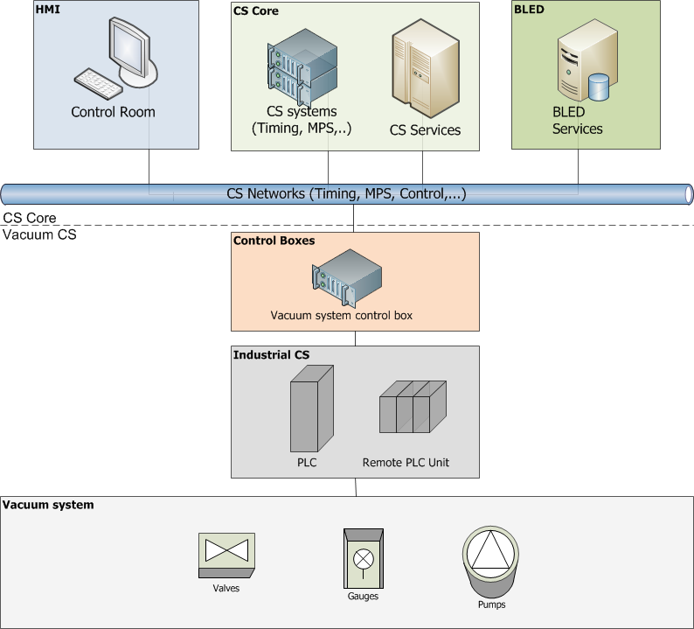
1.1 Vacuum Control System
An Integrated Approach
Epics Domain
ICS team responsibility
Vacuum team responsibility for project/installation
Vacuum team responsibility for Operation

Slide 6
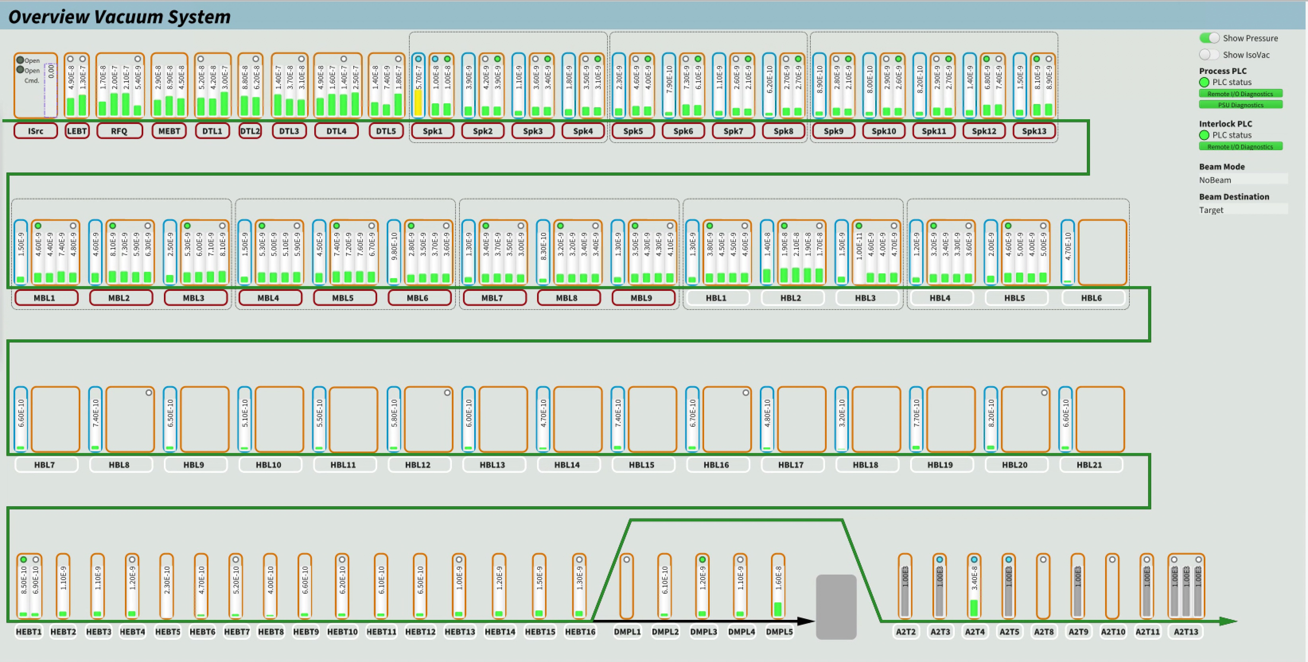
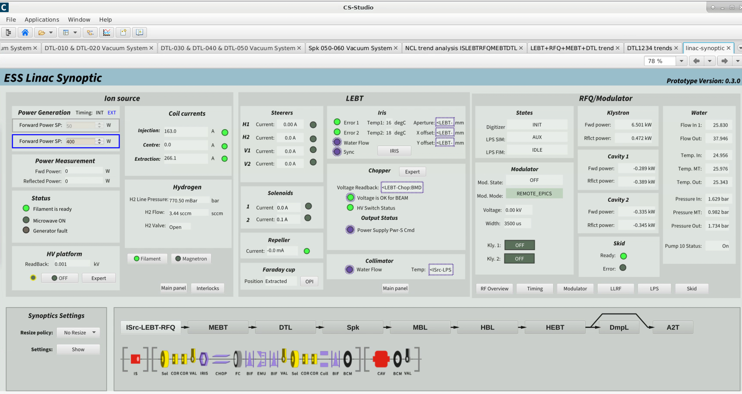
1.2 Accelerator: NCL/SCL/DP
From Ion Source (IS) to Dump Line : vacuum system operational (OPIs)

Slide 7
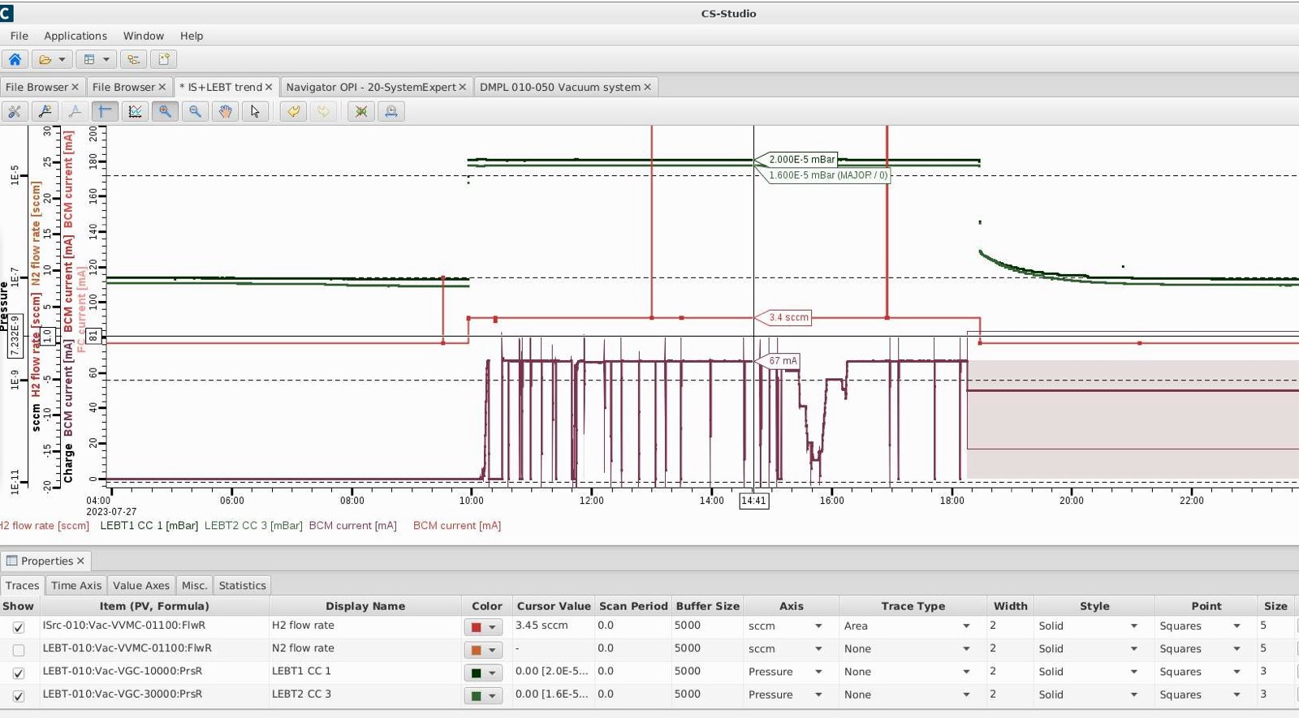
1.2 Accelerator: NCL
Ion Source (IS) + Low Energy Beam Transport (LEBT)

Slide 8
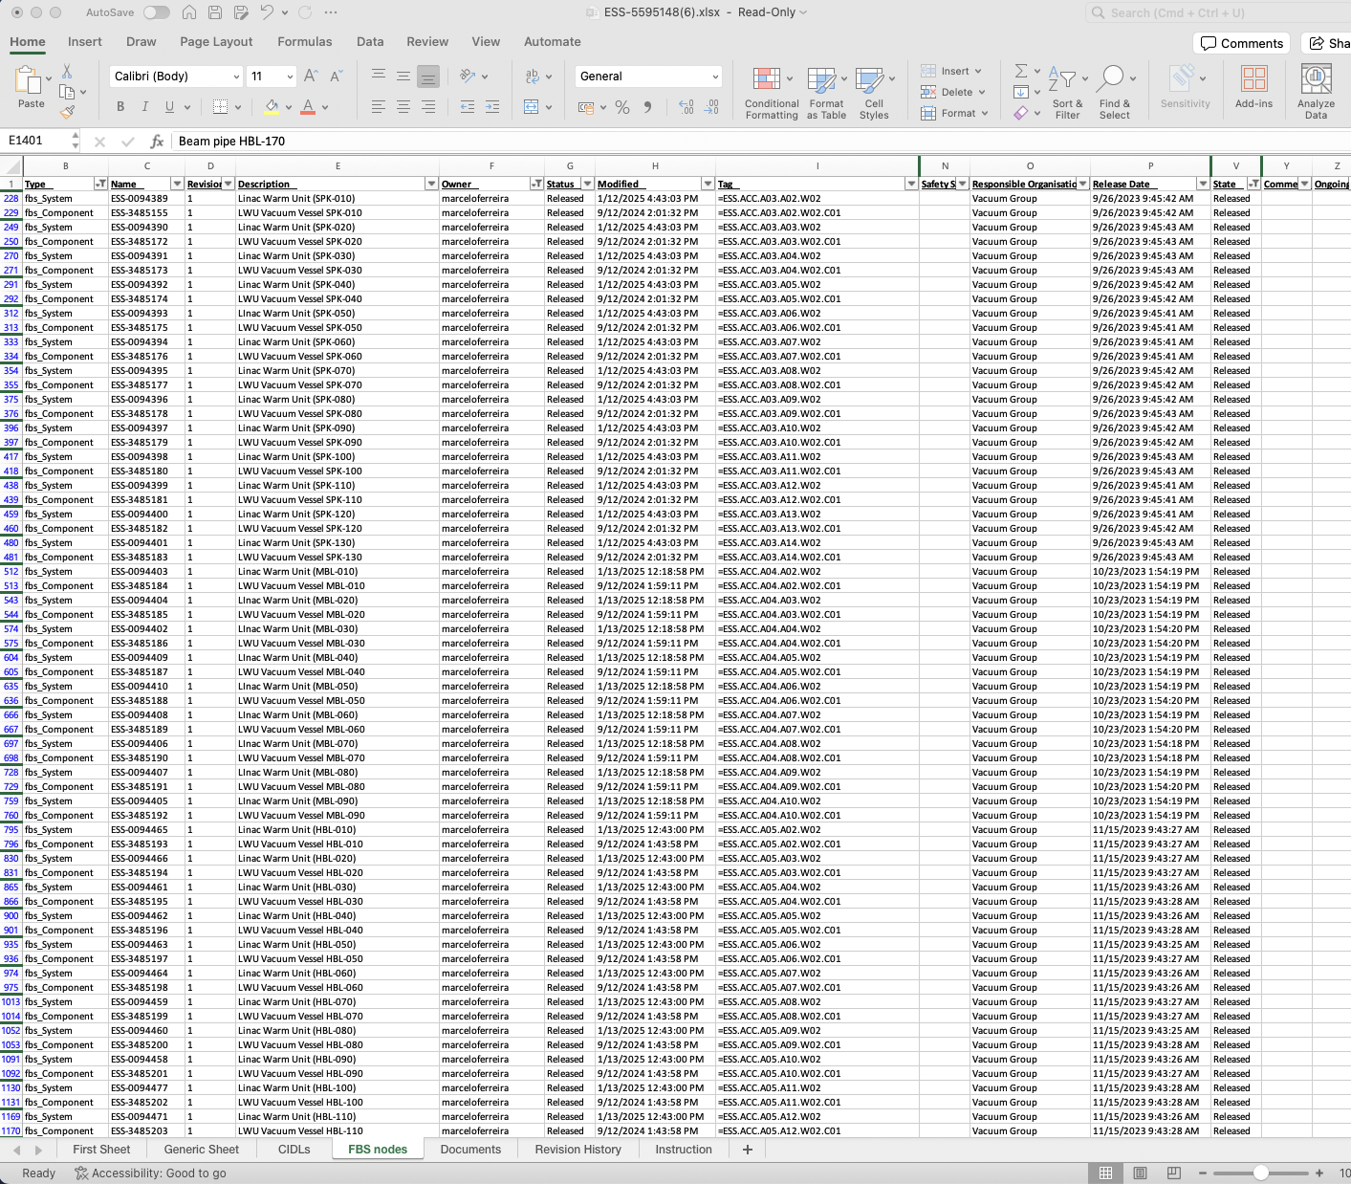
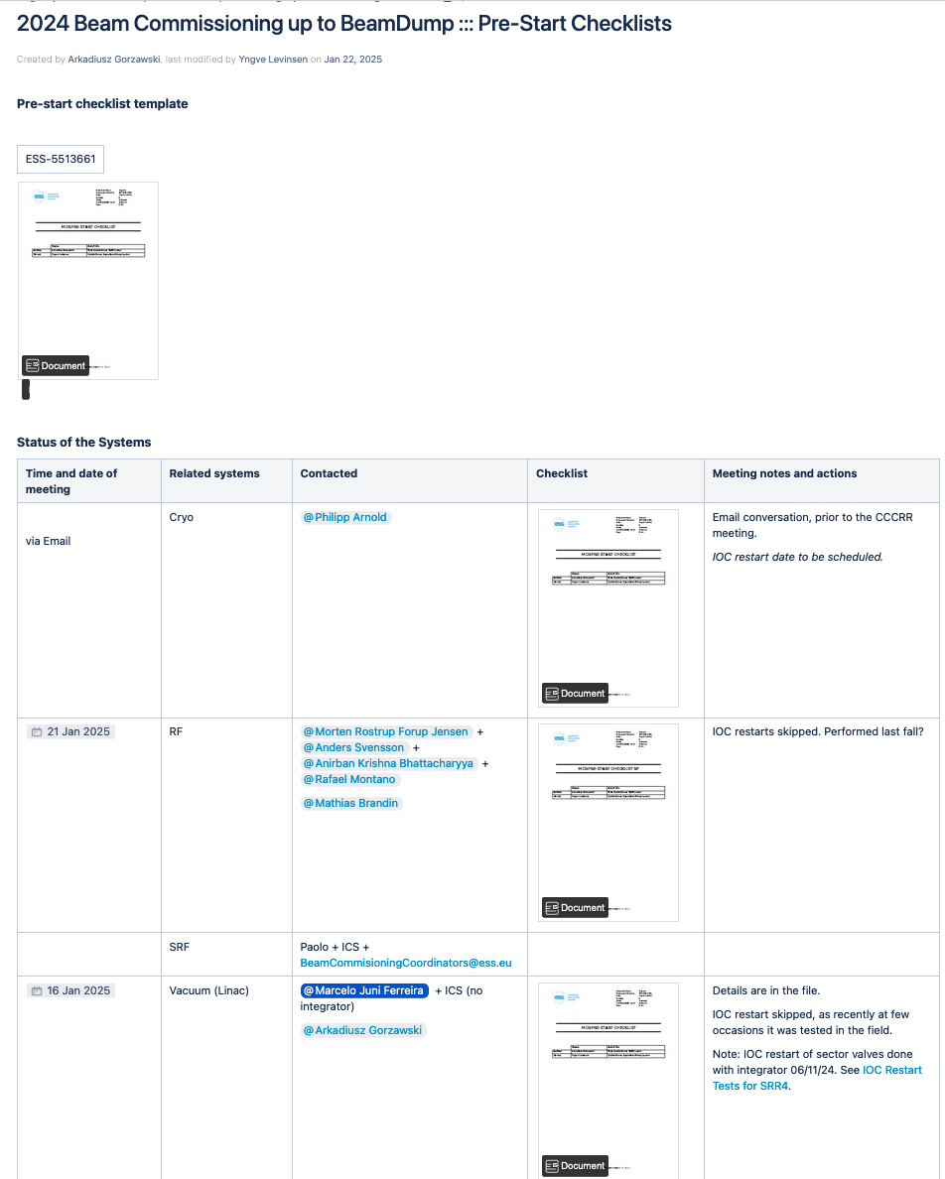
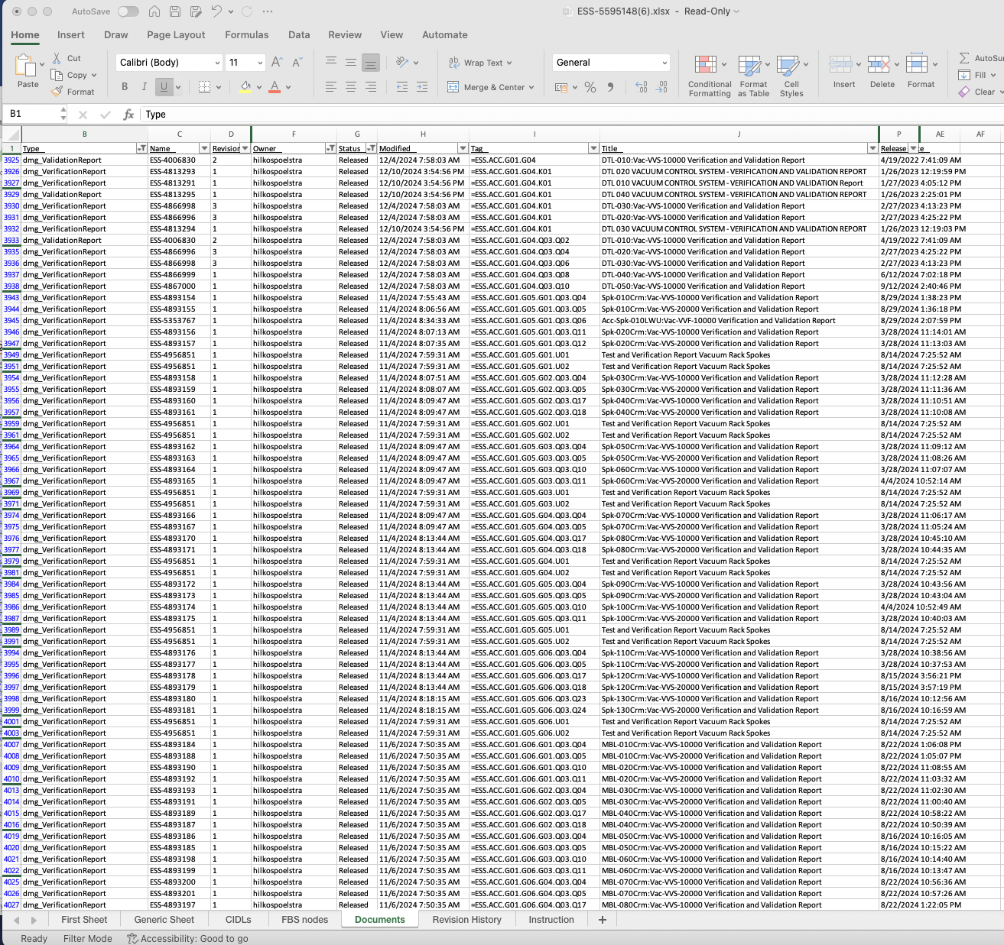
2. Status of documentation
CIDL + inspections + pre-start check list + permit
All Vacuum CIDL listed for BOD are on released status (453). All components on preliminary status are related to cryomodule not installed for 2 MW configuration (106).
Pre-start checklist list made with CRO group.
All documents for Vacuum Control System inspections done and released, including MPS-VAC interfaces (permanent energization authorization requested, waiting answer).
- CDRs and PDR’s done and no remarks left,
No NCR’s.
In-kind TA finished.
All TLP close/end/completed

Slide 9
3. Operation and maintenance
Standardization of procedure: electrical and hardware
maintenance in spare/supplies is estimated by average over 3 years period,
Periodic inspection/maintenance follow the code for each area: i. electrical: specific code requirements defined and regular as required (ESS-5491320); ii. Hardware: it depends on factory requirement of each device, approach defined by function (Vacuum Handbook part 2 ESS-0012895),
System ready for BOD!!!

Slide 10
8. Summary
Use the best available information on ESS vacuum system to create a reasonable scenario for maintenance and operation, taking the benefits of the Vacuum Policies:
Use of standardization of equipment and procedures to simplify maintenance and operation (scale),
Use of Framework Agreements for major components: dry pumps, turbo pumps, IP+NEG, valves, etc,
On-call for Vacuum System in place as need it.

Slide 11
Thanks!

