Slide 1
Cryogenic System
ESS System Acceptance Review SAR4
4th February 2025
PRESENTED BY Philipp Arnold / Henry Przybilski

Slide 2
Agenda
1 Scope description and status
2 Documentation, CIDLs and CRs
3 NCRs and other known issues
Applicable codes and compliance
5 Tests pre and post beam
6 Start up checklist
7 Earlier recommendations

Slide 3
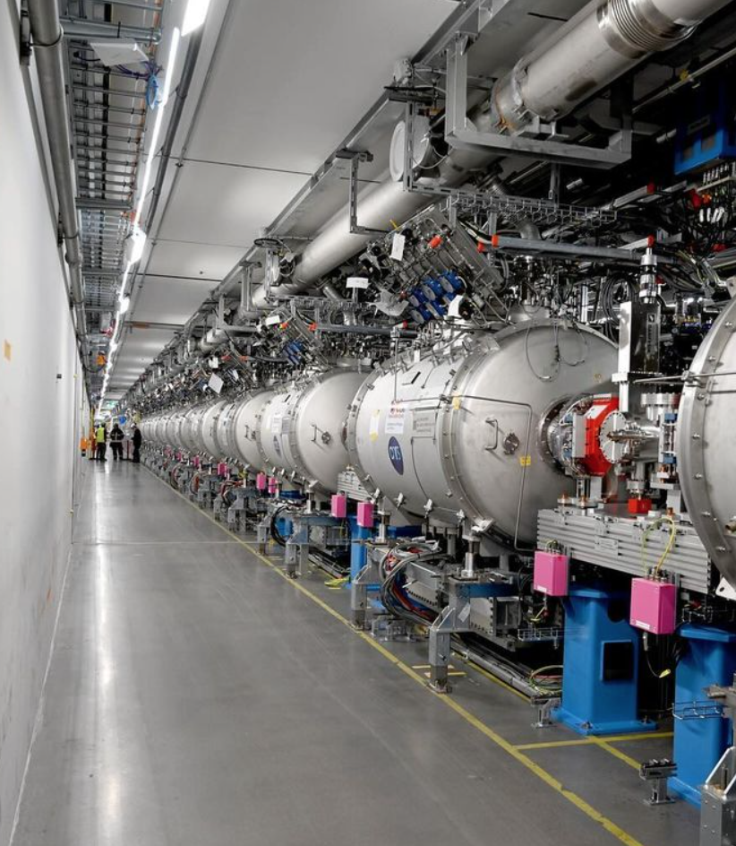
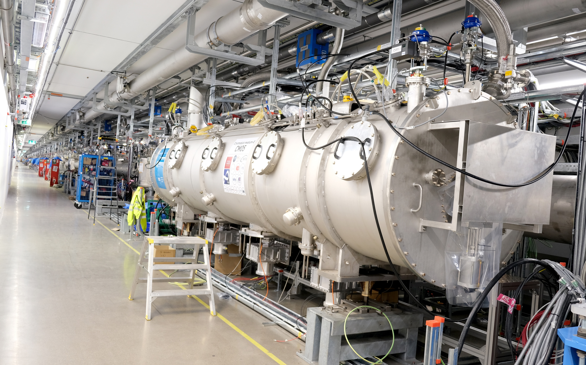
Cryomodules and Distribution System
Cryogenics for the Super Conducting Linac in a nutshell
Target
Normal Conducting Linac
Super Conducting Linac
ISrc
LEBT
RFQ
MEBT
DTL(5)
Spoke(13)
MBL(9)
HBL(21)
HEBT
Dump
Valve boxes
ACCP
CBX
ACCP
WCS
Accelerator
CryoPlant

Slide 4
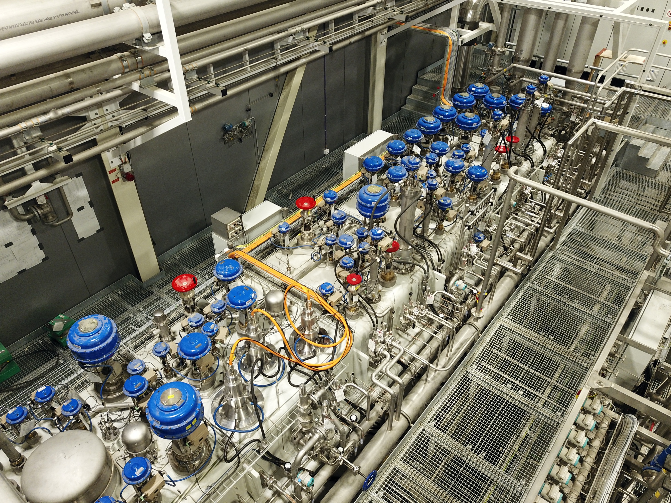
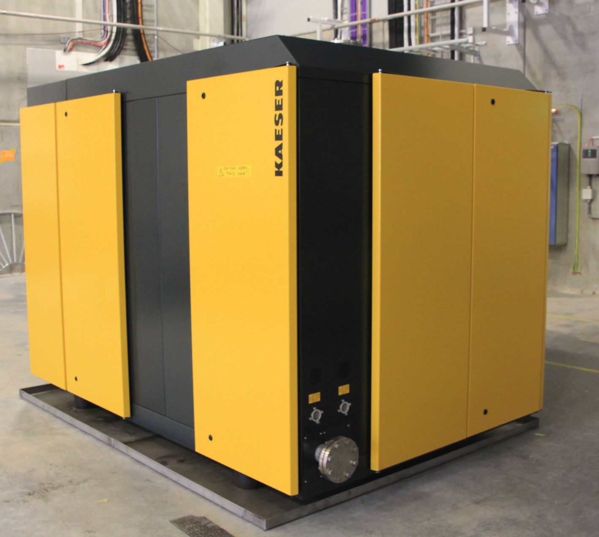
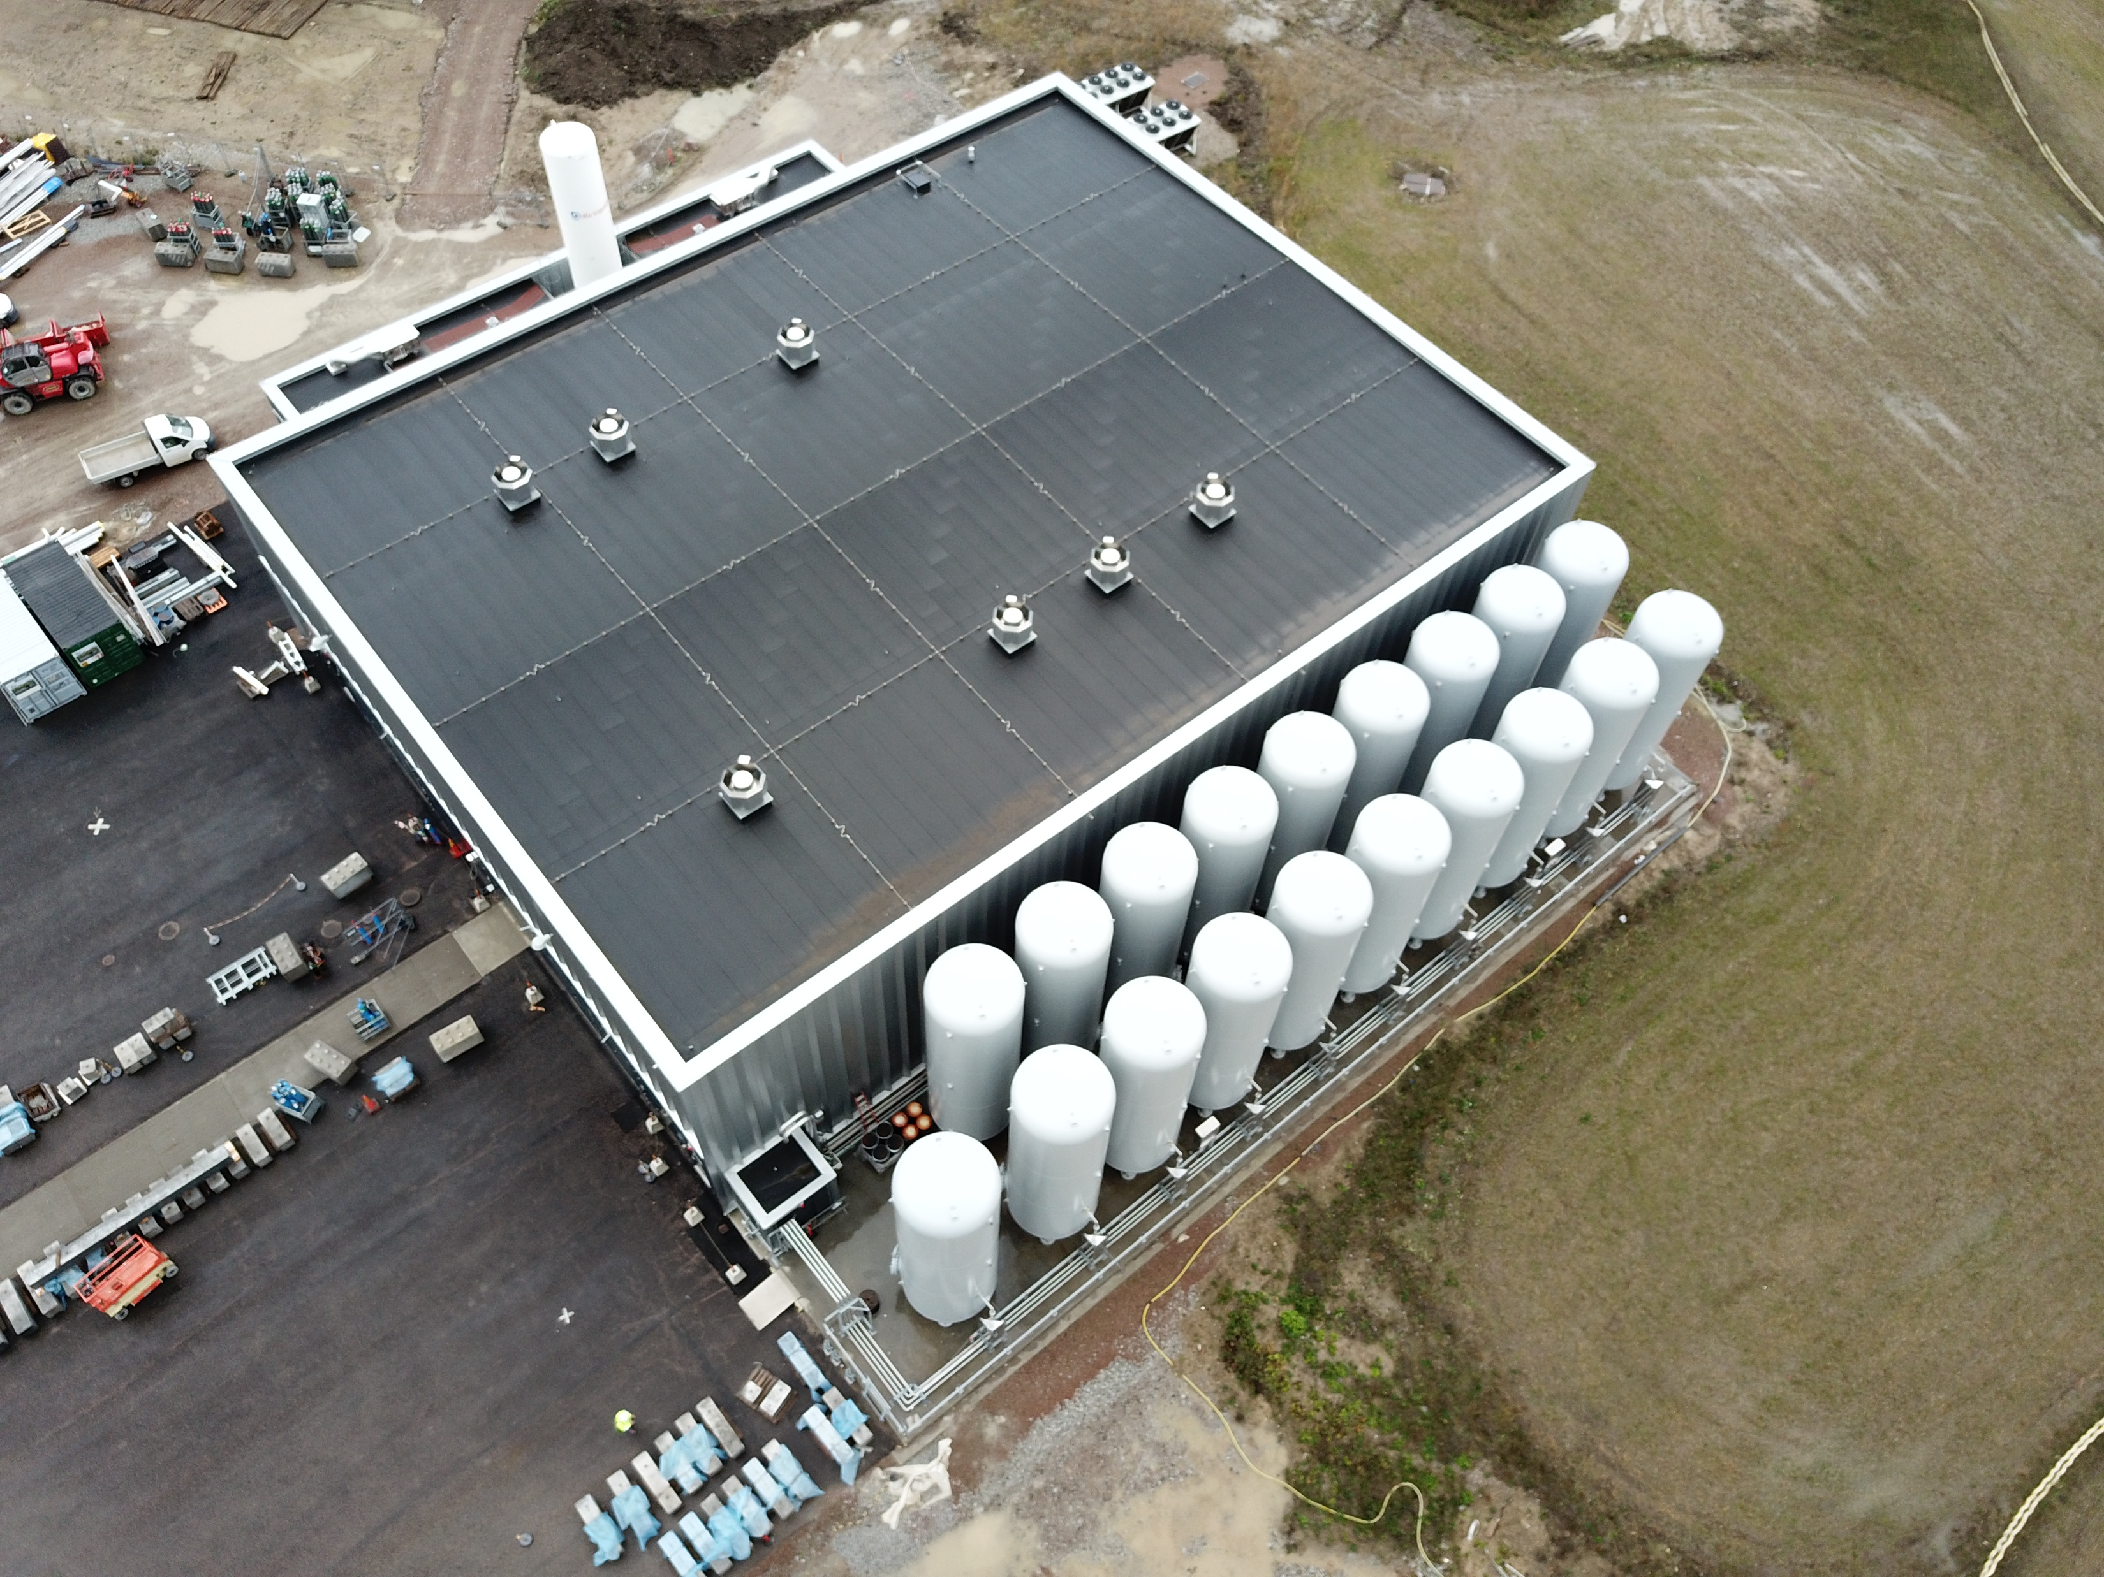
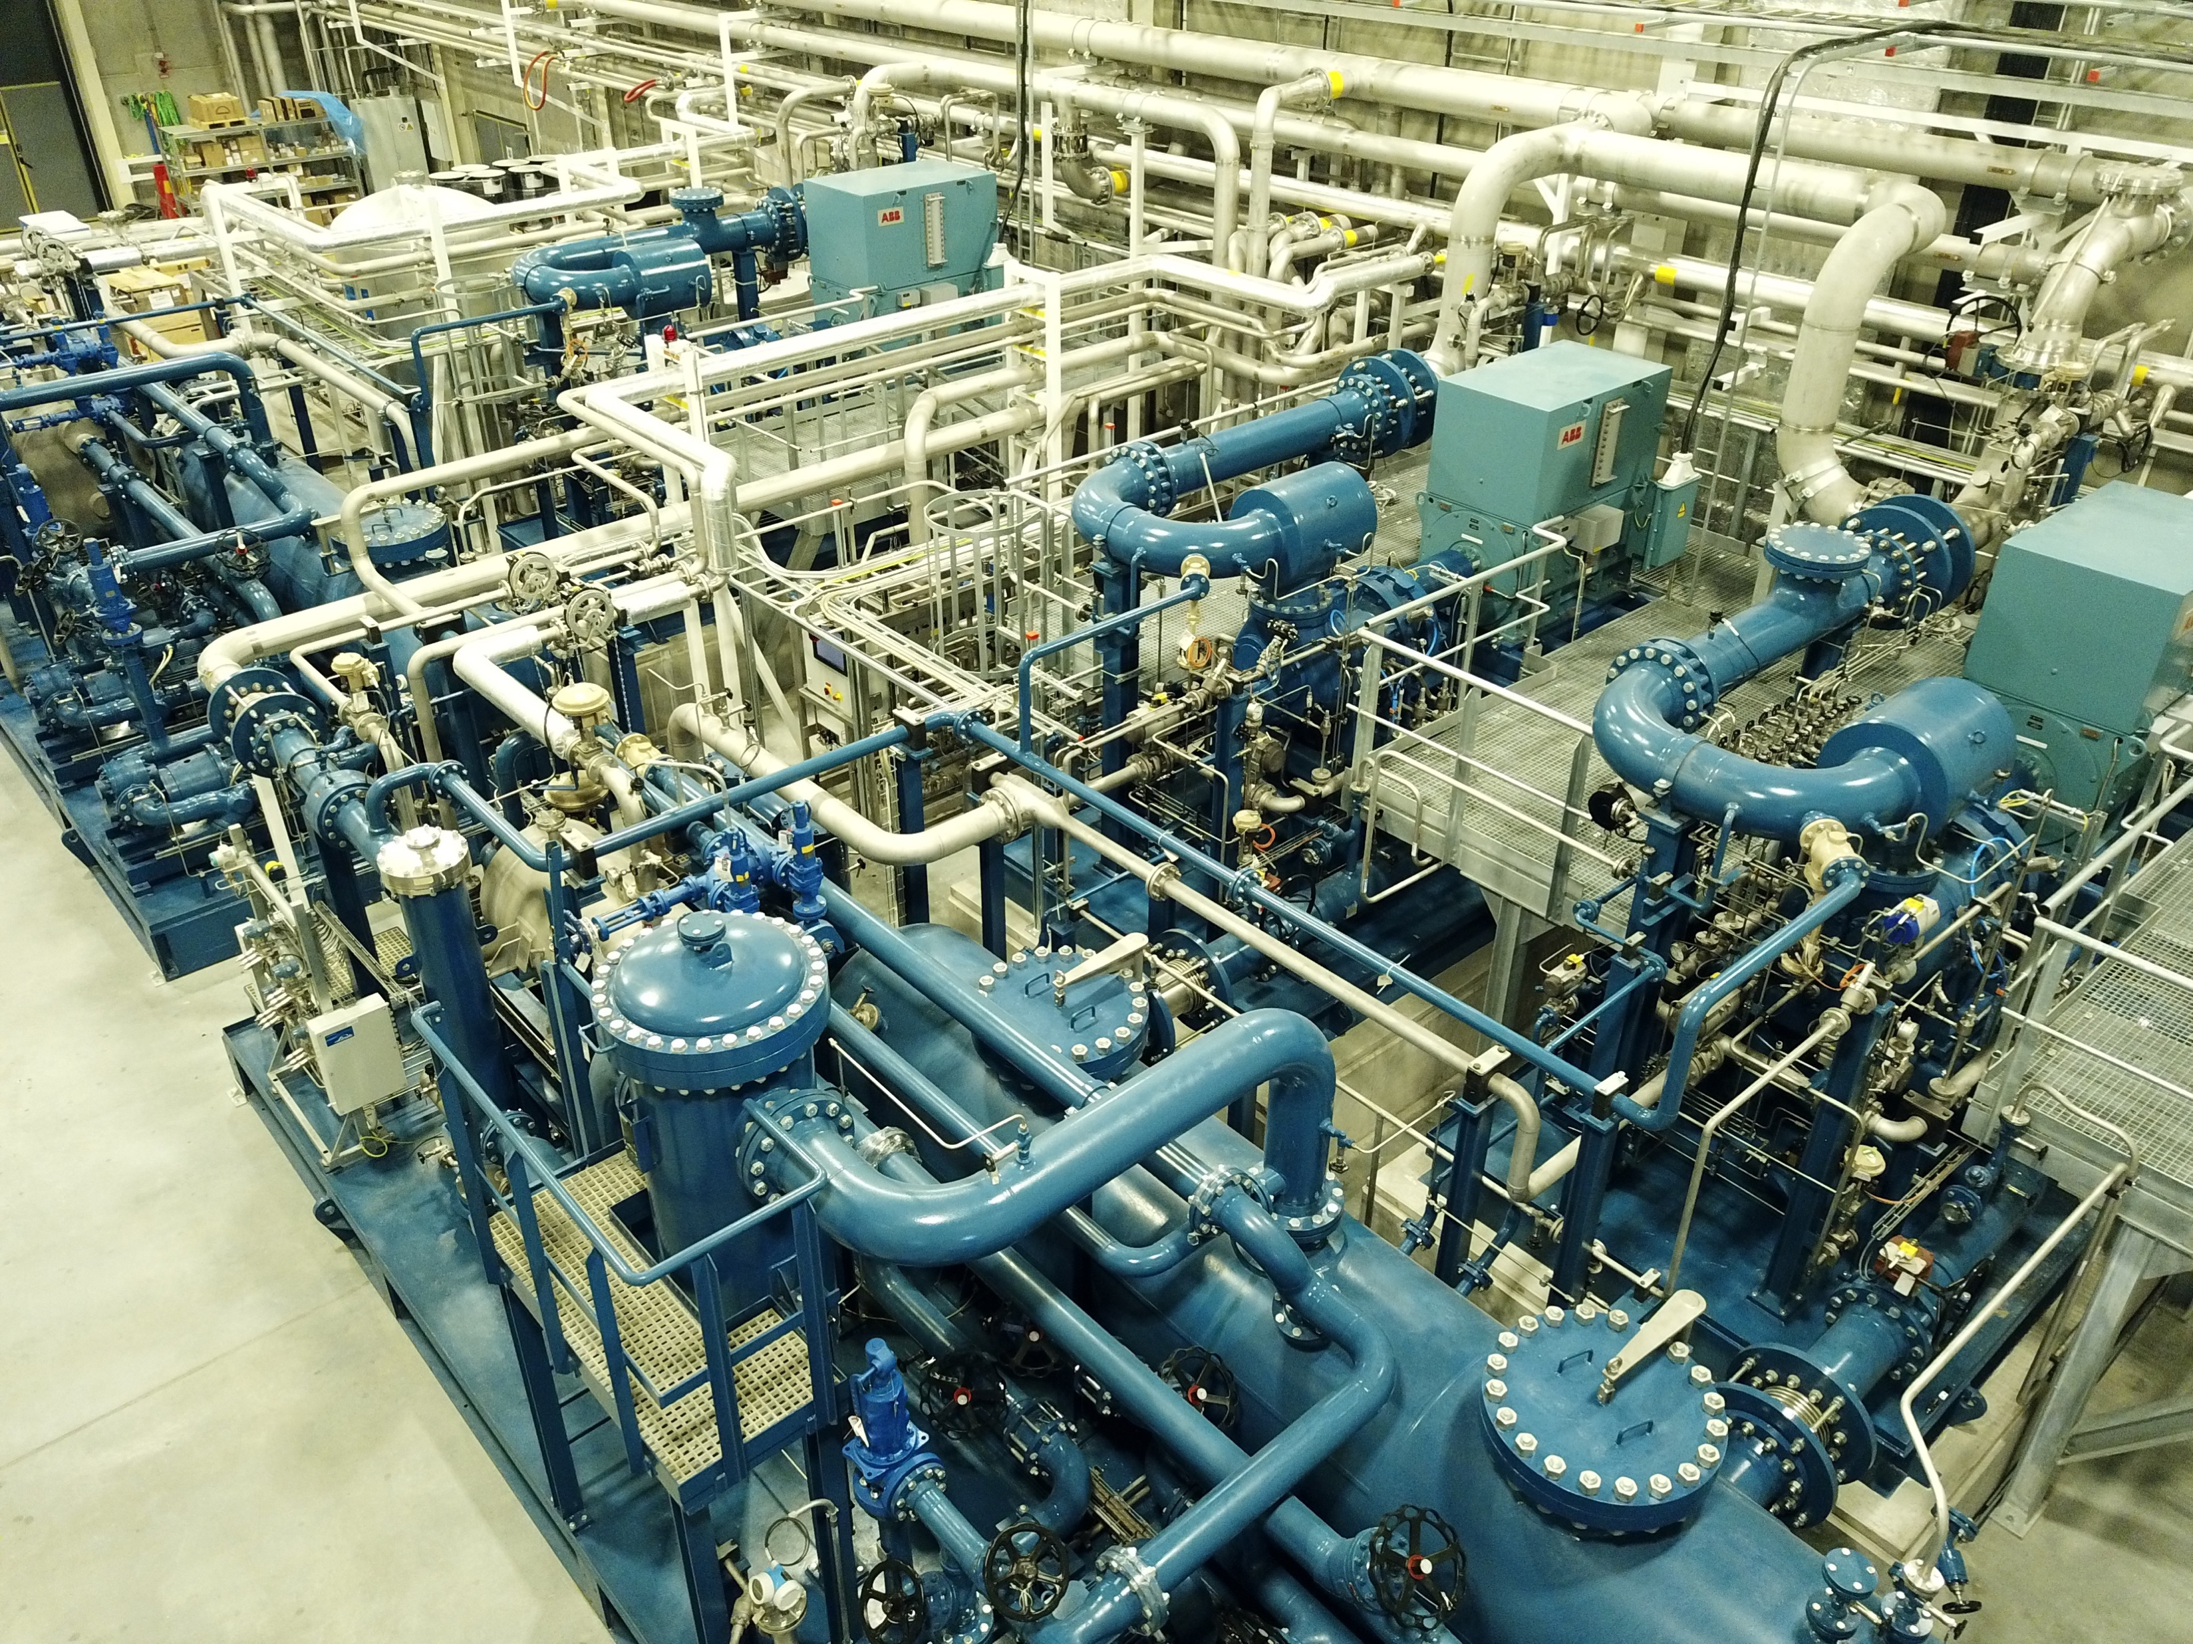
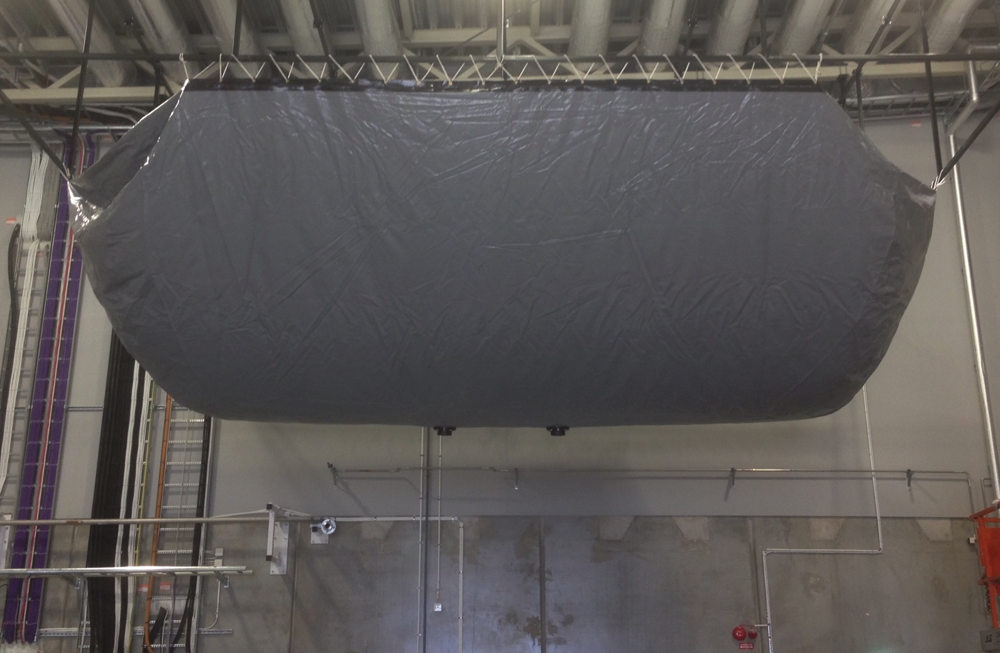
Accelerator Cryoplant
…and auxiliary systems
Rec
Sys
ACCP
CBX
ACCP
WCS
TICP
WCS
4

Slide 5
Documentation, CIDLs, CRs
ACCP/CDS docu complete, all CIDLs, 1 CR for CMs closed
Main documentation of ACCP and CDS
CIDLs for ACCP and CDS in CHESS as verified
CIDLs for CM (see SCL cavities talk – Cecilia Maiano)
✅
✅
✅
✅

Slide 6
NCRs and other known issues
…being worked on, no show stoppers at the moment
No open NCR for ACCP and CDS, they are all closed now.
No open NCR for CM. NCR raised during SAT and installation are closed.
Some issues on Cryo that need work
BCP testing as HP compressor → test planned in week 7/2025
BCP and HP compressors cannot seamlessly be swapped → improvement project planned until summer 2025
BCP cannot yet operate as SP compressor → piping changes in summer break
Cold compressor full spare cartridges and upgrade to AMB outstanding
Operational issues (CC inlet filter, 80K adsorber regeneration, etc)
several issues on Cryo controls, for instance
No redundant PSUs in CDS/CM cabinets
No redundant level controllers
ACCP controls running on a legacy system with hardware approaching its end of life
Glitches in the Controls Network for remote monitoring and Alarms handling

Slide 7
Safety of cryogenic systems operations
Cryogenics safety and particular focus on pressurised equipment
SCL commissioning risk assessment ESS-5493839 (for OHS)
Risk assessment for pressurisation of Cryo ACCP, TMCP, TICP according AFS 2017:3 ESS-4973360 (for QC)
Risk assessment for pressurised systems according to AFS 2017:3 for CDS and CMs ESS-5003254 (for QC)
Area Hazard Analysis of cryo buildings (HCB, CXH, CTLG) ESS-0104828
Task risk assessment cryogenics operations ESS-3153113
Summary of Safety Helium Collector ESS-5461033
Summary and sizing of the Linac CDS pressure safety devices ESS-0101321
Elliptical cryomodule Safety relief device sizing ESS-3231794
Cryogenic Safety Review (8 June 2016) for spoke safety device design

Slide 8
Applicable codes and compliance
And how this effects our operation and maintenance
- Cryogenics Electrical Cabinets maintenance manual ESS-5585959 according to template ESS-3585736 following
Swedish Electrical Safety Act (SFS 2016:732)
ELSÄK-FS 2022:3
ELSÄK-FS 2022:1
CDS / CMs pressurised equipment maintenance manual ESS-5585925 follows
Operation and control of pressurised equipment AFS 2023:11
ESS rules for principles for in-service inspection ESS-0053218
ESS procedure for performing in-service inspection ESS-3218570
All cryo pressurised equipment is registered in EAM

Slide 9
Continuous activities
Technically, Cryo activities are tied to cold SCL and not to beam
- Validation tests performed prior to cooldown
- Monitoring of system health at all time
- CM cryogenics performance
Heat load measurements at different time (periodically)
Optimisation of control system parameters (continuous task)
Integral monitoring (across discipline, for instance vacuum levels)
Continuous improvements on cryo controls on CMs / CDS and ACCP

Slide 10
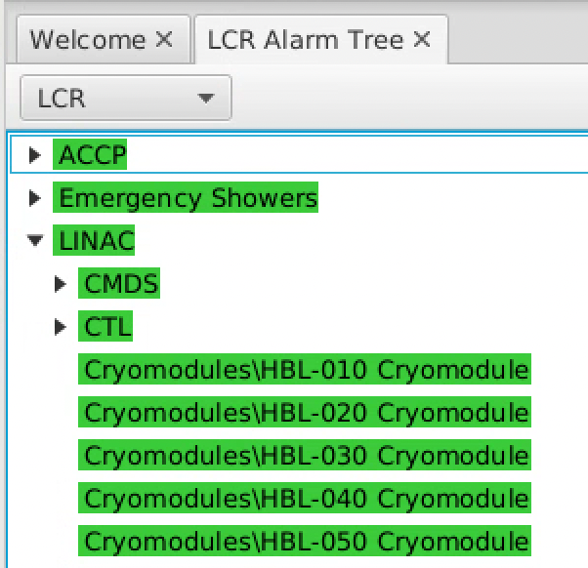
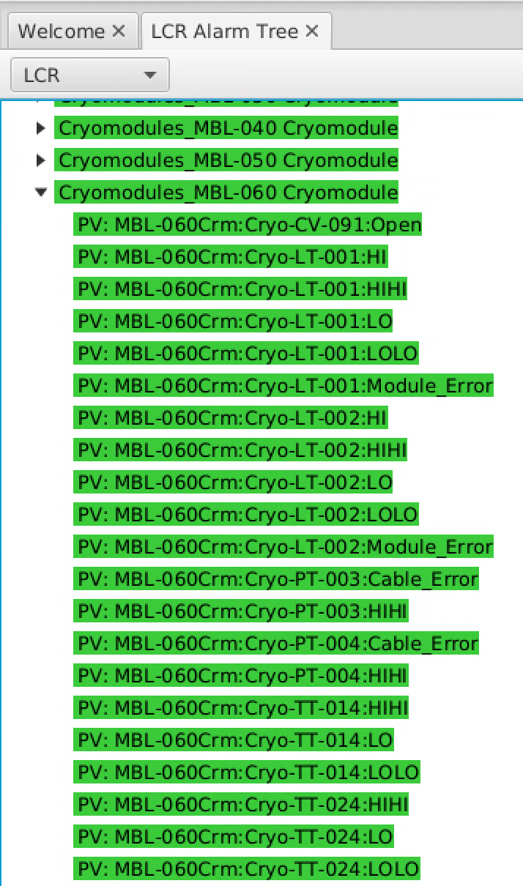
MCR docs and communication
Check list, docs, olog entries…
CDS and Cryomodules
ESS documents
Checklist for both CDS and CMs (https://confluence.ess.eu/display/AO/2024+Beam+Commissioning+up+to+BeamDump+%3A%3A%3A+Pre-Start+Checklists)
Subset of Cryo related alarms are in the LCR alarms configuration (Cryoplants + CMs) → monitored by MCR unless otherwise communicated during the day
Test reports (Cryo, ICS, SRF) and instructions in CHESS
Daily communication with MCR
Olog entries with instructions

Slide 11
Earlier recommendations
First time SAR for Cryo
Last review was the Cold coupler conditioning review (CCCR) before cooling down the SCL
Last remaining recommendation is a burst disc exchange procedure which is now drafted and in approval workflow in CHESS: ESS-5587333
Recommendations for CDS IRR and TRR all closed
Earlier recommendations not relevant anymore as systems are in ”as validated” state and fully functional

Slide 12
Finish presentation

