Slide 1
SAR4 ICS Software
Status of systems and verification

Slide 2
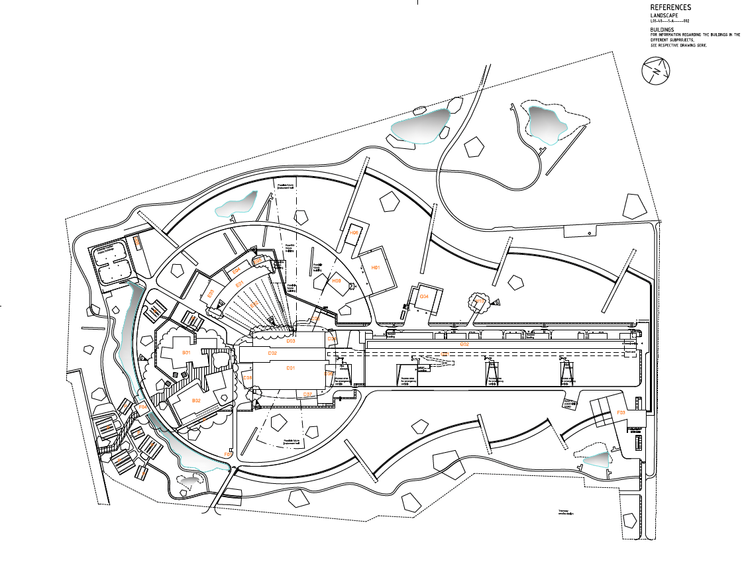
Introduction - Control system software scope
Control system software
The control system software scope is applicable to many functions of the integrated control system at ESS and thus does not have a well-defined physical location.
The ICS software portfolio consists of about 25 functions/deliverables critical for the function, reliability and efficiency of the facility.
In total the scope contains ~958 kLoC with ~798 kELoC

Slide 3
Type of Software Work Activity
Definitions
Development
A new requirement is needed for operation, currently not in scope of the current tools.
Funding has been acquired and allocated and resources assigned to implement it
Maintenance
A functionality is in operation. No increase in functionality is forseen
The service must be kept up to date in line with the eco-system and tool chain
Support
A functioning system requires changes or addition functionality as needed by operations. Includes debugging
The scope of the changes and timeline for implementation is matched to available resources
Prioritisation is managed
Legacy
Products that are in use but we will replace or deprecate

Slide 4
ICS SW Project, High Level
High Level Overview of Effort in 3 Sub-Topics
Management / Project (Overhead)
Configuration and Management Tools
Support
Maintenance
User Interface Applications and Services
Support
Maintenance
Operations Data Services
Support (Physics and Control Room)
Maintenance
Legacy
Now, 2024
2027-12-31
End of Construction
Beginning of Operation

Slide 5
Operations Software Services
Listed by category
User Interface Applications and Services
CS-Studio - Phoebus
OPI Panel builder, Alarm Service, Save and Restore, Super Cycle, Logbook
Public Operations Screens, ESSNotify, Sequencer, Fault Tracker
Operational Data Services
Archiver, Synchronous Data Service
Configuration and management tools
ESS EPICS Environment
CE-deployment, Channel finder, naming
Plcfactory, cable

Slide 6
CSStudio – Continuous Delivery
Current Setup of Workflow
Key:
Control Room Operators
Perceived Progress
ICS Software developers
Issues
Backlog
Community Feedback
IT DevOps Team
CS-Studio core developers (external to ESS)
Planning
ToDo
InProgress
Review
Community Review
Done
Product Release
DeployToTest
Validation
DeployToOps
Abs(unscaled Time)

Slide 7
CS-Studio, Deployment to MCR
Final steps of workflow to establish a production version in MCR
Currently used (production) phoebus release decided by operators
Operators trigger a switch from test to production after verification of changes
ICS Software team deploy regularly to the MCR test release through work orders
Details of each test release documented in confluence and tracked in ICS SW CS-Studio Jira board
Once a new production is established in MCR, a full site roll-out can be applied

Slide 8
Conclusion
CS-Studio and other services are working and in production
Operational Sequencer is deployed as initial minimal working product
Fault Tracker is a new tool available in test mode
Documentations about the systems available on confluence
Training courses are available on ESS EPICS and soon, using CS-Studio
Key challenges:
Managing ongoing requests for changes and updates
Balancing community collaboration with ESS needs

Slide 10
Lines of Code (LOC)
Illustrating the Scale of complexity in modern programming
Individual ability to manage lines of code 10-100k
ICS SW group ~1M
Software Frameworks:
React – 100k
Sprintboot 1.2M
Django 500k
Small web app 500k
Mobile app 1M
Large web app up to 10M
Enterprise Software up to 50M
Operating System or Gaming system up to 100M

