Slide 1
SAR4 - Infrastructure and Services
Status of services, verification and validation
PRESENTED BY Remy Mudingay, IT Infrastructure & Operations Group

Slide 2
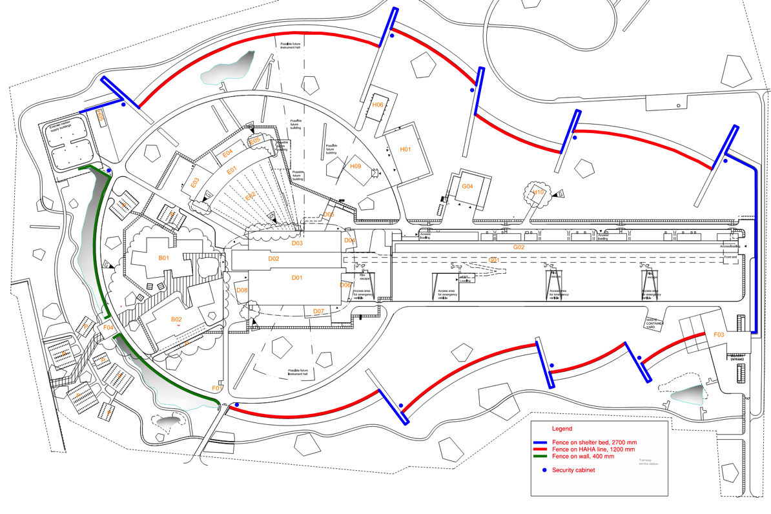
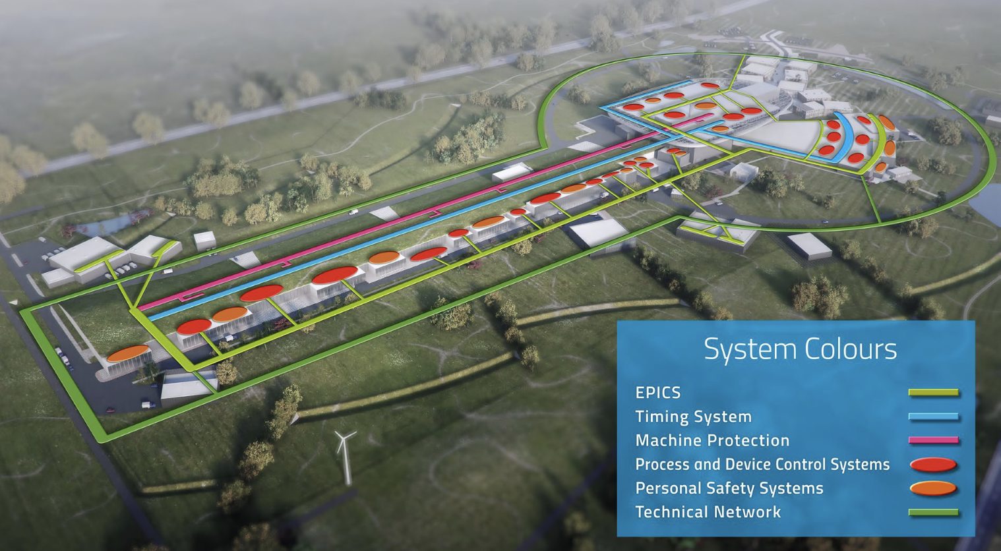
Core Compute resources are infrastructure elements
ESS Central Server hall
MCR Server room
- 2.24 PB storage
- 4.9 PB backup
- 2000 virtual machines
Linac Controls Network, Timing, PLC remote IO networks
- 6000 IP devices
Remote access tools
Directory services
Firewall and security tools
Monitoring system resources
GPS NTP
2025-02-04

Slide 3
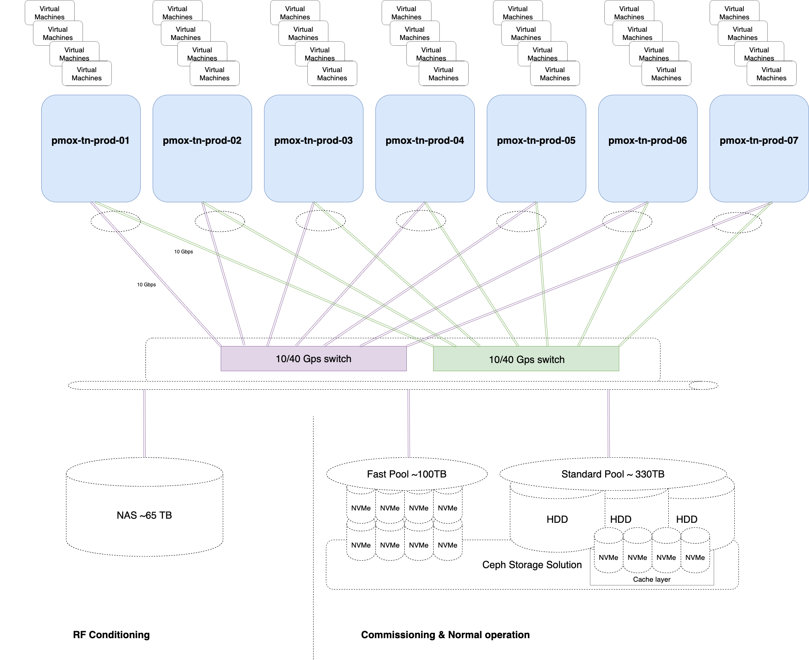
Verification reports
ESS-2915516 Controls Infrastructure Verification Report
Network performance
5.76 Tbps (bidirectional) through capacity
100ms maximum latency per port
Storage performance
Global Storage throughput 38.3 Gbps (4.7 GB/s)
Input / Output write operations 65.6K IOPS
* Benchmark conducted in 2021

Slide 4
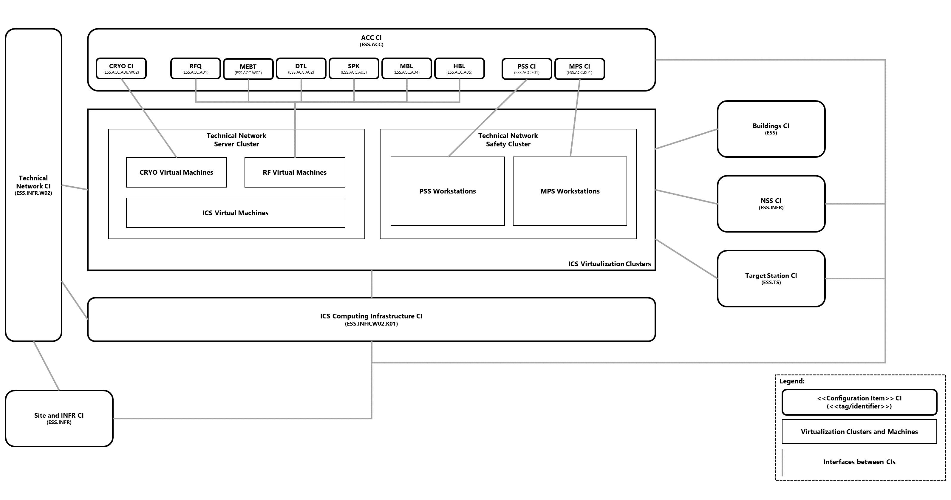
Computing Infrastructure
CIDL CI OS-0000039

Slide 5
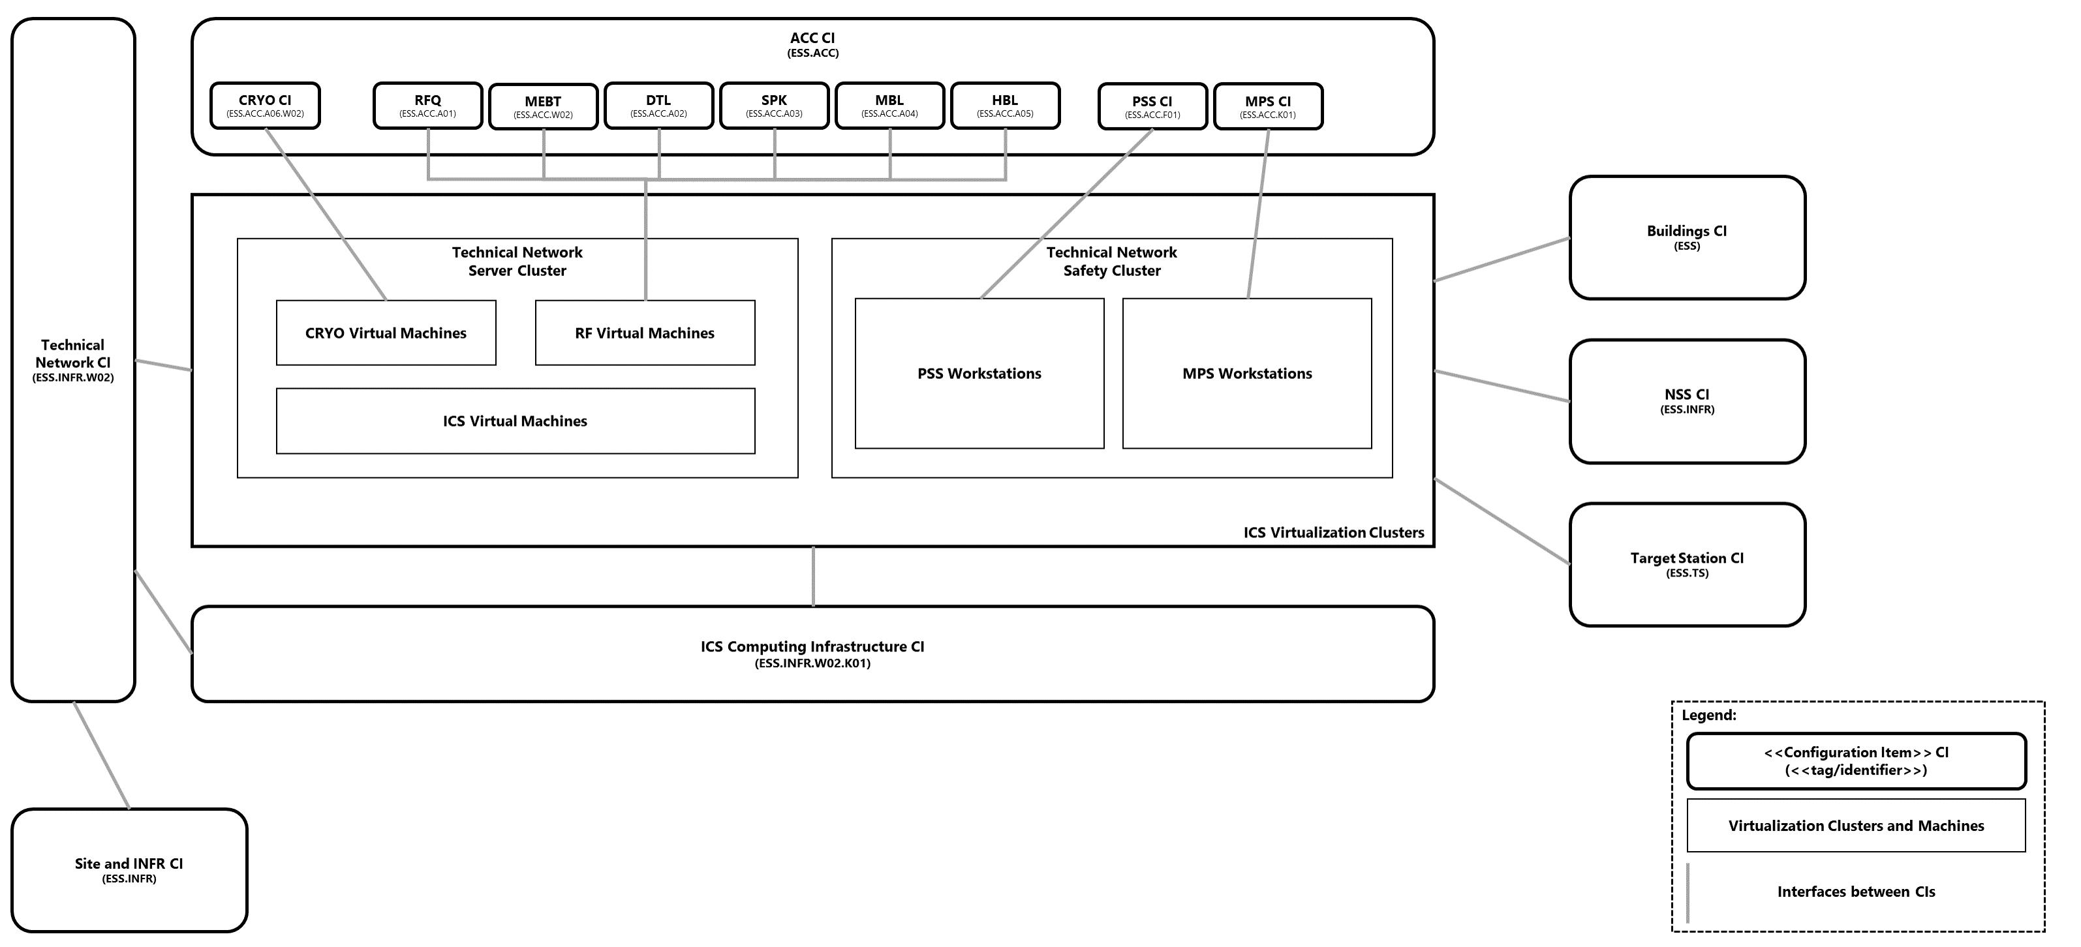
Technical Network
CIDL CI OS-0000038

Slide 6
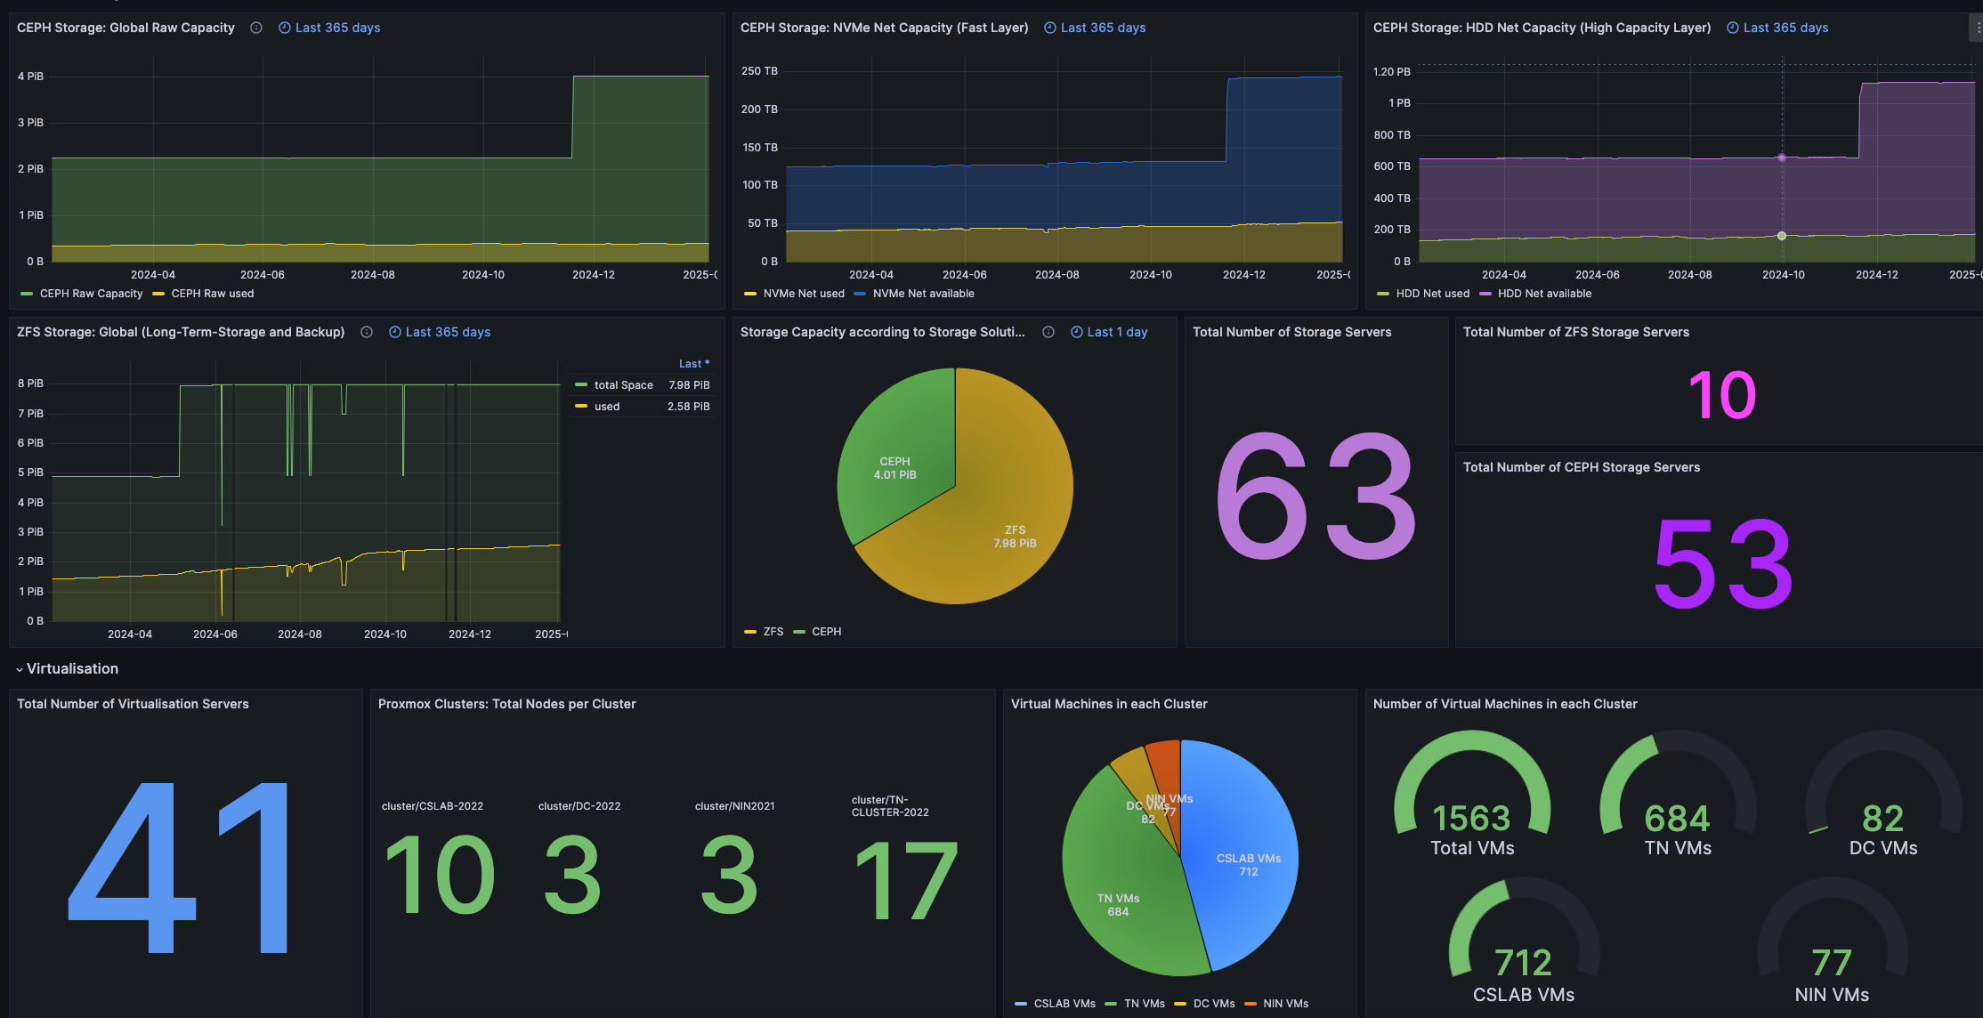
Computing & Storage Performance Metrics

Slide 7
Network Performance Metrics
~ 20 Gbps throughput
~ 1 Million pps
160 Mbps of broadcast traffic

Slide 8
Summary
On call since 2019
Future procurement for network equipment needs to verify IP directed broadcast requirement for EPICS https://gitlab.esss.lu.se/ics-infrastructure/ipdirectedbroadcast
We believe that we are ready, despite the unknown storage I/O and throughput requirements
Upgrade timeline for the Network and Core is being evaluated – not yet planned
The network is 7 years old, and the manufacturer support is expected to end in 2027

