Slide 2
ACC PSS, ACC ODHDS & CB ODHDS
System Acceptance Review 5 (2025-02-04)
PRESENTED BY Morteza Mansouri
2025-02-04

Slide 3
1
ACC PSS

Slide 4
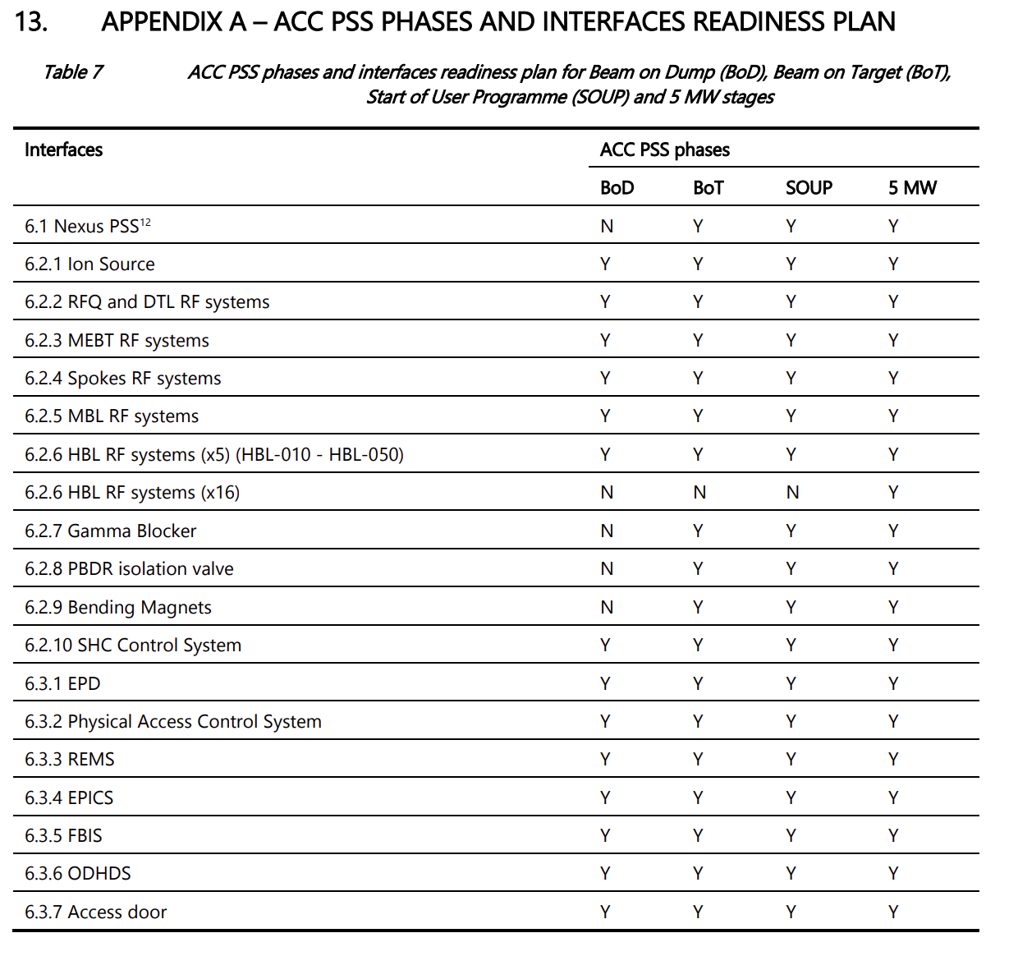
ACC PSS: Scope and status
The modulator for HBL-040 has been replaced. The ACC PSS interface with the modulator is re-installed, awaiting retest during weeks 6 & 7.
The ACC PSS integrated test with REMS is planned for maintenance days in weeks 8 & 9.





X



X





Slide 5
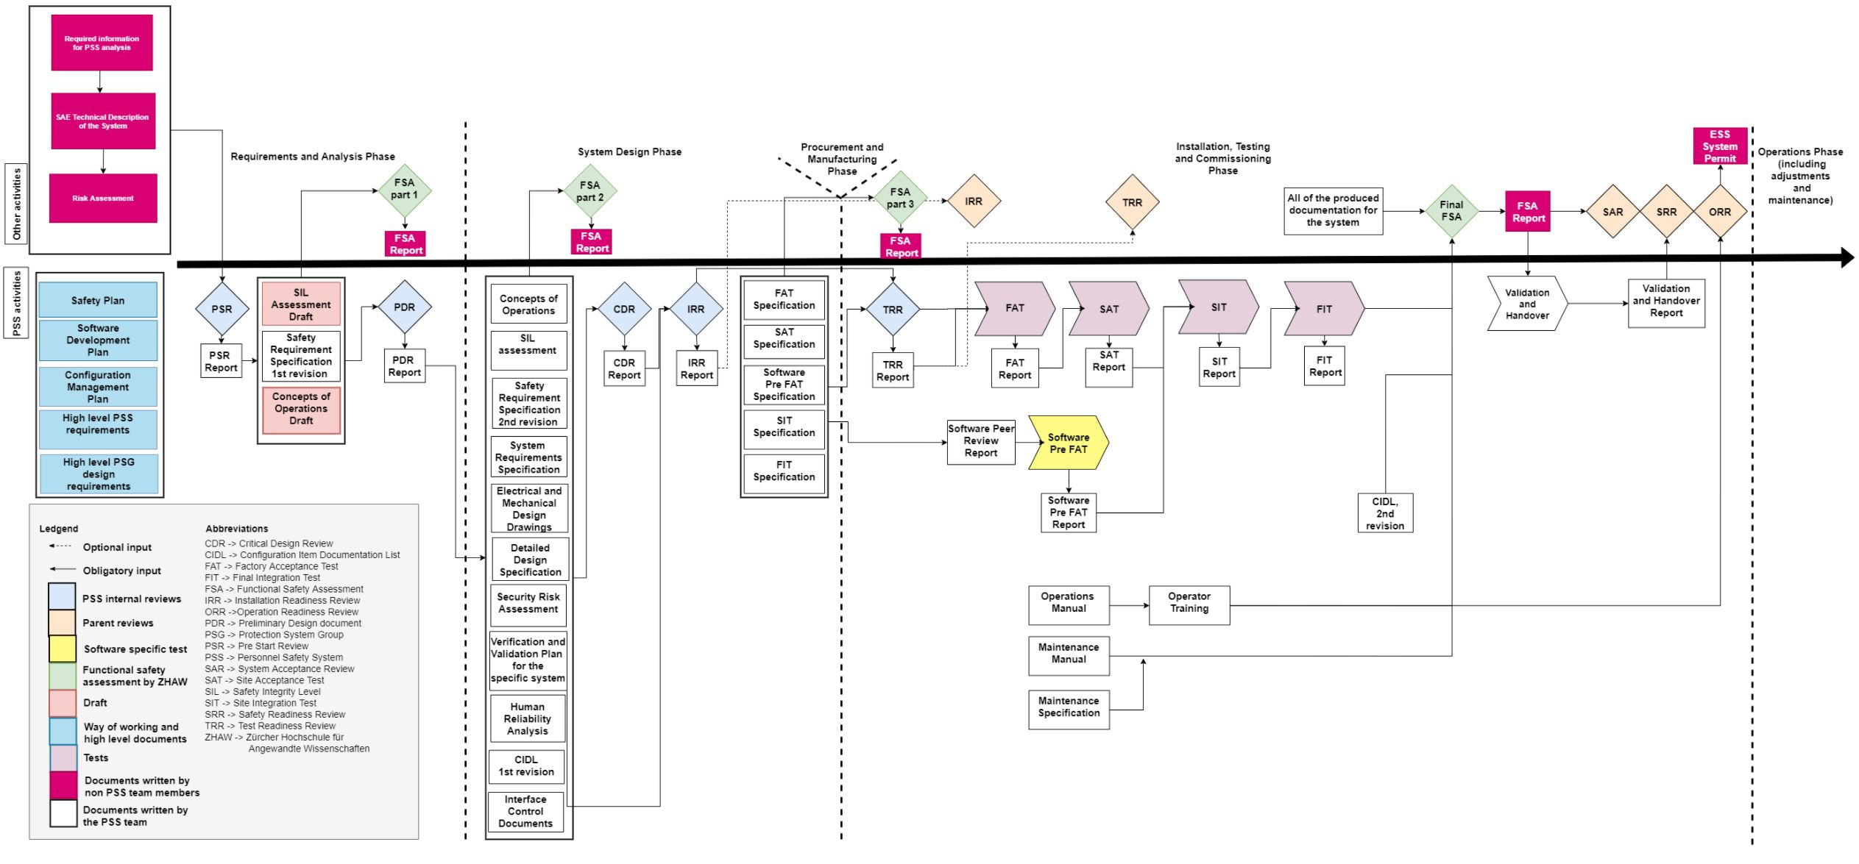
ACC PSS: current status
Post implementation review in the Risk index for Accelerator (ESS-3878402) should be completed by ACC
See back-up slide











Another rev. is required following the REMS test

Work in progress to prepare by SAR5 in EAM

Slide 6
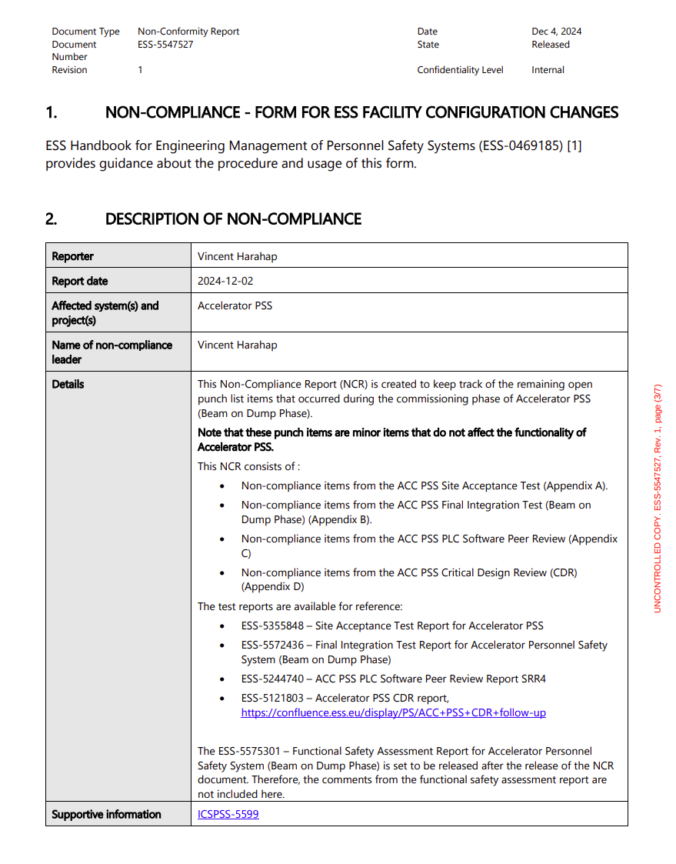
ACC PSS: non-compliances (ESS-5547527)

Slide 7
ACC PSS: non-compliances
Item | Comment
Non-compliances from the ACC PSS HWSAT report (ESS-5355848) | All critical items are addressed. Some equipment still missing the complete set of lables. see ICSPSS-5678
Non-compliances from the ACC PSS CDR report (ESS-5121803) | All critical items are addressed. The remaining items are the following: Two minor improvement to the ACC PSS SIL assessment Order spares for safety tokens Improve the quality of Risk index for Accelerator (ESS-3878402) by adding relevant reference analysis documentation (for accelerator division) See ACC PSS CDR Follow-up

Slide 8
ACC PSS: non-compliances
Item | Comment
Non-compliances from the ACC PSS SW peer-review report (ESS-5244740) | All critical items are addressed. The remaining items are the following: Improve quality of ACC PSS & Gamma Blocker ICD (ESS-3231606) Consider the proposal on how to implement ACCPSS_SIF6 See ICSPSS-5680
Non-compliances from the ACC PSS FIT report (ESS-5572436) | The critical remaining items are the following: Integrated test with REMS: The test shall be done prior to BoD. It is planned for maintenance days in weeks 8 & 9. CCR ESS-5540580 Installation of mirrors between the beamline and northern wall of the tunnel to facilitate search: Installation is ongoing and will be completed in weeks 6 & 7. Improvement of lighting between beamline and the northern wall of the tunnel to facilitate search: Approval from RP to keep temporary lights during BoD operation. Permanent lighting will in place prior to BoT. See ICSPSS-5679

Slide 9
ACC PSS: CCRs & further improvements
Item | Comment
Reverification of ACC PSS interface with HBL-040 modulator | The interface box is re-installed, awaiting retest during weeks 6 & 7. CCR ESS-5594536
Improve the occupancy counter function of ACC PSS | The occupancy counter of ACC PSS is automatically reset to zero upon losing integrity of access control to the area (e.g. an e-exit door is open). ACC PSS will be updated to make this reset manually instead, in order to enable operators to reset the counter considering the access status, and number of individuals still in the tunnel. The update is planned for weeks 6 &7. See ICSPSS-5889 CCR ESS-5604777
Address issue with PAS | We have recently observed issues with person stuck inside PAS during entry or exit cycles. PAS sensors will be adjusted to improve the situation. The update is planned for weeks 6 &7. See ICSPSS-5642

Slide 10
ACC PSS: CIDL
See OS-0000011

Slide 11
2
ACC ODHDS & CB ODHDS

Slide 12
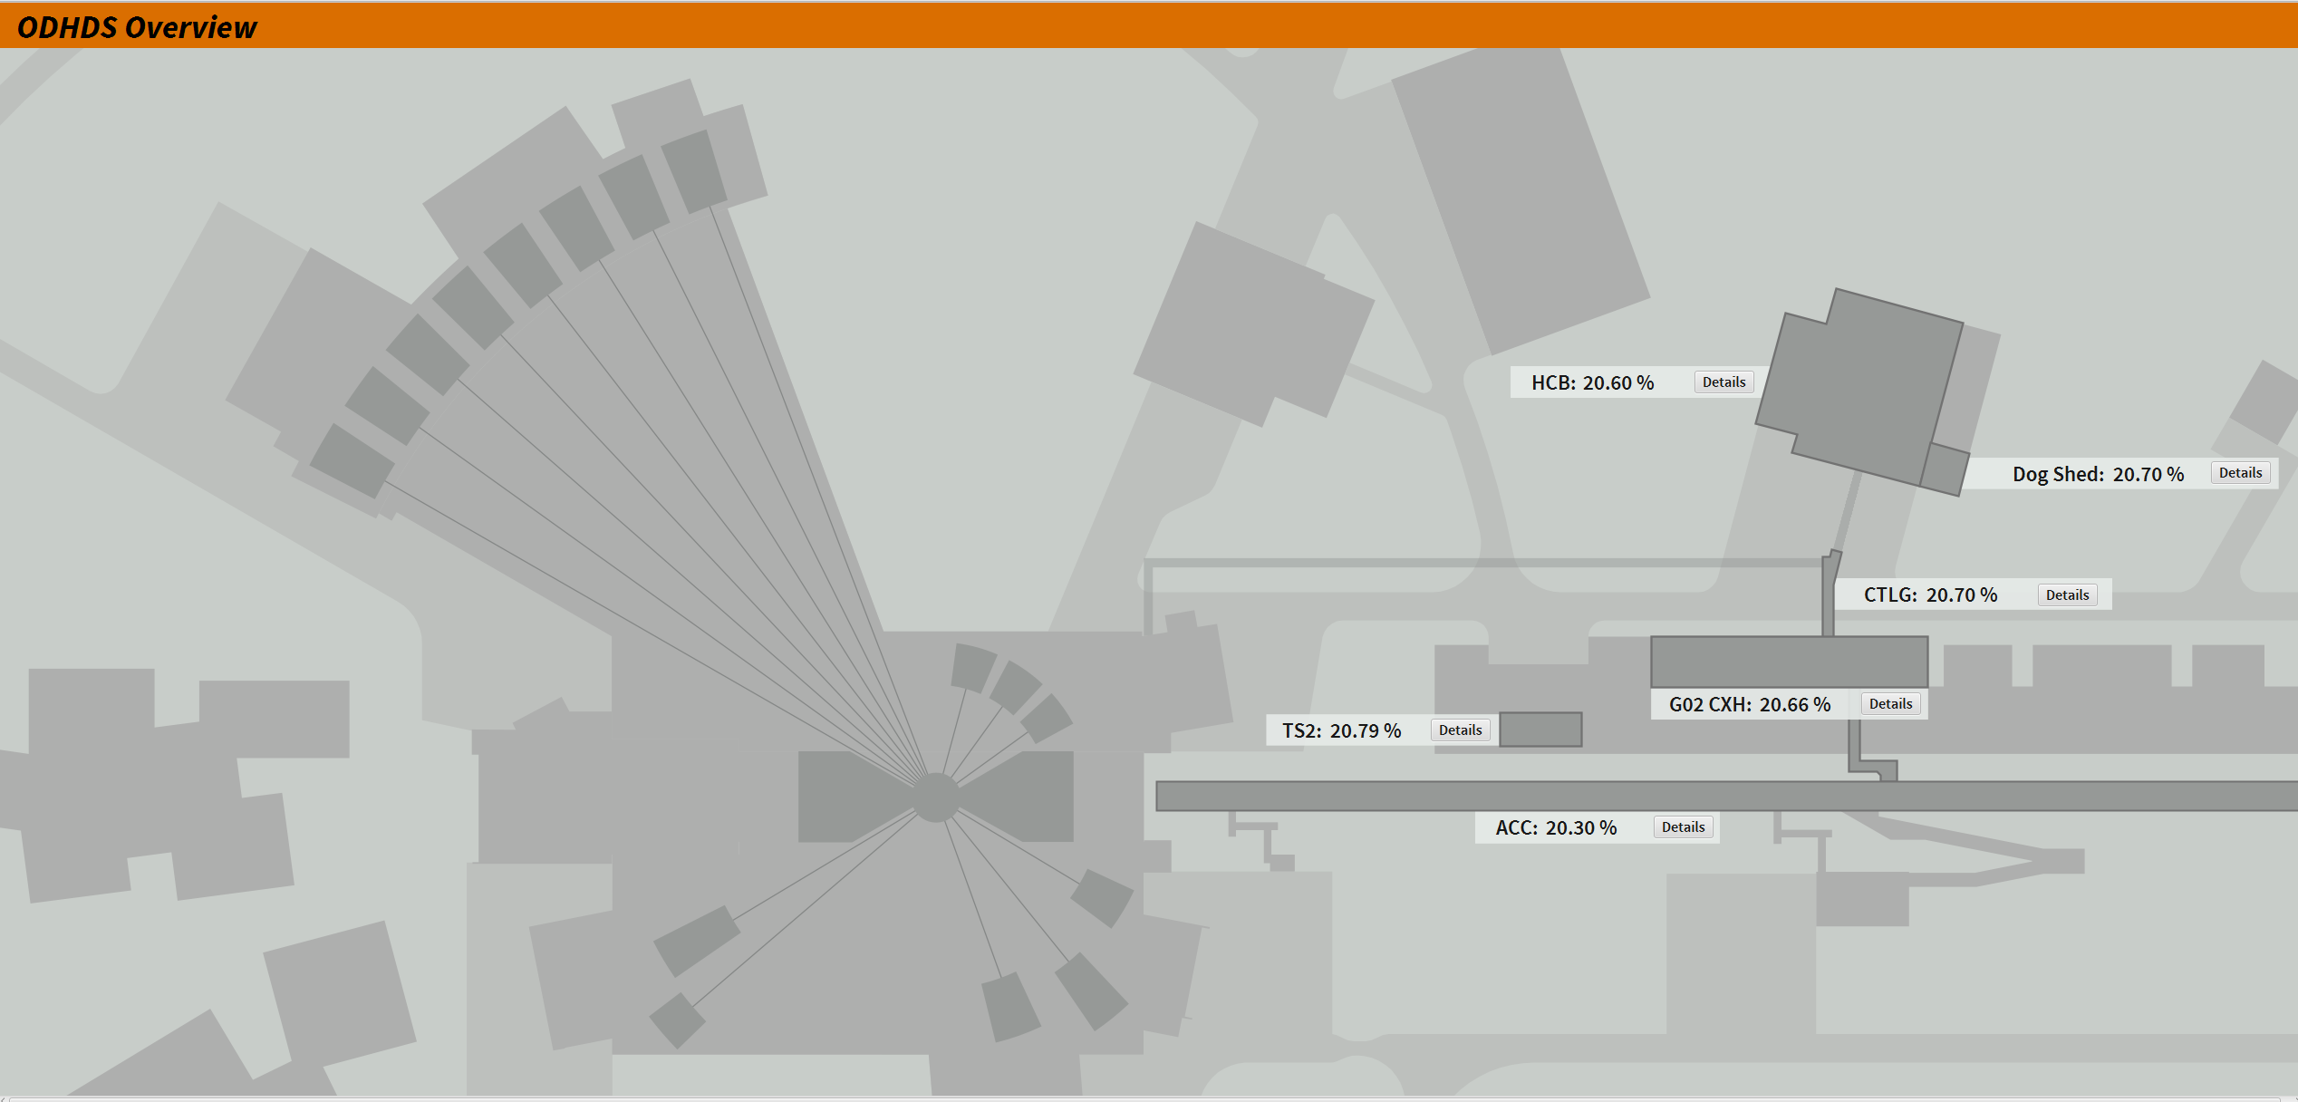
GDS: CB ODHDS & ACC ODHDS
CB ODHDS
ACC ODHDS

Slide 13
ACC ODHDS & CB ODHDS: Interfaces
CB ODHDS
ACC ODHDS
Interface | Status
EPICS
Fire alarm system (Sepura radio, AVARN)
TS2 PSS
Interface | Status
EPICS
Fire alarm system (Sepura radio, AVARN)
ACC PSS







Slide 14
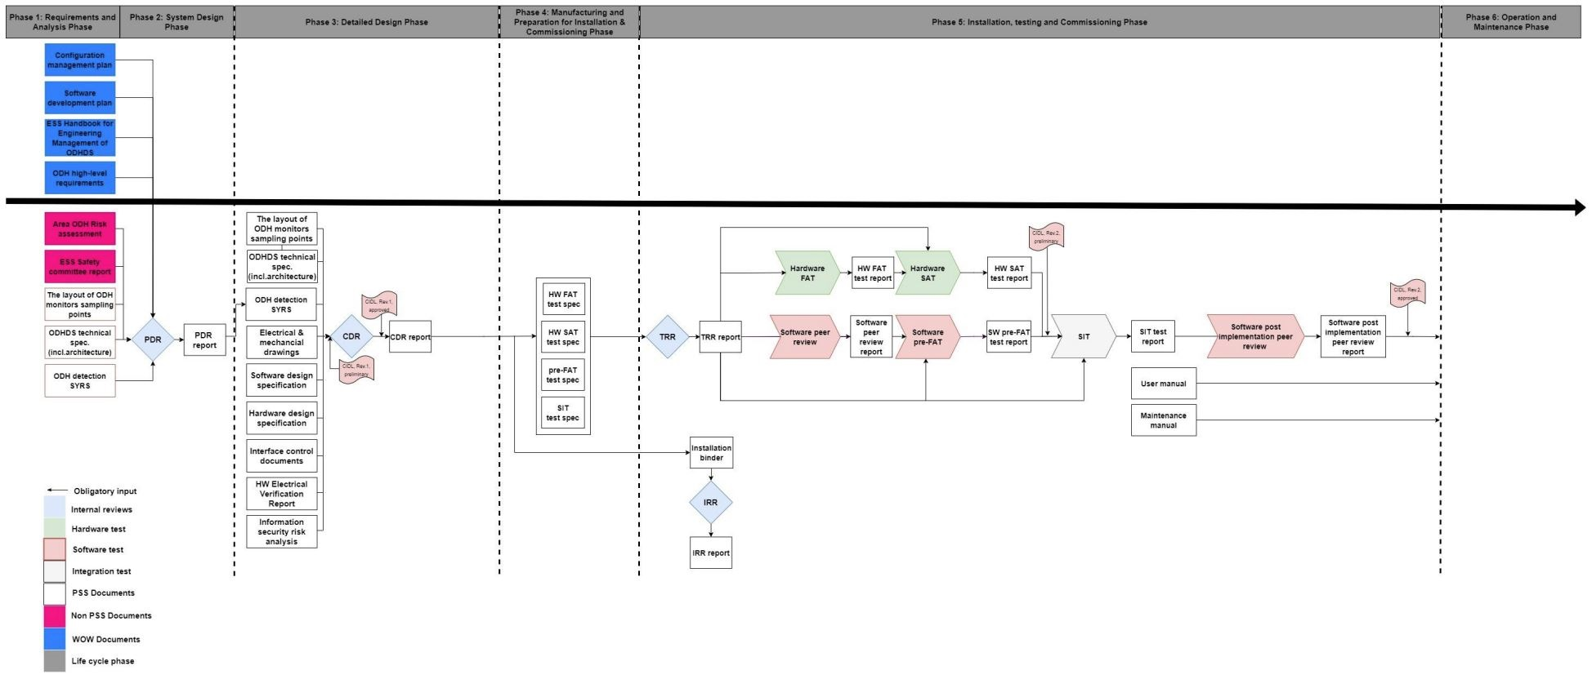
ACC ODHDS & CB ODHDS status









Work in progress to prepare maintenance specs in EAM by SAR5
Action items are addressed. See ACC ODHDS CDR Follow-up

Slide 15
ACC ODHDS & CB ODHDS: CIDLs
For CB ODHDS see OS-0000091
For ACC ODHDS see OS-0000092

Slide 16
Thank you! Questions?

Slide 17
Back-up slides

Slide 18
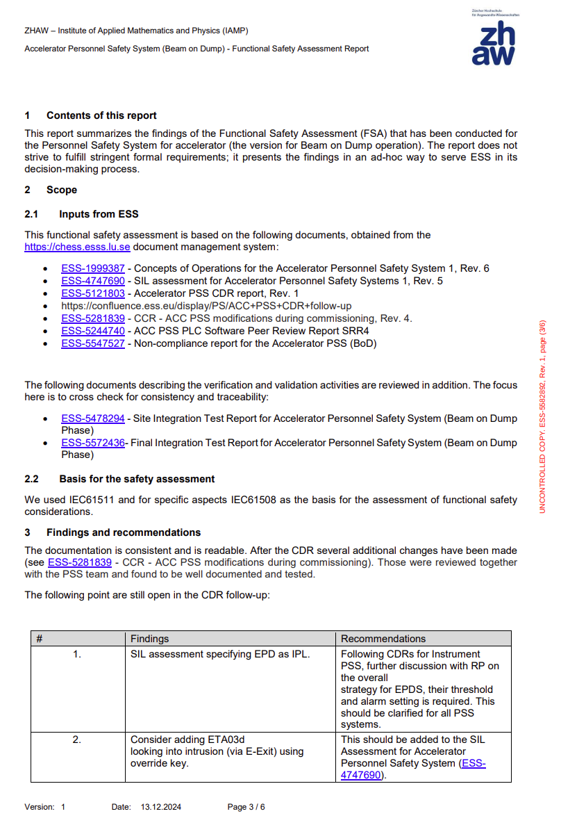
ACC PSS: FSA findings

Slide 19
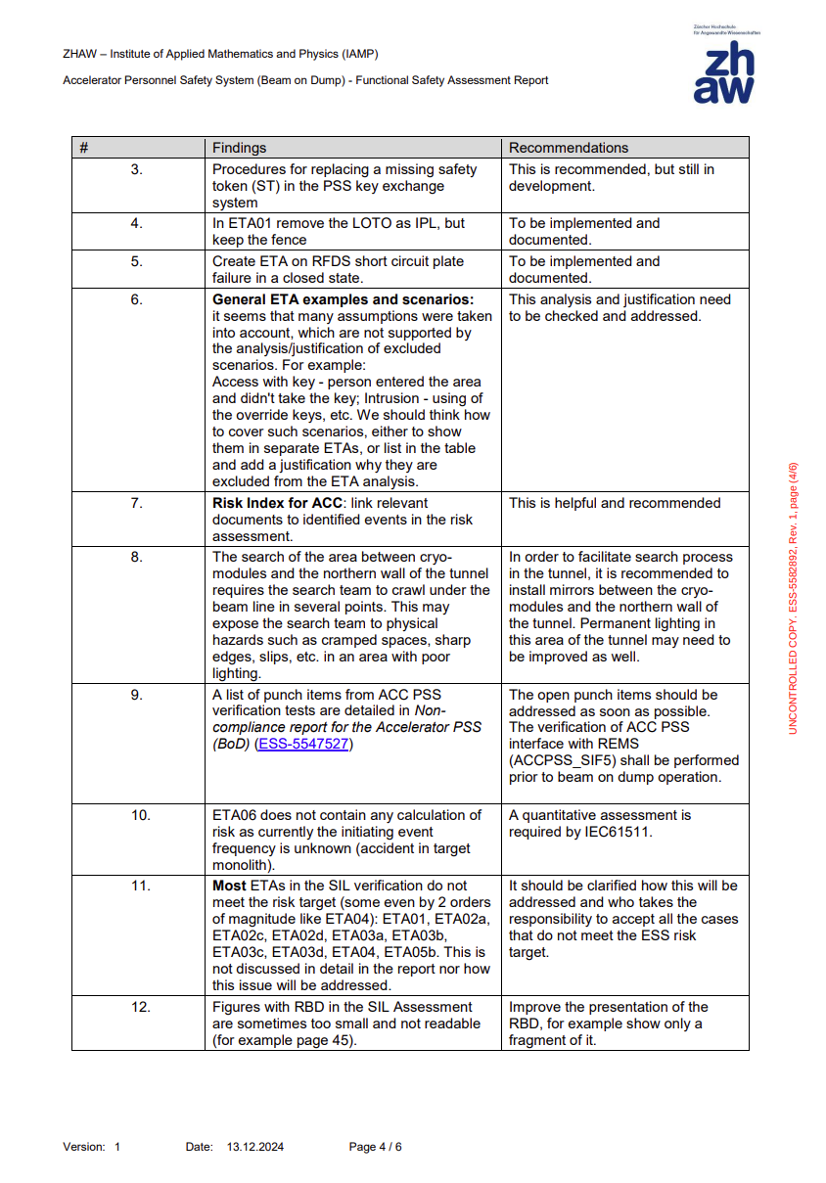
ACC PSS: FSA findings

Slide 20
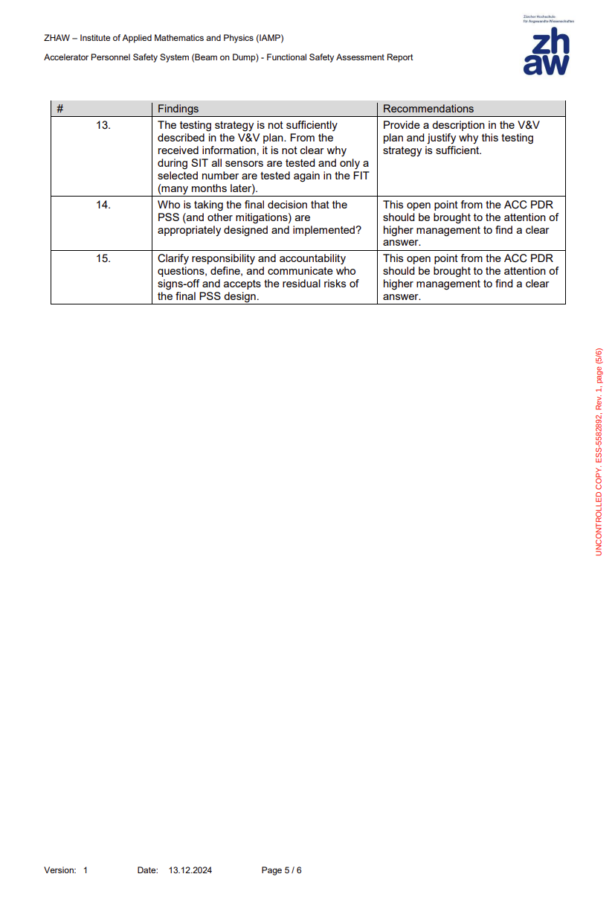
ACC PSS: FSA findings

