Slide 1
Agenda SAR4 Facility
1 Electrical infrastructure (=ESS.INFR.W01) – Dan Jensen
2 Cooling (=ESS.INFR.W04) and instrument air (=ESS.INFR.W05) – Björn Eldvall
3 HVAC, heating, ventilation, AC (=ESS.INFR.G01.G01) – Lars Persson
4 Fire safety (=ESS.INFR.FM01) fire alarm / sprinkler – Lars Oskarsson
5 Fire sealing (e.g. =ESS.INFR.U04.U01.U02.A01) – Lars Oskarsson

Slide 2
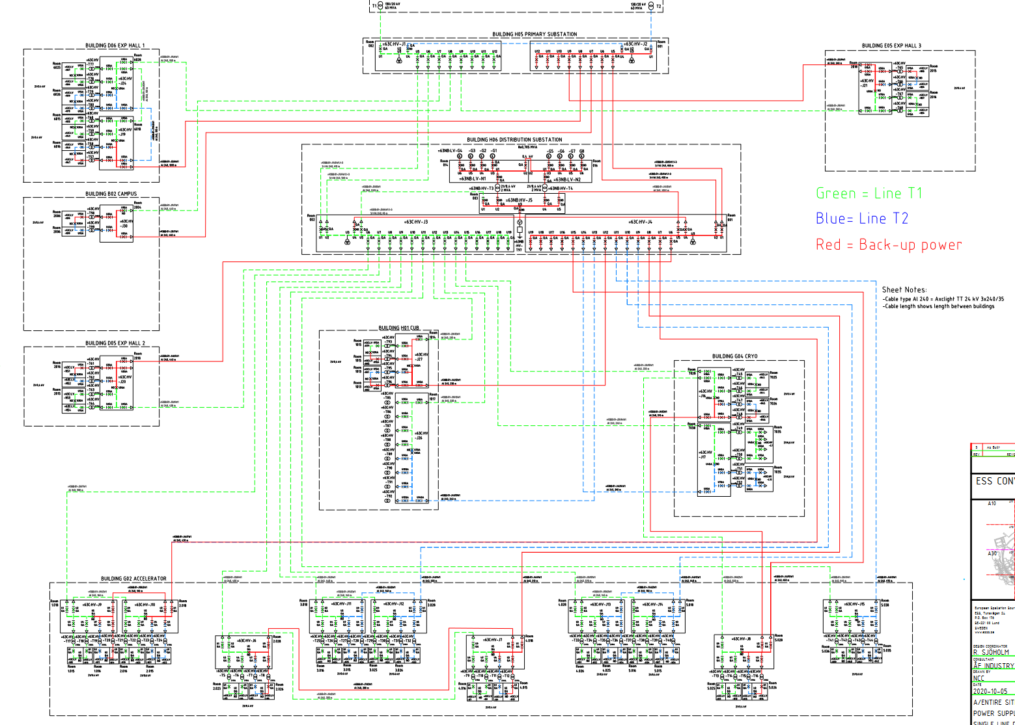
Electrical infrastructure
((=(ESS.INFR.W01)
SCOPE
Incoming 21kV via H05 primary subst and H06 distribution subst to 78 transformers in electrical substions and then to distribution panels around the site.
Also including diesel backup, lighting and power control system.
ESS-2705778 Single line diagram back-up power
STATUS
In operation. See CIDL OS-0000019 (Electrical Power Distribution and OS-0000096 (LV distribution G buildings)
ISSUES
Disturbances on incoming networks from Kraftringen and EON which can stop production.
SSCI2S
Service group: Surge protection device on LV N18 and N14 (classified in ESS-4837895).
HVAC: Power distribution panels (N11N1, N48N5) for G01 tunnel (classified in ESS-4905342).
OTHER
On-call 24/7, 1 electrical technician
TESTING
Preventive maintenance is ongoing on a daily basis EAM schedules (input listed in ESS-3071519).
ESS-3184159 is maintenance plan for Accelerator.
Regular partial discharge (PD) and thermographic testing to early detect issues.
Operation of power supply described in ESS-1109708.

Slide 3
Cooling water and instrument air (IAR)
(=ESS.INFR.W04), (=ESS.INFR.W05)
High Beta
Medium Beta
Low Beta
SCOPE
CWH, CWM and CWL from H01 CUB and return. Delivery points in G02 Gallery Building. Instrument air (IAR) from compressors in D05, G02 and G04 (common loop) and B02 (local loop, no redundancy).
STATUS
In operation, with limited capacity of CWH and CWM in G02 due to ongoing change in cooling substations (CCR ESS-4747642). CIDL OS-0000124 (CWH), OS-0000125 (CWM), OS-0000126 (CWL), OS-0000123 (IAR).
CW Risk assessment (pressurised) ESS-3919081, IAR Risk assessment ESS-5604141.
ISSUES
Investigation for increasing redundancy for G04 Cryo Compressor to support higher availability. Ongoing investigation for too high level of oxygen in CWH. Closed permanent NCR 10457 (CWH) and 10458 (CWM) related to not following ESS design rules. Ongoing NCR 10503 (CWH) and 10502 (CWM).
SSCI2S
N/A
OTHER
On-call 24/7, 1 mechanical technician
TESTING
Supporting the accelerator cooling commissioning. Ongoing discussions about receiving systems (skids). Maintenance partly managed in EAM (ongoing work).

Slide 4
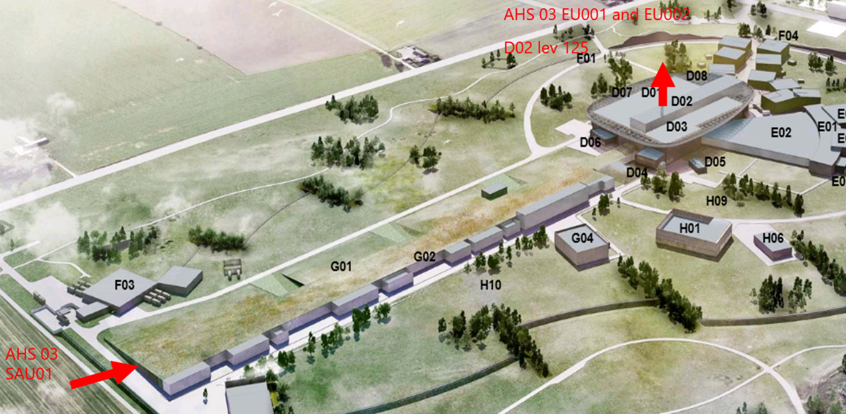
HVAC (heating, ventilation, air-conditioning)
(=ESS.INFR.G01.G01)
SCOPE
Ventilation in G01 Tunnel with controlled temperature and humidity of supply air. Controlled exhaust through D02 Stack with HEPA filters.
Ventilation in G02 Gallery Building. Cooling of racks.
STATUS
In operation. Pressure test performed. CIDL OS-0000052.
ISSUES
Rack cooling: Moisture creates water issues. Ongoing installation of trays to control the water.
SSCI2S
3 RSF: 1 Confine activated air, 2 control emission, 3 limit inventory.
Ventilation system G01 (=ESS.INFR.G01.G01.G01.G01.F01) including control systems (classified in ESS-4905342).
OTHER
On-call 24/7, 1 mechanical technician (same as cooling)
TESTING
All maintenance in EAM.
Operation Manual G01 HVAC: ESS-5401743

Slide 5
Fire safety – fire alarm
(=ESS.INFR.FM01)
SCOPE
Detect fire, evacuate people and alarm.
Smoke detectors and aspiration system, including evacuation alarm.
STATUS
In operation. See CIDL OS-0000027
ISSUES
N/A
SSCI2S
Service group: G01 fire alarm system (=ESS.INFR.FM01.FM02.P01) (classified in ESS-4837895)
OTHER
N/A
TESTING
Regularly tested according to SBF 110:6, see ESS-0147093 Systematic Fire and Explosion Prevention.

Slide 6
Fire safety – sprinkler
(=ESS.INFR.FM01)
SCOPE
Detect and control fire to avoid manual intervention. System fed from H10 sprinkler building, with 2 tanks of total 850m³.
Sprinkler G01 Tunnel: Pre-action system with dry pipes. Activation requires both heat and smoke. G02 Gallery Building: Standard wet system.
STATUS
In operation. See CIDL OS-0000027.
ISSUES
Sprinkler in Tunnel: SRR-50 and insurance company remark about effectiveness, Planned updates to change sprinkler heads and increase coverage in FEB part of tunnel. See report in ESS-4795207. Remarks from 3rd party about blocked coverage.
SSCI2S
Service group: G01 sprinkler system (=ESS.INFR.FM01.FM02.FM01), Fire fighting system H10 (=ESS.INFR.FM01.FM01).
OTHER
N/A
TESTING
Regularly tested, including 3rd party, according to SBF 120:8, see ESS-0147093 Systematic Fire and Explosion Prevention.

Slide 7
Fire sealing
(e.g. =ESS.INFR.U04.U01.U02.A01)
SCOPE
The purpose is to maintain the fire cells and provide air tightness for supporting under-pressure in the tunnel
STATUS
The sealings are installed and approved. Inspection report: ESS-5590860
ISSUES
No defined routine for opening up / re-close sealings.
SSCI2S
The sealings are part of the SSCI2S G01 tunnel concrete structures related to RSF-C-ACC-L1-009_Confine_ (classified in ESS-4837895).
OTHER
The stubs are in the FBS: =ESS.INFR.U04.U01.U02, LBS in both G01 and G02
TESTING
All openings of sealings shall be approved. Sealings shall be inspected by RP before operation, routine for this still to be implemented.

Slide 8
Finish presentation

