Slide 1
SAR4 – Shielding
PRESENTED BY Wolfgang Hees, Lena Johansson (RP)

Slide 2
1. Brief scope description
This presentation combines scope from Accelerator and Target.
The scope for SAR4 includes the following shielding (from ESS-0357253 - ESS Operational Limits and Conditions Rev 14):
FEB Chicane Wall (=ESS.ACC.F03.F01)
Drop Hatch Shielding (=ESS.ACC.F03.F02)
FEB Penetrations Shielding (=ESS.ACC.F03.F03)
Alignment Penetrations Shielding (=ESS.ACC.F03.F04)
Stub Extensive Shielding (=ESS.ACC.F03.F05)
CTL Gallery Wall (=ESS.ACC.F03.F06)
Stub Lower Shielding (=ESS.ACC.F03.F07)
Tuning Beam Dump shielding (=ESS.ACC.W04.R01)
Neutron Shield Wall (=ESS.TS.SSS.F01.F03.F06.F02.F03)
ACCSYS scope
600 t
600 kEUR
6 y
Target scope

Slide 3
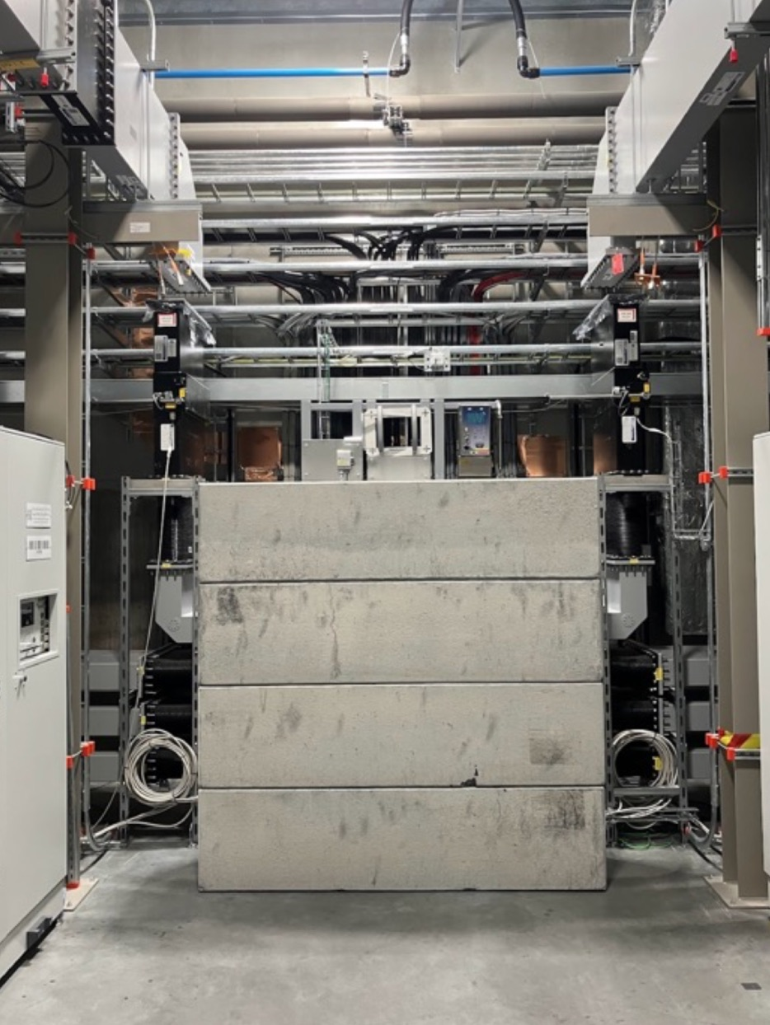
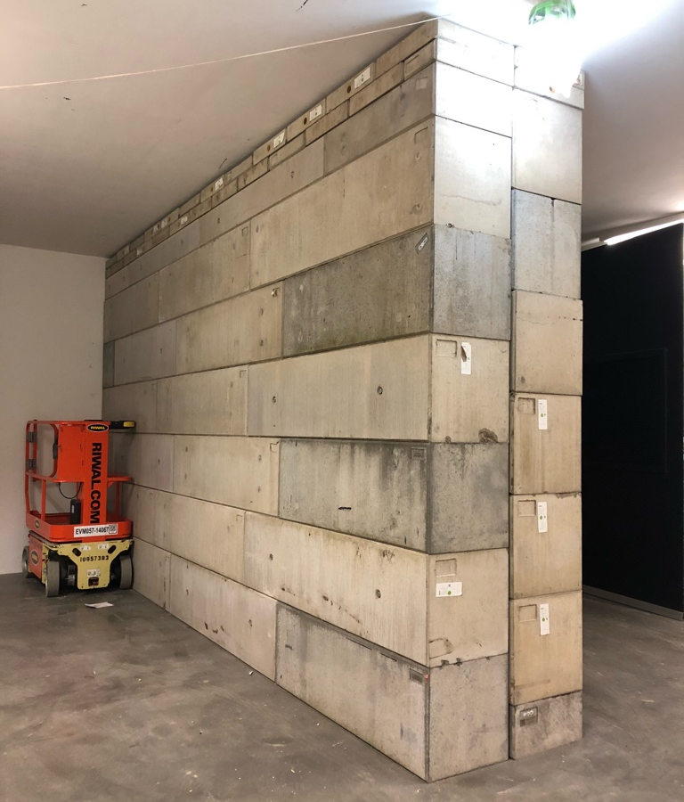
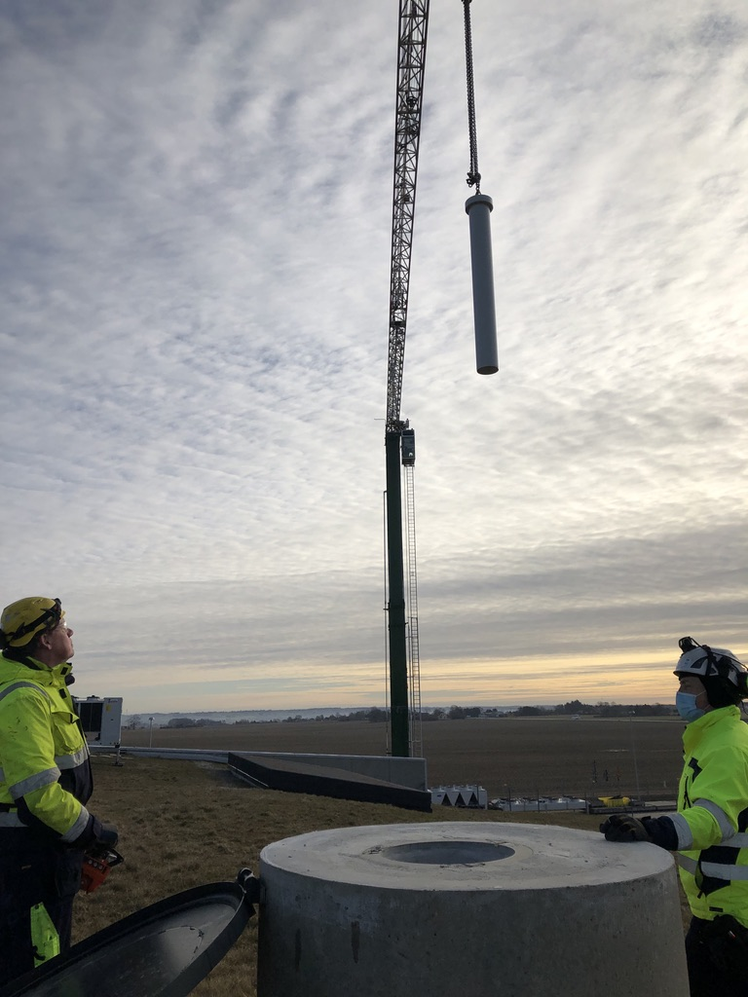
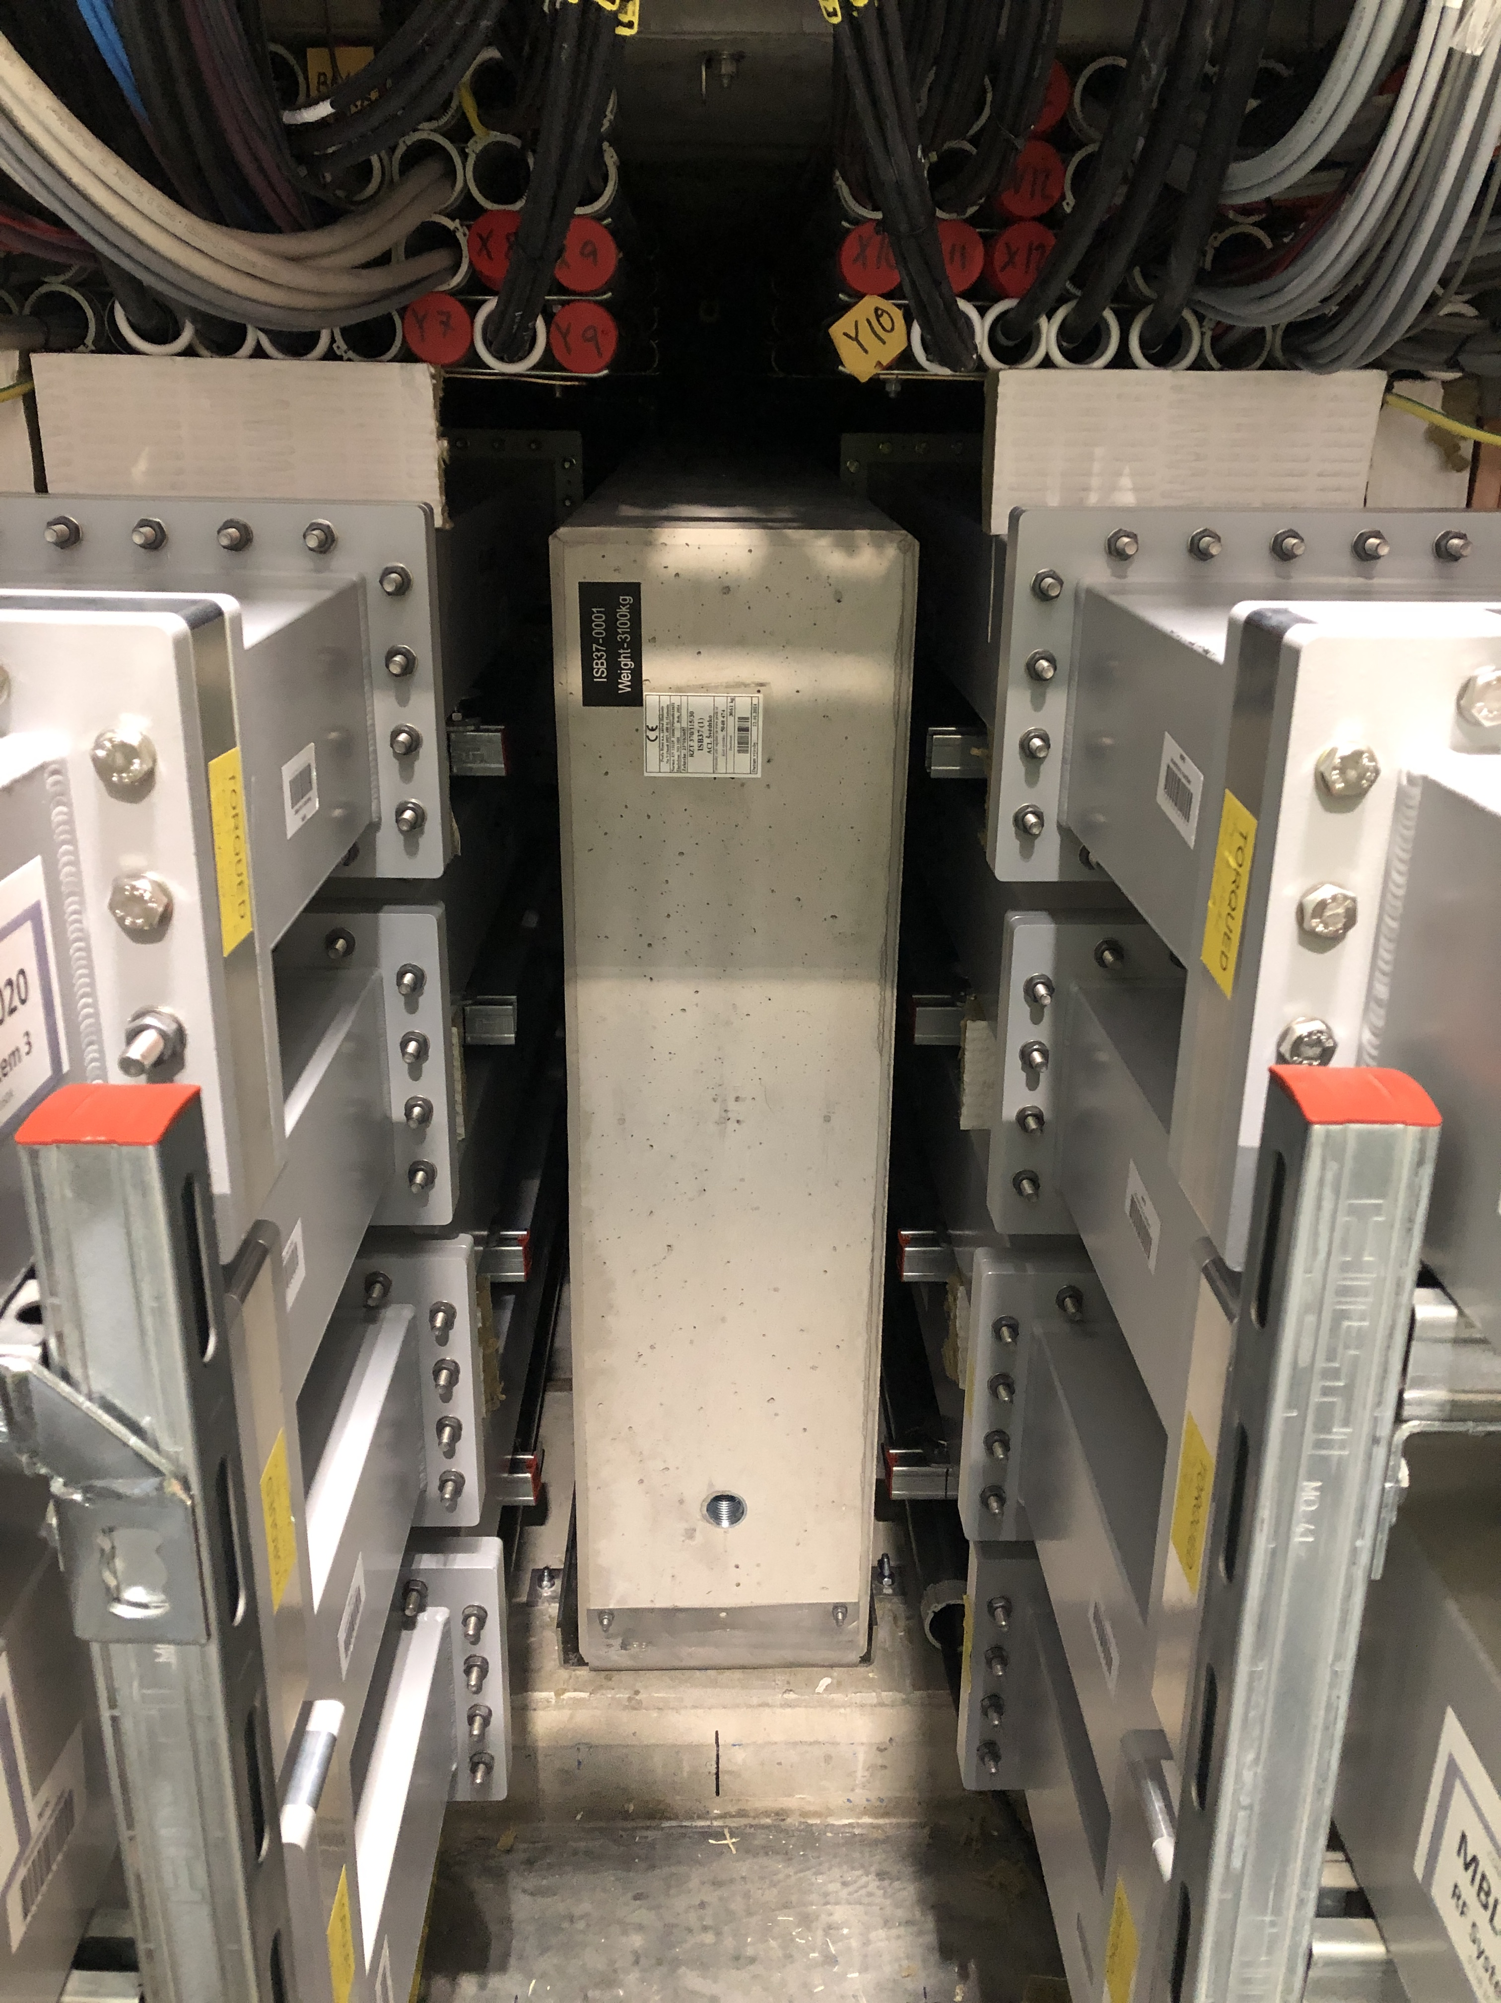
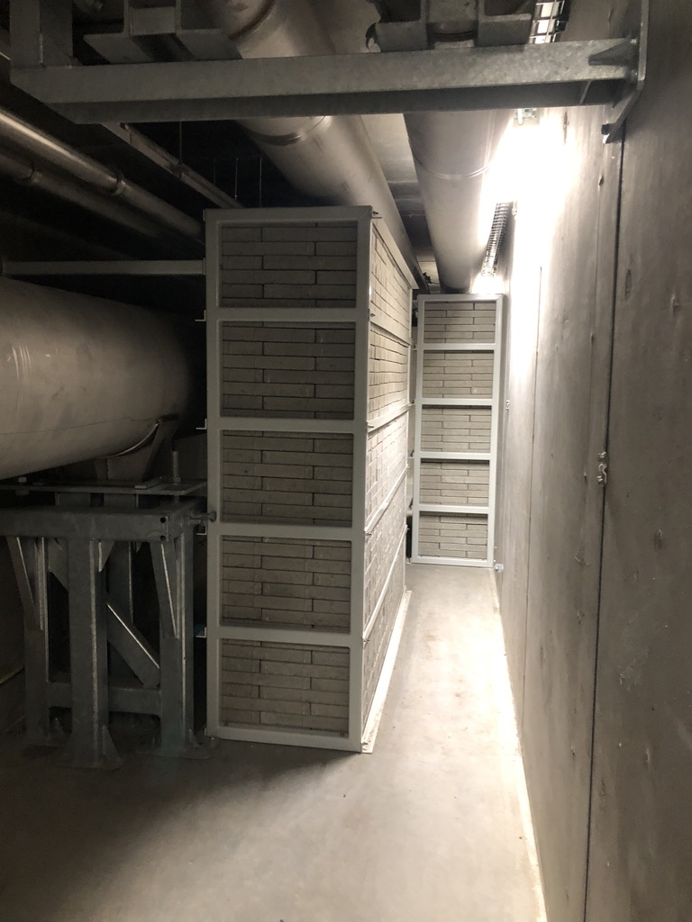
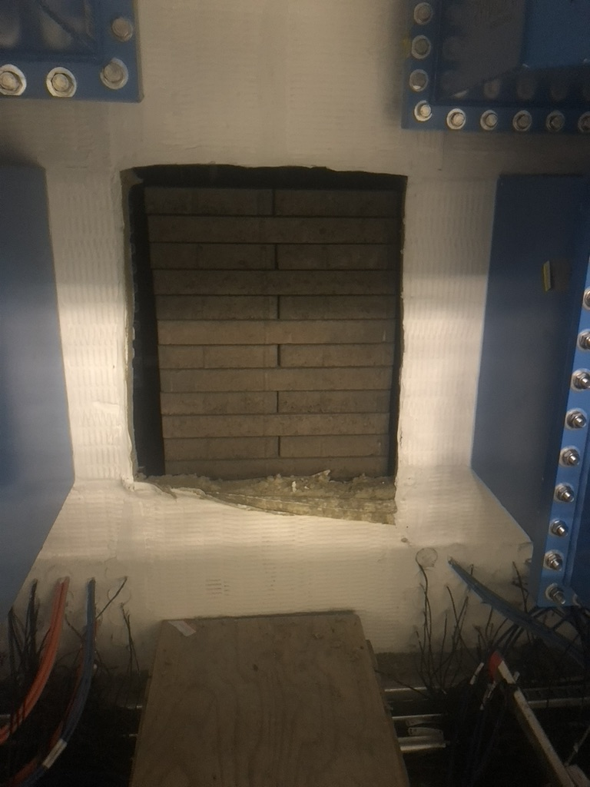
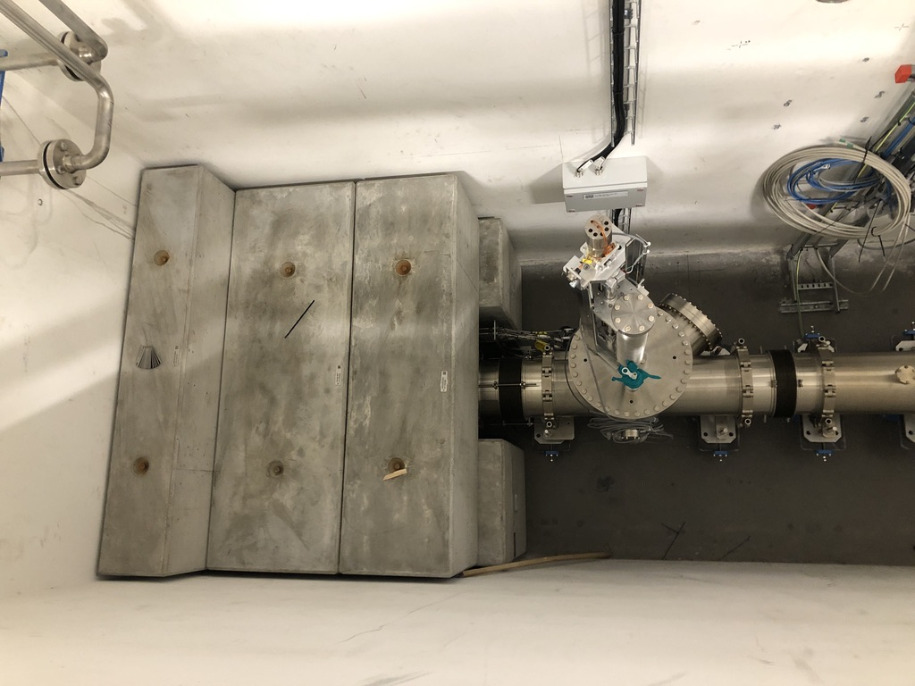
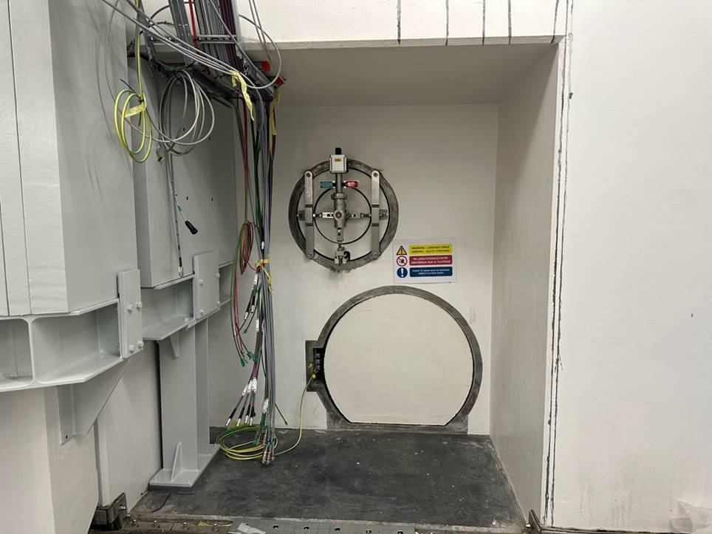
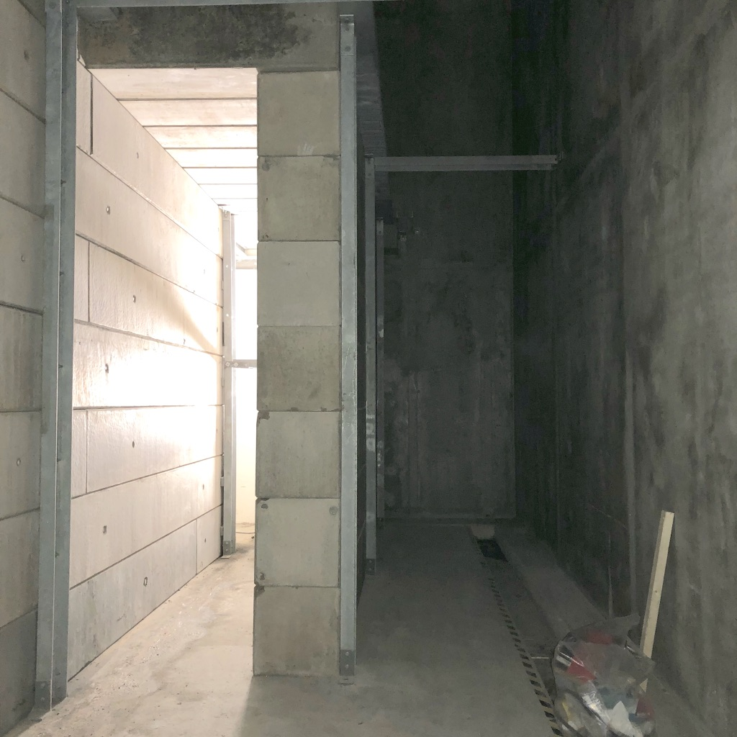
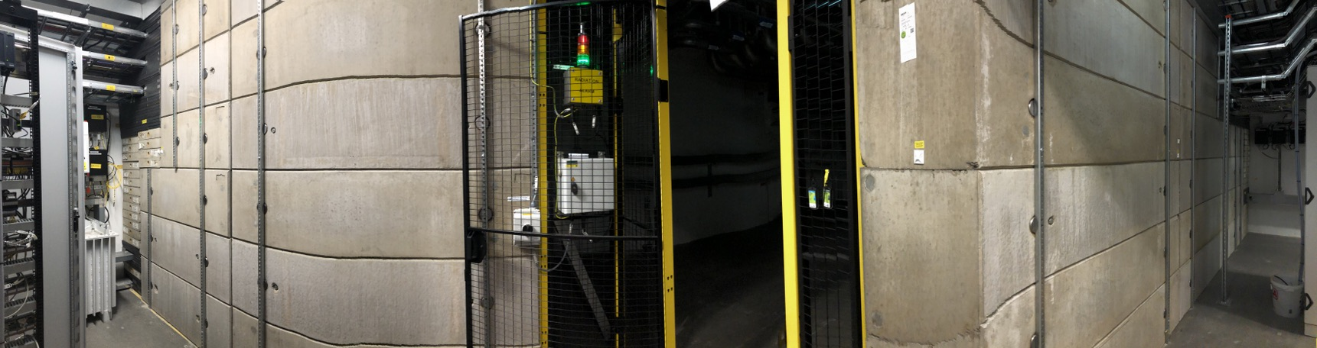
FCW
APS
CGW
SES
SLS
DHS
BLS
NSW
FPS

Slide 4
2. Brief status of the systems
All systems have been installed and verified by RP, see verification report ESS-5590904.
3. Status of documentation
All documents are available and released.
shielding part | functional specification | calculation report | FBS / drawings | quality protocol | installation report
FCW | ESS-3438643 | ESS-1401292 | ESS.ACC.F03.F01 | ESS-3153062 | ESS-3440028
DHS | ESS-3439008 | ESS-1401292 | ESS.ACC.F03.F02 | ESS-3145703 | ESS-3439959
FPS | ESS-3439233 | ESS-1401292 | ESS.ACC.F03.F03 | ESS-3159437 | ESS-3440025
APS | ESS-3439234 | ESS-1401292 | ESS.ACC.F03.F04 | ESS-3210480 | ESS-3439958
SES | ESS-4924408 | ESS-1401292 | ESS.ACC.F03.F05 | ESS-5266103 | ESS-5590902
CGW | ESS-4923746 | ESS-1401292 | ESS.ACC.F03.F06 | ESS-5590370 | ESS-5545688
SLS | ESS-4803804 | ESS-1401292 | ESS.ACC.F03.F07 | ESS-4804062 | ESS-4804062
BDS | ESS-0037848 | ESS-0037848 | ESS.ACC.W04.R01 | ESS-1977894 | ESS-2491139
NSW incl. PBDR, concrete plug and manhole concrete plug | ESS-0321796 ESS-0321868 | ESS-0322246 ESS-0679987 | ESS.TS.SSS.F01.F03.F06.F02.F03 ESS.TS.SSS.F01.F01.F08 ESS.TS.SSS.F01.F01.F09 ESS-1273256 ESS-3476529 | ESS-4614558 | ESS-5423282 ESS-4113346 ESS-4113347 ESS-4113348 CFPRO-874

Slide 5
6. Does the system have any SSCI2S function?
4. Known issues deemed OK to proceed
  See comments in verification report ESS-5590904: small gaps found between concrete blocks of shielding walls outside stubs 150, 240 and 270. Operational RP will specifically survey around these gaps and decide if mitigations are required. This will be determined during the shielding validation performed during beam operation.
5. Are there any NCRs related to the system?
  No NCRs.
  All shielding in this scope has SSCI2S function.
7. Applicable codes and compliance
  Shielding configuration control and inspections are described in ESS handbook for Radiation Protection chapter 9. Shielding ESS-0239725.

Slide 6
9. Recommendations from previous reviews
8. Tests needed with beam
Shielding validation plan
  Shielding validation will be done during beam operation. The plan is in development, see ESS-5596090 Shielding validation for beam on tuning beam dump.
  RP will document the procedure for shielding validation separately from the beam commissioning plan.
  ESS-4969998 (for NCL) and ESS-5596090 (for SCL)

