Slide 1
SAR4 EPICS Integrations
Status of systems and verification

Slide 2
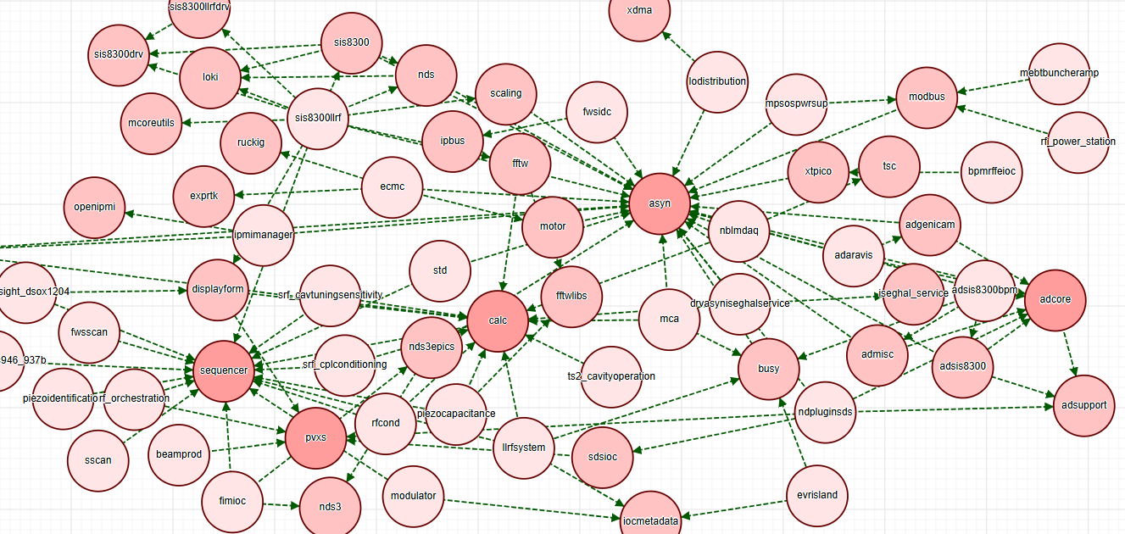
ESS EPICS Environment
The ESS EPICS Environment (e3) forms the basis of all IOC’s at ESS. The environment consists of:
A set of build tools
96 pre-compiled EPICS modules packaged for dynamic loading
This architecture allows us to deploy very thin IOC’s where substantial parts of the complex logic (e.g. implementation of protocol, state machines and similar) are loaded on demand from pre-tested community modules.
The current production versions of e3 are:
7.0.8.1/5.1.1 (recommended for new projects) and 7.0.7/5.0.0 (maintained)
But all previous versions are still available and usable.
The current e3 environment is stable and no changes or updates planned.

Slide 3
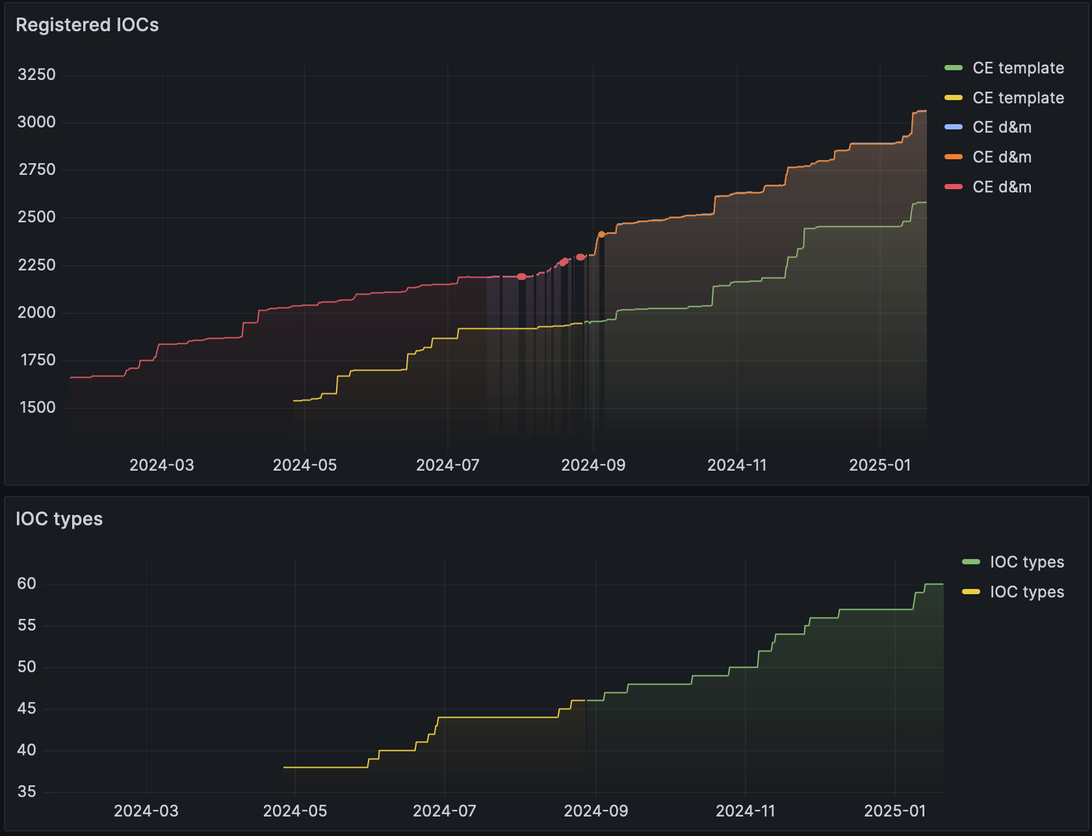
EPICS deployments
During 2024 the number of deployed IOC’s has grown substantially. This growth is supported by a dedicated deployment tool (ce-deploy) which ensures rapid, re-producible deployments including full and repeatable host configuration.
The majority of new IOC’s today are generated using our template tool (ce-template) which allows us to automatically generate IOCs based on type definitions and configurations in simple human-readable files. This reduces the risk of human error creating faults in our systems and allows us to rapidly and securely perform updates across entire classes of systems.

Slide 4
Cryogenic EPICS integrations
 | PLC’s | Power supplies | Level controllers
IOC’s | 48 | 41 | 28
Process values | ~ 500.000 | ~ 24.000 | ~14.000
Archiver configuration | Yes | Yes | Yes
Alarm configuration | Yes | Yes | Yes
OPI’s | Yes | Yes | Yes
Status | All systems deployed, complete, verified and stable. | All systems deployed, complete, verified and stable. | These IOC’s are effectively deprecated. These systems are monitored using the PLC interface.
Requests for changes and updates for the systems are still coming in with regularity, which makes finding a stable baseline challenging. Updates to software and network infrastructure may extend downtime caused by such changes.
Electrical grounding issues were identified in 2024-12. After resolving these the level controllers seem stable.

Slide 5
Beam diagnostic EPICS integrations
 | APTM | BCM | BPM | EMU | BLM | WS/FWS | IMG | FC | IBS
IOC’s | 9 | 24 | 138 | 7 | 77 | 56 | 5 | 4 | 1
Process values | ~47k | ~1.35k | ~1.7M | ~3.2k | ~53k | ~112k | ~1.1k | ~20k | ~450
Archiver configuration | In progress | In progress | In progress | In progress | In progress | Yes | In progress | Yes | Yes
Alarm configuration | To be defined | To be defined | To be defined | To be defined | To be defined | To be defined | To be defined | Yes | Yes
OPI’s | Yes | Yes | Yes | Yes | Yes | Yes | Yes | Yes | Yes
Status | Deployed but requires updates | Deployed, complete and stable | Deployed, complete and stable | Deployed, complete and stable | Deployed, stable but requires updates | Deployed, stable but requires updates | Deployed, stable but requires updates | Deployed, complete and stable | Deployed, complete and stable
BI library repository (libxda) need to be set public in order for ICS CE-deployment. Currently deployment is done with cellMods for APTM, IMG and BLMs.
MEBT EMU and LEBT EMU DAQ IOCs are currently running manually on IOxOS boards. The FW in the process of being updated and tested to allow CE-deployment.
Some systems (APTM, IMG, BLMs and WS) require final integration updates which also depends on ongoing tests and work together with BI.
Some EVR IOCs still to be deployed – IMG DUMPL systems installed recently.
IPMI crate monitoring not deployed

Slide 6
Radio frequency EPICS integrations
 | LLRF | LPS | Spk PS | Modula-tor | Auxiliary | Tuners | Timing | RF Orch | SDS
IOC’s | 91 | 182 + 91 | 26 | 16 | ~700 | 13 + 82 | 91 + 15 + 10 | 14 | 170
Process values | ~210k | ~ 500k | ~15k | ~4k | ~300k (?) | ~20k + 30k | ~160 k +3 k + 5k | ~6k | ~40k
Archiver configuration | Yes | Yes | Yes | Yes | Yes | Yes | Yes | Yes | No
Alarm configuration | Yes | Yes | Yes | To be defined | To be defined | To be defined | To be defined | Yes | To be defined
OPI’s | Yes | Yes | Yes | Yes | Yes | Yes | Yes | Yes | Yes
Status | All systems deployed | All systems deployed | All systems deployed | All systems deployed | Some missing | All systems deployed | All systems deployed | Spk + NCL missing | NCL LLRF missing
Some PV names mismatch which causes problems in archiver
Some IOCs still to be deployed – IPMI Manager, Arc Detector, Piezo algorithm IOC
Some network configuration issues on some auxiliary IOC (XT-Pico), work in progress

Slide 7
Other EPICS integrations
 | LWU Magnets | Vacuum
IOC’s | 68 | 182
Process values | ~31k | ~ 232k
Archiver configuration | Yes | Yes
Alarm configuration | To be defined | Yes
OPI’s | Yes | Yes
Status | All systems deployed and verified. The alarm configuration yet to be defined. | All systems deployed, complete, verified and stable.

Slide 8
Verification status
NCL EPICS applications
 | ISrc & LEBT |  | RFQ |  | MEBT |  | DTL
General controllers | ISrc & LEBT Control LEBT Iris | R | RFQ Cavity Local Protection | R |  |  | DTL High-level Controls DTL Cavities | R
Choppers | LEBT Chopper | R |  |  | MEBT Chopper | R
RF equipment |  |  | LLRF Fast Interlock Slow Interlock | R R R | LLRF Fast Interlock | R R | LLRF Fast Interlock Slow Interlock | R R R
BMD equipment |  |  |  |  | MEBT Magnets and PS | R
PBI equipment | LEBT EMU LEBT Collision avoidance | P R |  |  | MEBT EMU MEBT WS MEBT Collision avoidance | R R R
Water cooling | Cooling Skid | R | Cooling Skid | R | Cooling Skid | R | DTL Water Cooling | R
Notes
For details see NCL control system documentation tracking sheet (link).
PBI verification reports mainly handled by system owners
RF IOCs & OPIs are tested together with RF Group
see RF IOCs deployment overview
Legend
R Verification report Released/review
P Verification report Preliminary draft
P Verification report Preliminary start

Slide 9
Verification status
SCL EPICS applications
 | Spokes |  | MBL & HBL |  | A2T
RF equipment | LLRF Slow Interlock Fast Interlock Pin Diode Spoke Amplifier (RFPS) Tuners Sensors (Arc detector, Electron pickup) | R P P P P P P | LLRF (MBL, HBL) Slow Interlock Fast Interlock (MBL) Pin Diode Klystron Tuners Sensors (Arc detector, Electron pickup) | R P R P P P P
Cryo equipment | Spoke Cryomodules Reports are released for all cryomodules | R | Elliptical Cryomodules Reports are released for all cryomodules | R
PBI equipment | SCL Wire Scanner |  |  | R
 | Insertable Beam Stop (SPK, MBL) |  |  | P
Other equipment |  |  |  |  | Tuning Beam Dump (temperature monitoring) | R
Notes
For details see SCL control system documentation tracking sheet (link).
PBI verification reports mainly handled by system owners
RF IOCs & OPIs are tested together with RF Group
see RF IOCs deployment overview
Legend
R Verification report Released/review
P Verification report Preliminary draft
P Verification report Preliminary start

Slide 10
Verification status
Accelerator infrastructure systems EPICS applications
 | Accelerator infrastructure
Timing system (TDS) | Timing Distribution System | R
RF equipment | Master Oscillator Phase Reference Line | P P
Cryo equipment | Accelerator Cryoplant Cryogenics Distribution Cryogenic Transfer Line CMDS Safety functions and Interlocks CMDS Automatic Control Sequence | R R R R R
Helium systems | Safety Helium Collector | R
CF Process (Water) systems | Verification report link | R
CF HV systems | Verification report link | R
CF HVAC systems | Verification report link | R
Legend
R Verification report Released/review
P Verification report Preliminary draft
P Verification report Preliminary start

Slide 11
Conclusion
The ESS EPICS Environment is released and providing a stable platform for all IOC’s
The majority of new IOCs are automatically generated using template tools, minimizing risk for mistakes
Our IOC’s are deployed and monitored using a best-in-class tool chain
Verification is complete and reports released is completed for most systems
For remaining systems verification is ongoing together with system owners
Key challenges:
Completing remaining system verification
Managing ongoing requests for changes and updates

