Slide 1
2-bender option for nEDM

Slide 2
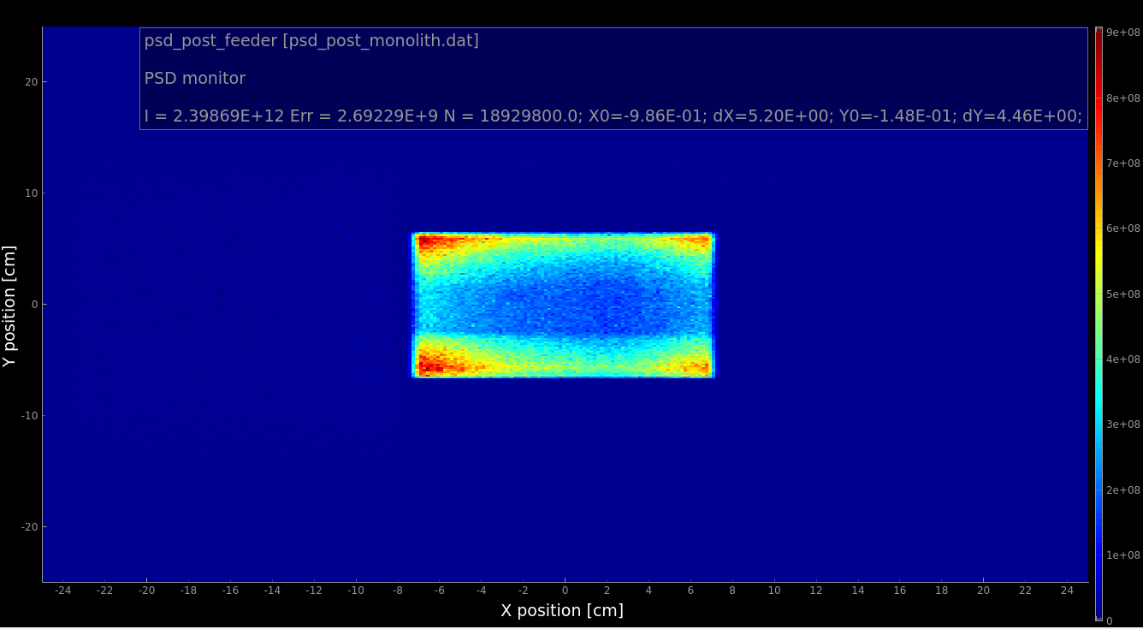
Features of the E5 beam extraction
Lower intensities in the middle of the guide
Higher intensities in the lower and upper part

Slide 3
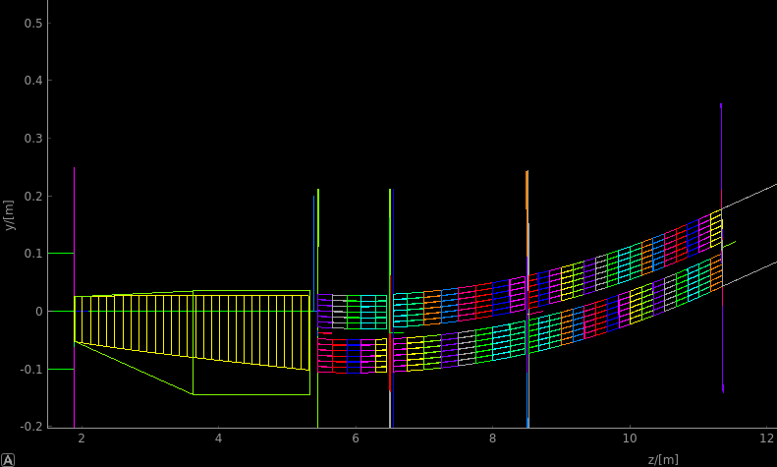
Horizontal separating plate
A thick separating plate acts as a LOS blocker
With 6 cm height bending angle can be reduced from ~5 to ~3.5 degrees
A 1.5 cm plate with 3.5degrees curving angle gives a minimum of 25 cm of material in the LOS before bunker wall
Second LOS blocking after bunker wall in the second bender

Slide 4
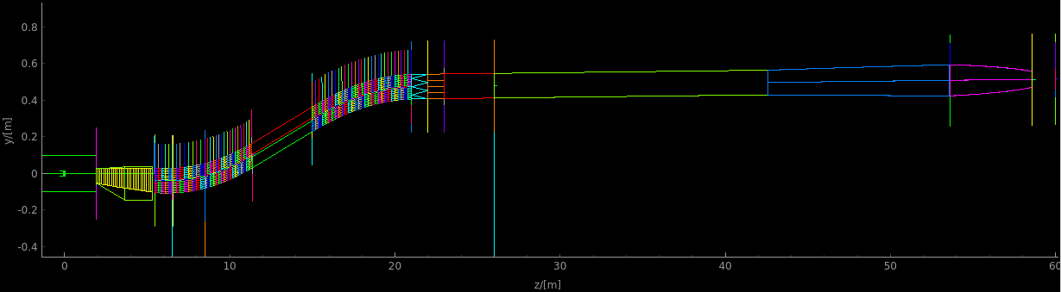
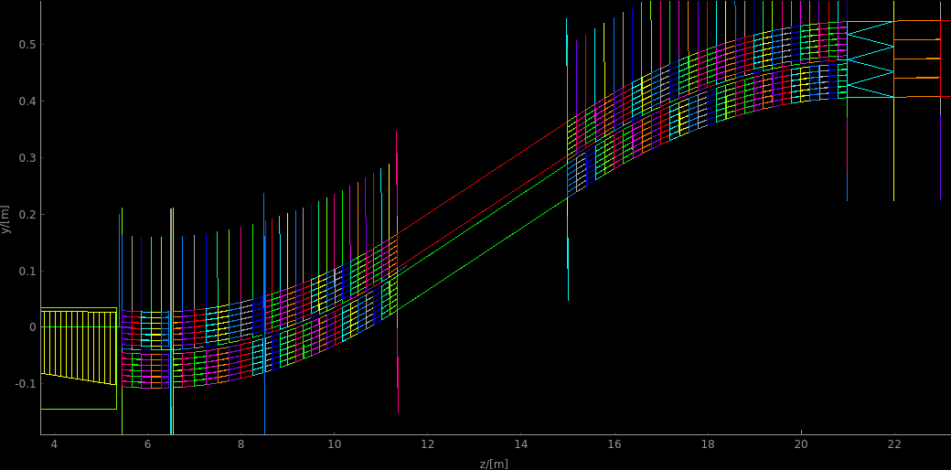
Guide concept update
2 independent 6-channel bender systems
  6 cm high each
  1.46 cm thick separating plate
  Total height kept to 13.46 cm as before
Lower bending angles (3.48 and 3.06 deg)
  Improved vertical divergence
  Improved focusing with refit of splitter vertical dimensions
  Improved transfer of short wavelengths,
  Improved FOM for total (capture) flux sensitive experiments

Slide 5
FOM in the cells @ 5MW
 | n/s 8.8-9.0AA | n/s total | n/s/cm2/AA@8.9A | n/s/cm2 total
A.10 | 7.7E08 | 2.3E09 | 2.55E07 | 1.5E07
A.5 | 7.3E08 | 2.2E09 | 2.45E07 | 1.5E07
B.10 | 7.3E08 | 1.4E09 | 2.45E07 | 9.3E06
B.5 | 7.0E08 | 1.3E09 | 2.35E07 | 8.7E06
C | 8.3E08 | -- | 2.75E07 | --
D | 8.73E08 | 2.65E9 | 2.91E07 | 1.79E07
E | 8.28E08 | 1.6E09 | 2.82E07 | 1.07E07
F | 9.72E08 | -- | 3.24E07 | --
G | 1.26E09 | -- | 4.20E07 | --
H | 1.08E09 | 3.28E09 | 3.60E07 | 2.19E07
I | 1.03E09 | 1.96E09 | 3.60E07 | 1.31E07
A: C-polarizer, m=3 guides, ANNI original chopper settings, PDC1@6.5m and PDC2@26m Results for 10 and 5 slits in bender 1.
B: C-polarizer, m=3 guides, ANNI original chopper settings, PDC1@6.5m and PDC2@42.5m Results for 10 and 5 slits in bender 1.
C: C-polarizer, no choppers, wavelength restricted to 8.8-9.0AA, open choppers
D: Curved with V-shaped polarizer, PDC1@6.5m and PDC2@26m
E: Curved with V-shaped polarizer, PDC1@6.5m and PDC2@42.5m
F: Curved with V-shaped polarizer, wavelength restricted to 8.8-9.0AA, open choppers
G: Theoretical max, straight guide (slits preserved), V-polarizer, wavelength restricted to 8.8-9.0AA, open choppers
Curved with V-shaped polarizer, 2 benders, PDC1@6.5m and PDC2@26m
Curved with V-shaped polarizer, 2 benders, PDC1@6.5m and PDC2@42.5m
In the options A-F, H, I line of sight is lost at 11.5 meters (just before the bunker wall)

Slide 6
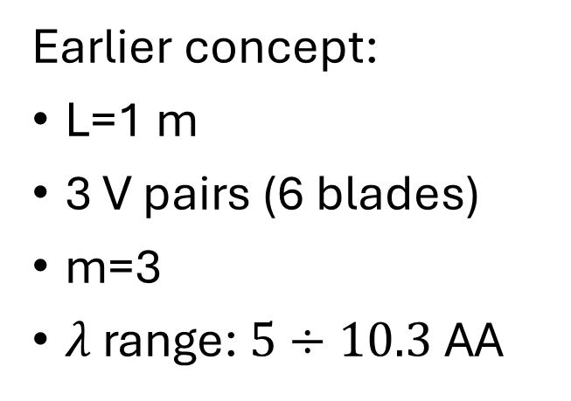
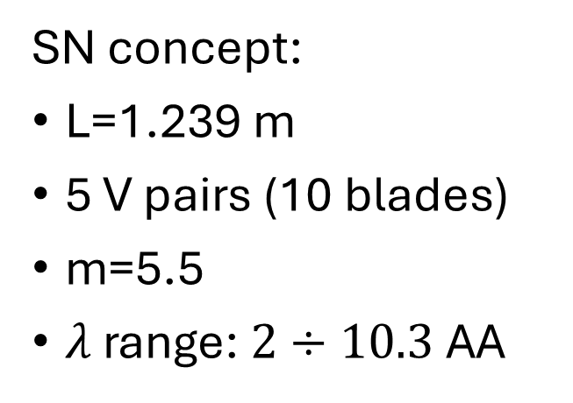
V-polarizer concept proposed by SwissNeutronics
Earlier concept:
L=1 m
3 V pairs (6 blades)
m=3
$λ$ range: $5÷10.3$ AA
Pro:
Simplified construction compared to separated polarizers for low-and high wavelengths
Contra:
Higher m-value, lower angle, hence higher attenuation for large wavelength
SN concept:
L=1.239 m
5 V pairs (10 blades)
m=5.5
$λ$ range: $2÷10.3$ AA

Slide 7
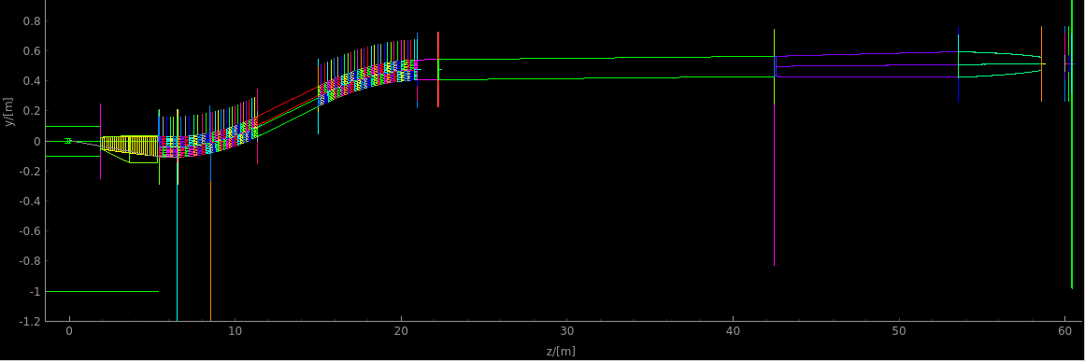
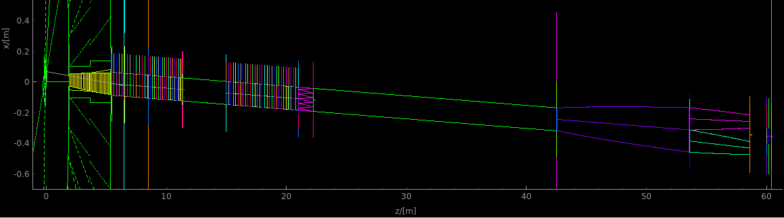
V-polarizer concept proposed by SwissNeutronics

Slide 8
FOM in the cells @ 5MW
 | n/s 8.8-9.0AA | n/s total | n/s/cm2/AA@8.9A | n/s/cm2 total
A.10 | 7.7E08 | 2.3E09 | 2.55E07 | 1.5E07
A.5 | 7.3E08 | 2.2E09 | 2.45E07 | 1.5E07
B.10 | 7.3E08 | 1.4E09 | 2.45E07 | 9.3E06
B.5 | 7.0E08 | 1.3E09 | 2.35E07 | 8.7E06
C | 8.3E08 | -- | 2.75E07 | --
D | 8.73E08 | 2.65E9 | 2.91E07 | 1.79E07
E | 8.28E08 | 1.6E09 | 2.82E07 | 1.07E07
F | 9.72E08 | -- | 3.24E07 | --
G | 1.26E09 | -- | 4.20E07 | --
H | 1.08E09 | 3.28E09 | 3.60E07 | 2.19E07
I | 1.03E09 | 1.96E09 | 3.60E07 | 1.31E07
K | 9.99E08 | 1.89E09 | 3.52E07 | 1.26E07
A: C-polarizer, m=3 guides, ANNI original chopper settings, PDC1@6.5m and PDC2@26m Results for 10 and 5 slits in bender 1.
B: C-polarizer, m=3 guides, ANNI original chopper settings, PDC1@6.5m and PDC2@42.5m Results for 10 and 5 slits in bender 1.
C: C-polarizer, no choppers, wavelength restricted to 8.8-9.0AA, open choppers
D: Curved with V-shaped polarizer, PDC1@6.5m and PDC2@26m
E: Curved with V-shaped polarizer, PDC1@6.5m and PDC2@42.5m
F: Curved with V-shaped polarizer, wavelength restricted to 8.8-9.0AA, open choppers
G: Theoretical max, straight guide (slits preserved), V-polarizer, wavelength restricted to 8.8-9.0AA, open choppers
H Curved with V-shaped polarizer, 2 benders, PDC1@6.5m and PDC2@26m
I Curved with V-shaped polarizer, 2 benders, PDC1@6.5m and PDC2@42.5m
K Vertical V polarizer, m=5.5 2 benders, PDC1@6.5m and PDC2@42.5m
In the options A-F, H, I line of sight is lost at 11.5 meters (just before the bunker wall)

Slide 9
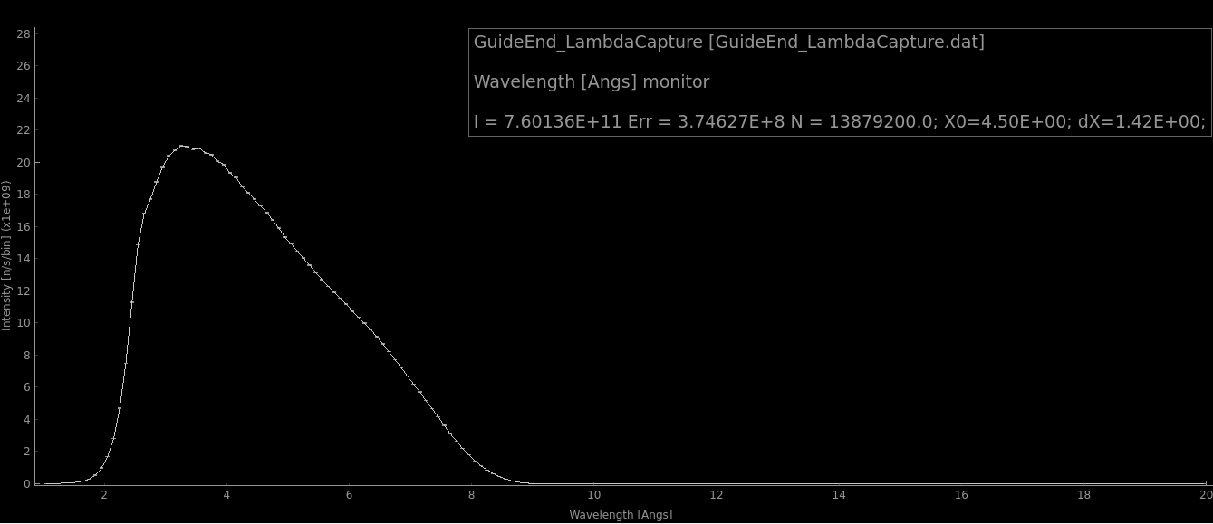
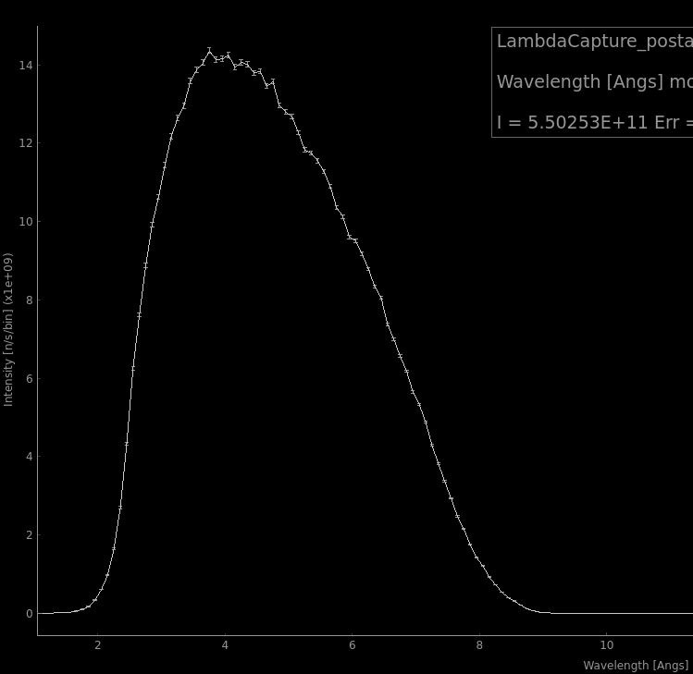
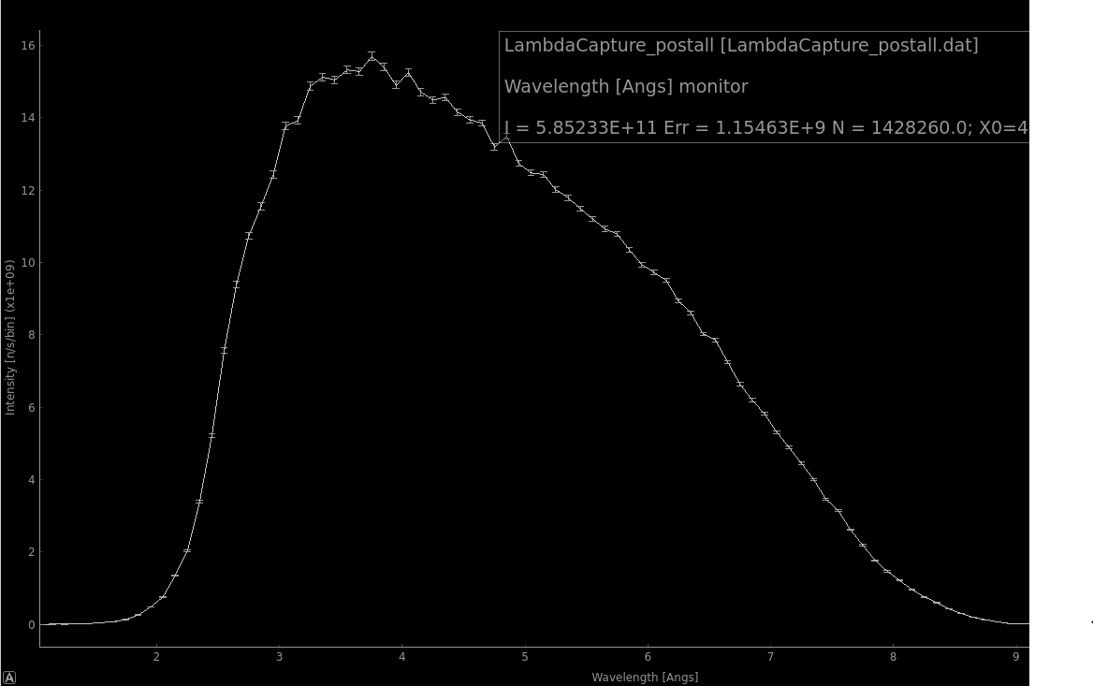
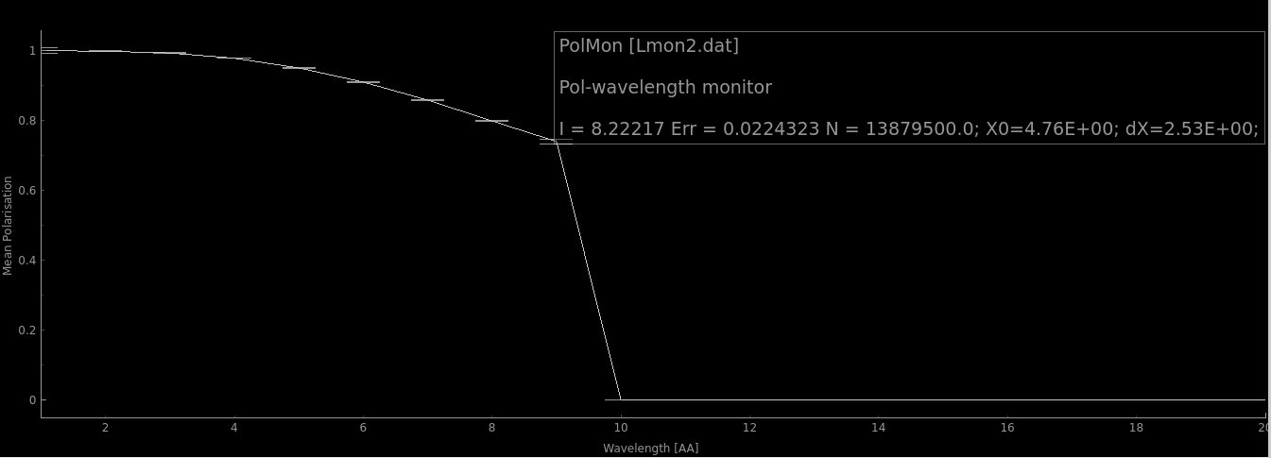
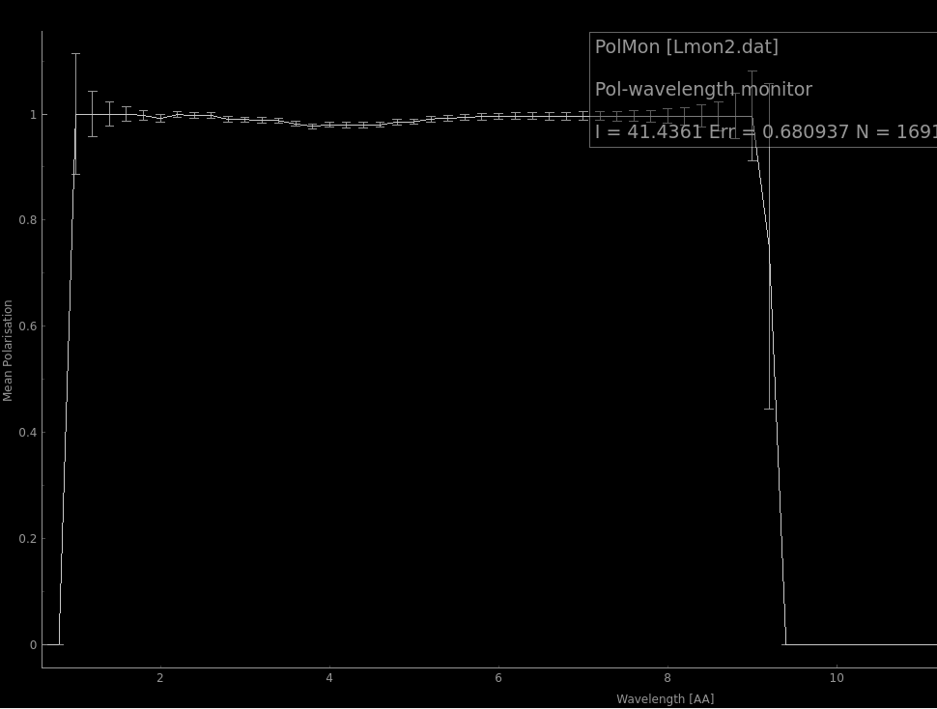
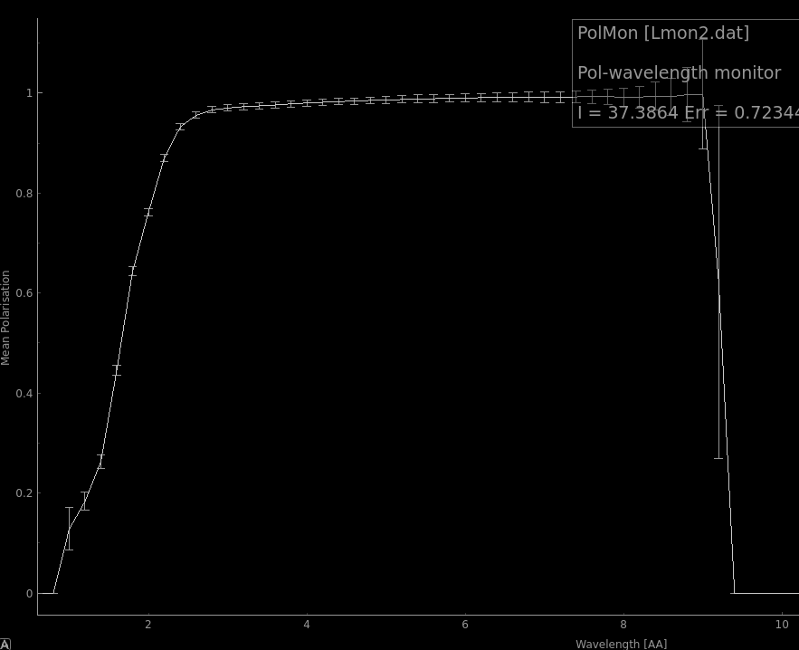
Capture flux vs ANNI proposal
ANNI original,
FOM=7.6E11n/s
2 benders,
curved_pol+Vpol (m=3)
FOM=5.5 E11n/s
2 benders,
Vpol (m=5.5)
FOM=5.85 E11n/s
In the 2-bender option
  5.5E11 n/s capture flux
  15cm W x 13.46 cm H beam at exit (or 2x6cm on top of each other)
LOS to the moderator blocked twice in the 2-bender option, before and after the bunker wall
LOS not blocked until ~18 m in the original ANNI proposal.

