Slide 2
Proposals, DMPs and FAIR
@ESS
PRESENTED BY Fredrik Bolmsten

Slide 3
Agenda
1 Proposals
2 Proposal do's and don'ts
3 Data Policy
4 Data Management Plans

Slide 4
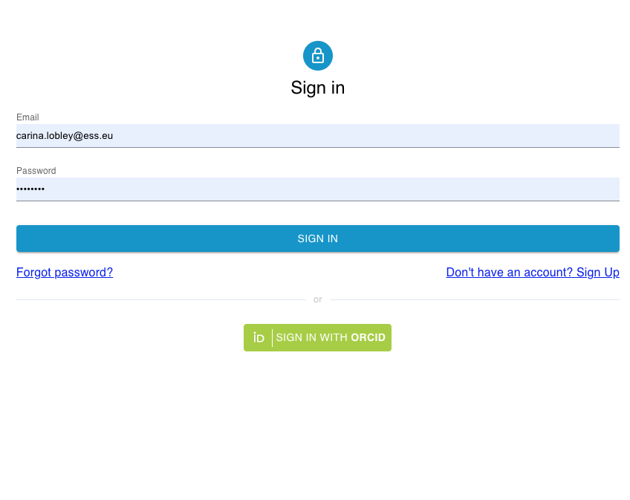
Proposals

Slide 5
Obtaining Access to ESS
Who might be an ESS user?
Five access routes are specified:
    Peer Reviewed Access
    Quick Access
    Discretionary Access
    Proprietary Access
    Alternative Access Routes
  Access routes 1, 2, 3 & 5 are free at the point of use and represent the majority of users. Proposals are selected on the basis of excellence.
  Proprietary access will be via a negotiated contract for each user

Slide 6
The User Journey
Users notify ESS of team
User training
Experiment safety review
Travel and accommodation
Ship samples
Physical Access
Dosimetry
Feedback
Experiment report
Data curation
Expenses review
Publications
KPIs
Submit proposals
Technical review
Excellence review
Result notification
Registration
Proposal
Scheduling
Planning
Performing & Analysing
Wrap-up & Harvesting
Register
Personal Data
Digital Access
Experiments
Sample environments
Local contacts
User lab facilities
Experiment notification
Data directories in place
Automatic data processing
Manual data processing
Notes:
The ESS user journey at ESS is long and complicated, starting from their first interaction when they register through to the publication of science at the end. We aim to integrate this journey as much as possible. As is clear there are many stakeholders in this journey, often involving the UOS but not owned by the user office.
Not a blocker for first science - BUT
The more deeply we embed these processes in time for our first friendly users, the better we embed ESS expectations in the user community. The more transparent and consistent we are in our delivery of service to users, the greater their ability to comply with their needs. If guidelines are uniformly implemented, we will be able to identify the needs of the users as they become apparent and adapt to best meet these needs. Difficult to change poor processes once they have become ‘normal’ and we don’t want to lay the foundation for this.

Slide 7

Proposal Submission and Review
call for
proposals
proposal
template
proposal
submission
excellence
review
publish
results
proposal
workflow
proposal
completion
technical
feasibility
director
decision
The same proccess is replicated at all large scale research infrastructures
Notes:
Talk through the current peer reviewed access process.
So far we have designed a proposal submission and review process for a ‘standard’ peer reviewed experiment, assuming this will be our most significant use case.
- tailored to the DEMAX requirements for calls 2a (proposal submission) and 2b (proposal submission and review).
- very happy with the success of virtual peer review meeting. This could be significant for us when we have few proposals and a broad range of science to review, even if not all reviews/reviewers are remote.
Proposal review and results can be a little awkward and the process needs to be documented and become familiar. Software tools are there but not always perfectly presented
ACTION: Giovanna – are you happy with this process as our backbone? Do you see additional steps for which we need to cater?
ACTION: Giovanna – without an access policy we don’t have any agreed access routes. We have run peer reviewed DEMAX access and are now running a rolling call for access with internal ESS science review.
COMMENT: Carina’s pet hope is to reach a stage where ESS feels it can apply anonymized peer reviewing of proposals in some form to reduce impact of unconscious bias.

Slide 8
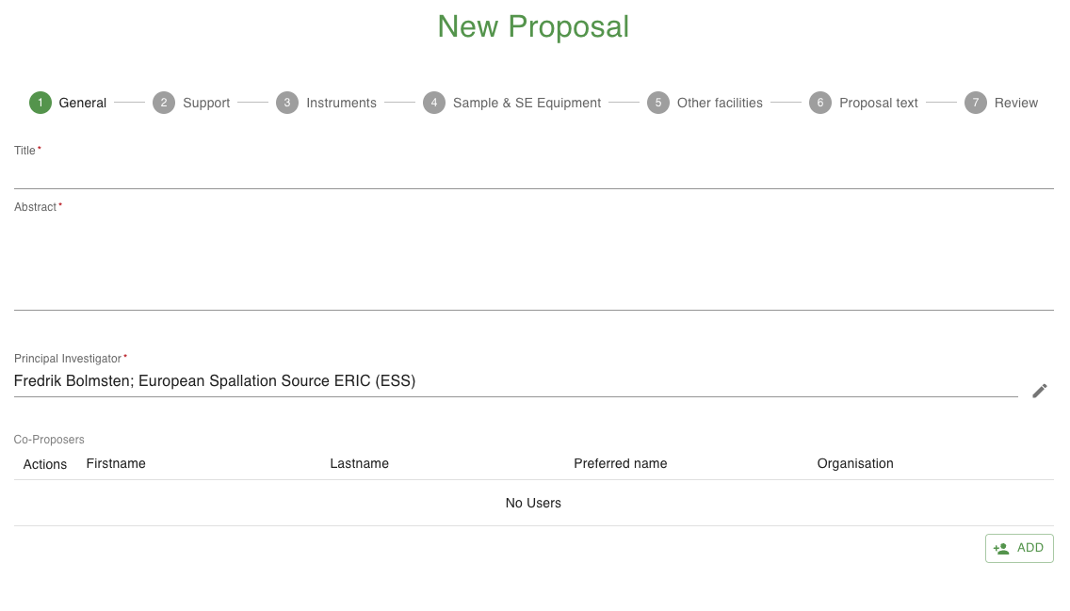
Draft/Submission
Proposal Topics
General
Support
Instruments
Sample & Sample Environment
Other Facilities
Proposal Text

Slide 9

Technical Review
Is it possible and safe to carry out the experiment
Investigate the feasibility of the proposed experiment
An unfeasible technical review does not necessearly mean no scientific merit
Give an estimate for days required
Check with safety regarding concerns
Give general comment to reviewers

Slide 10
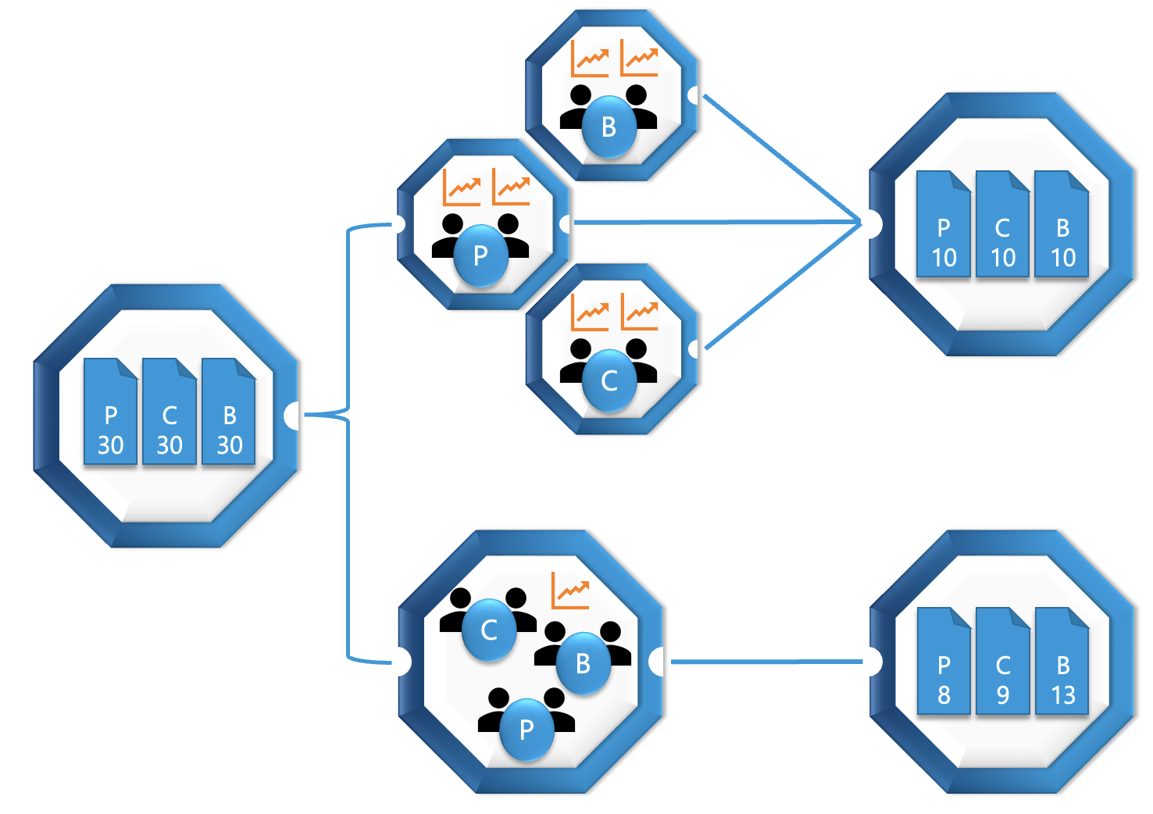

Excellence Review
Scientific Evaluation and Access Policy
Judge scientific excellence
    Grade
    Comment
    Control feasibility
    Check previous work
Meeting:
    Rank proposals
    Time allocate

Slide 11
Proposal do's and don'ts

Slide 12
Preparing a Winning Proposal
Scientific Evaluation and Access Policy
Practical tips:
1) start early
2) always talk to the instrument scientist(s) for the latest updates and advice
3) check all the questions you need to answer and carefully review that they are suitably addressed
4) ask the user office for help if using the software is presenting challenges – as far ahead of time as you can
5) do not miss the deadline for submission
Writing tips:
1) write for a well educated, scientifically interested audience
2) use gramatical, uncomplicated language (usually English) to be easily read and understood
3) comply with length guidelines and number of figures
4) be precise about the sample(s) and experiment(s) you plan
5) explain why the science requires the tools you are asking for and why it needs to be done now very clearly

Slide 13
Adding value to a proposal
Scientific Evaluation and Access Policy
Always remember:
Make the impact of the research clear – you can’t afford wasted words
Clearly state the need for the instrument you request
Indicate what other research will complement this experiment
Demonstrate the prior art that your team has which will make this successful
Explain why now is the time for this work
Let the reviewer know if the sample is ready to go – if it isn’t clearly explain how it will be ready in time and any mitigation for problems
The peer reviewers have a collective memory – they will know if they rejected this proposal before so be clear what has changed in the new approach
Express your motivation – why does this work give you joy? In a bundle of proposals in the same format, it’s amazing how enthusiasm stands out

Slide 14

Data Policy

Slide 15
ESS Data Policy
Main elements
ESS is the custodian of raw data and metadata from all beamlines
ESS will automatically collect metadata for all experiments
ESS will store metadata in a metadata catalogue
High level metadata will be published as soon as possible, i.e. Title, Authors, Beamline, Abstract
Experimental team has sole access to the data during the so-called embargo period of 3 years; request to extend embargo period can be made
After embargo ESS will make the data “Open Access”
Proprietary i.e. commercial data belong by default to the PI and are not archived unless explicitly agreed

Slide 16
ESS Data Policy
Questions
Analysis
  Access to the results of analysis performed on raw data and meta data is restricted to the person or persons performing the analysis, unless otherwise requested by those persons. If the raw data being analysed is still restricted, access to the analysis results must be granted by the PT.
Long term storage
  If ESS decides to stop acting as a custodian of some scientific research data after 10 years, ESS will inform the PIs concerned in a timely manner allowing them to make a copy of the scientific research data that was generated by their proposal(s), provided ESS is aware of the e-mail address of the PI.

Slide 17
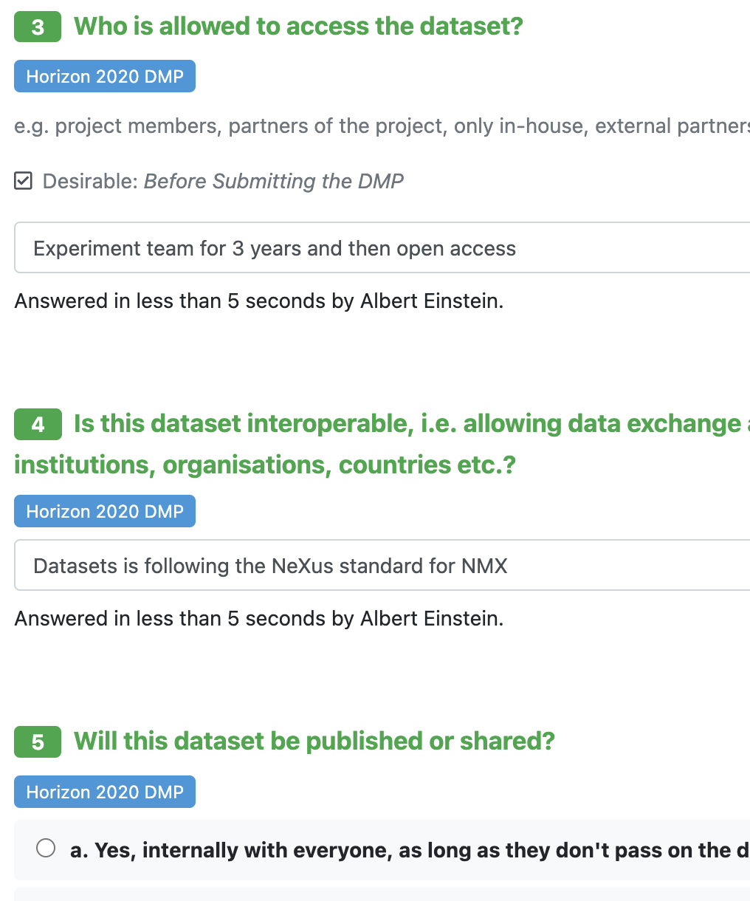
Data Management Plans

Slide 18
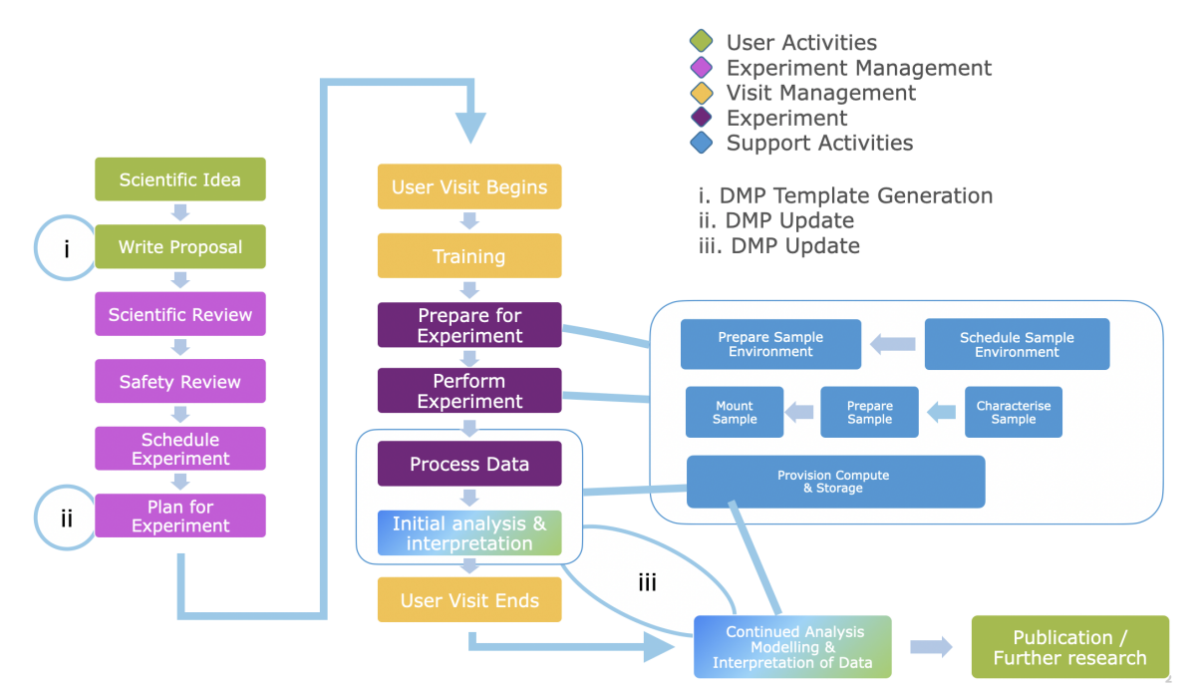
Overview
Theory
A data management plan, or DMP, is a document where information about the data management in a research project is collected. The plan covers all phases of the project, from planning and collection, production or generation of data, to analysis, publication, and archiving.
Purpose
A communication channel between the facility and the user to understand the needs that will arise from the data collected at experiment time and analysis.

Slide 19
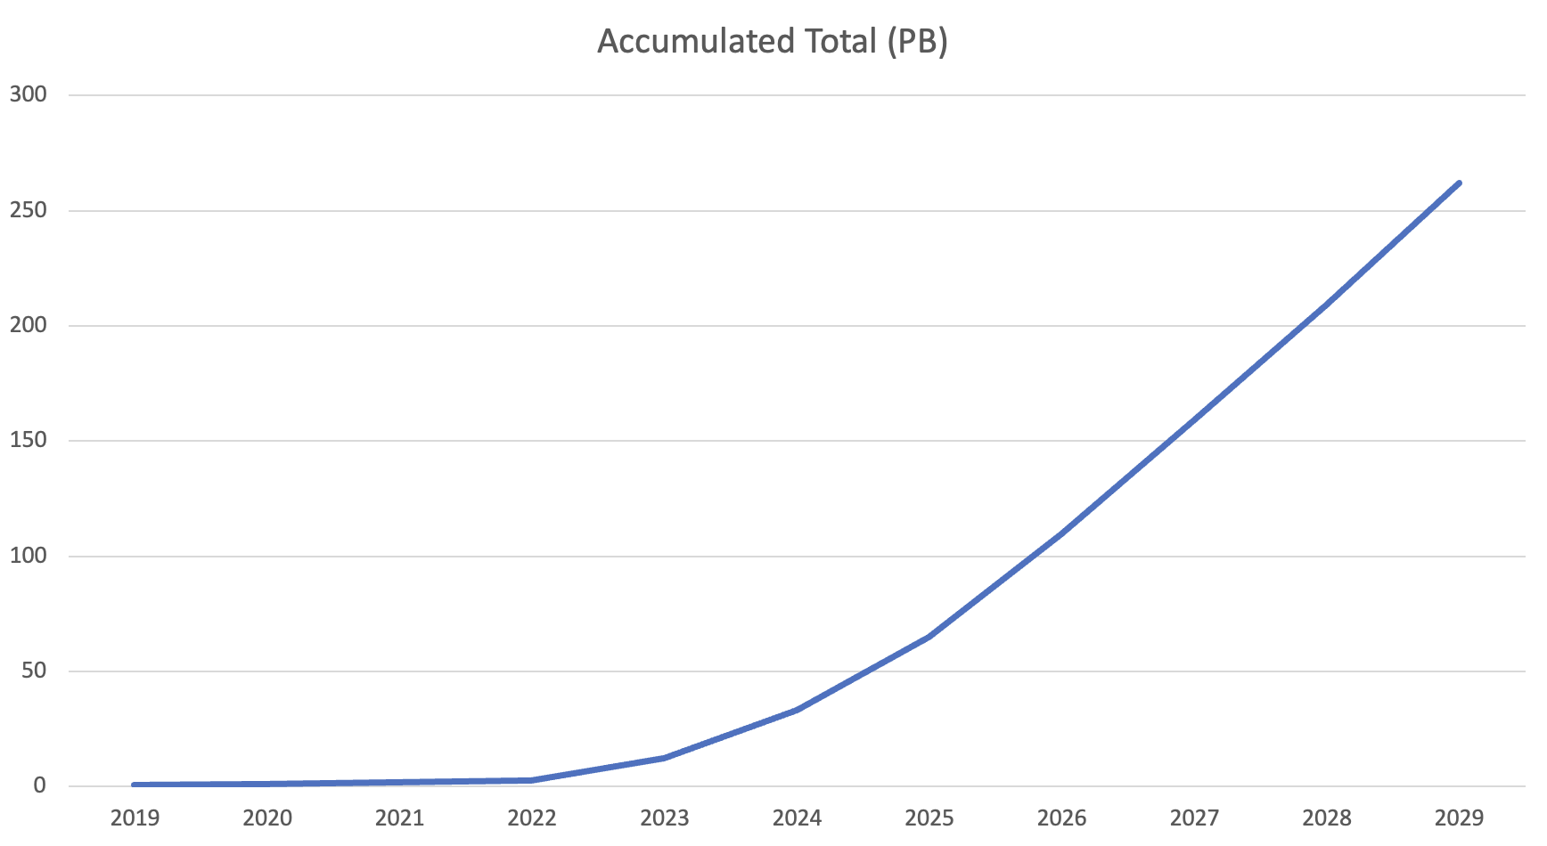
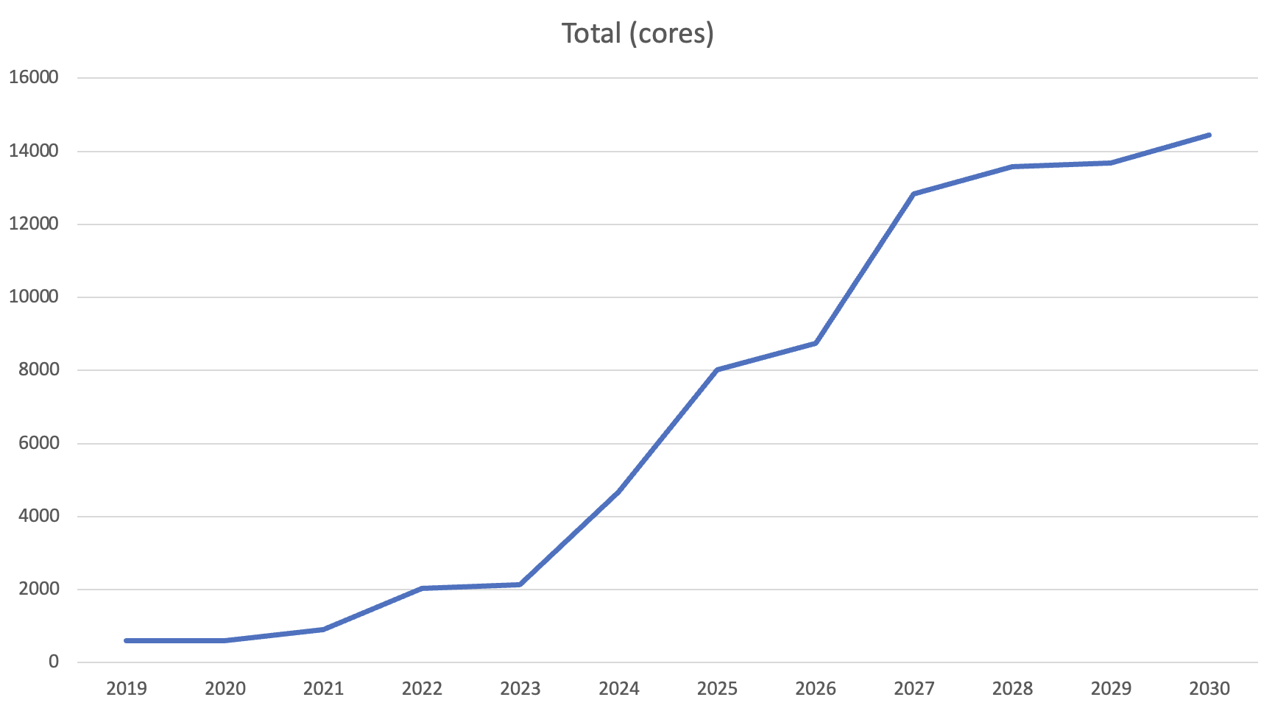
Storage & Processing
Handling the data
The increasing data rates caused by next generation detectors is making data handling a key issue for facilities as users are less capable of handling storage and processing themselves.
These storage and processing requirements has made data management plans a requisite for users and the facility to understand the needs that will arise from the experiment.

Slide 20
Questions
PaNOSC & Horizon 2020
Which file formats are used?
Which tools, software, technologies or processes are used to generate or collect the data?
Which software, processes or technologies are necessary to use the data?
Are different versions of the dataset created?
Which versioning strategy is applied for this dataset?
Which technology or tool is used for versioning?
To what extent will infrastructure resources be required (e.g. CPU hours, bandwidth, storage space... etc.).
Where is the dataset stored during the project?
Under which URL can the dataset be accessed during the project?
Are there internal project guidelines for a consistent organisation of the data? If so, where they are documented?
…

