Slide 2
Simulations
What are they and why do we need them?
PRESENTED BY Mads Bertelsen

Slide 3
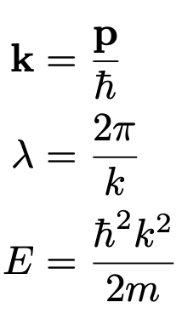
Neutron scattering
Resolution in scattering
Wavevector
Wavelength
$$I(q, ∆E)$$
Detector: n/s
Energy

Slide 4
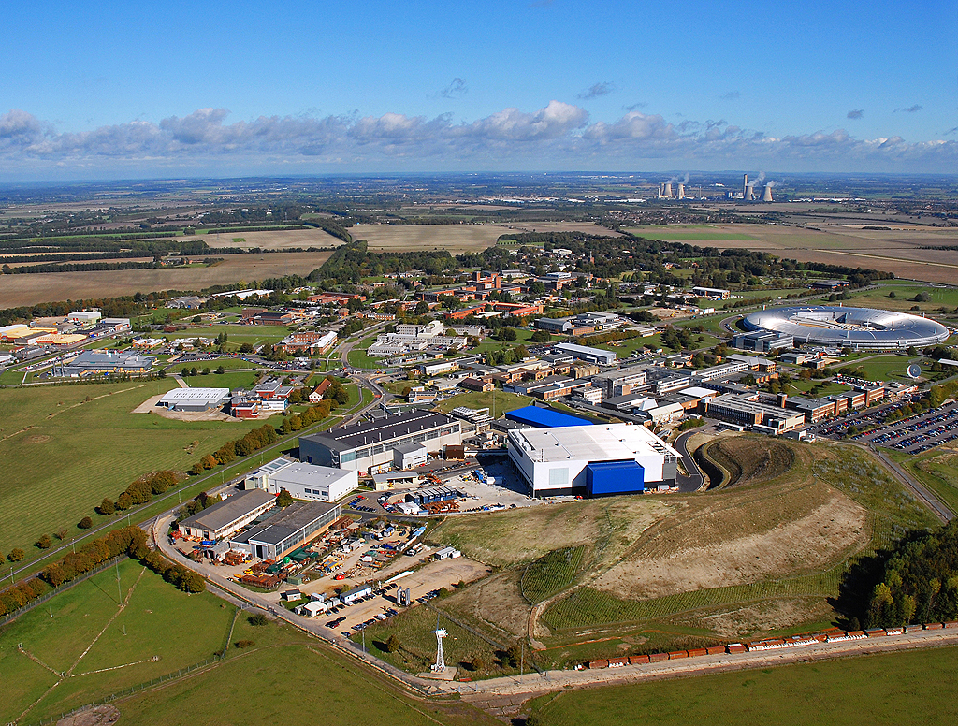
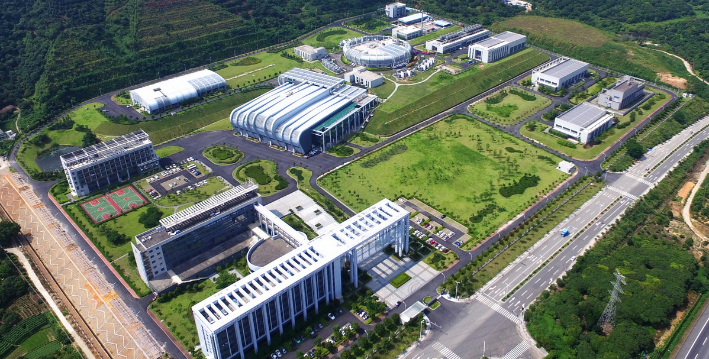
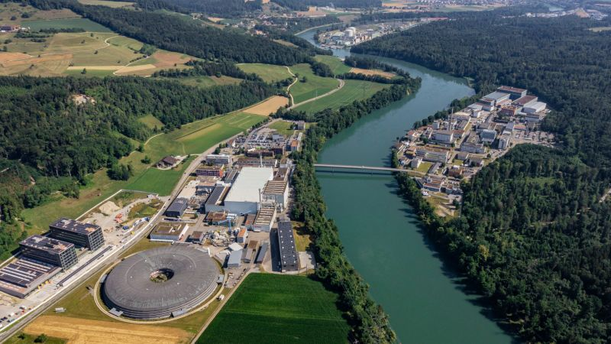
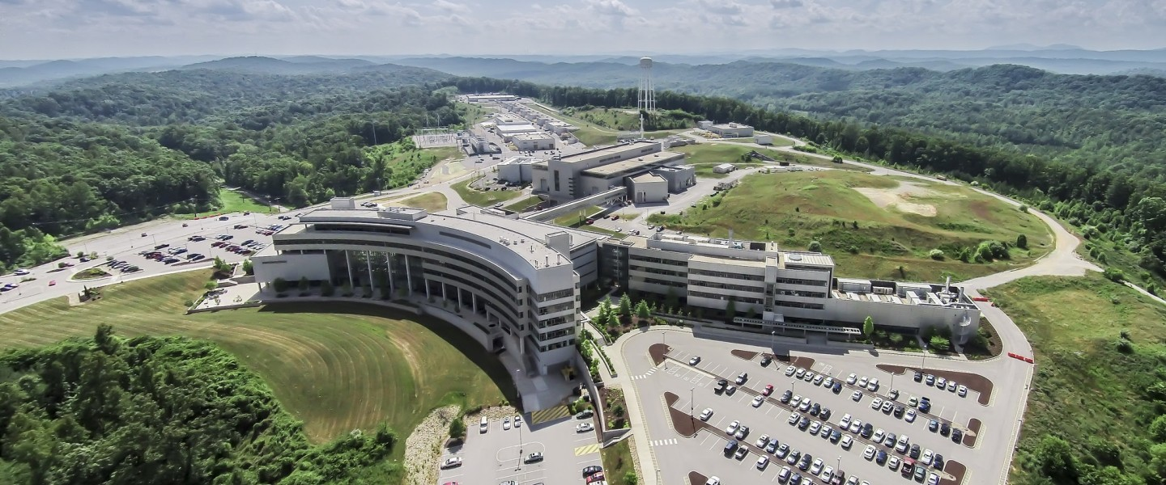
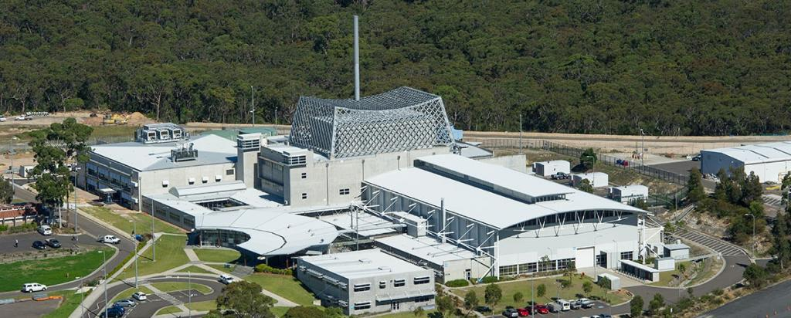
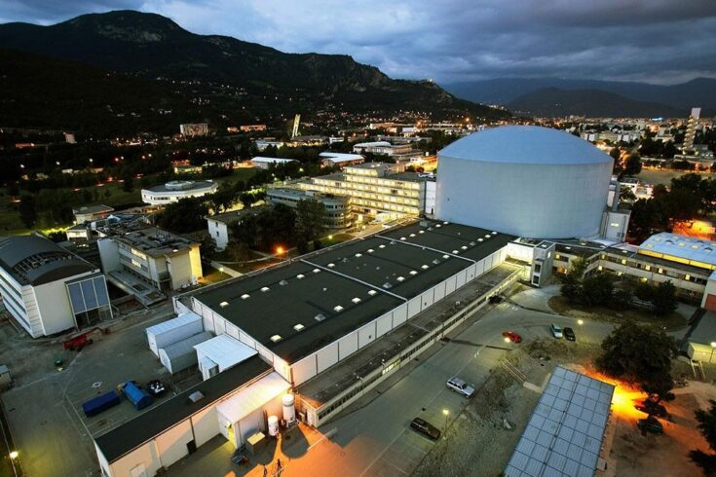
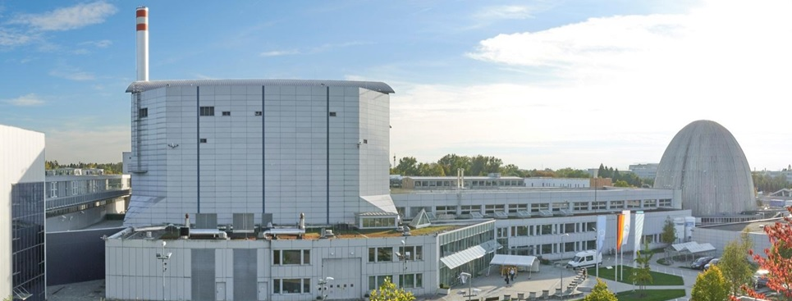
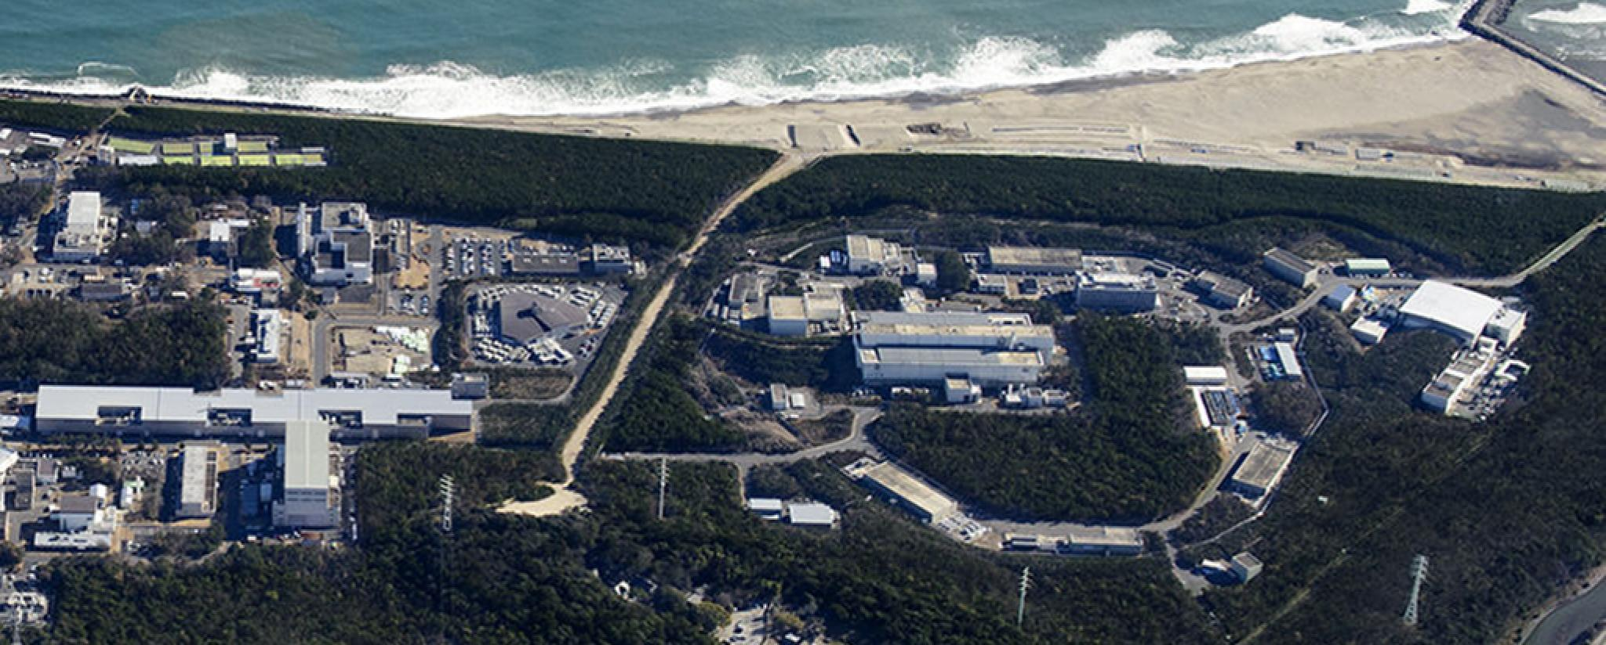
Sources
ISIS UK
CSNS China
PSI Switzerland
~5 pulsed
~20 continuous
Pulsed uses an accelerator
Continuous uses a reactor
(An exception to each)
SNS USA
Neutron intensity
ANSTO Australia
Pulse
Continuous
time
ILL France
FRM 2 Germany
J-PARC Japan
Notes:
Measure faster
Smaller samples
Important, but trivial. Could just measure longer
Allow seeing faster processes that are not reproducible, like when a battery is charged/discharged so fast that it is damaged

Slide 5
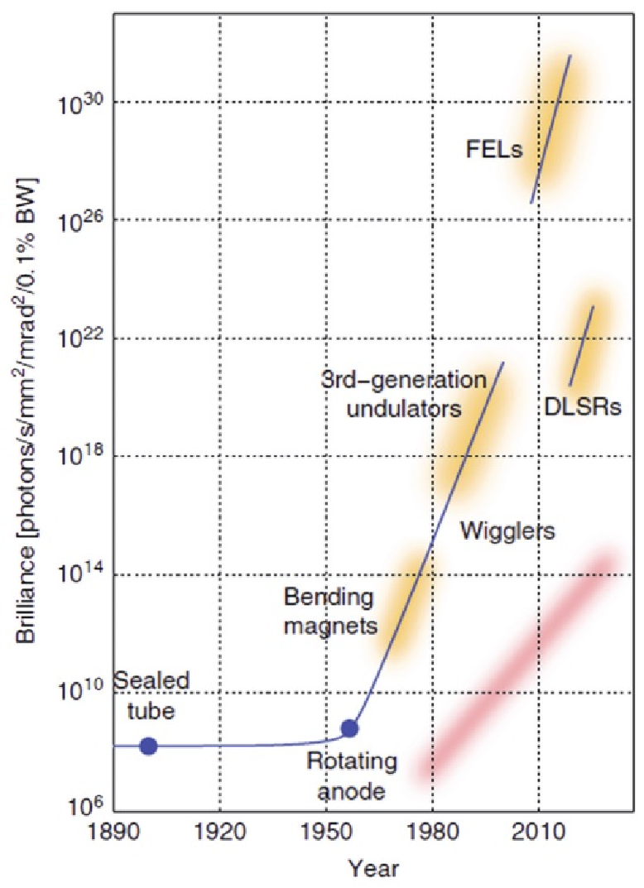
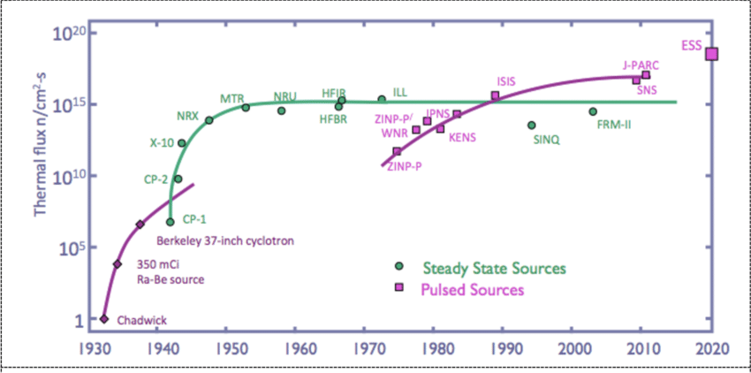
Sources
Brightness
X-rays
Neutron sources
A Proposal for a Next Generation European Neutron Source,
K. H. Andersen, C. J. Carlile
Ultrafast Single-Particle Imaging with Intense X-Ray Pulses,
Zhibin Sun et. Al.

Slide 6
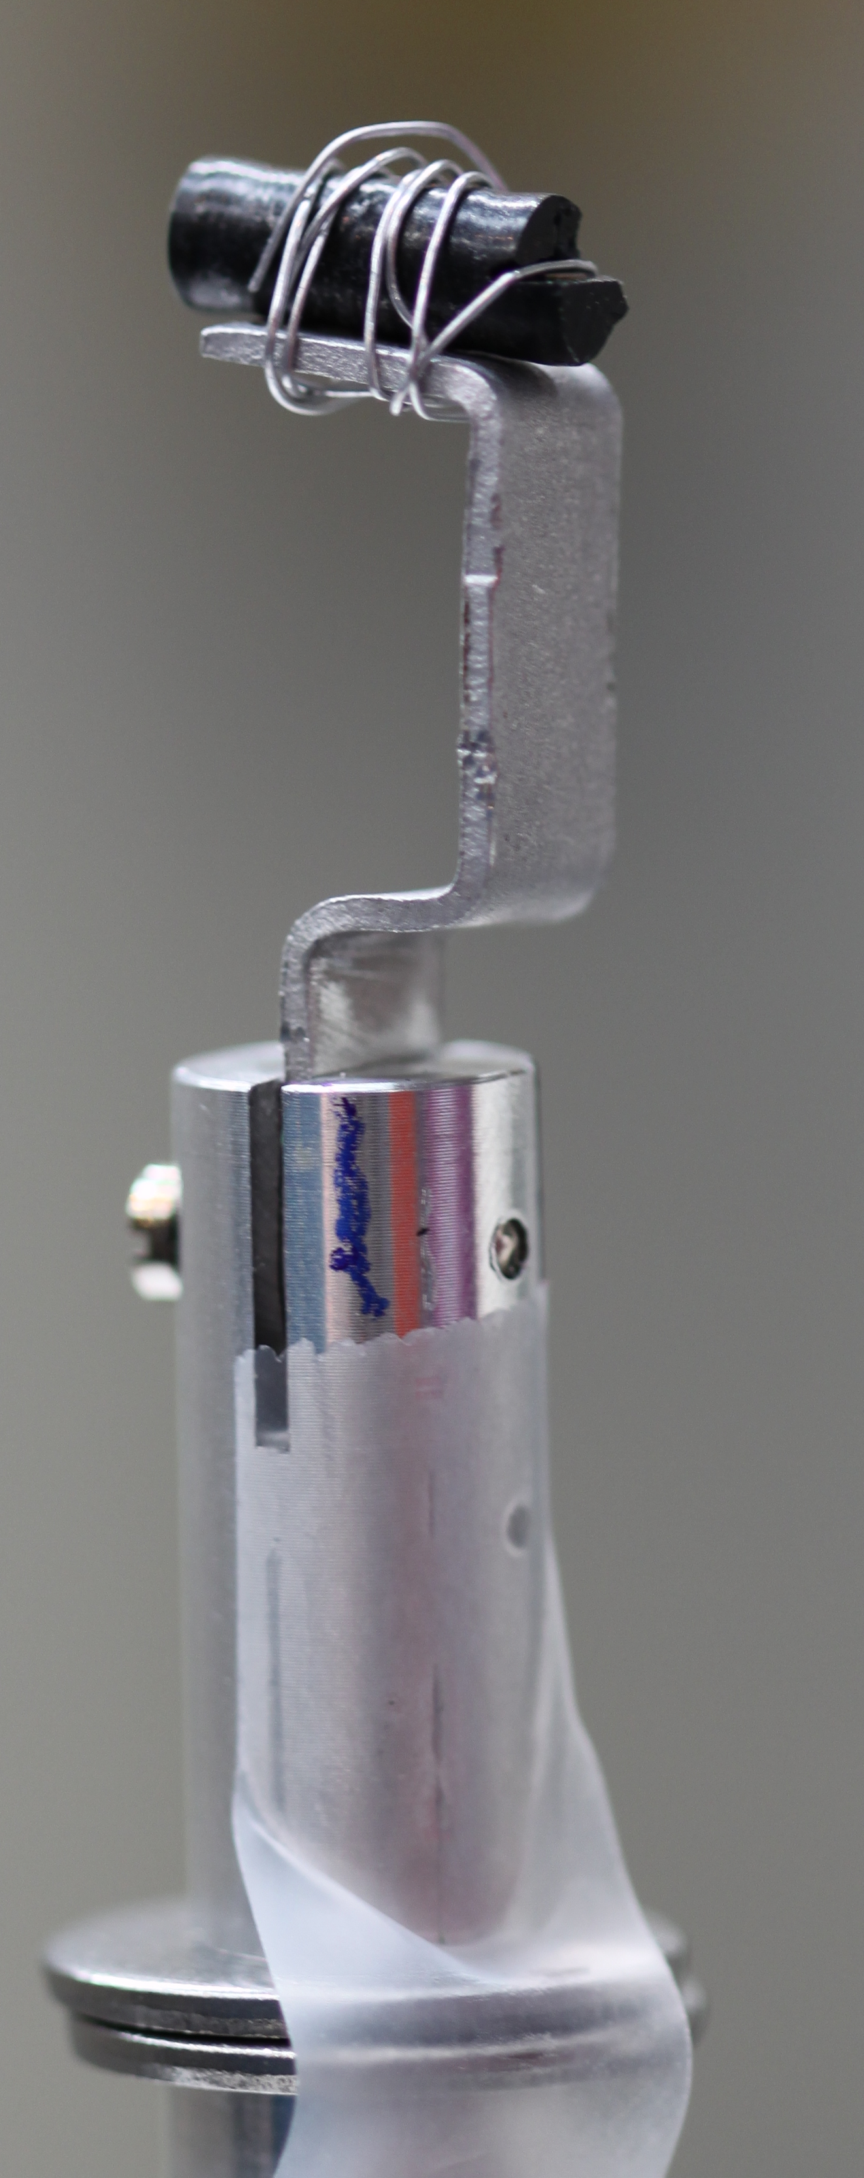
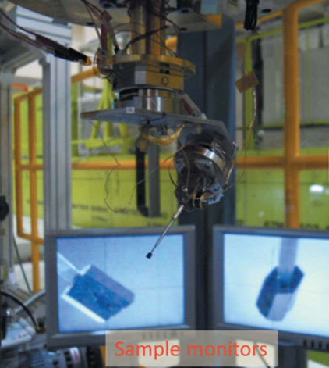
Neutron scattering
What could be done with a more powerful source?
  Measure smaller samples
  Measure at better resolution
  Perform measurements faster
  Investigate faster irreversible processes
    Battery damage when rapidly discharged
Photo: Pia Ray Jensen
Takashi Ohhara et al.
J. Appl. Cryst. (2016). 49, 120-127
Notes:
Measure faster
Smaller samples
Important, but trivial. Could just measure longer
Allow seeing faster processes that are not reproducible, like when a battery is charged/discharged so fast that it is damaged

Slide 7
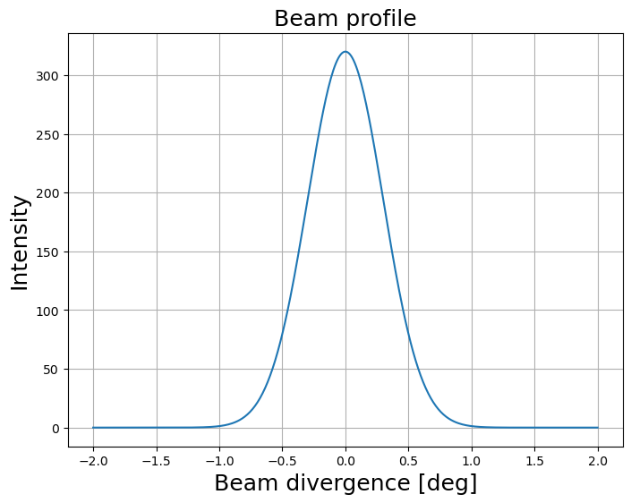
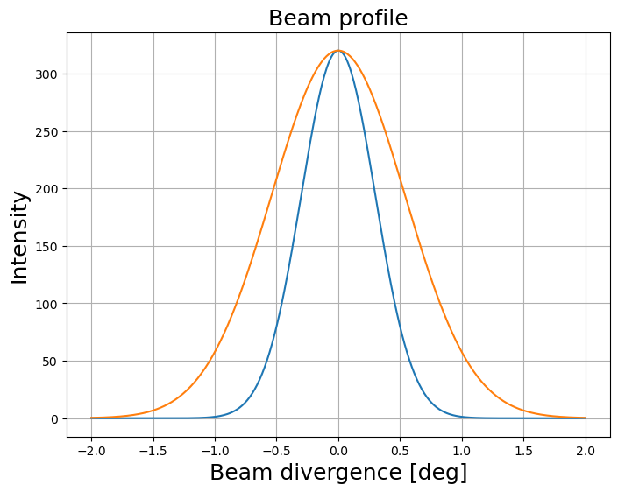
Neutron scattering
Flux limited technique
  Trade off between resolution and flux
    q resolution ~ angle and energy
    E resolution ~ time and distance
Divergence
z
v
𝜂x
x
Notes:
Measure faster
Smaller samples
Important, but trivial. Could just measure longer
Allow seeing faster processes that are not reproducible, like when a battery is charged/discharged so fast that it is damaged

Slide 8
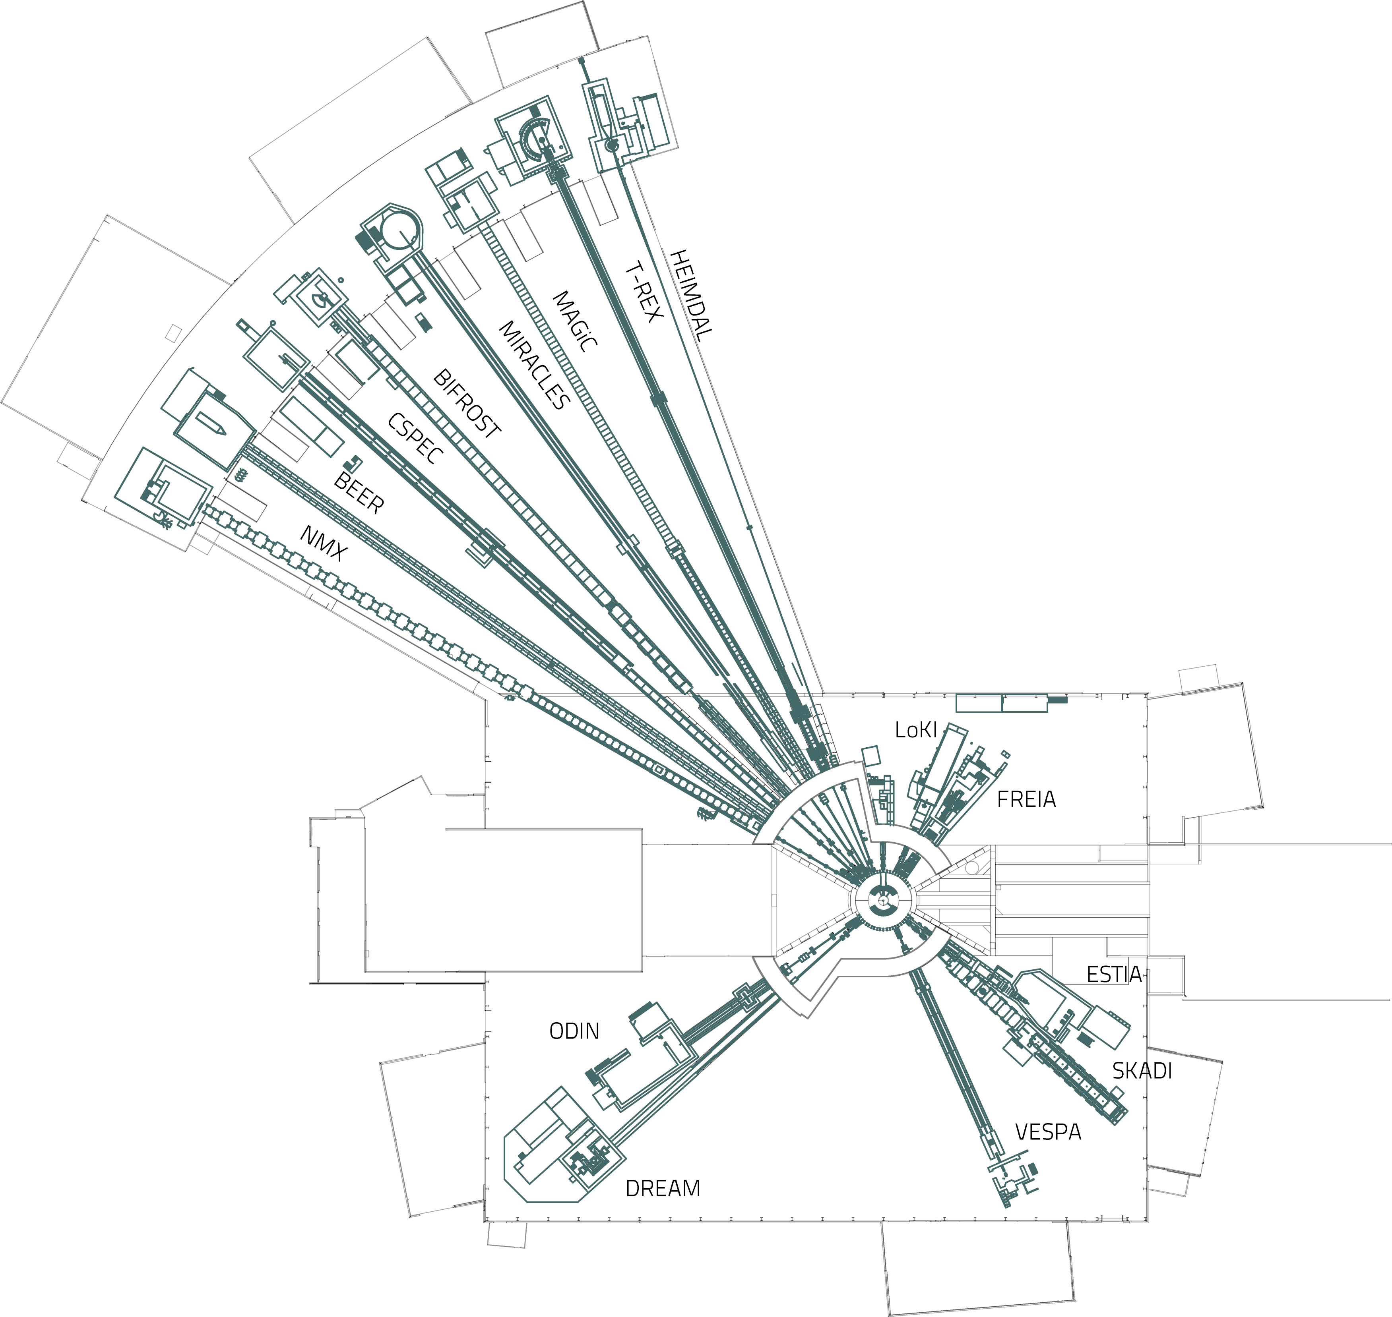
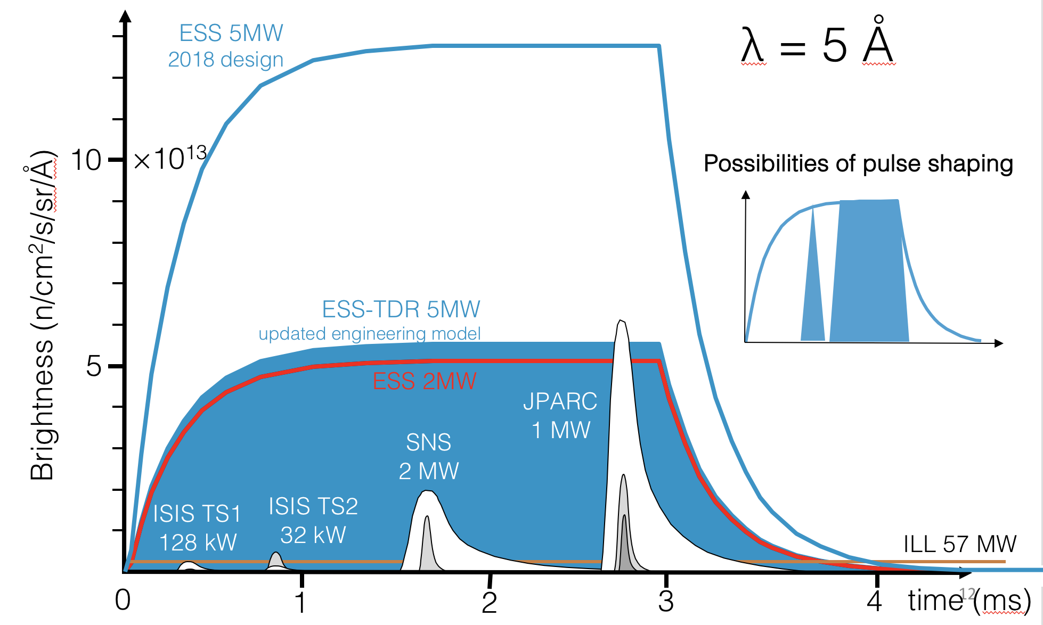
The European Spallation Source
Instruments - Pulse
  14 Hz
  Long pulse
  4% duty cycle
162 m
Proton beam

Slide 9
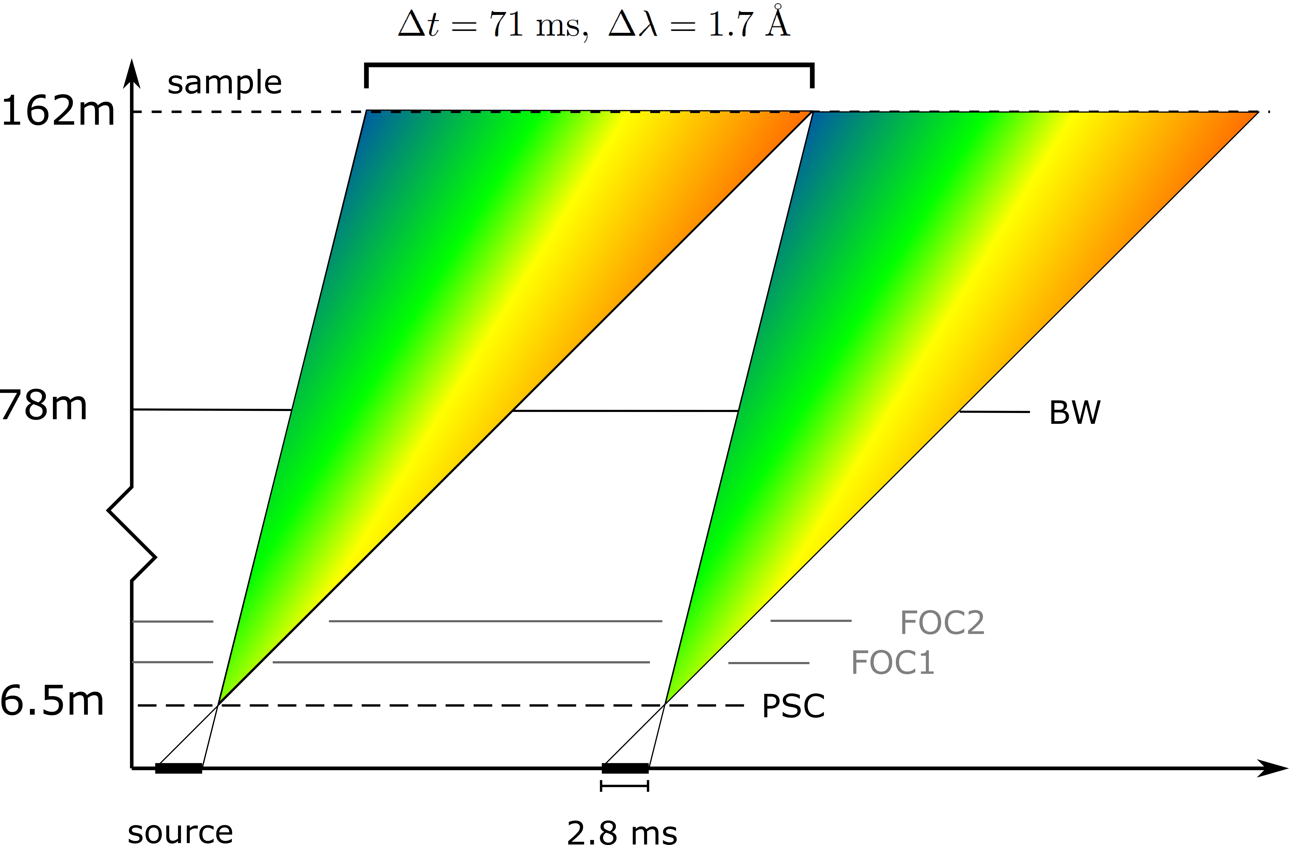
The European Spallation Source
Instruments – Time of Flight
  14 Hz
  Long pulse
  4% duty cycle
162 m
Proton beam

Slide 10
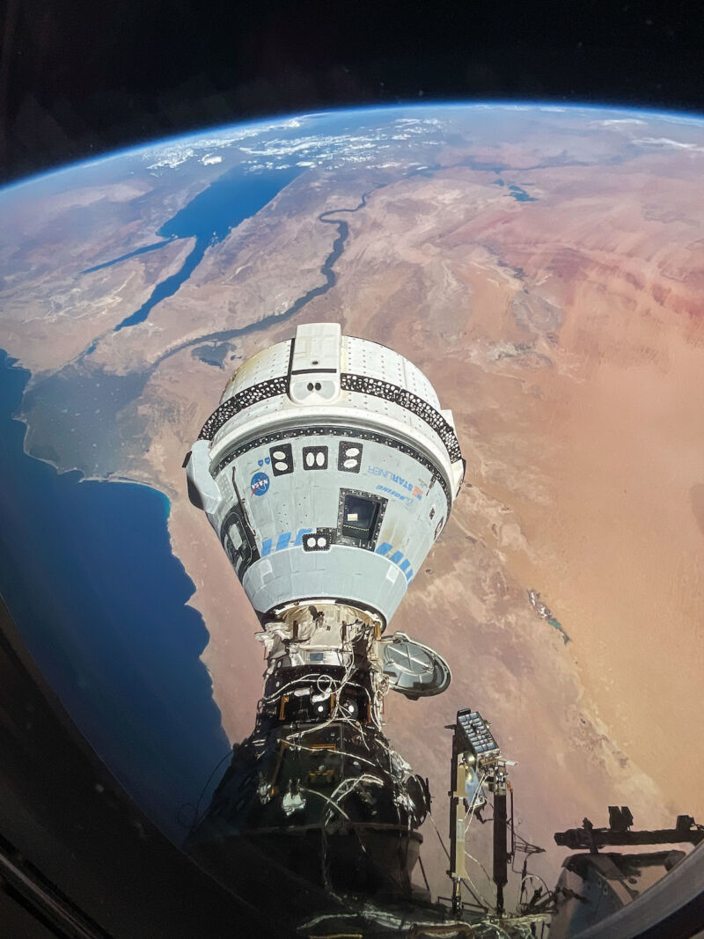
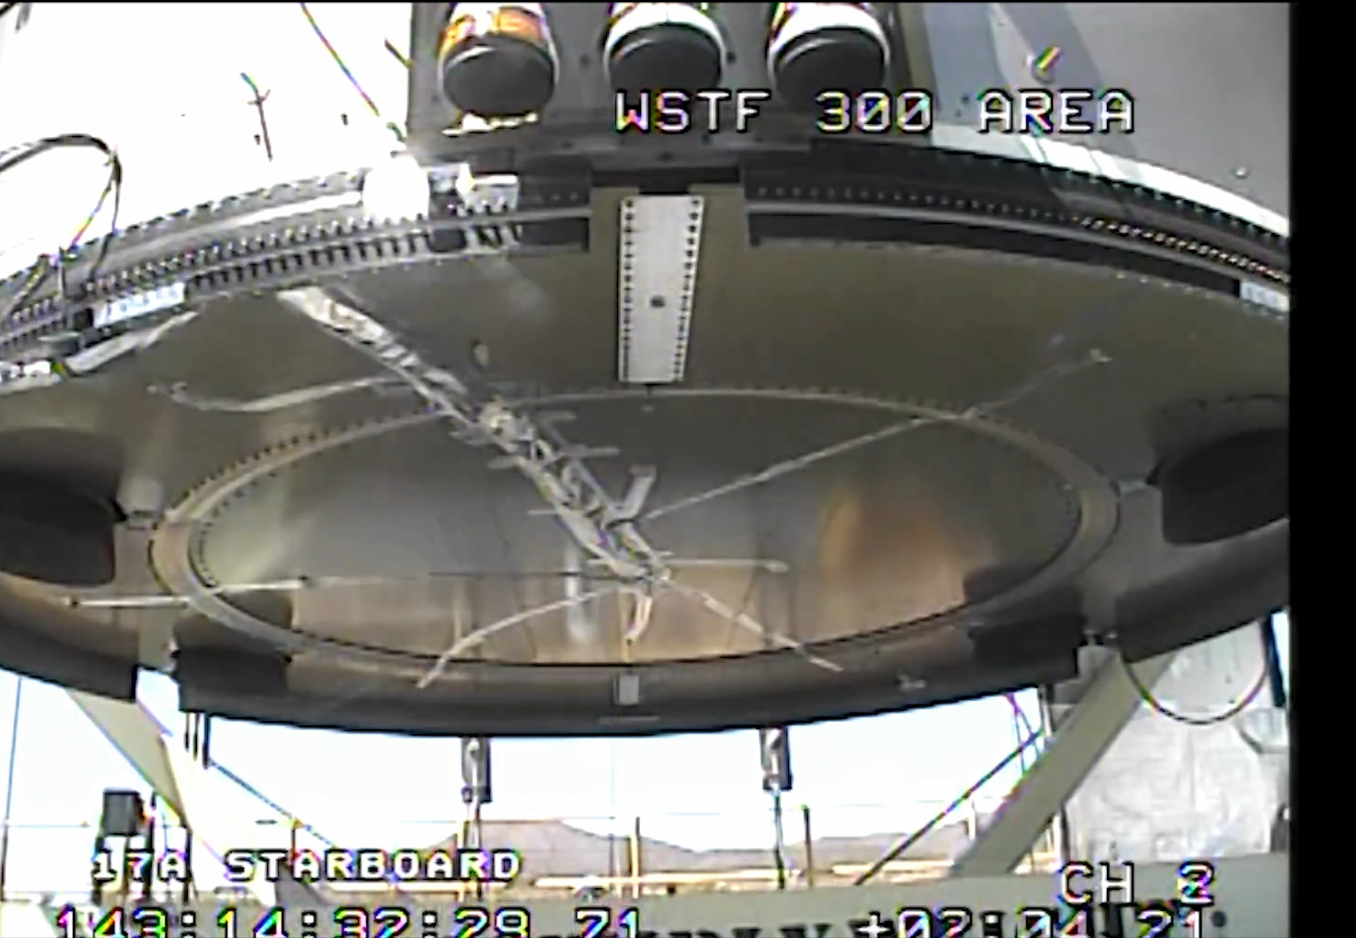
Simulations
What are simulations?
Noun
Imitation of a situation or process
  The action of pretending
  Create a computer model of something

Slide 11
Simulations
Why do we need them?
  Estimate performance of instrument
    Design of instrument
    Estimate of required measurement time
  Prepare for beamtime
    Try out different instrument settings
    Get mock data to try analysis code
  Investigate unexpected results
    Can “cheat” in simulations
    May explain surprising features in data

Slide 12
Simulations
What kind of simulations
  Monte Carlo
    Known probability distributions
    Use random numbers to sample these
    Repeat and generate statistical estimate
  Interactive example

Slide 13
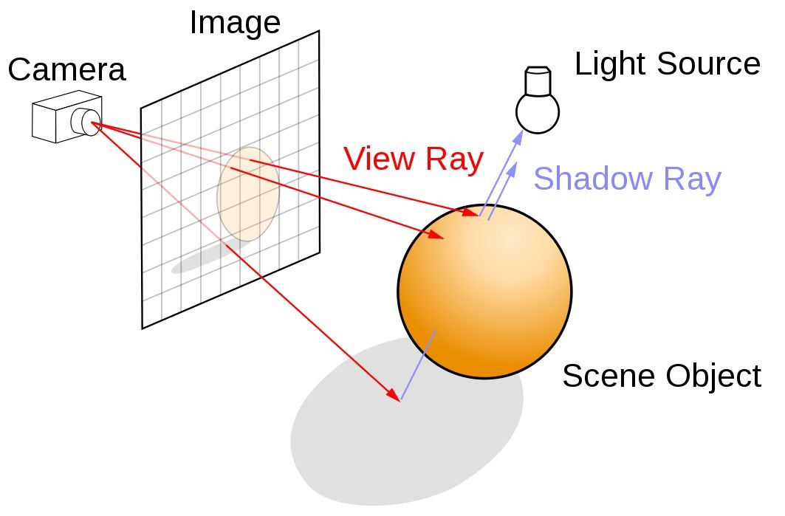
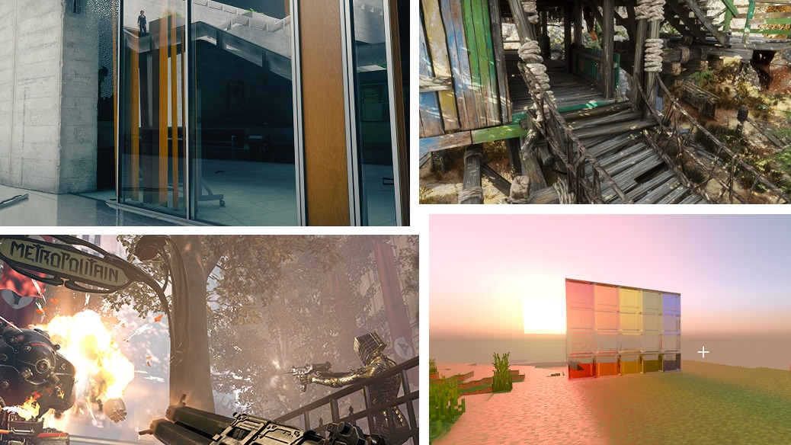
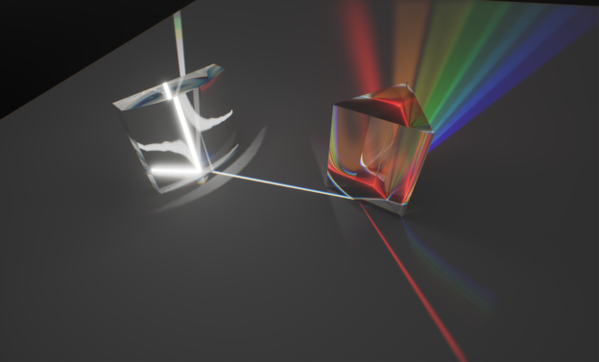
Simulations
What kind of simulations
  Ray Tracing
    Trace paths of rays to learn geometrical information
Images from NVIDIA developer documentation

Slide 14
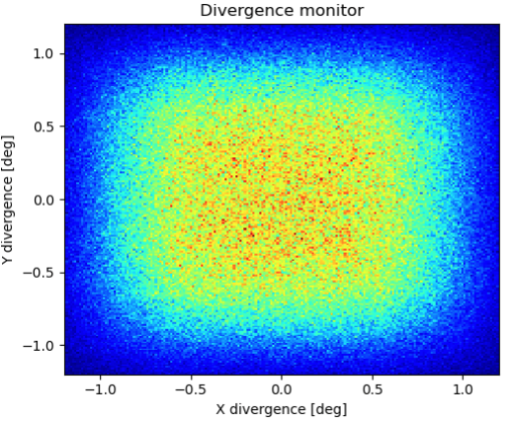
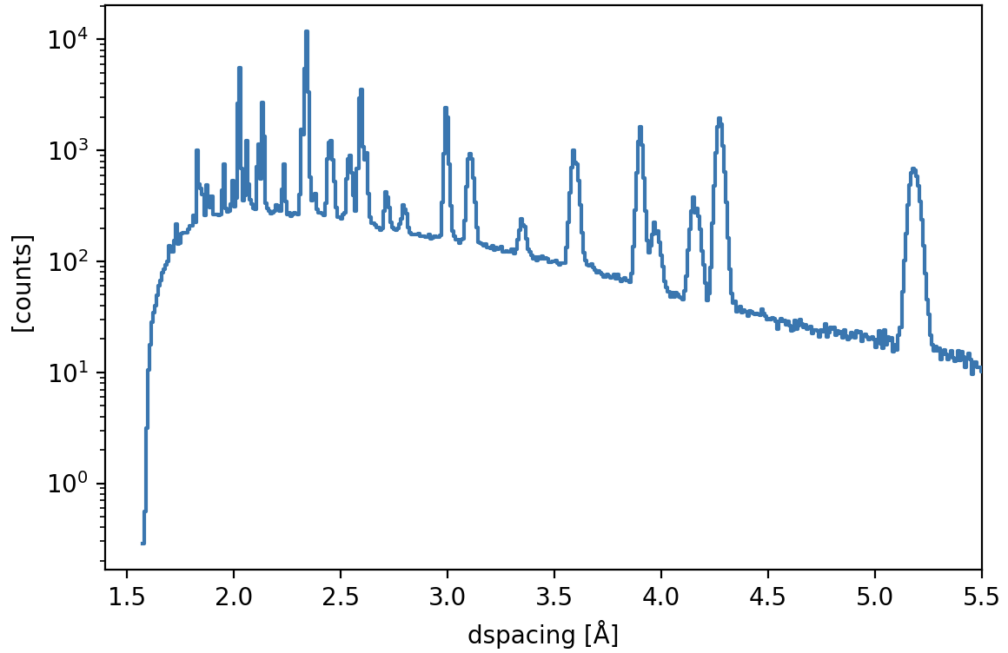
Simulations
Monte Carlo ray-tracing
  Build model of instrument
  Trace neutrons through
    Use Monte Carlo for each interaction
  Build enough statistics to describe performance in terms of:
    Flux
    Resolution
    Background (some types)

Slide 15
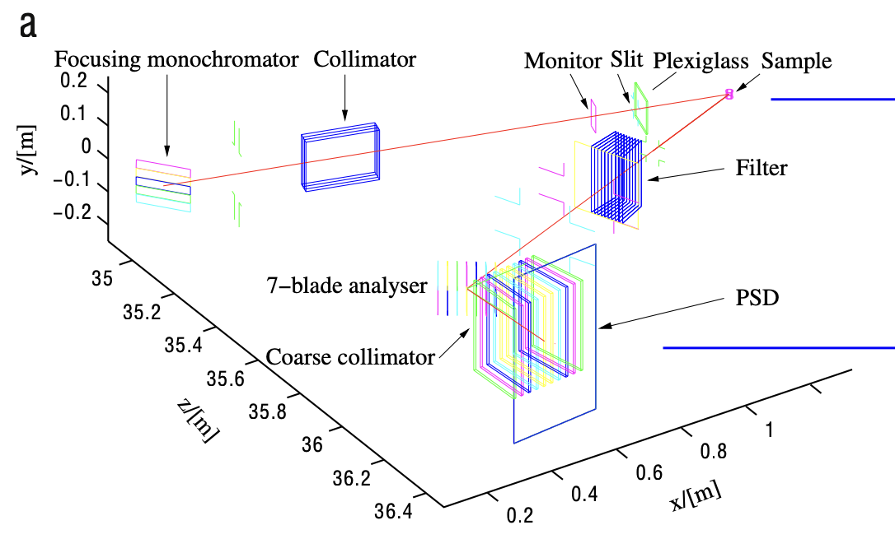
Simulations
Results
  RITA-II Triple axis instrument @ PSI
L. Udby, P.K. Willendrup, E. Knudsen, Ch. Niedermayer, U. Filges, N.B. Christensen, E. Farhi, B.O. Wells, K. Lefmann.
Nuclear Instruments and Methods in Physics Research A 634 (2011) S138–S143

Slide 16
Simulations
Measured data
Results
  Armor @ PSI, Switzerland
Misaligned simulation
0.02 deg
Perfect simulation
J. Stahn, U. Filges and T. Panzner. Eur. Phys. J. Appl. Phys. (2012) 58: 11001

Slide 17
Questions?

