Slide 2
McStas instrument simulations
Mads Bertelsen
PRESENTED BY Mads Bertelsen

Slide 3



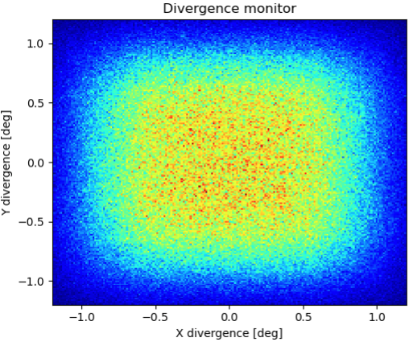
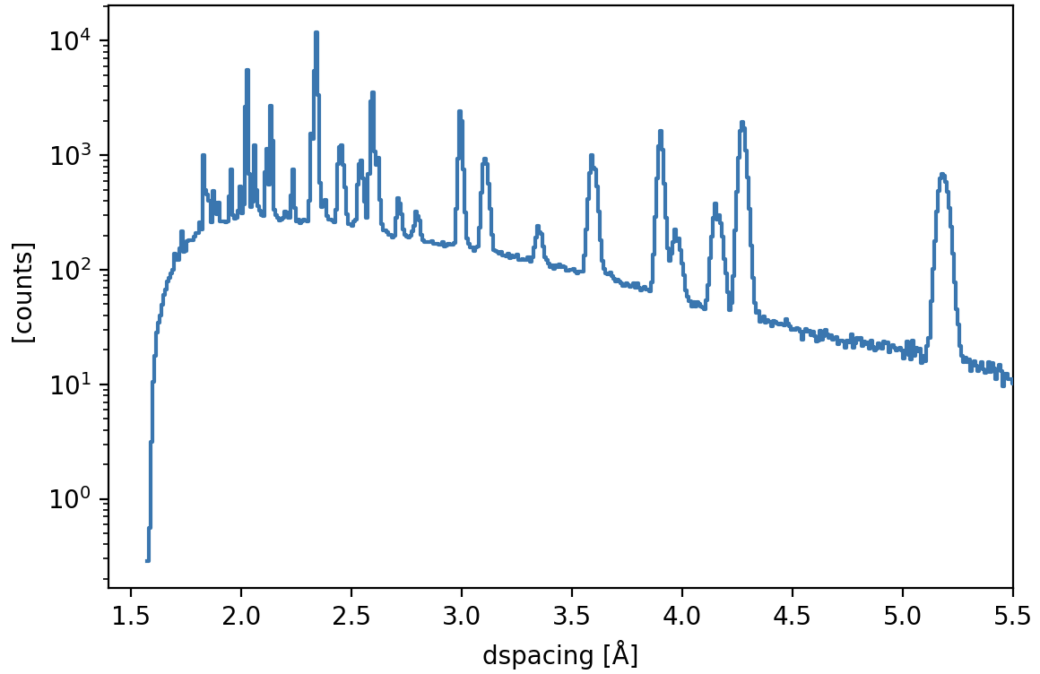
McStas
Overview
  Monte Carlo ray-tracing simulation
  Specialized for neutron scattering
  Started 1998 at RISØ, DK
  2 Full time developers at DMSC
Peter Willendrup
Mads Bertelsen

Slide 4
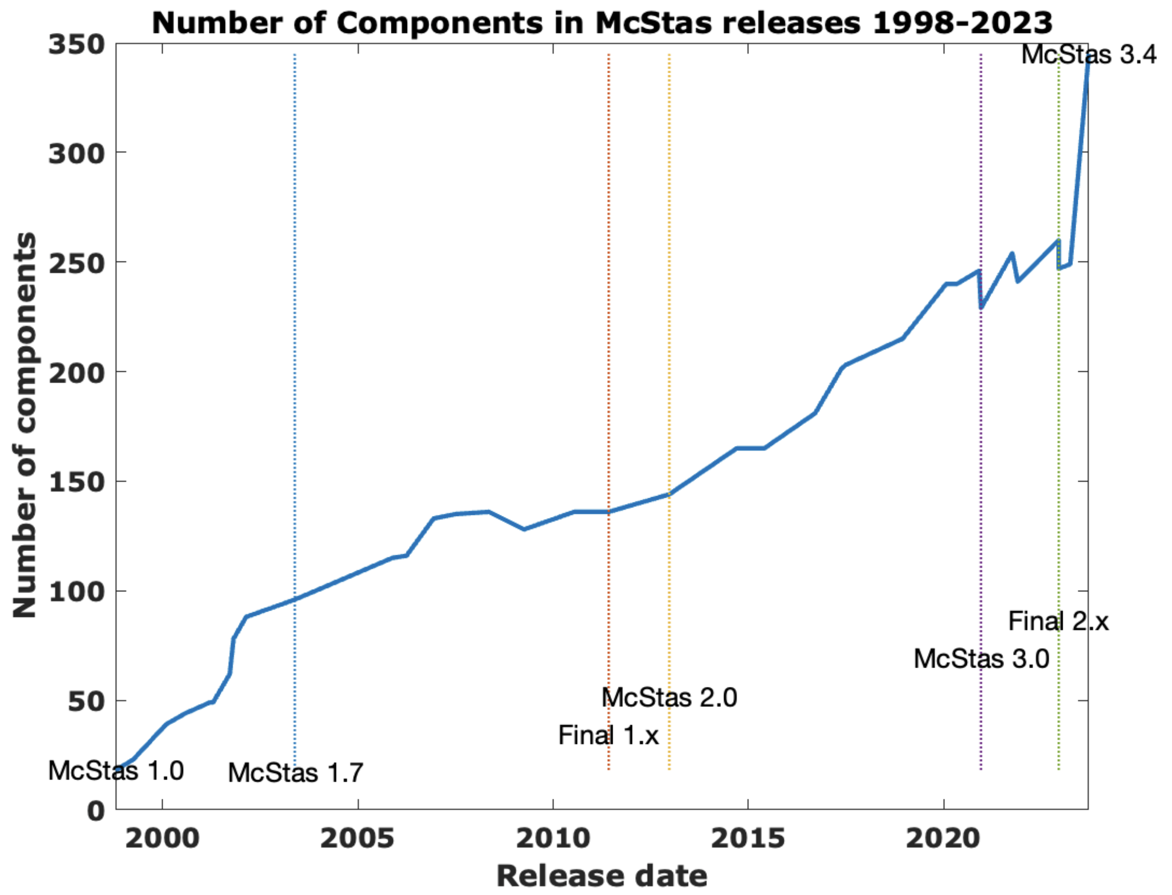
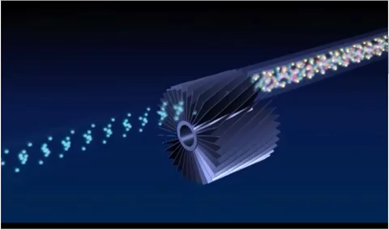
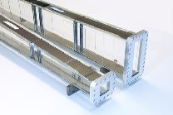
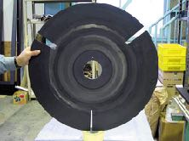
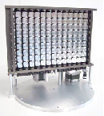
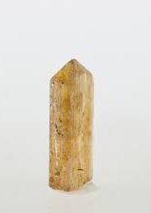
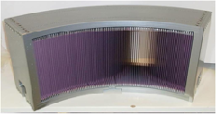
McStas
Components
  Large component library
  Beamline components / Samples / …
  McStas instruments is a sequence of components

Slide 5

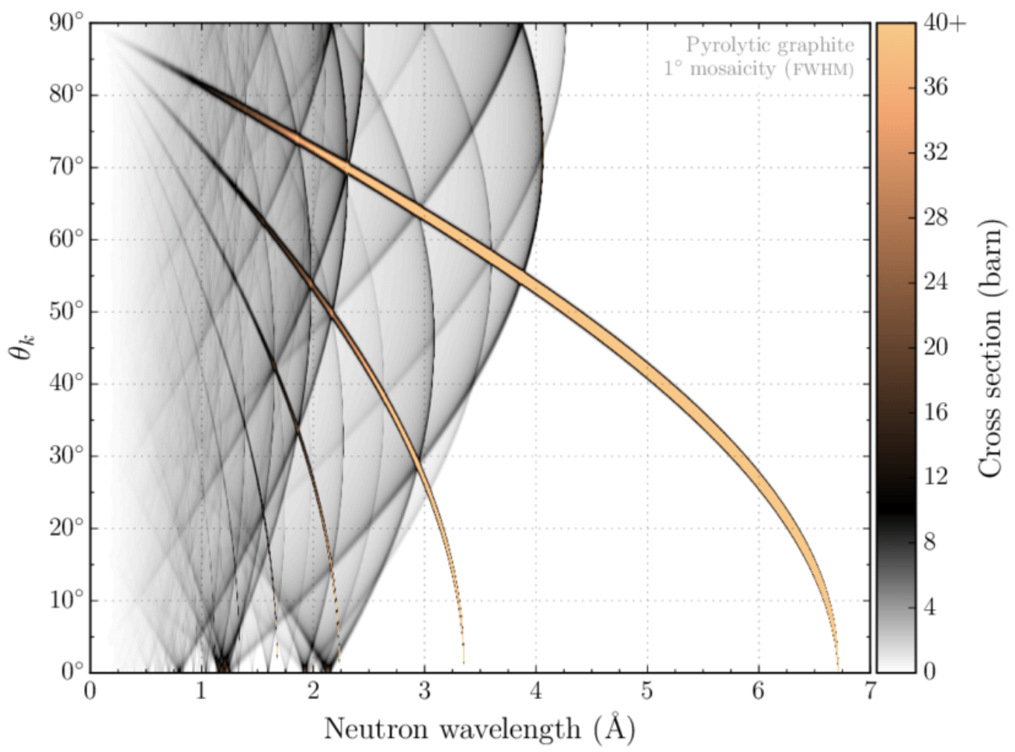

McStas
NCrystal in McStas
  NCrystal scattering kernel library
    Single crystals, powders, gasses, …
    Stand-alone or as plugin, for example GEANT-4
    Plugs into McStas as:
      Sample component / Union process
Bragg scattering in Pyrolytic graphite
Elastic neutron scattering models for Ncrystal, Thomas Kittelmann and Xiao-Xiao Cai, (2021)
Thomas Kittelmann
https://github.com/mctools/ncrystal/wiki
https://github.com/mctools/ncrystal-notebooks

Slide 6
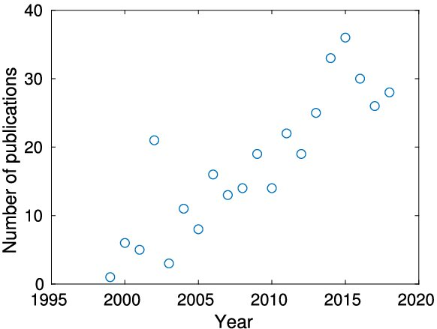
McStas
Community
  Accepted and trusted in community
  More than 400 citations of main papers
  Used to design many ESS instruments
McStas (i): Introduction, use, and basic principles for ray-tracing simulations,
P. K. Willendrup and K. Lefmann, Journal of Neutron Research (2019)

Slide 7
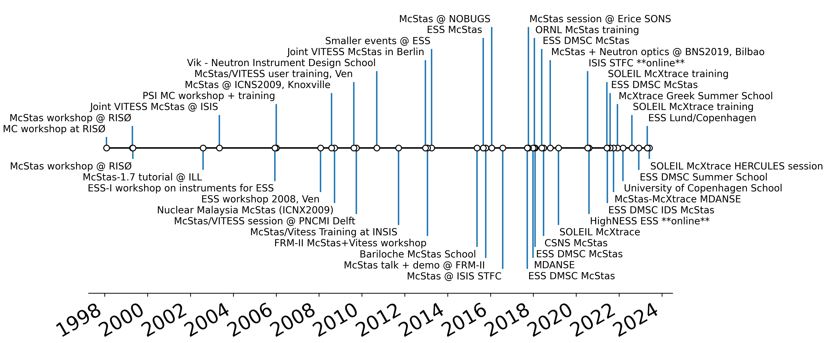
McStas
History of schools
+ e-learning + Local schools + University courses

Slide 8
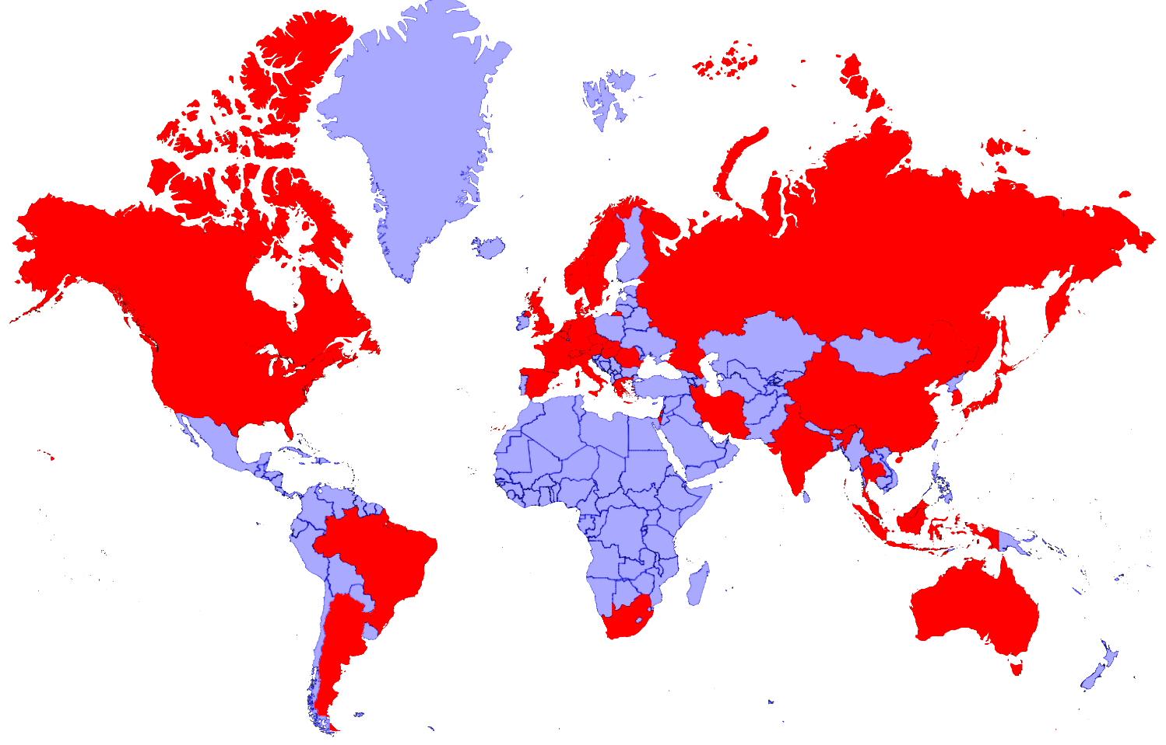


















McStas
Map of usage

Slide 9
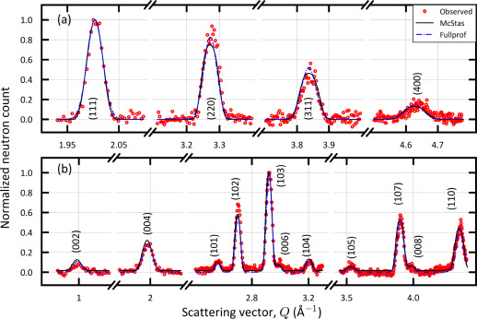
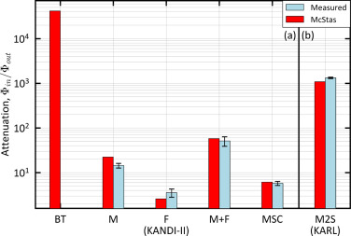
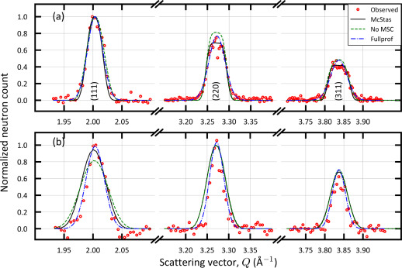
McStas
KANDI-II 2.47 Å wavelength
Si
Verification
  Can replicate real instruments well
  Powder diffractometers in Israel
Gr₂GaC
Foil intensity measurements
KARL Si sample
PG 2.421 Å
Cu 0.98 Å
Verification of the McStas code using two double axis neutron diffractometer,
D. Potashnikov, A. Pesach, O. Rivin, O. Ozeri, Z. Yungrais, M. Bertelsen and E. N. Caspi,
NIMA (2024)

Slide 10
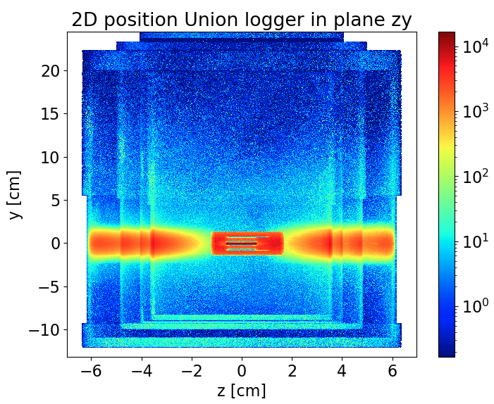
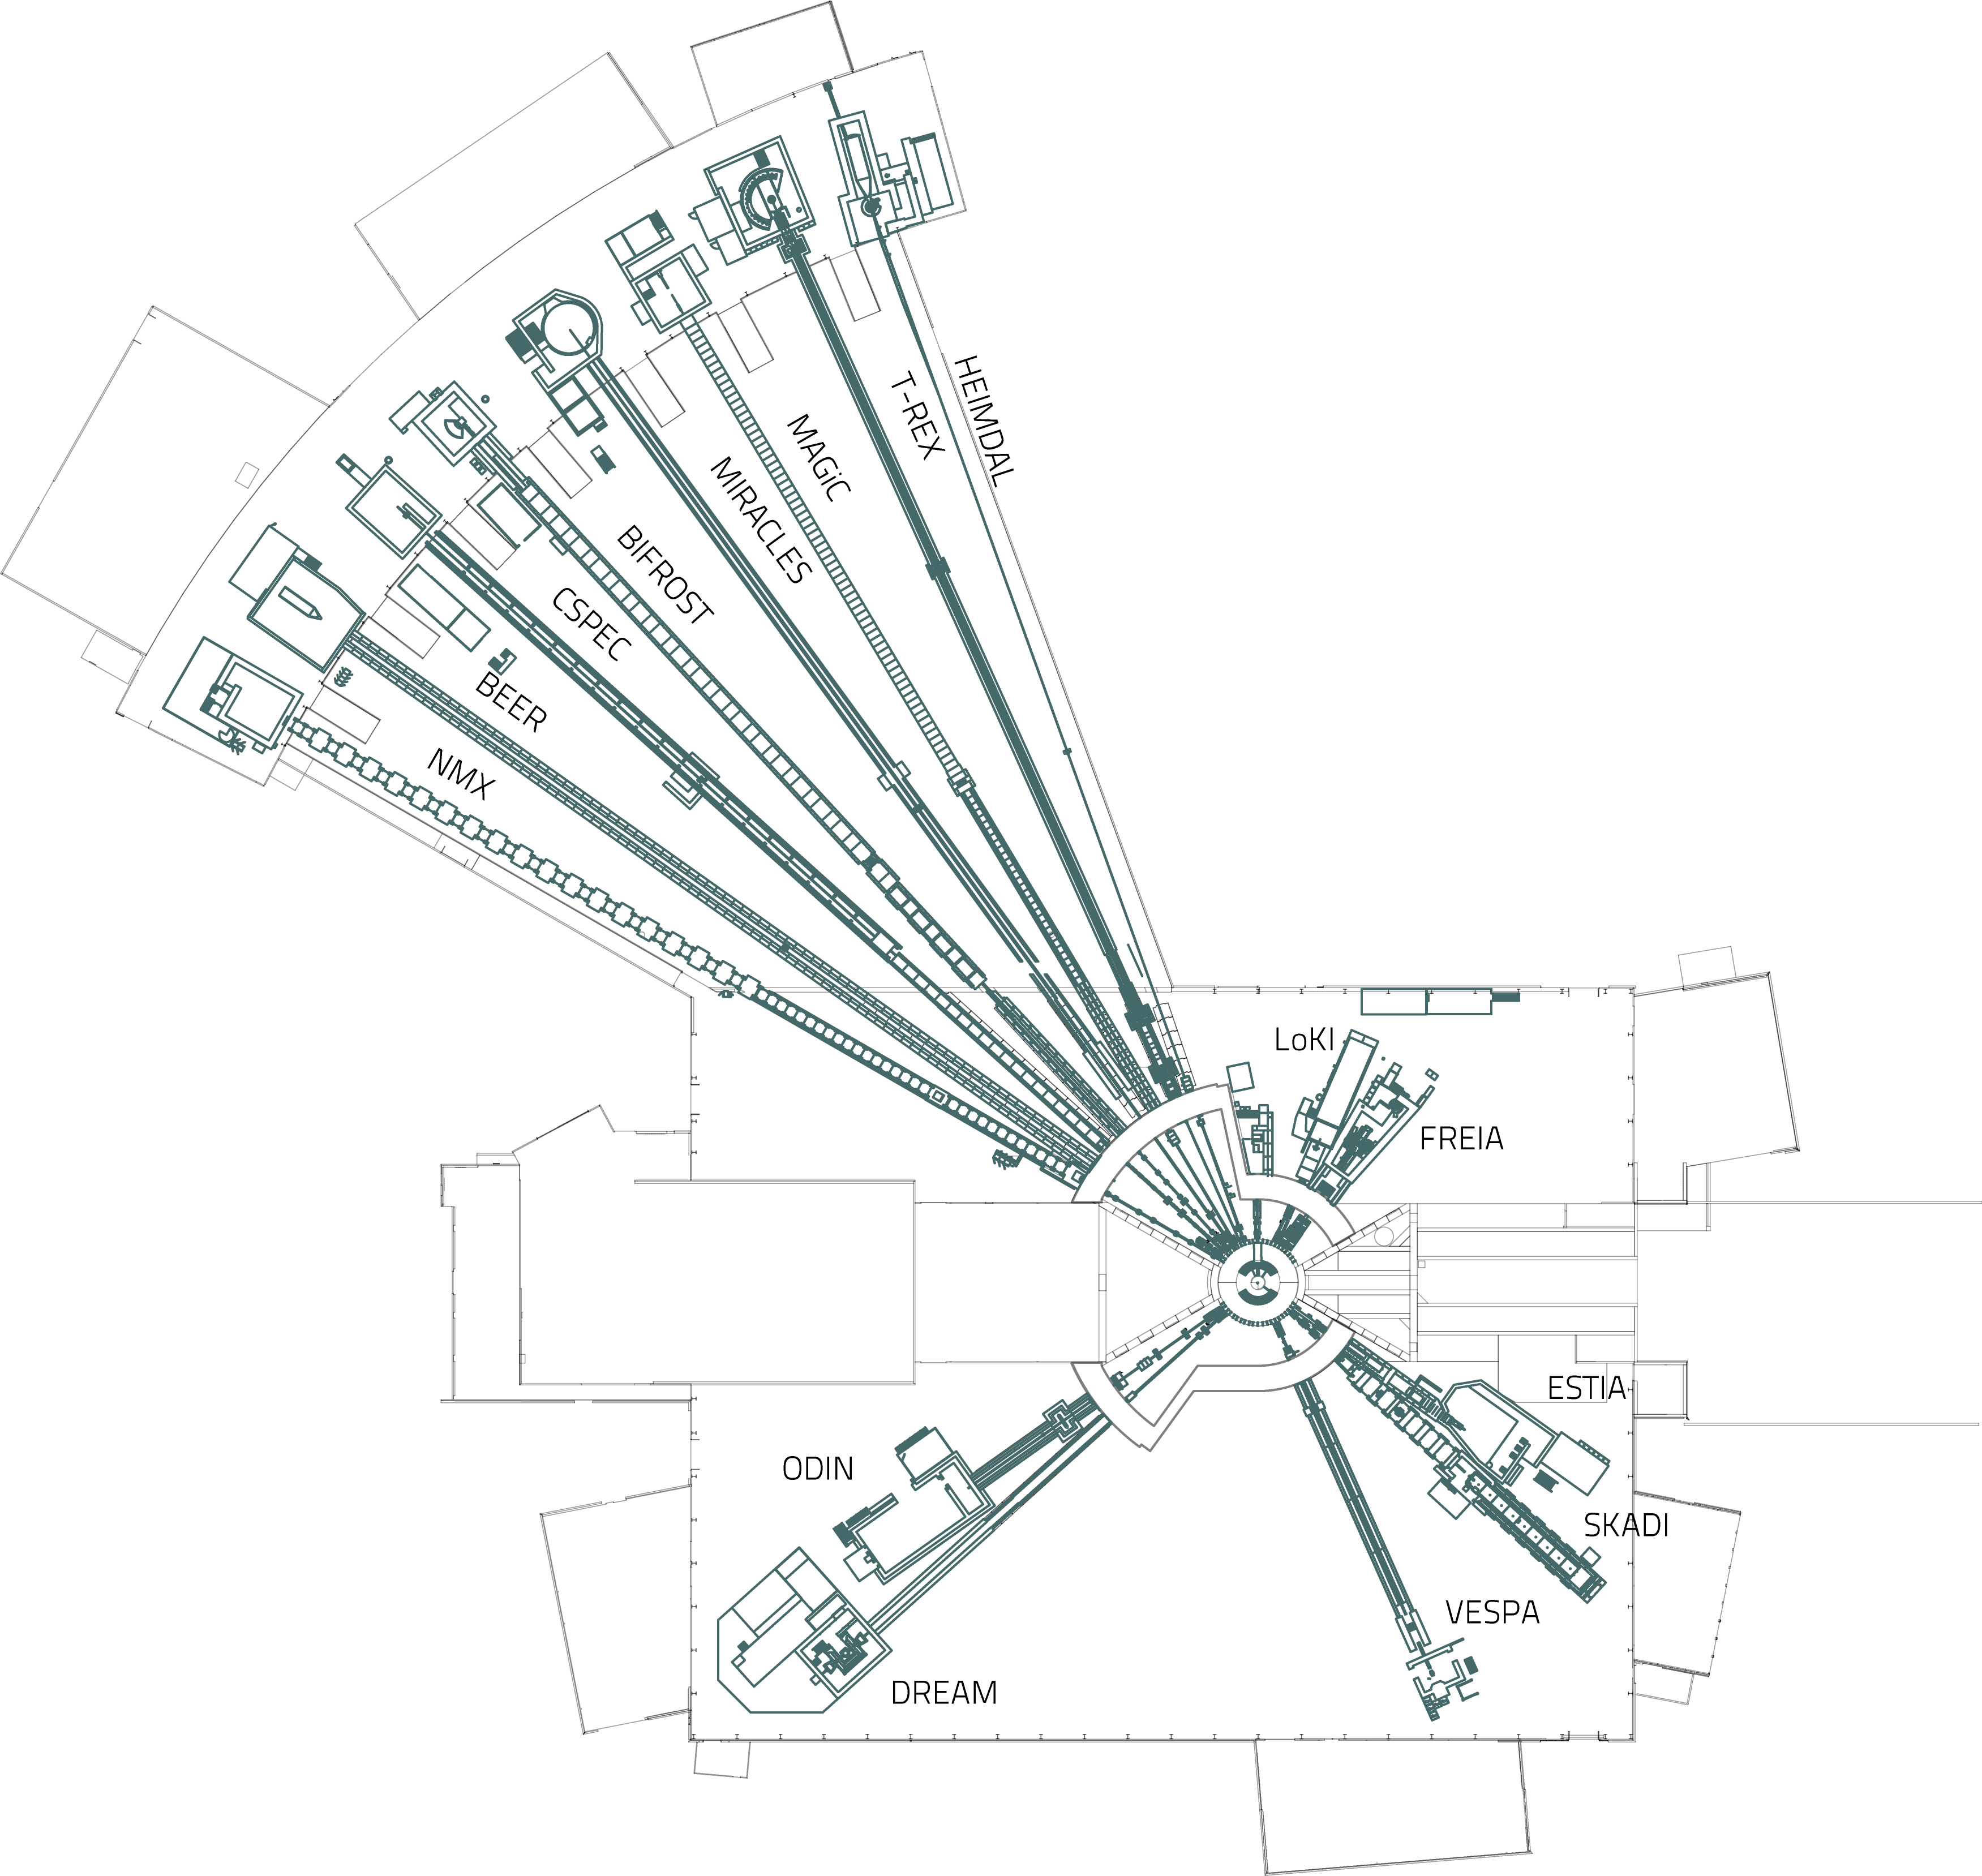
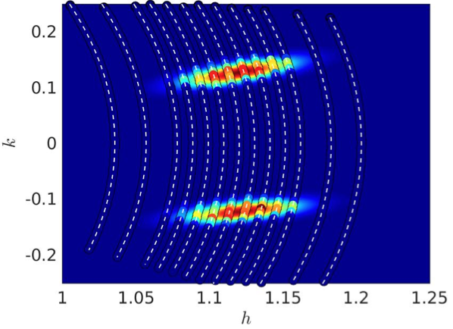

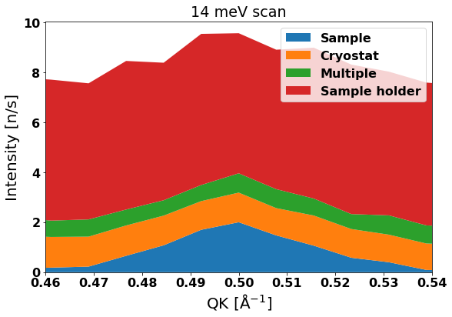
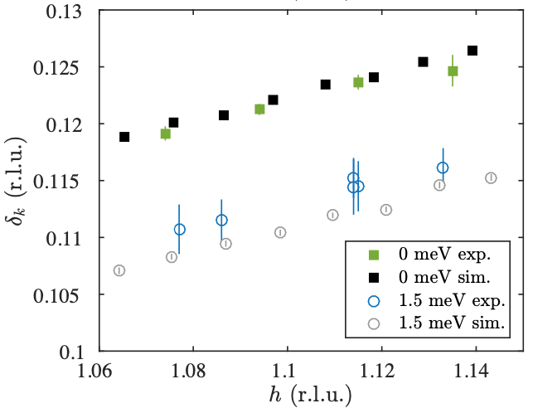
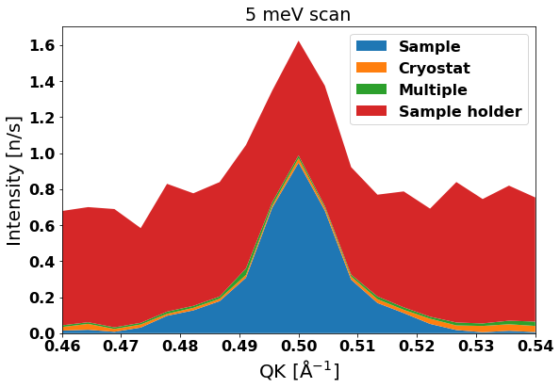
McStas
Cases
Preparation
Design
Virtual experiment
Instrument
Cryostat
Sample holder
Sample
Explanation
“For all instruments, their design has been optimised and their performance thoroughly evaluated using both analytical calculations and Monte-Carlo ray-tracing simulations …”
Investigation of instrument resolution effects on surprising result from measurements, eliminating possible explanations.
Simulated scan of double peak in q
14 meV setting
Confirmation of hypothesis, excludes resolution effects
5 meV setting
G. Simutis, J. Küspert, Q. Wang, J. Choi, D. Bucher, M. Boehm, F. Bourdarot, M. Bertelsen C. N. Wang, T. Kurosawa, N. Momono, M. Oda, M. Månsson, Y. Sassa, M. Janoschek, N. B. Christensen, J. Chang, D. G. Mazzone,
Commun Phys 5, 296 (2022)
H. Jacobsen, S. L. Holm, M.-E. Lăcătuşu, A. T. Rømer, M. Bertelsen, M. Boehm, R. Toft-Petersen, J.-C. Grivel, S. B. Emery, L. Udby, B. O. Wells, K. Lefmann,
Phys. Rev. Lett. 120, 037003 (2018)
K. H. Andersen et. al. The instrument suite of the European Spallation Source, Nucl. Instrum. Methods Phys. Res. A, vol. 957, 163402 (2020)

Slide 11
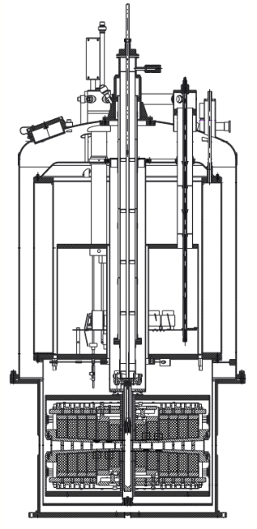
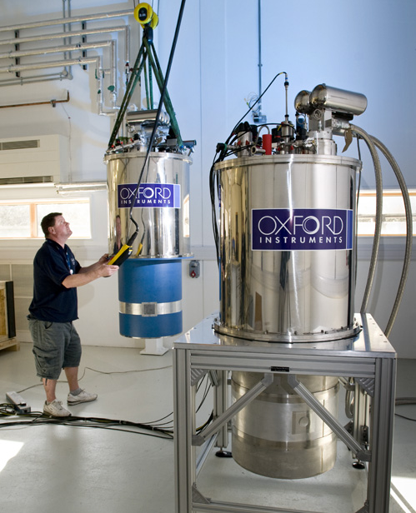
McStas
Union components
  User can assemble sample materials
  Multiple scattering in complex geometry
Incoherent_process
Al
Powder_process
Incoherent_process
Sample
Single_crystal_process
Incoherent_process
Inelastic sample
Single_crystal_process
Phonon_simple_process

Slide 12
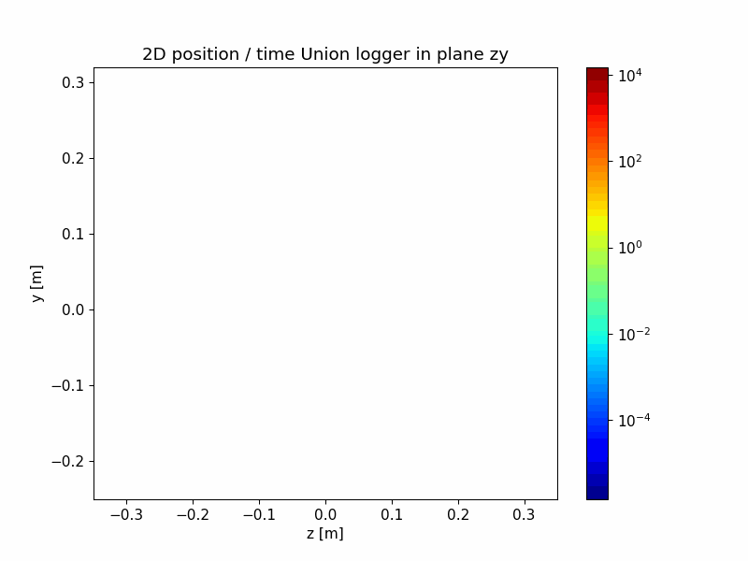
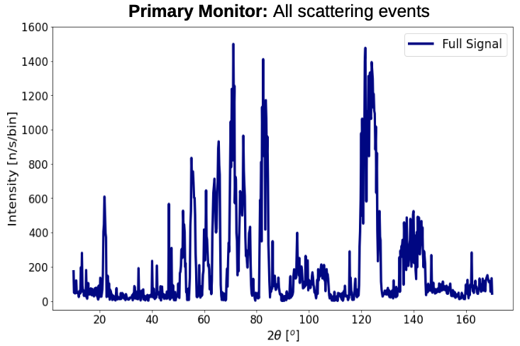
McStas
Magnet project
  Describe geometry and materials
  Good student project
Using McStas Union components to simulate a magnet sample environment and predicting background with machine learning,
Petroula Karacosta, Master thesis with Kim Lefmann, University of Copenhagen

Slide 13

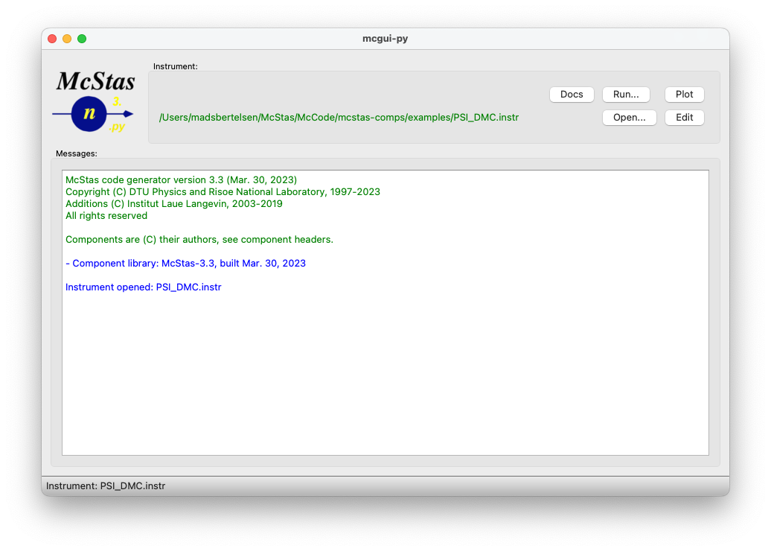

McStas
McStas instrument file
User interface
DEFINE INSTRUMENT example(theta)
DECLARE
// C-code – declare variables
double two_theta;
INITIALIZE
// C-code - perform initial calculations
two_theta = 2.0*theta;
TRACE
// McStas component sequence
Monochromator = Monochromator_flat(
yheight=0.1, zdepth=0.05, Q=1.78)
AT (0,0,2.0) RELATIVE source
ROTATED (0, theta, 0) RELATIVE source
FINALLY
// C-code – perform calculations after simulation
  C meta-language instrument file
  Help and plotting from mcgui

Slide 14
McStas
y
User interface
Instrument file
Simulated instrument
x
COMPONENT A(par=2)
AT (0, 0, 0.5)
ROTATED (-10, 0, 0)
z
COMPONENT B(width=0.3)
AT (0, 0, 4.0)
ROTATED (10, 0, 0)
COMPONENT C(length=2.5)
AT (0, 0, 11.5)
ROTATED (-12, 0, 0)

Slide 15
McStas
Execution of simulation
Simulated instrument
  Assemble from component library
  Place components in a sequence
  Place them in simulated space
  Execute through terminal or mcgui
Instrument file
c file
Executable
COMPONENT A(par=2)
AT (0, 0, 0.5)
ROTATED (10, 0, 0)
COMPONENT B(width=0.3)
AT (0, 0, 4.0)
ROTATED (-10, 0, 0)
COMPONENT C(length=2.5)
AT (0, 0, 11.5)
ROTATED (12, 0, 0)
McStas
compiler
Users
c - compiler

Slide 16
McStas
McStasScript overview
  Python McStas API
    Build instrument object
    Execute simulation
    Receive data as Python objects
  Open source
  https://github.com/PaNOSC-ViNYL/McStasScript
  Comprehensive test suite
Local components
McStasScript
Produced data
Generate instrument file
Instrument file
c file
Executable
McStas
compiler
Users
c - compiler

Slide 17
To Python slides for demo!

