Slide 2

Welcome to the
PRESENTED BY Mads Bertelsen

Slide 3




Sponsors
First a thanks to our sponsors
  Possible to avoid sign up costs due to our four sponsors
  Also thanks to all the people at DMSC who contributed to making this happen
Swedish graduate school providing research training for neutron scattering
Danish organization that provides funding for travel to x-ray and neutron facilities for experiments
French research federation bringing together professionals working in neutron scattering

Slide 4
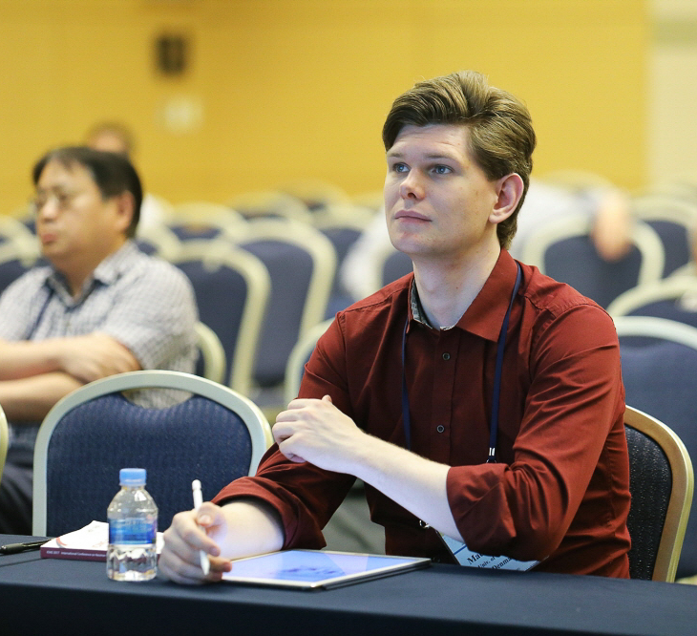

Introduction
Who am I?
Studied physics at University of Copenhagen
PhD with Kim Lefmann (graduated 2017)
Joined ESS DMSC in 2019
Mainly work with McStas instrument simulations
In modelling group with:
    Peter Willendrup: Main McStas developer
    Thomas Kittleman: Main Ncrystal developer
Mads Bertelsen

Slide 5
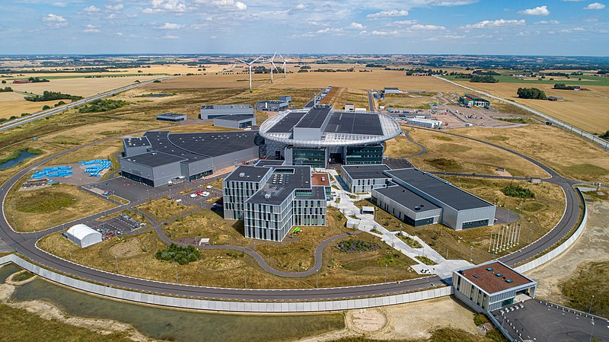
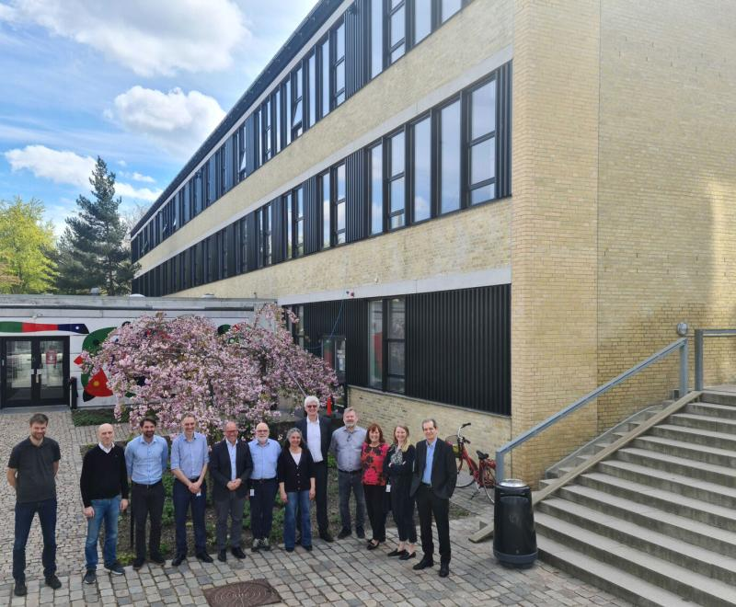















ESS and DMSC
One project, two host countries
European Spallation Source (ESS)
ESS in Lund
Data Management and Software Centre (DMSC)
DMSC in
Copenhagen

Slide 6
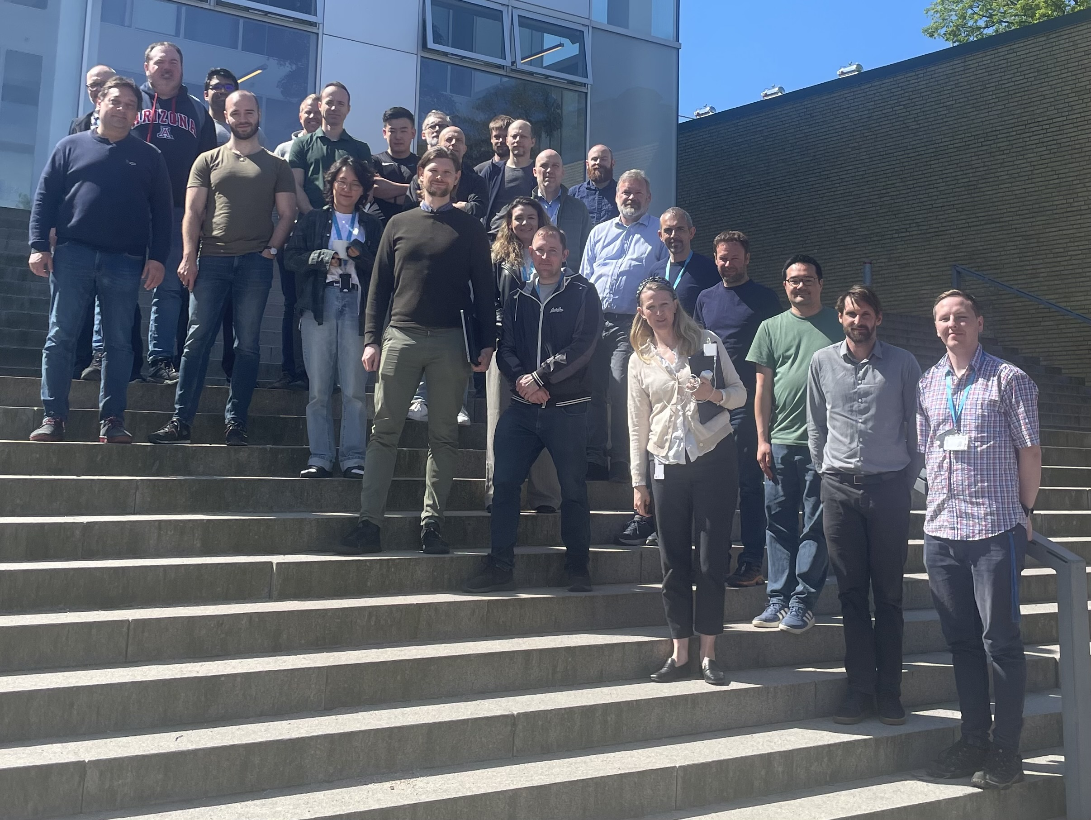
Facility and Software
One project, two host countries
  This summer school is organized by DMSC
  Approximately 42 full time employees
  Will reach over 60 at full operation
  Very international, 20 countries represented
  Responsible for scientific software for ESS
  Not all software for running the facility

Slide 7
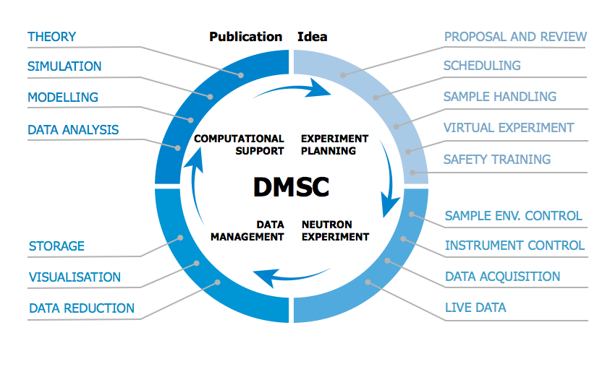
Facility and Software
DMSC Responsibilities

Slide 8
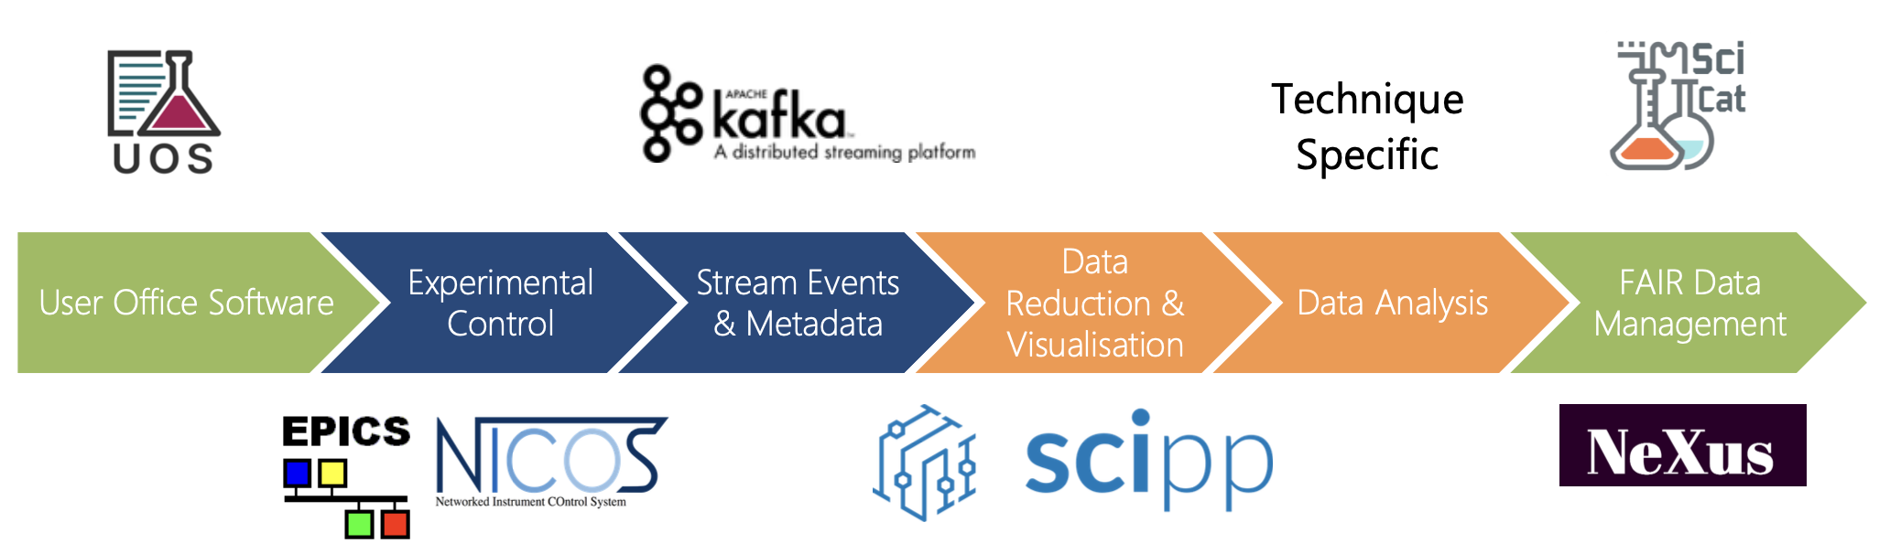
Facility and Software
DMSC Responsibilities
Monday | Tuesday | Wednesday | Thursday | Friday
See site | Talk on user office | Reduction | Analysis | Storage
Poster Session | Intro to storage
Python | Simulation
 | AI Game |  | Dinner

Slide 9
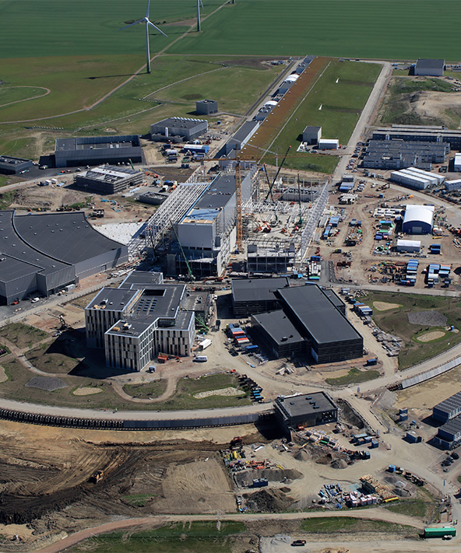
ESS Overview

Slide 10
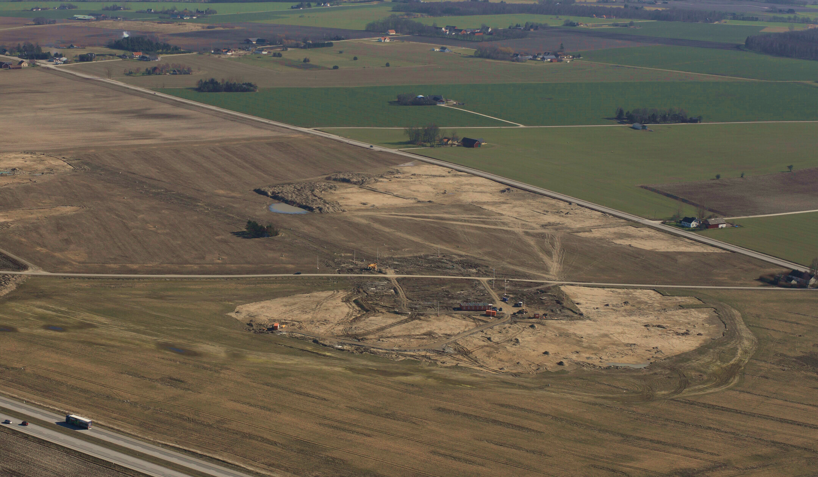
The European Spallation Source
12th of March 2014

Slide 11
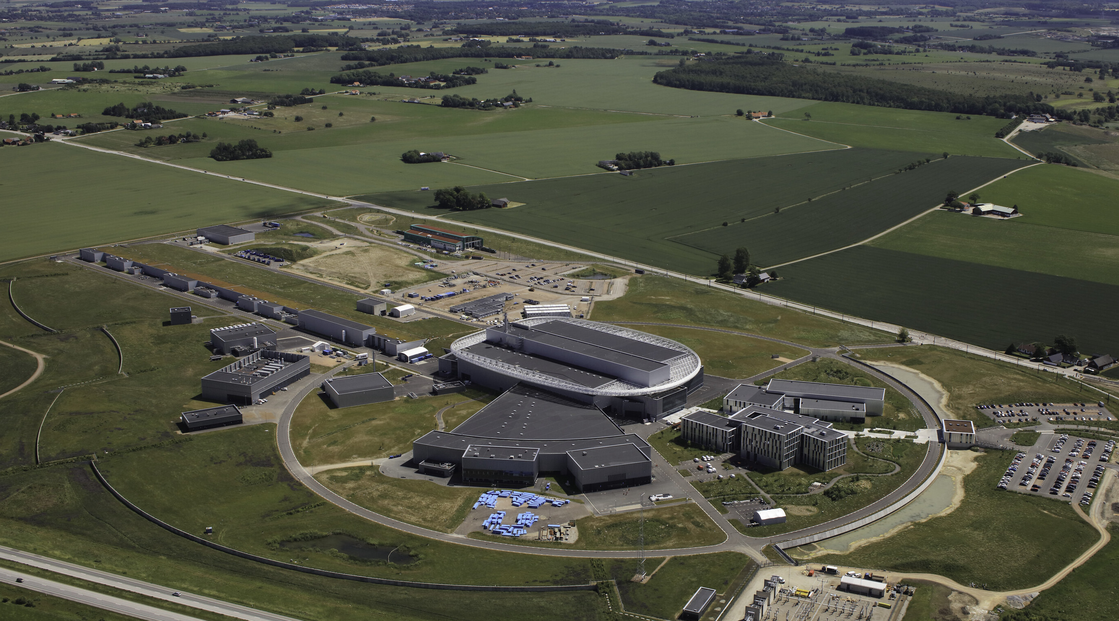
The European Spallation Source
16th of June 2022

Slide 12
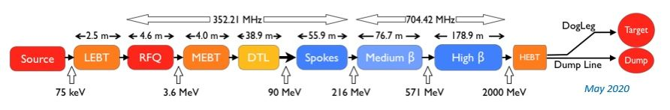
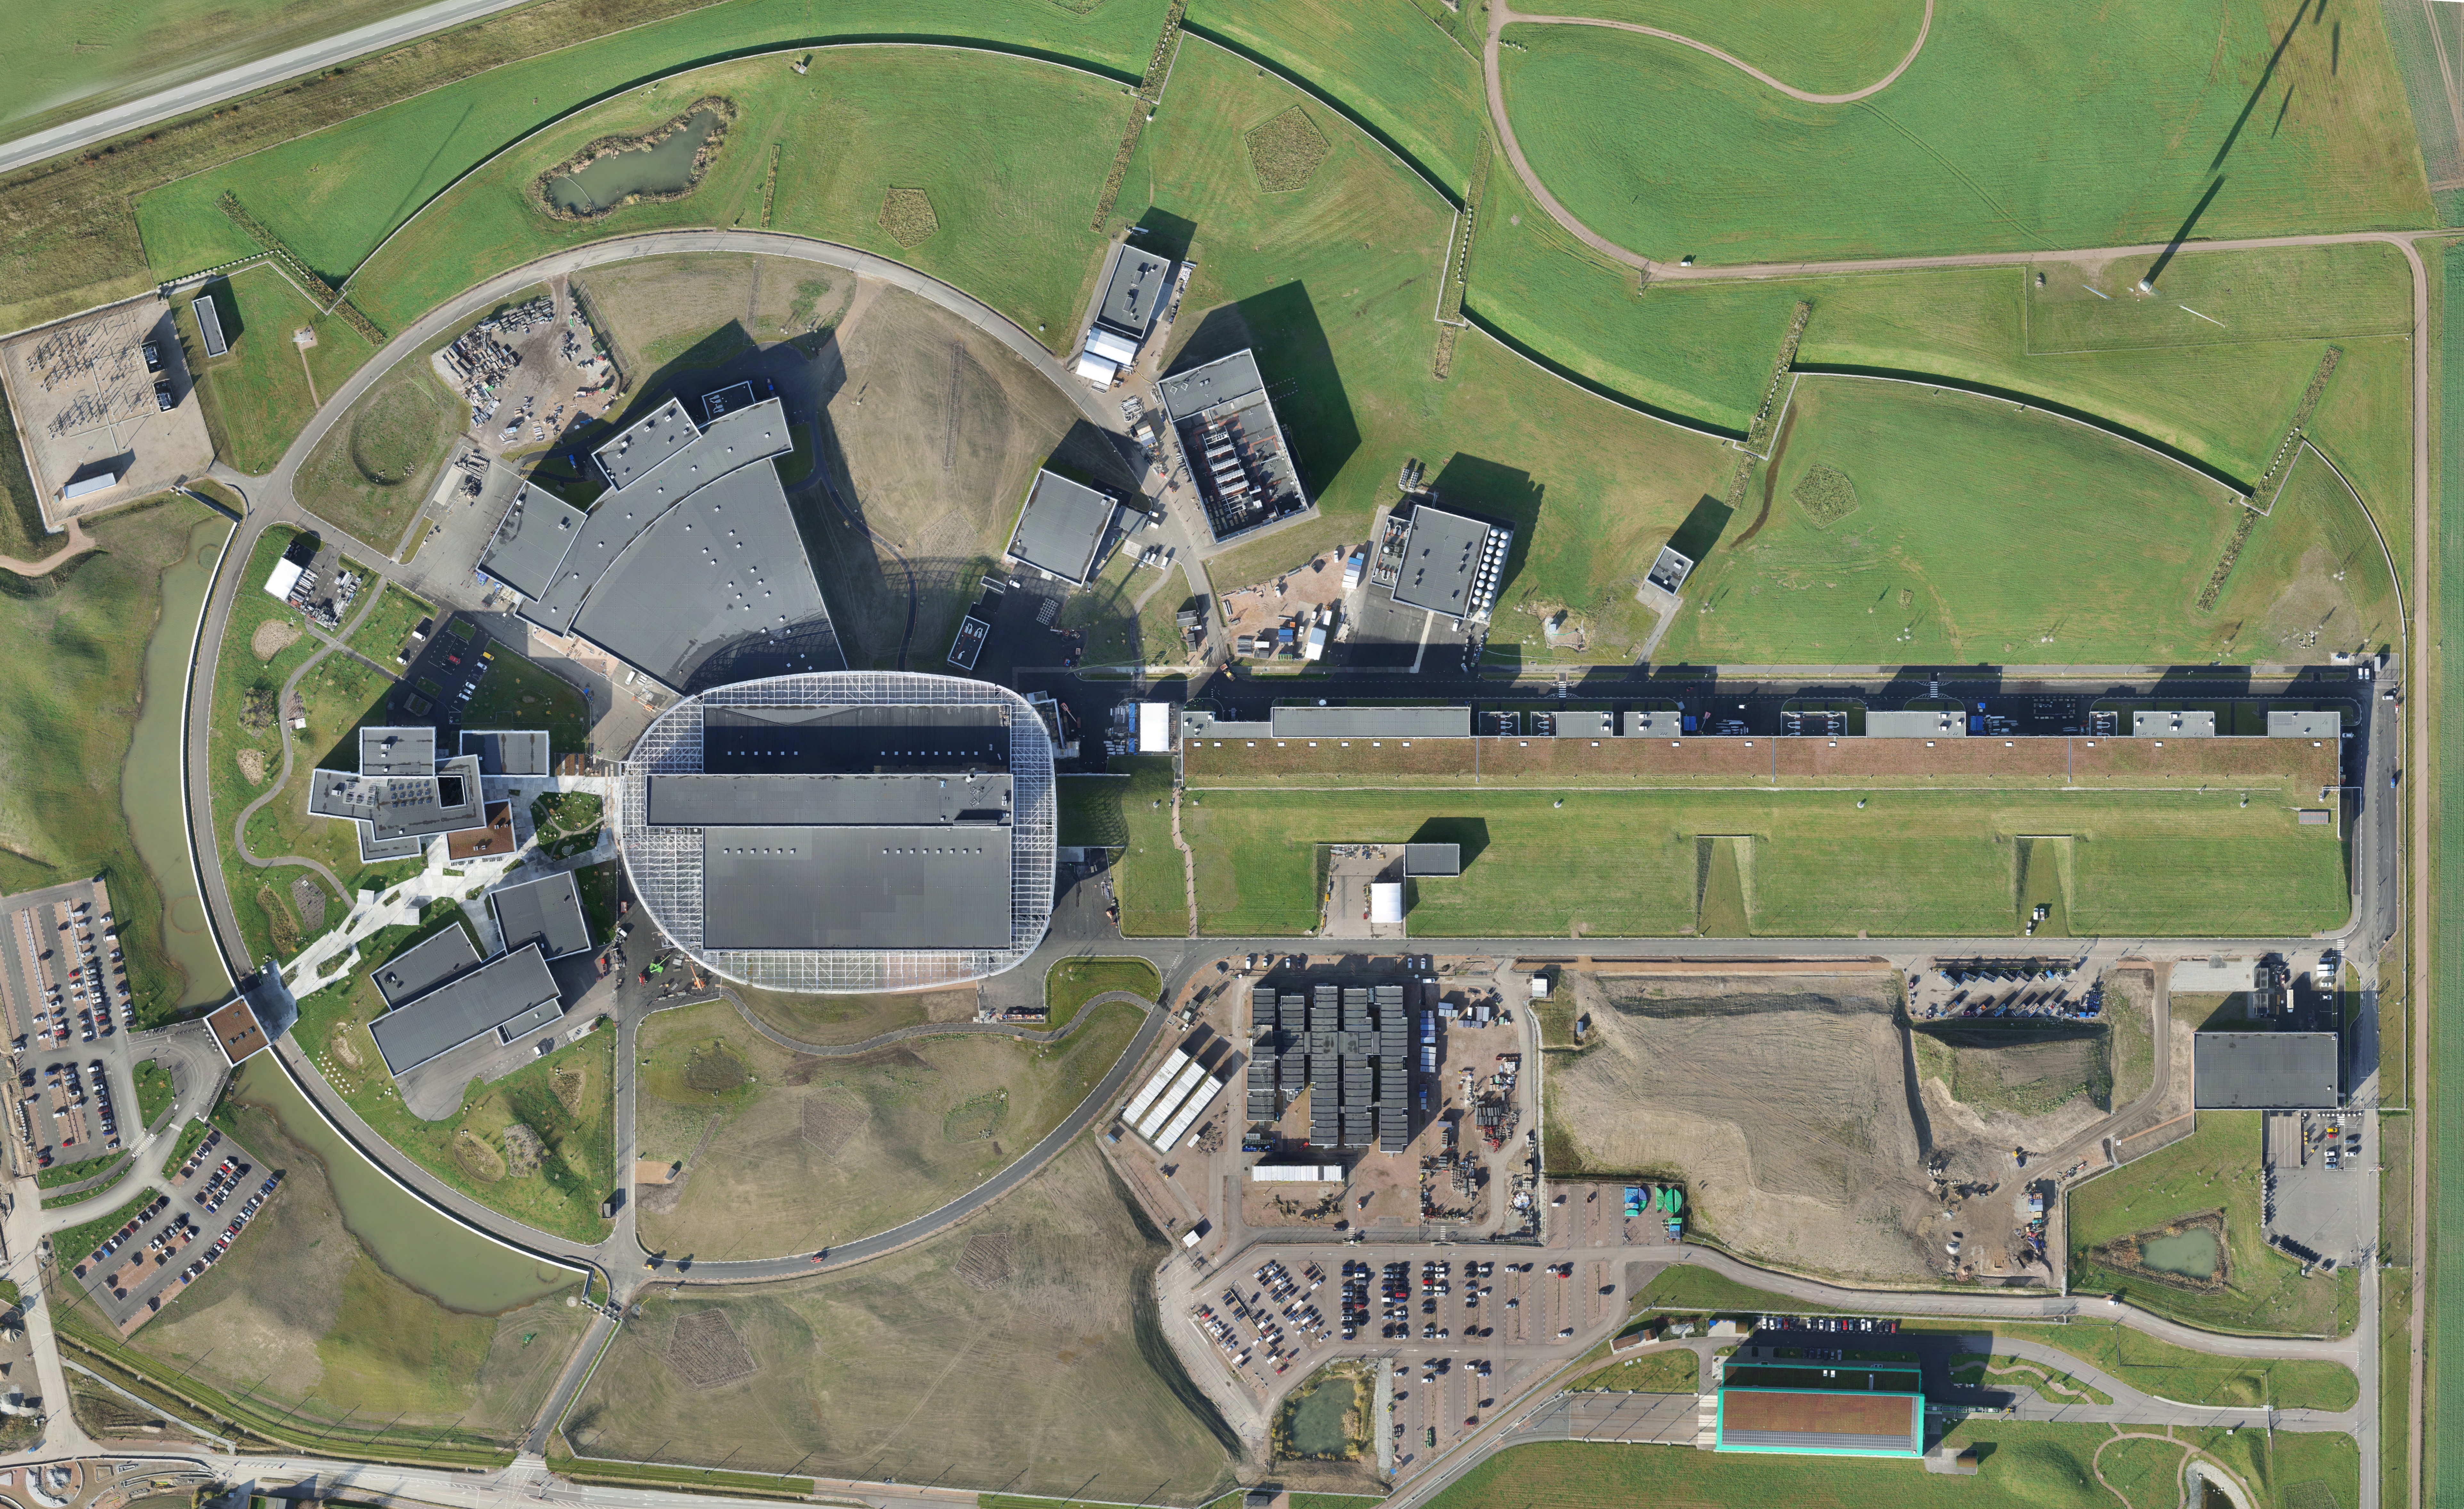
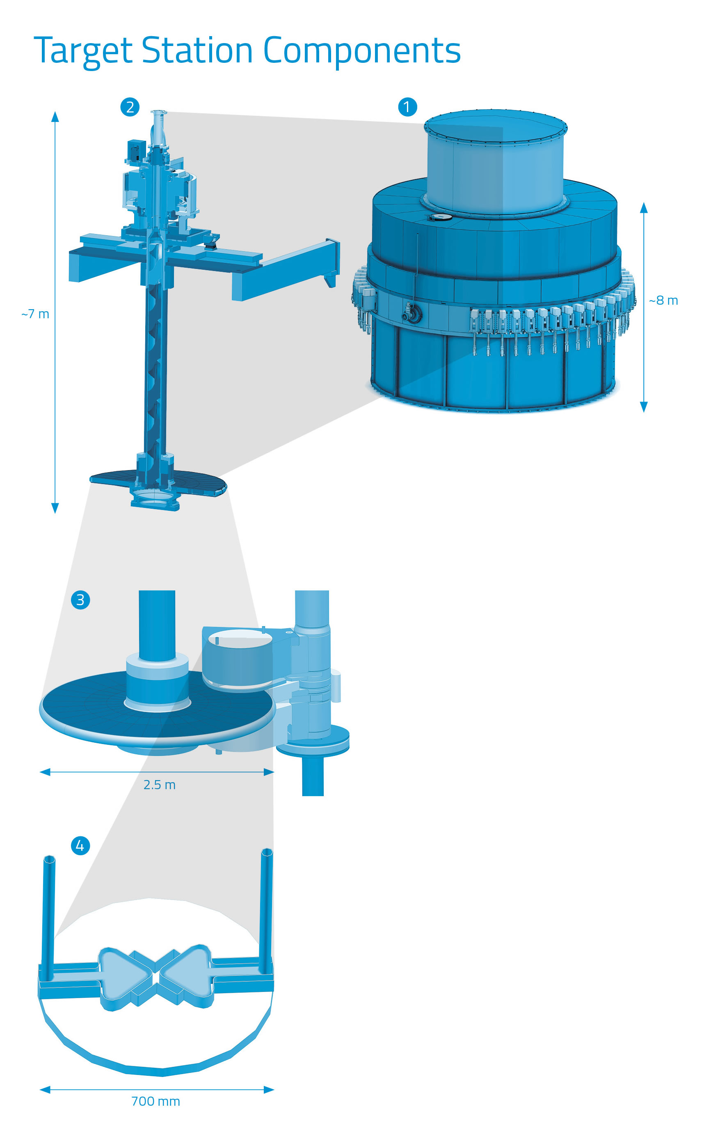
The European Spallation Source
2 MW Proton Accelerator - Goal of 5 MW
178.9 m
76.7 m
55.9 m
38.9 m
4.0 m
4.6 m
2.5 m
HEBT
High ß
Medium ß
Spokes
DTL
MEBT
RFQ
LEBT
Source
2000 MeV
517 MeV
216 MeV
90 MeV
3.6 MeV
75 keV
Copyright Skanska, photographer: Skanska Surveyors

Slide 13
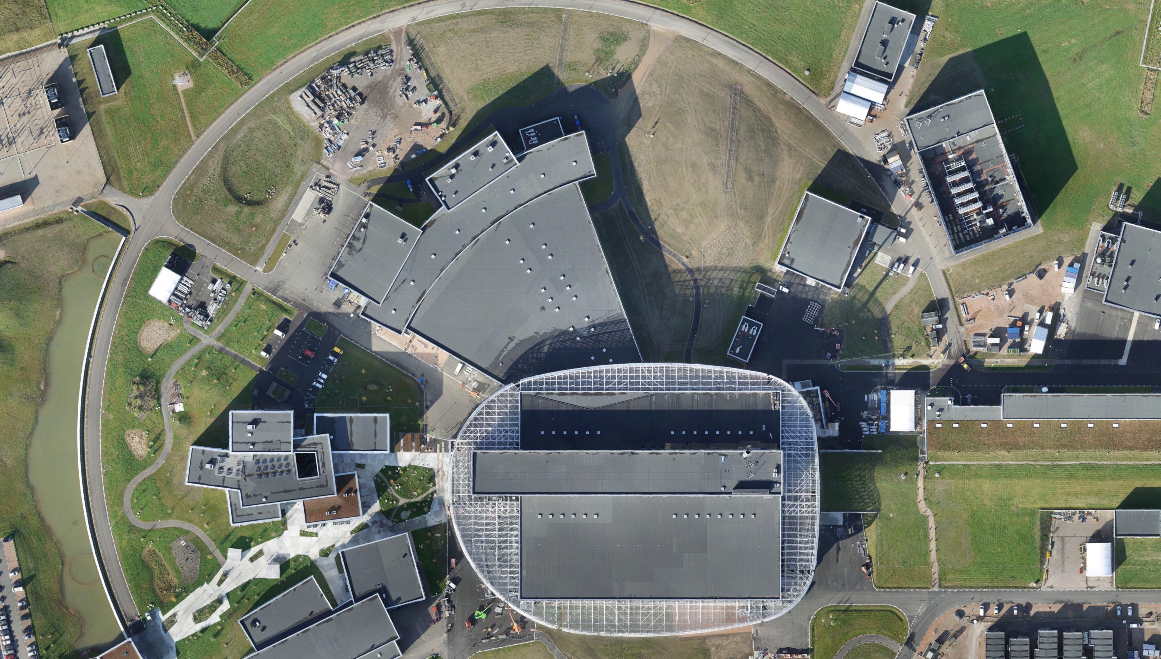
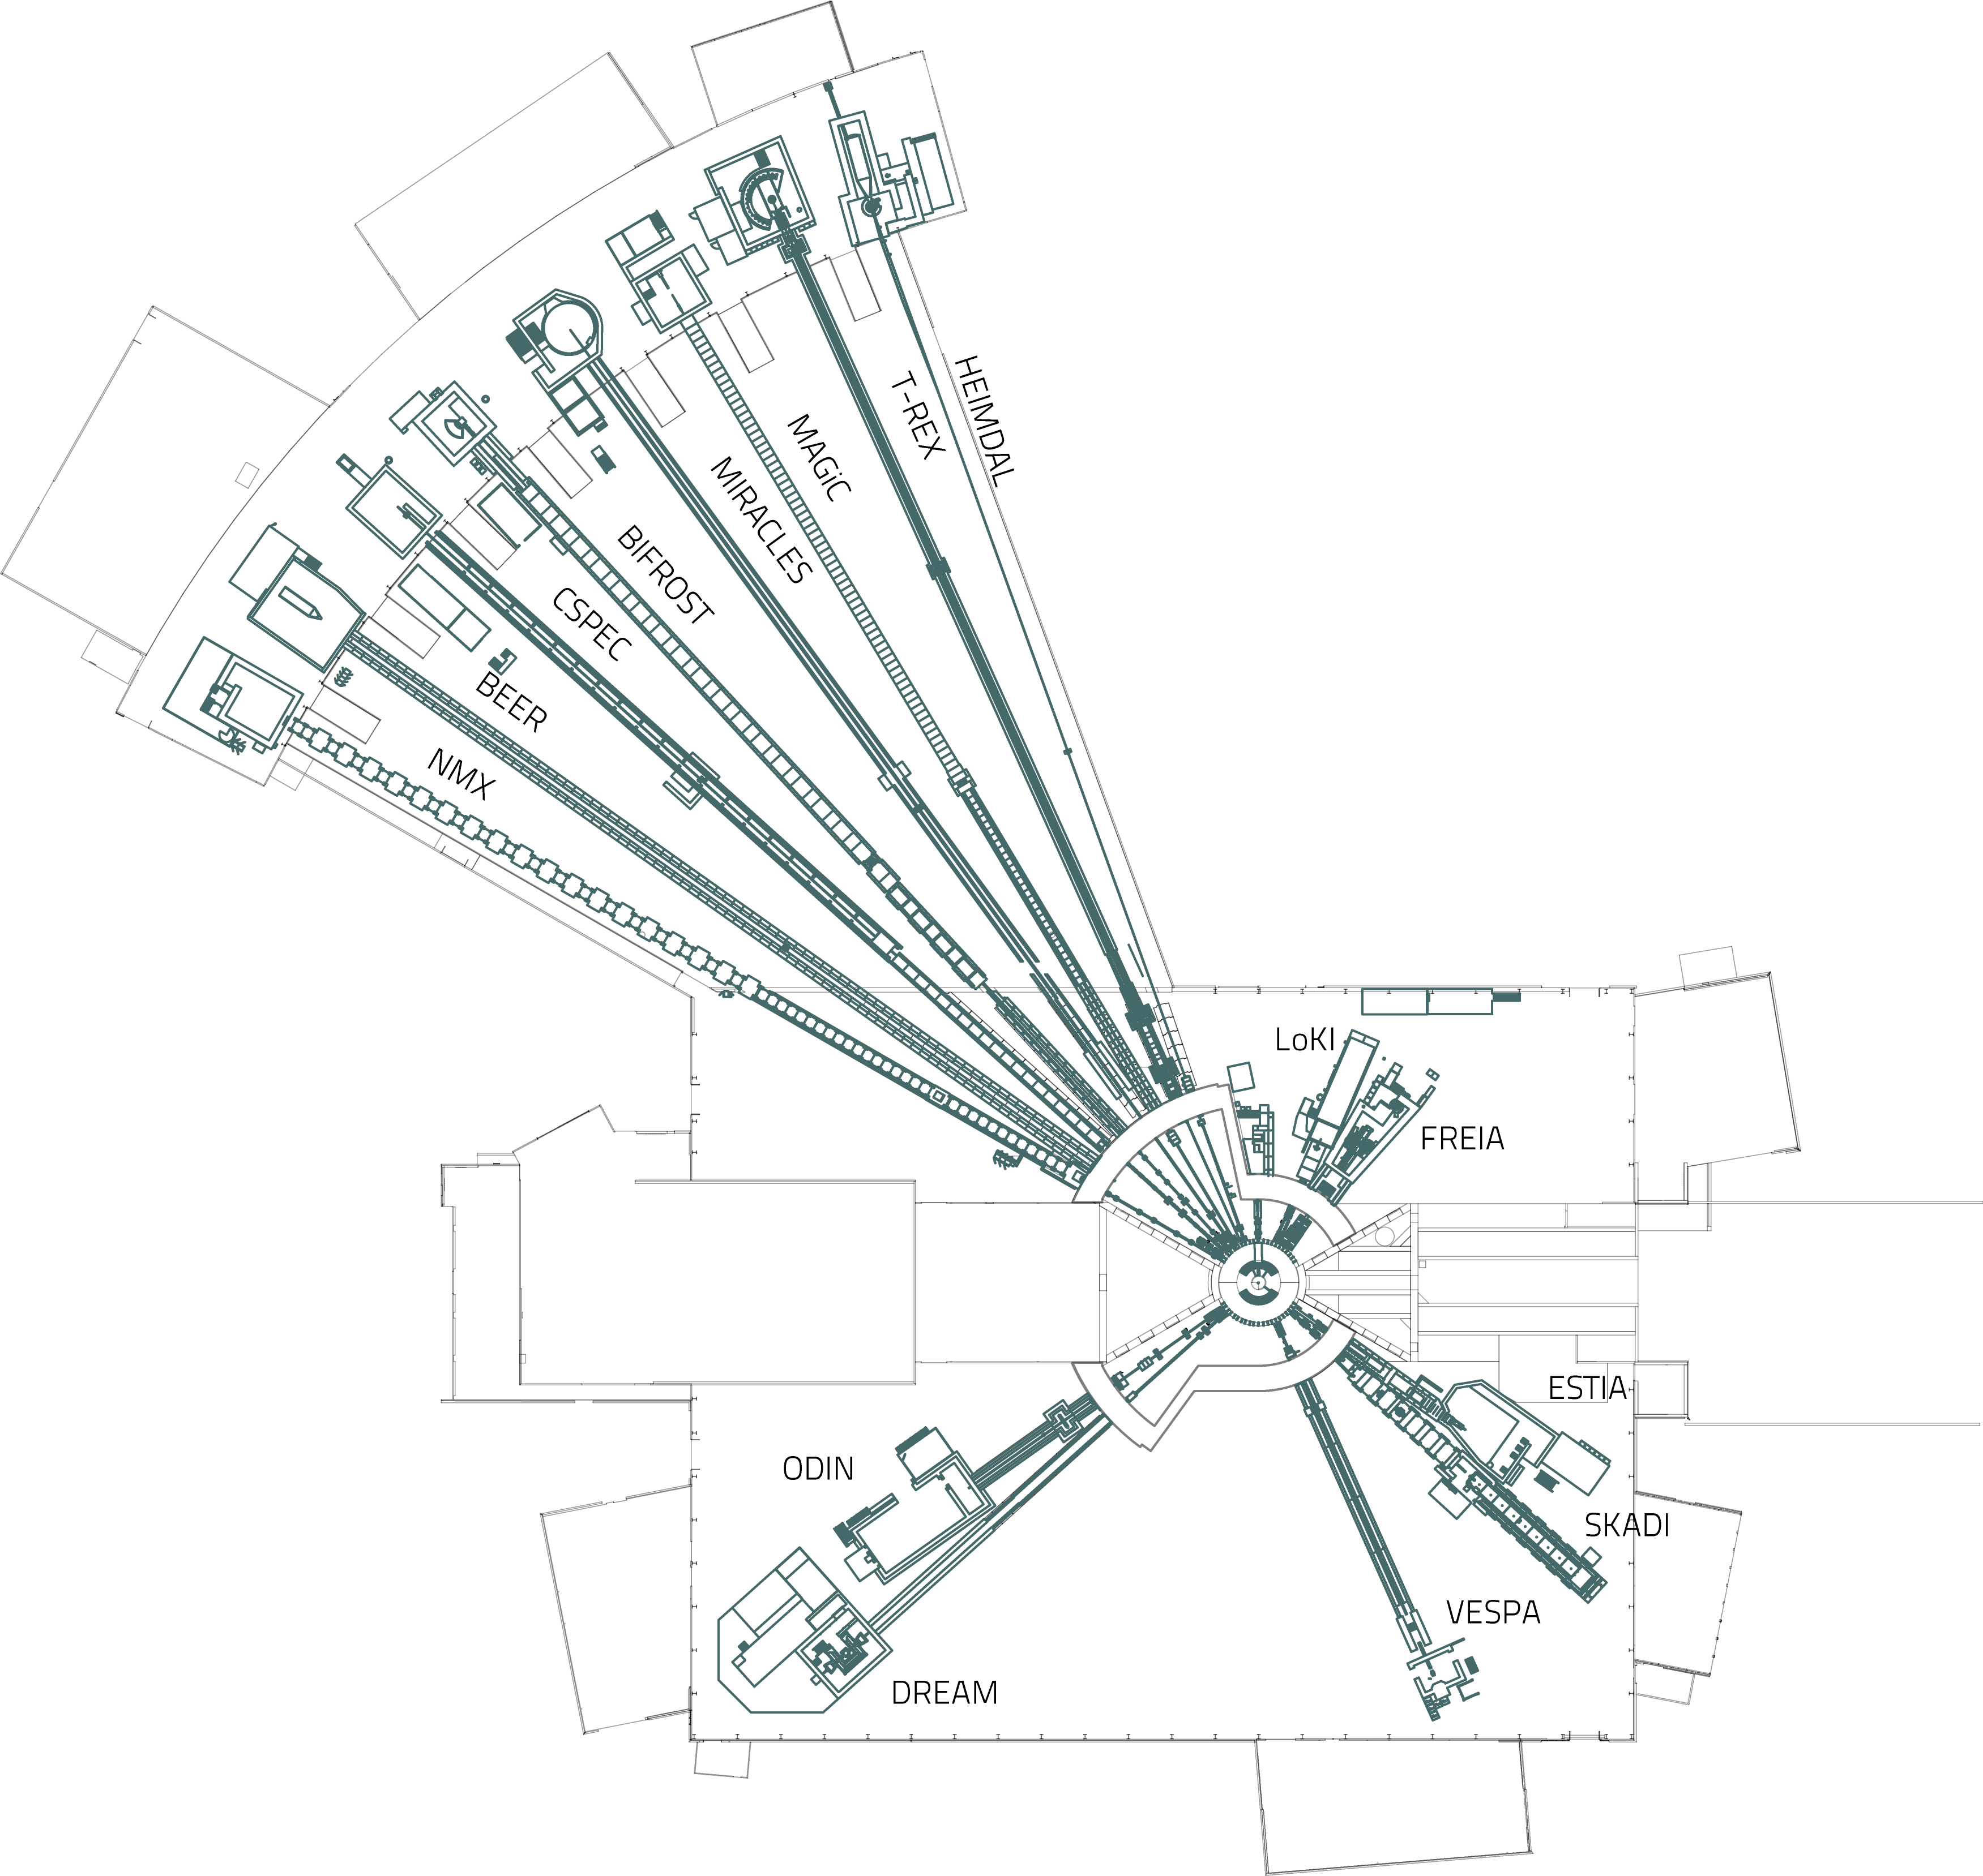
The European Spallation Source

Slide 14
The European Spallation Source
Instrument backend
Neutron guide
Choppers
Neutrons released

Slide 15
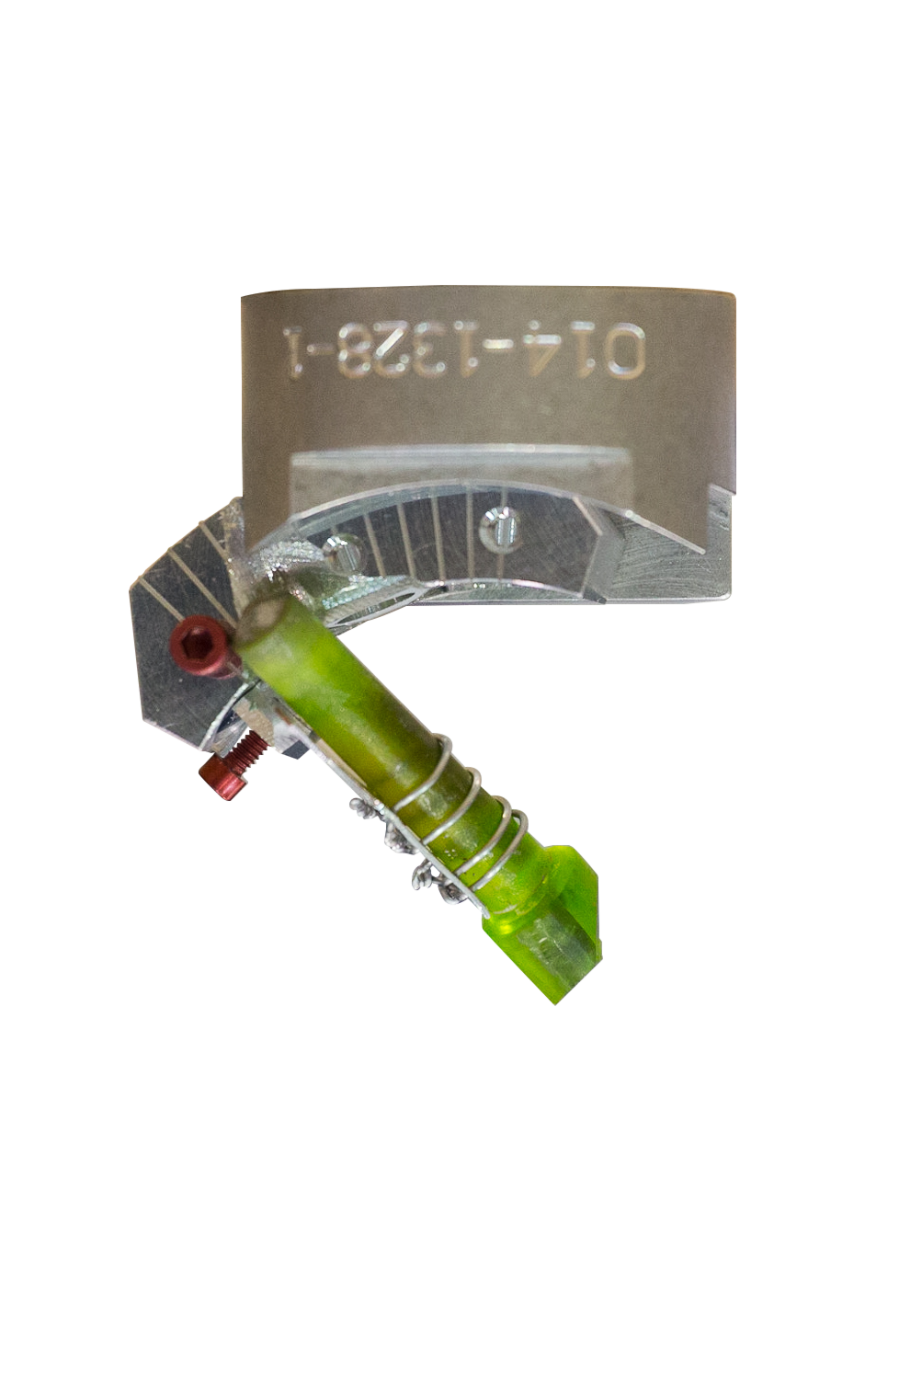
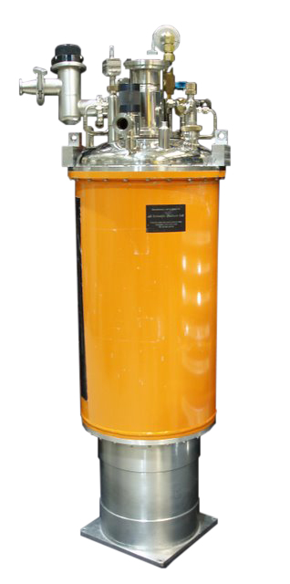
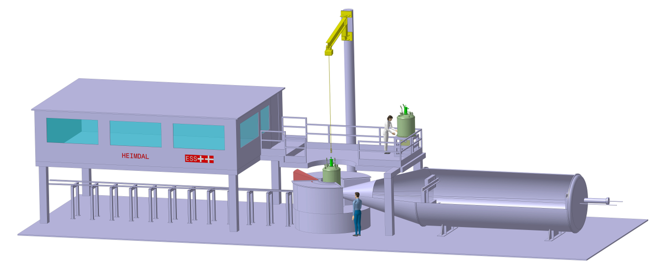
The European Spallation Source
The HEIMDAL instrument
Instrument – Sample Environment - Sample

Slide 16
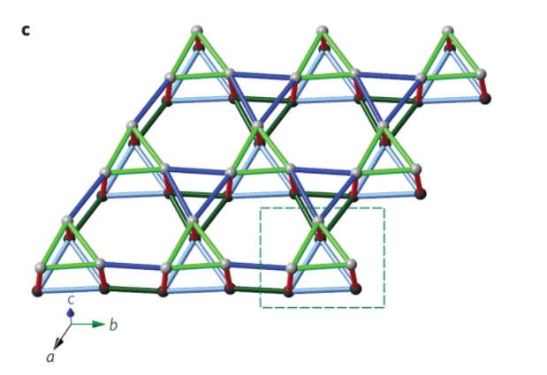
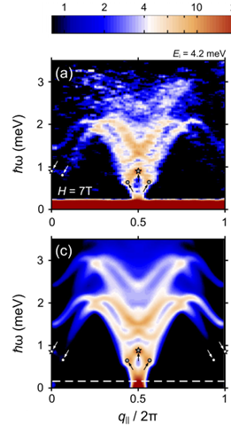
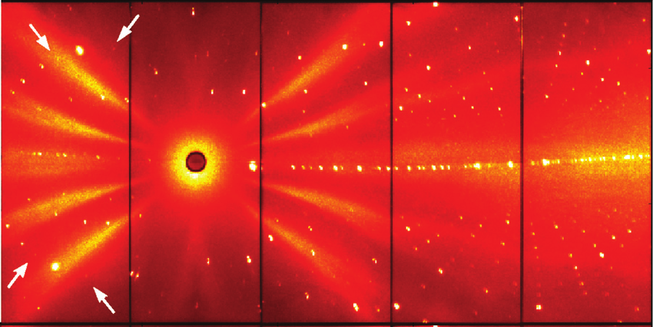
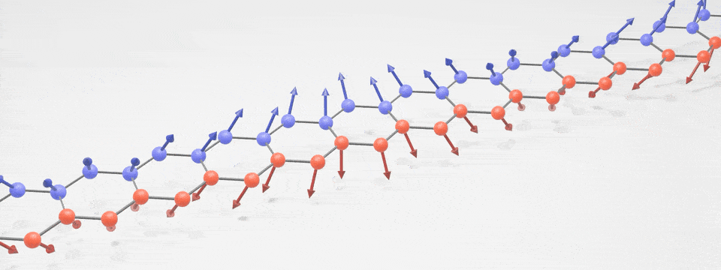
The European Spallation Source
Neutron scattering
D. Schmidiger, et. al. Phys. Rev. Lett. 111, 107202 (2013) LET @ ISIS.
Strong-leg Heisenberg spin-1/2 ladder at 7 T and 70 mK
C. Balz et al, Nature Physics (2016)
Detector
M., Pascal, et. Al. Influence of Cr doping on the magnetic structure of the FeAs-strips compound CaFe_{4}As_{3}: A single-crystal neutron diffraction study, 10.1103/PhysRevB.88.104414, Physical Review B
Web: A spin wave detective story: Nist researchers verify surprising behavior in 2D magnet
Notes:
Slide with example of neutron scattering data and conclusion from it.
Here is diffraction data for a battery, we can see the charge level and find the hydrogen
The battery can operate, and be in a sample environment, for example controlled pressure / temperature
We have to have a stable state to measure for the required time, minutes or hours. Often charge and discharge many times to get all the data.

Slide 17
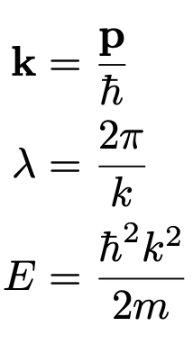
The European Spallation Source
Description of scattering
Wavevector
Wavelength
Energy

Slide 18
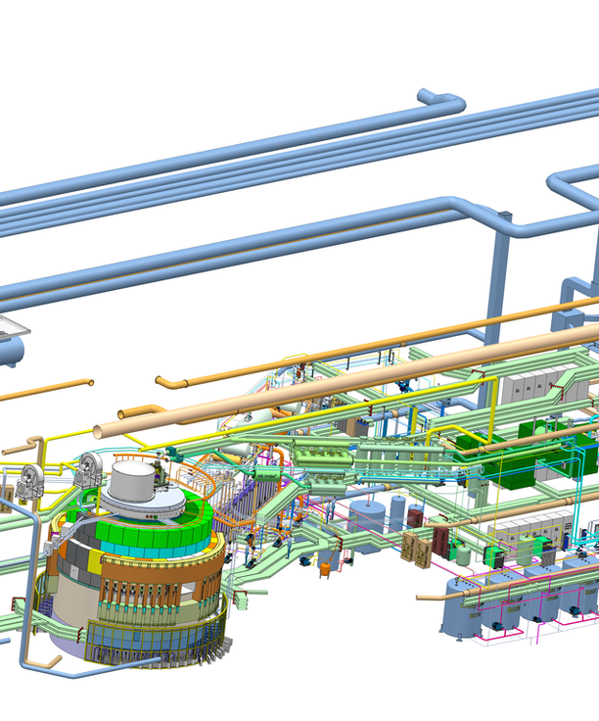
2
ESS Technical

Slide 19
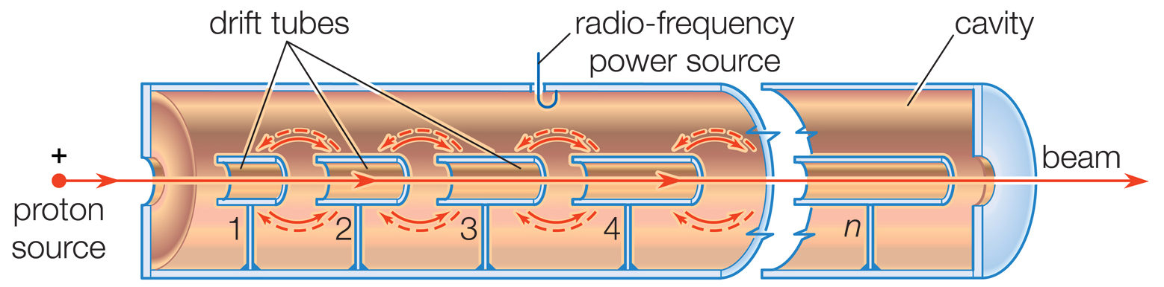
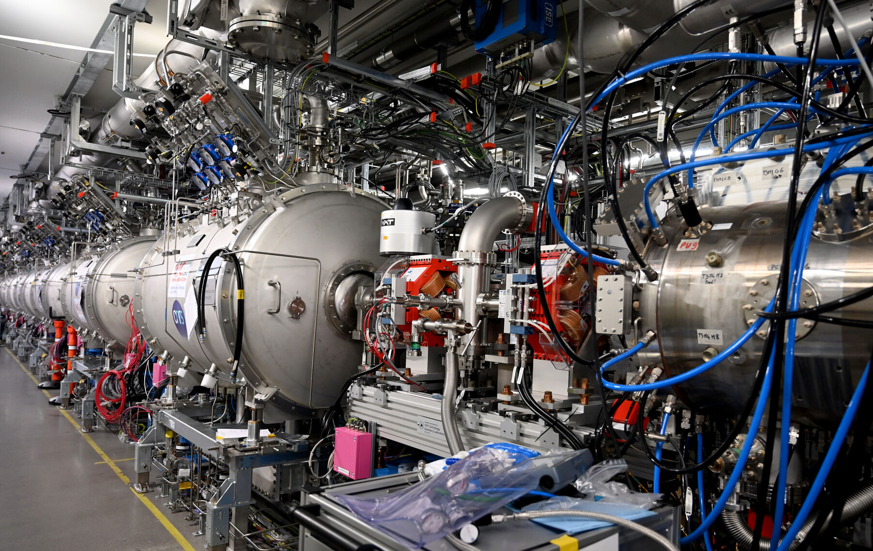
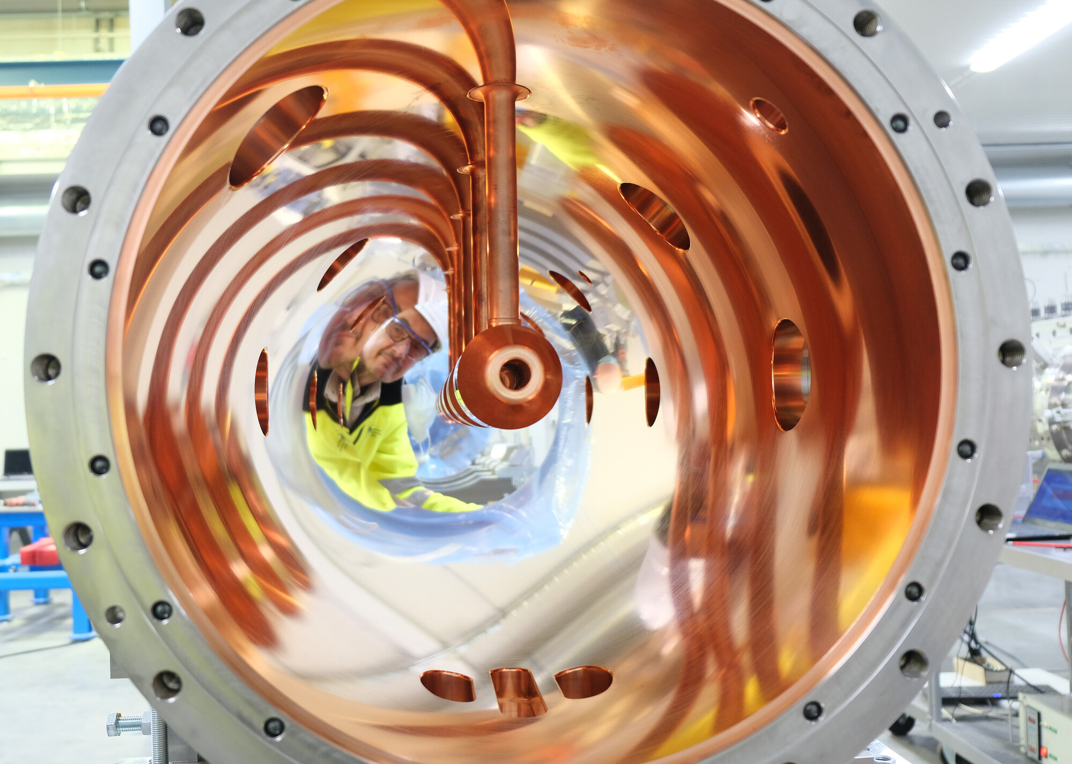
The European Spallation Source
Accelerator
  Proton accelerator
  2 MW beampower installed, goal of 5 MW

Slide 20
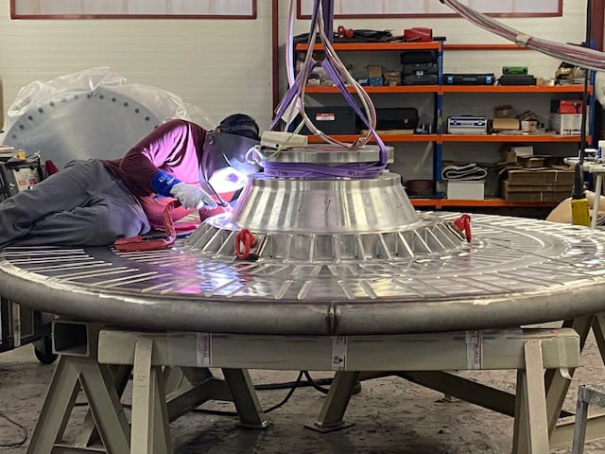
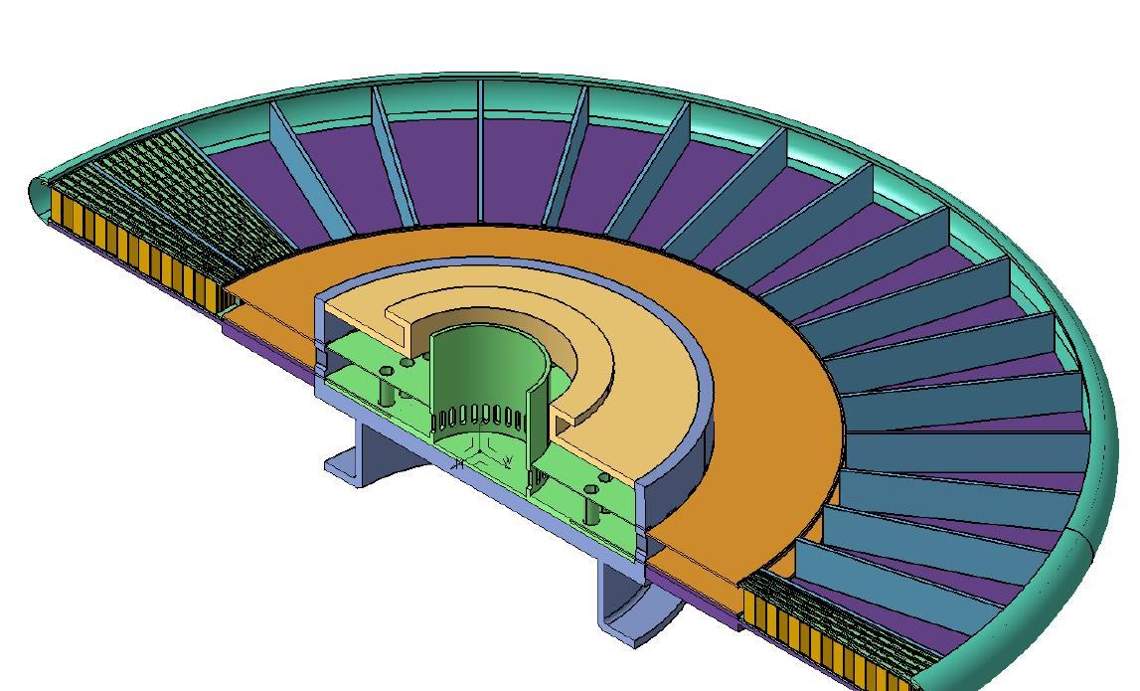
The European Spallation Source
Target
  Rotating at around 0.5 Hz
  36 sections of tungsten target
  Total weight 4.9 tons
  Tungsten cooled by liquid helium
High energy neutrons
Proton beam

Slide 21
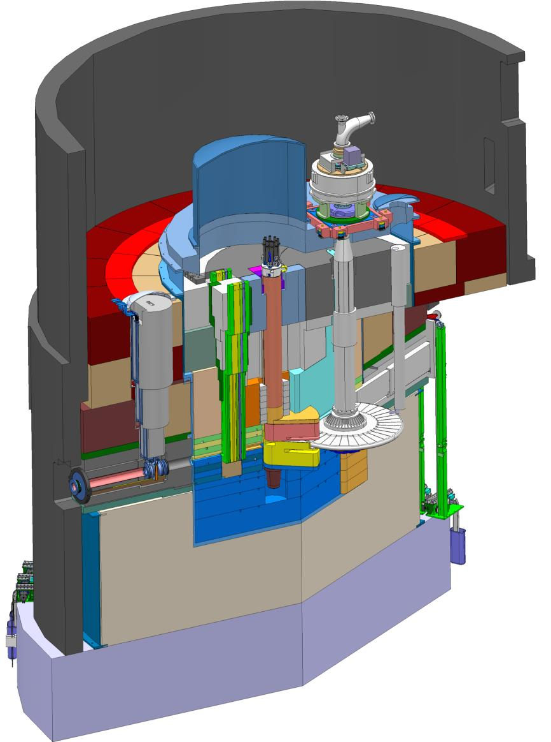
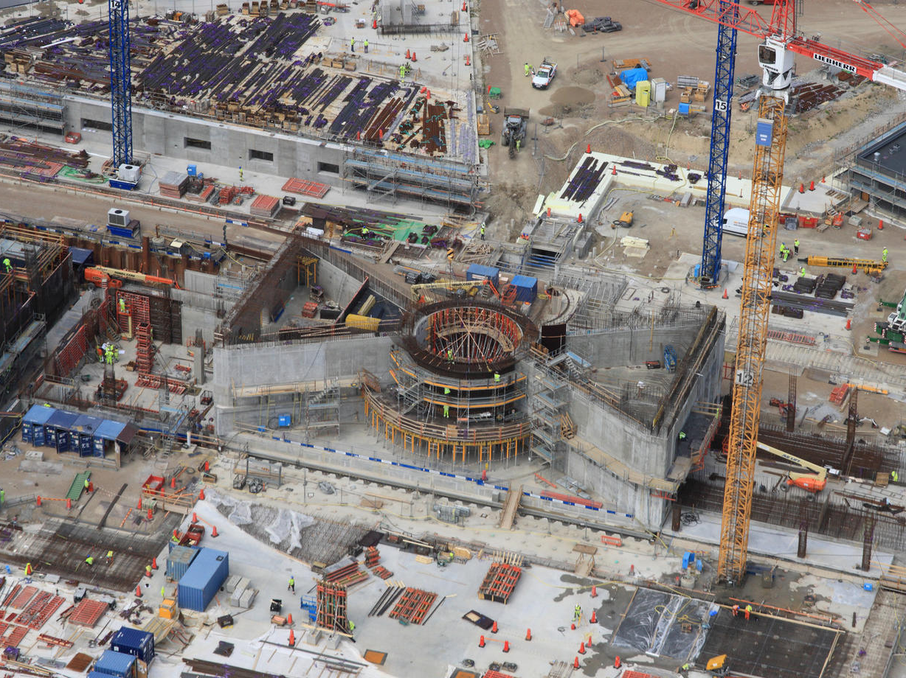
The European Spallation Source
Target
  6000 tons steel of shielding around target
  Proton beam enters
Target
Proton beam

Slide 22
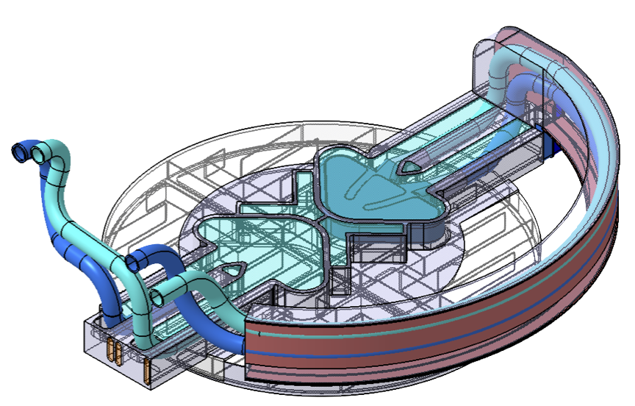
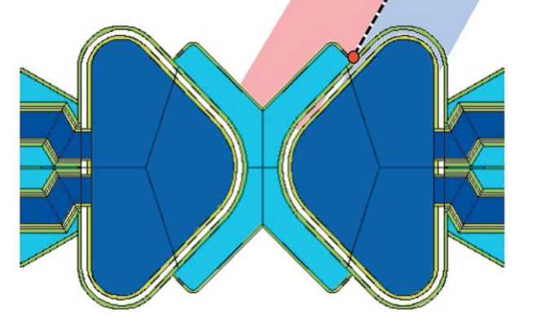
The European Spallation Source
Moderator
  Moderator reduce the neutron energy
  Reach equilibrium with material temperature
  Thermal and Cold neutrons
  270 K H₂0 and 20 K H₂

Slide 23
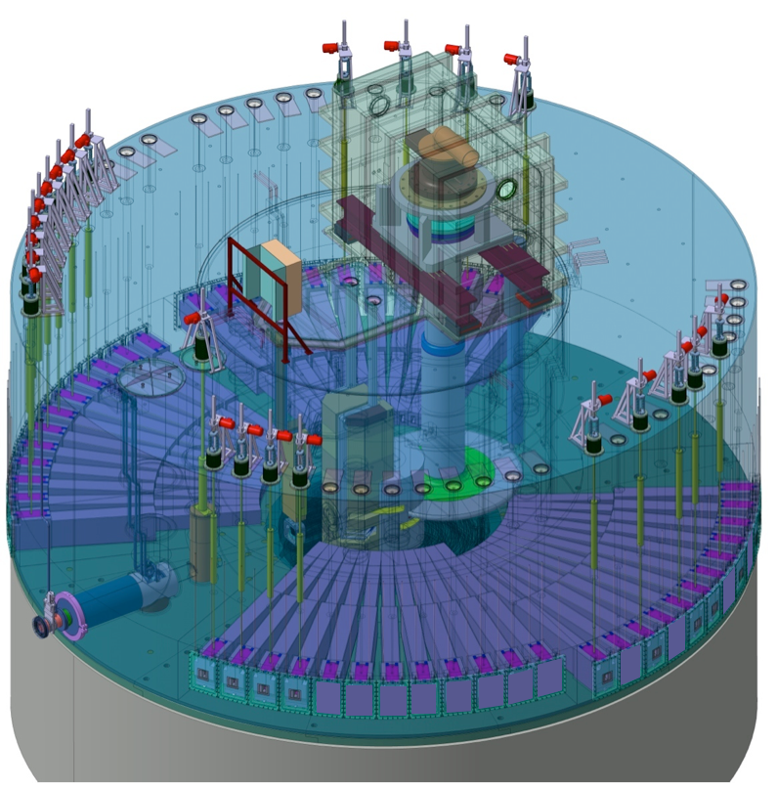
The European Spallation Source
Beamports
  Moderator visible from 240 degrees
  Many beamports view moderator
Proton beam

Slide 24
The European Spallation Source
Instruments
162 m
Proton beam

Slide 25
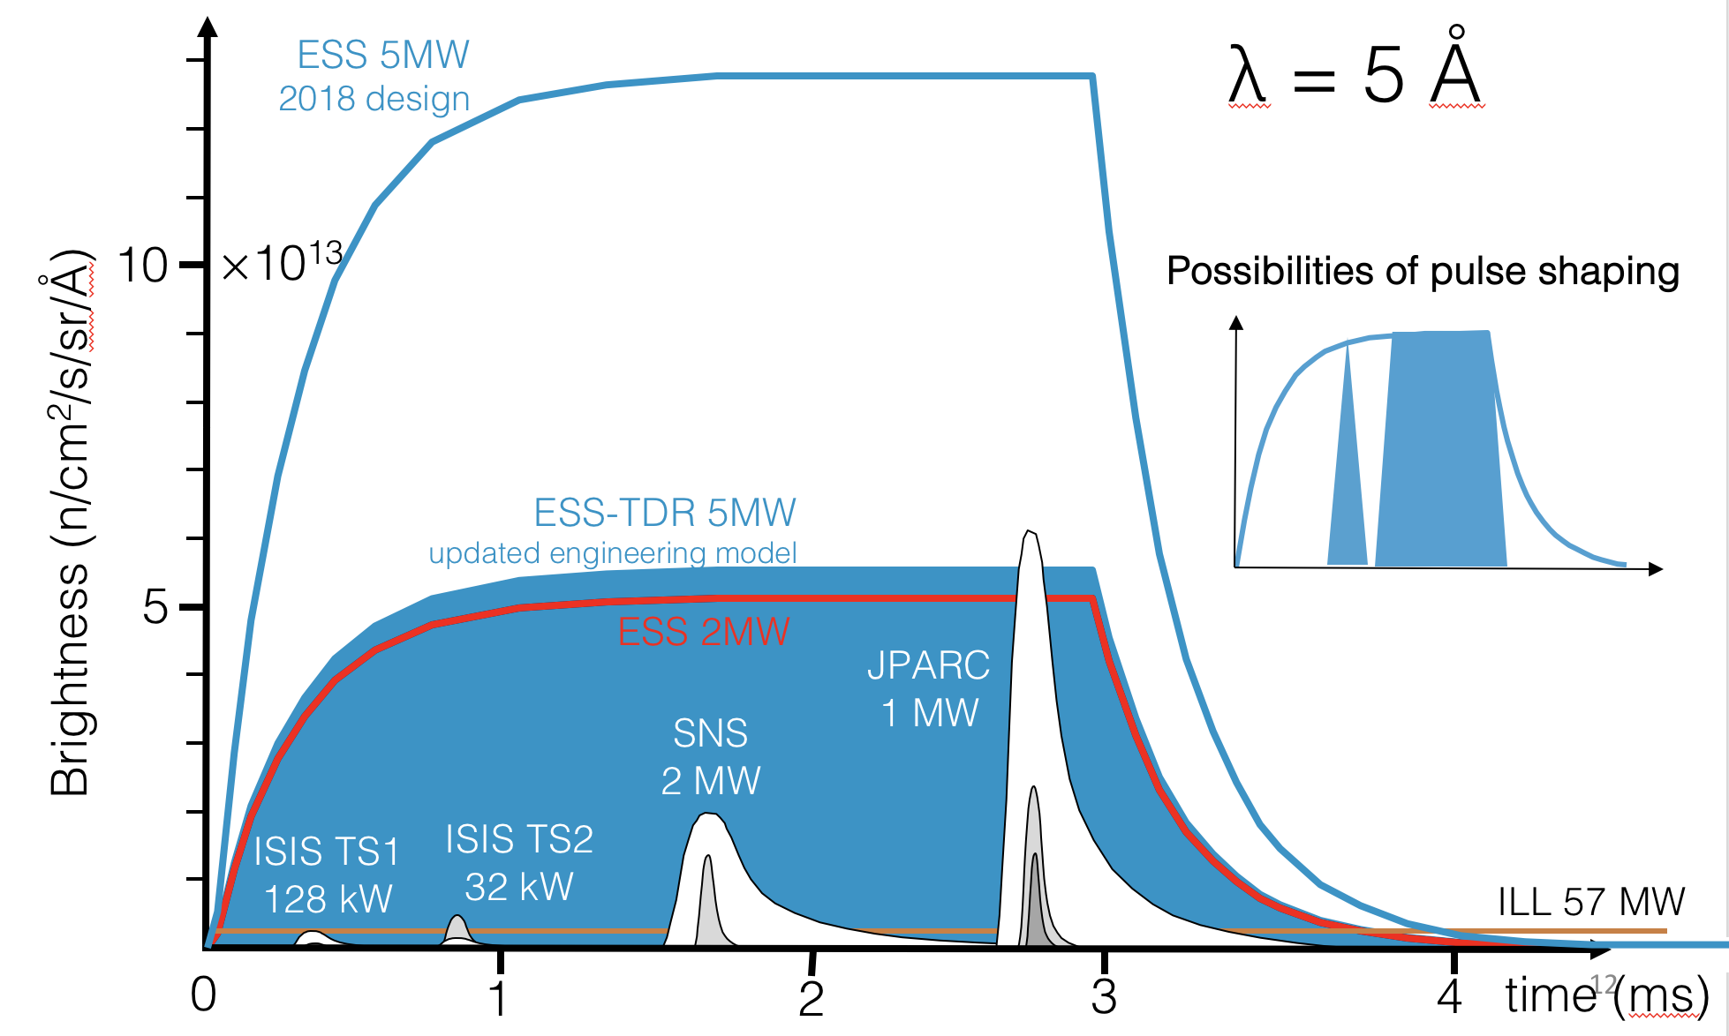
The European Spallation Source
Instruments - Pulse
  14 Hz
  Long pulse
  4% duty cycle
162 m
Proton beam

Slide 26
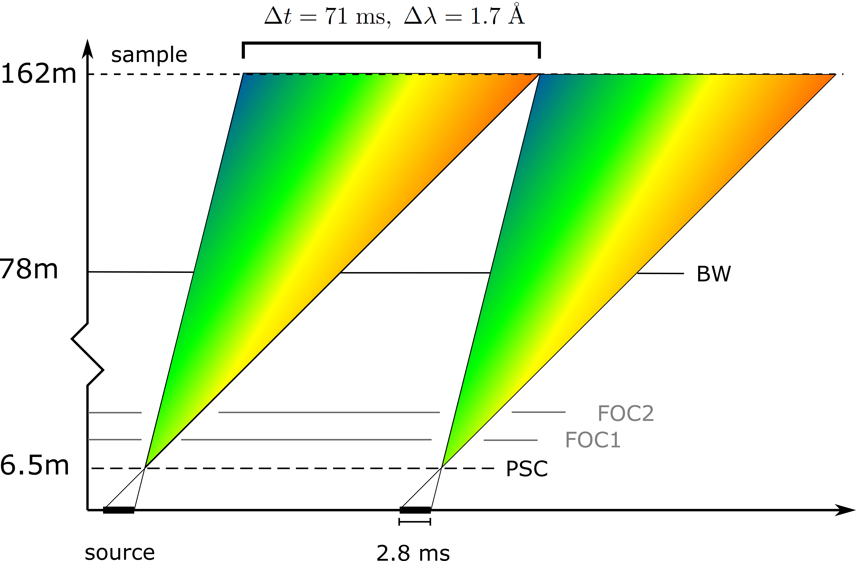
The European Spallation Source
Instruments – Time of Flight
  14 Hz
  Long pulse
  4% duty cycle
162 m
distance
Proton beam
time

Slide 27
Lets go see it, though first a word on safety

