Slide 1
M-value considerations

Slide 2
FOM in the cells @ 5MW
 | n/s 8.8-9.0AA | n/s total | n/s/cm2/AA@8.9A | n/s/cm2 total
A.10 | 7.7E08 | 2.3E09 | 2.55E07 | 1.5E07
A.5 | 7.3E08 | 2.2E09 | 2.45E07 | 1.5E07
B.10 | 7.3E08 | 1.4E09 | 2.45E07 | 9.3E06
B.5 | 7.0E08 | 1.3E09 | 2.35E07 | 8.7E06
C | 8.3E08 | -- | 2.75E07 | --
D | 8.73E08 | 2.65E9 | 2.91E07 | 1.79E07
E | 8.28E08 | 1.6E09 | 2.82E07 | 1.07E07
F | 9.72E08 | -- | 3.24E07 | --
G | 1.26E09 | -- | 4.20E07 | --
H | 1.08E09 | 3.28E09 | 3.60E07 | 2.19E07
I | 1.03E09 | 1.96E09 | 3.60E07 | 1.31E07
K | 9.99E08 | 1.89E09 | 3.52E07 | 1.26E07
A: C-polarizer, m=3 guides, ANNI original chopper settings, PDC1@6.5m and PDC2@26m Results for 10 and 5 slits in bender 1.
B: C-polarizer, m=3 guides, ANNI original chopper settings, PDC1@6.5m and PDC2@42.5m Results for 10 and 5 slits in bender 1.
C: C-polarizer, no choppers, wavelength restricted to 8.8-9.0AA, open choppers
D: Curved with V-shaped polarizer, PDC1@6.5m and PDC2@26m
E: Curved with V-shaped polarizer, PDC1@6.5m and PDC2@42.5m
F: Curved with V-shaped polarizer, wavelength restricted to 8.8-9.0AA, open choppers
G: Theoretical max, straight guide (slits preserved), V-polarizer, wavelength restricted to 8.8-9.0AA, open choppers
H Curved with V-shaped polarizer, 2 benders, PDC1@6.5m and PDC2@26m
I Curved with V-shaped polarizer, 2 benders, PDC1@6.5m and PDC2@42.5m
K Vertical V polarizer, m=5.5 2 benders, PDC1@6.5m and PDC2@42.5m
In the options A-F, H, I line of sight is lost at 11.5 meters (just before the bunker wall)

Slide 3
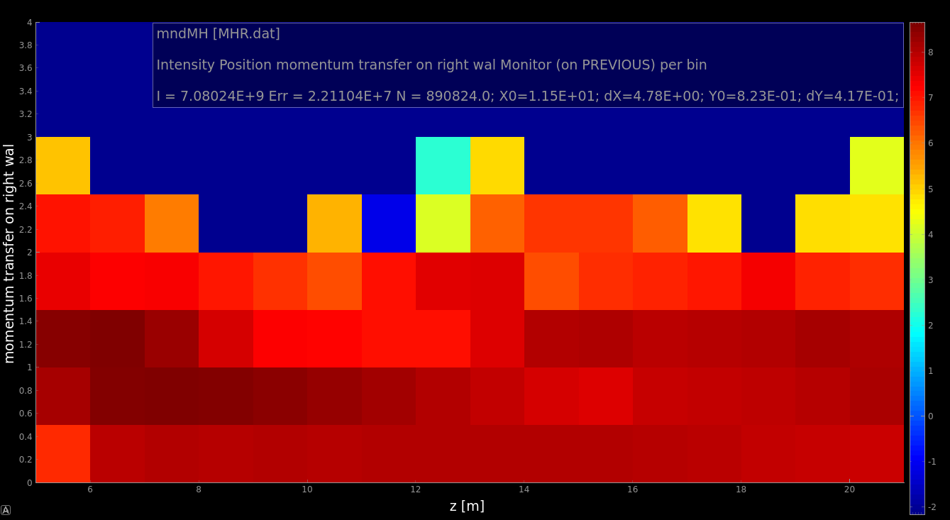
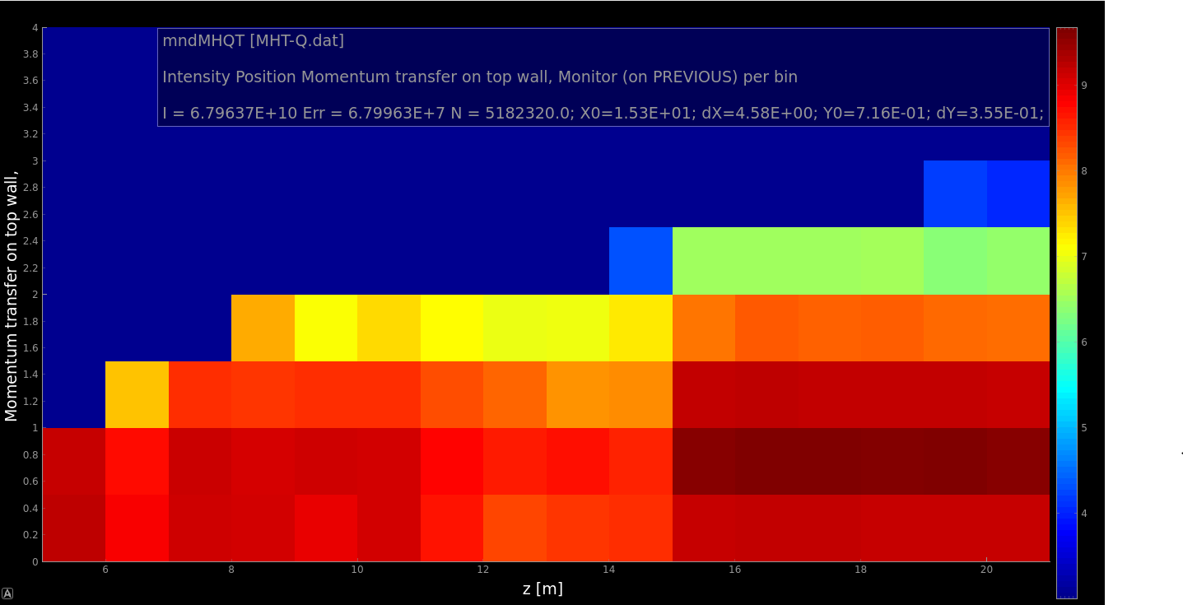
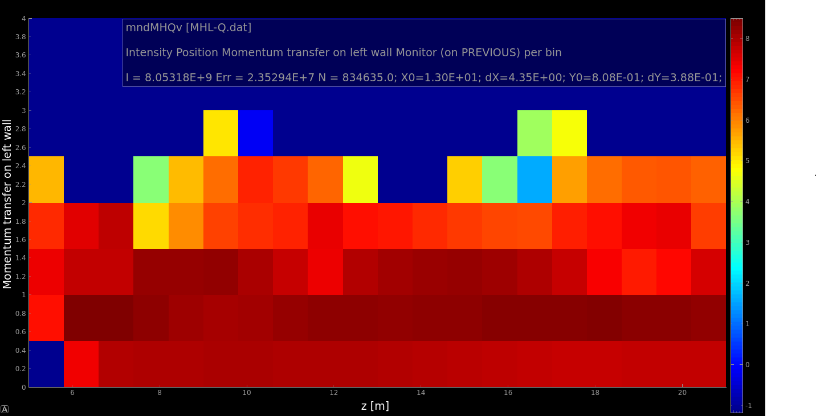
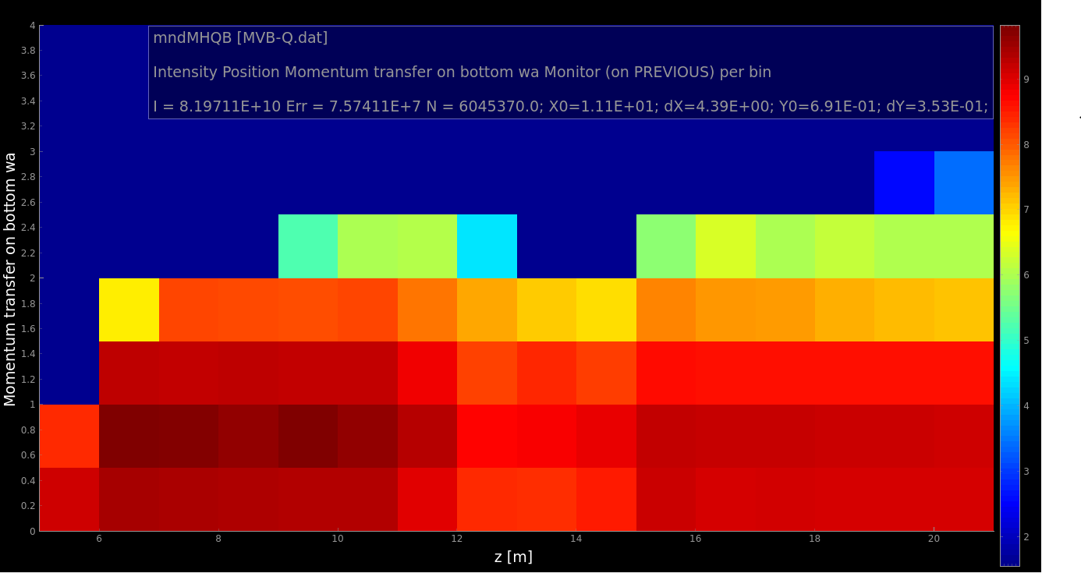
Momentum transfer at reflection, 9AA
R
T
Use of logging capabilities of neutron states in McStas v2.7
Momentum transfer at reflection is logged in units of Qc for Ni
Sufficient with m=2 everywhere except for the focusing part of the splitter where m=3 is beneficial (the difference is however a few per cent).
L
B

Slide 4
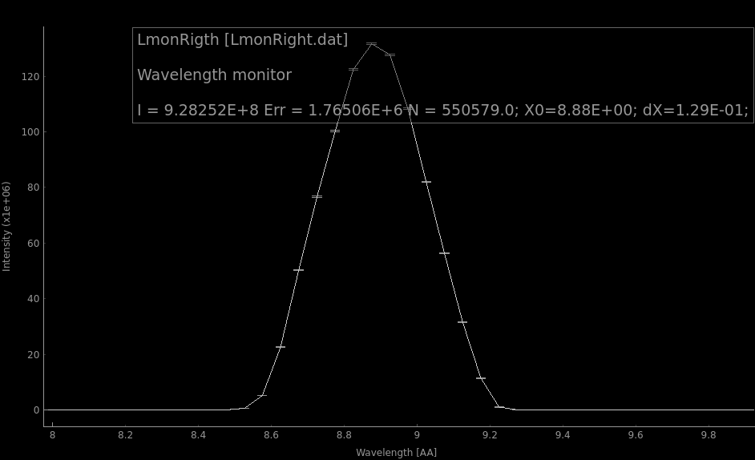
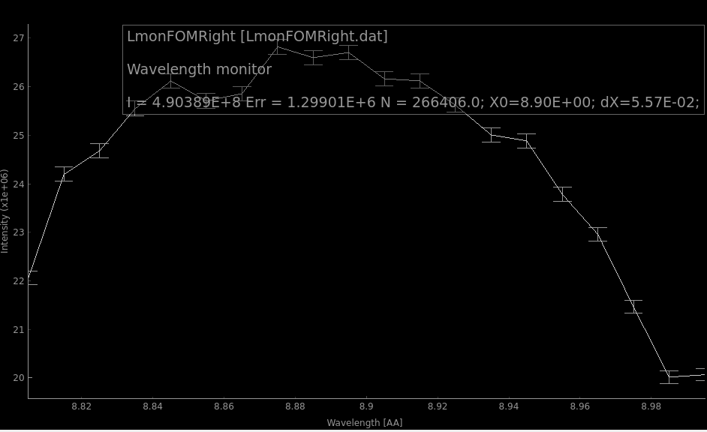
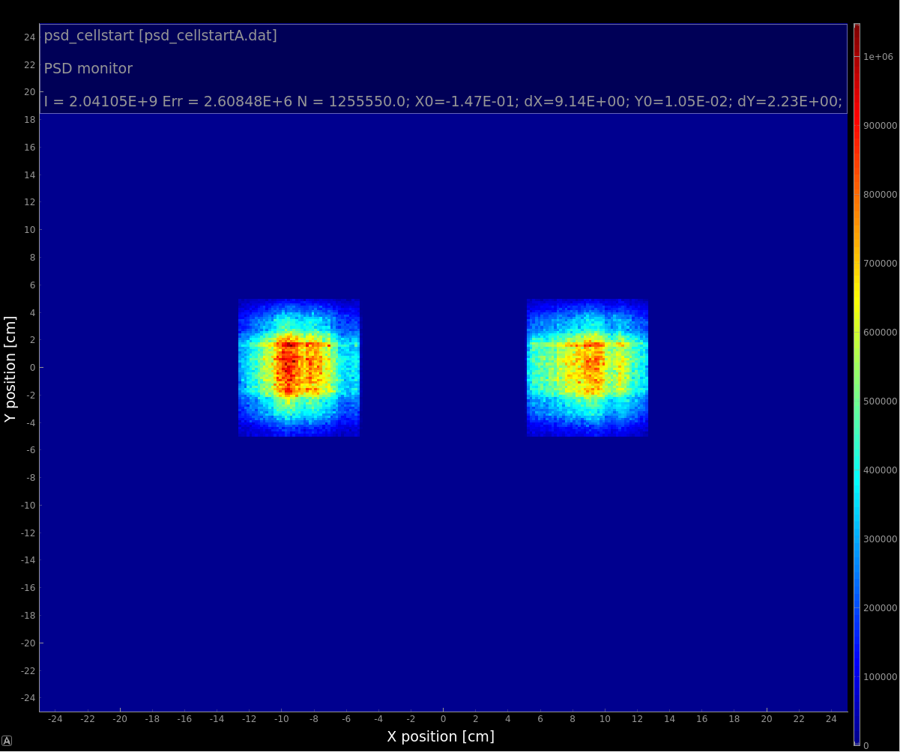
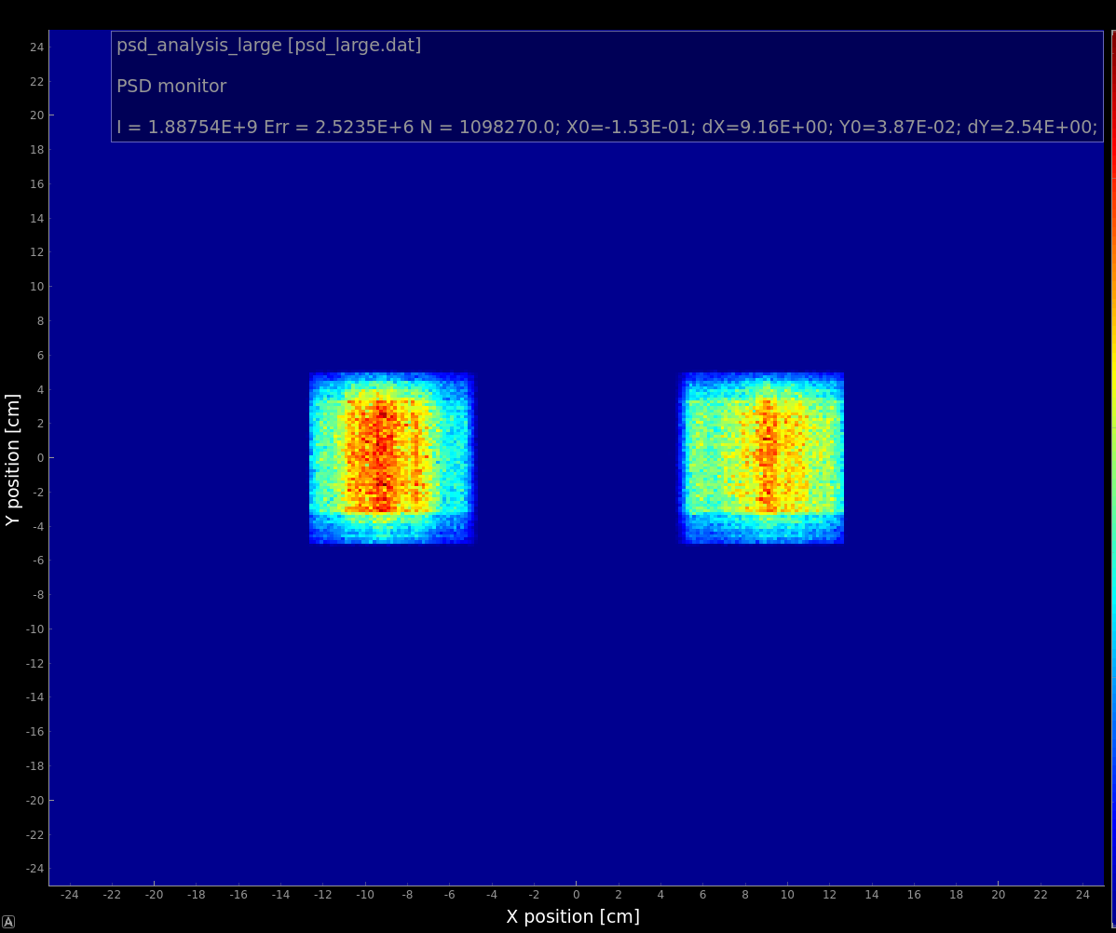
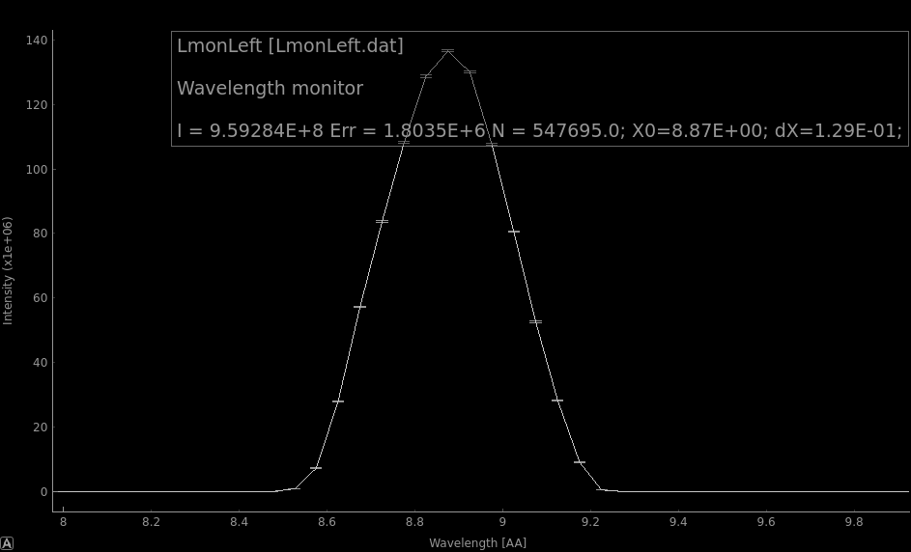
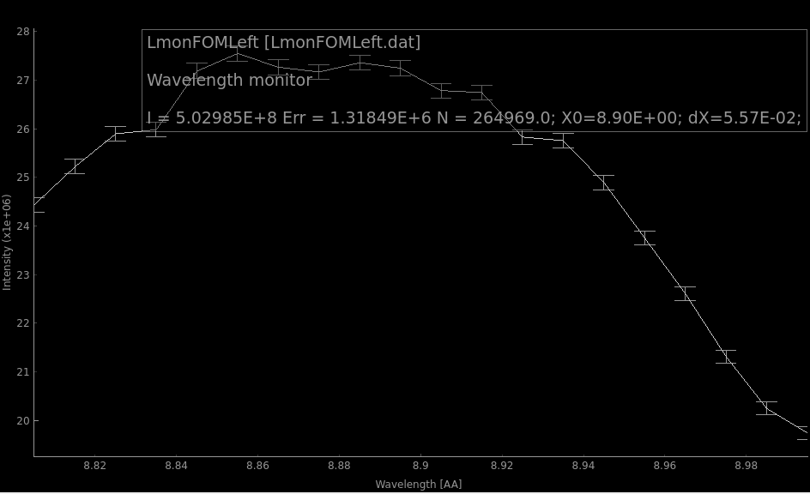
Beam profiles -- McStas
 | Left cell | Right cell
Total neutrons/s | 9.6E08 | 9.3E08
8.8-9AA neutrons/s | 5.0E08 | 4.9E08
Two sets of wavelength monitors for the left and right parts of the splitter + PSD monitors at cells entrance and exit
2% difference in neutron fluxes in left and right cell
1.6E08 n/s escape cells through the cell walls (if scattering off liquid He is neglected)

Slide 5
Beam profiles, empty cells
McStas->mcpl -> PHITS dump file.
A “blackhole” absorber is set at the cell entrance.

Slide 6
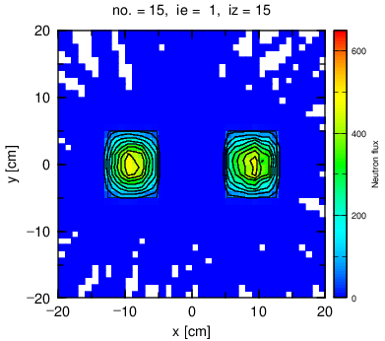
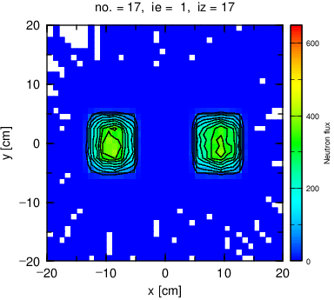
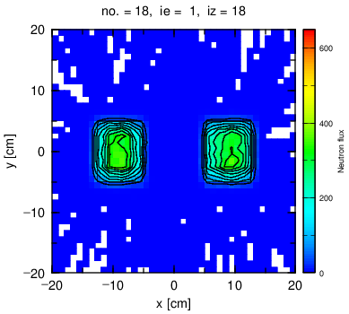
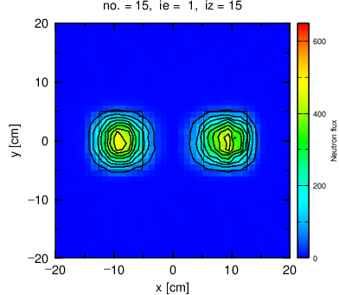
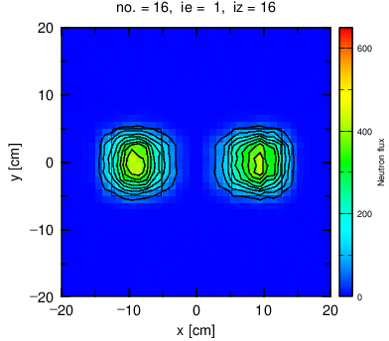
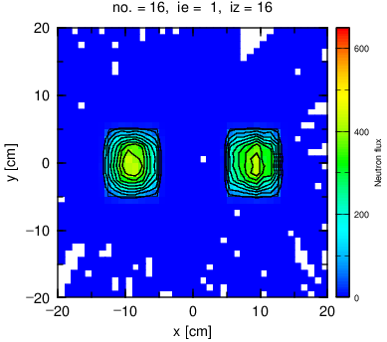
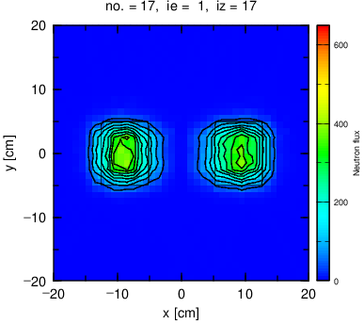
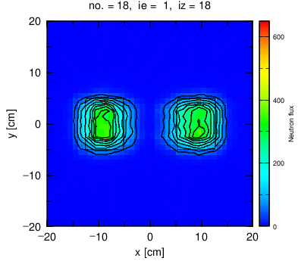
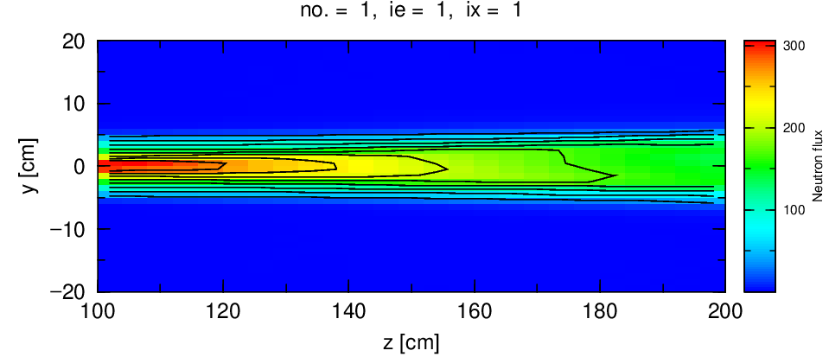
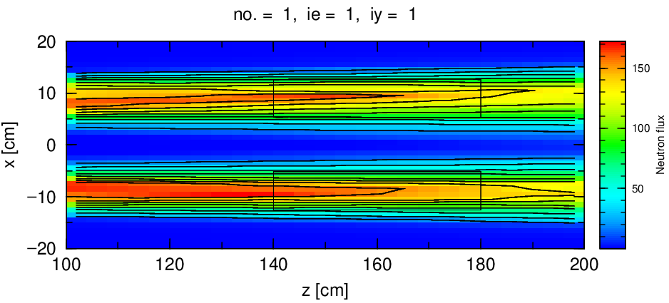
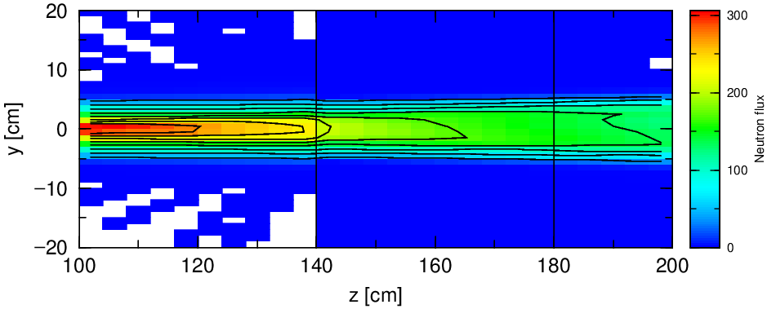
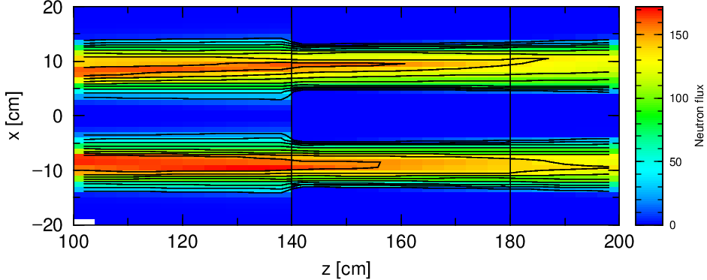
Beam profiles, empty cells

Slide 7
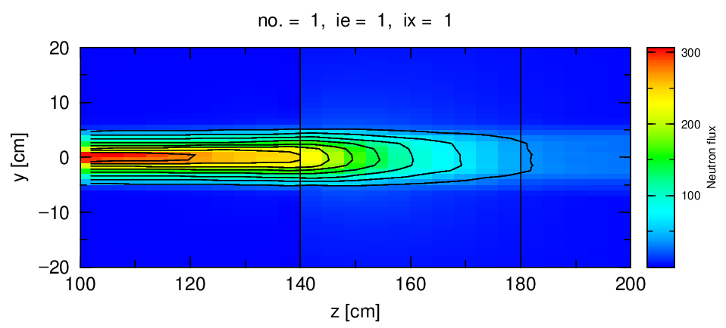
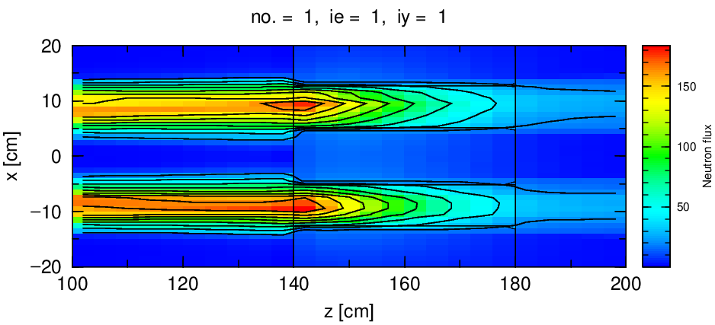
Beam profile, filled cells
PHITS run with cells filled with He with lHe density of 0.125 g/l (but using available cross sections for 300K)
Only about 20% of neutrons are reaching the downstream bottom of the cells
Liquid He X-section is around 0.1 bn for 9AA (1meV) Y. Abe, N. Morishima NIMA (2001)
Results in approx. 526 cm mean free path and 7.5% attenuation due to scattering on 40 cm.

Slide 8
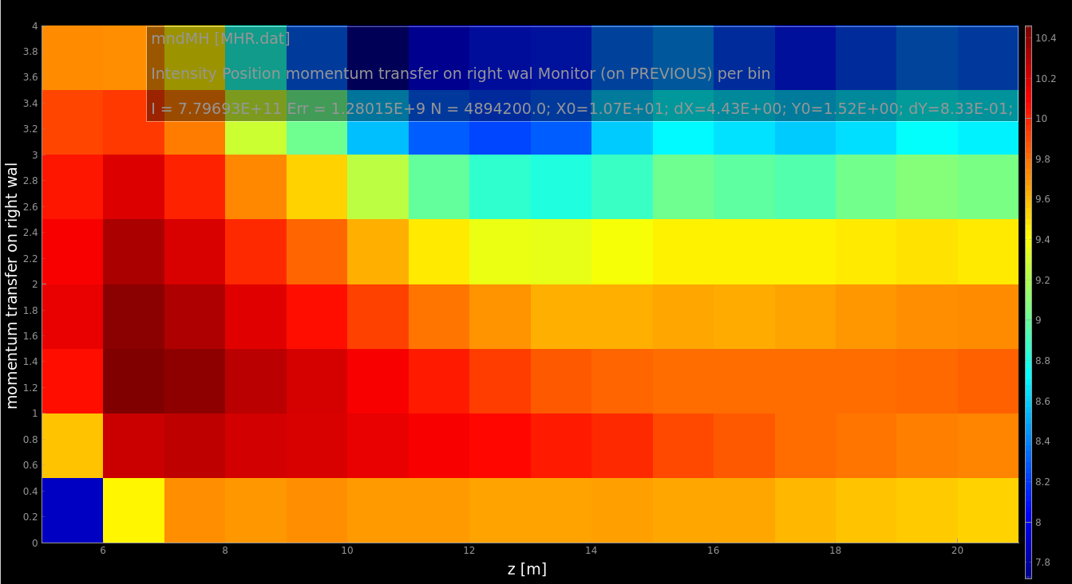
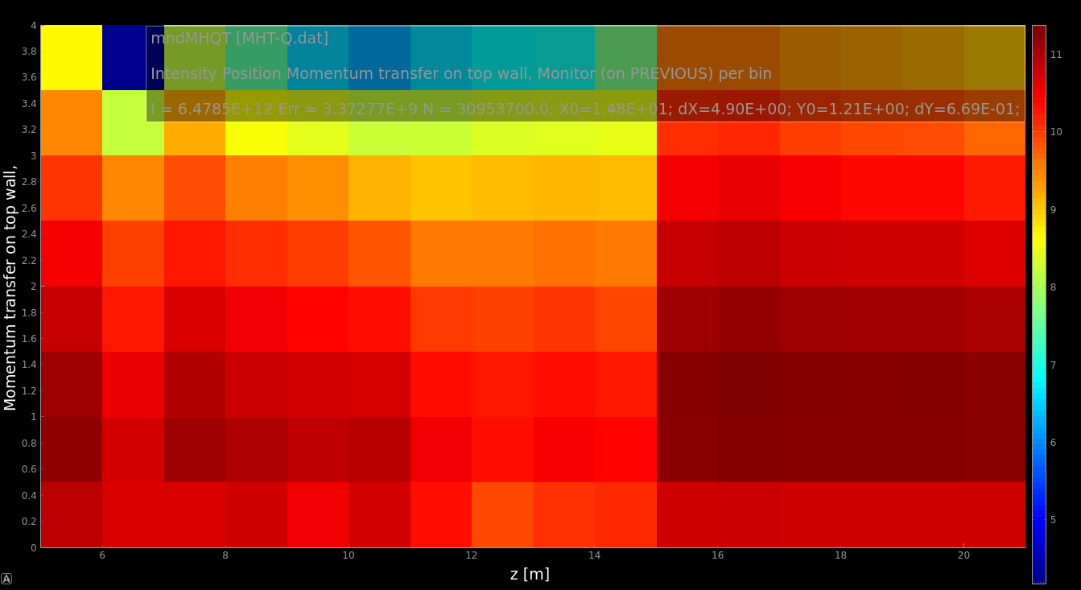
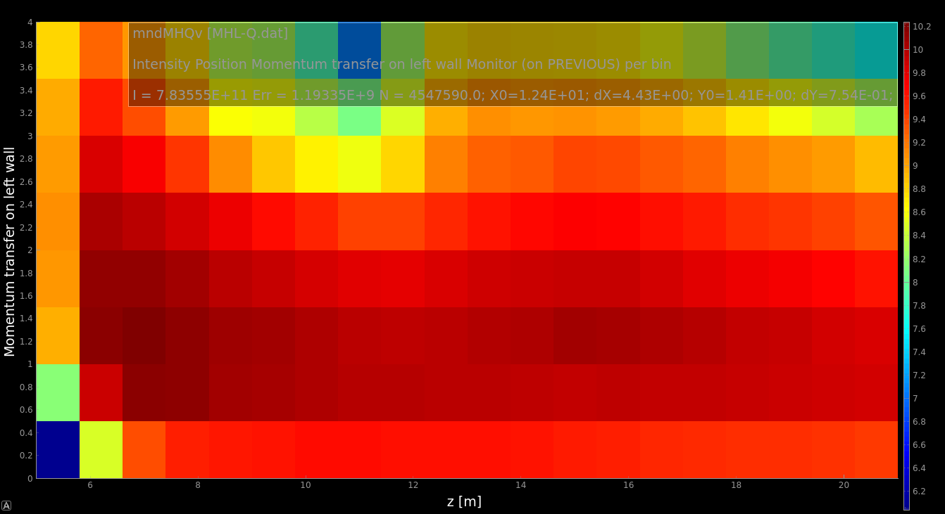
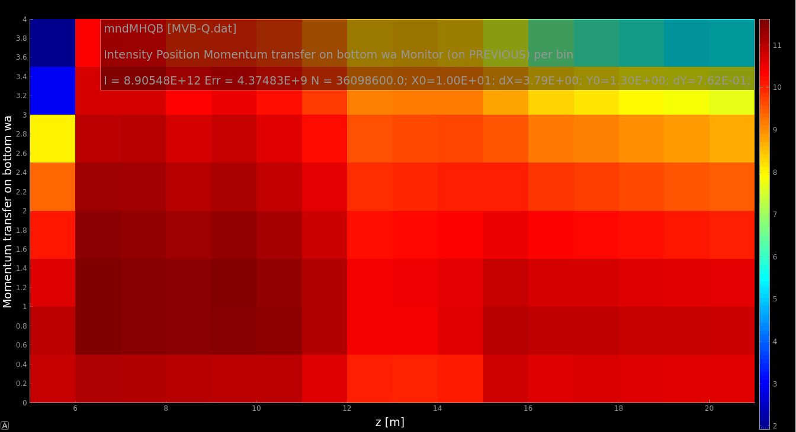
Momentum transfer at reflection 2-10AA
R
T
L
B
Reflected weight is weighted by wavelength to represent figures relevant for capture flux transfer.

Slide 9
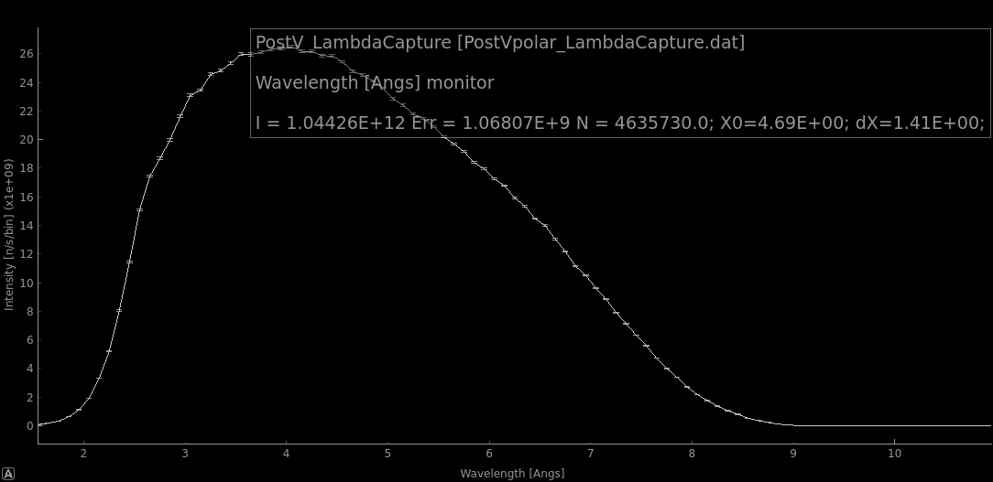
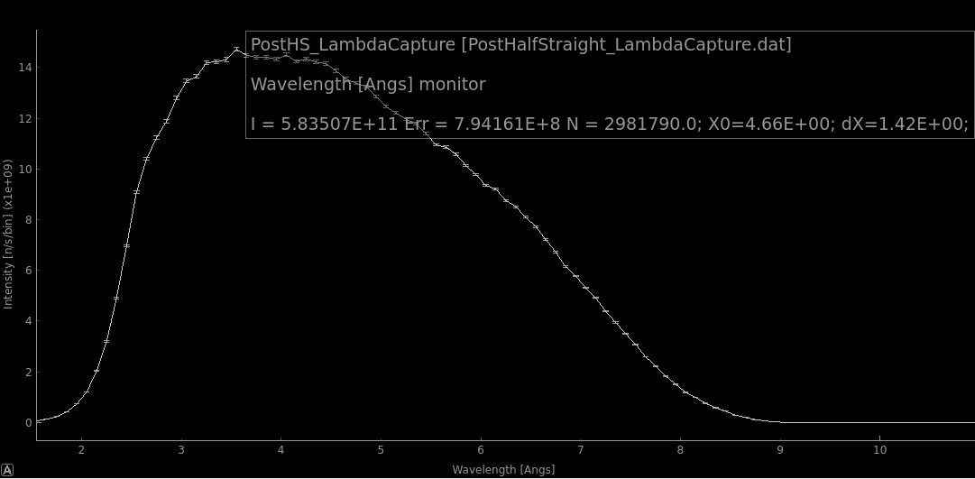
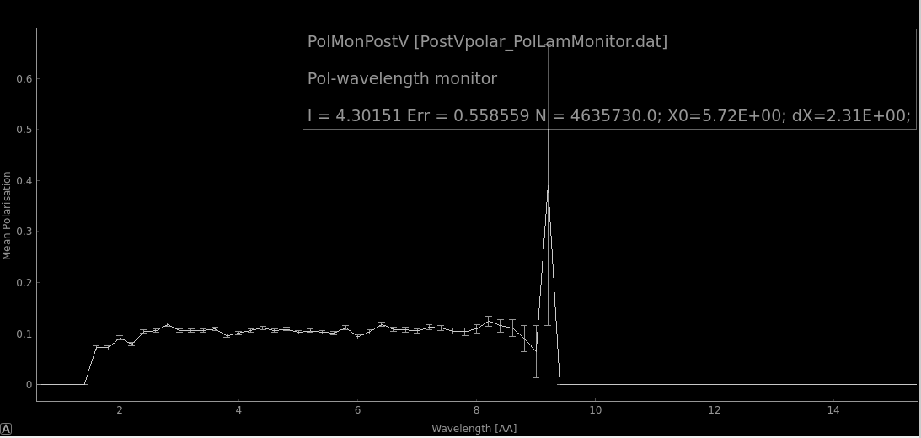
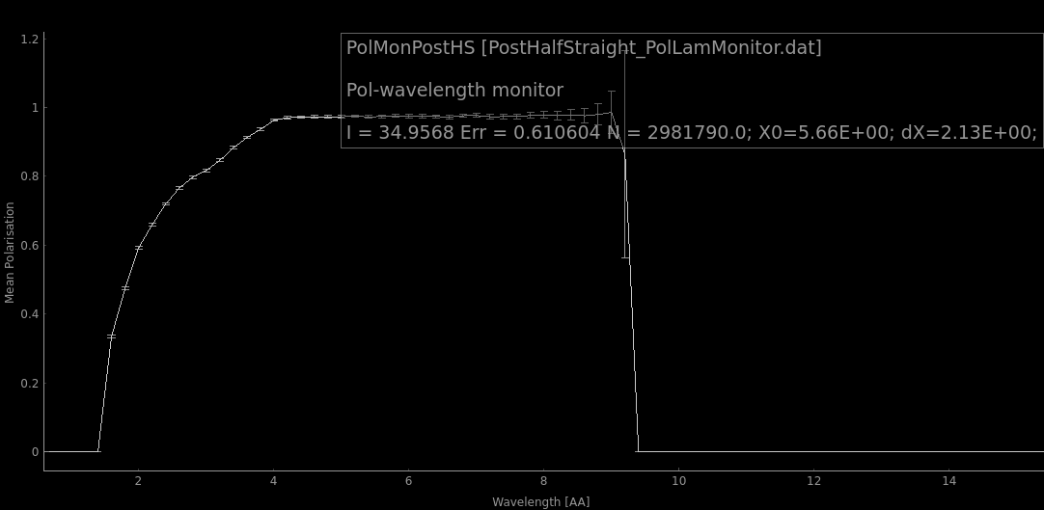
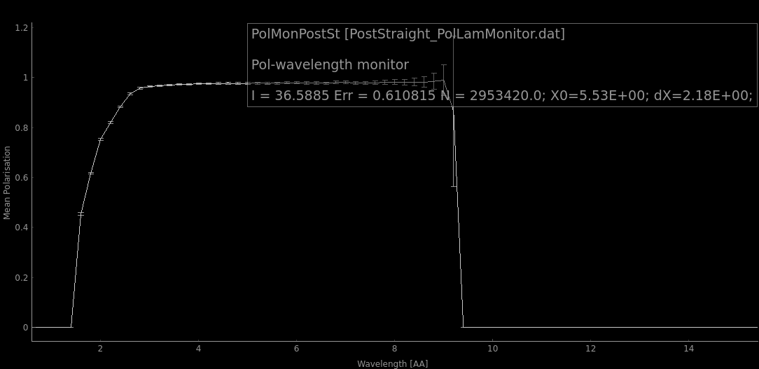
Polarization issues
Simulation with FOC1 and FOC2 on, splitter is not considered
M-values fixed to m=3 everywhere except for the outer surfaces on the curved parts where it is fixed to 3.5
NPD gamma FOM and polarization next to Vpolarizer, ~4.5m and ~9m away.

