Slide 1
Cell wall hits as background

Slide 2
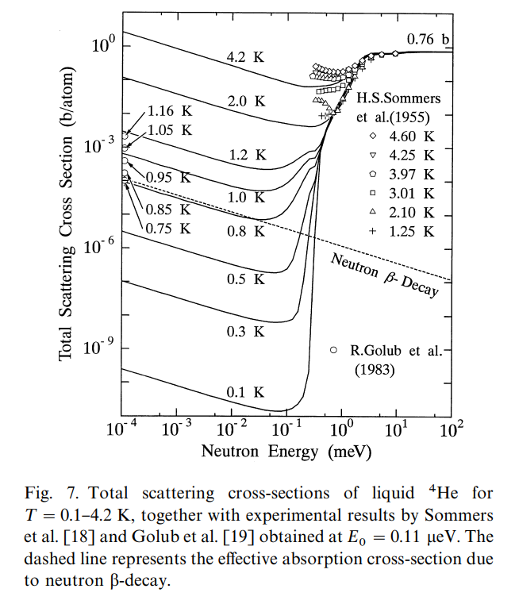
Neutron scattering in liquid He
lHe4 – 125g/l
0.125/4*6.02E23=0.019E24 at/cm3
9AA = 1meV
1meV -> 0.1bn total x-section
Macroscopic total Xsection = 0.1*0.019 = 0.0019 cm-1
Mfp 526 cm
scattering proba at 40 cm -> 7.5%

Slide 3
UCN conversion vs cell wall hits
Neutron flux 3.6E7 n/s/cm2/AA at 8.9AA
2.2E-8 * 3.6E7 = 0.792 n/cm3/s in the cells
0.792*6000 = 4.75E3 ultracold neutrons/s
~4.75E-06 of the incoming neutrons in usable wavelength range.
Neutron mean lifetime = 879 s
New ultracold neutrons = decays -> 4,75E3 decays/s with 4.2E06 neutrons in the cells
Background ~ total number of neutrons hitting cell walls
1.6E08 – due to beam divergence, imperfect focusing. (McStas calculation)
(1.96E09-1.6E08)*0.075 = 1.02E08 – from scattering in lHe
In total 2.6E08 neutron hitting cell walls pr second
~0.13 of incoming beam,
~2/3 of the total wall hits are due to imperfect focusing.

Slide 4
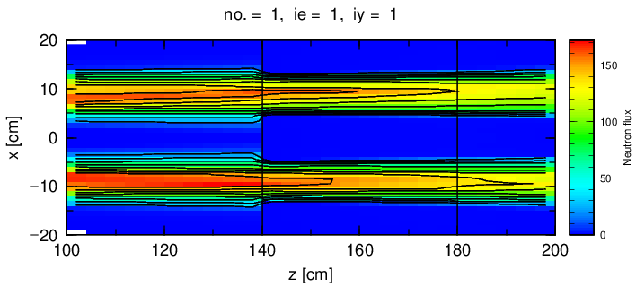
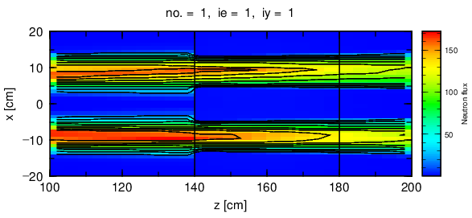
Scattering simulation off lHe
lHe Xsections provided by Douglas Di Julio.
1.96E09n/s at cell entrance, PHITS:
2.16E08 n/s at cell walls @0.8K
3.14E08 n/s at cell walls @4.0K
Pen and paper
4.75E3 UCN/s
2.6E08 n/s at cell walls
1.6E08 n/s from $8.8÷9.0$ AA
Temperature | Entry flux (arb.units) | Exit flux (arb.units) | fraction of wall hits (PHITS)
0.8K | 2.61E3 | 2.32E3 | 0.11
4.0K | 2.61E3 | 2.19E3 | 0.16

Slide 5
Wall hits summary
Fraction of cold neutrons hitting cell walls can be reduced by
Restricting chopper settings to transmit neutrons only in usable wavelength range ~30% reduction of wall hits
Improving focusing/beam collimation can reduce wall hits up to 60%
Around 70% reduction for (wall hits)/(UCN production rate) with two factors optimized

Slide 6
Chopper opening time optimization
PDC chopper settings from ANNI proposal:
92 degrees@70Hz
Fit to be fully open during ESS pulse duration
Transmission of unusable wavelengths
Partial cut of neutrons of usable wavelength due to pulse spread

Slide 7
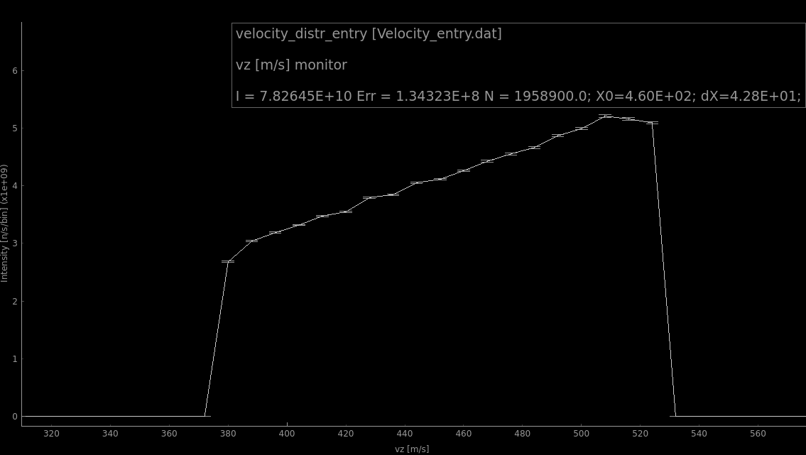
Numerical optimization
Transmission of particular wavelengths depending on PDC chopper slit angle is calculated by simple terms.
ESS pulse duration and chopper opening times and velocity distributions are accounted for.
Delays and opening angles are treated as random variables.
Each set of opening angles and chopper delays gives a point in ([8.8to9.0 neutrons] vs [all wavelengths neutrons]) space

Slide 8
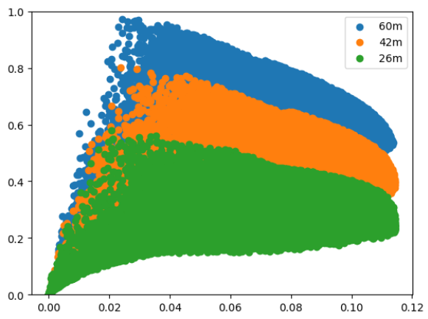
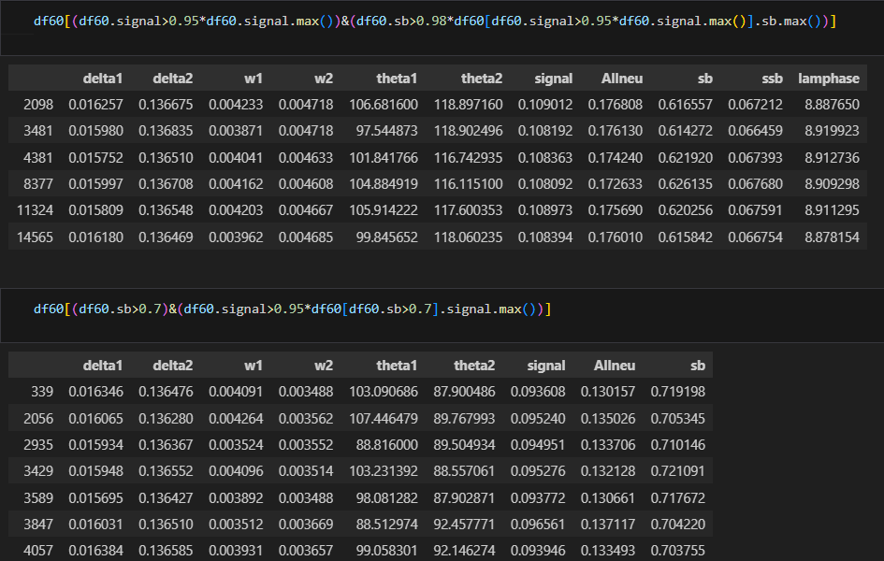
Numerical optimization: results
A signal/background ratio is mostly defined by PDC-2
To improve signal/background a certain sacrificing of UCN production is unavoidable
Plots can be used to find an optimum: e.g. around 70% neutrons in usable wavelength range with up to 85% of maximal available intensity of usable neutrons can be achieved.
“signal/background”, [8.8,9]/total neutrons
“signal”, n/s within [8.8,9]AA, arb units

Slide 9
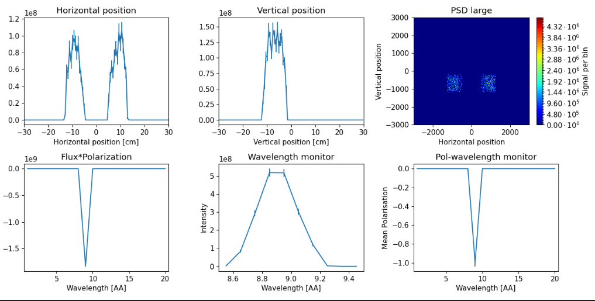
Monte-Carlo optimization
Chopper settings can be directly included in guide_bot optimization
Optimization should go towards maximizing flux of usable wavelengths and minimizing all other wavelength.
FOM, e.g. [8.8 to 9.0 AA neutrons]*([8.8 to 9.0 AA neutrons]/[All neutrons])
Optimization variables: PDC slit angles and delays.
Result of optimization for
60 m long instrument:
~1.0E09 neutrons in [8.8,9.0]AA
with 0.55 for s/b.
Caveat:
Optimization does not necessarily maximize flux of
[8.8 9.0]AA neutrons.

Slide 10
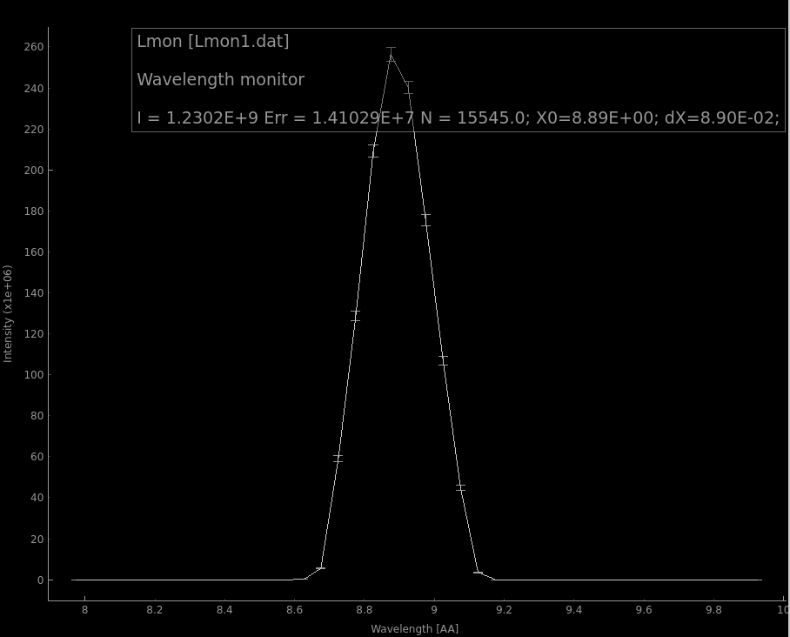
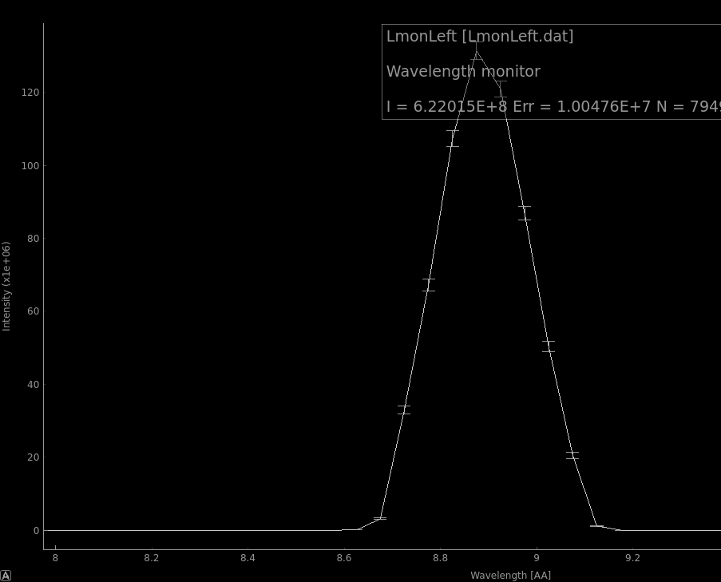
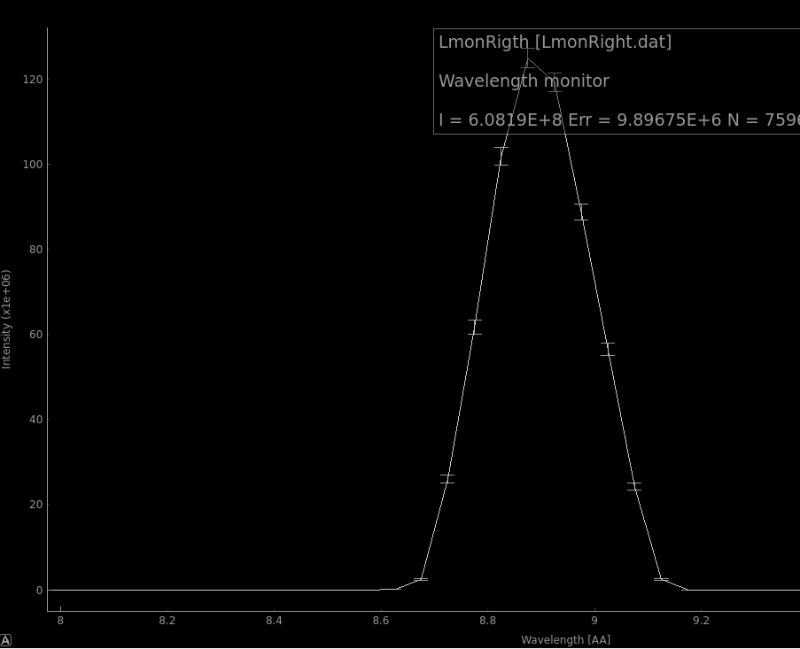
80 m results
Both cells
Left cell
Right cell
Compared to 60 m instrument:
More uniform flux distribution between the cells
Improved ratio of usable/all wavelengths (to 0.75 with 8.8E8 n/s within 0.2AA)

Slide 11
80 m results
Signal (peak height) is proportional to chopper opening times (wide pulse)
Background is proportional to square of chopper opening time (also wide pulse)

