Slide 1

Presentation JUAS
Louis Rinolfi
Director
Lund, August 2015

Slide 2
JUAS is 17 km South of CERN
CERN
JUAS

Slide 3
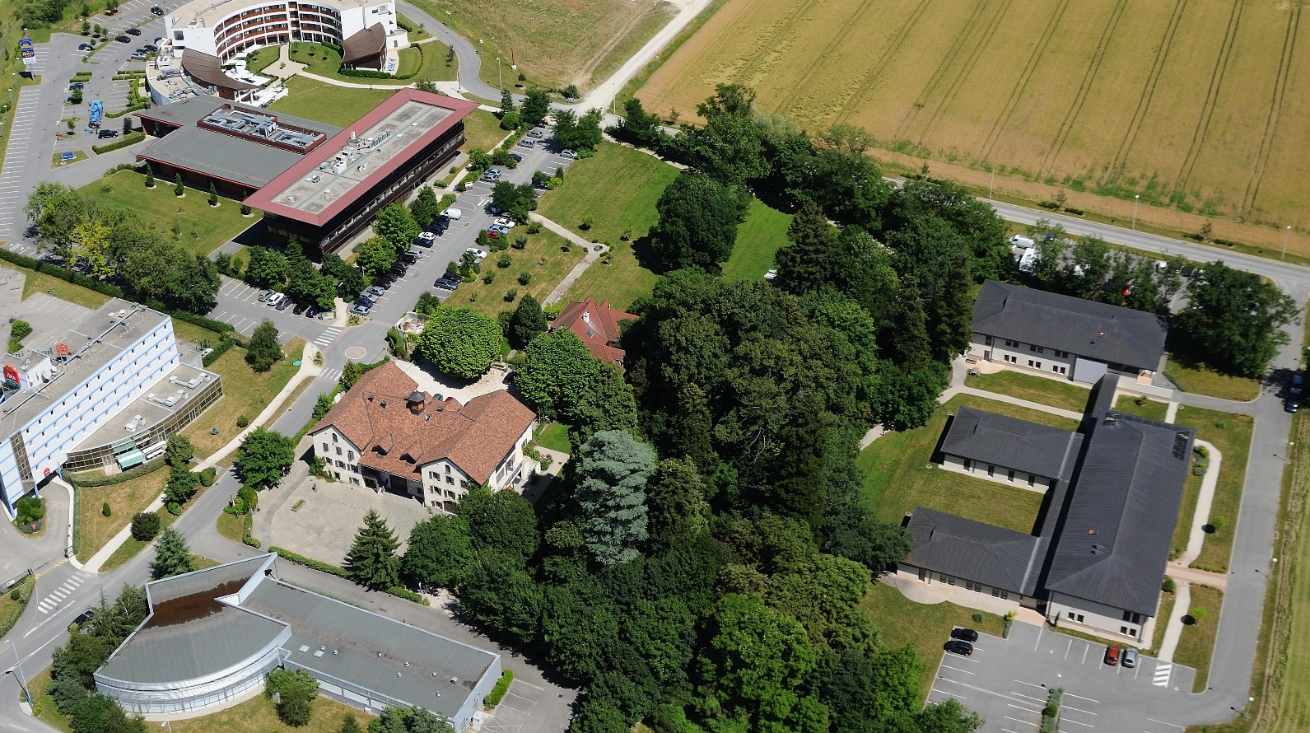
Mont Blanc 1 building
JUAS school

Slide 4

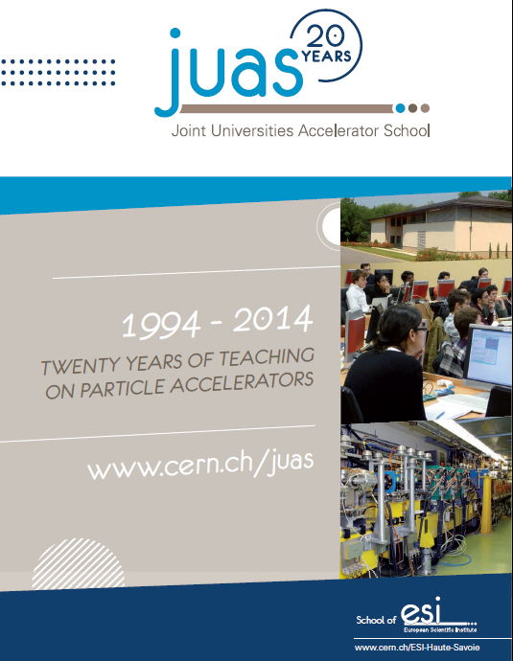
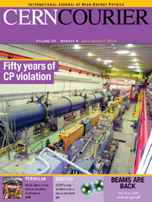
JUAS 2014
20th years anniversary
Brochure
Celebration at LPSC - University of Grenoble
LPSC = Laboratoire de Physique Subatomique et de Cosmologie
Friday 25th April 2014
July / August 2014
Article in the CERN Courier about this anniversary

Slide 5
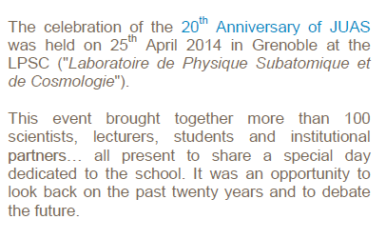
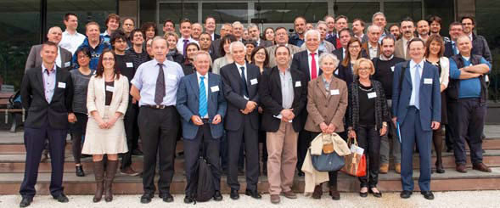
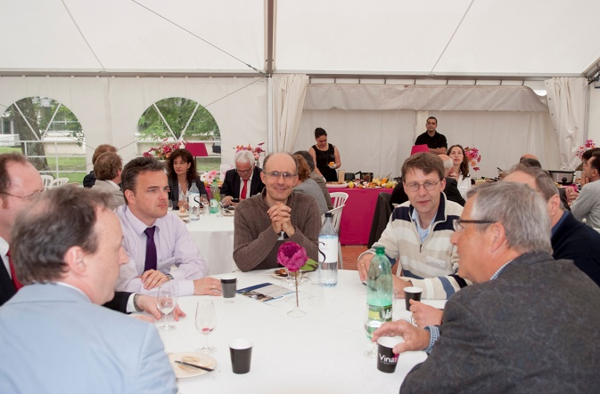
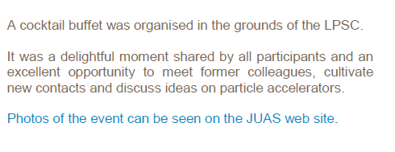

Slide 6
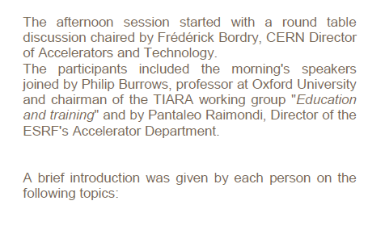
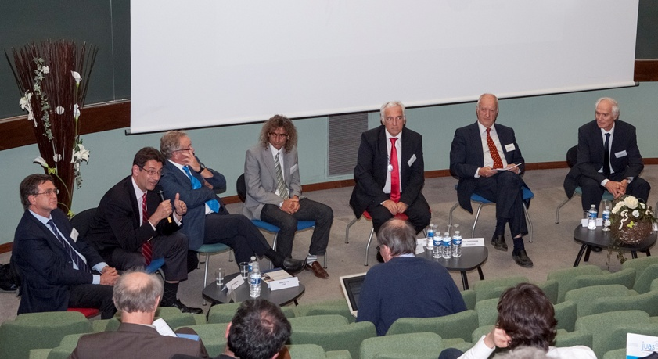

All presentations are available on the JUAS web site: www.cern.ch/juas
Special thanks to our partners in this event:

Slide 7

















France
Germany
15 partner universities
Spain
Italy
United Kingdom

Slide 8
Professors and assistants 2015 –Session 1
Professors / Assistants | Lecture | Home
P. Bryant | Introduction to Accelerators | Retired CERN
H. Henke | Relativity & Electromagnetism | University Berlin
J.M. De Conto | Particle optics | University J. Fourier
A. Latina / J. Resta Lopez / R. Alemany | Transverse Beam Dynamics | CERN
G. Sterbini / N. Fuster | MADX | CERN / Valencia Uni.
E. Métral / E. Benedetto | Longitudinal Beam Dynamics | CERN
J.B. Lallement / V. Dimov | Linacs | CERN
Y. Papaphilippou | Linear imperfections + Non linear effects | CERN
M. Migliorati | Space charge + Instabilities | University Roma
R. Bartolini | Synchrotron radiations | Oxford University
F. Chautard | Cyclotrons | GANIL
T. Perron | Injection / Extraction | ESRF

Slide 9
Professors and assistants 2015 – Session 2
Professors / Assistants | Lecture | Home
F. Caspers / M. Wendt | RF engineering including superconductivity | CERN
P. Chiggiato / R. Kersevan | Vacuum | CERN
Tommasini / Russenschuck | Magnets design | CERN
T. Zickler / J. Bauche | Normal conducting magnets | CERN
M. Wilson / P. Ferracin | Superconducting magnets | Retired / CERN
P. Forck | Beam instrumentation | GSI - Darmstadt
T. Thuillier | Particle sources | LPSC Grenoble
E. Zimoch | Accelerator control | PSI - Villigen
W. Mondelears | Low energy electron accelerators | Gent university
W. Kleeven | Accelerators for industrial & medical appl. | IBA - Belgium
S. Bousson | High current proton linacs | IN2P3/IPNO - Orsay
R. Miralbell | Therapeutic applications | HUG - Geneva
S. Meyroneinc | Particle therapy and accelerators | Institut Curie - Paris
X. Queralt | Radiation safety | ALBA - Barcelona

Slide 10
Seminars in 2015 – Session 1
Professors | Lecture | Home
U. Amaldi | History of particle accelerators as a tool for discoveries | TERA
L. Rinolfi | Future high energy colliders | CERN / JUAS
Seryi | Sciences and art of inventiveness | JAI / Oxford
R. Assmann | Laser plasma acceleration | DESY
Seminars in 2015 – Session 2
Professors | Lecture | Home
E. Prat | Free electron laser | PSI
M. Steck | Techniques of beam cooling | GSI

Slide 11
Overview of JUAS courses
Session 1 : Sciences and Physics of Particle Accelerators
Session 2 : Technology and Applications of Particle Accelerators
 | Number of professors + assistants | Lectures | Tutorials | Seminars | Total
Session 1 | 21 | 68 h | 40 h | 4 h | 112 h
Session 2 | 21 | 63 h | 21 h | 2 h | 86 h
 |  | Visits (CERN, ESRF, PSI, HUG) | Practical works at CERN | Practical works at BERGOZ | Grand total
Session 1 | 112 h | 8 h | - | - | 120 h
Session 2 | 86 h | 16 h | 12 h | 6 h | 120 h

Slide 12
Overview of students status
2015 | Masters | PhD | Professionals | Total | Presented exam
Course 1 | 13 | 11 | 12 | 36 | 24
Course 2 | 13 | 6 | 16 | 35 | 18

Slide 13
JUAS students 2015 by countries

Slide 14
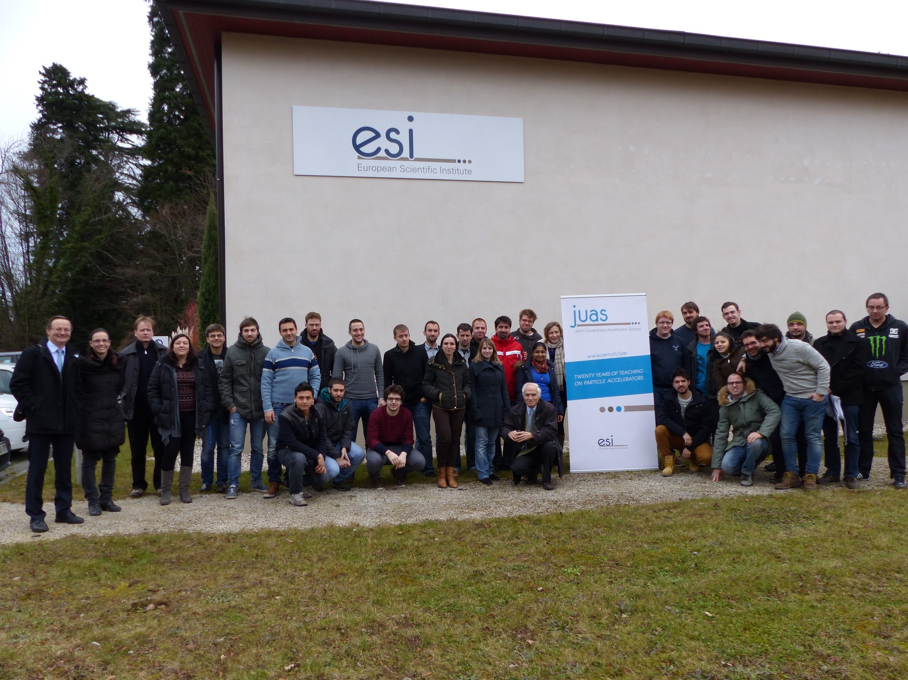
Students JUAS 2015 – Session 1
Sciences & Physics of Particle Accelerator

Slide 15
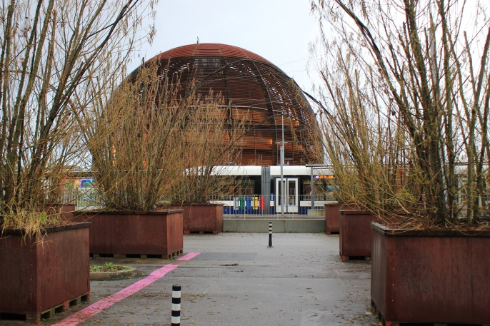
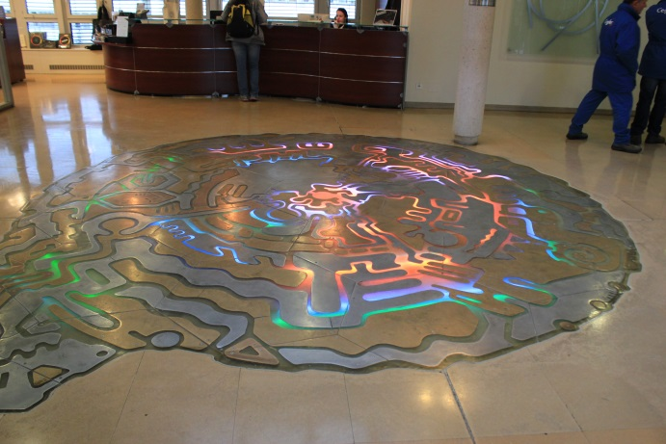
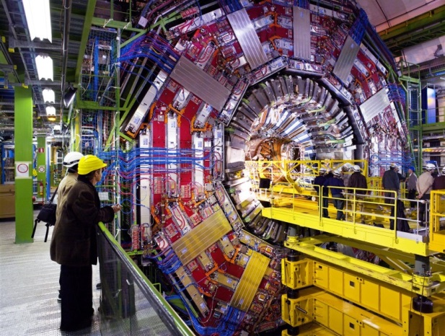
Visit at CERN
Friday 16th January 2015
Programme:
13:00 Lunch at CERN
13:30 Bookshop (if you want)
14:00 Presentation of CERN (L. Rinolfi)
14:45 Film
15:00 Bus start for CMS detector (Point 5 in Cessy)
15:30 Start CMS visit (4 groups)
17:30 End of CMS visit

Slide 16
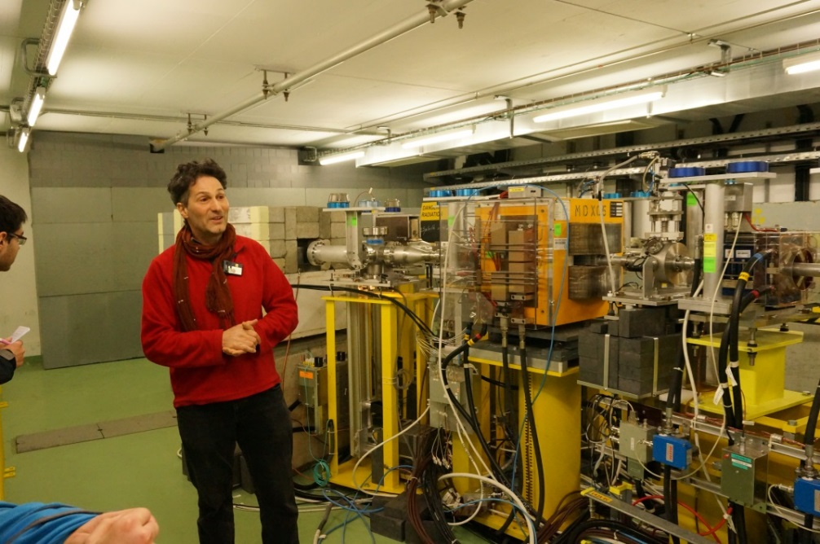
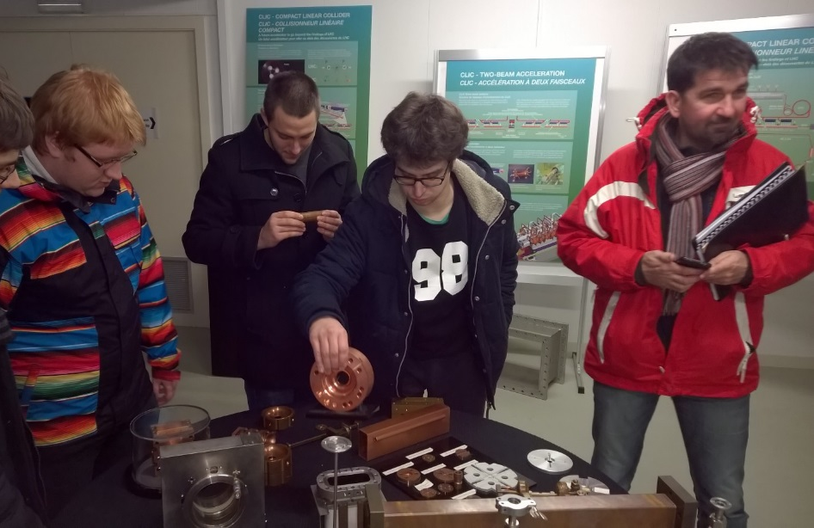
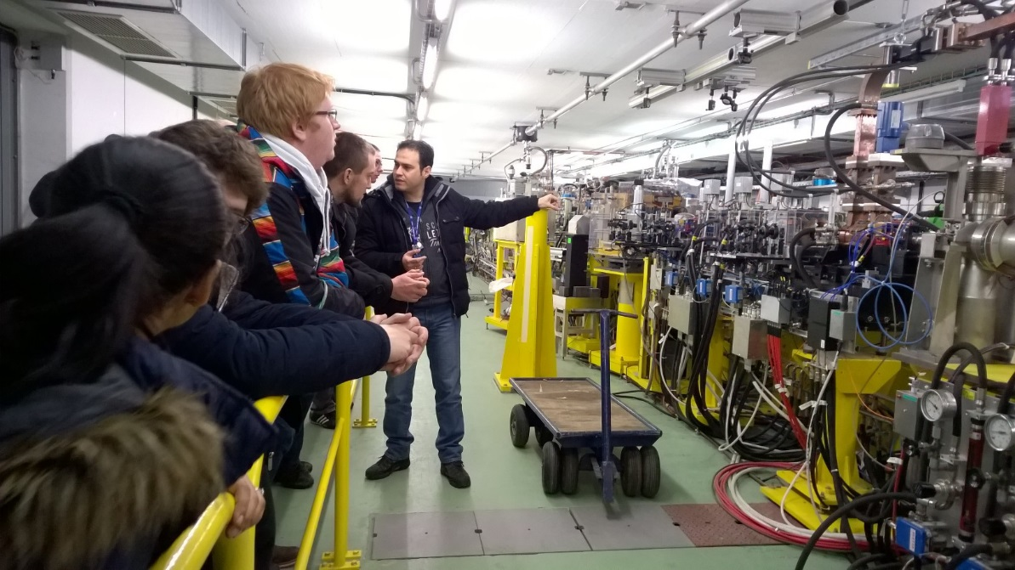
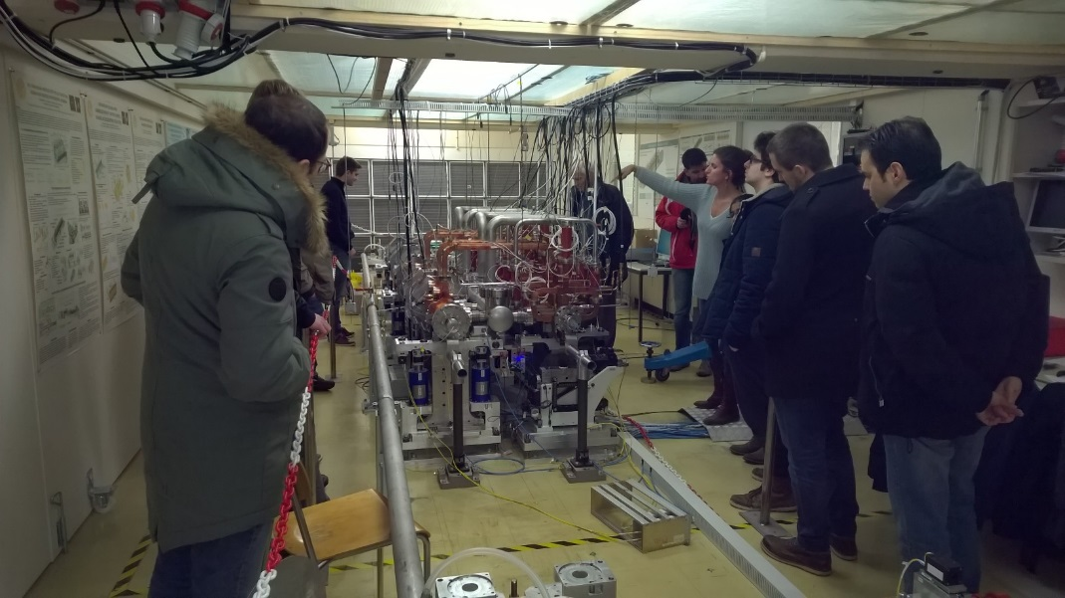
CLIC Test Facility (CTF3) at CERN
W. Farabolini as a guide
Inside the CLIC Show Room
The 12 GHz accelerating structures
The 120 MeV Linac for the Probe Beam

Slide 17
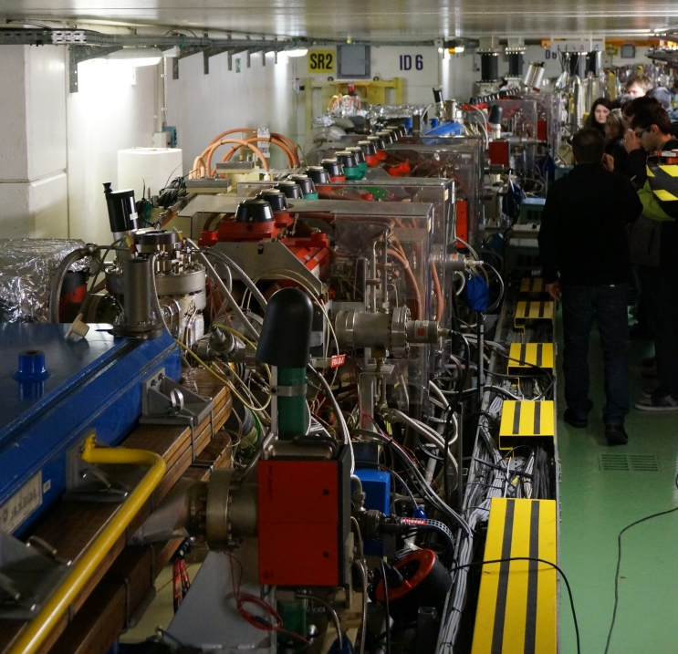
ESRF at Grenoble

Slide 18
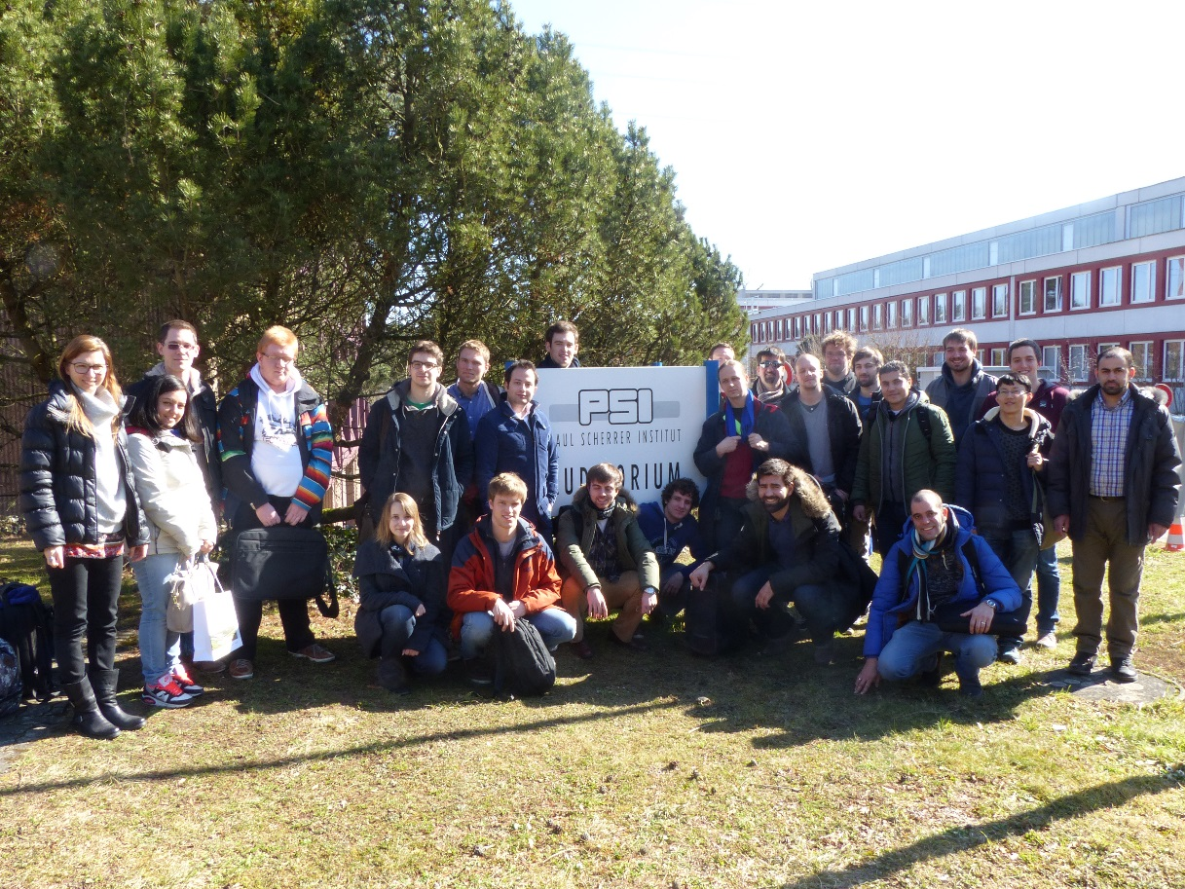
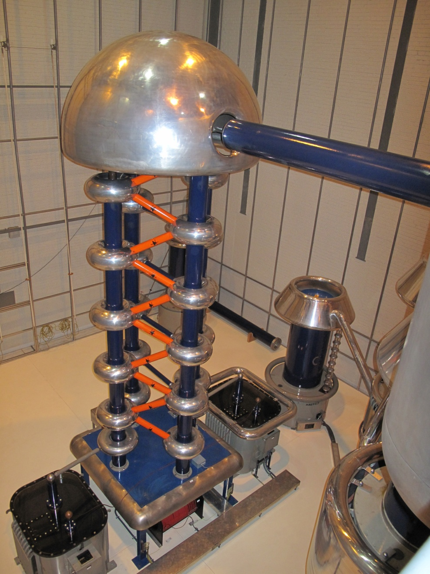
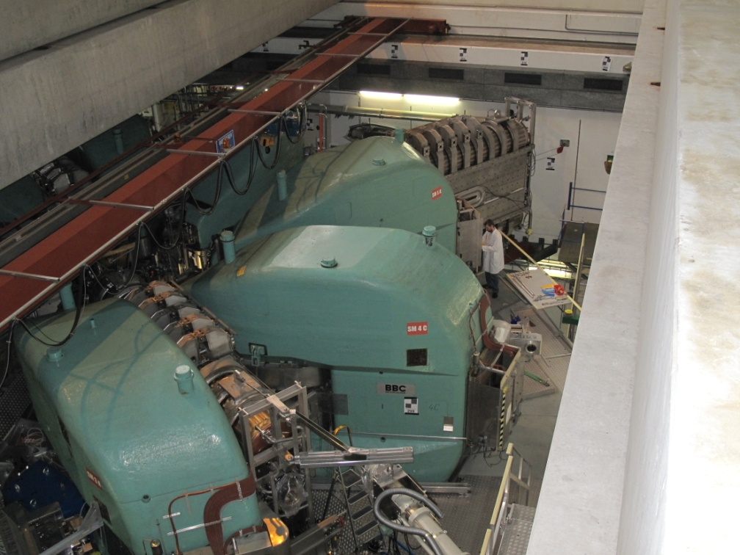
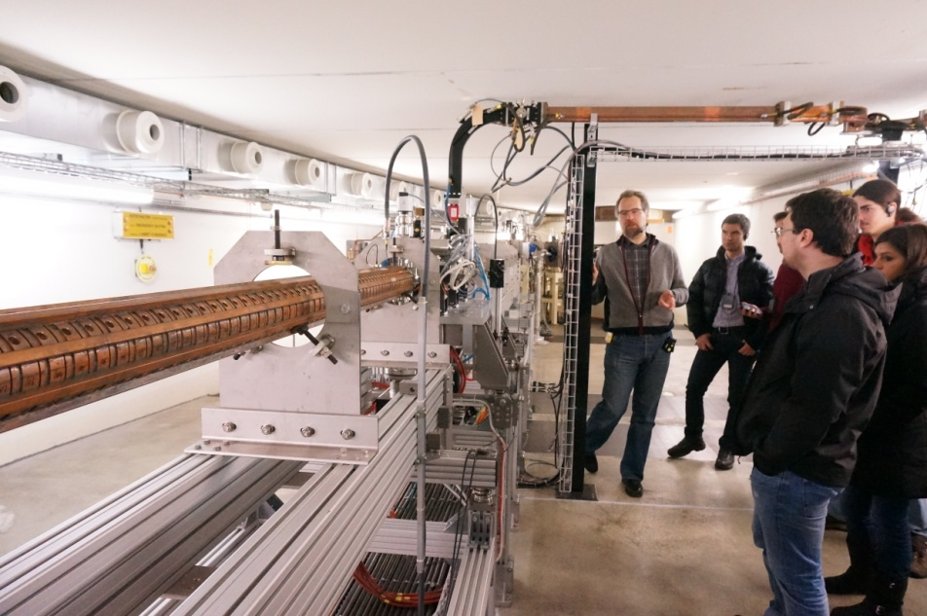
PSI visit
The Cyclotron at PSI

Slide 19
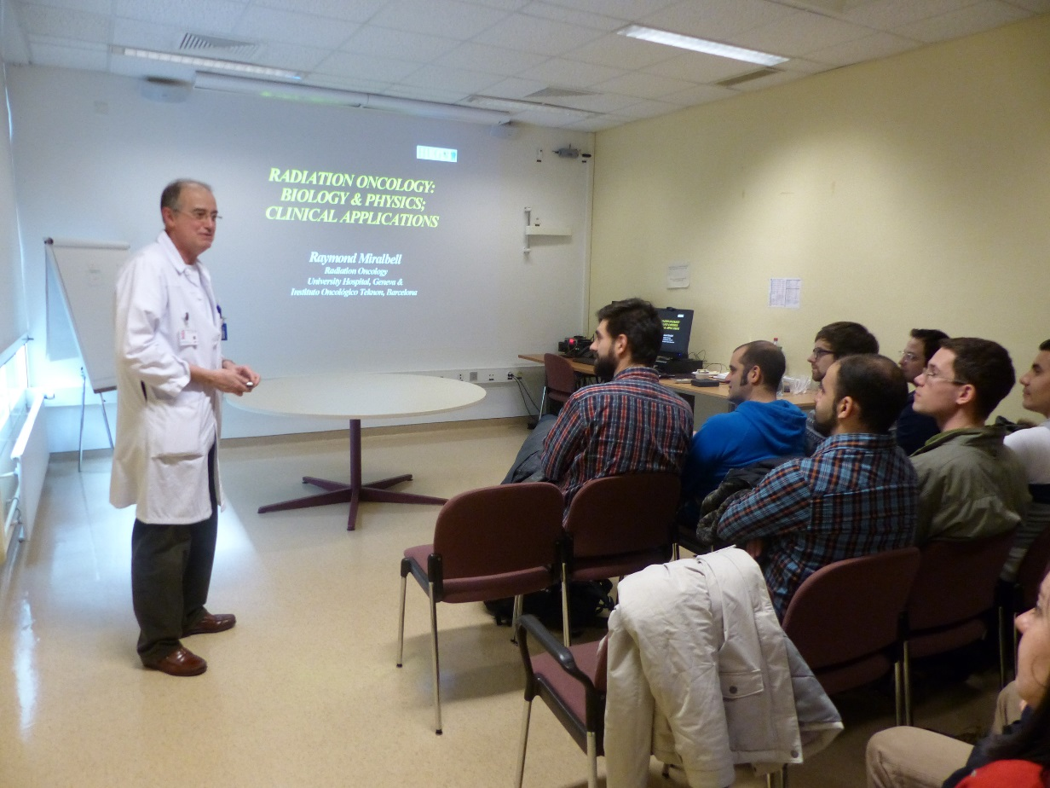
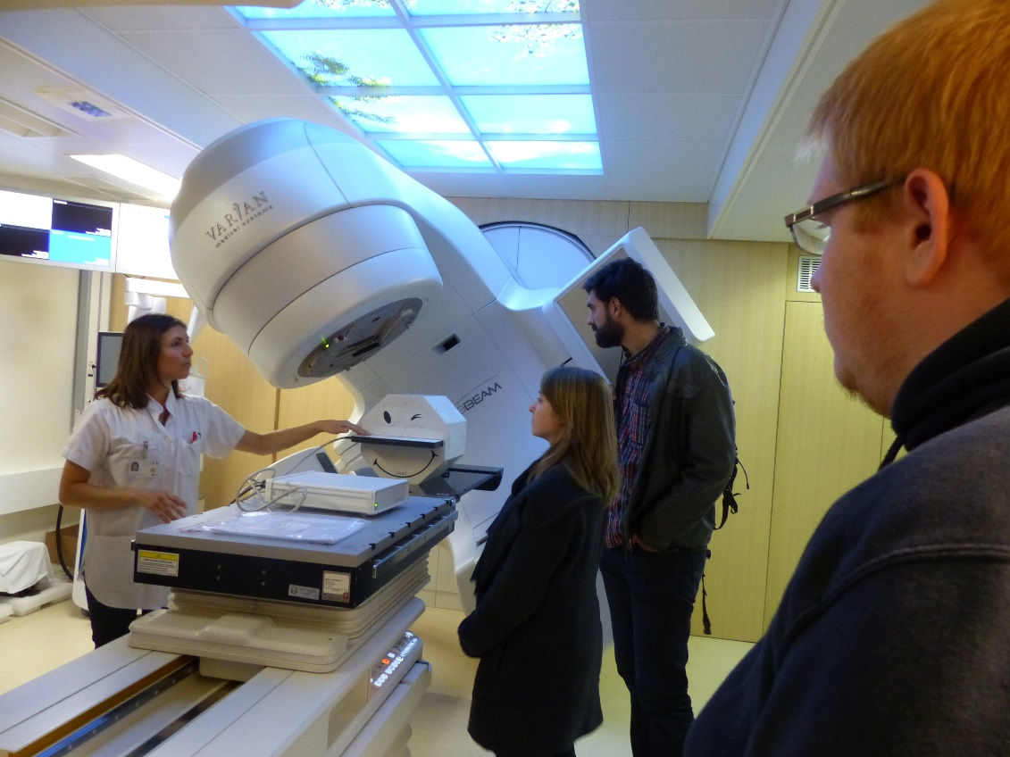
HUG visit
Inside the radiotherapy room
Lecture by Prof. Miralbell

Slide 20
EXAMINATION
Each student who gets an average mark of 10/ 20 (or above) can receive ECTS credits recognized by the partner Universities.
There are 5 topics, each of them lasts 1.5 hour:
Session 1: Session 2:
* Transverse Beam Dynamics * RF
* Longitudinal Beam Dynamics * Magnets
* Synchrotron Radiations * Beam Instrumentation
The remaining 2 exams are announced the week 4 and 9 (weeks before the exams)
For each examination, all written documents are permitted and a pocket calculator.

Slide 21
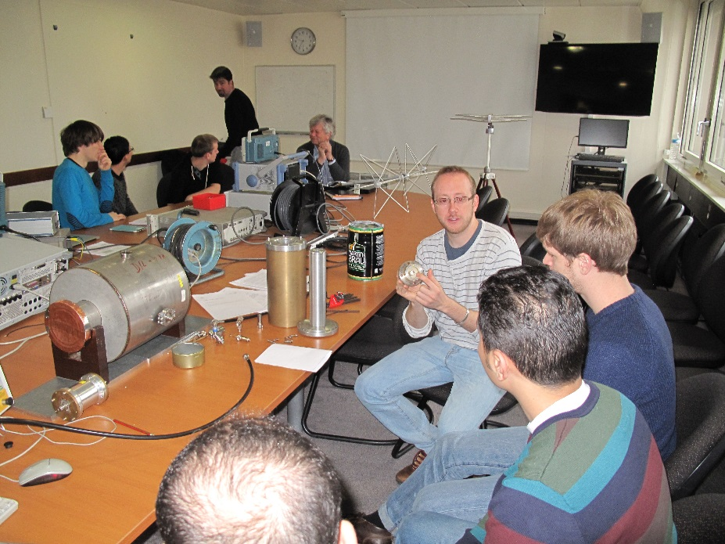
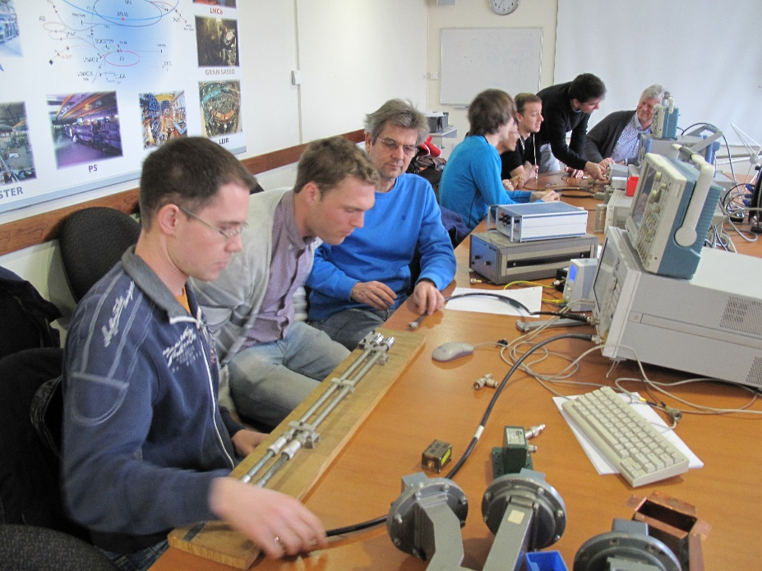
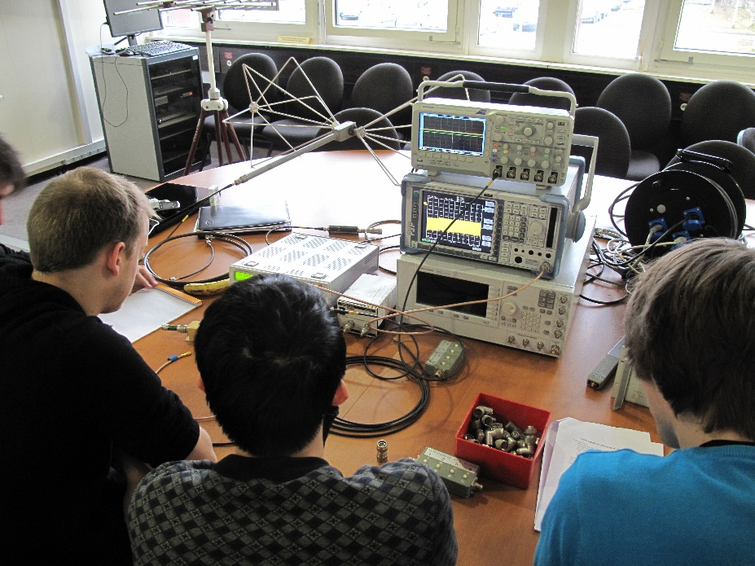
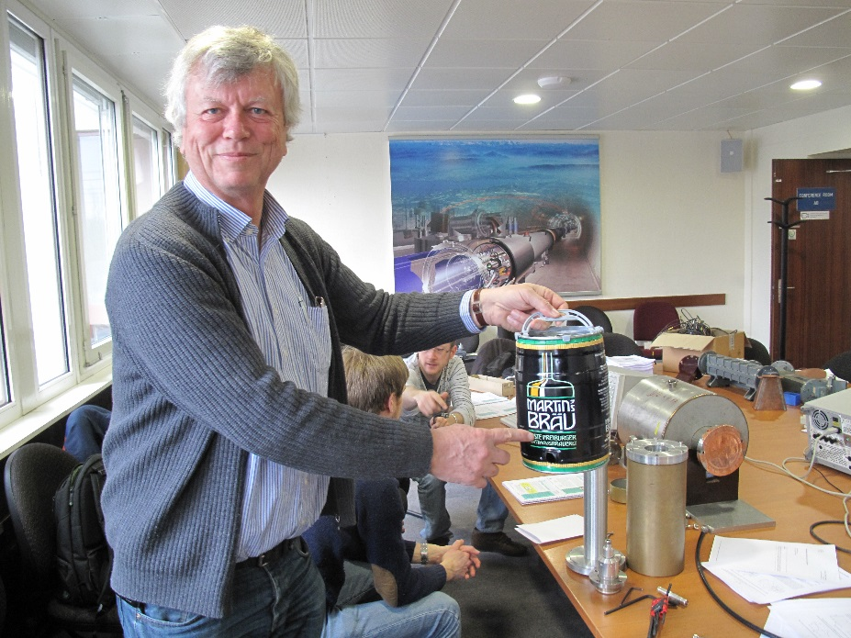
Practical days at CERN: RF group

Slide 22
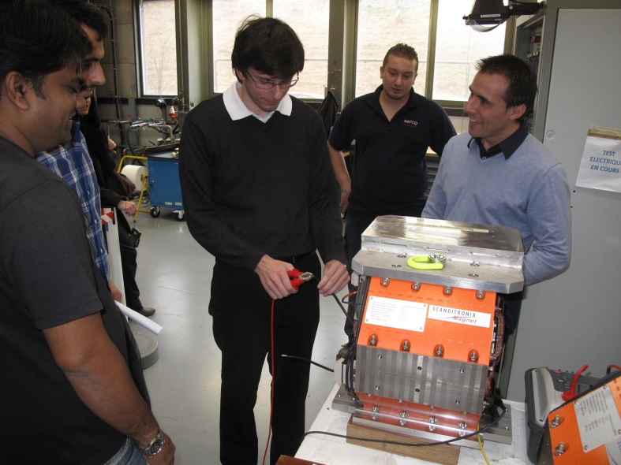
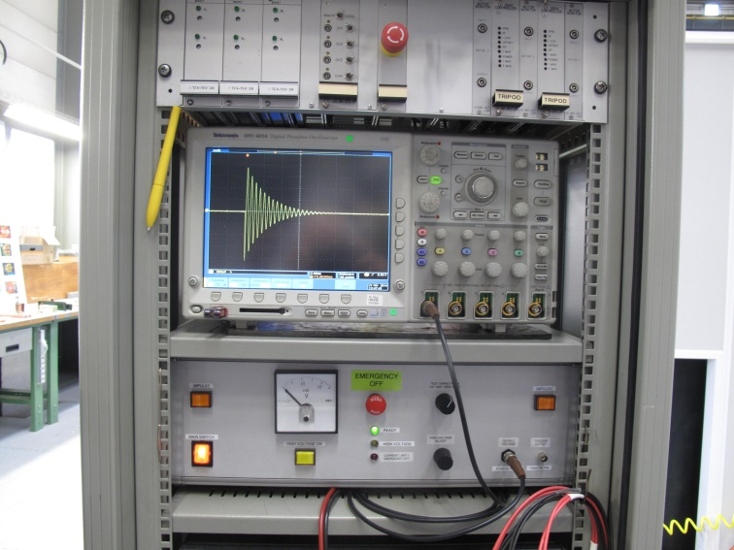
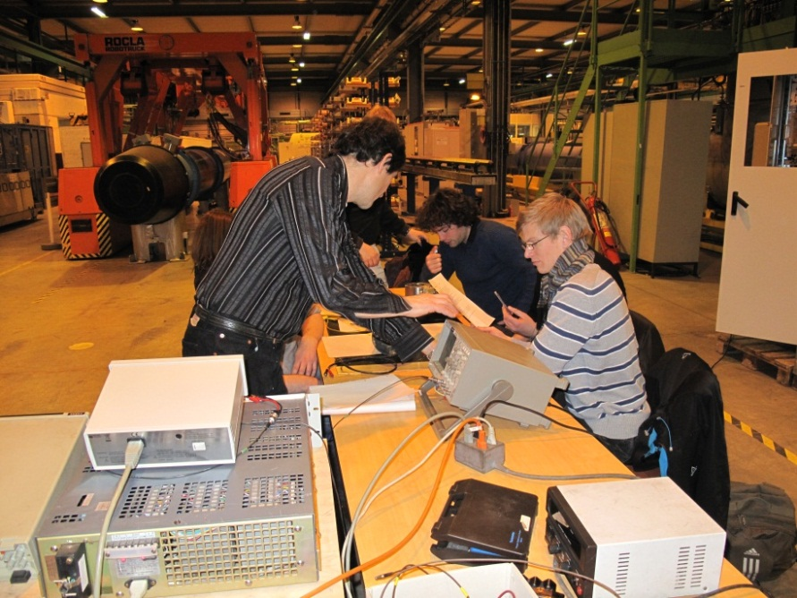
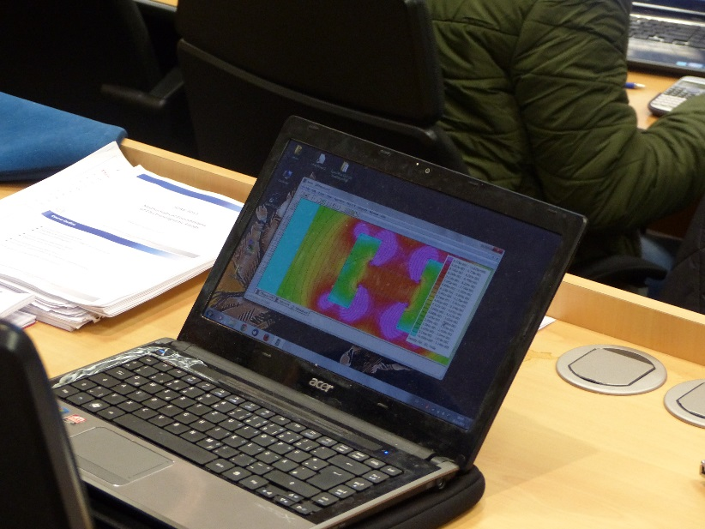
Practical days at CERN: Magnets group

Slide 23
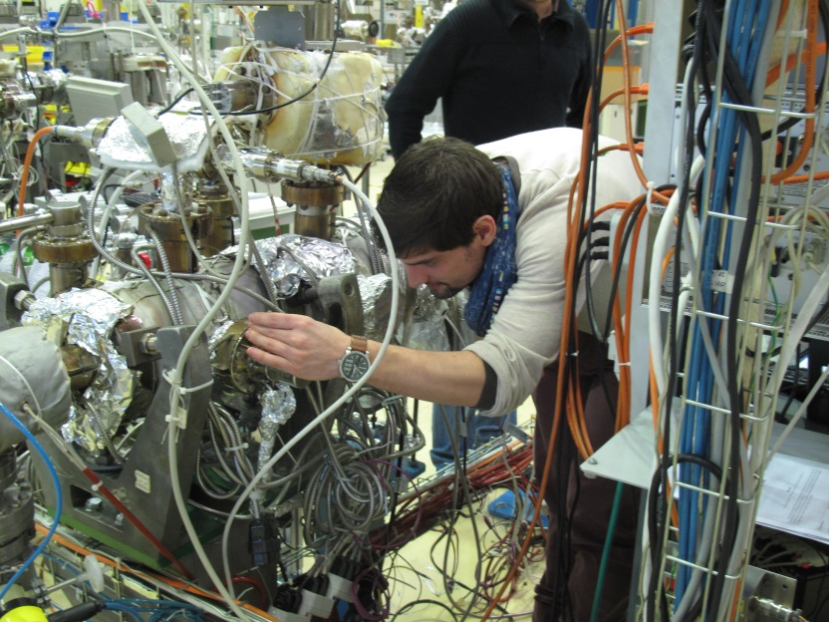
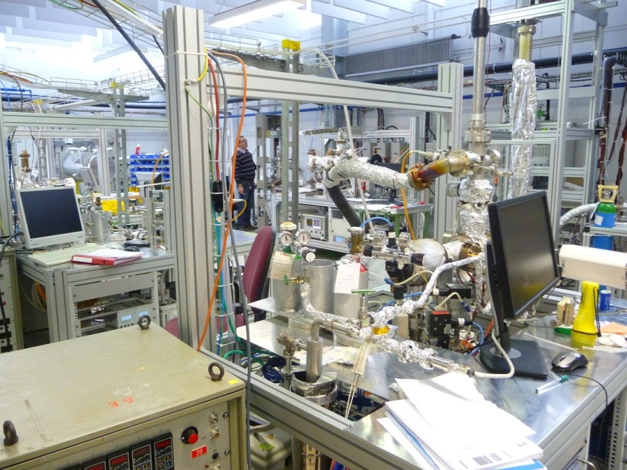
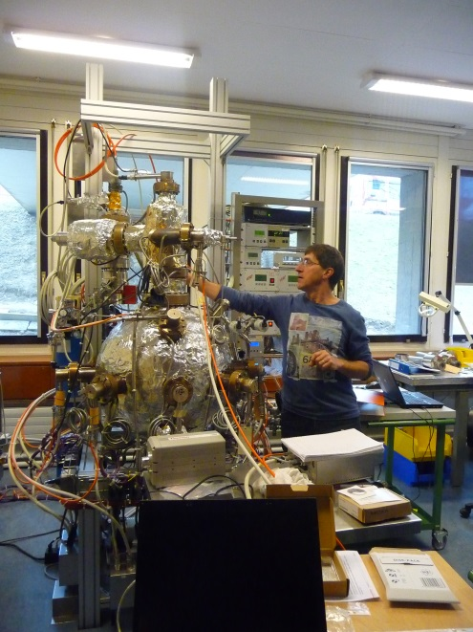
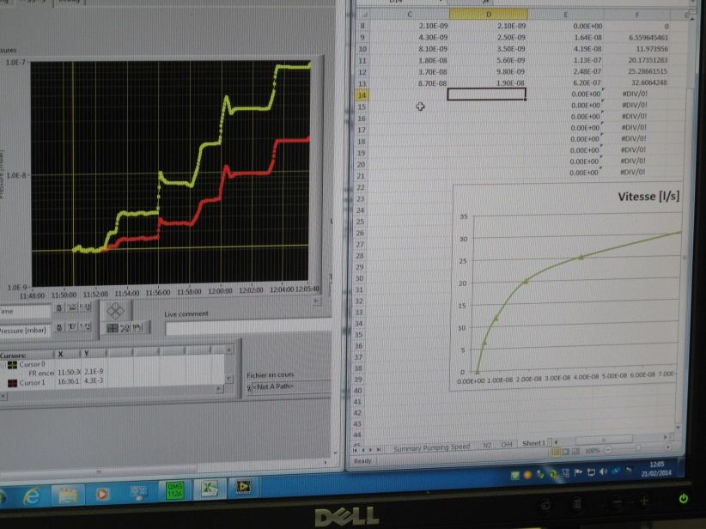
Practical days at CERN: Vacuum group

Slide 24
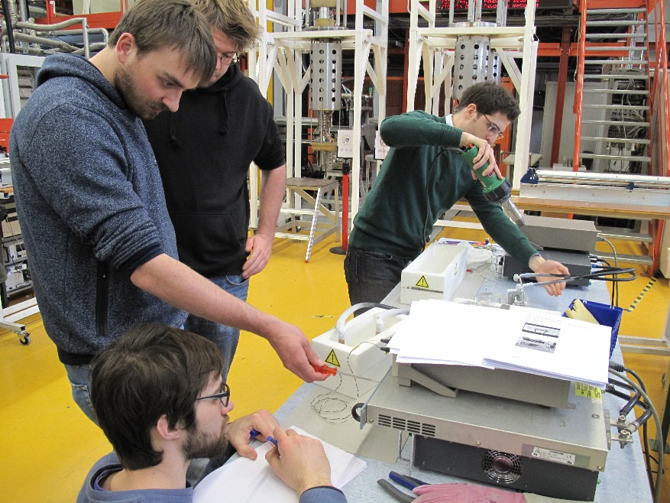
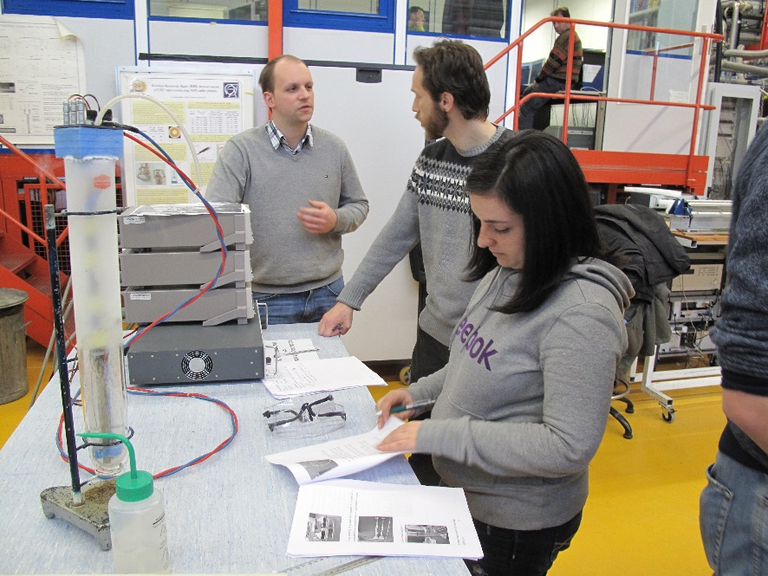
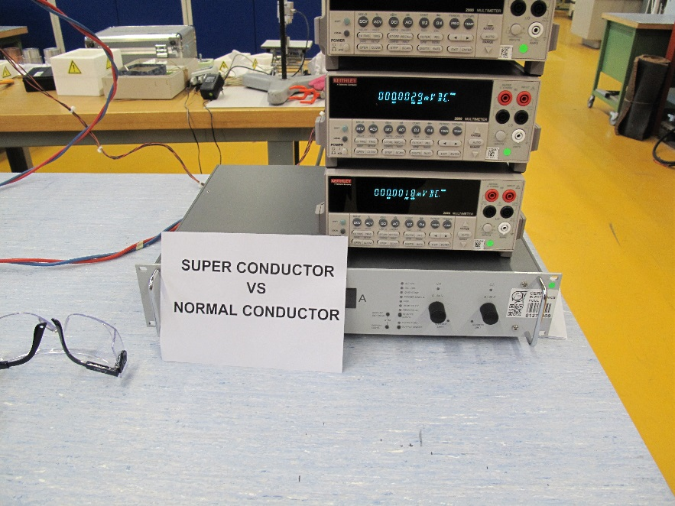
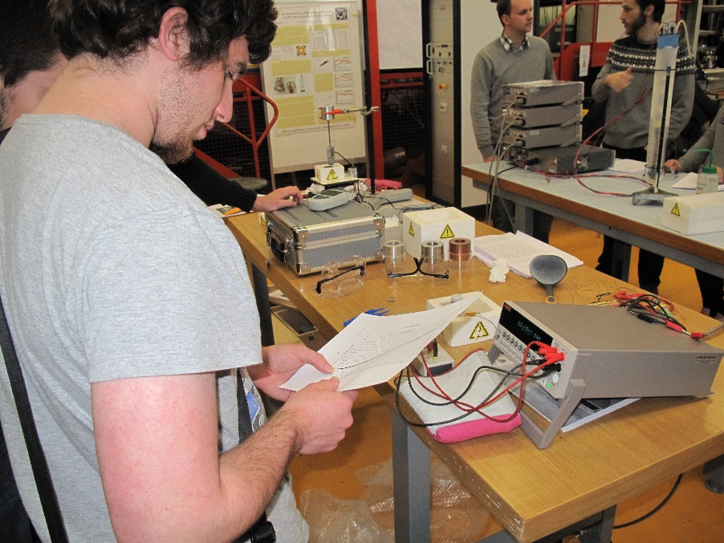
Practical days at CERN: Superconductivity group

Slide 25
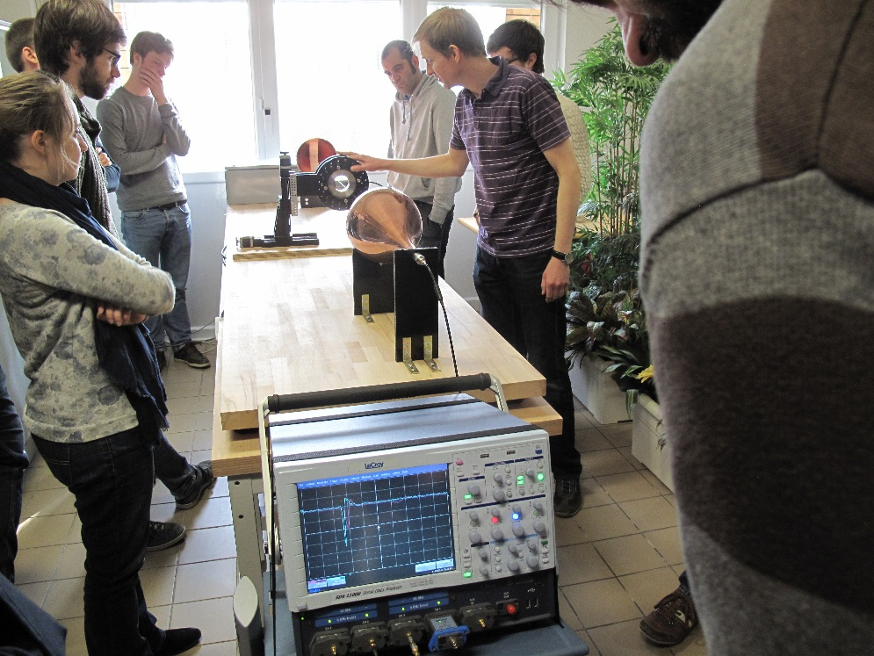
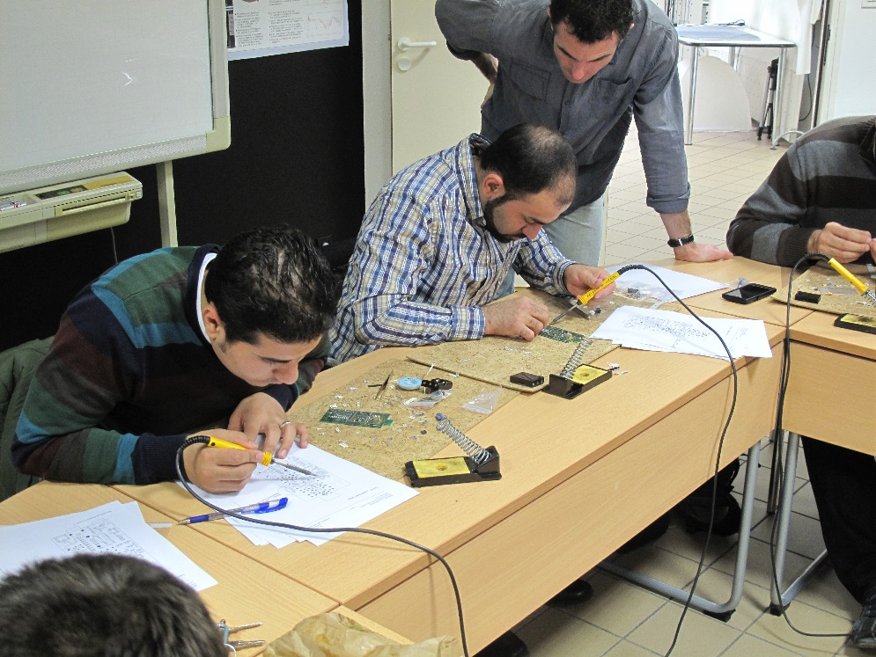
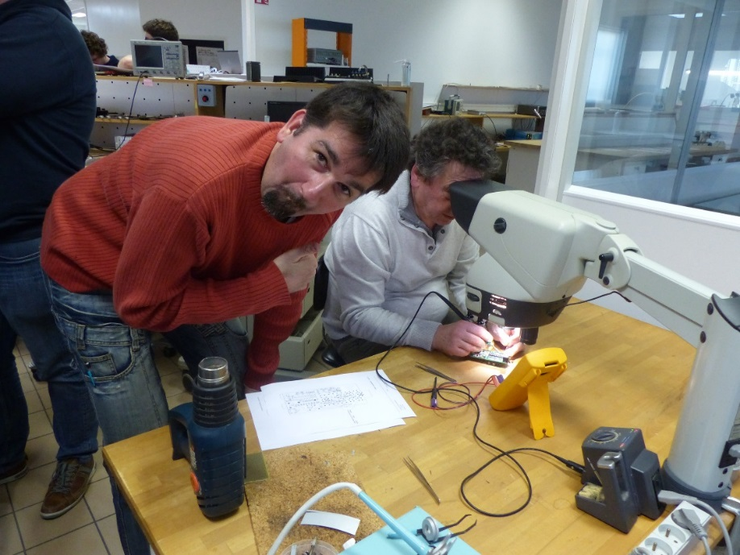
Practical day at Bergoz
Goubau Line
Soldering printed circuits for a Wi-Fi meter

Slide 26
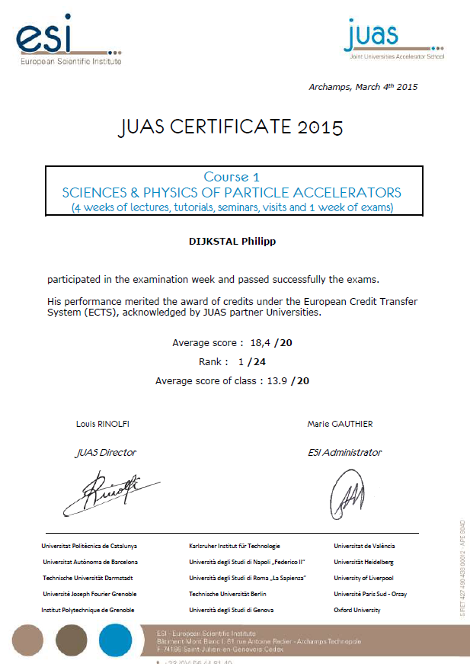
JUAS certificate of examination
for session 1
Each student who obtains a mark equal (or above) to 10 / 20 received such certificate

Slide 27
European Credit Transfer System (ECTS)
Students passing the exam of:
- Session 1 (“Physics of Accelerators”)
- Session 2 (“Technology of Accelerators”)
receive ECTS credits from their universities

Slide 28








France
Germany
UK
Spain
Italy
Sweden
Switzerland

Slide 29



JUAS sponsoring from private companies
=> provides financial support for JUAS student
=> opens his company for a full day for practical works
cover the cost to print RF course booklets in color
Thank to Fritz Caspers

Slide 30

Accelerator Conference award for JUAS
Each year one JUAS student receives a grant to attend the IPAC conference.
There are requirements to attend IPAC:
Follow JUAS courses
Obtain the best marks at the examination
Continue in the field of particle accelerator
Present work at the conference
Serve as for other supported students (scientific secretary, JUAS stand, Poster, …)

Slide 31
  Summary
  22nd edition : January - March 2015
  56 students - 17 nationalities
  16 Master
  15 PhD
  25 professionals
  45 lecturers
  15 European partner universities
  (France, Germany, Italy, Spain, UK)
  ECTS credits delivered to the students by the universities
  19 Sponsors (research facilities, companies)
  International Advisory Board (hosted in 2015 by University of Liverpool)
  visits to CERN, PSI, Geneva University Hospital, ESRF & practical sessions at CERN, PSI and Bergoz Instrumentation
  IPAC Conference for JUAS students
www.cern.ch/juas
www.esi-archamps.eu

