Slide 1

Introduction to
Synchrotron Light Sources
Pedro F. Tavares
MAX IV Laboratory
Lund, Sweden

Slide 2
Summary
What is Synchrotron Light ?
Why Synchrotron Light ?.
The MAX IV Synchrotron Light Source : the next generation is here
How do we do it ? See following lectures.

Slide 3
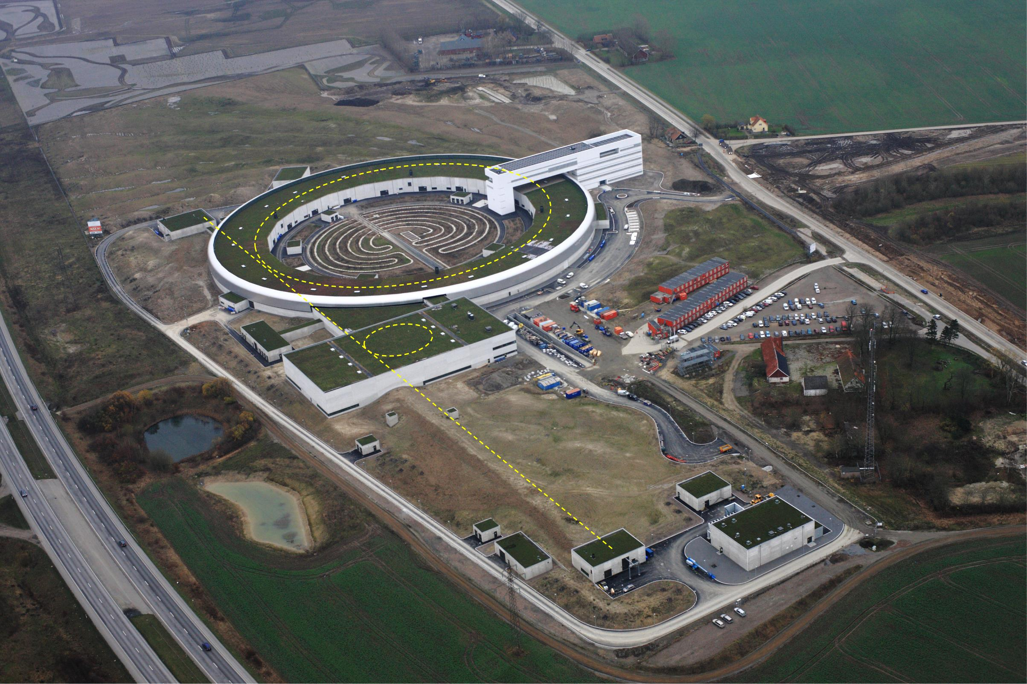
What is Synchrotron Light ?
Ring (528 m circumf)
Experimental stations
Properties:
Wide band
High intensity/Brilliance
Polarization
Time structure
Ring (96 m circumf)
Linear accelerator (ca 250 m)
Electron source
Pictures and animation by S.Werin

Slide 4
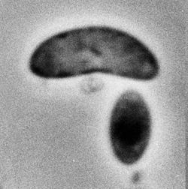
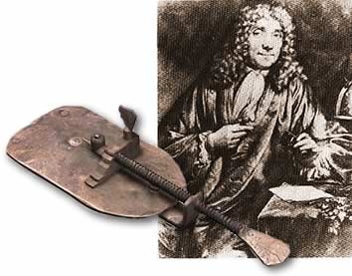
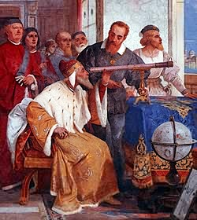
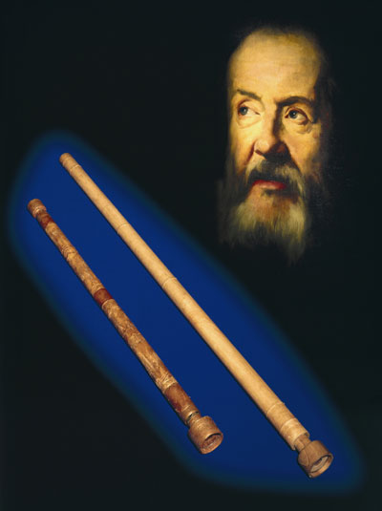
Using Light To Understand the World
Anton van Leeuwenhoek
1632-1723
Galileo 1564 - 1642
The telescope is presented to the Doge of Venice

Slide 5
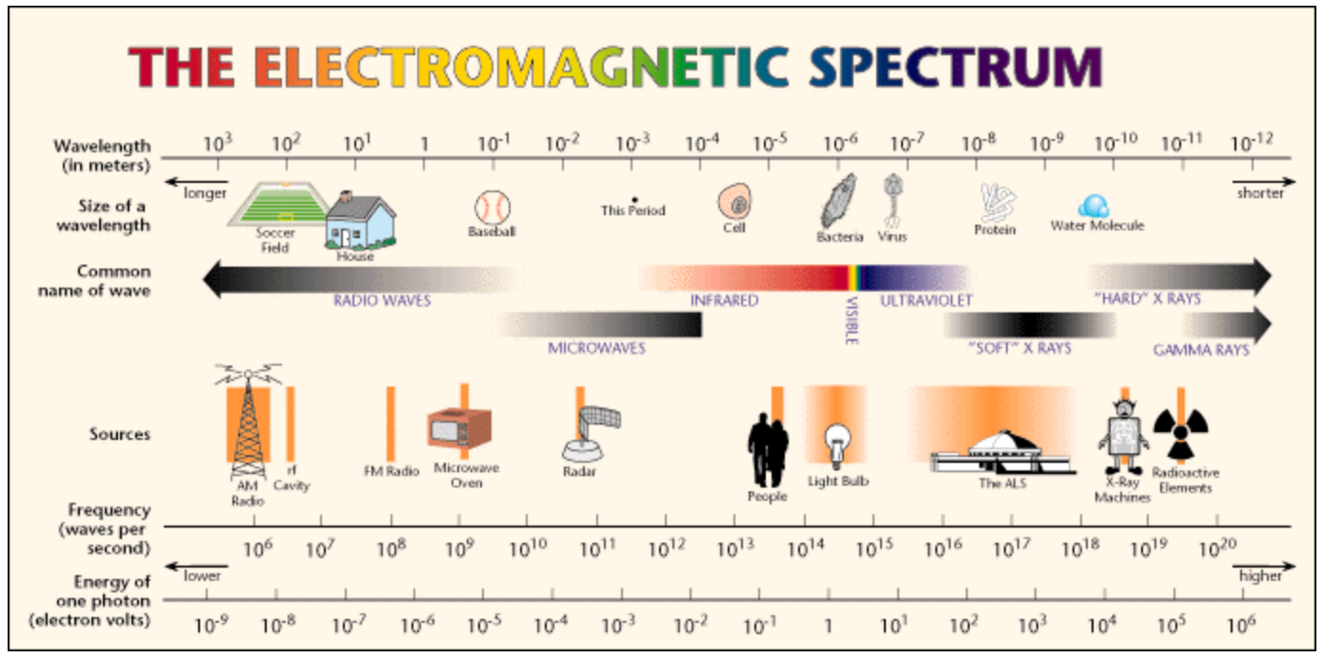
Why Synchrotron Light ?
Image: Lawrence Berkely Lab

Slide 6
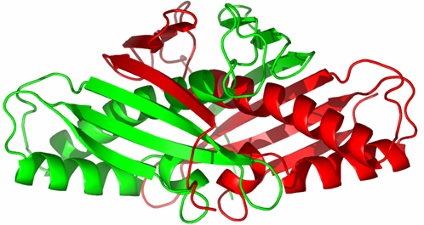
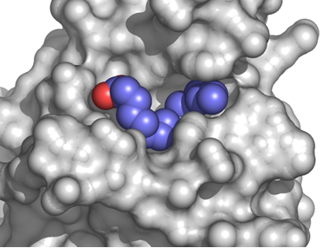
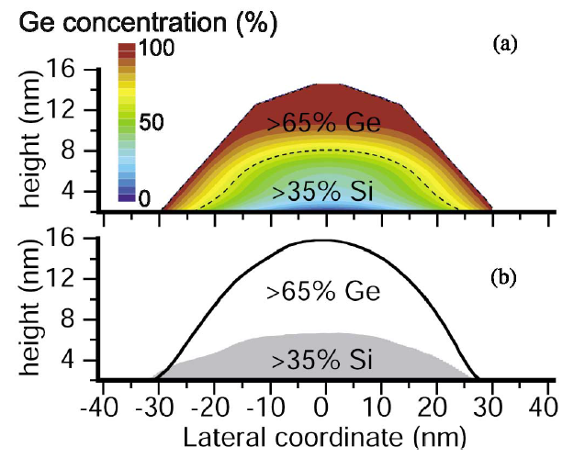
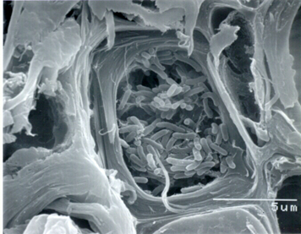
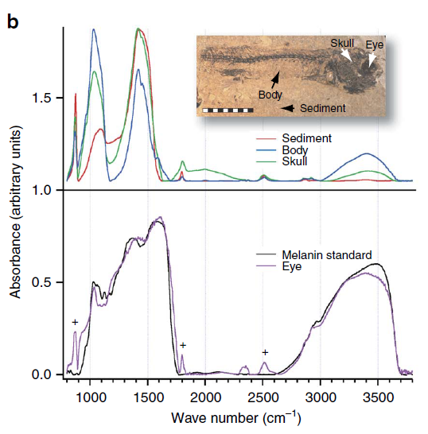
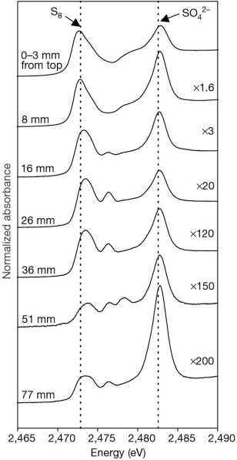
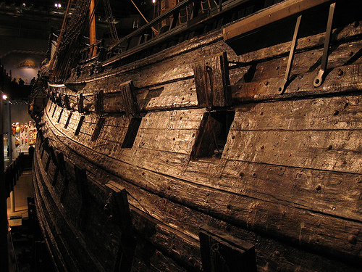
Why Synchrotron Light ?
A.Malachias et ak, 3D Composition of Epitaxial Nanocrystals by Anomalous X-Ray Diffraction, PRL 99, 17 (2003)
OLIVEIRA, M. A. et al. Crystallization and preliminary X-ray diffraction analysis of an oxidized state of Ohr from Xylella fastidiosa. Acta Crystallographica. Section D, Biological Crystallography, v. D60, p. 337-339, 2004
Photo: Vasa Museum
Sandstrom, M. et al. Deterioration of the seventeenth-century warship vasa by internal formation of sulphuric acid. Nature 415, 893 - 897 (2002)
J.Lindgren et al, Molecular preservation of the pigment melanin
in fossil melanosomes, Nature Communications DOI: 10.1038/ncomms1819 (2012)

Slide 7
MAX IV

Slide 8

SR Light Sources WorldWide
Operational
Under construction
Design
Equator

Slide 9
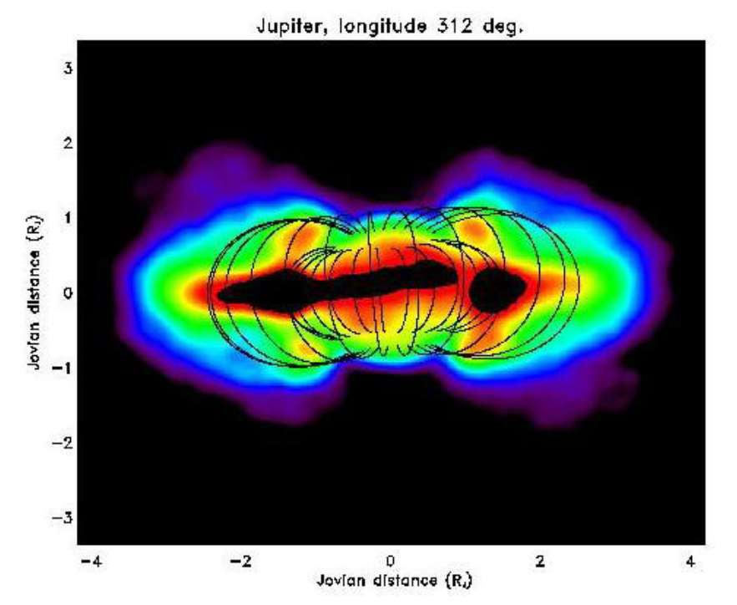
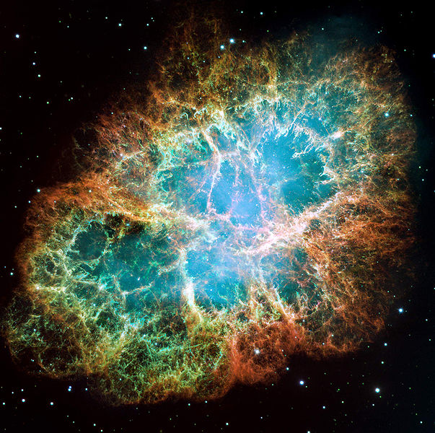
SR in nature too !
Jupiter
Crab Nebula
Image: Imke de Pater
From hyperphysics.phy-astr.gsu.edu

Slide 10
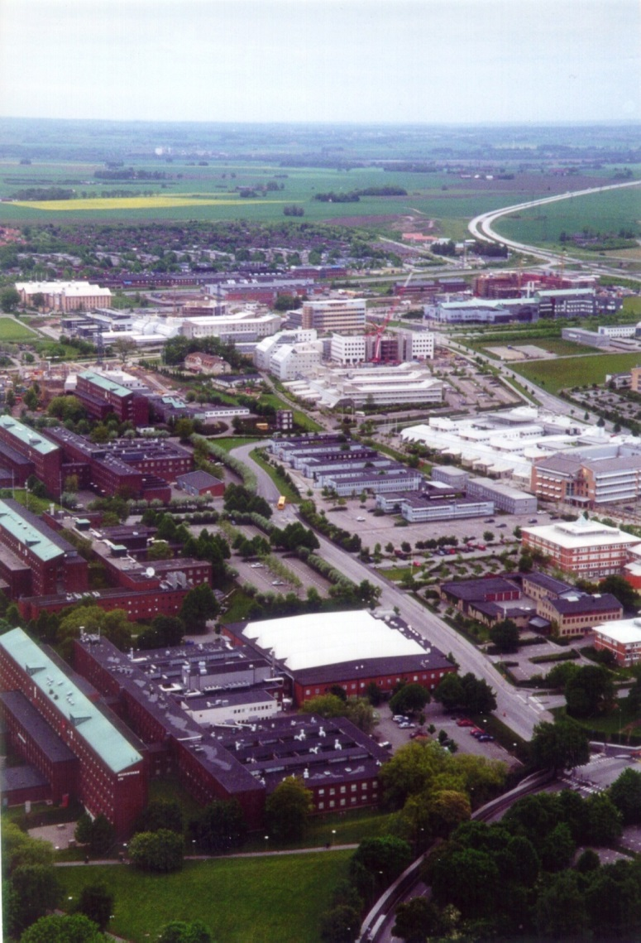
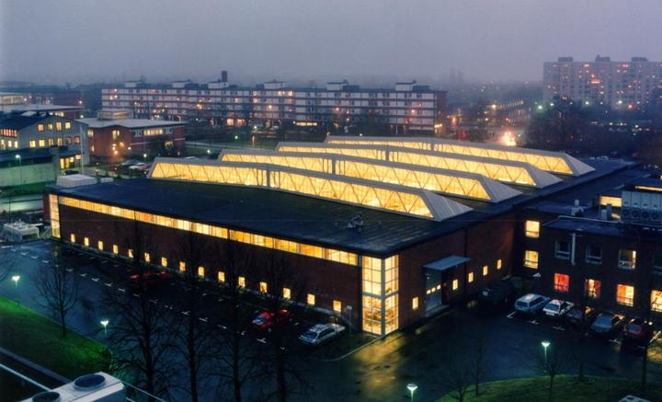
MAX IV laboratory (MAX-lab)
A National Laboratory for synchrotron radiation
at Lunds University
History
1981 – MAX-lab is formed
1986 – First experiments at MAX I
1997 – First experiments at MAX II
2005 – MAX IV Conceptual Design Report
2009 – Decision to build MAX IV
Slide by S.Werin

Slide 11
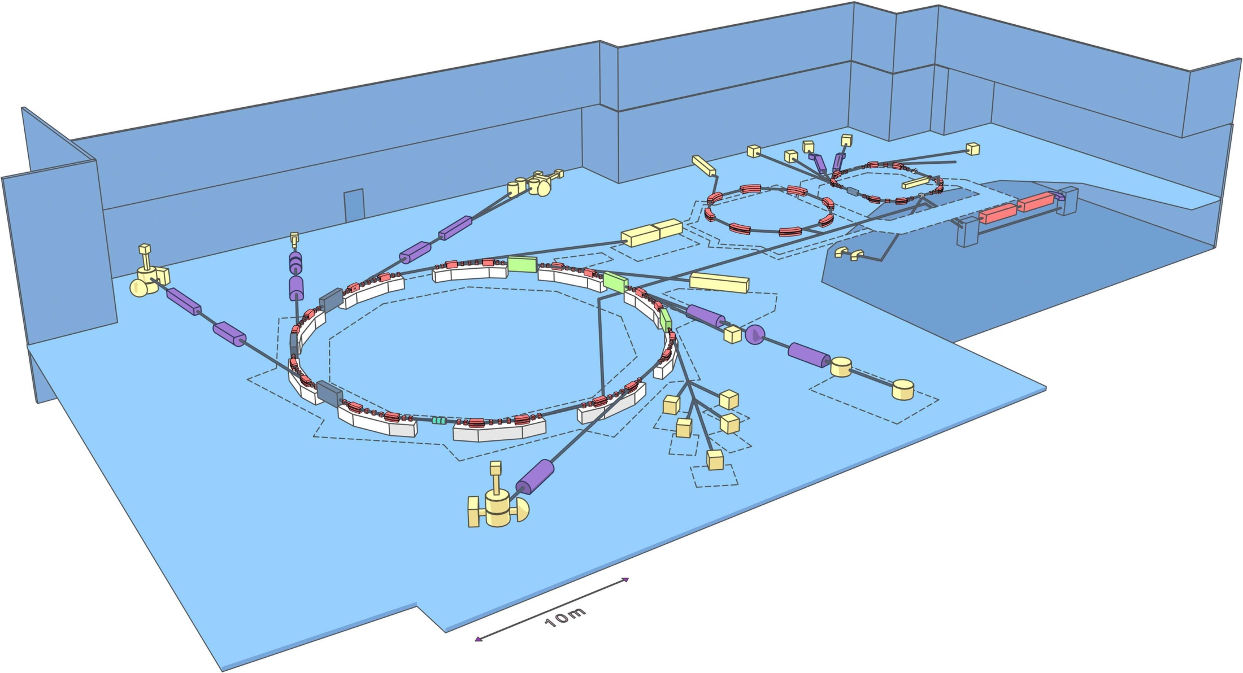
Synchrotron Laboratory (MAX-lab)
Pictures and animation by S.Werin

Slide 12
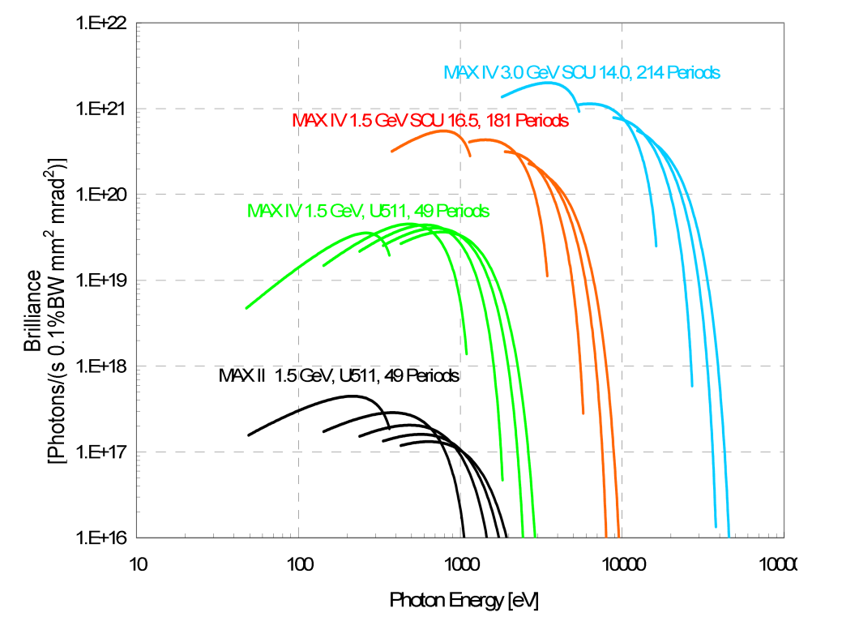

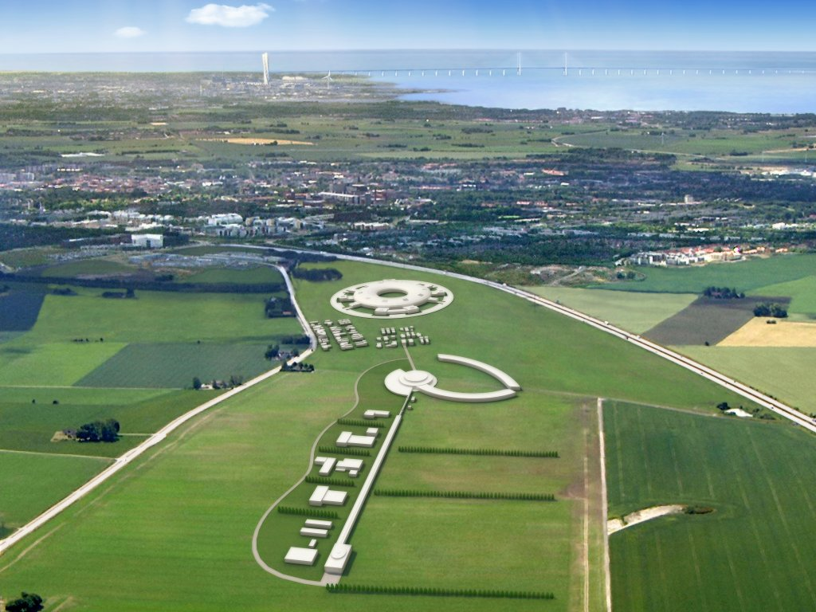
Tack för att ni lyssnade
Slide by S.Werin

Slide 13
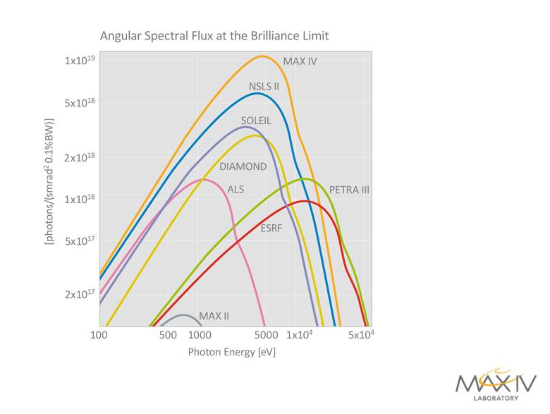
Why will MAX IV be the best?
Brilliance from some SR sources
Slide by S.Werin

Slide 14
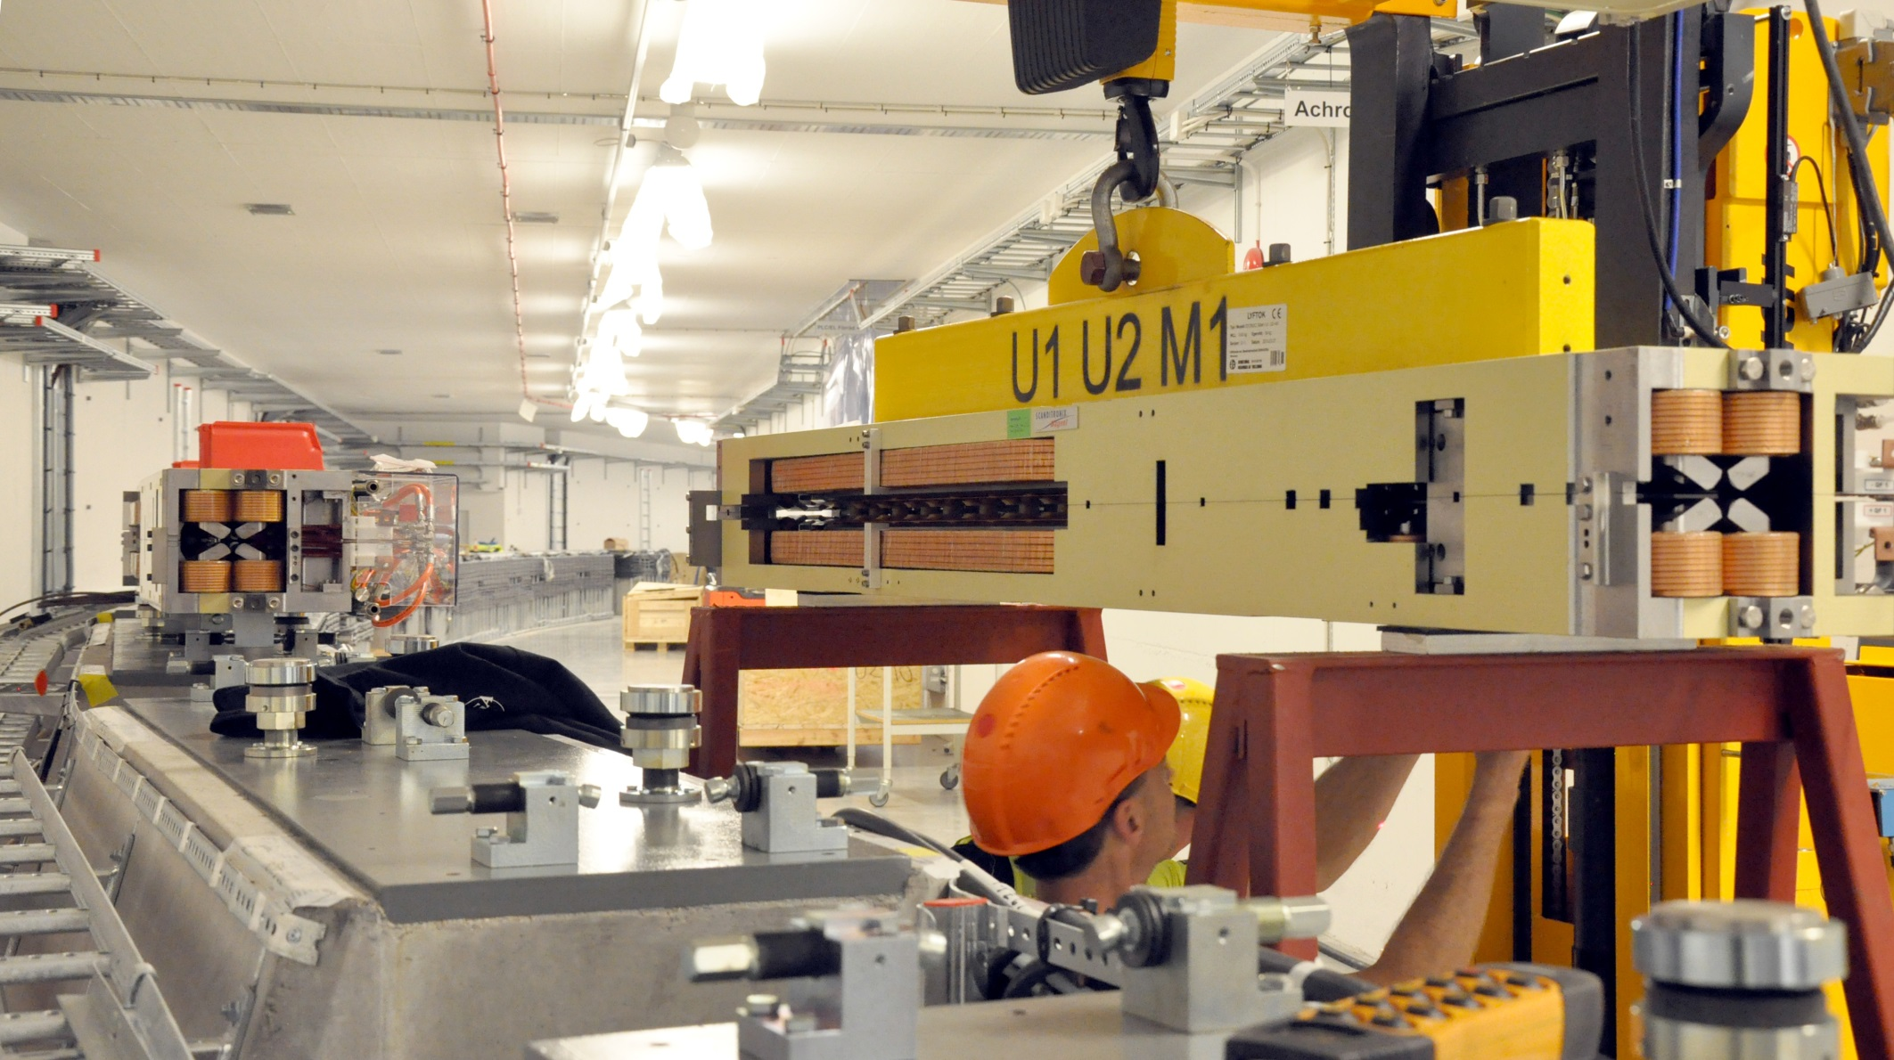
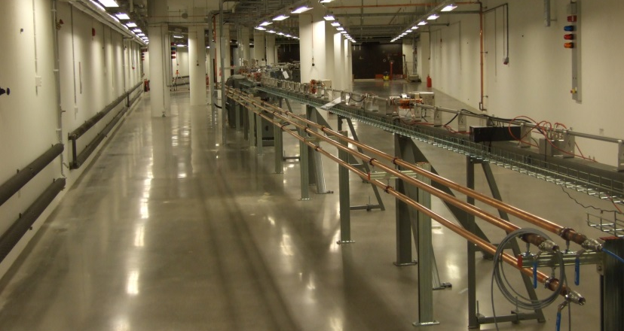
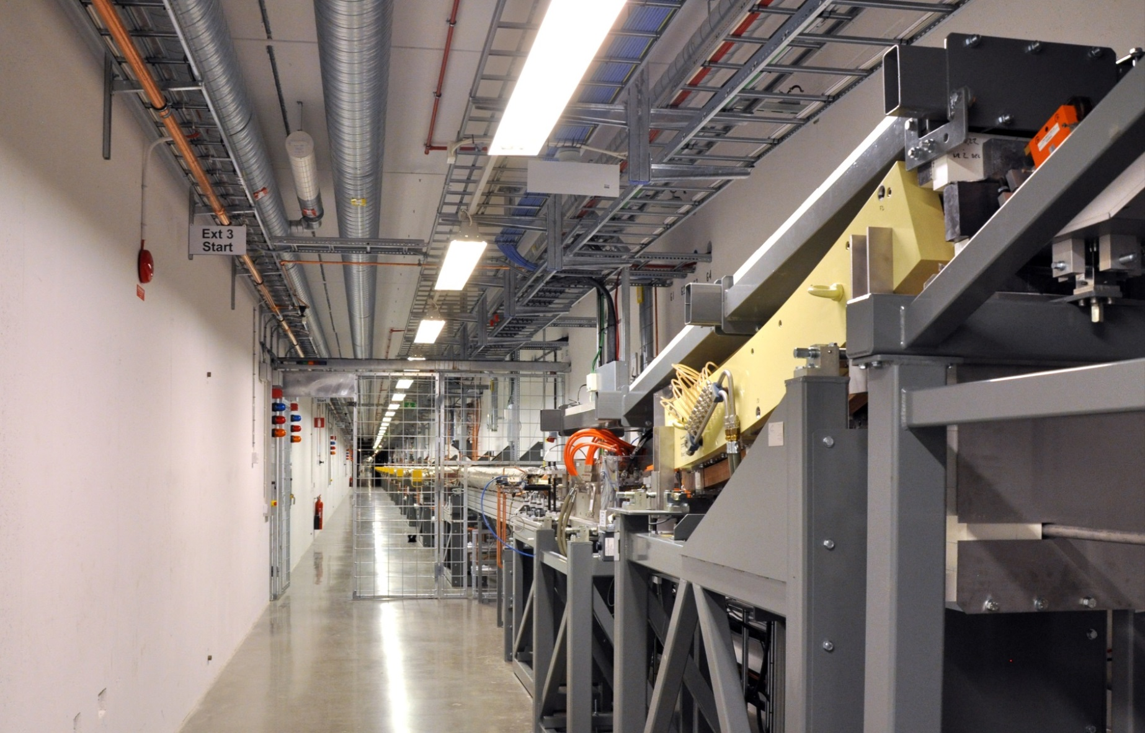
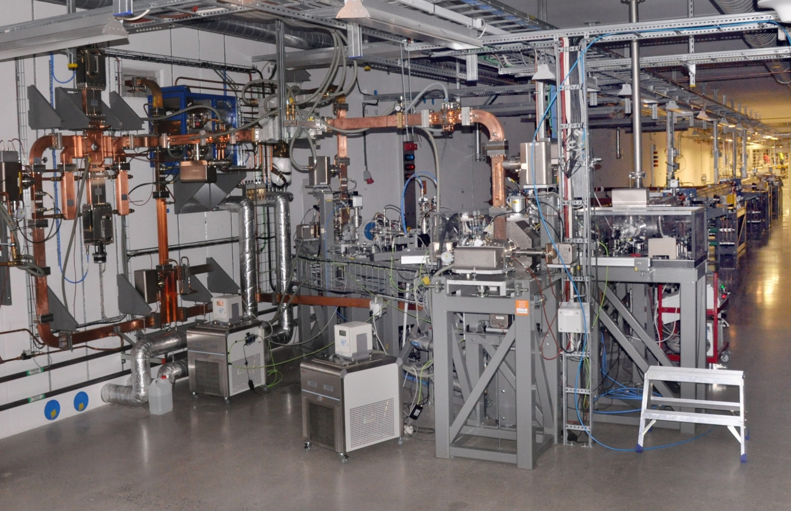
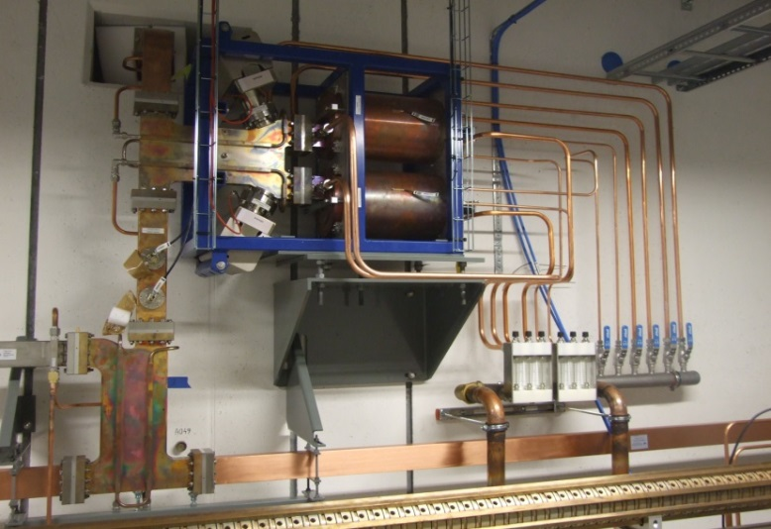
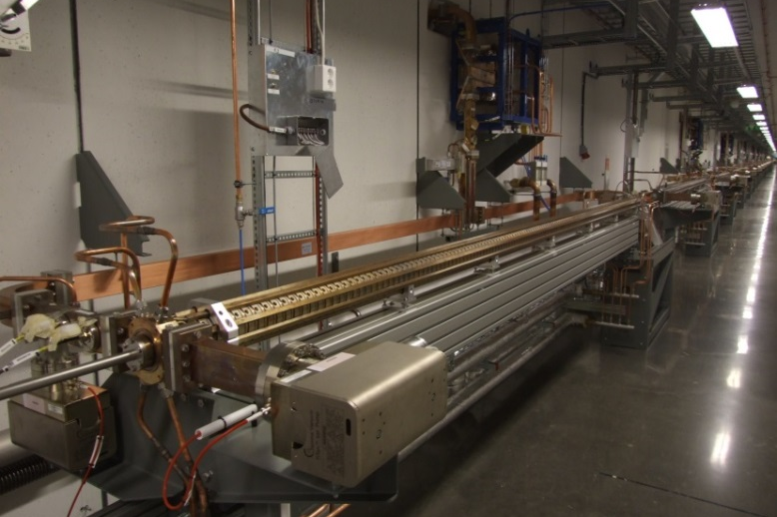
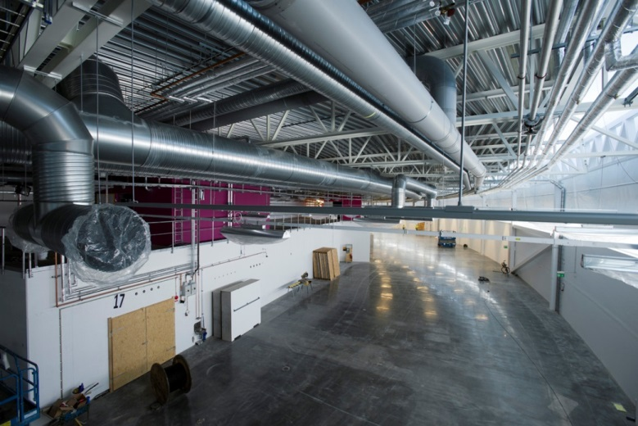
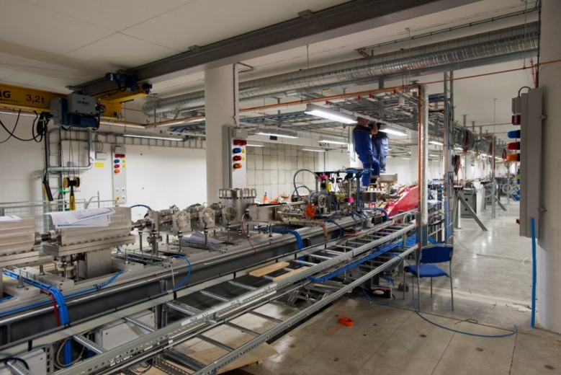
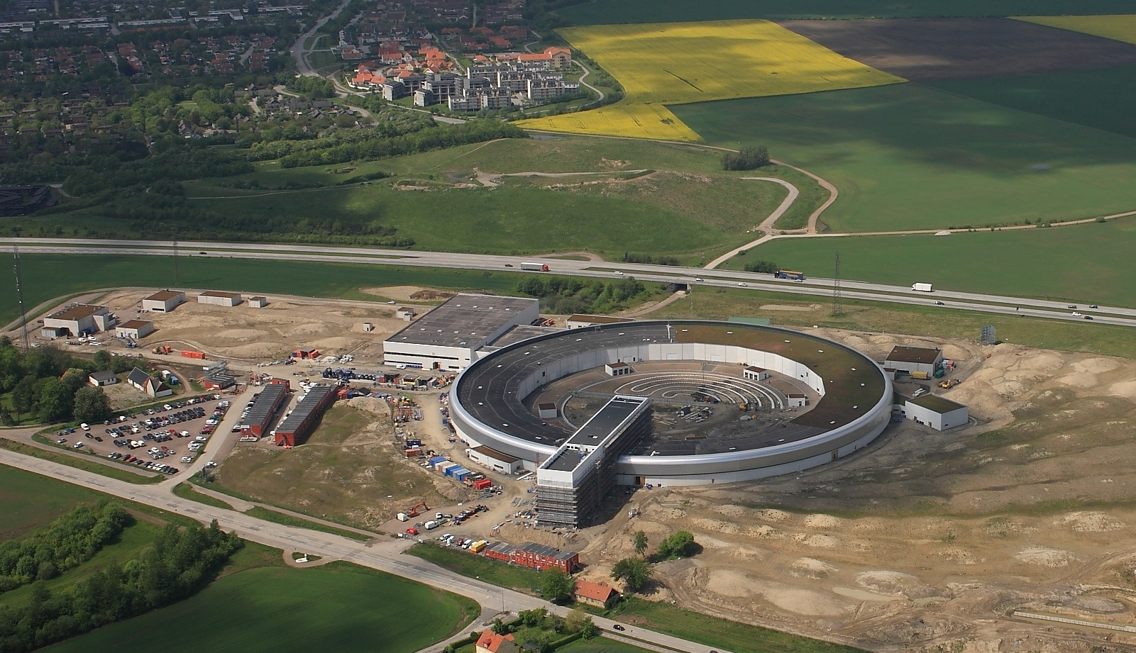

Slide 15
MAX IV in a nutshell
2 electron guns
250 m linear accelerator
2 storage rings(528+96 m)
~30 experimental stations
(1 finnish-estonian+1 danish)
1 short pulse facility
2000 first sketches
2009 ready for start of construction
2014.12 first electrons accelerated
2015.01 linear accelerator at full energy
2015 first experiments
2015 the rings are completed
2016 first experiments at the rings
2016.06 Inauguration
Sweden’s largest research facility
Building 2 billion kr (->rent) (PEAB, Whilborgs)
Accelerator 1 billion kr
Beamlines + experimental stations 0.1 billion/pc
Financed by Lund University, Research council, Vinnova and Region Skåne.
MAX IV is not ESS 😉

Slide 16
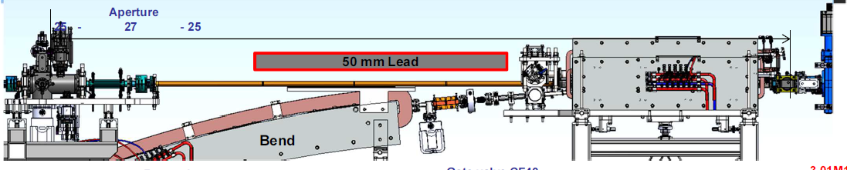
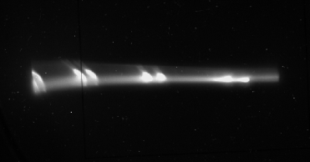
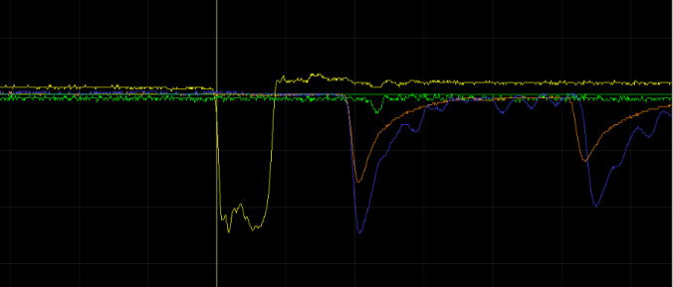
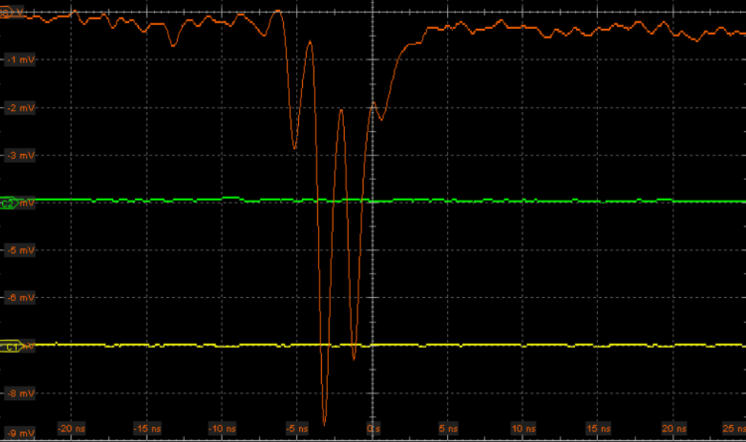
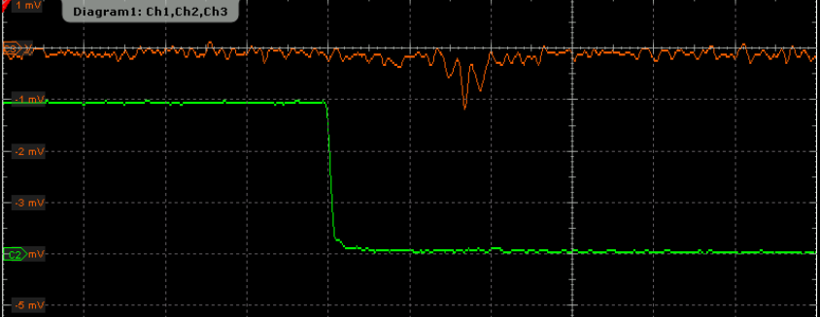
MAX IV Commissioning Highlights
M1
Beam observed at the end of TR3 and into the ring !

Slide 17
And that´s all…..
Thank you for your attention !

