Slide 1
Accelerator Components and Technologies
Christine Darve
Nordic Particle Accelerator School, NPAS2015
http://www.eit.lth.se/index.php?ciuid=922&L=1
Lund University
August 19, 2015

Slide 2
Outline
  Types of Particle Accelerators
  Accelerator Characteristics
  RF Cavity
  Superconductivity and Superfluidity
  Examples of the Particle Accelerators:
    The European Spallation Source (SRF cavities R&D)
    The LHC (low-beta magnets environment and Controls)
    The Tevatron (accelerator complex and technologies)

Slide 3
Acknowledgements & references
Acknowledgement to D. McGinnis, M. Vretenar and P. Lebrun
US-Particle Accelerator School, http://uspas.fnal.gov/materials/materials-table.shtml
CERN Accelerator School http://cas.web.cern.ch/cas
A few books
RF Linear Accelerators, T.P. Wangler, Wiley, 2008
RF Superconductivity for Accelerator, H. Padamsee, J. Knobloch, T. Hays, Wiley, 2011
An introduction to particle accelerators, E.J.N. Wilson, Oxford Univ. Press, 2001
An introduction to the physics of high-energy accelerators, D.A. Edwards & M.J. Syphers, Wiley, 1993
The principles of circular accelerators and storage rings, P.J. Bryant & K. Johnsen, Cambridge Univ. Press, 1993

Slide 4
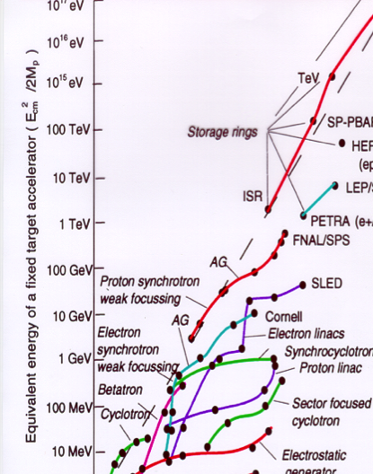
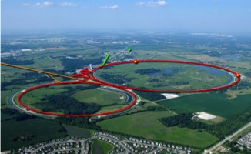
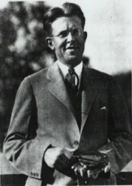
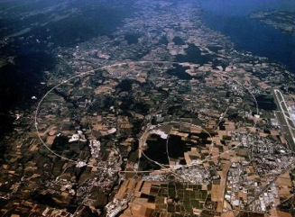

Type of Particle Accelerators
Each generation built on the accomplishments of the previous ones raising the level of technology ever higher
>1980 -Tevatron @ Fermilab
980 GeV
Ernest Lawrence
(1901 - 1958)
Livingston’s diagram
>2008 - LHC @ CERN
7-14 TeV
80 keV

Slide 5
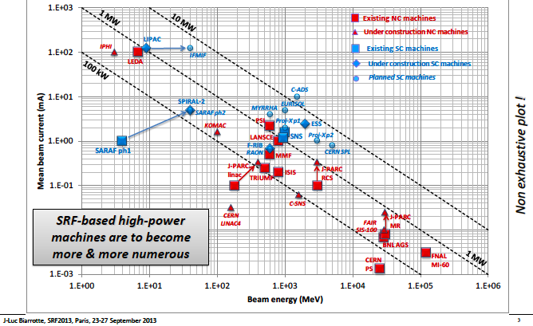
High power H/D beams around the world
Notes:
Accelerator-based for interdisciplinary research, nuclear research, fundamental physics, spallation sources.
e.g. SNS, MYRRHA, C-ADS
FNAL, CERN
IPHI
SPIRAL- radioactive ion

Slide 6
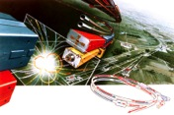
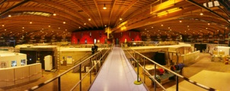
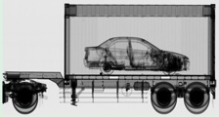
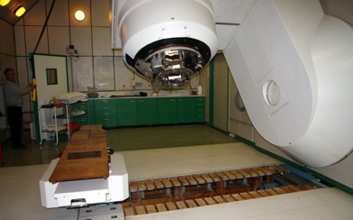
Type of Particle Accelerators
Used for ?
Today: > 35,000 accelerators are in operation around the world
.. and “has been”
FNAL
Discovery science: e.g. High Energy Physics
Materials research/manufacturing: e.g. light sources, spallation source, Accelerator Driven Systems (ADS)
National security
Medical Applications:
e.g. Neutron and Proton Therapies
MRI and NMR
SLS
X-ray scanning
iThemba LABS

Slide 7
Outline
  Types of Particle Accelerators
  Accelerator Characteristics
  RF Cavity
  Superconductivity and Superfluidity
  Examples of the Particle Accelerators:
    The European Spallation Source (SRF cavities R&D)
    The LHC (low-beta magnets environment and Controls)
    The Tevatron (accelerator complex and technologies)

Slide 8
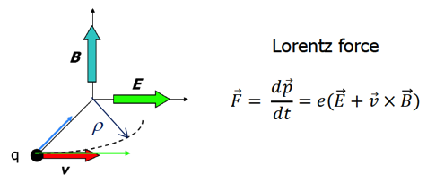

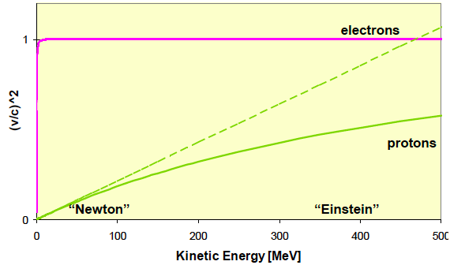
  Accelerator Characteristics
  ElectroMagnetism - Lorentz
Electric Fields to accelerate charged particles
RF accelerator components
Magnetic Fields to bend, steer, (de)focus
→ Magnet components
 | Electron | Proton
Rest mass [Kg] | 9.11E-31 | 1.67E-27
Rest mass [MeV] | 0.511 | 938
V~0.95 c [MeV] | 1.1 | 2000
ratio | 1 | 1836
Notes:
Einstein ? Newton ?

Slide 9
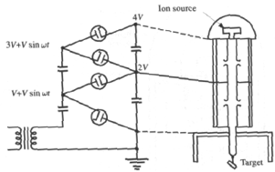
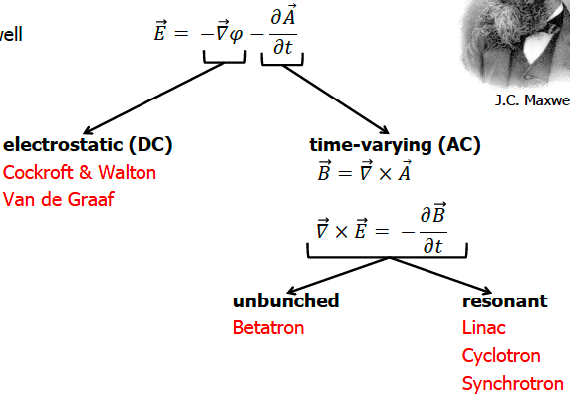
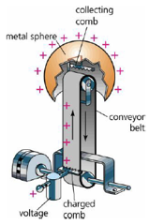
Accelerator Characteristics
ElectroMagnetism - Maxwell

Slide 10
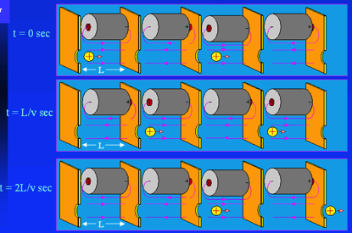
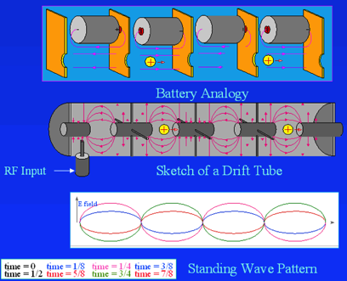
Accelerator Characteristics
DC to AC Accelerators
    Linear Accelerators (LINAC): Large space charge
    DC and AC components: Cockroft-Walton and Van de Graff, RFQ, DTL, RF cavities
Each Linear Accelerator starts by a source followed by DC accelerator components
Need to switch to AC due to the accumulation of high voltage causing sparking
So we need to use Radio-Frequency sources
As an effect, the beam is bunched
⬅ Principle of the Drift Tube Linac:

Slide 11

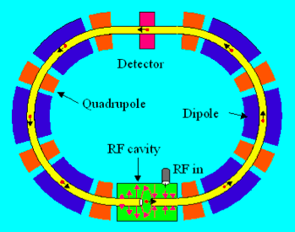
  Accelerator Characteristics
    ESS LINAC is 600m long (350m of acceleration) and reaches an energy of 2 GeV
    Assuming we need a 7 TeV machine (LHC), the Linac should be 1,225 km long !
    Linac over and over ?
    → Synchrotron Accelerators:
    Space charge effect becomes small
    * Cover range where particle velocity is nearly cst.
    e.g. LHC, Tevatron
Linac 2 GeV
11

Slide 12
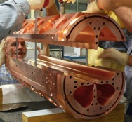
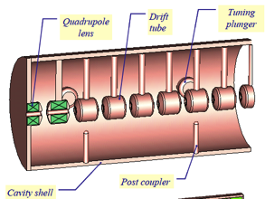
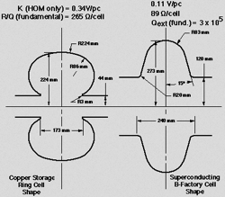
Accelerator Characteristics
Family of Linac component
RF Quadrupole
Drift Tube Linac
At low energy proton, the RFQ permits:
        1. Bunching of the beam
        2. Focusing quadrupole
        3. Accelerating
Every cell is different, focusing quadrupoles in each drift tube
If f >10 MHz, the DTL acts like an antenna and radiates energy instead of using it for the acceleration
RF cavity
EM fields enclosed in a cavity with resonant frequency matching that of RF generator

Slide 13
Outline
  Types of Particle Accelerators
  Accelerator Characteristics
  RF Cavity
  Superconductivity and Superfluidity
  Examples of the Particle Accelerators:
    The European Spallation Source (SRF cavities R&D)
    The LHC (low-beta magnets environment and Controls)
    The Tevatron (accelerator complex and technologies)

Slide 14
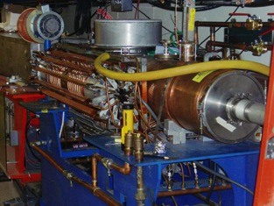
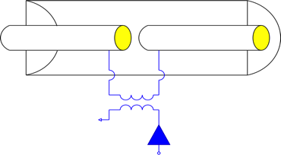
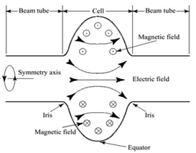
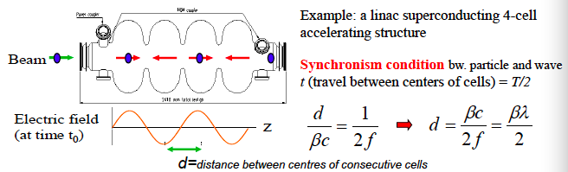
RF Cavity
FNAL Booster Cavity
Gap
Beam
Power Coupler
Waveguide
Power Amplifier (Klystrons)
RF Input

Slide 15
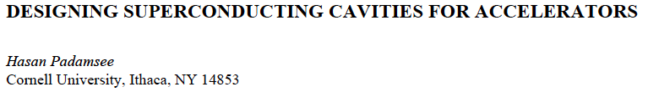
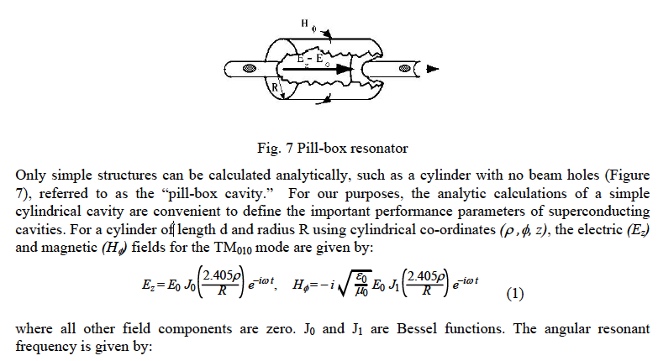
RF Cavity

Slide 16
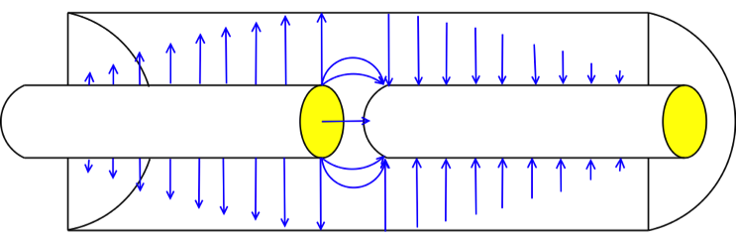
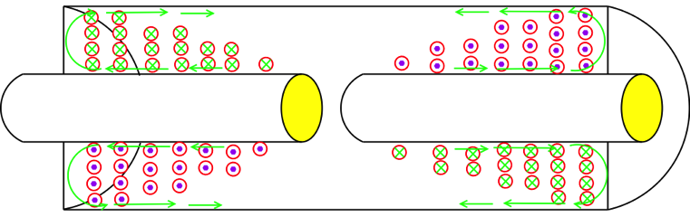

RF Cavity
Cavity Field Pattern
For the fundamental mode at one instant in time:
Electric Field
Out
In
Wall Current
Magnetic Field

Slide 17
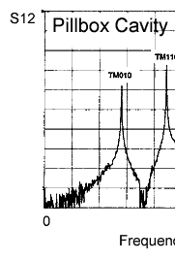
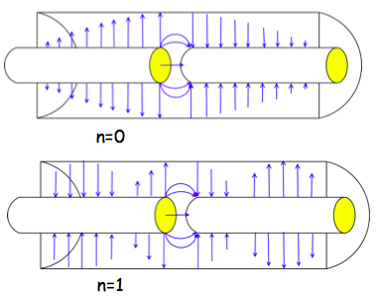
RF Cavity
Cavities Modes
Fundamental and High Order Modes (HOM)

Slide 18
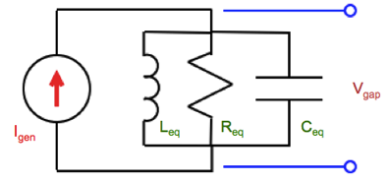
RF Cavity
RLC Model for Cavity Mode
Around each mode frequency, we can describe the cavity as a simple RLC circuit.
R_{eq} is inversely proportional to the energy lost
L_{eq} is proportional to the magnetic stored energy
C_{eq} is proportional to the electric stored energy
Position:
Amplitude:
Width
Function of geometry and cavity material
Function of geometry

Slide 19
RF Cavity
RLC Parameters for a Transmission Line Cavity
For the fundamental mode of the transmission line cavity:
The transfer impedance of the cavity is:

Slide 20
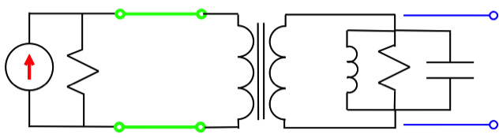
RF Accelerator
The cavity is attached to the power amplifier by a transmission line.
The internal impedance of the power amplifier is usually matched to the transmission line impedance connecting the power amplifier to the cavity.
  As in the case of a Klystron protected by an isolator
  As in the case of an infinitesimally short transmission line
R_{gen}
V_{gap}
Z_{o}
L_{eq}
R_{eq}
C_{eq}
I_{gen}

Slide 21
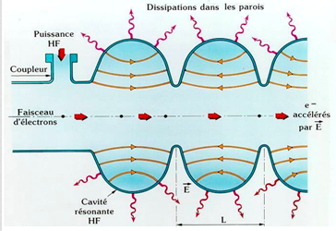

SRF Cavities Performances
Accelerating gradient
Peak Surface fields
Power Dissipation
Cavity Quality
Shunt Impedance
Few limitations of performance:
Thermal Breakdown, alias quench
Field Emission: Electron induced by an electrostatic field
Multipacting: electron avalanche
Limit power loss in the cavity wall:
By using low-resistant material or superconductors
By rounding the shape to optimize the field distribution
Limit shape edge to prevent field emission
Good vacuum to limit breakdown

Slide 22
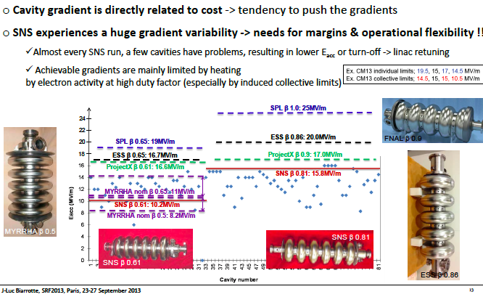
Cavity gradients

Slide 23
Cavity Q
If the cavity walls are lossless, then the boundary conditions for a given mode can only be satisfied at a single frequency.
If the cavity walls have some loss, then the boundary conditions can be satisfied over a range of frequencies.
The cavity Q factor is a convenient way the power lost in a cavity.
The Q factor is defined as:

Slide 24
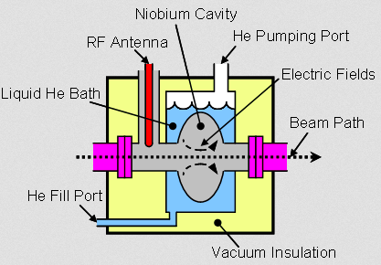
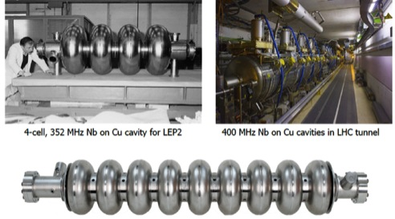
Cavities and Cryomodules
RF cavities housed in cryomodules, which keep the RF cavities working in a superconducting state, without losing energy to electrical resistance

Slide 25
Outline
  Types of Particle Accelerators
  Accelerator Characteristics
  RF Cavity
  Superconductivity and Superfluidity
  Examples of the Particle Accelerators:
    The European Spallation Source (SRF cavities R&D)
    The LHC (low-beta magnets environment and Controls)
    The Tevatron (accelerator complex and technologies)

Slide 26
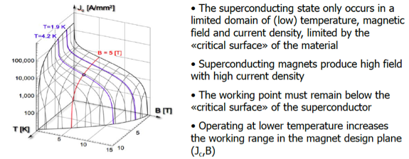
Superconductivity and Superfluidity
Superconductivity became a key-technology for particle accelerator. Superconductivity allows :
  To operate high-field, high current density magnet operating above the saturation of iron,
  To build high-field, low-loss RF Cavities (low wall resistance)
  Reducing overall electrical consumption of the machines

Slide 27
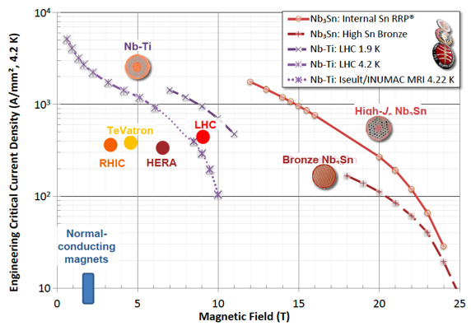
Superconductivity and Superfluidity

Slide 28
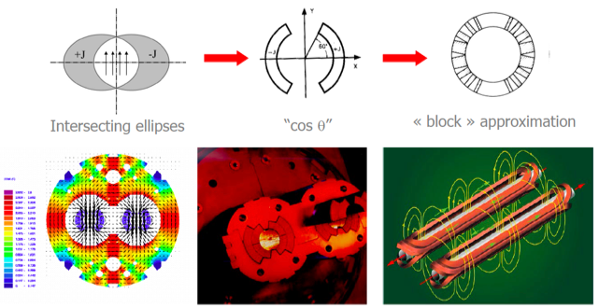
Superconducting Magnets
In a superconducting magnet, the field is given by the current distribution in the windings (Biot & Savart’s law).
When present, the iron only acts as a flux return yoke

Slide 29

Superfluidity of Helium
Helium (25 %) is the most common element in Universe after Hydrogen (73 %)
Two isotopes: ³He (fermion) & ⁴He (boson)
Helium II - Quantum fluid
Exceptional heat transfer
Specific heat transition at 2.17 K - T_{λ}
Enormous heat conductivity at moderate flux (3,000 x OFHC copper at 1.9K)
> Thermo-mechanical - fountain effect
Tevatron operation
LHC operation
Notes:
Few DT along the cell
very large specific heat (typically 105 times that of the conductor per unit mass, 2 × 103 times per unit volume), combined with the enormous heat conductivity at moderate flux (3000 times that of cryogenic-grade OFHC copper, peaking at
1.9 K)
The amount of energy needed to raise the temperature of a kilogram of helium by one degree (the specific heat, C_{p}) shown in Figure 6 is very large for both He I and Helium II.
As an example, Copper has a C_{p} of 0.03 J/kg - K at 2 K, while the C_{p} of Al at the same temperature is approximately 0.11 J/kg - K. The specific heat of Helium II just below T_{l} at 1 bar is of the order of 12,400 J/kg - K, dropping to approximately 2,900 J/kg - K in the normal state.

Slide 30
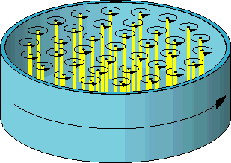

Superfluidity of Helium
The two-fluid model for helium II
Normal-fluid fraction:
excited states atom (phonons & rotons)
➔ like a conventional viscous fluid
finite density , r_{n}
finite viscosity, η
entropy, s
Superfluid fraction:
- atoms that have undergone BEC
➔ like an ideal inviscid liquid resulting in the absence of classical turbulence.
finite density, r_{s}
NO viscosity
carry NO entropy
irrotational behavior for an inviscid fluid
but vortices can be generated in the superfluid component
Macroscopic quantum physic system simplification
The two-fluid model is only a phenomenological model !
Quantized vortices
Counter-flow turbulence

Slide 31
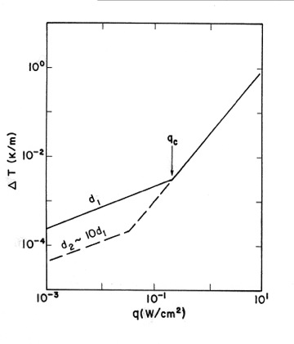
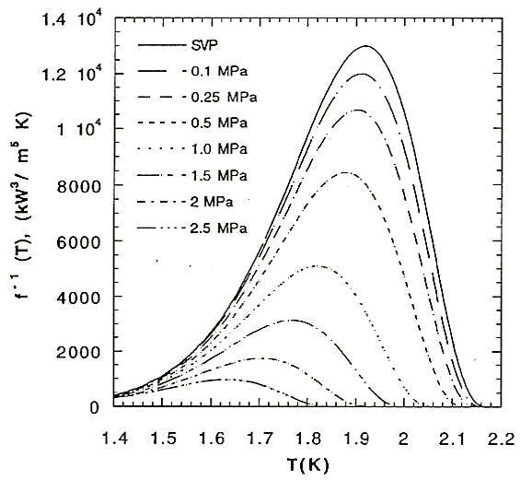
Thermal conductivity of helium II
Heat transport regimes at 1.9 K
Thermal resistivity function
e.g. d > 1mm, q > 10mW/cm²
Low flux regime dT/dx ~ q
In mutual friction regime:
Mutual- friction regime
Laminar
High flux regime
dT/dx ~ q³
Turbulent
A_{GM} Gorter-Mellink mutual friction parameter
Internal convection of the super-fluid and normal-fluid components
Counter-flow mechanics
No bulk flow
Heat flux
Notes:
D1~ 10 micron for 10-4K/m
Cu (@3.6 K) = 1.2 W/cm^{2 ;} He I (@3.6 K) = 3.6 e-6 W/cm²
Cu (@1.9 K) = 1.6 W/cm^{2 ;} He II (@ 1.9 K) = 24 W/cm²
Heater changes super fluid
into normal. More super
flows through plug
increasing pressure in
container, and fluid squirts
out top in a fountain

Slide 32
Outline
  Types of Particle Accelerators
  Accelerator Characteristics
  RF Cavity
  Superconductivity and Superfluidity
  Examples of the Particle Accelerators:
    The European Spallation Source (SRF cavities R&D)
    The LHC (low-beta magnets environment and Controls)
    The Tevatron (accelerator complex and technologies)

Slide 33
The European Spallation Source

Slide 34
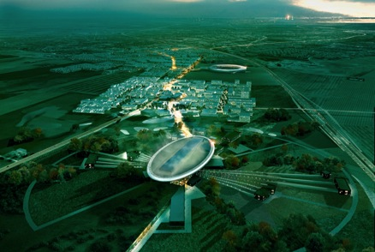


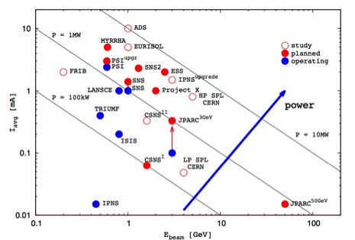
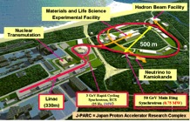
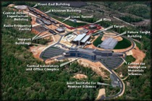
The European Spallation Source
Philosophie de “Pré-vert”: Greenfield
Will bring new insights to the grand challenges of science and innovation
Collaborative project: more than 17 countries
2014: Start of construction phase of the world's most powerful linear proton accelerator
2019: Provide the world's most advanced tools for studying materials with neutrons
(~ 450 employees; > 2500 users / year)
Europe 2019: The European Spallation Source
(<5 MW)
2.86 ms long pulse !
Lund, Sweden
Japan 2008:
JPARC (<1MW)
USA 2006:
SNS (<1.4 MW)
1 GeV, 26 mA in linac, 627 ns long pulse, 60 Hz
Notes:
Promote science, competitivity and complementarity of Life Science as operated in the USA and Japan.
USERS
Build capacity and partnership (in Europe) around science and innovation
Green-field – new investment – pre-vert
Complementarity of scientific tool: LS and NS
Each builds on the previous and prepares for the next
regional and European impact
Intensity frontiers
Beam-to-target : 2006—2019

Slide 35
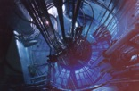
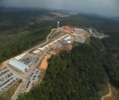

High time average and peak flux
10²⁰
Reactor Sources
Spallation Sources
J-PARC
ESS
HFIR
ILL
LANSCE
ISIS
CSNS
10¹⁵
MTR
HIFAR
MARIA
ORPHEE
IPNS
SALAM
HANARO
SNS
NRX
HFBR
NIST
ZING-P’
Dhruva
CARR
PIK
NRU
SAFARI-1
JRR-3
ETERR-2
FRM-II
OPAL
LVR
RSG
SINQ
IBR-II
HOR
JEEP II
KENS
X-10
WNR
Effective thermal neutron flux n/cm²-s
ZING-P
10¹⁰
CP-2
CP-1
10⁵
Berkeley 37-inch cyclotron
Particle driven pulsed
350 mCi Ra-Be source
Particle steady state
Pulsed reactor
Fission reactors
1
Chadwick
1930
1940
1950
1960
1970
1980
1990
2000
2010
2020
2030
(Updated from Neutron Scattering, K. Skold and D. L. Price, eds., Academic Press, 1986)

Slide 36
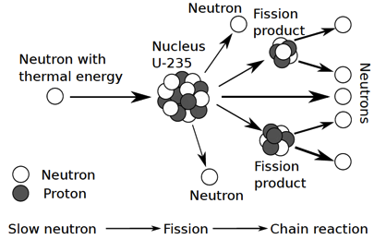
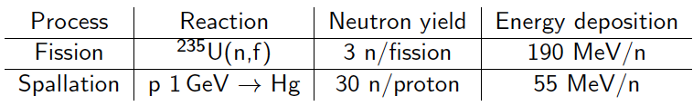

Fission and Spallation
Spallation is a non-elastic nuclear interaction induced by a high-energy particle producing numerous secondary particles

Slide 37

Target Station includes systems that address nuclear hazards
Spain was one of the first countries to send a Letter of Intent committing to the construction of the European Spallation Source, and a close collaboration has followed. In November 2014, ESS-Bilbao was chosen as the in-kind partner for the ESS target system
High bay
~ 130 m long
Remote Handling Systems
Fluid Systems
Target monolith, incl. Moderator & Reflector Systems, and Target Systems
Accelerator – Target interface
Remote Handling Systems including hot cells and associated equipment for maintenance and storage of irradiated components
Target Safety System including credited controls to protect public and environment from radioactive hazard
Fluid Systems including He and H₂O coolant loops, ventilation, filtering, etc.

Slide 38

Target station converts protons to “slow” neutrons
Target Monolith
Diameter ~ 11 m; Height ~ 8 m
Mass ~ 7000 tonnes (mainly steel)
The tungsten wheel concept:
The target wheel will measure 2.5 meters in diameter, is estimated to weight 4 tonnes, and is divided into 36 radial sectors
Proton Beam Window
Monolith Vessel
Functions:
Convert protons to usable neutrons
Heat removal
Confinement and shielding
Unique features:
  Rotating target
  He-cooled W target
  High brightness moderators
Moderator & reflector plugs
Target Wheel
Notes:
Explan spallation:
Moderation
Why choice of Solid tungsten
Low radioactive inventory

Slide 39
ESS long pulse potential
8
x10¹⁴
ESS 5 MW
2015 design
thermal moderator
λ=1.5 Å
7
Possibilities of pulse shaping
6
5
Brightness (n/cm²/s/ster/Å)
4
ESS 5 MW
2013 design (TDR)
3
2
SNS
1.4 MW
JPARC
300 kW
ISIS TS1
128 kW
ISIS TS2
32 kW
1
ILL 57 MW
0
time (ms)
1
2
3
4

Slide 40
Accelerator Technical performances
Design Drivers:
High Average Beam Power
5 MW
High Peak Beam Power
125 MW
High Availability
> 95%
Key parameters:
    -2.86 ms pulses
    -2 GeV
    -62.5 mA peak
    -14 Hz
    -Protons (H+)
    -Low losses
    -Minimize energy use
    -Flexible design for mitigation & future upgrades
NC FE
Spoke
M-β
H-β
352.21 MHz
704.42 MHz
2.4 m
4.6 m
3.8 m
39 m
56 m
77 m
179 m
Target
Source
LEBT
RFQ
MEBT
DTL
Spokes
Medium β
High β
HEBT & Contingency
75 keV
3.6 MeV
90 MeV
216 MeV
571 MeV
2000 MeV
The scope contingency for the accelerator project consists of the RF sources and installation costs (after 2019) for the high beta-part of the linac
The fully equipped cryomodule for the high-beta linac are IK contributions and are not part of the scope contingency. The infrastructures needed for the construction of these are only available during ESS construction.

Slide 41

Linac redesign to meet ESS cost objective
352.21 MHz
704.42 MHz
2.4 m
4.6 m
3.8 m
39 m
56 m
77 m
179 m
Target
Source
LEBT
RFQ
MEBT
DTL
Spokes
Medium β
High β
HEBT & Contingency
75 keV
3.6 MeV
90 MeV
WP4
216 MeV
571 MeV
2000 MeV
WP5
Beam power (MW) | 5
Beam current (mA) | 62.5
Linac energy (GeV) | 2
Beam pulse length (ms) | 2.86
Repetition rate (Hz) | 14
 | Num. of CMs | Num. of cavities
Spoke | 13 | 26
Medium β (6-cell) | 9 | 36
High β (5-cell) | 21 | 84
[SRF2013 – “The ESS Superconducting Linear Accelerator”, C. Darve, M. Eshraqi, M. Lindroos, D. McGinnis, S. Molloy, P. Bosland and S. Bousson]
Notes:
400 m/ 600 m tunnel = SRF

Slide 42



Front End Section
Ion Source
  Microwave Discharge Ion Source
  Proton peak current ~75 mA
  Total drain current ~100 mA
  Output Energy 75 keV
  Provided by INFN-LNS, Catania
  Experience from TRIPS ion sources
LEBT (Low Energy Beam Transport)
  Dual solenoid layout
  Functions:
    Transport and match input the RFQ
    Clean the beam pulse from the rise/fall time of the source with a slow chopper
    Provide different level of beam current with an iris
  Provided by INFN-LNS, Catania
  Design close to the IFMIF LEBT
Extraction system of the ESS ion source
(Courtesy L. Celona)
Prototype proton source operational, and under further development, in Catania. Output energy 75 keV.
IFMIF source and LEBT at CEA-Saclay

Slide 43





Front End Section
RFQ
  352 MHz 4-vanes RFQ
  5 segments of ~90 cm
  Functions:
    Accelerates
    Bunches the pulse in a train of bunches
    Focuses in the 3 planes
    Provide different level of beam current with an iris
  Foreseen transmission > 90 % for 70 mA input beam
  Provided by CEA-Saclay
MEBT
  Fully instrumented MEBT ~ 4.5 m
  Functions:
    Transport and match into the DTL
    Characterize the beam
    Fast chopping of the beam with rise/fall time ~ 10 ns
  Provided by ESS-Bilbao
Design exists for ESS RFQ similar to 5 m long IPHI RFQ at Saclay. Energy 75 keV->3.6 MeV.
MEBT layout (Courtesy B. Cheymol)
Design work at ESS Bilbao for MEBT with instrumentation, chopping and collimation.

Slide 44


Front End Section
DTL (Drift Tube Linac)
  352 MHz
  5 tanks
  Length ~ 40 m
  Output energy: ~90 MeV
  Provided by INFN-LNL, Legnaro
Six klystrons
  352 MHz
  with a maximum saturated power of 2.8 MW
  and a duty factor of 4% are required for the Front End
DTL 3D view (Courtesy P. Mereu)
DTL design work at ESS and in Legnaro, 3.6 ->90 MeV.
Picture from CERN Linac4 DTL.

Slide 45



Super-Conducting Linac
2 Spoke Cavities per Cryomodule
Segmented SRF linac with RT focusing elements
Ti. Helium tank
Cold tuning System
Power coupler
4 Elliptical Cavities per Cryomodule
Notes:
2 spoke – 3 gap
4 cavity – SNS like
Segmented SRF linac with RT focusing elements

Slide 46



Spoke cavity string and cryomodule package
Diameter
1350 mm
2900 mm

Slide 47

Cavity Cryomodule - Generic
Similar to SNS in size and purpose : re-use the same concepts
Similar medium and high-beta cavity cryomodules
    Common design: Small length difference between medium and high-beta cavities
    Distance between power couplers
    Vacuum vessels, thermal shield, supports, alignment system.
Only minor differences:
  Length of the inter-cavity bellows, details in cryo piping, beam pipe bellows
  Tuner piezo frames
  Penetration of the antenna for Q_{ext} adjustment

Slide 48




Elliptical Cryomodule Components
50K Thermal shield
Positioning optical devices
Two phase He pipe
Lateral port
(CTS, alignment)
Vacuum vessel
(stainless steel - 1200 mm diam.)
Tie rods (TA6V)
Space frame
Positioning jacks
(3 at 120°)
Power coupler
Guide rail and wheel
Waveguide transition
Cryogenic line interface
He. safety valve
Access traps to the tuners

Slide 49




Elliptical Cryomodule Components
Cold tuning System
Space frame
5-cell elliptical cavity
Diameter
1200 mm
Power coupler
Ti Helium tank
6600 mm

Slide 50


Cryomodule Interfaces
Most AD internal Work Packages (beam optics, RF, cryo, vacuum, test stands, electrical, cooling, installation)
External WPs cryomodule, cavity and designers and potential In-Kind collaborators
Control command (Control Box, PLC, LLRF, MPS, EPICS)
Data-logging ICS teams
ESS ES&H
Conventional Facility
ESS system engineer, QA
Survey experts
Transport
Cryogenic distridution
Cryogenic distribution
Control system
Beam Diagnostic
Beam Optics
Previous Linac version for comparison ➔
Beam Vacuum
Radio-Frequency

Slide 51



Cold Tuning System
Spoke CTS
Elliptical CTS
Type V ; 5-cell prototype
+/- 3 mm range on cavity
Stepper motor and planetary gearbox (1/100e) at cold and in vacuum
2 piezo stacks
Slow tuner
Main purpose : Compensation of large frequency shifts with a low speed
Actuator used : Stepper motor
Fast tuner
Main purpose : Compensation of small frequency shifts with a high speed
Actuator used : Piezoelectric actuators
&

Slide 52



Lorentz De-tuning
Because of the enormous gradients in superconducting cavities,
  the radiation pressure deforms the cavities
We expect over 400 Hz of detuning in the ESS cavities.
  Unloaded cavity bandwidth = 0.07 Hz
  Loaded cavity bandwidth = 1 kHz
The mechanical time constant of the cavities is about 1 ms compared to the pulse length of 3 ms
  Static pre-detuning as done in SNS will not be sufficient
  Dynamic de-tuning compensation using piezo-electric tuners is a must!
  Or else pay for the extra RF power required

Slide 53


Fundamental Power Coupler
Antenna
Vacuum
Outer conductor
(LHe-cooled)
Spoke:
335 kW
Elliptical:
1.1 MW
Inner conductor
(water-cooled)
Al₂O₃
ceramic disc
WR2300
Short circuit
RF input
Doorknob

Slide 54
ESS Requirements and RF Parameters
Spoke cavities
Elliptical cavities
Frequency (MHz) | 352,2
Optimum beta | 0,50
Operating temperature (K) | 2
Nominal Accelerating gradient (MV/m) | 9
Lacc (βopt.x nb gaps x λ/2) (m) | 0,639
Bpk (mT) | 79 (max)
Epk (MV/m) | 39 (max)
Bpk/Eacc (mT/MV/m) | <8,75
Epk/Eacc | <4,38
Beam tube diameter (mm) | 50
RF peak power (kW) | 335
G (Ω) | 130
Max R/Q (W) | 427
Qext | 2,85 10⁵
Q0 at nominal gardient | 1,5 10⁹
 | Medium | High
Geometrical beta | 0.67 | 0.86
Frequency (MHz) | 704.42
Number of cells | 6 | 5
Operating temperature (K) | 2
Epk max (MV/m) | 45 | 45
Nominal Accelerating gradient (MV/m) | 16.7 | 19.9
Q₀ at nominal gradient | > 5e9
Q_{ext} | 7.5 10⁵ | 7.6 10⁵
Iris diameter (mm) | 94 | 120
Cell to cell coupling k (%) | 1.22 | 1.8
p,5p/6 (or 4p/5) mode sep. (MHz) | 0.54 | 1.2
Epk/Eacc | 2.36 | 2.2
Bpk/Eacc (mT/(MV/m)) | 4.79 | 4.3
Maximum. r/Q (W) | 394 | 477
Optimum β | 0.705 | 0.92
G (Ω) | 196.63 | 241
RF peak power (kW) | 1100

Slide 55


SRF Cavities Development
Spoke cavity
Elliptical cavities
→ Stiffeners on the Spoke bars
(vacuum pressure)
→ No HOM power couplers
Hydroformed Ti bellows
(+/- 3mm range)
994 mm
Stiffeners (LFD compensation)
NbTi flange
(w/bore holes for alignment & assembly tool)
+Al hex. gaskets
550 mm
418 mm
Power coupler port
Ti He vessel
Medium beta:
6 cells – beta=0.67
Length 1259,40mm
High beta:
5 cells – beta=0.86
Length 1316,91mm

Slide 56






Medium-β Elliptical Cavities
K_{L} reduction using compensation rings for medium and high-beta
RF/mechanical design
Lorentz detuning
Nominal wall thickness [mm] | 3.6
Cavity stiffness Kcav [kN/mm] | 2.59
Tuning sensitivity Df/Dz [kHz/mm] | 197
K_{L} with fixed ends [Hz/(MV/m)²] | -0.36
K_{L} with free ends [Hz/(MV/m)²] | -8.9
Pressure sensitivity K_{P} [Hz/mbar] (fixed ends) | 4.85
K_{ext} (tank + tuner)≈30 kN/mm
K_{L}≈-1 Hz/(MV/m)²
Δf ≈ 325 Hz @ 18 MV/m (1/3 of cavity bandwidth )

Slide 57



Cavity Prototypes
The 3 spoke cavities prototypes:
named: Romea, Giulietta and Germaine
Romea
Giulietta
Germaine
View of the cavity inside: the spoke bars

Slide 58

Spoke cavity Performances
(Jan-June 2015)
Spoke cavity exceeding ESS requirements in vertical test on both Eacc and Qo
Eacc_max=15.3 MV/m achieved with “Romea”
Several MP barriers but easily processed.
Qo > 1.6 10¹⁰
Strong FE at max gradient
Limitation is the cooling capacity (unstable conditions, cavity in vertical position)

Slide 59


Slide 60



Elliptical Cavity Preparation
High beta cavity fabrication (Zanon and RI)
Vertical Electropolishing system@ CEA
    Study of the tooling in progress @ CEA
    Example of the tooling for the assembling of the coupler on the cavity in clean room

Slide 61



High β Elliptical Cavity Activities in Clean Room

Slide 62

Magnetic shield
Courtesy of J. Plouin/ CEA
Achievable with 1.5 mm,
µ_{r} =20000 shielding material
Limit contribution of the trapped flux to the surface resistance to 4 nΩ
Limit the external static field to Bext = 14 mG.
→ Required shielding efficiency equal to 35.

Slide 63


Cryomodule life-cycle
High pressure rinsing
In clean room (ISO5 or ISO4)
Cavity fabrication
Chemical treatment
Validation test of the cavity in vertical cryostat
Transport
Cryomodule components fabrication
Cryomodule reception and storage
Qualified cavity storage
Cavity string assembling in clean room
Cryomodule assembling
Validation test of the cryomodule
Processed couplers storage
Tools fabrication
Cryomodule storage
Coupler RF processing
Space frame
Tuning system
Assembling in clean room
Magnetic shield
Cryomodule on beam line
TA6V rods in X pattern to keep the beam axis at the same position during cool down
Power coupler fabrication
Beam valves and extremity flange
Courtesy of Pierre Bosland CEA/IRFU
63
Notes:
QA control

Slide 64





Elliptical Assembly Procedure
Cavity string assembly in clean room
Build on existing knowledge (SNS, XFEL)
Develop Training and “Fabrication file”
Pre-industrialization
Industrialization
Cold mass assembly (outside the clean room)
Spaceframe
Thermal shield
Vacuum
vessel
Design concept of the tooling: most of parts will be used for both types of elliptical cryomodules
Notes:
Only minor differences:
Length of the inter-cavity bellows, details in cryo piping, beam pipe bellows
Tuner piezo frames
Penetration of the antenna for Q_{ext} adjustment

Slide 65






Infrastructure in Saclay
    Clean room for the M-ECCTD (and H-ECCTD)
High Pressure Rinsing HPR
    Possible IKC for the assembly by industry at Saclay (XFEL cryomodules assembly)
    Uses the current infrastructure at Saclay
    Benefits from the experience of the XFEL cryomodule assembly (ALSYOM)
IS0 7 27,5 m²
Water cleaning
IS0 5
52,69 m²
    The clean room inauguration
    → May 13th 2014
Notes:
Only minor differences:
Length of the inter-cavity bellows, details in cryo piping, beam pipe bellows
Tuner piezo frames
Penetration of the antenna for Q_{ext} adjustment

Slide 66

Spoke assembling in clean room/IPNO
Courtesy of D. Reynet / IPNO

Slide 67

Process and Instrumentation
Operating Modes under definition
Instrumentation function
  Monitoring
  Control
  Interlock
  Alarms

Slide 68

Control integration

Slide 69

Spoke linac (352 MHz) RF System Layout
26 Double Spoke cavities
Power range 280-330 kW
Combination of two tetrodes
Other options:
Solid State Amplifiers
Large power supply (330 kVA) to supply 8 stations (16 tetrodes)

Slide 70



Elliptical (704 MHz) RF System Layout
One cavity per klystron
4 klystrons per modulator
16 klystrons per tunnel penetration
Tunnel

Slide 71

Elliptical (704 MHz) RF System Layout
Klystrons
Racks and Controls
Modulator
WR1150 Distribution
4.5 Cells of 8 klystrons for Medium Beta
10,5 Cells of 8 klystrons (IOTs) for High Beta

Slide 72
Outline
  Types of Particle Accelerators
  Accelerator Characteristics
  RF Cavity
  Superconductivity and Superfluidity
  Examples of the Particle Accelerators:
    The European Spallation Source (SRF cavities R&D)
    The LHC (low-beta magnets environment and Controls)
    The Tevatron (accelerator complex and technologies)

Slide 73





CERN and the Large Hadron Collider
Searching for the Higgs boson !
data : 20 km of CDs stacked per year

Slide 74

Key technologies of the LHC accelerator
Superconducting magnets
  1,250 ton of NbTi superconducting materials
  7,600 km of superconducting “Rutherford” cables
  9,600 magnets (incl.1,232 dipoles, 392 quadruples)
Superfluid helium cryogenics (< 2 K) and vacuum techniques
  Pressurized and saturated superfluid helium, in two-phase flow
  Cryostats and thermal insulation
  Efficient and large capacity helium refrigerators
  Cryogen storage and mgt (120 ton of He)
Two Phase He II
heat exchanger
Pressurized He II bath containing magnet
Notes:
Field reproducibility/precision ~ 10-3
Field homogeneity ~ 10-4

Slide 75


LHC Magnets

Slide 76




LHC Magnets
7,600 km of cable made of 270,000 km of strand (6 earth circumferences)
→ filaments : 6 times back and forth to the Sun + 150 trips to the moon
 | Inner Cable | Outer Cable
Number of strands | 28 | 36
Strand diameter | 1.065 mm | 0.825 mm
Filament diameter | 7 µm | 6 µm
Number of filaments | ~ 8900 | ~ 6520
Cable width | 15.1 mm | 15.1 mm
Mid-thickness | 1.900 mm | 1.480 mm
Keystone angle | 1.25 ° | 0.90 °
Transposition length | 115 mm | 100 mm
Ratio Cu/Sc | ≥ 1.6 | ≥ 1.9

Slide 77



The low-beta magnets at the LHC
Inner Triplet for final beam focusing/defocusing
Q=Q_Arc x 10
➔ Critical system for LHC performance
American contribution to the LHC machine
IP5
IP8
+ D1
IP2
IP1
77

Slide 78




The low-beta magnets at the LHC
Underground views : 80-120 m below ground level
Air flow m/s
One way
Tunnel restriction
Experimental Hall
Looking toward IP
Escape path

Slide 79



Type of instrumentation : cryo-magnets
TT821
Interface with QRL
xx9xx
EH821
EH8xx: cryo-electrical heaters
PT8xx: based on passive strain gauge
TT8xx: Pt100, CernoxTM
Low-beta system
xx8xx
Notes:
5 mK at 2 K

Slide 80







Electrical feed-boxes
CV8xx: control valve
LT8xx: liquid helium level gauge
(based on superconducting wire)
*HTS leads
*Vapor cooled leads

Slide 81



General architecture of the cryogenic system
50 m x 50 m
up to 100 m
30 m x 30 m
3’000 m

Slide 82



18 kW @ 4.5 K helium refrigerators
Linde
33 kW @ 50 K to 75 K
23 kW @ 4.6 K to 20 K
41 g/s liquefaction
Warm compressors
Air Liquide

Slide 83




2.4 kW @ 1.9 K refrigeration units
Cold compressor key technology
IHI - Linde
Cartridge 1st stage
Air Liquide
Axial-centrifugal impeller

Slide 84


Cryogen management (helium, nitrogen)
Cryogen storage
Courtesy of Laurent Tavian

Slide 85
Outline
  Types of Particle Accelerators
  Accelerator Characteristics
  RF Cavity
  Superconductivity and Superfluidity
  Examples of the Particle Accelerators:
    The European Spallation Source (SRF cavities R&D)
    The LHC (low-beta magnets environment and Controls)
    The Tevatron (historical accelerator complex and technologies)

Slide 86






Booster RF
Cockcroft_Walton
Unified control system for the entire complex
400 MeV Linac
8 GeV Booster Synchrotron
120 GeV Main Injector Synchrotron
1 TeV Tevatron Synchrotron
antiproton source – target/debuncher/accumulator
antiproton “Recycler” storage ring
fixed target lines
Simultaneous operation of
Tevatron proton-antiproton collider (storage ring)
Antiproton production and storage (~0.5 Hz)
120 GeV fixed target to Meson lab (~0.1 Hz)
120 GeV fixed target to NUMI/MINOS (~0.5 Hz)
8 GeV fixed target to MiniBoone (~5 Hz)

Slide 87

f
Fermilab Accelerator Division

Slide 88

f
Fermilab Accelerator Division

Slide 89

f
Fermilab Accelerator Division

Slide 90

Tevatron magnet cross-section
6.5 km of superconducting magnets operating @ 3.6 Kelvin:
+777 dipoles
+216 quads
+204 correction elements
+ coils made of NbTi alloy wire
+ wire size is 8 mm
+11 million wire-turns in a coil
+ 42,500 miles of wire per magnet

Slide 91




One typical cooling loop for the Tevatron

Slide 92



Central Helium Liquefier - CHL
The Central Helium Liquefier consists of:
Four parallel reciprocating 4,000 HP helium compressors (6.8 MW total power)
Two Claude cycle cold boxes (6,400 liters/hr, peak at 9000 liters/hr)
15 helium gas storage tanks (1,500 m3, 1.7 MPa, at RT)
One Nitrogen Reliquefier (4,680 liters/hr)
600,000 liters of LN2 storage
Purification system

Slide 93


Summary
Accelerator Components requires:
State-of-the-art material performance
Challenging design
Unique technologies
Lots of materials available at:
US-Particle Accelerator School, http://uspas.fnal.gov/materials/materials-table.shtml
CERN Accelerator School http://cas.web.cern.ch/cas
Joint Universities Accelerator School
The domain of Particle Accelerator needs YOU !!!

