Slide 1
Reducing cell wall hits
20.03.2025

Slide 2
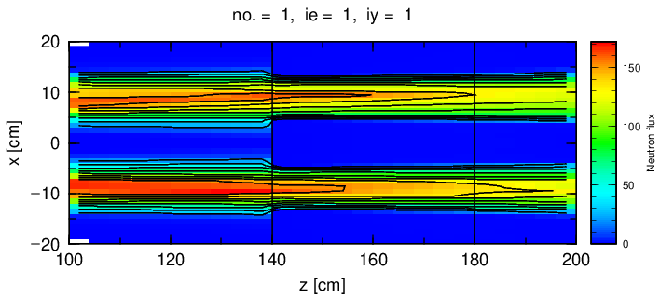
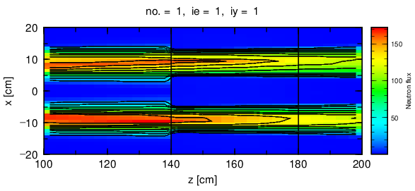
Scattering simulation off lHe (PDC2@42m)
lHe Xsections provided by Douglas Di Julio.
1.96E09n/s at cell entrance, PHITS:
2.16E08 n/s at cell walls @0.8K
3.14E08 n/s at cell walls @4.0K
Pen and paper
4.75E3 UCN/s
2.6E08 n/s at cell walls
1.6E08 n/s from good n’s $\sim 8.9$ AA
Temperature | Entry flux (arb.units) | Exit flux (arb.units) | fraction of wall hits (PHITS)
0.8K | 2.61E3 | 2.32E3 | 0.11
4.0K | 2.61E3 | 2.19E3 | 0.16

Slide 3
Cell wall hits
Background ~ total number of neutrons hitting cell walls
1.6E08 – due to beam divergence, imperfect focusing.
(Total beam)*(lHe scatter proba)=1.8E09*0.075 = 1.02E08n/s
In total 2.6E08 neutron hitting cell walls pr second
~0.13 of incoming beam,
~2/3 of the total wall hits are due to imperfect focusing.
To reduce background:
Reduce total flux keeping “good” 8.9AA neutrons
Improve beam focusing

Slide 4
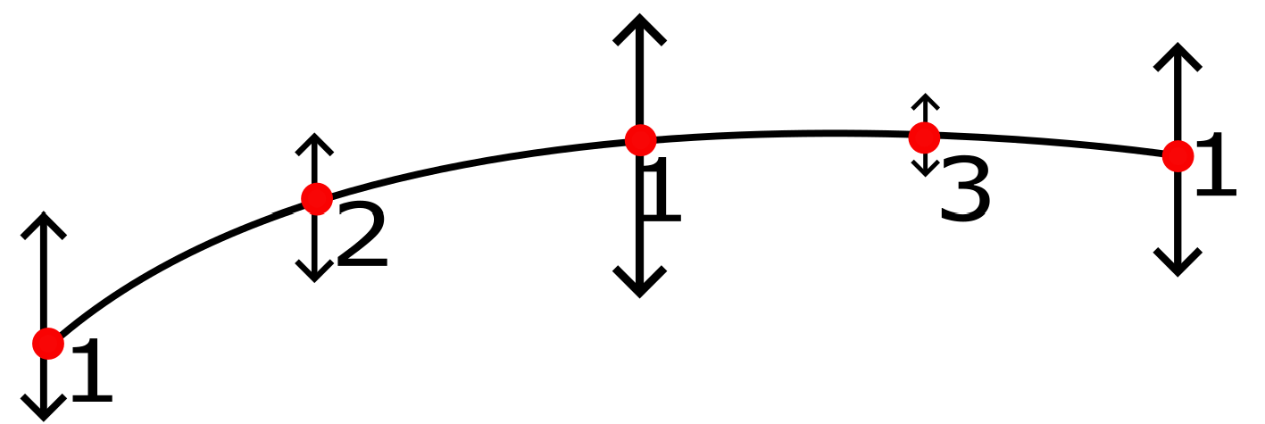
Improved focusing
Method: fit by generic order 2 surfaces using tapered shapes (similar to HIBEAM monolith insert fitting)
The order 2 surface is completely defined by 5 points:
Set points at start, end and middle of the fitted guide section
Define a range for a point at quarter length so that fit is possible at all
Select point at quarter length, define range for the last point at ¾ length
Define all other points defining segments (12 pcs) of the guide section

Slide 5
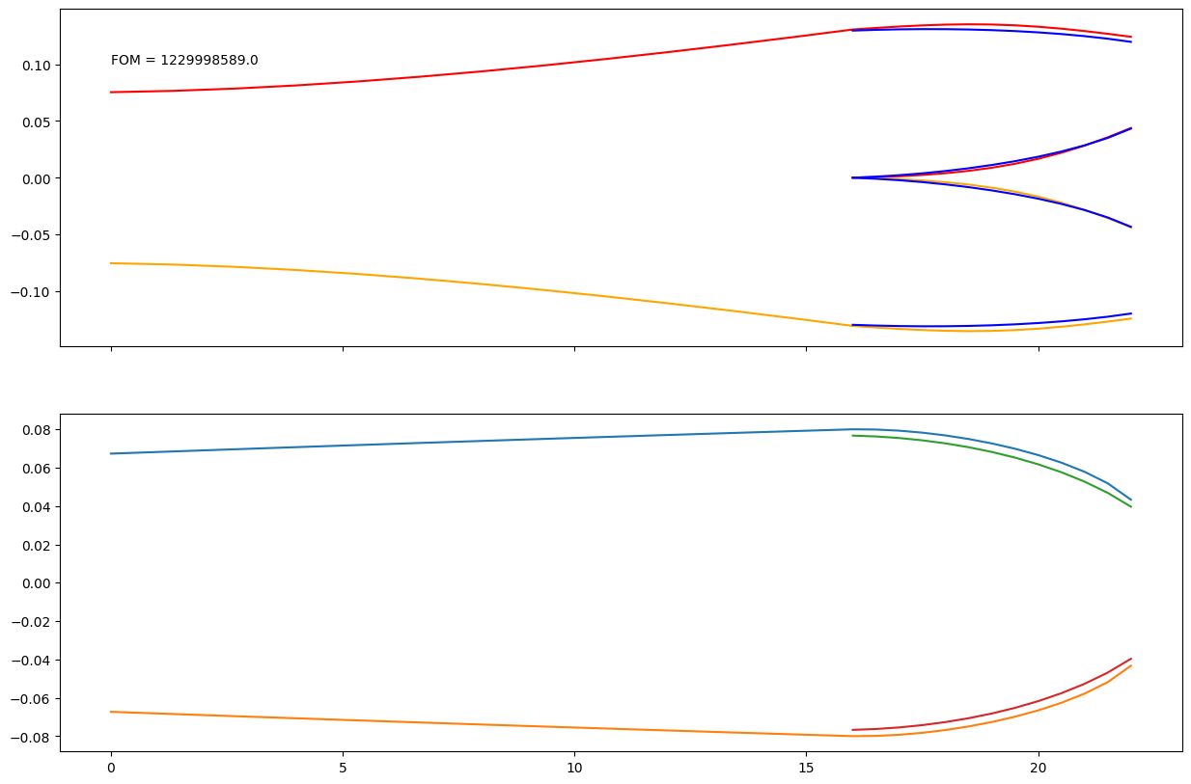
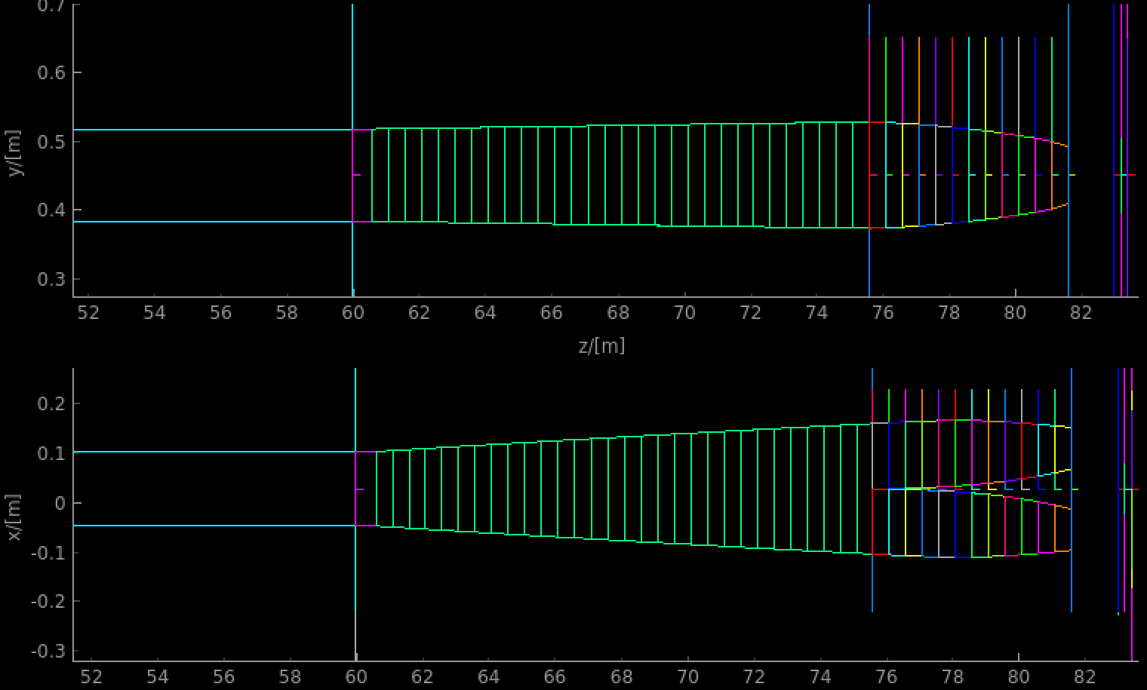
Optimization, 80 m long instrument
One of options with “inside out” curving
Optimization towards highest flux at the bottom of the cells
Experimenting with lengths of focusing and defocusing sections (can afford with 80m+)
Helps to a limited extend due to Liouville theorem: smaller beam cross sections increases divergence
Hdiv 1@15 cm width → 2deg@7.5 cm width (~1.7 cm shift at 0.5m path)
Stochastic optimization produces different options with similar FOM
Options are checked for ratio of wall hits to flux at cell bottom for an optimal choice

Slide 6
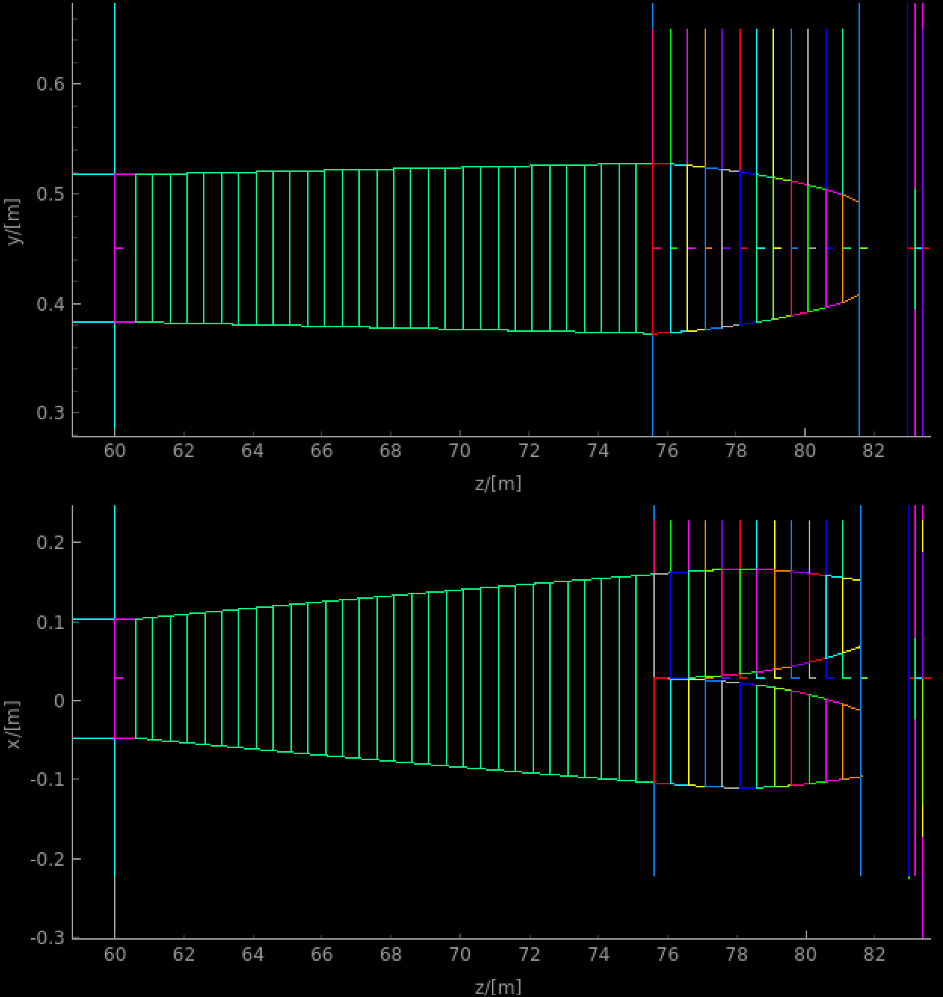
Optimal option
Defocusing length 15m
Focusing length 6 m
Total instrument length 83.5 m
Chopper settings:
PDC1@6.5m - 103 degrees opening,
PDC2 @60m - 82 degrees opening,
Flux at bottom of the cels: 1.25E9 n/s
8.8-9.0AA flux in the cells: 8.87E8 n/s
“Good”/All = 0.71
6.81E7 n/s wall hits due to imperfect focusing (factor 2.5 reduction in absolute numbers, 40% reduction when seen relative to total flux)
1.25E9*0.075 = 9.38E7 n/s wall hits due to lHe scattering

Slide 7
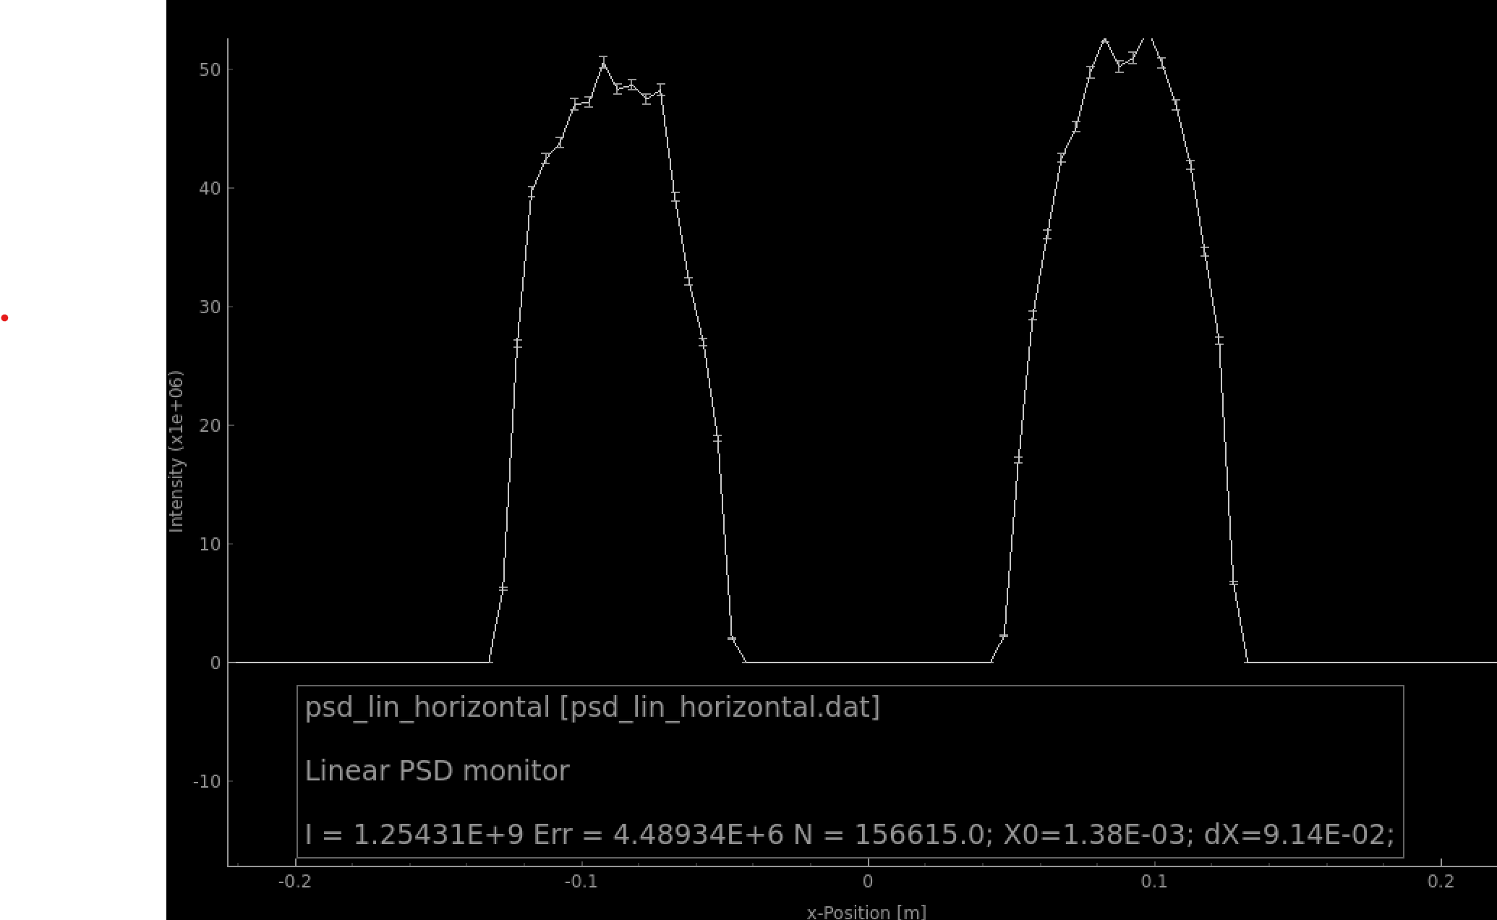
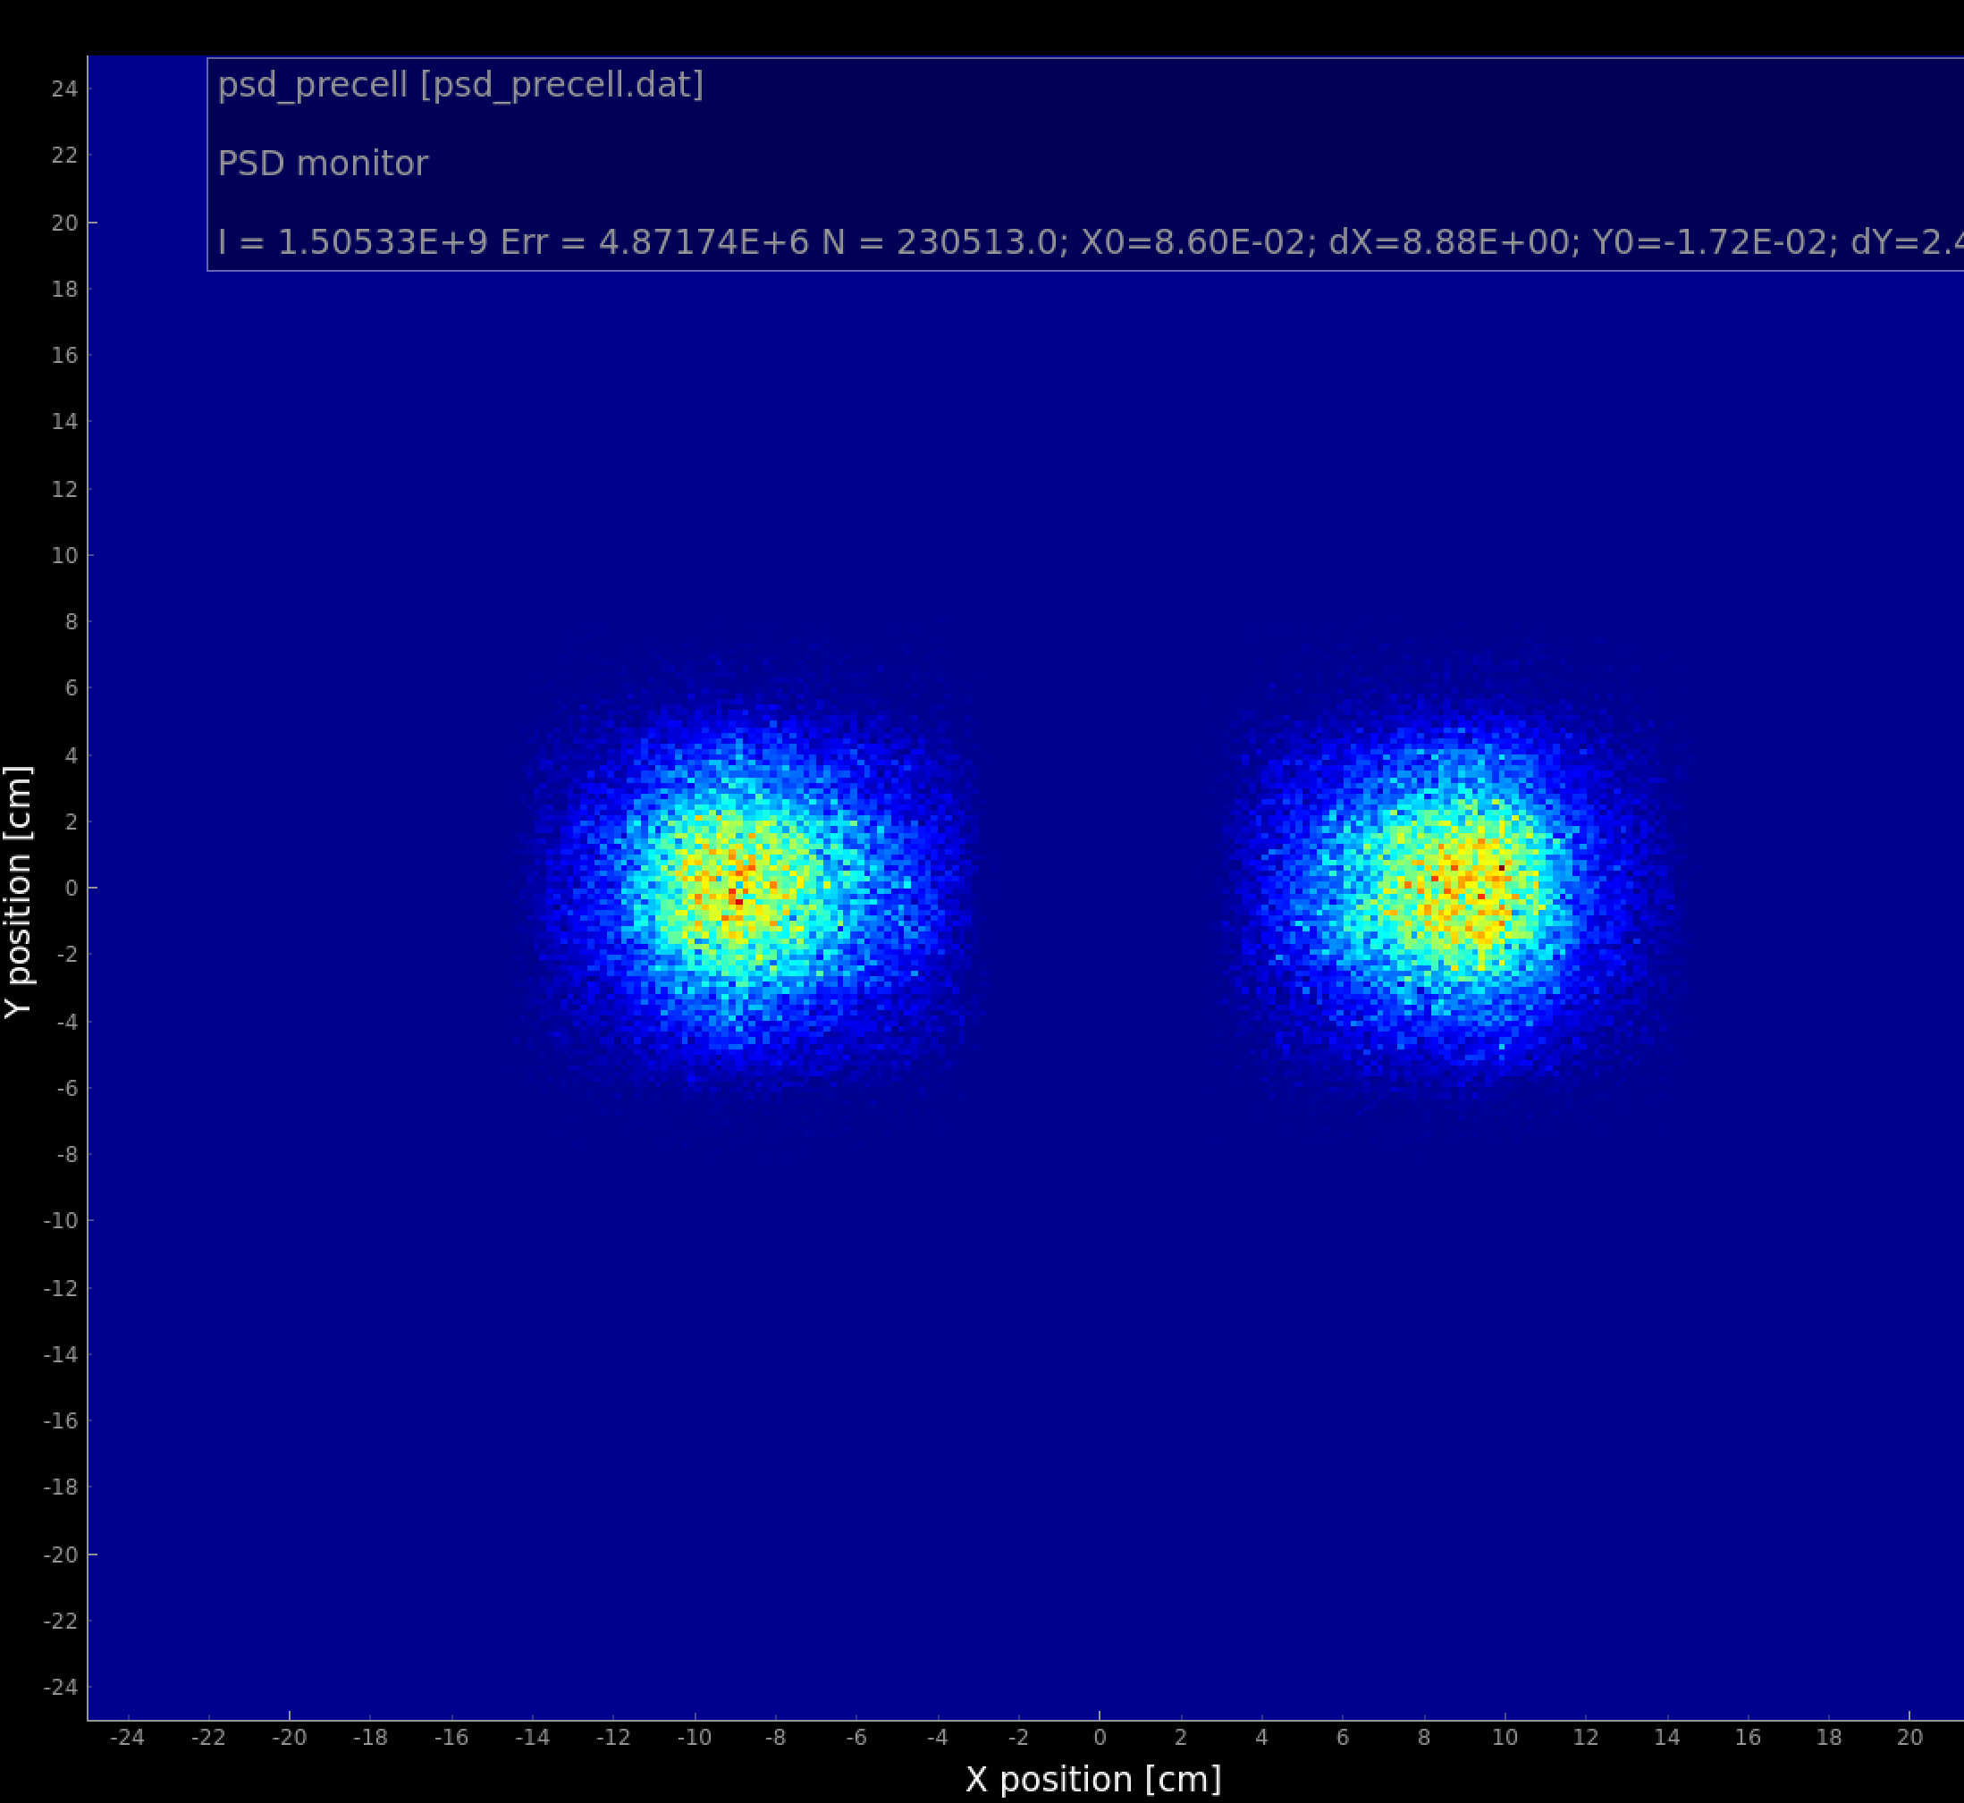
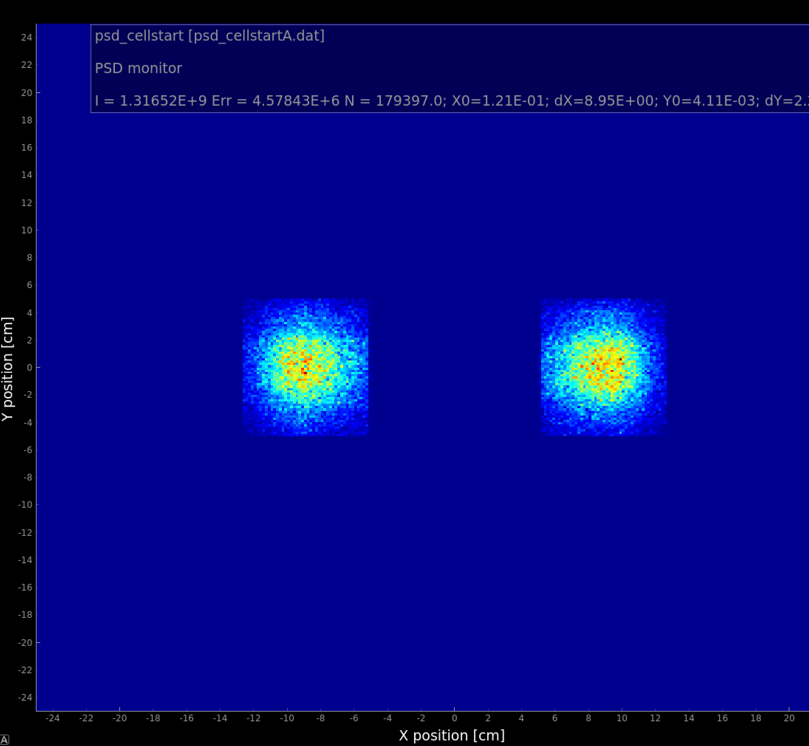
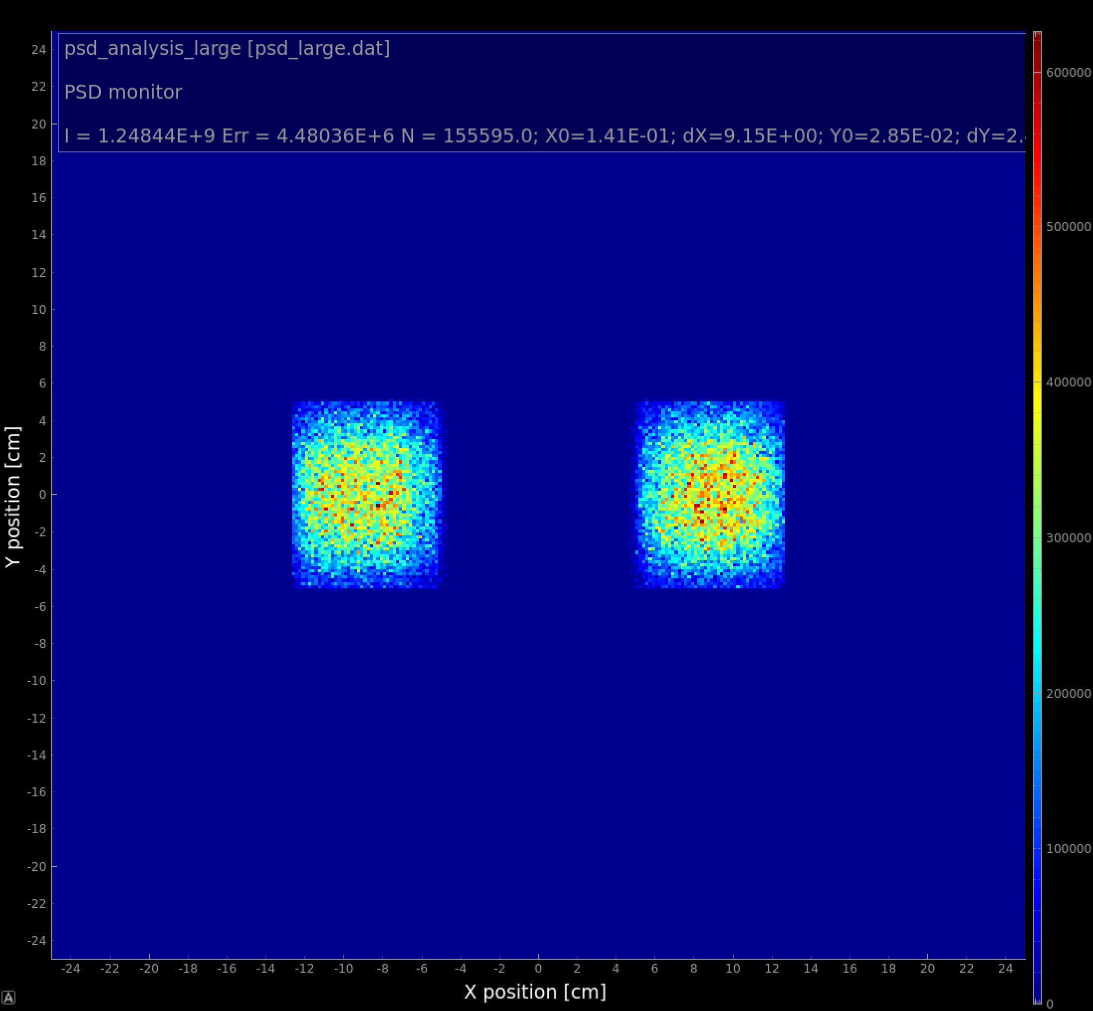
Optimal option, beam profiles
4.53E8 n/s
4.41E8n/s
2.5% imbalance for ‘good’ neutrons
Before the cell
Entering cells
Cell bottom

Slide 8
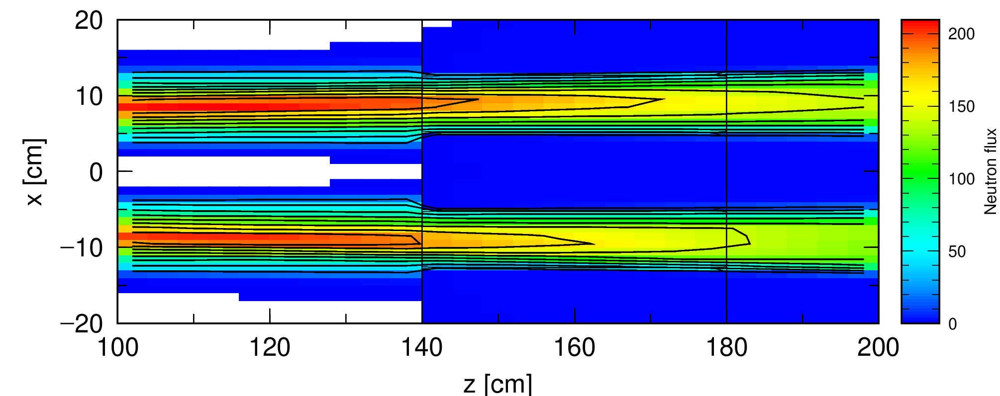
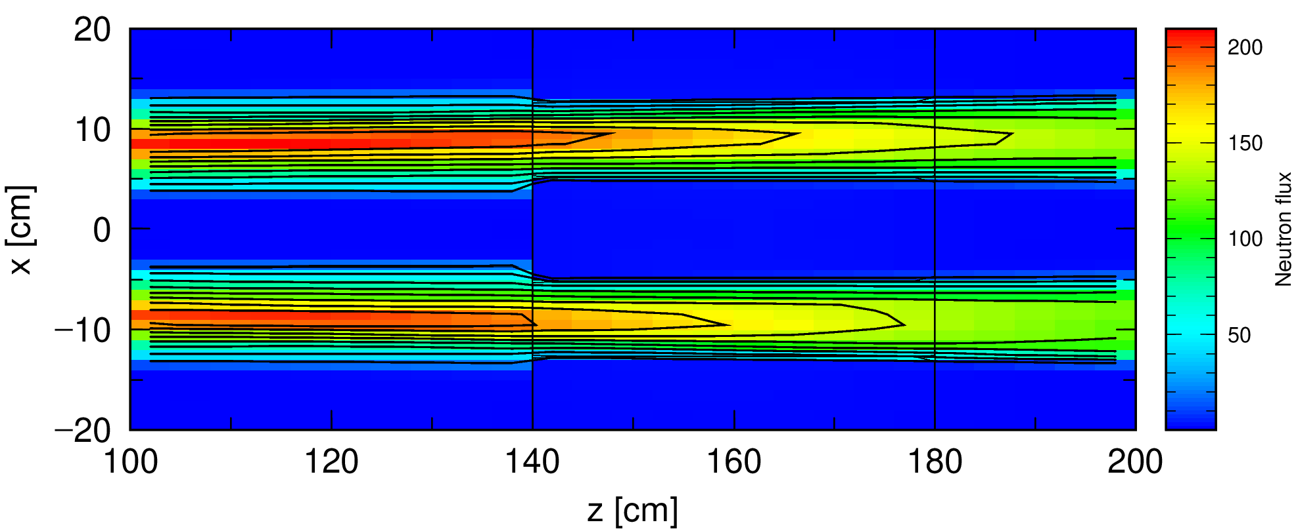
Scattering simulation off lHe, new splitter, PDC2@60m
Pen and paper, McStas
4.3E3 UCN/s
1.61E08 n/s walls hits total
9.37E07 n/s from good n’s ~$8.9$AA
~6.8E7 n/s from imperfect focusing
lHe Xsections provided by Douglas Di Julio.
1.32E09n/s at cell entrance, PHITS:
1.04E08 n/s at cell walls @0.8K (was 2.16E08)
1.76E08 n/s at cell walls @4.0K (was 3.14E08)
Temperature | Entry flux (arb.units) | Exit flux (arb.units) | fraction of wall hits (PHITS)
0.8K | 2.77E3 | 2.55E3 | 0.079
4.0K | 2.77E3 | 2.41E3 | 0.13
0.8K
4.0K

Slide 9
Conclusions
With improved focusing the background is dominated by scattering in lHe for 4K
Imperfect focusing contributes to ~60% of wall hits at 0.8K if beam is cut to cell entry dimensions (before reoptimizing splitter it was >75% )
Some reduction can be still reached by increasing fraction of “good” neutrons which is for now ~70% and (?) beam shaping prior to cells.
Outlook
Empiric formula for UCN production is obtained under assumptions of constant dn/dL, can change with exact account of spectrum
Optimal chopper settings search could implement pulse time structure.

Slide 10
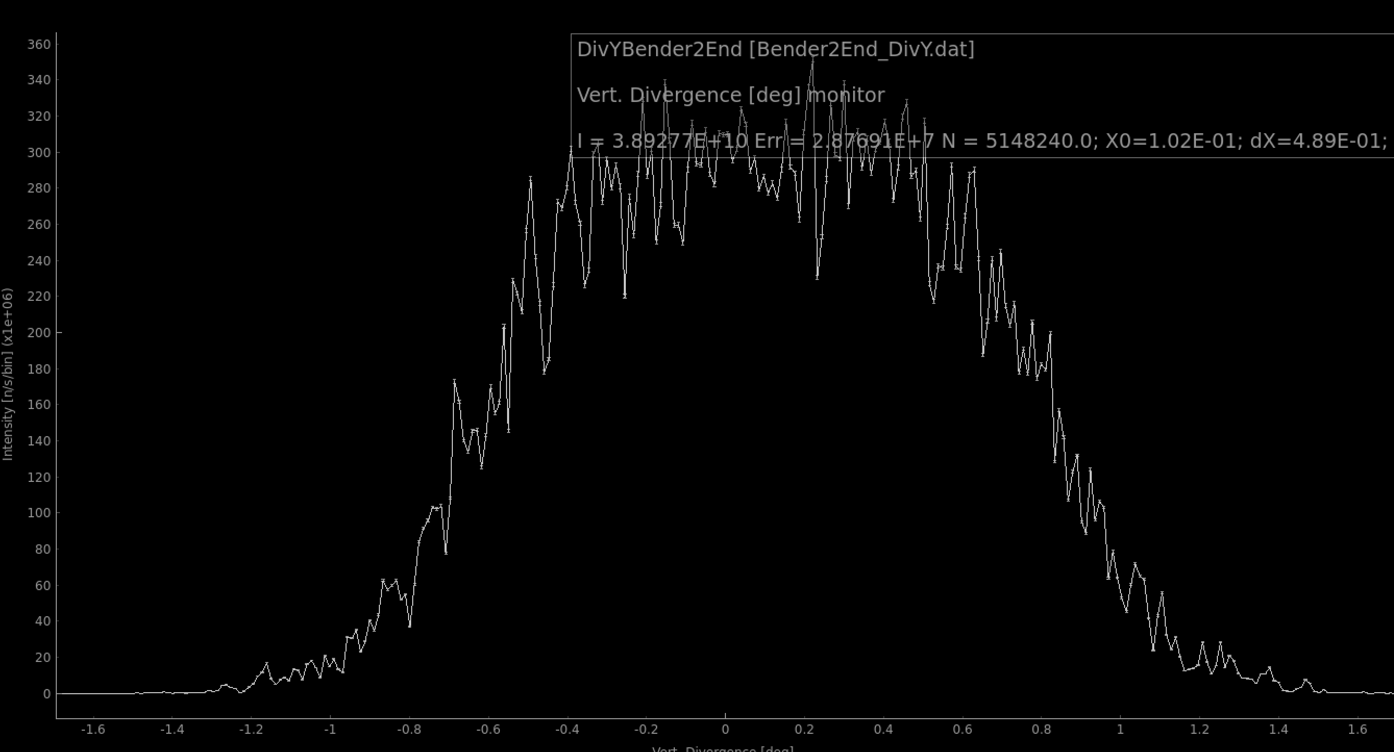
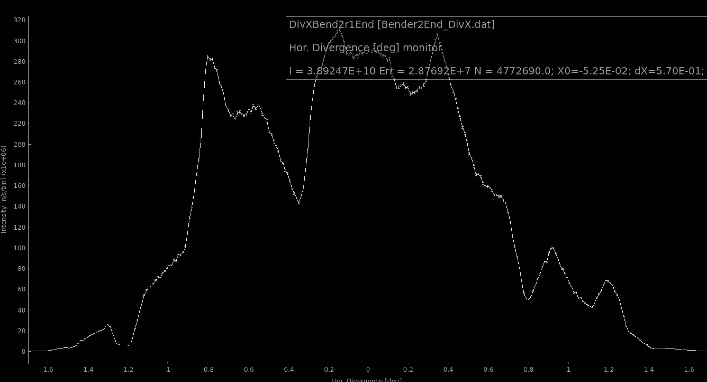
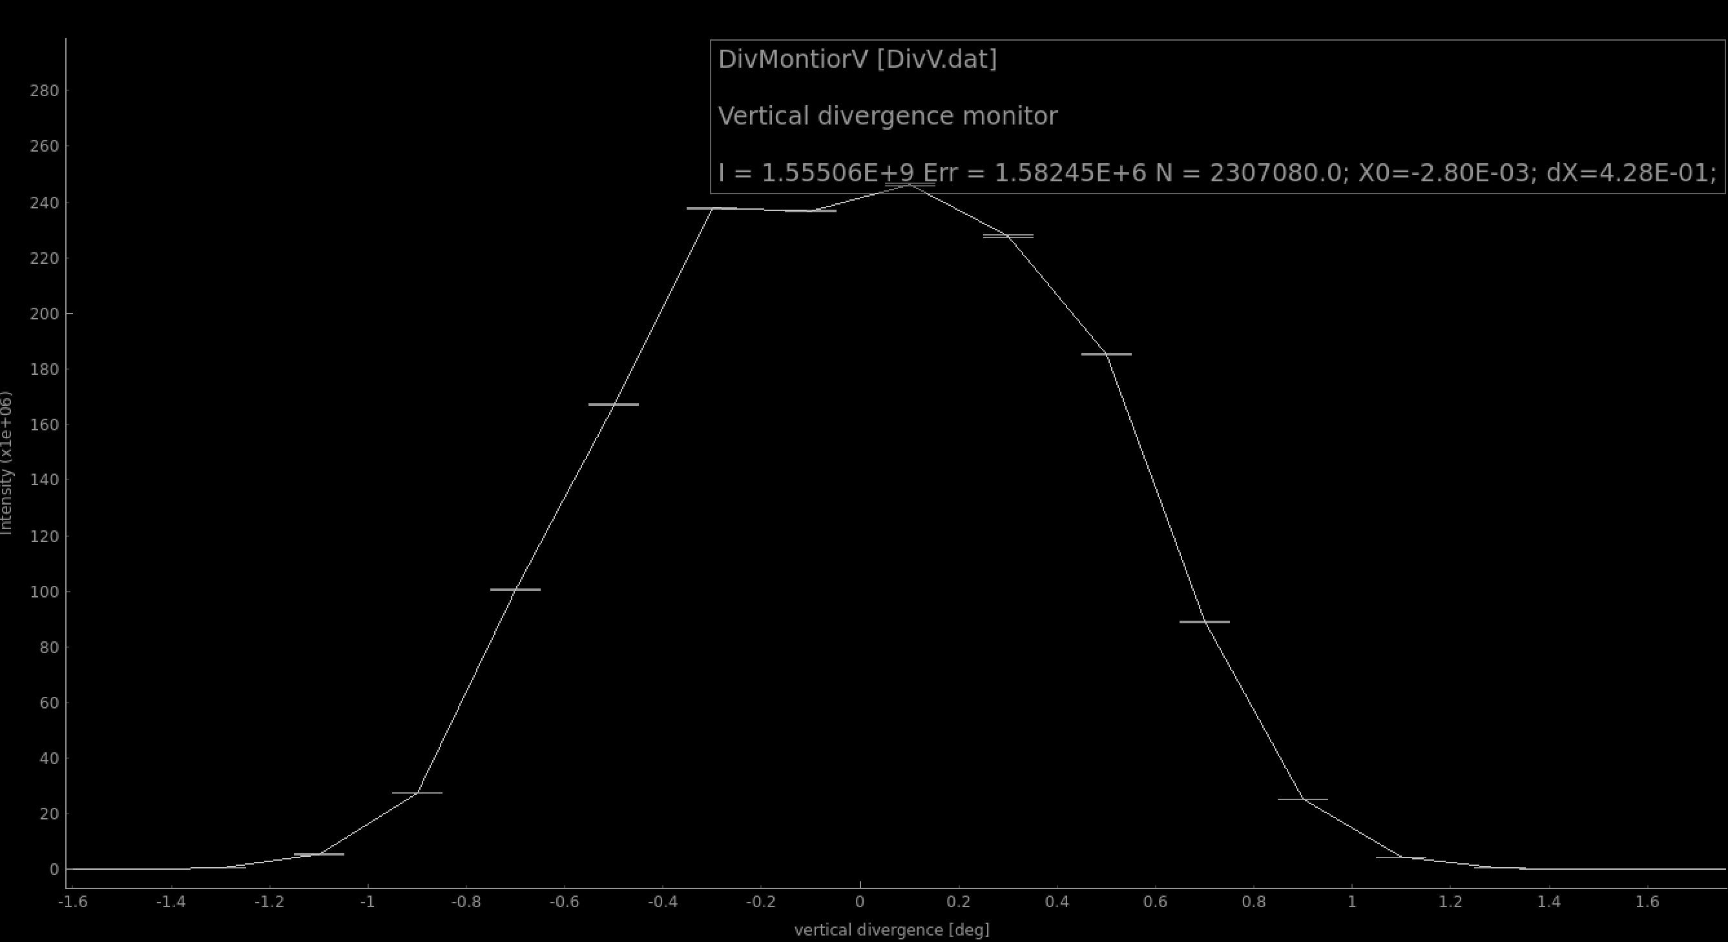
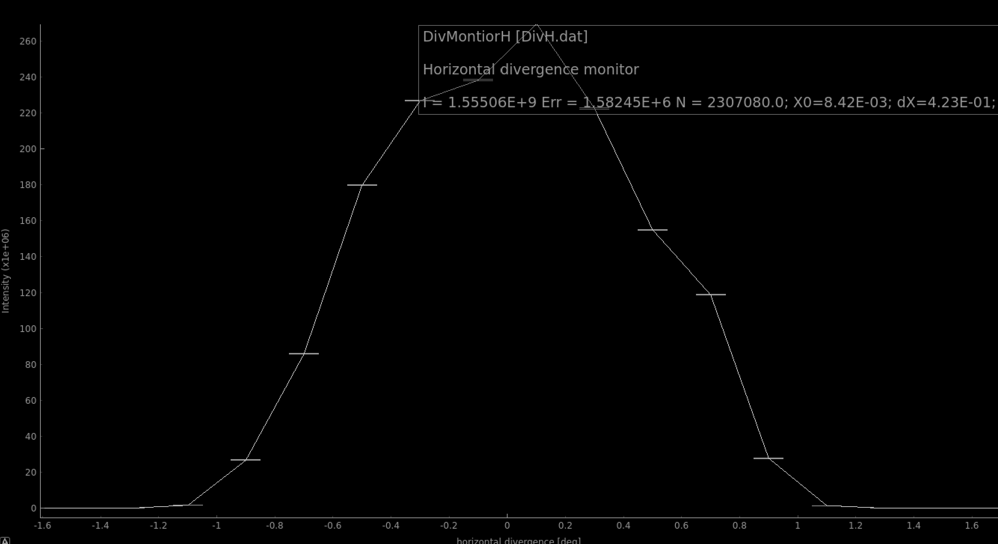
Backup – divergencies after bending/after defocus
Y
X

