Slide 1
Improving UCN per total neutron flux ratio
03.04.2025

Slide 2
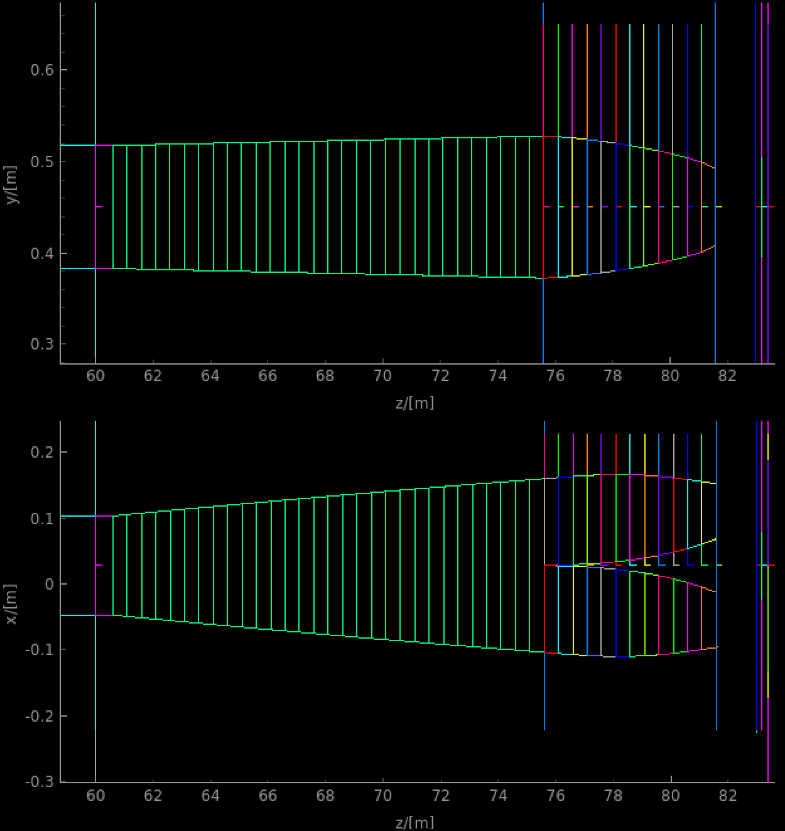
Optimal option for neutron optics (2nd order curves)
Defocusing length 15m
Focusing length 6 m
Total instrument length 83.5 m
Chopper settings:
A simple pulse structure is used
PDC1@6.5m - 103 degrees opening,
PDC2 @60m - 82 degrees opening,
Flux at bottom of the cels: 1.25E9 n/s
8.8-9.0AA flux in the cells: 8.87E8 n/s
“Good”/All = 0.71
Wall hits constitute about 8% of total beam intensity.

Slide 3
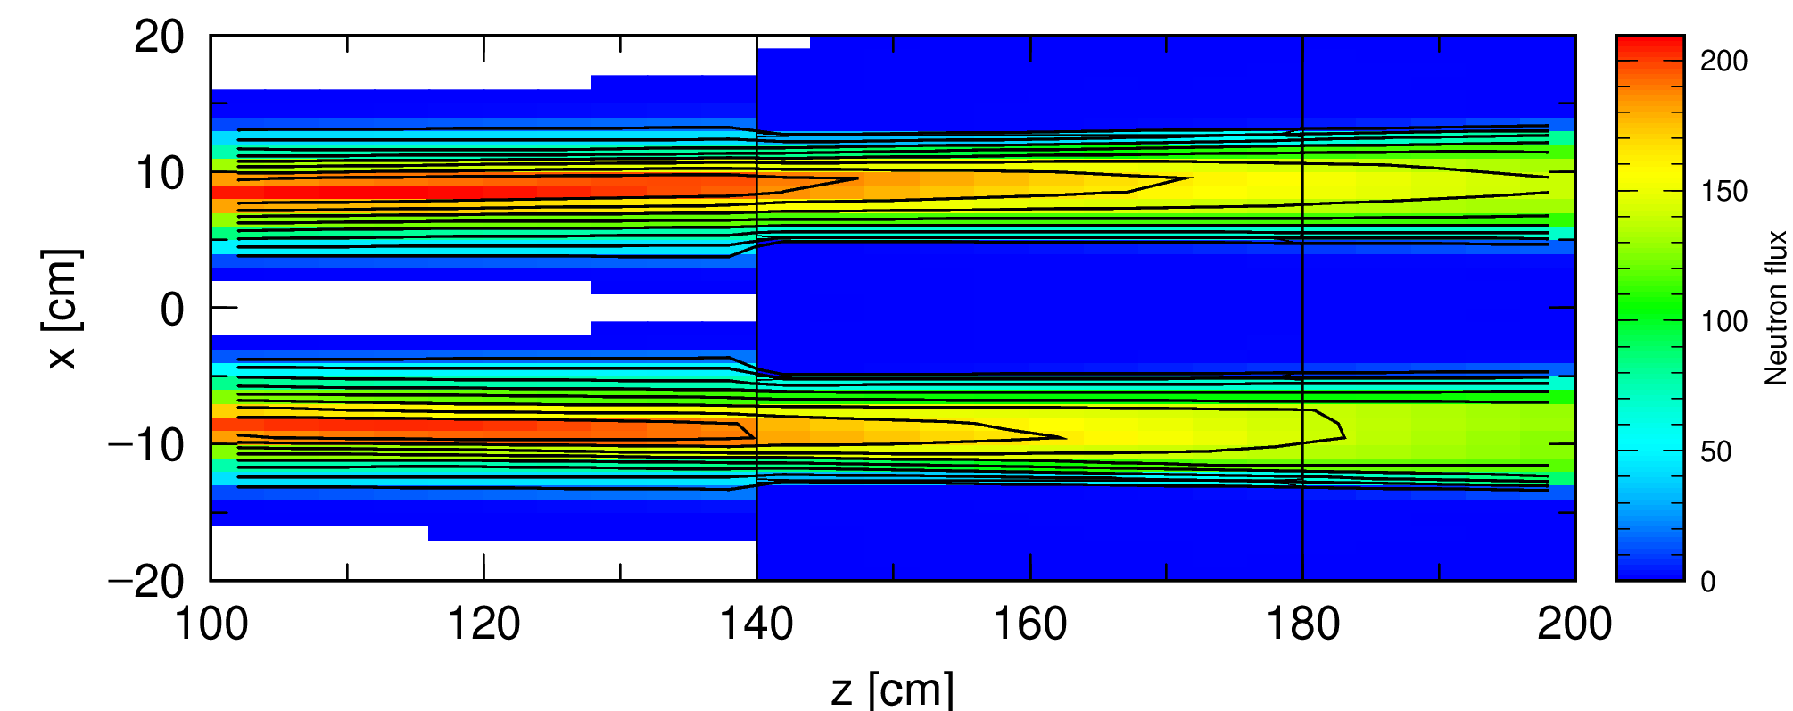
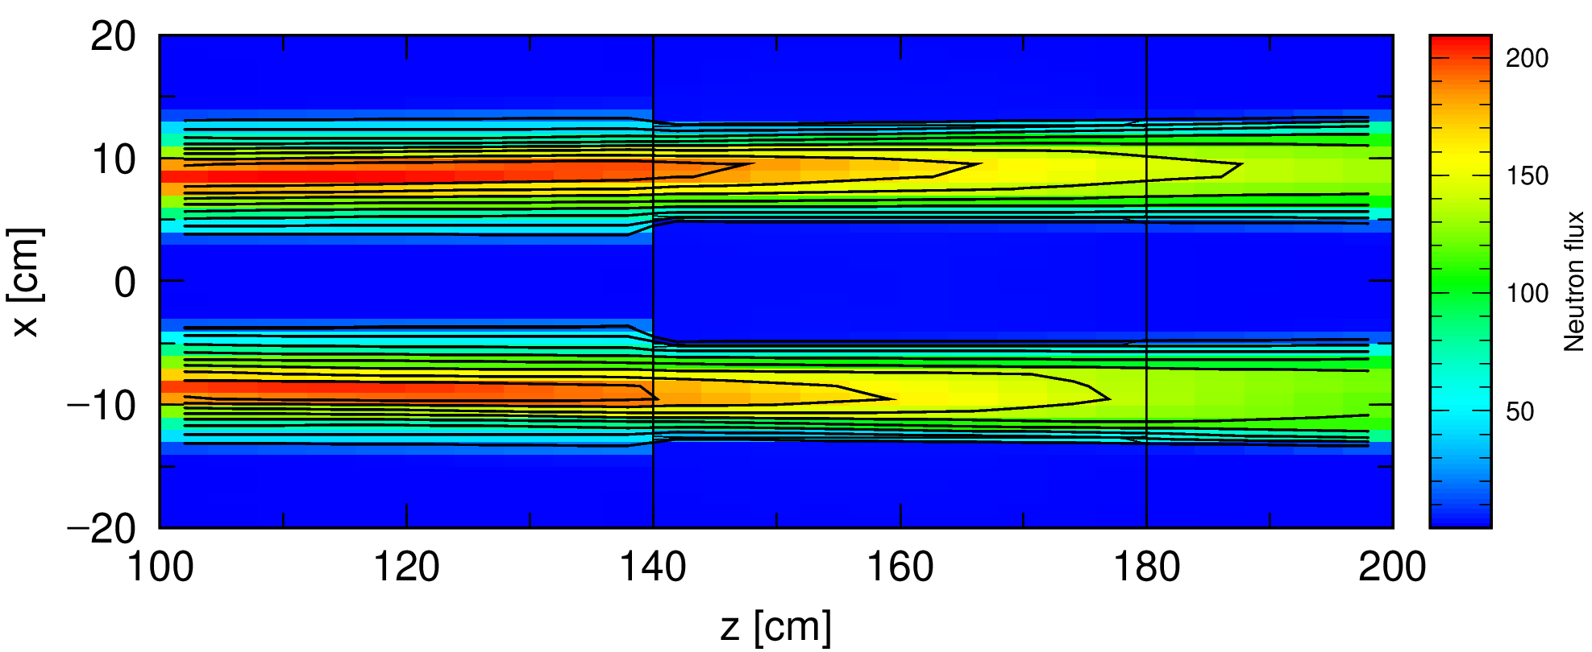
Scattering simulation off lHe, new splitter, PDC2@60m
Pen and paper, McStas
4.3E3 UCN/s
1.61E08 n/s walls hits total
9.37E07 n/s from good n’s ~$8.9$AA
~6.8E7 n/s from imperfect focusing
lHe Xsections provided by Douglas Di Julio.
1.32E09n/s at cell entrance, PHITS:
1.04E08 n/s at cell walls @0.8K (was 2.16E08)
1.76E08 n/s at cell walls @4.0K (was 3.14E08)
Temperature | Entry flux (arb.units) | Exit flux (arb.units) | fraction of wall hits (PHITS)
0.8K | 2.77E3 | 2.55E3 | 0.079
4.0K | 2.77E3 | 2.41E3 | 0.13
0.8K
4.0K

Slide 4
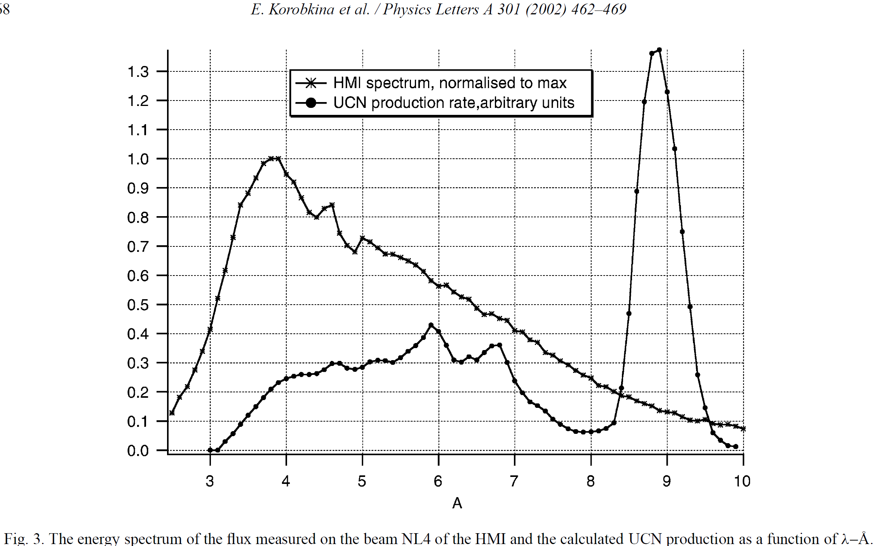
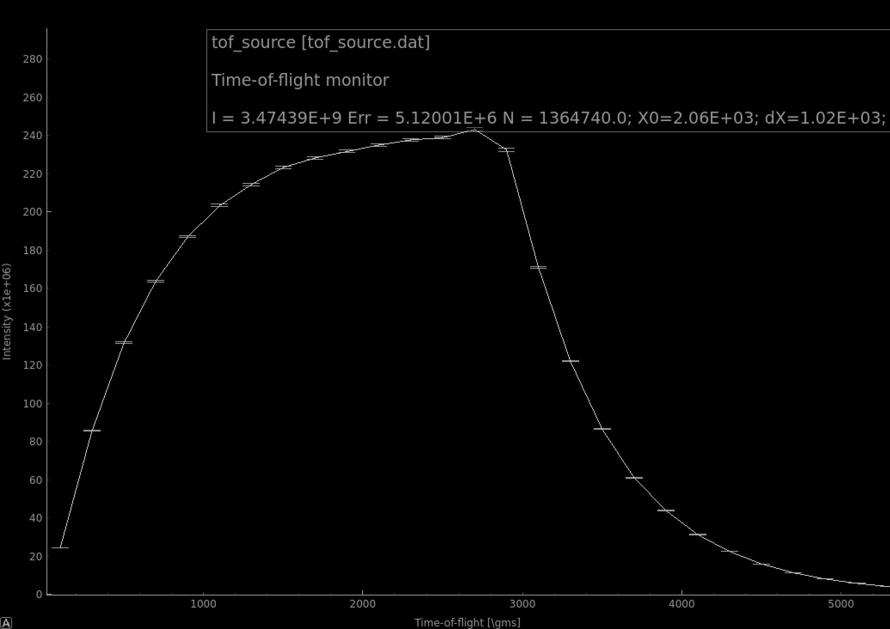
Critical input for chopper optimization
A rather broad distribution in wavelength for UCN conversion
ESS pulse is rather different from a simple step

Slide 5
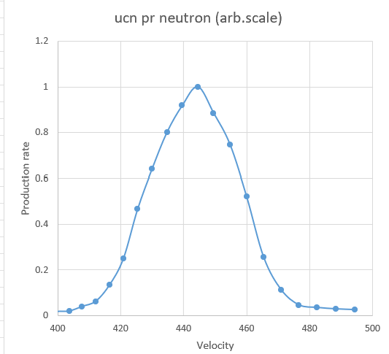
UCN conversion rates
λ,AA | Velocity, m/s | UCN per neutron
8 | 494.5 | 3.17E-08
8.1 | 488.3950617 | 3.59E-08
8.2 | 482.4390244 | 4.37E-08
8.3 | 476.626506 | 5.76E-08
8.4 | 470.952381 | 1.41E-07
8.5 | 465.4117647 | 3.2E-07
8.6 | 460 | 6.54E-07
8.7 | 454.7126437 | 9.39E-07
8.8 | 449.5454545 | 1.11E-06
8.9 | 444.494382 | 1.26E-06
9 | 439.5555556 | 1.15E-06
9.1 | 434.7252747 | 1.01E-06
9.2 | 430 | 8.06E-07
9.3 | 425.3763441 | 5.86E-07
9.4 | 420.8510638 | 3.13E-07
9.5 | 416.4210526 | 1.67E-07
9.6 | 412.0833333 | 7.79E-08
9.7 | 407.8350515 | 4.97E-08
9.8 | 403.6734694 | 2.41E-08
9.9 | 399.5959596 | 2.07E-08
The plots are digitized and UCN conversion efficiency recalculated as a function of wavelength.
Normalization follows from a calculated number of 2.2E-08 UCN per neutron/s/cm2/AA at 8.9 AA under assumption of a slow varying spectrum [Korobkina et al, PhysLett A301 (2002)].
Maximal conversion efficiency is 1.26E-06 UCN/neutron at 8.9AA.

Slide 6
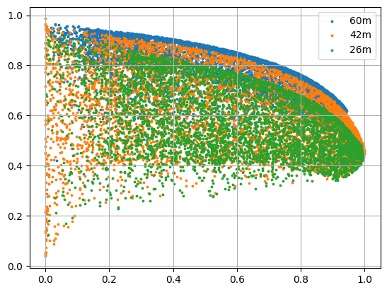
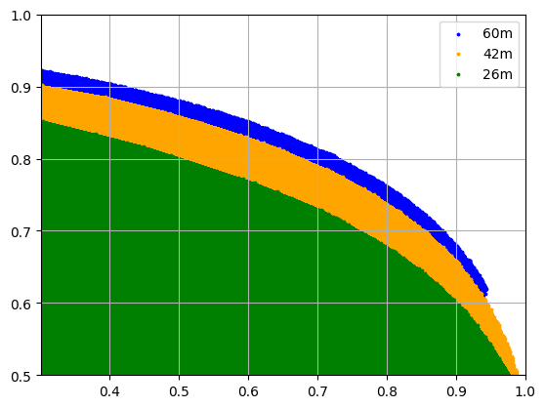
Optimization workflow
Random sampling of chopper opening times and delays
Calculation of total neutrons/s after PDC2 and UCN production rate using conversion efficiency
Output:
UCN rate per neutron relative to maximal achievable (1.26E-06)
Overall UCN production relative to maximal achievable (with open choppers)
(UCN/neutron)/(UCN/neutron)_max
(UCN/s)/(UCN/s)_max

Slide 7
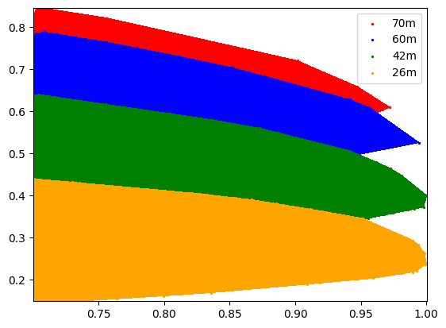
Realistic vs “Good/all” optimization (both with account of ESS pulse structure)
(UCN/neutron)/(UCN/neutron)_max
“Good”/all
(UCN/s)/(UCN/s)_max
“Good”/max
A significant difference in performance gain with increasing PDC2 distance

Slide 8
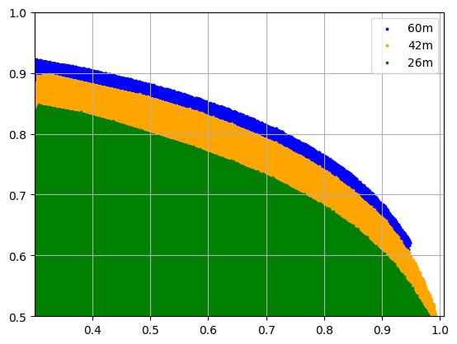
Highlights from improved optimization
 | PDC2@26m | PDC2@42m | PDC2@60m
Delay 1, s | 0.0015-0.0017 | 0.0013-0.0016 | 0.0015-0.0017
Theta 1, deg | ~106-180 | ~130-300 | ~250-350
Delay 2, s | 0.060 | 0.096 | 0.136
Theta 2, deg | ~120 | ~180 | ~250
UCN production /max | 0.8 | 0.8 | 0.8
UCN conversion/max | 0.67 | 0.73 | 0.76
Selection criteria
above 80% of maximal UCN production rate
Highest possible UCN/neutron
Opening angles Theta are recalculated from chopper opening times assuming 70Hz frequency (hence numbers close to full circle)

Slide 9
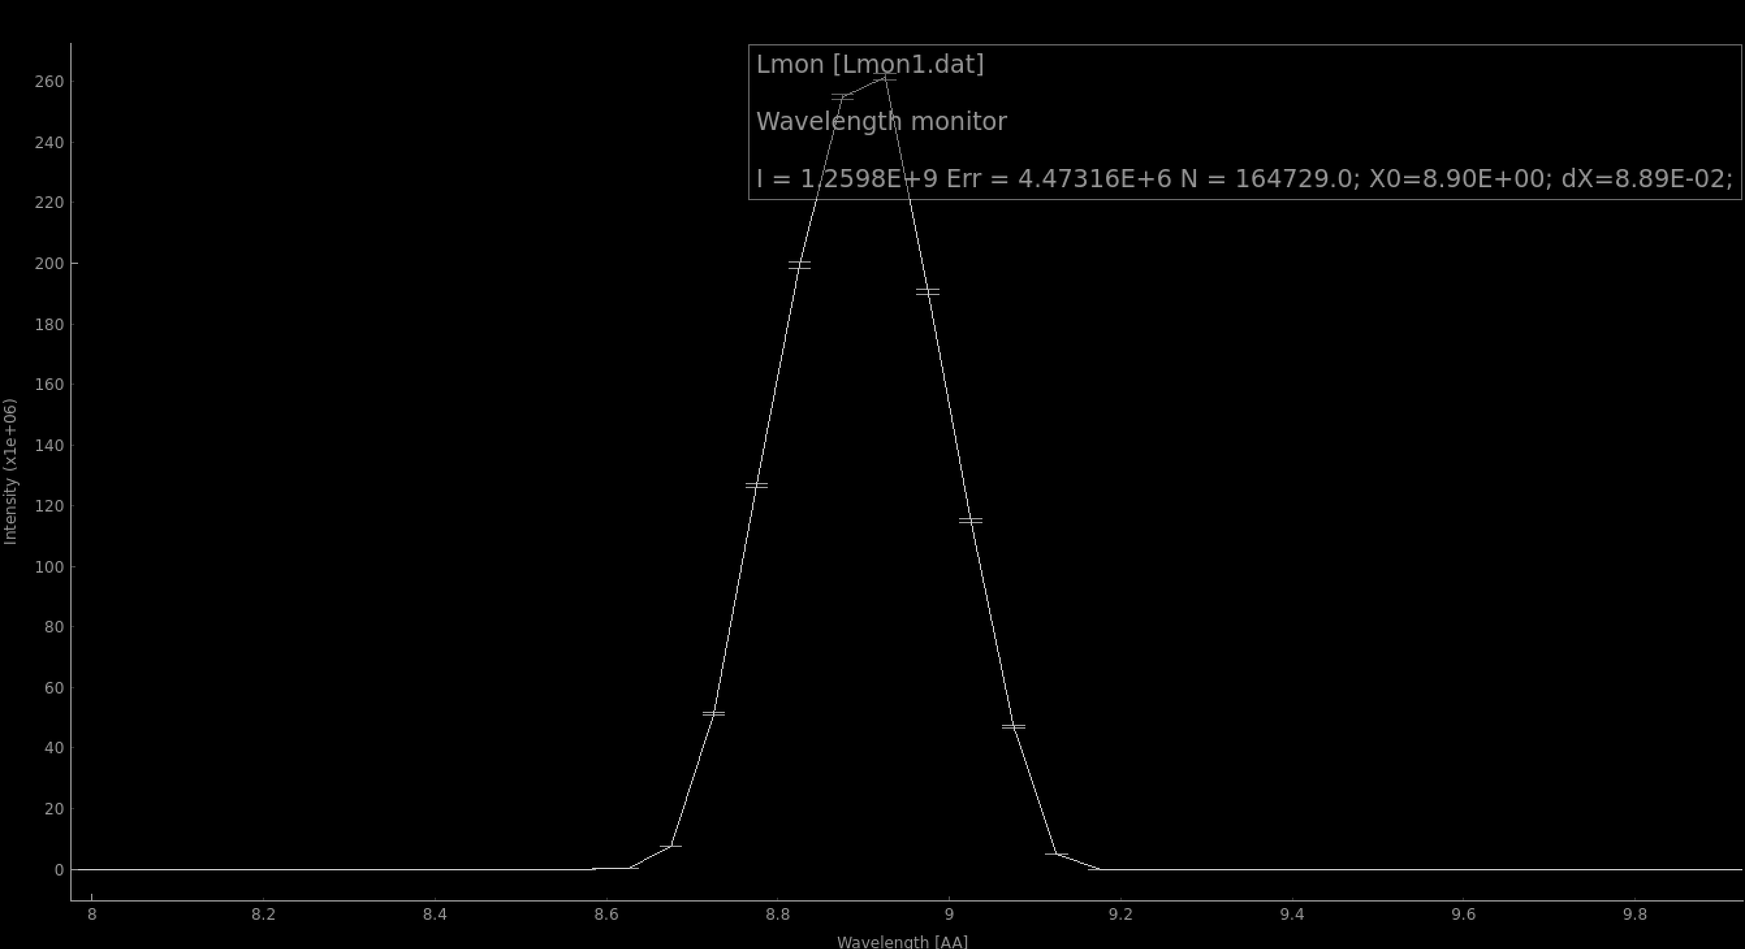
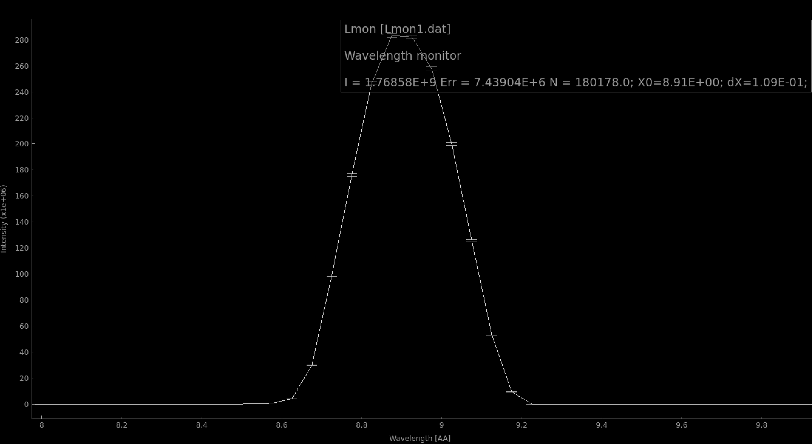
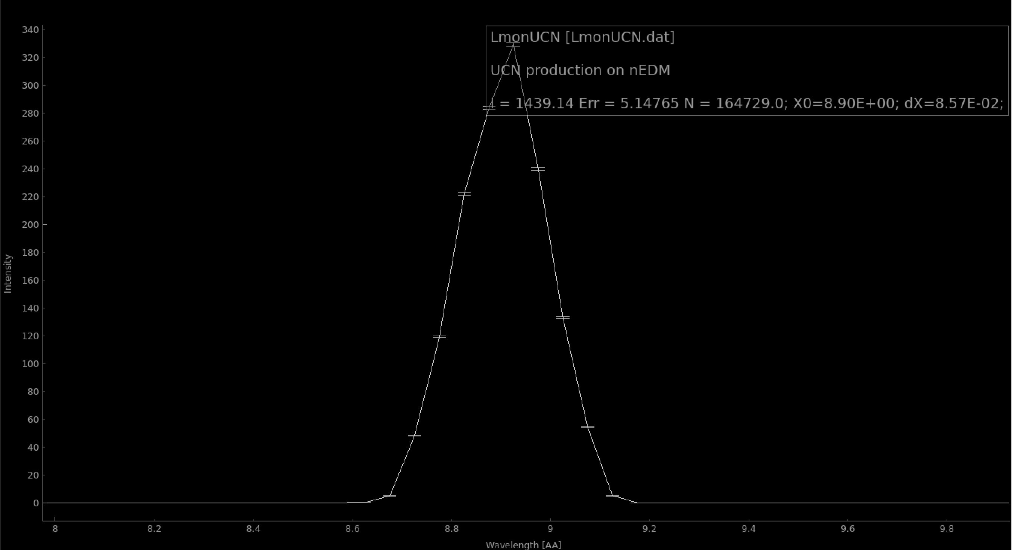
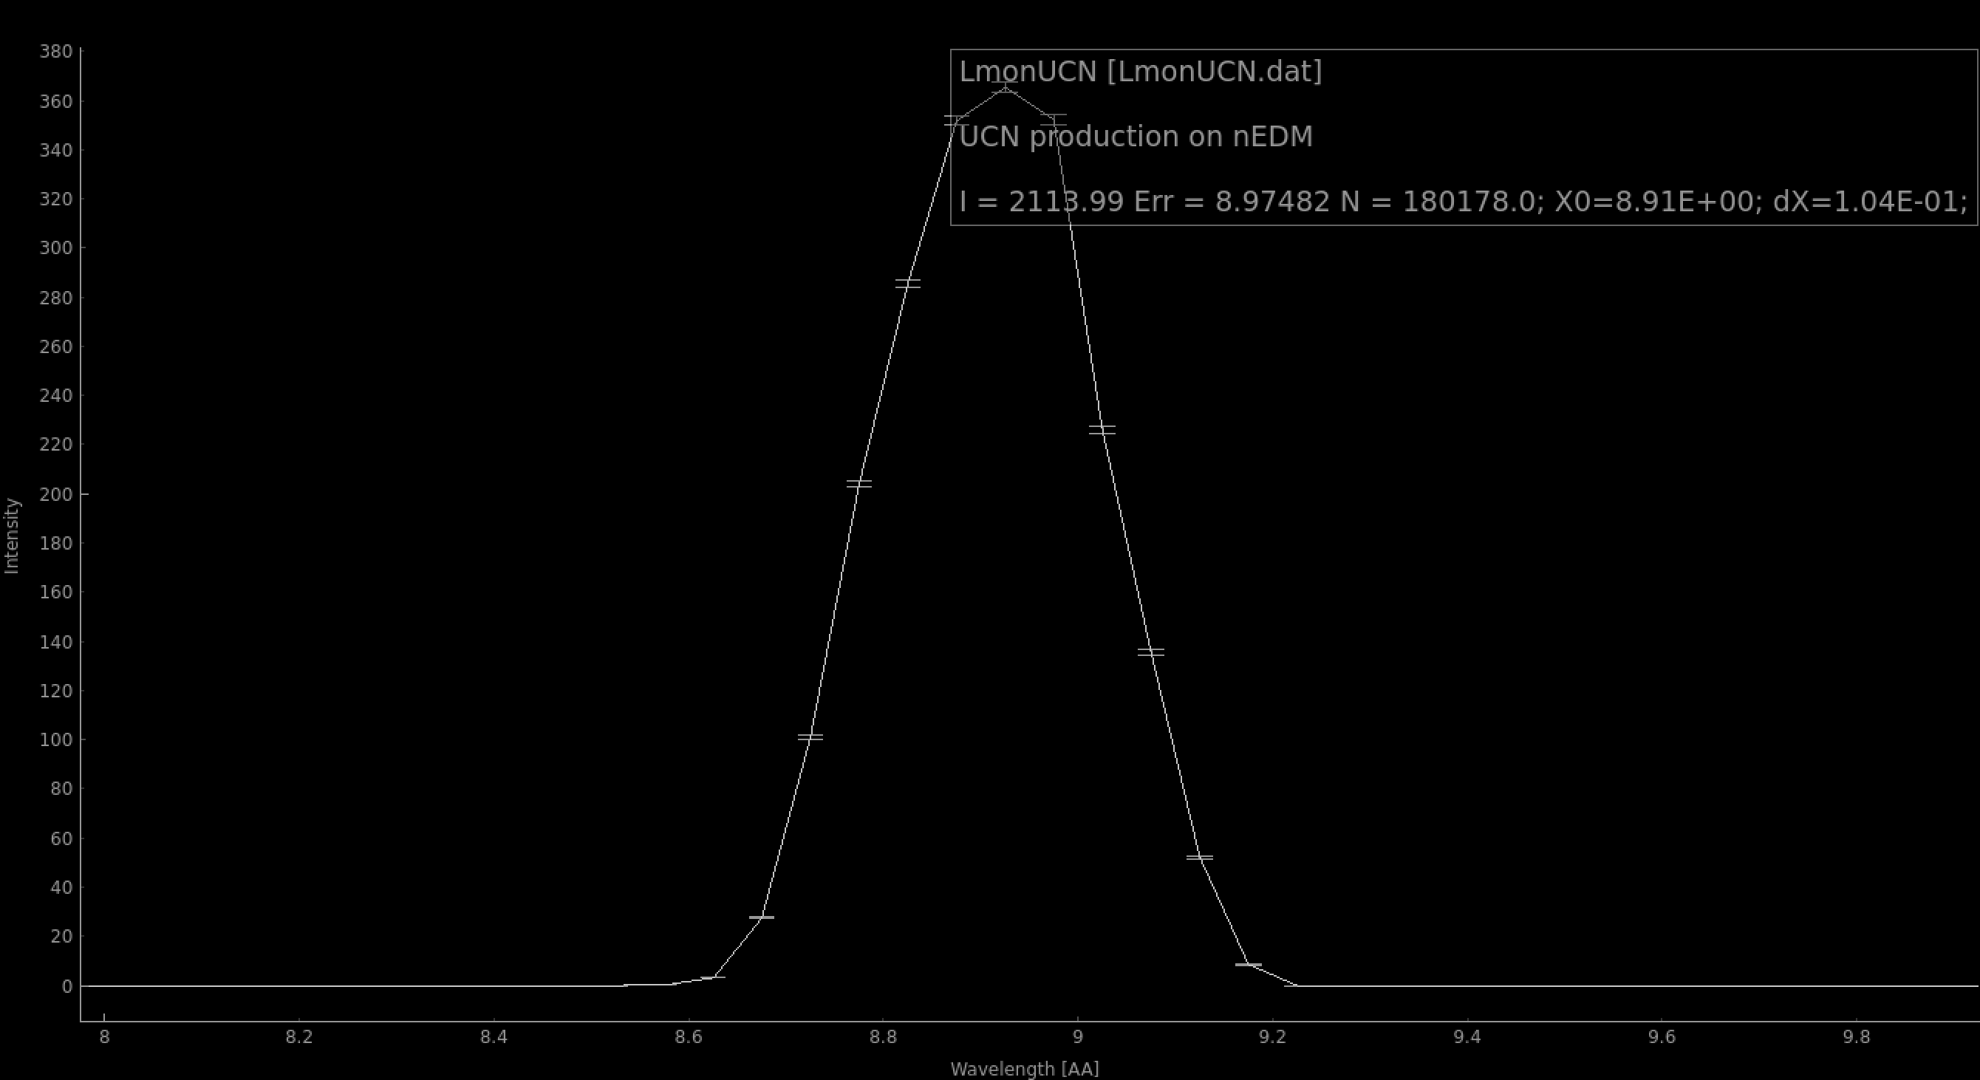
Performance comparison
Good/all optimization
UCN conversion rate account
PDC2@60m, PDC1_theta = 100.5 deg, PDC2_theta = 85 deg.
UCN/Total_flux=1.14E-06 (0.91 of 1.26E-06)
1.44E3 UCN/s (31% of theoretical max)
PDC2@60m, PDC1_theta = 196 deg, PDC2_theta = 119 deg.
UCN/Total_flux=1.19E-06 (0.95 of 1.26E-06)
2.1E3 UCN/s (45% of theoretical max)

