Slide 1
nEDM optics design
Kick-off meeting for engineering design project

Slide 2
Starting point
Beamport axis
Optics focus
Beamport axis
Optics focus
The instrument utilizes a E5 beamport
The in-monolith optics is optimized for HIBEAM experiment
The focusing point is displaced with respect to the beamport axis (V50cmH45m@60m)

Slide 3
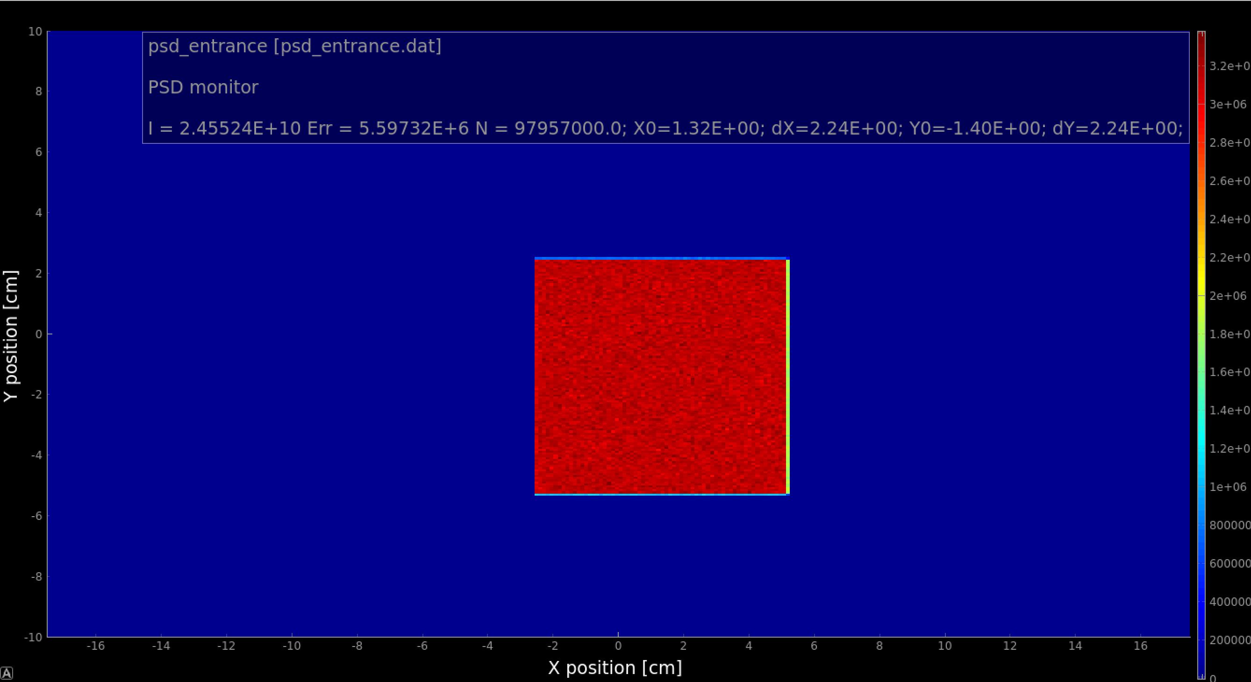
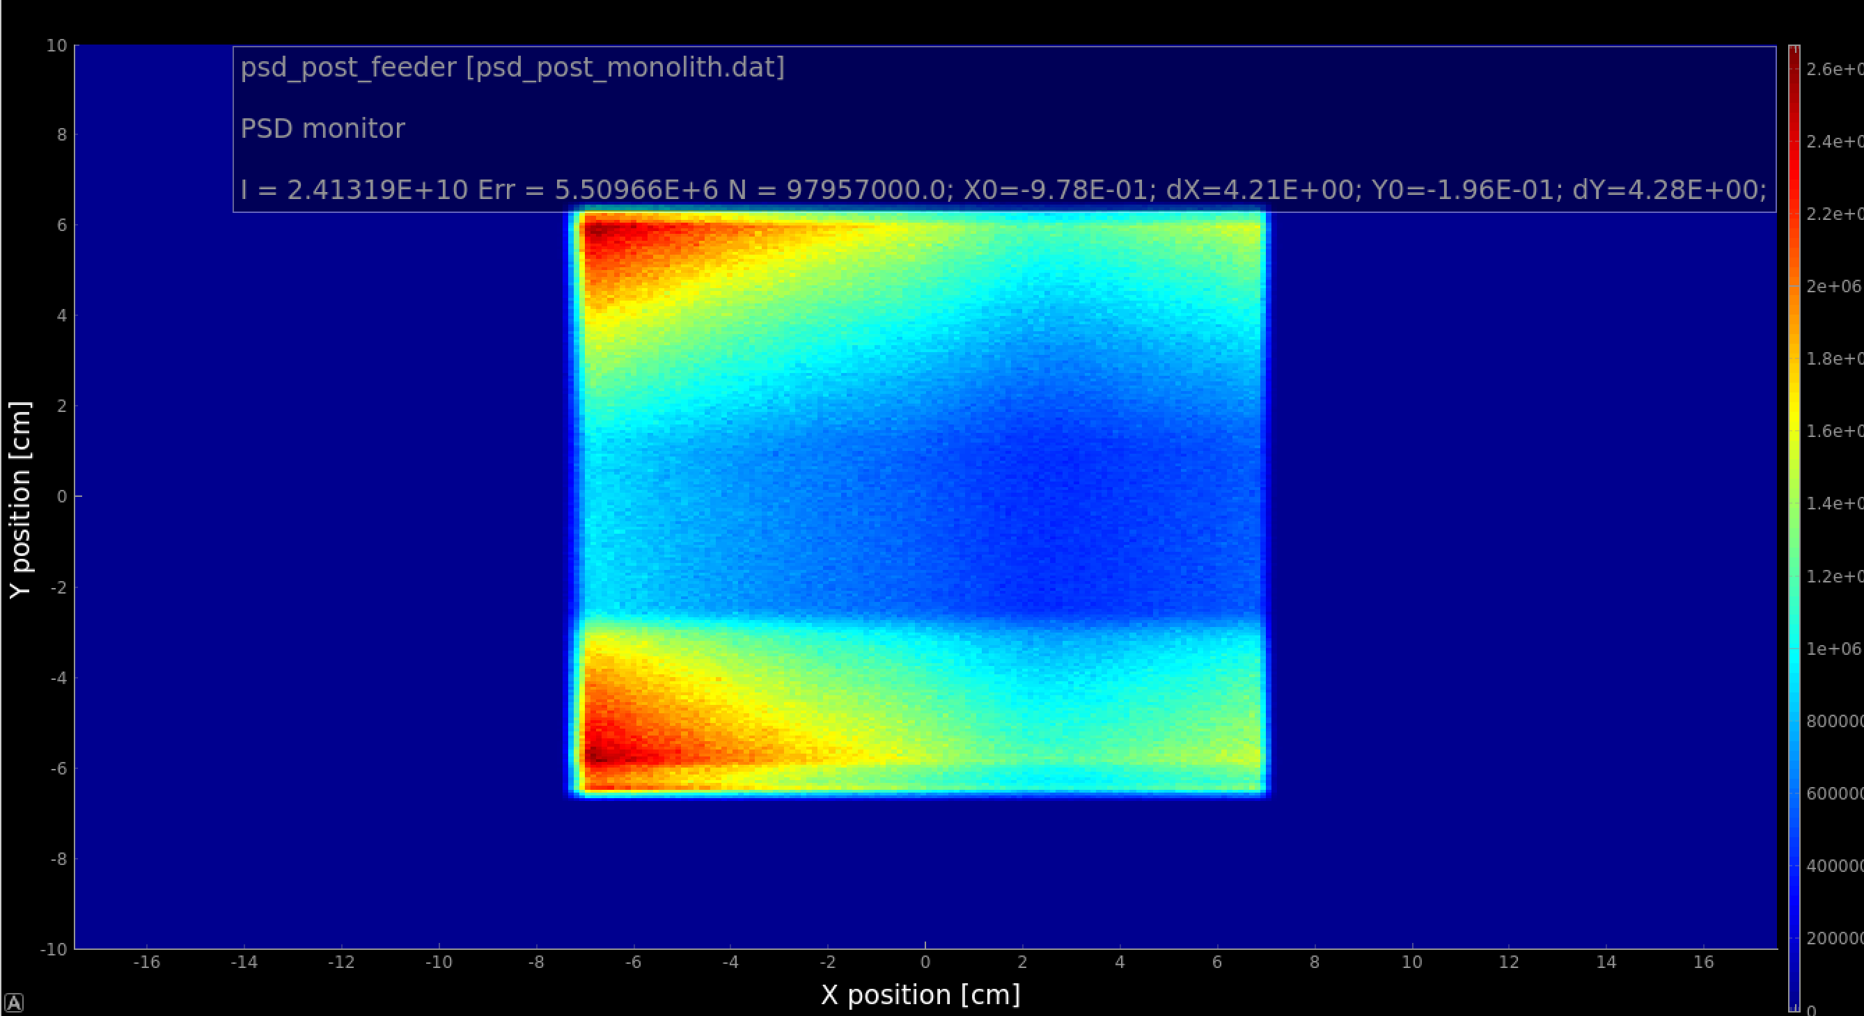
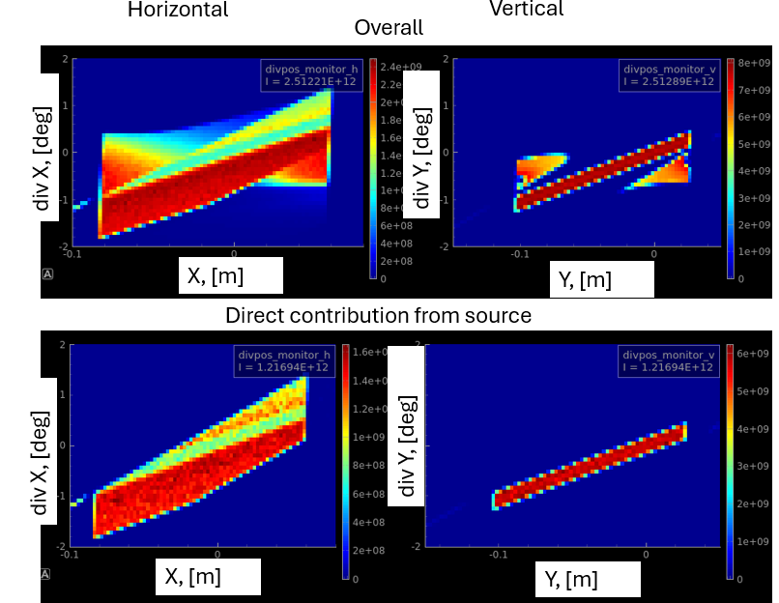
Beam profile past monolith
2m
5.5 m
~15% of intensity
Inside the box
Wide and flat moderator:
Higher horizontal divergence
The optics is reflecting towards a distant point:
The center of the opening in the monolith is depopulated with neutrons.
Blocking the center of the opening has minor effect on the overall performance
Notes:
½ of the neutrons are reflected by the optics, apparent from comparing numbers in with and without optics in the vertical divergence. Covering 1/3 of the opening would reduce the intensity by just 1/6, that is 15%.

Slide 4
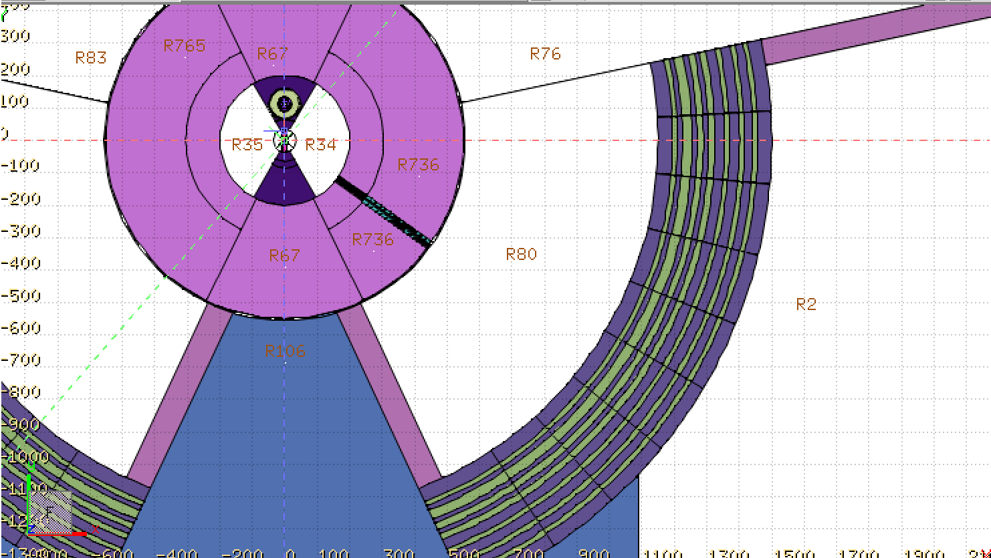
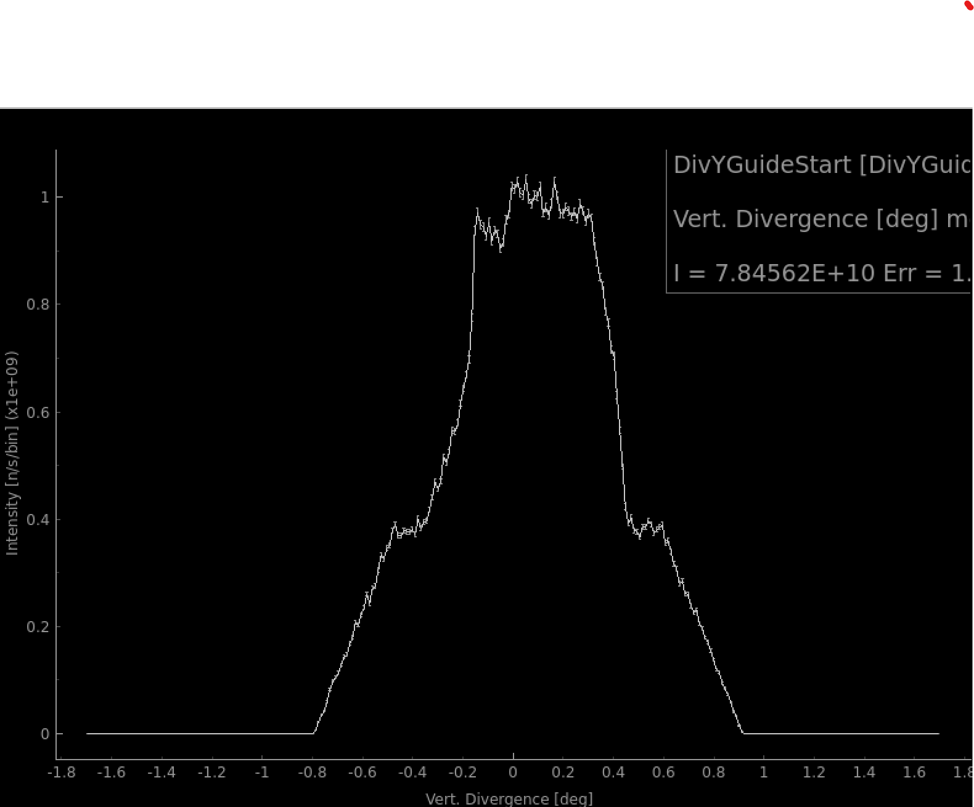
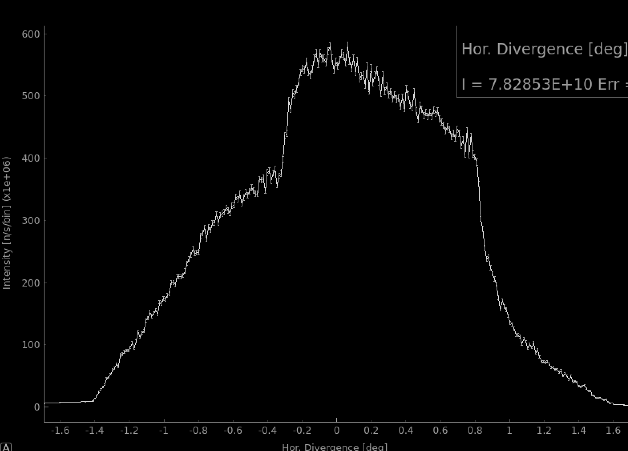
Avoiding line of sight
The ESS bunker provides shielding against fast neutrons.
LOS is preferably to be blocked by bending before the bunker wall, ~11.5 from the moderator
Vertical bending is preferred due to divergence profiles.
Bending to avoid LOS before bunker wall for the full guide height requires bending for over 5 degrees resulting in performance loss.
Go for a 2 stacked benders option
6 m

Slide 5
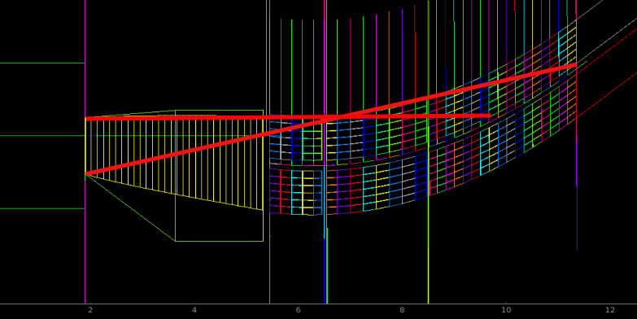
Two stacked benders
The bender is split in two 6-channel parts stacked vertically
LOS is avoided with 3.48 degrees bending angle @11.35m from the moderator
Thickness of the LOS blocker is ~1.5 cm which ensures a minimum of 35 cm of material in the line of sight. Can be increased in case of high fast neutron background with minor effect on the performance.
Same splitting is preserved in the bunker wall feedthrough and the second bender.

Slide 6
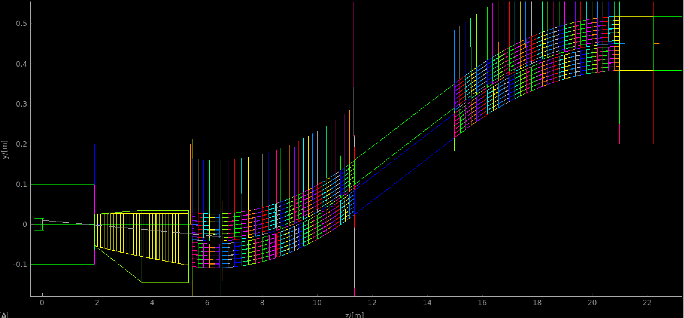
Multichannel benders
 | Bender 1 | Bender 2
Length, m | 5.9 | 6.0
Bending angle, deg | 3.48 | 3.00
# of channels | 2 x 6 | 2 x 6
Height, cm | 13.46 | 13.46
Width, cm | 15.06 | 15.06
Bending angle of the first bender is partly compensated as it points 0.477 degrees downwards at the start
The beam is horizontal after the bender 2.

Slide 7
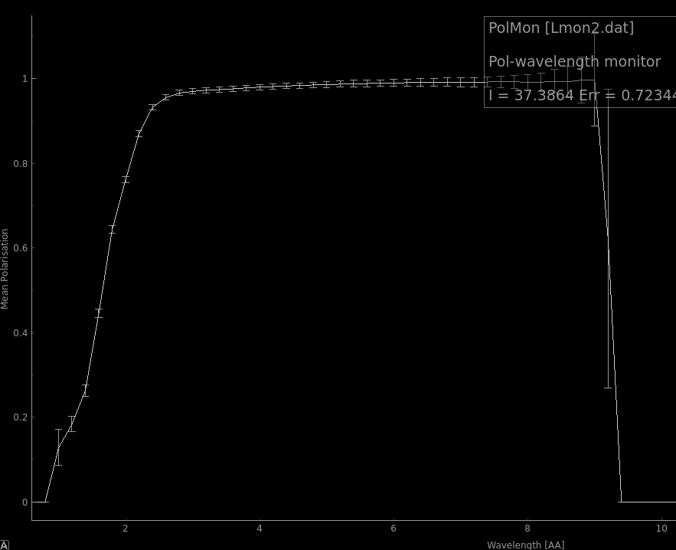
V-cavity polarizer
Param. | Value
Length, m | 1.239
Widht, cm | 15.04
Height, cm | 13.46
V-cavities | 5
m-value | 5.5
V-cavity polarizer deflects neutrons with unwanted polarization at an angle which can’t be transported in the guide
Requires some space after for the polarization to settle

Slide 8
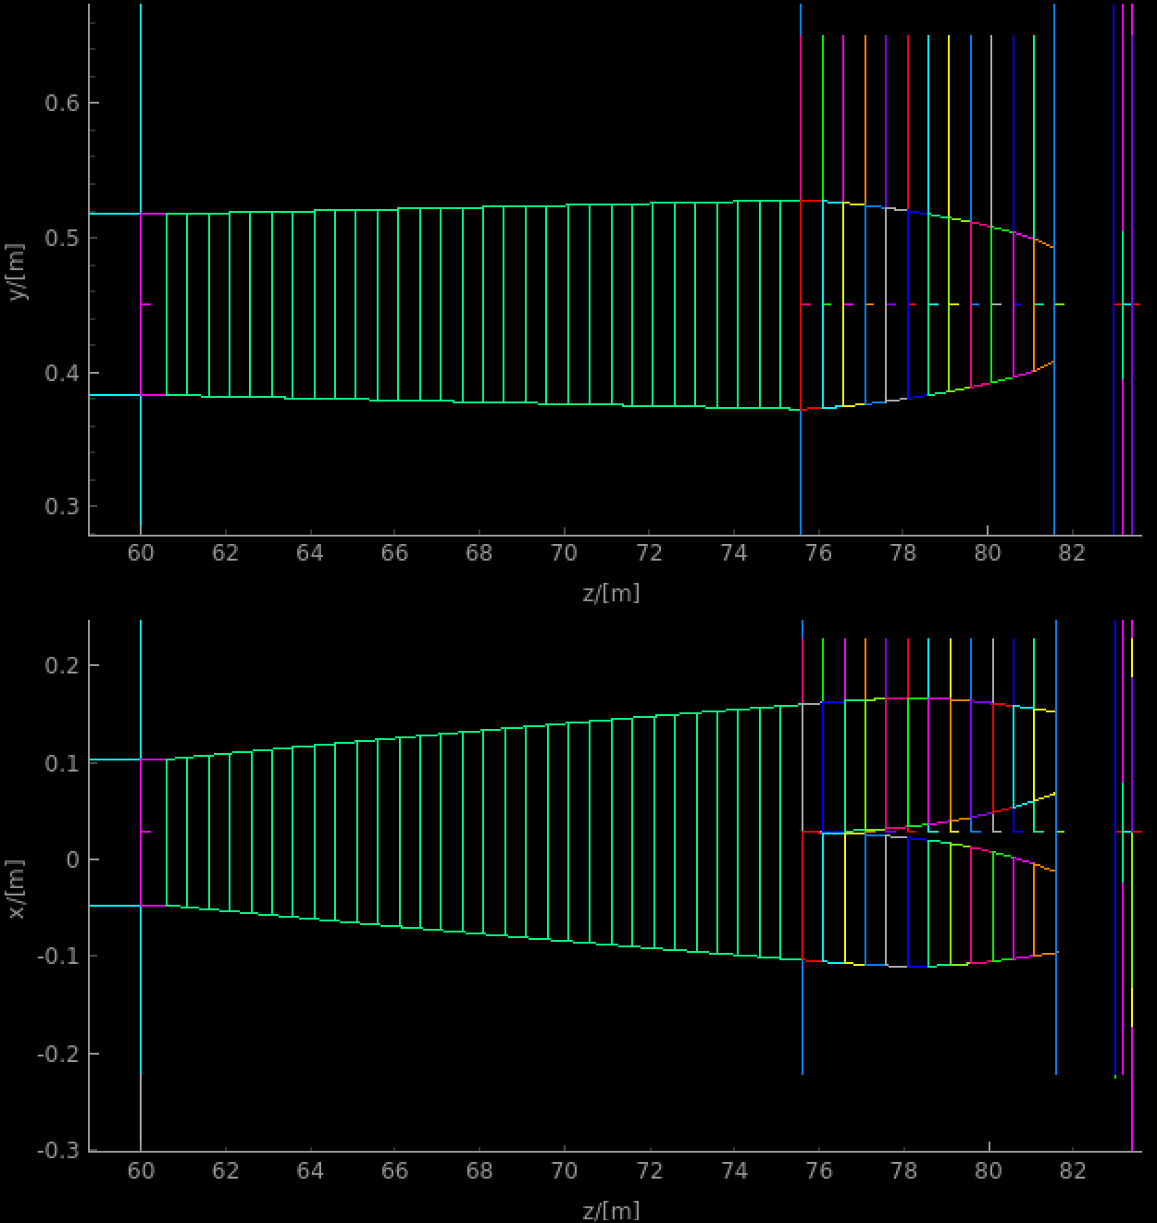
Splitting and focusing
Side veiw
The splitting and focusing part is optimized to give maximal neutron flux at the downstream bottom of the cells
Focusing and defocusing parts are optimized using quadratic surface parameterization and given as off files.
Top view

Slide 9
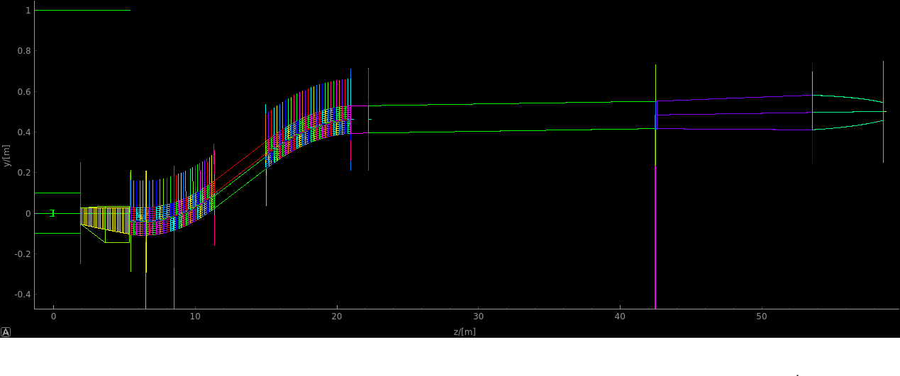
Instrument layout
FOC2
Bunker wall insert
PDC1
FOC1
Monolith
insert
PDC2
PSC
Defocusing
Focusing
splitter
V-cavity
polarizer
The length of the instrument can be varied, depending on the selected position for the second pulse definition chopper which defines resolution.

Slide 10
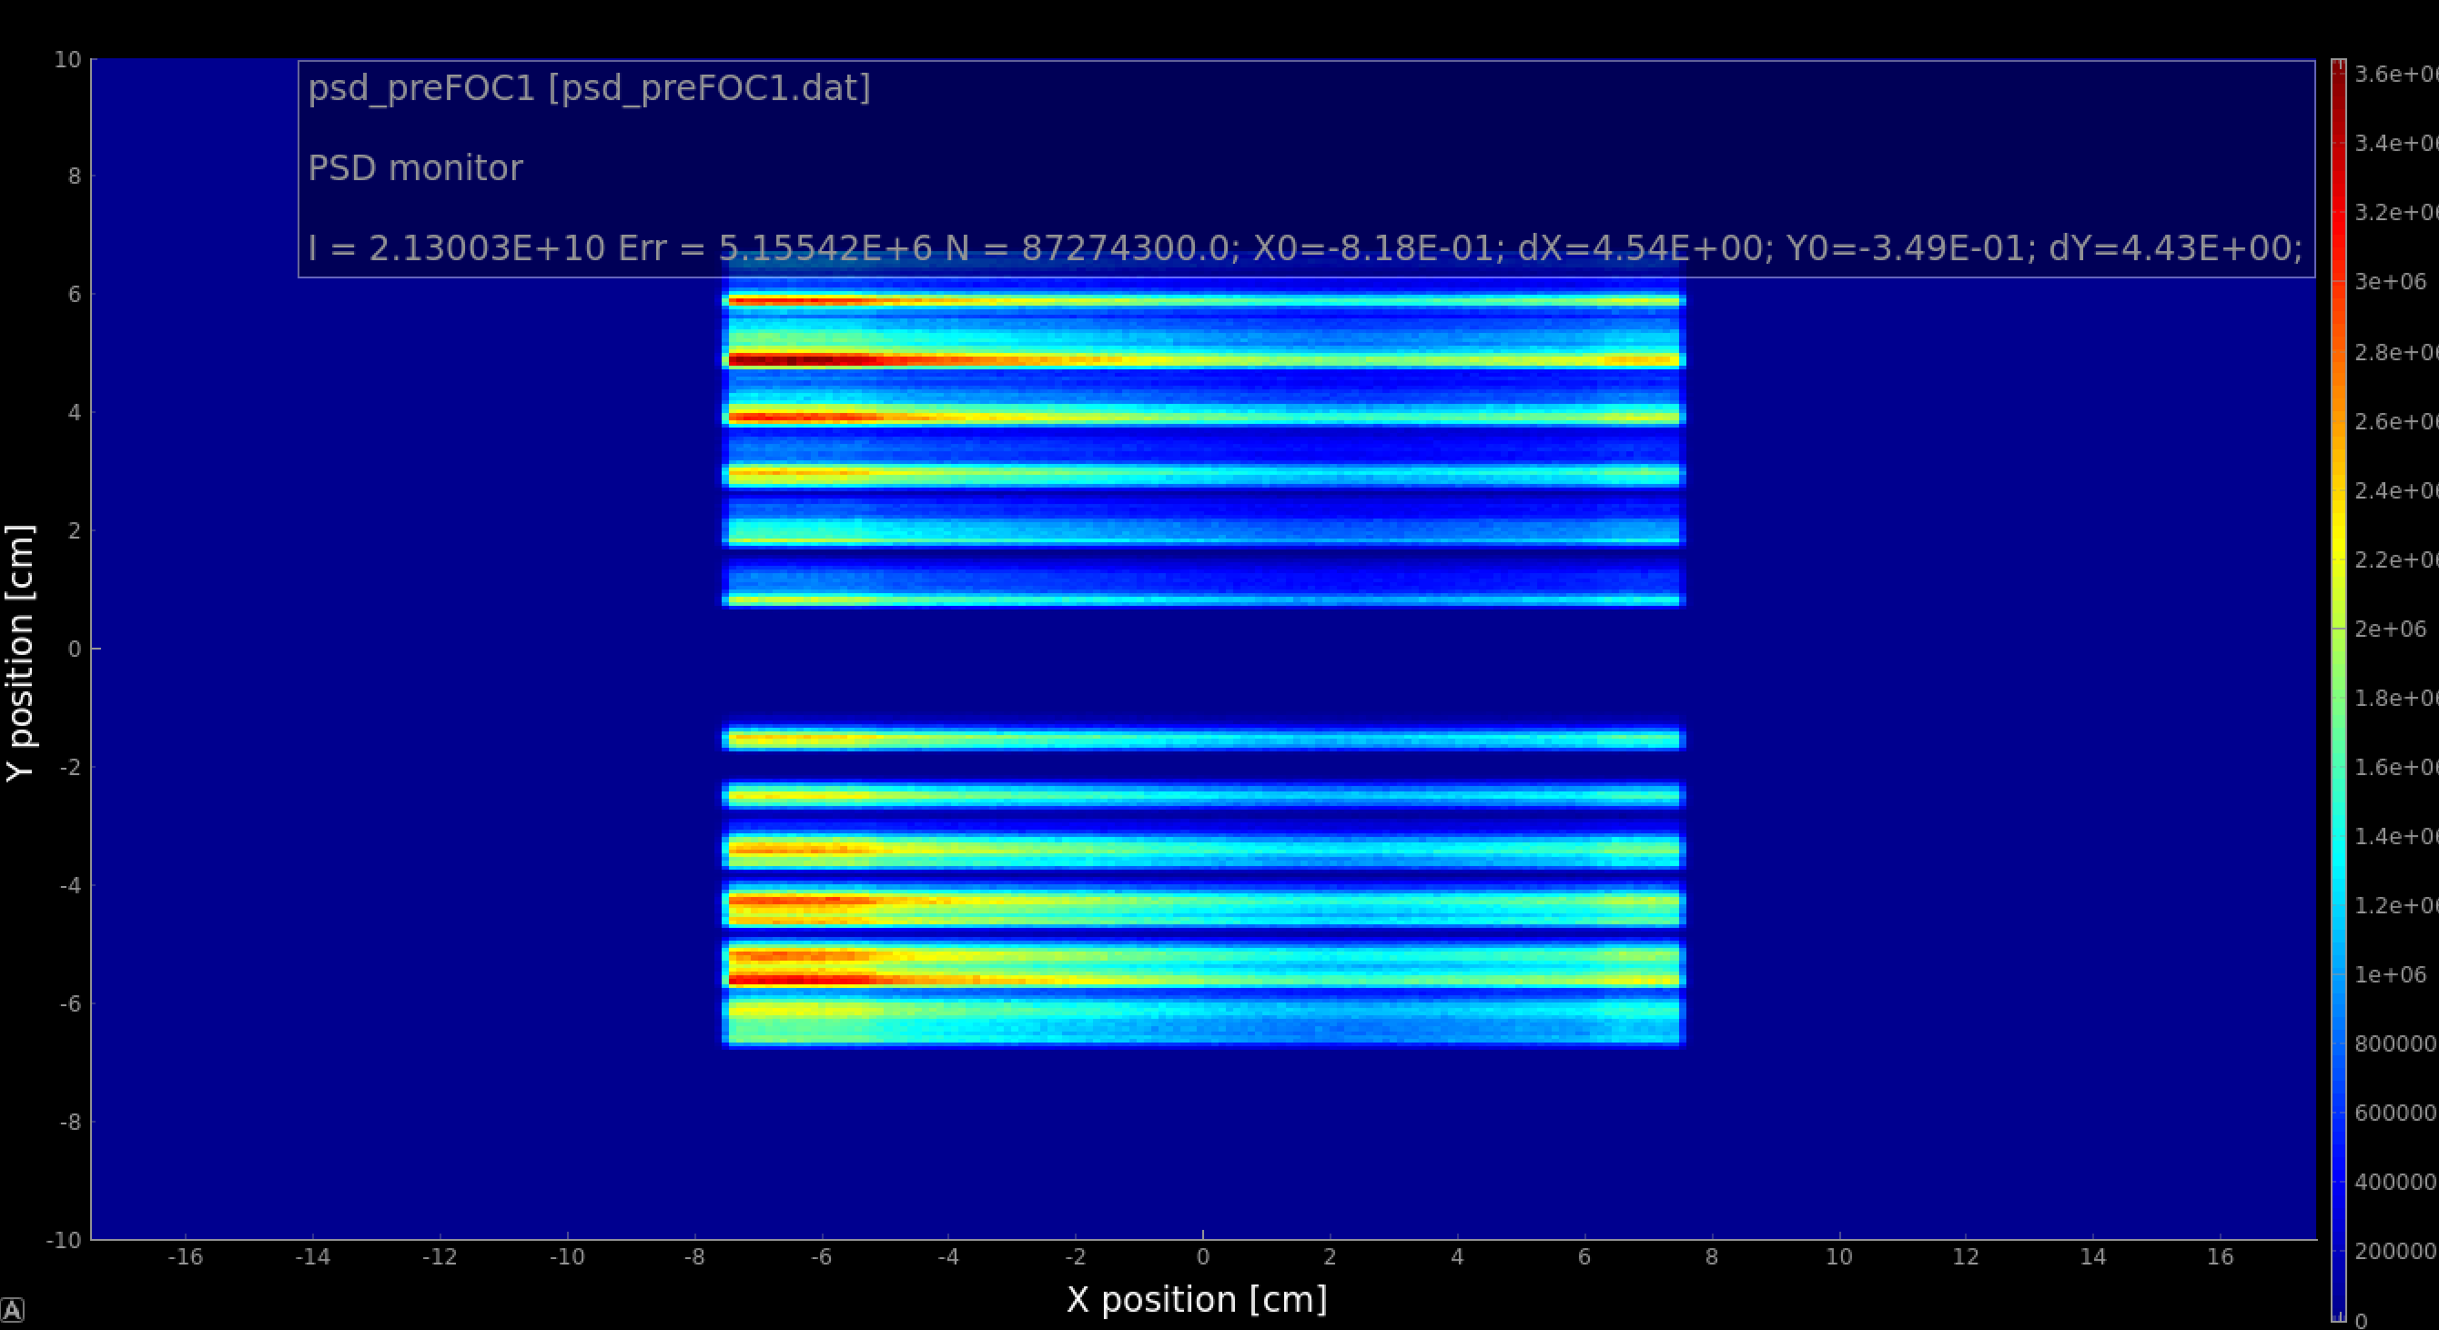
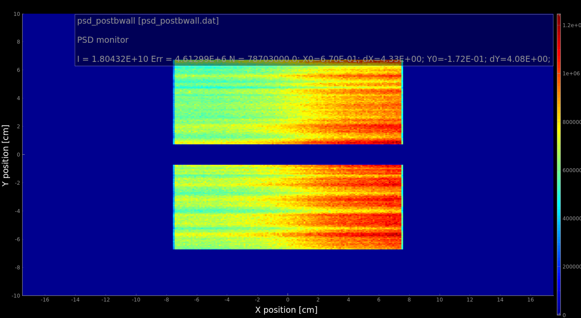
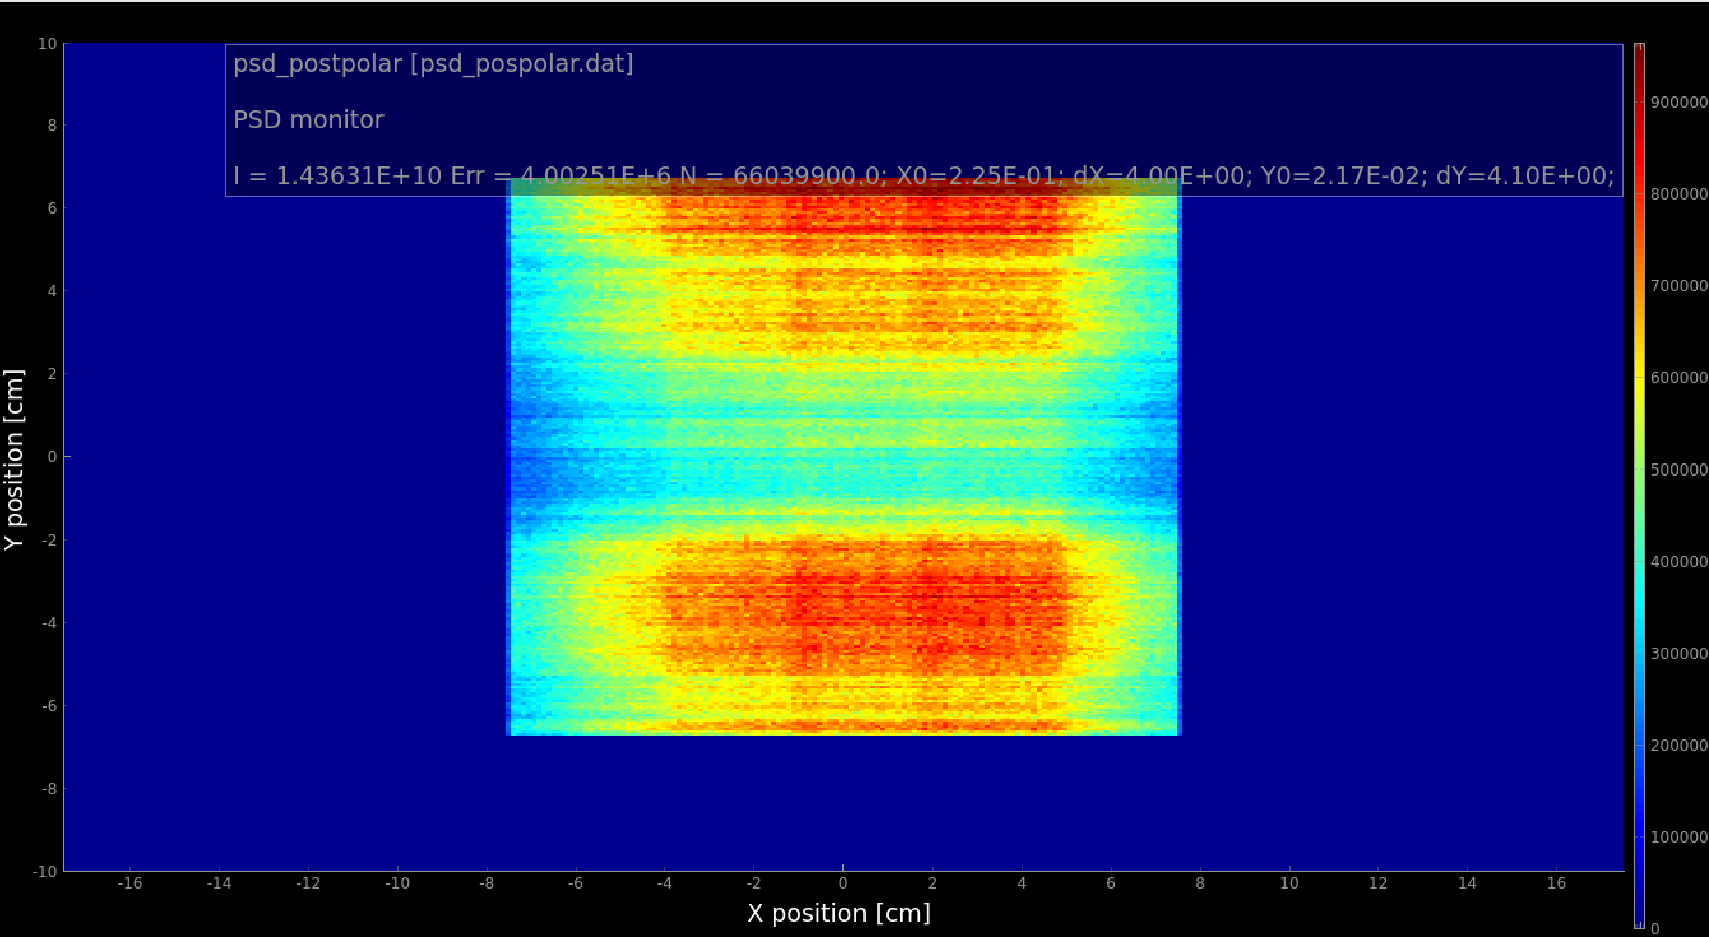
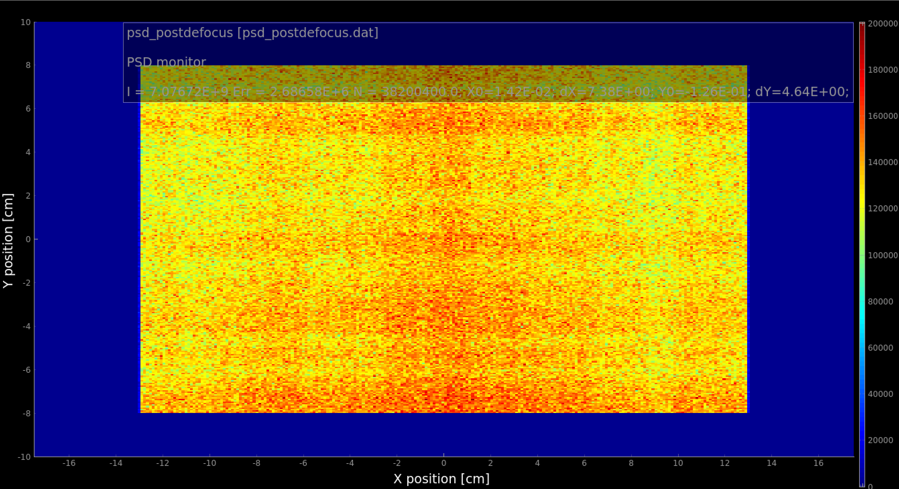
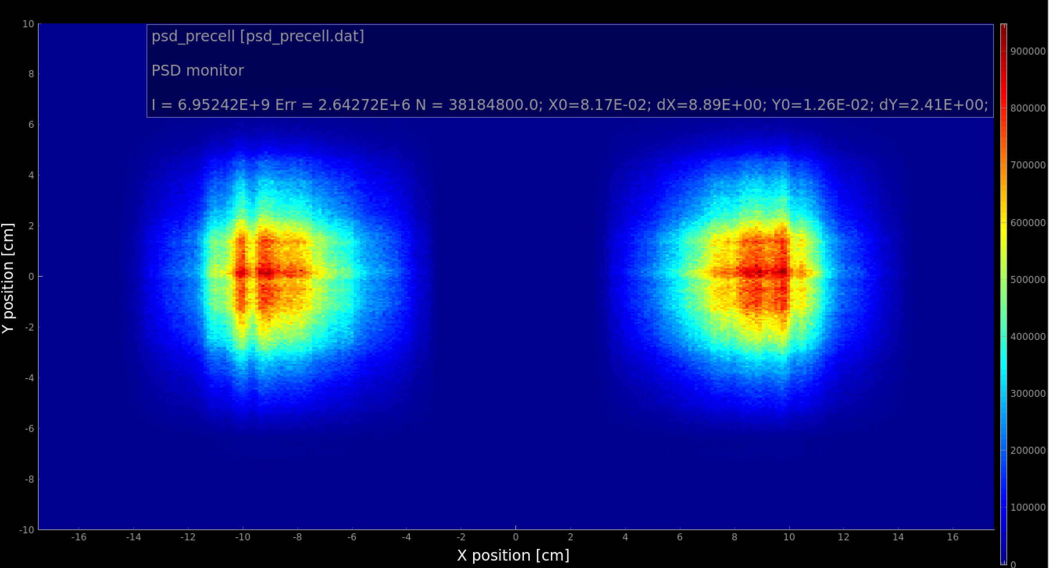
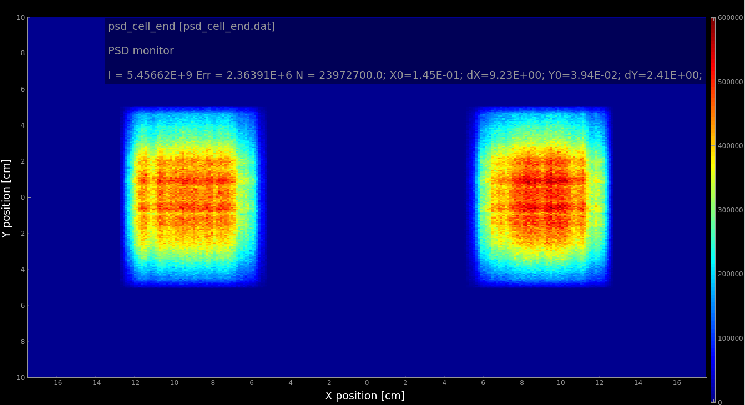
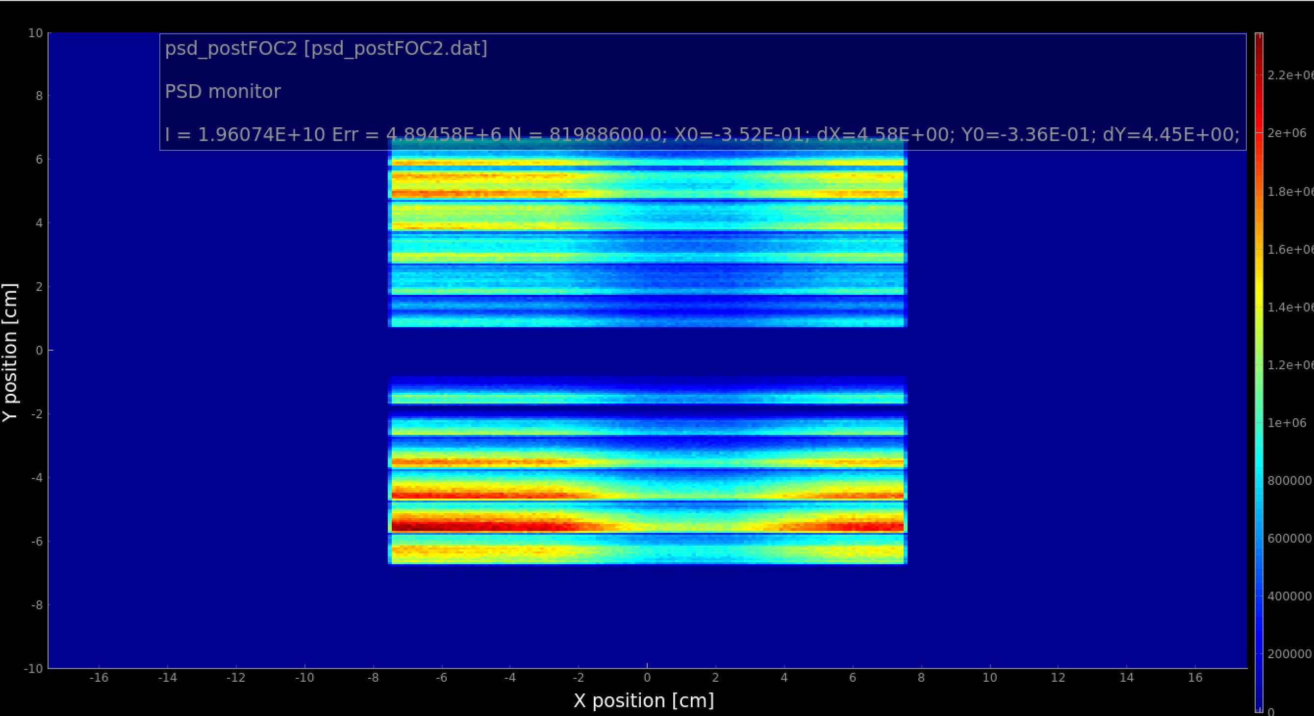
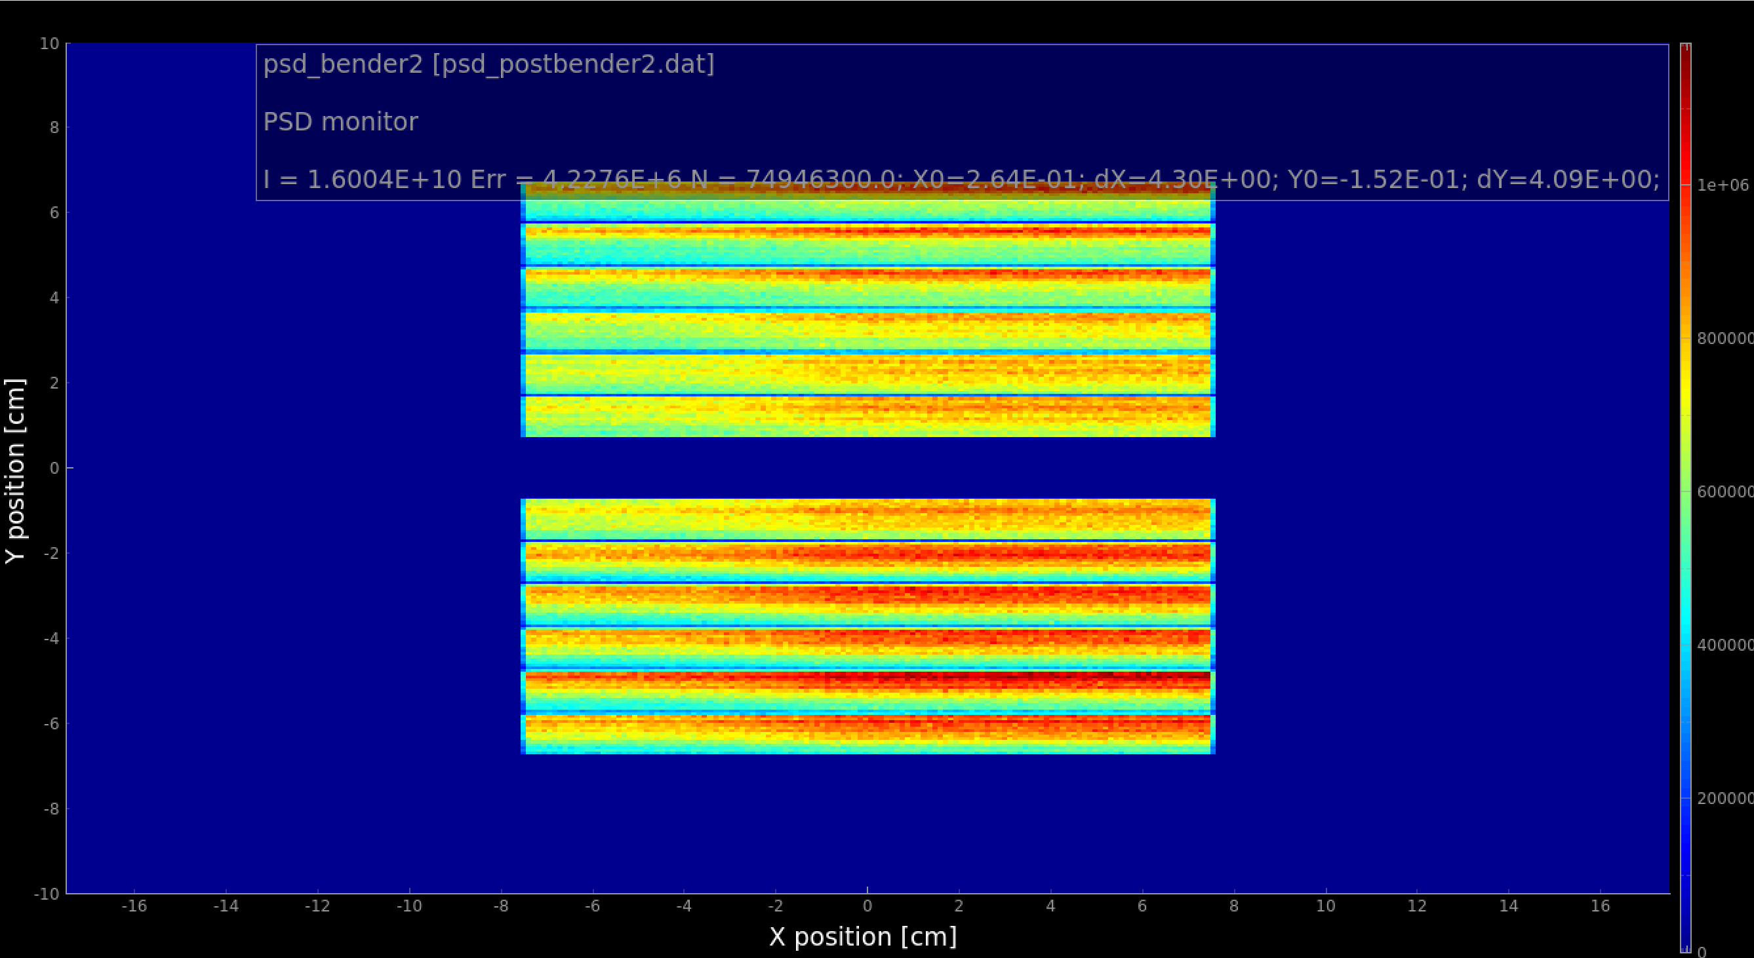
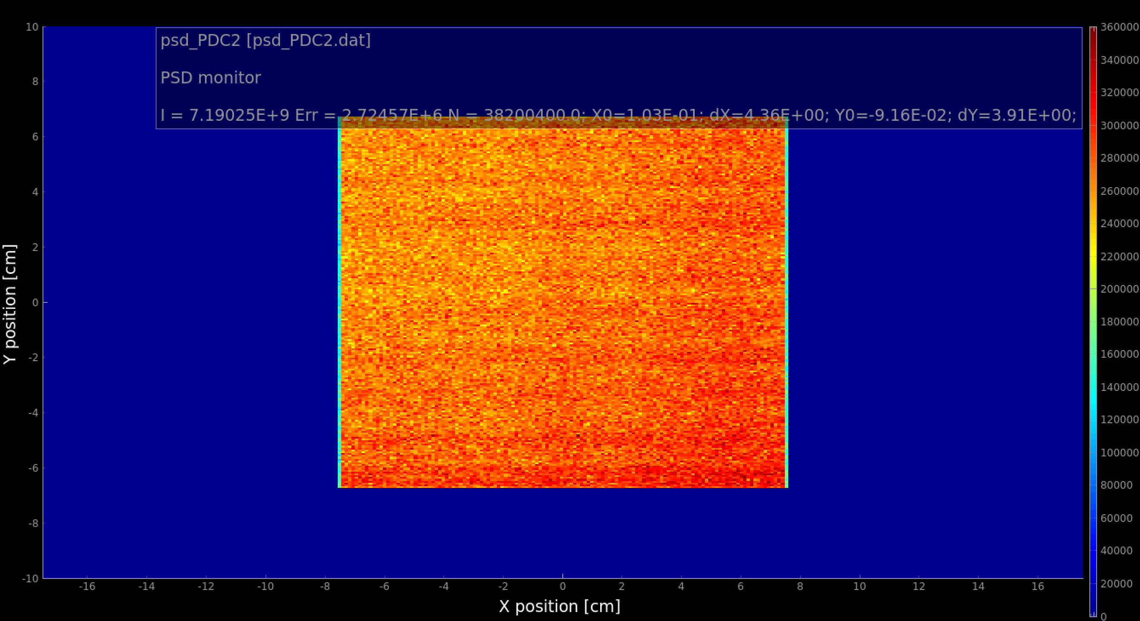
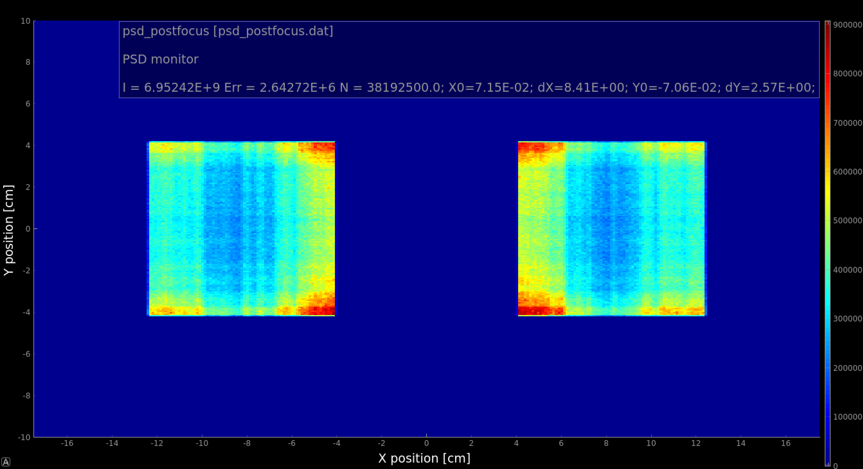
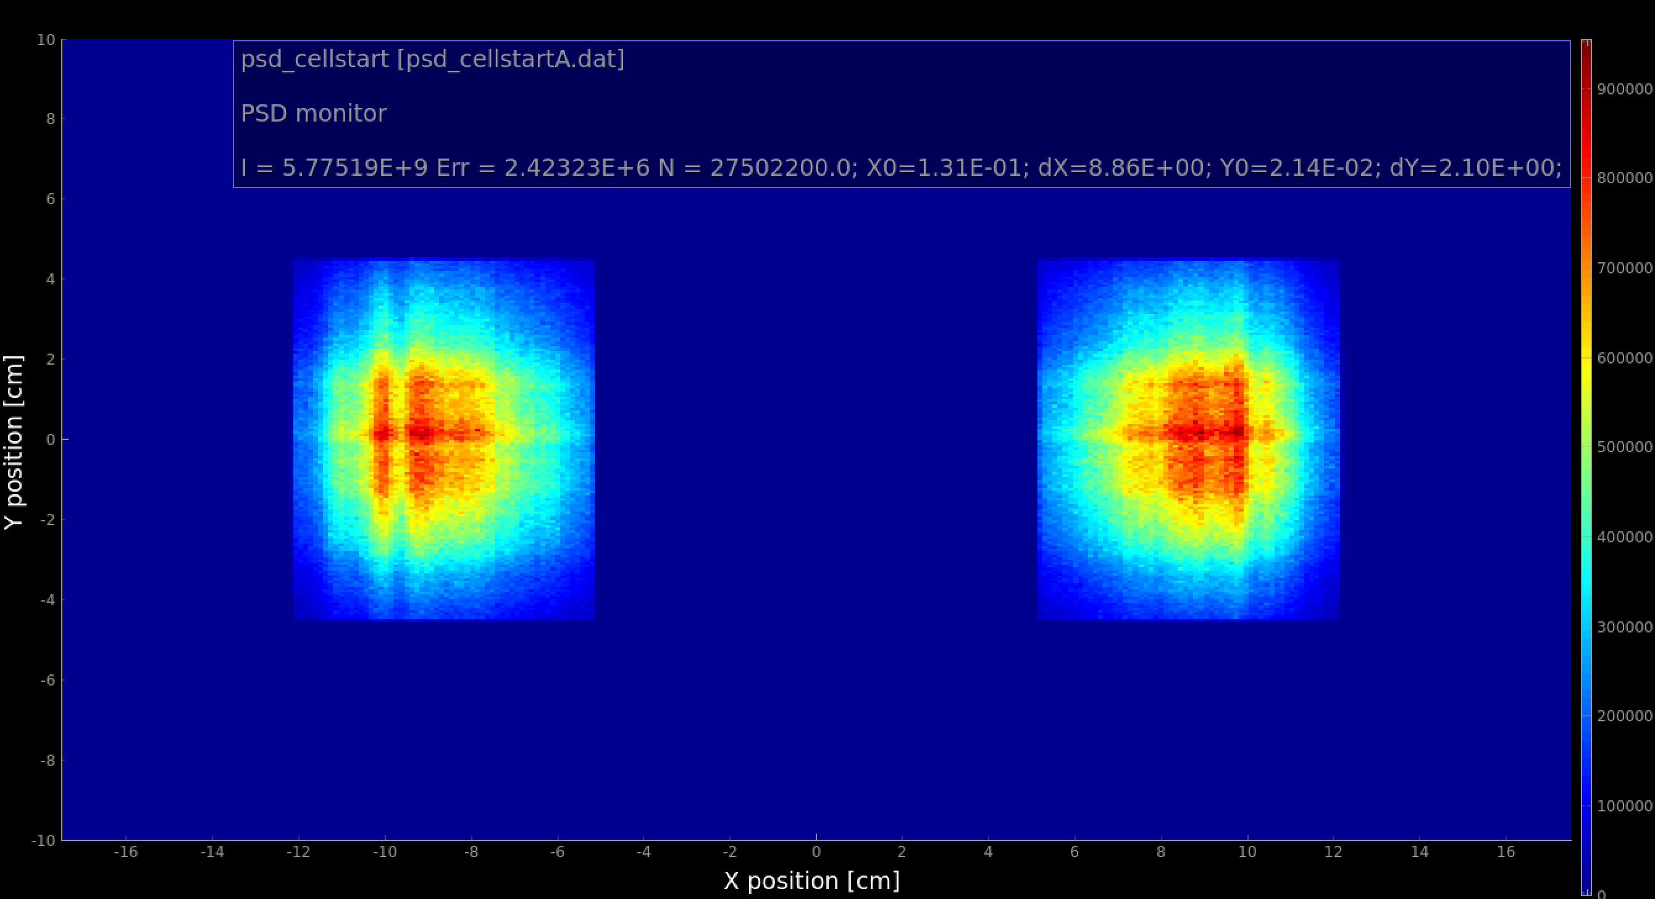
Performance of the neutron optics
Notes:
This is optics performance

Slide 11
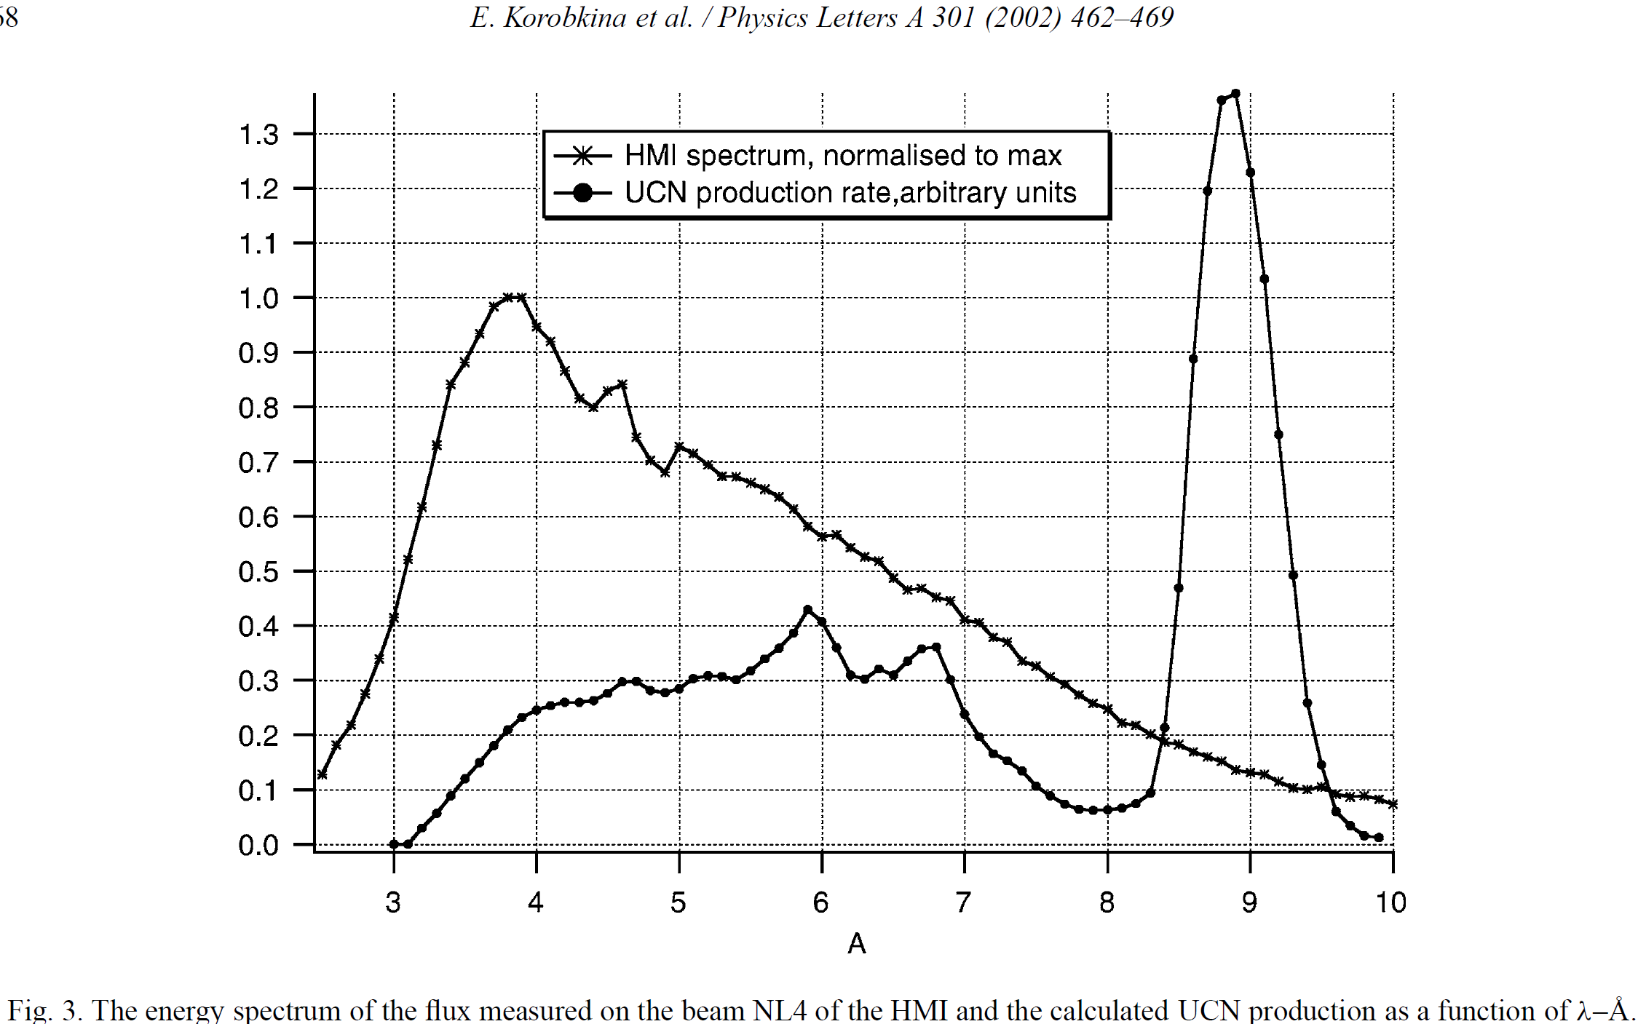
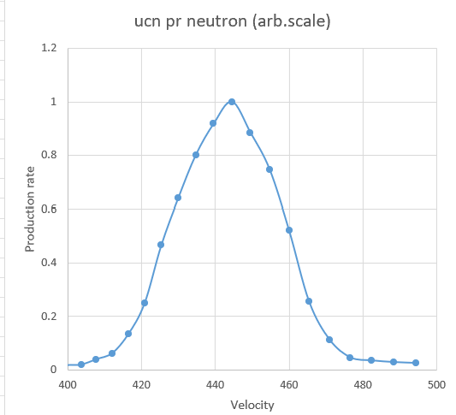
Chopper cascade optimization
λ,AA | Velocity, m/s | UCN per neutron
8 | 494.5 | 3.17E-08
8.1 | 488.3950617 | 3.59E-08
8.2 | 482.4390244 | 4.37E-08
8.3 | 476.626506 | 5.76E-08
8.4 | 470.952381 | 1.41E-07
8.5 | 465.4117647 | 3.2E-07
8.6 | 460 | 6.54E-07
8.7 | 454.7126437 | 9.39E-07
8.8 | 449.5454545 | 1.11E-06
8.9 | 444.494382 | 1.26E-06
9 | 439.5555556 | 1.15E-06
9.1 | 434.7252747 | 1.01E-06
9.2 | 430 | 8.06E-07
9.3 | 425.3763441 | 5.86E-07
9.4 | 420.8510638 | 3.13E-07
9.5 | 416.4210526 | 1.67E-07
9.6 | 412.0833333 | 7.79E-08
9.7 | 407.8350515 | 4.97E-08
9.8 | 403.6734694 | 2.41E-08
9.9 | 399.5959596 | 2.07E-08
Optimization is performed by sampling the pulse definition chopper settings as random variables and calculating UCN production and total neutron transmission

Slide 12
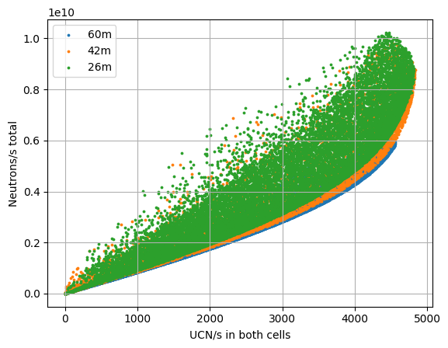
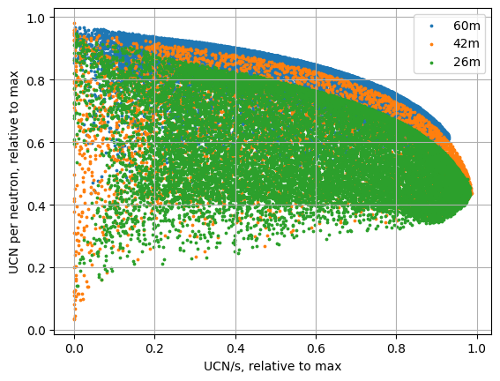
UCN production vs background
Optimization output in absolute (left) and relative (right) units.

Slide 13
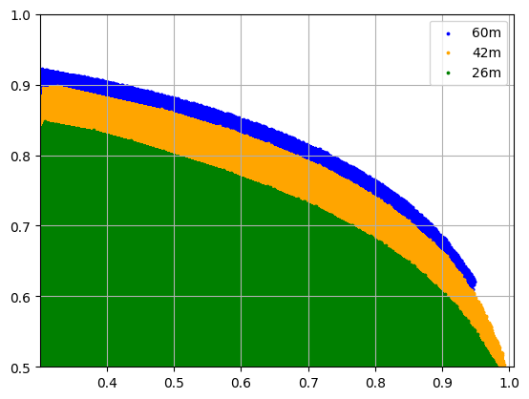
Highlights from optimization
 | PDC2@26m | PDC2@42m | PDC2@60m
Delay 1, s | 0.0015-0.0017 | 0.0013-0.0016 | 0.0015-0.0017
Theta 1, deg | ~106-180 | ~130-300 | ~250-350
Delay 2, s | 0.060 | 0.096 | 0.136
Theta 2, deg | ~120 | ~180 | ~250
UCN production /max | 0.8 | 0.8 | 0.8
UCN conversion/max | 0.67 | 0.73 | 0.76
Selection criteria
above 80% of maximal UCN production rate
Highest possible UCN/neutron

Slide 14
PDC2 position effect: same low background
Chopper settings are selected to provide same ratio of UCN/total neutron in the cells (above 0.85 of max achievable)

Slide 15
PDC2 position effect: same high UCN yield
Chopper settings are selected to provide same UCN yield, ~0.8 of max
For 60m distance PDC2 frequency has to be lowered down to 42Hz (large opening times)
No improvement of signal to background for PDC2@60 meters vs PDC2@42 meters for high UCN yields.

