Slide 2
nEDM STATUS OF THE MECHANICAL DESIGN
HIBEAM/nEDM engineering project kick-off meeting
PRESENTED BY Madalin Alexandru Bartis
Notes:
The current status of the mechanical design for the nEDM project, as part of the nEDM engineering efforts.

Slide 3
Agenda
1 Scope and Deliverables of the design
2 nEDM CAD Overall Dimensions
3 nEDM CAD Updates
4 What are the next steps

Slide 4
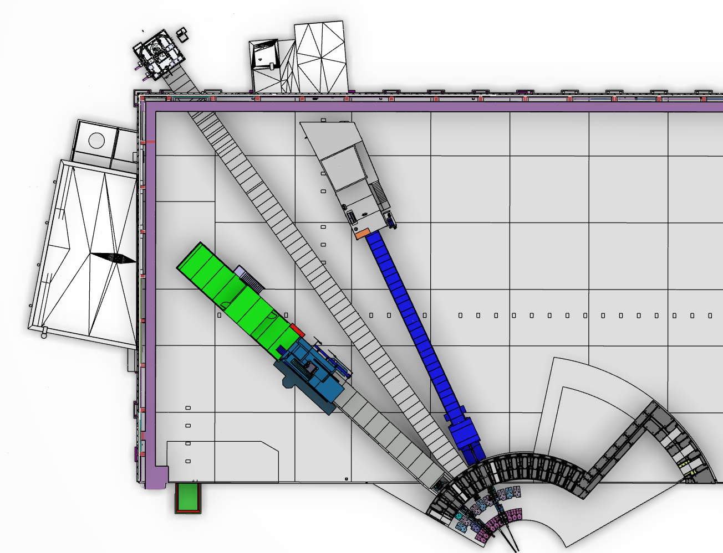
Scope and Deliverables of the design
The position of nEDM Instrument is on E5.
E5
E7
nEDM
E3
VESPA
SKADI
SKADI
Notes:
Status of the mechanical design for the nEDM project, as part of the nEDM engineering efforts

Slide 5
nEDM positioning

Slide 6
nEDM Overall CAD Dimensions
Bunker wall edge
Moderator
nEDM
nEDM shielding
85 m (from the Moderator to the Annihilation Target)
Notes:
sUp from 5.5 m from TCS we have the monolith insert / from 5.5 to 6 the bridge beam guide / bunker area
Target monolith starts at 2m from the ESS moderator

Slide 7
Overview of D03
nEDM – Port E5
VESPA – Port E7
SKADI – Port E3

Slide 8
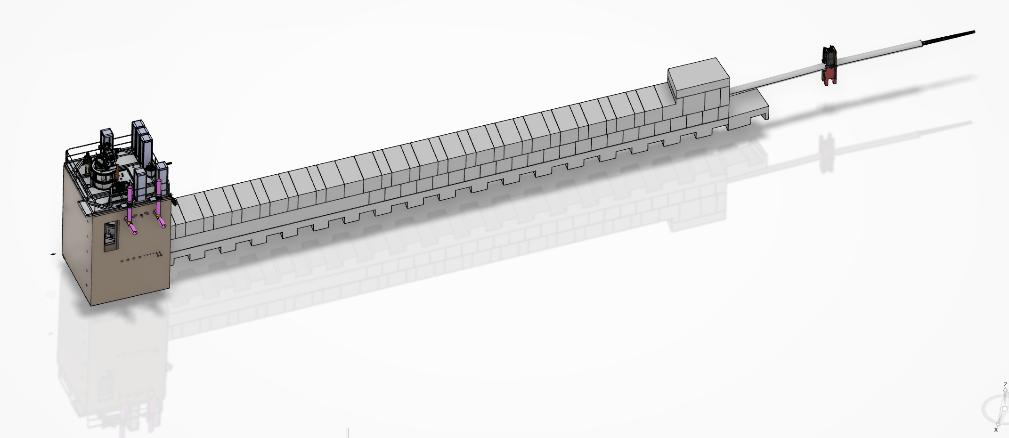
HIBEAM CAD Updates
nEDM Placeholder Shielding
nEDM
Neutron guides
Heavy shutter

Slide 9
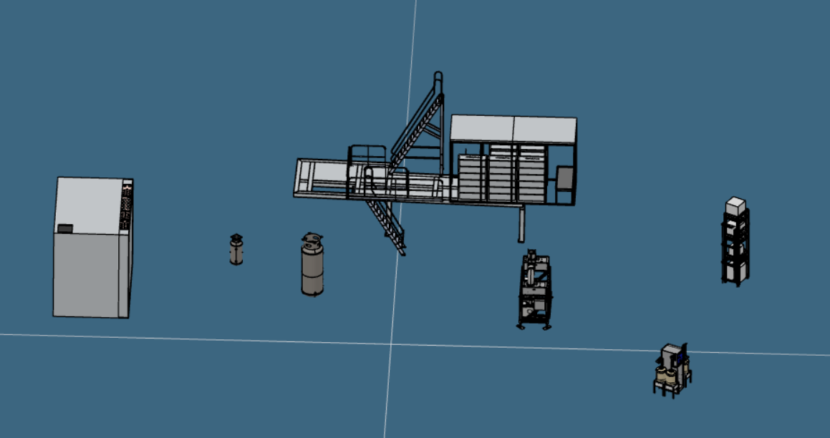
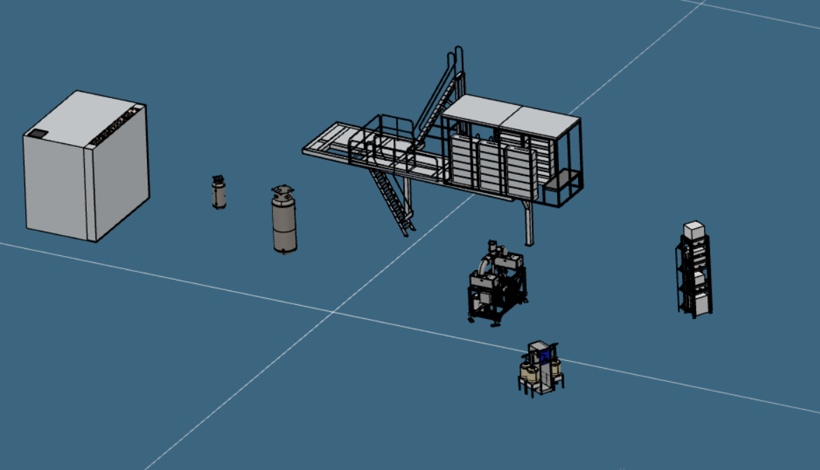
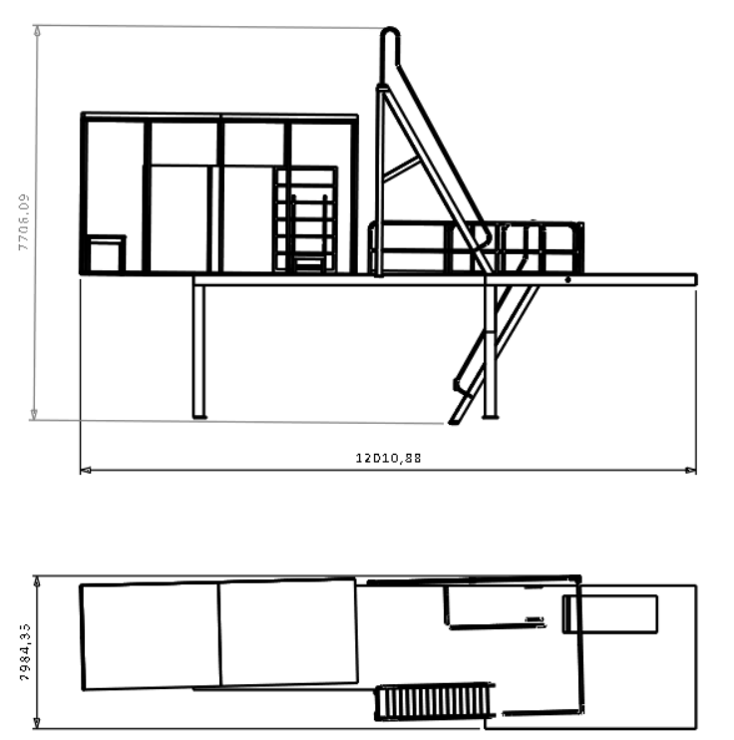
Next Steps
Engineering activities: 1. Our next steps on the engineering side include adding the necessary infrastructure into the model—this includes service lines, supports, and auxiliary systems.

Slide 10
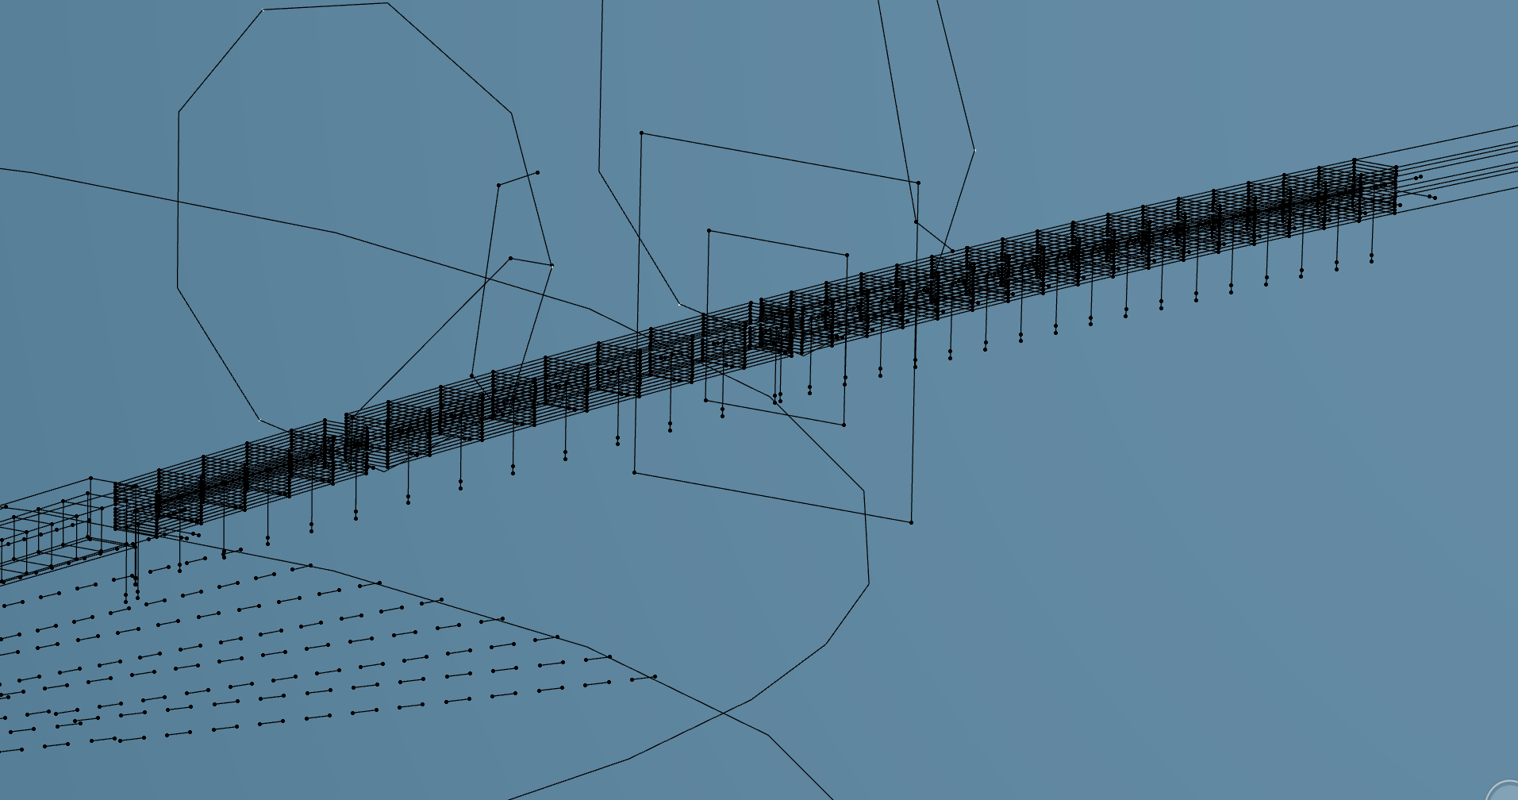
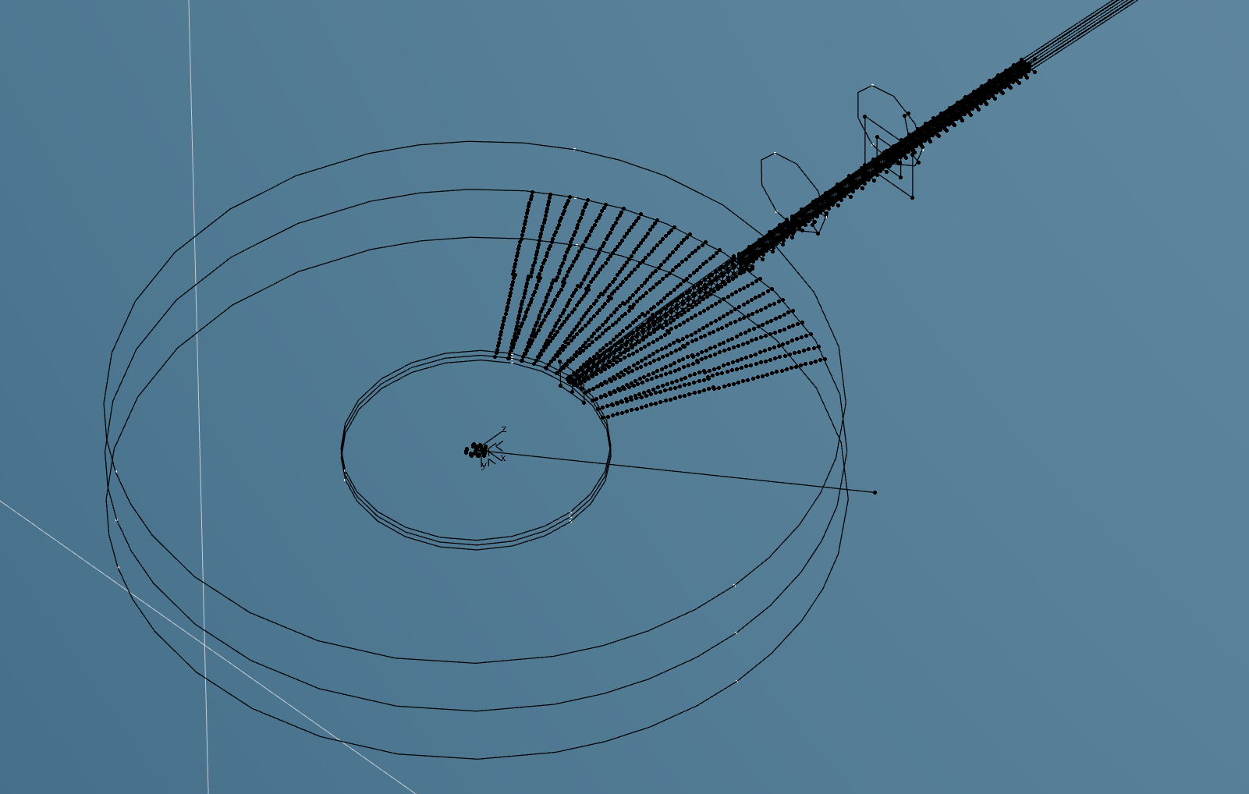
Next Steps
Engineering activities:
2. nEDM guide design has now been finalized and will soon be integrated into the CAD model.

Slide 11
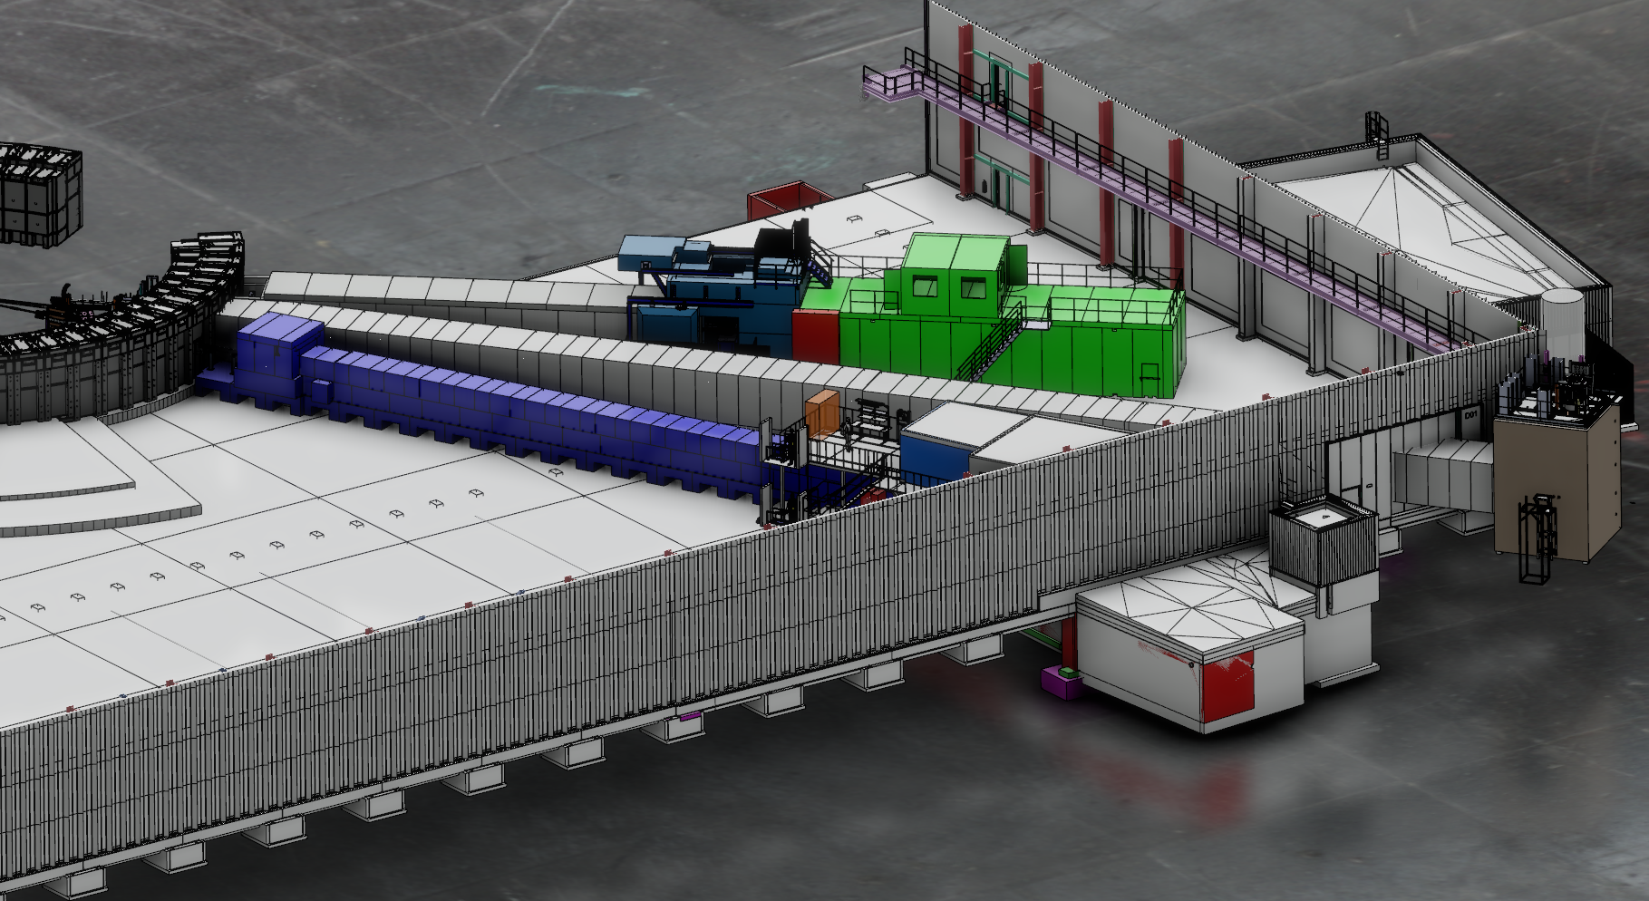
Questions:
Infrastructure 3D Models: Where will the auxiliary infrastructure 3D items be located in the main CAD model?
Layout Review Meeting: Can we schedule a longer meeting to go through the entire layout of the nEDM system in detail?

Slide 12
Thank you for your attention.

