Slide 1




Single-crystal orientation terminal for NTDS
China Spallation Neutron Source
Neutron Technology Development Team
Presenter: Yuhua Ma
mayuhuaw2016@foxmail.com

Slide 2
Outline
Research Background
Physical Design
Summary and Outlook

Slide 3
Research Background
Spectrometer Requirements
Main functions
Reciprocal vector and direction
Check single crystal quality
Single crystal directional cutting
Single crystal property/scattering test under special environment
Future developments (Laue lines, single-crystal stress, etc.)
Existing design meets
(1) High-energy inelastic spectrometer: 2026
(2) Polarized inelastic spectrometer: 2029
(3) Cold neutron direct geometric inelastic spectrometer: 2029
(4) Elastic diffuse neutron spectrometer: 2029
(5) Single-crystal neutron diffraction spectrometer: 2029
1
2
3
4
Future Expansion
Testing conditions met: First half of 2026
5

Slide 4
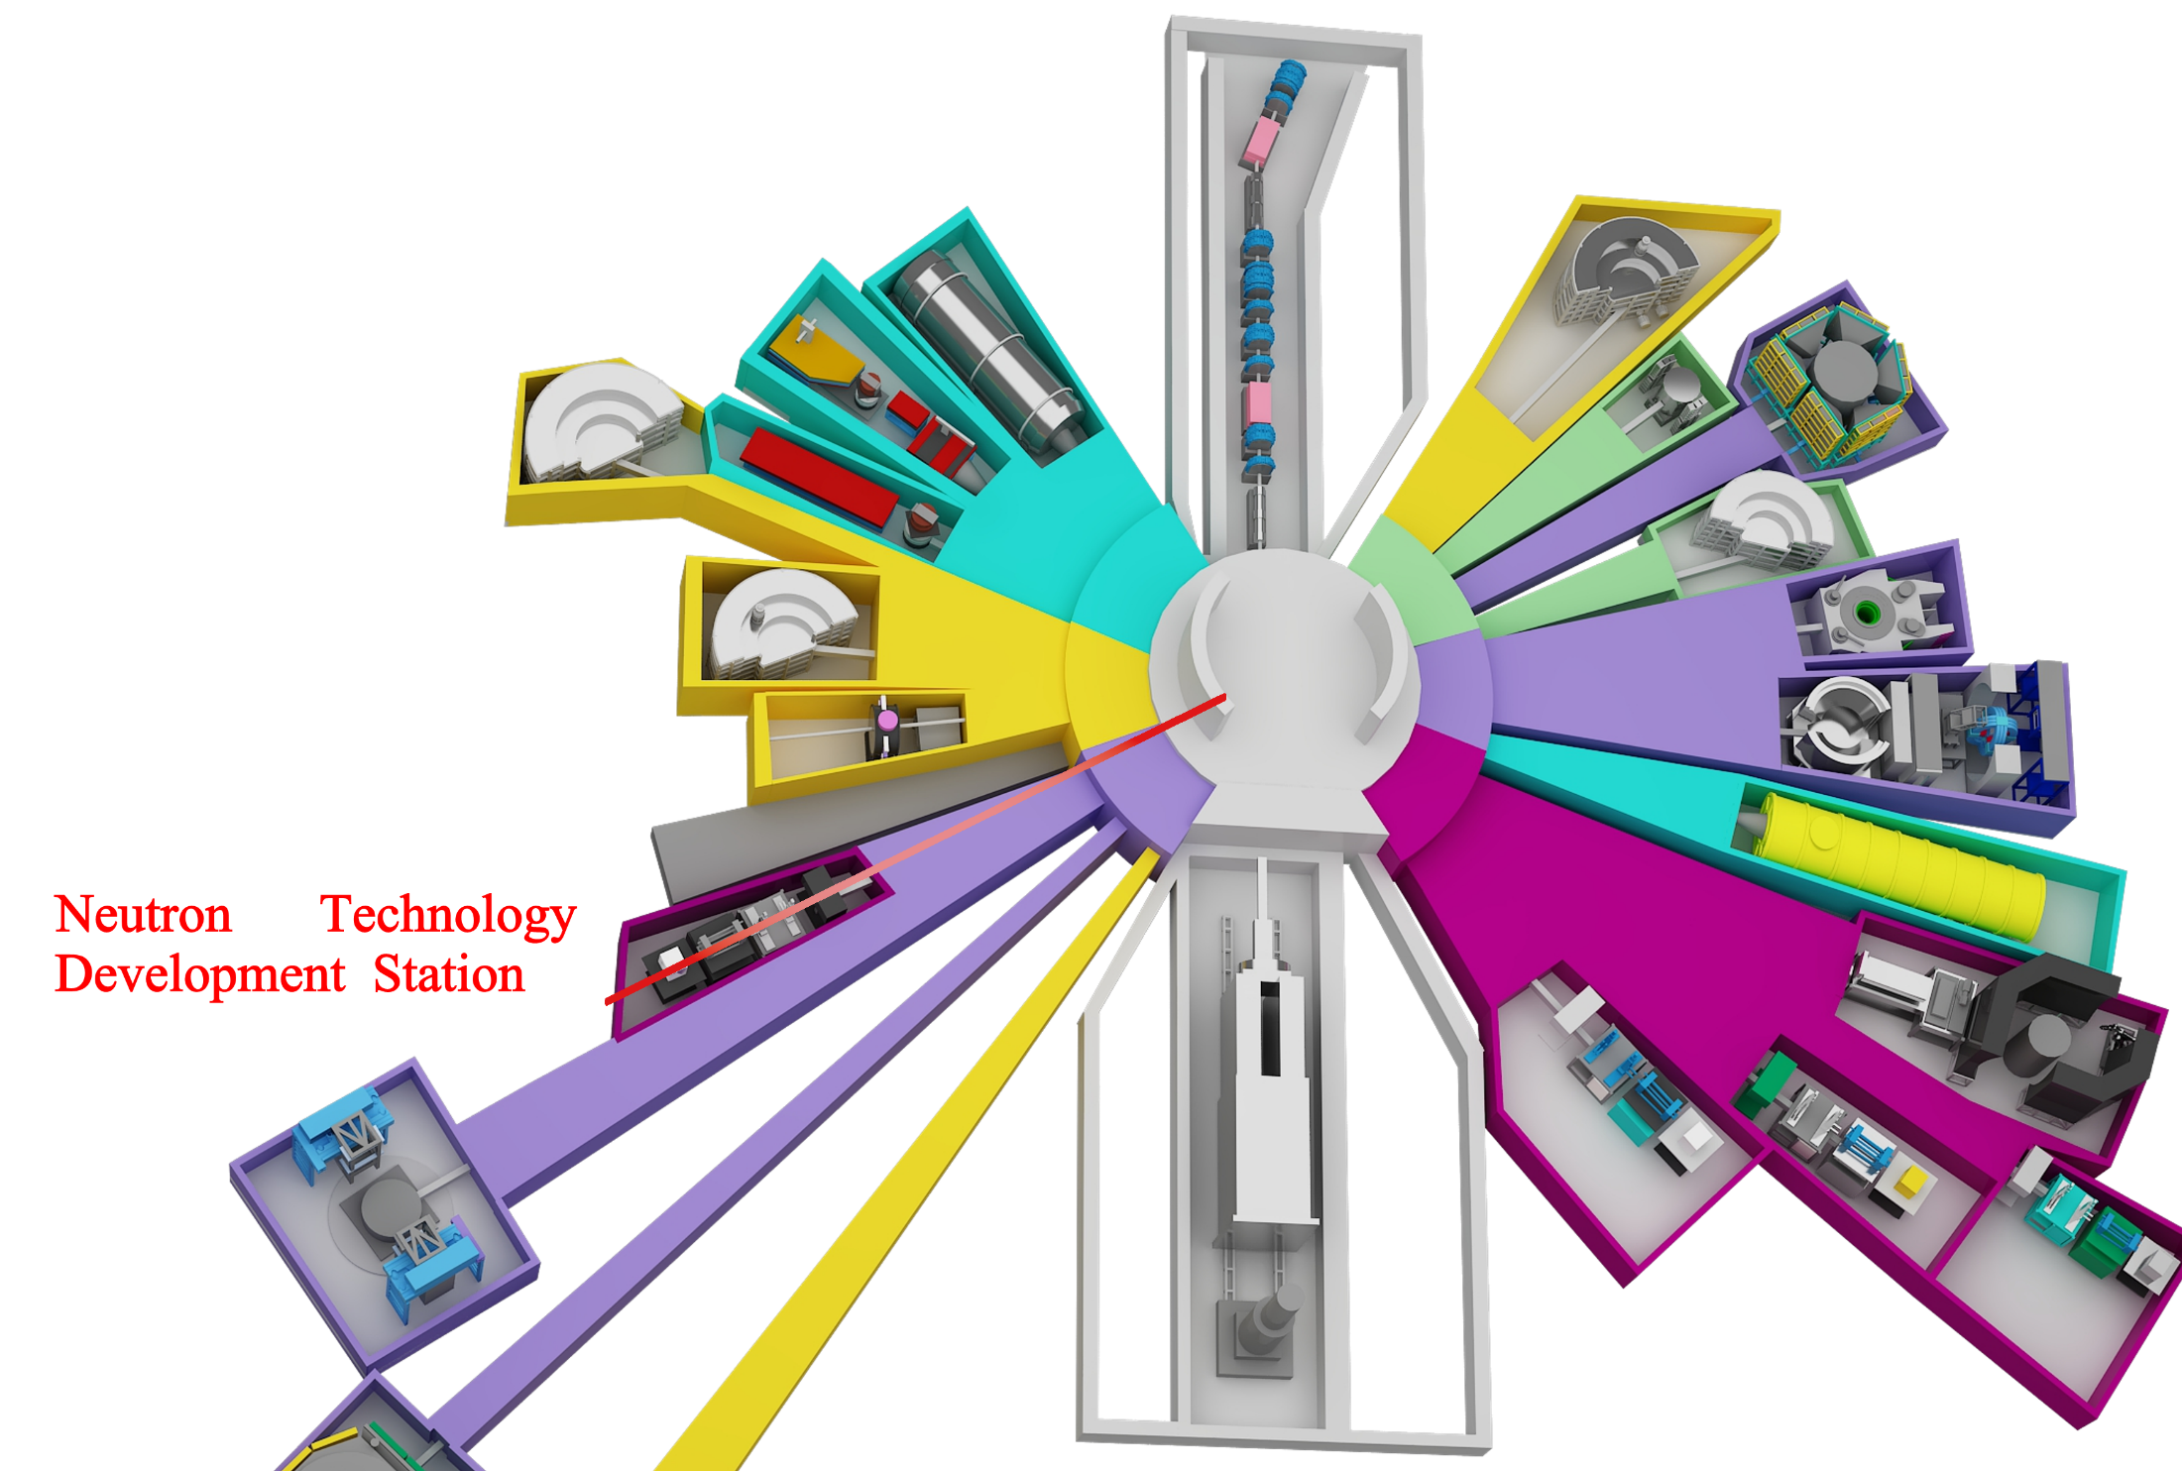
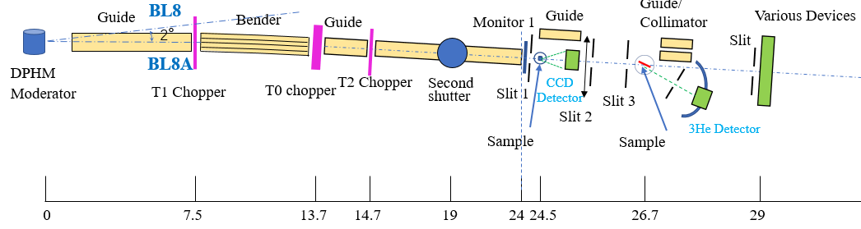
Physical Design
Device Overview
Physical Design
Detection System
single crystal orientation neutron imaging device
The device is located at Beam Line 8A of the CSNS.
Key Components：
Decoupled and Poisoned Hydrogen Moderator
Chopper assembly
Bent guide and straight guide
Beam spot size control
Beamline Characteristics:
Cold neutron energy region(1~100meV)
Adjustable energy spectrum
Low divergence(FWHM=±0.405°)
Time-of-flight (TOF) type
Terminal 1
Single-crystal orientation

Slide 5
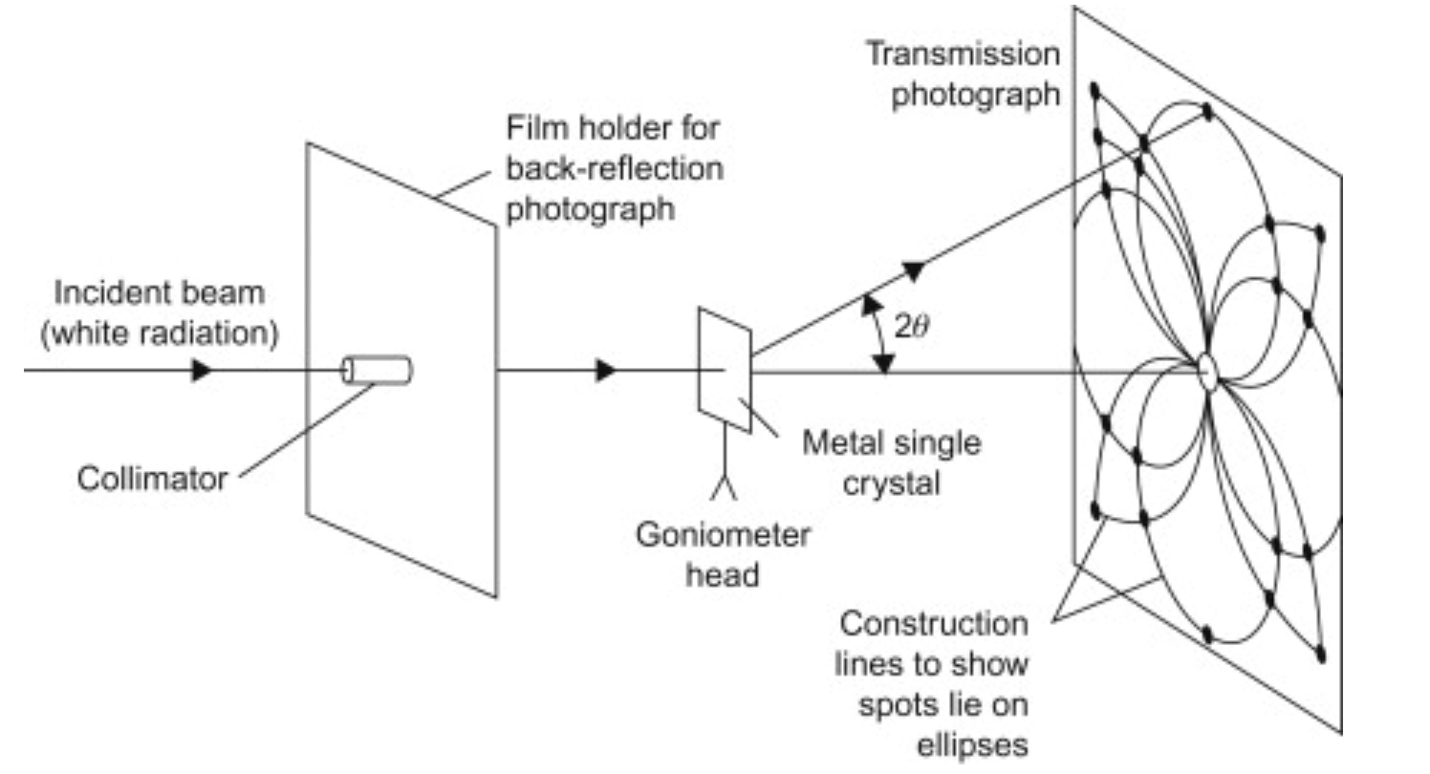
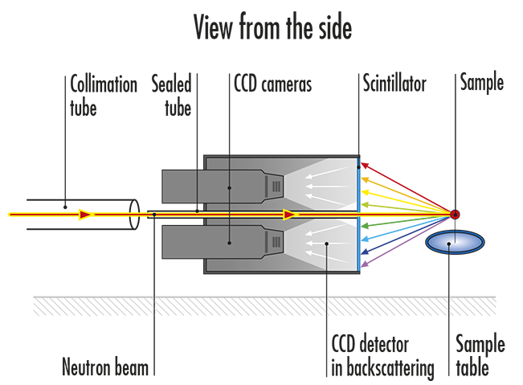
Physical Design
Device Overview
Physical Design
Detection System
Overall Physical Design
Design Specifications
Wavelength Range | 1.5~6.5Å
Orientation Accuracy | ＜0.5°
Detector | Coverage angle: 20°~60°; Spatial resolution: < 200 μm
Scattering geometry
Mode | Diffraction Pattern | Beam Spot | Detector | Q Range | Count | Summary
Back scattering | Hyperbolas or straight lines, similar to X-rays | Not adjustable | Central hole required, complex structure | High | Low | Advantages: Simple analysis, high resolution; Disadvantages: Increased cost due to detector hole; beam spot size limited
Forward scattering | Ellipses or parabolas, different from X-rays | 0.1~25 mm | Simple structure | Low | High | Advantages: Simple detector structure, adjustable beam spot; Disadvantages: Significant sample absorption
Incident mode selection forward scattering geometry

Slide 6
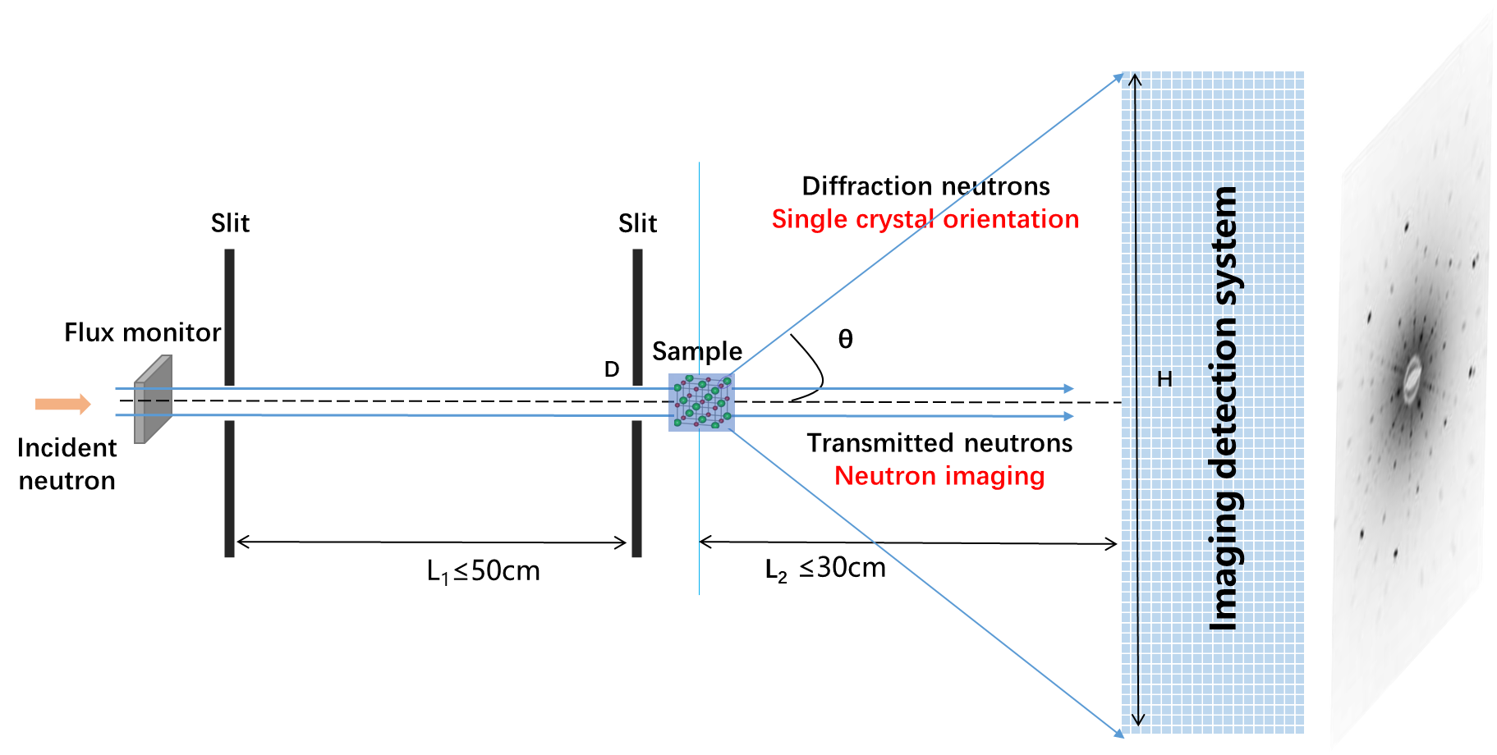
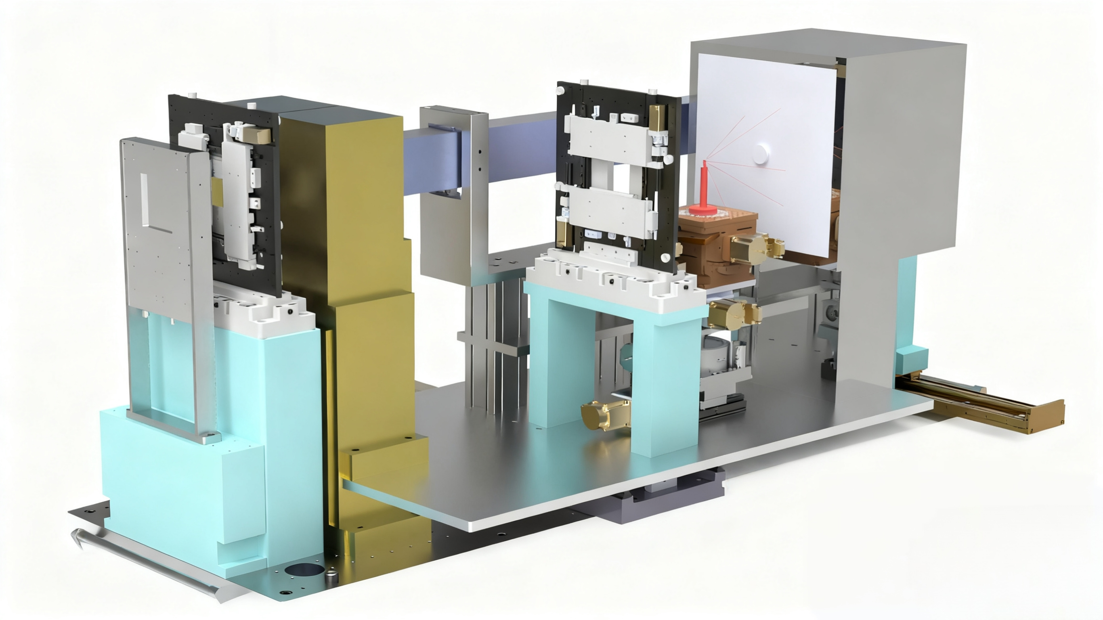
Physical Design
Device Overview
Physical Design
Detection System
Physical Design
Scintillator screen CCD-based neutron imaging detection
Continuous wavelength beam irradiation
Adjustable beam spot size
Adjustable diffraction angle coverage
Realize Laue diffraction and neutron imaging simultaneously
L/D: 0~500

Slide 7
Physical Design
Device Overview
Physical Design
Detection System
Experimental Procedure
Experiment Switching and Preparation
Measurement of initial diffraction
Manual Orientation
Electric Orientation
Experiment ended
Return the sample stage to original position, manually adjust the sample holder, and repeat the adjustment until the center of the diffraction spot is found when the sample stage is in its initial position.
Check equipment status, set chopper, slit, etc.
Adjust sample holder position for rough positioning.
Initiating the experiment;
Laue diffraction
Calculate the diffraction center, adjust the sample stage, and record the rotation direction and angle.
Remove the sample holder (containing the sample).
Test complete.
Beam Shutter close
Beam Shutter open
Beam Shutter open/close
Beam Shutter close

Slide 8
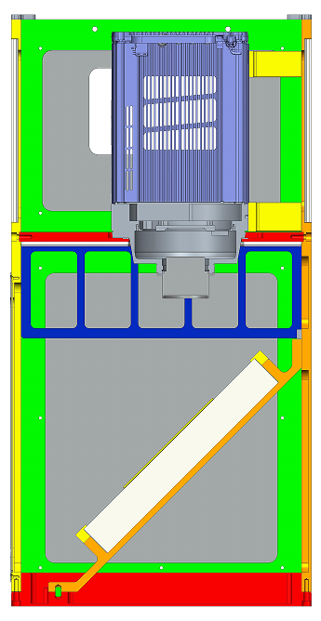
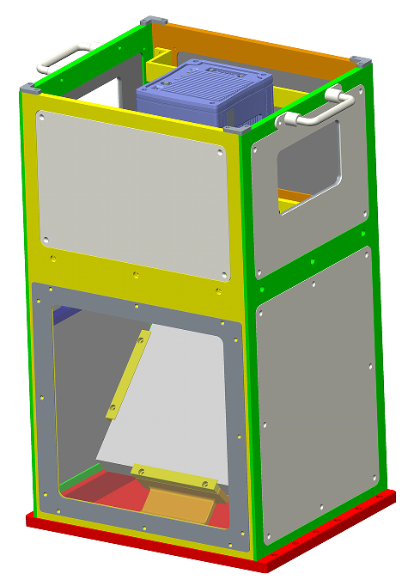
Physical Design
Device Overview
Physical Design
Detection System
Detection System
Overall Design
Shielding and Light Avoidance
Neutron and gamma shielding
Boron-aluminum alloy、 Lead
Key Specifications:
FOV: 22cm × 22cm
Spatial Resolution: < 200um
Light avoidance
Camera sealing ring
614mm
Darkbox sealing plate step design
380mm
311mm

Slide 9
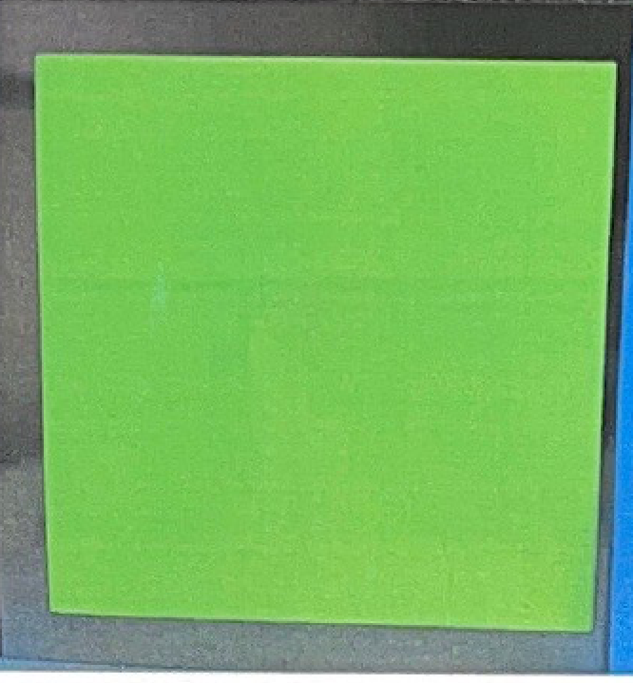
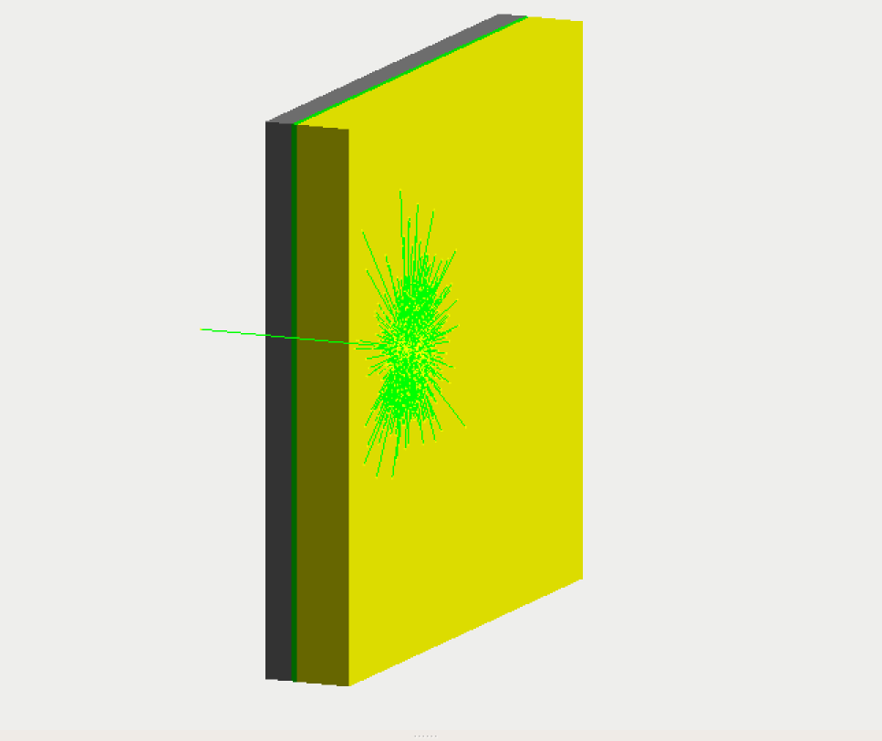
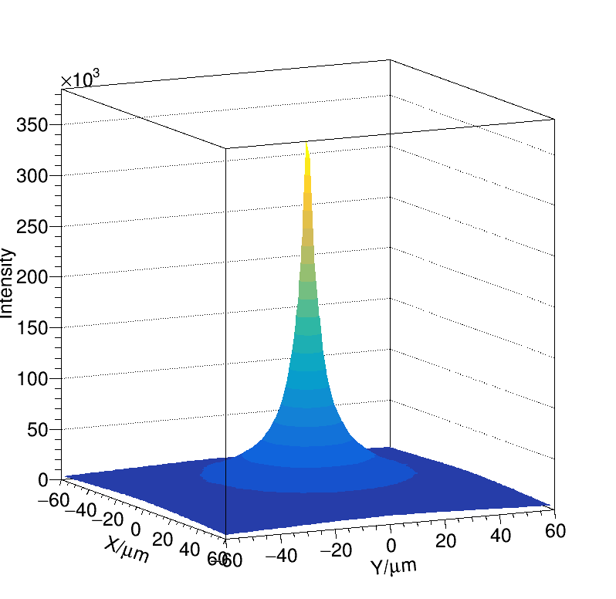
Physical Design
Device Overview
Physical Design
Detection System
Neutron Scintillator Screen
⁶LiF/ZnS(Cu)—high light output (~10000 photons/n), good uniformity, stable performance; size and spatial resolution meet design requirements
Main parameters: 220 mm×220 mm, thickness 100 μm, ⁶LiF/ZnS (1:2), emission wavelength 530 nm (green light)
Substrate
Detection surface
Geant4 simulation:
screen thickness 100 μm
beam spot size σ = 54 μm
Incident
nutron
Flashing fluorescence
CCD Camera
Scintillator
Camera Model | Pixel Size | Readout Noise | Dark Current Noise | Readout Rate | ADC bit | Quantum Efficiency@530nm
PI SOPHIA 2048B | 2048x2048x15μm | 3.5 e-@200kHz | 0.00025 e-/p/s | 0.9 fps | 16 | >90%

Slide 10
Outlook: Facility Planning and Scientific Application
1
Implementation scheme design
A scheme for measuring the orientation of single crystals using Laue diffraction experiments was proposed, and the complete physical design of the neutron detector was completed.
It is expected to be completed by the end of 2026. Upon completion, it will enable the measurement of the microstructure of single crystals, support the development of other spectrometers, and provide a key means to reveal the mechanisms of matter evolution.
2
Scientific objective
Dedicated to the research of single-crystal orientation and neutron imaging methodologies and experimental techniques, this research aims to achieve the correlation measurement of material microstructure and macroscopic morphology, providing a research platform for revealing the service and evolution mechanisms of materials under extreme conditions.
3
Construction Planning
Laue diffraction spectrum indexing and crystal rotation calibration;
Development of NTDS single-crystal orientation data processing software;
Development of automated experimental techniques, including automatic crystal rotation and automatic measurement of diffraction spots.

Slide 11
THANKS
Please offer your comments and corrections!
Welcome to apply for using beams and for cooperation!

