Slide 1




The Progress of the Multi-Physics Instrument at CSNS
Huaican Chen
On behalf of MPI group
Institute of High Energy Physics of Chinese Academy of Sciences
International Collaboration on Advanced Neutron Sources XXV, Sweden, 2026
Notes:
Good afternoon, everyone.
I'm Hui Chen Chen come from China sports and neutral source.
Thanks the community give me this chances to introduce our instrument on behalf of the MPI group.
The title of the presatention is the progress of the MPI at CSNS.
This is the campus of the CSNS, and I thinks you can learn more about CSNS for our colleague repoert., so we can skip this part.

Slide 2
Outline
Brief introduction
The performance of the MPI
Sample environment
Scientific Highlights
How to apply the beam time
Summary
Notes:
This is the outline of my talk.
First I give a brief introduction of MPI and then I will introduce its perfoemance.
Then I will show you some sample environment in MPI and also some scientific highlight.
at last, I will show you how to apply the beamtime of MPI. And a small summary.

Slide 3
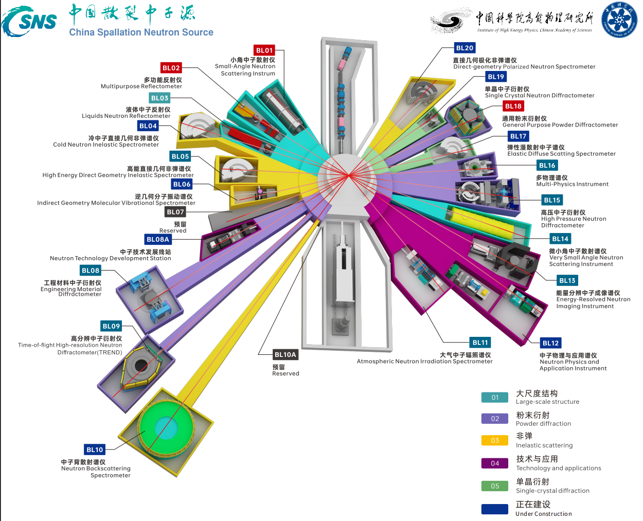
Brief introduction
Layout of the instrument hall in CSNS
BL16: Multi-Physics Instrument (MPI)
  The MPI was constructed in cooperation between CSNS, DGUT(Dongguan University of technology), and CITYU (City University of Hong Kong.
  MPI construction began in 2018, and it opened to users in the fall of 2021. Since then, we have completed more than 500 user proposals.
  MPI is a total scattering diffractometer that measures both the Bragg and diffuse components of materials.
Notes:
This is the layout of the of the in instrument hall in CSCS.
The Multi-Physics Instrument, also called MPI is located in the beam line 16th.
It was constructed in cooperation between CSNS, DGUT(Dongguan University of technology), and CITYU (City University of Hong Kong.
The MPI construction began in 2018, and it opened to users in the fall of 2021. Since then, we have completed more than 500 user proposals.
And the MPI is a total scattering diffractometer, we can use it to measures both the Bragg and diffuse components of materials.

Slide 4
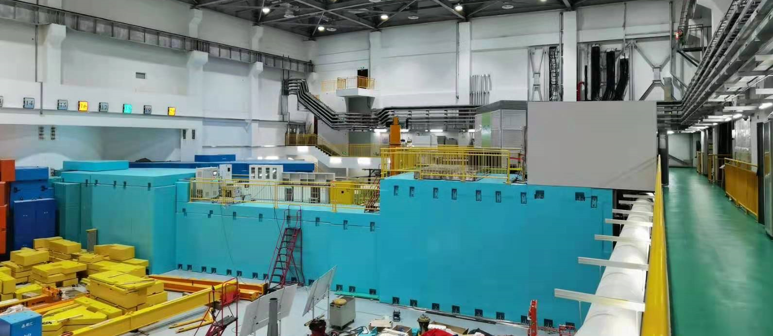
Brief introduction
The overview of the MPI
Target
Control room
Beam line
Scattering room
The CSNS-MPI is a Total Scattering Diffractometer, which is cooperation constructed by CSNS, DGUT, and CITYU, and will be used to study the ordered and disordered materials.
Notes:
This is the The overview of the MPI, you can see, it is target, beam line, and this is Scattering room and control room.

Slide 5
Brief introduction
The structural components of MPI
Key parameter: 1) location: 16# beam line; 2)Moderator: Decoupled water at 300K; 3) The length of the primary flight path：L1=30 meter; 4) The length of the second flight path: L2 = 1~3meter;5) Wavelength：0.1~4.5 Angstrom;6) Q range：0.1~50 Angstrom⁻¹; 7) Best Q resolution：0.3%; 8) The Flux of neutron at the sample position：5×10⁷ n/s/cm² @170 kW.
Notes:
This picture shows the The structural components of MPI
The mpi face decoupled water moderator
We have three chopper to get wavelength for 0.1 to 4.5 A
The neutron guide was use to increase the flux at the sample position, and we also have an exchanger system to get high flux and high resolution mode.
In order to get high neutron detector efficiency, we use the helum 3 dectectors, which covers from 2 to 170 degress, so we can get the big Q range.

Slide 6
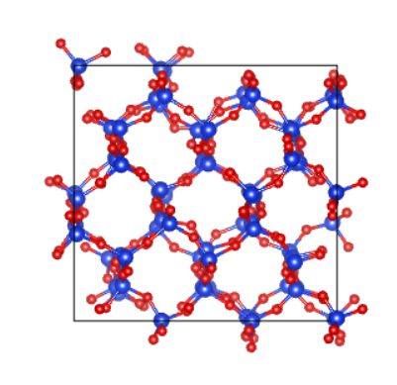
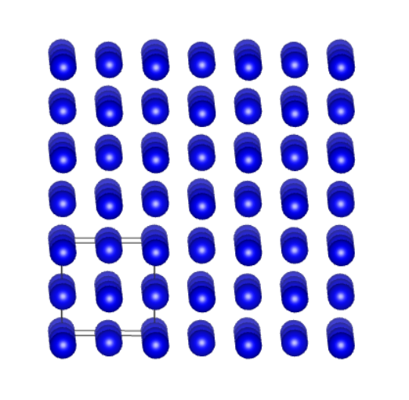
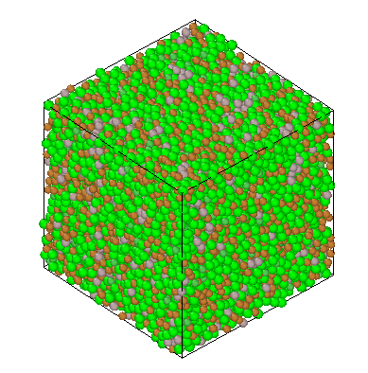
Brief introduction
Neutron total scattering
Total scattering = Bragg diffraction+ Diffuse scattering
long-range order
Local disorder
Long-range disorder
Notes:
What is the neutron total scattering?
The total scattering include bragg scattering and diffuse scattering
As we know, The Bragg diffraction signal reflects structure information about the long-range ordered of materials..
So we can get its the long-range ordered structure from neutron diffactrion
and the diffuse scattering is comes from the disorder structure of the materials, such as local disorder and long-range disorder.
Thus if the materials is the long-ranger order, we can use the ND to get its structure, but if the materiasl have long-range order and local disorder structure, we can use total scattering to get its information.

Slide 7
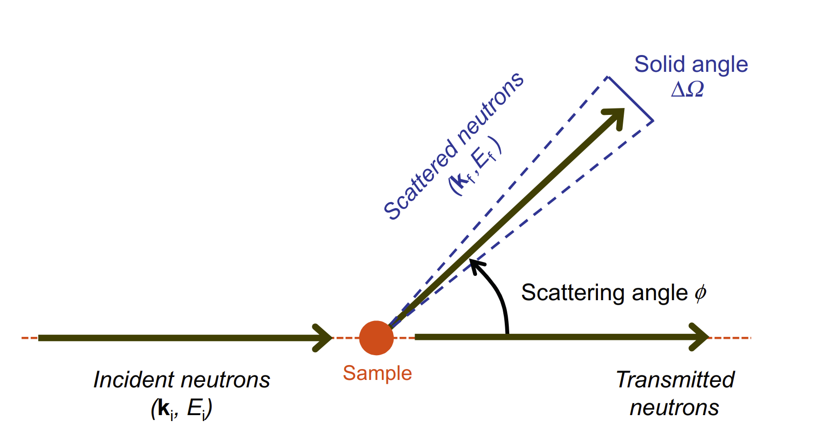
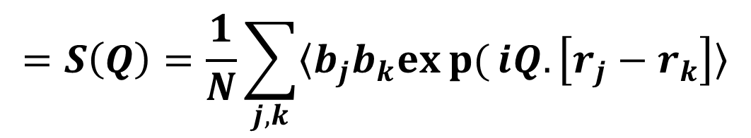
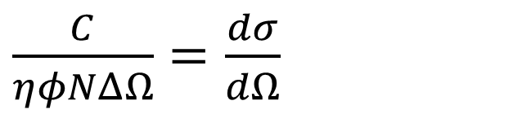
Brief introduction
The measured value in a neutron total scattering experiment is the number of neutrons detected by the detector within a given solid angle and scattering angle range, and the relationship between the counting rate and the neutron scattering differential cross section is：
$\frac{C}{ηφNΔΩ}$ $=\frac{dσ}{dΩ}$
$$=S\left(Q\right)=\frac{1}{N}\sum_{j,k}{〈b_{j}b_{k}exp{(}iQ.\left[r_{j}−r_{k}\right]〉}$$
Measurement
Theory
𝜂 (𝜆) is the detector efficiency,
𝜙 (𝜆) is the neutron flux at the sample,
𝑁 is the number of atoms in the sample
Δ Ω is the solid angle detected by the detector
We obtained$η\left(λ\right)、φ(λ)、$ $ΔΩ$through vanadium rod calibration.
Notes:
The measured value in a neutron total scattering experiment is the number of neutrons detected by the detector within a given solid angle and scattering angle range,
and the relationship between them is this one,
so we can get scattering structure factor,Sq

Slide 8
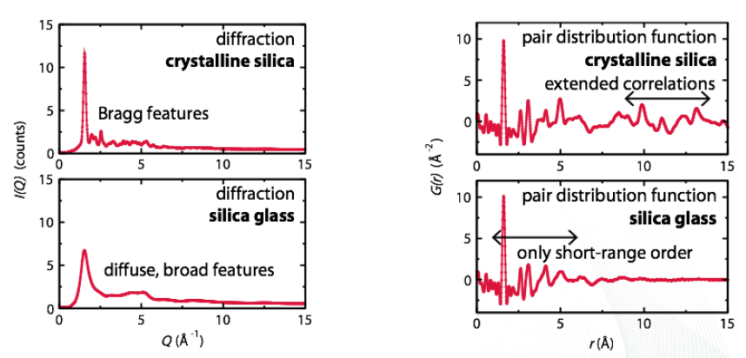
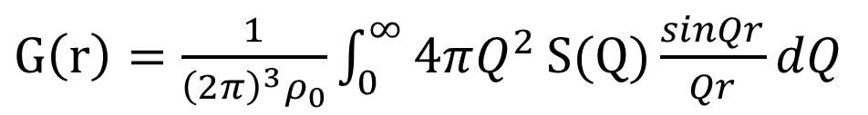

Brief introduction
Neutron total scattering, Sq and Gr
$$S(Q)=ρ_{0}\int_{0}^{∞}{4πr^{2}G(r)\frac{sinQr}{Qr}dr}$$
$G\left(r\right)=\frac{1}{{\left(2π\right)}^{3}ρ_{0}}\int_{0}^{∞}{4πQ^{2}}S(Q)\frac{sinQr}{Qr}dQ$
FFT
Notes:
This is the typical Sq and Gr of the crystalline silca and silica glass
You can see, the crystalline silca show typic bragg features, and the slilica galss shows diffuse and broad features.
By FT transtformation, we get the Gr, the real space information.
Both the samples shows the similar struscute at short –range order, and shows the different features at long-range order.

Slide 9
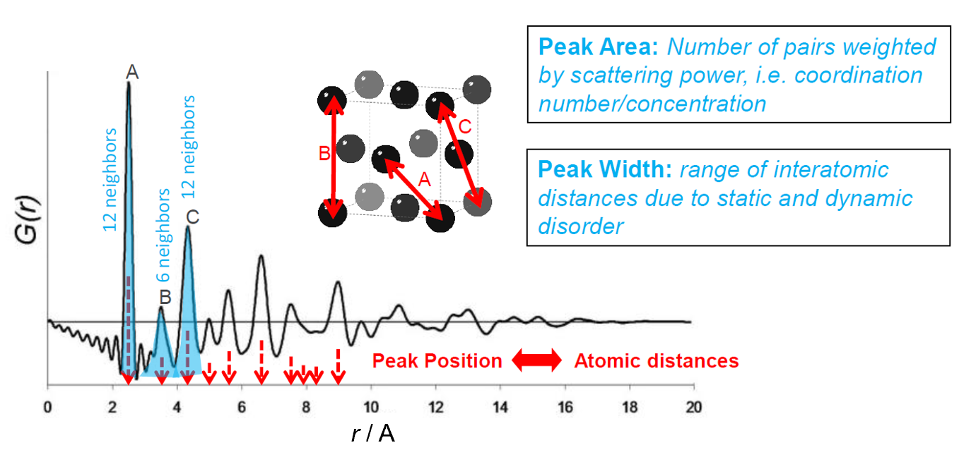
Brief introduction
Atom pair distribution function(PDF), Gr
Notes:
So from the Gr, we can get
the atomic dsitances from peak postion
atom coordination from the peal area
and also range of the interatomic distance from the peak width
And also some other information, such as size of the nano-particals.

Slide 10
Brief introduction
Science Goals ：(including but not limited to)
In situ measurement of the structure of the materials under the different or extreme environment；
In situ measurement of the metallic glasses under different temperature and pressure；
Determination of the structure of liquids, function materials, engineering materials, high-entropy alloys, and completely unknown materials；
Determination of the material transition state under the extreme conditions；
Nano structure measurement and effect of environment on nano-structure
……..
Provide the platform for the material research on ordered and disordered material

Slide 11
The performance of the MPI
The neutron flux
Neutron energy spectrum of MPI
Beam power | Neutron flux
CSNS@100kW | 3.0×10⁷n/s/cm²
CSNS@140kW | 4.2×10⁷n/s/cm²
CSNS@160kW | 4.87×10⁷n/s/cm²
CSNS@170kW | 5.0×10⁷ n/cm²/s
The neutron flux was tested at the sample position using lithium glass detector current mode neutron time of flight method (Current mode Time-Of-Flight，CTOF).
The Wavelength is in the range of 0.1-4.5Å, and the neutron flux at sample position is 5.0×10⁷ n/cm²/s@170kW
J. P. Xu, W. Yin*, Nuclear Inst. And Methods in Physics Research, A 927(2019)161, 1013(2021)165642
Notes:
This is the Neutron energy spectrum of MPI, we tested using lithium glass detector by CTOF method at the sample position .
We can see, the Wavelength of the mpi is in the range of 0.1-4.5Å, and the neutron flux at sample position is 5.0×10⁷ n/cm²/s@170kW, and also the flux is increasing as the beam power.

Slide 12
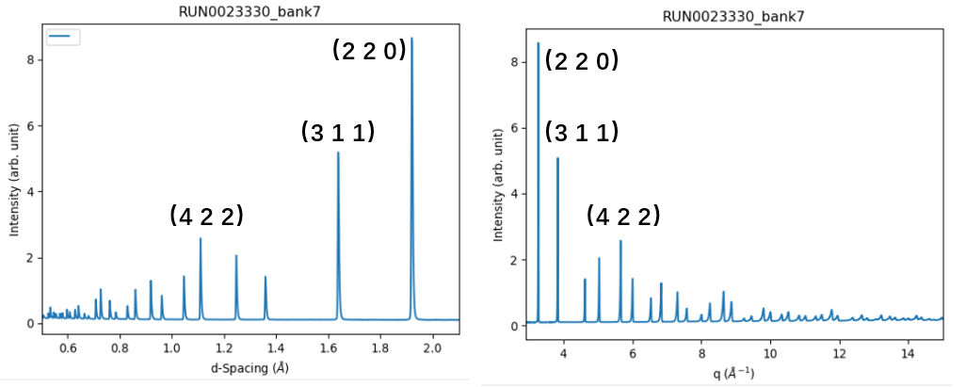
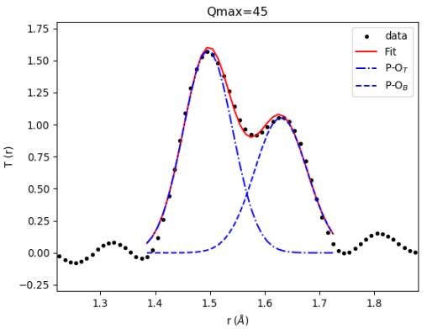
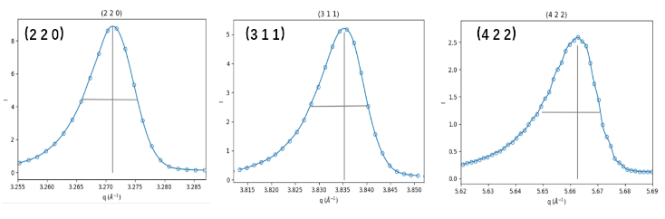
The performance of the MPI
The resolution
Silicon(NIST 640f)
Q_{max}=45 Å⁻¹
Sodium metaphosphate
Δr=0.13 Å
Peak diffraction Q(Å⁻¹) | (h k l) | dQ/Q（%）
3.271 | （2 2 0） | 0.289
3.835 | （3 1 1） | 0.304
5.663 | （4 2 2） | 0.369
The best diffraction resolution is 0.3%, and the real space resolution is 0.1Å
Notes:
The resolution of the MPI we tested by stardard sample,Silicon,and get the best resolution is 0.3 percent.
The real space resolution is tested we used the sodium metaphosphate sample, this materials have two bond with the difficence of 0.13 A, and we get this value. But we think the real space resolution can reach 0.1 A,
now we are trying to find matrials to prove this.

Slide 13
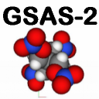
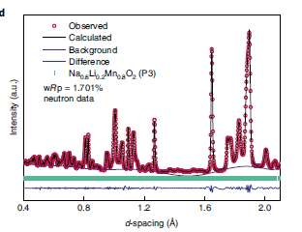
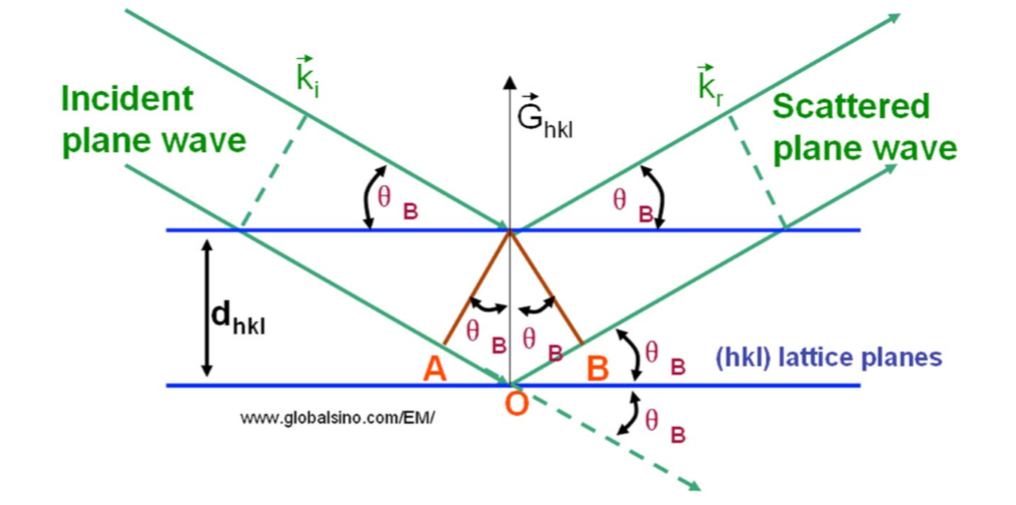
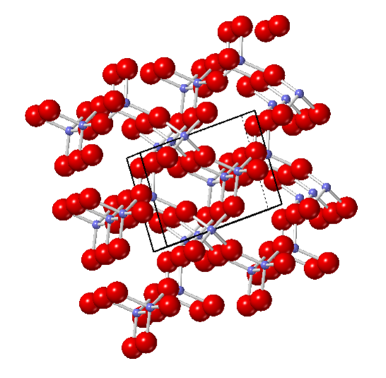
The performance of the MPI
Neutron diffraction
$$2dsinθ=nλ$$
Theory
Experiment and fitting
Atomic structure
The MPI can conduct structural research on long-range ordered materials.
Notes:
SO the MPI can conduct neutron diffraction, by fiting, we can get the atomic structure of the long-range ordered materials

Slide 14
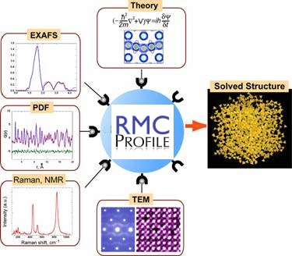
The performance of the MPI
Neutron total scattering
$$\frac{dσ}{dΩ}=S\left(Q\right)=\frac{1}{N}\sum_{j,k}{〈b_{j}b_{k}exp{(}iQ.\left[r_{j}−r_{k}\right]〉}$$
Theory
Experiment and fitting
Atomic structure
The MPI can conduct structural research on disordered materials.
14
Notes:
Ans also, the MPI can conduct neutron total scattering experiment, by fiting, we can get the atomic structure of the short-range order and disordered materials.

Slide 15
The performance of the MPI
Data analysis process for MPI
Quasi-ordered structure
Pair Distribution Function (PDF) Refinement
Detectors
DAQ
Data
Reconstruction
Data
Reduction
Molecular dynamics (MD) simulation
3D micro-
structure
Monte-Carlo and Reversed Monte-Carlo simulation
Disordered structure
Measurement
Data Analysis
Material Structure
Notes:
This this data analysis process of the MPI,
include DAQ, DATA reconstruction、data reduction process.
Our colloleger have give a details report about this in this morning

Slide 16
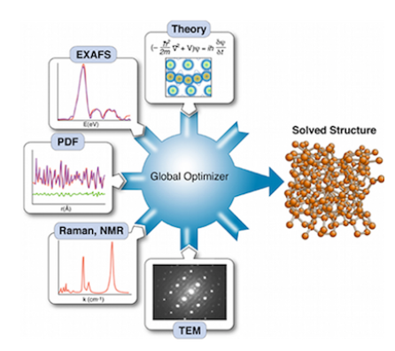
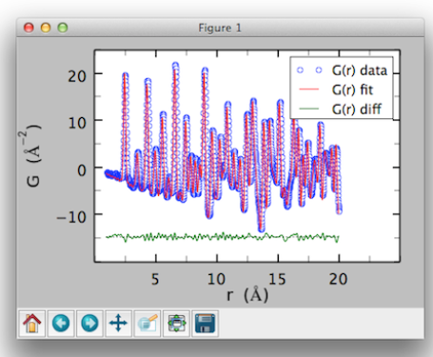
The performance of the MP Instrument
The Data Analysis of MPI
Neutron diffraction
GSASII https://subversion.xray.aps.anl.gov/trac/pyGSAS/wiki/InstallWindows
Z-Code https://z-code-software.com/
Fullprof https://www.ill.eu/sites/fullprof/
PDF
PDFGUI or DiffPy https://www.diffpy.org/index.html
RMCProfile http://www.rmcprofile.org
Provide a variety of data formats to meet users' different data analysis needs!
Notes:
For the data ansisi
the mpi user can use GASAii Z-code and fullprof to refine the neutron diffraction data
and the PDF data can fit with PDFgui/diffpy and PMC profile.
Now we can Provide a variety of data formats to meet users' different data analysis needs!

Slide 17
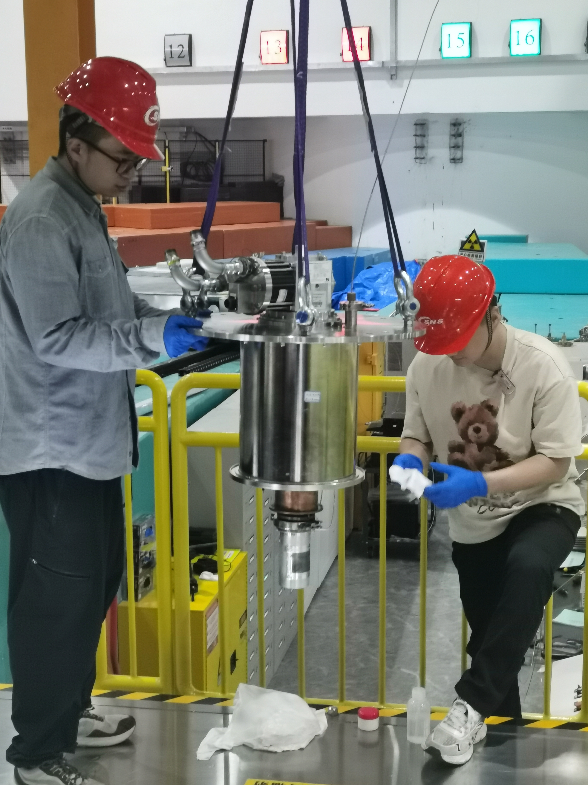
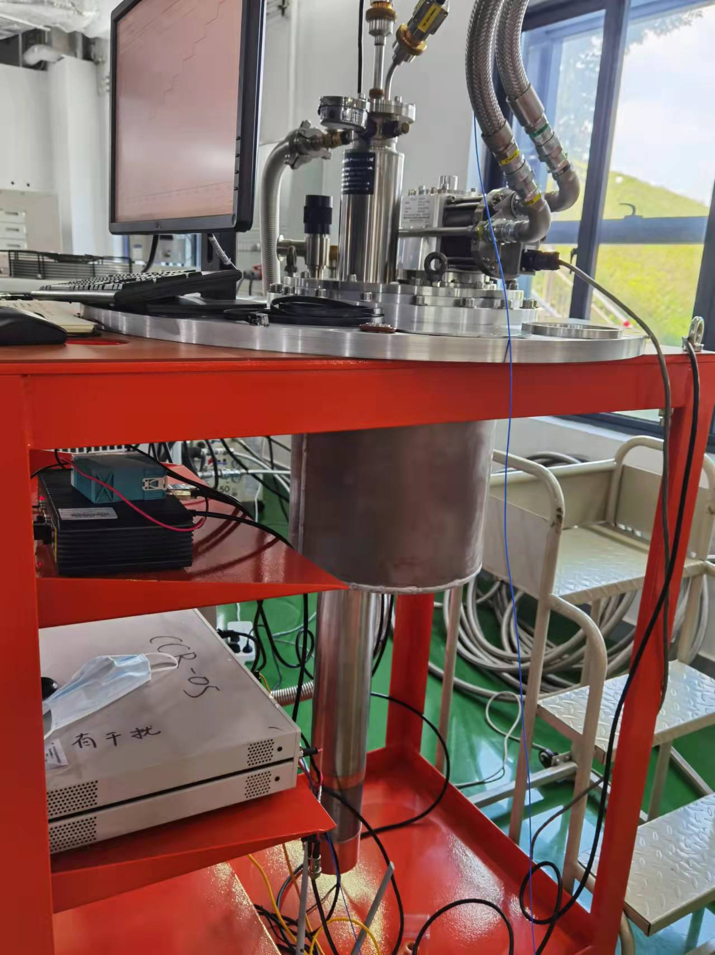
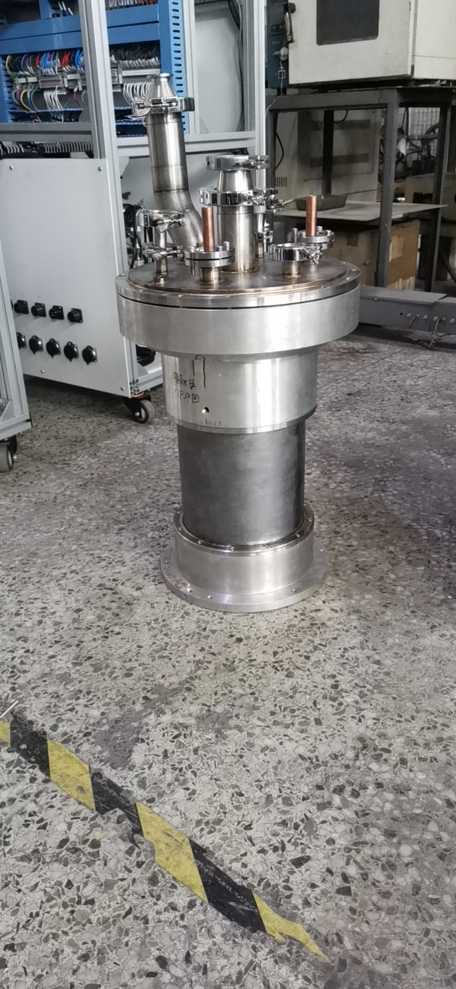
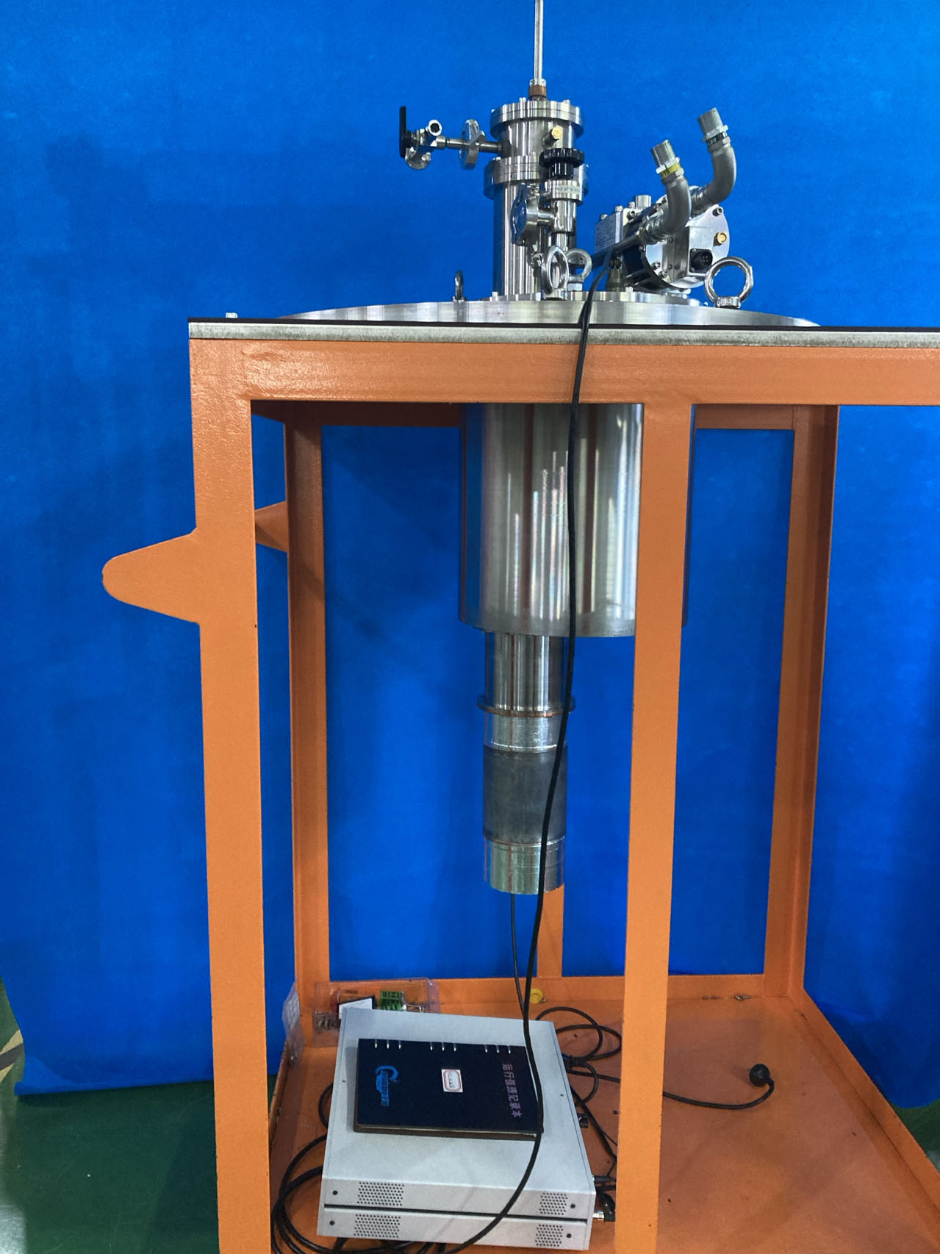
Sample environment
Furnace and cryostats
CCR05
CCR06
CCR09
HOT02
20K-500K
4K-600K
5K-700K
RT-1473K
MPI offer a variety of high- and low-temperature sample environments to meet users' requirements.
Notes:
Now we have furnace and cryostats,
for the low temperature test, we have different cryostats from 4 k to 700 K
And also have an HOT furnace, from room temperature to 1473 k

Slide 18
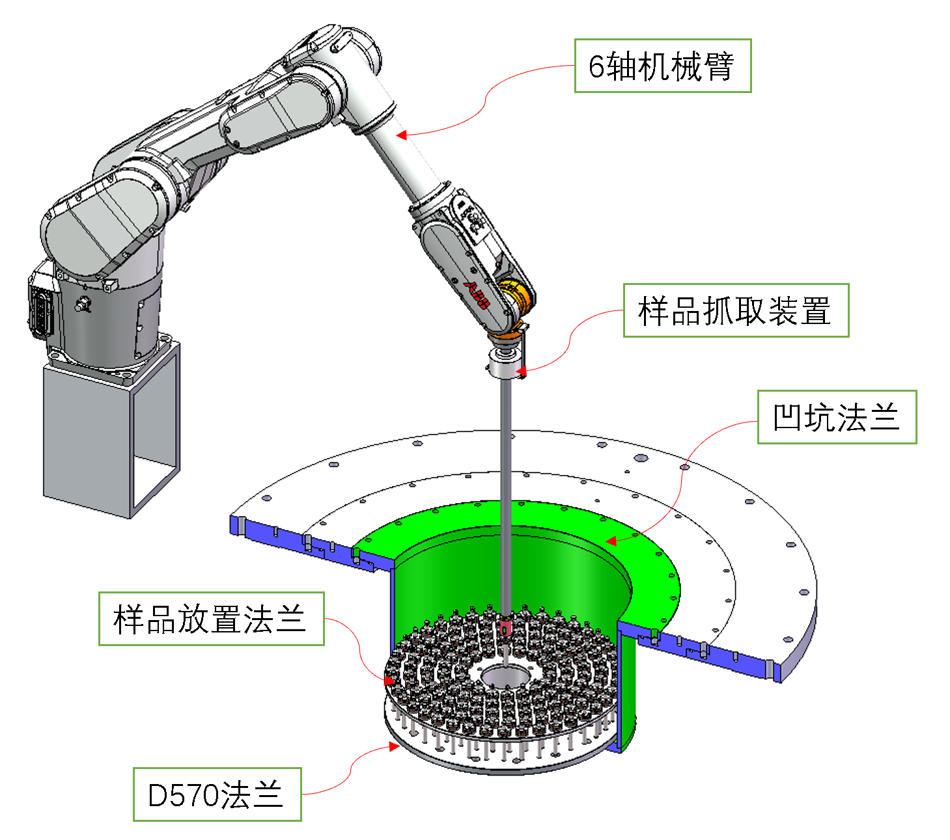
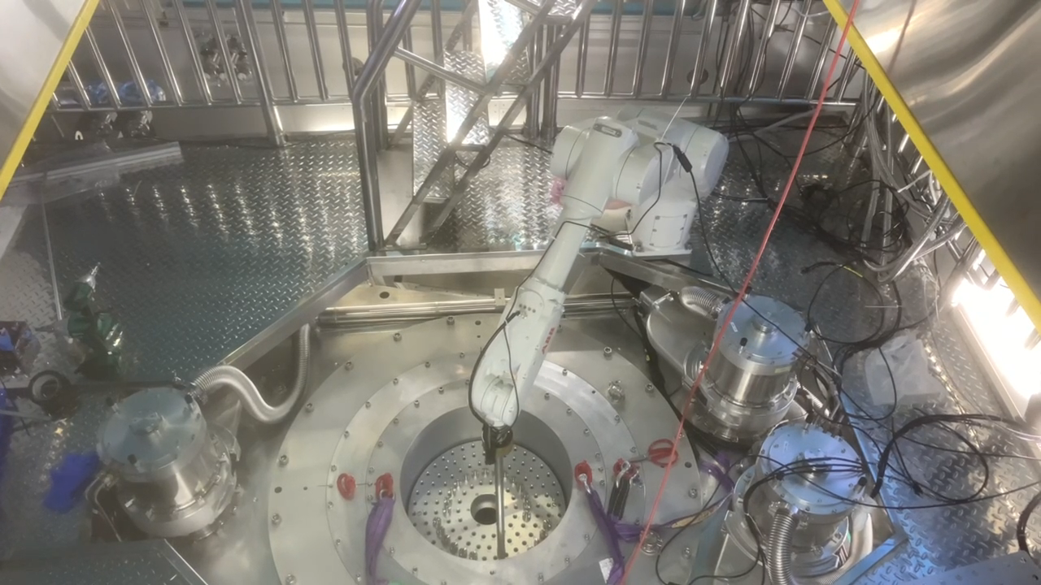
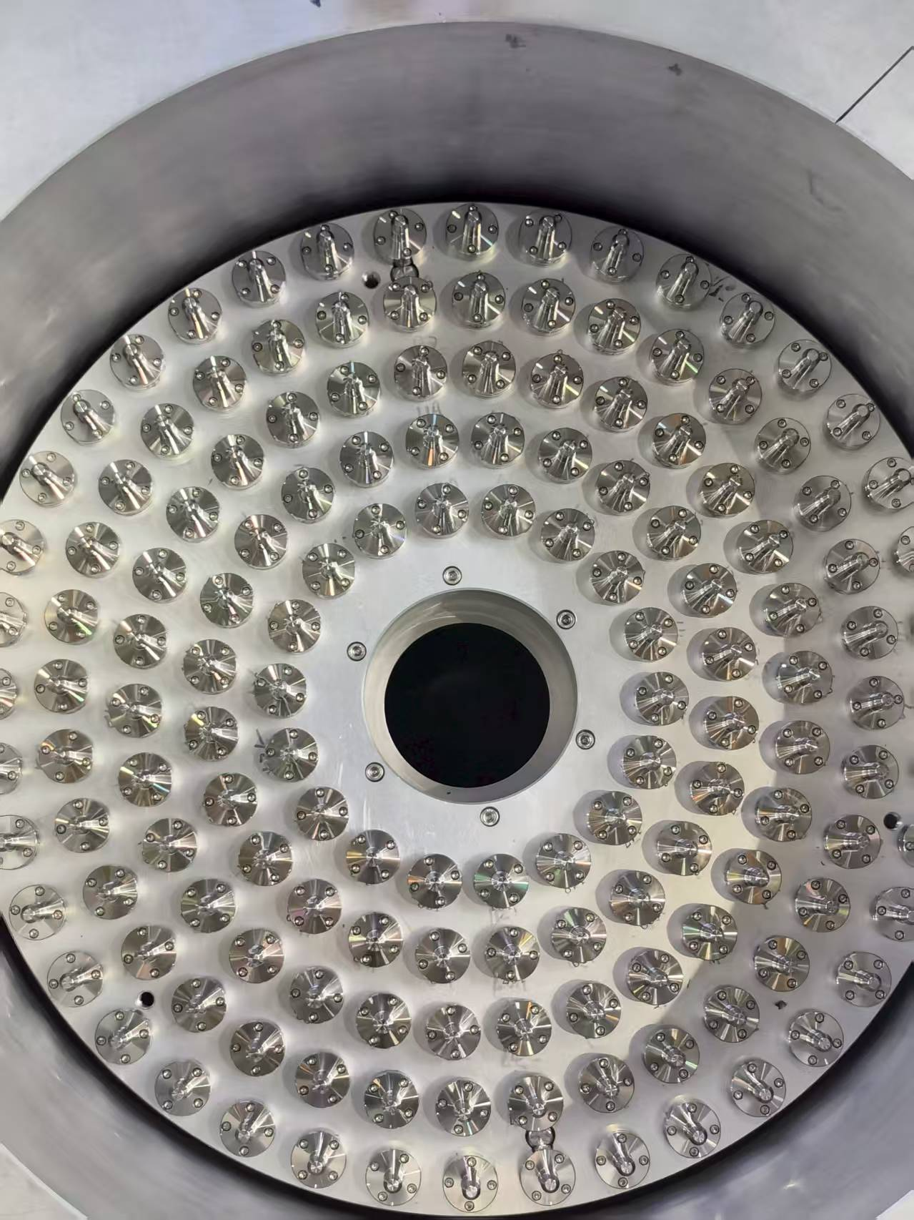
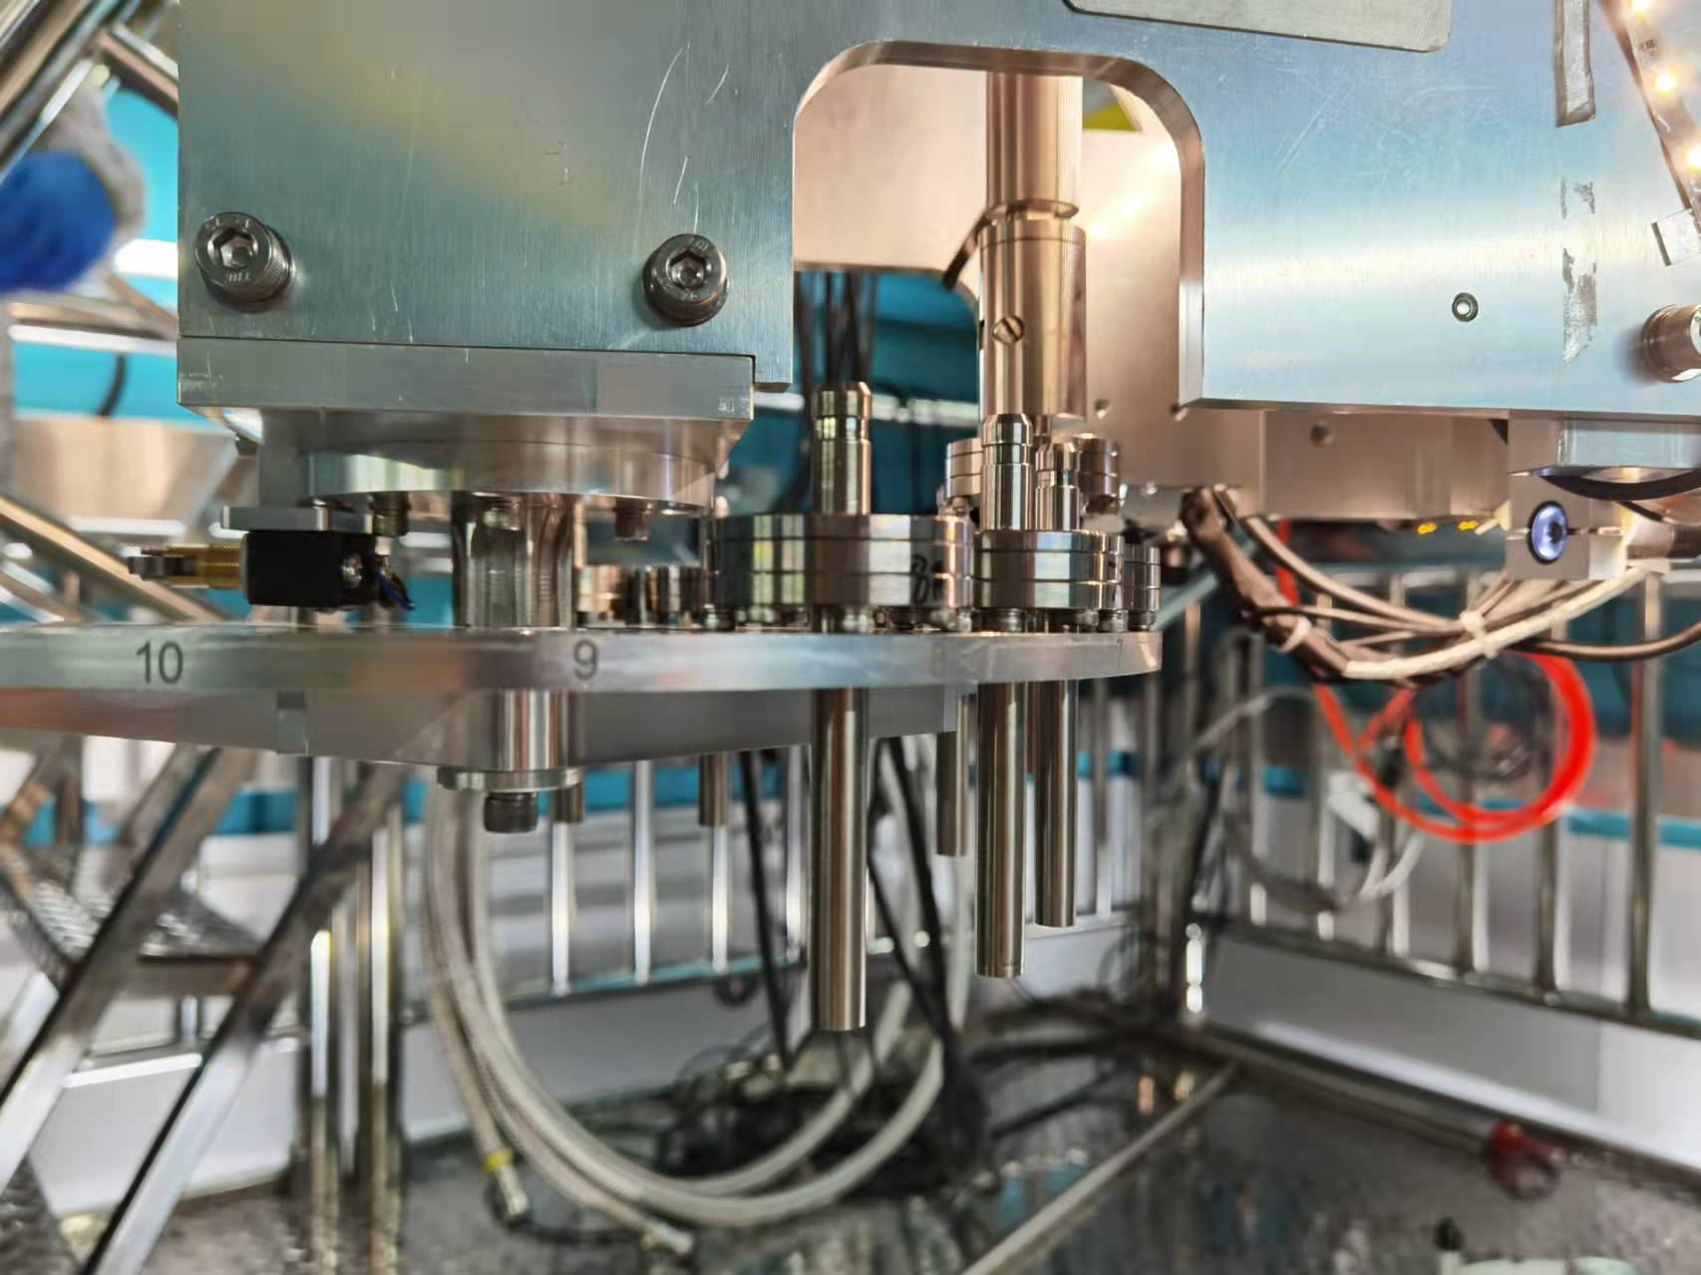
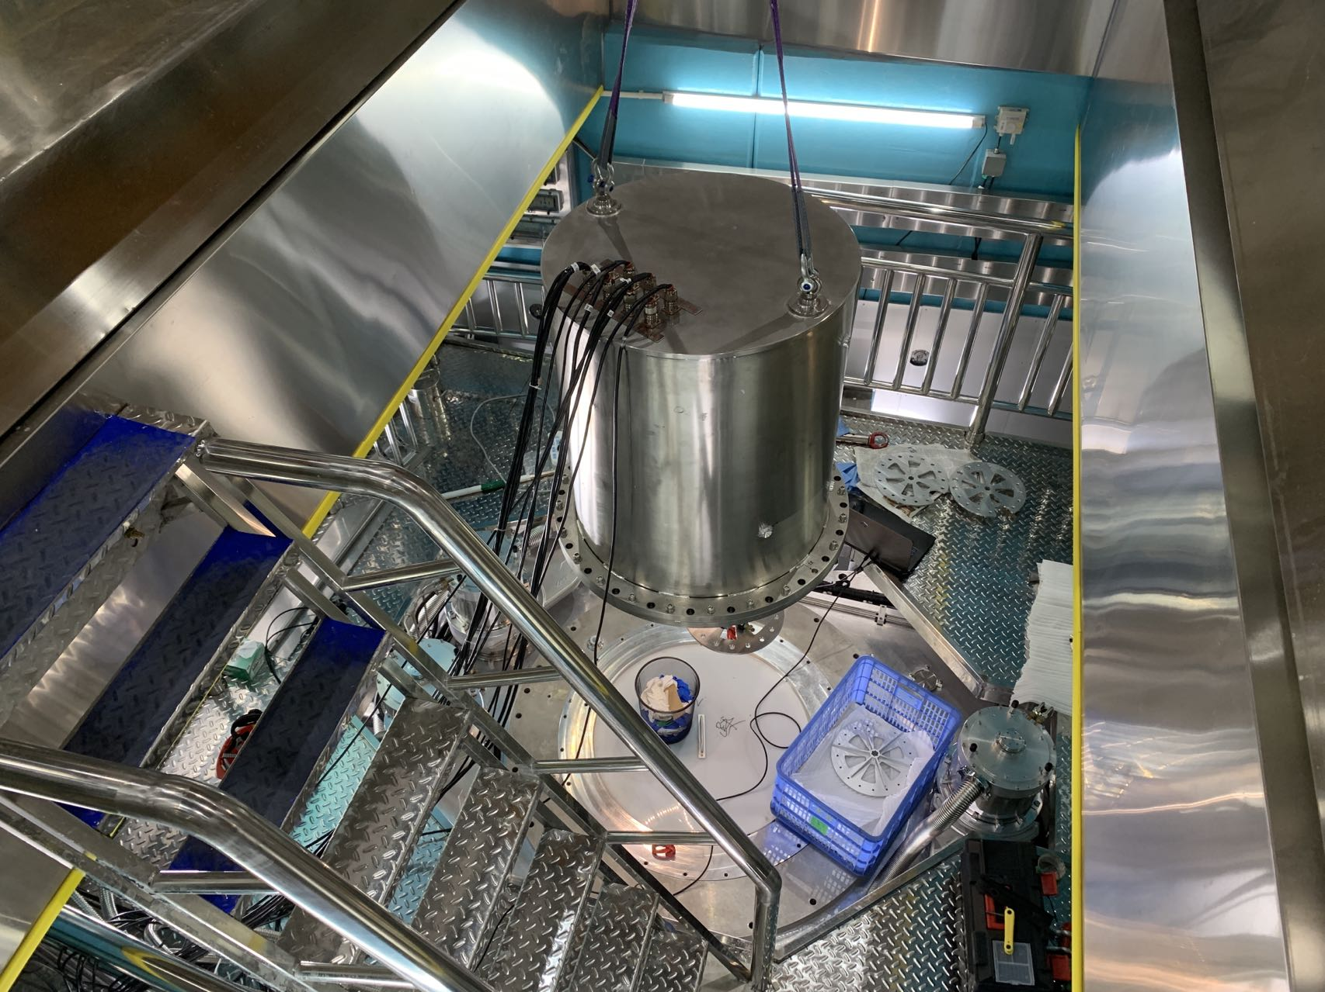
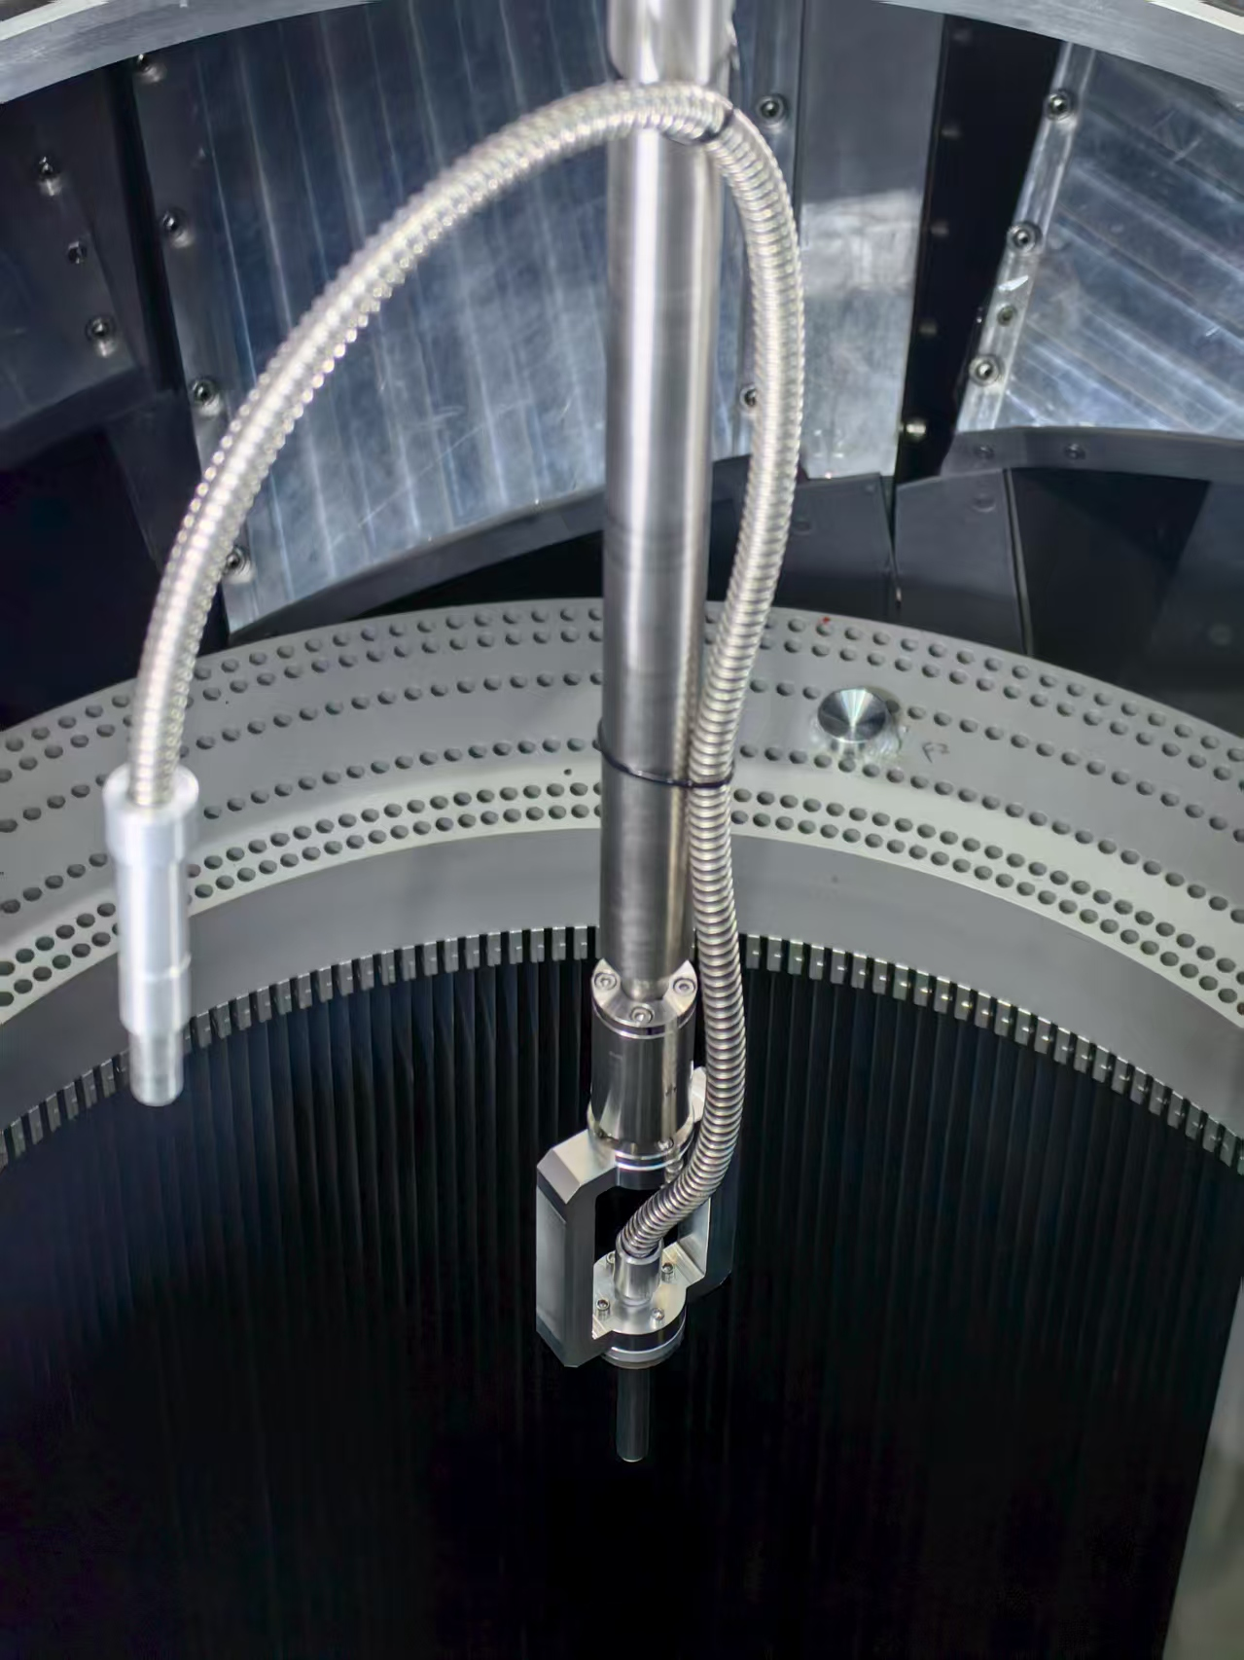
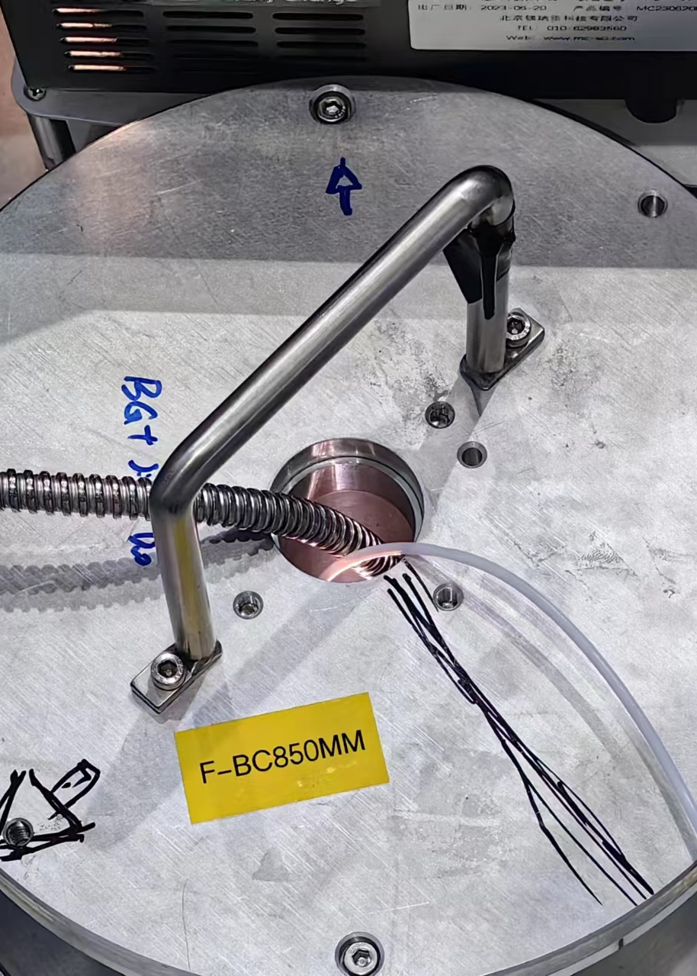
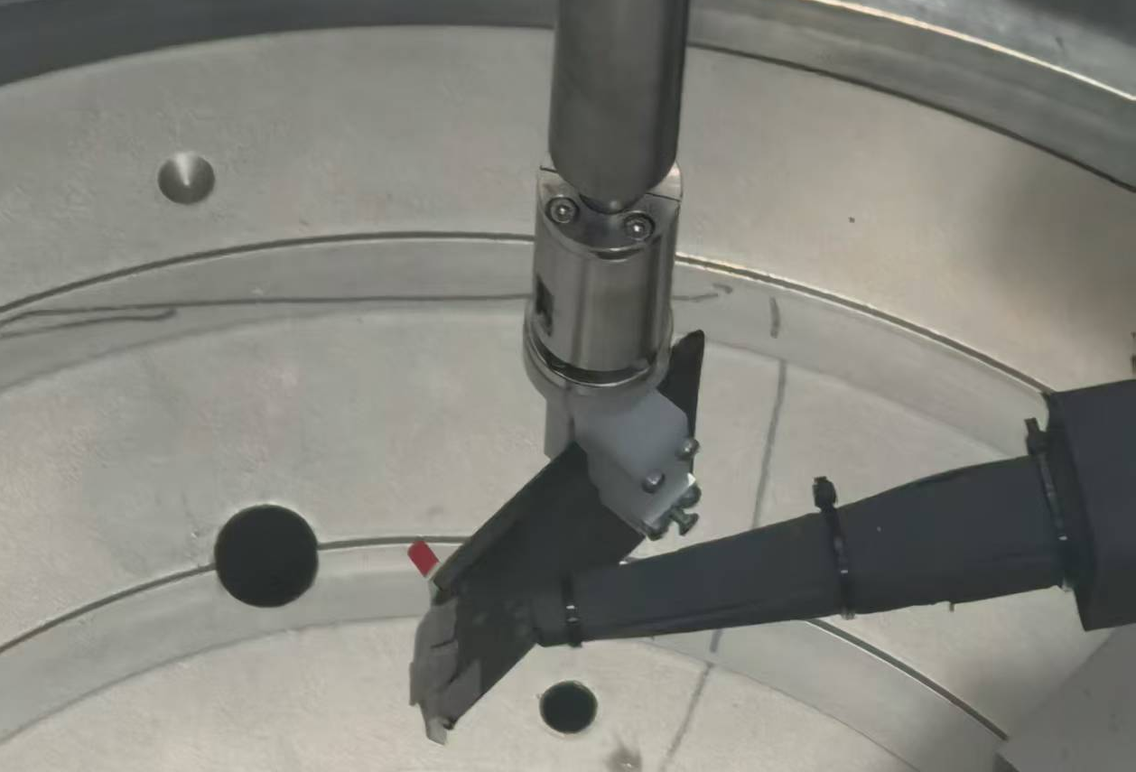
Sample environment
Autochanger
Autochanger V2
MPI have two different autochanger：
Autochanger V1：
Load 22 samples
vacuum environment operation
Autochanger V2：
Capable of rapidly testing up to 148 samples
Work in air
Compatible with various sample sizes, and coupled with in-situ charge/discharge, in-situ photocatalysis, high-throughput testing, and more.
High-throughput testing
In-situ photocatalysis
In-situ charge/discharge
Autochanger V1

Slide 19
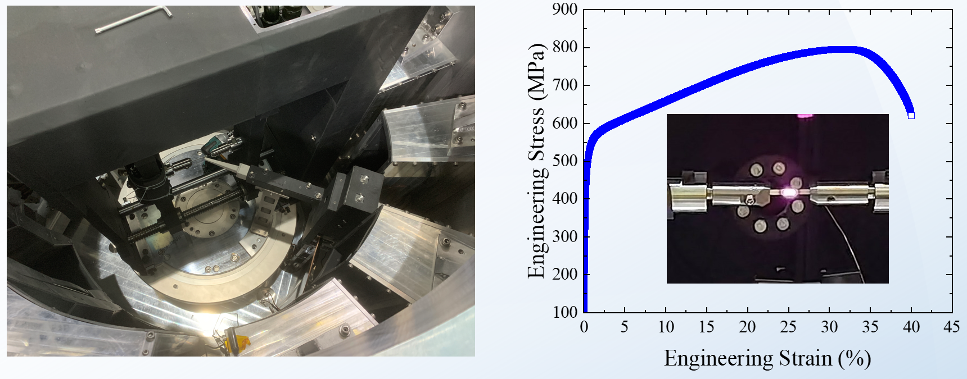
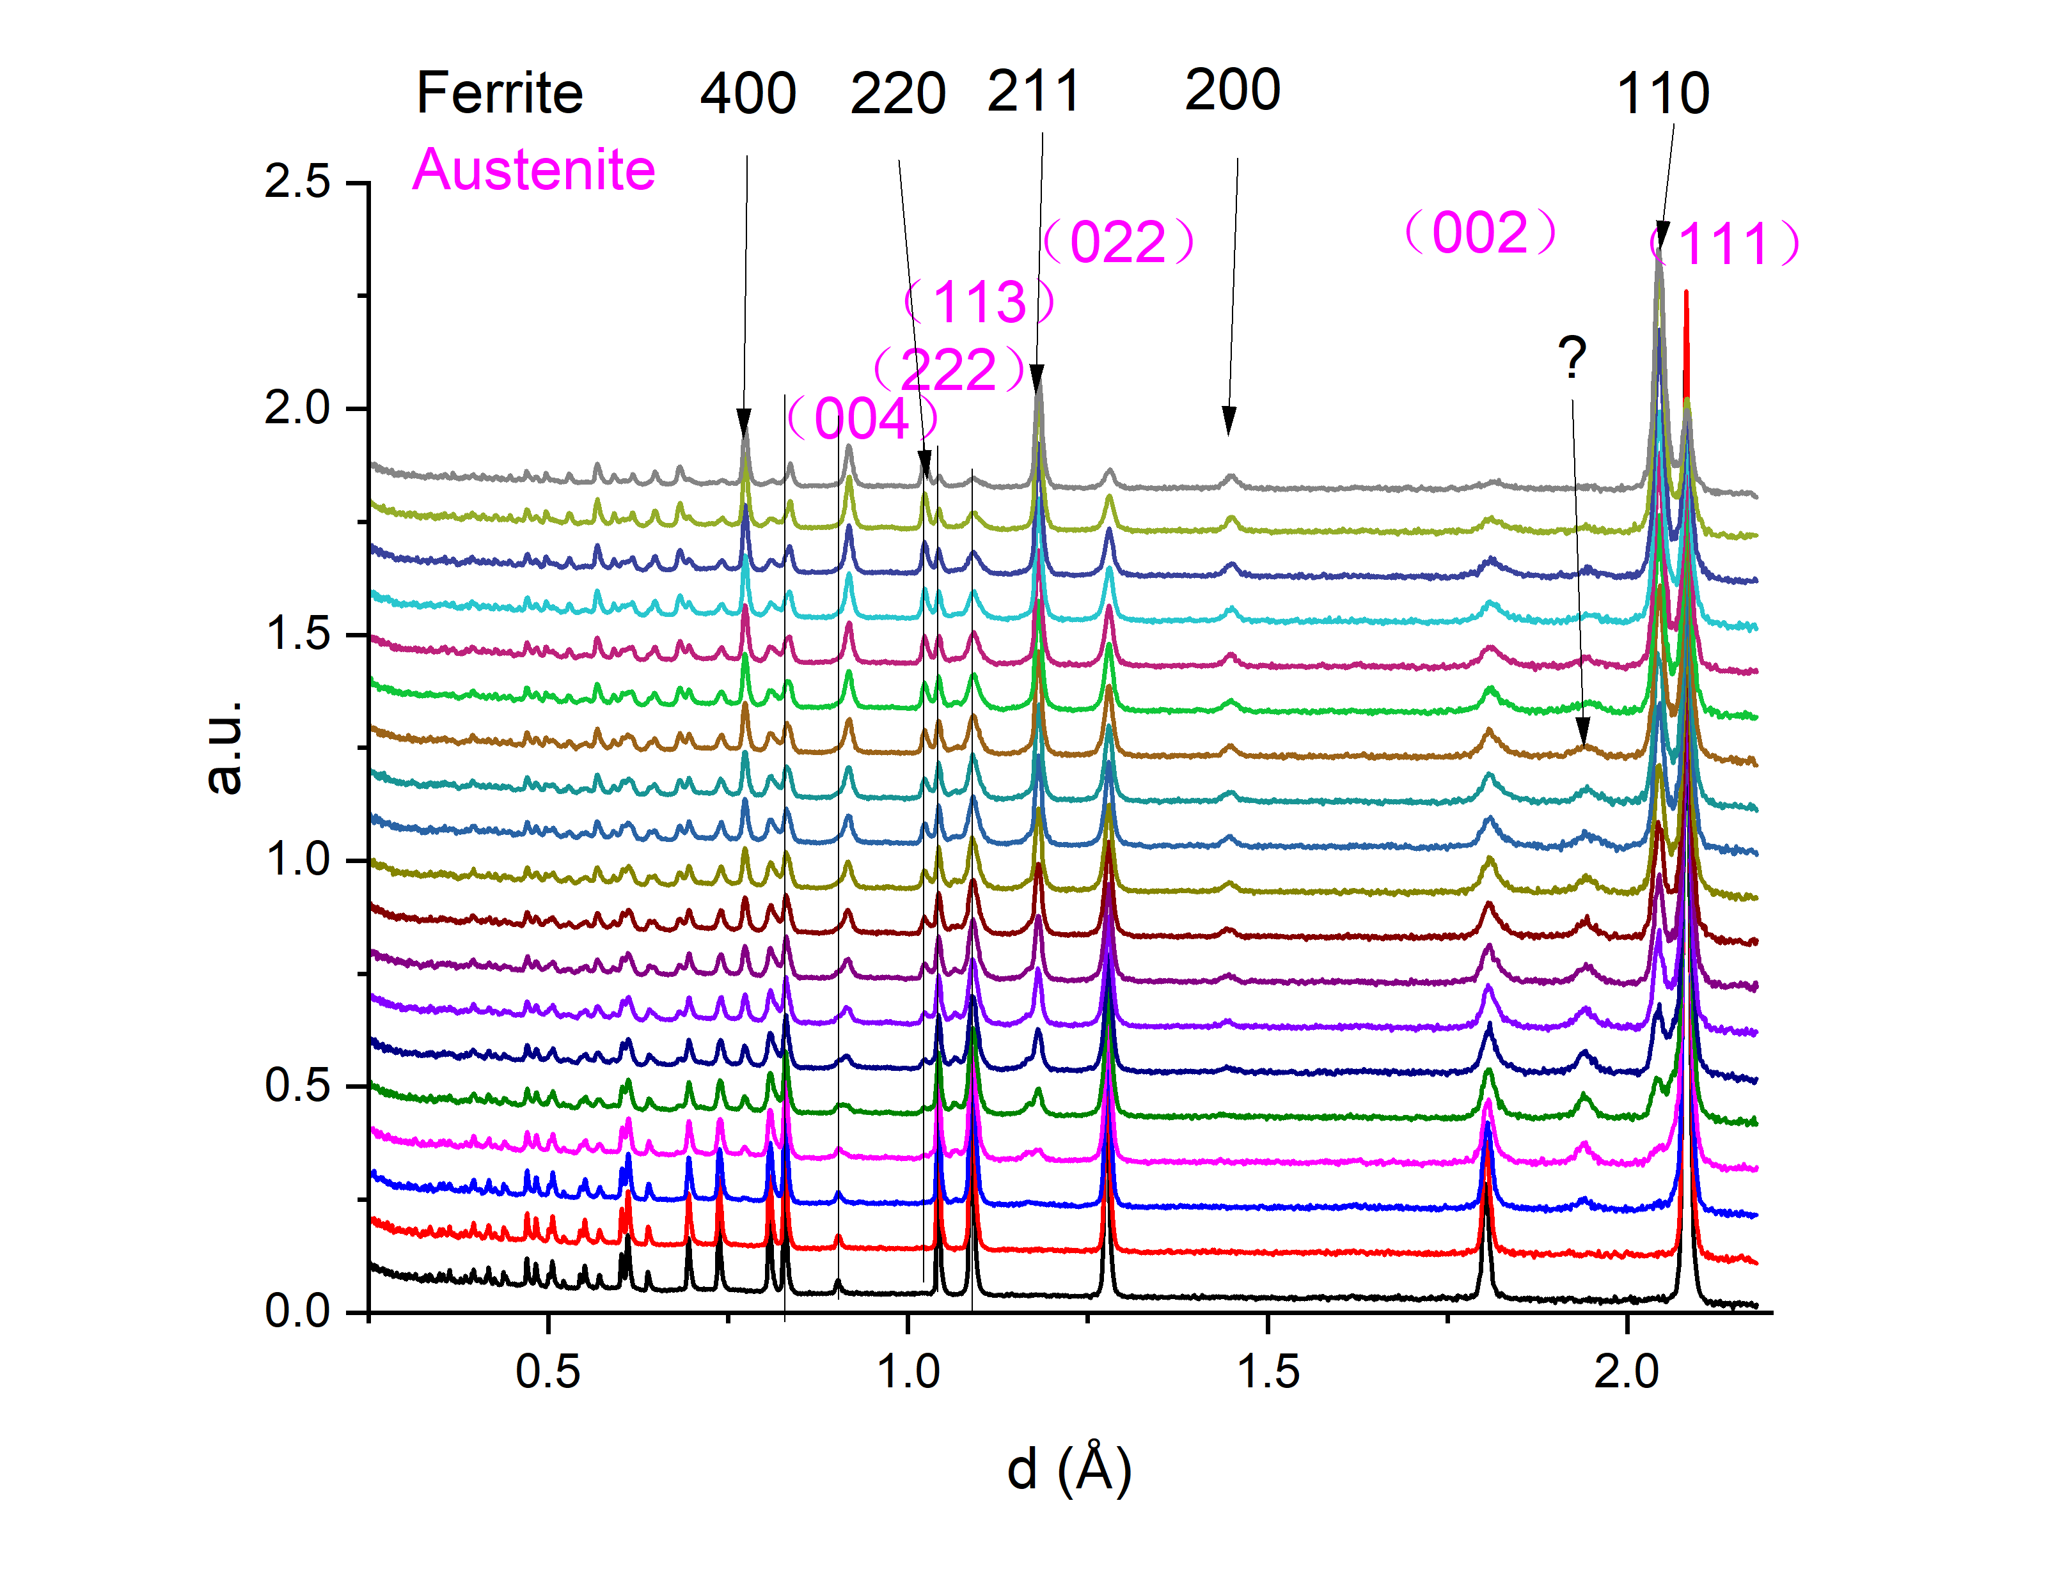
Sample environment
In-situ mechanical loading equipment
FeMnTi alloy (load rate 0.5mm/min)
Parameters
Maximum load | 30kN
Load rate | 0.05~250 mm/min
Temperature | RT-1600K
Materials Science & Engineering A 925 (2025) 147847
MPI enables in-situ tensile testing to investigate the deformation mechanisms of alloys
Notes:
For the mechanical research of the alloy,
we have in 30 kilonewton
this is the examples, we can clear see the phase change of the alloy under deformation

Slide 20
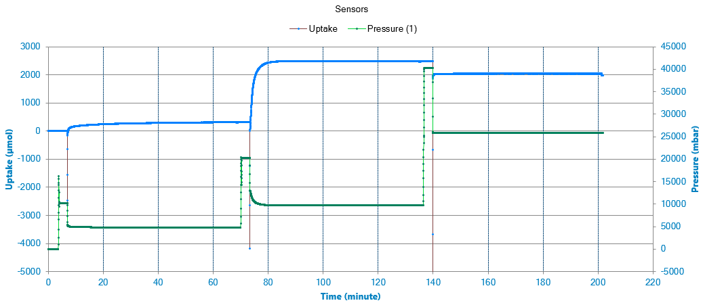
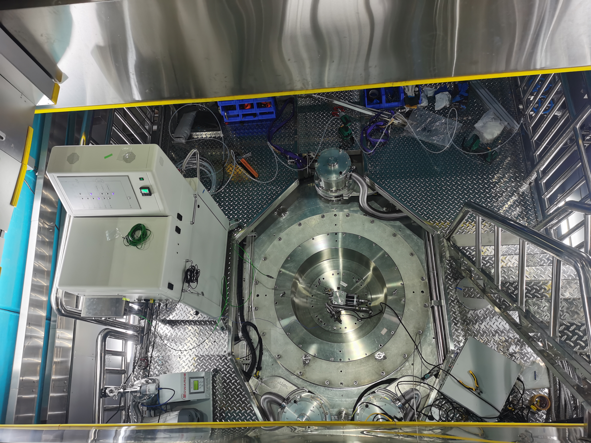
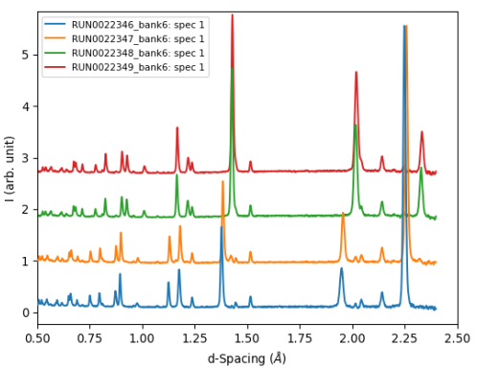
Sample environment
In-situ gas adsorption equipment
Gas adsorption (IMI, HIDEN)
2.5MPa
0.5MPa
1.0MPa
Using this setup, in situ neutron diffraction measurements of deuterium absorption in palladium (Pd) were carried out under various pressures at 200 K.
Notes:
For catalysis research, we have
the in situ gas adsorption equipment,
coupled with the cystoats, we can carry out the experiment at low temperature with different pressure.
We have finish the deuterium absorption in Pd at 200K.

Slide 21
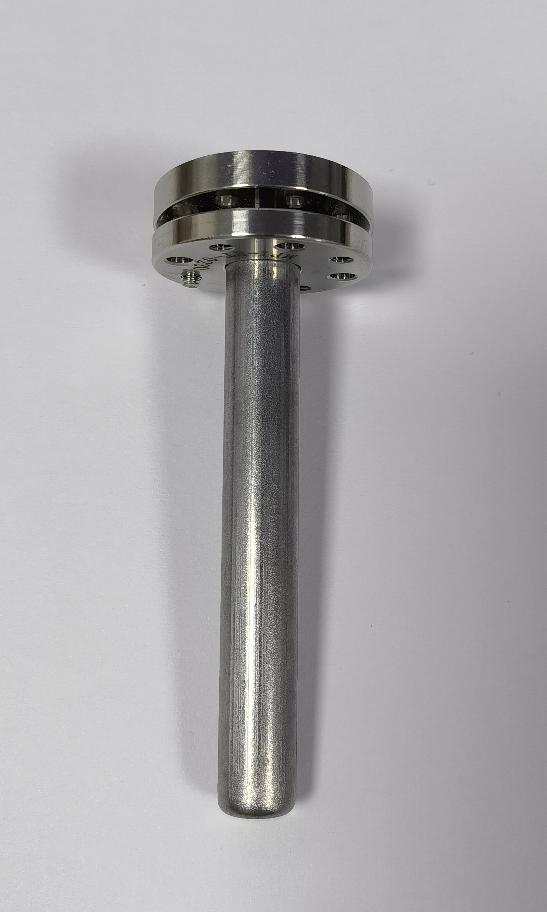
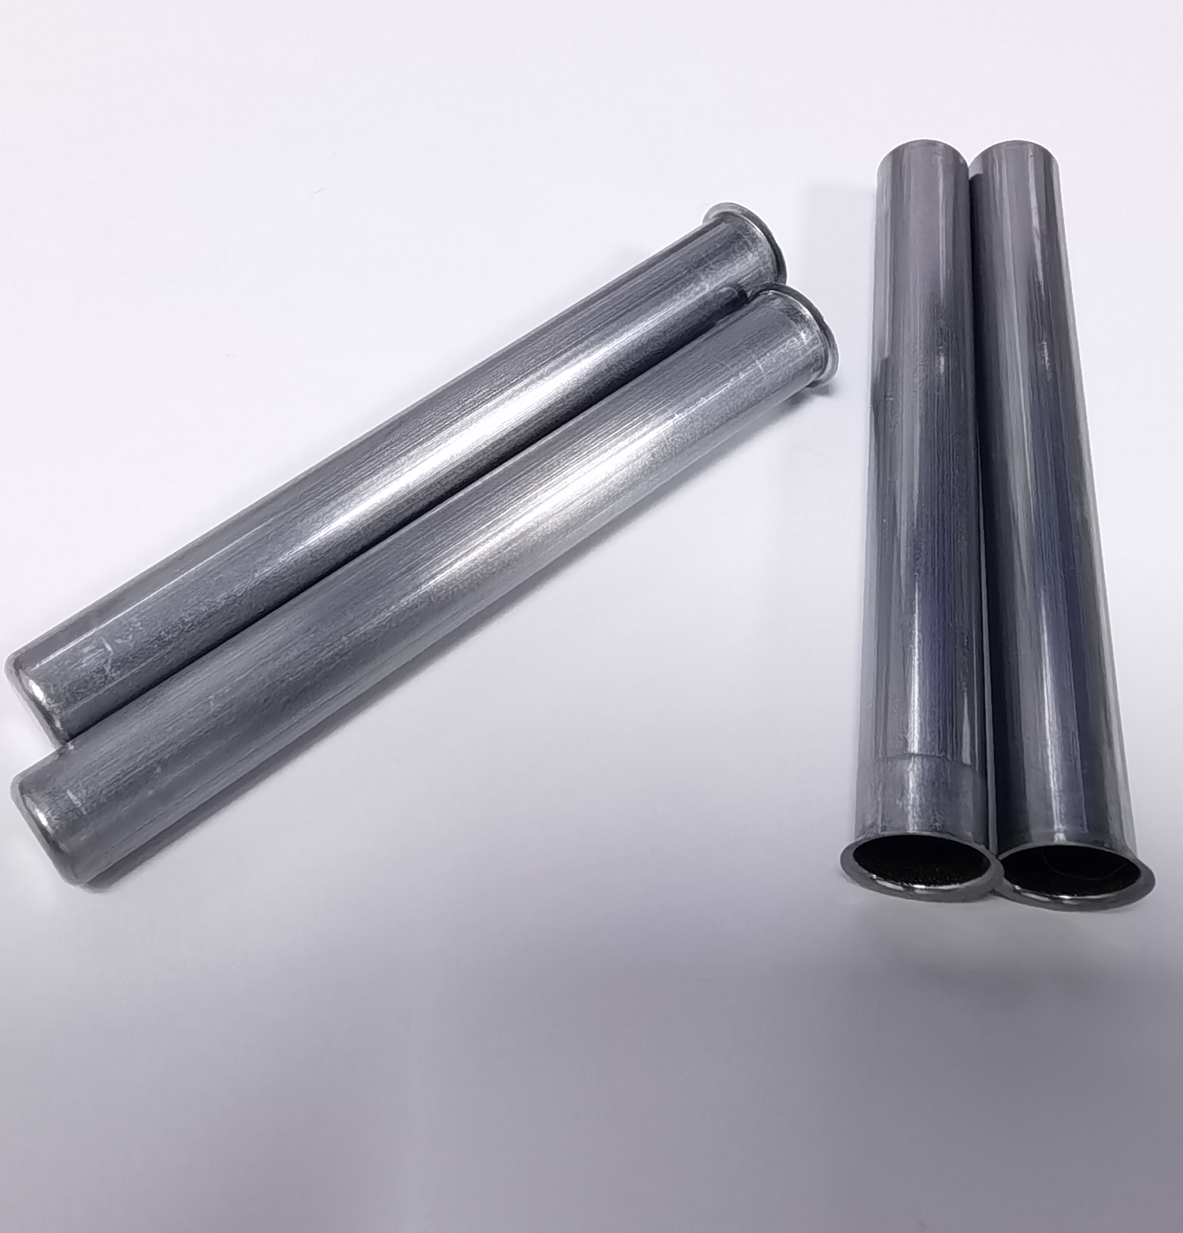
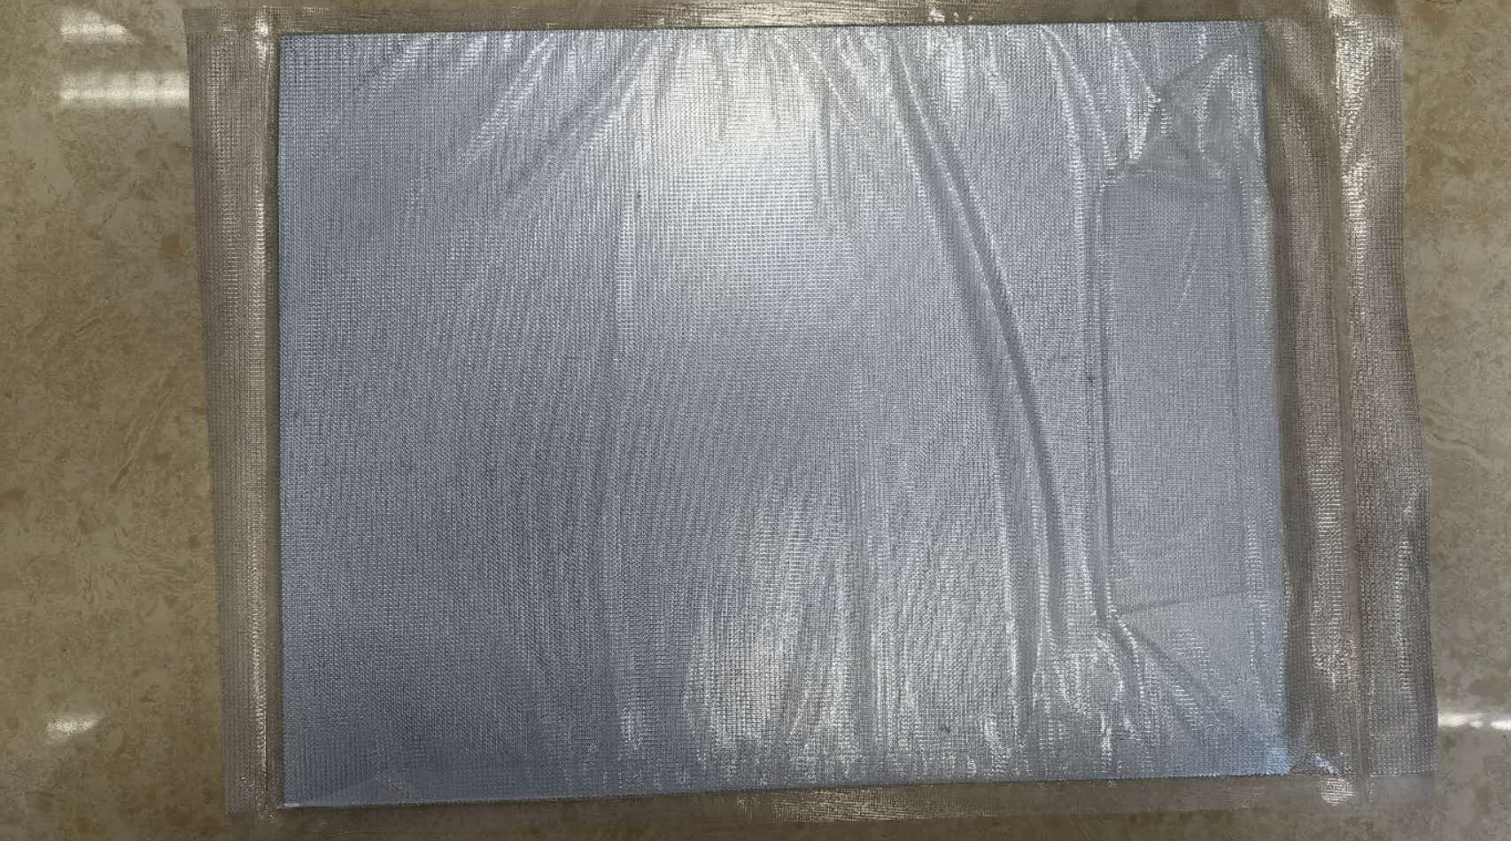
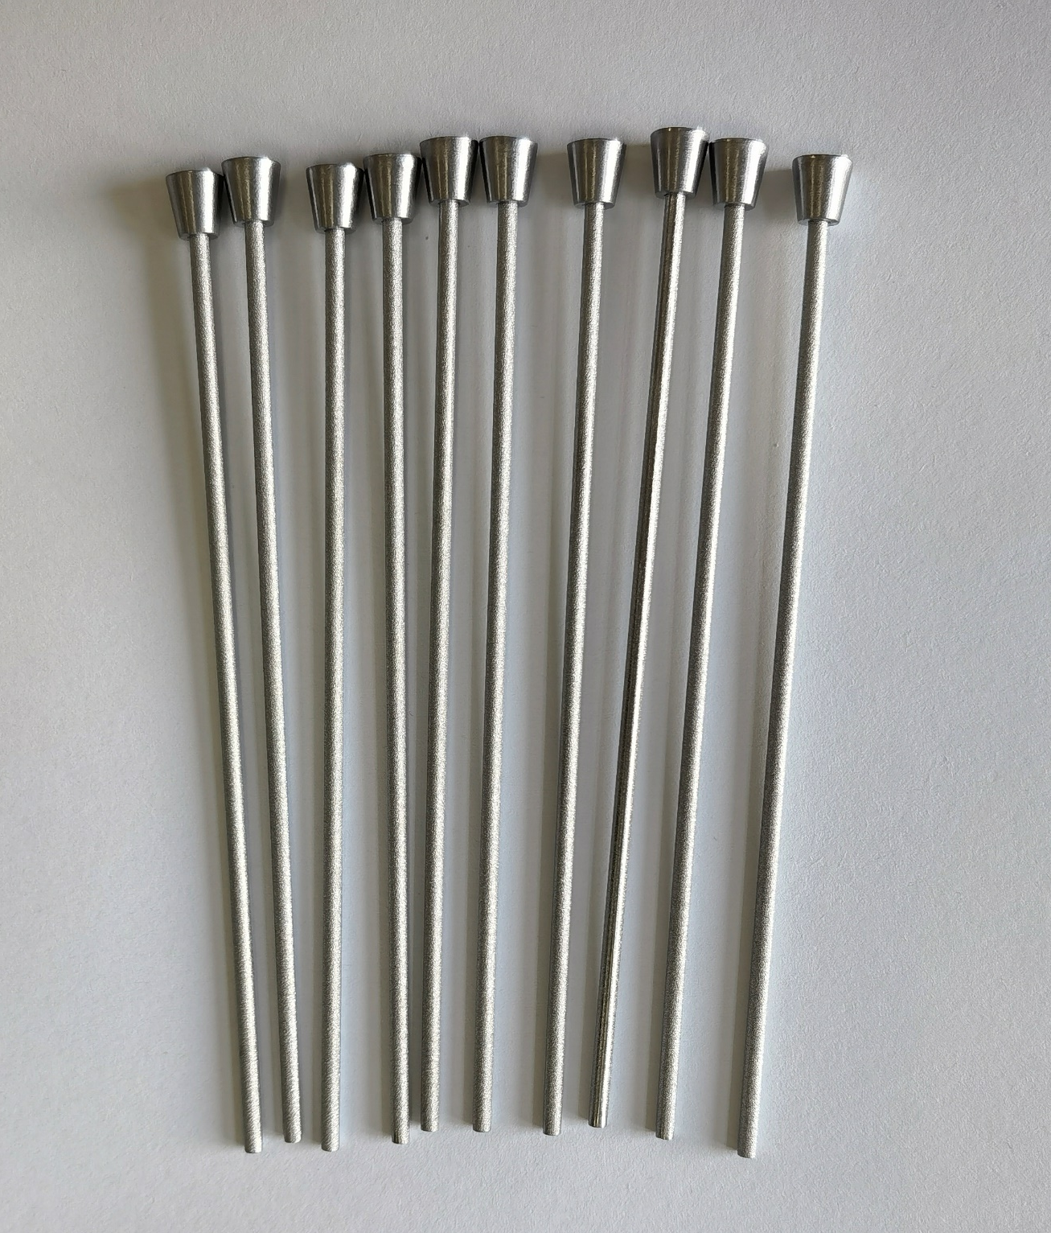
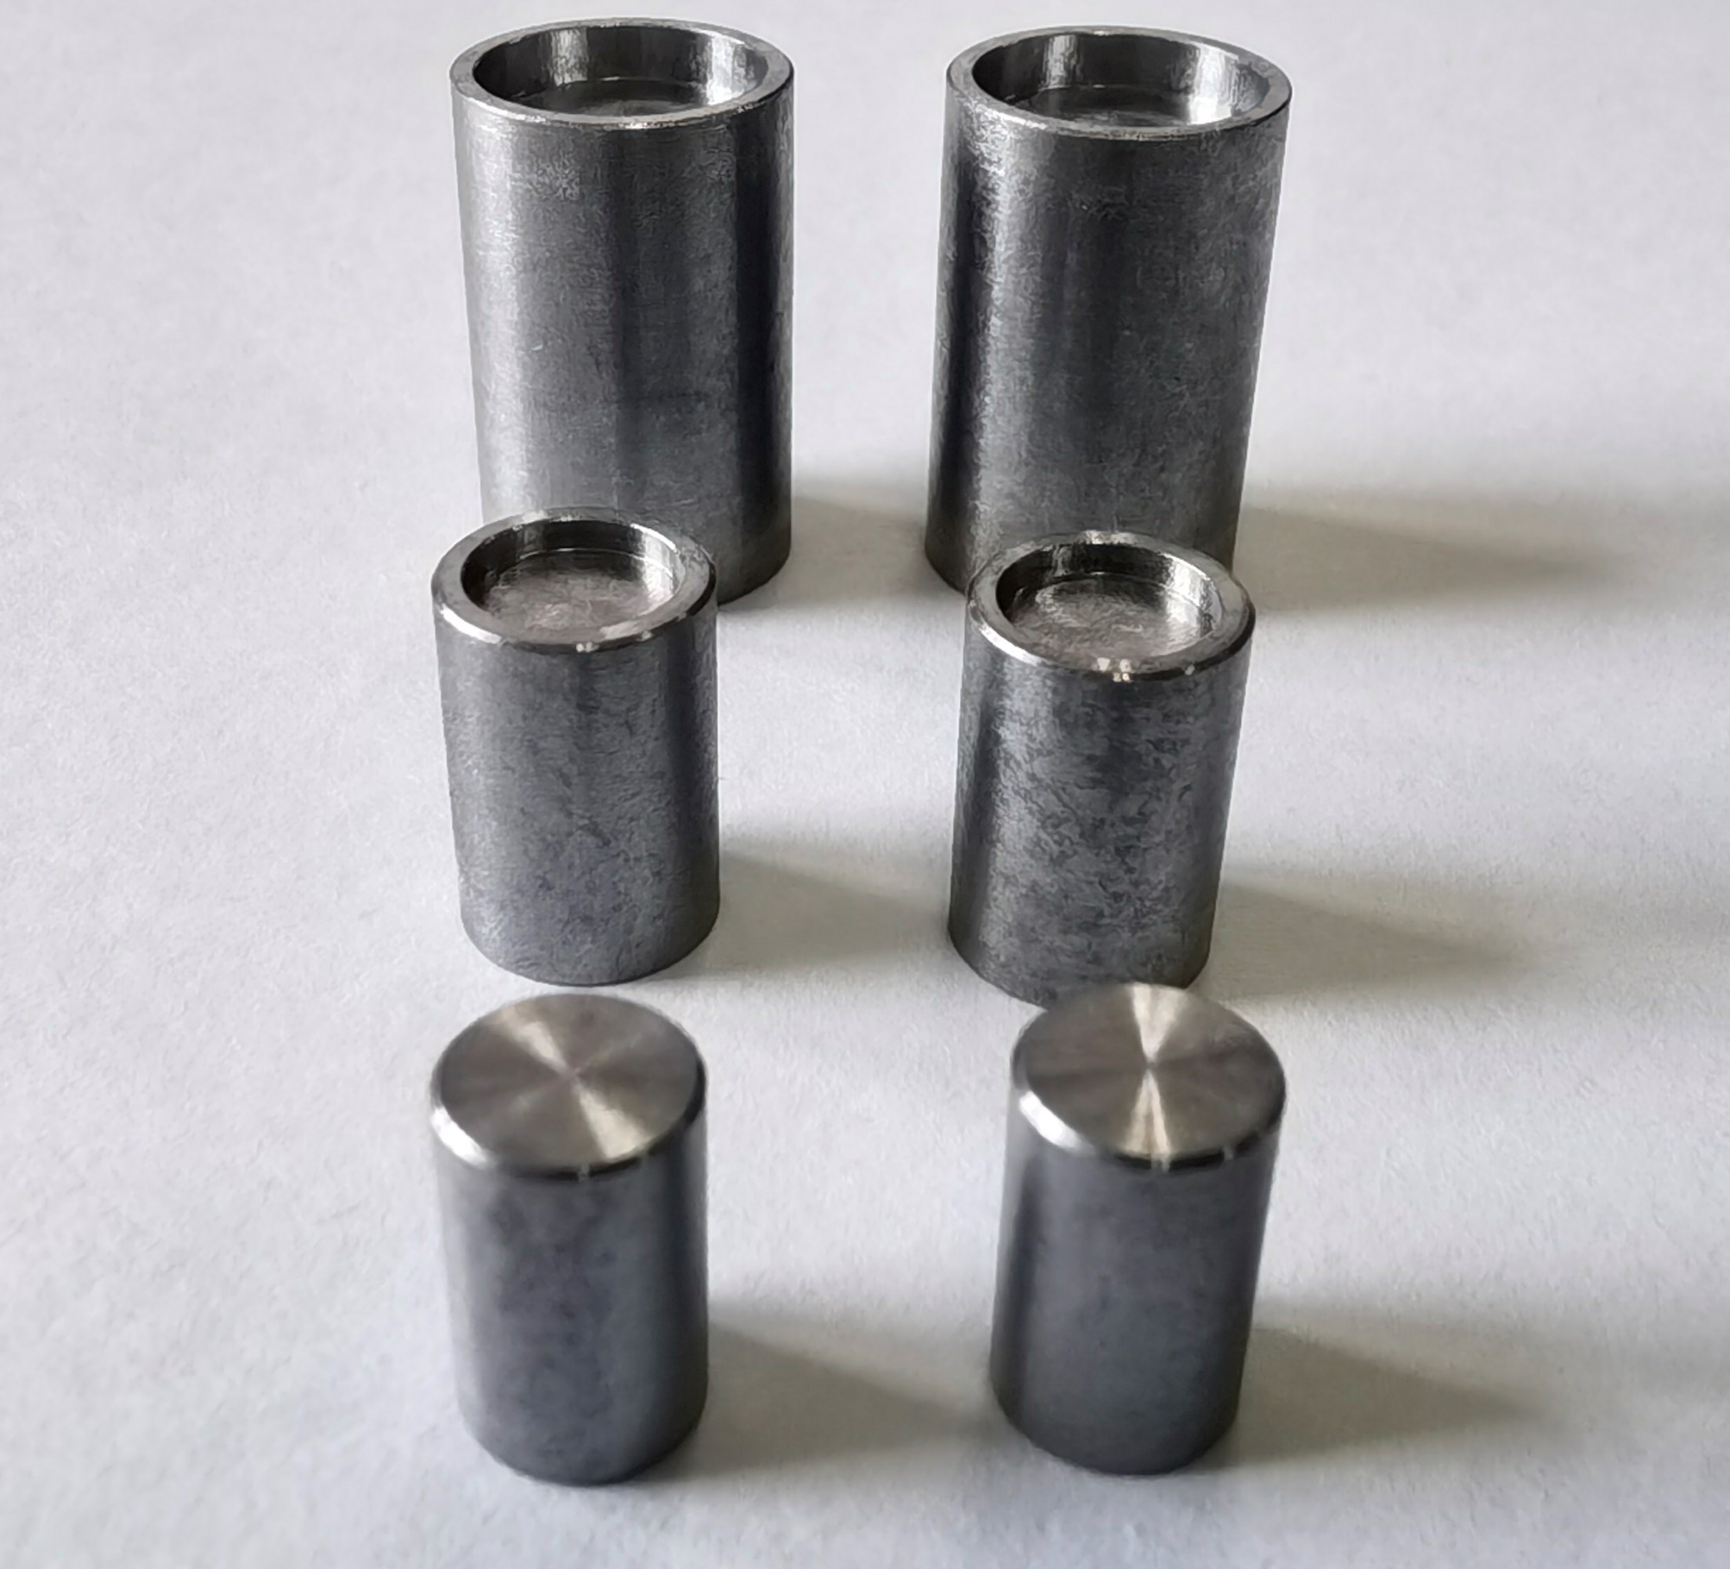
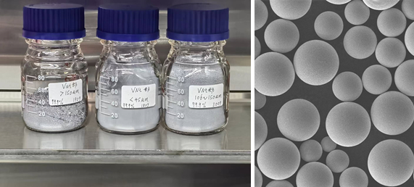
Sample environment
Non-matrix alloy
Background from V and non-matrix alloy
The Vanadium with some small peaks, and is difficult to removed.
Null-matrix alloy is a type of alloy with a zero or near zero neutron scattering cross-section, characterized by the absence of neutron diffraction peaks.
Null-matrix alloy is friendly for neutron scattering experiments, can be used as the beam windows of the samples environment.
CSNS have successfully prepared non-matrix alloy sample holders, plates, and supporting components for neutron scattering experiments.
Vanadium
Non-matrix alloy
Sample holders
plates
Supporting component
Powder

Slide 22
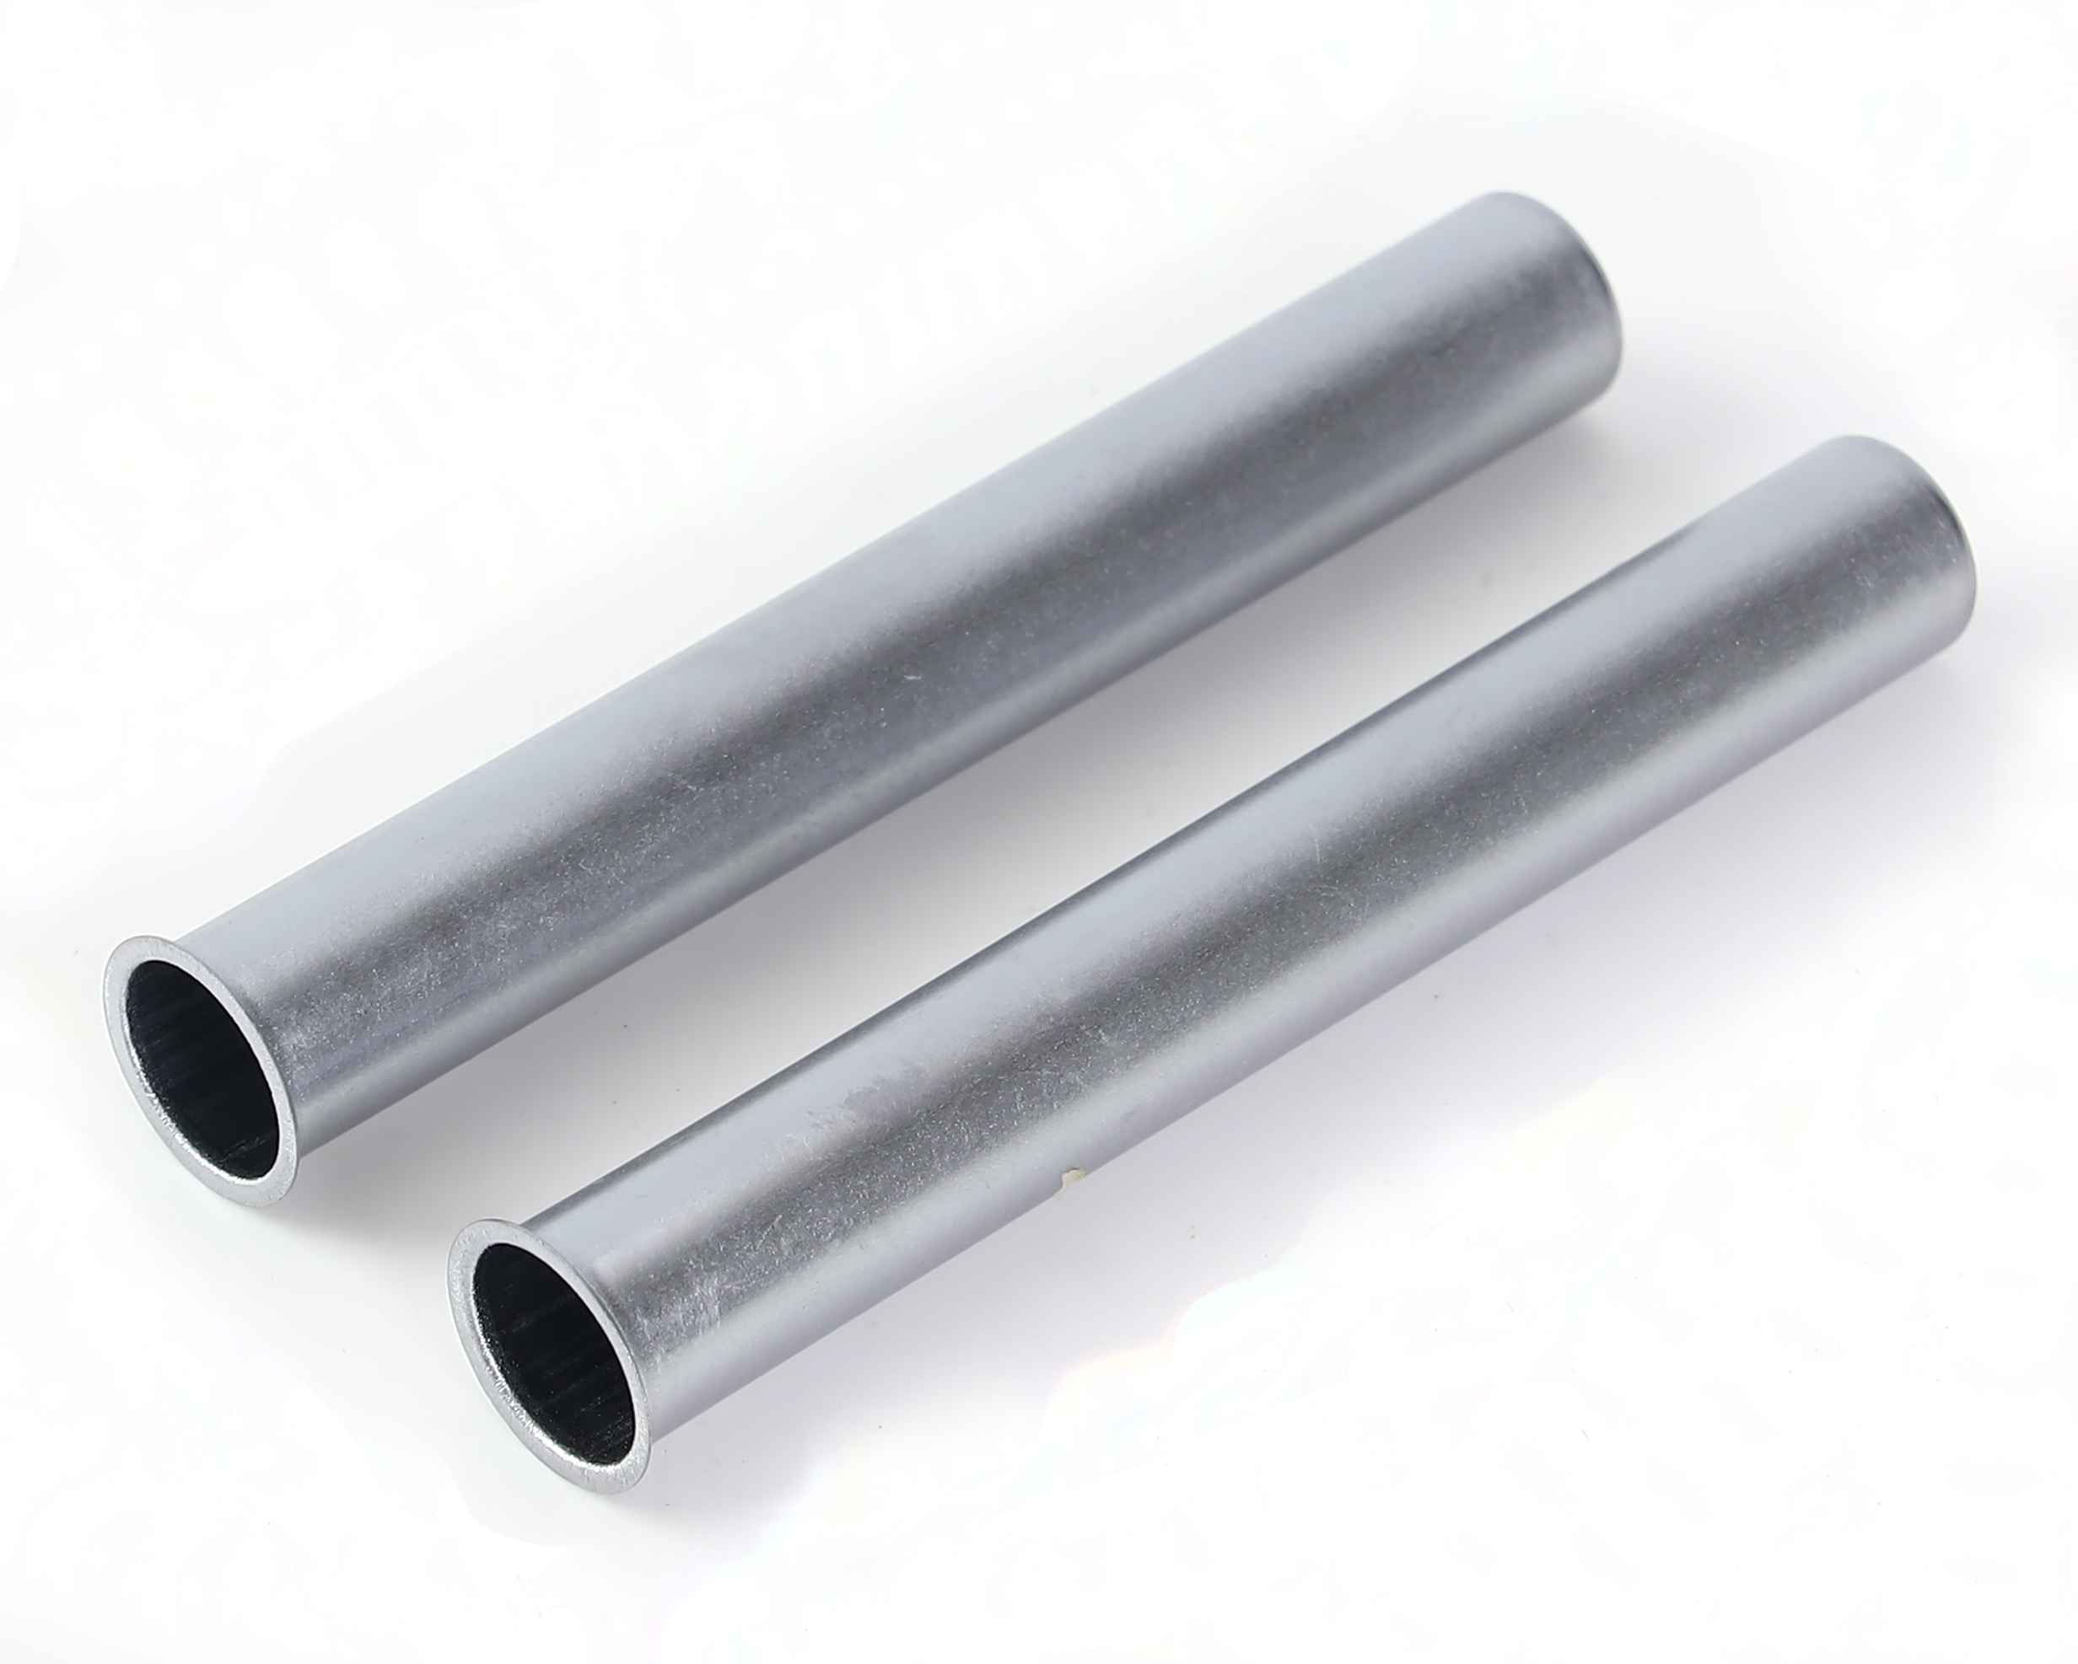
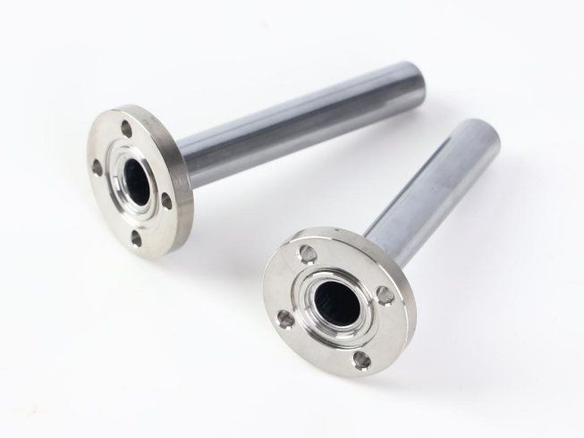


Sample environment
Non-matrix alloy sample holders
Type:CSNS-NV-10-SF
Wall thickness: 0.15 mm
Size: φ10(6)×75
Welding flange
Type:CSNS-NV-10-NF
Wall thickness: 0.15 mm
Size: φ10 (6)×75
flangeless
Type:CSNS-NV-10-WF
Wall thickness: 0.15 mm
Size: φ10 (6)×75
with assembled flange
Type: CSNS-NV-P
Thickess: 0.1~5 mm
Size: 300× 300 mm
Contact us:
hnjm6178@163.com
Or chenhuaican@ihep.ac.cn
Notes:
Now we can provide different sample holder for neutron experiment.
If you want, you can constat us.

Slide 23
Scientific Highlights
The MPI has been running for more than four years and has completed over 500 proposals.
Its research fields cover energy, glasses, alloys, functional materials, and others.
Applied proposals and finished
Research fields
Applied proposals
MPI finished
DGUT
Notes:
Since then,

Slide 24
Scientific Highlights
User Publications
MPI vs NOMAS and NOVA
Publications
2021
2022
2023
2024
2025
MPI
NOVA
NOMAD
From opening, the users have been published more than 190 papers, include Nature, Science, Nature Energy, Nature Sustainability, and JACS, and so on.
The number of published papers increases year by year.
Notes:
We have very hard work user,
we also compare with other total scattering neutron instrument,
As our publications show, we are at the same research level, so we think we're doing a great job with MPI.

Slide 25
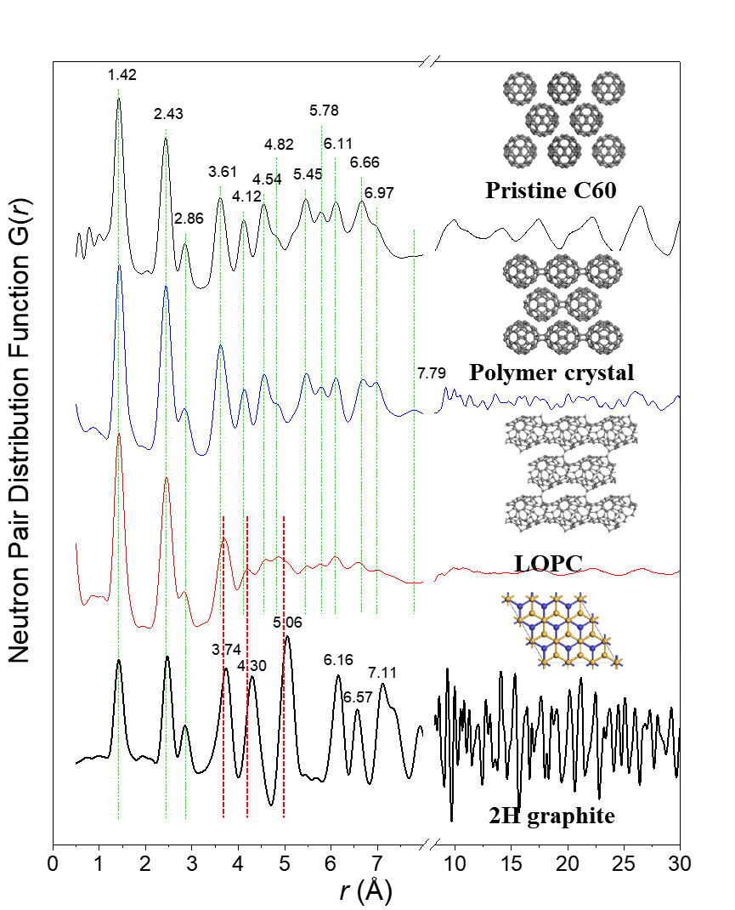
Scientific Highlights
Long-range ordered porous carbons (LOPC) produced from C₆₀
This research reports the gram-scale synthesis of a new type of carbon material, LOPC.
The nPDF was used to characterized the atomic-scale structure of the long-range ordered porous carbon (LOPC)
LOPC exhibited vanishing peaks due to significant disorder, whereas the C₆₀ polymer crystal retained more peaks, consistent with its more ordered structure.
Neutron total scattering provided crucial local structural information that complemented other techniques like XRD and TEM in confirming the unique, disordered yet long-range ordered nature of LOPC.
Nature 2023, 614, 95
Notes:
I will show some examples.
neutron total scattering provided crucial local structural information that complemented other techniques like XRD and TEM in confirming the unique, disordered yet long-range ordered nature of LOPC
LOPC exhibited vanishing peaks due to significant disorder, whereas the C₆₀ polymer crystal retained more peaks, consistent with its more ordered structure.
neutron total scattering was used to obtain the pair distribution function (PDF) for characterizing the atomic-scale structure of the long-range ordered porous carbon (LOPC)

Slide 26
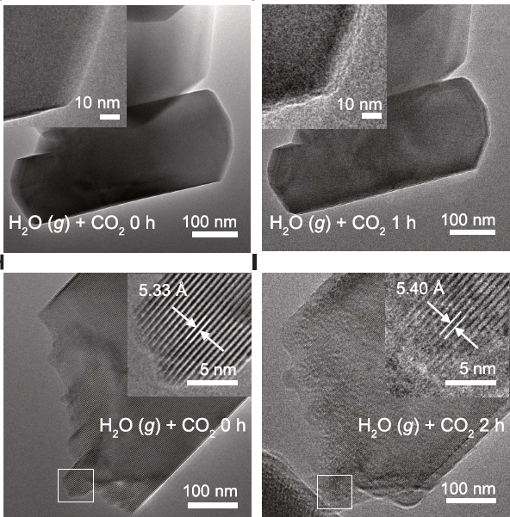
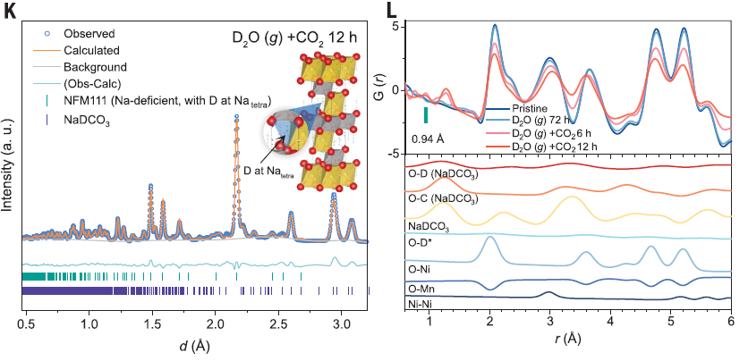
Scientific Highlights
Decoupling the air sensitivity of Na-layered oxides
NPD and nPDF confirmed that during acid degradation, protons intercalate into the tetrahedral sites of sodium-layered oxides, thereby providing key bulk structural evidence for revealing the degradation mechanism.
Science 385, 744–752 (2024)
Notes:
The study reveals that water vapor (H₂O) is not inherently destructive on its own but acts as a critical "bridge" that enables two distinct degradation pathways when coupled with other air components: Acid Degradation and Oxidative Degradation

Slide 27
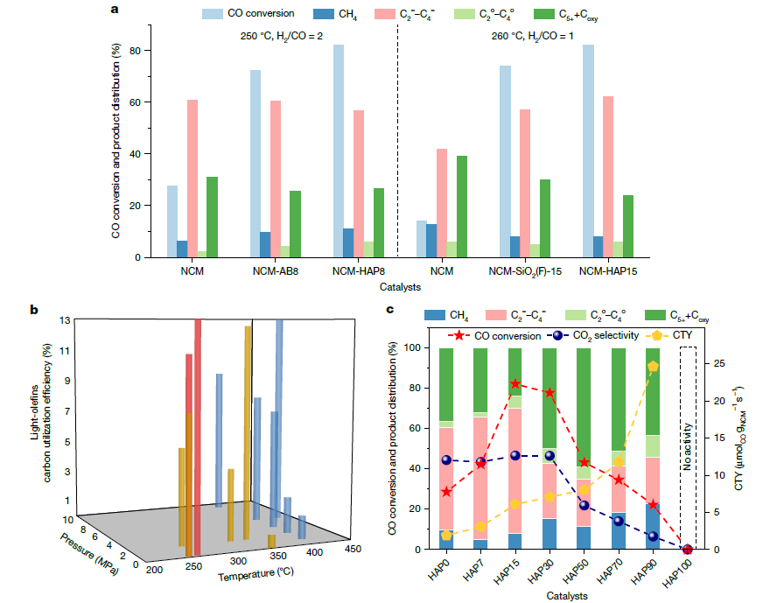

Scientific Highlights
Hydroxy-induced cobalt oxides for syngas to light olefins
Neutron diffraction was used to provide precise information on the crystal structure (particularly symmetry) and phase composition of the catalyst's active phases, which is crucial for understanding how the hydrophilic promotion strategy alters the catalyst structure and enhances performance.
Nature 652, 89–95 (2026)
Notes:
This study presents a novel hydrophilic strategy for the direct conversion of syngas (CO and H₂) into light olefins (ethylene, propylene, butylene) under mild conditions. They get Enhanced Performance of the catalyst
This design achieved high CO conversion (70–82%) and light olefin selectivity (>60%).

Slide 28






How to apply the beam time
Website：https://user.csns.ihep.ac.cn/
Contact us：chenhuaican@ihep.ac.cn
xujuping@ihep.ac.cn
Notes:
Tab

Slide 29
Summary
Multi-Physics Instrument (MPI) now is opening and we sincerely hope it will be a platform for disordered and ordered materials for neutron scattering users.
Welcome to apply the beamtime of the MPI! Welcome to join us!
Thanks for your attention!

