Slide 1
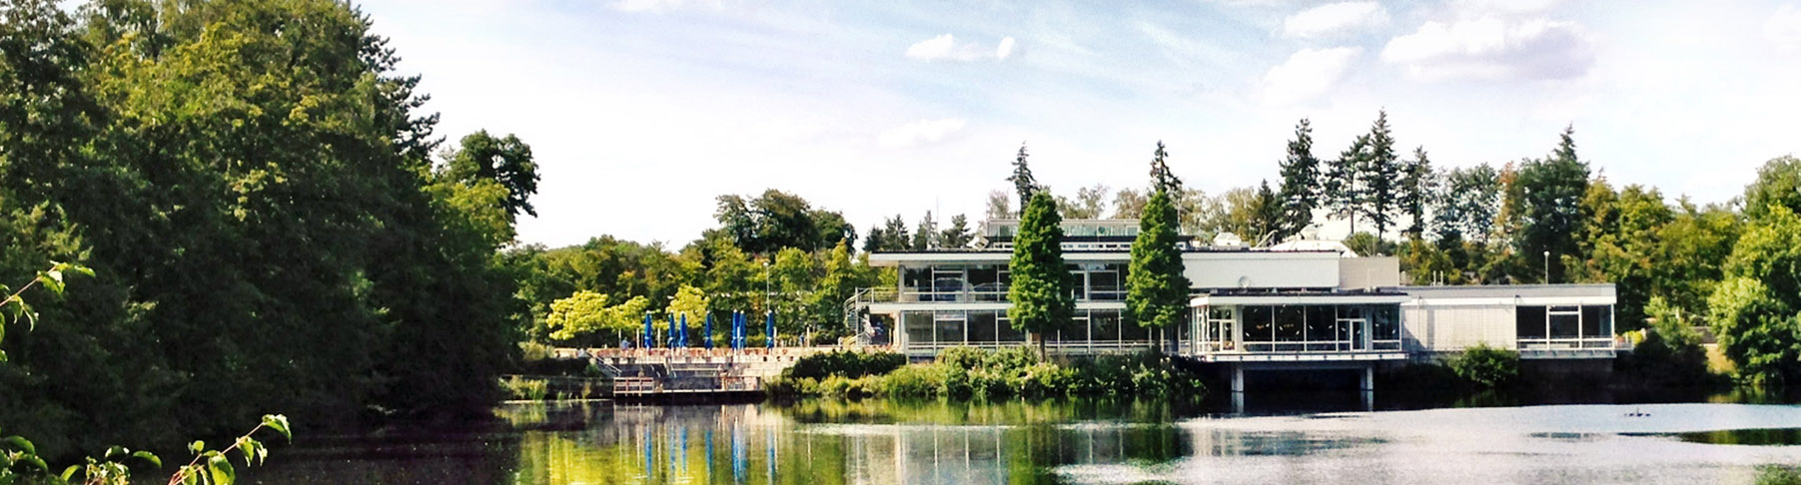
Feasibility Study of a Single Crystal Diffractometer for Biological Macromolecules at a High Brilliance Neutron Source
April, 16th, 2026 I Jialian He Supervisor: Tobias E. Schrader
Notes:
Good morning everyone. I am Jialian He, a postdoc from julich forschungszentrum. My supervisor is Tobias Schrader. Today I would like to present my work on the.

Slide 2
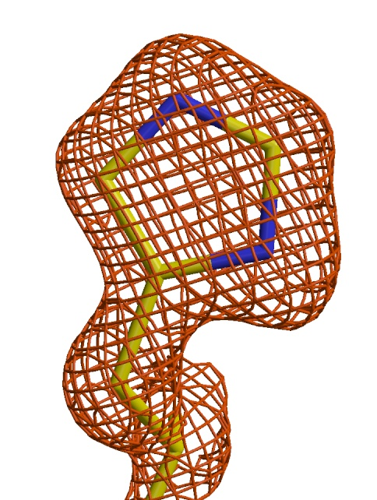
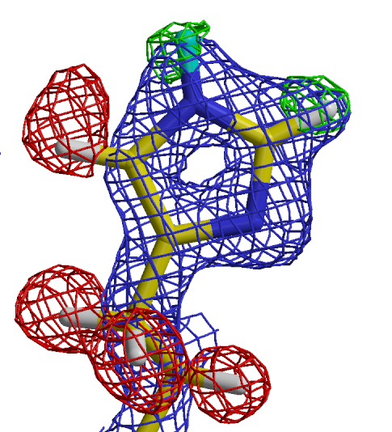
X-ray data versus neutron data on the same protein
X-ray d_{min}= 1.5Å:
neutrons d_{min}= 1.5Å:
65% D
80% D /
20% H
H
Nε2
Cε1
Nδ1
H
H
H
2Fo-Fc map; +1.5σ
2Fo-Fc map; +1.5σ
Fo-Fc omit-map; -3.0σ
Fo-Fc omit-map; +3.0σ
Much less radiation damage as compared to x-rays: Metallo-proteins can be measured without reducing the metal centres
Niimura N, Chatake T, Ostermann A, Kurihara K, Tanaka T. (2003) Z. Kristallogr. 218:96
Notes:
X-ray can give overall structure of protein, but they cannot reliably locate hydrogen atoms.
On the right, we have neutron data at the same resolution. Here, we can directly observe hydrogen and deuterium atoms,as well as their occupancies and positions.
The location of hydrogen atoms is essential in studying the biological process.
Even a single hydrogen atom can change our understanding of a biological mechanism.
In addition, neutrons cause much less radiation damage, which makes it possible to study sensitive systems like metallo-proteins without reducing the metal centers.

Slide 3
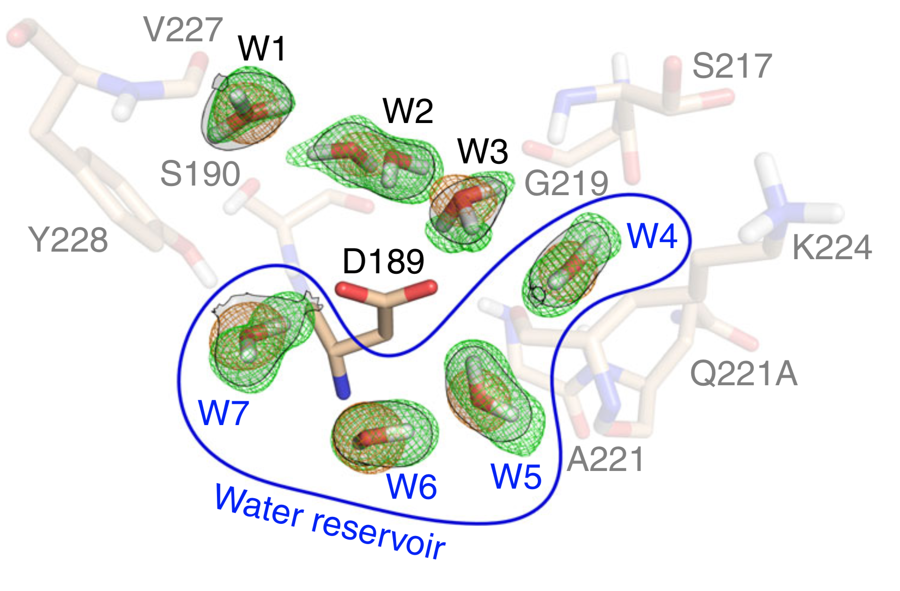
Water structure in binding pocket of the unliganded form of trypsin:
d_{min} = 1.45Å
neutron Fo-Fc omit-map 4σ
X-ray 2Fo-Fc map 1.5σ
the ligand-free binding pocket is occupied by water molecules
characterized by a paucity of H-bonds and high mobility
Schiebel J. et al., Nat. Commun. (2018), 9:3559
Notes:
A very nice example of this is the water structure in the binding pocket of trypsin.
Here, neutron data reveal several water molecules inside the ligand-free binding pocket.
These water molecules are weakly bound and highly dynamic.

Slide 4
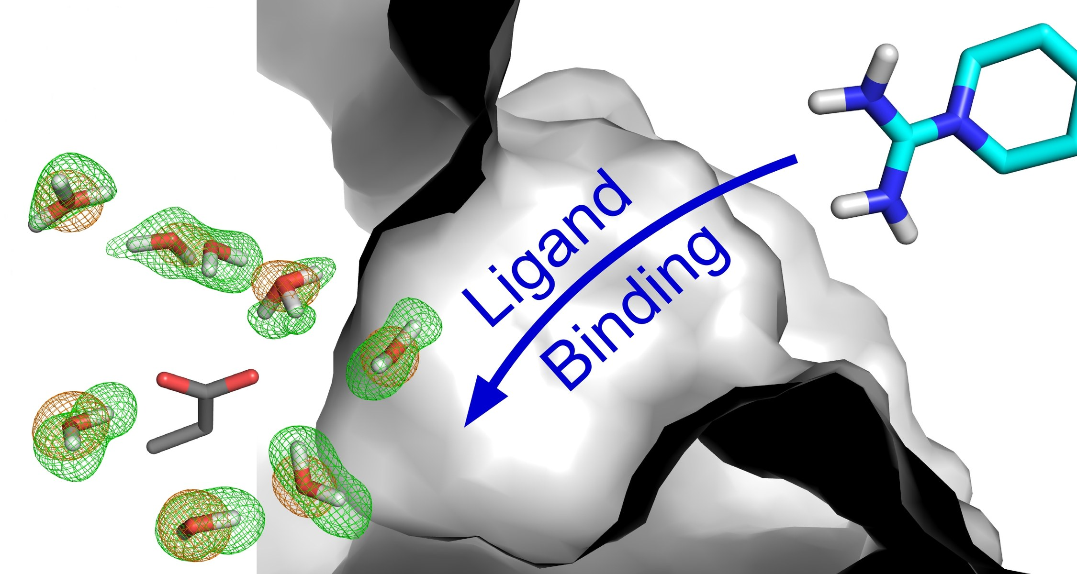
Water structure in binding pocket of the unliganded form of trypsin:
d_{min} = 1.45Å
binding
pocket
Asp189
It is likely that this phenomenon can be a key factor
in fuelling ligand binding via water displacement
Schiebel J. et al., Nat. Commun. (2018), 9:3559
Notes:
When a ligand binds, these water molecules are displaced.
This displacement contributes significantly to the binding free energy.
So understanding hydrogen and water is essential for understanding ligand binding mechanisms.

Slide 5
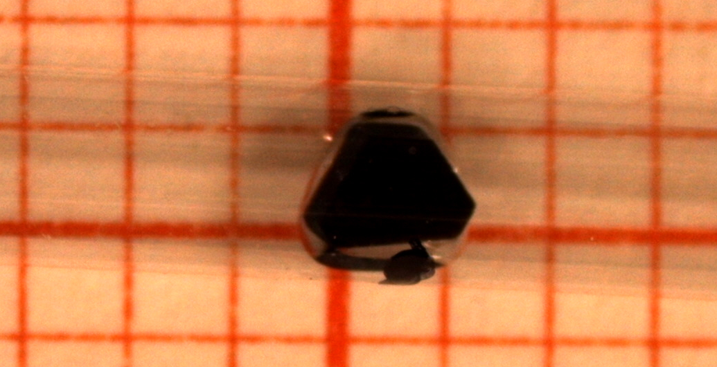
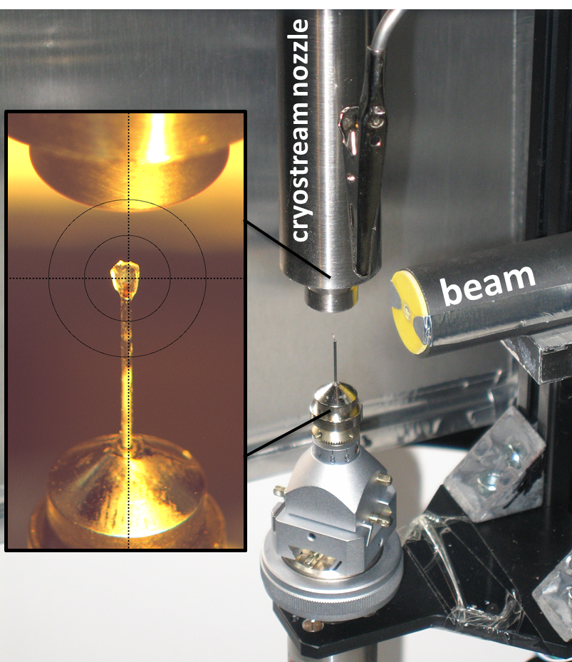
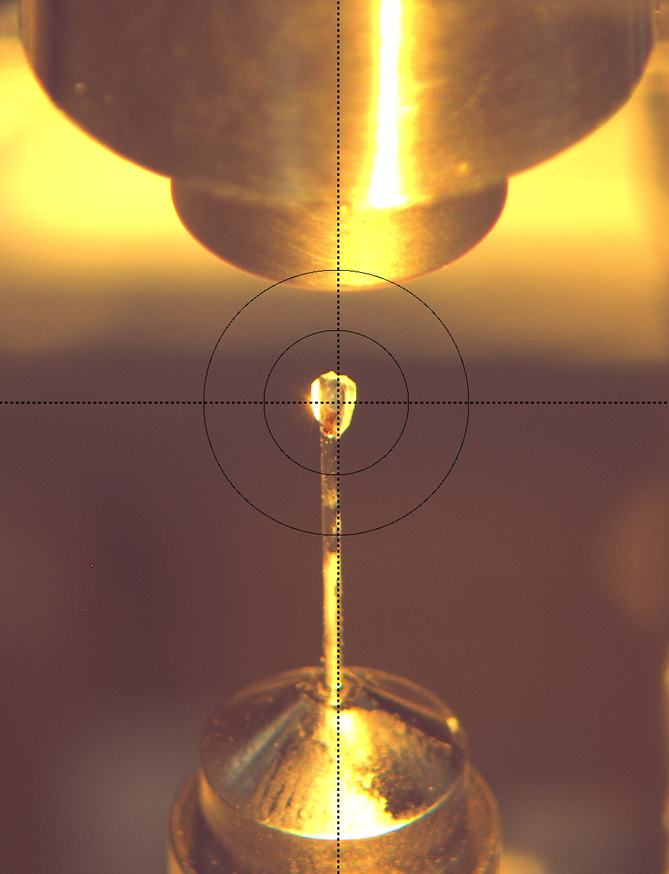
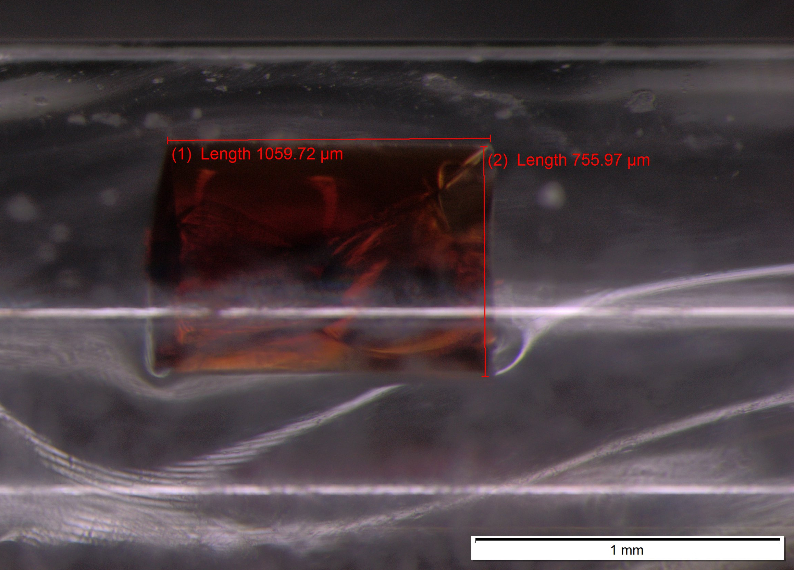
Protein crystal necessary for this method
Typical:
1 mm³
Minimal:
0.1 mm³
Cryostream at 100 K
Room temperature
Notes:
However, neutron protein crystallography also comes with challenges.
They require relatively large protein crystals, the size is typically between 0.1 and 1 mm³. This is because neutron flux is relatively low, so we need larger samples to obtain sufficient signal.
So overall, neutron protein crystallography is powerful, but they also require more demanding sample preparation.

Slide 6
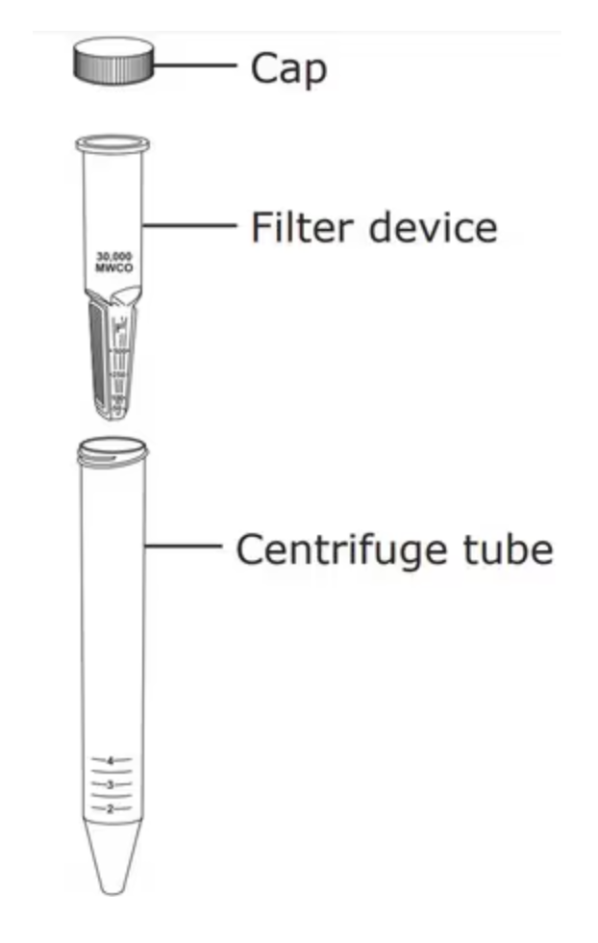
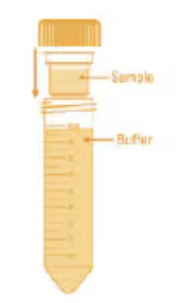
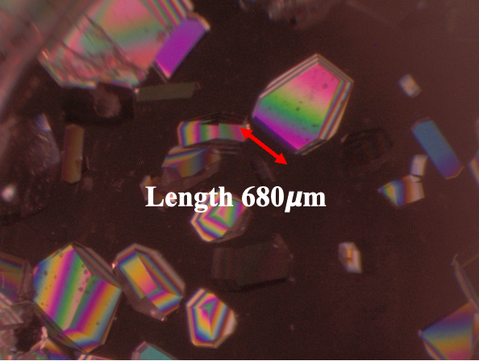
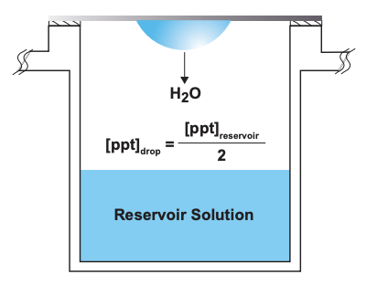
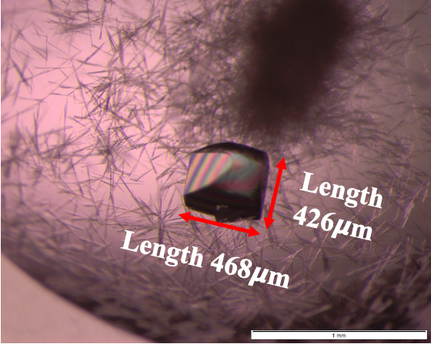
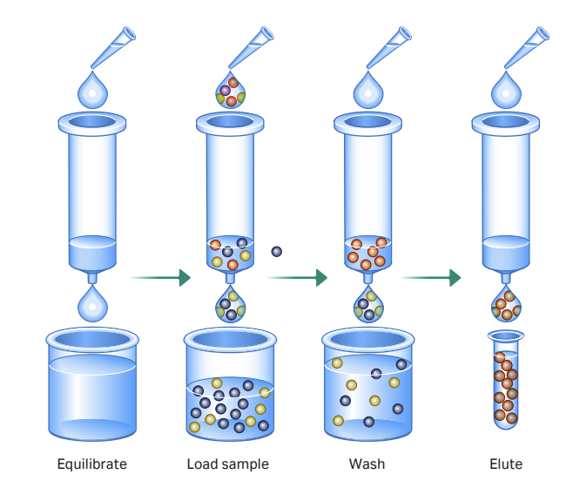
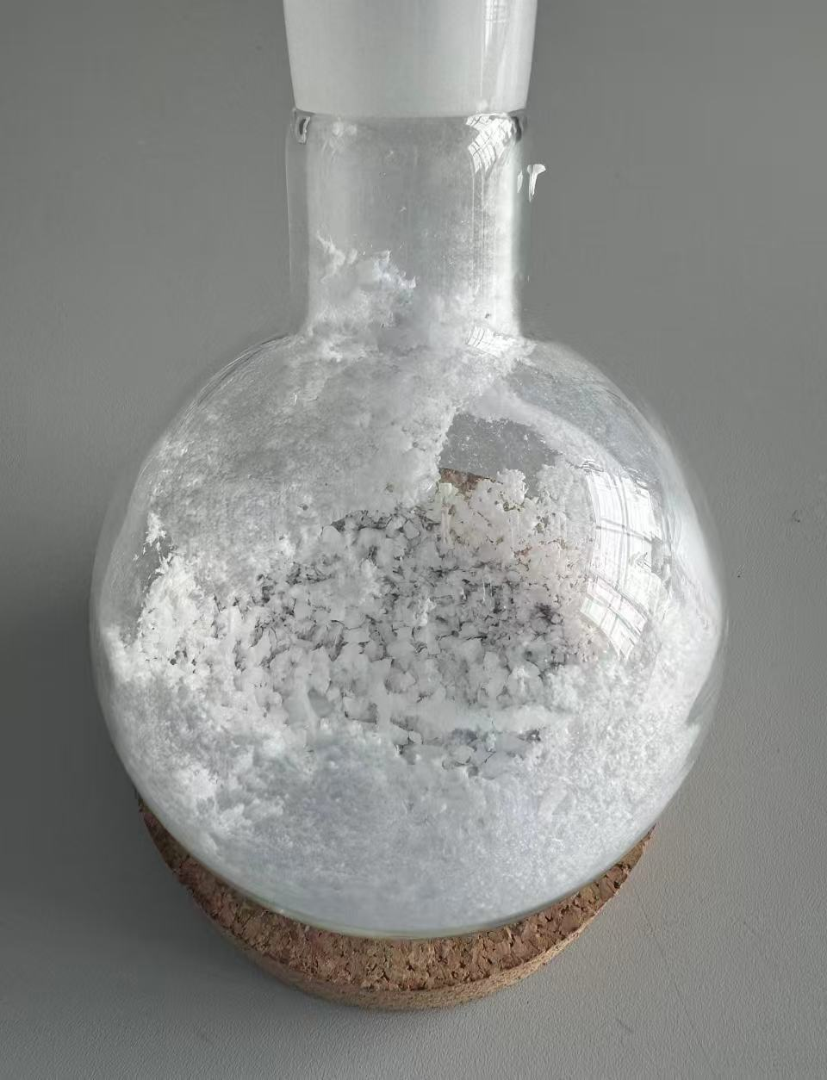
Crystallization
Purification
Stock solution
Siliconized coverslip
buffer (D₂O)
D₂O
buffer removal
dissolved
Streptavidin in D₂O
Dialysis
Centrifuge
Crystallization droplet:
5𝜇l ST/STB
+5𝜇l buffer
Crystal
Desalting
Freeze drying
Notes:
deuterition buffer removal, wirte" buffer removal", change the buffer,

Slide 7
What is the accessible market place?
Accessible for neutron protein crystallography: Here, Protonation states and proton positions can be determined.
But many proteins are not enzymes, so the protonation states are not so relevant...
Notes:
So, after discussing the capabilities of neutron protein crystallography, the next question is: what is actually the accessible market for this technique?
On this slide, it shows the distribution of X-ray structures as a function of resolution. Most protein structures fall into the resolution range between 1.0 and 2.5 Å,
This is important because this resolution range is also accessible for neutron protein crystallography.
That means, in principle, a large number of already known protein systems could be re-investigated using neutrons.
However, not all proteins require hydrogen information. So the relevant market is focused on systems where protonation states and hydrogen bonding are critical.

Slide 8

World map of neutron diffractometers optimized for protein crystals
MaNDi@SNS
Imagine@HFIR
iBIX@J-PARC
BIX-3 and BIX-4
In construction:
NMX@ ESS
LADI@ILL
LADI-B@ILL
BioDiff@FRMII: unit cells <100 Å for the next 2 years
Notes:
At the same time, the number of available instruments worldwide is very limited.
The iBix in Japan is not easily accessible for other countries. The Mandi and Imagine in US are not easy to apply for and go to take an experiment. The only options for us are LANDI in ILL and Biodiff in FRMII. But Biodiff is not available now. So we have submitted a proposal to ILL.
Access is therefore highly constrained.
This is particularly critical because: neutron experiments require large crystals and long beam time
So even at existing facilities, the throughput is relatively low.
Therefore, there is a clear need for more accessible instruments for biological macromolecules

Slide 9
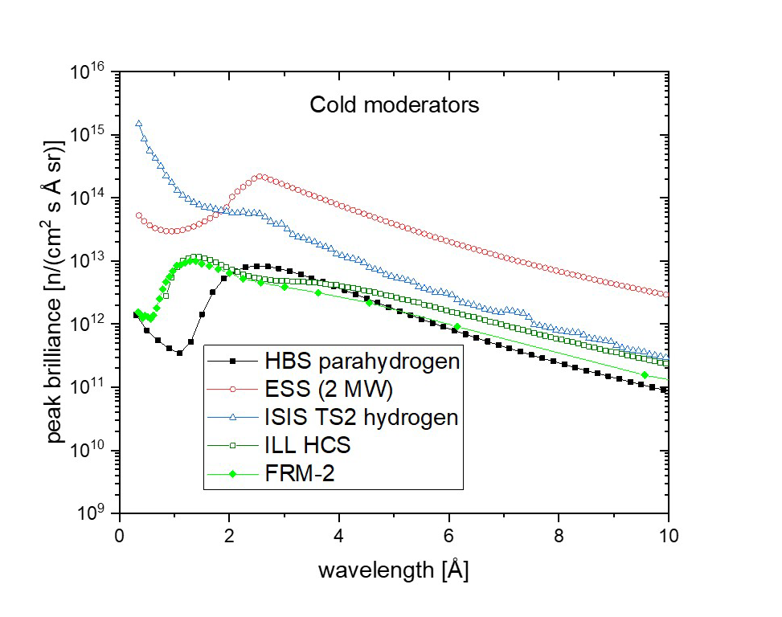
Thermal versus cold Moderator of HBS
Simulated brilliance as a function of wavelength of the 24 Hz HBS target
station for the cold moderator (right) in comparison with simulated
brilliance values of neutron facilities that exist or are under construction
Source: Techical Design Report of HBS
Notes:
So whether HBS can provide competitive performance.
On this slide, it shows the simulated brilliance as a function of wavelength for the 24 Hz HBS cold moderator shown as the black line, compared to existing and upcoming neutron facilities. The x-axis shows the wavelength, and the y-axis shows the peak brilliance.
What we can see is that: In the wavelength range around 2 to 4 Å, which is typically used for protein crystallography, the brilliance of HBS is comparable to existing facilities.
Therefore, HBS is a viable source for neutron protein crystallography.

Slide 10
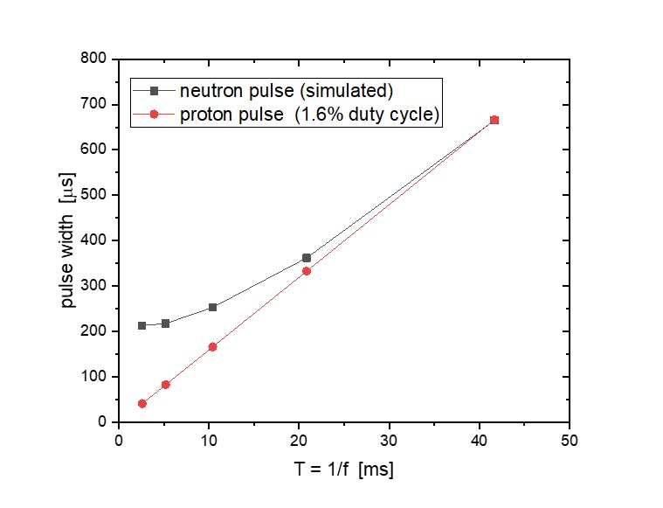
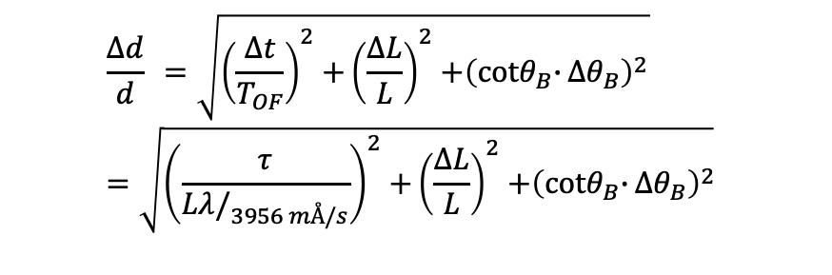
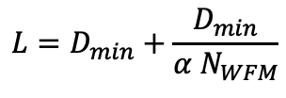
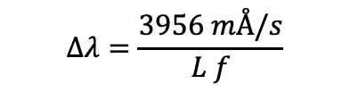
Main instrument parameters
Band width:
$$Δλ=\frac{3956 mÅ/s}{L f}$$
24 Hz
$$\frac{Δd}{d} =\sqrt{{\left(\frac{∆t}{T_{OF}}\right)}^{2}{+\left(\frac{ΔL}{L}\right)}^{2}+{\left({cotθ}_{B}{∙}Δθ_{B}\right)}^{2}} =\sqrt{{\left(\frac{τ}{{Lλ/}_{3956 mÅ/s}}\right)}^{2}{+\left(\frac{ΔL}{L}\right)}^{2}+{\left({cotθ}_{B}{∙}Δθ_{B}\right)}^{2}}$$
Resolution:
96 Hz
dominating for short wavelengths
negligible for long instruments
dominating in forward scattering
f: source frequency
α: duty cycle
τ: pulse length
L: instrument length
D_{min}: min. chopper distance
λ: wavelength
θ_{B}: Bragg angle
N_{WFM}: number of frames in wavelength frame multiplication
Improved resolution by pulse shaping requires instrument length:
$$L=D_{min}+\frac{D_{min}}{α N_{WFM}}$$
Notes:
Based on the available brilliance, we can define the main instrument parameters of the diffractometer.
First, the wavelength bandwidth is given by this formula meaning that longer instruments and higher frequency lead to a smaller bandwidth.
The resolution can be expressed as a combination of three contributions: the time term, the geometrical term, and the angular term.
The first term is the time resolution term. Here, delta t mainly comes from the pulse width. For short wavelengths, the time term is important,
The second term is the path length uncertainty, delta L over L. For long instruments, this contribution is usually negligible for the total resolution .
The third term is the angular contribution, which is proportional to cotangent of the Bragg angle times delta theta. This means that at small Bragg angles, cot(theta) becomes very large.
The angular uncertainty itself comes from: beam divergence sample size and detector resolution
Therefore, for small scattering angles, the angular term becomes critical.
This is why pulse shaping is essential if we want to improve the resolution. However, improving resolution requires a longer instrument.
This is also illustrated on the right: lower frequency sources, like 24 Hz, have longer pulse widths, which require longer instruments to achieve good resolution.
So overall, we need to balance bandwidth, resolution, and instrument length.
And this leads directly to our design choices for the HBS macromolecular diffractometer.
However, resolution alone is not sufficient — we also need to consider how strong the measured signal is.

Slide 11
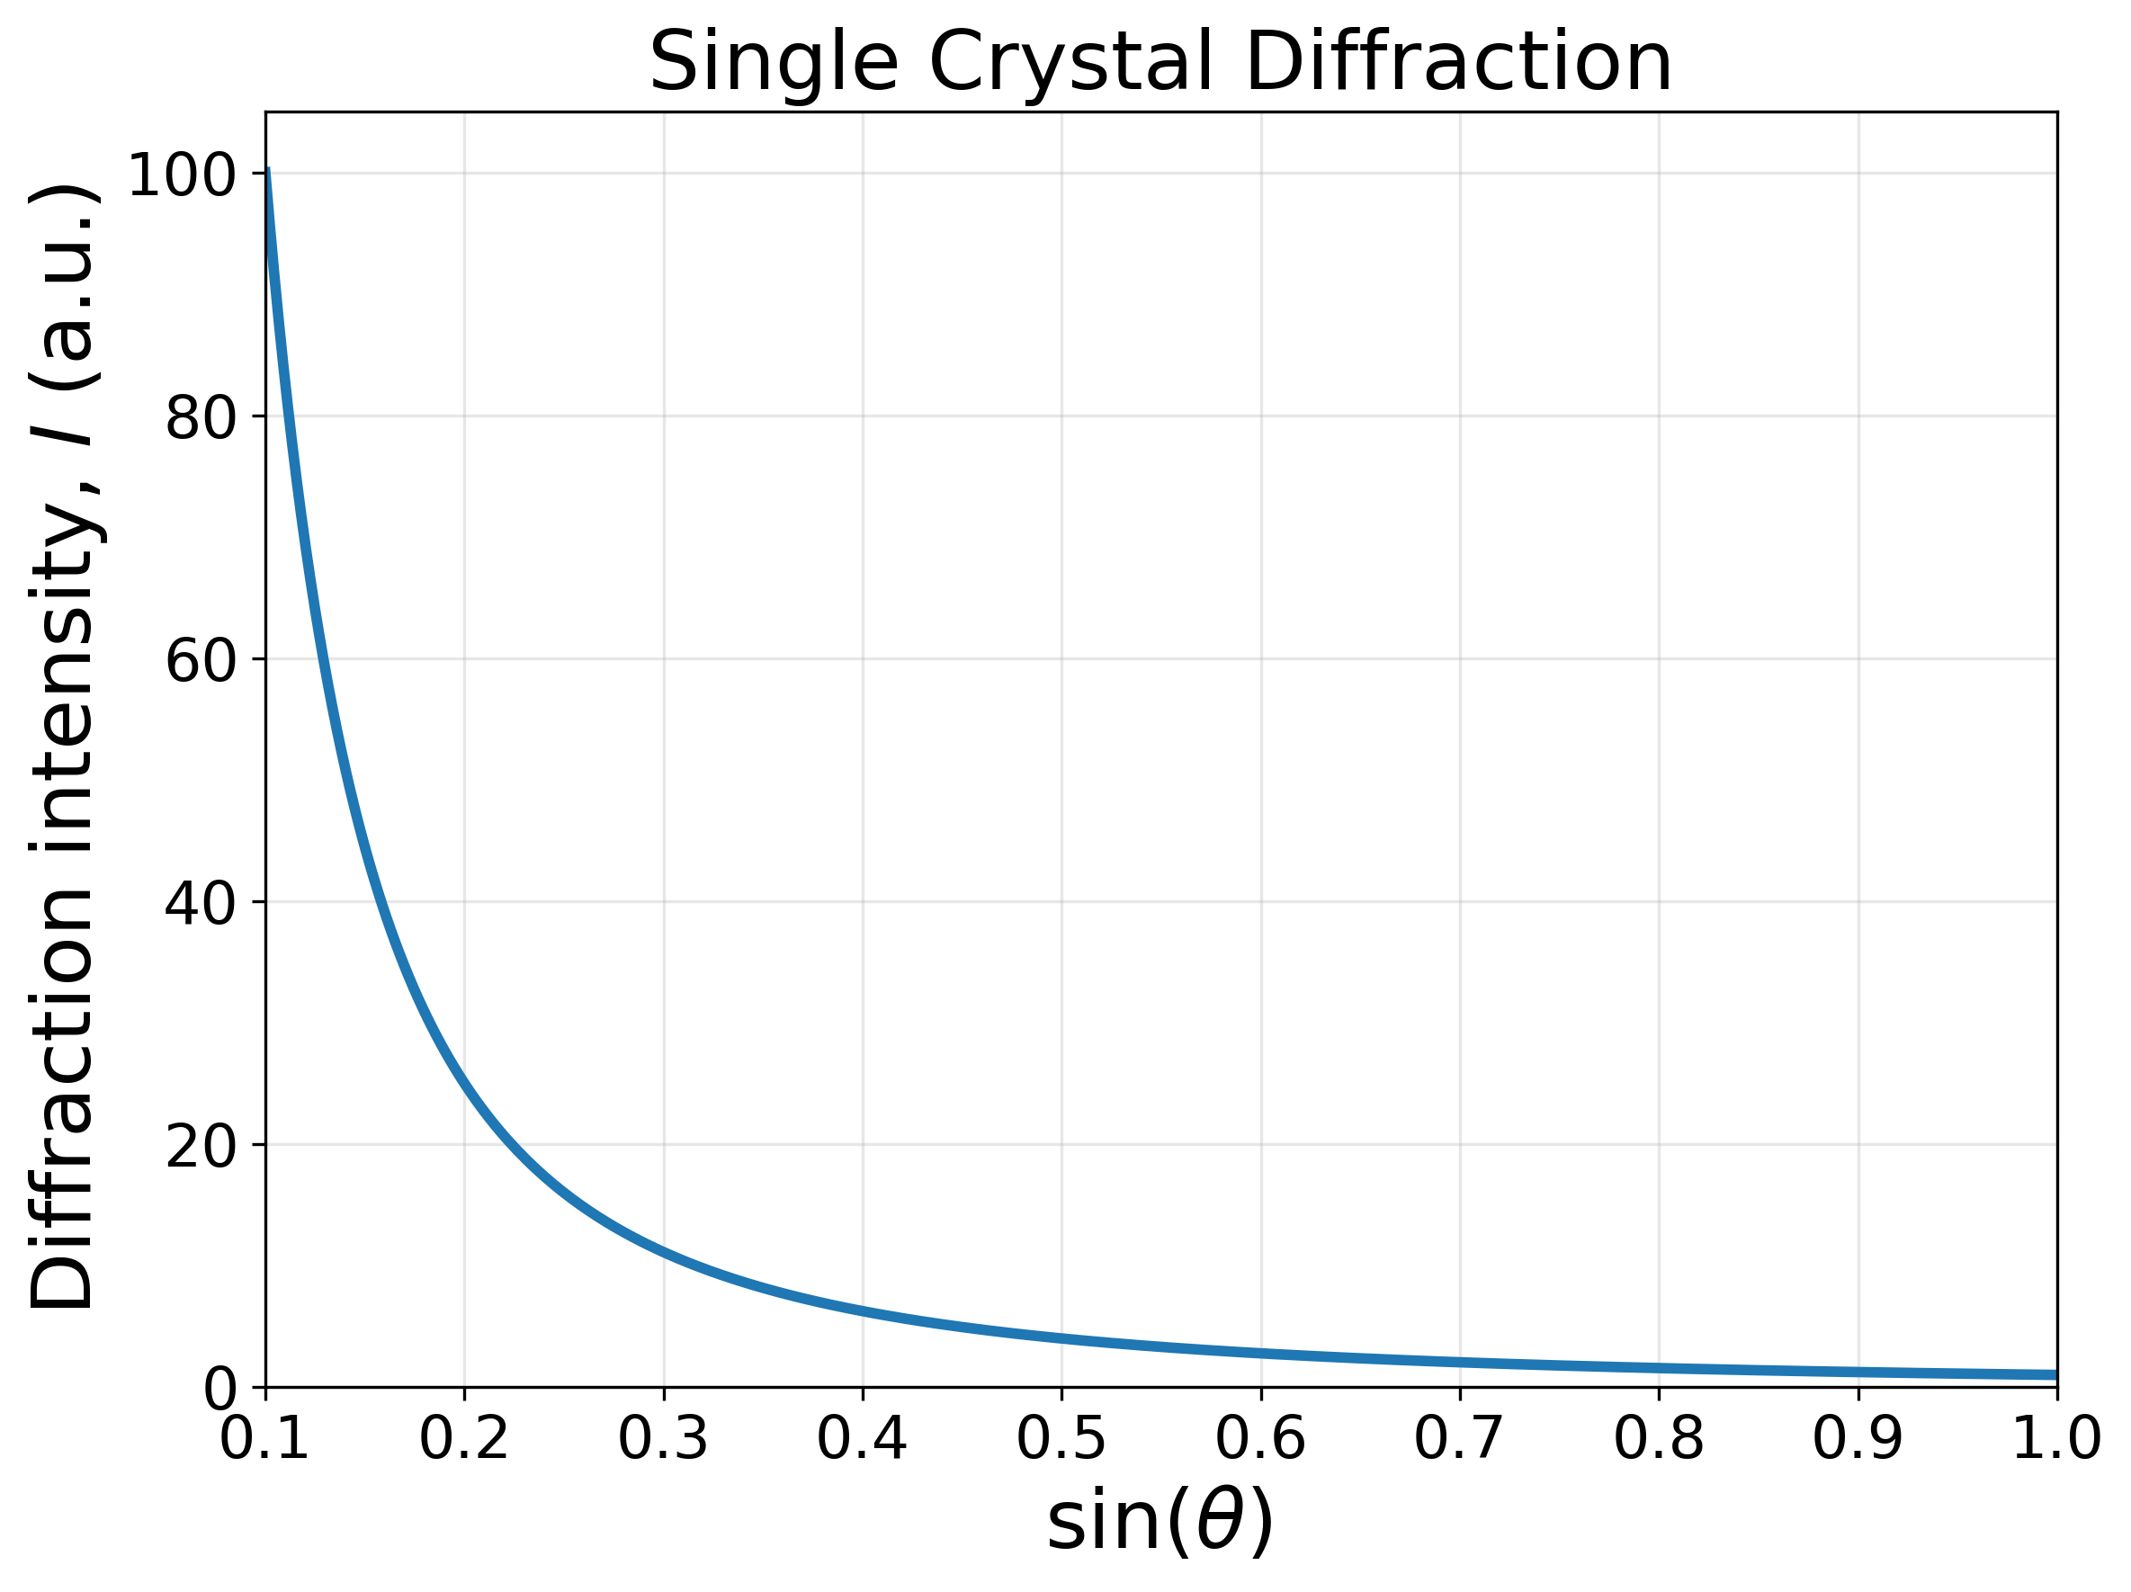
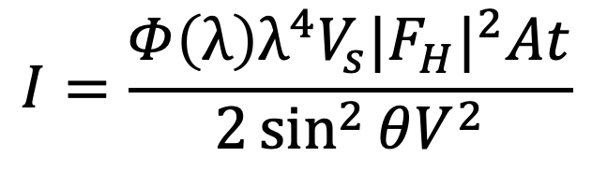
diffracted intensity
$$I=\frac{Φ\left(λ\right)λ^{4}V_{s}{|F_{H}|}^{2}At}{2\sin^{2}{θV^{2}}}$$
Φ(λ): the time-averaged differential flux at the sample
V_{s}: the sample volume
V: the unit cell volume
|F_{H}|: the structure factor amplitude
A: the transmission factor
t: the counting time
The high-resolution reflections have to compete with the noise coming from incoherent scattering from the sample itself;
Another noise source is scattering from the air around the sample in the vicinity of the detector.
Notes:
The diffracted intensity is given by this expression.
The integrated intensity of a Bragg reflection is given by:the neutron flux the wavelength the sample volume the structure factor and the counting time
An important term here is the angular dependence, which appears as 1 over sin²θ. This means that the intensity strongly depends on the scattering angle.
As shown in the plot, the intensity decreases rapidly with increasing $\sin{θ}$, meaning that reflections at higher angles — that is, higher resolution reflections — are much weaker.
This is why low-angle reflections are usually strong and easy to measure, while high-resolution reflections at large angles are much weaker.
At the same time, these high-resolution reflections have to compete with background noise, mainly from incoherent scattering in the sample and from air around the detector.

Slide 12
Optimizing parameters
Application
Scattering experiments on large single crystals
Concept and requirements
Flux
Divergence: ±0.4 °
Sample size: ≤2mm³
Choices
Low frequency (24Hz, 1042𝜇s)
70 m length (moderator to sample)
Characteristics
Bandwidth: 2 Å, standard: 2-4 Å
Resolution: ~2%
Target
&
Moderator
Sample
&
Detector
Tapering guide
1st focal point
2nd focal point
source_focus_xw
0m
0.5m
39.6m
40m
guide_linw
guide_loutw
(1) source_focus_width (m);
(2) guide_linw (m);
(3) guide_loutw (m).
Notes:
This schematic shows the basic layout of the instrument.
The main requirements are a high neutron flux, a controlled divergence of about ±0.4°, and a sample size up to 2 mm³.
Based on the earlier discussion, we choose the low frequency of 24 Hz and an instrument length of about 70 meters.
This is necessary to achieve the desired resolution.
With this design, we would like to choose a bandwidth of 2A, typically 2-4 and to obtain a resolution of approximately 2%
To achieve this, We use an elliptical guide geometry and focus on optimizing three key parameters of the guide system
the source focus width is the Width of the target.
guide_linw (m) is the distance from 1st focal point to real guide entry.
guide_loutw (m) is the distance from real guide exit to 2nd focal point.

Slide 13
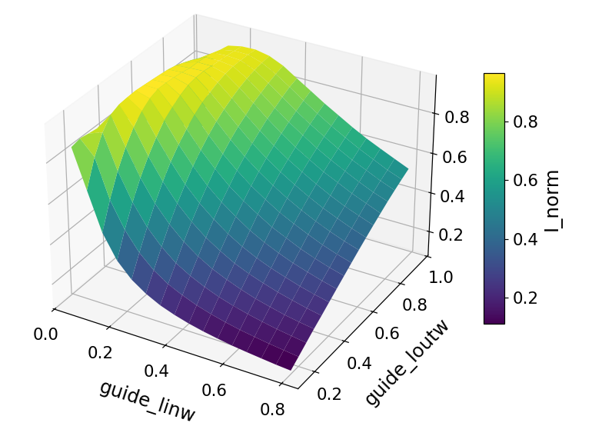
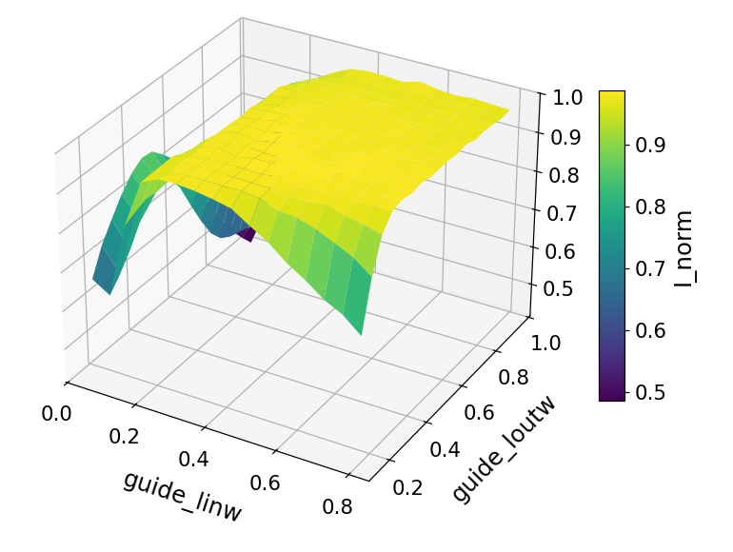

Tapering guide optimization
source_focus_width=0.004m
source_focus_width=0.012m
Normalized Intensity
Normalized Intensity
guide_linw
guide_loutw
guide_loutw
guide_linw
source focus width (m): Width of the target
guide_linw (m): distance from 1st focal point to real guide entry
guide_loutw (m): distance from real guide exit to 2nd focal point
Notes:
Here, we study how the elliptical guide geometry affects the neutron intensity.
The two plots show the normalized intensity as a function of the three parameters.
Although the intensity is slightly higher with bigger source_focus_xw. Regarding the small size of sample below 2 square milimeter, we prefer the smaller source_focus_xw since it can provide smaller divergence distribution.

Slide 14
Tapering guide optimization
source_focus_width=0.004m
Parameters:
Source_radius: 0.012m
Frequency: 24Hz
Intensity: 2.85*10¹¹ n/cm²/sr
Wavelength band: 2-4 Å
Detector size: 2mm * 2mm
Divergence: ±0.4 °
Normalized Intensity
source_focus_xw=0.004m,
guide_linw=0.2m,
guide_loutw=1.0m.
The highest of the guide width: 0.019m
guide_loutw
guide_linw
Flux=3.28*10⁶ n/s/cm²
Brilliance transfer: 90.2%
Notes:
Based on this optimization, we select a specific set of parameters.
This configuration results in a neutron flux of approximately $3.3×{10}^{6}$neutrons per second per square centimeter at the sample position.
we achieve a brilliance transfer of about 90%, indicating that the guide efficiently transports the neutron phase space with minimal losses.
Under these conditions, the maximum guide width is about 19 mm, which is feasible in the engennering part

Slide 15
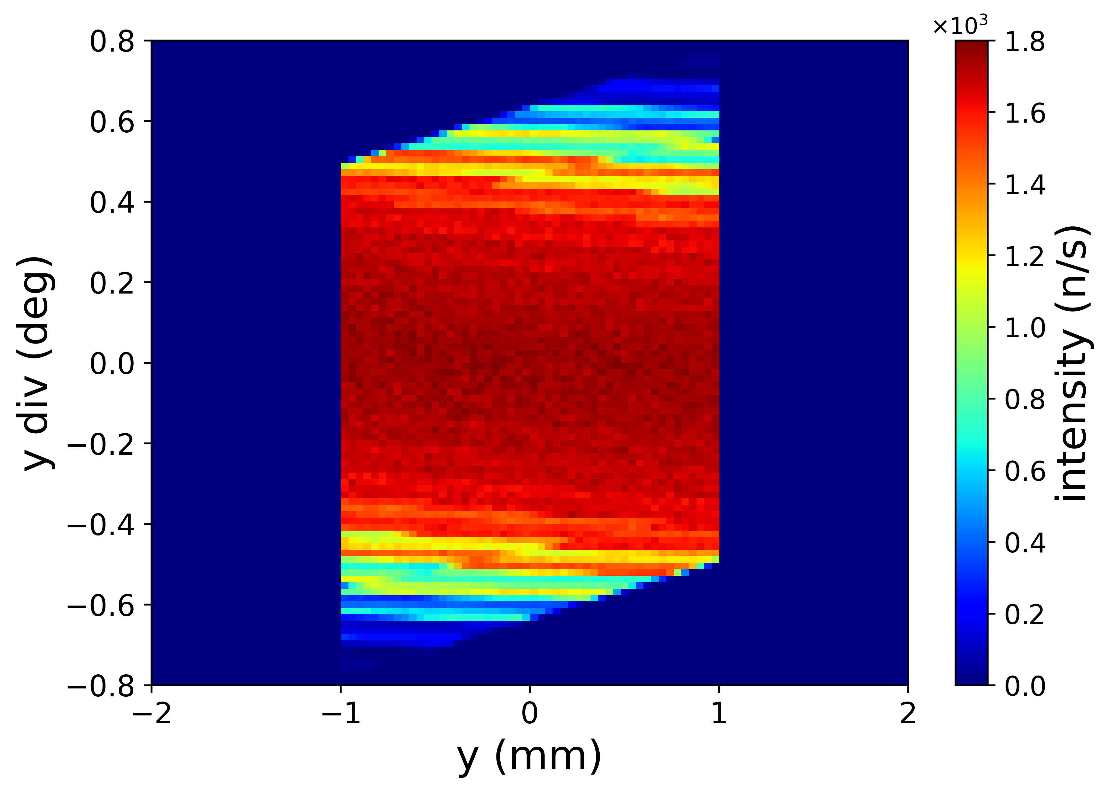

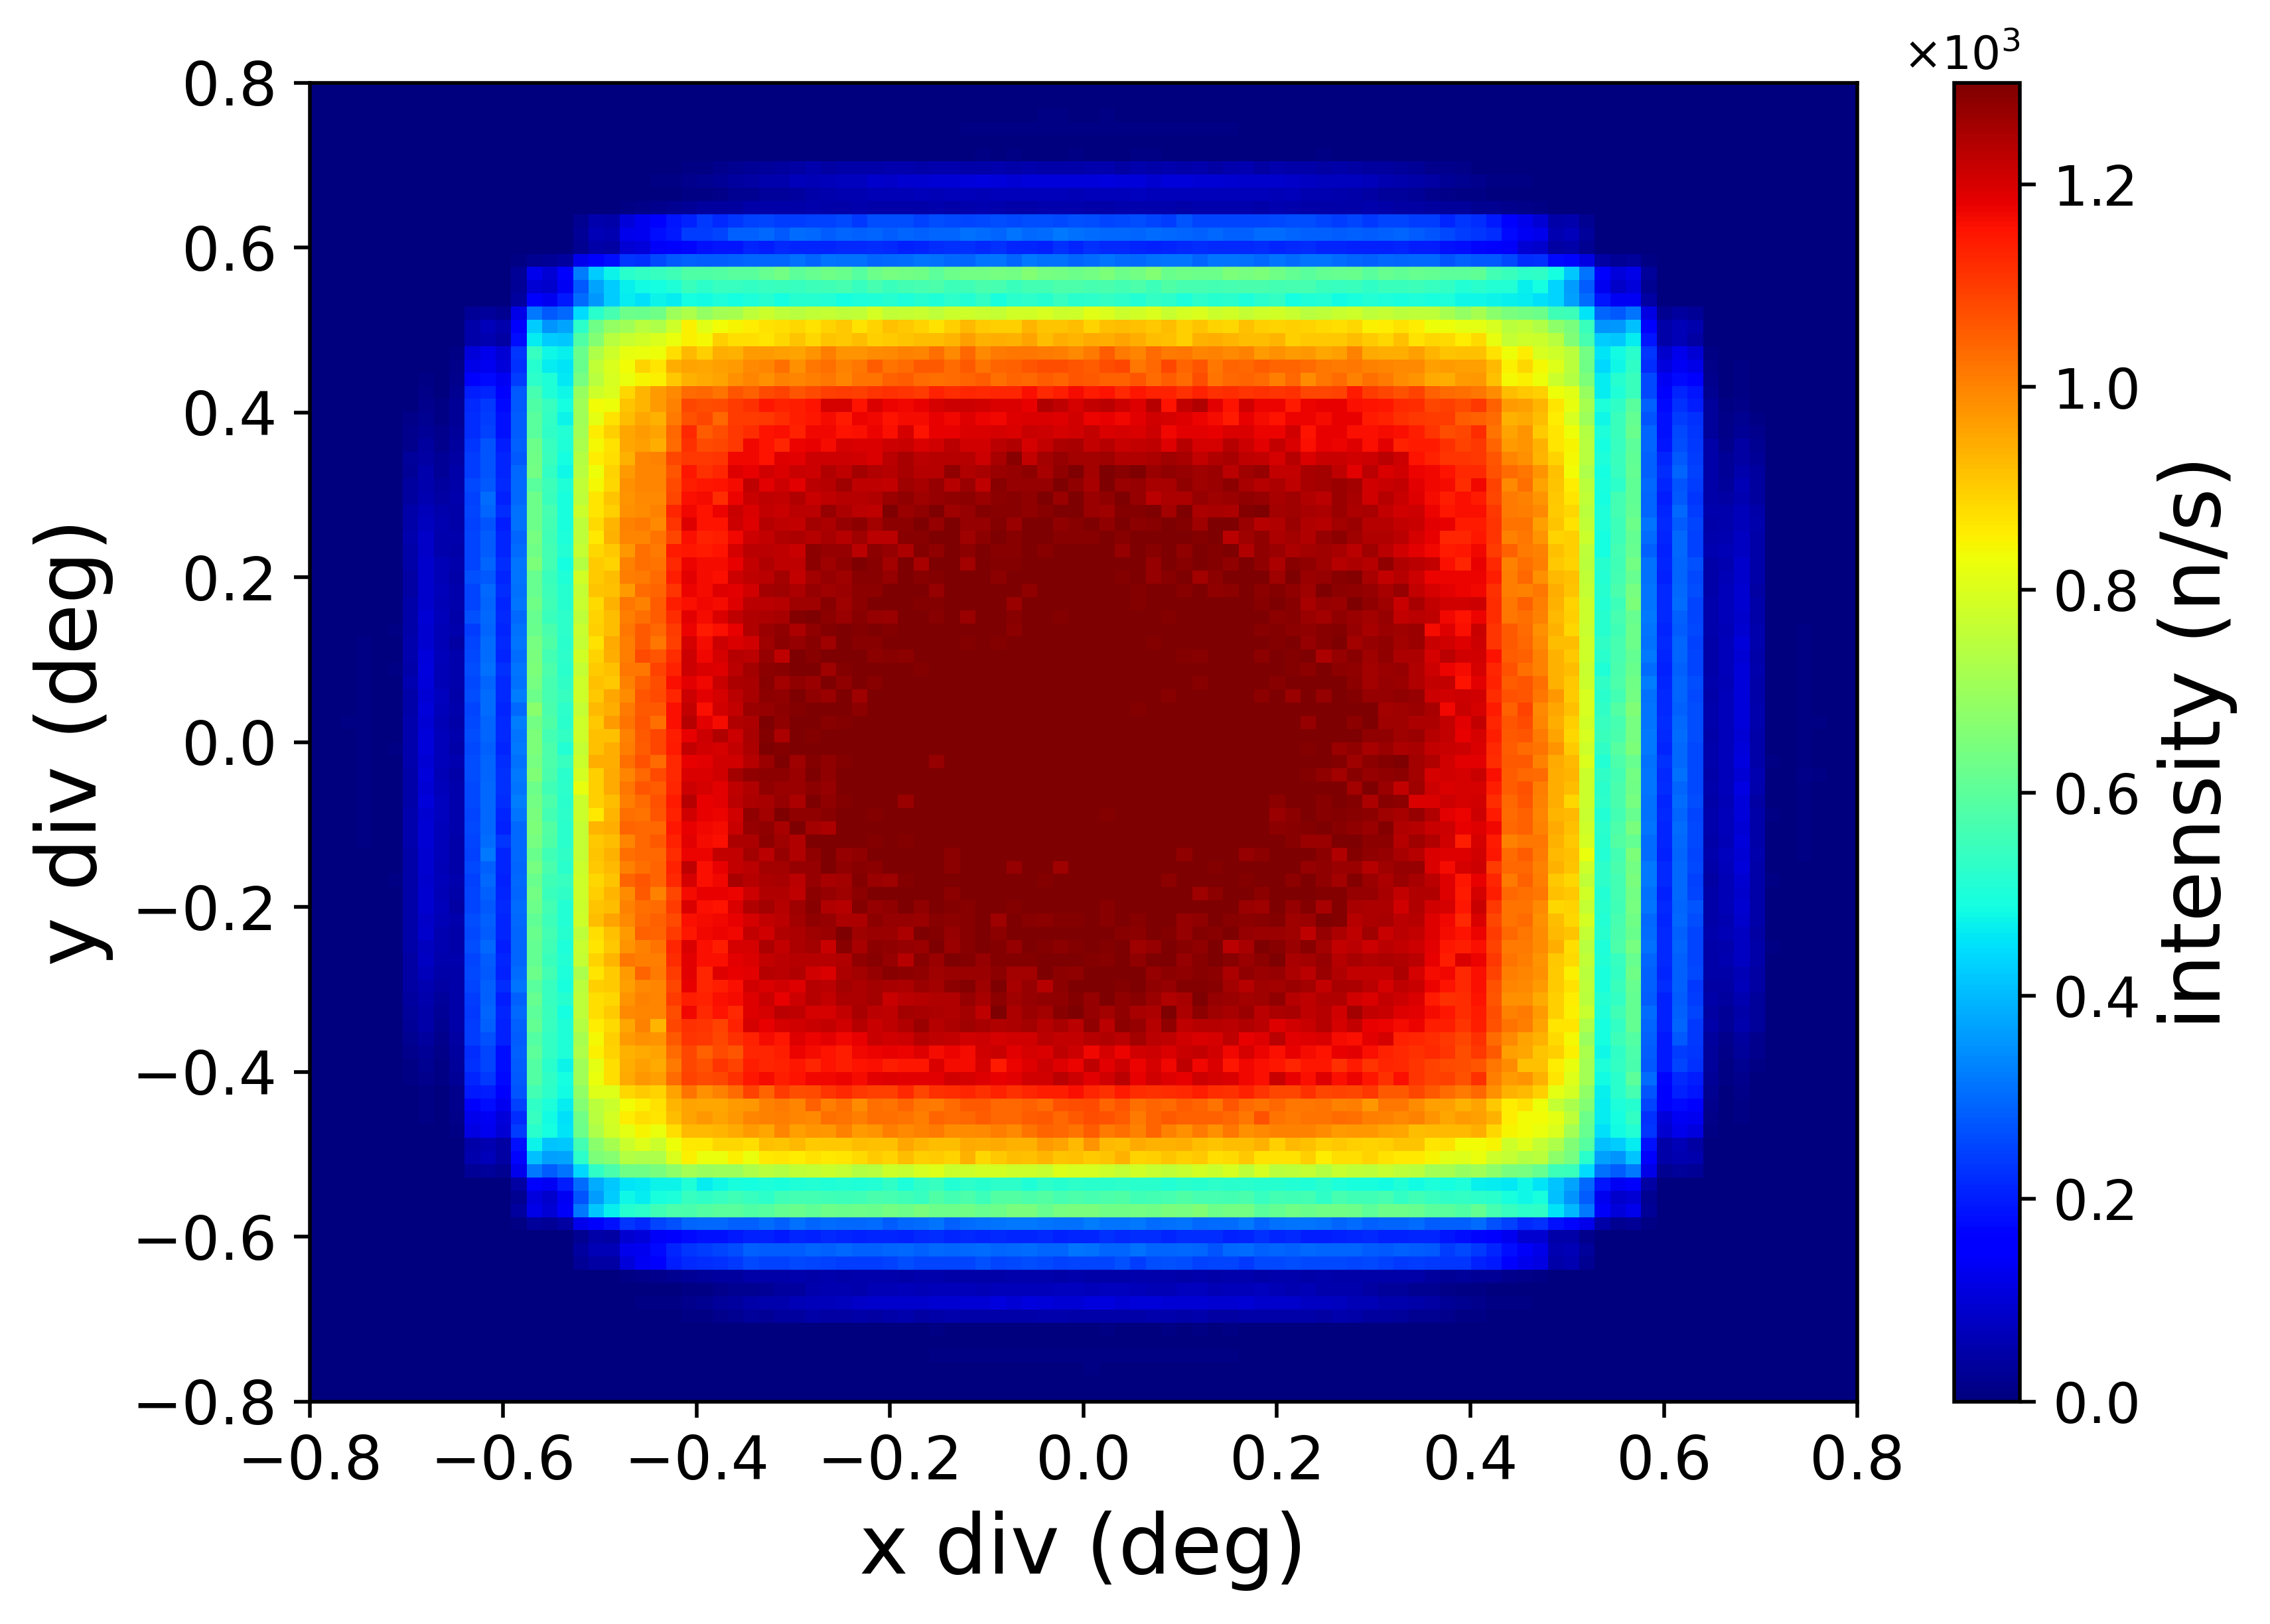
Neutron phase space at the sample position
A homogeneous and well-confined phase space is obtained at the sample position
Notes:
This slide shows the neutron phase space at the sample position.
The left and middle plots represent the spatial distributions in the horizontal and vertical directions, while the right plot shows the angular distribution, or divergence.
The white dashed boxes indicate the selected phase space that is actually used at the sample.
We can see that the intensity inside this region is quite uniform, and the distribution is well confined both in position and in angle.
This means that the neutron guide efficiently transports the phase space without significant distortion or loss.
As a result, we obtain a homogeneous and well-defined beam at the sample position, which is essential for reliable diffraction measurements.

Slide 16
Future work
Pulse shaping?
Focusing guide? Not focusing guide?
Wavelength shifting
Notes:
In the future, several aspects can be further optimized. This includes pulse shaping, guide design, and wavelength shifting techniques.

Slide 17
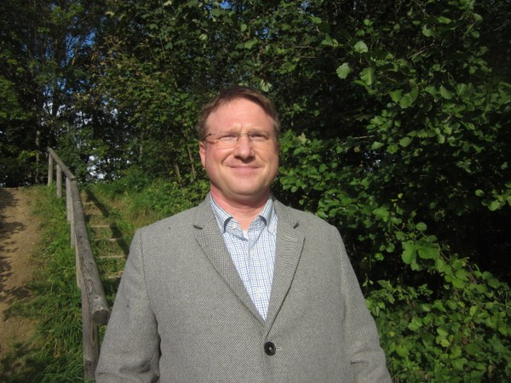


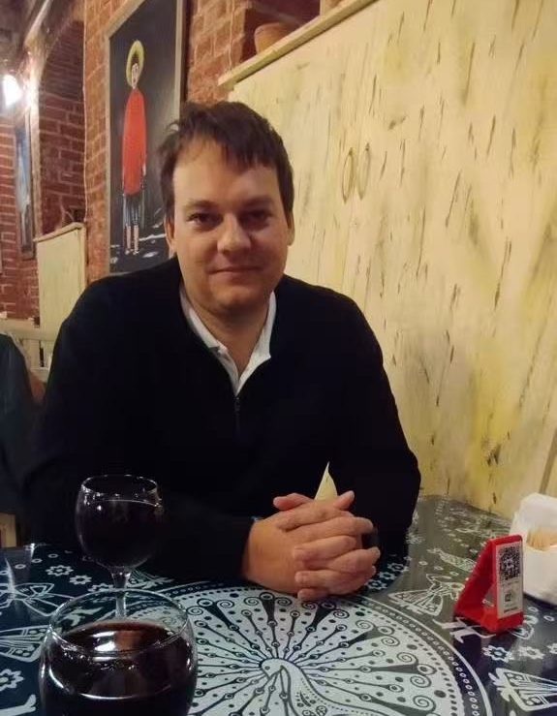

Acknowledgement
Tobias E. Schrader
Klaus Lieutenant
Peter Konik
Notes:
Finally, I would like to acknowledge the people who supported this work.
I would like to thank my supervior Tobias E. Schrader for his guidance.
I also thank Klaus Lieutenant and Peter Konik for valuable discussions and contributions.

Slide 18
Thank you!
Notes:
Thank you for your attention.

