Slide 2
ESS Target Station Project Update
PRESENTED BY Rikard Linander

Slide 3
Outline
1 Preamble – Background and Context for the ESS Target Project
2 ESS Target Station Project Current Status
3 Challenges and Issues
4 Achievements and Successes
5 Concluding Remarks

Slide 4
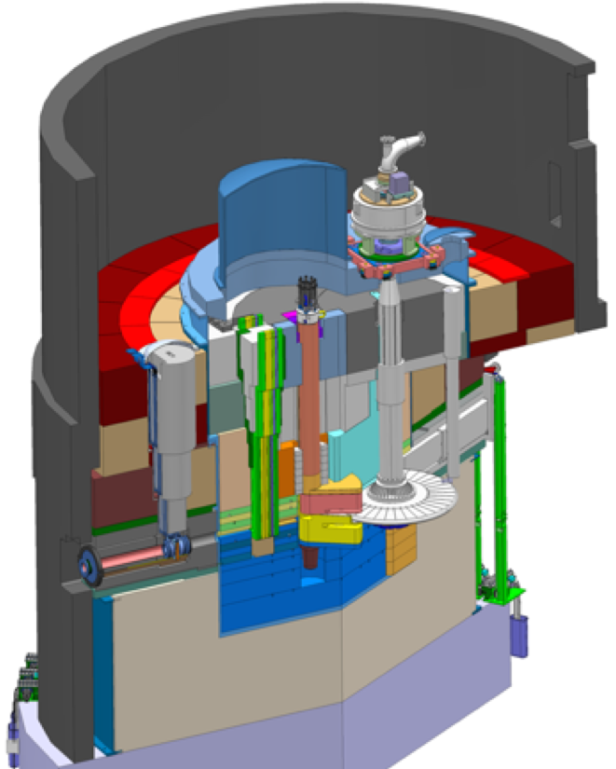
1
Preamble Background and Context for the ESS Target Project

Slide 5
Preamble
The contextual background for the ESS target station project
Ambitions
Aiming for unprecedented performance in terms of proton beam power, neutron flux, etc
Exploring new scientific capabilities
Creating provisions for future scientific ideas
Important conceptual decisions and largely unique features
5 MW proton beam power capacity
Long-pulse (2.86 ms) with 14 Hz repetition rate
Helium-cooled rotating tungsten target
Low profile moderators (cold and thermal)
Maximised access to the neutron source for scientific instruments
Building on existing knowledge
Understanding issues and failures encountered for existing peer facilities
Reusing well-performing and proven technology

Slide 6
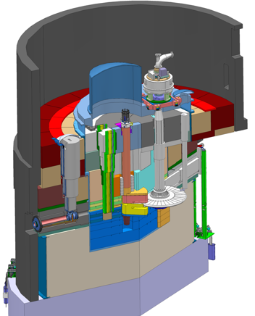
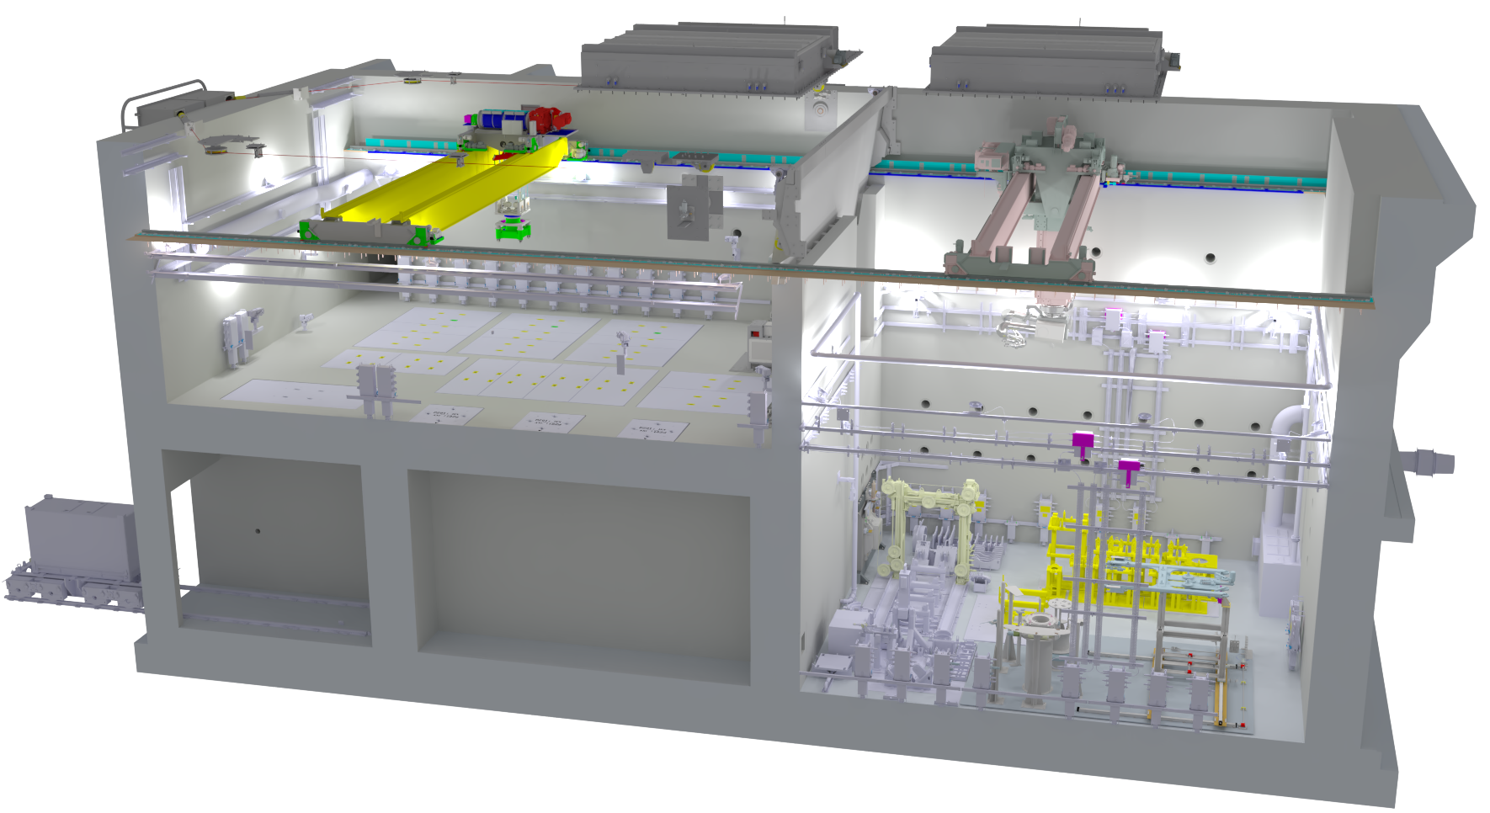
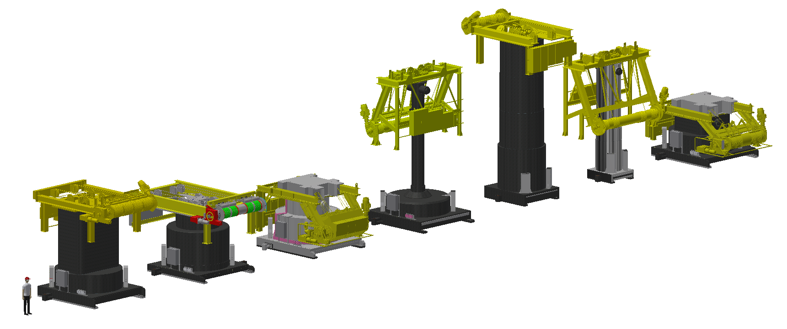
Preamble
Target Safety System
Monitors five critical operating parameters and prohibits proton beam if outside limits determined by the radiation safety analyses
The realisation of the ESS target station project
moderator and reflector
Target Systems
Tungsten target material inside a rotating, disc-shaped pressure vessel
Helium cooling, 3 kg/s, 11 bar, 40 °C inlet/240 °C outlet
proton beam instrumentation plug
monolith vessel
Moderators
Provisional locations of moderators above and beneath the target wheel
1st MR exploits the upper space:
Cold, 30 mm high, liquid H₂, 17 K
Thermal, 30 mm high, H₂O, 300 K
Remote handling systems
Large active cells for safe storage and processing of spent radioactive target components
Seven shielded casks for transfer of spent components from monolith to active cells
neutron beam extraction port
target monitoring plug
proton beam
target wheel
Monolith Systems
Evacuated Monolith Vessel for maintaining inert and neutron transparent conditions
Shielding structures outside and inside the vessel
Access openings for neutron beam extraction and for service/replacement of internals
proton beam window

Slide 7











2
ESS Target Station Project Current Status

Slide 8
ESS Target Station Project Current Status
The ESS Target Station is close to be ready to operate with proton beam
By 2025-11 all target station systems for neutron beam production were fully installed, commissioned, and functionally verified
Integral testing and commissioning had commenced and are still on-going
The project were on track for start of operation 2026-03
However, recent events led to damage our Moderator/Reflector Plug which prohibits operation with proton beam until its replacement component becomes available
Early 2026 the license to operate with proton beam on target was received
Meanwhile, during 2026, works continue
Integral target station operation to gain experience and to train the organisation
Addressing findings from the testing and functional integration
Resolving remaining punch list items important for reliable future operation
Finalising the remote handling systems

Slide 9
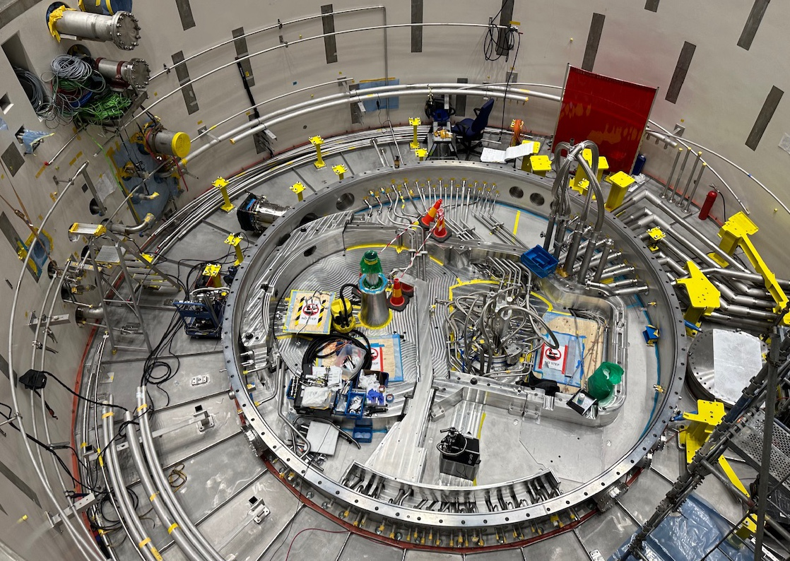
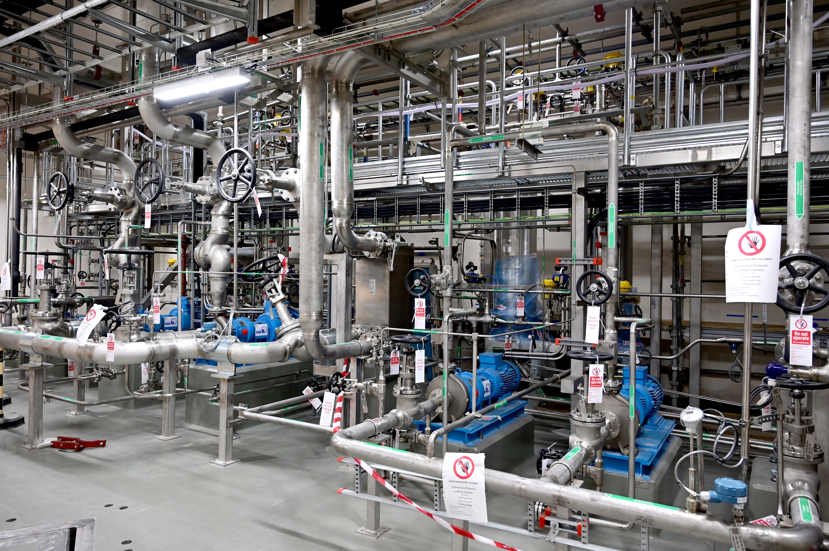
Monolith systems group
Photographs
All cooling systems feed and return pipes connected to their monolith vessel penetrations
Water-cooling systems

Slide 10
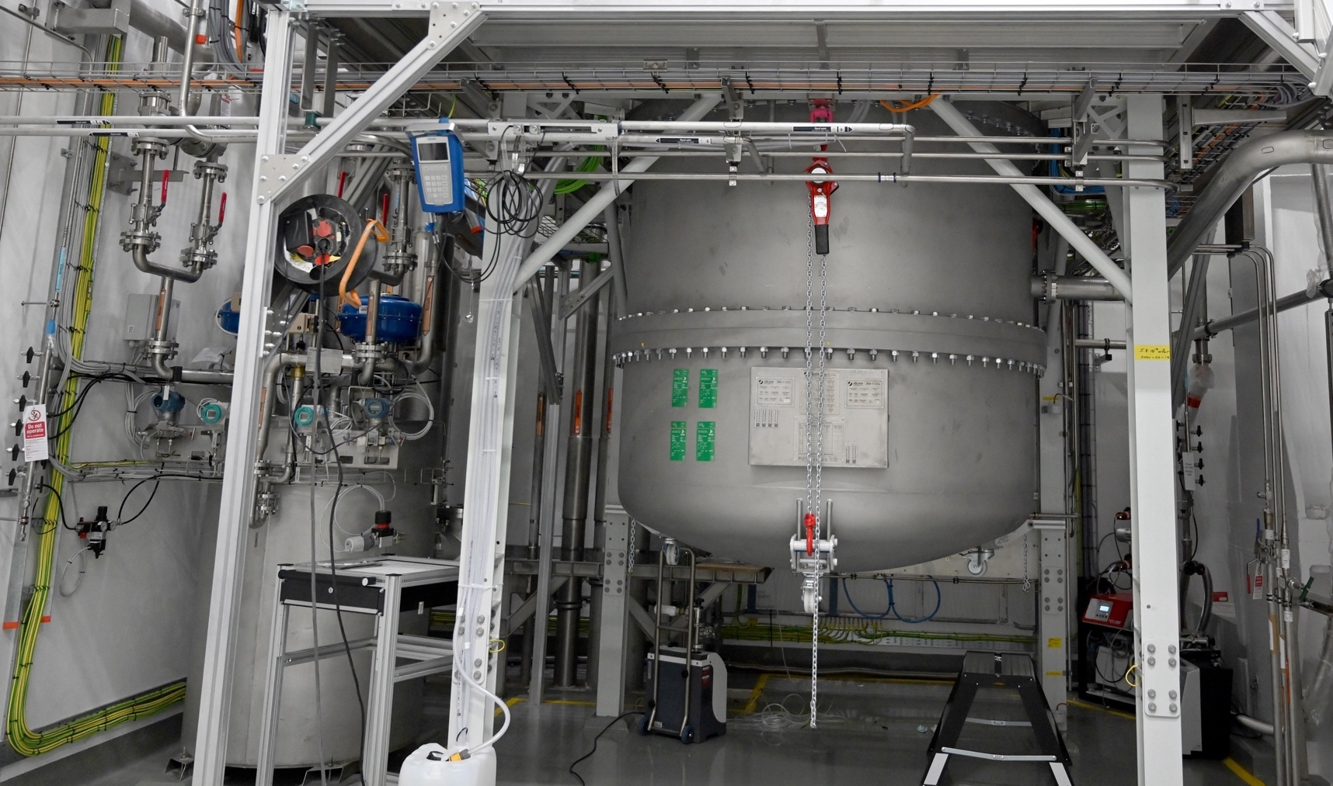
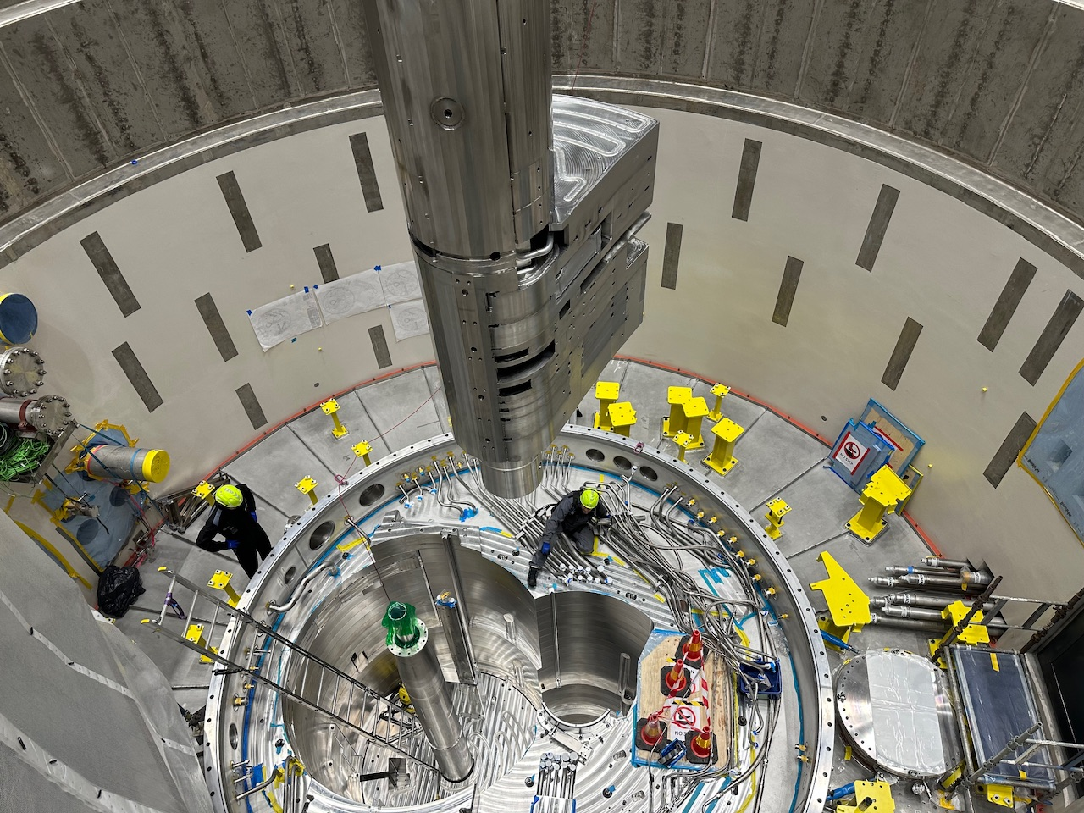
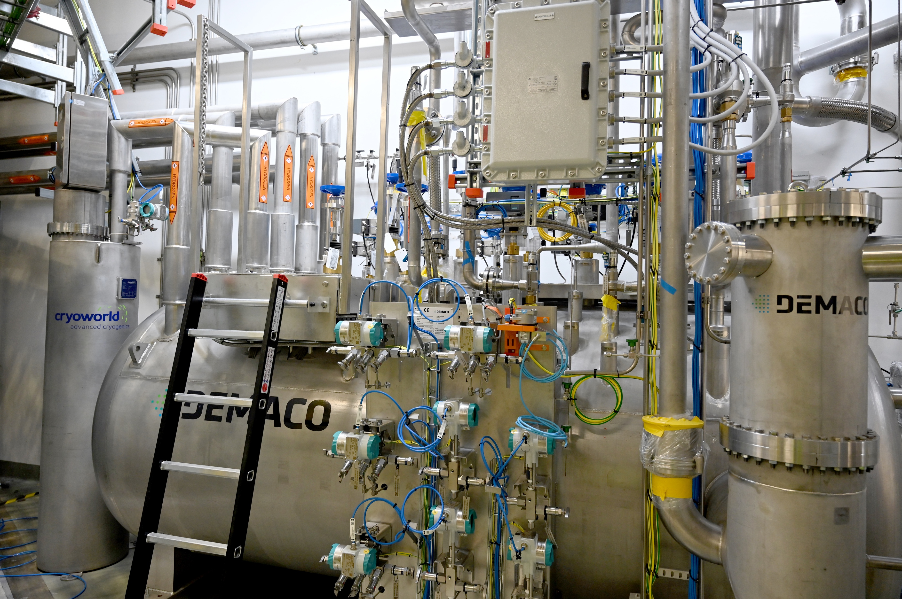
Moderator systems group
Photographs
Cryogenic Moderator System Cold Box
Cryogenic Moderator System Junction Box
Installation of the Moderator/Reflector Plug

Slide 11
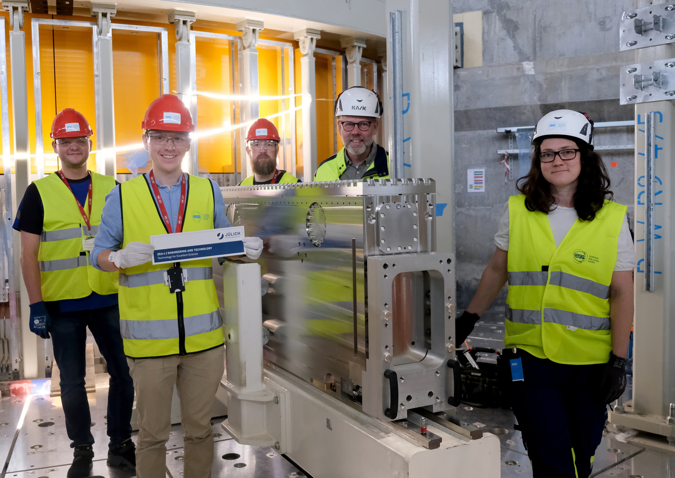
Neutron beam extraction systems group
Photographs
Last Neutron Beam Port Insert being installed together with in-kind partner FZJ

Slide 12
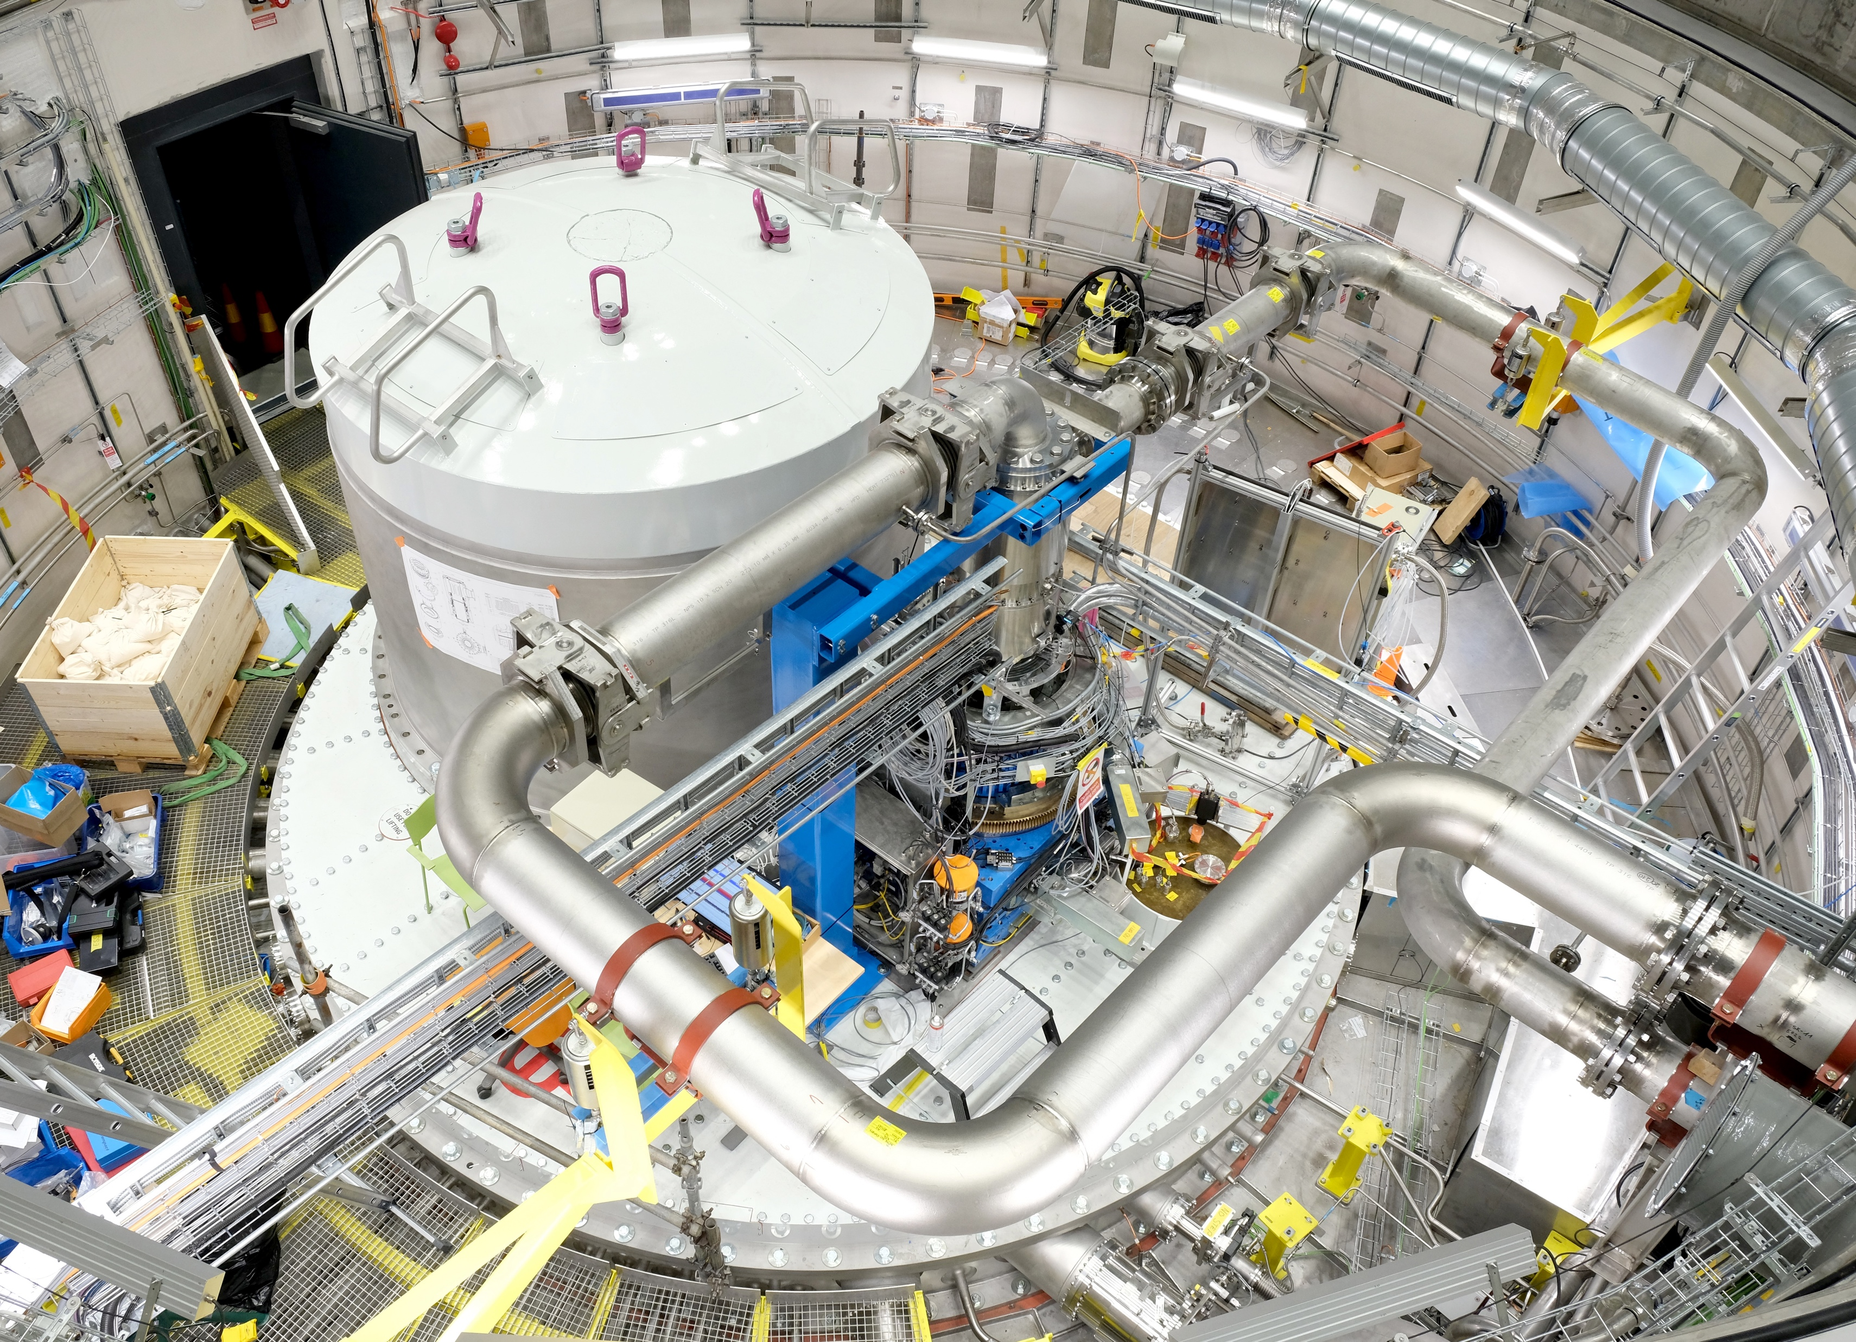
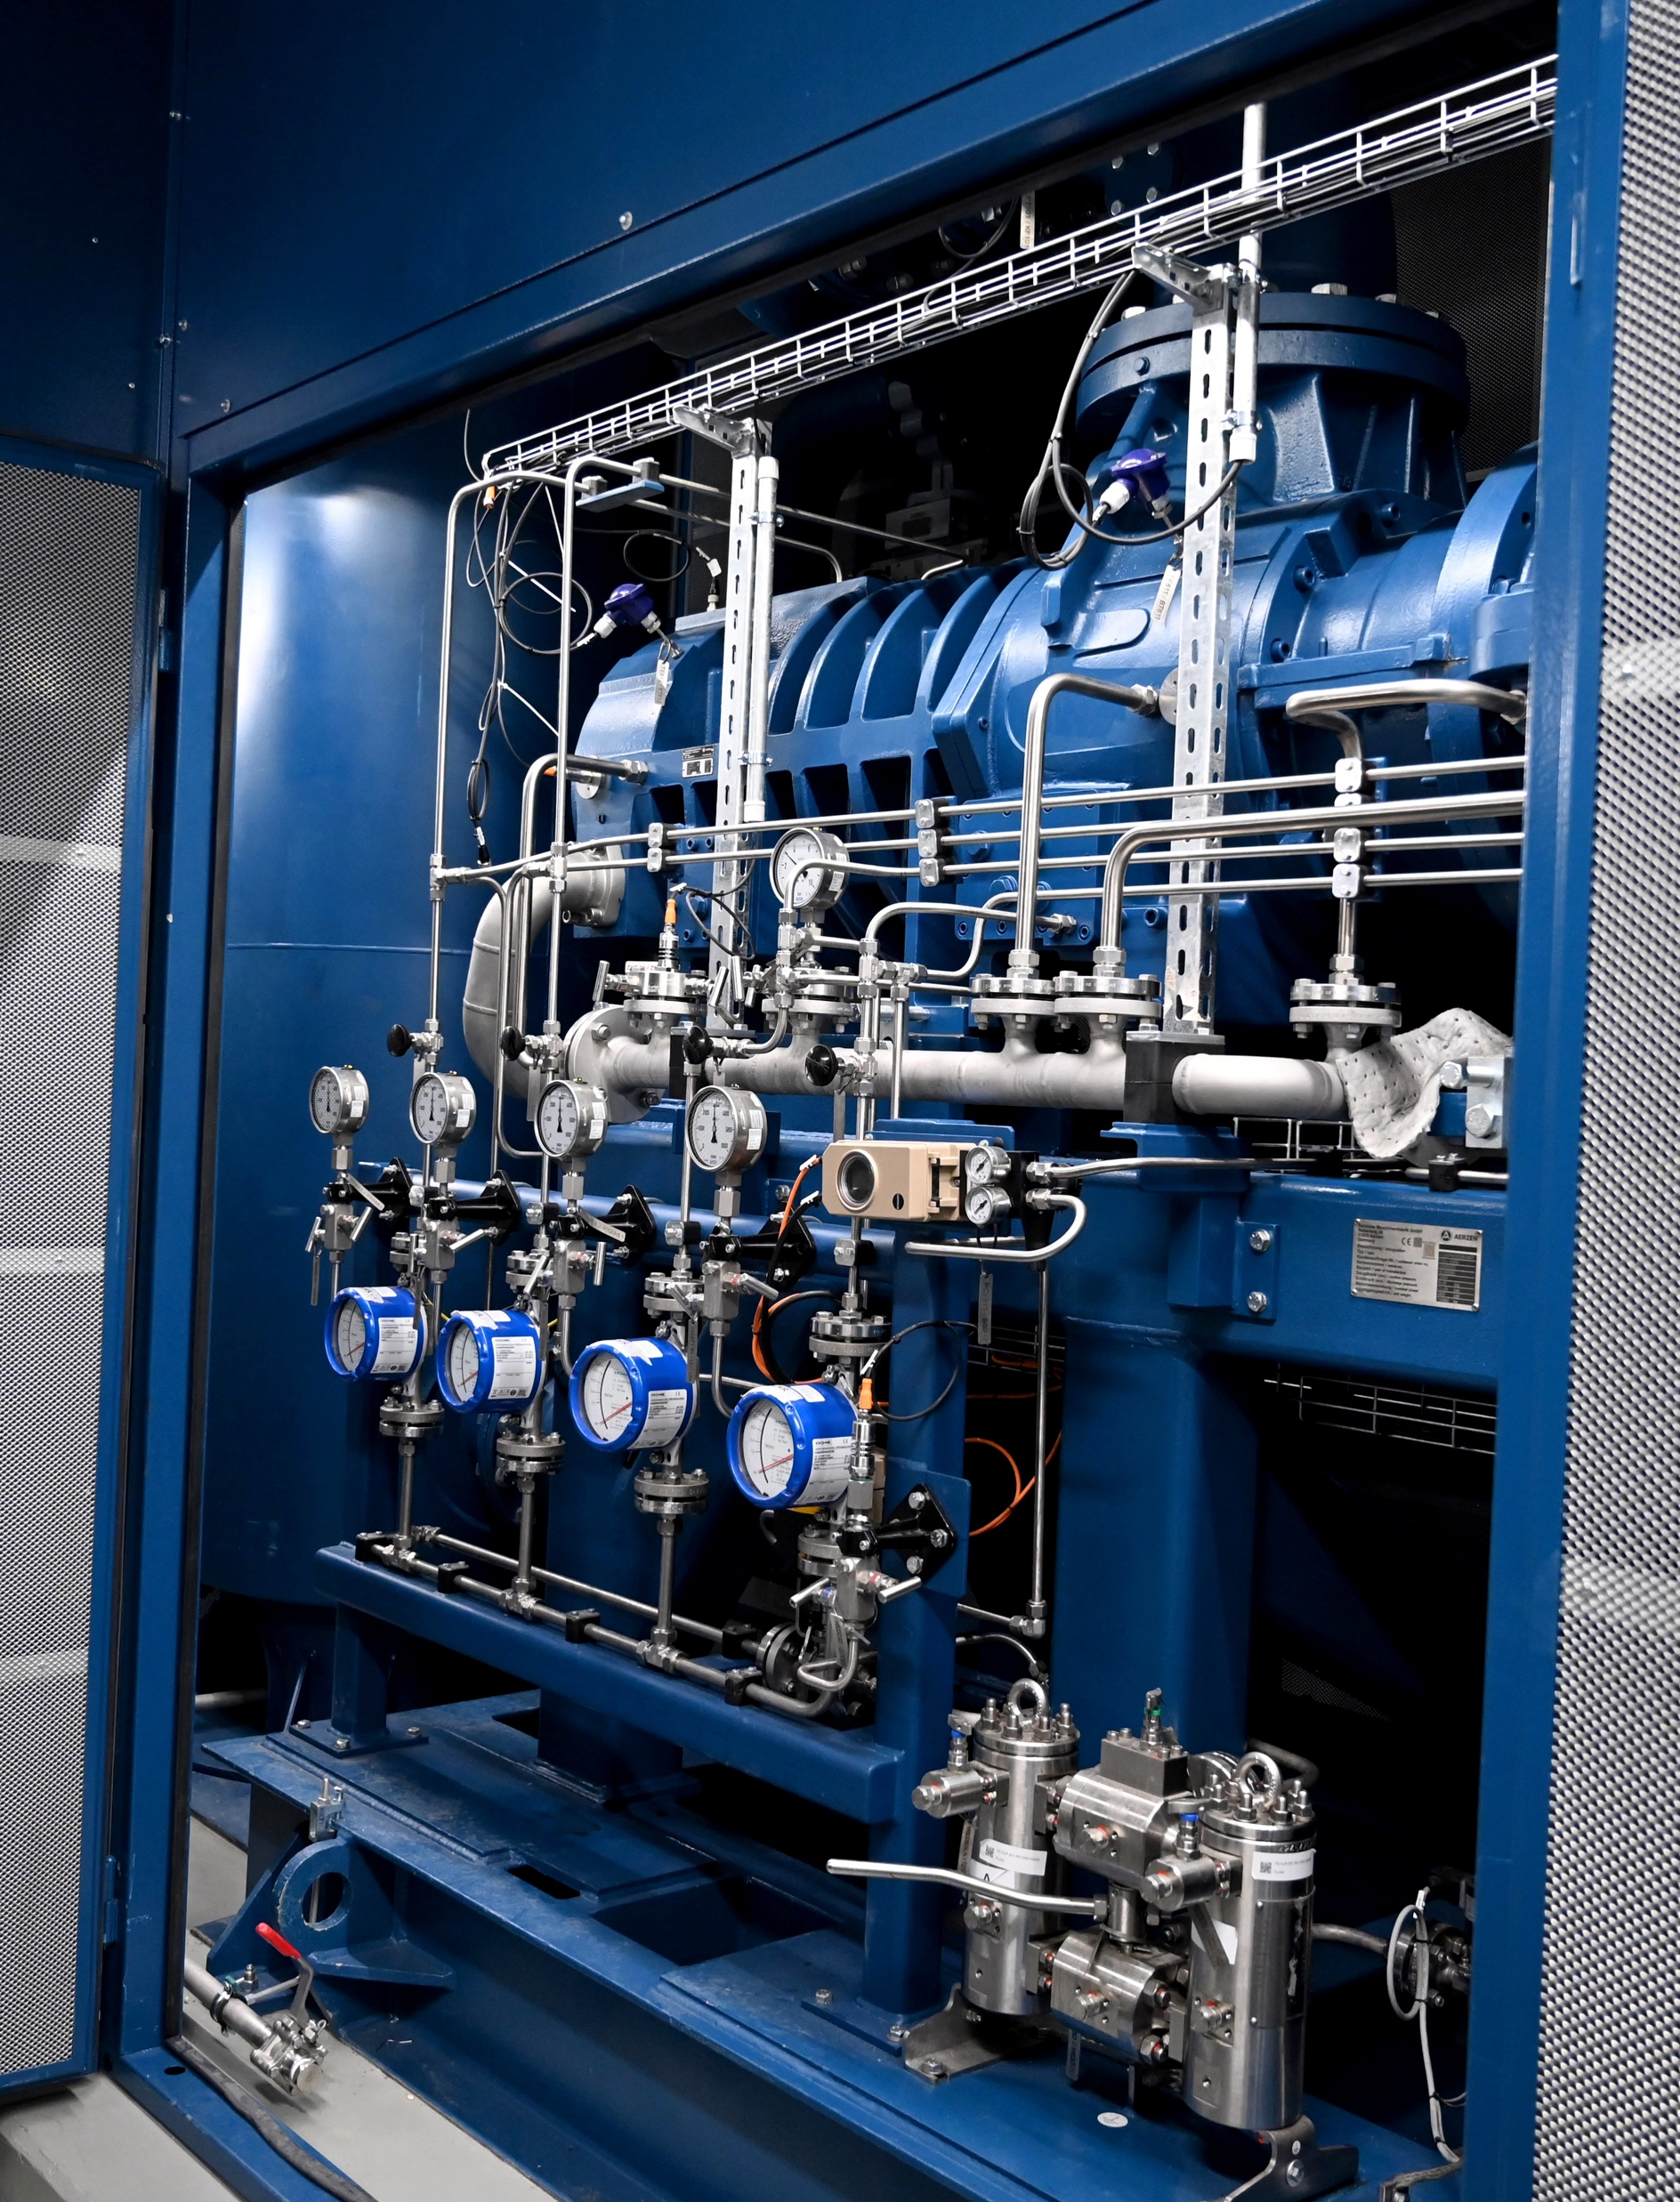
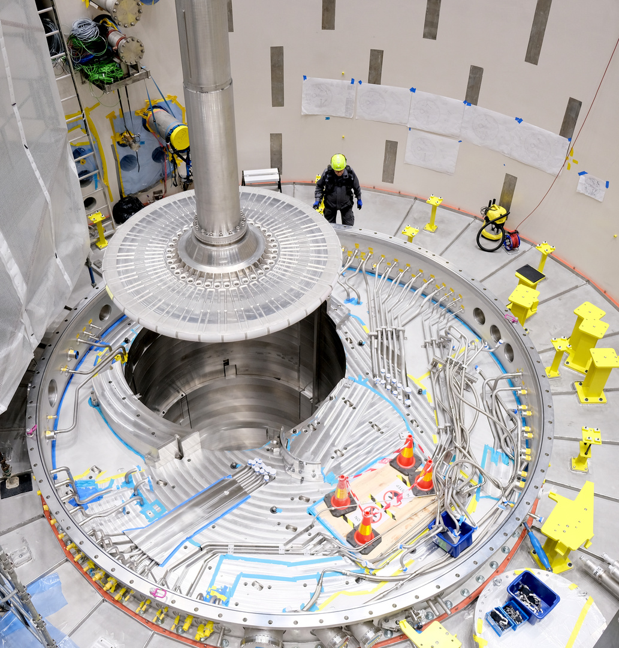
Target systems group
Photographs
Installation of the Target Wheel
Target drive unit, including the helium rotary union, and helium feed and return lines installed and connected
Helium screw compressor

Slide 13
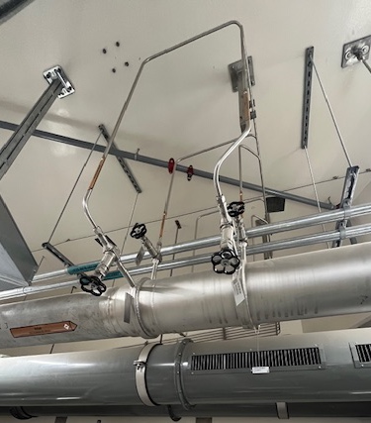
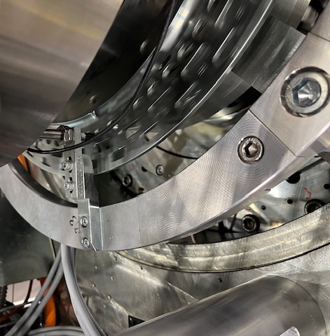
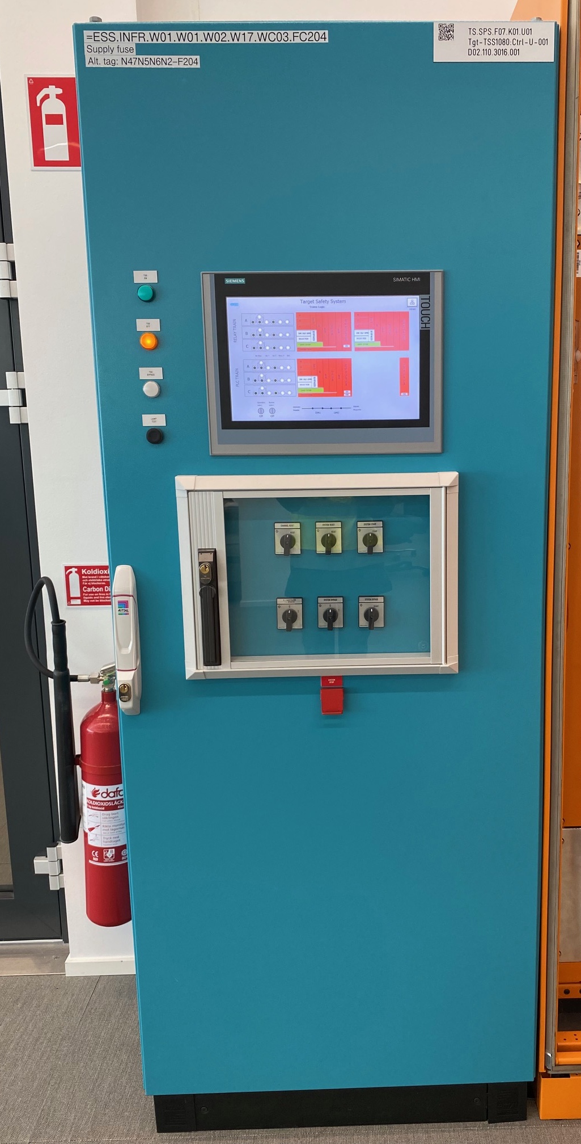
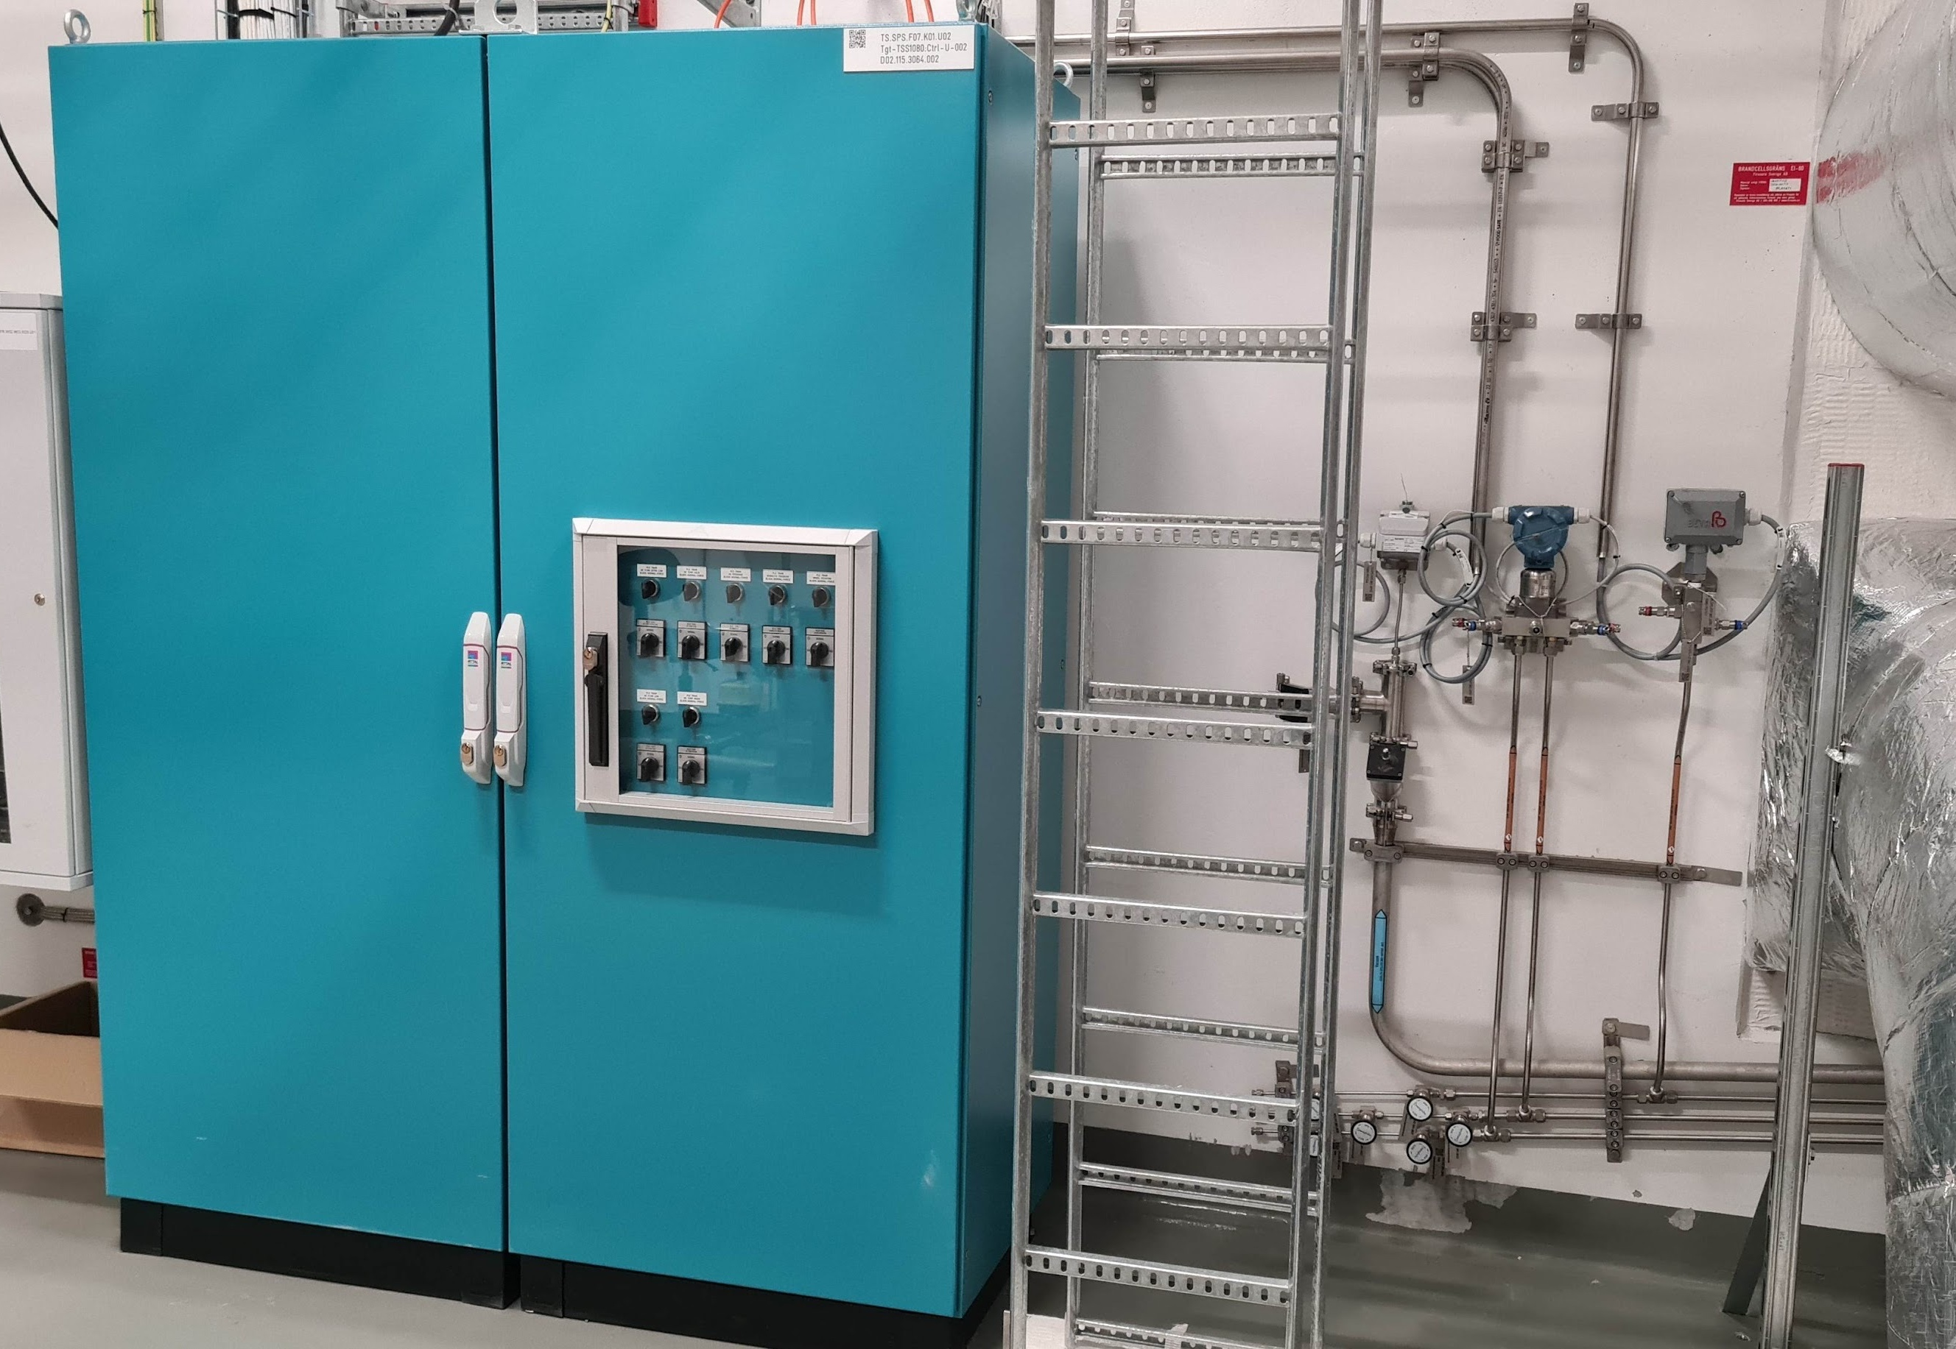
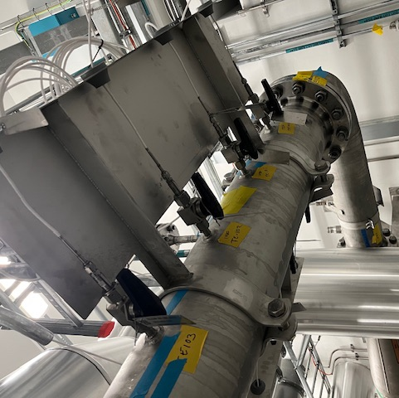
Target Safety System
Photographs
TSS field control cabinet
TSS venturi tube flow measurement
TSS target wheel rotation sensor
TSS helium temperature sensors
TSS control room cabinet

Slide 14
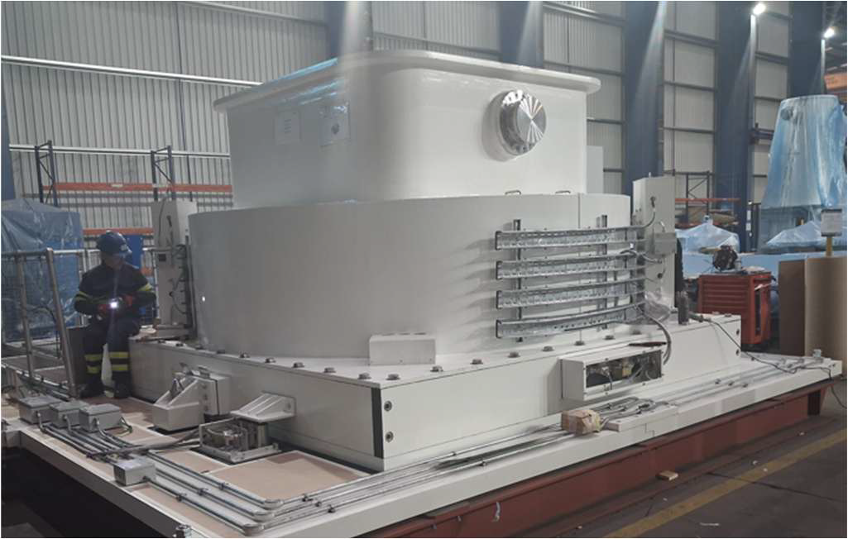
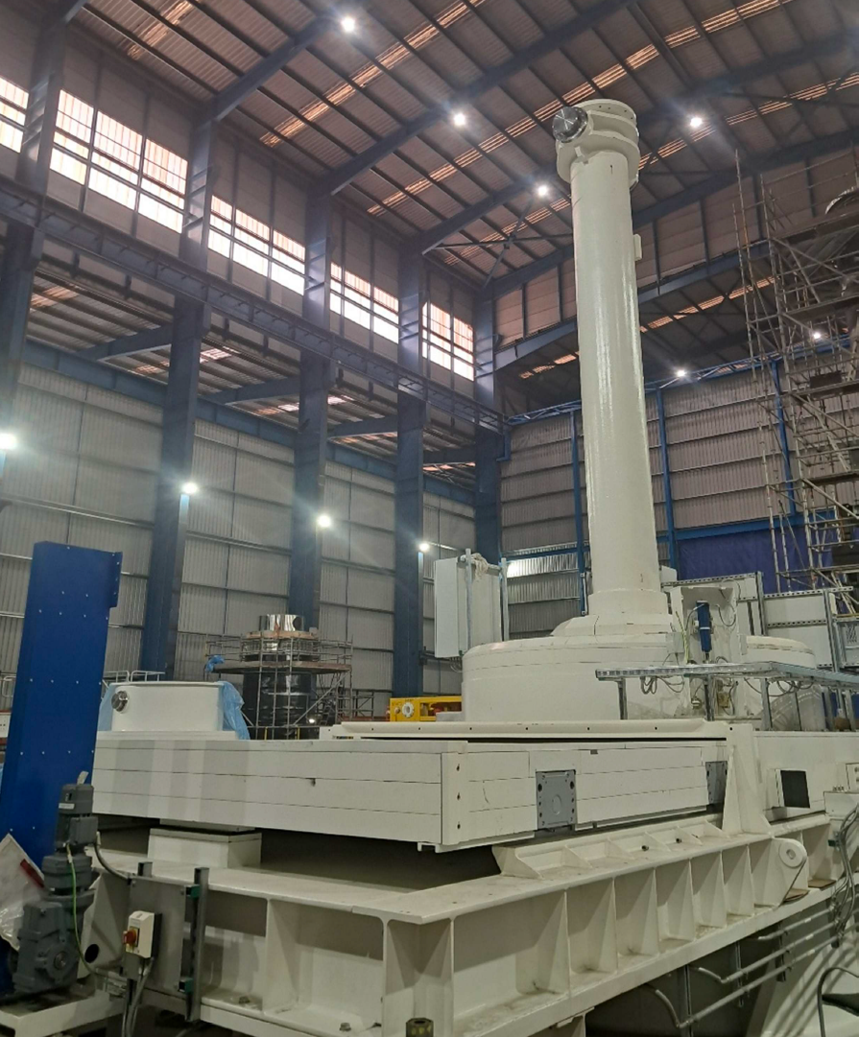
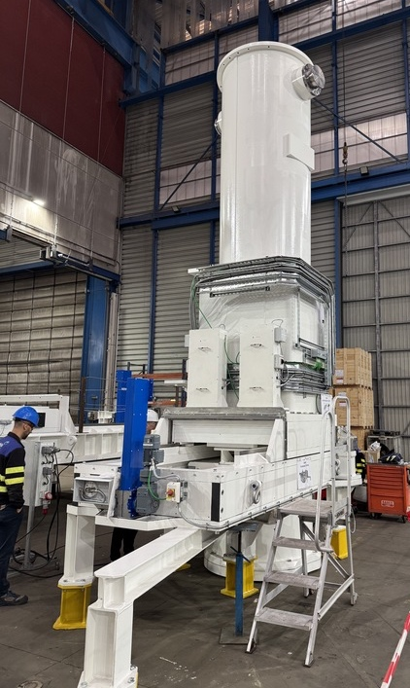
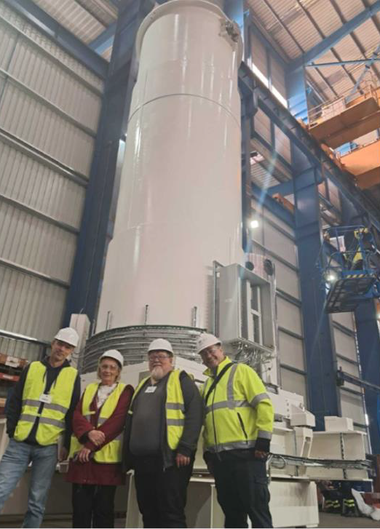
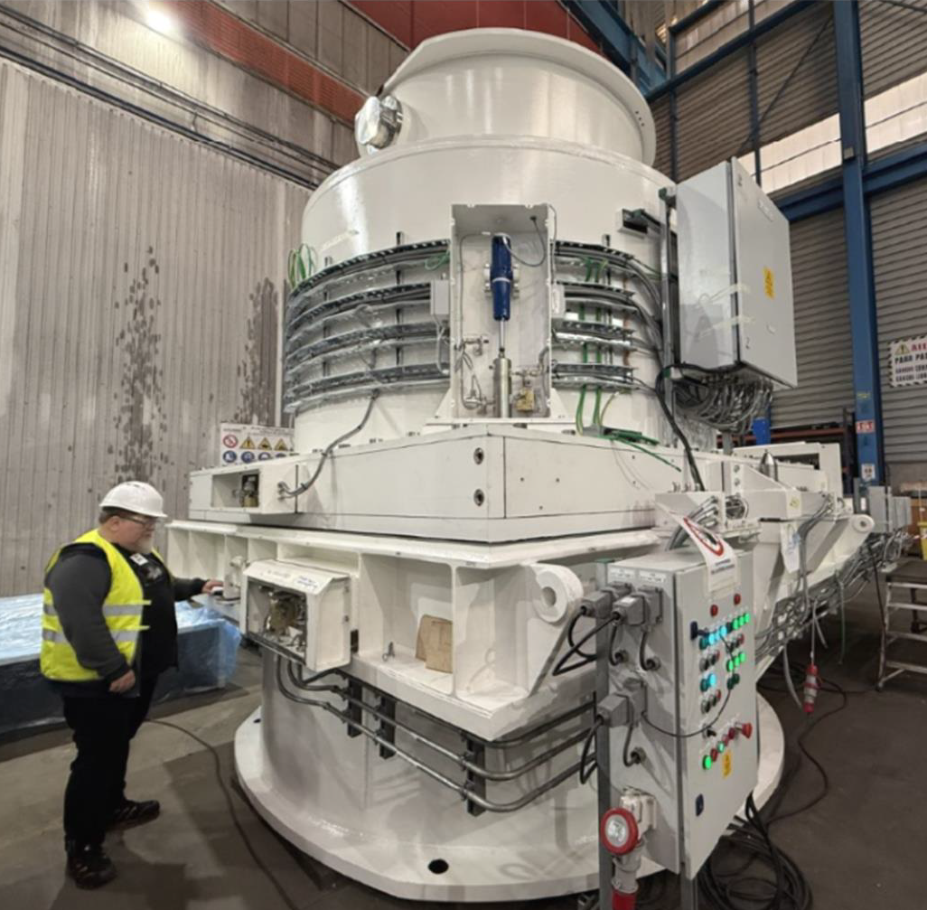
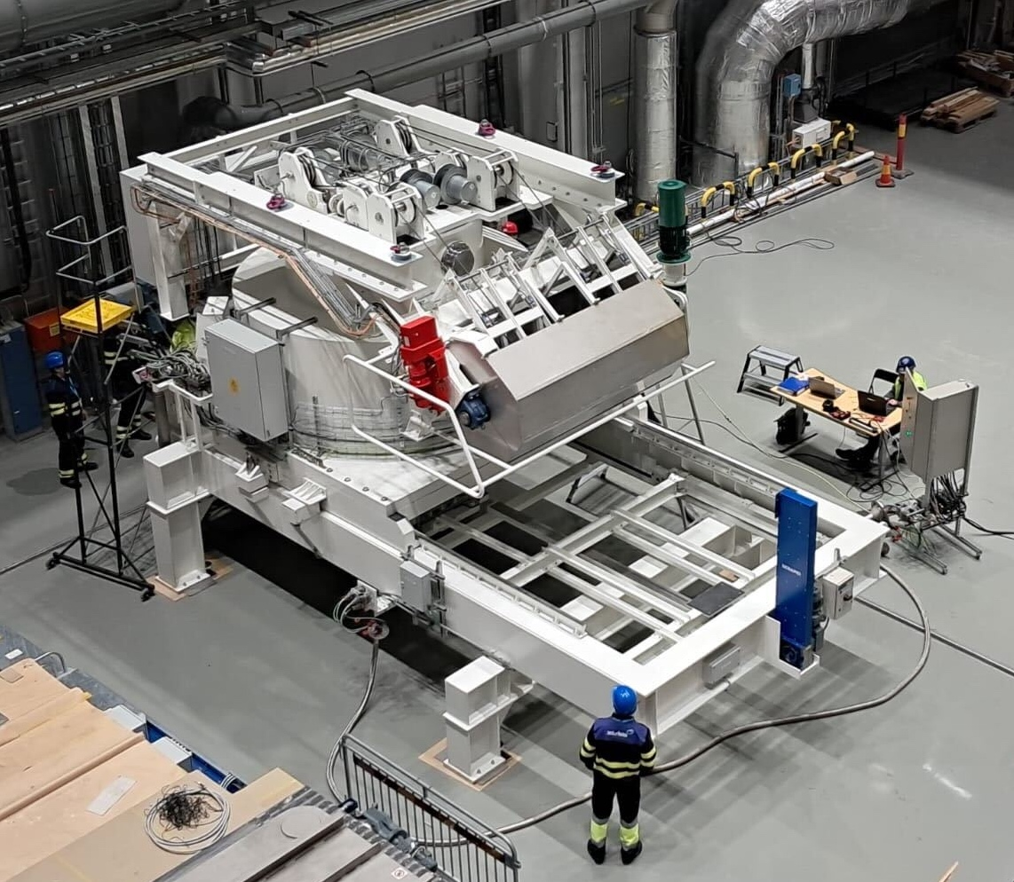
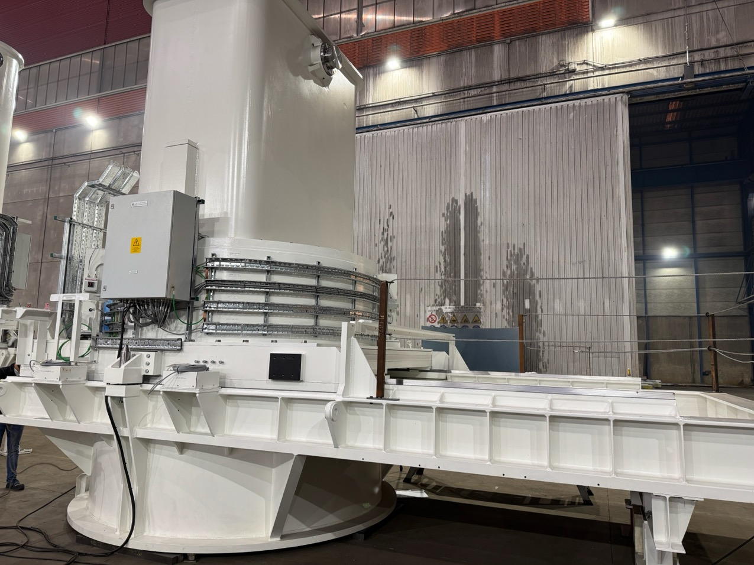
Remote handling systems
Photographs of casks bodies
#7
#9
#5
#4
#3
#1
#2
#3 with hoist

Slide 15
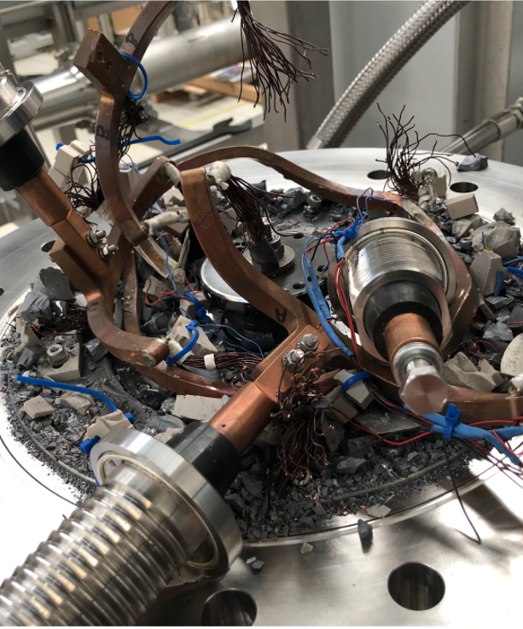
3
Challenges and Issues

Slide 16
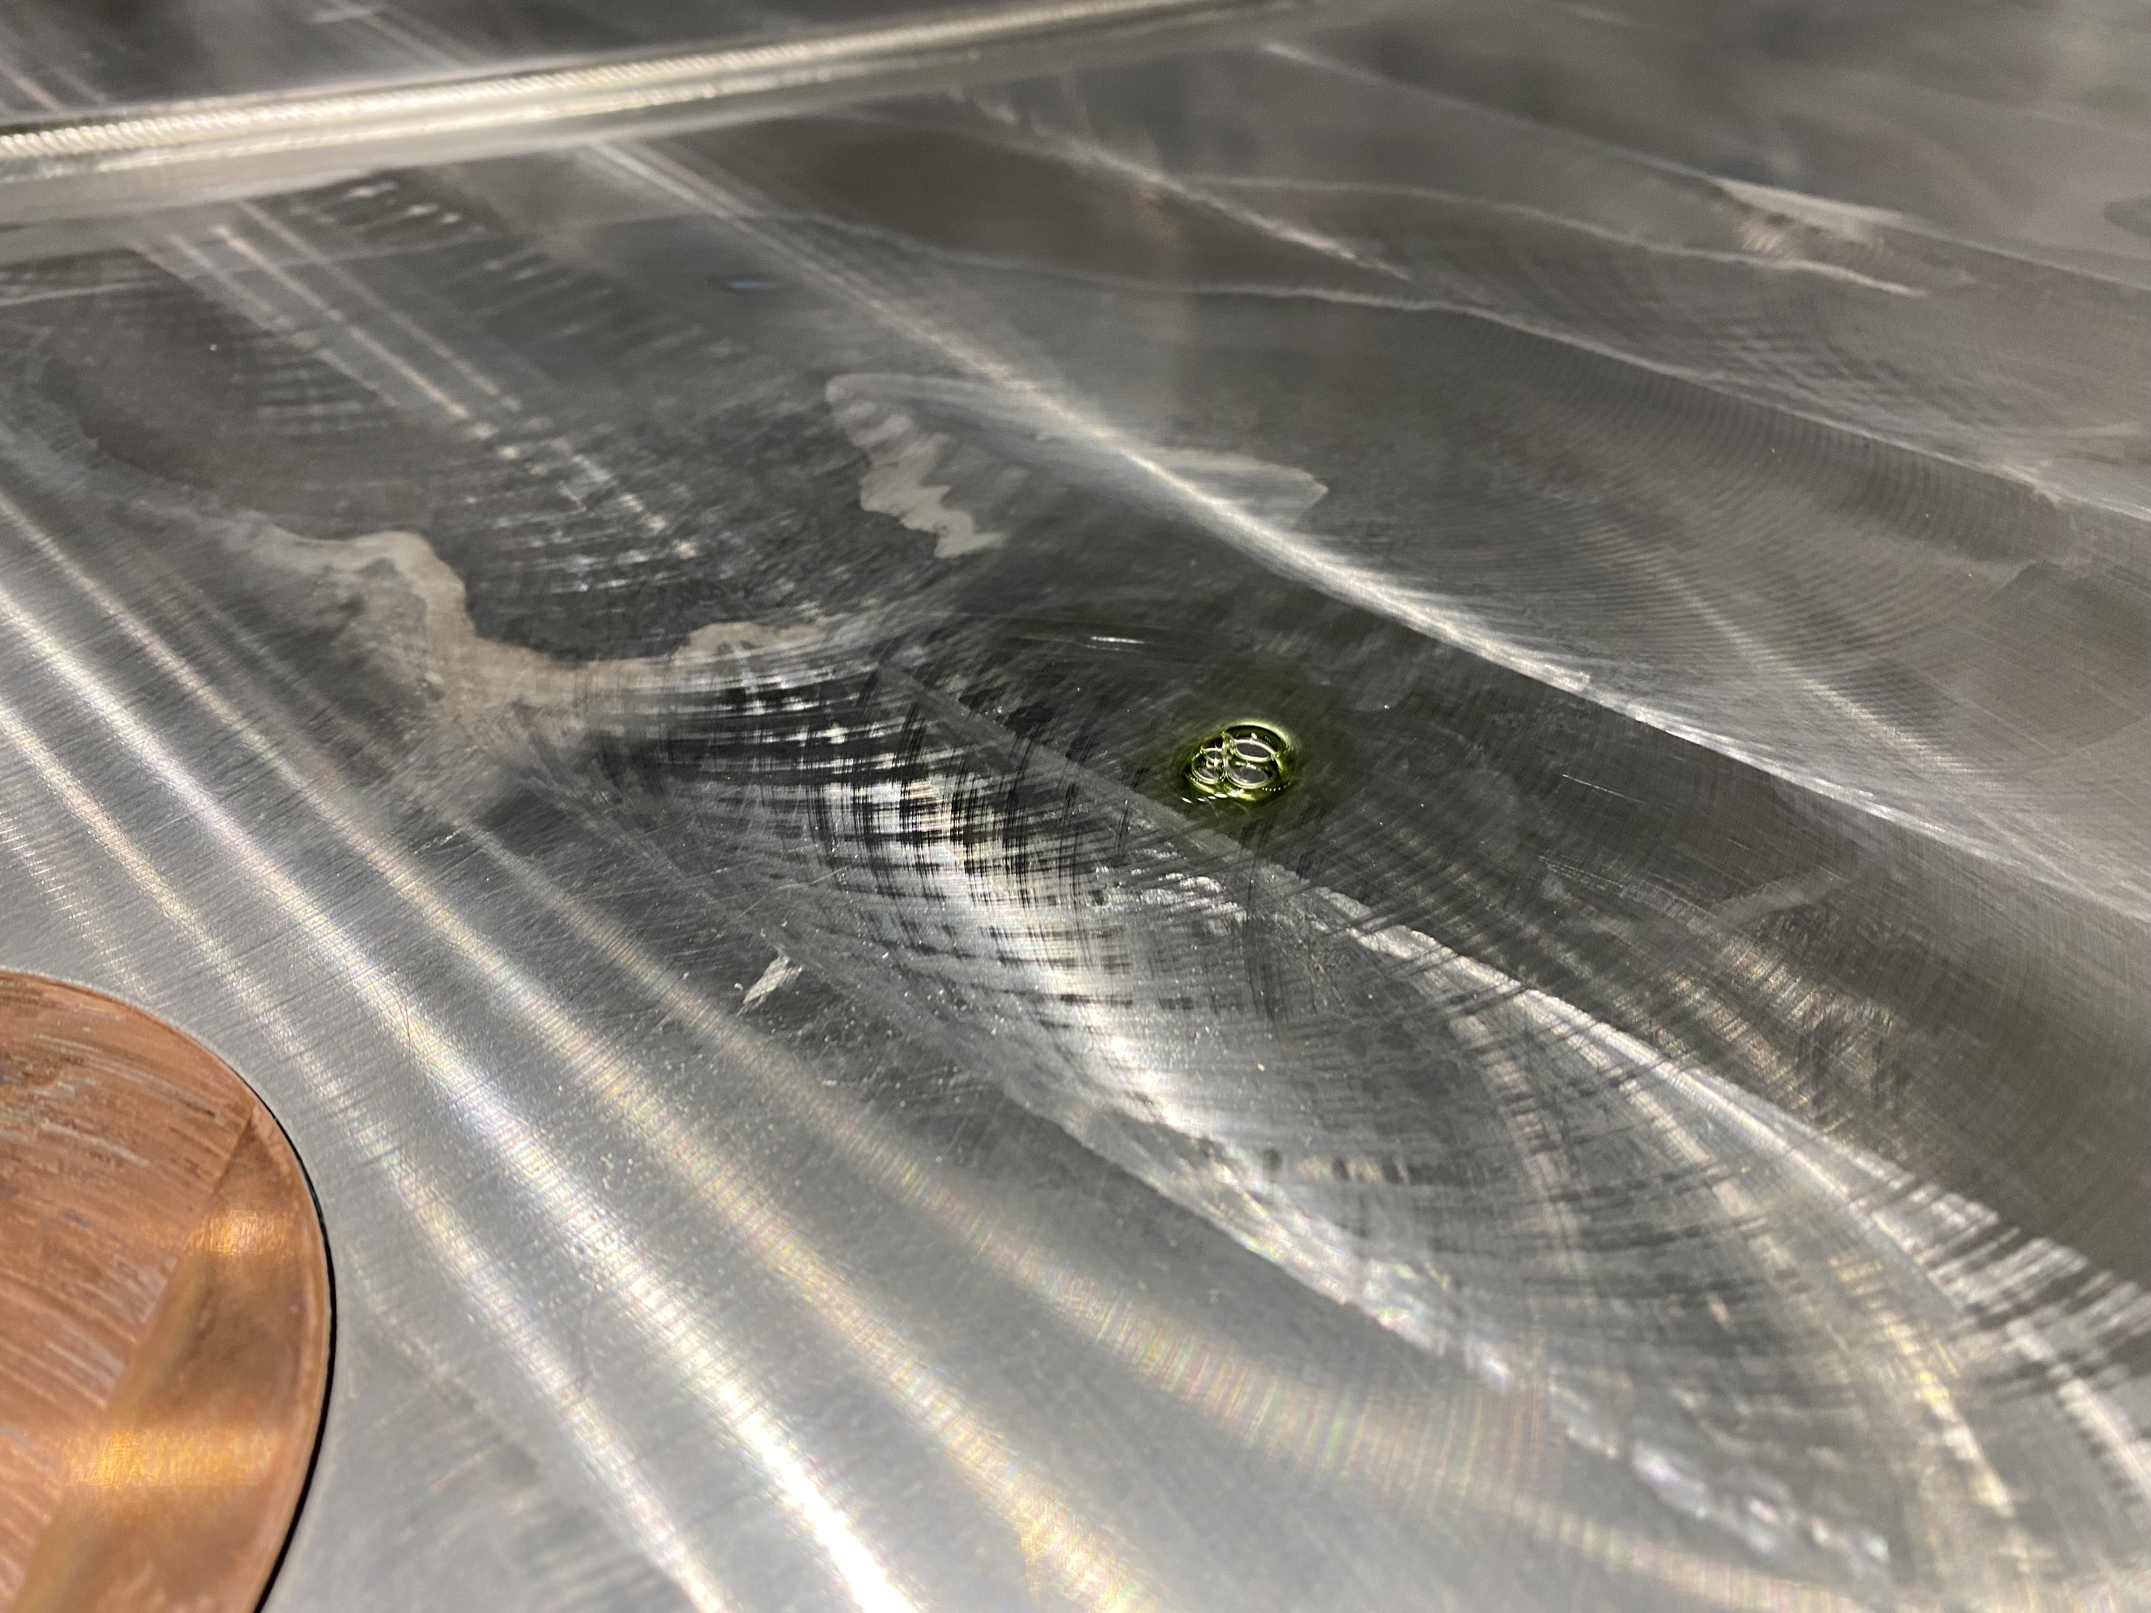
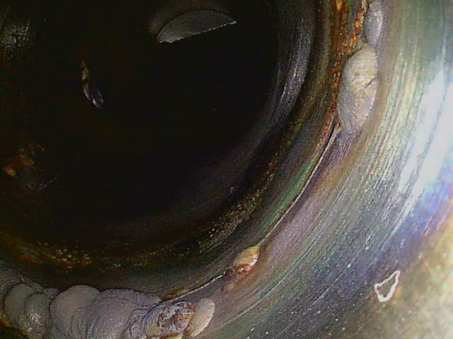
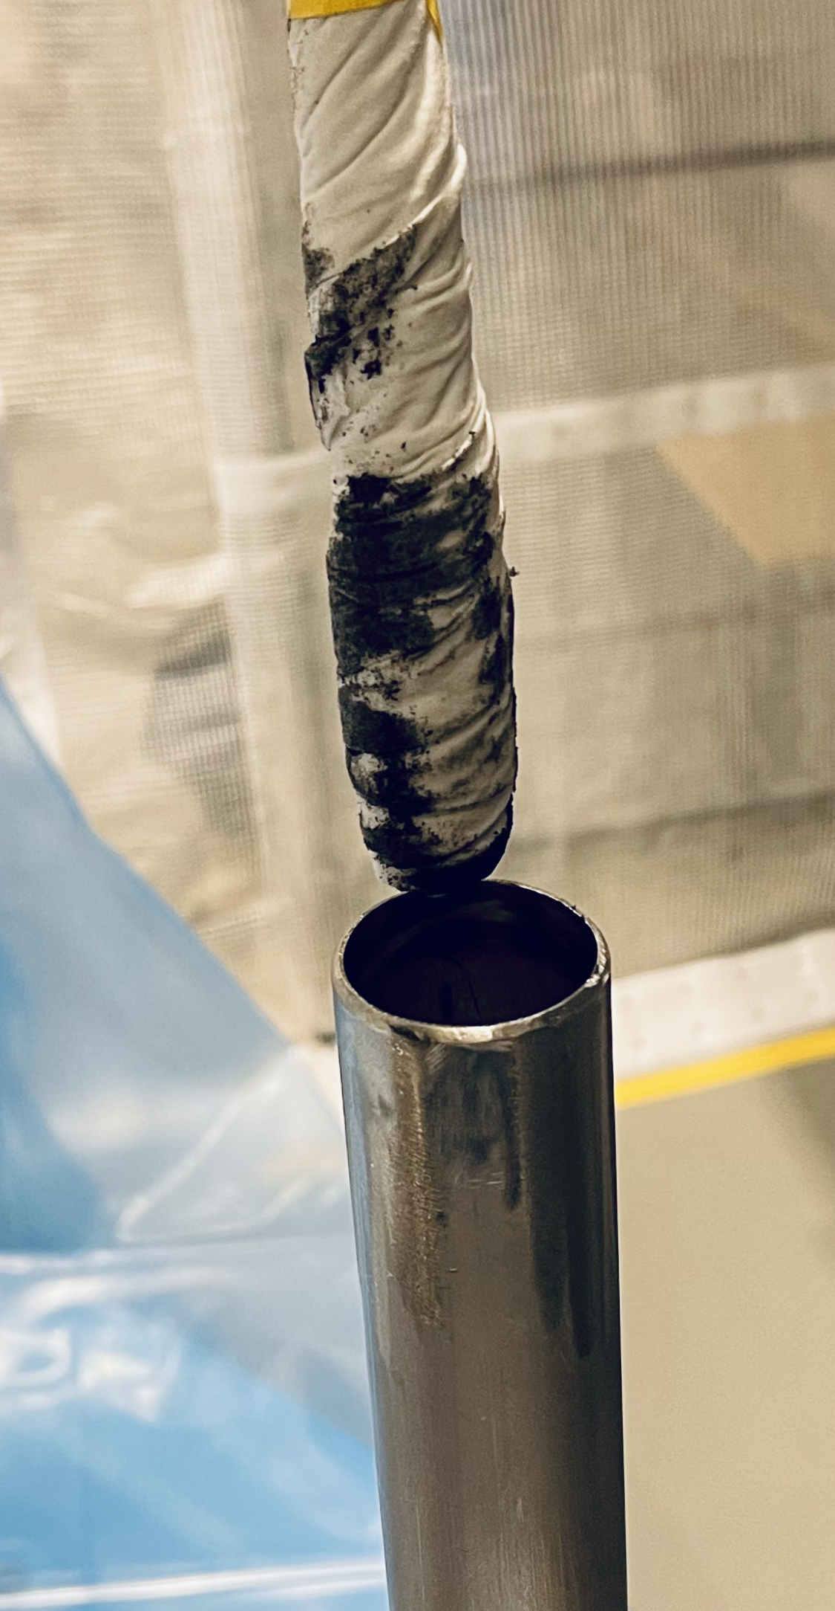
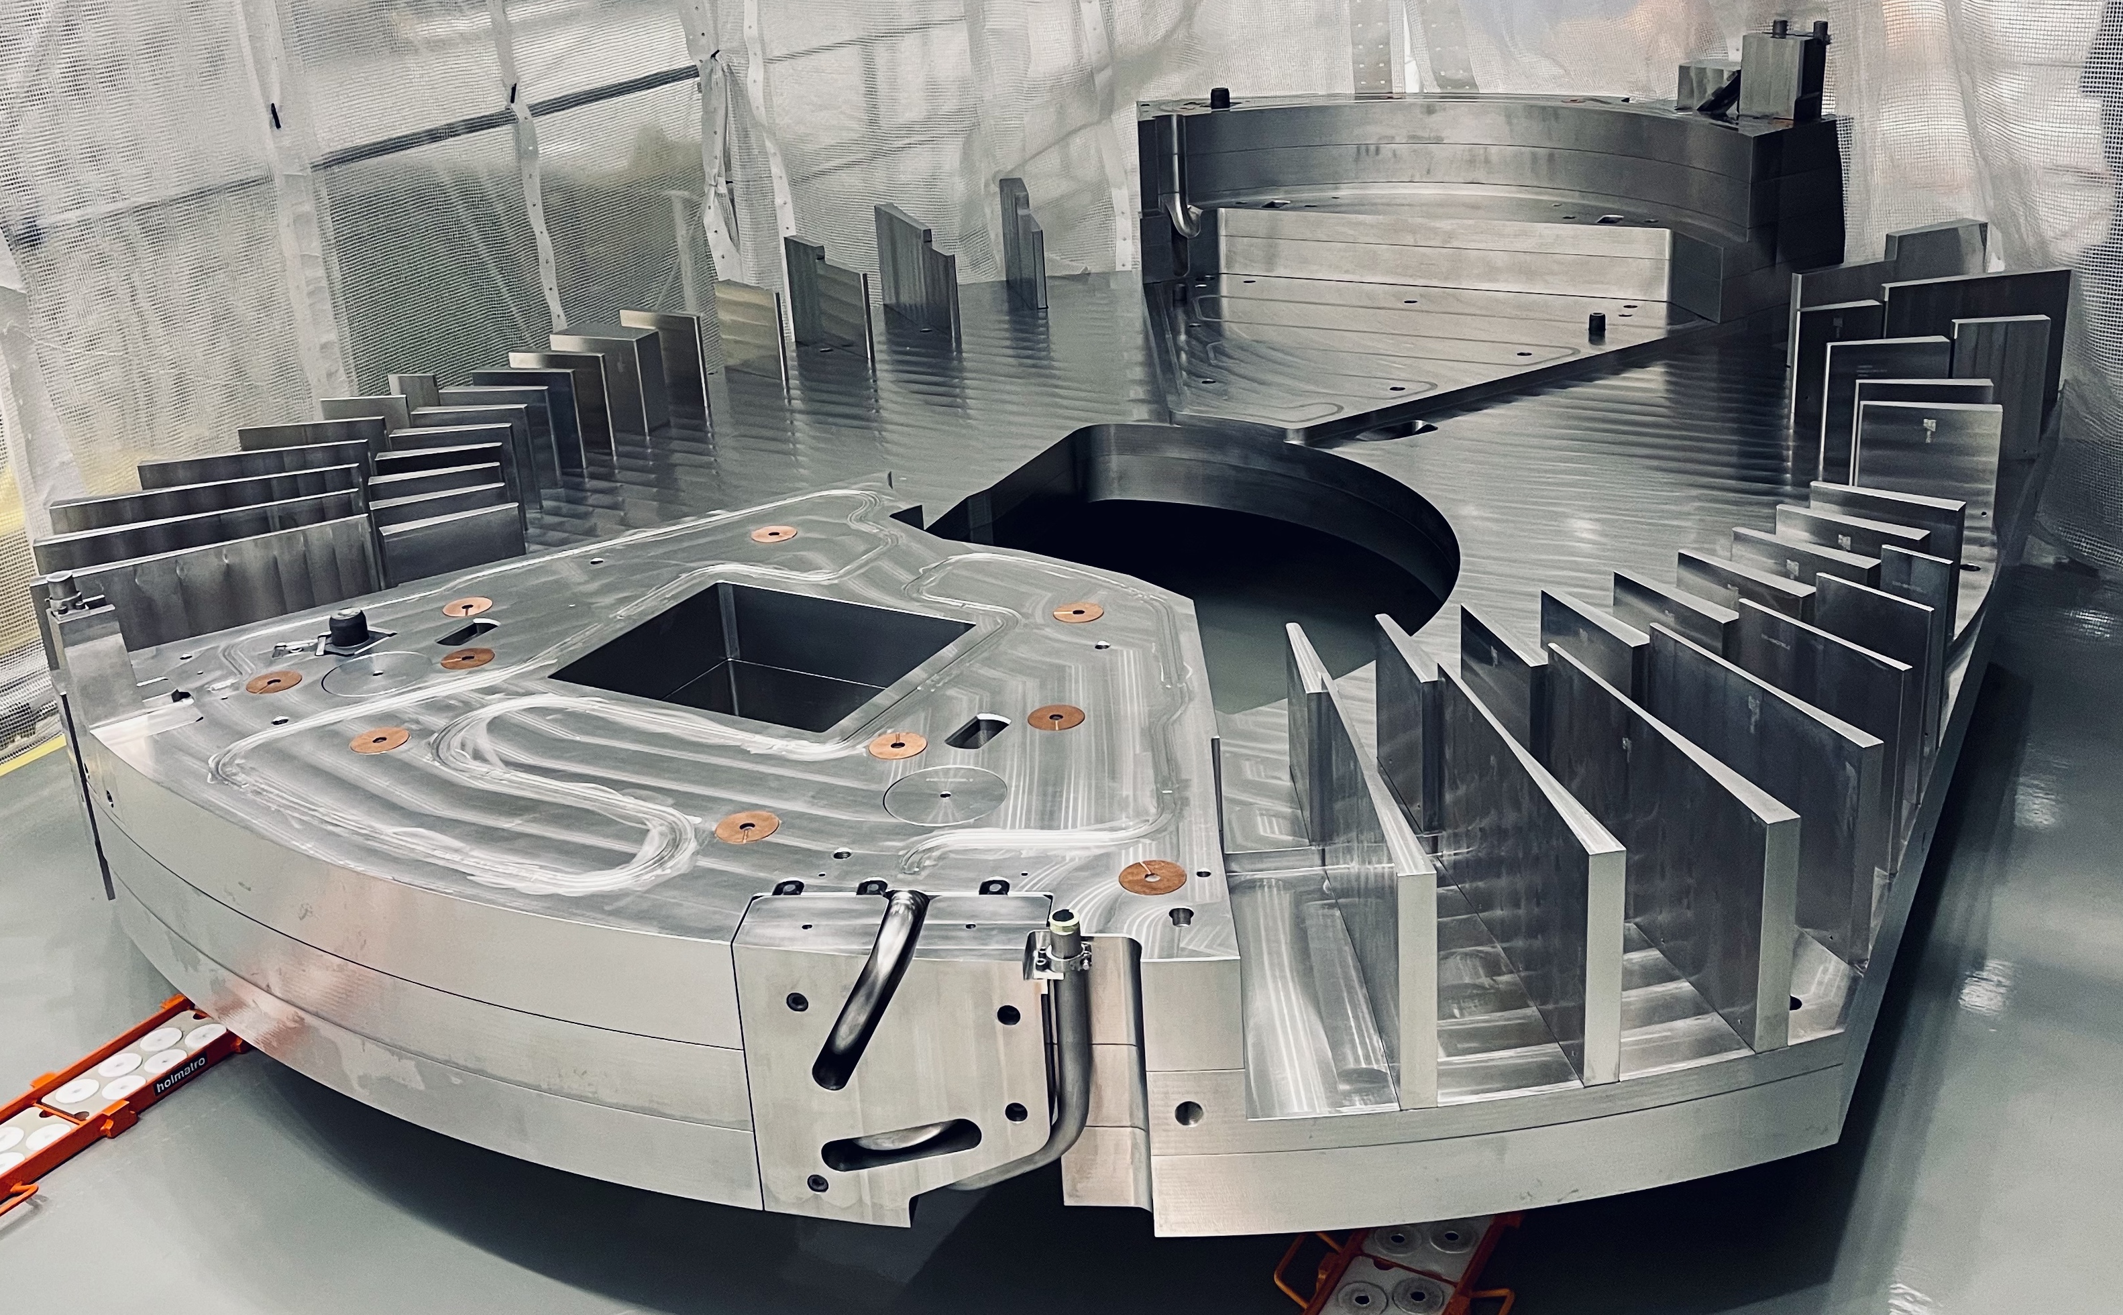
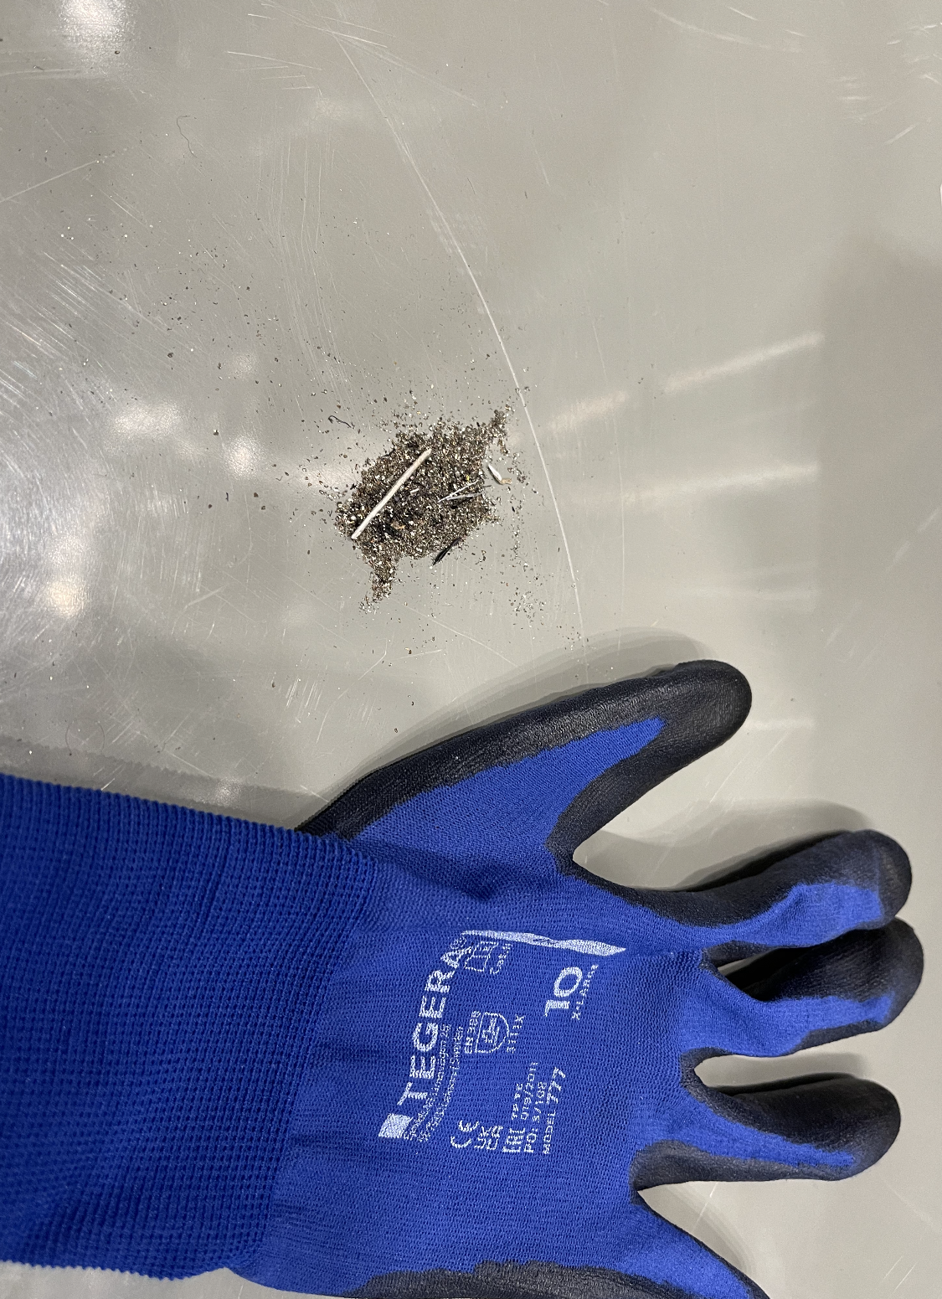
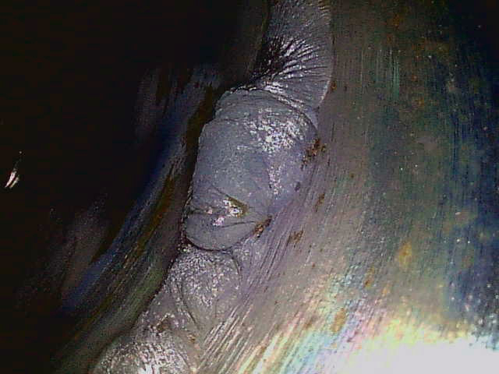
Weld Quality and Cleanliness
Monolith Inner Shielding
Upon receipt of several monolith inner shielding blocks, issues with both cleanliness and weld quality were found
Already extensive Factory Acceptance Tests and inspection programmes proved insufficient. Our lesson learned was that even more intensified quality control were needed earlier in the process. (And pandemics do not help)
The necessary remedial measures were technically straight-forward, while the schedule impact were concerning.

Slide 17
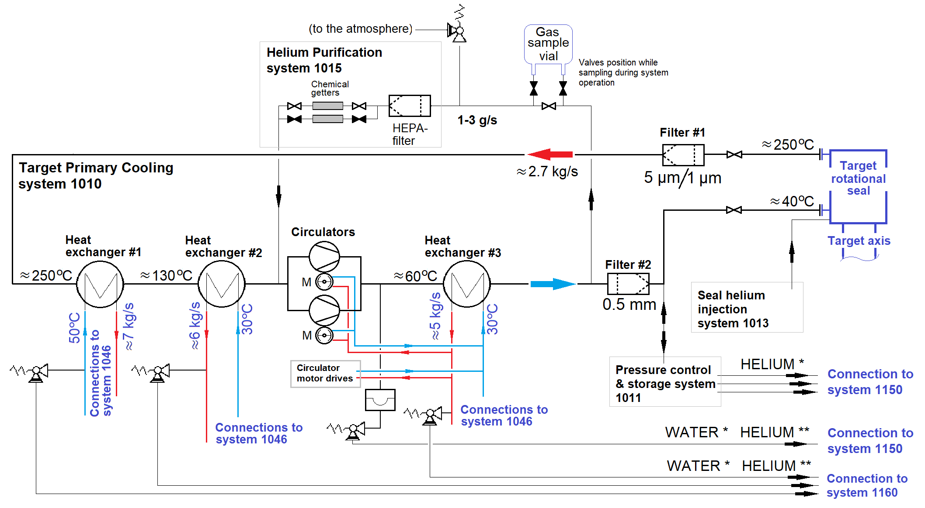
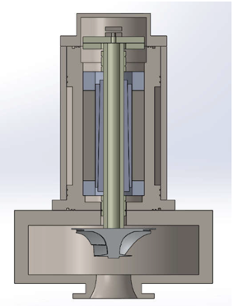
Helium Circulator Failure
The helium system flowchart

Slide 18
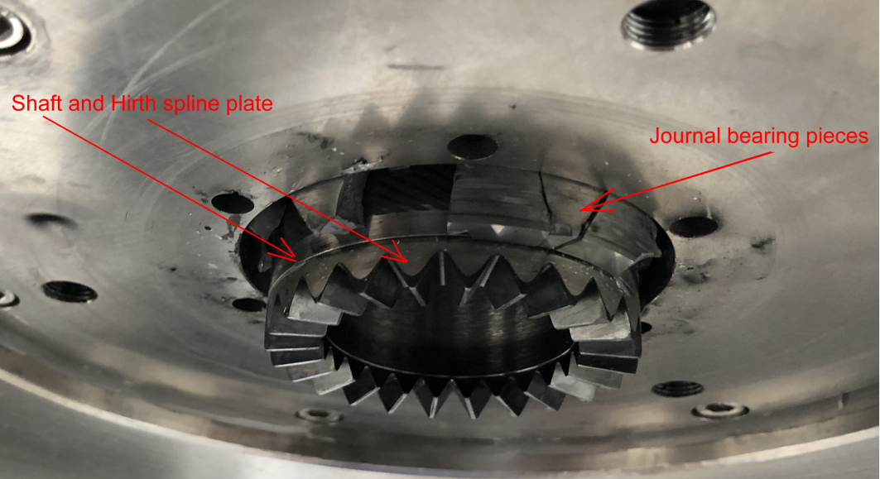
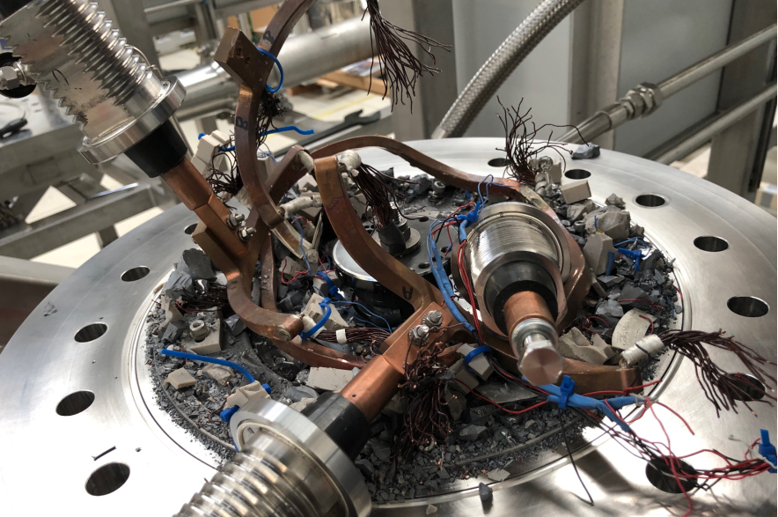
Helium Circulator Failure
Damages to both circulator assemblies
Damaged lower part of the journal bearing of the rotor in the circulator #1
Damaged upper part of the motor for the circulator #2
The most likely direct cause of the failure was debris in the test loop coupled with a non-robust design
Our two-fold remedial action was (A) to recover the failed turbo machines by implementing new motors and bearings of different type and (B) to procure and install an alternative industrial, robust screw compressor technology
For mitigating future risks, both alternatives were pursued in parallel

Slide 19
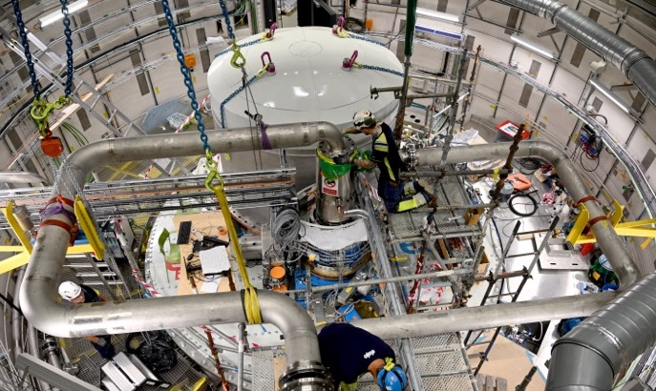
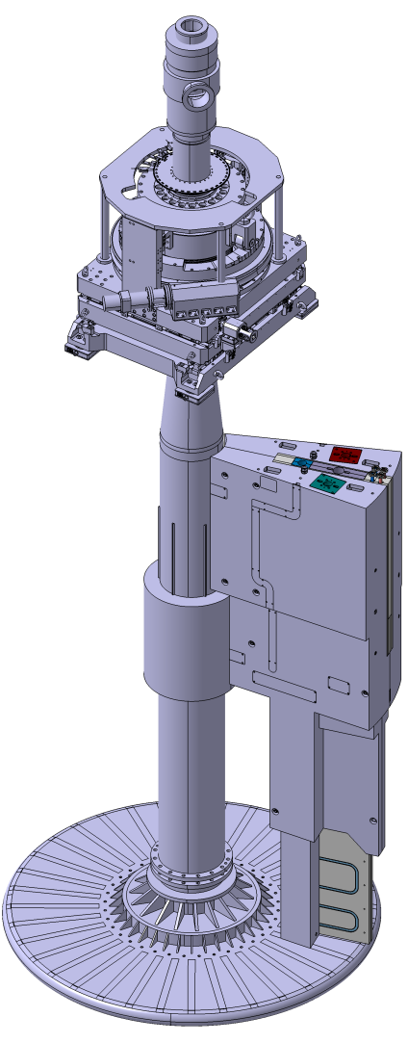
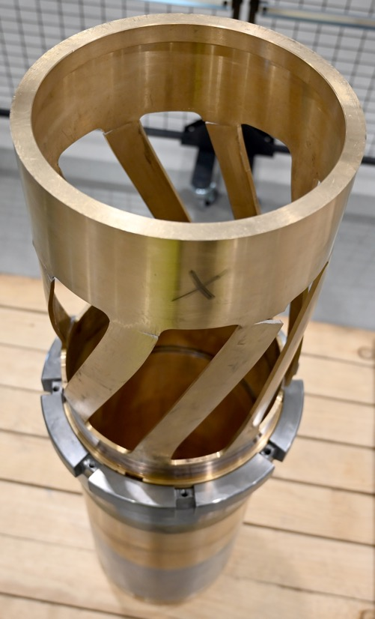
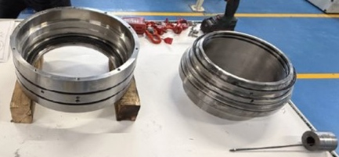
HRU issues
The challenges with the Helium Rotary Union (HRU)
The HRU Function
Convey helium between stationary piping and rotating target
Challenges
Complex load pattern
Mechanical, static/dynamic/cyclic
Thermal, expansion/high temperatures
Make possible mounting/dismounting
Leak-tightness
Minimising radioactive emissions and He loss
Minimising internal by-pass
For mounting purpose
Internal sleeve
For leak-tightness the HRU has an internal sealing cartridge
Rubber o-rings
between parts without relative rotation
Graphite rings
between parts with relative rotation

Slide 20
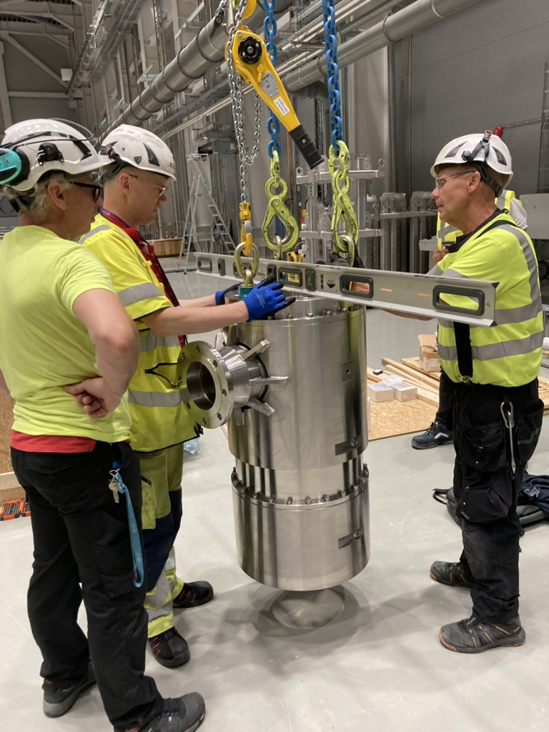
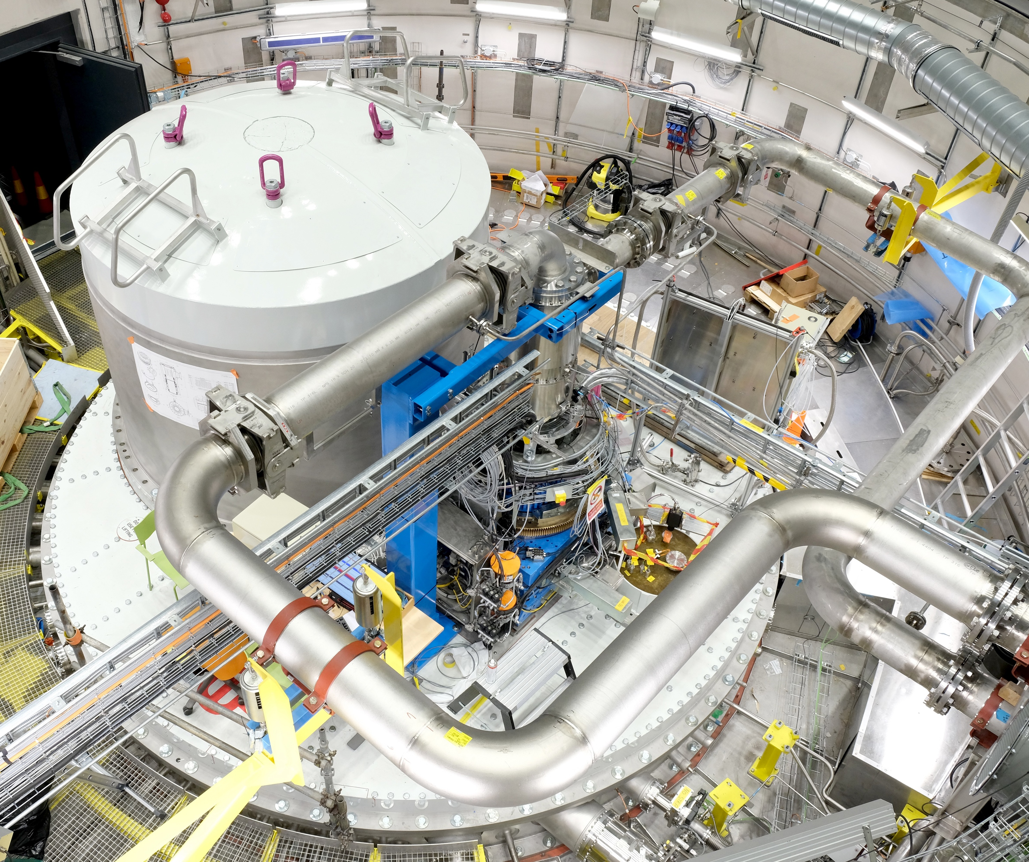
HRU issues
The recovery of the Helium Rotary Union (HRU)
Mitigative actions for the HRU challenges are
HRU version 1 is pursued for primary use at BoT
Extensive experience with the component has been gained during cold commissioning
Spare parts are available
Technicians have trained refurbishment and can get support from manufacturer
An alternative HRU version 2 is under development
Includes lessons learned from HRU#1 through important design modifications
Can be fitted sealing cartridges with several different technologies, by modular design
Aim is to have this alternative available as backup at time of BoT

Slide 21
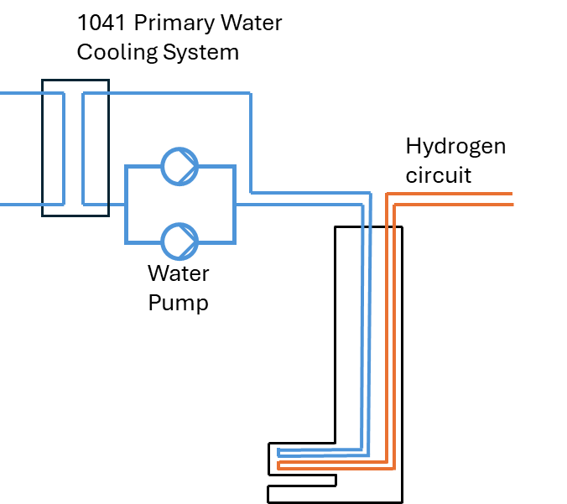
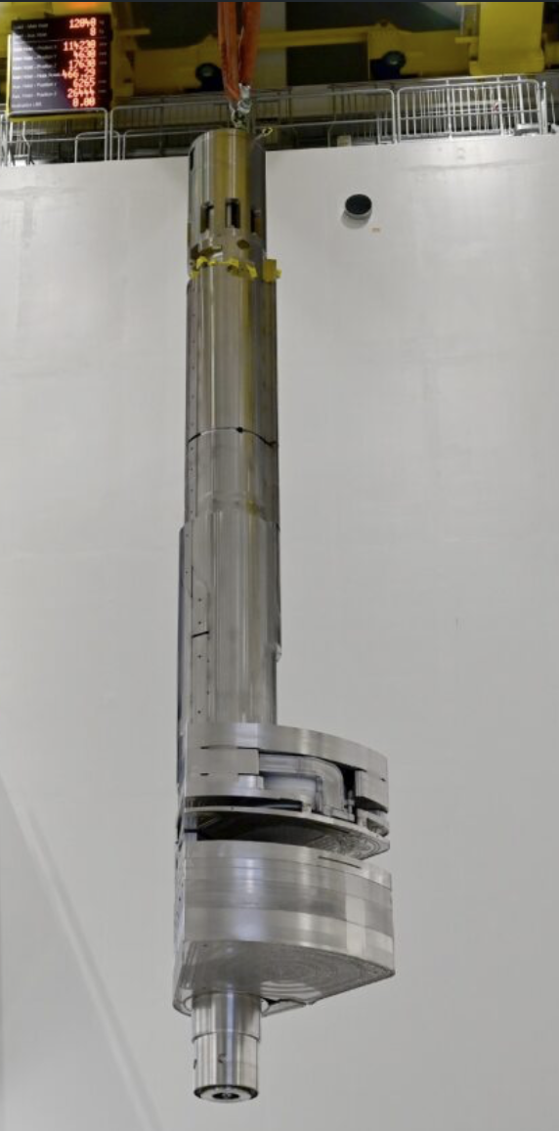
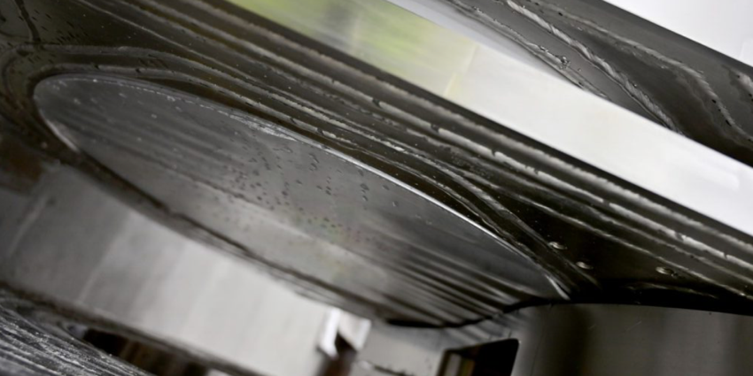
Damage of Moderator/Reflector Plug
2025-11-25 – Target systems were configured for integrated system testing
Cryogenic moderator hydrogen loop was operating normally
Thermal moderator/pre-moderator water loop was operating normally
Power transient caused water pump to trip and restart was delayed
When pump restarted flow very low likely through bypass loop
Data indicated loss of vacuum in both monolith and cryogenic pipe insulation
After extraction of the MRP#1 a few days later the damage was obvious and deemed not repairable
Direct cause is ice formation due to stagnant water coupled with “tight” design with the cryogen H₂
The remedial action is to install the MRP#2, which was already in production, during second half of 2026

Slide 22
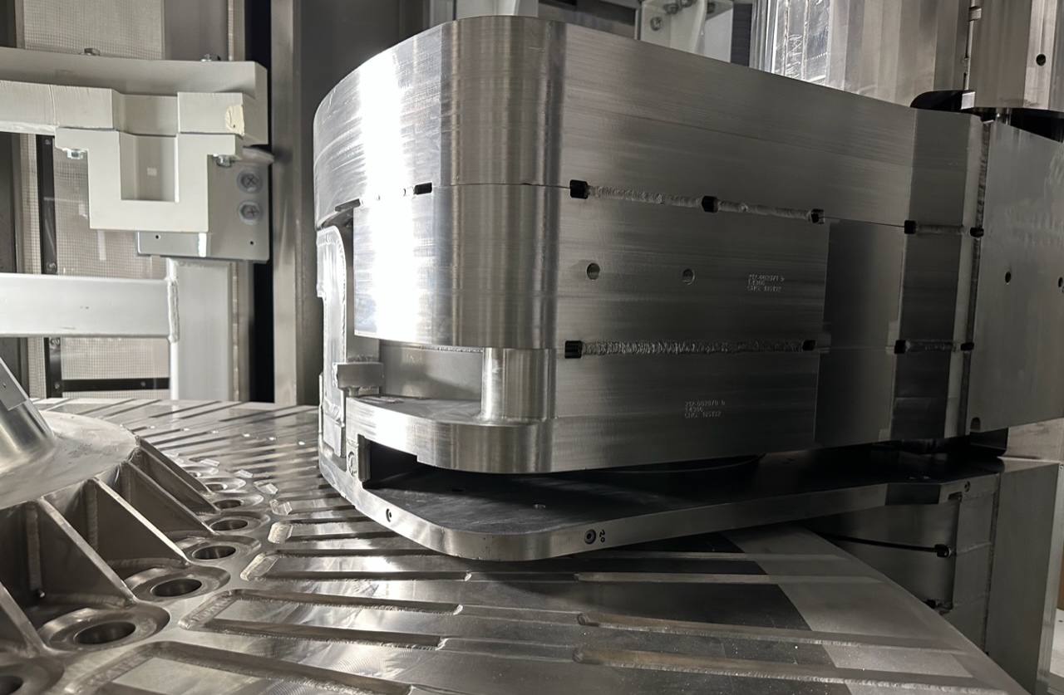
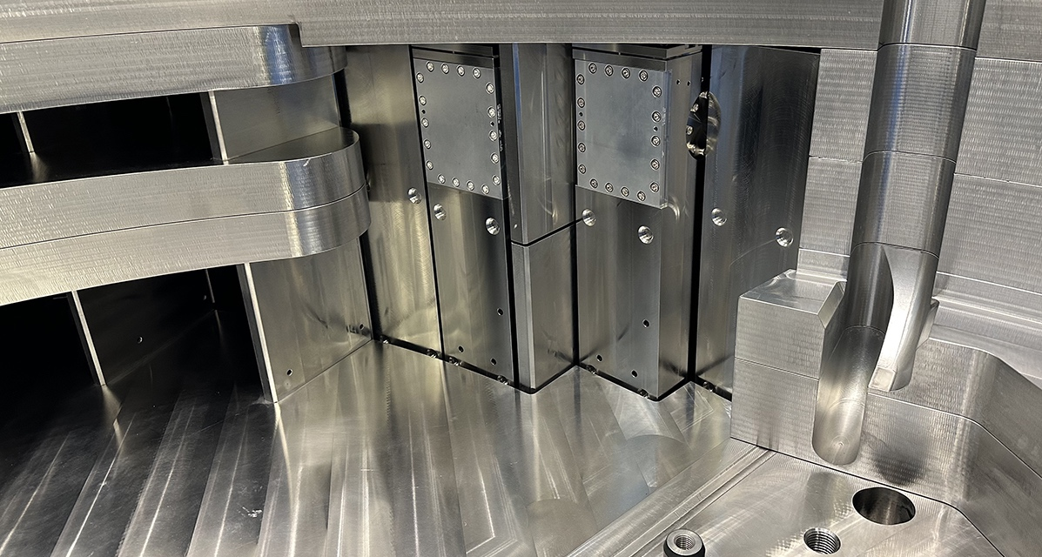
4
Achievements and Successes

Slide 23
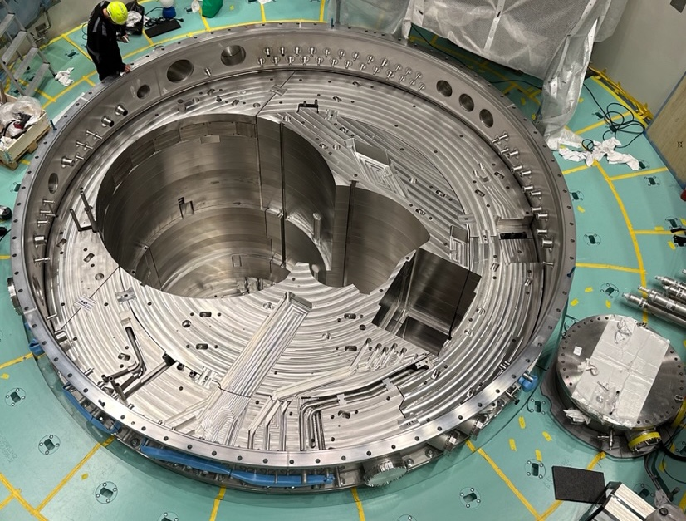
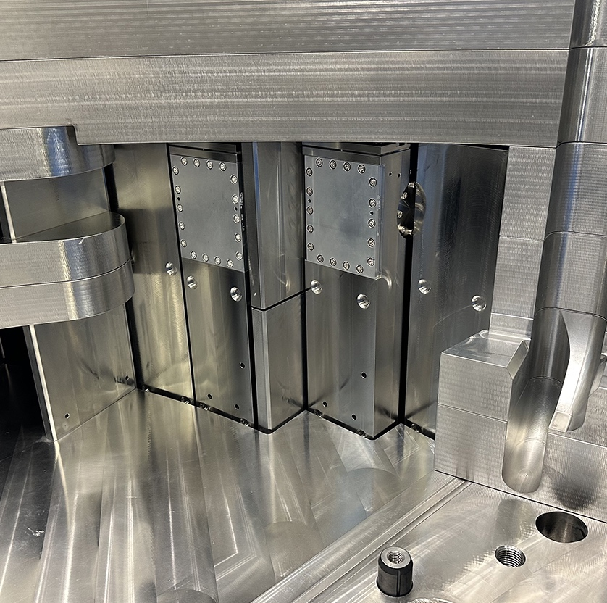
Monolith vacuum performance
Monolith cleanliness and vacuum compatibility
Hardware configuration
Vacuum boundary
Monolith and PBW vessels
Connection ring
Neutron beam port tubes
Neutron beam windows
Internals
Neutron beam port inserts and plugs
All permanent inner shielding
Feed pipes for water-cooled shielding
Successful achievement of monolith vacuum performance
Leak tightness confirmed for the vacuum boundary
No significant contamination of the monolith was found, i.e. sufficient cleanliness
Excellent repeatability

Slide 24
Precision of the neutron beam extraction
As-installed precision for neutron beam extraction
The precision of the neutron beam extraction relies on the manufacturing and installation results of many components, some large and heavy, others very delicate.
The ultimate requirement
Maximum misalignment between each neutron extraction optics assembly and their corresponding optimal moderator surface.
With reference to each beam line’s theoretical centre line the misalignment should be within ±2 mm (vertical), ±3 mm (lateral) and ±5 mm (axial).
The successful end-result
All individual structures were built and installed within their specified local geometrical tolerances.
Positioning deviation of the neutron beam port inserts, as-installed, were confirmed within a few hundred micrometres, relative to the theoretical moderator position.
Together with the expected repeatability precision for replacement of the moderator/reflector plug, i.e., ±1 mm (vertical) and ±2 mm (lateral), the required precision will be accomplished!

Slide 25
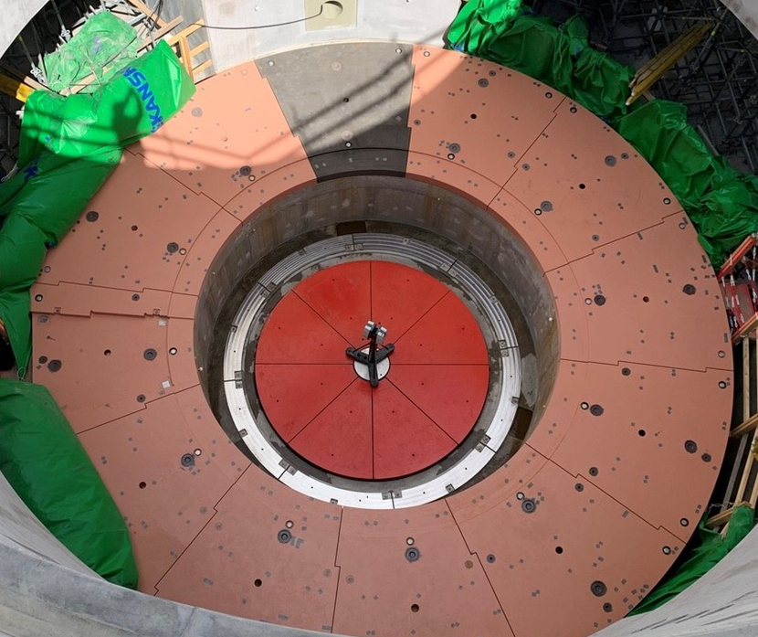



Precision of the neutron beam extraction
Maximum deviation from nominal position
Baseplate 0.6 mm (vertical)
Monolith vessel 0.5 mm
Port tubes after welding 2.9 mm (lateral)
Moderator/reflector seat 0.05 mm (vertical) 0.14 mm (horizontal)
Note that average deviation values are generally significantly better.

Slide 26


Precision of the neutron beam extraction
Maximum deviation from nominal position
Shielding top interface with remote handling system (casks) 0.6 mm
Moderator/reflector plug positioning Expected first time install <0.5 mm
Expected replacement repeatability precision, by remote handling, <1 mm (vertical) and <2 mm (horizontal)
Positioning of the Neutron Beam Port Inserts 0.2 mm (vertical) 0.3 mm (lateral & axial)
Note that average deviation values are generally significantly better.

Slide 27

5
Concluding Remarks

Slide 28
ESS Target Station Project Current Status
The ESS Target Station is close to be ready to operate with proton beam
By 2025-11 all target station systems for neutron beam production were fully installed, commissioned, and functionally verified
Integral testing and commissioning had commenced and are still on-going
The project were on track for start of operation 2026-03, but now forecast early 2027
Due to the damage of the MRP#1, BoT relies on delivery of the MRP#2 which is currently forecast 2026-10
System modifications for mitigating similar damage to MRP#2 are in work
Early 2026 the license to operate with proton beam on target was received
Meanwhile, during 2026, works continue
Integral target station operation to gain experience and to train the organisation
Addressing findings from the testing and functional integration
Resolving remaining punch list items important for reliable future operation
Finalising the remote handling systems

Slide 29
Remarks on organisational readiness to operate
Pending installation of MRP#2 we will be ready to start operation with proton beam, but learning to operate stably, efficiently and with expected availability will take time
Getting ready to operate stably and efficiently
Engineered radiation safety features, performance and capacity requirements are verified and validated
However, full understanding of the neutron factory behaviour requires extended usage and operation experience
Training and learning on the job will be instrumental for mastering the art of operating the ESS Target Station
Collaboration will be more important than ever before
Within ESS; with internal functions, interfaces and stakeholders
Continued support by and exchange with our project partners
With the worldwide community and peer facilities

Slide 30
Thank you for your attention

