Slide 1
The Swiss Spallation Neutron Source SINQ
Michel Kenzelmann
ICANS 2026, 13 April 2026

Slide 2
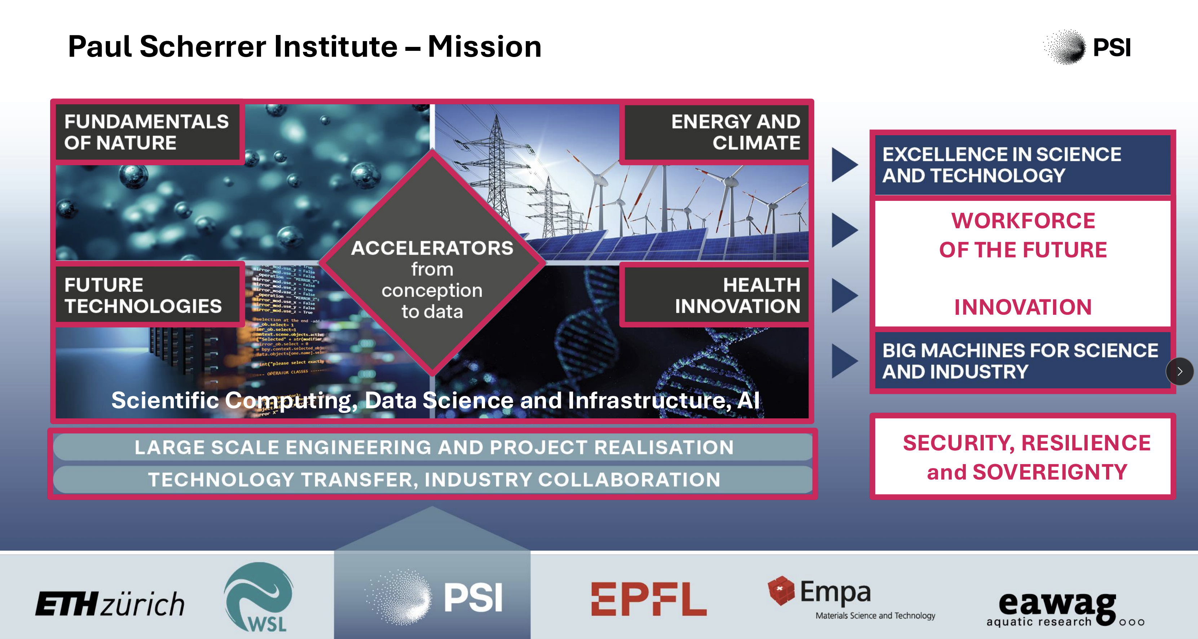
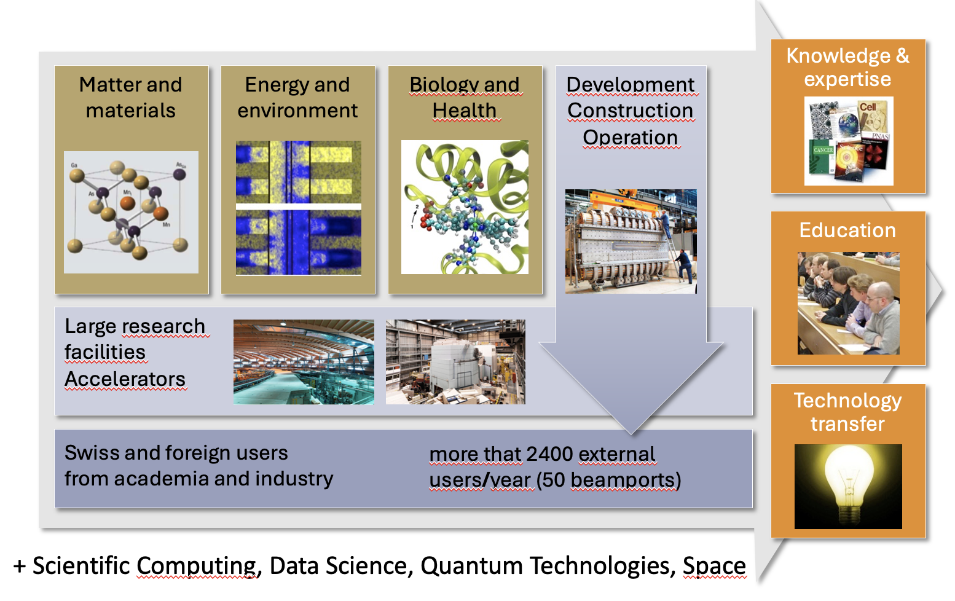
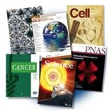
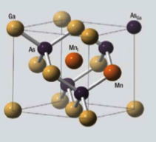
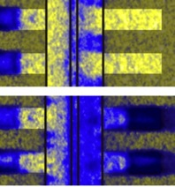
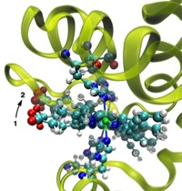
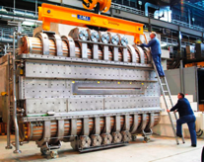
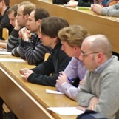
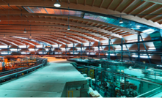
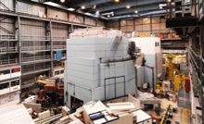

Mission of PSI
Knowledge &
expertise
Matter and materials
Energy and environment
Biology and Health
DevelopmentConstructionOperation
Education
Large research
facilities
Accelerators
Technology transfer
Swiss and foreign users
from academia and industry
more that 2400 external users/year (50 beamports)
+ Scientific Computing, Data Science, Quantum Technologies, Space
Notes:
PSI has a special task in Switzerland:
It develops, builds and operates complex large research facilities, which - due to their size and complexity – can only be realised once in Switzerland.
These facilities are often as large as sports halls or even bigger
The complex facilities are not used by PSI scientists exclusively but are at the disposal of all Swiss and foreign scientists from academia or industry. Therefore, within the course of a year more than XY scientists from a range of disciplines visit us and use our XY specialised beam ports for their experiments.
Our own research (in-house research) benefits from having the large research facilities on campus. We focus on three areas: materials research and particle physics («matter»), energy and environment, as well as human health. I will give you some examples of these areas later on.
The results of our work are, of course, new knowledge and expertise, whether it be in the manner of the aforementioned publications in scientific journals, reports, analyses or similar.
But the results of our work are also reflected in the training and education of our staff, who leave PSI and thus transport knowledge into society at large. Each year about 200 members of staff leave PSI to work in the private sector, in the civil service or in other research organisations.
Moreover, we transfer our knowledge to industry via typical technology transfer measures like joint projects or licensing and patents.
Background information
On the images you can see:
Matter and materials: symbol for the arrangement of atoms in a crystall structure.
Energy and environment: distribution of water in a fuel cell.
Human health: structure of the myoglobin molecule, which is responsible for vital processes while breathing.
Development, construction, operation: one of the accelerator cavities of the large proton accelerator at PSI.
Large research facilities: left: SLS-hall; right: target-bloc in the SINQ, where the neutrons are produced.
Knowledge and expertise: thumbnail featuring the front covers of several scientific journals.
Education: thumbnail with a lecture hall.
Technology transfer: thumbnail: the bulb represents a good idea or an inspiration.

Slide 3
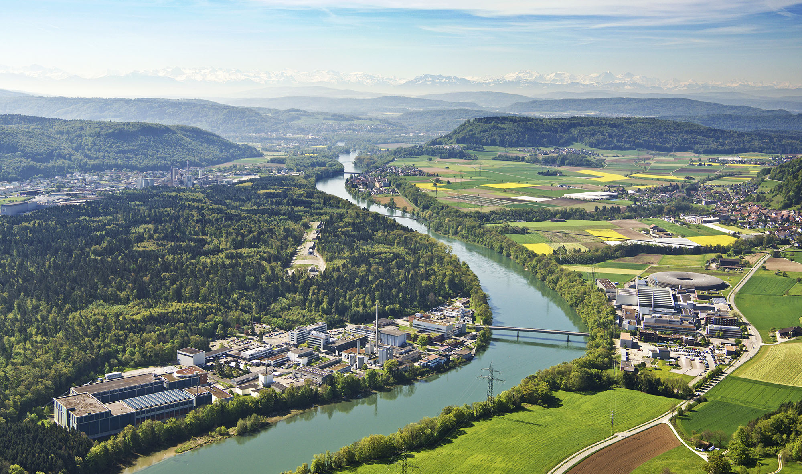
Agenda
Paul Scherrer Institut
SwissFEL
SLS
SINQ
SμS
Notes:
This is an areal view of the PSI, looking towards the south. On the horizon at distance of about 100km, you see on the snow-covered Swiss Alps.
In the foreground, you see the PSI and the reason of its existence, which are large user facilities: a muon, a neutron, a synchrotron and a free-electron laser facility.

Slide 4
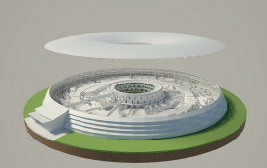
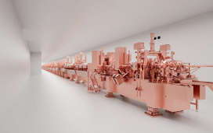
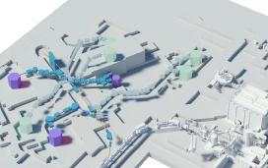
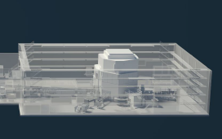
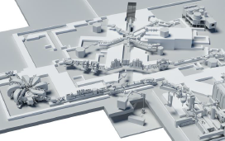
Large-scale user facilities at PSI
Several large facilities at single location and integrated in single institute
Five large user facilities with peer-review access
Swiss Light Source
SwissFEL
CHRISP: particle physics facility
Swiss Neutron Spallation Source
Swiss Muon Source

Slide 5
Paul Scherrer Institute in numbers
Where Science meets Society
Overall staff 2100 (1/3 externally financed)
320 PhD students, 100 technical students
4800 users/year
1400 publications/year
5900 patients/year

Slide 6
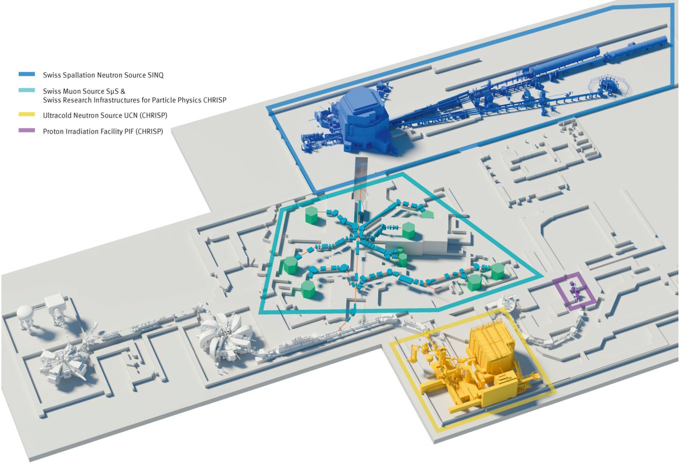
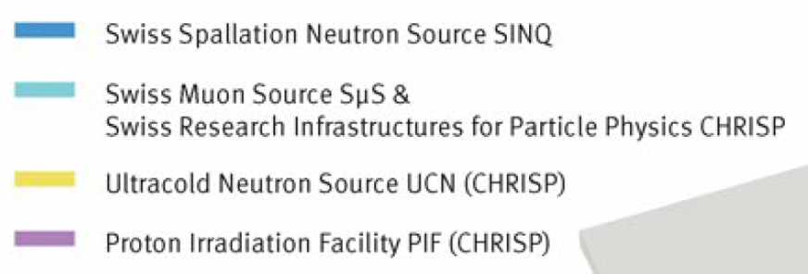
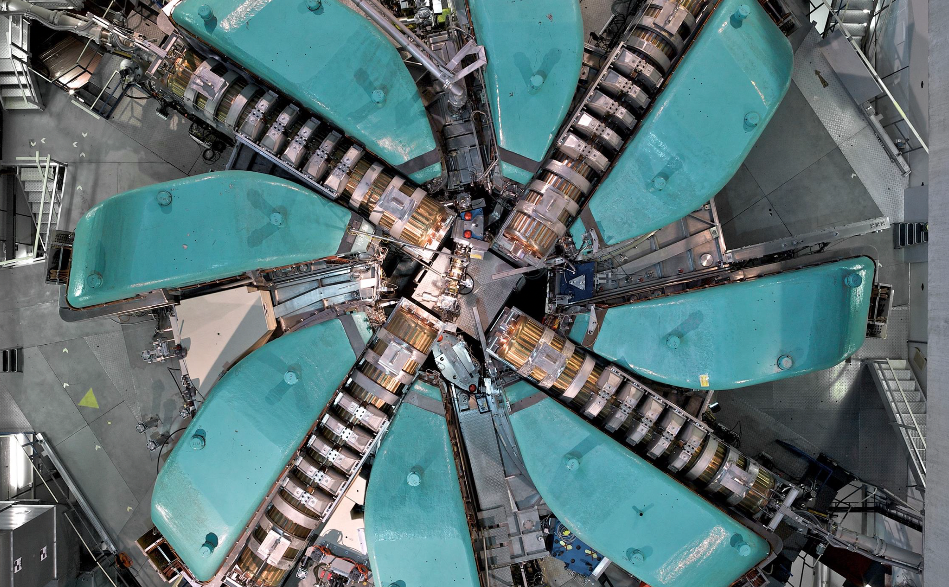
HIPA and SINQ

Slide 7
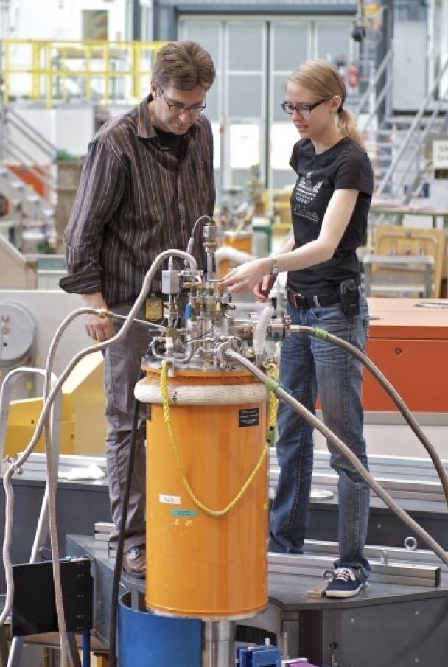
SINQ operations and user instruments in 2024 and 2025
In 2024: SINQ ran from late May through Christmas with 13 user instruments
In 2025: SINQ ran from late May through Christmas with 10 user instruments
SANS-LLB will enter user service this summer
NEUTRA was upgraded in 2025 und re-enters user service this summer
POLDI is being upgraded and is not available currently

Slide 8
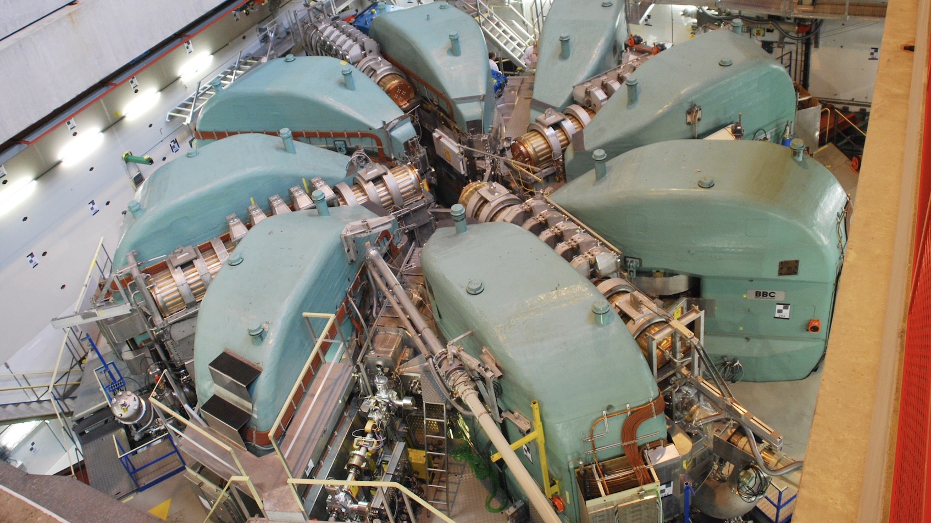
Availability HIPA
2025: 90.8%

Slide 10
Submitted proposals SINQ

Slide 11

Five years history key numbers SINQ
 | 2021 | 2022 | 2023 | 2024 | 2025
Instruments (open for proposals) | 10 | 12 | 13 | 13 | 10
Instrument days | 1662 | 1578 | 1658 | 1570 | 1511
Experiments | 417 | 419 | 457 | 426 | 359
User visits | 524 | 784 | 810 | 660 | 529
Individual users | 365 | 557 | 577 | 475 | 380
New proposals | 697 | 629 | 306 | 790 | 203

Slide 12
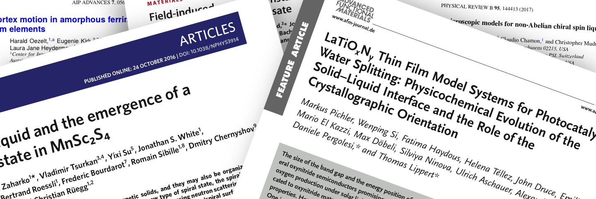
Publications SINQ – 10y history
The figures for 2020 and afterwards are affected by the shutdown period
of SINQ between 01/2019 and 07/2020, and continuing upgrades
on about 25% of the user instruments since 2020.

Slide 13
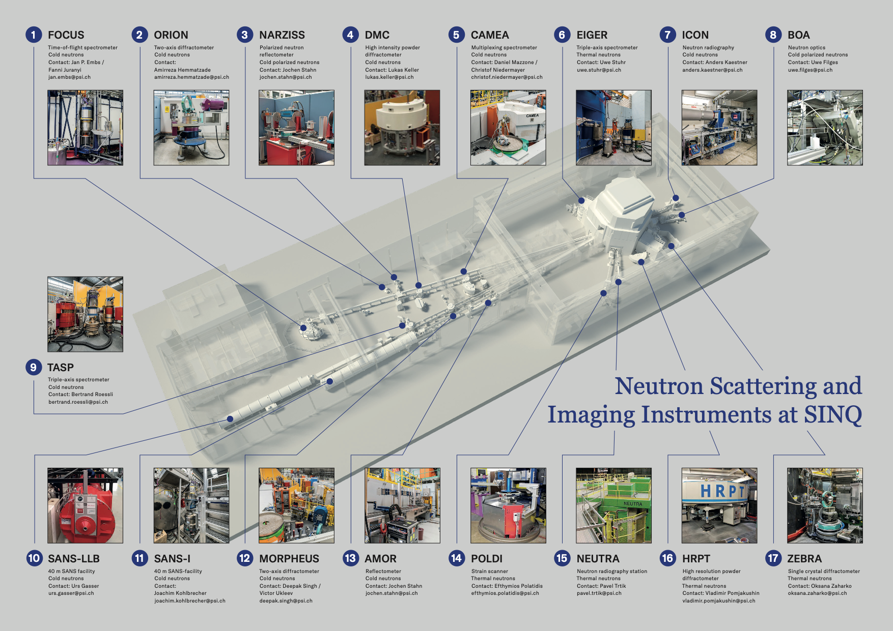
Notes:
We operate 17 instruments, the great majority of which are in a peer-review access system.
These are all designed to study specific aspects of allow the structure or dynamics of a wide range of materials.

Slide 14
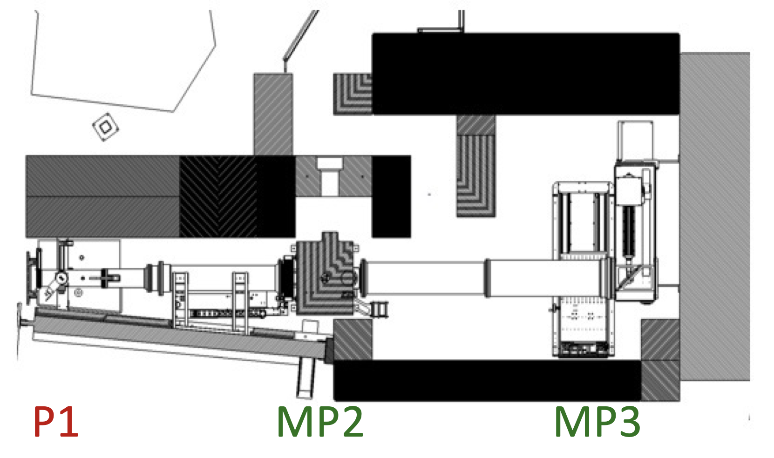
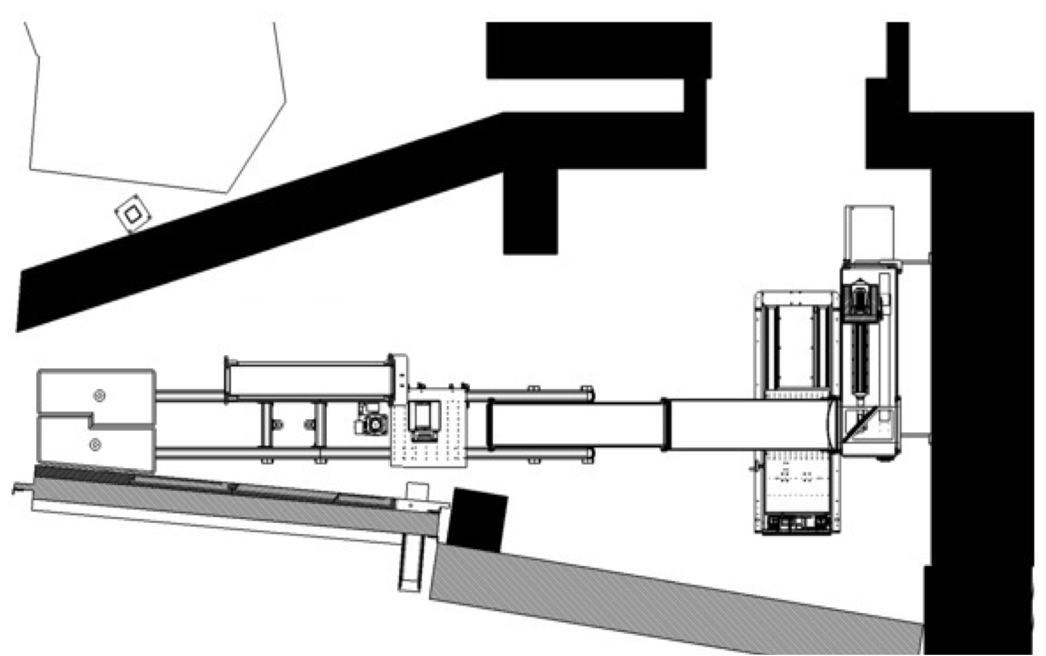
Upgrades: thermal imaging instrument NEUTRA
The original NEUTRA has been the SINQ Day-1 Instrument of SINQ
Significant bunker enlargement
Higher flexibility of our thermal neutron imaging instrument
Three different measurements positions, with access to higher flux position
Use of higher resolution detectors and dedicated neutron optics possible
In-situ bimodal N/X-ray imaging option possible
In collaboration with IFE, Norway
new
old

Slide 15
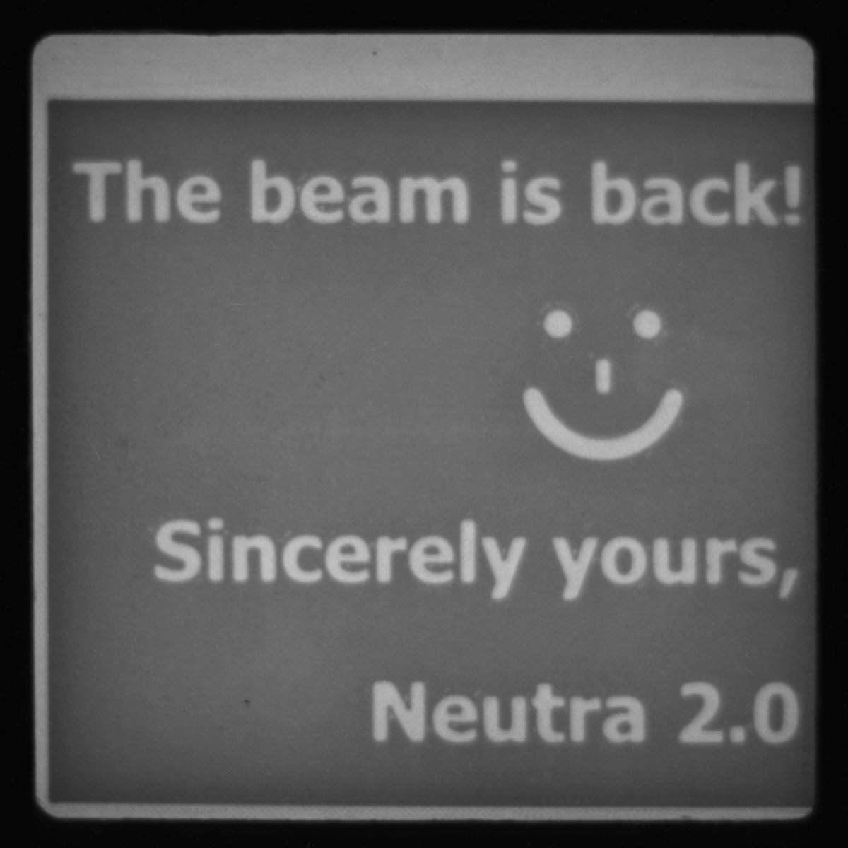
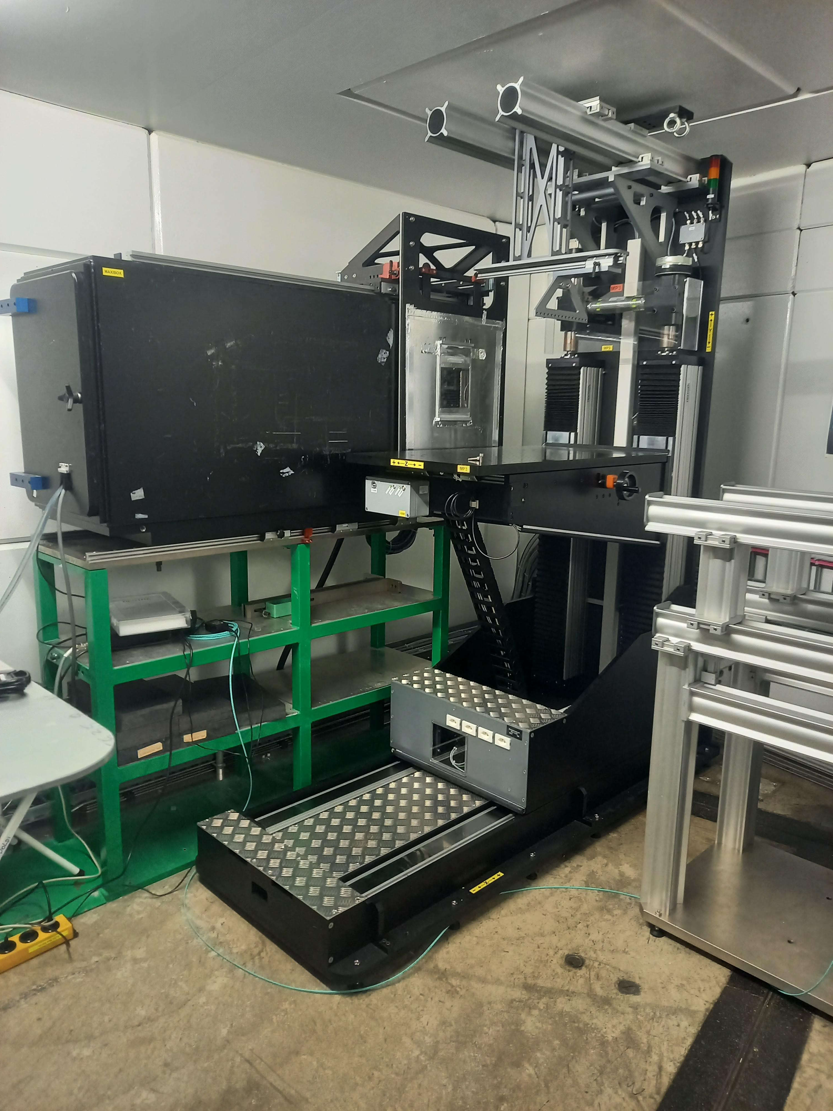
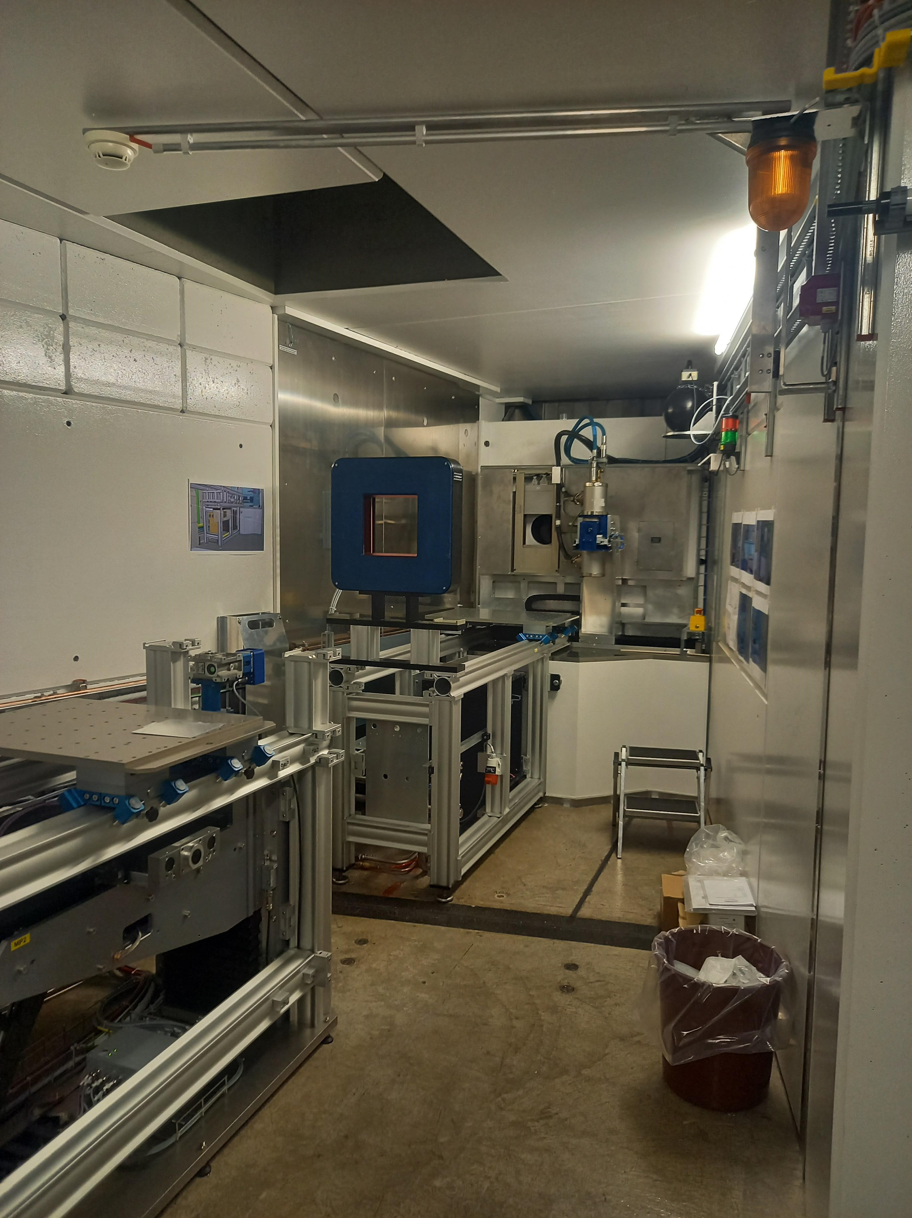
Upgrade of NEUTRA – highlight slide for DIRK Dec/2025 meeting
  2024-Nov 24th - The last user experiment at the old NEUTRA
  2025-Jan 10th - Old NEUTRA fully decommissioned
  2025-Nov 7th - Provisional approval to open the shutters + 1st image acquired
Main instrument scientist: Pavel Trtik (LNS)
1st neutron radiography @ NEUTRA 2.0

Slide 16

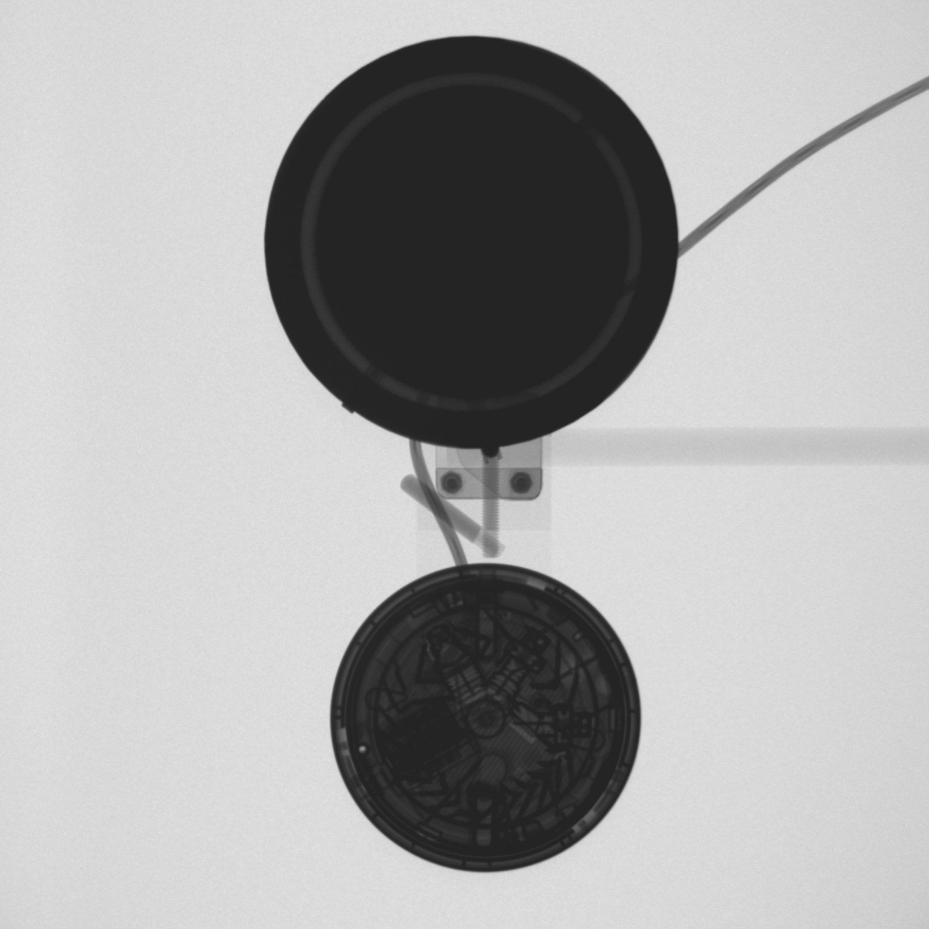
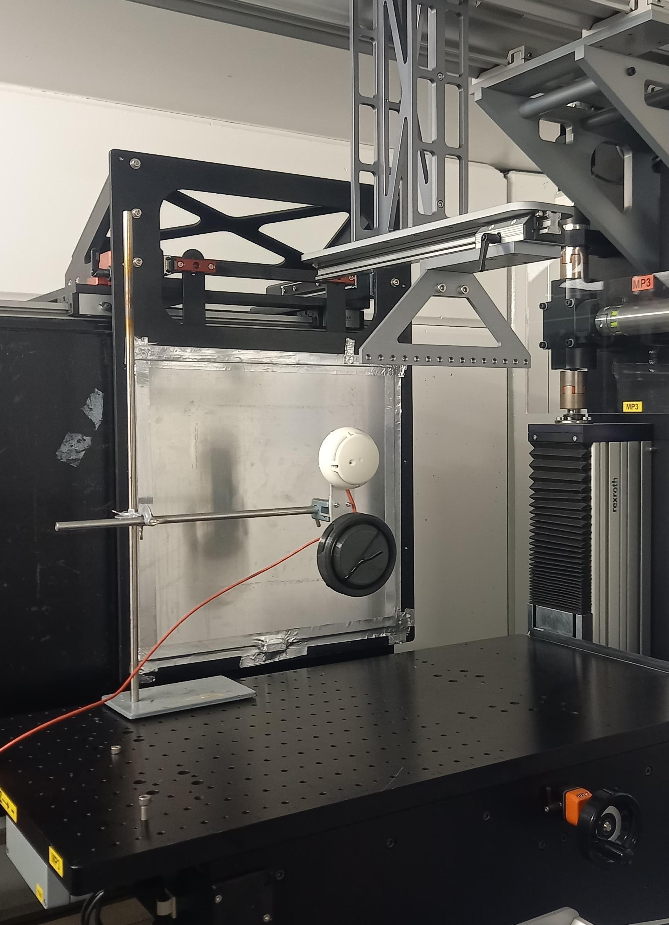
First commercial beamtime on NEUTRA
Neutron imaging and irradiation of smoke alarm sensors
AXPO Nov 28th – Dec 1st
-0.2 1.2
294 mm

Slide 17

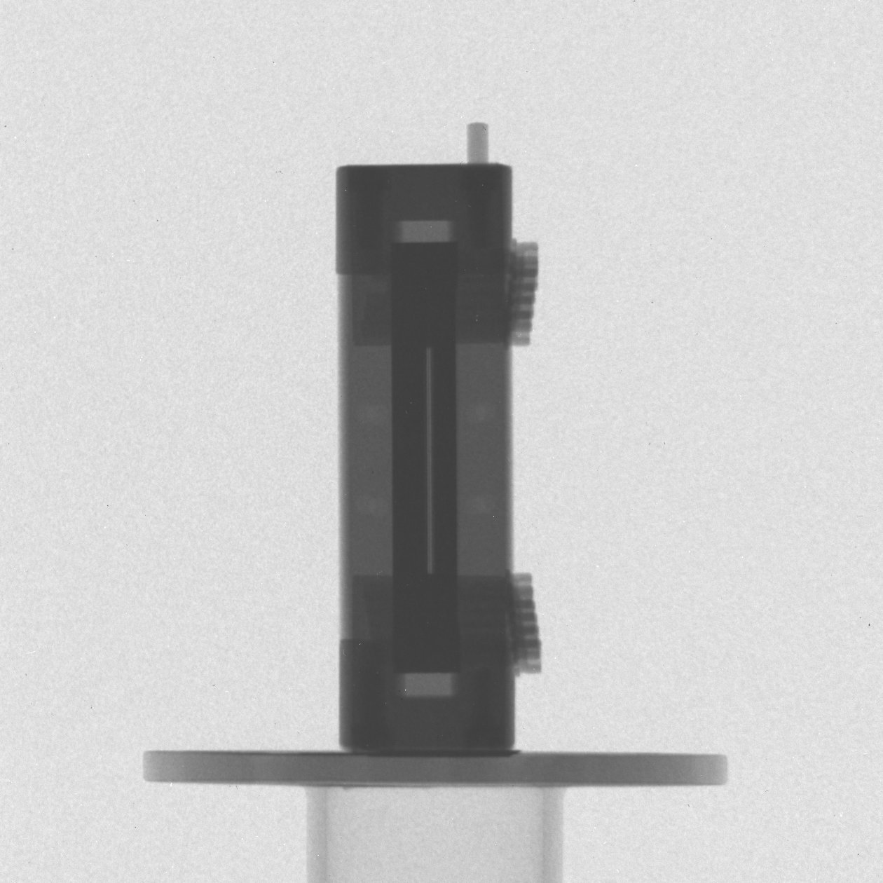
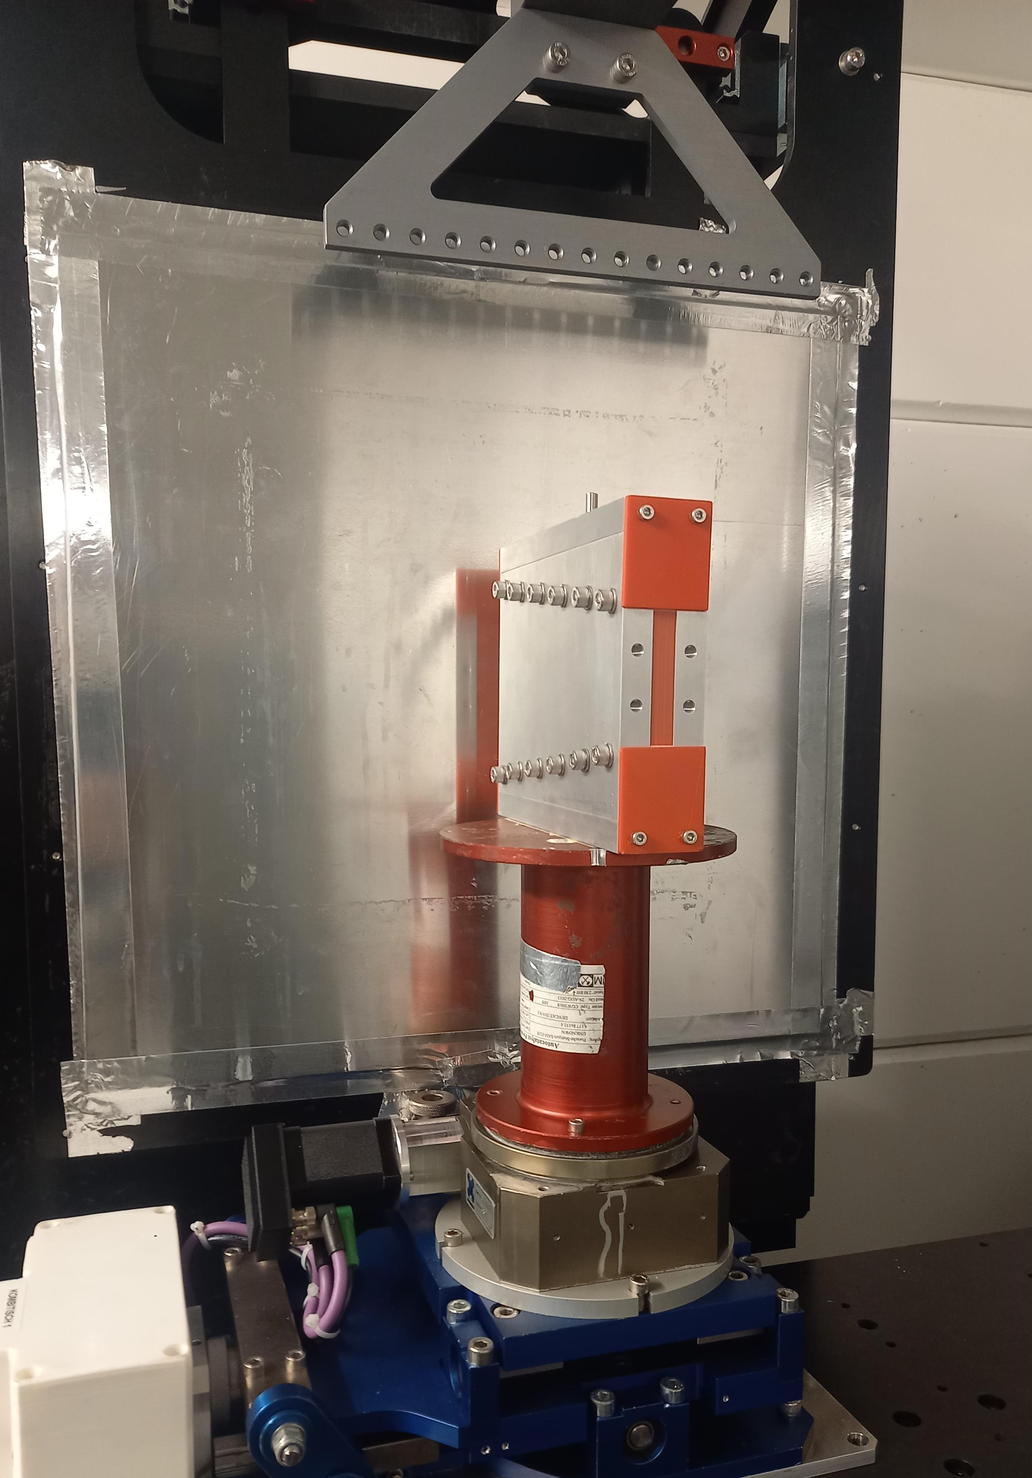
First in-house/user NEUTRA experiments
-0.2 1.2
1st user beamtime (Lehmann, Trtik, Speidel)
Neutron imaging of a Buddhist statue
Provenance: Lauren Gallery, Marietta, GA, USA
Dec 18th, 2025
-0.2 1.2
205 mm
1st in-house beamtime (Filges, Trtik)
Quality control of the neutron collimators for POLDI beamline
Dec 10th, 2025
240 mm

Slide 18
Upgrade: engineering diffraction instrument POLDI
Two detector banks allow simultaneous measurement of 2 strain directions
Pre-sample vertical focusing increases flux two-fold
Optimized elliptical horizontal optics
New CASCADE detectors from CDT
Overall we expect a >10 performance increase
In collaboration with IFE, Norway, and ANAXAM
Main instrument scientist: Florencia Malamud (LNS)
8m Horizontal: Elliptical guide; Vertical: Double elliptic guide
2m N-Optics w/ multi-function

Slide 19
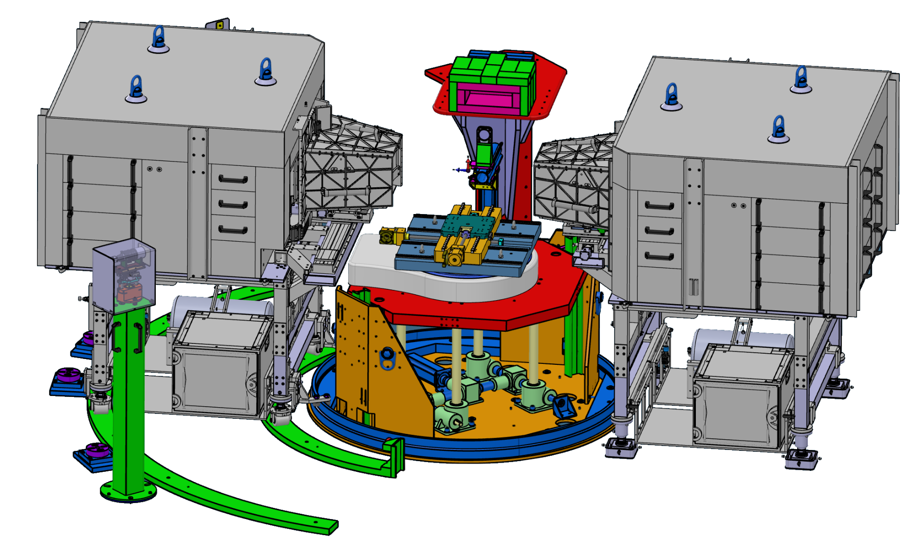
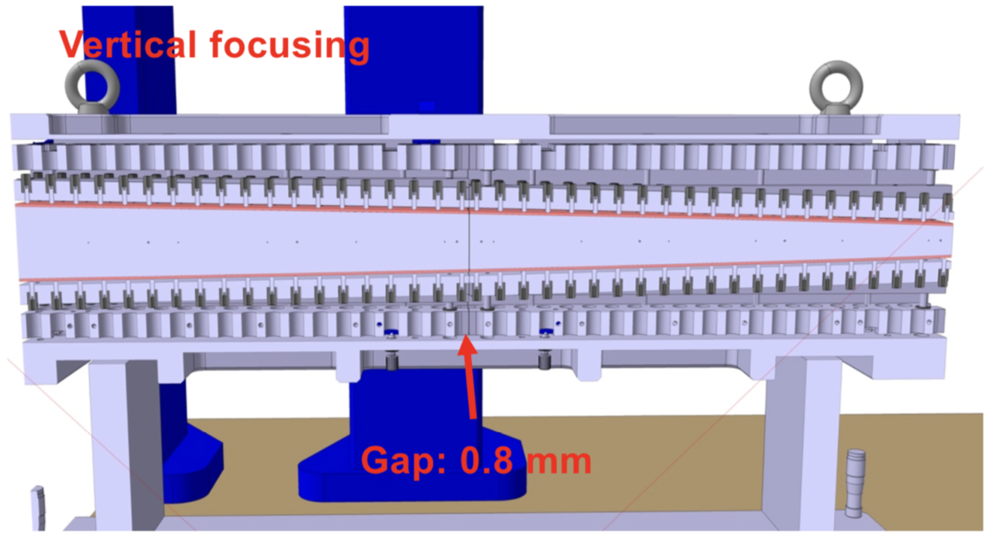
POLDI 2.0
Upgrade started Nov 2025
Both detectors passed site acceptance test
Design of shielding and neutron optics are being finalized and ordered soon
Hot commissioning planned for 2017
In collaboration with IFE, Norway, and ANAXAM

Slide 20
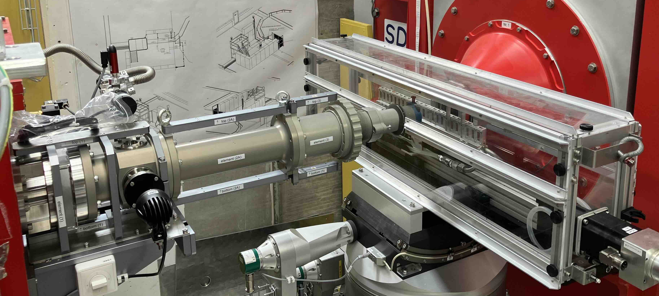
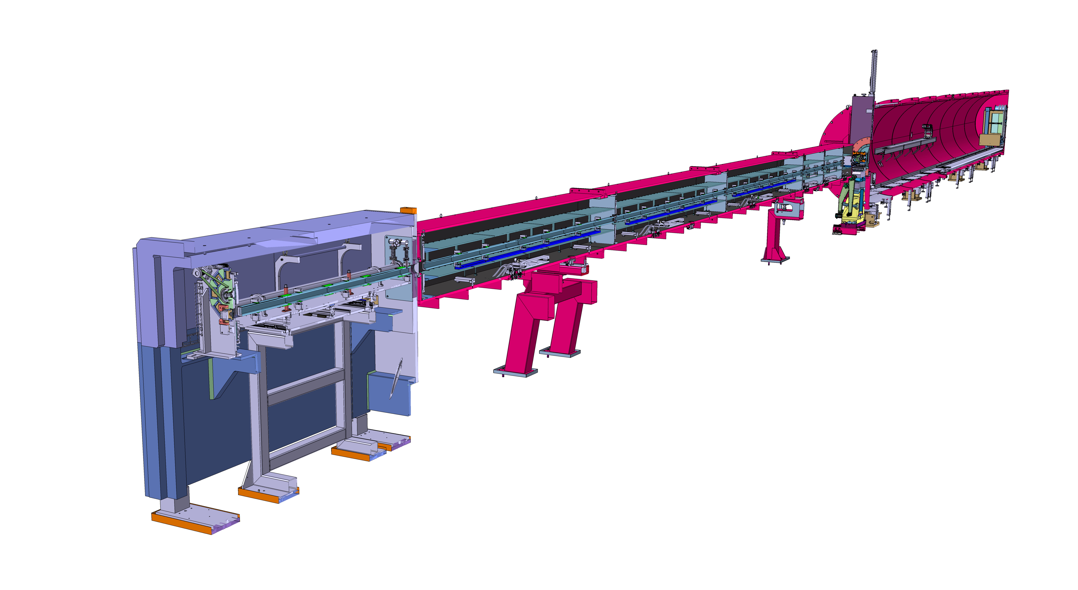
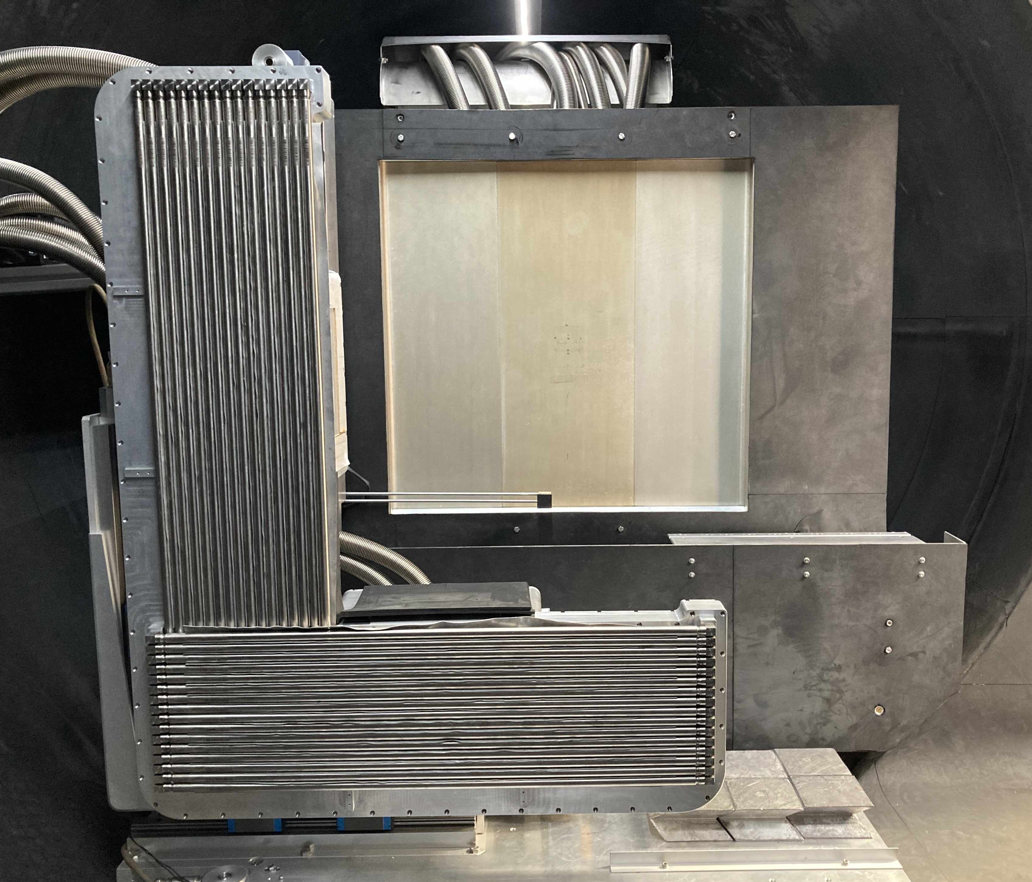
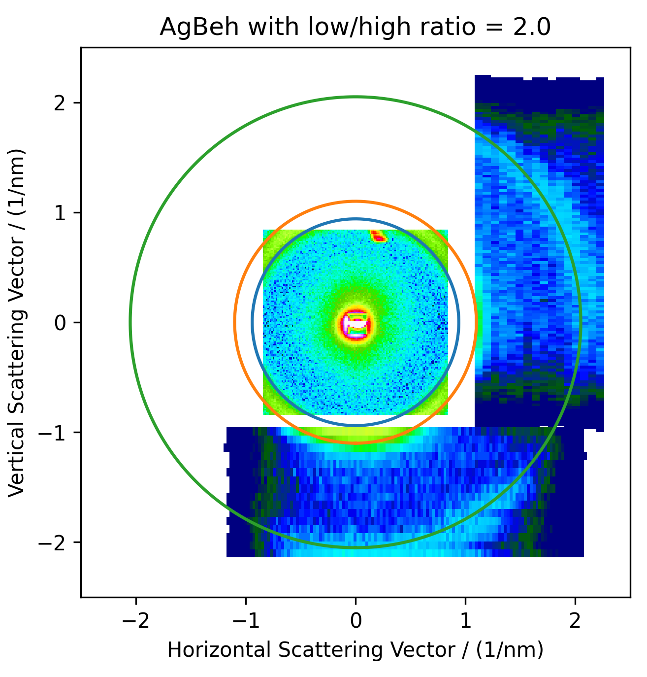
SANS-LLB in user service
Modern long SANS instrument (20m tank)
6-7x higher neutron flux than SANS-II
Order of magnitude of performance increase (over SANS-II) for soft matter
In collaboration with LLB, France
50% perfect of the user beam time will be distributed by a LLB peer-review committee

Slide 21
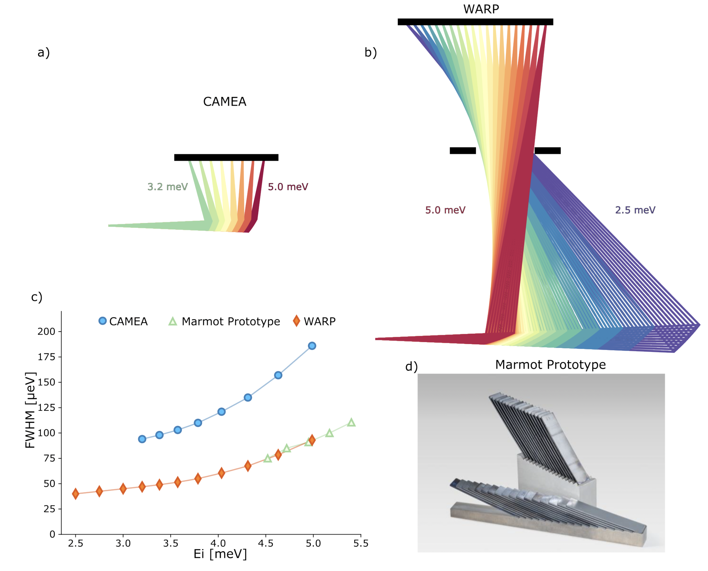
Planned instrument upgrade projects
FOCUS: upgrade of chopper electronics
WARP: Upgrade of TASP with Marmot-CAMEA type secondary spectrometer (in collaboration with EPFL and ILL)
EIGER: installation of velocity selector
Possibilities for external partners to contribute to future instrument upgrades
Notes:
Emphasize that there is less background, allowing qualitive new experiments
More info possibly in later talks

Slide 22
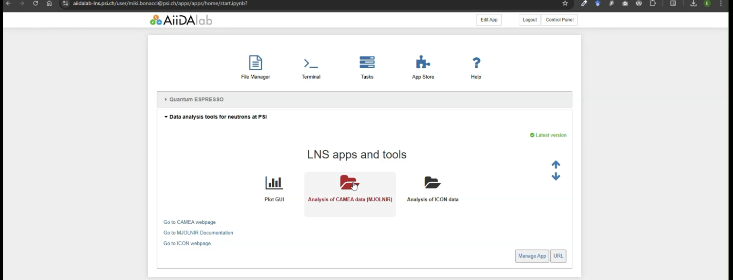
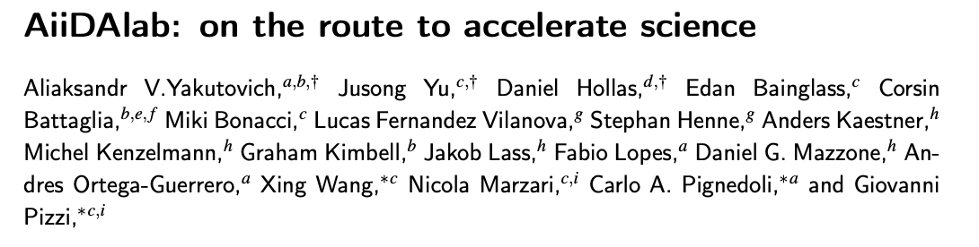
Digital laboratory
Installation of ”Apps”: Reduction software, simulation software (phonons, molecular dynamics, spin waves, etc), DFT simulations (Quantum Espresso and similar)
https://arxiv.org/pdf/2512.22173

Slide 23
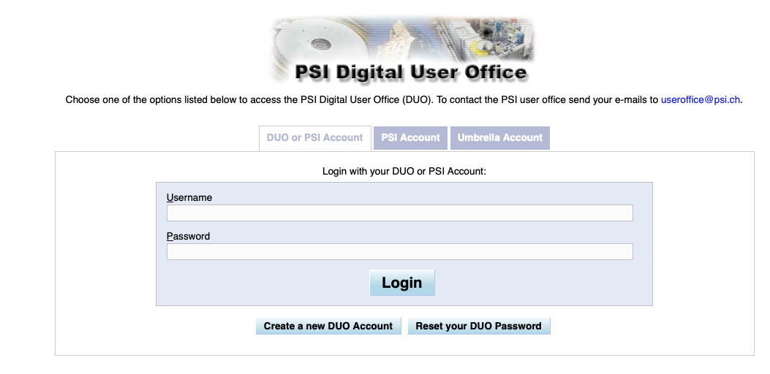
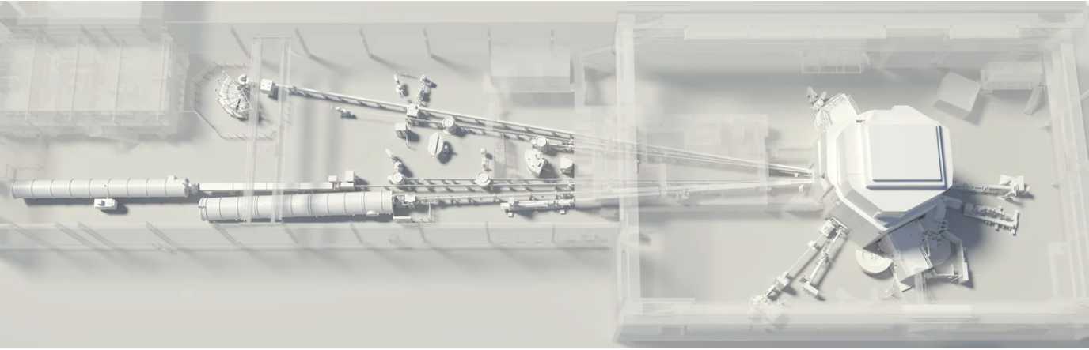
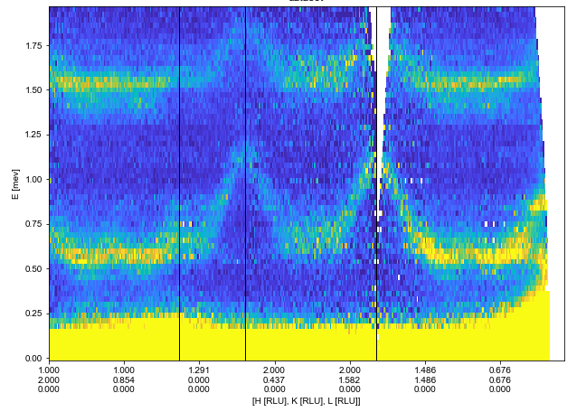
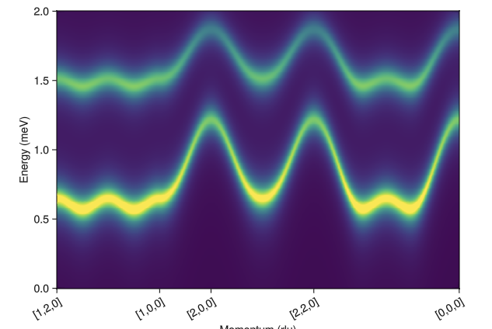





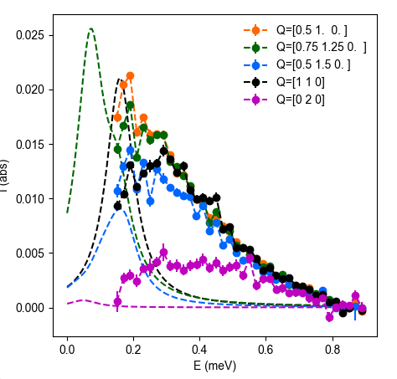
Optimizing the experiment life cycle
Preparation phase
Experimental phase
Analysis/Publication phase
PSI Center for Neutron and Muon Sciences
13.03.2026

Slide 24

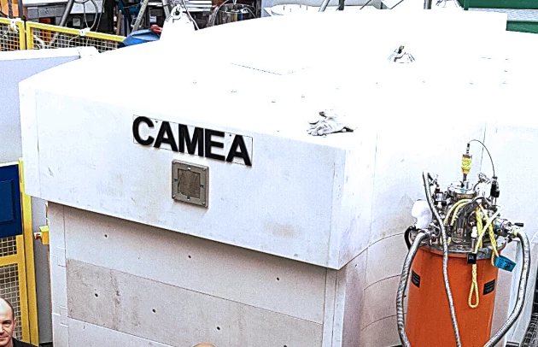




Secure global data connection
HPC (Merlin, Ra, CSCS, …)
(Optional)
Web browser
SSH via AiiDA
frontend
HTTPS
/camea/20201923/
PSI VMs
User 1
Live data storage
Web browser
HTTPS
CAMEA
frontend
server (backend)
/camea/20242013/
User 2
NFS mount
NFS mount
HTTPS
Web browser
/camea/20201923/
frontend
/camea/20242013/
PSI NFS mount for CAMEA data
/camea/20246188/
User 3
/camea/20246188/
/camea/20242013/
…
…

Slide 25
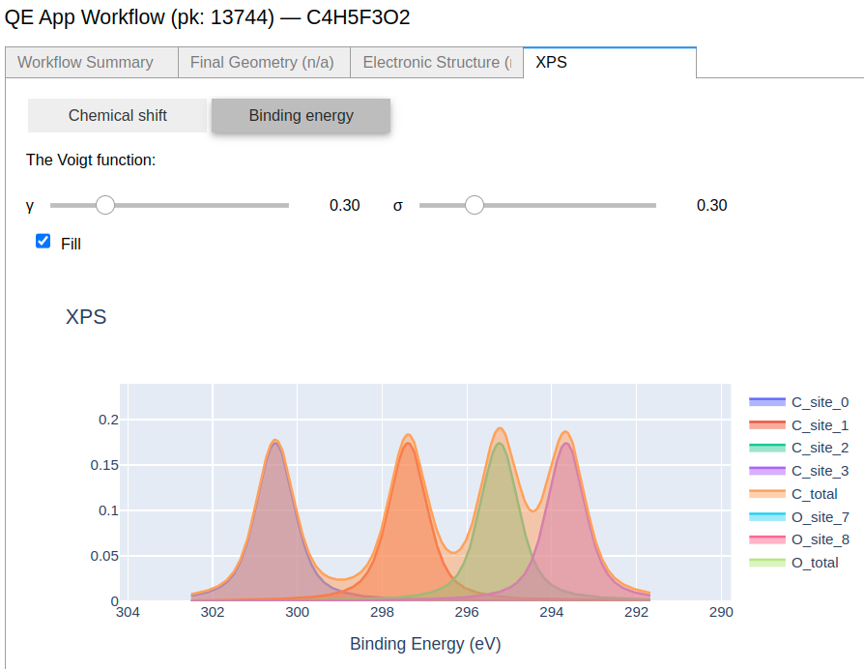
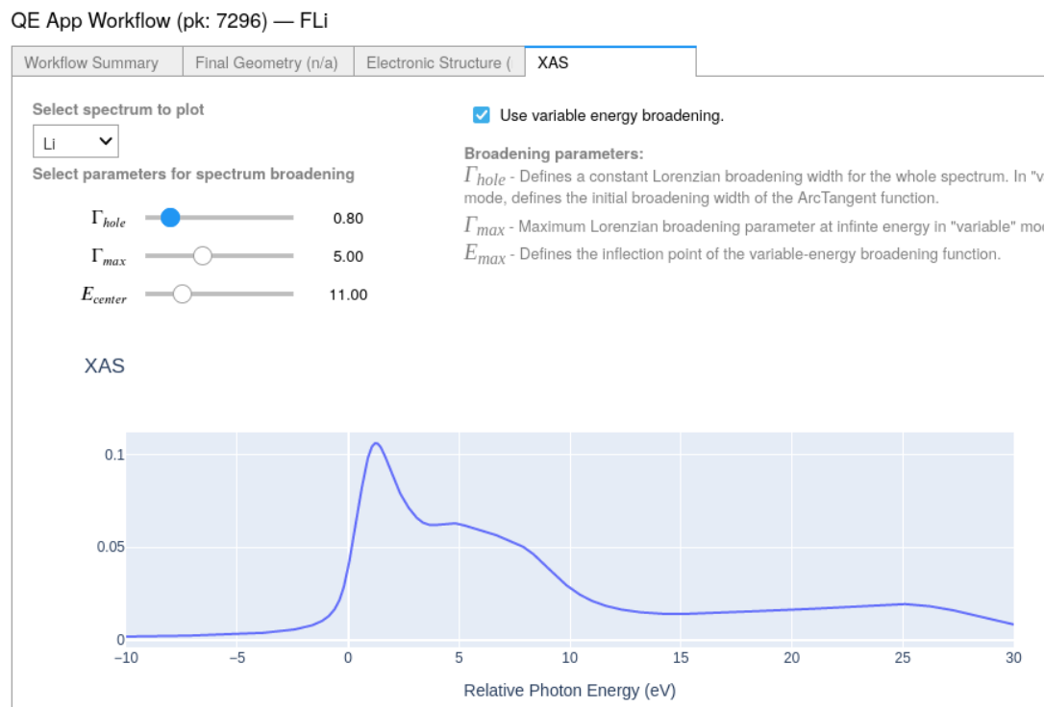
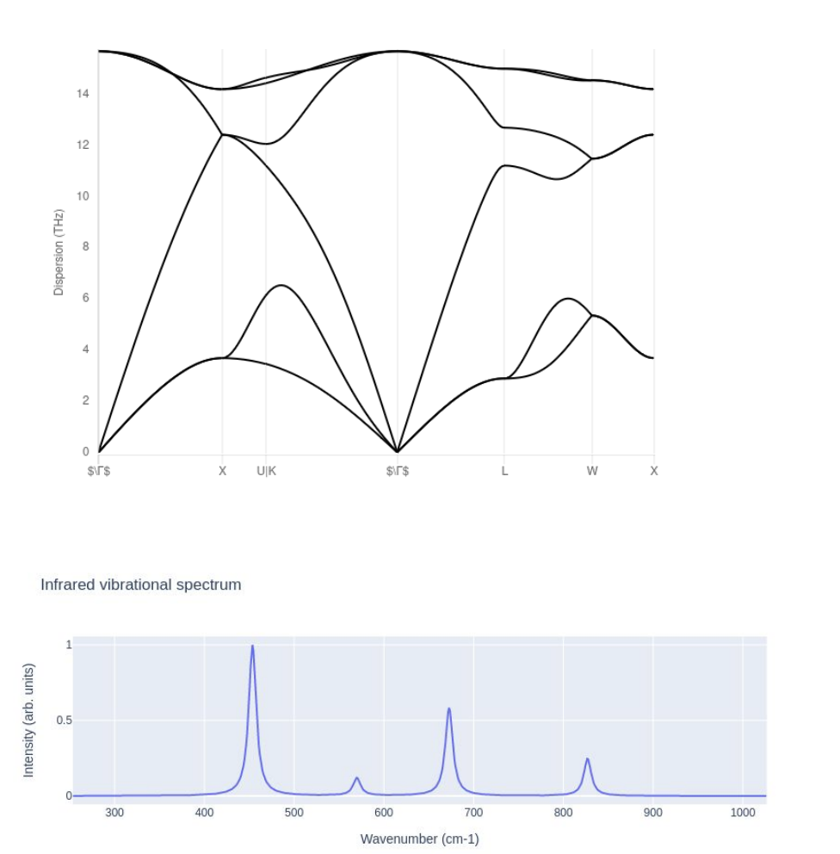





Simulations-as-a-service
XPS
XAS
PDOS
IR+Raman
Plugin
Muons
Band structure
And more!
Contributors: E. Bainglass (PSI), M. Bercx (PSI), M. Bonacci (PSI), D. Dou (EPFL), P. Gillespie (CNR-NANO Modena), M. A. Hernández-Bertrán (CNR-NANO Modena), D. Hollas (Bristol), N. Marzari (EPFL, PSI), A. Ortega-Guerrero (Empa), C. Pignedoli (Empa), D. Prezzi (CNR-NANO Modena), G. Pizzi (PSI), I. Timrov (EPFL, PSI), X. Wang (PSI), J. Yu (PSI), A. Yakutovich (Empa)

Slide 26






SINQ++ : Neutrons for Science and Society
Shaping Tomorrow: Excellence in Swiss Neutron Science from PSI, Swiss Universities, and Industry Leading Partners
Science and Society
Fusion, Transmutation and Fission Materials Science (NES)
Understanding Biological / Hydrogenated Systems
Soft Matter: Medicine, Smart Coatings, Switching Devices
Applied Materials & Engineering
Advanced Isotope Production (NES)
Fast Neutron Irradiation for Space Science
In-situ studies of Active / Energy Materials
Multimodal Imaging of Hierarchical Architectures
Quantum materials : coherence, devices, dynamics

Slide 27


SINQ++: North Hall SINQ Expansion and Source Renewal
Renewal of SINQ source after 30+ years of operation
Isotope production at SINQ target
New irradiation facility for electronics and advanced materials
New neutron capabilities for applied materials, soft matter & industry
Possibility for collaboration with European partners
2024-2026 : Technical study of cold source optimization and beamline performance
Project realization targeted in 2030s
SINQ 2025
Meet the Swiss and European demand for neutron research capabilities at an existing source
SINQ⁺⁺ Vision
updated parts are colored

Slide 28





SINQ⁺⁺ Cold Source Upgrade
Present Cold Source:
25 K liquid D₂
Passive cooling with thermosyphon effect
Reentrant holes not exploited
Scenario 1: Minor improvements: remove cooling pipes & re-entrant hole, purer ortho-D₂ at 20 K → ≈ +20 % brightness.
Scenario 2: Major overhaul: completely filled liquid-D₂ tank, two optimized re-entrant holes, active D₂ circulation → +80-+100 % brightness.
All cold instruments: brightness gains a factor 1.8-2 above 4 Å
Guide Hall North (NEW)
Guide Hall South (EXISTING)
Proposed Cold Source Design:
Actively cooled Liquid D₂ allows lower temperature of 20K
Higher ortho-D₂ purity (~99%)
Optimised reentrant holes for better extraction
N. Rizzi
(P-doc)
Notes:
Re-Design Nico – Why using ortho-D2? Lower flux at cold wavelengths with para-H2 (Nico checked this).
Engineering highlights: requires cryogenic redesign (pump-driven D₂ loop, micro-channel cooling, removal of thermosiphon).
Validation: FOM = source brilliance at emission windows; multi-objective optimization with Dakota identifies best REH depths (≈ 5 cm).
The heart of SINQ++ is a new cold source designed to double the brightness across all instruments.
Starting from a validated MCNP model, we explored incremental tweaks through to a complete redesign.
The most promising configuration—a fully filled, actively cooled liquid-D₂ tank with optimized re-entrant holes—shows up to 80 % higher brilliance in the cold range, potentially more with further optimization.

Slide 29



SINQ⁺⁺: Societal and Strategic Applications of Neutron Science
Testing of Advanced Nuclear Materials
Fusion blanket material
4th generation reactors
Transmutation
Compact mobile reactors
Validation/tests of space electronics for
Satellites
Space exploration
Planes
Science Case Workshop
29-30 April 2026
Paul Scherrer Institute

Slide 30
Thank you.
Michel Kenzelmann
ICANS 2026

