Slide 1
Multiple time sampling for Monte Carlo ray-tracing instrument simulations
Mads Bertelsen, Peter Willendrup
ICANS 2026
PRESENTED BY Mads Bertelsen

Slide 2
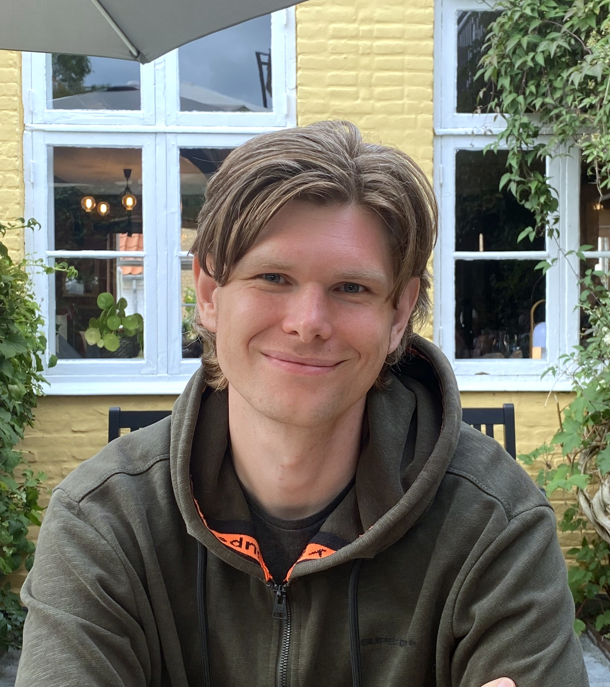
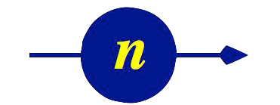
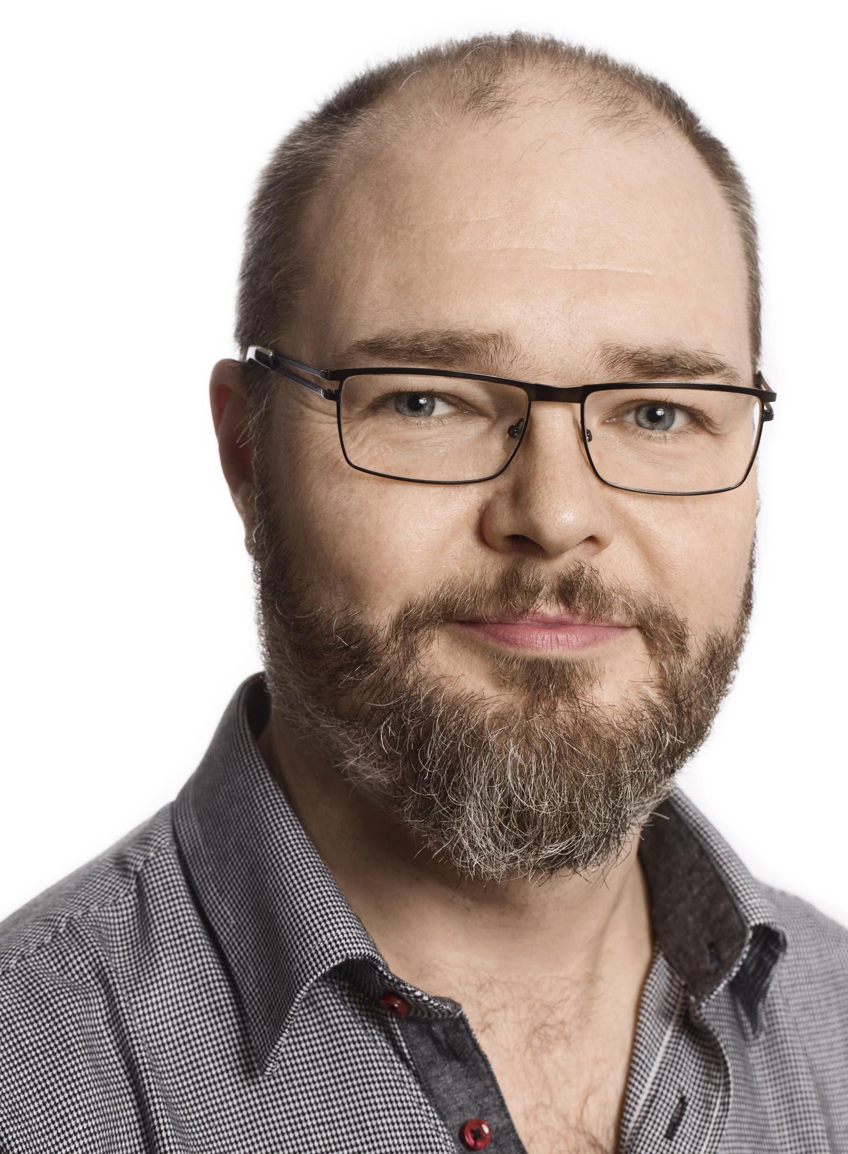
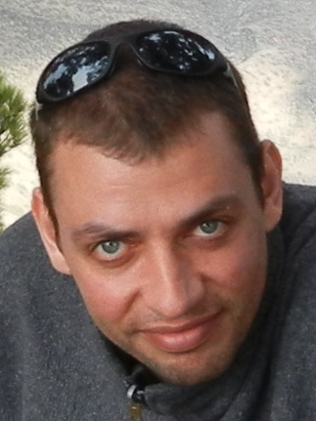

Instrument simulations
Simulation team @ DMSC
McStas
Supported – continuously developed for 28 years
Modular – build instrument from large component library
Flexible – edit or create components locally
Peter Willendrup
Mads Bertelsen
Fast – a laptop is typically sufficient
Community driven – components & instruments contributed
  Can always be improved
    Add capabilities
    User experience
    Increase computational speed
Thomas Kittelmann
Torben
Nielsen

Slide 3
McStas optimization
Monte Carlo performance
  We are often asked: “Can we simulate this in real time?”
  Real source intensity
    Single 2 MW ESS pulse: ~10¹⁰ thermalized neutrons entering the guide
    Instruments with flux on sample ~10¹⁰ n/s/cm²
  McStas speed
    ESS instrument simulation on laptop: ~2 10⁵ rays per second
    Just need 10⁵ laptops?
We need to improve! Today we present a new optimization trick

Slide 4
McStas optimization
Performance tricks
  Limiting phase-space
  Focusing
  Weight – Reflection / Absorption
  Weight – Sampling interesting events

Slide 5
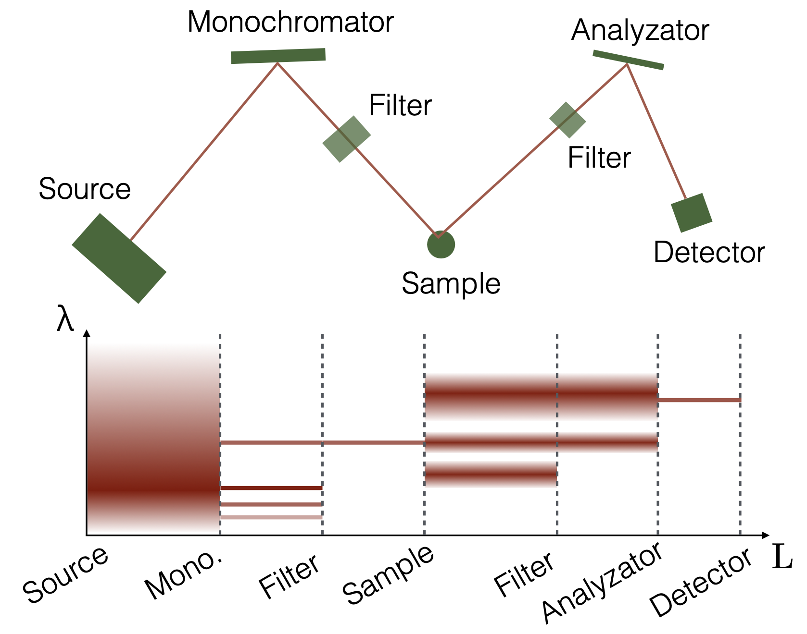
McStas optimization
Performance tricks
  Limiting phase-space
  Focusing
  Weight – Reflection / Absorption
  Weight – Sampling interesting events
Only start with these wavelengths

Slide 6
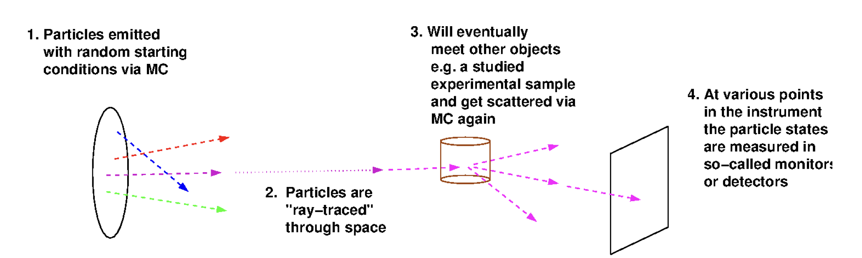
McStas optimization
Performance tricks
  Limiting phase-space
  Focusing
  Weight – Reflection / Absorption
  Weight – Sampling interesting events

Slide 7
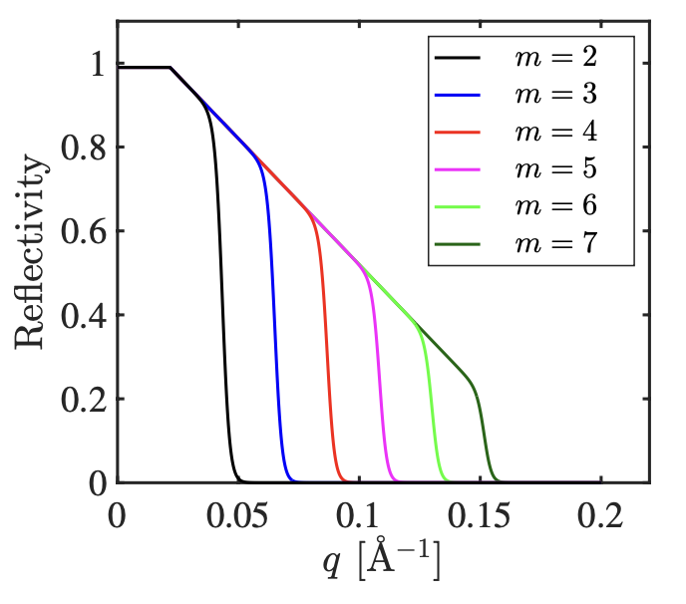
McStas optimization
Performance tricks
  Limiting phase-space
  Focusing
  Weight – Reflection / Absorption
  Weight – Sampling interesting events
Reduce ray weight p instead of removing the ray

Slide 8
McStas optimization
Reality – Low scattering probability
Performance tricks
  Limiting phase-space
  Focusing
  Weight – Reflection / Absorption
  Weight – Sampling interesting events
Sample
Detector

Slide 9
McStas optimization
Reality – Low scattering probability
Performance tricks
Simulation – Modified scattering probability
  Limiting phase-space
  Focusing
  Weight – Reflection / Absorption
  Weight – Sampling interesting events
Sample
Detector
Actual intensities recovered with weight transformation

Slide 10
McStas optimization
Performance tricks
  Limiting phase-space
  Focusing
  Weight – Reflection / Absorption
  Weight – Sampling interesting events
Even with these tricks, choppers are a problem

Slide 11
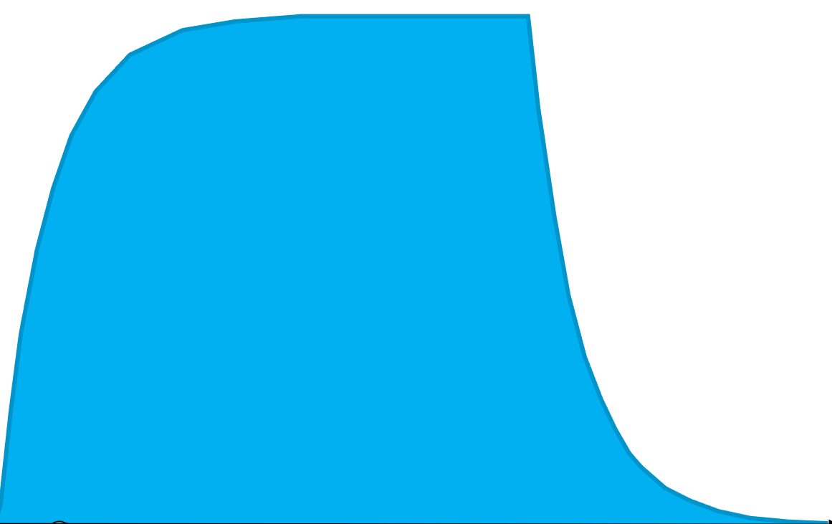
McStas optimization
Performance tricks
  Rays that do not hit a chopper opening are discarded
  Wasted compute

Slide 12
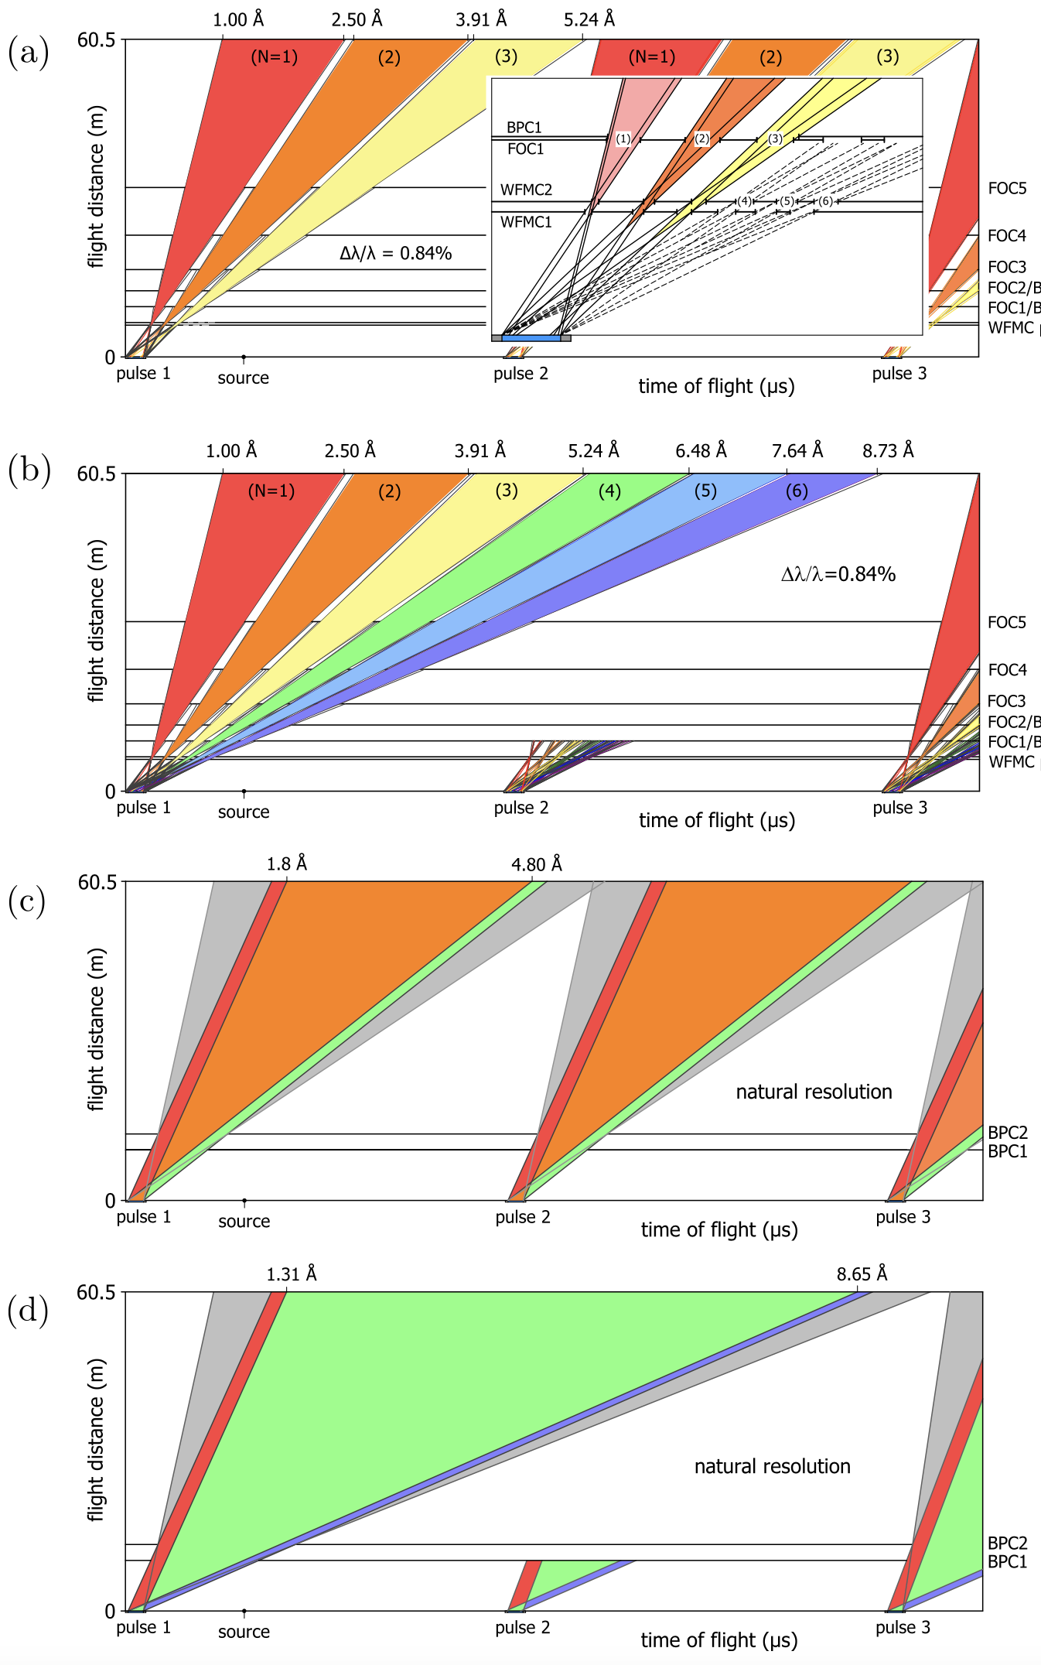
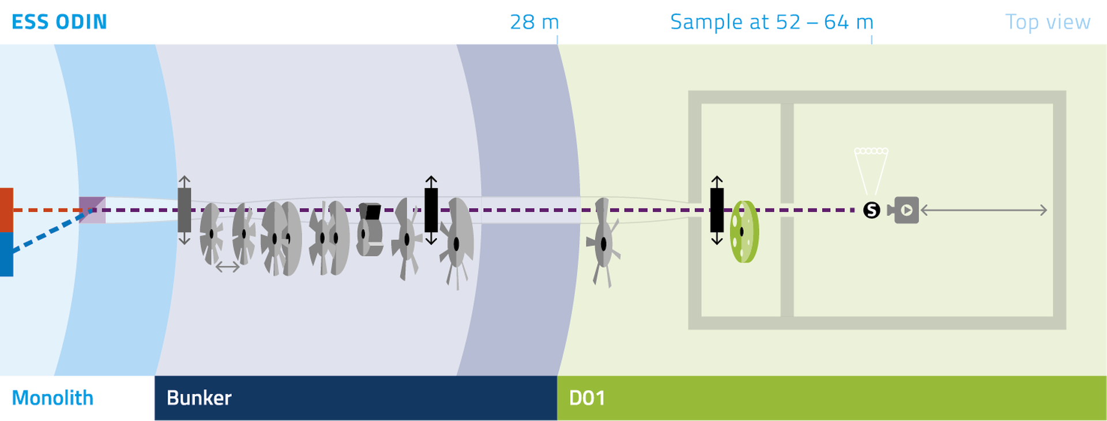
McStas optimization
ODIN as test case
  10 choppers
  Several chopper operating modes
  3/6 frame Wavelength Frame Multiplication (WFM )
  Variable distance between WFM choppers

Slide 13
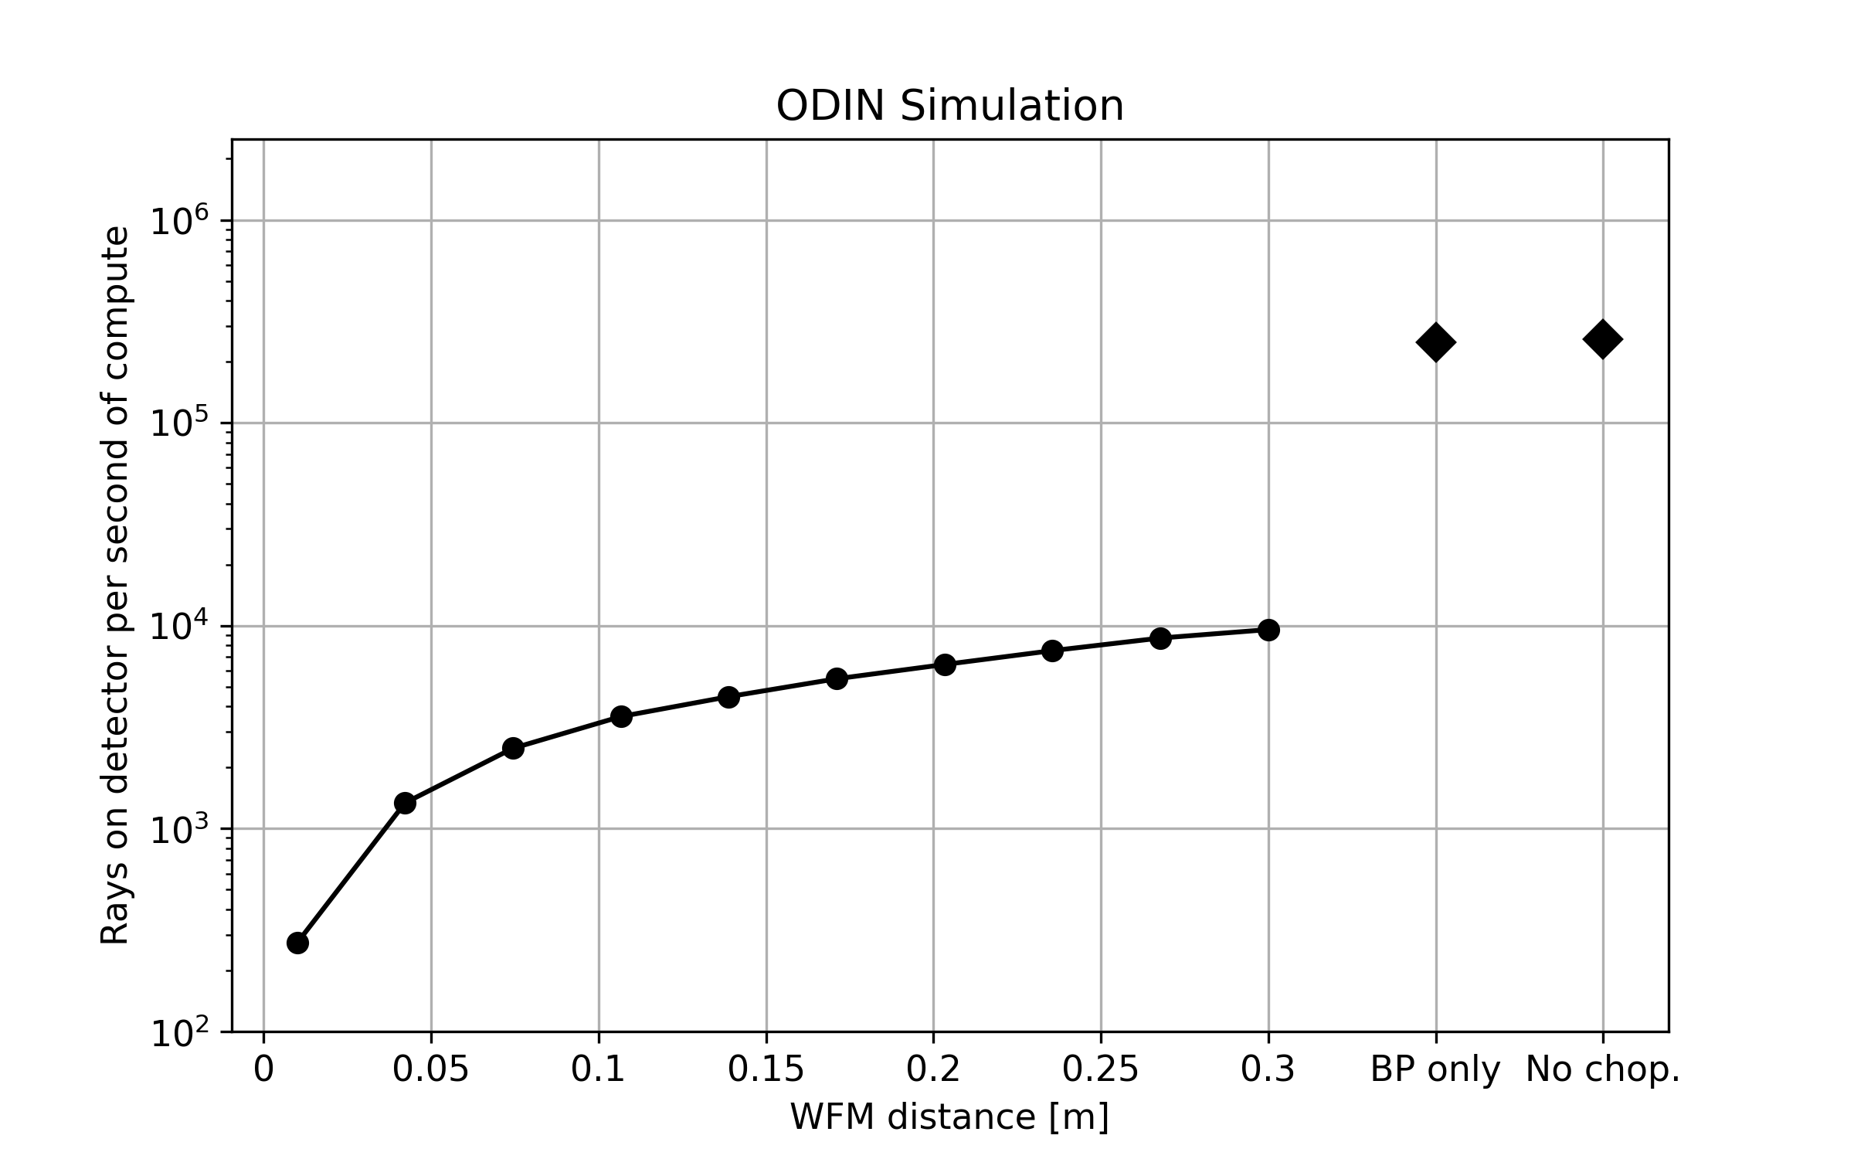
McStas optimization
Current performance on ODIN (no sample)
  2.5 10⁵ rays/s without choppers
  Same for band pass only
    Wavelength range chosen well
  WFM mode 10⁴ /s and lower

Slide 14
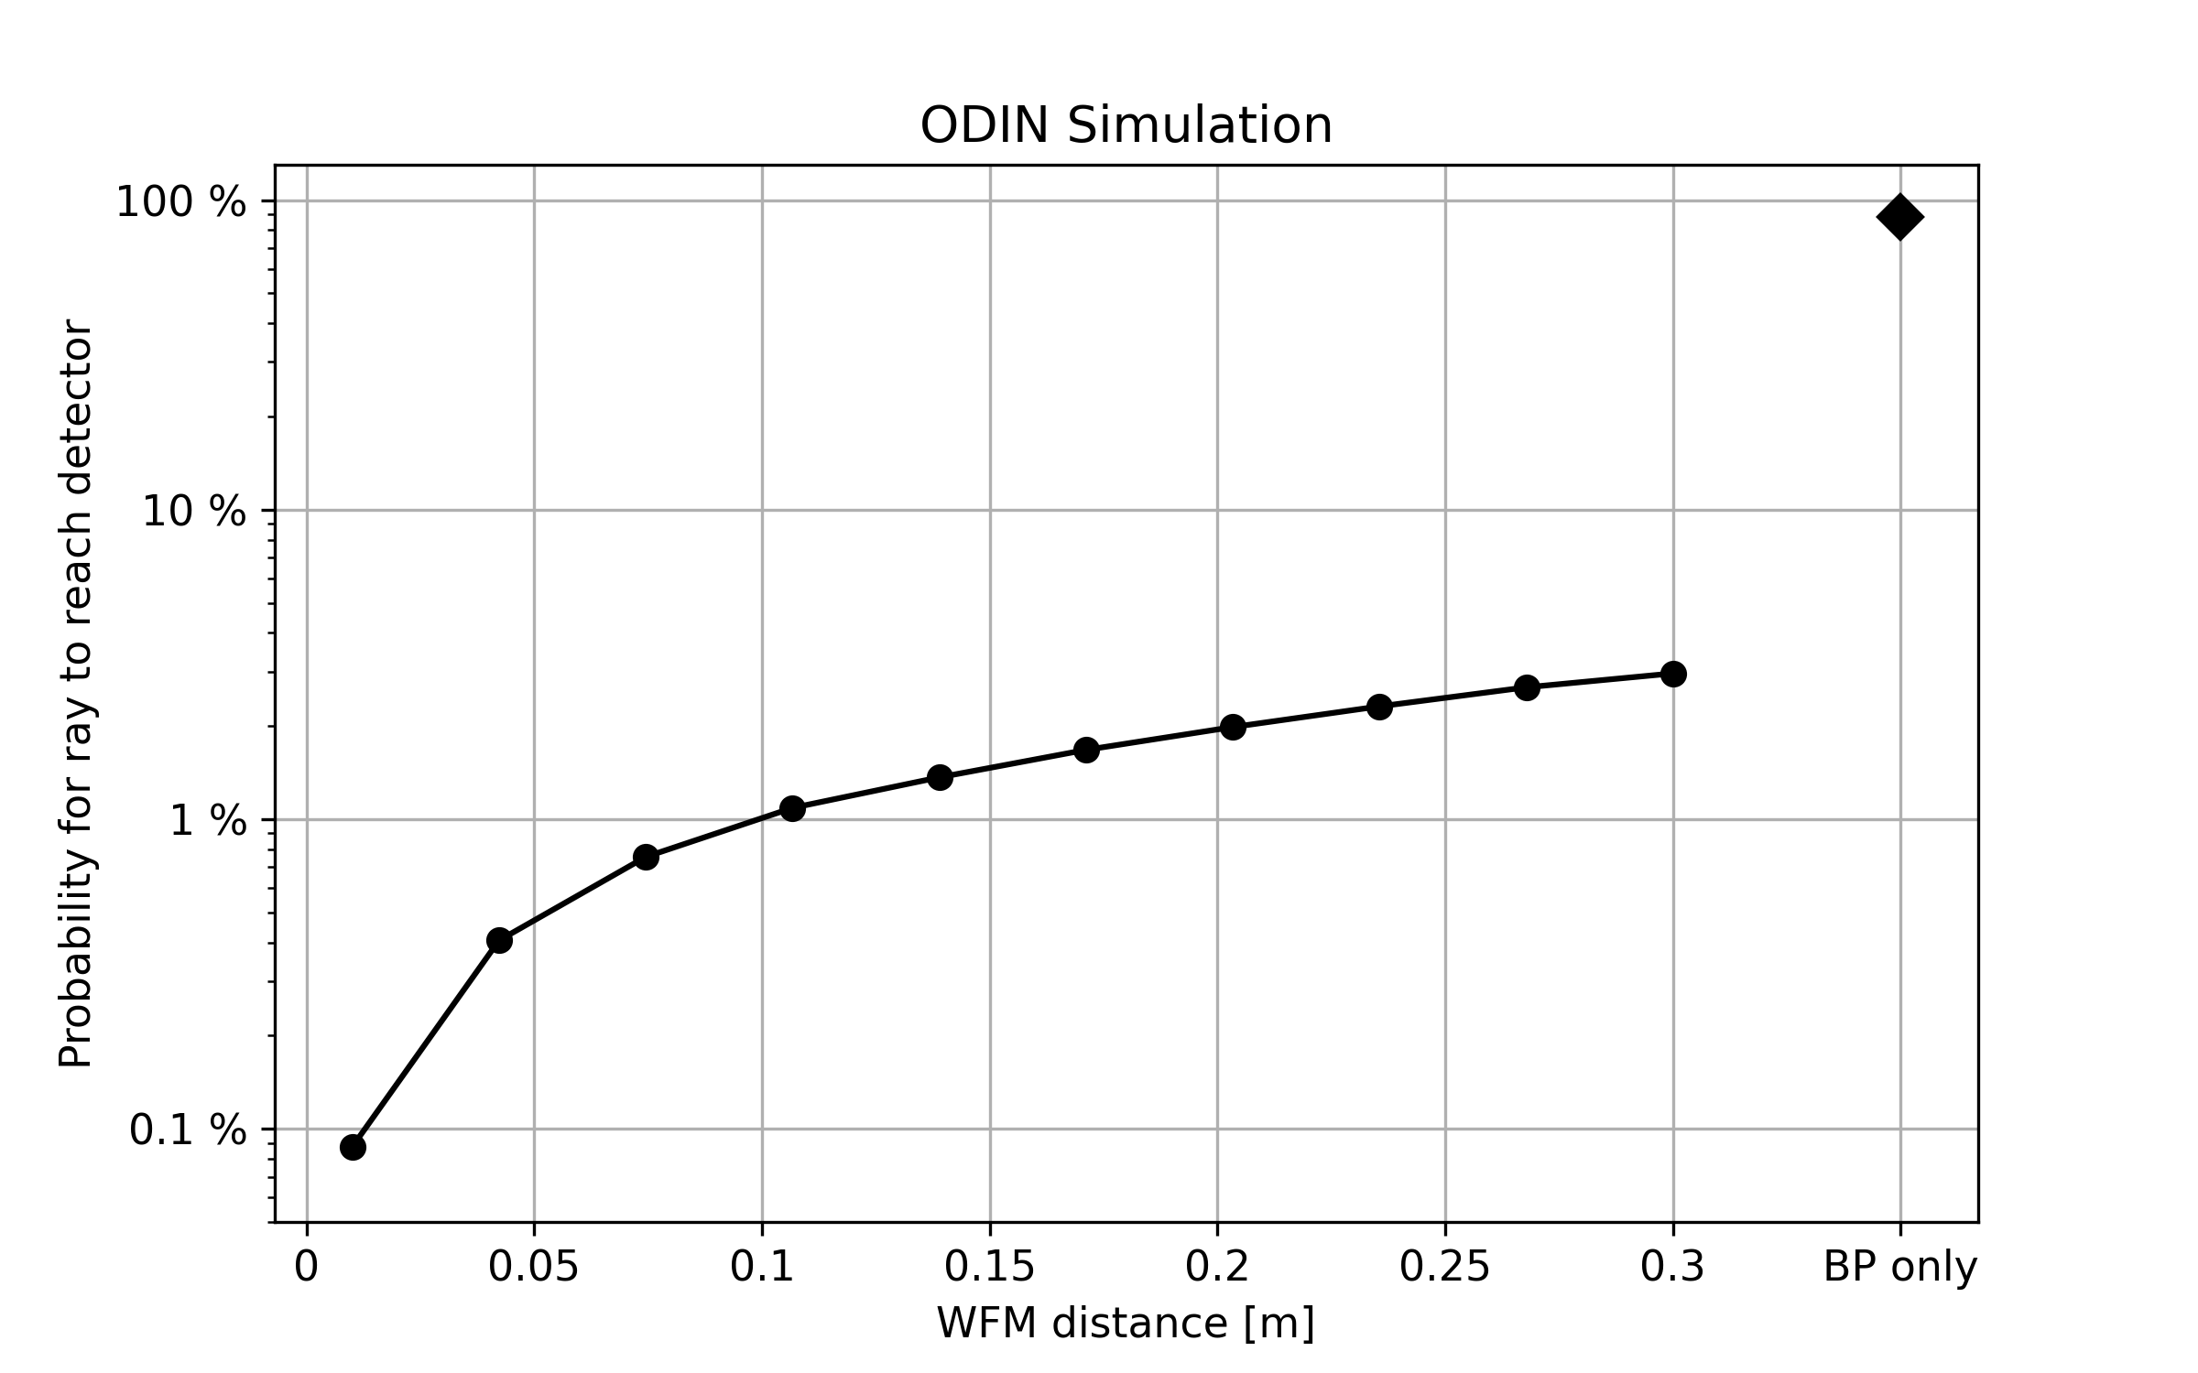
McStas optimization
Current performance on ODIN (no sample)
  Normalized to no chopper case
  Bandpass ~same number
  WFM much lower
    Many rays removed by choppers

Slide 15
McStas optimization
Multiple time sampling
Ray parameters
Position, Velocity, Weight, Time, Spin
Current McStas – one time sampled

Slide 16
McStas optimization
Multiple time sampling
Ray parameters
Position, Velocity, Weight, Time, Spin
Current McStas – one time sampled
Prototype – multiple times sampled from ESS Butterfly
and t_offset[100], p_t[100]

Slide 17
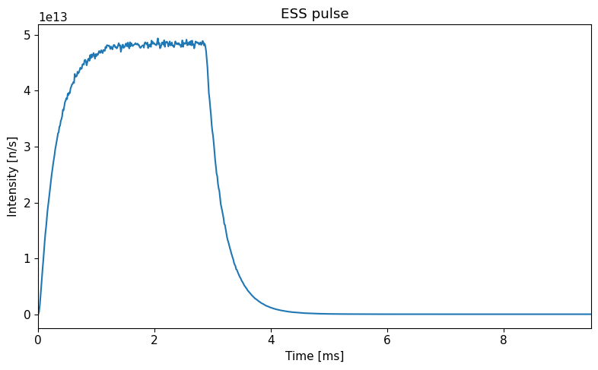
McStas optimization
Multiple time sampling
  ESS pulse time sampling
  Has to include tail
  Makes sense to use more times

Slide 18
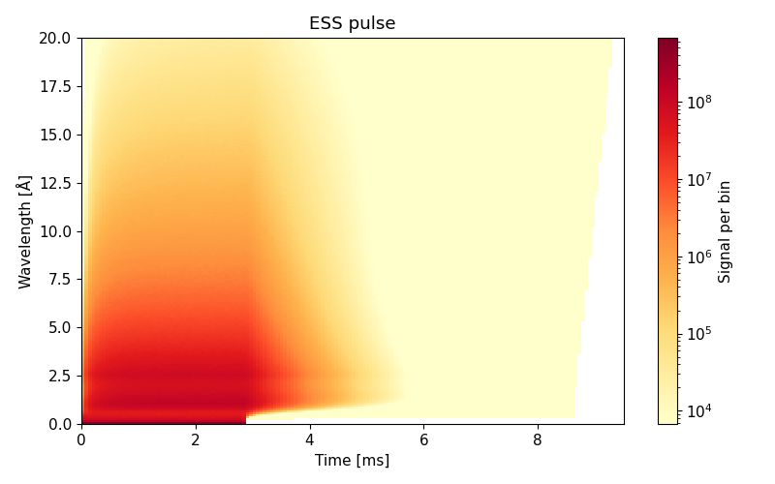
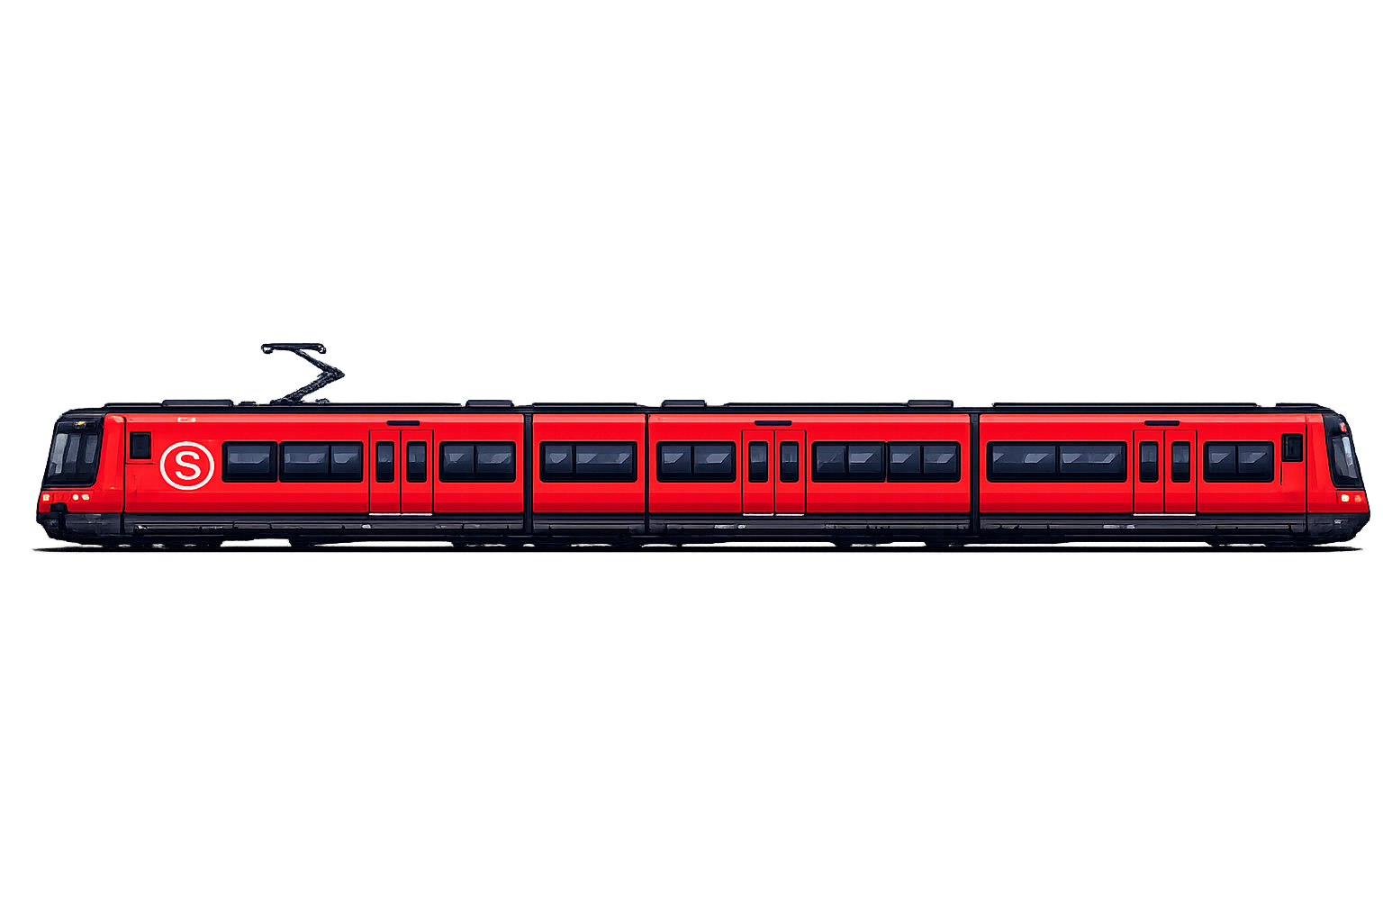
McStas optimization
Multiple time sampling
  ESS pulse time sampling
  Has to include tail
  Makes sense to use more times
  Sampling strategy
    Step 1: position, direction, wavelength
    Step 2: multiple time sampling
  Number of time samples
    Up to a given number, user parameter
    Adaptive, given number on chosen monitor to avoid over-sampling

Slide 19
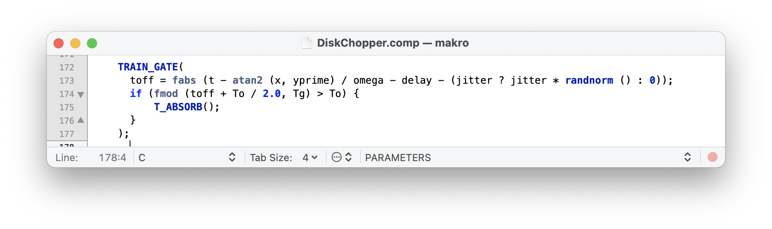
McStas optimization
Multiple time sampling
  Code updates necessary
    Components that ABSORB based on time (Choppers)
    Components that read time (Monitors)
  Components that unpack rays no longer support GROUP
    Multi slit choppers: Go from DiskChopper GROUP to MultiDiskChopper
  Need careful introduction to package

Slide 20
McStas optimization
Multiple time sampling performance
  Return to ODIN performance

Slide 21
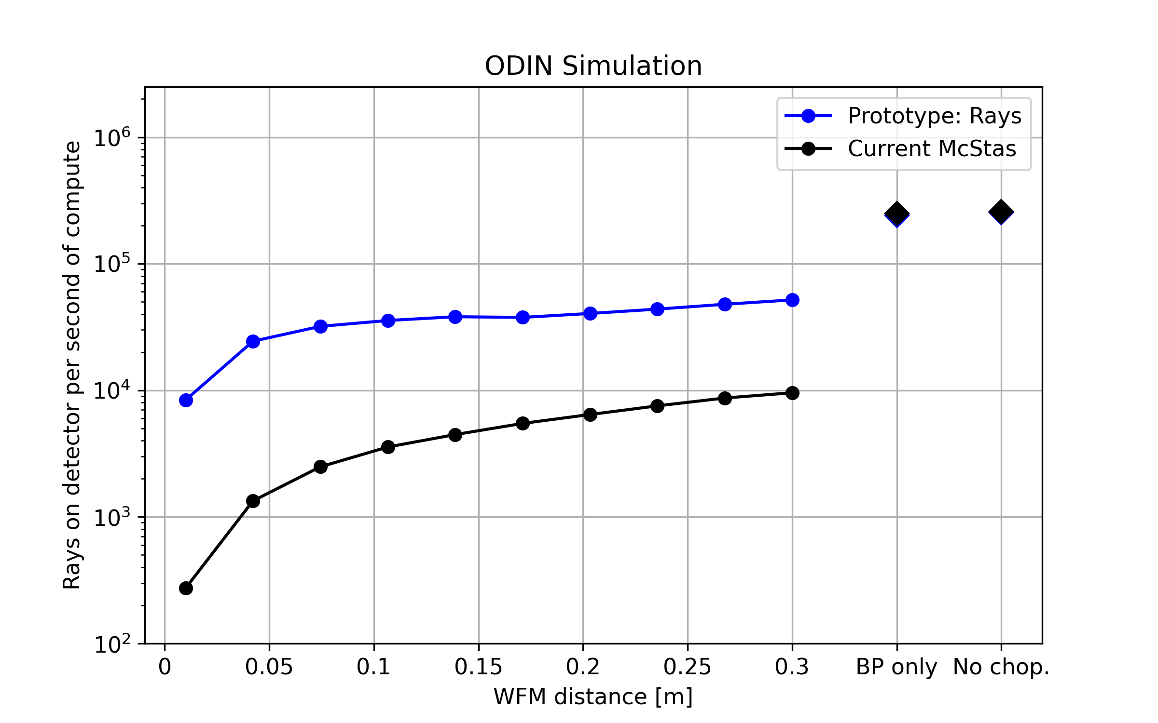
McStas optimization
Multiple time sampling performance
  Return to ODIN performance
  No choppers
    Can get more time information
  Only Band pass
    Same as without choppers
  WFM
    Significantly improved performance

Slide 22
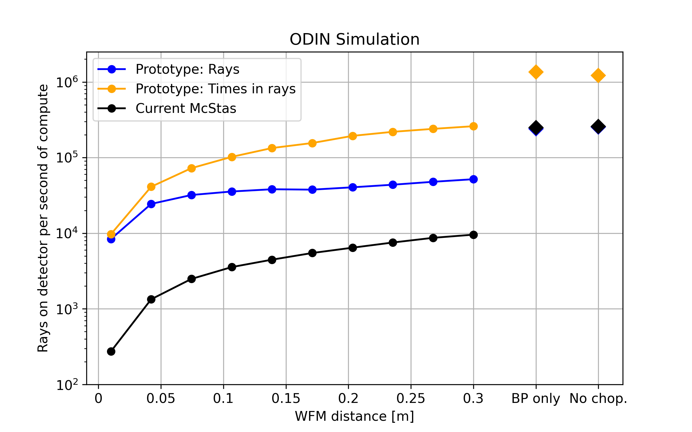
McStas optimization
Multiple time sampling performance
  Return to ODIN performance
  No choppers
    Can get more time information
  Only Band pass
    Same as without choppers
  WFM
    Significantly improved performance

Slide 23
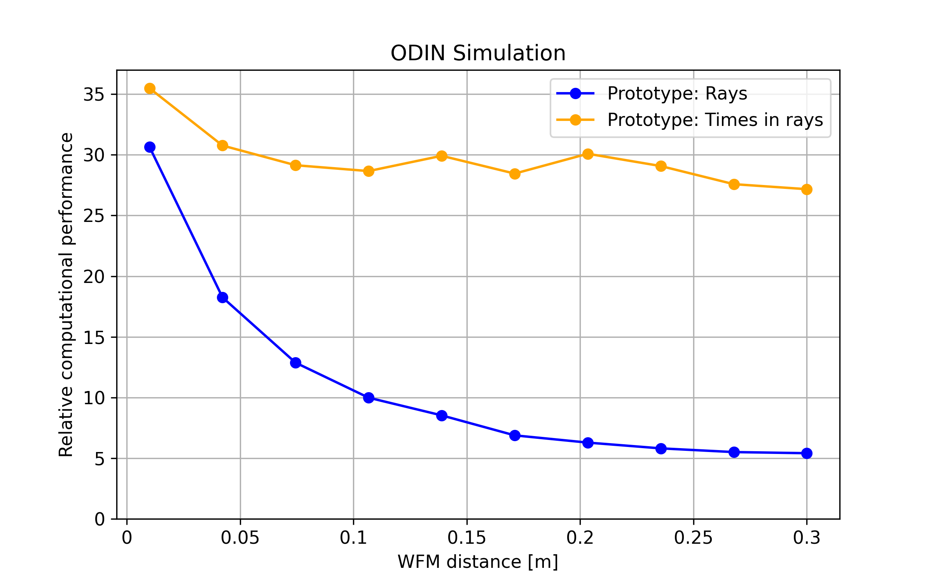
McStas optimization
Multiple time sampling performance
  Return to ODIN performance
  No choppers
    Can get more time information
  Only Band pass
    Same as without choppers
  WFM
    Significantly improved performance
    Gains between 5x and 35x

Slide 24
McStas optimization
Performance across ESS instruments
  ODIN Case
    White beam not using time information ~ 3% performance loss
    Parked choppers or BP using time information ~ 3-5x gain
    WFM mode ~ 5x-35x gain
Case | Expected performance gain
Single frame instruments | 2-5x (if time focusing used as baseline)
WFM or complex chopper solutions | Significant, like ODIN
Monochromating choppers | Large

Slide 25
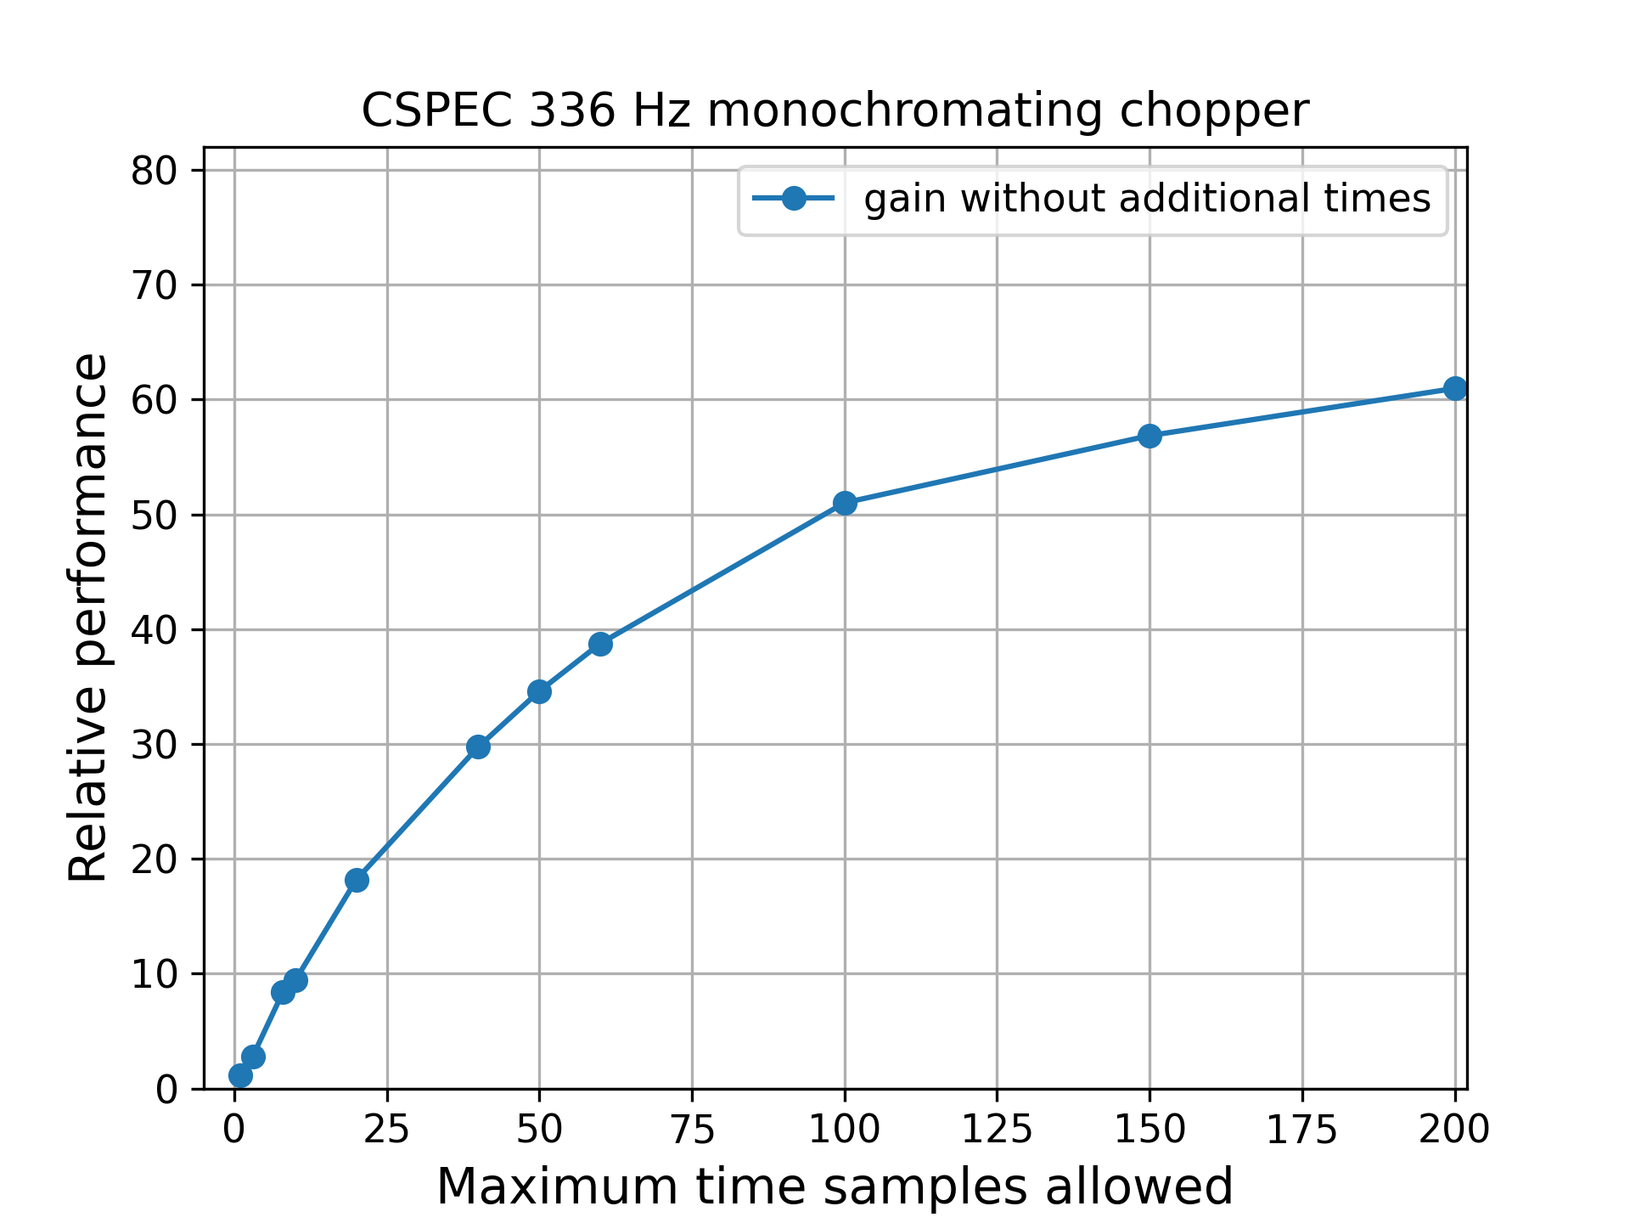
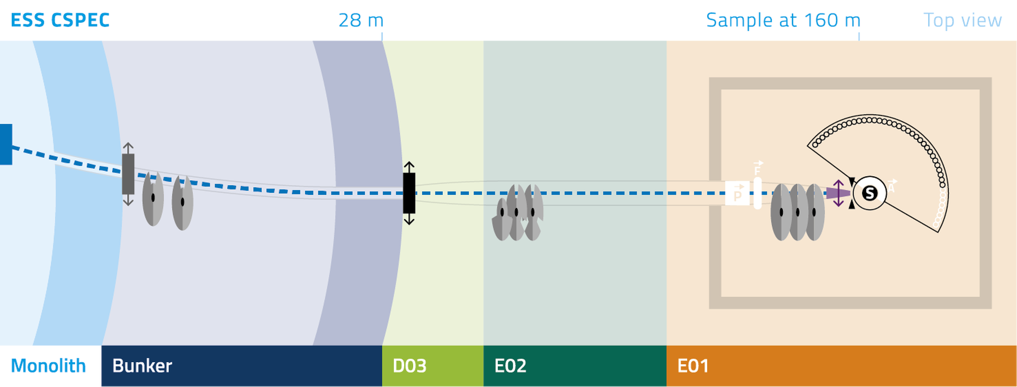
McStas optimization
Multiple time sampling performance

Slide 26
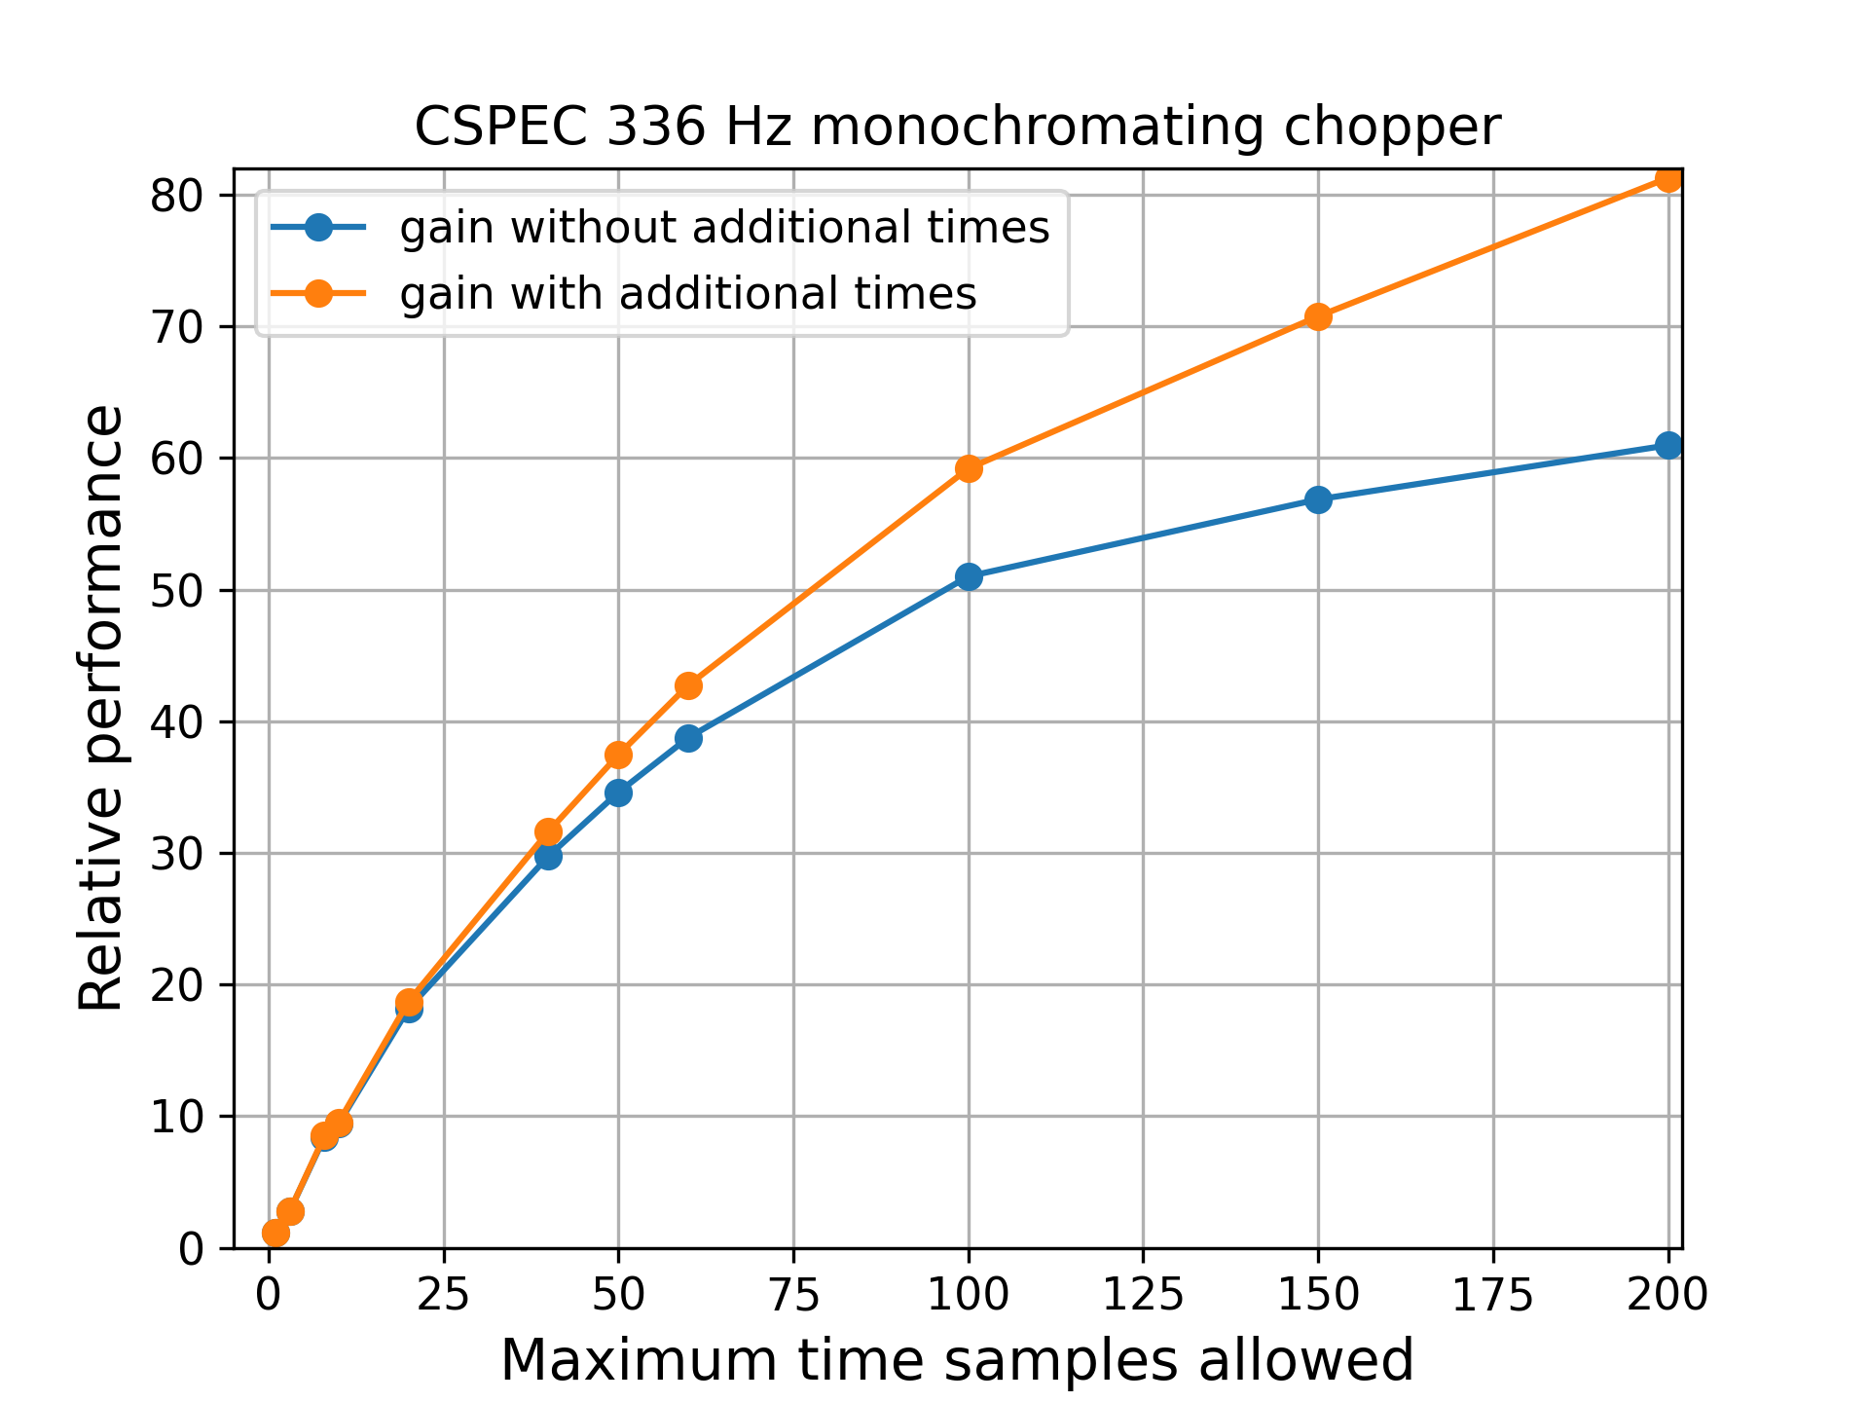
McStas optimization
Multiple time sampling performance

Slide 27
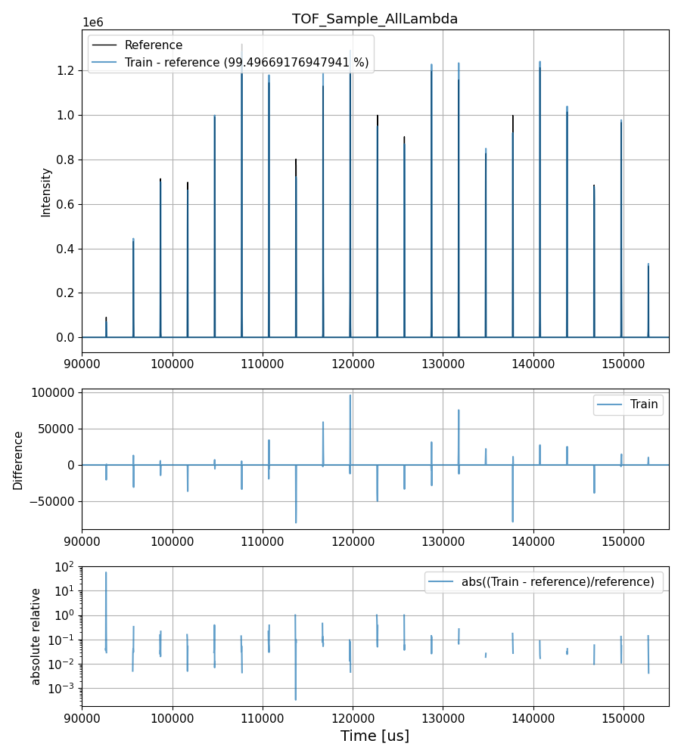
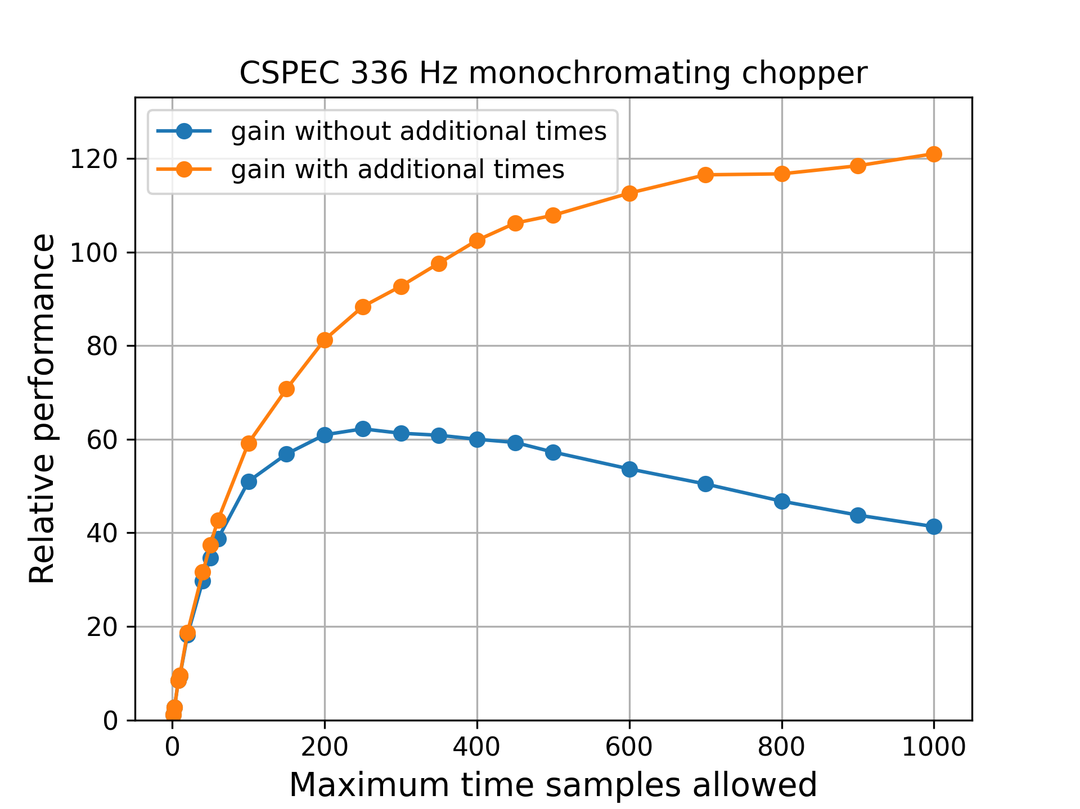
McStas optimization
Multiple time sampling performance
Example data at maximum 500 sampled times

Slide 28
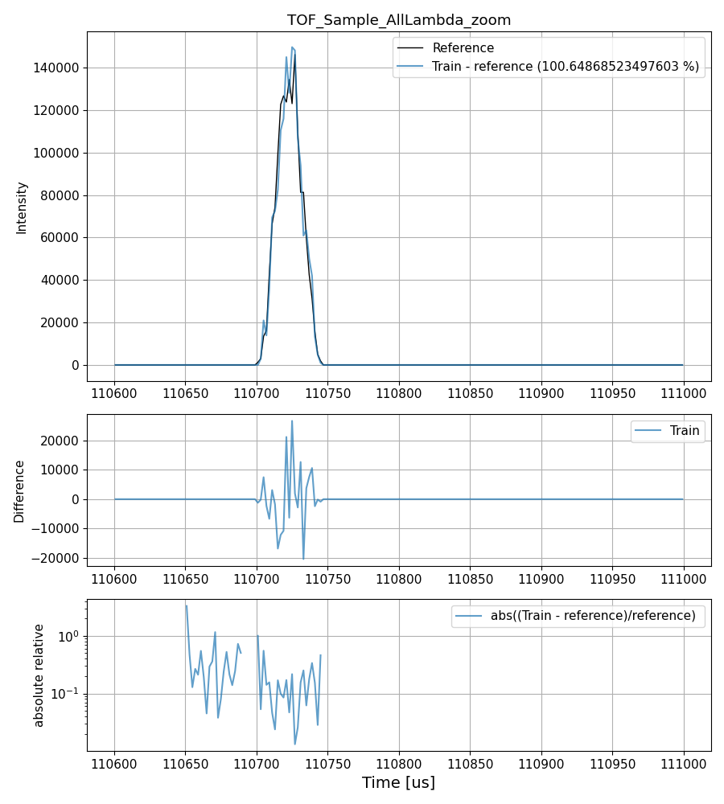
McStas optimization
Multiple time sampling performance
Example data at maximum 500 sampled times

Slide 29
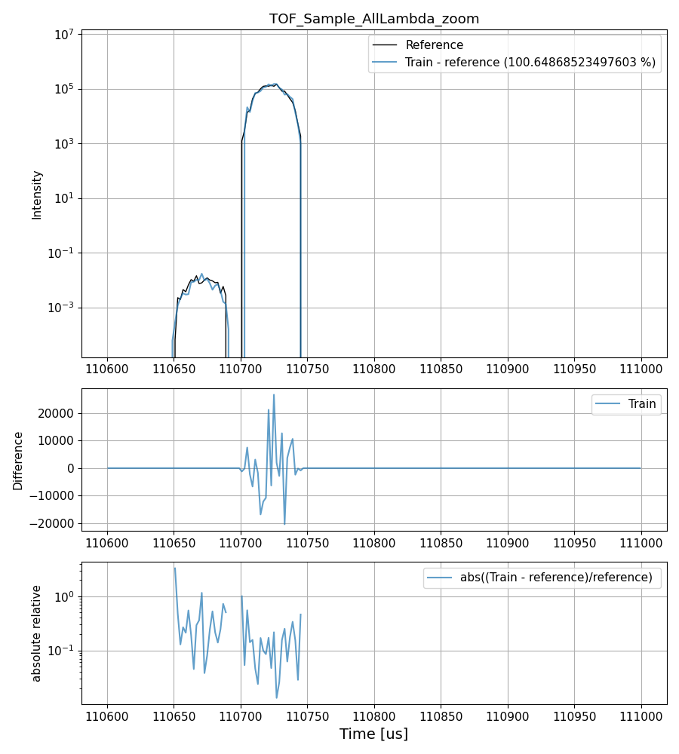
McStas optimization
Multiple time sampling performance
Example data at maximum 500 sampled times

Slide 30
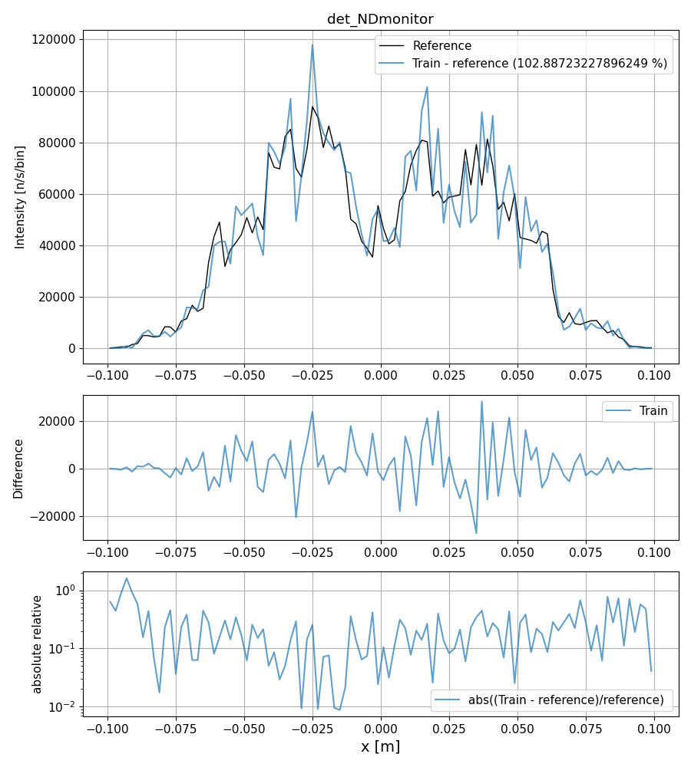
McStas optimization
2563 s vs 25.7 s
Multiple time sampling performance
Example data at maximum 500 sampled times

Slide 31
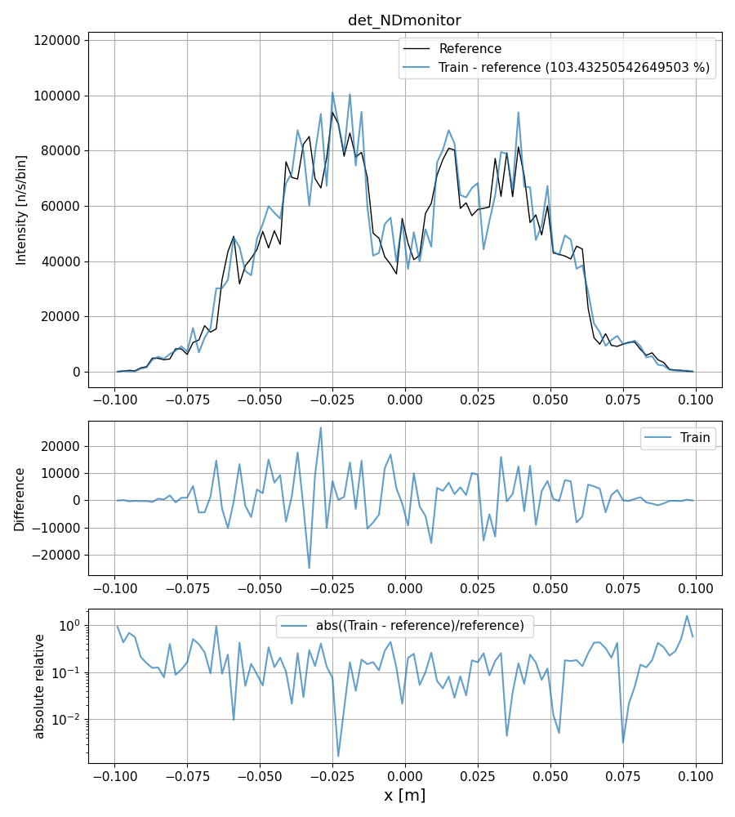
McStas optimization
2563 s vs 48.5 s
Multiple time sampling performance
Example data at maximum 500 sampled times

Slide 32
McStas optimization
Outlook
  Some additional considerations necessary before release
    Need to be carefully implemented to be backwards compatible
    Components where time impacts position or velocity need to be marked
      Doppler monochromator
      Others?
  Similar system would also be possible for spin

Slide 33
McStas optimization
Conclusion
  Used to get % gains when optimizing, not gain factors
  We see up to 120x gain at CSPEC (when time information used)
    Or in another way, reducing computation time by 99.2 %
  The gains are mainly where performance was problematic (high resolution tof)
    Simulation performance flatter with changing resolution
  These performance gains are independent on other speed ups
    time focusing / porting code to GPU’s
  Not in released McStas yet, prototype on github branch
  Simple to implement, can probably be used in other packages too

Slide 34
Thanks for your attention

