Slide 2
Achieving a Balanced Radiation Safety Case for the ESS Target Station
PRESENTED BY Linda r. coney

Slide 3
Agenda
1 ESS Radiation Safety Framework
2 ESS Target Station: Radiation Safety Case
3 How did we get here?
4 Questions?

Slide 4

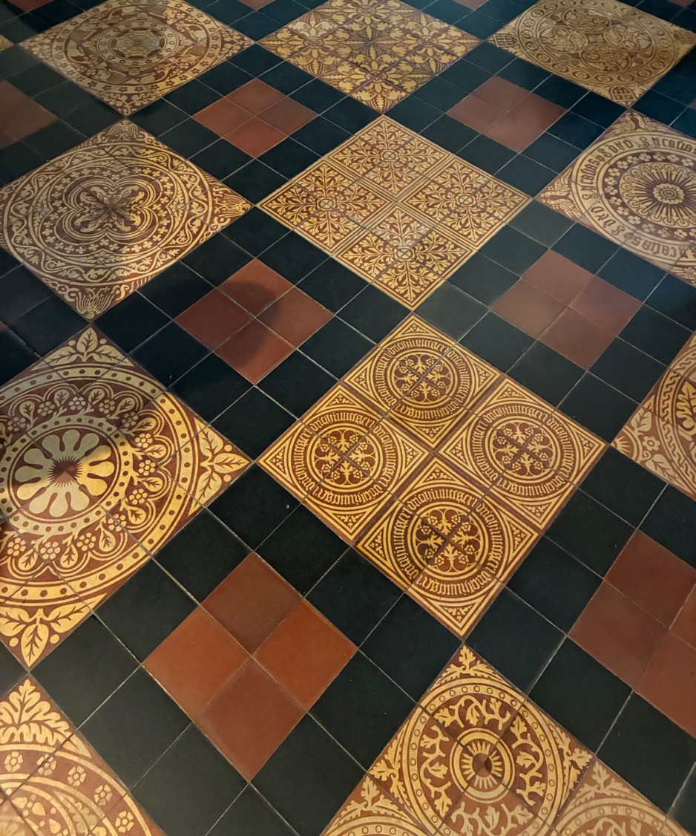
1
ESS Radiation Safety Framework

Slide 5
Radiation Safety Analysis Purpose
Protect ESS workers and the public from potential radiological consequences
Apply a systematic process to identify, evaluate, and control potential radiation hazards related to ESS areas.
Identify hazardous conditions and events associated with the facility processes, operations, work activities, and natural phenomena
High power beam impacting the tungsten target will create an inventory of nuclides
3000 kg of tungsten, 5 MW proton beam, 5-year target wheel lifetime
Understand potentially hazardous conditions and scenarios
Define necessary prevention and mitigation measures
Input to system design requirements – Target systems, ACC systems, Instruments, waste management, building features, shielding, HVAC, Controls, PSS, TSS
Identify need for radiation safety functions
Identify g evaluate g control these hazards

Slide 6
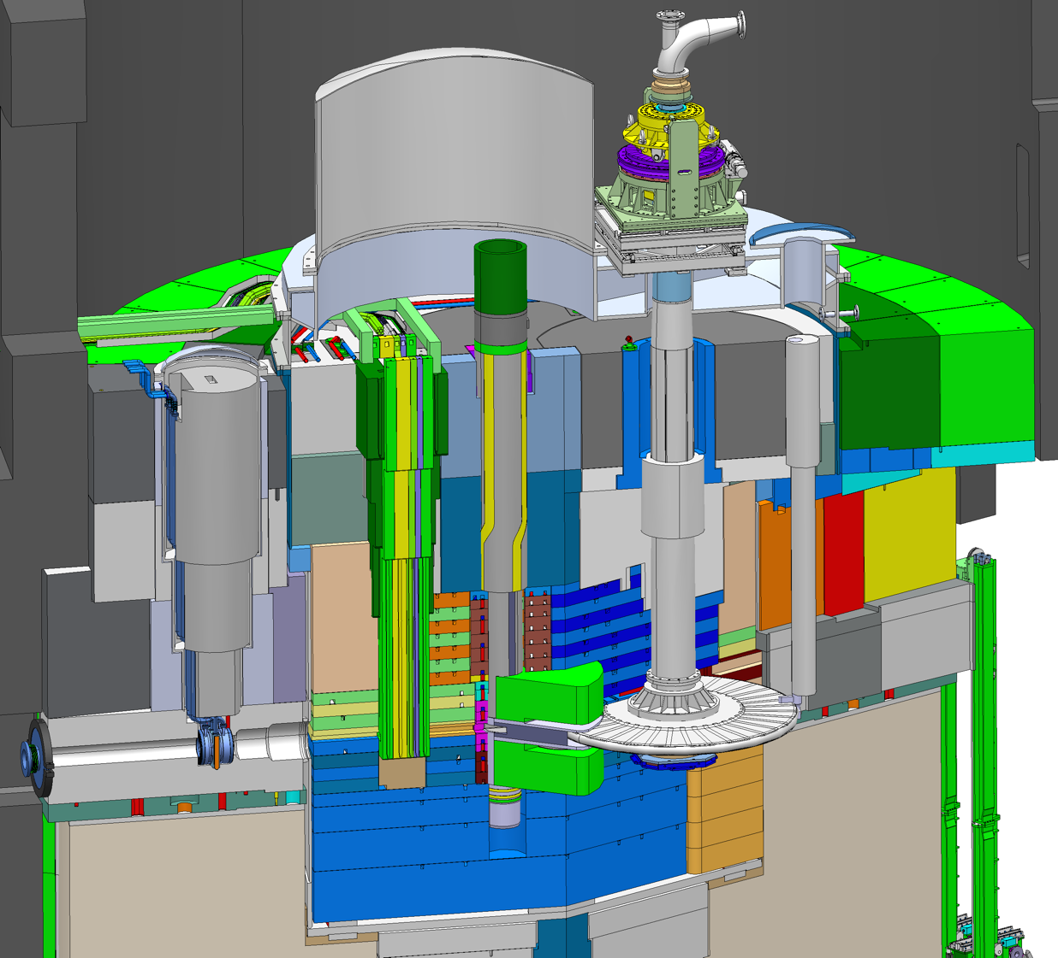
Engineering & Analysis 7-Steps
Step 4-5:
Hazard Analysis –> Bounding events
Event analyses for public
Define Safety Group RSFs
Event analysis for worker safety
New WRSFs (DID L3)
Radiation Safety Analysis & Classification with deliverables
Step 3:
Define RSFs for public, assign systems
Define WRSFs, assign systems
(DID L1 & L2)
Define source term for public
Do conditions meet the proposed area classification limits?
Step 1
Define the space
Define how you want to use it
Describe it, design it
Step 2:
Identify sources
Propose area classification
Characterize hazards
Many AAP & AAW reports
Step 6:
Safety Group RSFs
SSC classification
Step 5.5:
Barrier integrity Assessment
Step 5.7:
Define Safe State
Barrier int. report
Safe state report
Step 7:
DID
Concepts of Operations
System Descriptions
Step 6:
RSFs – Operational Group
WRSFs for workers (DID L1 & L2)
SSC classification for radiation safety
(mechanical, electrical/I&C, HVAC, civil, lifting)
Area classification for design
List of sources (prompt, residual, contamination)
Shielding design
Prompt dose rates
Activation calculations
Inventories, DAC levels
Step 2-3 Analysis Reports
List of RSF, WRSF, AM, SSC
DID analysis reports
ESS Categorization report
Many SSC classification reports

Slide 7
Engineering & Analysis 7-Steps
Step 4-5:
Hazard Analysis –> Bounding events
Event analyses for public
Define Safety Group RSFs
Event analysis for worker safety
New WRSFs (DID L3)
Radiation Safety Analysis & Classification with deliverables
Step 3:
Define RSFs for public, assign systems
Define WRSFs, assign systems
(DID L1 & L2)
Define source term for public
Do conditions meet the proposed area classification limits?
Step 1
Define the space
Define how you want to use it
Describe it, design it
Step 2:
Identify sources
Propose area classification
Characterize hazards
Many AAP & AAW reports
Step 6:
Safety Group RSFs
SSC classification
Step 5.5:
Barrier integrity Assessment
Step 5.7:
Define Safe State
Barrier int. report
Safe state report
Step 7:
DID
Concepts of Operations
System Descriptions
Step 6:
RSFs – Operational Group
WRSFs for workers (DID L1 & L2)
SSC classification for radiation safety
(mechanical, electrical/I&C, HVAC, civil, lifting)
Area classification for design
List of sources (prompt, residual, contamination)
Shielding design
Prompt dose rates
Activation calculations
Inventories, DAC levels
Step 2-3 Analysis Reports
List of RSF, WRSF, AM, SSC
DID analysis reports
ESS Categorization report
Many SSC classification reports

Slide 8
Engineering & Analysis 7-Steps
Step 4-5:
Hazard Analysis –> Bounding events
Event analyses for public
Define Safety Group RSFs
Event analysis for worker safety
New WRSFs (DID L3)
Radiation Safety Analysis & Classification with deliverables
Step 3:
Define RSFs for public, assign systems
Define WRSFs, assign systems
(DID L1 & L2)
Define source term for public
Do conditions meet the proposed area classification limits?
Step 1
Define the space
Define how you want to use it
Describe it, design it
Step 2:
Identify sources
Propose area classification
Characterize hazards
Many AAP & AAW reports
Step 6:
Safety Group RSFs
SSC classification
Step 5.5:
Barrier integrity Assessment
Step 5.7:
Define Safe State
Barrier int. report
Safe state report
Step 7:
DID
Concepts of Operations
System Descriptions
Step 6:
RSFs – Operational Group
WRSFs for workers (DID L1 & L2)
SSC classification for radiation safety
(mechanical, electrical/I&C, HVAC, civil, lifting)
Area classification for design
List of sources (prompt, residual, contamination)
Shielding design
Prompt dose rates
Activation calculations
Inventories, DAC levels
Step 2-3 Analysis Reports
List of RSF, WRSF, AM, SSC
DID analysis reports
ESS Categorization report
Many SSC classification reports

Slide 9
Achieving the Operation License
How do we do this?
Demonstrate
That we understand the radiation hazards for the facility.
That we have identified the necessary radiation safety functions to manage them.
That we have properly implemented the systems to execute those functions.
The systems meet the requirements defined by the analyses (functions, classification, reliability, quality, withstand appropriate loads, etc.).
The systems follow ESS design rules.
Meet the SSM conditions (regulator re. radiation safety)
Rules for radiation safety analysis, facility design, barriers, system design, analysis, etc.
Follow the ESS processes -> deliverables -> develop systems -> verify safe facility -> meet conditions
Radiation safety analysis & classification, ESS design & development, Radiation protection

Slide 10
ESS Licensing
More than rad safety analysis – cSAR has 16 chapters
Introduction
Scope
Site description (Tech)
Facility description (Tech)
Basic radiation safety principles (ESH)
Organisation, governance and management of practices (WoW, Tech)
Protection of workers (ESH)
Protection of the general public and the environment during anticipated operations (ESH)
Radioactive waste, decommisioning and costs (ESH)
Emergency preparedness (ESH)
Design and assessment (Tech/ESH)
Mechanical devices (Tech/Q)
Physical protection (ESH&S)
Information security (ESH&S)
Operations (OID/Tech)
Facility safety (RSTF, 7-steps) (Tech)
Scope split between ESH& Security part of the organization, Technical Directorate, Operations – ALL are involved & important
Alignment across areas is critical and complex

Slide 11
Connections from Radiation Safety Analyses
Impact on/feedback from other areas
Operational Limits & Conditions (Ops)
Facility monitoring (Ops, RP)
Maintainability
Operability
Safe state determination (ESH&S)
Procedures to reach safe states (Ops)
Emergency management (ESH&S)
Security (ESH&S)
Radwaste (ESH&S)

Slide 12
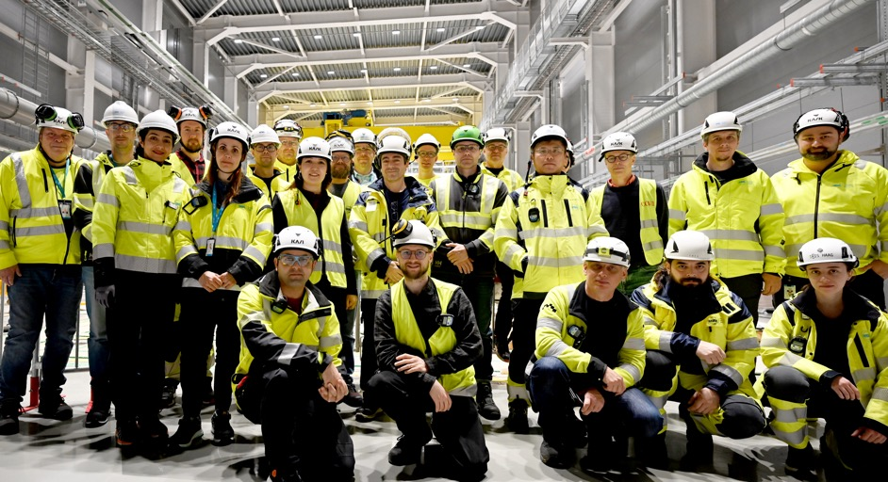
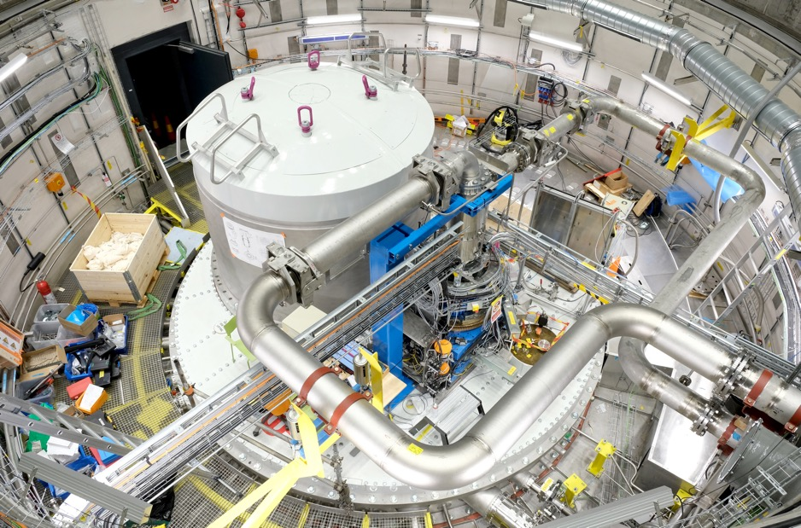
2
ESS Target Station: Radiation Safety Case

Slide 13
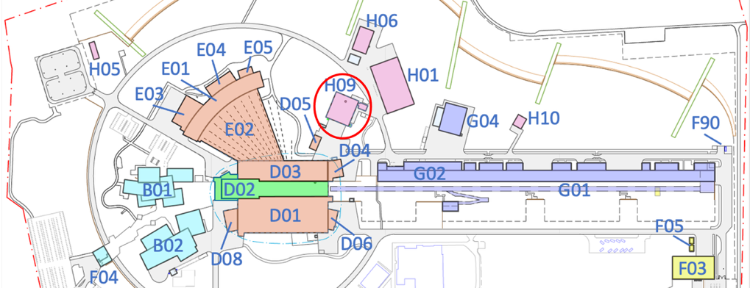
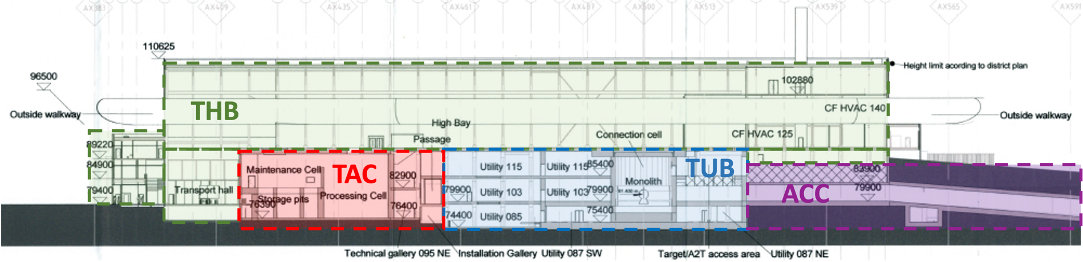
What areas are involved?
Neutron source, waste management – all of D02
D02

Slide 14
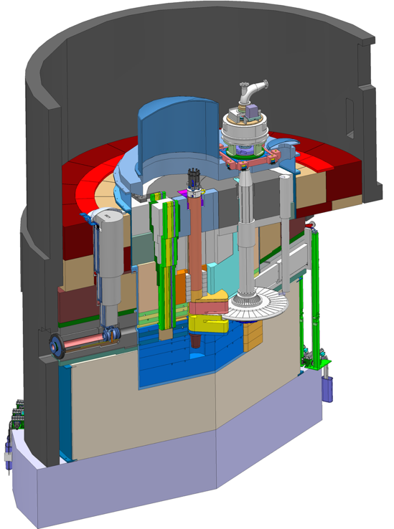
Key Features of the ESS Target Station
Neutron Factory
Step 1
Moderator and reflector
proton beam instrumentation plug
Target Safety System
Monitors target coolant flow, pressure and temperature, monolith pressure, & target wheel rotation
Prohibit beam on target if parameters are outside limits
Helium cooling of target material
Mass flow 3 kg/s
Pressure 11 bar
Temperature inlet/outlet 40 °C/ 240 °C
monolith vessel
neutron beam extraction port
Rotating solid tungsten target
36 sectors
Mass, total 11 tonnes, including 3 tonnes of W
Rotates 23.3 rpm, synchronized with pulsed proton beam 14 Hz
proton beam
target wheel
target monitoring plug
proton beam window
Diagnostics and instrumentation
Controlled and integrated commissioning and operation of the accelerator and target
Fluorescent coating of PBW and target front face
Optical paths, grid profile monitor, aperture monitor
Wheel monitoring including position, temperature, vibration, as well as internal structure
Moderators
Provisional locations of moderators above and beneath the target wheel, i.e. monolith centre
1st MR plug exploits the upper space, offering:
Cold, 30 mm high, liquid H₂ moderators, 17 K
Thermal, 30 mm high, H₂O moderator, 300 K

Slide 15
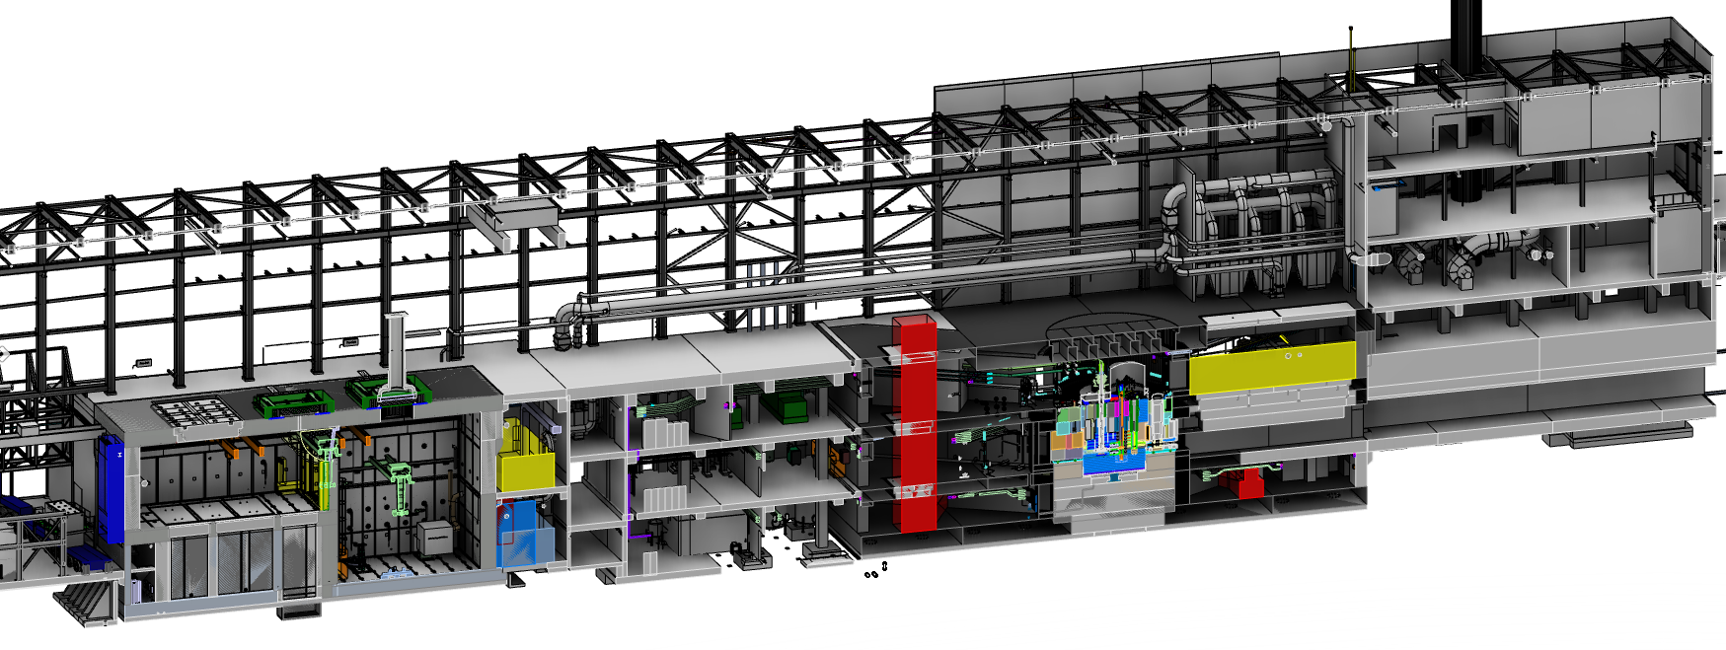
Key Features of the ESS Target Station
Remote Handling
Step 1
Utilities and cooling plant
Helium cooling of target wheel
Water cooling of moderators, plugs and shielding
Intermediate water loops between primary circuits and conventional facility utilities
Helium cryoplant for cold moderator system
Nuclear grade HVAC system
Remote handling systems
Large active cells for safe storage and processing of spent radioactive monolith components
Shielded casks for transfer of spent components from monolith to active cells
High Bay
22 m
130 m
Transport hall
37 m
proton beam
NF monolith
D2T (drift to target)
Active Cells Facility
Utilities block

Slide 16
Radiation Hazards & Safety Provisions for Public
Radiation Safety Functions (RSF) and Administrative Measures (AM)
Step 2-3
Public – Neutron Factory
Prompt:
Shield: Civil structures, monolith shielding (permanent & removable), beam drift room shielding
Residual:
Shield: same as for prompt + casks
Limit monolith component irradiation time – replacement schedule (AM)
Decay time for monolith components (AM - maint)
Contamination
Limit irradiation time – monolith component replacement schedule (AM)
Water: Decay gas in GLS before release (AM – maint), exchange primary water before tritium limit (maint)
Contamination
Tungsten, helium
Maintain source temperature:
Distribute beam on target wheel – raster magnets for beam modes that require it
Rotate wheel
Cool target wheel & tungsten (helium cooling systems – system 1010)
Purify helium (1010, 1015)
Stop beam delivery to protect wheel – Machine Protection System of Systems (MPSoS) (L2)
Confine helium (1010, 1015, pressure control, sensing lines)

Slide 17
Safety Provisions for Workers
Worker Radiation Safety Functions (WRSF) and Administrative Measures (WAM)
Step 2-3
Workers – Neutron Factory
Prompt:
Shield: around primary water systems
Access control in utility block (WO, training)
Control access based on radiation level (RP team, WO, procedures, monitoring)
Prevent proton beam if workers in specific areas & prevent access when beam on target (L1 WO, procedures) (L2 PSS)
Residual:
Shield: add local shielding for water systems, ion exchange columns, spent resin
Decay time for water – delay tanks
Decay time for ion exchange spent resin (WAM - maint)
Replace helium system filters, primary water components
Control access based on radiation level
Prevent access if beam on target, prevent beam on target if workers in area (water) (L1 WO, procedures) (L2 PSS)
Contamination:
Control access based on contamination level (RP team, WO, monitoring)
Water
Confine primary water & ion exchanger resin
Purify primary water
Controlled release from monolith (L1 vessel and extensions, vacuum, off-gas extraction system)
Confine unforeseen leakage (L2 building with floor drains, drain tanks, vessel, HVAC)
Tungsten, helium
Controlled release from monolith (L1 vessel, etc)
Controlled release from rooms (L1 civil structure, HVAC)
Control leakage (L2 monolith vessel & pressure relief system, helium pressure relief system, building, HVAC)

Slide 18
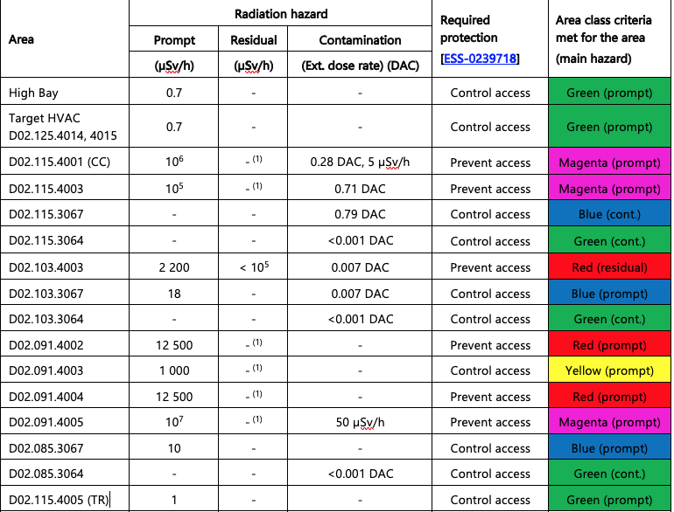
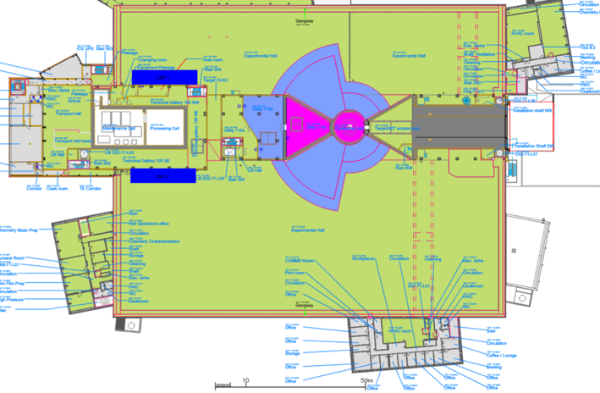
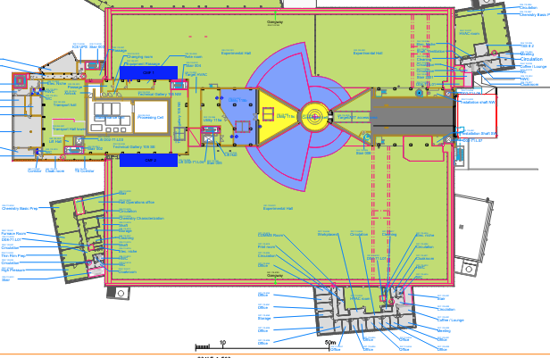
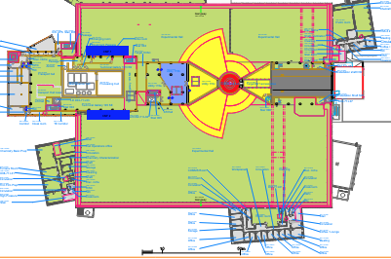
Anticipated Operations – Area classes
Identify & characterize hazards (prompt, residual, contamination)
Step 2-3
Production mode
Maintenance mode:
monolith closed
Maintenance mode:
Connection Cell work

Slide 19
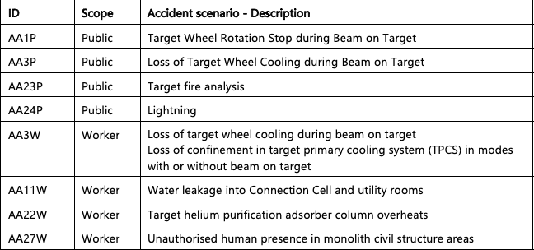
Bounding Event Analyses – Neutron Factory
Assessments identify where additional safety provisions are required
Step 4-5
Public
Safety Group required for stopped wheel and loss of cooling for tungsten:
Target Safety System (TSS) required
TSS also in global events that may initiate AA1P or AA3P: fire, lightning
Workers
Helium, tungsten: evacuate for helium leaks, isolate purification system before access (maint)
Water: evacuate for leak (maint)
Prompt: PSS detect intrusion & stop beam, emergency beam-off buttons in utility areas
Barrier-P/R-1: permanent & removeable shielding, civil structure around monolith
Barrier-T-1: tungsten bricks
Barrier-T-2: target wheel shroud, primary helium cooling system and associated confinement SSCs
Step 5.5

Slide 20
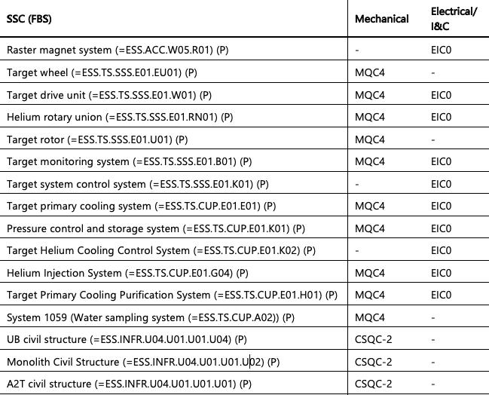
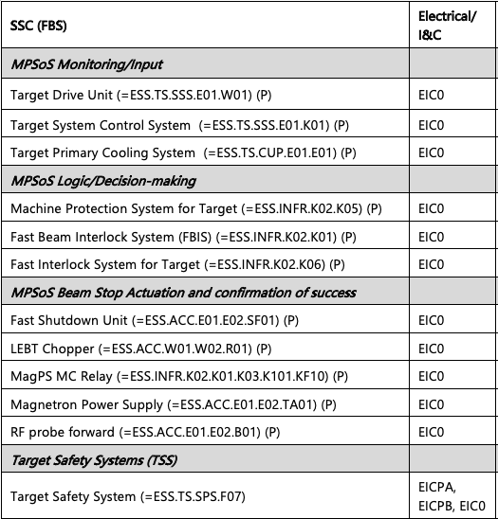
Neutron Factory - classified SSCs (Public)
Structures, Systems, & Components
Step 6
No classification for shielding SSCs

Slide 21
Defense in Depth
Structures, Systems, & Components
Step 7
Neutron Factory – public
Basic principles with respect to the public
Attenuate prompt radiation with shielding
Attenuate residual radiation with shielding
Maintain target tungsten integrity
Stop proton beam if process parameters are off-normal process – limit tungsten damage
Single level of DID (L1) sufficient to manage prompt & residual radiation
Three levels (L1, L2, L3) for contamination hazards due to activated target tungsten
Safety Group required – one system (TSS)
No Consequence Mitigating Group (L4)
Neutron Factory – workers
All functions for public and:
Worker presence allowed or prohibited depending on the mode & area
Three levels (DIDW-L1, L2, L3)
DIDW-L1, L2 access control for prompt & residual hazards
DIDW-L1, L2, L3 excludes beam on target or presence of workers in high class area
DIDW-L1, L2, L3: contamination hazards from target tungsten and cooling media (helium and water)

Slide 22
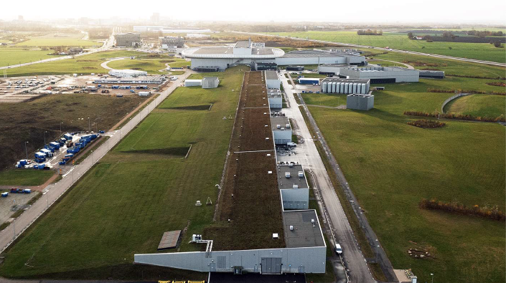
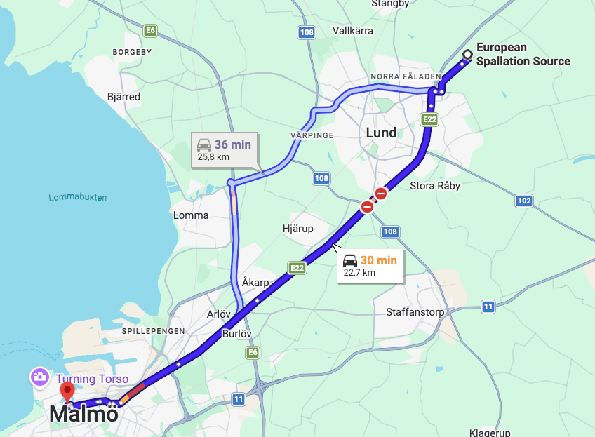
3
How did we get here?
And you may find yourself in a beautiful house
And you may ask yourself, “Well, how did I get here?”
Letting the days go by… Once in a Lifetime, Talking Heads (1980)

Slide 23
License to Operate – INP NOW
A step wise approach to routine operation license
Routine operation permit
Submission TBD
Received TBD
Trial operation permit NCL
Trial ops permit SCL
Trial ops permit BOT, NSS, H09
Submission Jul 2019
Received Oct 2020
Submission Dec 2024
Received Feb 2026
Extension for new Instruments
Submission Oct 2023
Received May 2024
Installation permit
Installation permit NSS & H09
Submission May 2016
Received Oct 2017 excl. NSS and H09 (rad waste)
Submission Mar 2022
Received Sept 2022
Siting permit
Submission Jan 2012
Received Jun 2014
INP = Intentional Neutron Production

Slide 24
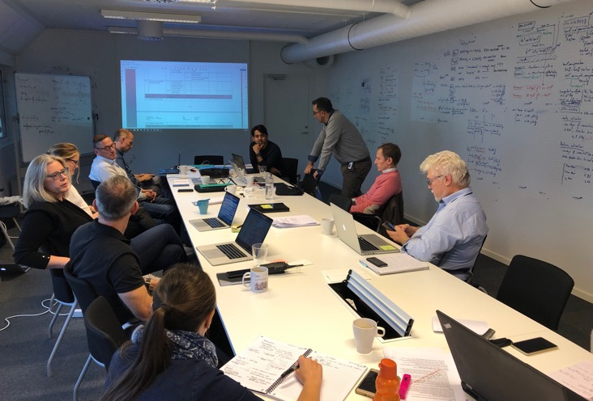
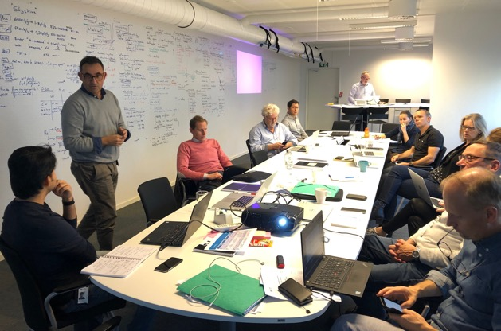
ESS Radiation Safety
A little history
September 2019 – Radiation Safety Task Force
Clarify & implement the ESS radiation safety analysis approach, RSF/WRSF ID, and SSC classification
Update existing analyses, execute complementary analyses, and manage RSF/WRSF identification
RSTF Team
Core team representing broad technical expertise and all facility areas of interest: Accelerator, Target Station, ICS, NSS, ESH, RadWaste, Building/Facility, Quality
Additional specialty resources: power supply,HVAC, Radiation Protection, rad monitoring, shielding, fire, mechanical components, engineering, security
Outcome & goals
Develop & implement 7-steps for SCL application
Align across facility
Evolved through INP application (for BOT) (2025)

Slide 25
Balancing Time, Energy, Impact
Consider carefully where to devote resources
Started with and spent significant time/energy on accident analyses
Built in structured Step 2-3 later
Early applications reported everything
Disproportionate time and text on event analyses – majority for Public resulted in acceptable risk
Public – we have 31 AAPs for ESS
4 require Safety Group RSFs (TSS)
5 with limited duration (>24 h) (shielding)
Workers – 38 AAWs, 21 defined new WRSFs
Start with normal ops
Define what you will have, what you need when things go right
L1 functions and SSCs are the foundation
Event class is critical, can be complex
Be clear on purpose/intent/strategy for radiation safety analyses for design
ex: AAs not intended to be realistic, rather deterministic
Exaggerated the impact – if ok, then done
Risk to apply these analyses to other purposes, it could result in overconstraints

Slide 26
Connect with Operations
Plan for operations along with design – easier earlier
Clear about the radiation safety process
Well-understood interplay with facility design & requirements for classification
Design requirements align with ESS rules
Less clear what it meant for Operations
Still working to communicate this
Operational Limits & Conditions (OLC)
Track maintenance – EAM/MCR tools
Significant overhead, especially for public safety SSCs
Get feedback to/from Operations ASAP
Establish an outline of planned ops and maintenance procedures
What is the envisioned approach? How often? Who?
Avoid untested or limited lifetime tech
Clever use of other SSCs
Bigger workload on analysis – easier on ops
Define needed, not nice to have
Build in flexibility
Conservative assumptions reduce reliance on them
Tough to track impact of assumptions
Eg. Don’t rely on HVAC in AAPs, unless it makes it worse!

Slide 27
Optimize the Safety Case
Focus on essentials – clarify public vs workers safety case
After SCL, re-examined safety case with respect to the public
Applied knowledge gained in later steps back to Step 2-3
Narrowed the focus – identified what is important for the public and what is not
Shifted away from default to RSF, instead define what it means to be an RSF
Impact on Operations re. public SSCs
Applied for Accelerator, Target Station, and NSS
ACC:
Distilled MPS functions to essentials
Pared down MPS/beam instrumentation – no BLMs, no GRID, no optical system
Align beam destination w/beam parameters
Beam loss: only beam current monitors for A2T losses
Monitor raster magnets, wheel rotation, synchronisation, helium cooling parameters
Removed water systems
Neutron Factory water systems, HVAC – only for workers (ACF HVAC still for public)
NSS: only permanent shielding for public
General – defined minimum required SSCs to execute functions

Slide 28
Map to Defined Operations Plan & Parameters
Help Operations and system owners know when functions & SSCs apply
Safety case for 5 MW
Demonstrate facility built for full capability
Early commissioning (especially) not near max power
What is the difference?
Different beam configurations
Different inventories
Causes confusion re. what is required for early commissioning vs for 5 MW
Sensitivity studies for lower beam power
Define when functions are needed
From the start? After 1 year? After 2 MW?
Tie into facility modes – eg. Production vs Maintenance
Be clear about descriptions for how the facility is operated as a user facility vs commissioning
Define parameters tied to activation calculation in useful units (e.g. MWh)
Don’t just check the worst… find the bottom edge – ‘bounding for not needed’

Slide 29
Thank you for listening – Questions?

Slide 30
Engineering & Analysis
Radiation Safety Analysis & Classification
Step 1: System/facility description, Concept of operations including modes of operation
Step 2: Identify & characterize radiological hazards (prompt, residual, contamination) in operations
Step 3: Identify Radiation Safety Functions (RSFs) and Worker Radiation Safety Functions (WRSFs), Administrative Measures (AM) for normal operations & maintenance
Step 4: Accident/event analysis
List of events to consider with event class (ranking from H2 to H5, high to low frequency)
Potential impact of event on workers and public
Bounding events based on previous list and assessment
Quantitative impact on public and workers
Step 5: RSF and WRSF identification from accident analyses
Step 5.5: barrier integrity
Step 5.7: define facility safe state
Step 6: RSF categorization and SSC classification by sub-discipline
Step 7: Defence in Depth (DID) – justification of independence of DID level

Slide 31
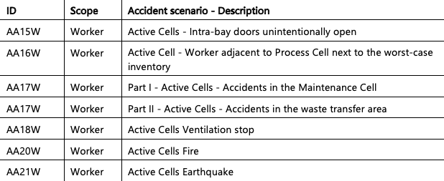
Bounding Event Analyses – ACF
Assessments identify where additional safety provisions are required
Public
Workers

Slide 32
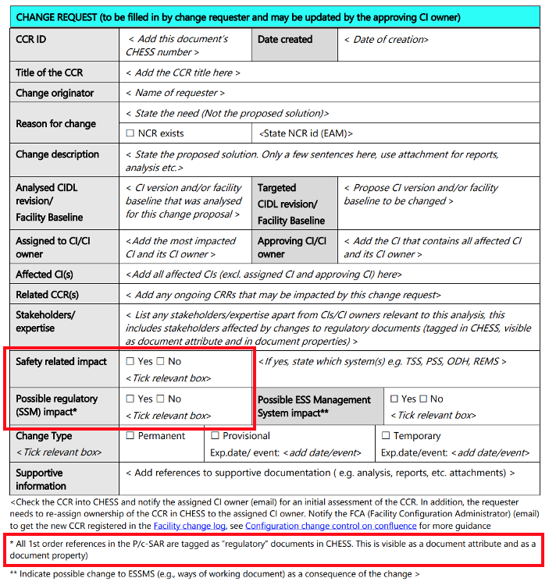
Connections/impact for Target Division
How does all of this affect our work?
Testing
Verify compliance with requirements – functionality, reliability, ability to maintain
Manage noncompliance – Licensing team, SSM
Change control
Any changes to the SSCs, ways of working (e.g. operations procedures, radwaste storage) need to be assessed from the perspective of radiation safety.
Ways of working as we evolve toward Commissioning/Operations
Safety case defines (Step 1, 2-3, 4-5) how we plan to do things
Defines RSF/WRSFs required during different modes (Production/Cooling down vs. Maintenance/Start-up)
Demonstrate how to manage radiation hazards to workers during maintenance activities
Record knowledge/experience gained during testing – try things out now when its ‘easy’

Slide 33
Connections/impact for Target Division
Examples
Change control
Neutron Factory – Helium leak rate
NF, RH – reference document changes (1st, 2nd order)
Operations
NF – mode transitions
Ways of working
RH – Location of workers
Level of inventory
NF – circulate/purify He before transition to Maintenance mode
NF – exchange water
NF – radwaste leaves D02
RH – wait 14-days before remove monolith component
RH – wait before cutting, nothing else when cutting
System lifecycle
SARs (System Acceptance Review)
SSR5 (Safety Readiness Review 5)

Slide 34
Operations/Maintenance constraints
Transition between Neutron Factory modes
NF modes
Production | Prompt radiation Higher, circulating fluid inventories |  | Reduced access PSS rooms locked
Cooling Down | Remove residual heat Purify helium, then depressurize |  | Maybe open basement earlier
Maintenance | Lower, relocated or removed fluid inventory |  | Access allowed everywhere Need special monitoring for water, helium leak
Startup

Slide 35
Prep of references & cSAR
Important to:
Pay attention to Quality – content & document quality
Templates!
Do not underestimate the time needed to perform analyses, review them, incorporate them into the cSAR
Bring on board documentation/writing specialists
Assign someone to be responsible for checking alignment across areas
If you have different areas with different levels of hazard, do scoping calculations to allow focus on the most critical areas
Don’t just check the worst… find the bottom edge – ‘bounding for not needed’

