Slide 1
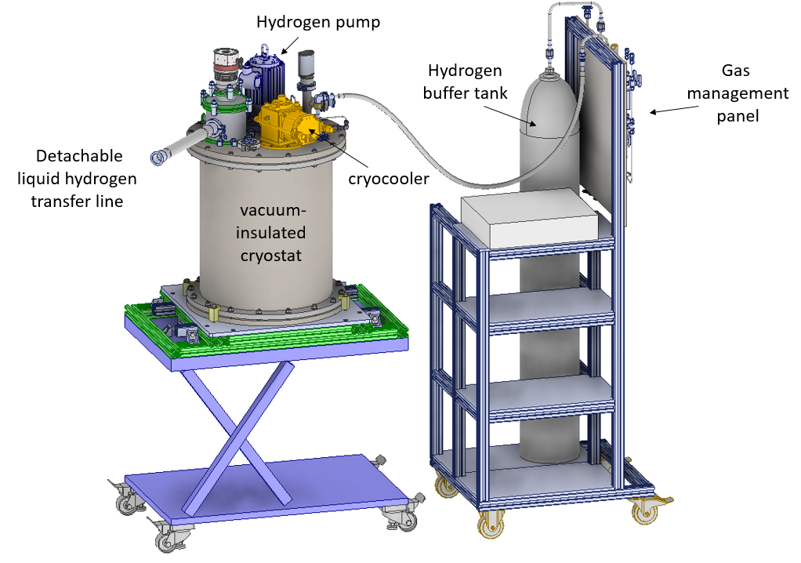
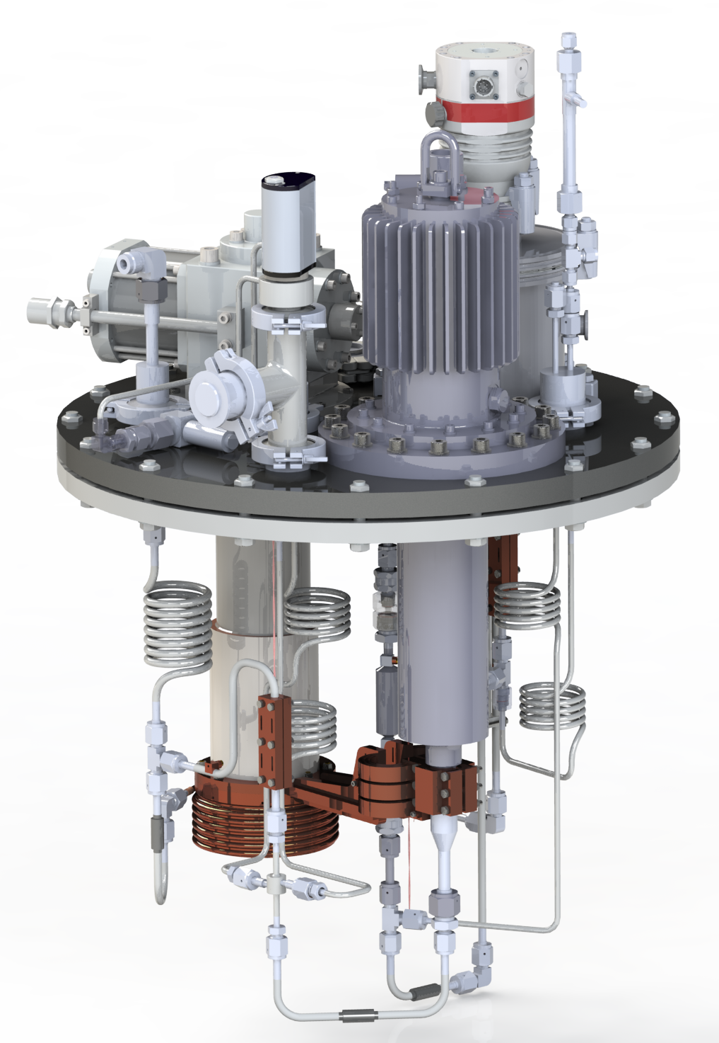

Design and operation of a 1-D para-H₂ cold neutron moderator at the JULIC Neutron Platform
U. Rücker, JCNS-HBS ICANS XXV Malmö 13.04.2026

Slide 2
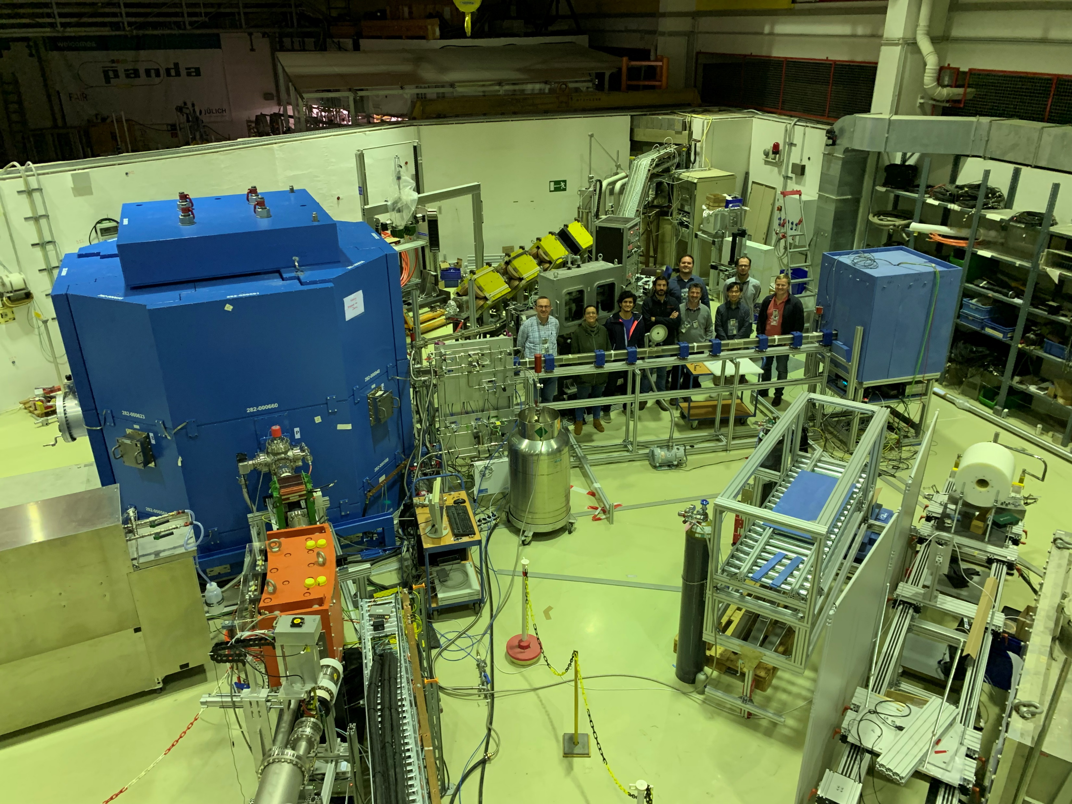
JULIC Neutron Platform
HBS Target station prototype
Shielding
Ta target
Cold moderators
Intensity * 10⁻⁵
8 beamports for ToF instruments
Operation Dec. 2022 – Dec. 2023

Slide 3
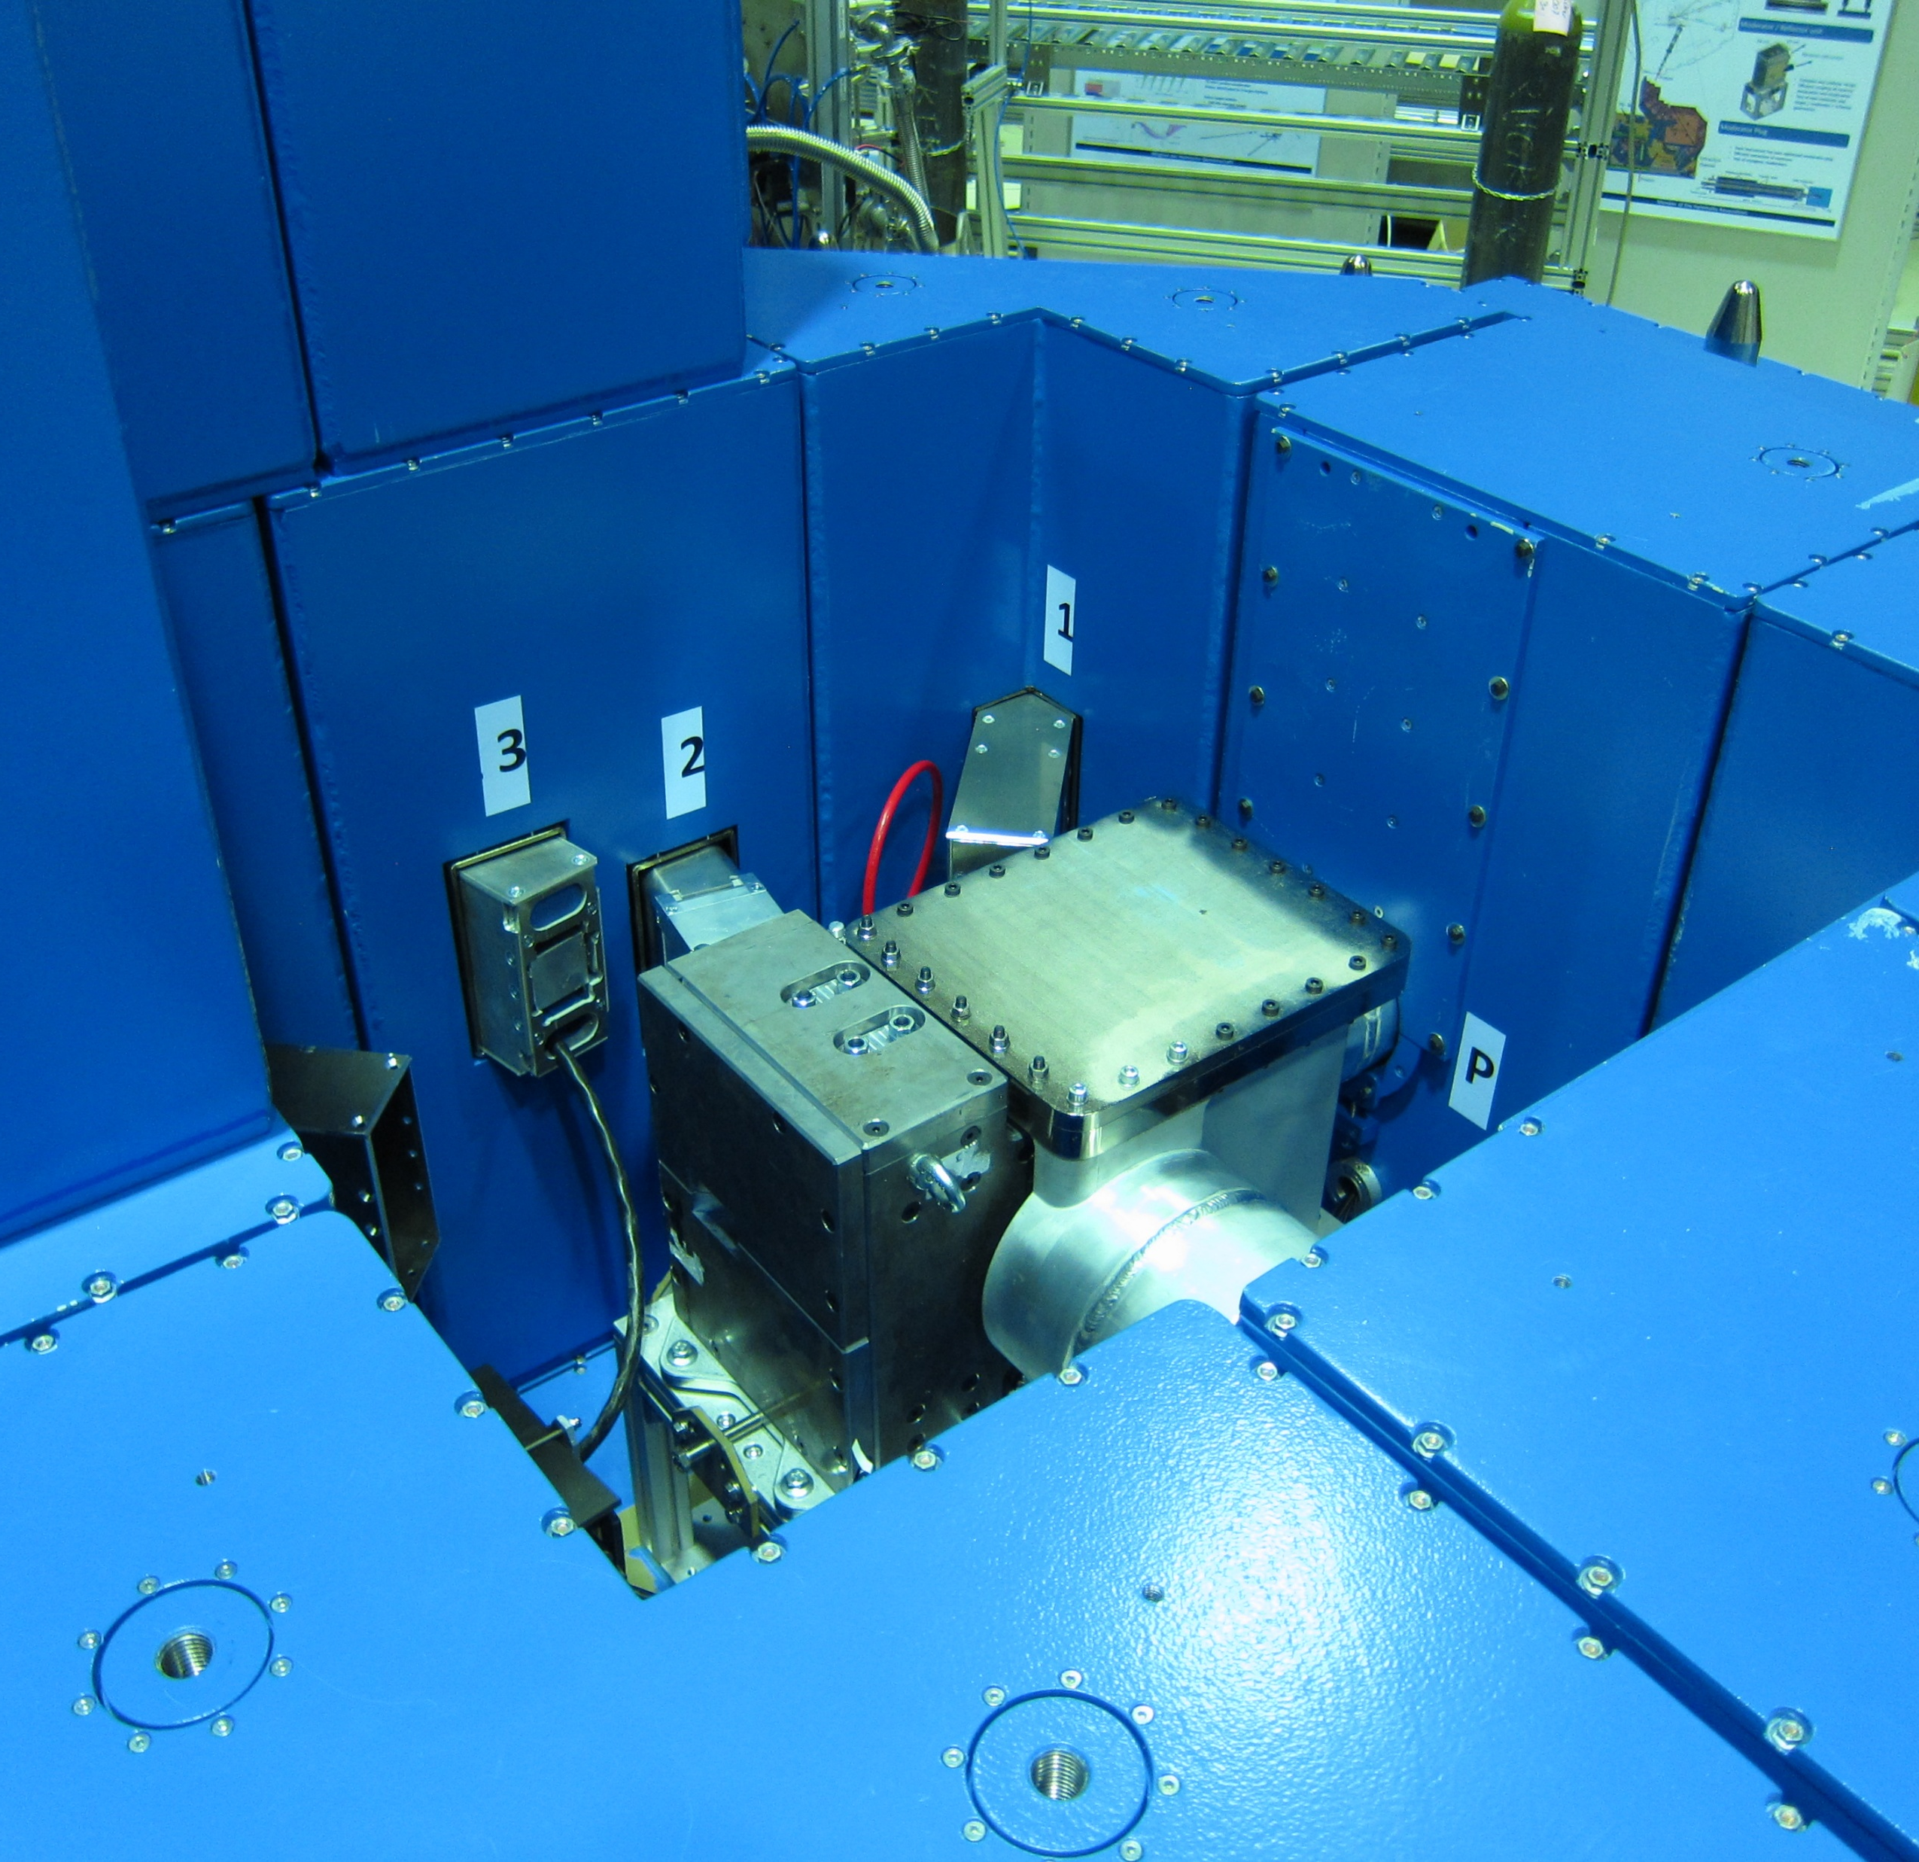
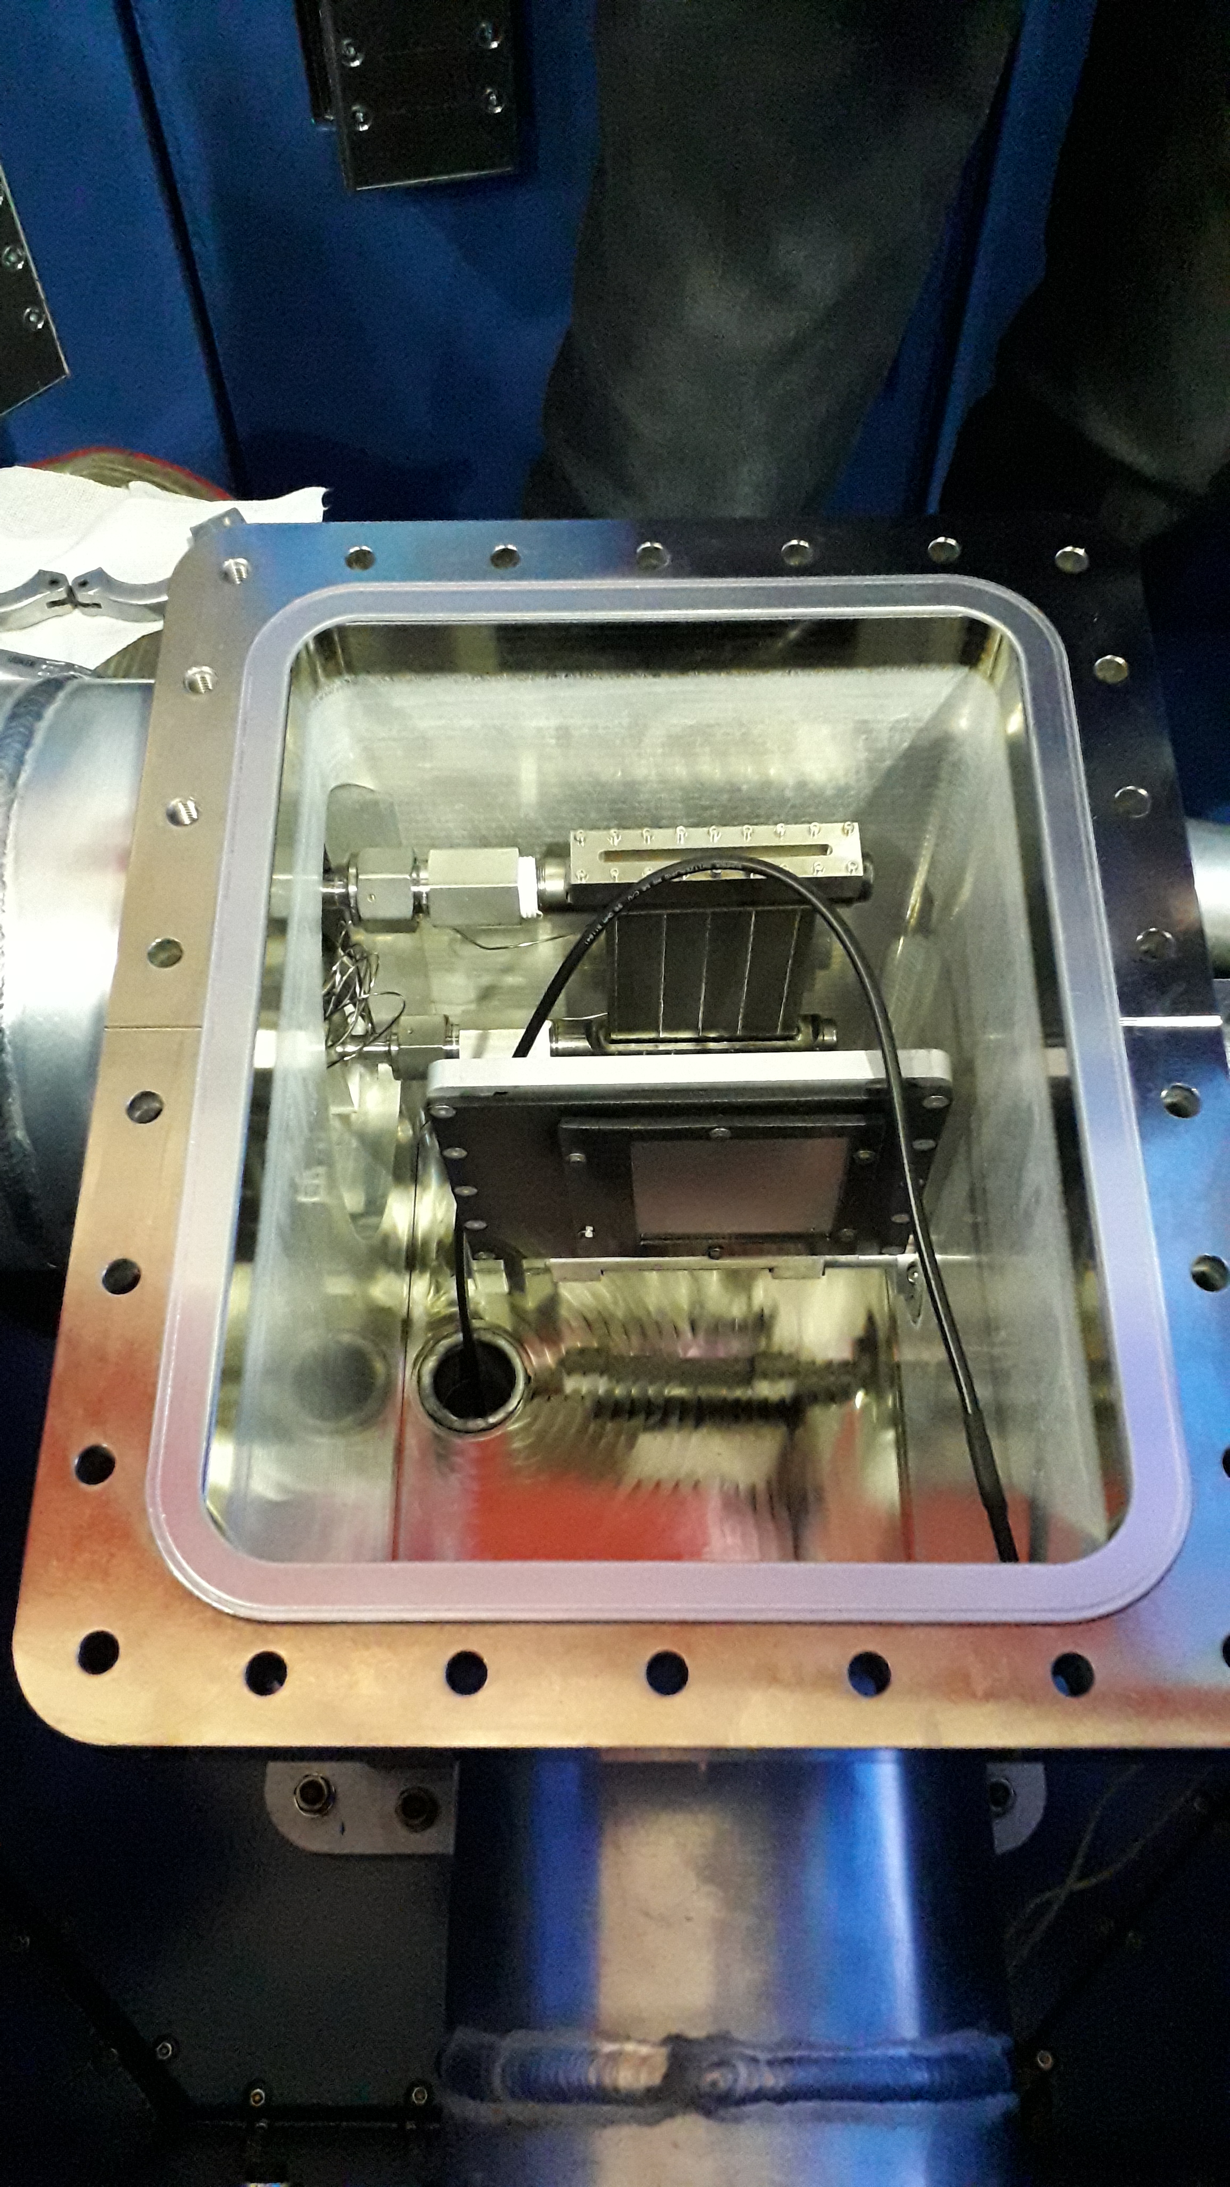
JULIC Neutron Platform
Inside: 1 m² playground for physicists and engineers
Target chamber
Primary beam
measurement
Moderators
Beam extraction

Slide 4
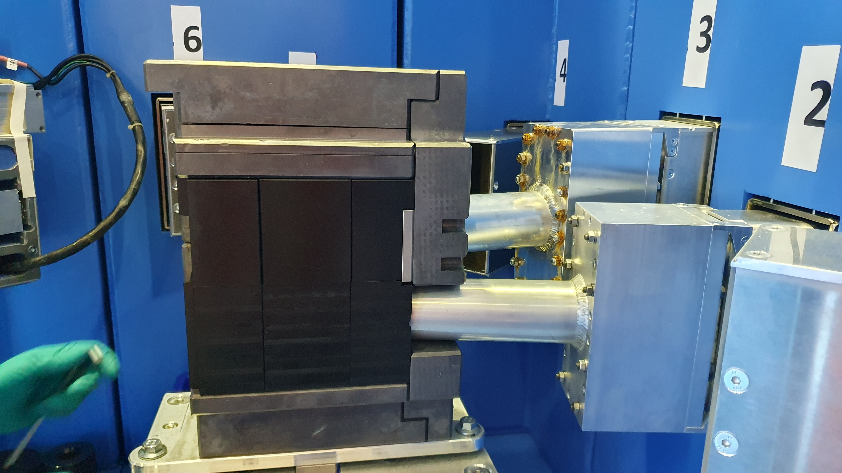
Moderators
Thermal moderator PE
Reflector 5 cm Pb
2 cold sources
low-temperature He cooled < 10 K e.g. solid CH₄
para-H₂ closed loop
Pb
p-H₂
PE
low-temp

Slide 5
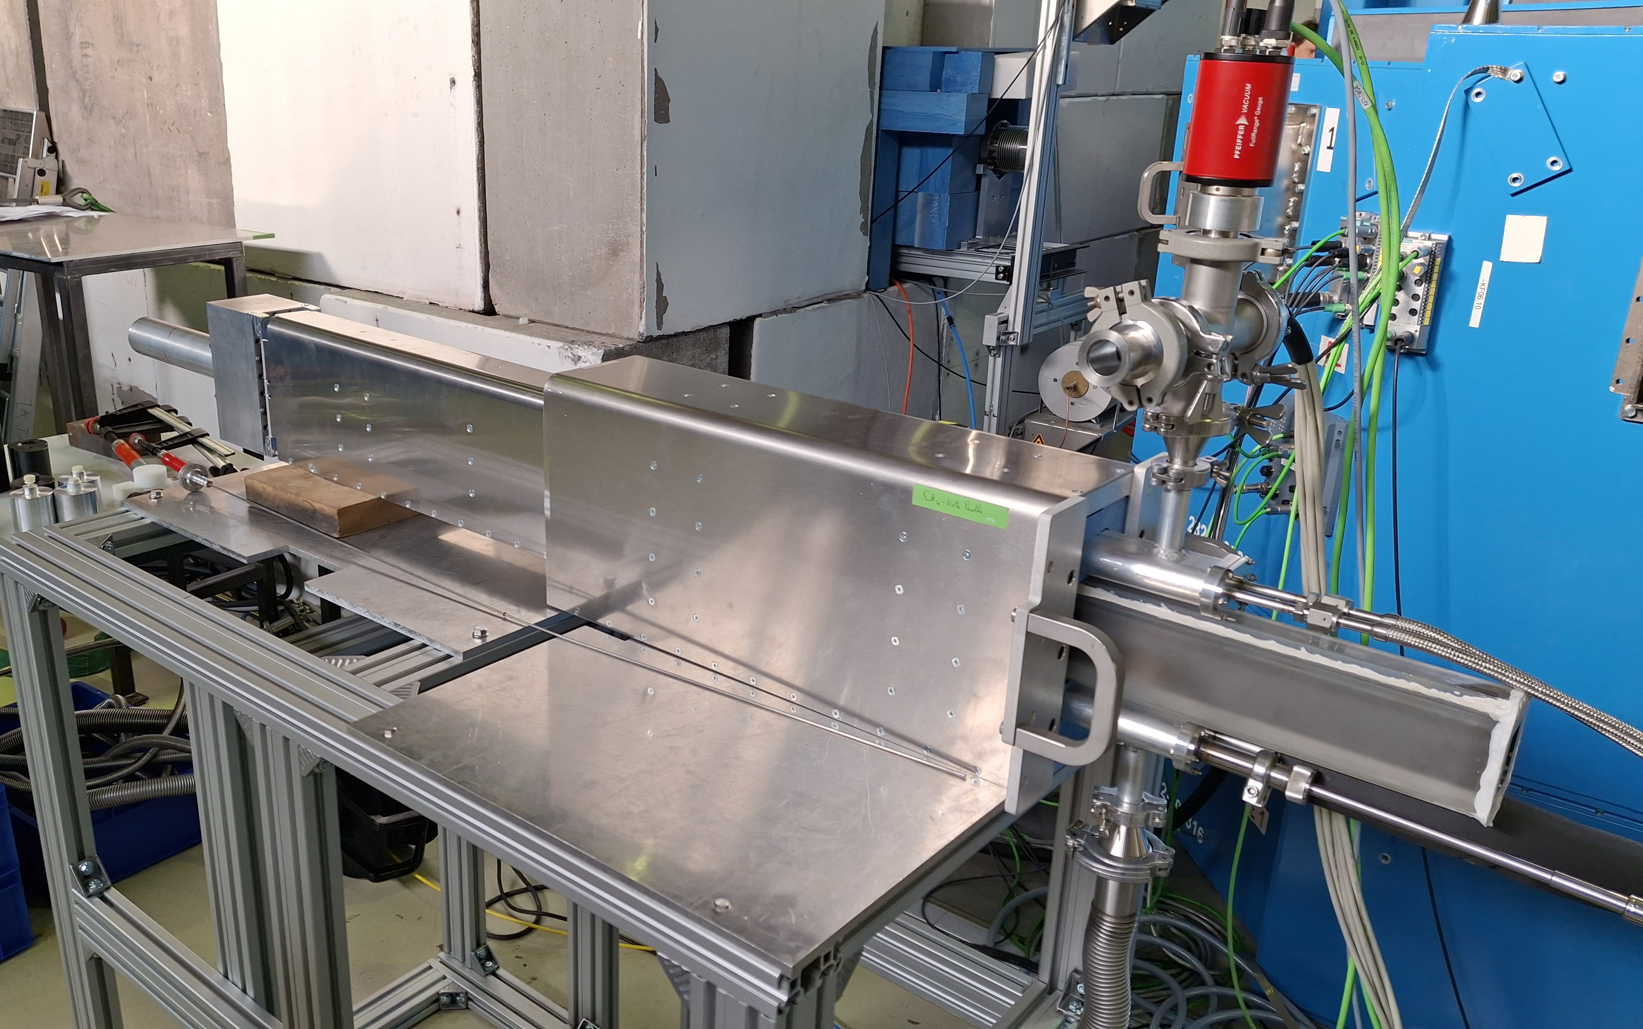
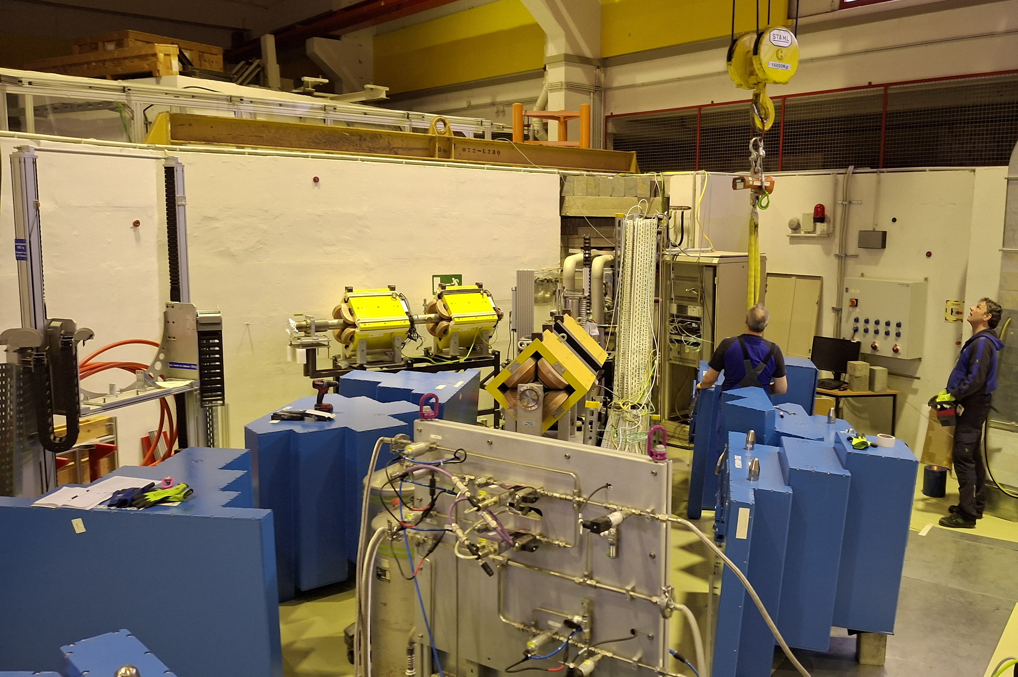
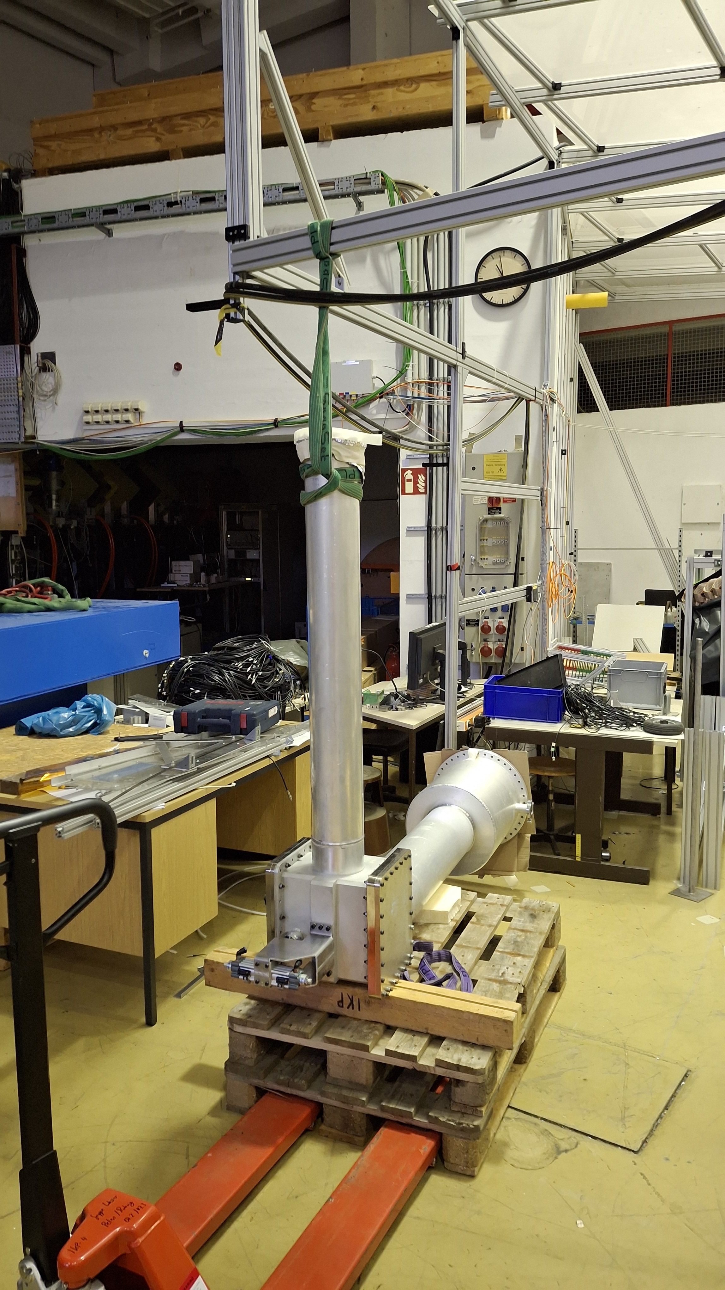
JULIC Neutron Platform today

Slide 6
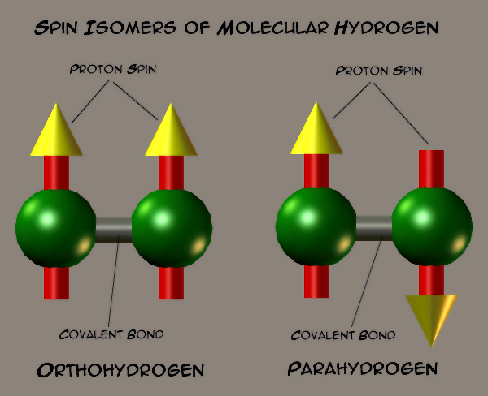
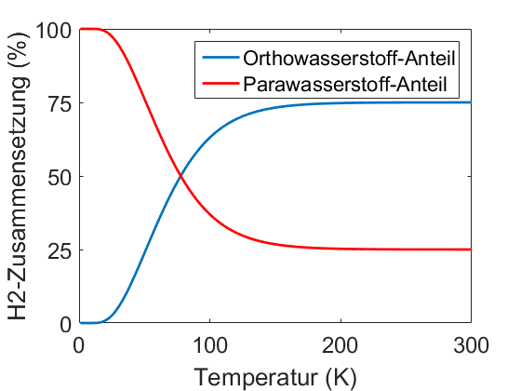
para-H₂
J: Nuclear molecular spin
ΔE = 15.1 meV ≙ 175 K
Forbidden transition ortho ↔ para
Lowest energy inelastic neutron interaction: Spin-flip in ortho-H₂
from Wikipedia: Spin isomers of hydrogen
Triplet state J=1
M = -1, 0, 1
Singlet state J=0
M = 0
Ground state
from Wikipedia: Ortho- und Parawasserstoff

Slide 7
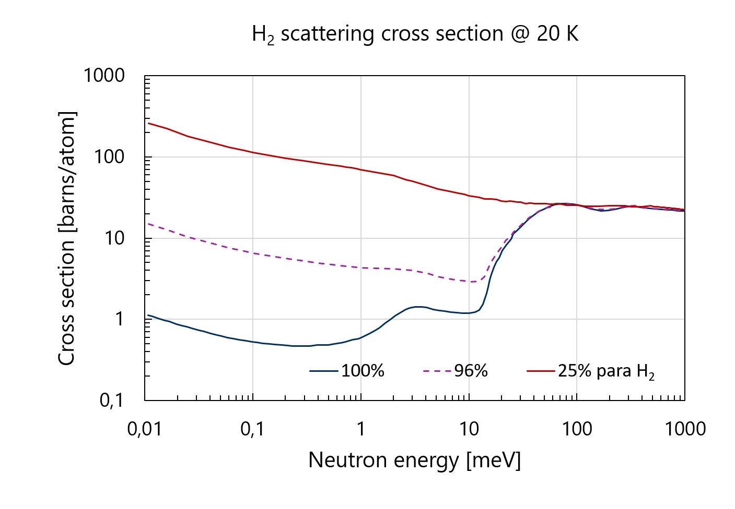
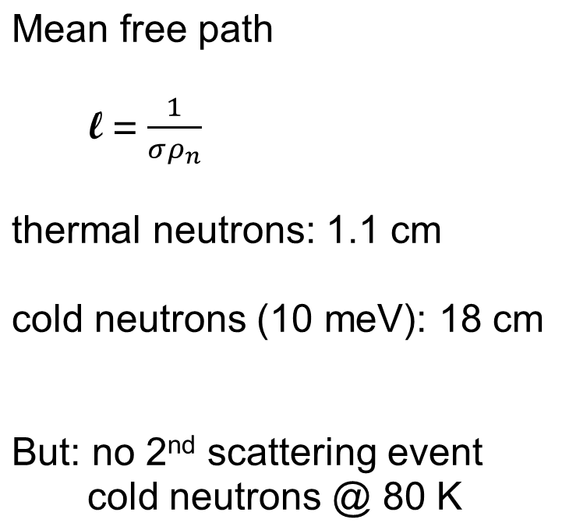
para-H₂ as cold moderator material
0.023
0.074
0.23
0.74
2.3
7.4
23
74
230
Mean free path [cm]

Slide 8
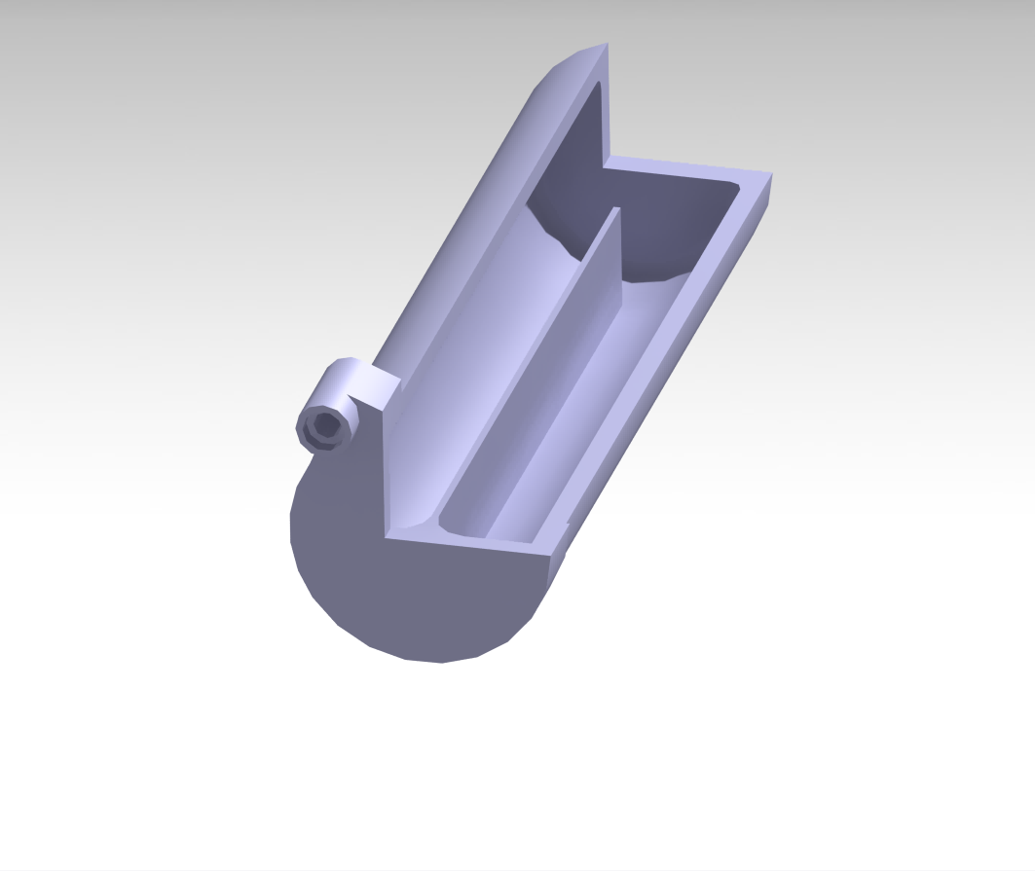
1-dimensional moderator
Feeding with thermal neutrons
across the entire surface shell
→ no extinction effects
Extraction along the axis
entire volume contributes
Liquid para-H₂ flow
Aim: build a simple and safe device
12 cm long
3.6 cm Ø

Slide 9
Closed-loop para-H₂ moderator cryostat
Sealed-in hydrogen volume
(800 bar l at room temperature)
Continuous operation
Liquid hydrogen is moderator
and cooling medium
Infrastructure: 3-ph AC 16 A power cooling water
(computer network)
Idea: 2020
Realization: 2022-23

Slide 10
Main components
Reservoir (at room temperature)
Main cryostat:
Closed-cycle cryocooler
Circulation pump
Catalyst
Outside the shielding block
Extension:
Moderator vessel
Embedded in the extraction plug

Slide 11
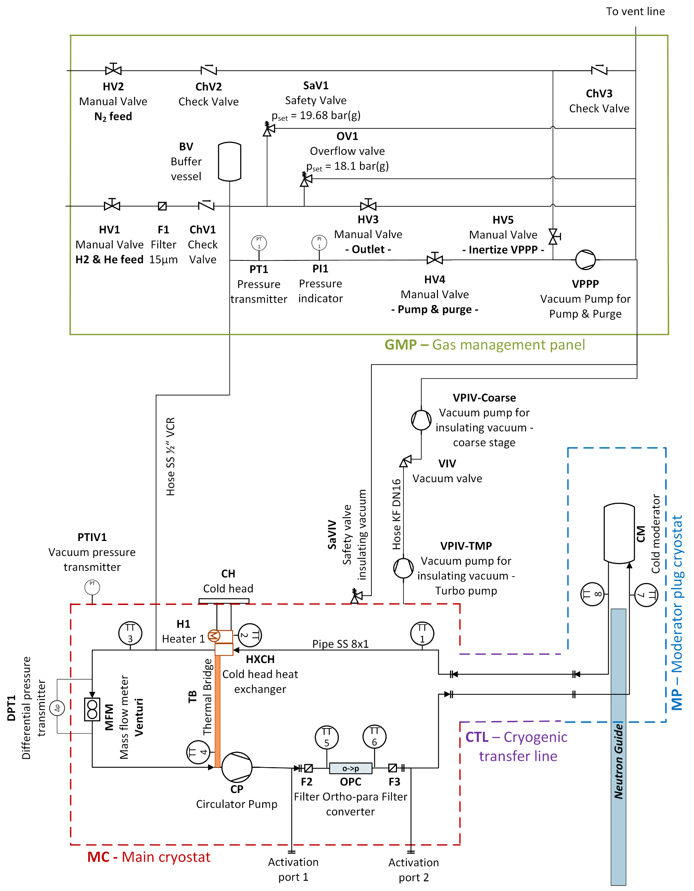
Schematic

Slide 12
Main cryostat

Slide 13

Main cryostat

Slide 14
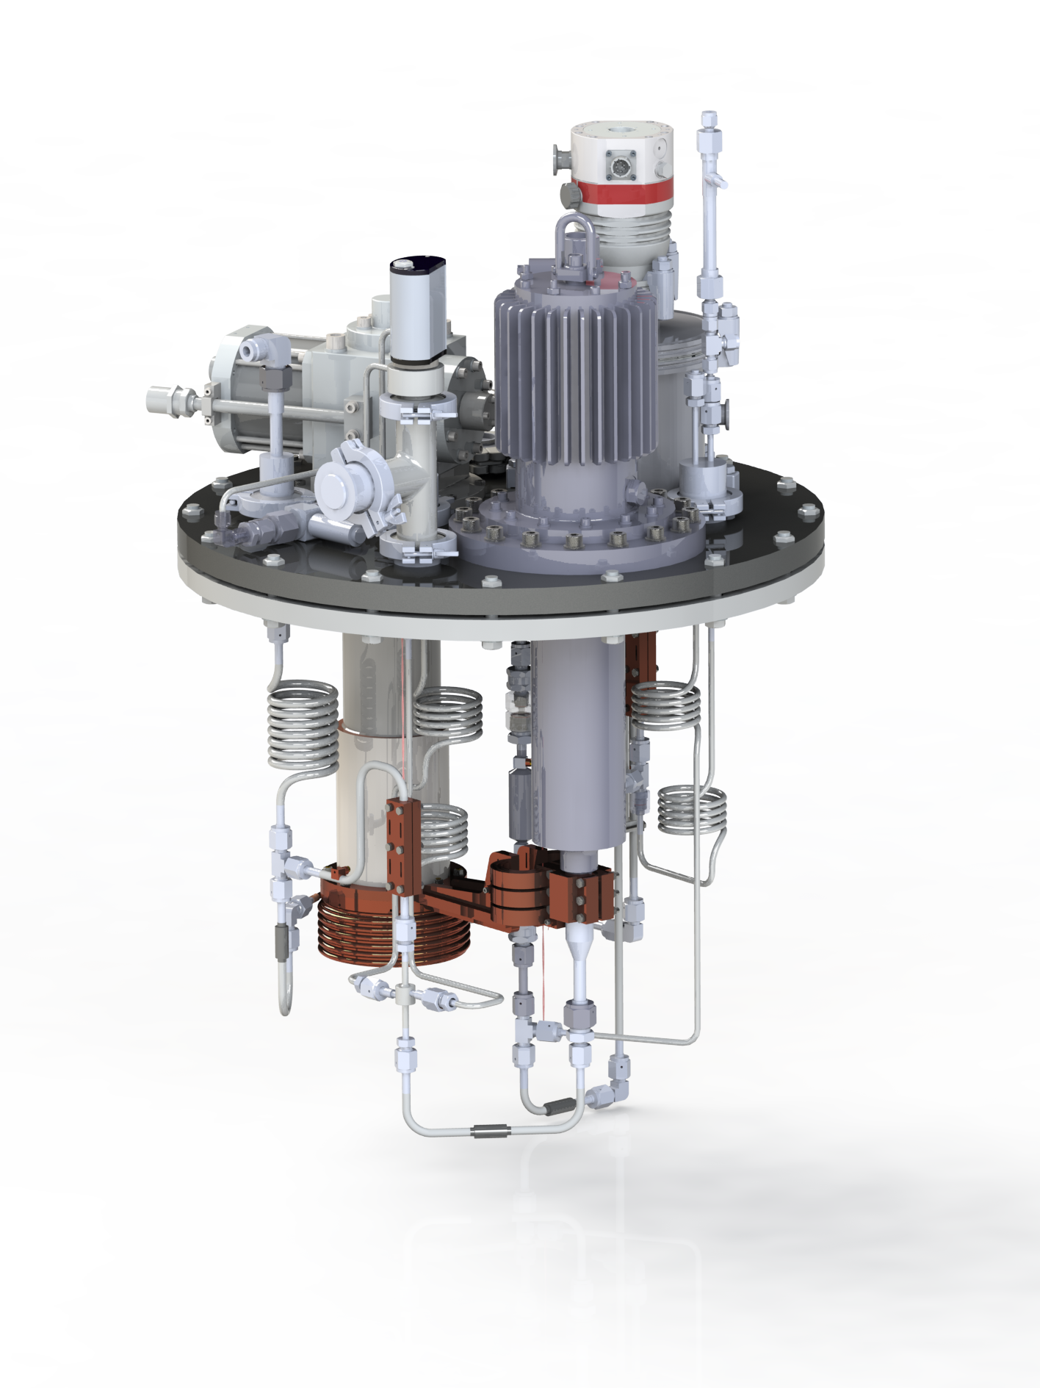
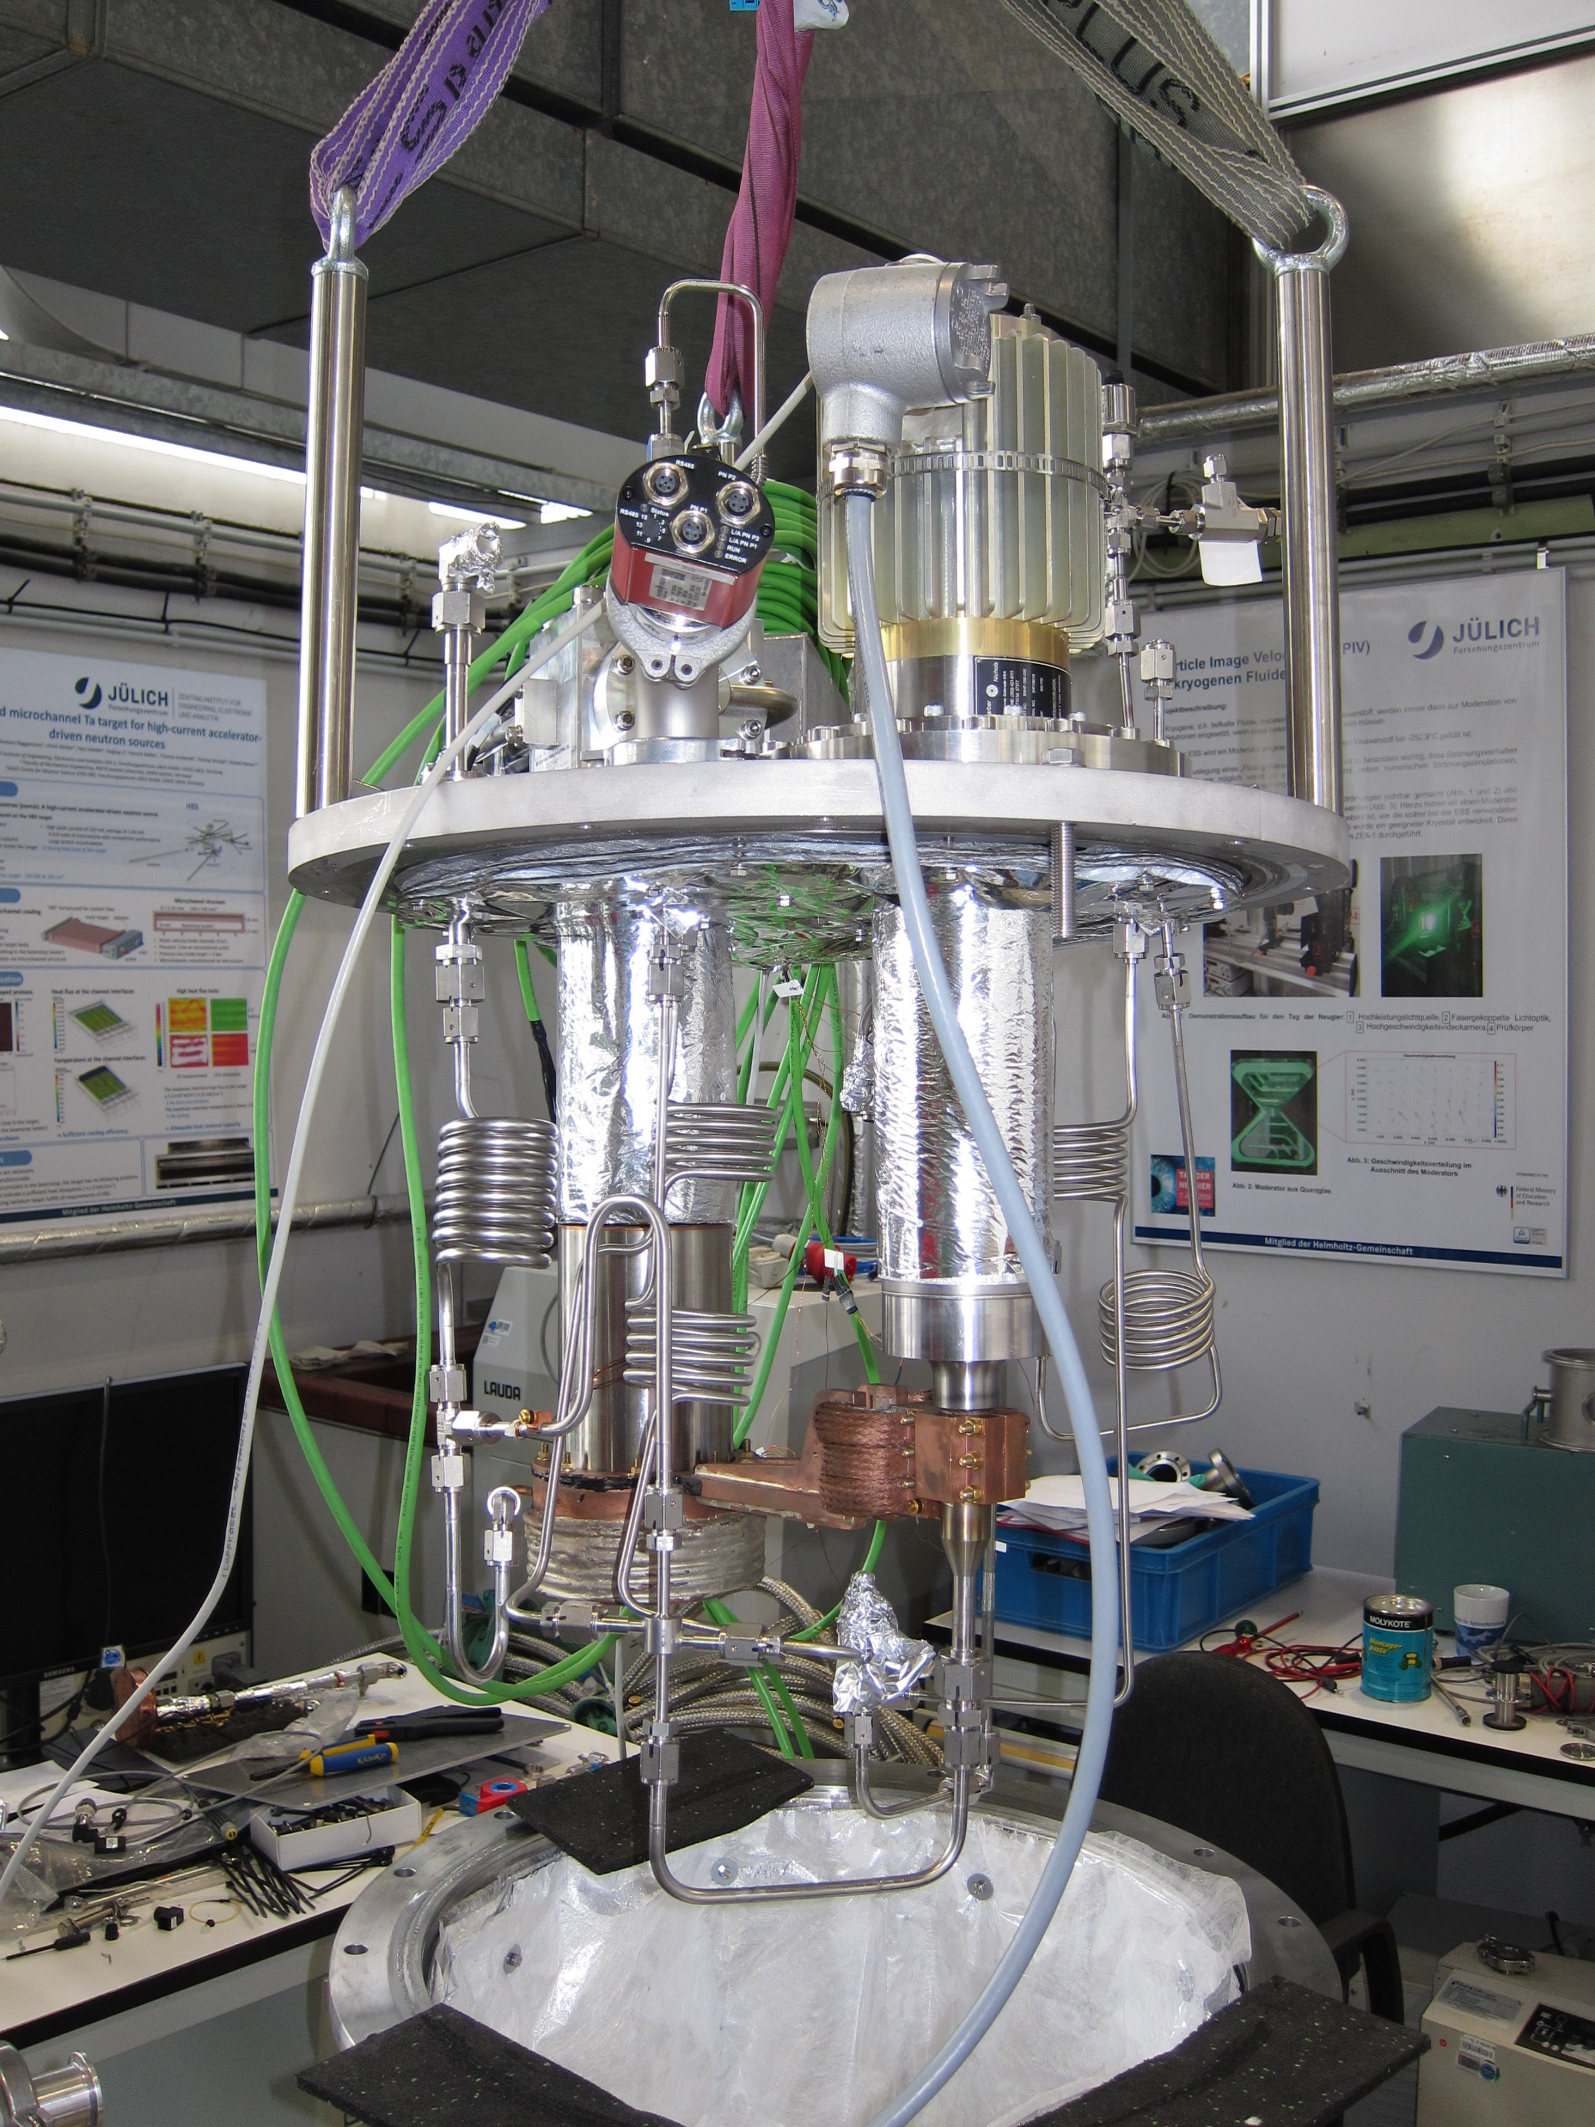
Main cryostat

Slide 15
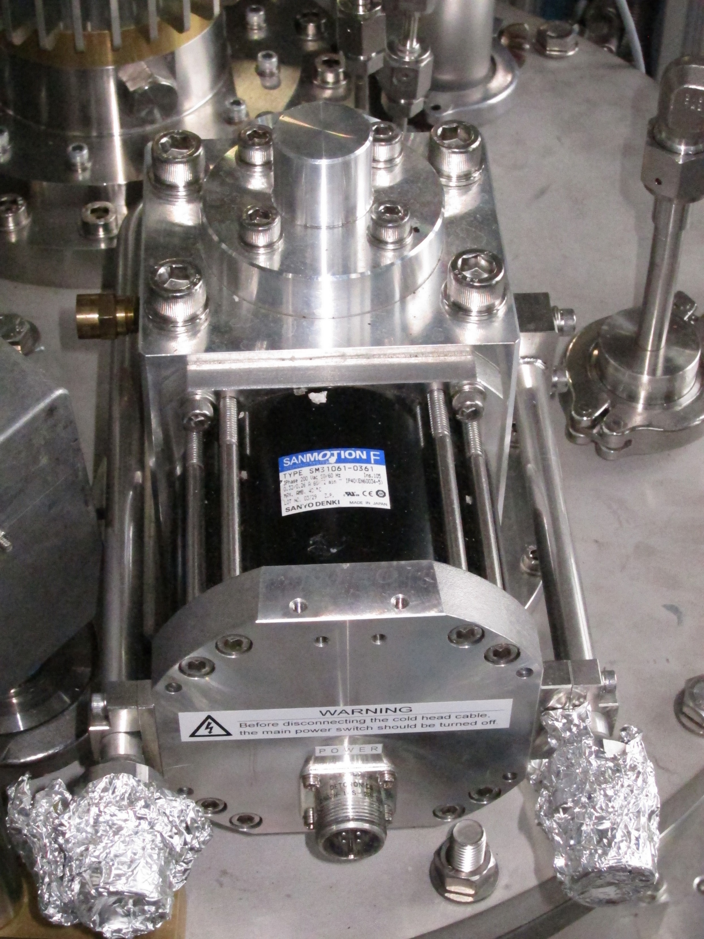
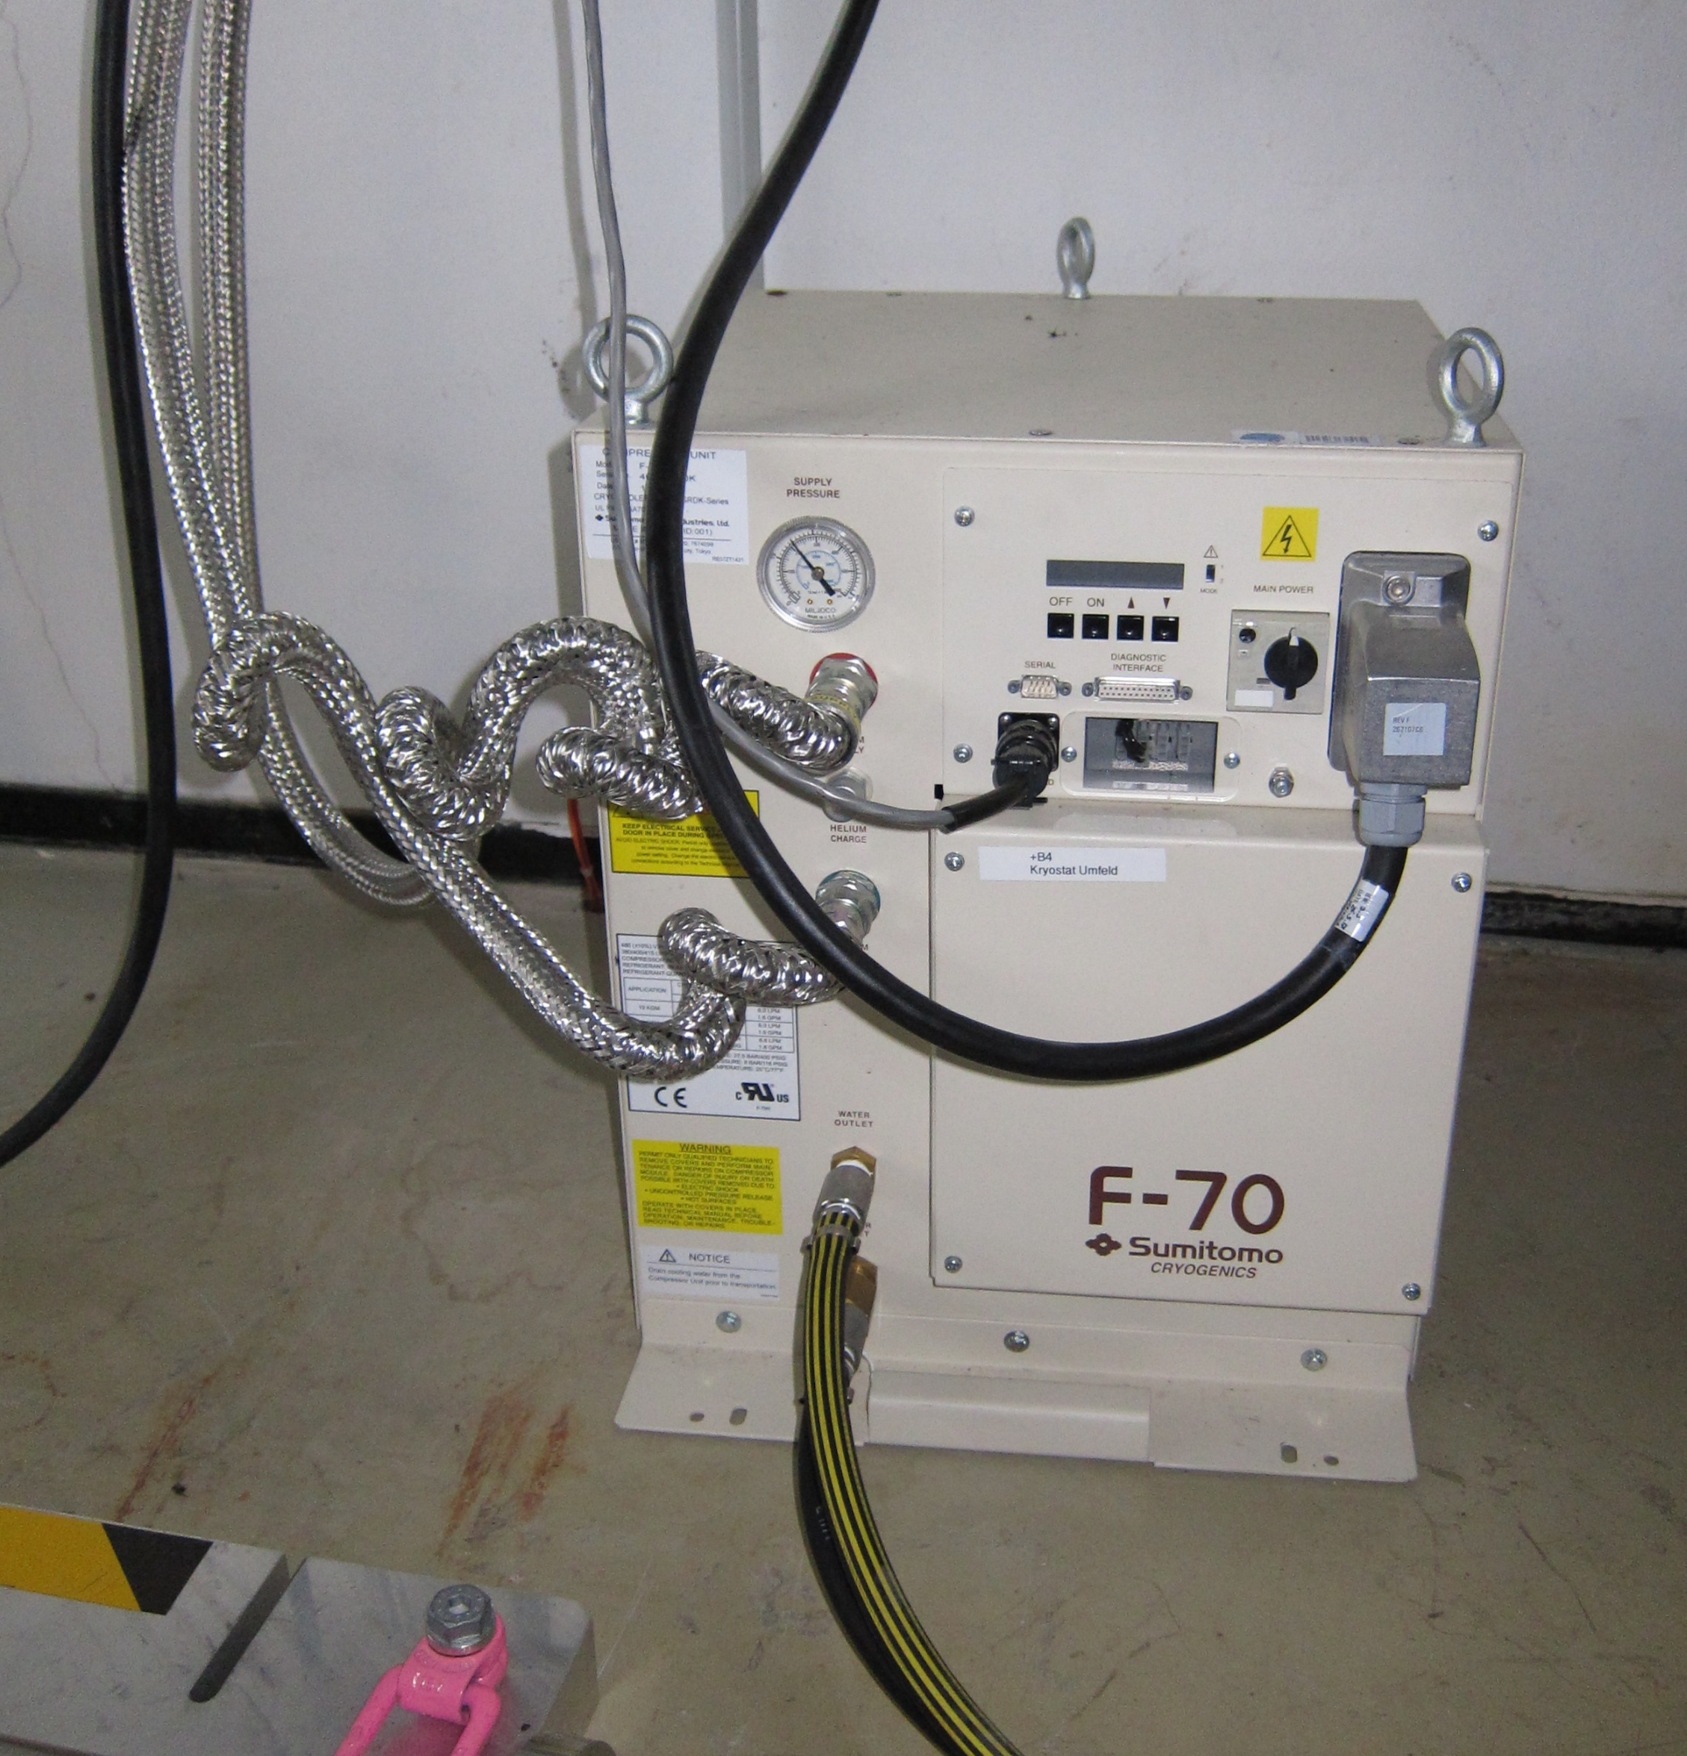
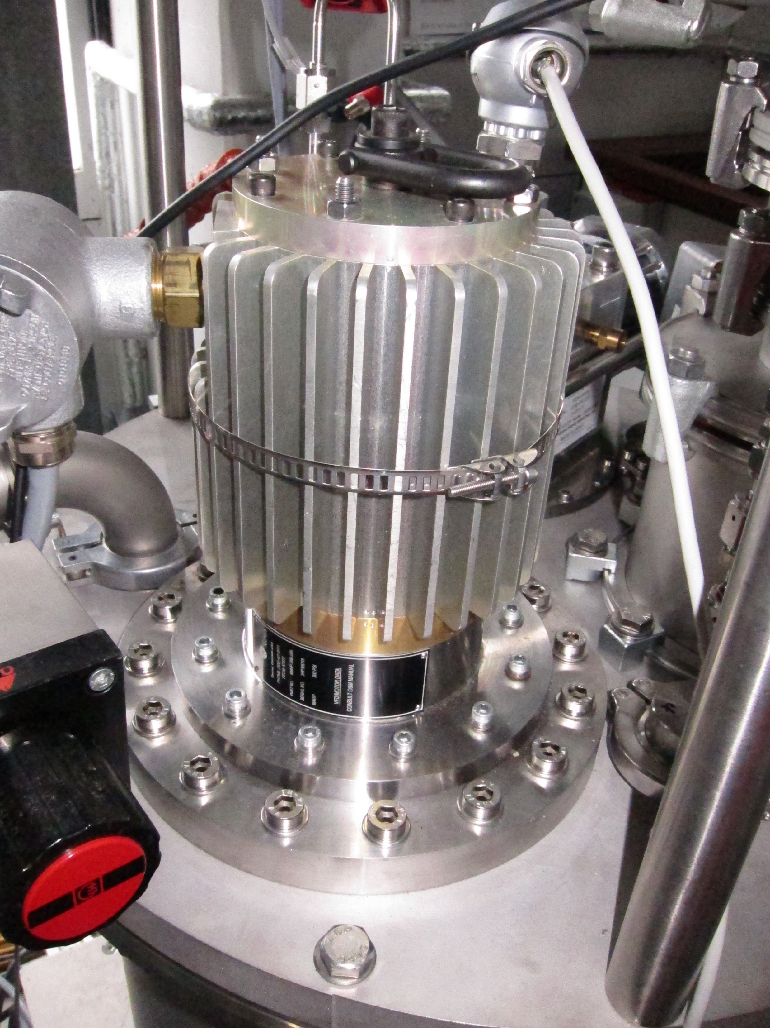
Main cryostat
BarberNichols liquid hydrogen pump
Sumitomo SRDK-500B cryocooler

Slide 16
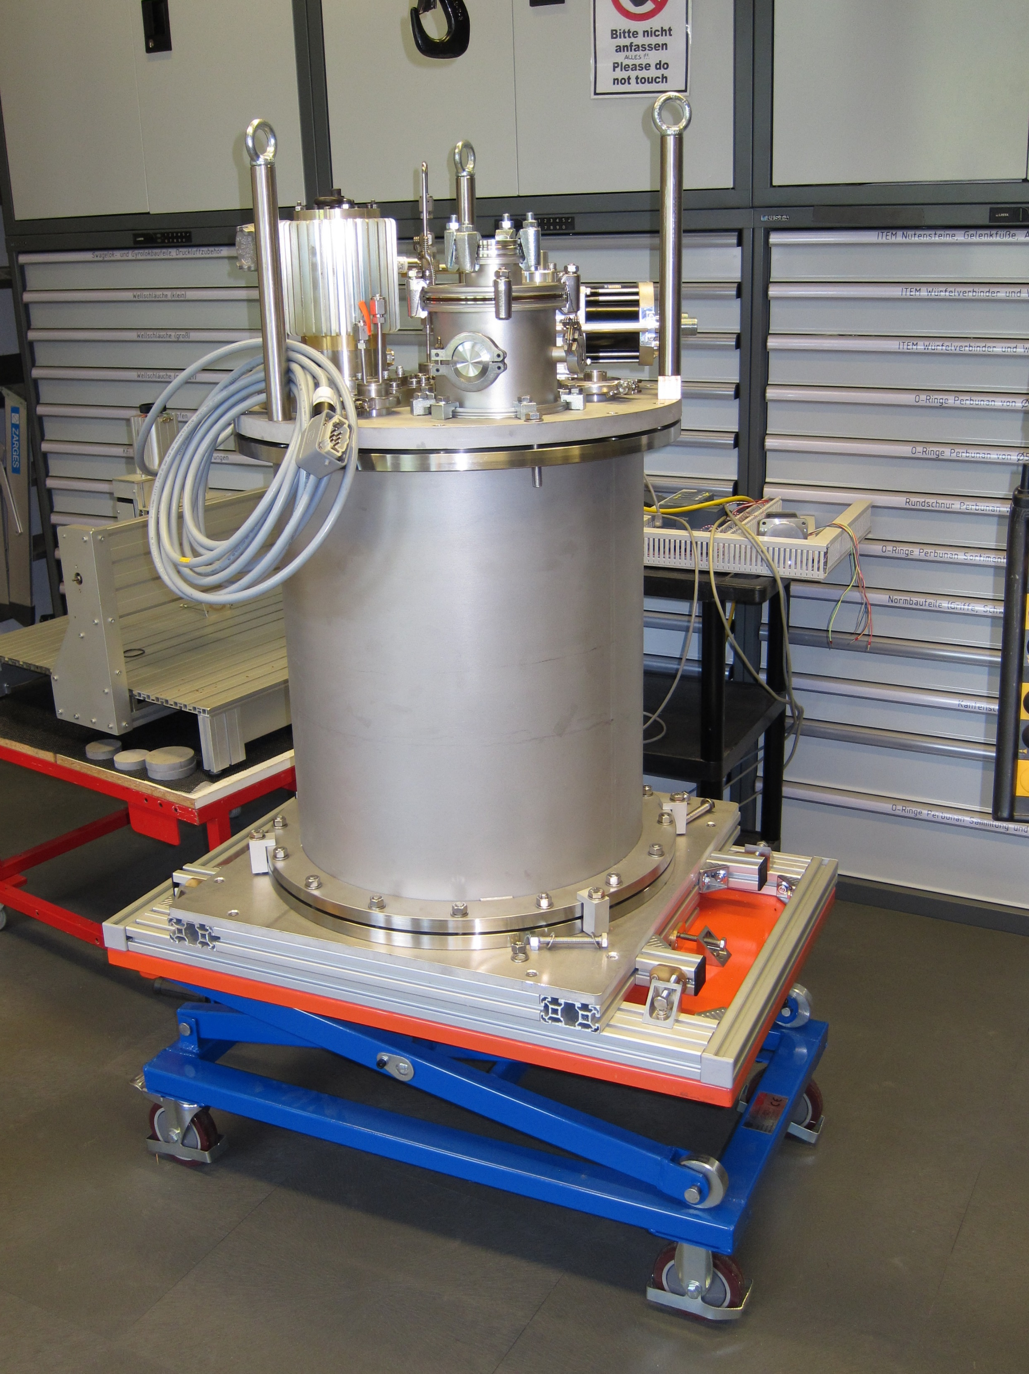
Main cryostat

Slide 17
Moderator plug

Slide 18
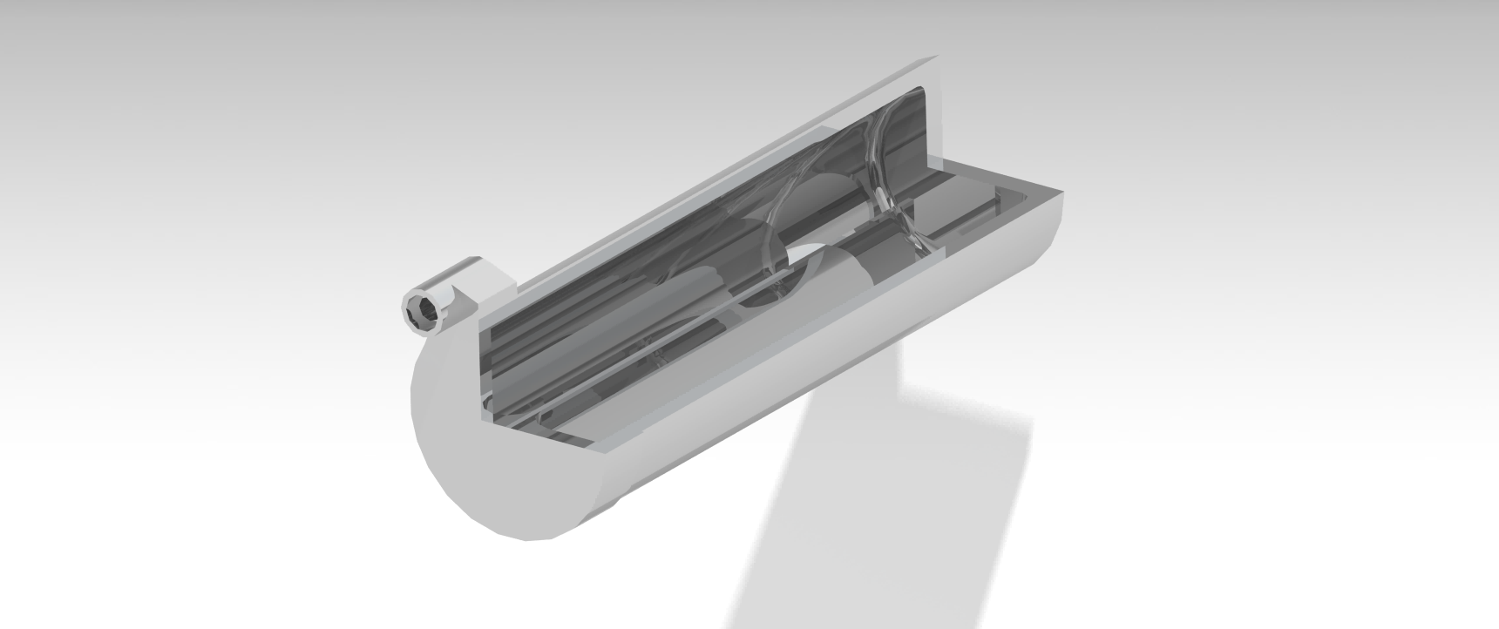
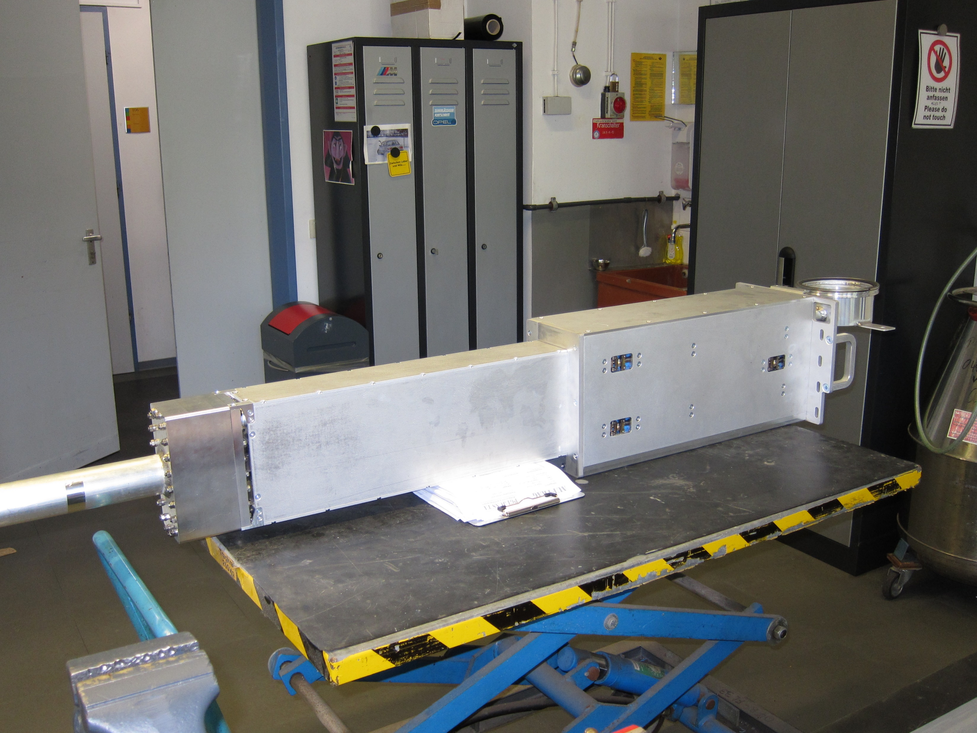
Moderator plug

Slide 19
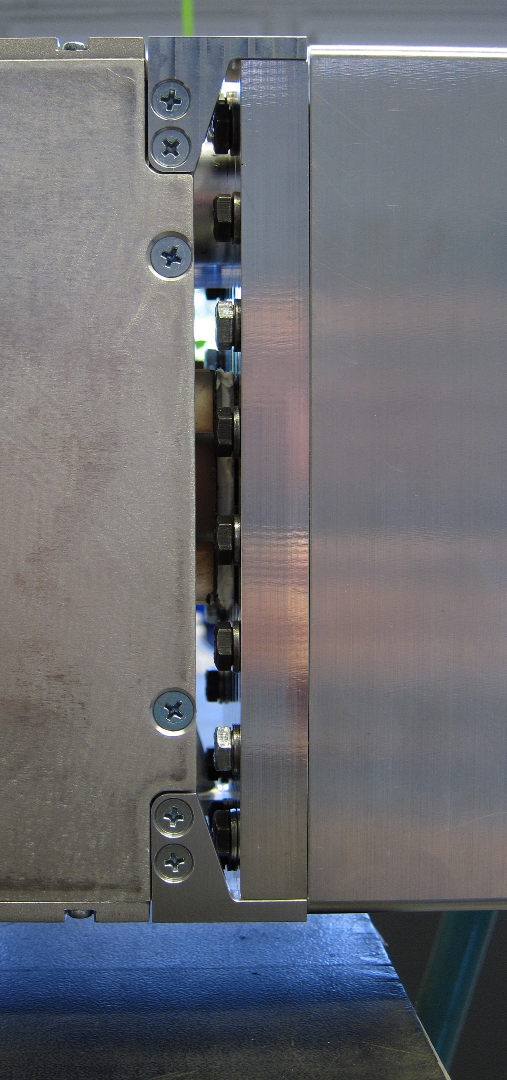
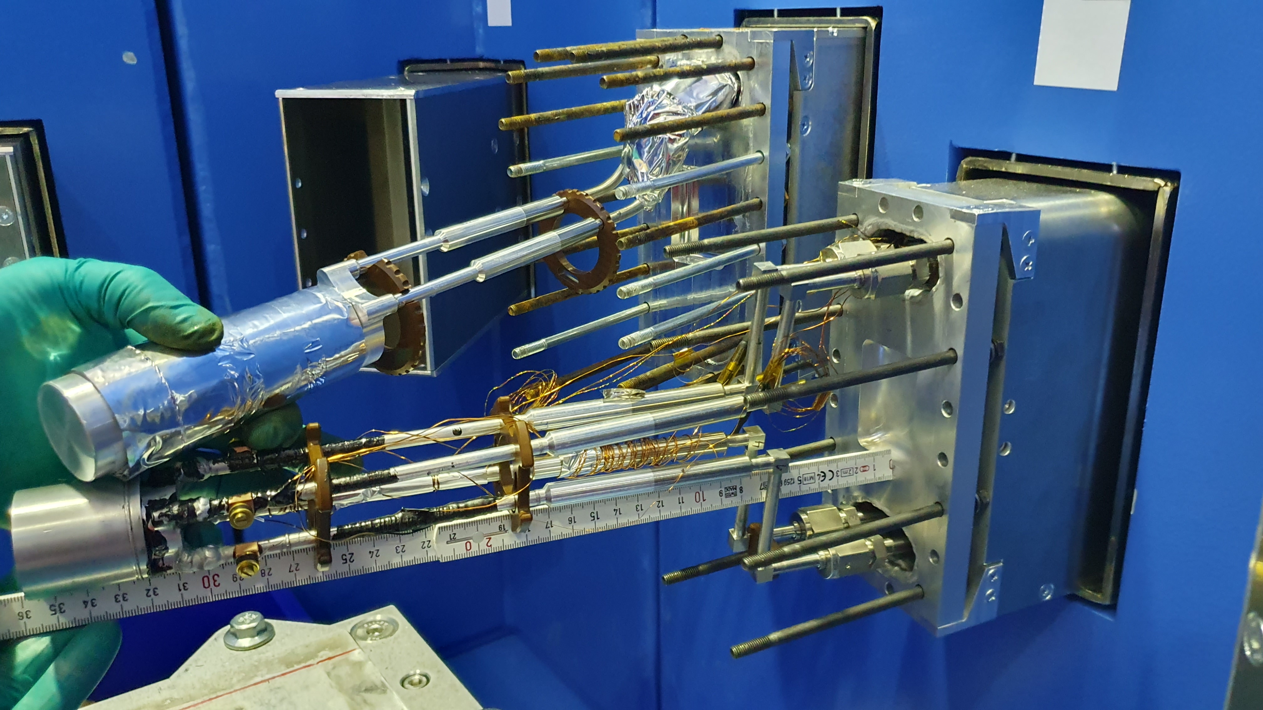
Moderator plug

Slide 20
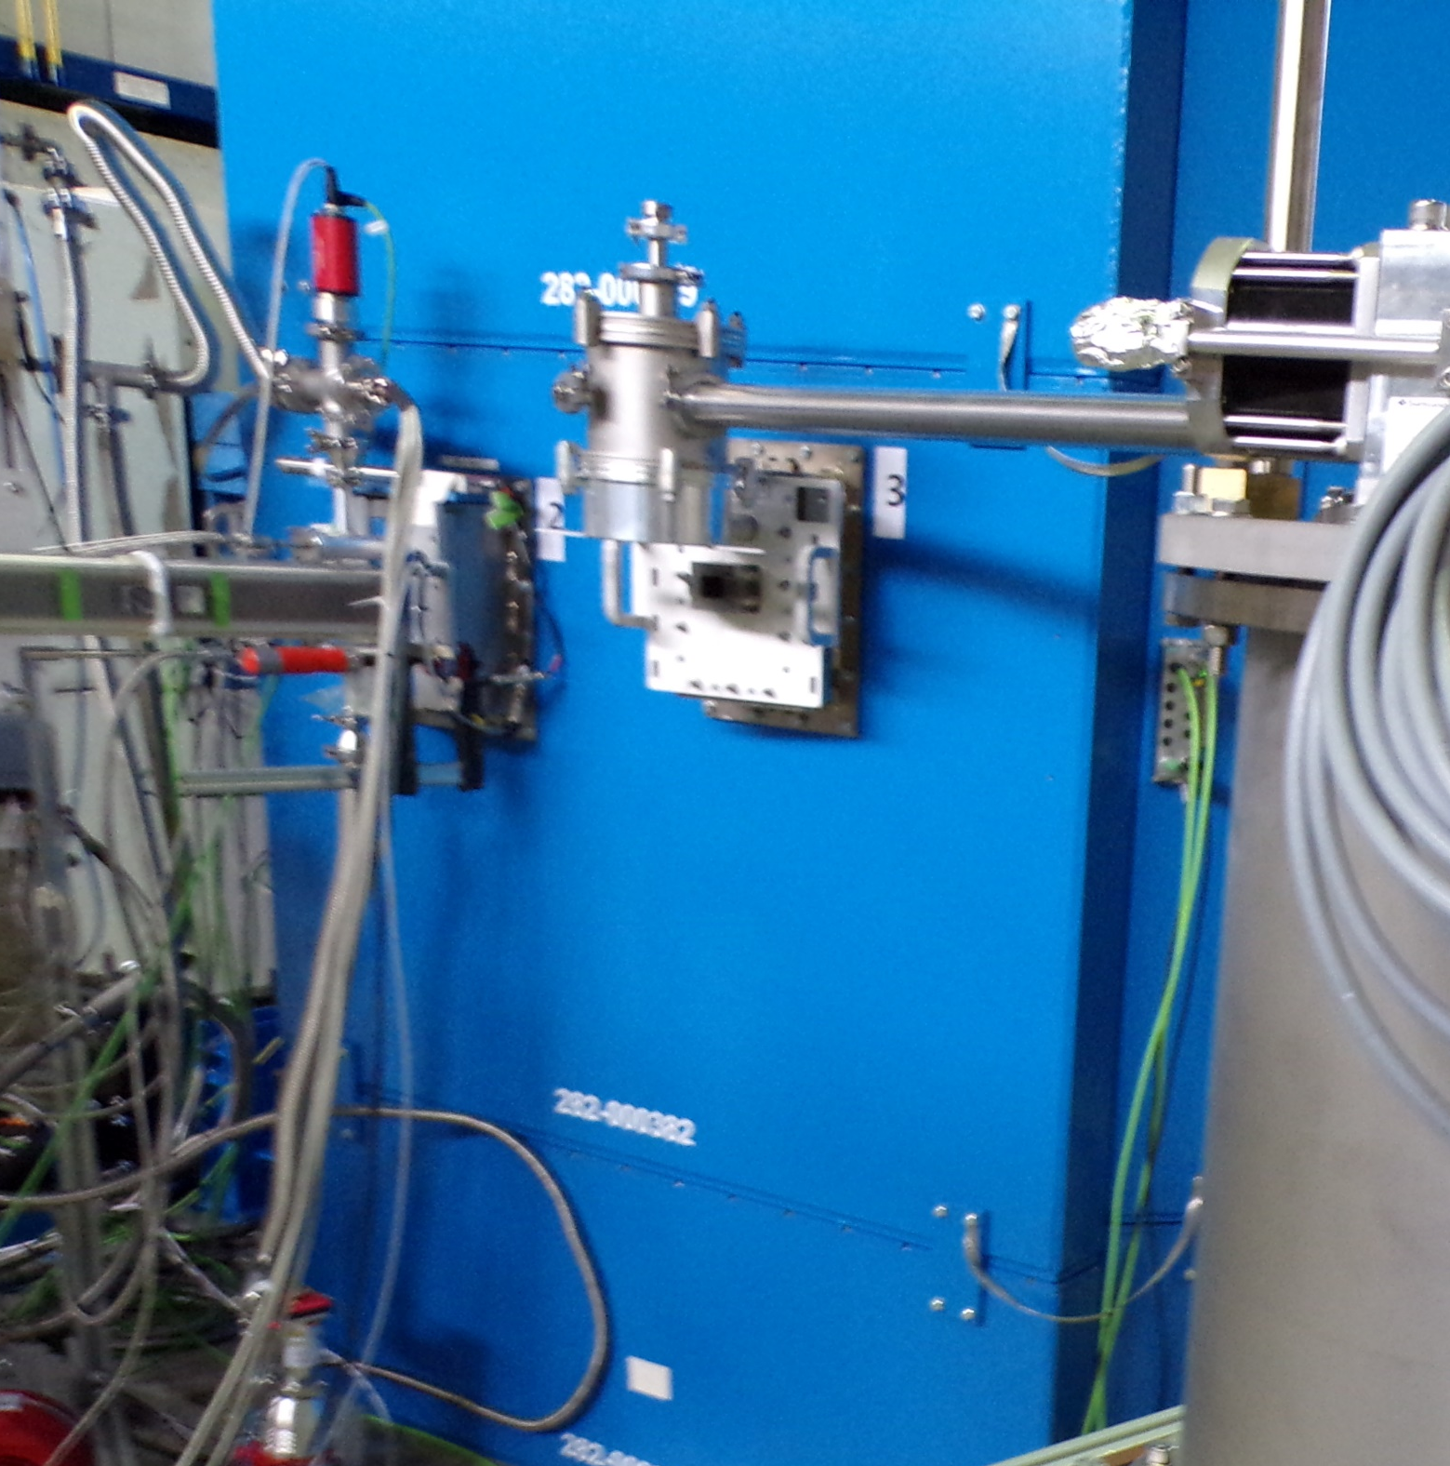
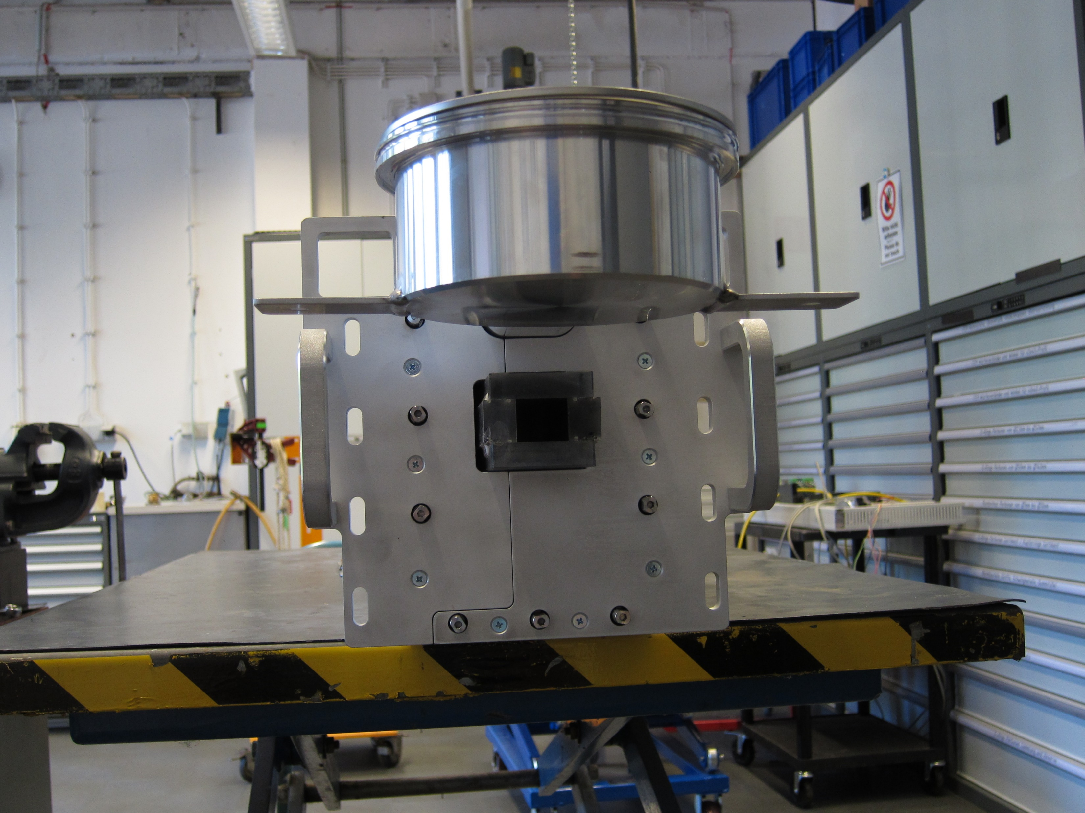
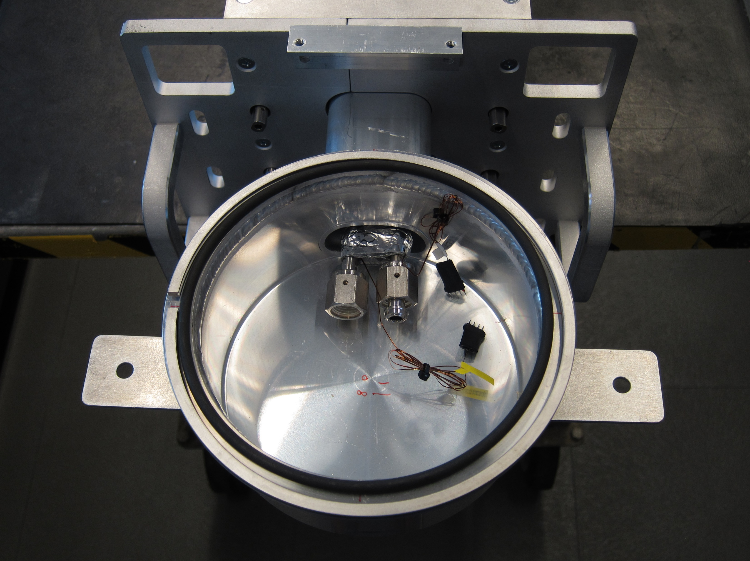
Moderator plug

Slide 21
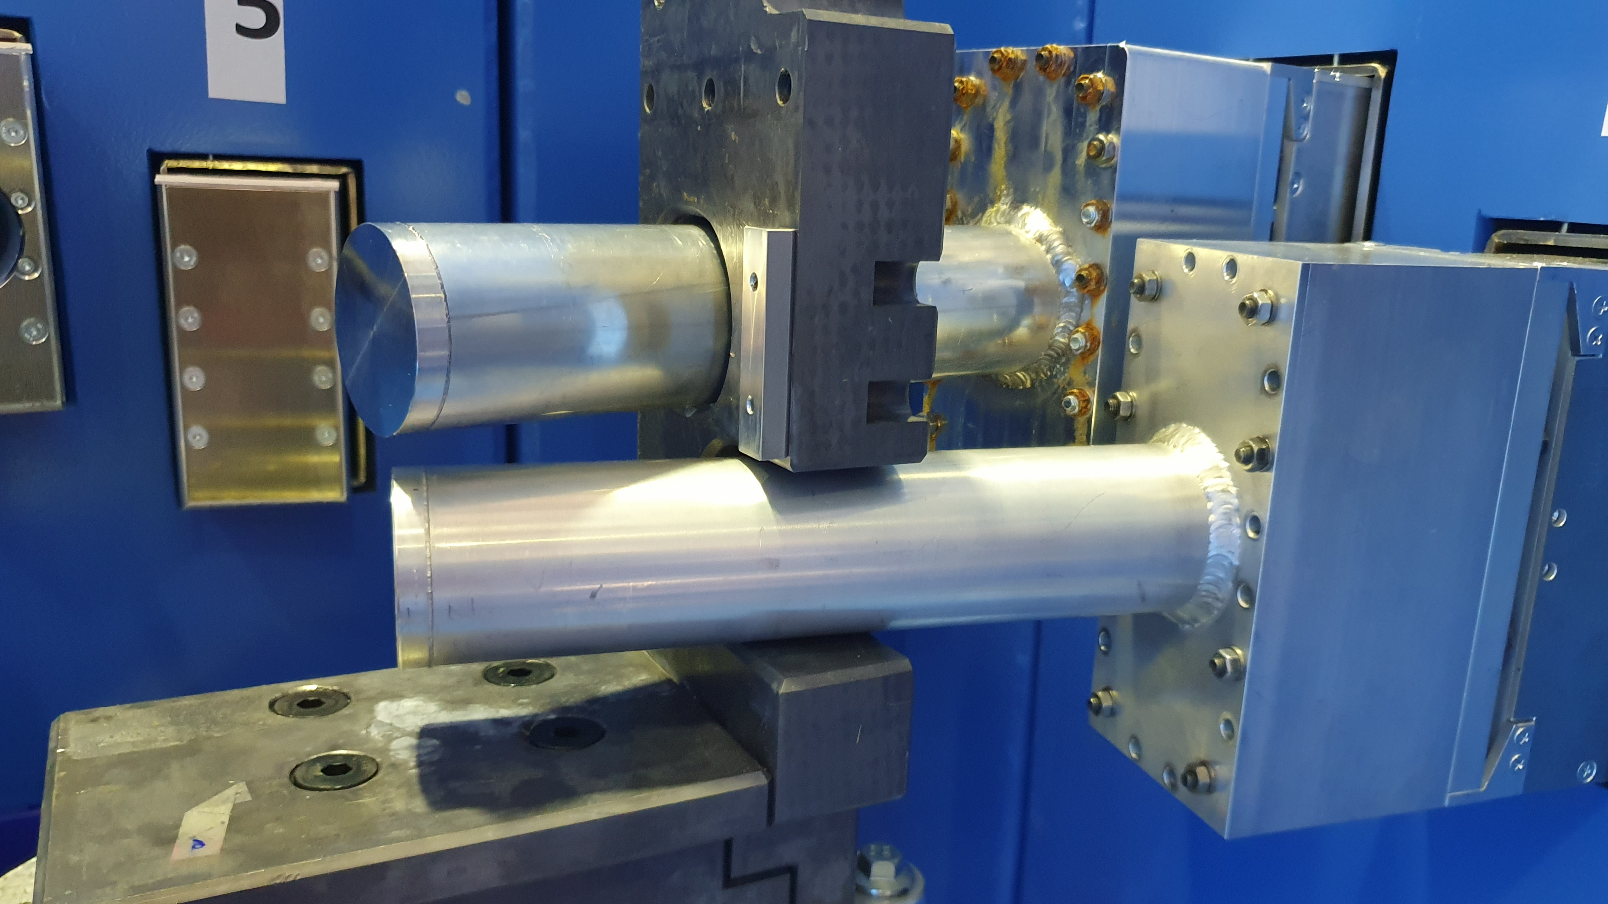
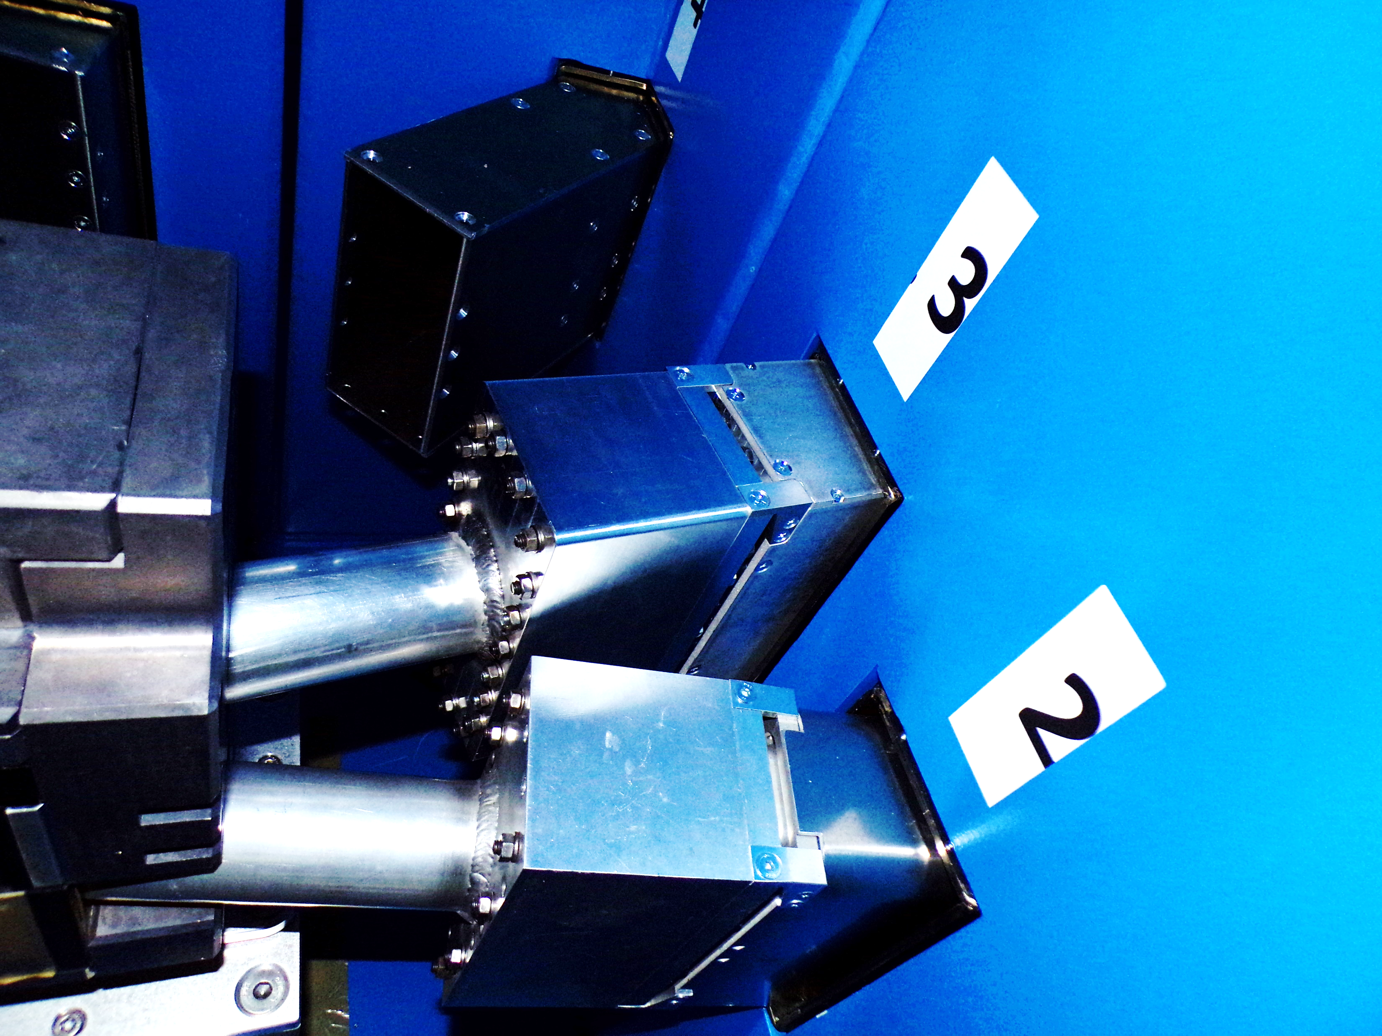
Moderator plug

Slide 22
Gas management panel

Slide 23
Gas management panel
50 l buffer cylinder
Safety valves
Manually operated

Slide 24
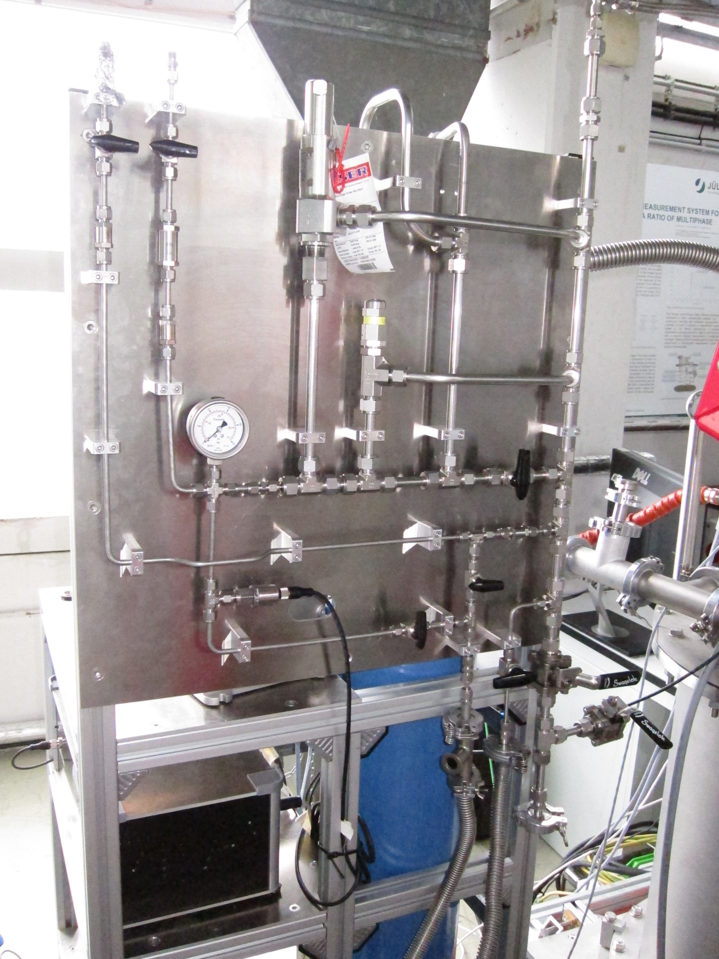
Gas management panel
50 l buffer cylinder
Safety valves
Manually operated

Slide 25
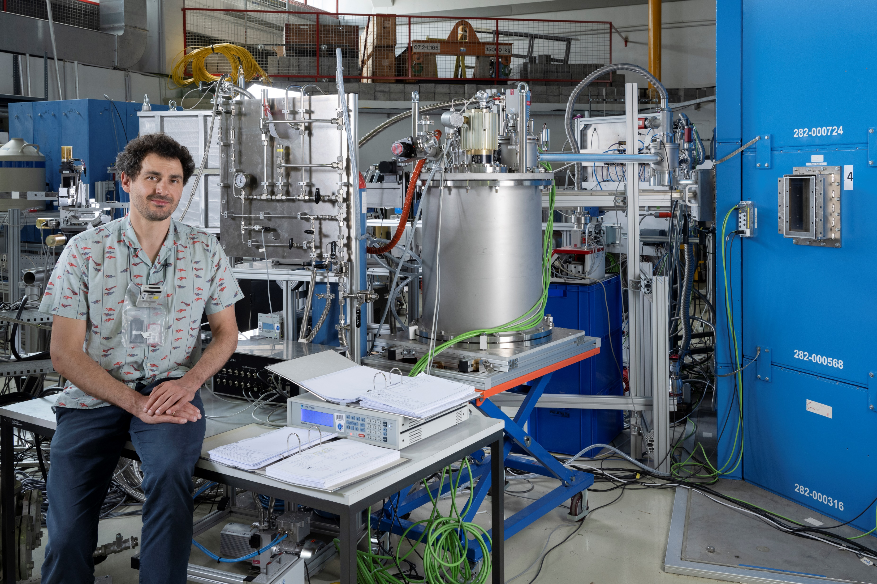
Complete system installed at the JULIC neutron platform

Slide 26
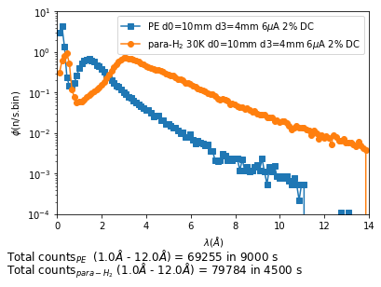
It works: Neutrons for HERMES
Continuous operation @ 11 bar, 26 K
for 10 days
Peak shifted 1.8 Å → 3.0 Å
Intensity x 2.2 (not optimal)

Slide 27
Easy operation: Cooldown within 6 hours
₁₀₀₀
T Coldhead [K]
T Mod In [K]
₁₀₀
T Mod Out [K]
Pump speed [rpm]
₁₀
Gas pressure [bar]
Mass flow
₁

Slide 28
Start of cryocooler @ 10:30h
₁₀₀₀
T Coldhead [K]
T Mod In [K]
₁₀₀
T Mod Out [K]
Pump speed [rpm]
₁₀
Gas pressure [bar]
Mass flow
₁

Slide 29
Start of circulation @ 80 K after 1:30 h
₁₀₀₀
T Coldhead [K]
T Mod In [K]
₁₀₀
T Mod Out [K]
Pump speed [rpm]
₁₀
Gas pressure [bar]
Mass flow
₁

Slide 30
Density increasing → Flow increasing, cooling of the moderator part after 2:45 h
₁₀₀₀
T Coldhead [K]
T Mod In [K]
₁₀₀
T Mod Out [K]
Pump speed [rpm]
₁₀
Gas pressure [bar]
Mass flow
₁

Slide 31
Condensation after 3:10 h
₁₀₀₀
T Coldhead [K]
T Mod In [K]
₁₀₀
T Mod Out [K]
Pump speed [rpm]
₁₀
Gas pressure [bar]
Mass flow
₁

Slide 32
Filling of moderator volume after 3:45 h
₁₀₀₀
T Coldhead [K]
T Mod In [K]
₁₀₀
T Mod Out [K]
Pump speed [rpm]
₁₀
Gas pressure [bar]
Mass flow
₁

Slide 33
Moderator full of liquid after 4:10 h
₁₀₀₀
T Coldhead [K]
T Mod In [K]
₁₀₀
T Mod Out [K]
Pump speed [rpm]
₁₀
Gas pressure [bar]
Mass flow
₁

Slide 34
Temperature stable after 5:15 h:
18.8 K moderator temp. 3.5 bar H₂ pressure
₁₀₀₀
T Coldhead [K]
T Mod In [K]
₁₀₀
T Mod Out [K]
Pump speed [rpm]
₁₀
Gas pressure [bar]
Mass flow
₁

Slide 35
Team:
Design (Main cryostat): S. Eisenhut, TU Dresden
Design (Moderator plug): A. Schwab, J. Baggemann, JCNS-HBS
Main components borrowed: Y. Beßler, ZEA-1
Manufacturing, assembly: JCNS workshop, esp. S. Pistel, N. Bernard
Project management: F. Suxdorf, JCNS instrument technology
Commissioning: M. Hannot, R. Rings, E. Rosenthal, ZEA-1
Neutron measurements: M.-A. Paulin, LLB Saclay

Slide 36
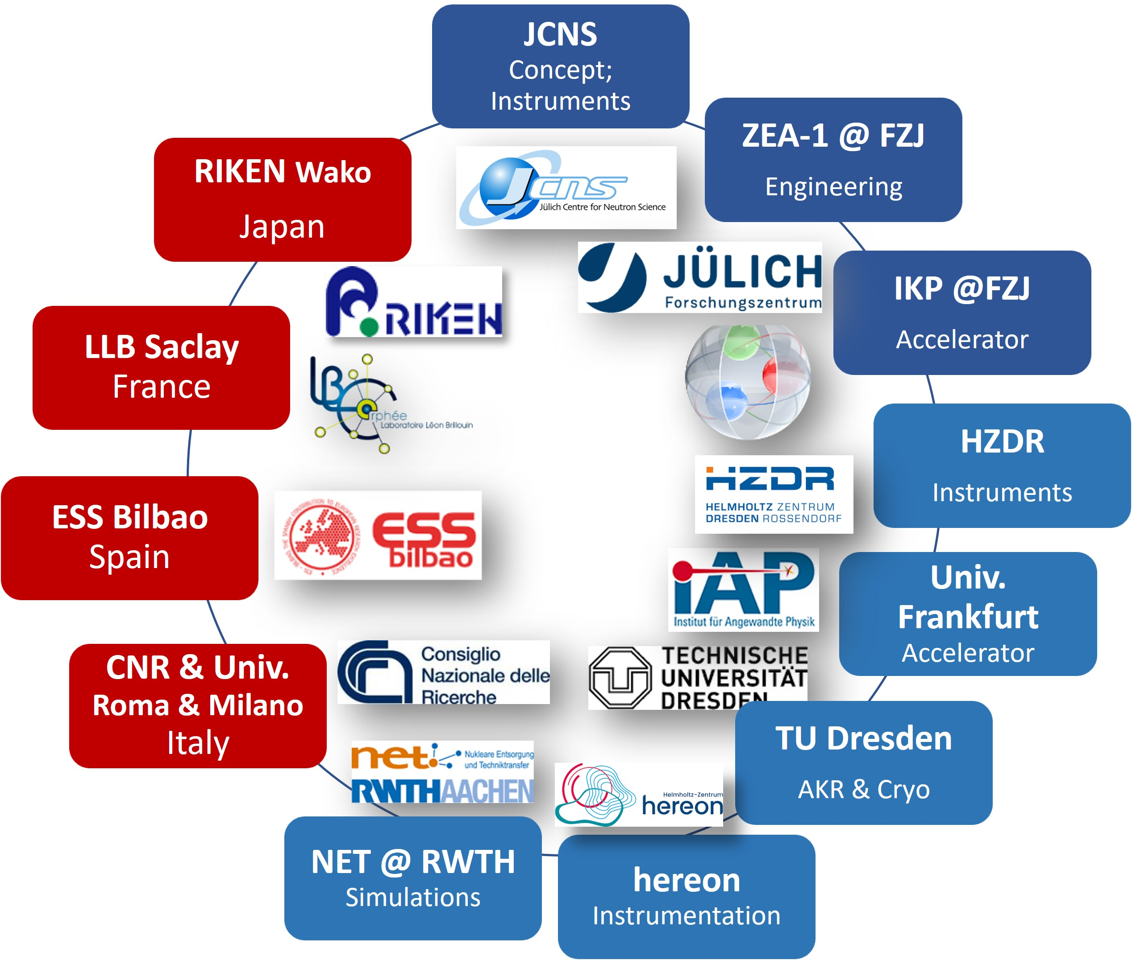




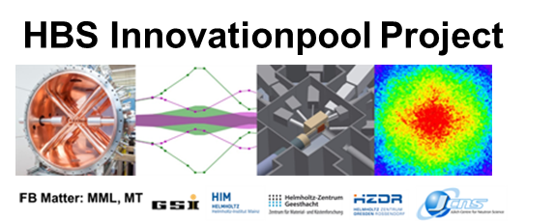





HBS Team
J. Baggemann
Th. Brückel
J. Chen
T. Claudio-Weber
T. Cronert (†)
Q. Ding
P.-E. Doege
M. El Barbari
T. Gutberlet
H. Kleines
J. Li
K. Lieutenant
Z. Ma
E. Mauerhofer
N. Ophoven
I. Pechenitzkiy
U. Rücker
S.A. Sambamurthy
N. Schmidt
A. Schwab
D. Shabani
E. Vezhlev
J. Voigt
P. Zakalek
- Design, verification,
instrumentation
ZEA-1:
Y. Bessler
R. Hanslik
R. Achten
M. Hannot
F. Löchte
E. Rosenthal
R. Rings
- Engineering
IKP-4:
O. Felden
R. Gebel
A. Lehrach
M. Rimmler
- Nuclear physics
INM-5:
B. Neumaier
- Radio isotopes
S. Böhm
R. Nabbi
- Nuclear simul.
Ch.Haberstroh
M. Klaus
S. Eisenhut
C. Lange
- Liquid H₂, AKR-2
H. Podlech
O. Meusel
- Accelerator
W. Barth
- Accelerator
/ HIM
@hbsneutron
https://hbs.fz-juelich.de/
J. Fenske
- Instrumentation
Notes:
<number>

