Slide 1





Conceptual Development of a Remote Automated Target Assembly for Accelerator-Based Mo-99 Production
Tarek El-Kordy
14.04.2026
ICANS XXV

Slide 2
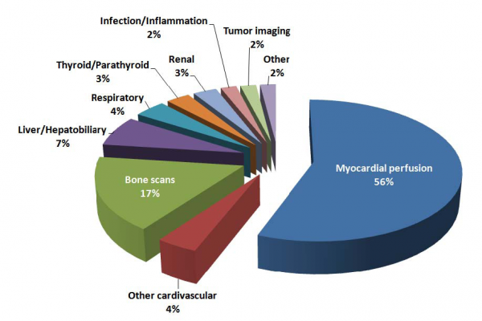


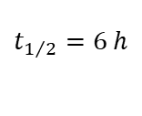

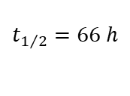


Radiotracer Technetium-99m
> 30 million diagnostic nuclear medical procedures annually worldwide
→ Most widely used radioisotope in diagnostic medicine
Germany: approx. 60,000 diagnostic exams weekly → 2400 Ci ⁹⁹Mo
$${}_{42}^{99}{Mo}$$
$$β^{−}$$
$${}_{43}^{99m}{Tc}$$
$$γ with 141 keV$$
$${}_{43}^{99}{Tc}$$
$$t_{1/2}=66 h$$
$$t_{1/2}=6 h$$
Transportation viable
(Almost) pure gamma emitter
Physical and biological half-life ideal for fast scanning and low exposure
IMV 2007 Nuclear Medicine Market Summary Report

Slide 3
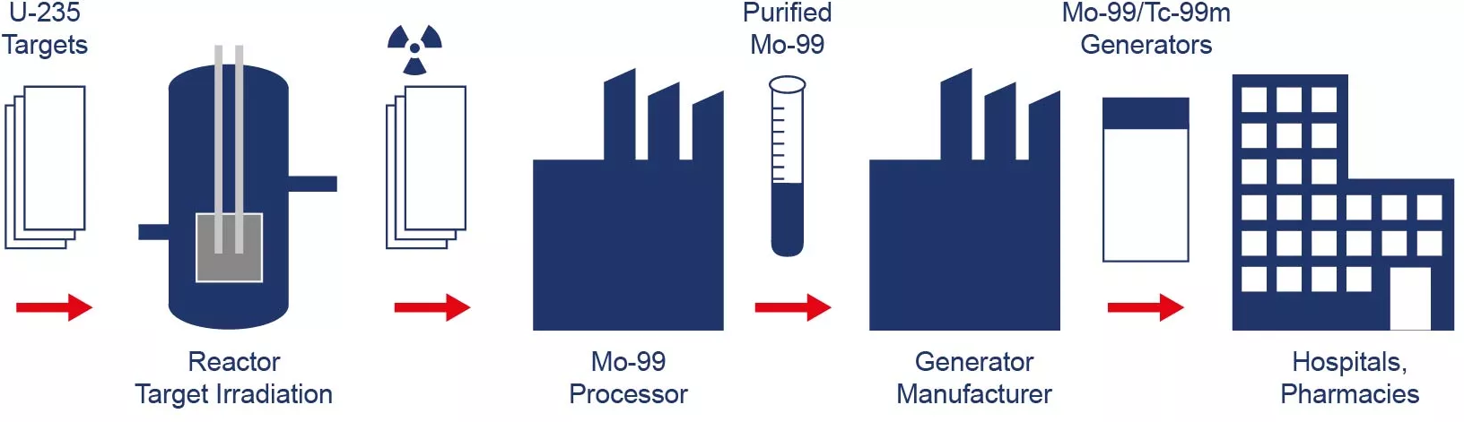
Conventional Production Method
Most ⁹⁹Mo is produced in research reactors with high neutron flux by irradiating targets made of highly or low-enriched uranium (HEU/LEU).
FRM II TUM
Problems: Radioactive waste, proliferation risks, aging reactor infrastructure

Slide 4

Joint Project 99MoBest
Protons
Tantalum
(Ta-Target)
Neutrons
^{nat}Mo
(Mo-Target)
⁹⁹Mo

Slide 5

99MoBest: Subprojects and Objectives
Isotope extraction
and delivery system
TMR Design Concept
Handling and Transport
Investigation of radiation protection and disposal procedures

Slide 6
Technical Design Challenges
Heat generation and transport within the target station
Thermo-mechanical stresses in the targets
Activated materials and activated corrosion products in the cooling water
Radiolysis leading to formation of radicals, ions and gases
Radiation exposure outside the target–moderator–reflector assembly
Radiation-induced degradation of electronics and structural materials
Cooling loop
Delay tank, degasser, ion exchanger
Shielding
Weekly replacement of irradiated molybdenum target
Annual replacement of highly activated tantalum target
Automated handling & transport system

Slide 7
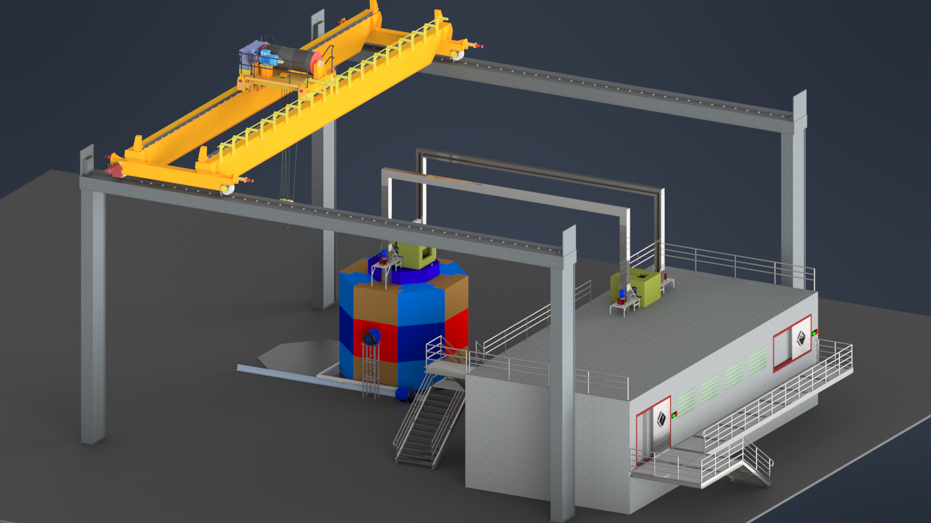
Gesamtaufbau

Slide 8
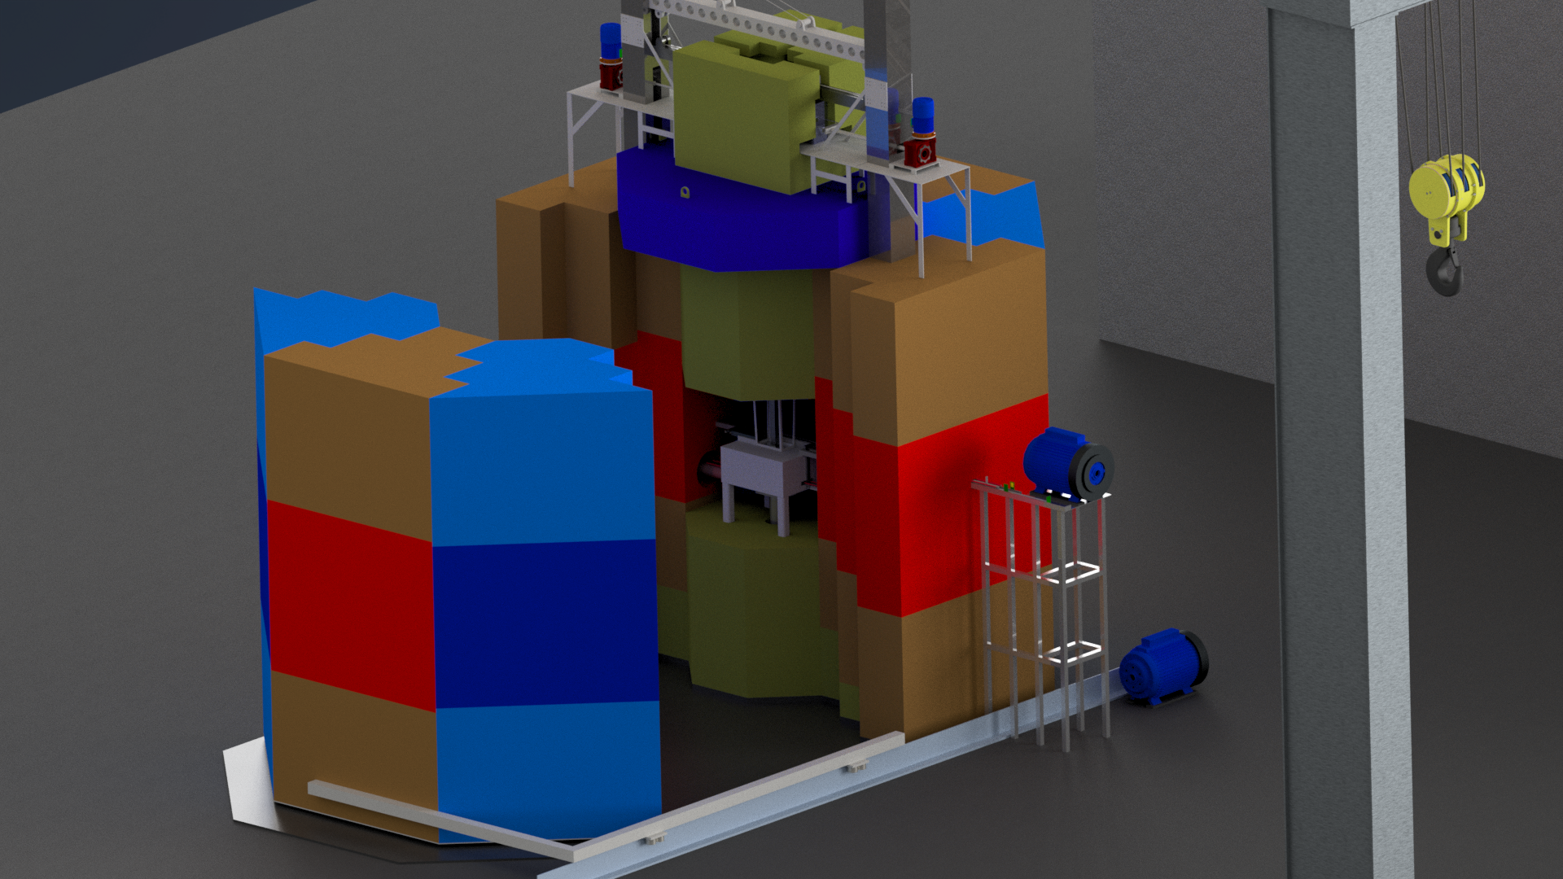
Target-Station

Slide 9

TMR

Slide 10
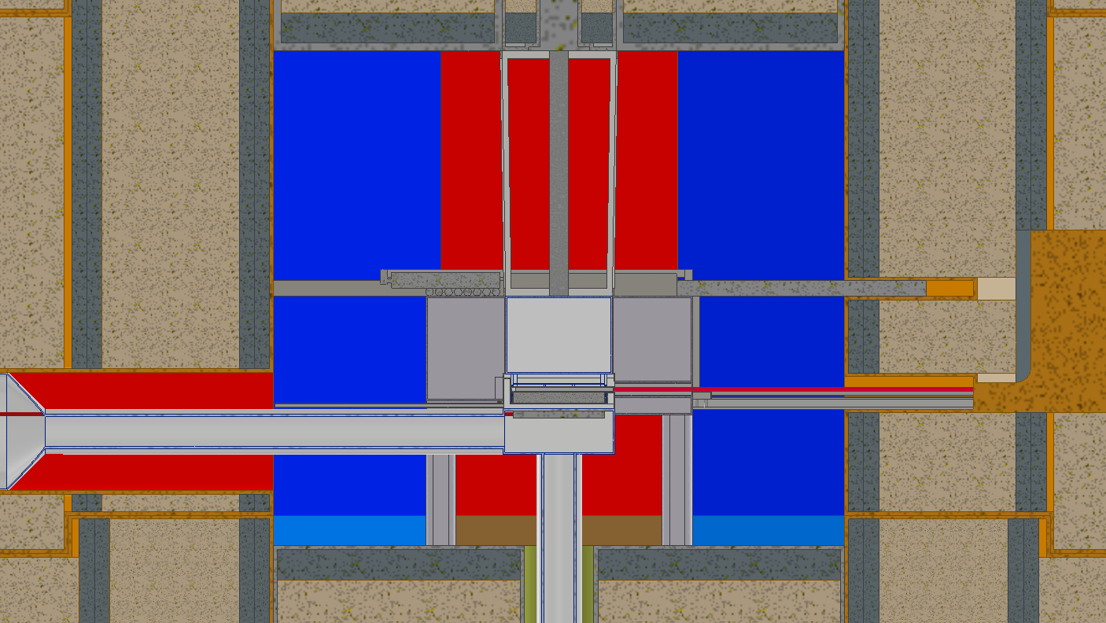
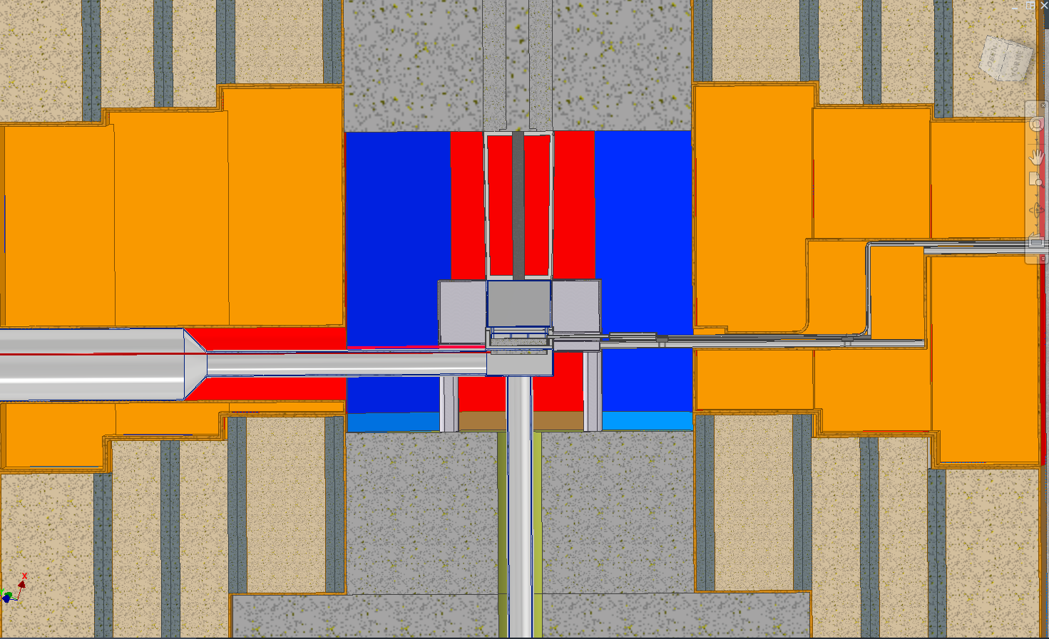
Querschnitt der Target-Station
Pb Shielding
MgO Reflector
BPE Shielding
Mo-Target
H₂O Moderator
Ta-Target

Slide 11
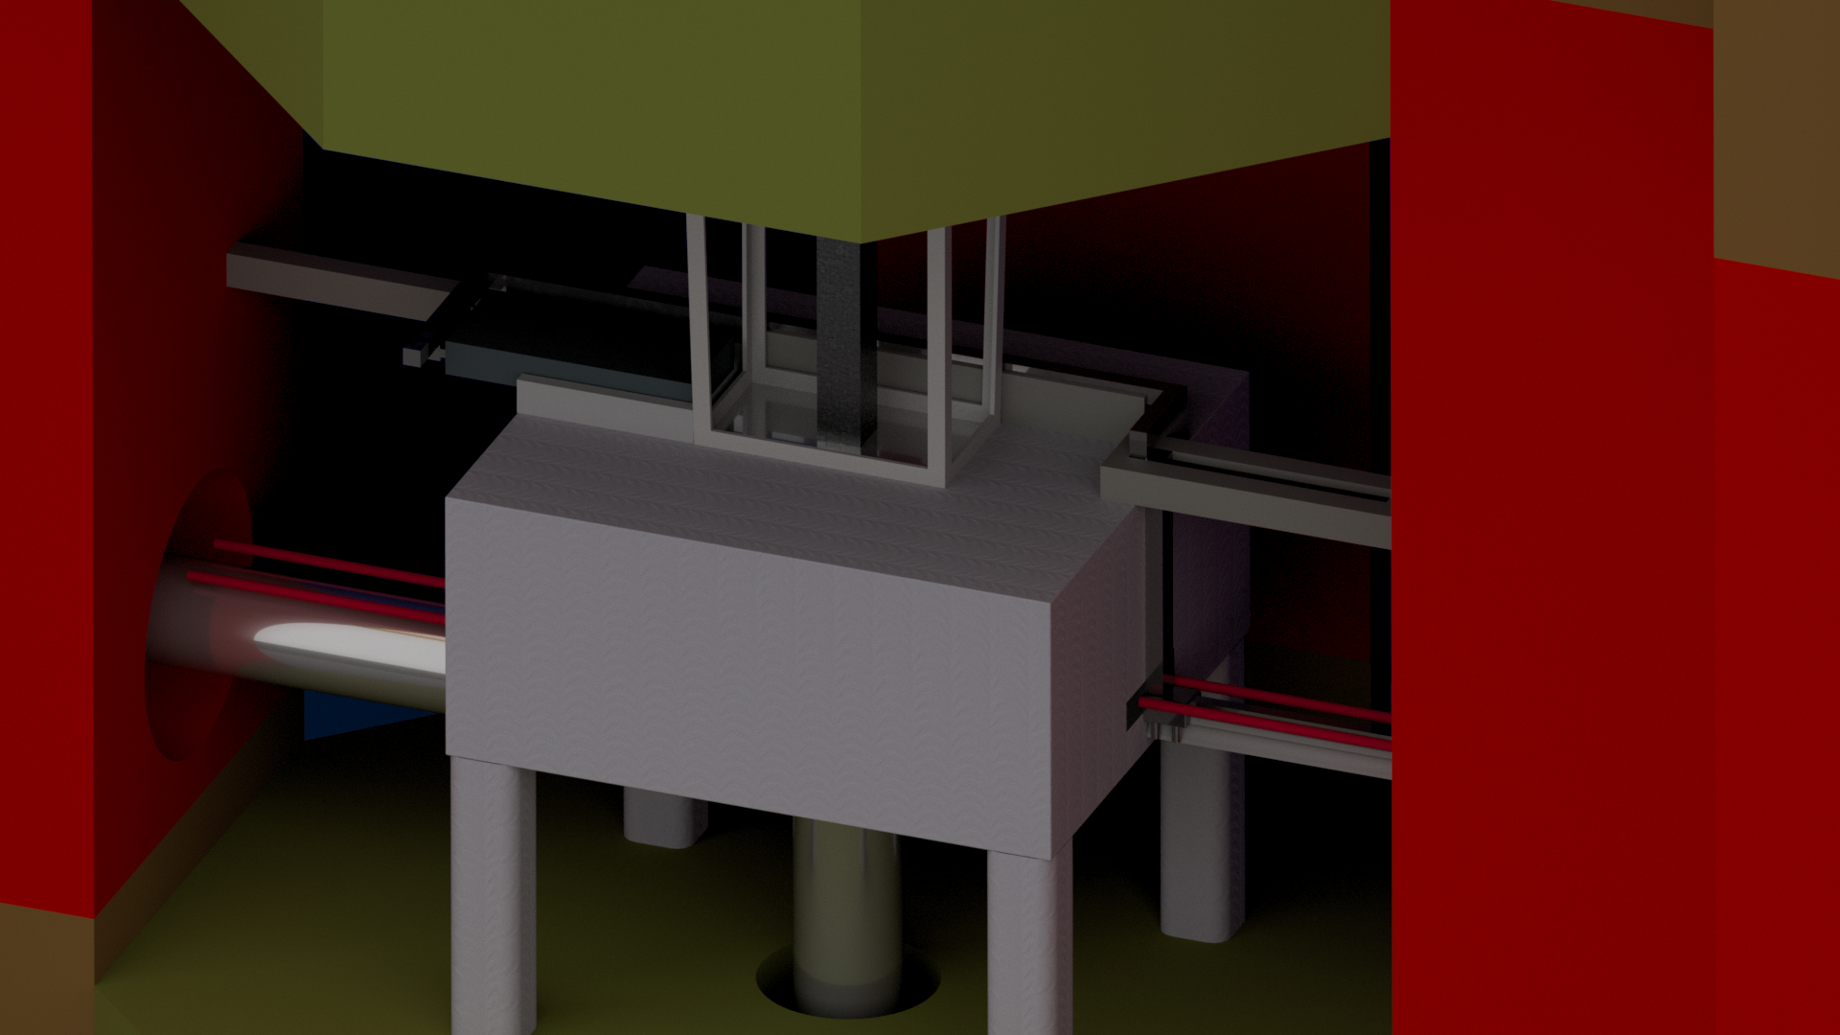
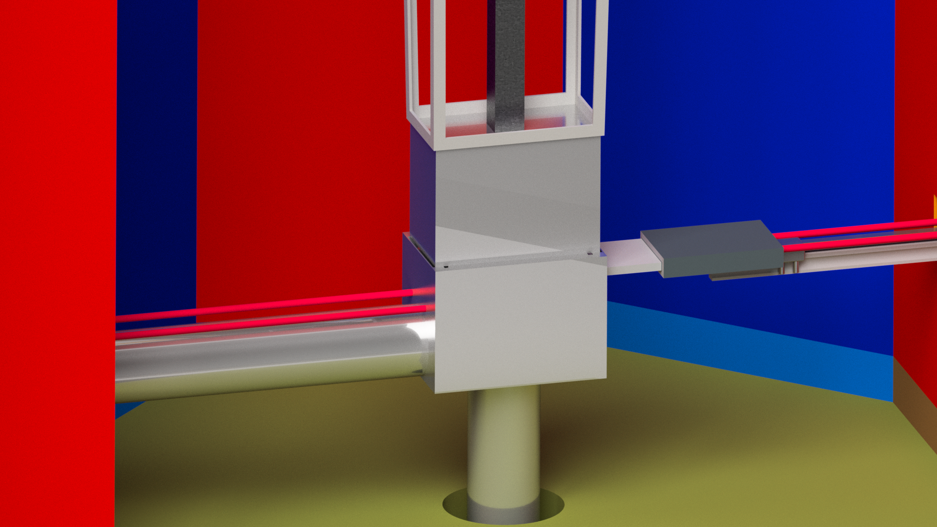
TMR (Transparenter Reflektor)

Slide 12
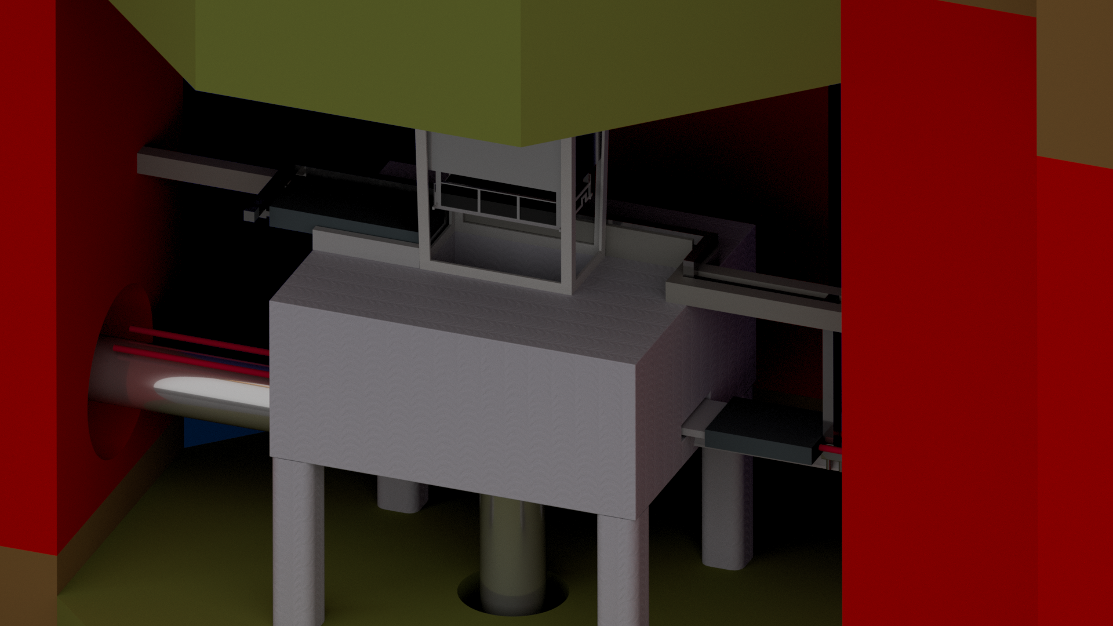
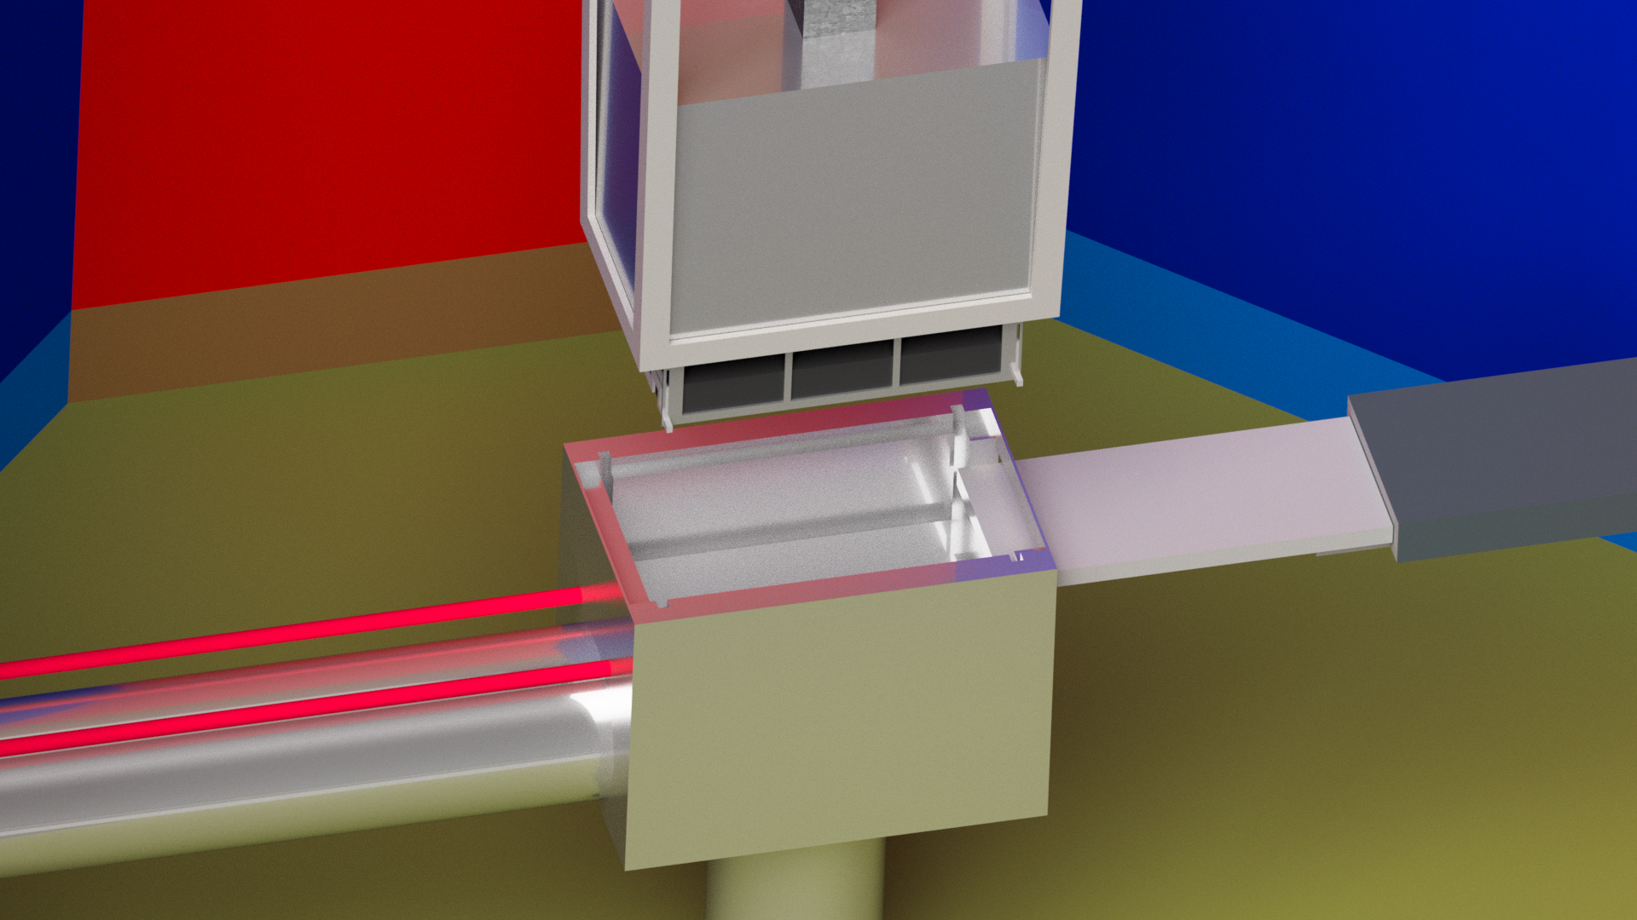
TMR (Transparenter Reflektor)

Slide 13
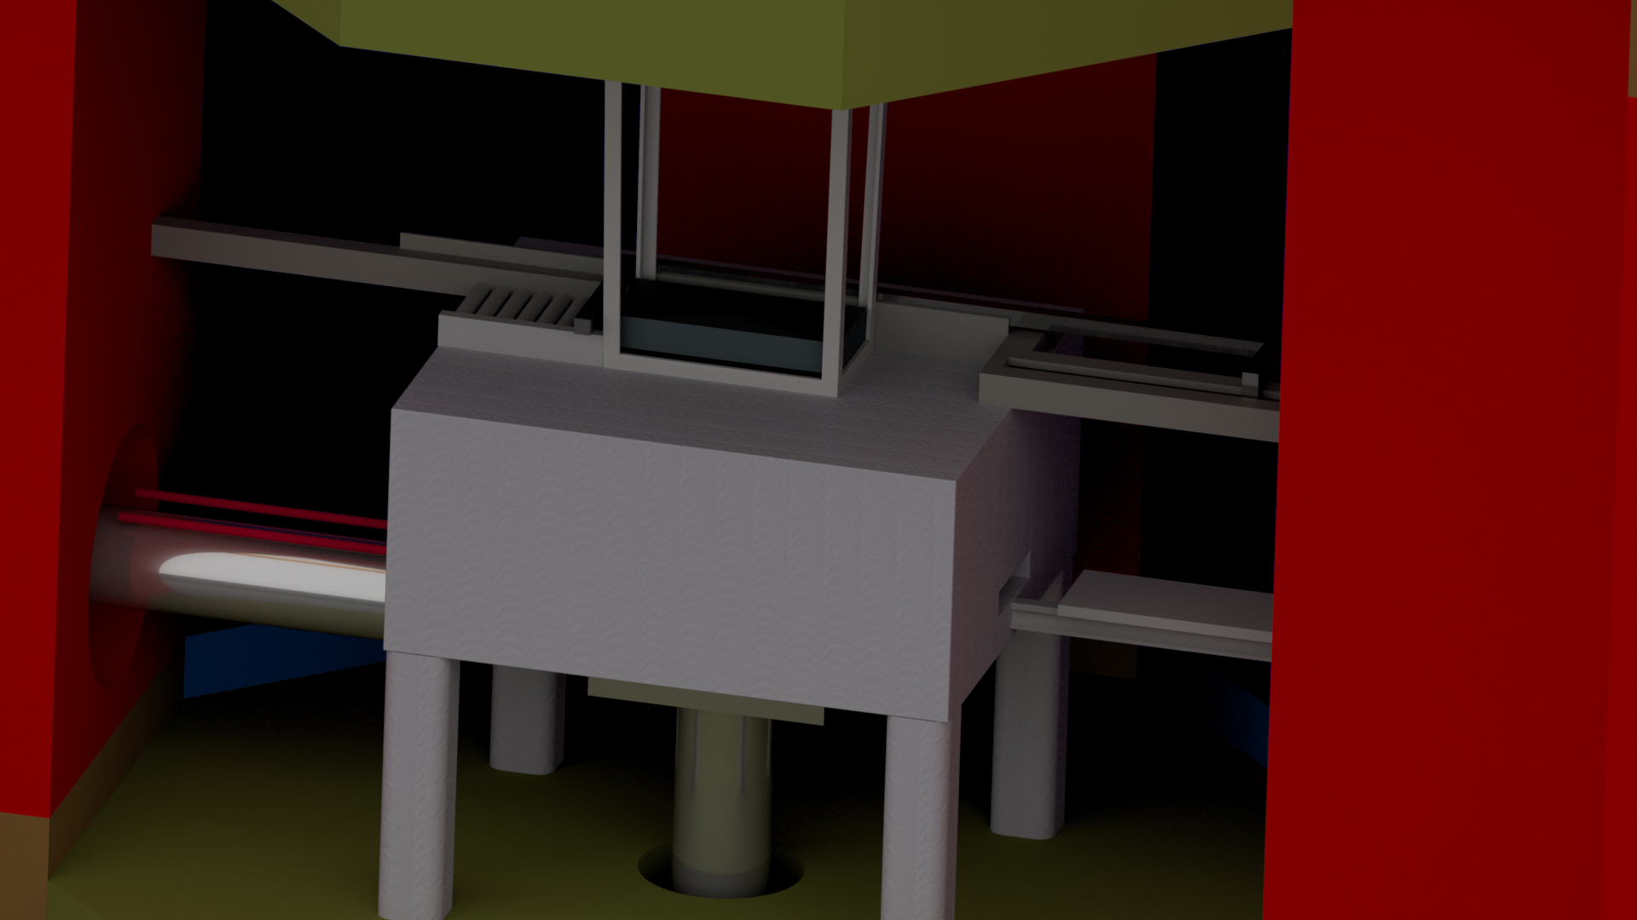
TMR (Transparenter Reflektor)

Slide 14
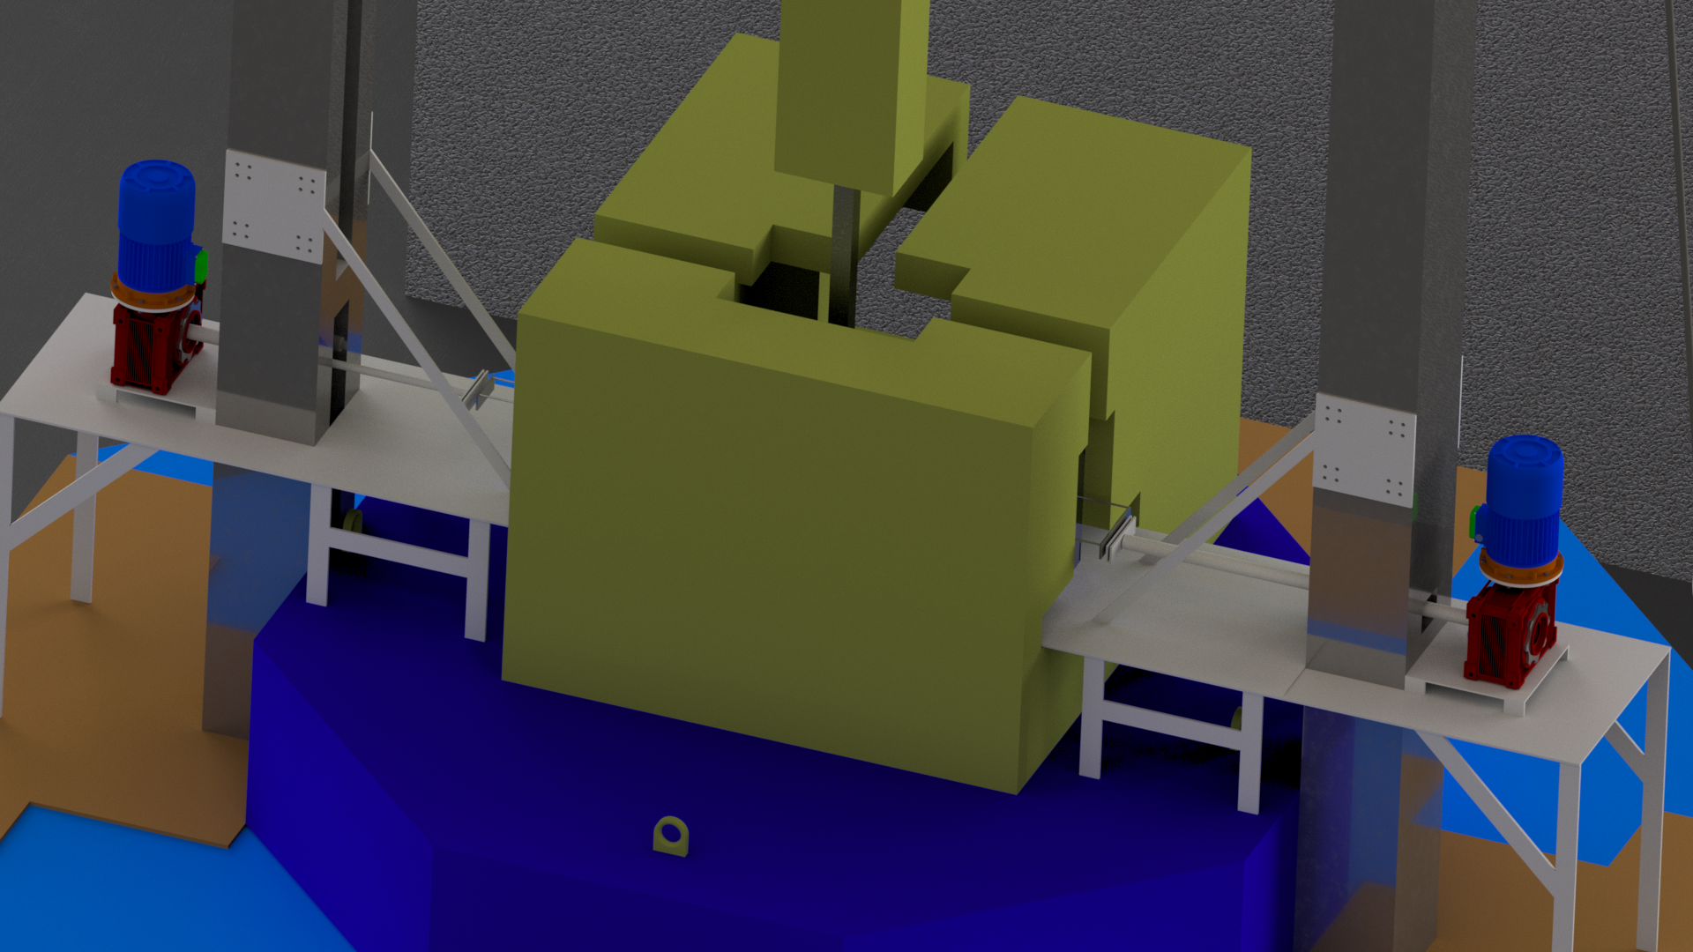
Anbringen der mobilen Abschirmung

Slide 15
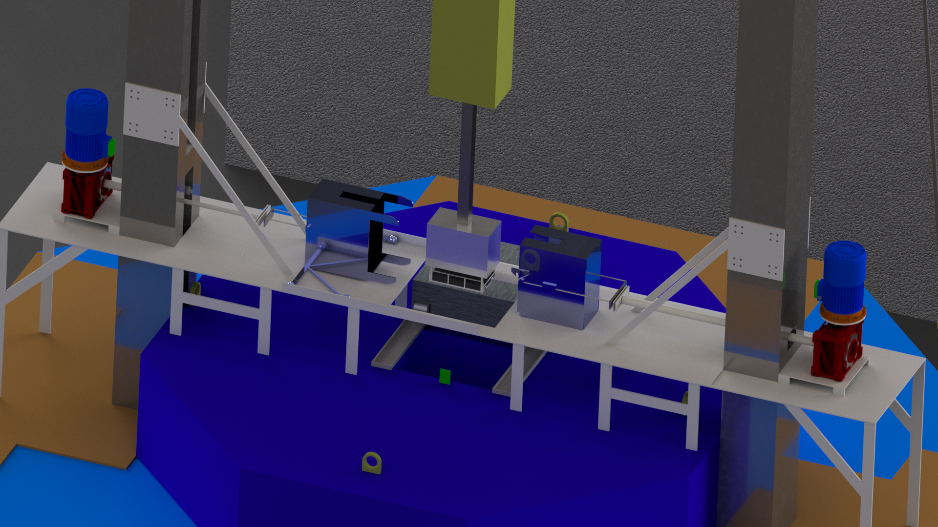
Anbringen der mobilen Abschirmung (transparent)

Slide 16
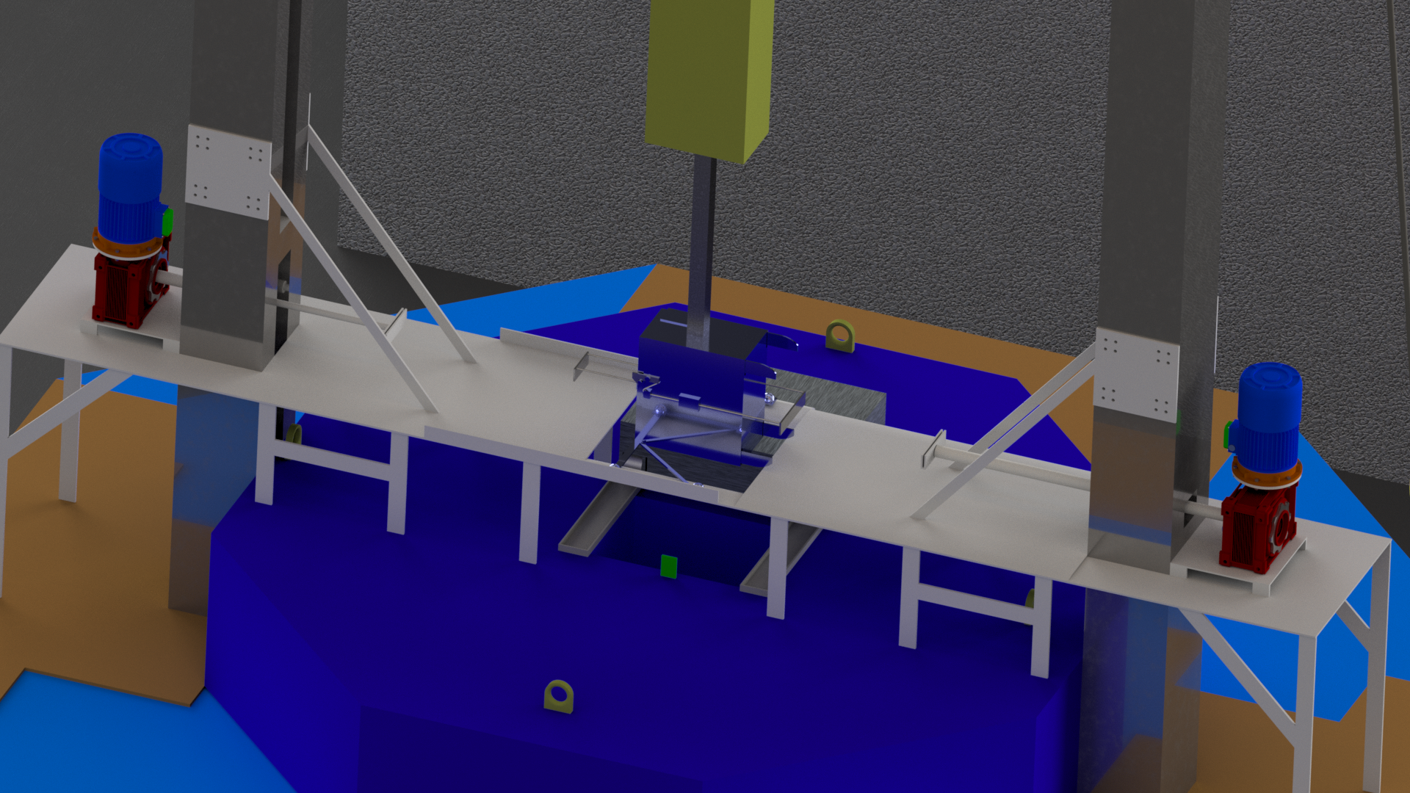

Slide 17
Gesamtaufbau

Slide 18
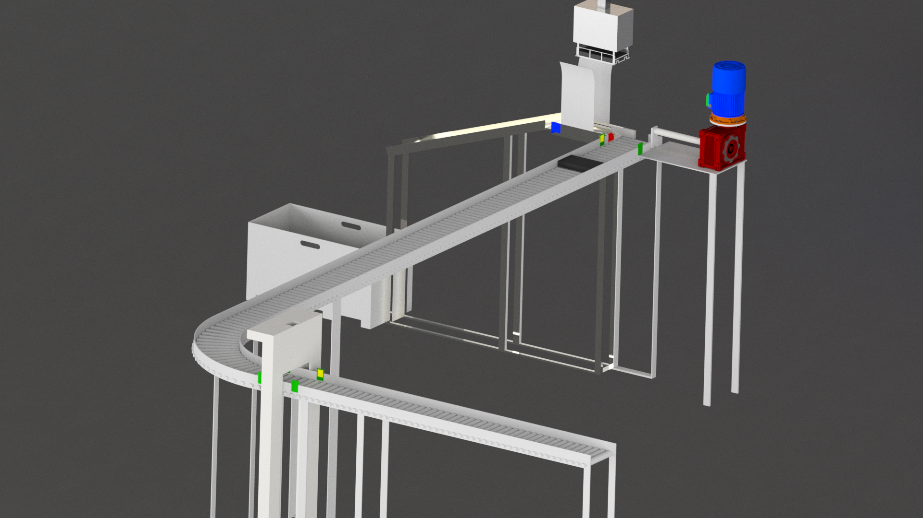
Austauschstation in der Heißzelle

Slide 19
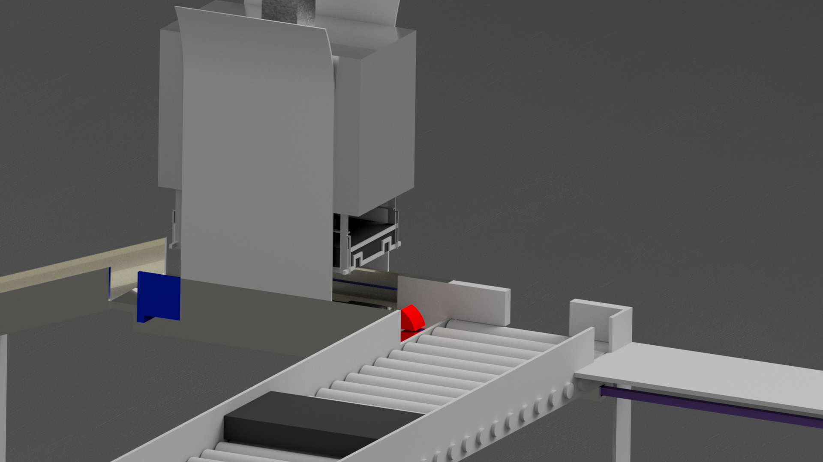
Austauschstation in der Heißzelle

Slide 20
What is a Digital Twin?
A digital twin is a virtual representation of a physical system that reflects its state, behavior, and properties (in real time).

Slide 21
Digital Twins in Radiation Environments
Virtual representation of inaccessible/high-radiation regions
Predictive maintenance: track damage, degradation, thermal fatigue
Optimize geometry and shielding, and minimize dose
Plan and test remote operations/robotics safely
Risk-free training & workflow rehearsal for operators → minimize worker exposure
Virtual Sensing: Reconstructs unmeasurable data (internal activation, flux) where physical sensors cannot survive
Lifecycle Management: Supports regulatory licensing with traceable data and optimizes long-term decommissioning/waste strategies.

Slide 22
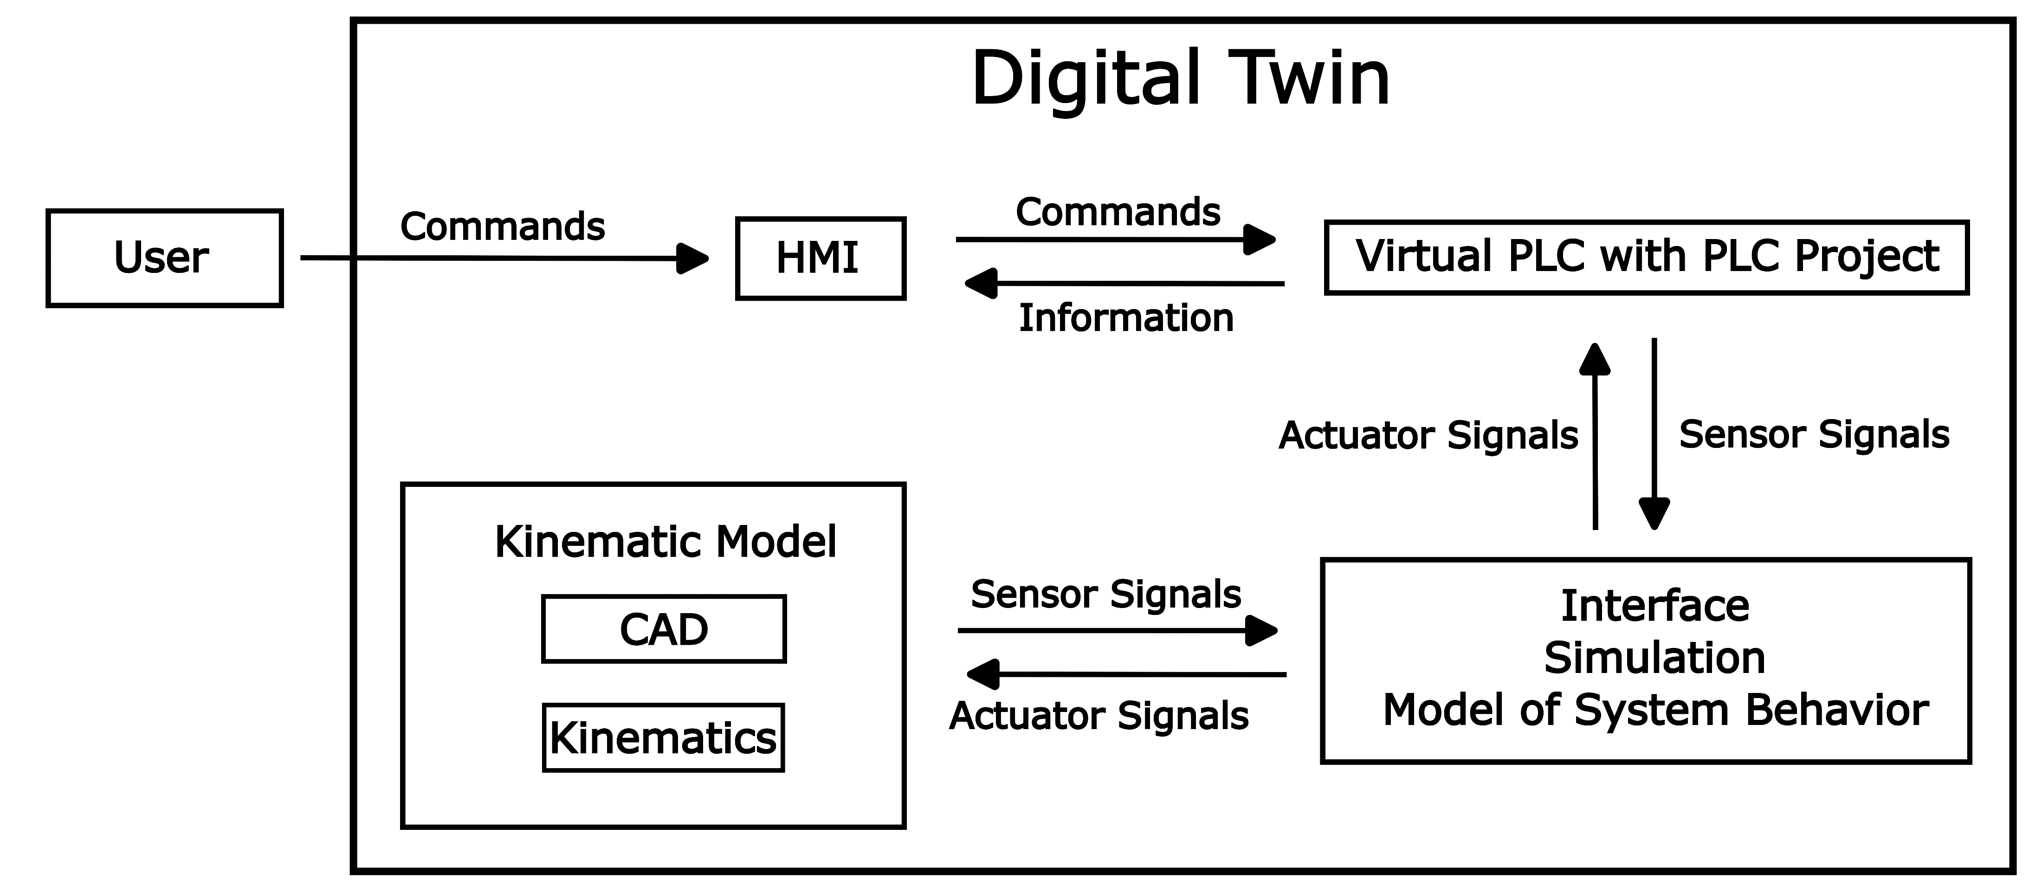
Digital Twin with Software in the Loop

Slide 23
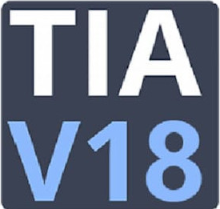




Digital Twin with Software in the Loop

Slide 24
Digital Twin with Software in the Loop
PLC programming (TIA, STEP 7)
HMI
Virtual Controller (PLCSIM)
CAD Model
Block Diagram with Machine Behavior,
Sensors and Actuators (Virtuos)
Connection between Virtual Machine and Virtual Controller (via TIA Export Tool and TIA Openness)
Simulation

Slide 25
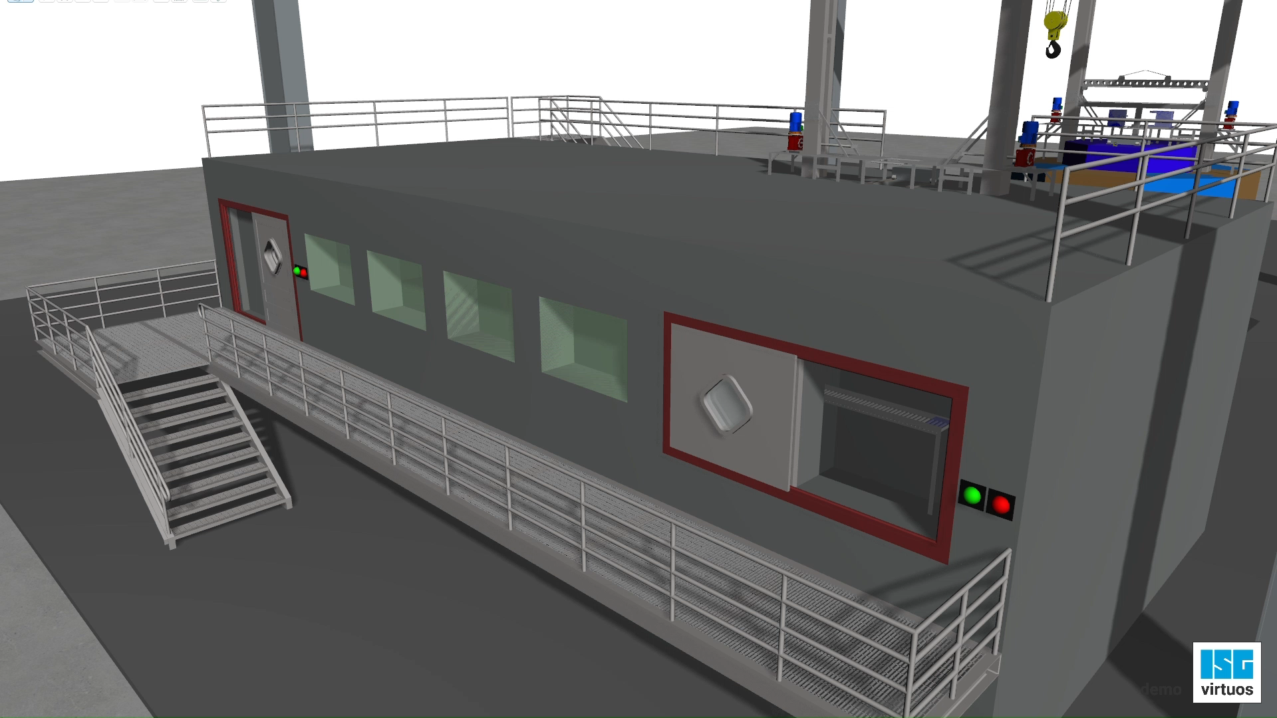
Austausch des Molybdäns

Slide 26
Conclusion and Outlook
Design of CAD model
Concept for remote, automated handling of irradiated targets
Implementation of initial digital twin of the system
Further work includes:
TMR design optimized for 2400 Ci of ⁹⁹Mo
Development of a generator system
Investigation of radiation protection
We are on track to deliver a feasible, comprehensive concept for sustainable production of ⁹⁹Mo.

Slide 27
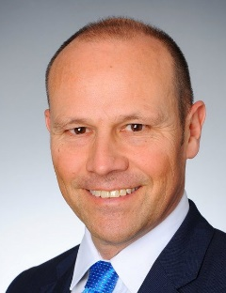
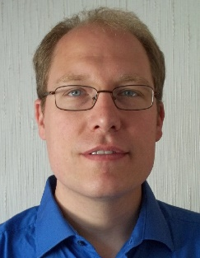
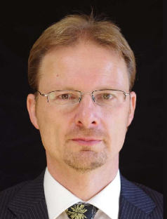
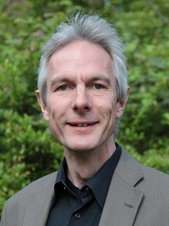
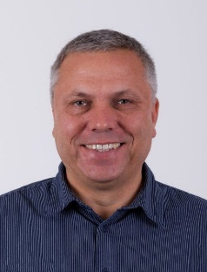



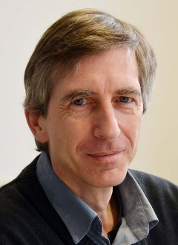
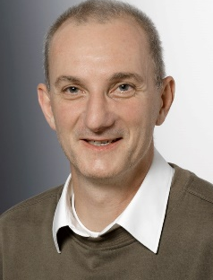
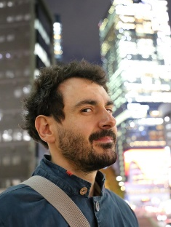
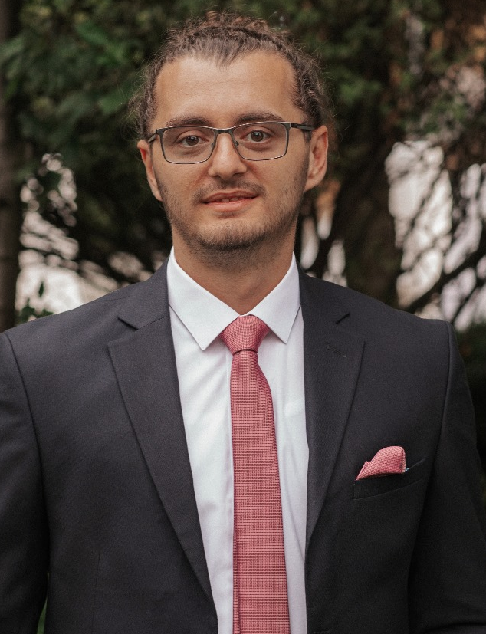
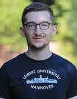

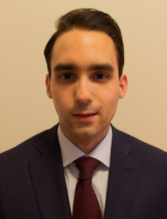
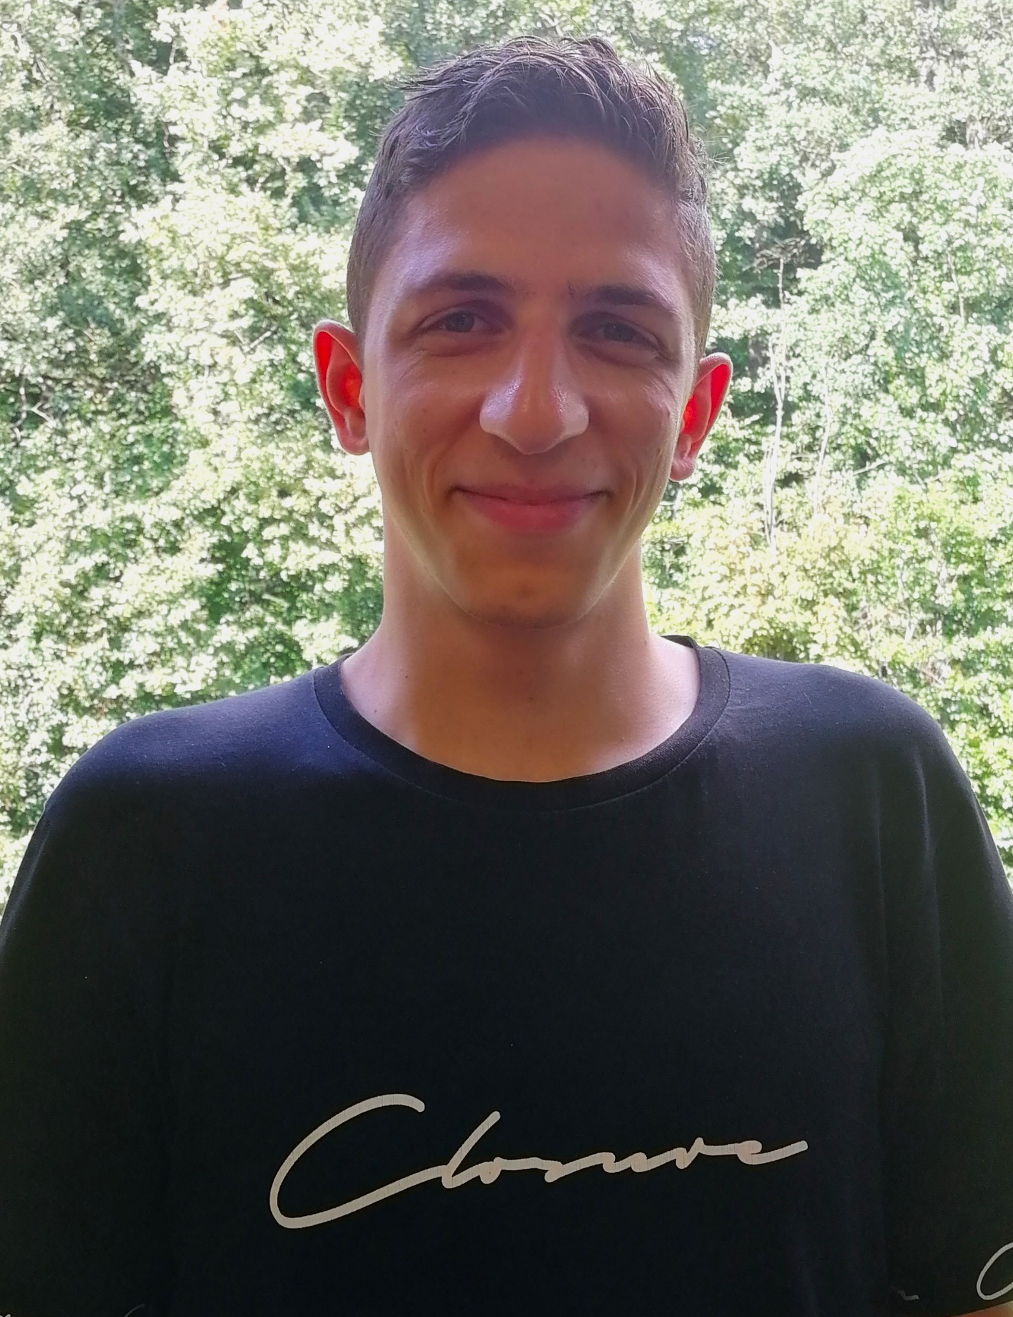
Project Contributors
Prof. Dr. Bernd Neumaier
Prof. Dr. Christoph Langer
Prof. Dr. Michael Butzek
Prof. Dr. Clemens Walther
Prof. Dr. Johannes Ermert
PD Dr. Erik Strub
Dr. Thomas Gutberlet
Dr. Eric Mauerhofer
Dr. Paul Zakalek
Doruntin Shabani
David Ohm
Marco Michel
Andreas Dragoun
Tarek El-Kordy

Slide 28
FH Aachen Department of Energy Technology BMFTR : 02NUK080B Tarek El-Kordy el-kordy@fh-aachen.de t.el-kordy@fz-juelich.de www.fh-aachen.de www.99mobest.uni-koeln.de

