Slide 2



The ESS Target Station, impact of Nuclear Maintenance on layout and Design
Göhran, Magnus [1], Dr. Jones, Carwyn [1], Dr. Blyth, William [2], Dr. Török, Szabina [3]
[1] European Spallation Source, ESS ERIC P.O Box 176, SE-221 00 Lund, Sweden
[2] UKAEA (RACE), Culham Science Centre, Abingdon, Oxfordshire, OX14 3DB, UK
[3] HUN-REN, Centre for Energy Research, Budapest Hungary
PRESENTED BY Magnus Göhran

Slide 3
Agenda
Setting the boundaries
Facility and Machine Development
Lessons Learned
Conclusions
In short: I will try to guide you through the impact of how some early design decisions have influenced the Target Station design and capacity to perform Nuclear Maintenance

Slide 4
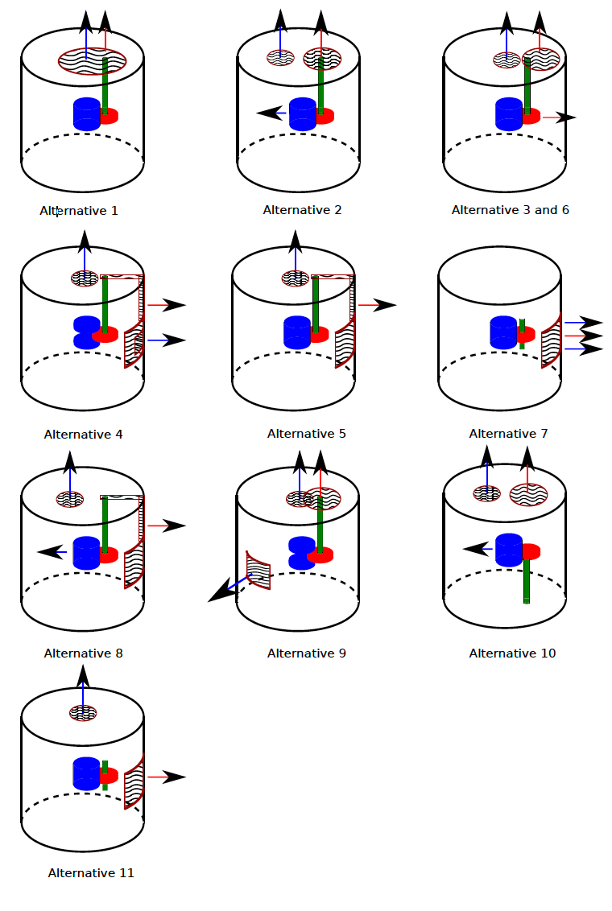
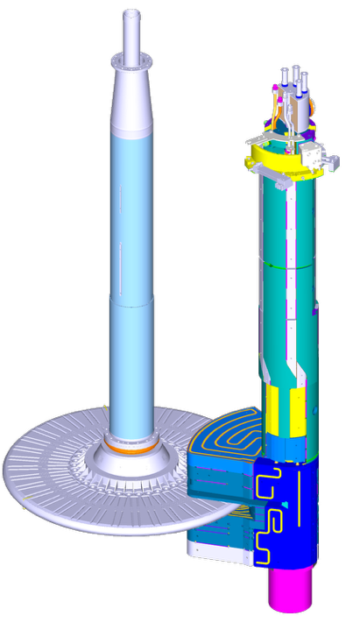
Setting the Boundaries
When speaking about Maintenance, two main tracks:
“We solve it once we designed our systems”
”Maintenance is part of the system design”
What decisions have to be made at an early stage?
  What are the drivers (radiation, system design, waste management, etc.)
  What basic elements of the facility need to be decided (logistics, interfaces, etc.)
What are the facility impacts from early decisions?
  System breakdown (Transport Casks, HotCell, Waste Management, etc.)
  Size of building(s), Lift capacities, Safety limitations, etc.
How will these decisions drive the facility layout and System Design?
👍
Blue = Moderator and Reflector Plug
Red = Target Wheel
Green = Shaft for Target Wheel
Black = Monolith (vacuum vessel)
Wave pattern = Monolith Maintenance access
➔ ESS choose “Alternative 2” (with a twist) – Maintenance done vertically

Slide 5
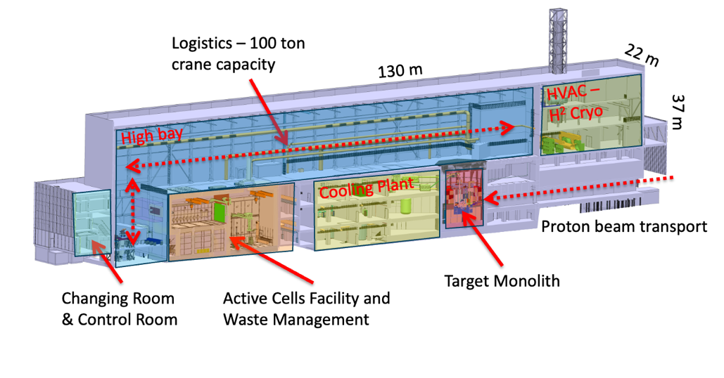
Boundary Consequences → Facility Layout
Vertical Maintenance:
Cask system to facilitate logistics in the High Bay
The HotCell (Active Cells Facility), disconnected from the Monolith
Allows the Utilities and Cooling Plant to be connected directly to the Monolith
Many Subsequent design impacts:
In Monolith shielding block design and stacking
Gaseous Target Helium Cooling
Waste storage capacity
Waste logistics and material logistics
Mock-up and Test Stands
General logistics and layout
Remote Handling System design
Etc..

Slide 6
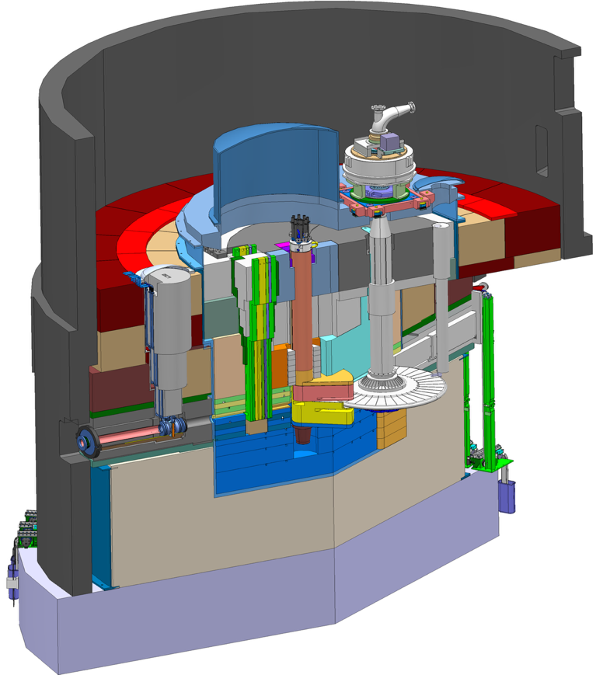
Boundary Consequences → Machine Design
Diagnostics to measure Proton beam parameters
→ Exchanged vertically
Monolith vessel in vacuum with lid configuration for component access
→ Design for life
Turning Target Wheel with shaft for cooling
→ Exchanged vertically
Stackable shielding blocks with streaming reduction design, size and weight to facilitate handling
→ Designed for life but handled vertically to facilitate component exchange
Moderator reflector plug with shaft for cooling and cryogenics
→ Exchanged with a twist and then vertically
Proton beam window to separate Monolith Atmosphere from Accelerator Vacuum
→ Exchanged vertically

Slide 7
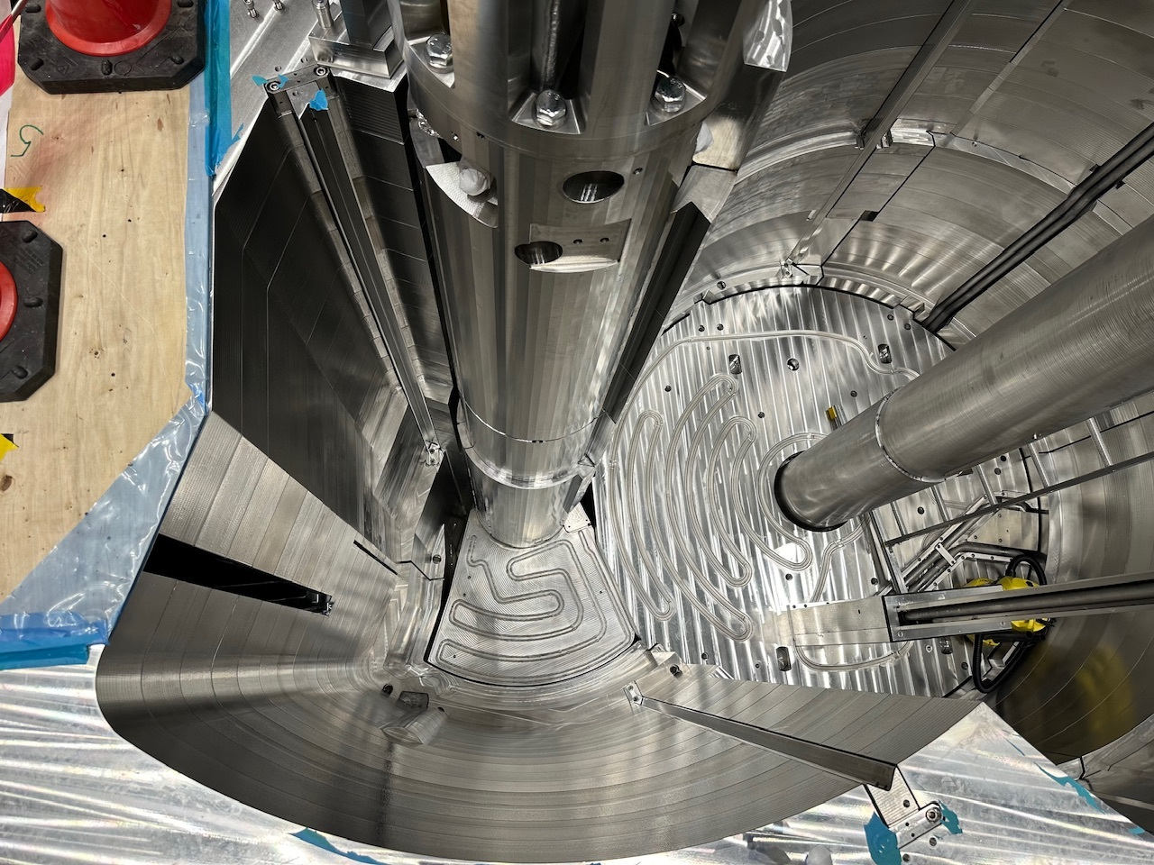
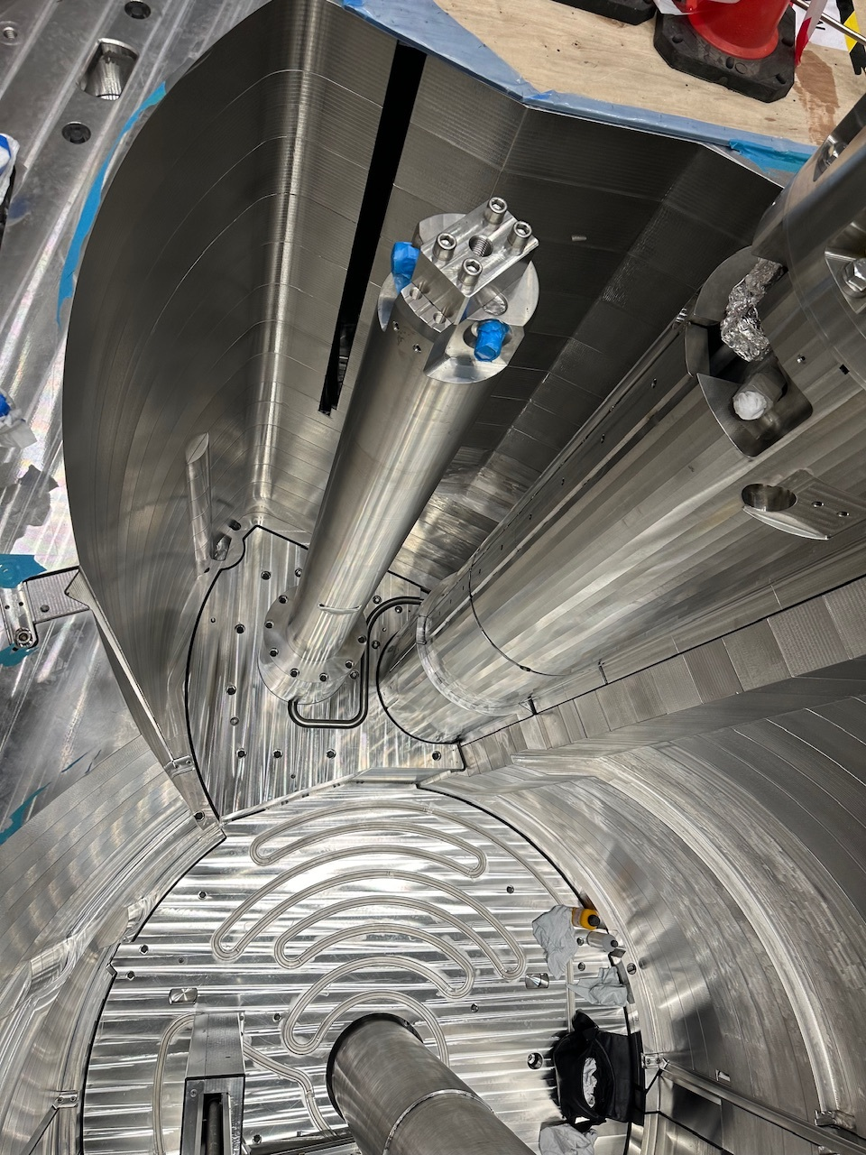
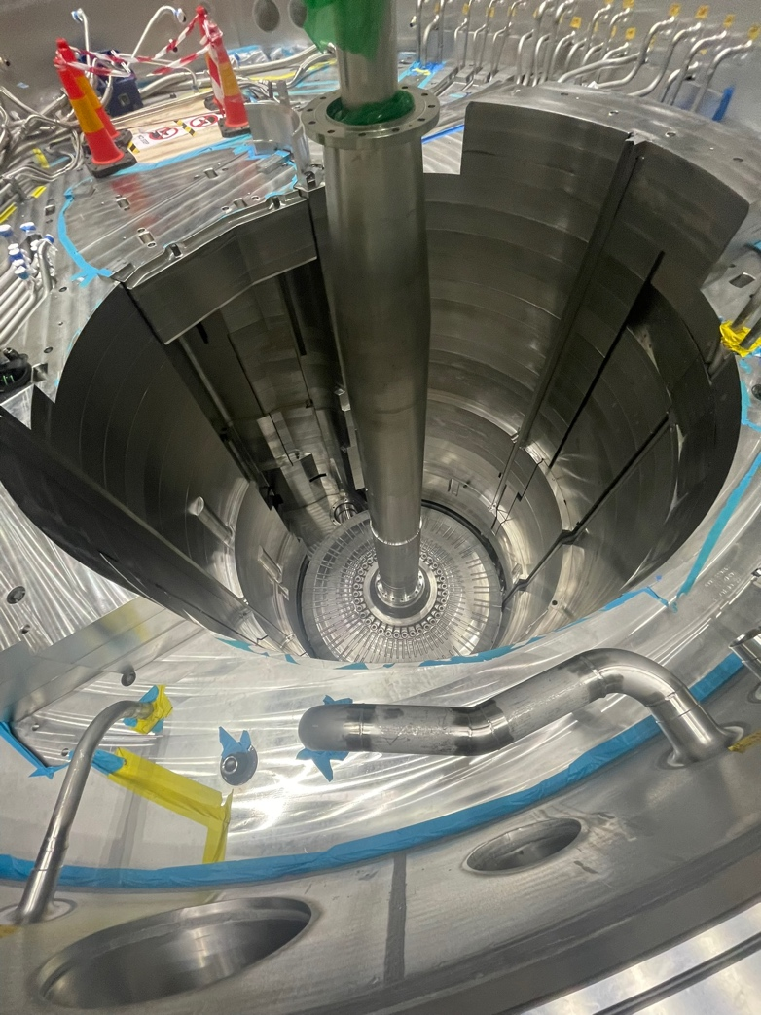
Boundary Consequences → Machine Design
Target Wheel installation
Moderator and Reflector Plug installation
Shielding stacking up on top of Target Wheel and Moderator & Reflector Plug

Slide 8
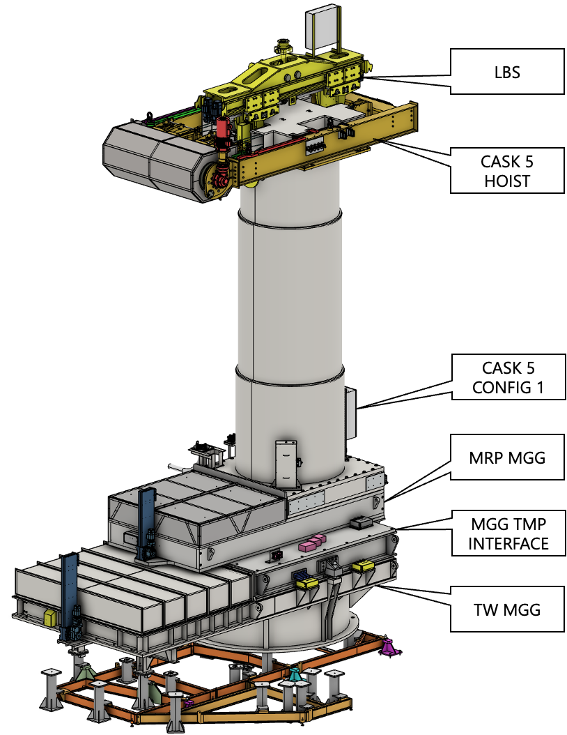
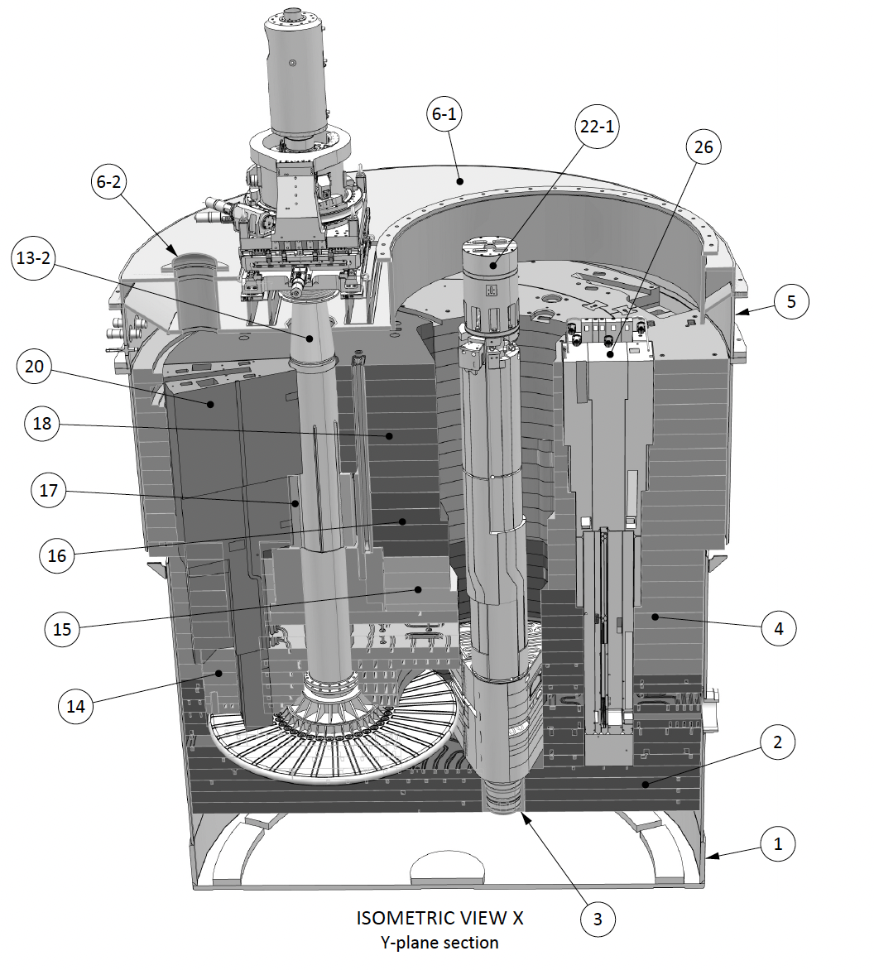
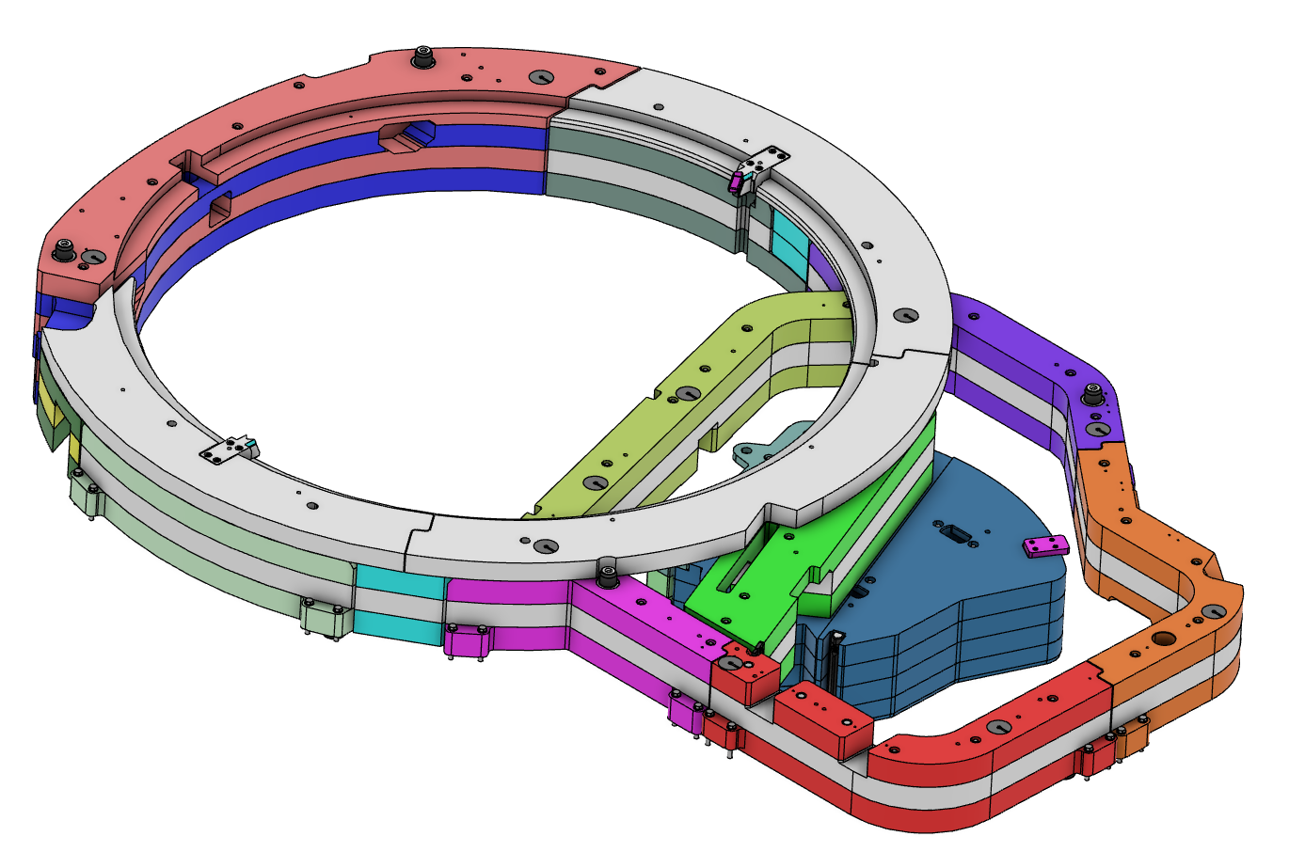
Boundary Consequences → Machine Design
Monolith Maintenance
Additional shielding on top off the monolith during cask operation
Moderator Twisted in the Monolith

Slide 9
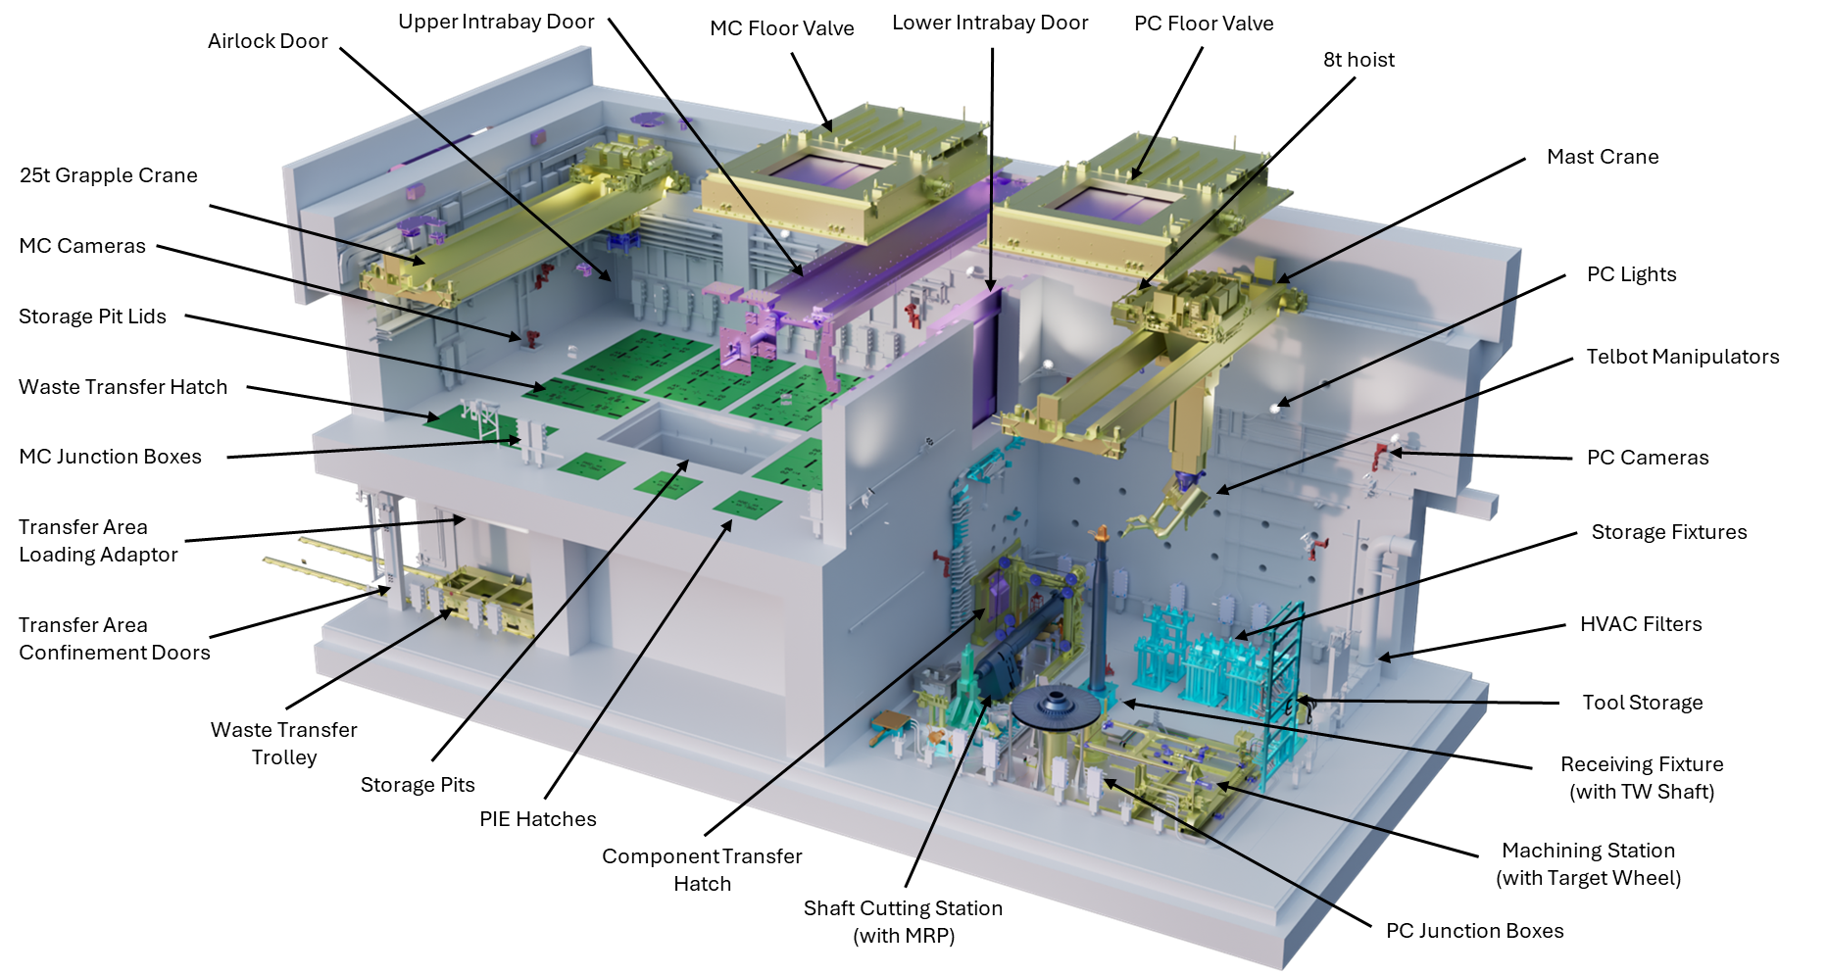

Boundary Consequences → Active Cells Facility
World’s largest windowless HotCell
Main Features:
Built to 100s Sv/h range
30x15x12 m (LxHxW)
1.3 m High Density Concrete
No windows
Process Cell
Maintenance Cell
Waste storage
Waste shipment

Slide 10
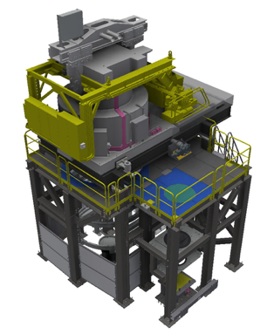
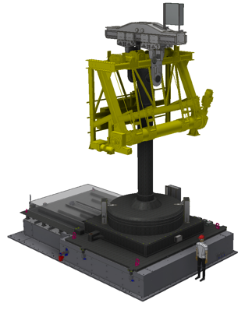
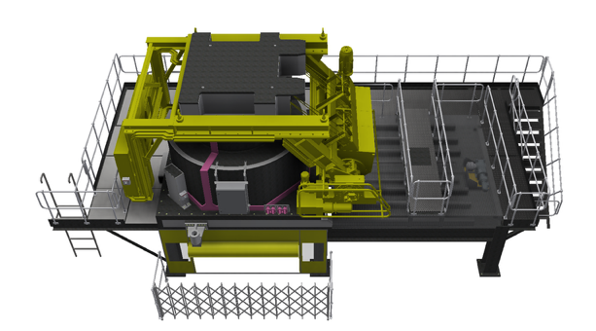
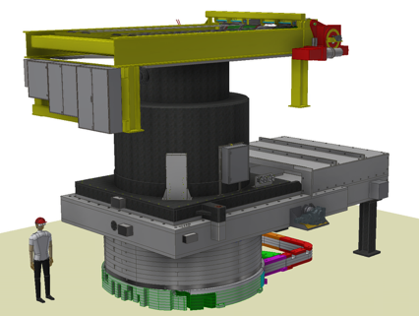
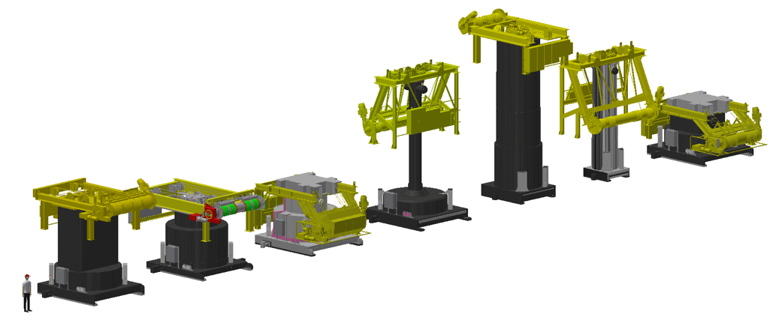
Boundary Consequences → Cask Assemblies
Mock-up & Test Stand
Active Cells - Floor Valve
Maintenance and Decontamination Station
7 Casks with 24 Configurations
Monolith Testbed

Slide 11
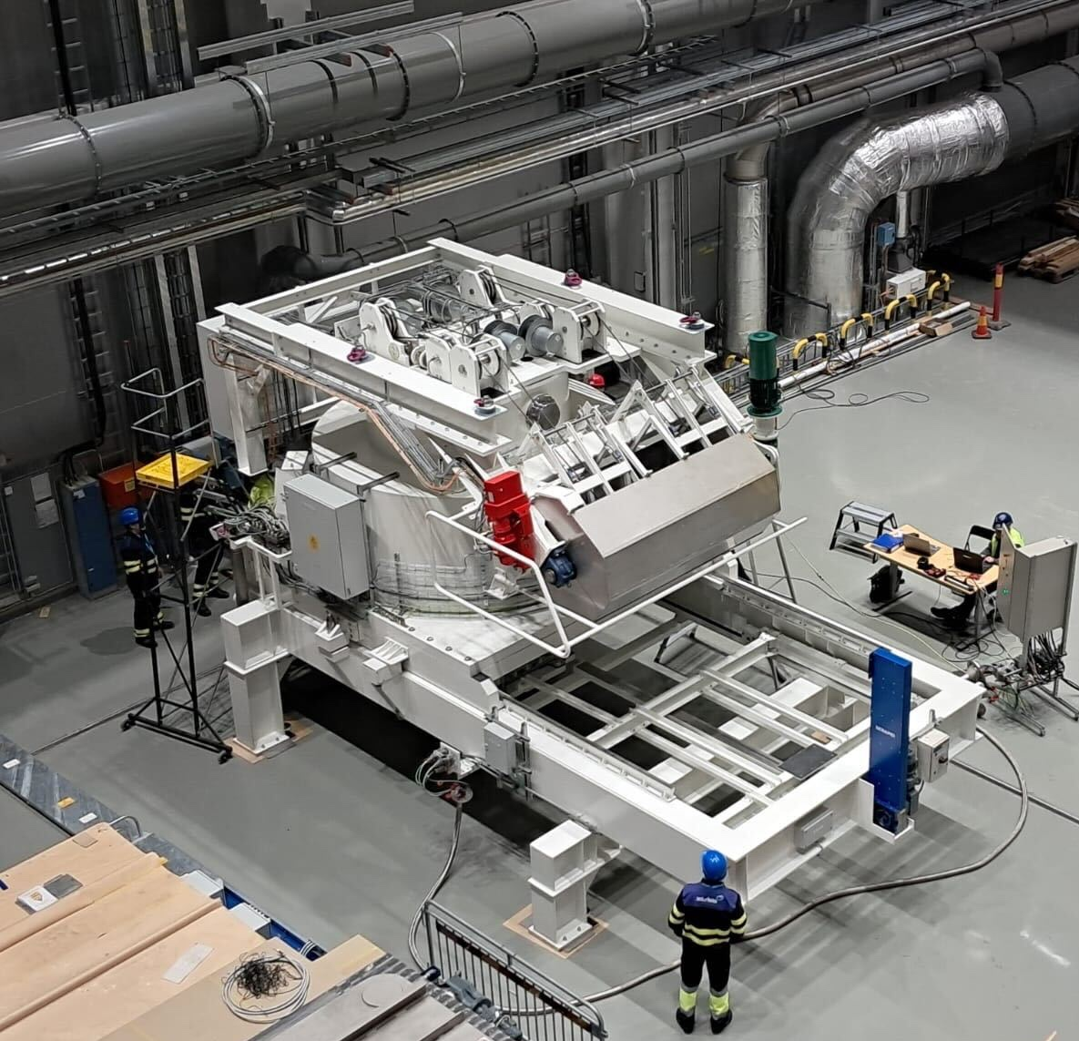
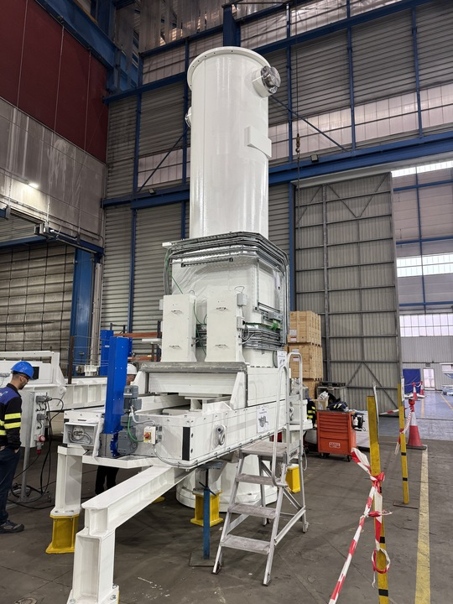
Cask Assemblies (examples)
Cask Assembly #3 with MUTS Gamma Gate
Cask Assembly #7 with Monolith Gamma Gate

Slide 12
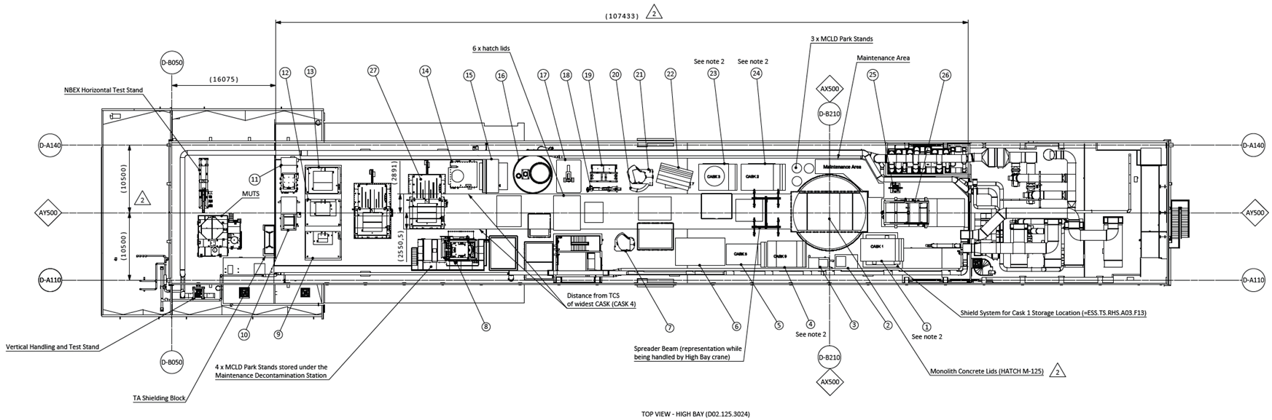
Why is this Important - Lessons Learned
Short term construction savings can sometimes be very expensive
  Example: High bay crane capacity reduction
Defining a minimum key set of requirements that drive the building design is key
  Seems obvious but is quite difficult – Example: number of casks/lifts to maintain monolith
In early design phase, change impact is difficult to predict
  Building size, width changed from 24 to 22 meters (example below)
Be brave, just because something hasn’t been done before does not mean it is a good solution
  Windowless HotCell
Remote Maintenance and Waste Management are significant cost drivers!

Slide 13
Wrap up and Conclusions
“All” of what you will see from the ESS Target Station layout during this conference, can be derived from the decision “Alternative 2” (with a twist), taken 2011-2012.
It is paramount that Nuclear Maintenance and Waste Management are allowed to influence these early decisions – it is applicable also to coming Fusion and 4th generation Fission plants as well – even if the scientific design has not been finalized.

Slide 14
Thank You!

