Slide 1
SKADI
Small-Angle Scattering at ESS
PRESENTED BY Sebastian Jaksch

Slide 2
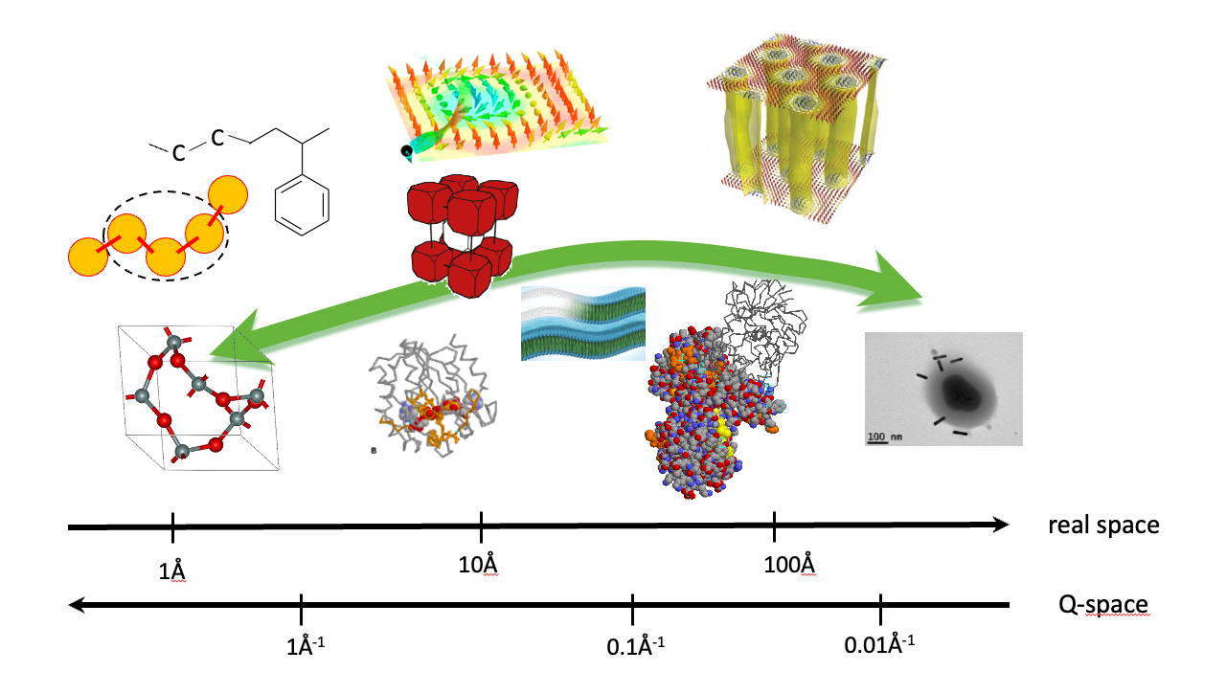
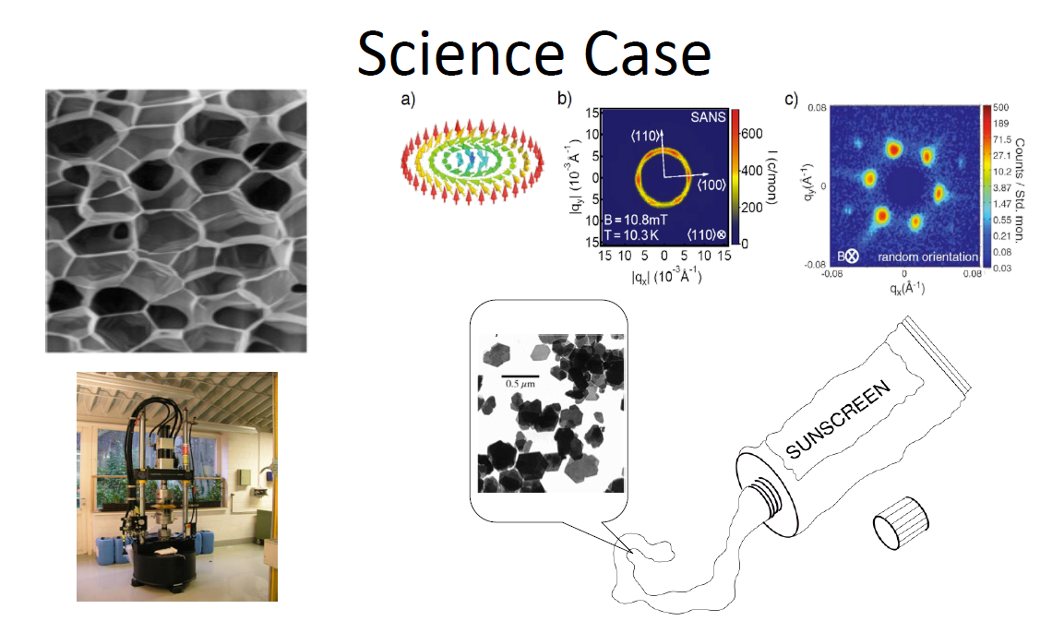
Science Case

Slide 3
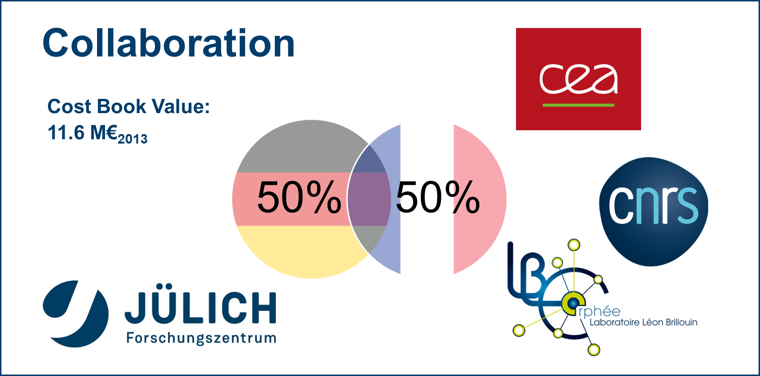
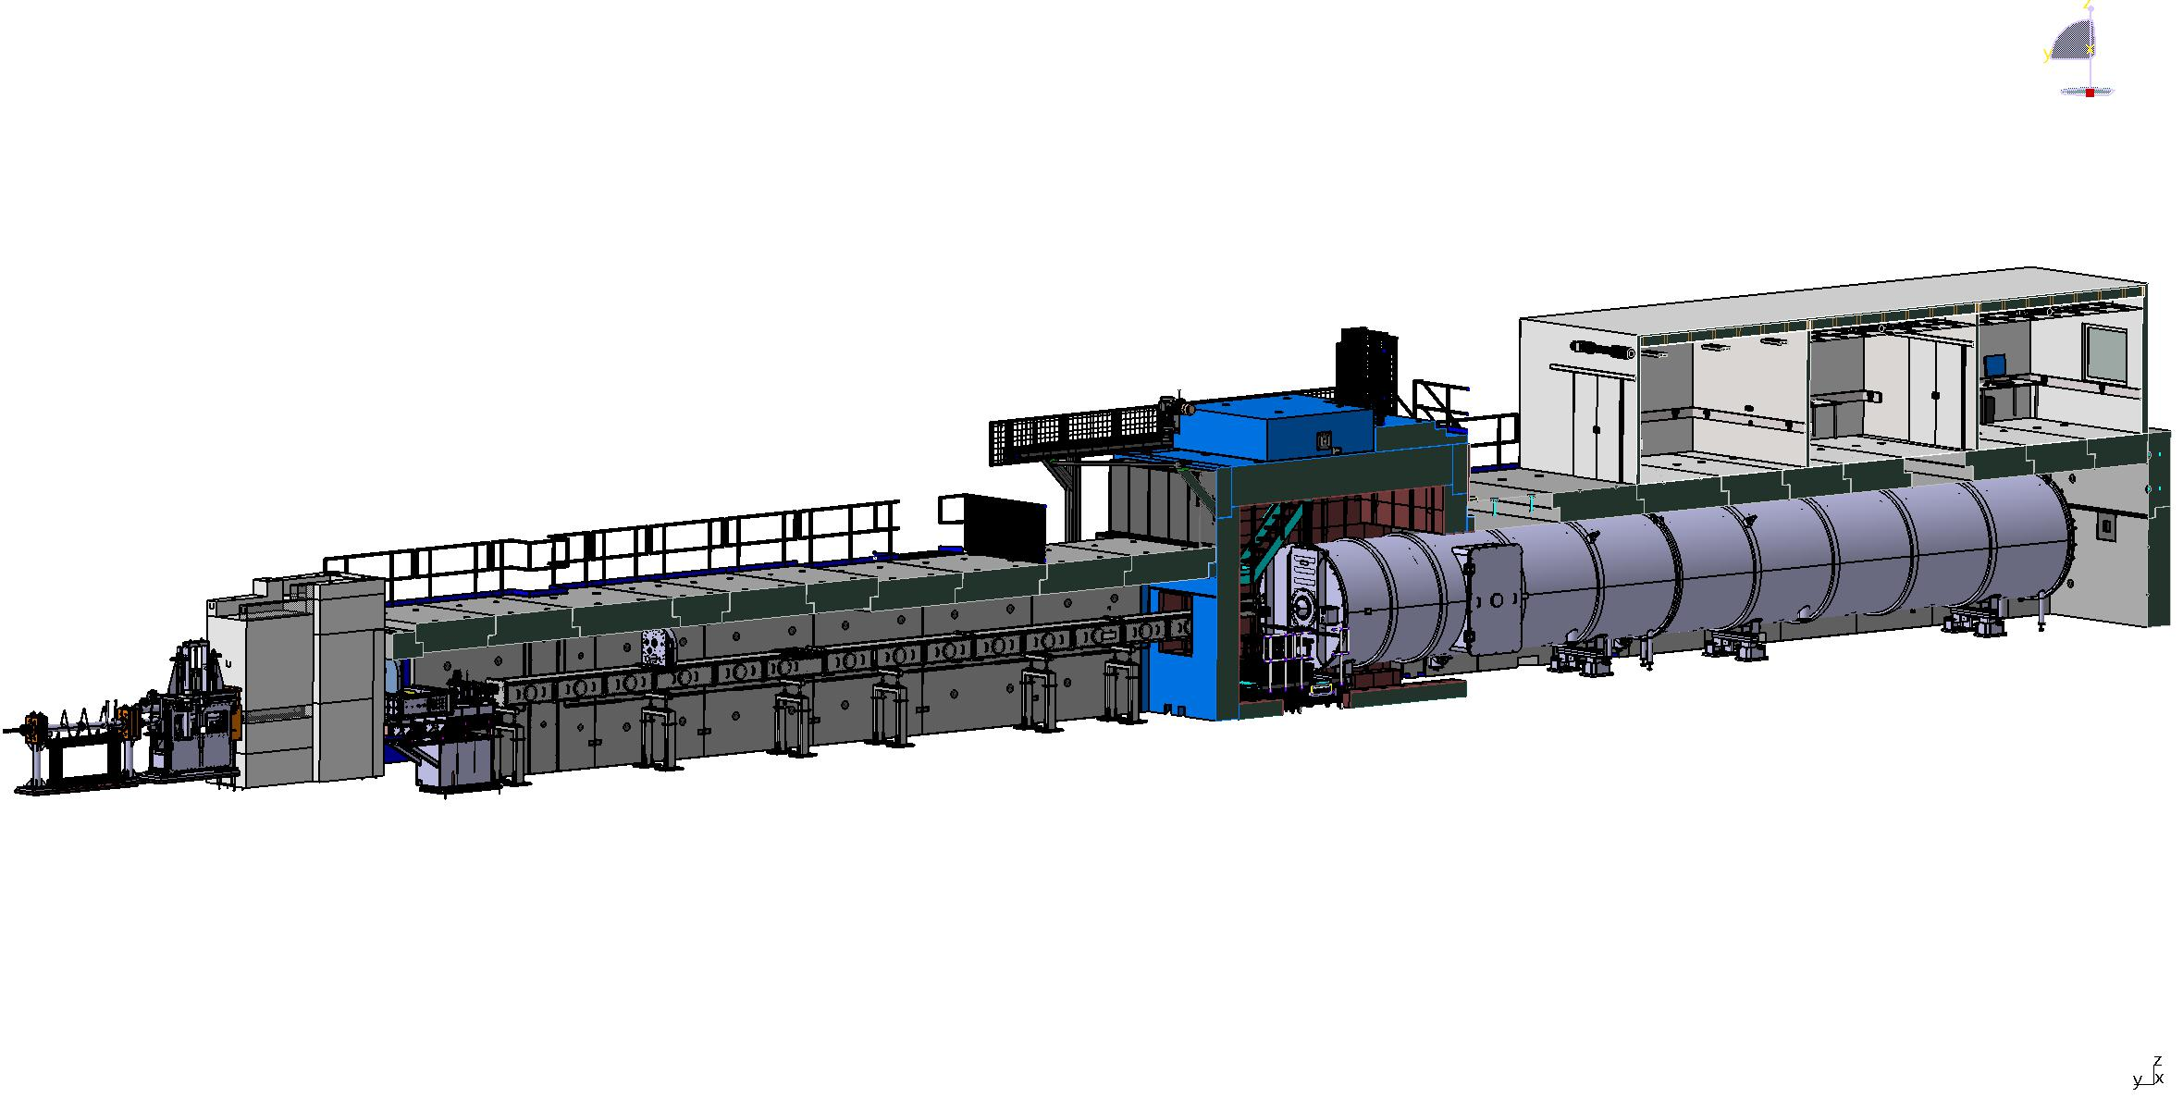
Instrument Overview
Hutch
Space for two teams and instrument workshop
Sample Exposure System
Sample area, shielding
Roughly 3x3 m open space, top and side accessible
Beam extraction Sysystem
NBOA, BBG, Reflector
Chopper System
Neutron detector system
Two independent detector banks movable, one fixed for low angles at 20 m
Beam geometry conditioning
Collimation and apertures
20, 14, 8 and 4 m plus slit VSANS
Heavy shutter
Beam filtering system
V-cavity polarizer, gradient spin flipper
Neutron Detector
1 m² active area on two banks (6x6 mm² resolution) and low angle detector (3x3 mm² resolution) at start,
2 m² full scope

Slide 4
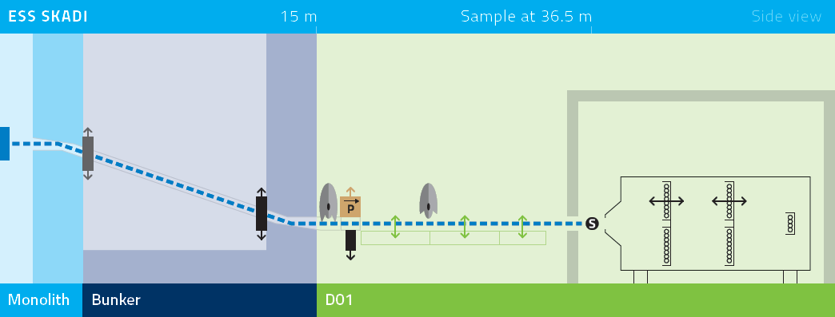
Simulated Performance Data
Technical Specification |  | Standard mode 14 Hz
Instrument class | Polarized SANS | Bandwidth | 5 Å
Moderator | Cold | Wavelength range | 3 – 21 Å
Q range | 10⁻⁴ – 1 Å⁻¹ | Momentum resolution | ΔQ/Q = 2 – 7%
Flux at sample (2 MW) | 3.6 x 10⁸ ns⁻¹cm⁻² | Pulse skipping mode 7 Hz
Detector type | Li-scintillator, pixelated | Bandwidth | 10 Å
Detector coverage (current) | 1 m² | Wavelength range | 3 – 21 Å
Detector coverage (full scope) | 2 m² | Momentum resolution | ΔQ/Q = 1 – 7%

Slide 5
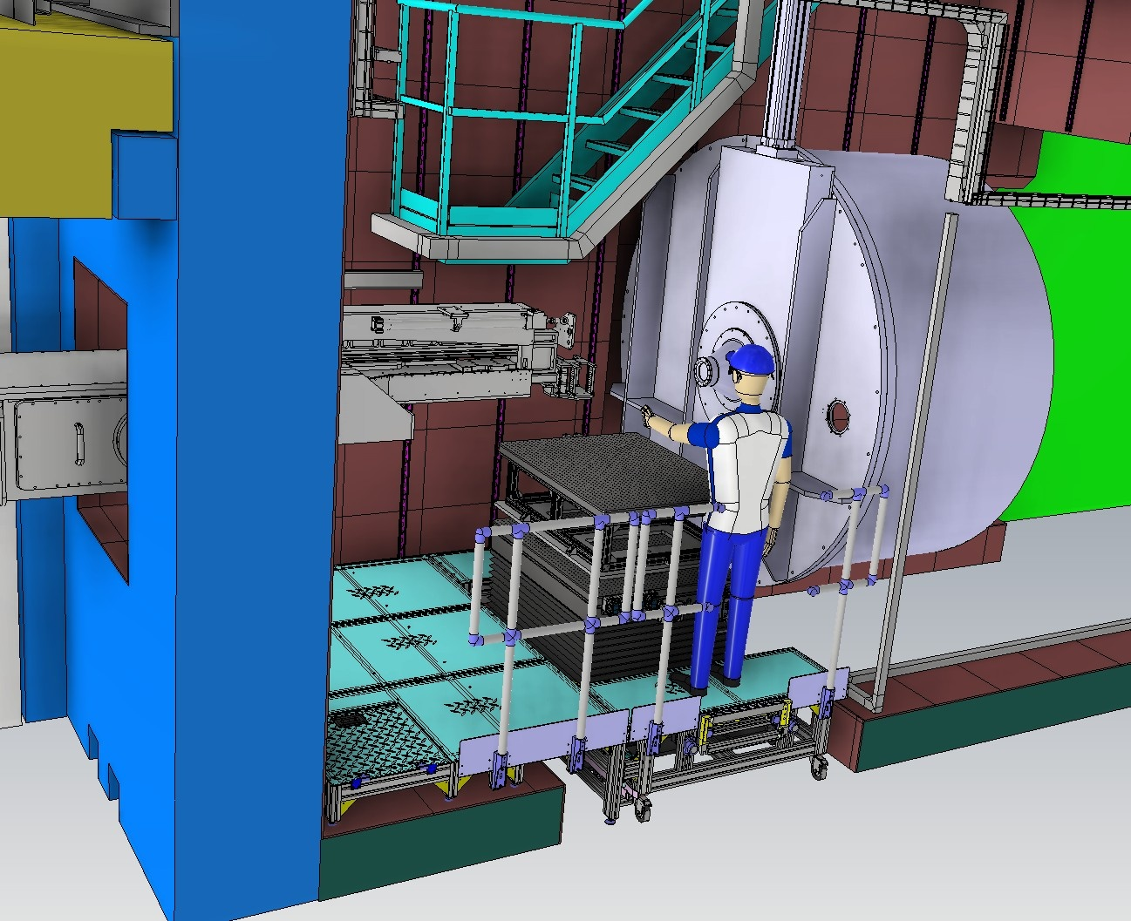
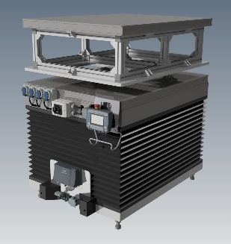
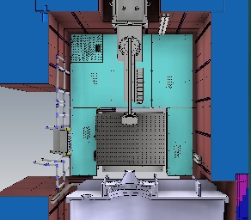
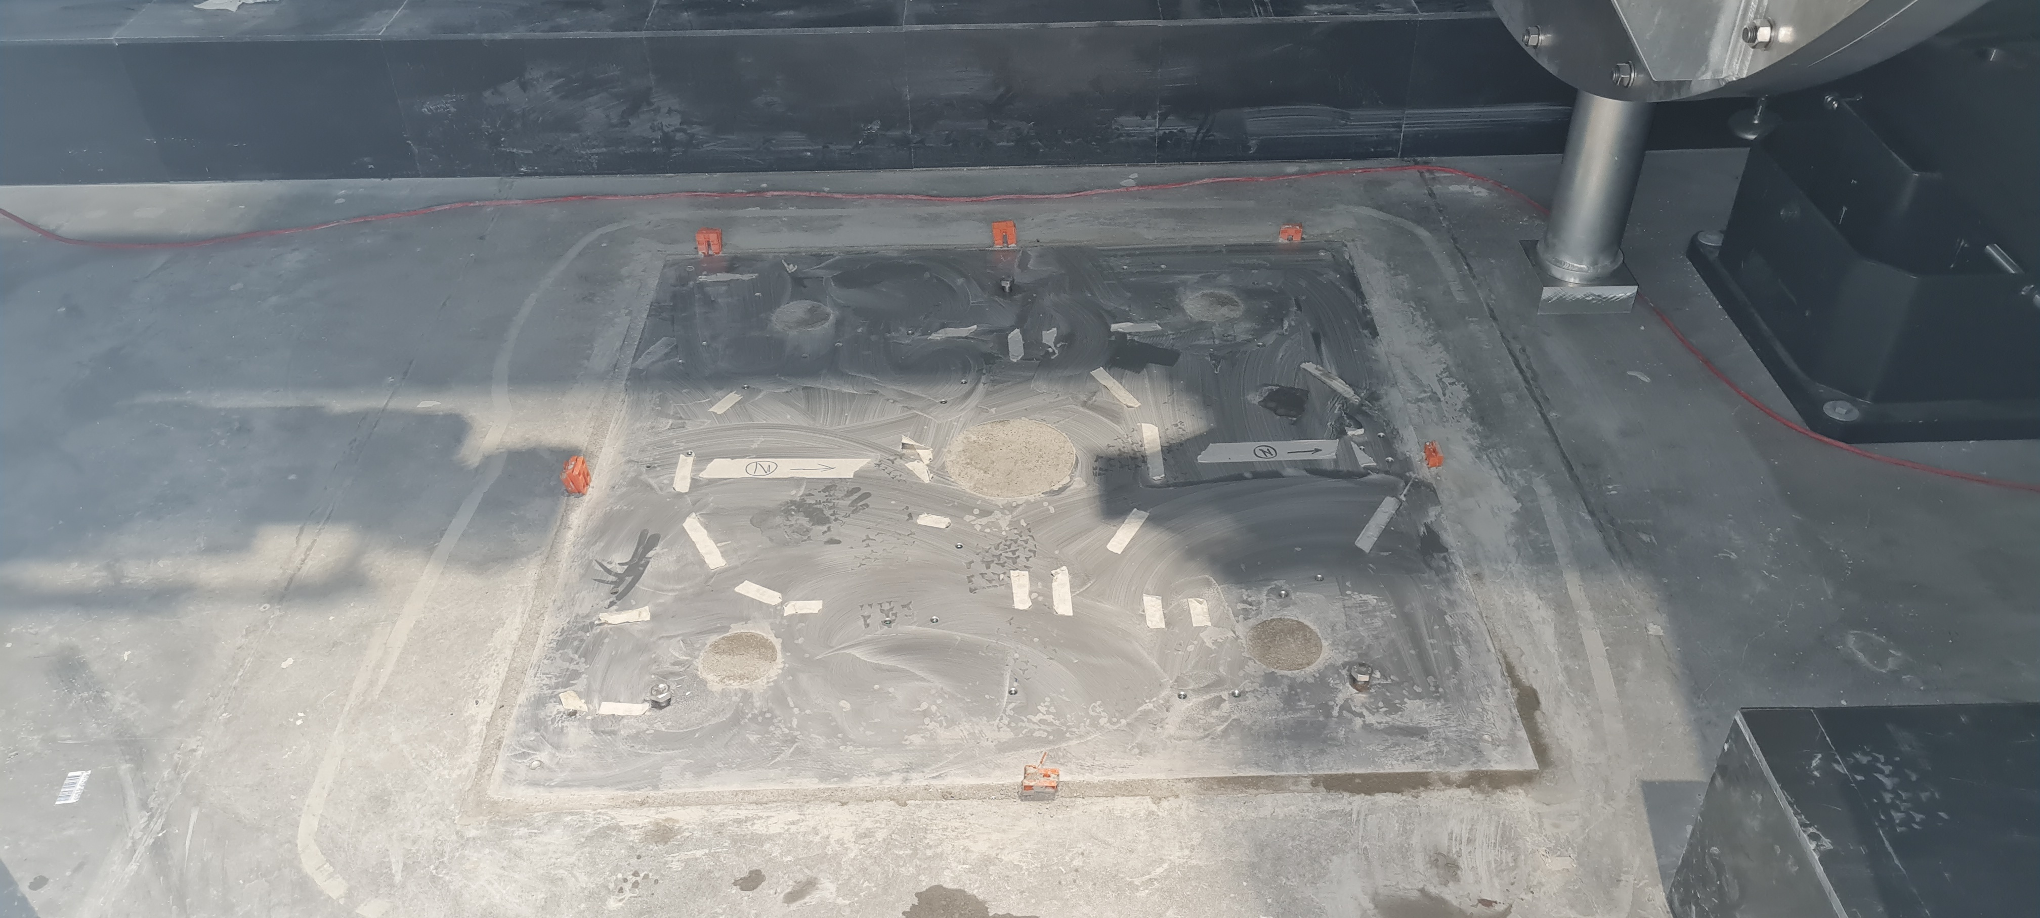
Sample Handling
Two exchangable sample tables with kinetic mounts
Up to 990 kg loads
Optical table on top
Huber axes and hexapods available

Slide 6
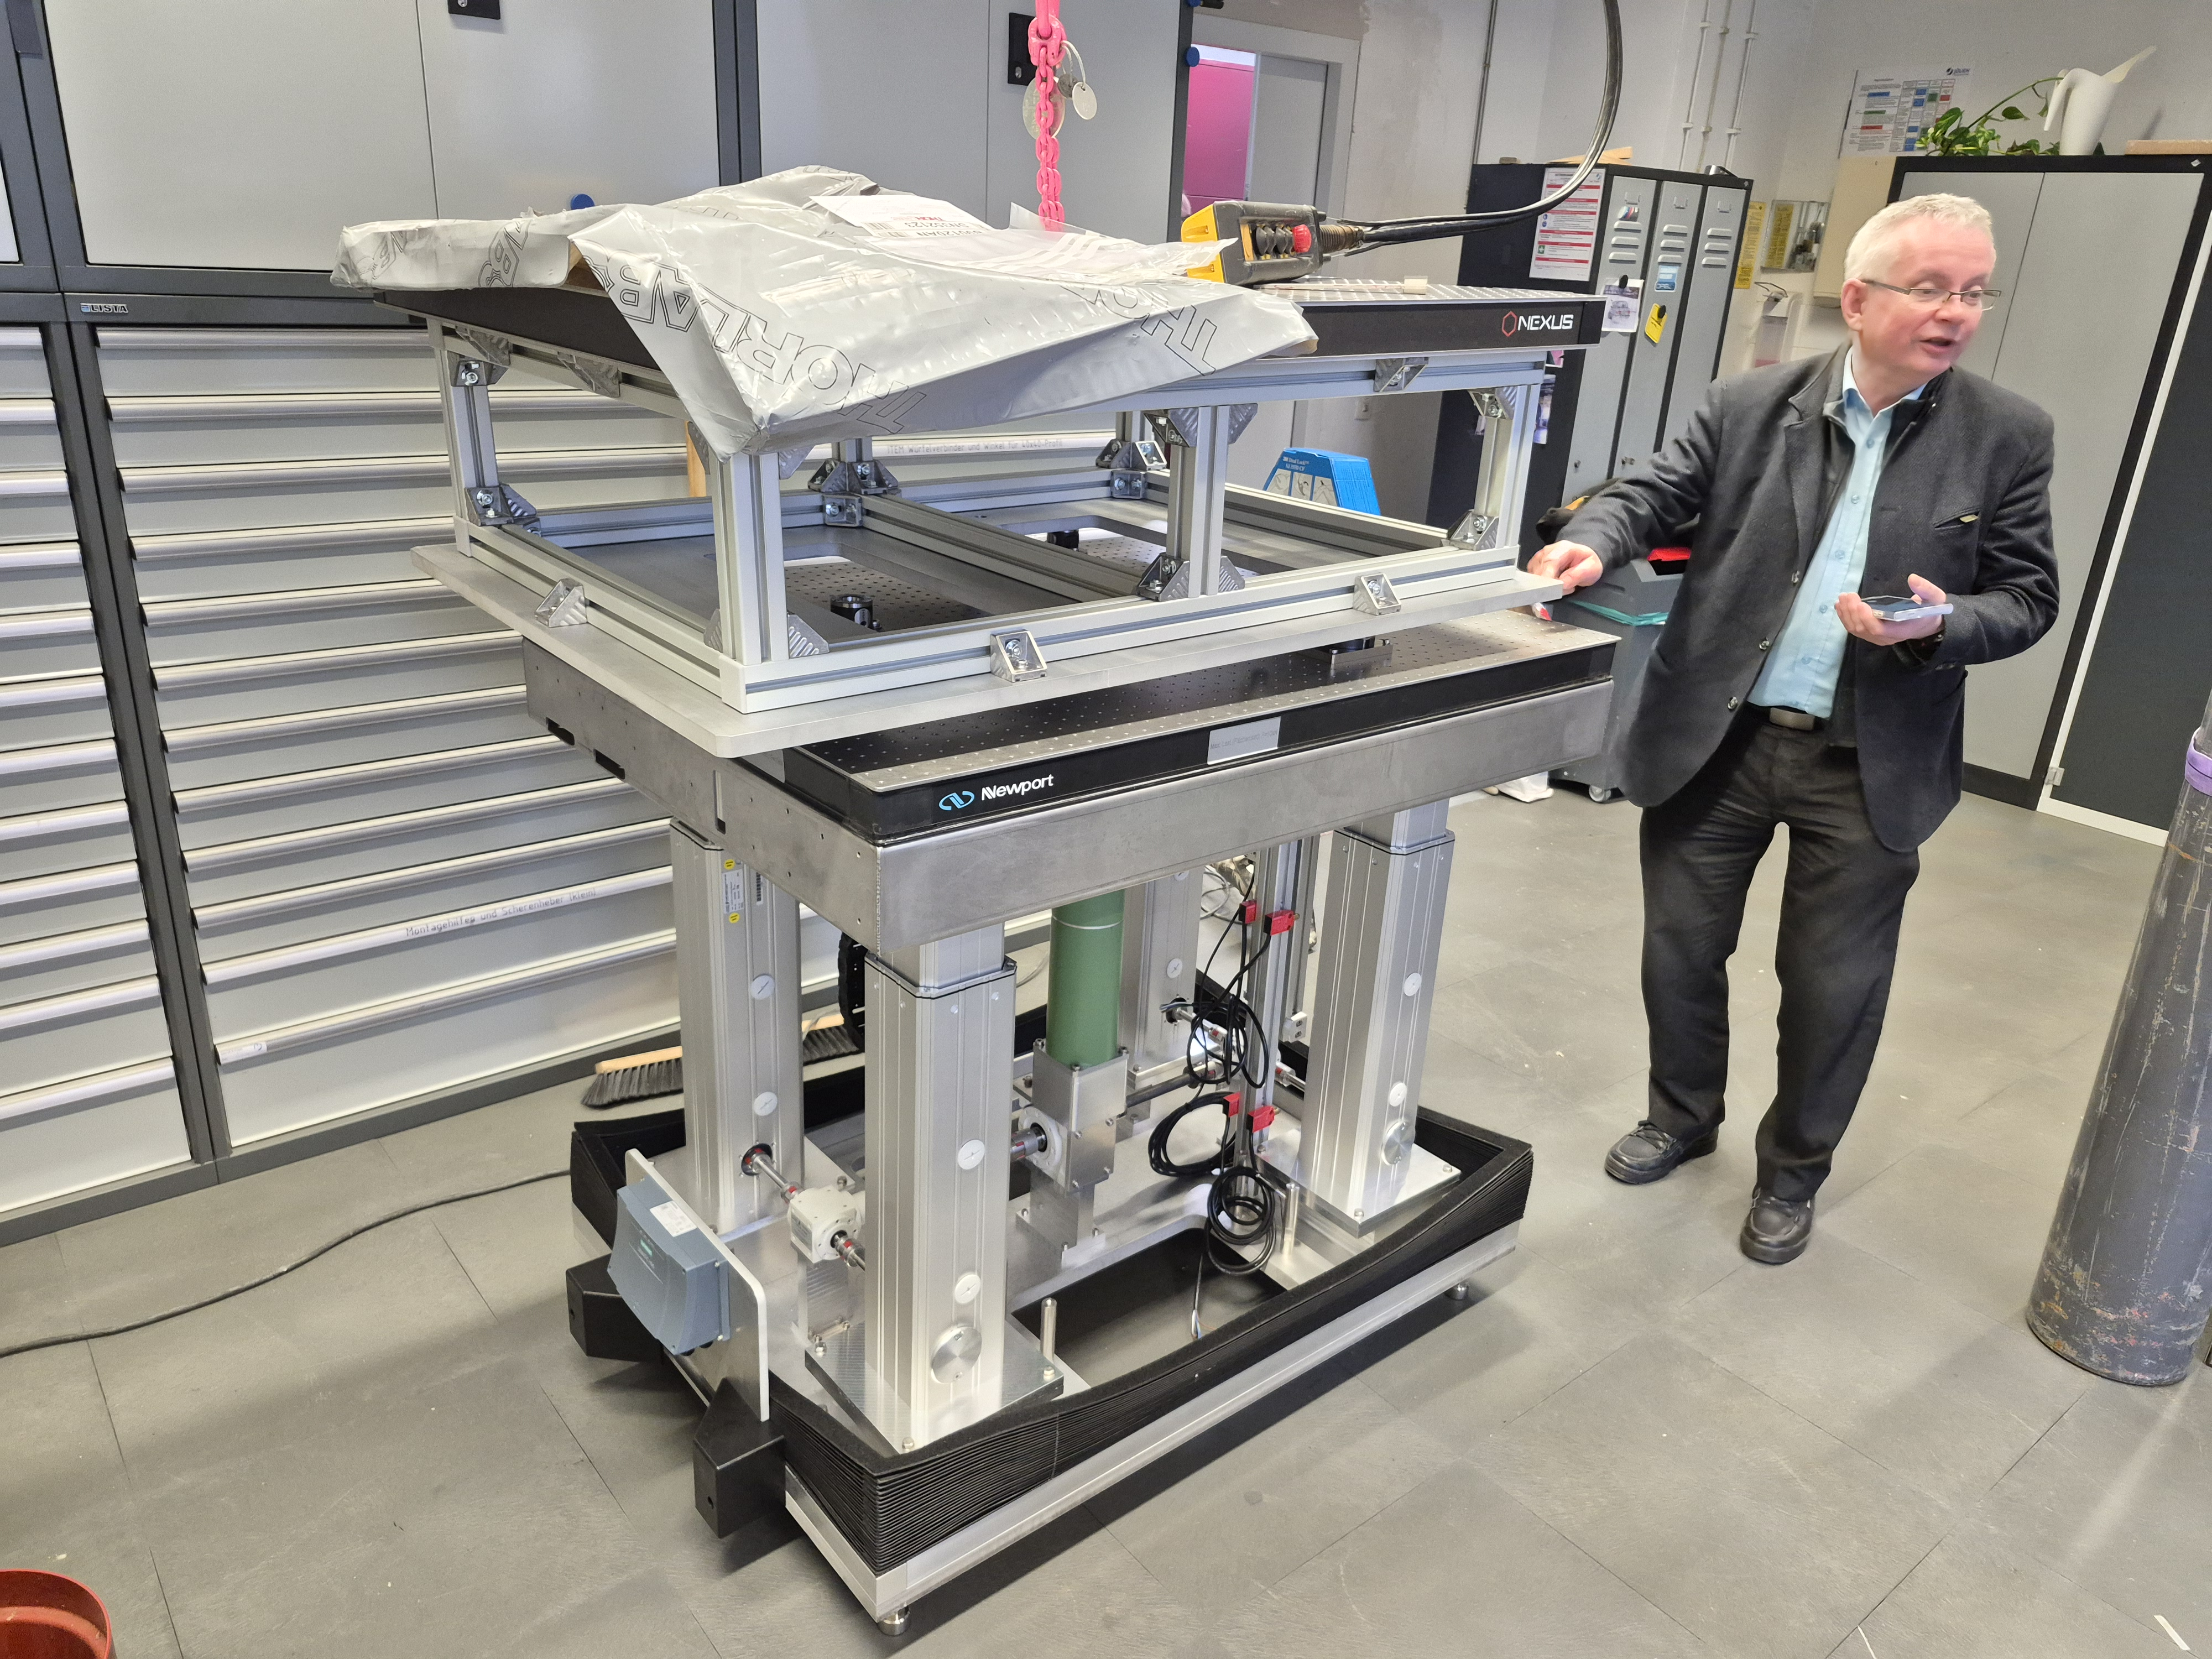
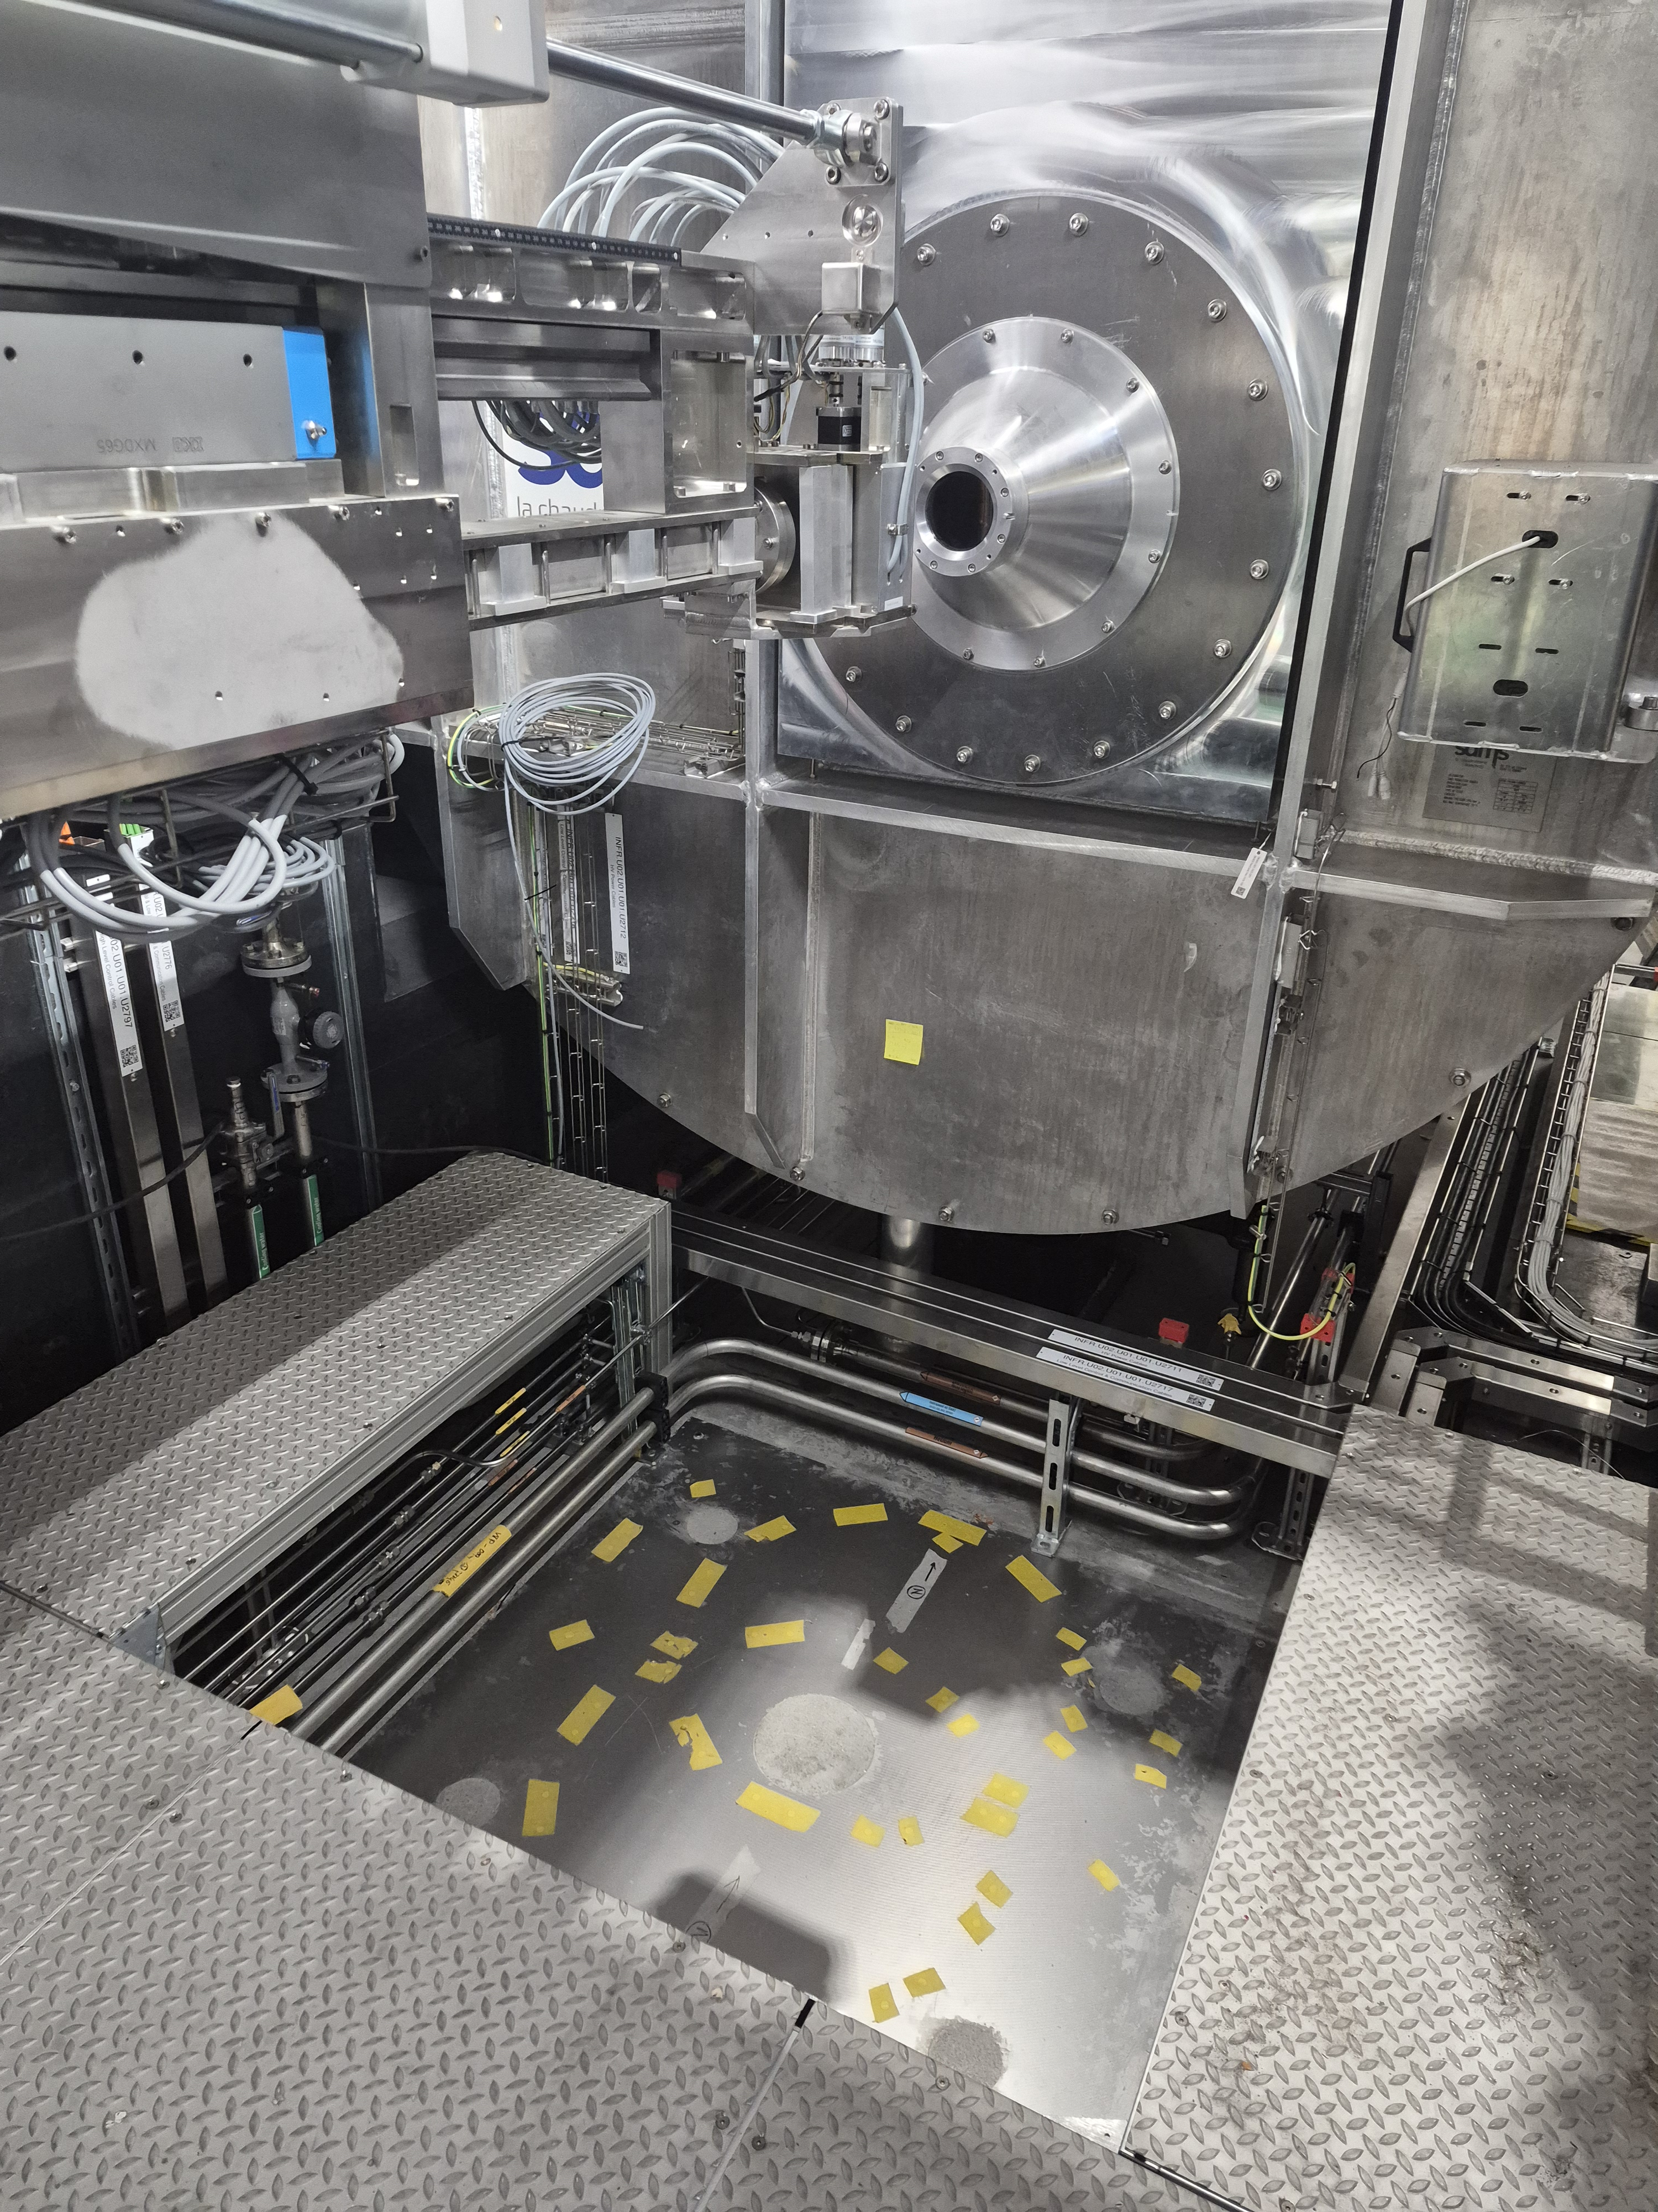
Sample Handling
Sample stack on top made from aluminium profiles
Simple to reproduce for custom sample environment
Power supply and connectors directly in the table for setup off-instrument

Slide 7
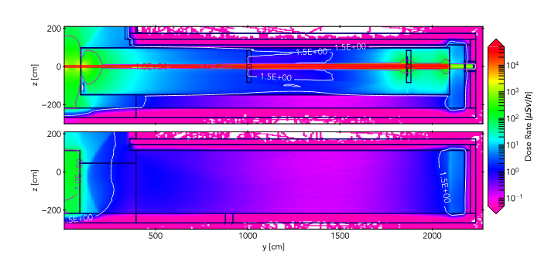
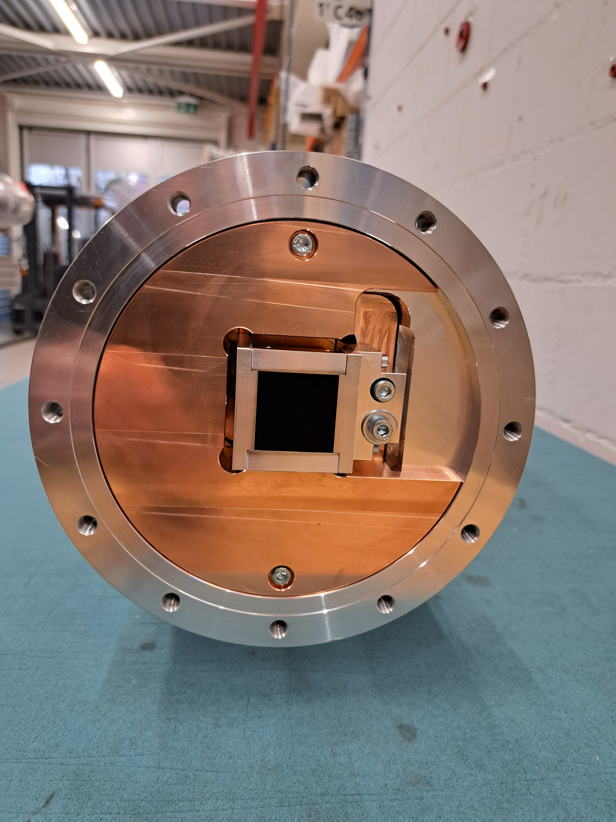
Background Minimization
Guidelines for low background instruments
Absorb early: Collimation shielding directly around the neutron guide inside the bunker
Do not scatter back onto the detector: Get lost box behind detector

Slide 8
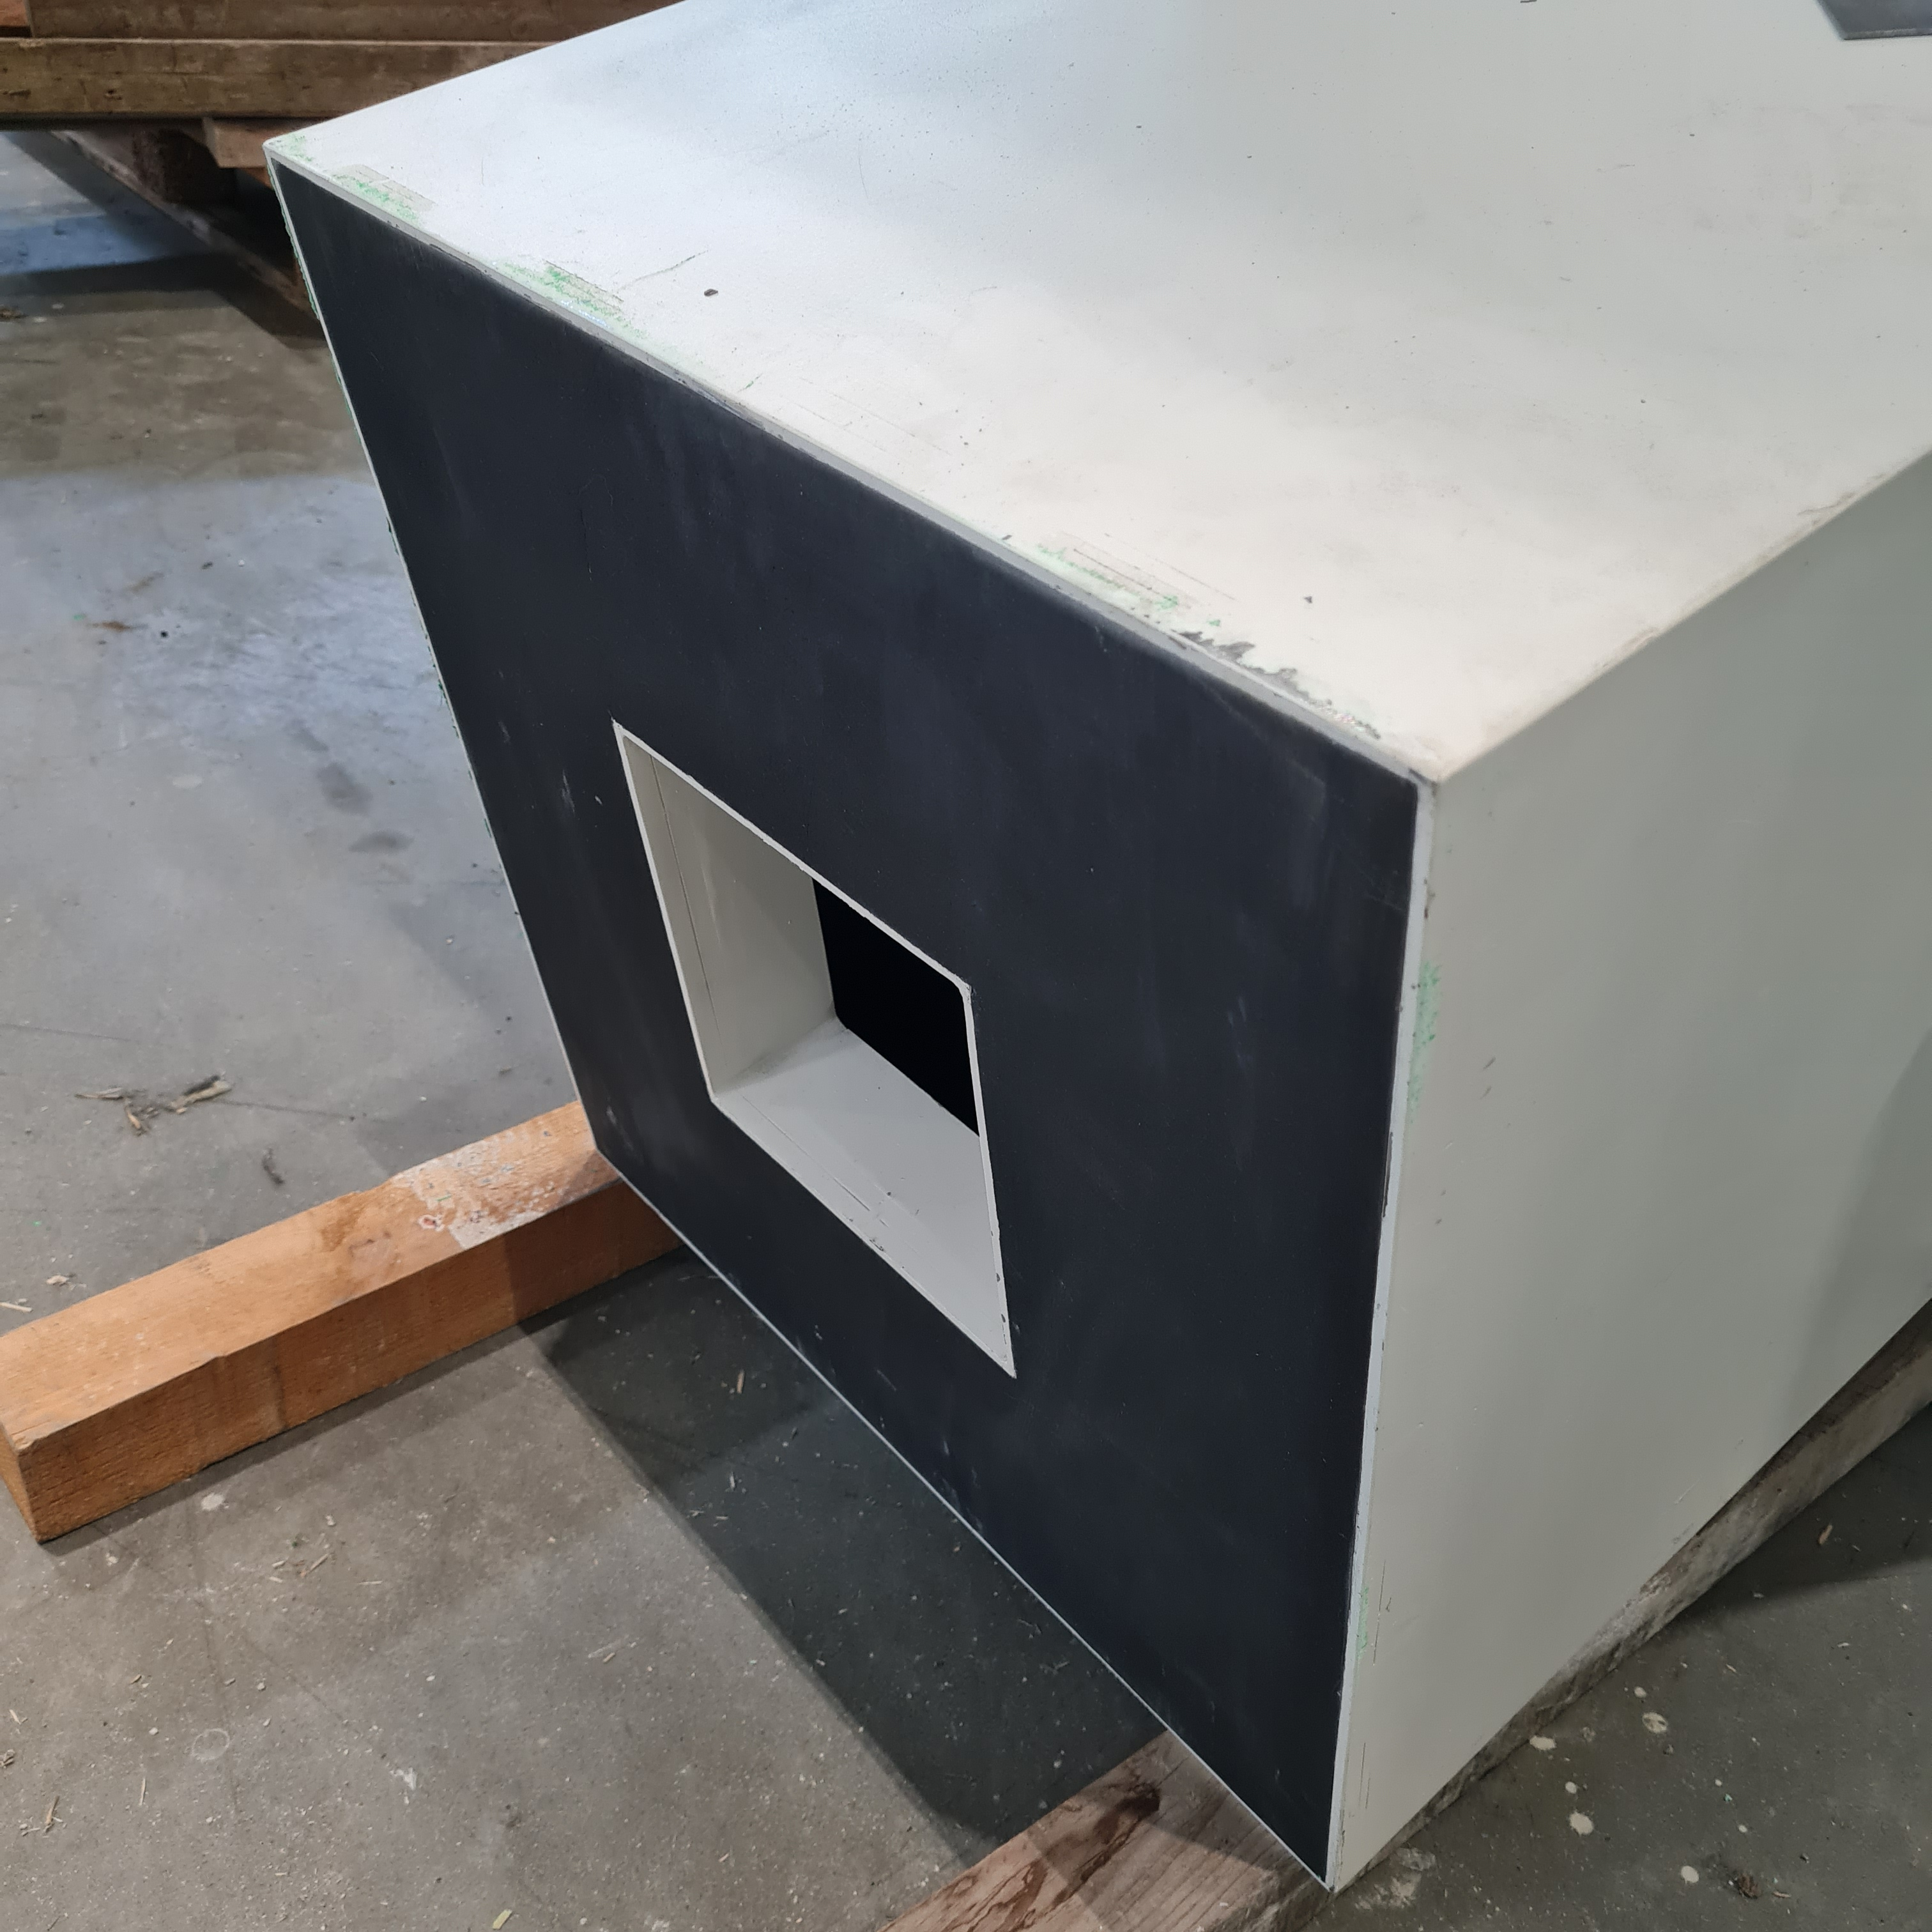
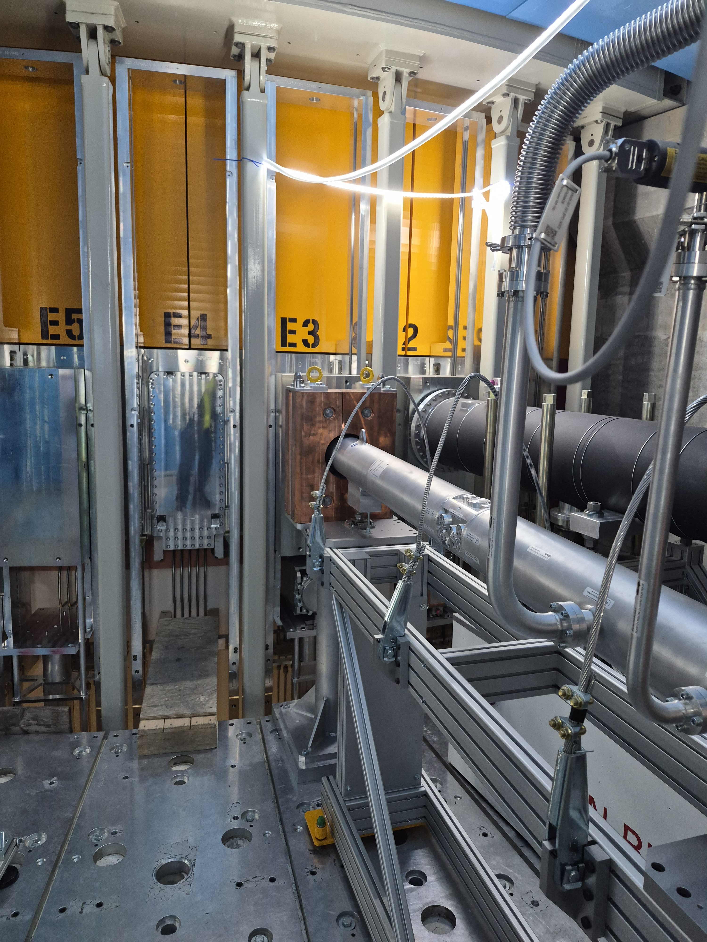
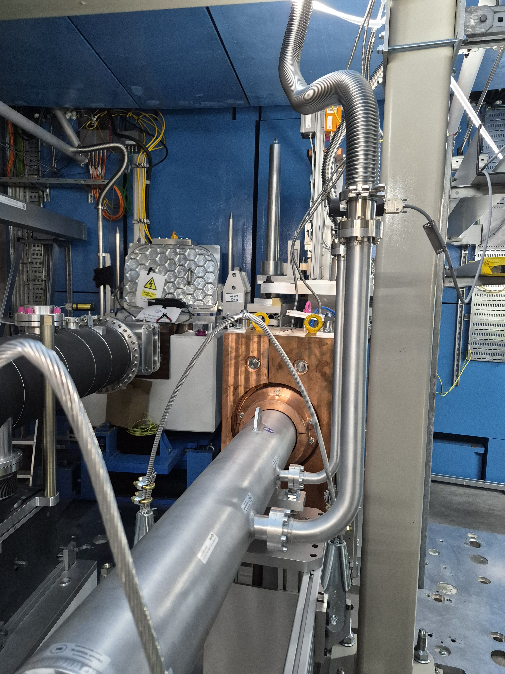
Background Minimization

Slide 9
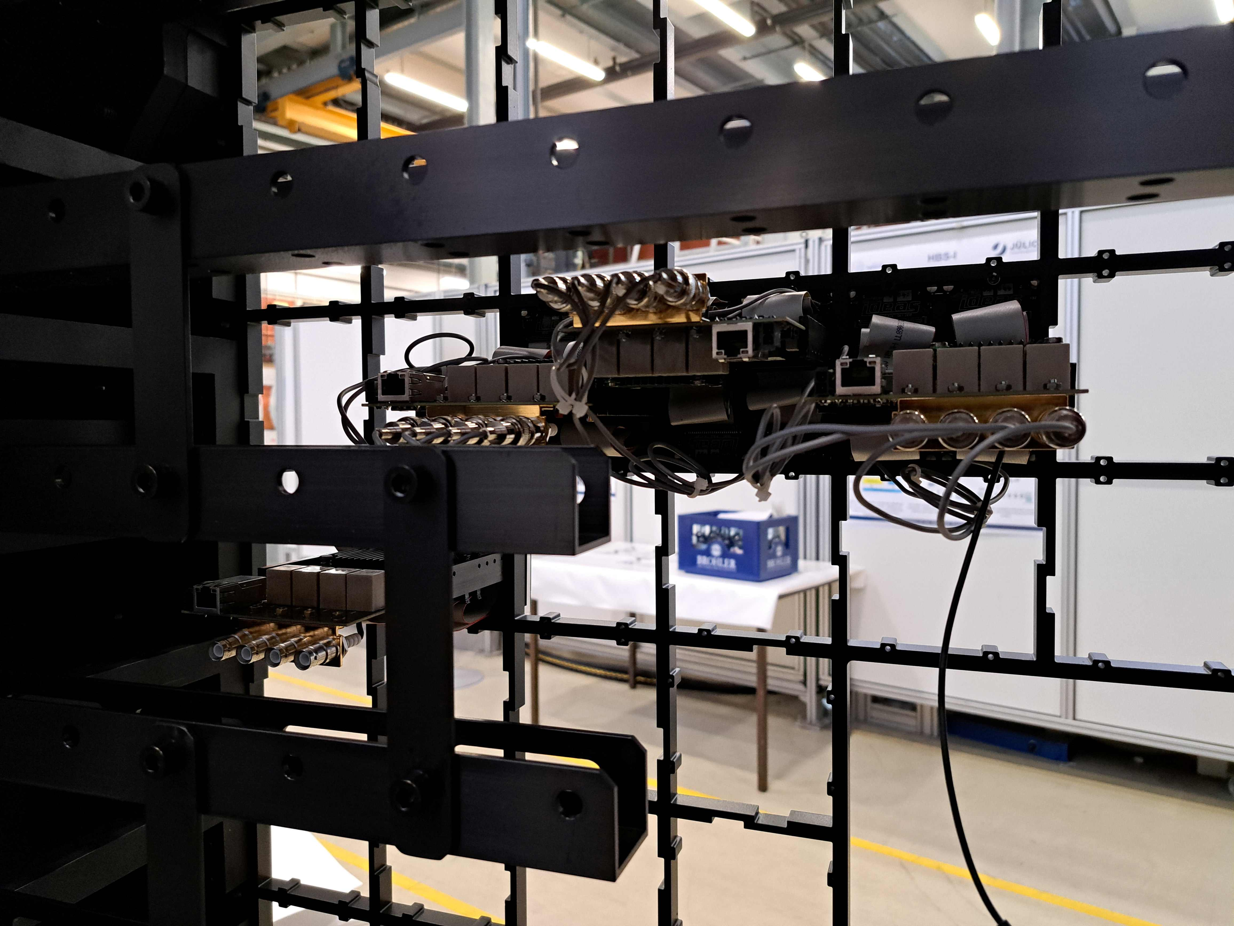
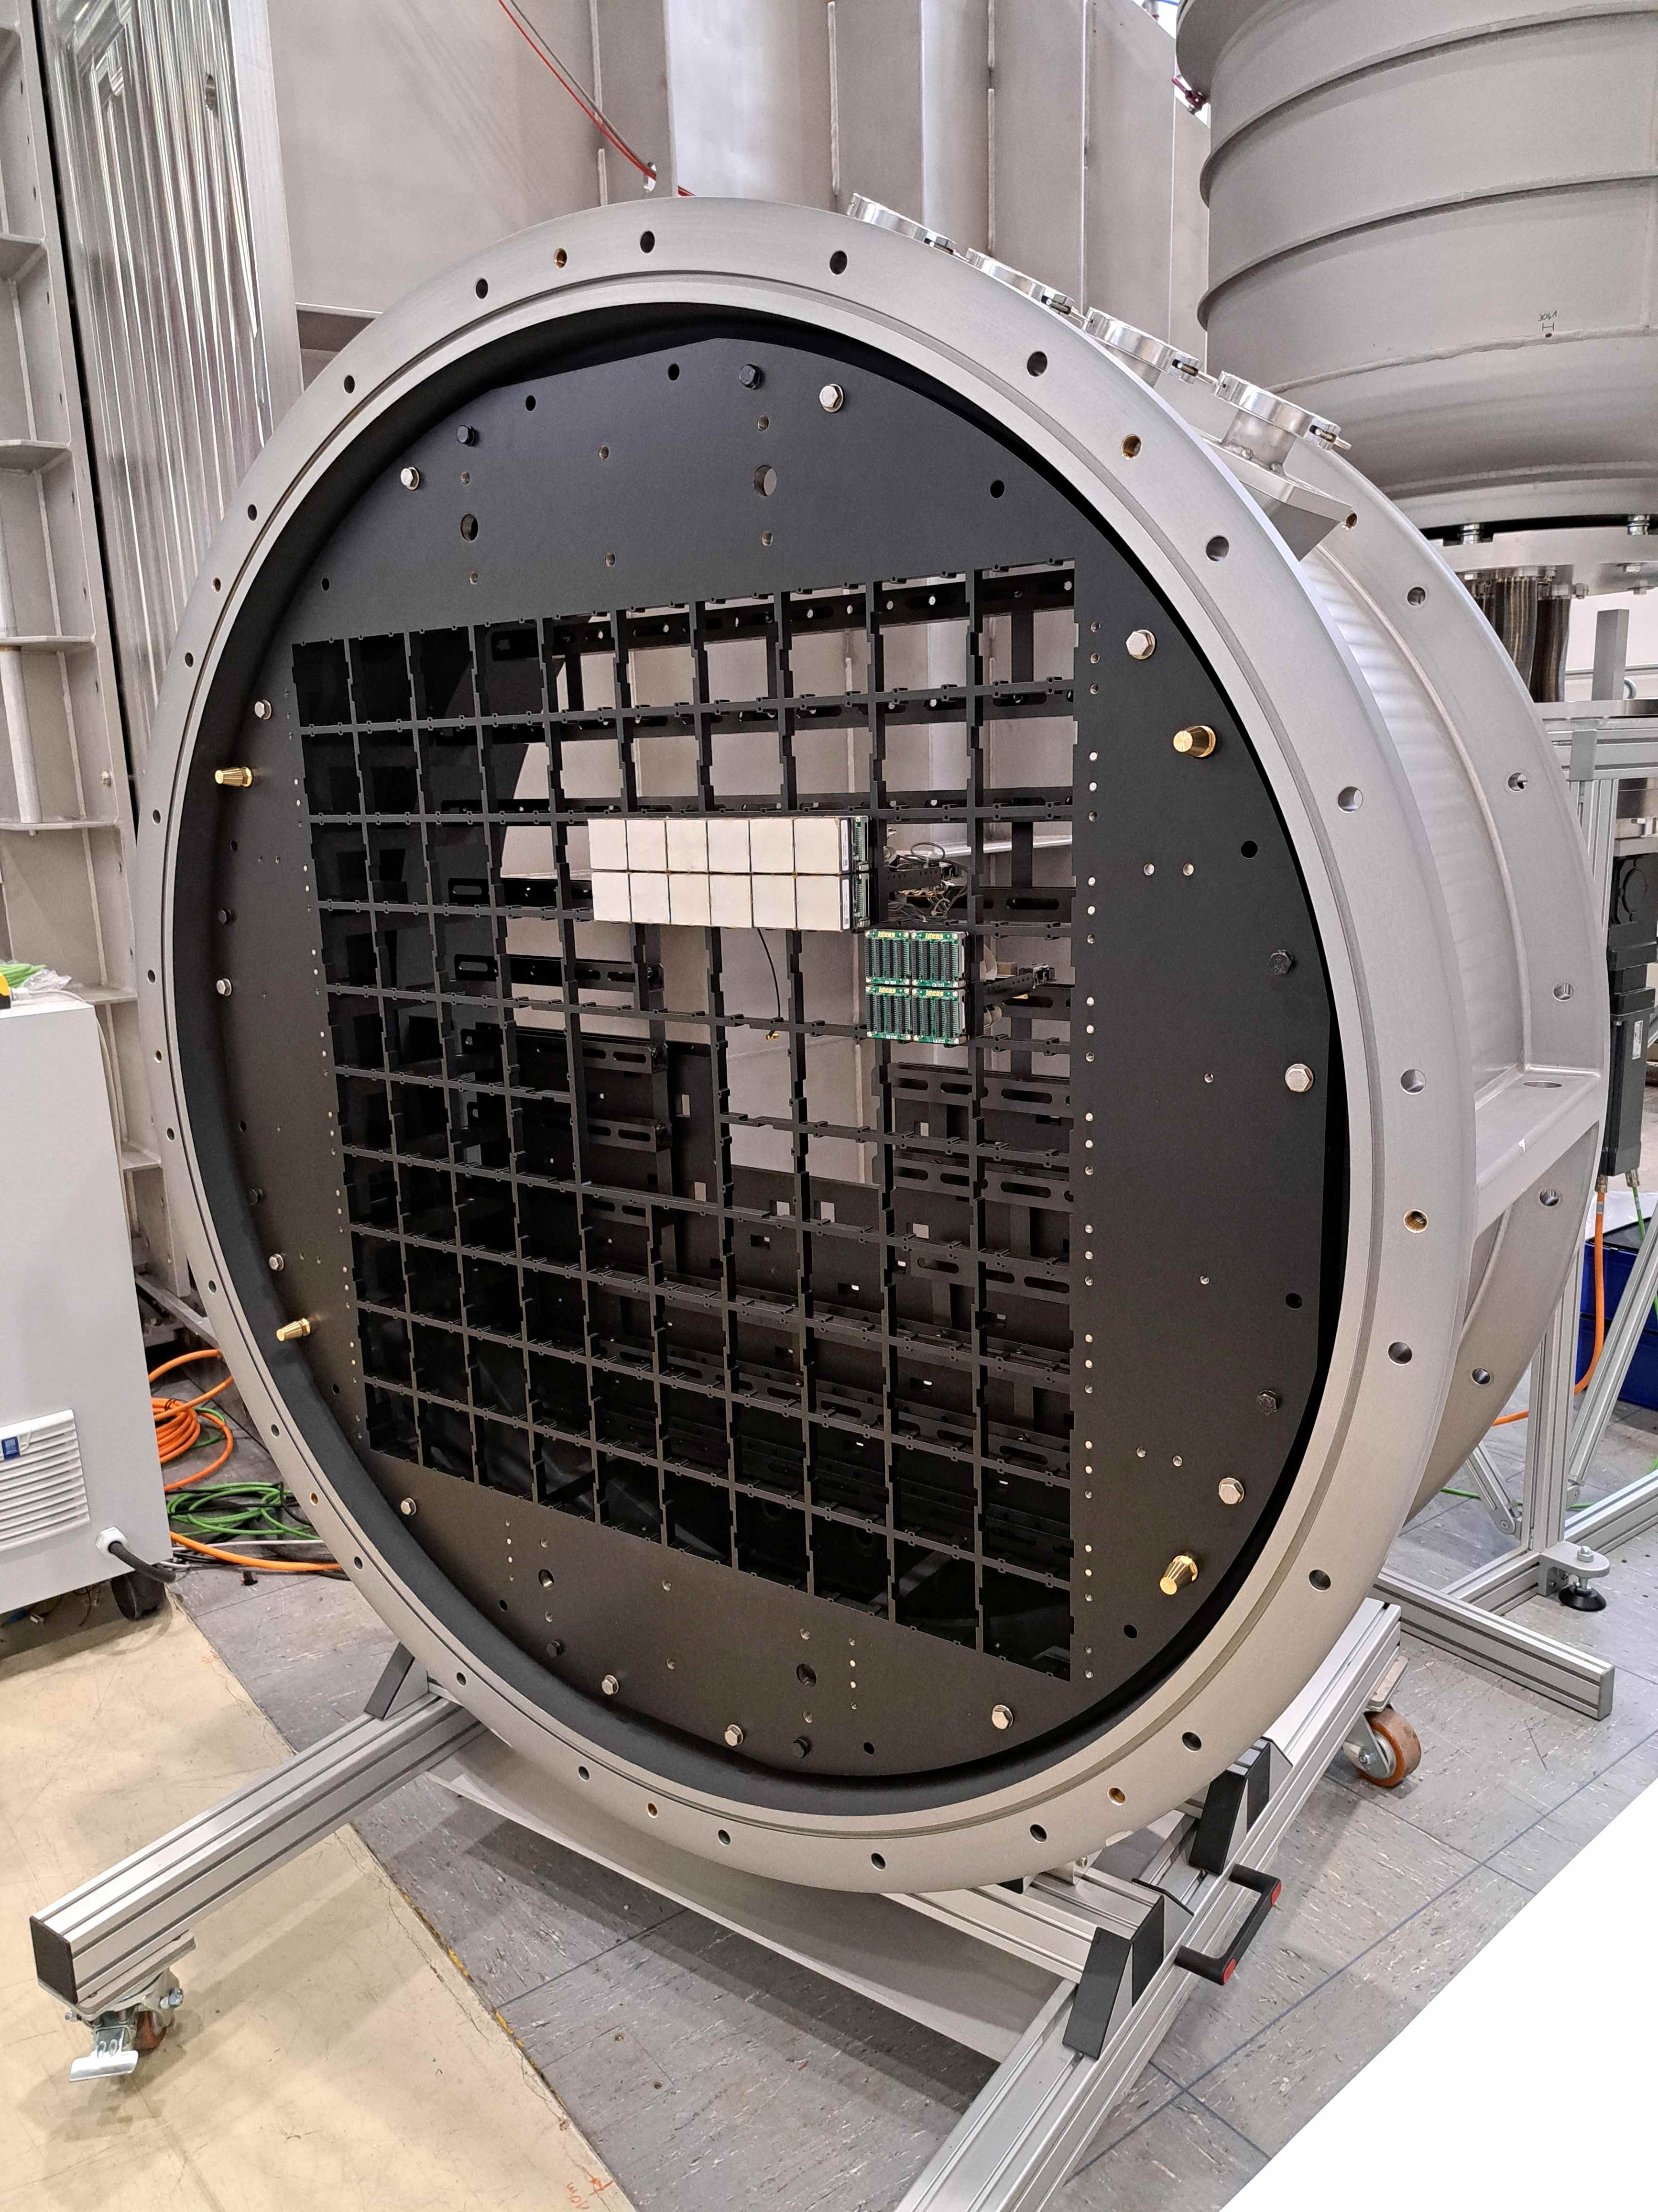
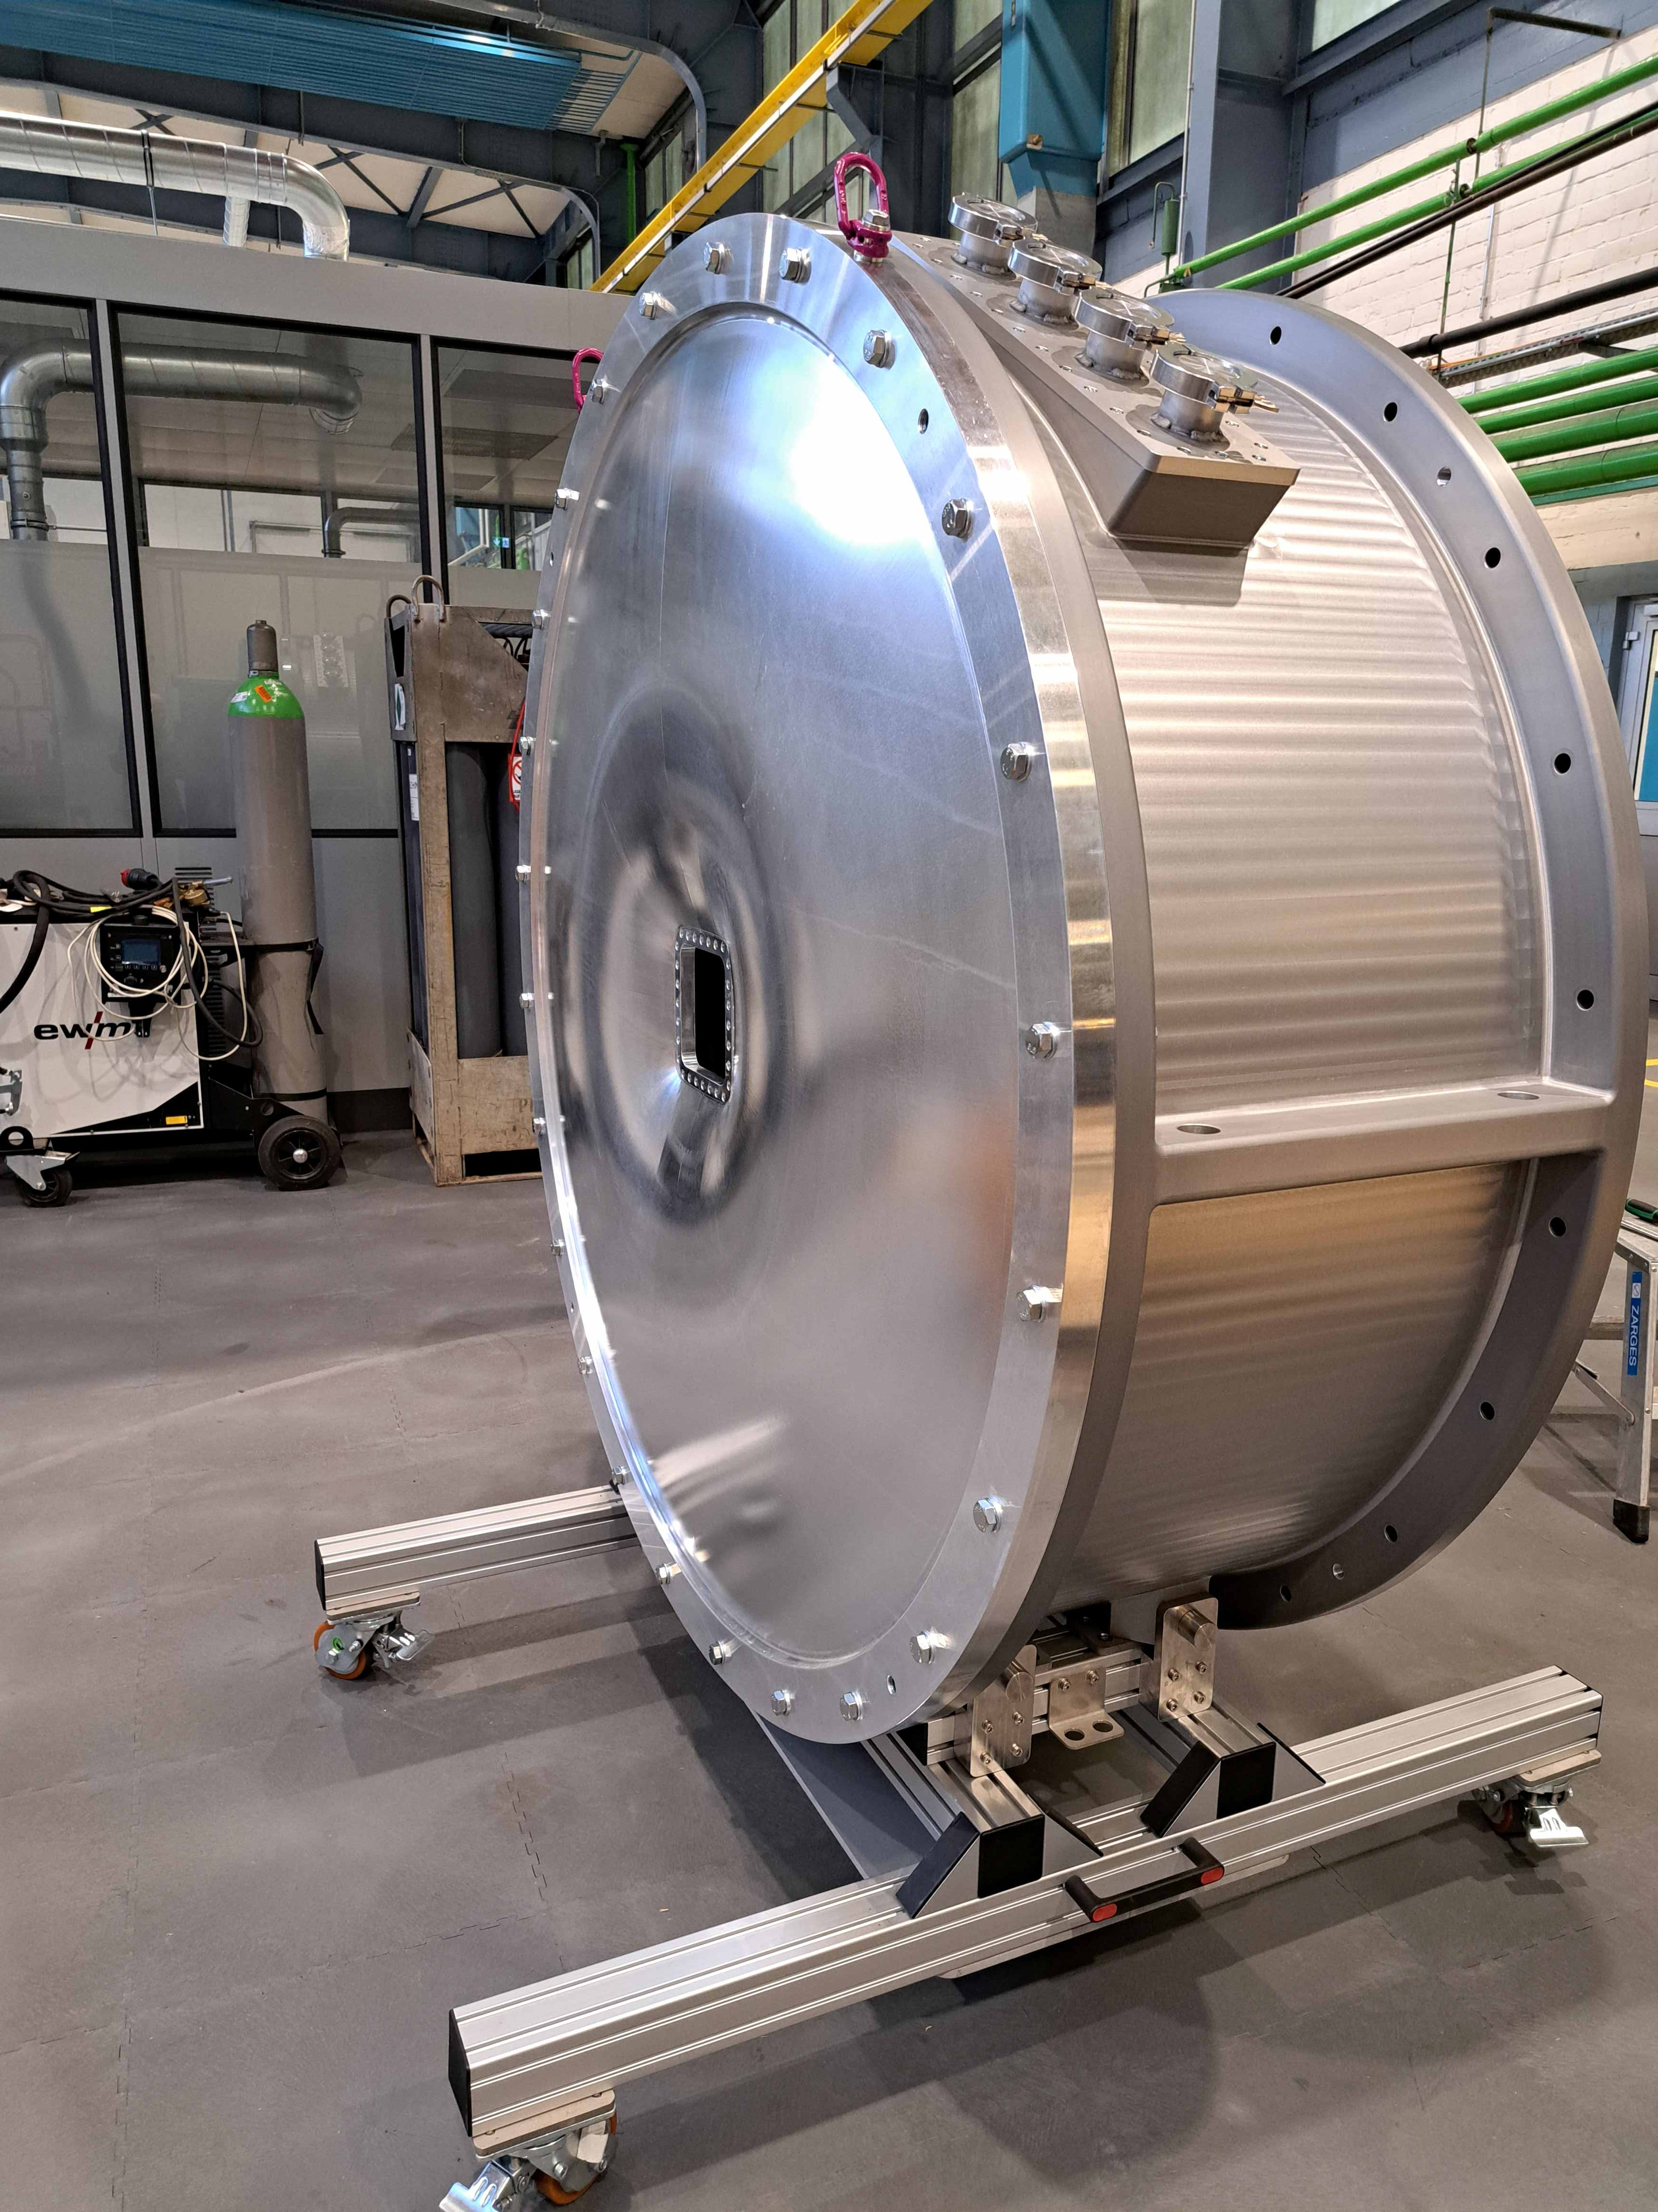
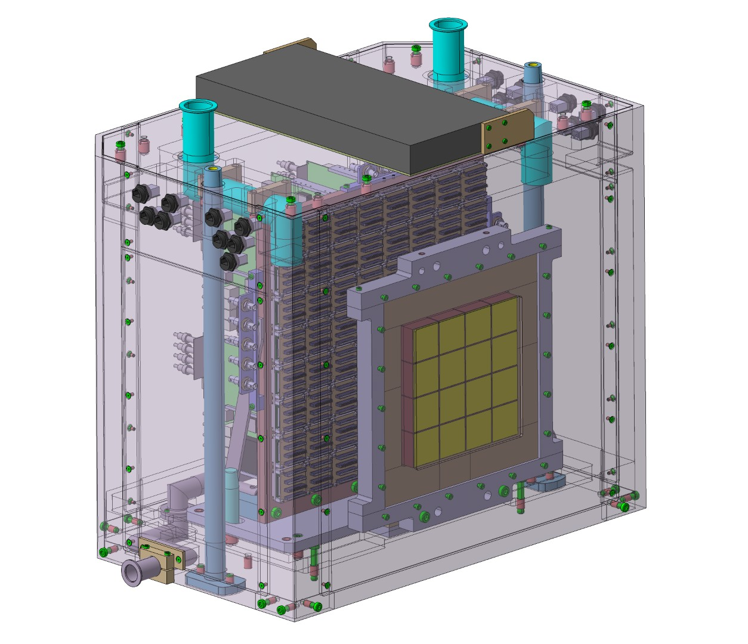
Detector
Pixelated scintillation detector
6x6 mm² or 3x3 mm² resolution
Direct beam capable
Starting with 50% coverage
Better than microsecond TOF resolution

Slide 10
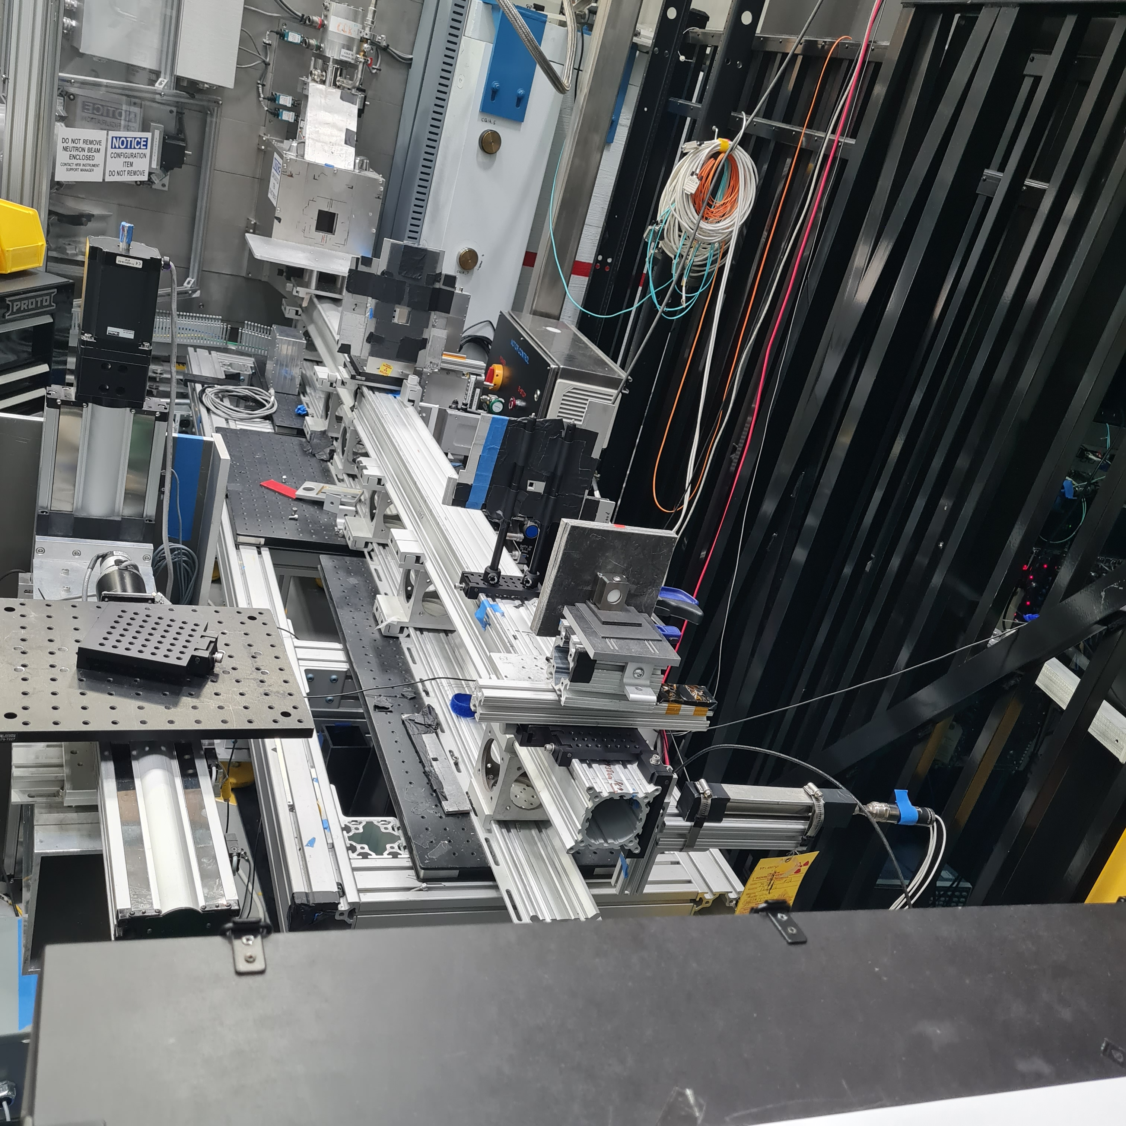
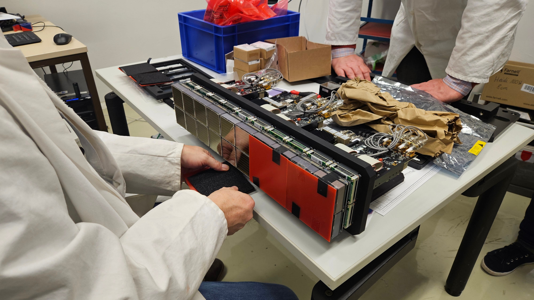
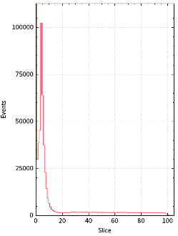
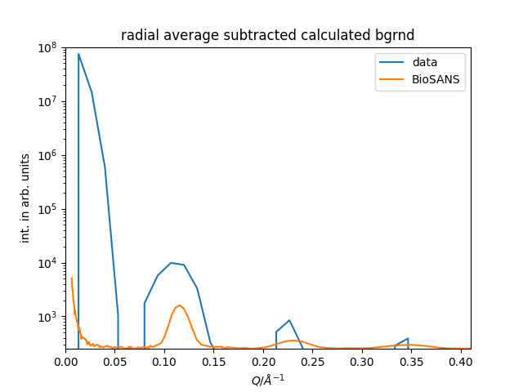
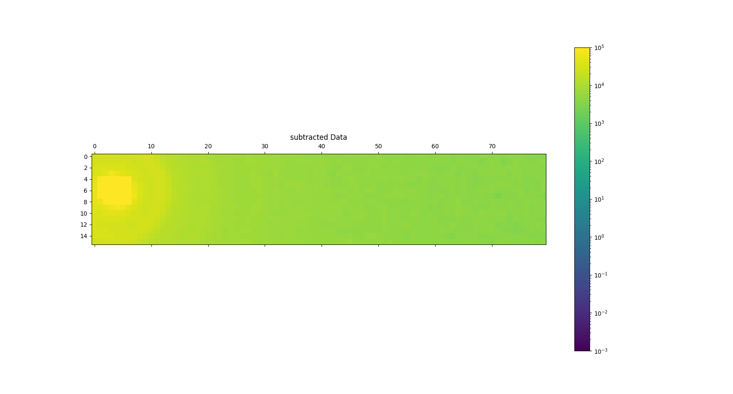
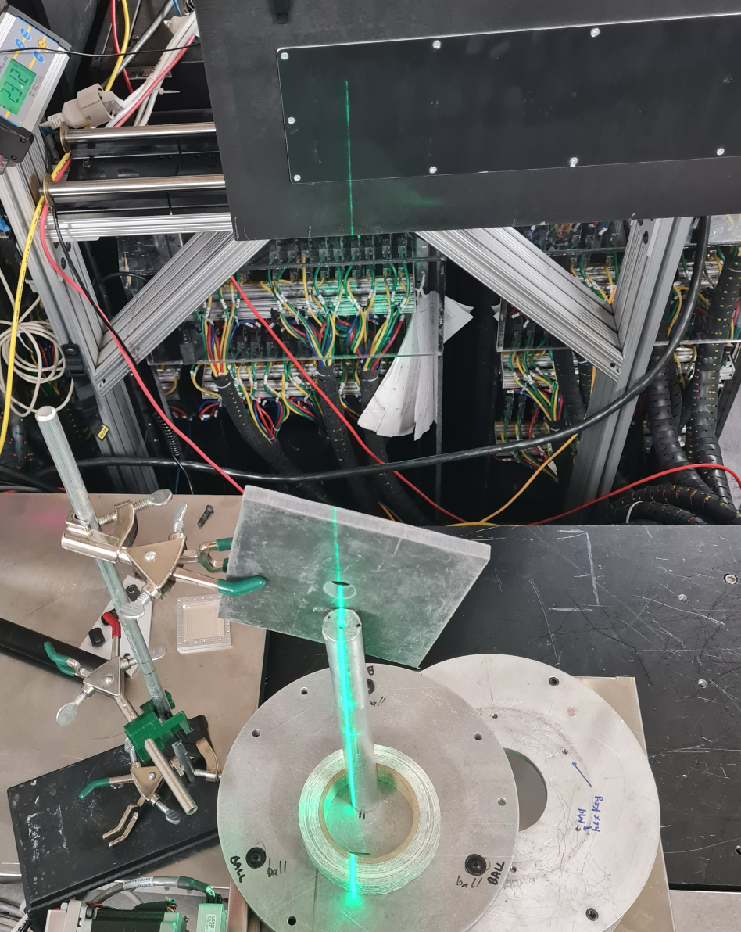
Detector

Slide 11
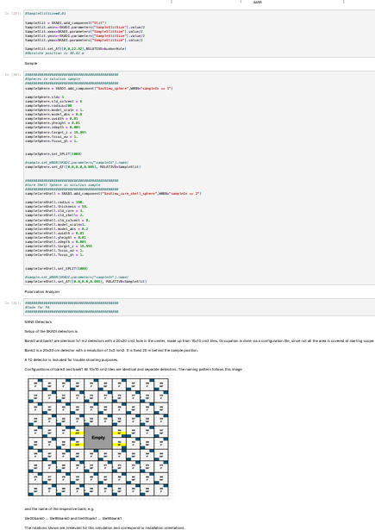
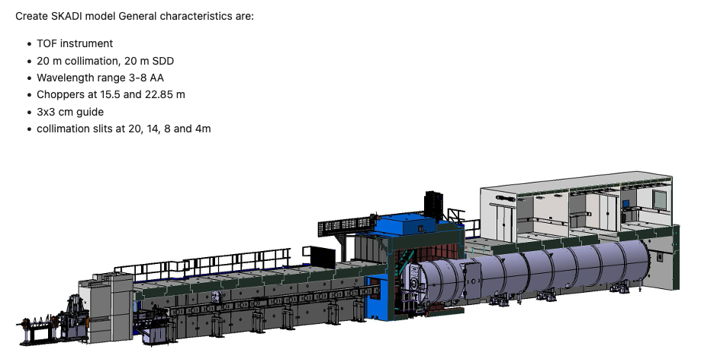
Simulation Preparation
Preparing for rollout
Users will be able to test different instrument configurations
Allows for pretesting of experiment time and optimized resolution in desired Q-range

Slide 12
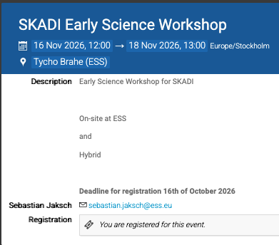
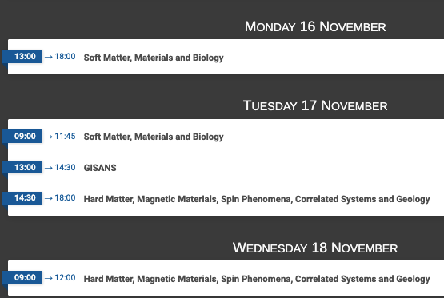
Early Science Workshop
https://indico.ess.eu/event/3938/

Slide 13
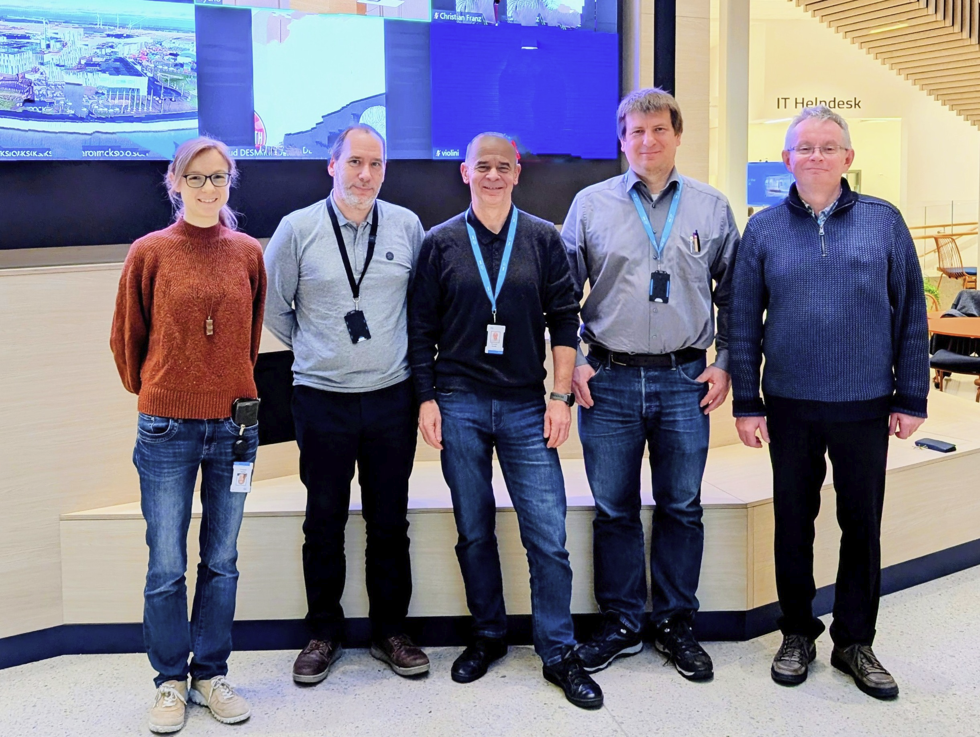
Thanks to ….
Romuald Hanslik, FZJ
Sylvain Désert, formerly LLB now ESS
Tadeusz Kozielewski, FZJ
Ralf Engels, FZJ
Tamires Gallo, ESS
Annika Stellhorn, ESS
Henrich Frielinghaus, FZJ
… And you, for your attention !

