Slide 1






FANTASTIC
Indirect geometry TOF spectrometer designed of the ICONE source
Student: Kyriakos KARYOS
Supervisors: Xavier FABREGES, Frédéric OTT
Notes:
Hello, my name is Kyriakos ,I am a PhD student at CEA/LLB and I’m supervised by Xavier Fabreges and Frederic Ott.
Today I will present fantastic which is an indirect geometry time spectrometer designed for ICONE

Slide 2

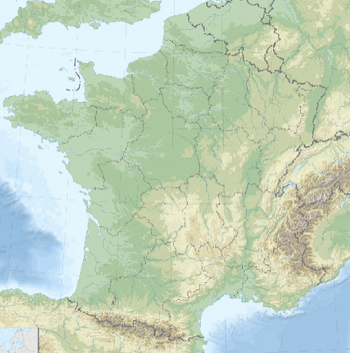
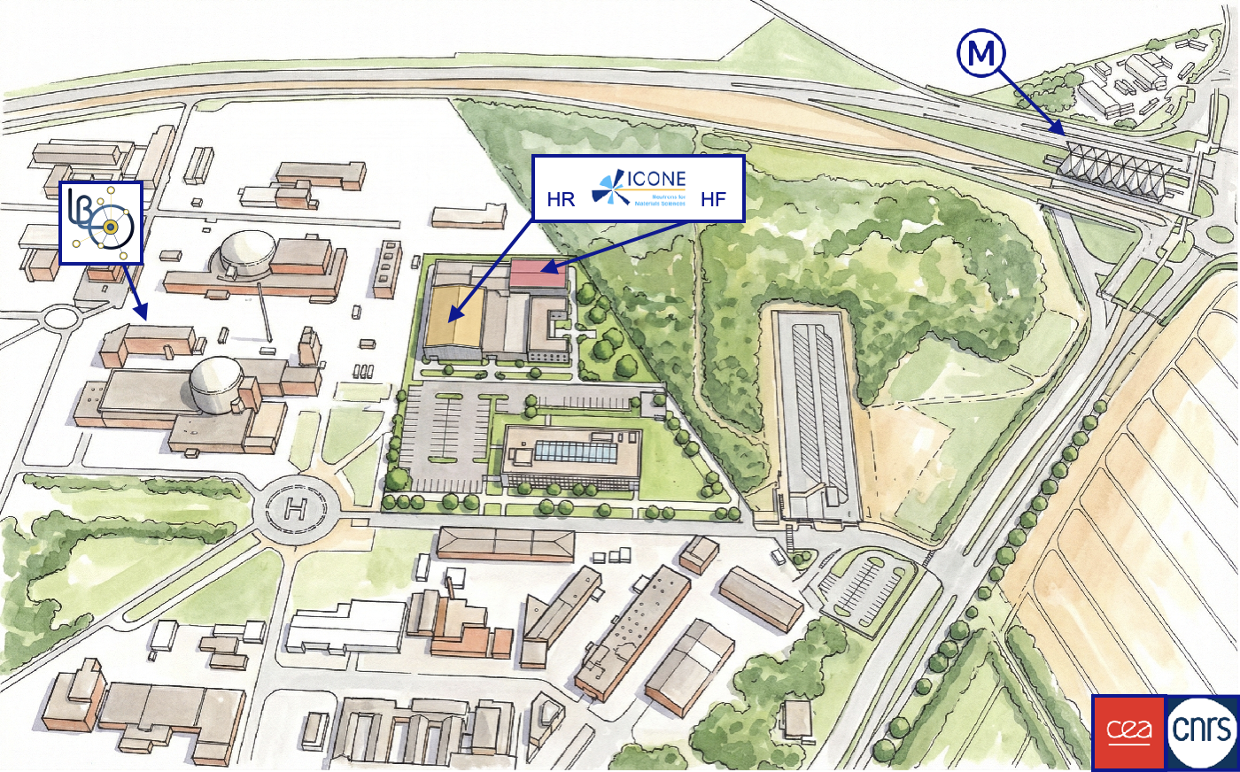
ICONE : Innovative COmpacte NEutrons facility

Slide 3
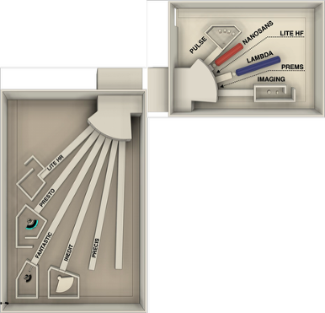
ICONE : Innovative COmpacte NEutrons facility
Access to neutron beams and instruments for the French scientific community over the next 40 years.
2 Targets :
  Target 1 : high flux 20 Hz, 2 ms
  Target 2 : high resolution 50 Hz , 0.4 ms
Instrument suite:
  SANS
  Imaging
  Reflectometry
  Diffraction
  Spectroscopy
Poster presenting ICONE by F.Ott
FANSTASIC : Indirect Geometry TOF spectrometer
High flux
High resolution
Notes:
ICONE stands for Innovative Compacte Nreutron facility and it’s a Hicans meaning a high current accelerator neutron source.
It aims to provide access to neutron beams and instuments for the Franch scientific community over the next 40 years
There are two targets, the first for high flux instrumnts , with 20 Hz Frequency and 2 ms pulse.
And the second for high resolution instuments , with 50 Hz frequency and 0.4ms pulse.
There will be a wide viriaty of instrument for SANS, imaging, reflectotry , Diffraction and spectroscopy.
FANTASTIC is located on second high resolution target

Slide 4

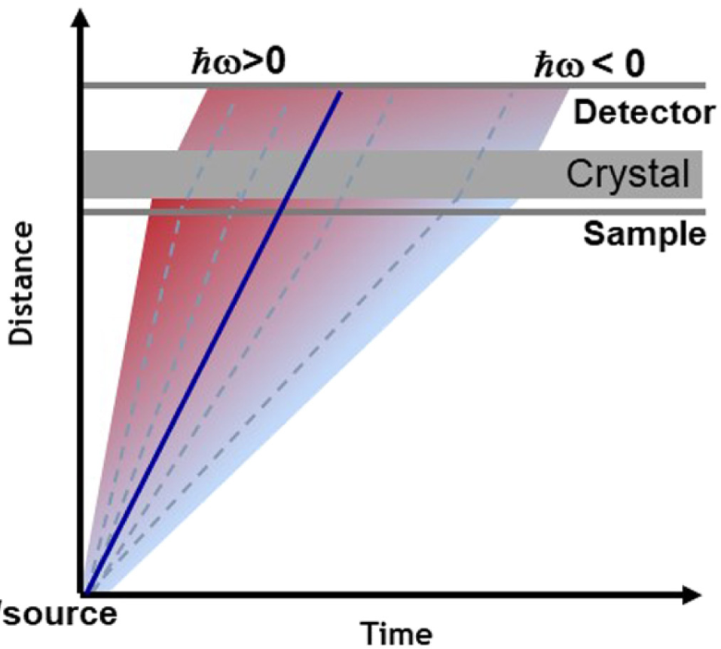
Indirect geometry TOF spectrometers
Indirect/Inverse Geometry
Polychromatic incident beam
Fixed final energy
Determine incident energy with the TOF
Notes:
There are two times of of TOF spectometers, direct and indirect or inverse geometry.
With direct the incident beam that hits the sample is monochromatic, meaning that we select one wavelenght using a chopper or a monochromator.
The final energy is calculated using the tof knowing the distance from the source to sample and the distance from the sample to the detector.
In indirect geometry spectometers, we have a white incident beam and then we can select one final energy using an analyser.
In this case the incident wavelenght will be calculated using the tof and the distances.

Slide 5
Instrument Design
Top view
Curved analyzers (30 in total)
Beryllium/Graphite/SM filter
PSD-TOF banana monitor
7 cm
ICONE source/moderator
Elliptical guide
120 º
12 cm
36.4 cm
0.5 m
1.5 m
35 m
sample
86.8 cm
PSD-TOF banana monitor
Beryllium filter
Side view
Curved analyzers
sample
36.4 cm
86.8 cm
25 cm
Slits/Collimators
50 cm
PSD-TOF monitors
56cmX2*1.9cm
Notes:
Regarding the design of the instrument
It is compromised by a 35 m long elliptical guide
An array of 30 curved analysers positioned evey 4 degrees 87cm from the sample.
The analysers reflect neutrons downwards to a position sensitive time of flight detector of two helium tubes
Half way between the sample and the analyser there’s a Be filter to remove the second harmonic and a banana monitor to help with the alignment of the sample

Slide 6
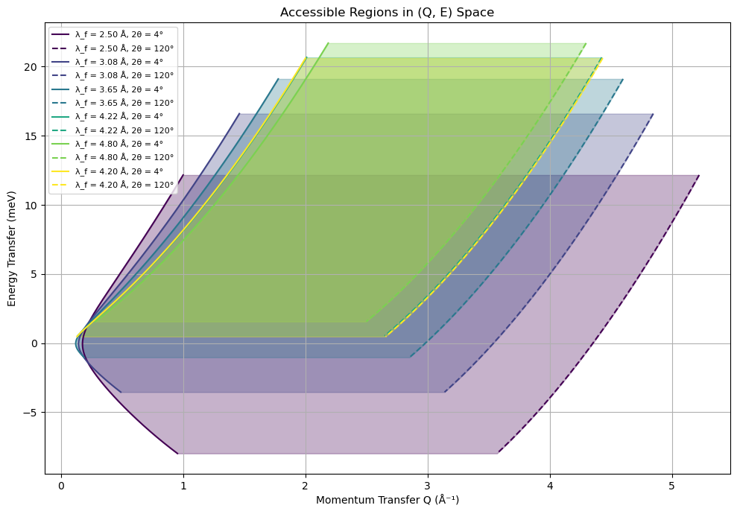
Accessible Q-ΔΕ region
Analyzers can rotate selecting different final wavelengths.
Access different Q-ΔE regions.
Longer wavelength -> Larger energy transfer and narrower Q ranger.
Shorter wavelength -> Smaller energy transfer and wider Q ranger.
Notes:
The analysers can be rotated in order to different final waveleghts.
Depending on the final wavelght different part of the Q-energy tranfer region can be covered.
If you choose a larger wavelght you can access a higher energy tranfer, but a narrower Q range.
And the opposite for a smaller waveleght.

Slide 7
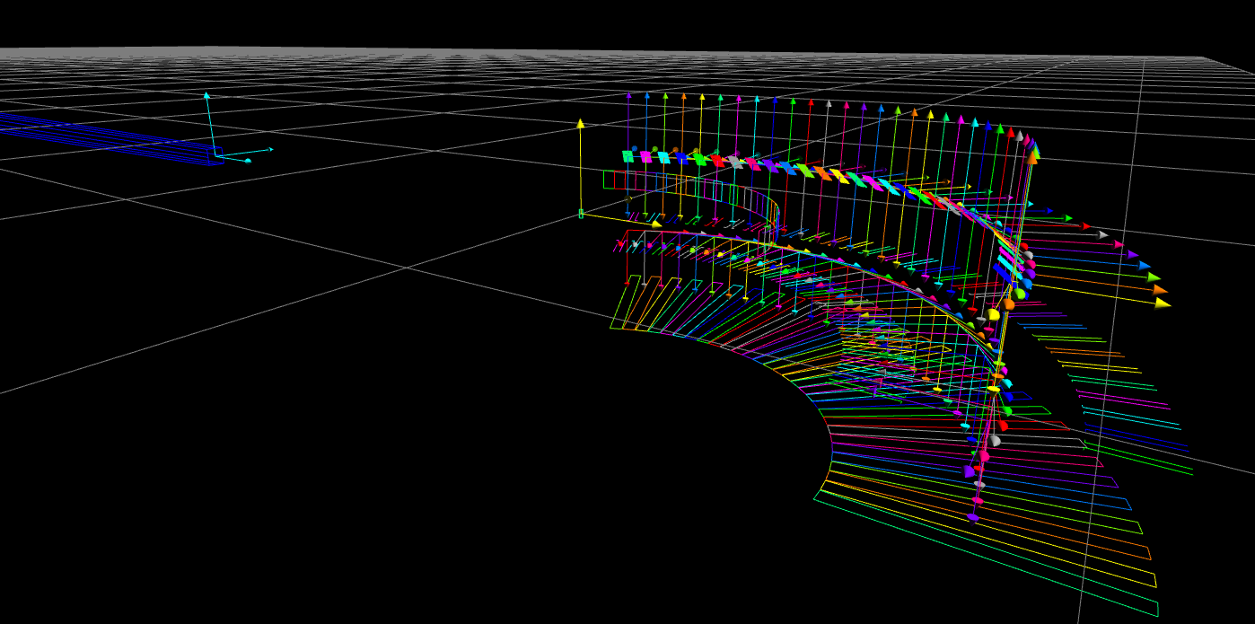

Notes:
The instrument is simulated in McStas
The filters, analysers, slits and detectors are group in order to act as one component.

Slide 8

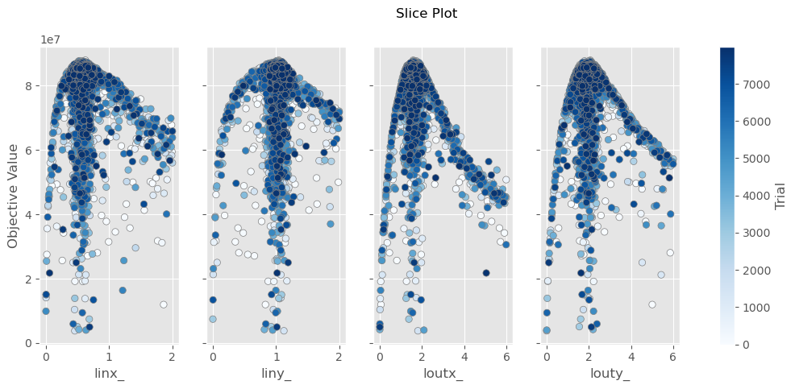
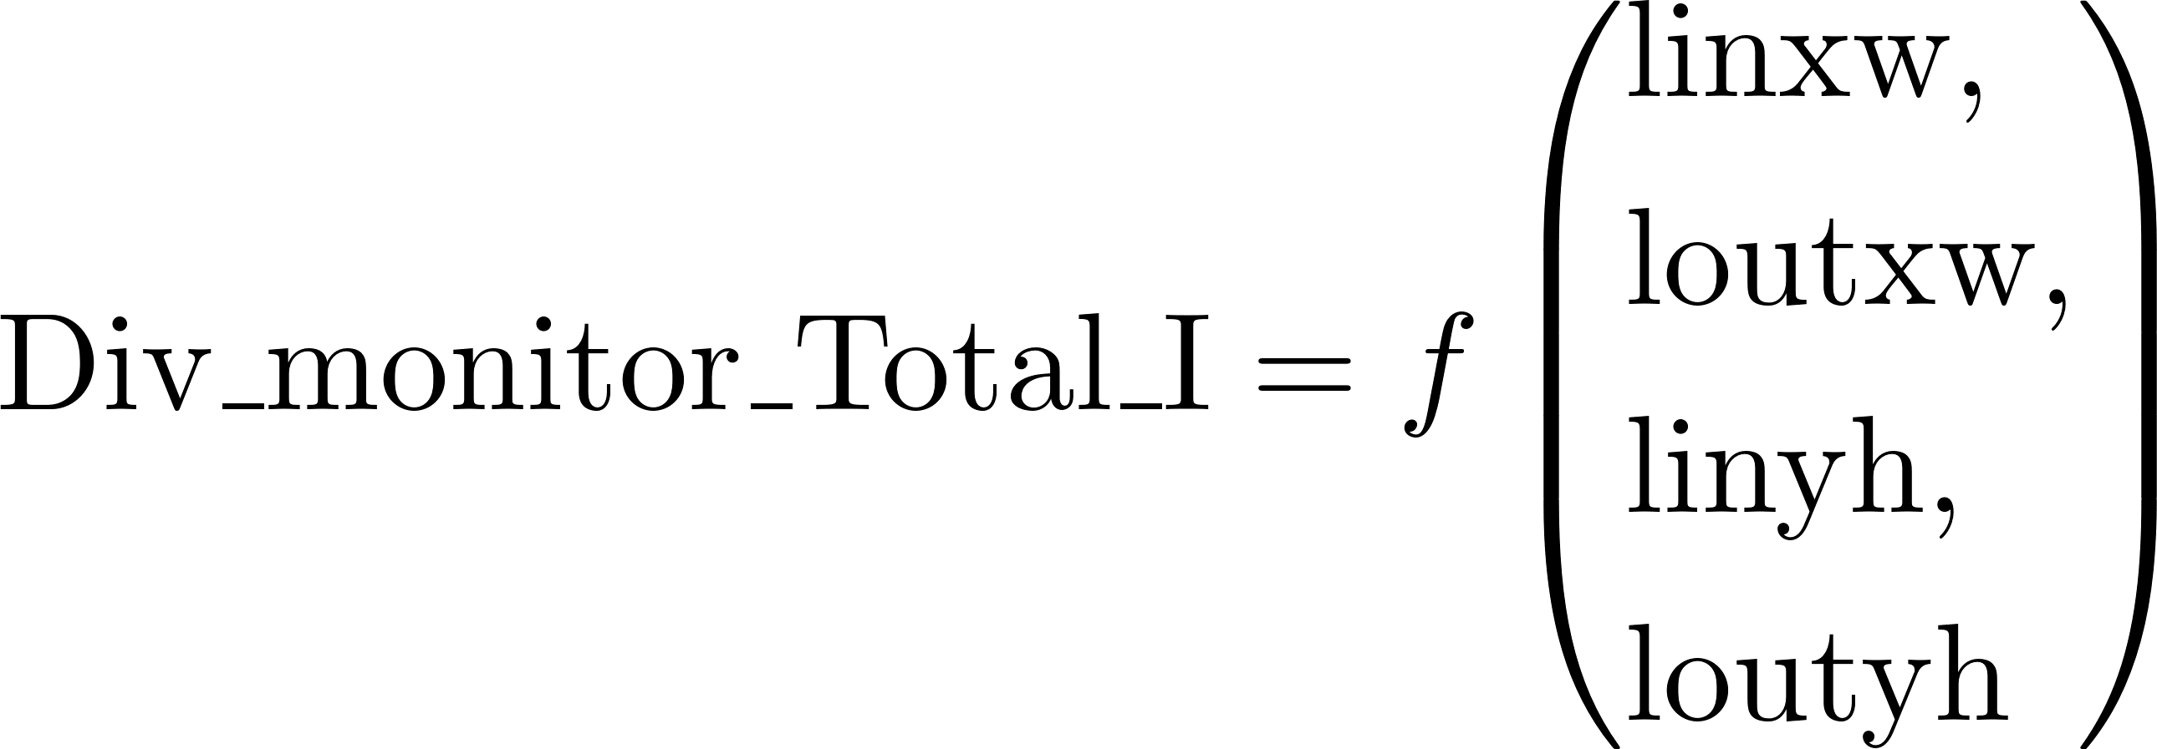


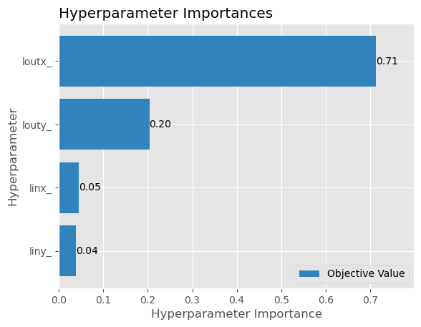
Guide parameter optimization
Sample size: 2cmX2cm
Divergence: +/- 1º
moderator
Elliptical guide
sample
12 cm
0.5 m
1.5 m
35 m
i trials
Best parameter combination
Notes:
The elliptical guide is defined by the distance from the focal point to the entrance or exit of the guide.
These parameters must be optimized to achieve maximum brilliance transfer.
To accomplish this, we used McStasScript to define a Python function that takes these parameters as input, runs a simulation, and returns the total intensity measured by a divergence monitor.
This monitor has dimensions of 2×2 cm, corresponding to the sample size we are optimizing for, and a divergence acceptance of ±1 degree.
To identify the optimal parameter combination, we used an optimization library called Optuna.
This library, instead of sampling blindly, builds probabilistic models of good and bad parameters combinations, and focuses sampling on the most promising regions of the search range, as you can see here.

Slide 9
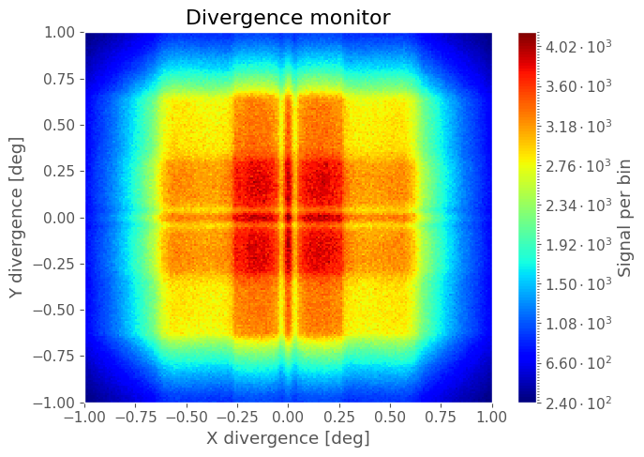
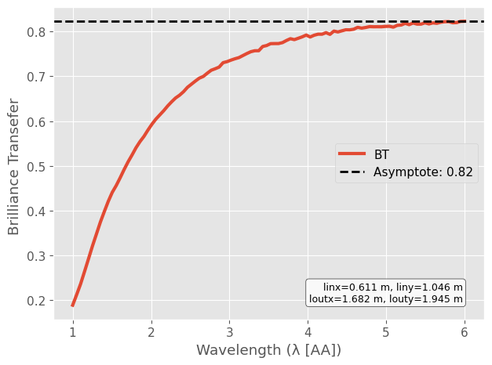

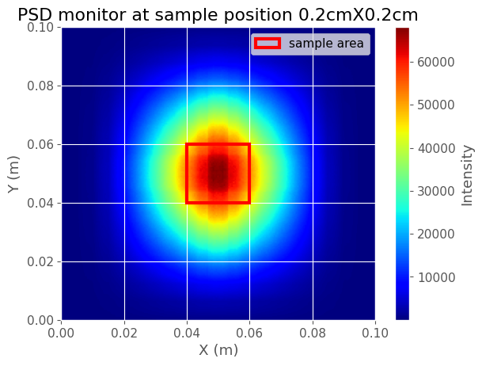
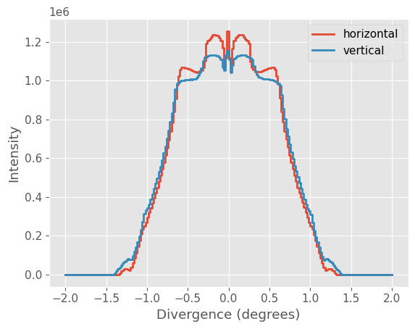
Brilliance
Notes:
For the best parameter combination given by optuna, we optain a brilliance tranfer of 82 per cent .
Here tou can see the divergence and a intensity at sample position.
The flux at sample position is of the order of magnitude ten to the seven neutrons per second per centimeter squared.

Slide 10
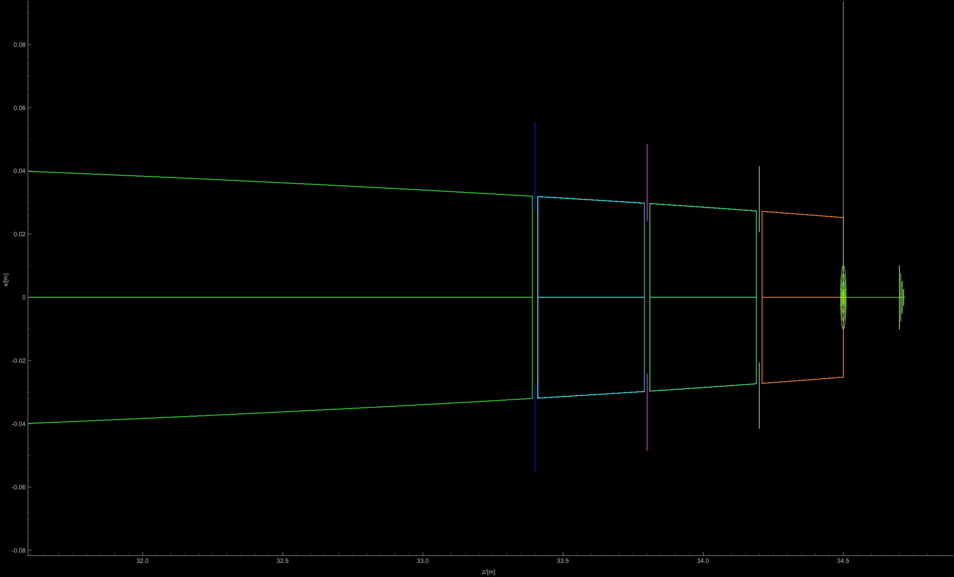
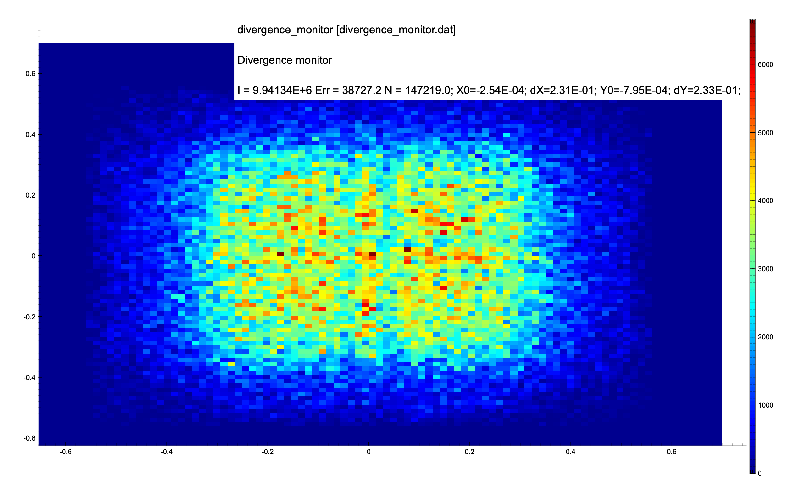
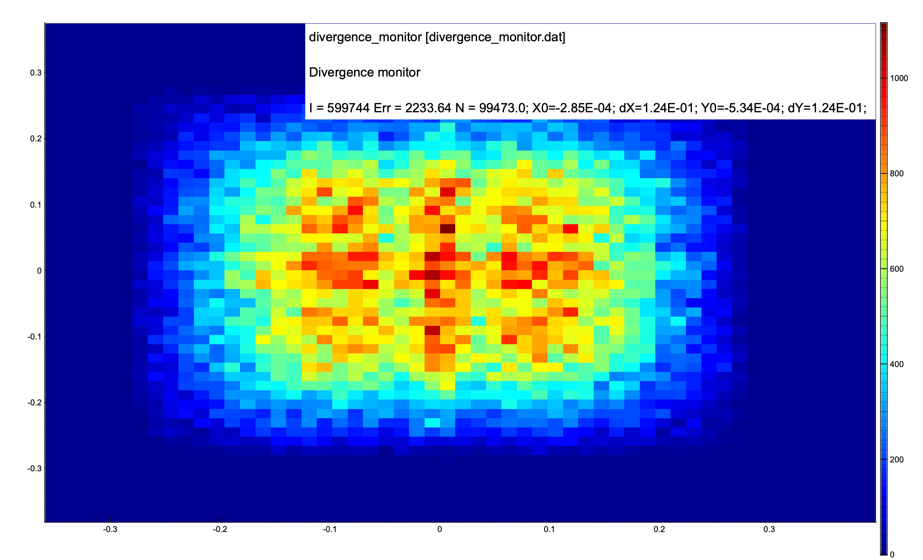
Divergence slits
Divergence = +/- 0.5 degrees
Divergence = +/- 0.25 degrees
Φ = 3.86 e6 n/sec/cm2
Φ = 5.16 e5 n/sec/cm2
Positions from guide exit:
0.3 m
0.7m
1.1m

Slide 11
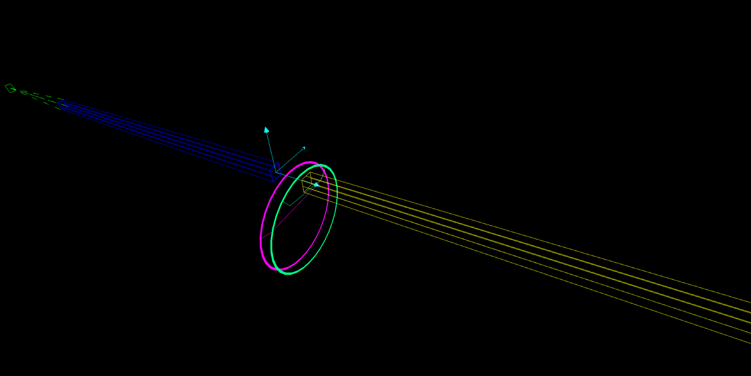
Chopper cascade - full digital twin

Slide 12

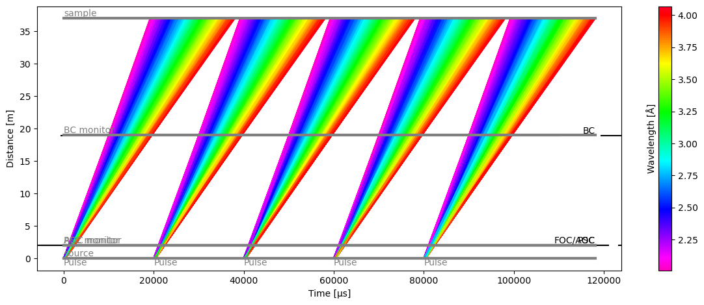
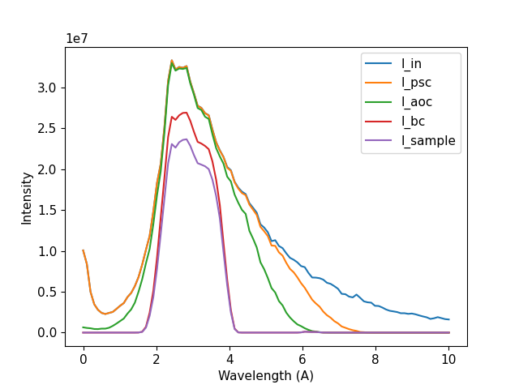
Choppers cascade – 1st configuration , 400μs pulse
Chopper | Opening | Frequency | Distance from the moderator
Pulse Shaping (PSC) | 140º | 50Hz | 2m
Anti Frame Overlap (AOC) | 40º | 50Hz | 2.05m
Bandwidth (BC) | 170º | 50Hz | 19m
BC
AOC
PSC
Notes:
The chooper cascade is compromised by 3 choppers
A pulse shapping , a Frame ovelpap , and Bandwidth chooper
Here you can see the distance – time digram
The waveleght distribution after each chooper and the pulse a sample position

Slide 13
Resolution degradation
τ = 400μs
65% usable
35% resolution degradation t = 3τ

Slide 14
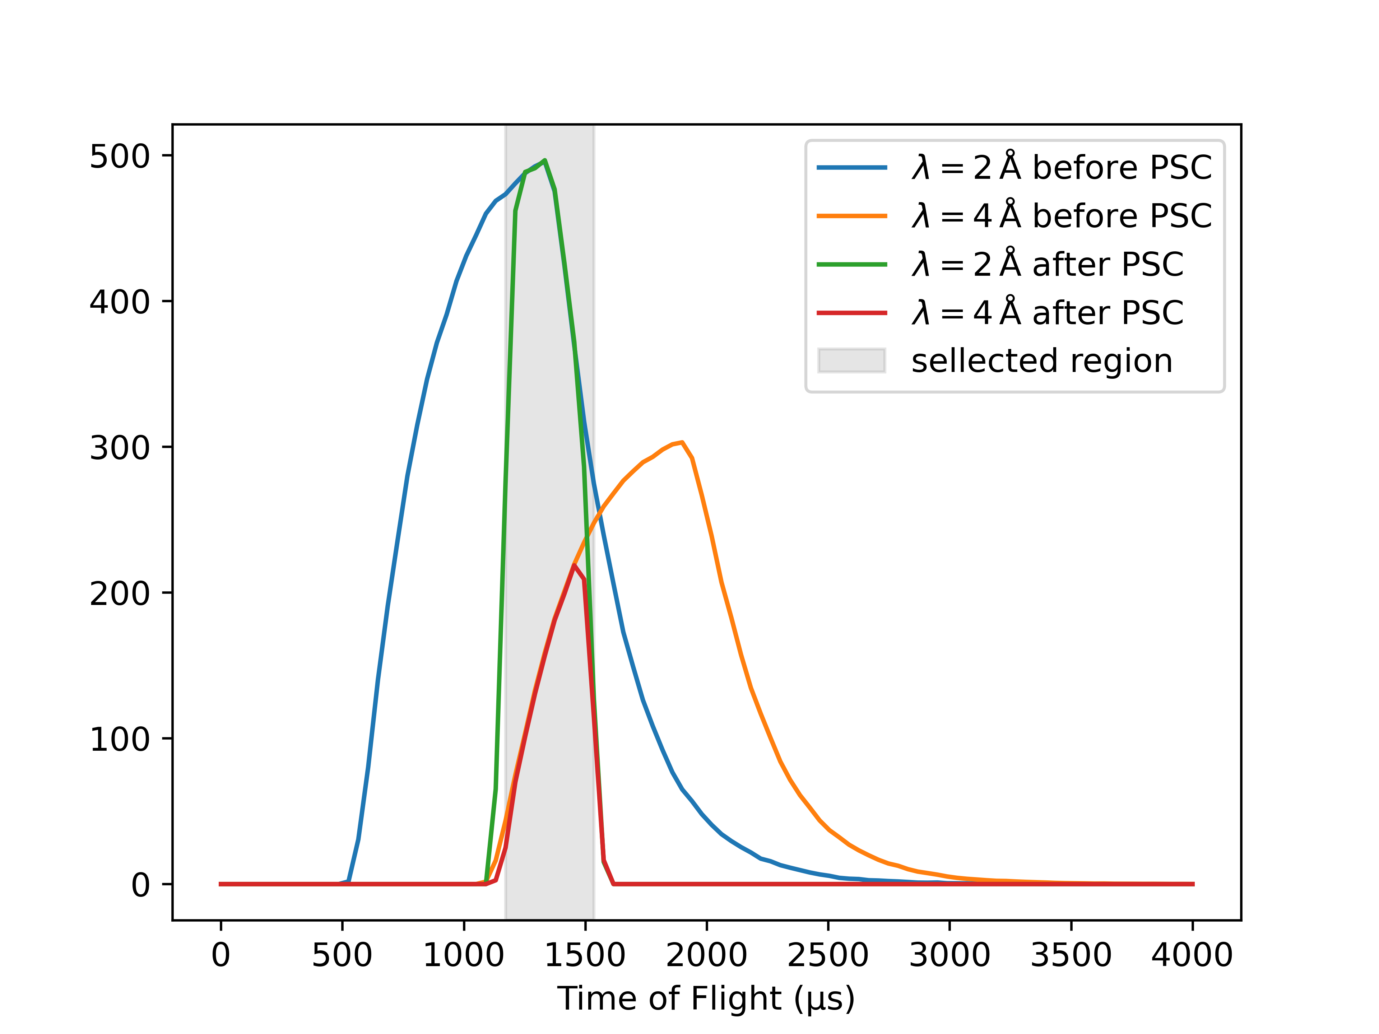
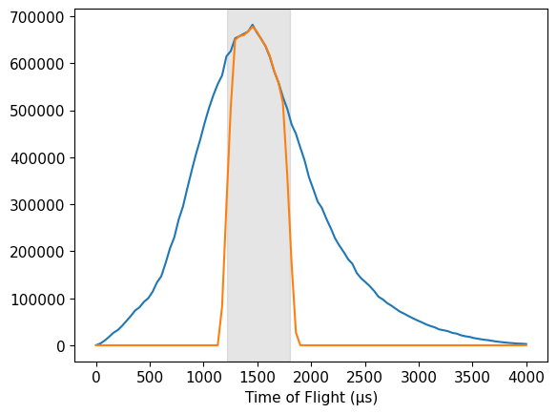


Choppers cascade – 2nd configuration , 800μs pulse
Chopper | Opening | Frequency | Distance from the moderator
Pulse Shaping (PSC) | 20º | N*40Hz | 1m
Anti Frame Overlap (AOC) | 20º | 40Hz | 1.05m
Bandwidth (BC) | 90º | 40Hz | 17m
Flux at sample position reduced by 54%
From:
Notes:
The chooper cascade is compromised by 3 choppers
A pulse shapping , a Frame ovelpap , and Bandwidth chooper
Here you can see the distance – time digram
The waveleght distribution after each chooper and the pulse a sample position

Slide 15
Energy resolution of an indirect geometry TOF instrument
Moderator pulse
Passing thought the guide - minimum and maximum number of reflections
Sample size
moderator depth
Analyser lattice spacing
v
v
v
Detector thickness
Sample size
Angular spread due to sample size
Notes:
To talk a bit about the resolution of the instrument,
There are several contributors to the resolution of the instrument.
There are uncertainties in time, length , lattice spacing of the analyser and angular distribution.
The most dominant factor is the time uncertainty due to the moderator pulse and the sample size.

Slide 16
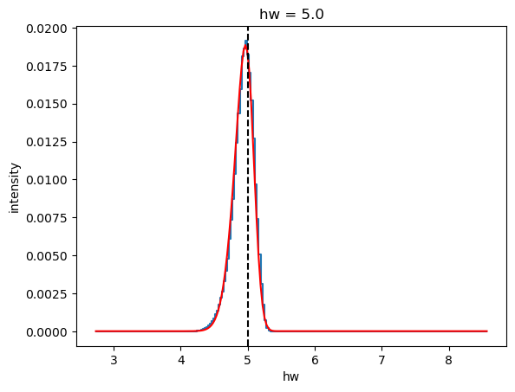
Energy resolution – methodology
Sample of d=0.02m , h =0.02 m
Direct beam, 2θ=0^{ο}
Tunnelling_sample or Incoherent sample – define the energy transfer
Detector below the analyzer -TOF signal
Convert TOF to hw
Fit hw ”signal” with a skewed gaussian
For different hw and λf

Slide 17
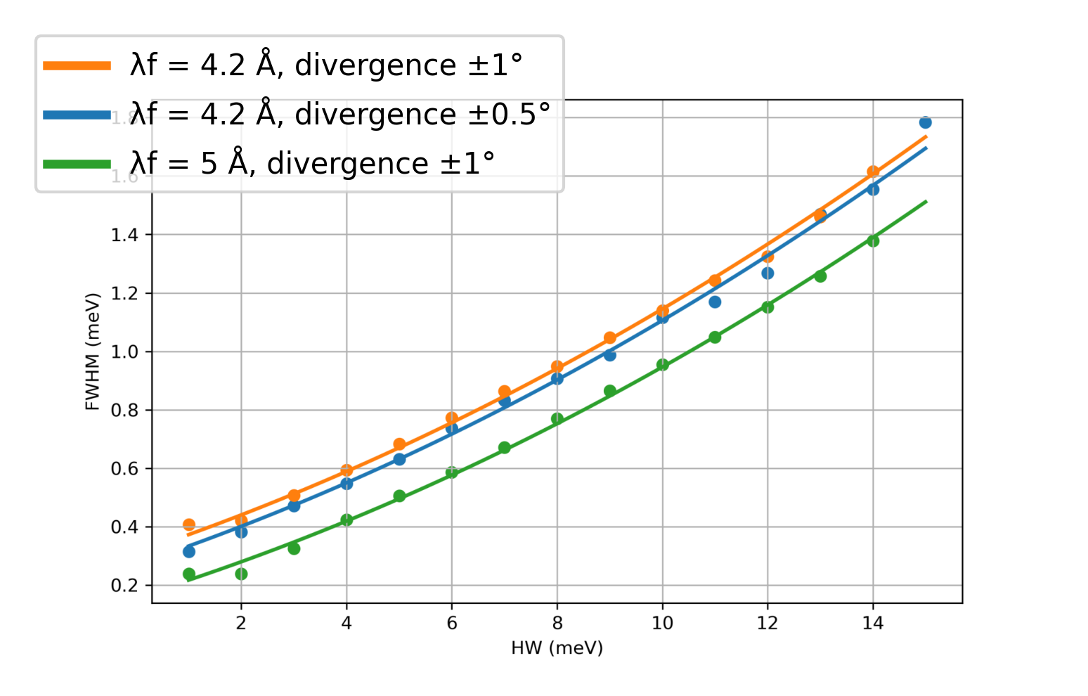
Energy resolution – 1st chopper configuration
Sample size: 2cmX2cm
Higher λf -> better resolution.
Resolution worsens for higher hw.
For the λf=4.2 AA fwhm=0.4-2 meV

Slide 18
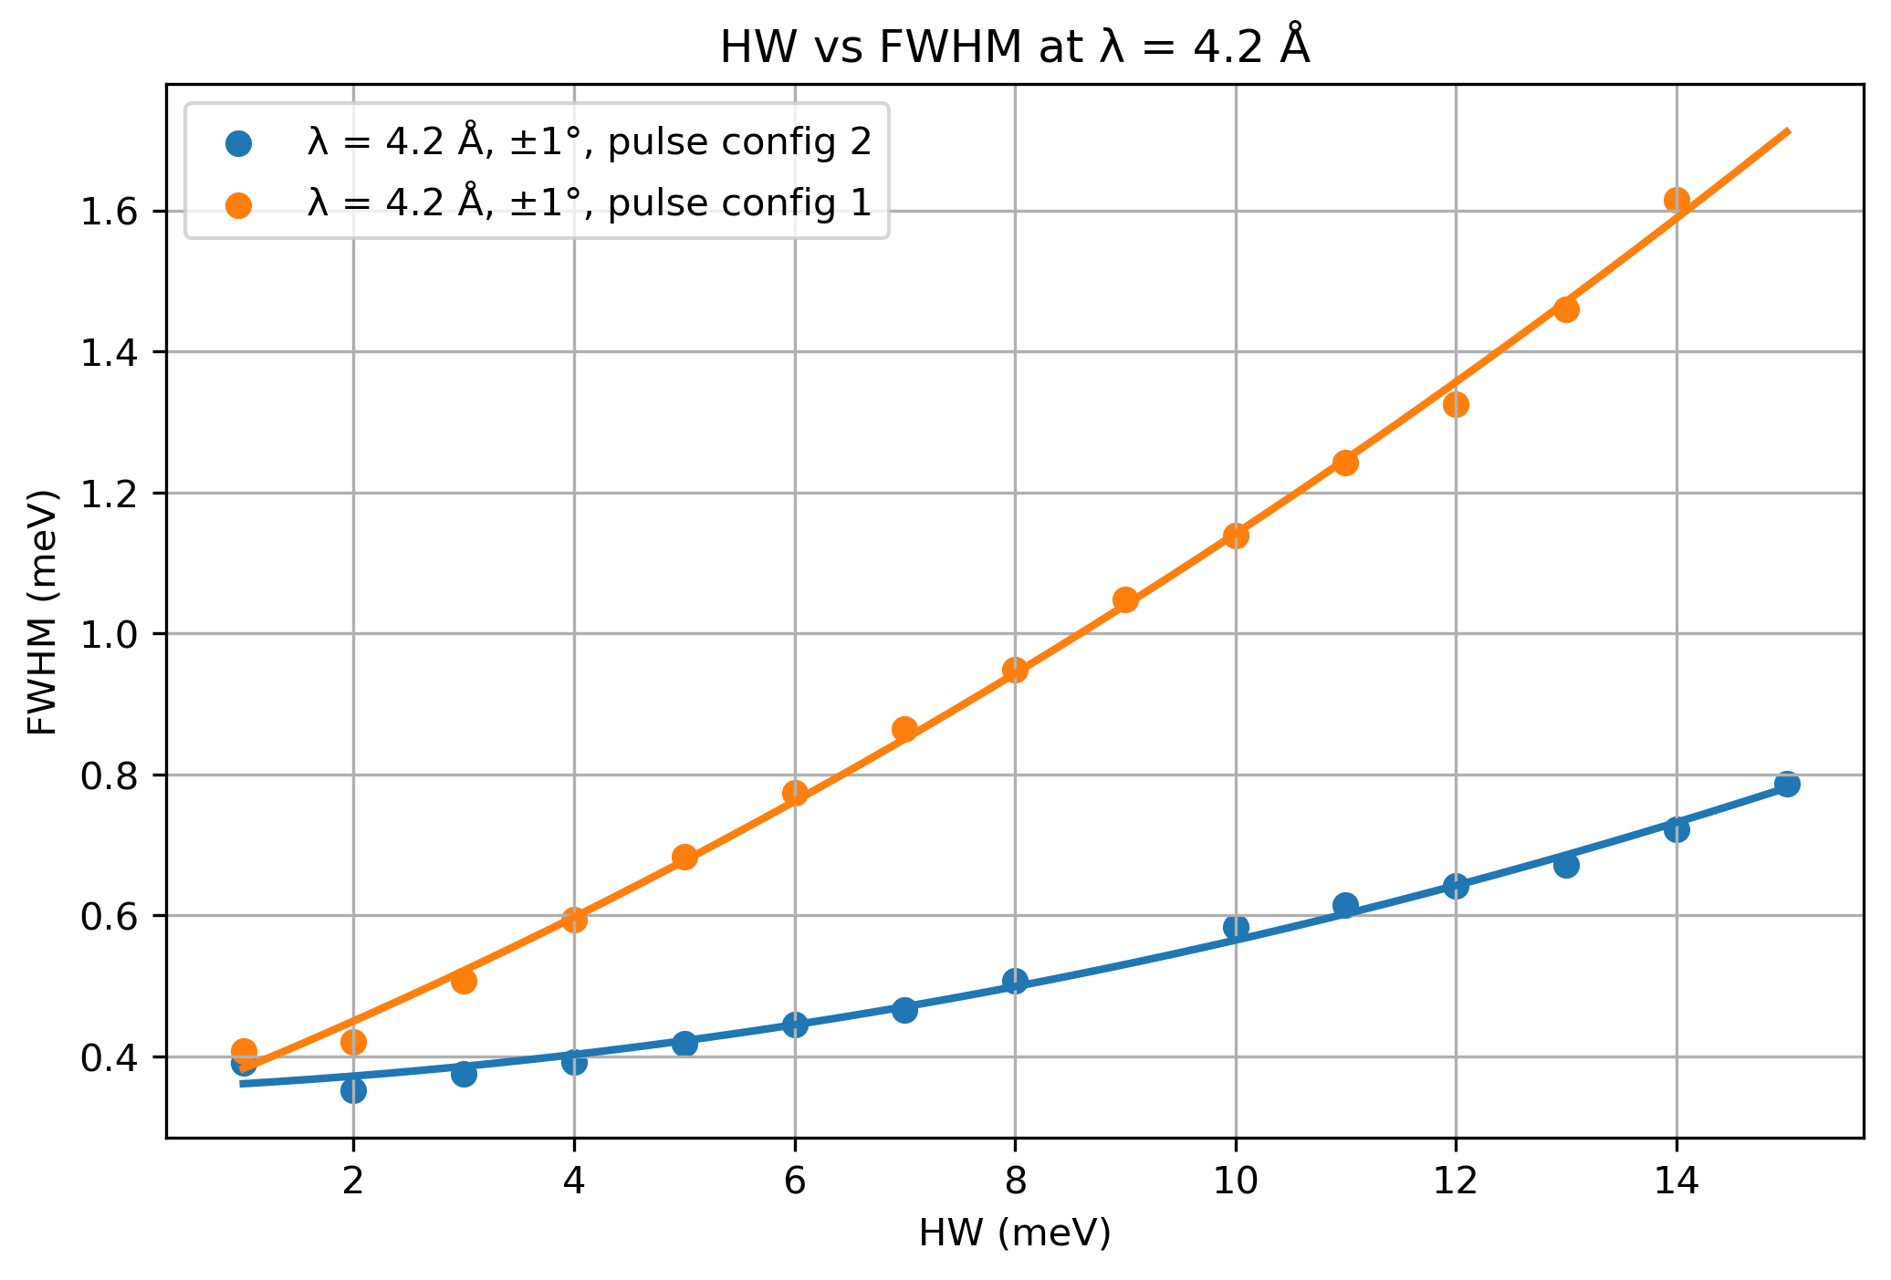
Energy resolution – 2nd chopper configuration

Slide 19
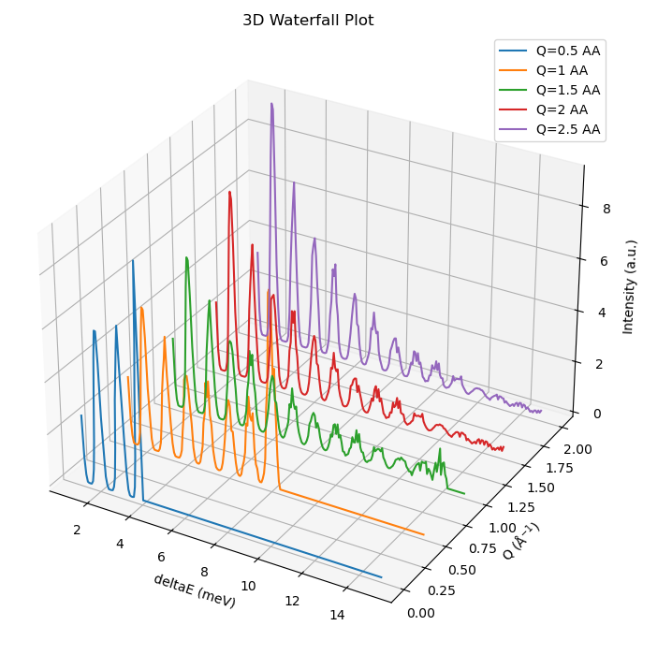
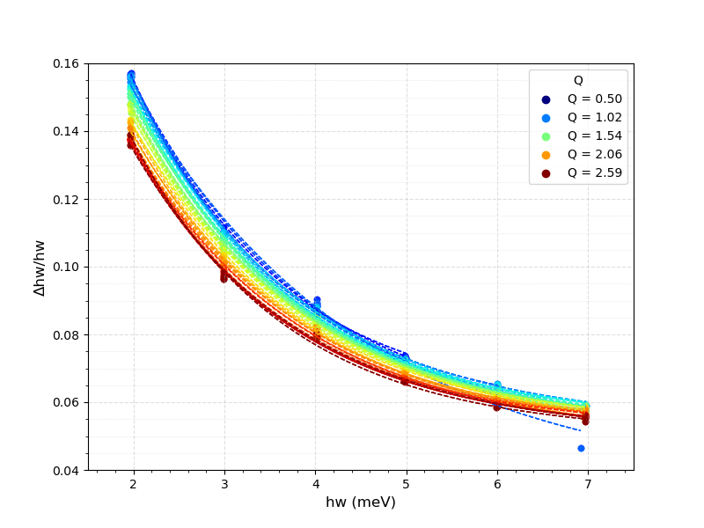
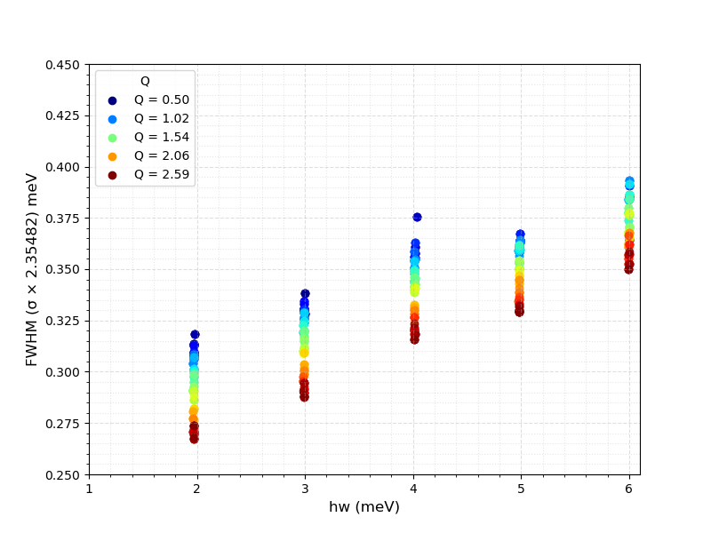
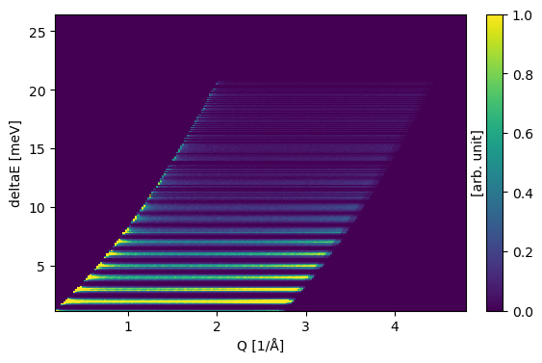
Energy resolution – Q dependence
Grid with horizontal – constant hw lines
Cut vertically
Higher Q -> slightly worst hw resolution
Δhw= 0.05 meV = 50μeV -> insignificant
Notes:
Another way to compute the energy resolution is by using the isotropic sample , with an input file of vertical lines, and then cut horizontally and fit the peaks with a gaussian. What we can take from here is that with increasing q , the energy resolution worsen, but this is insignificant with a maximum change of 50 μeV

Slide 20
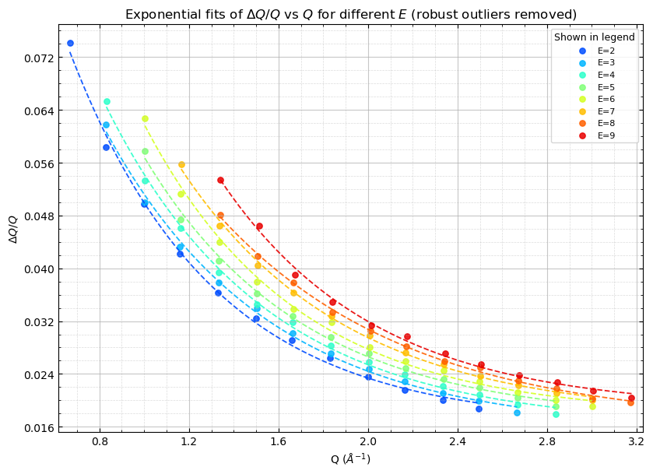
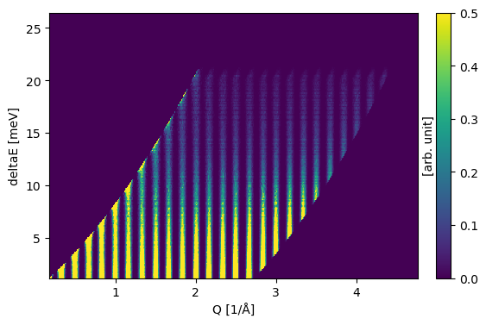
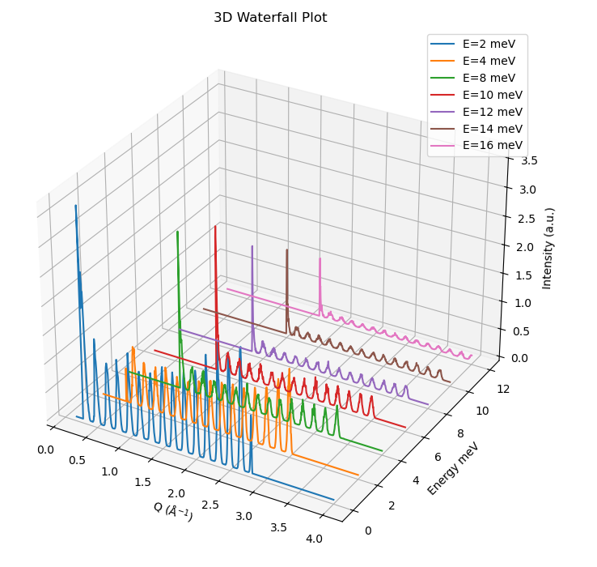
Q resolution
Grid with vertical – constant Q lines
Cut horizontally
Higher hw -> worst Q resolution
Notes:
Similarly for the Q resolution, we have an input file with horizontal lines and we cut vertically. From this we can take that with increasing energy transfer we have worst Q resolution with a maximum change of 0.035 1/AA which is significant

Slide 21
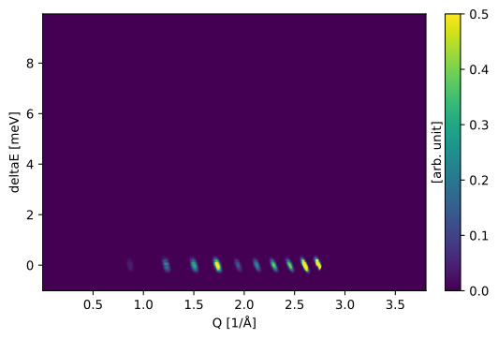
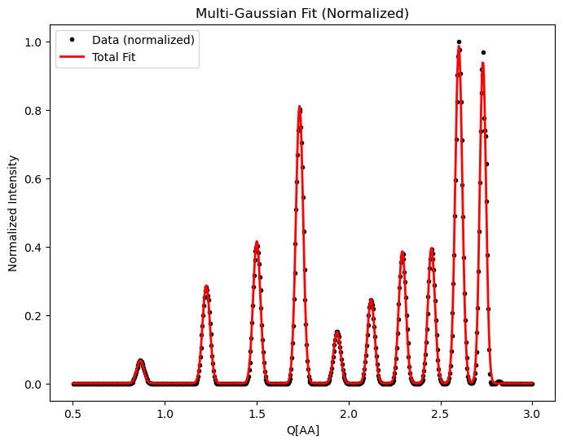
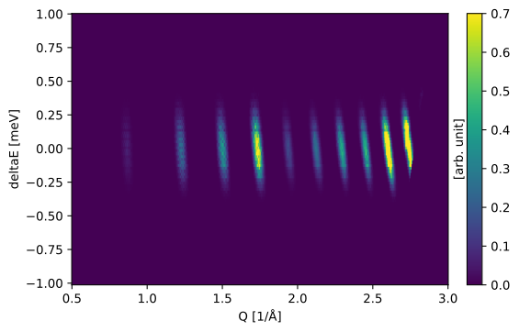
NACALF powder sample
Notes:
We have also used a NACALF powder to investicate the q resolution at the elastic line.
Here you can see the bragg peaks on the S(q, w ) diagram , and this is what we get if we cut at zero energy transfer

Slide 22
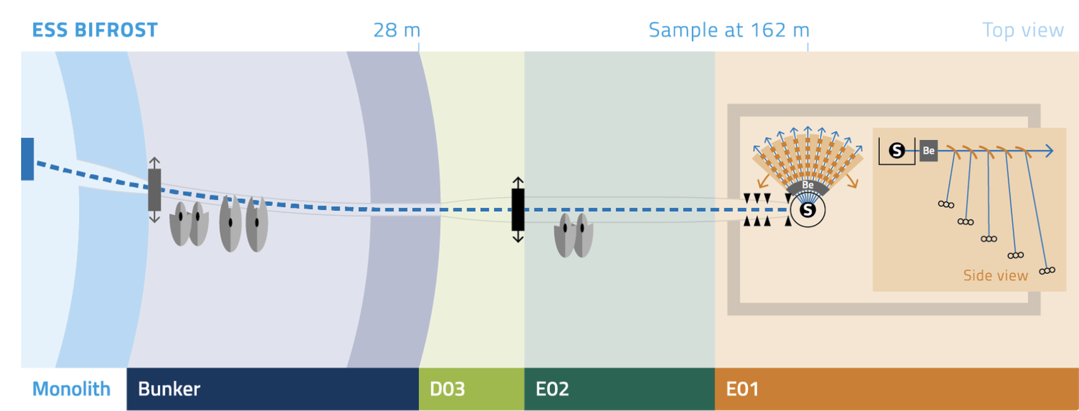
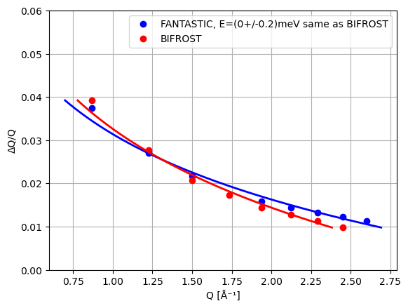
NACALF powder sample
BIFROST@ESS data, Kristine Krighaar master thesis
Notes:
This is a comparison with bifrost, as soo can see there is a large difference in Q resolution and we still need to investigate and understand the reason for this large difference

Slide 23
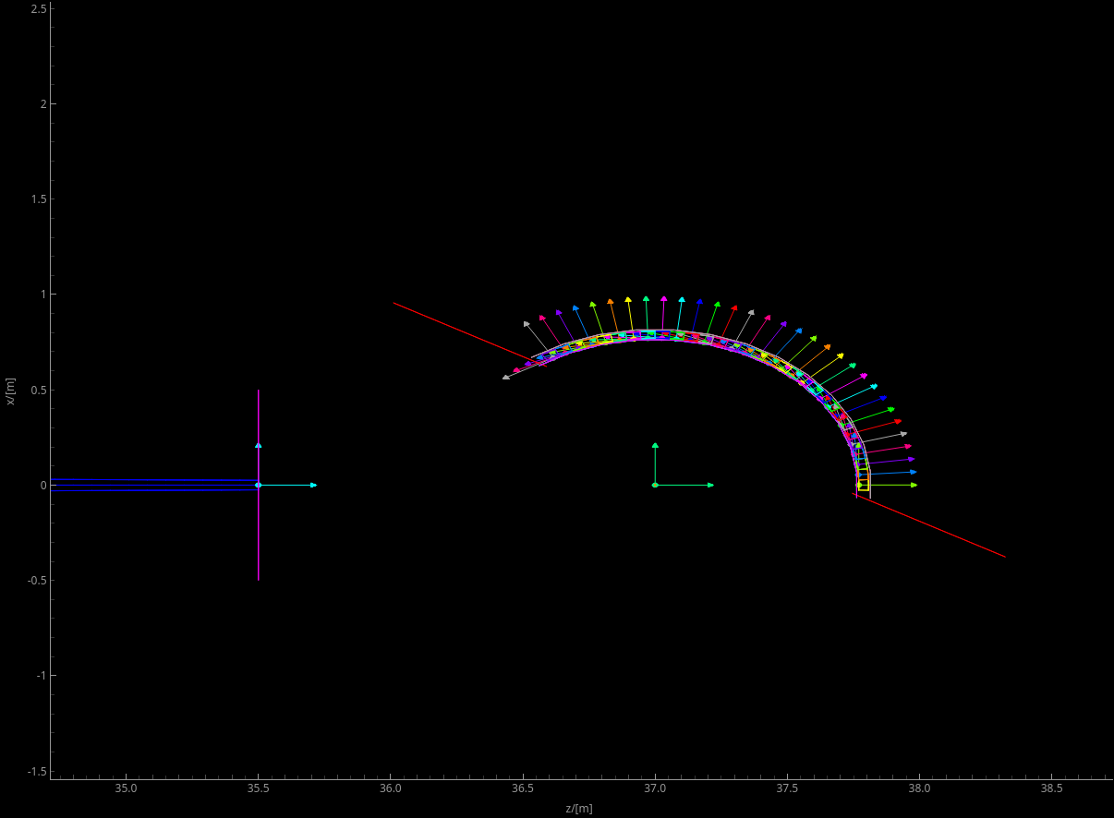
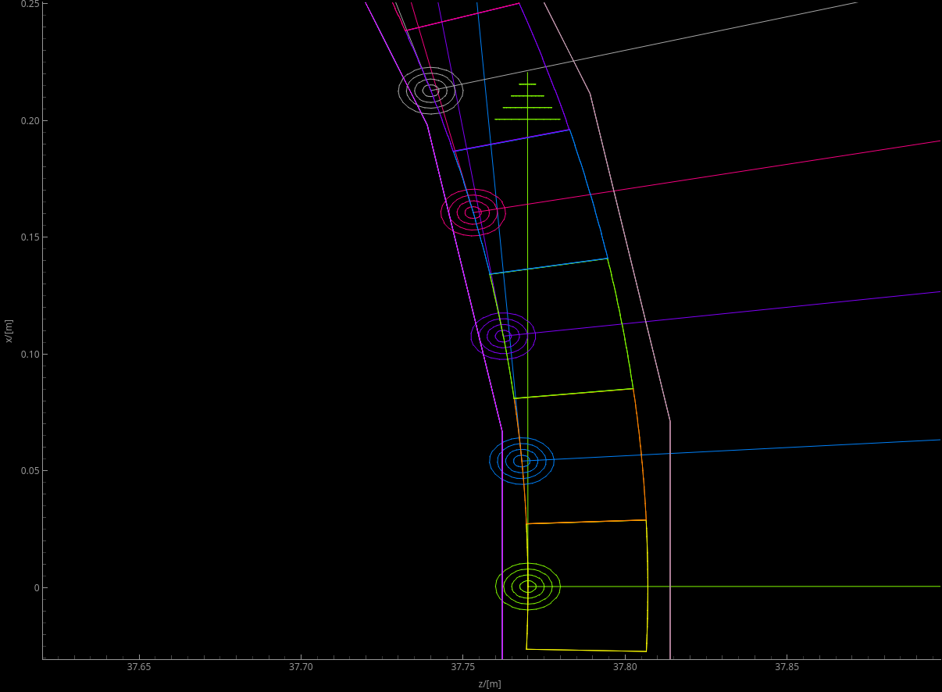
Neutron Filters - Discard the second harmonic
Notes:
Now I will talk about the options we have for neutron filters to absorb the second harmonic

Slide 24
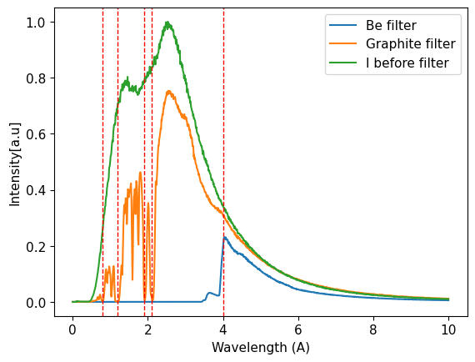
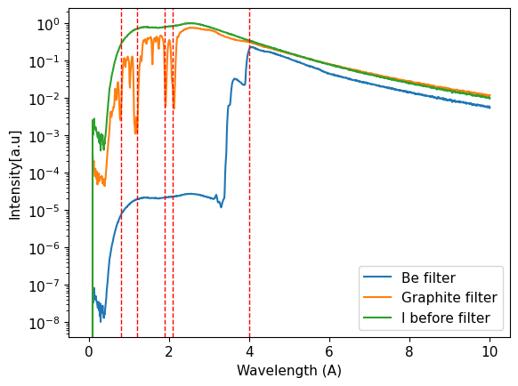
Neutron Filters: Beryllium or Graphite
Be : Select wavelengths of λf>4AA.
Depending on the wavelength range of the incident beam (usually 2-4AA), the elastic line might be inaccessible.
Graphite : Select specific wavelengths λf= 1.6, 2.4, 3.8,4.2 AA.
I_graphite>> I_Be. Be more suitable for weaker signals.
Notes:
First the options is Be or graphite filter.
For the graphite we can select specific wavelengths, 3.8 AA and 4.2 AA witch is a bit limiting , the other two can not detected because the will be reflected behind the sample
For the Be filter we can select wavelengths larger than 4AA.
The problem with these filters is that depending on the wavelength range of the incident beam the elastic line might not be accessible
Comparing graphite to Be , as you can see here the intensity for graphite is 4 orders of magnitude higher , so Be will be more suitable for weak signals

Slide 25
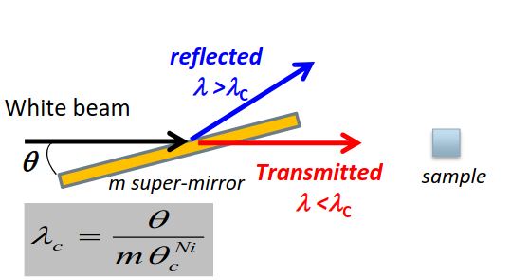
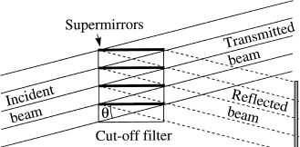
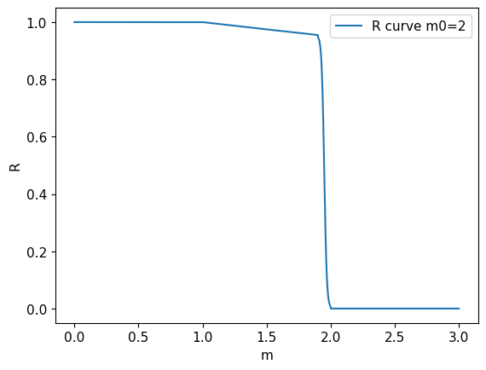
Neutron Filters: Super-mirror
Absorber
Sample
Adjust the wavelength cut-off based on the m-value and the tilt angle of the sm-channels
Very flexible
Suitable for very small samples (d=1.5 mm) – low divergence
Notes:
Another option is a super mirror filter.
Based on the m value of the mirror and the tilt of the channels we can adjust the wavelength cut off, something that makes it very flexible

Slide 26
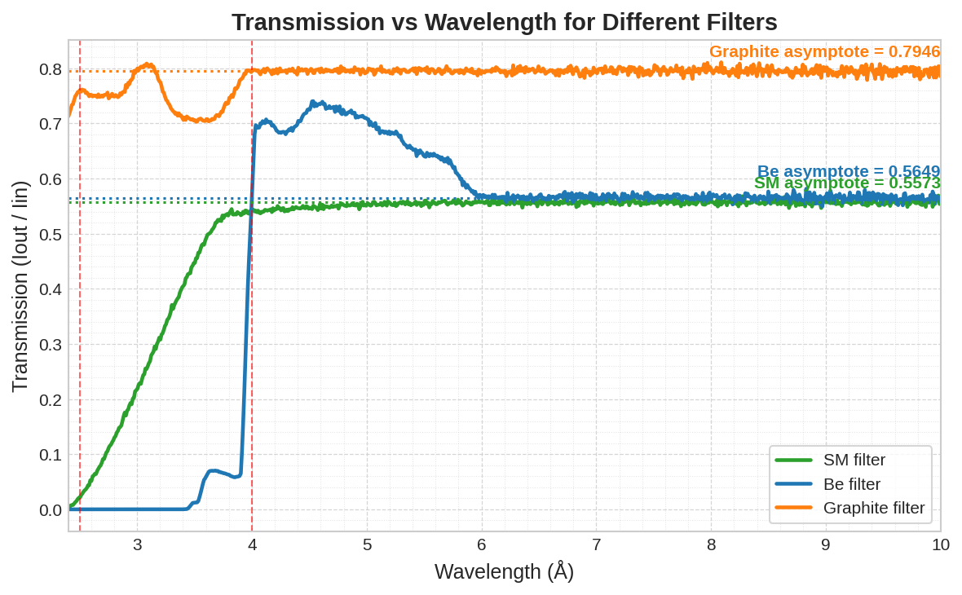
Neutron Filters : Transmission
λf= 4.2 ΑΑ
Notes:
Here I compare the transmission of the 3 filters. At 4.2 AA , graphite has the highest transmission at 80 % , the Be at 70% and then the super mirror at 56%

Slide 27

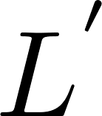
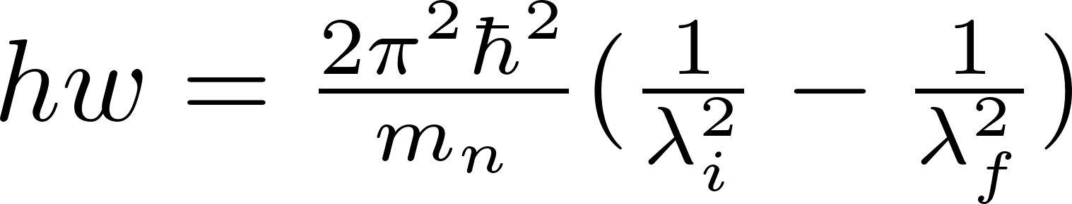

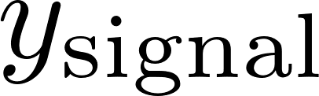
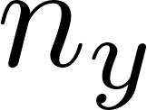
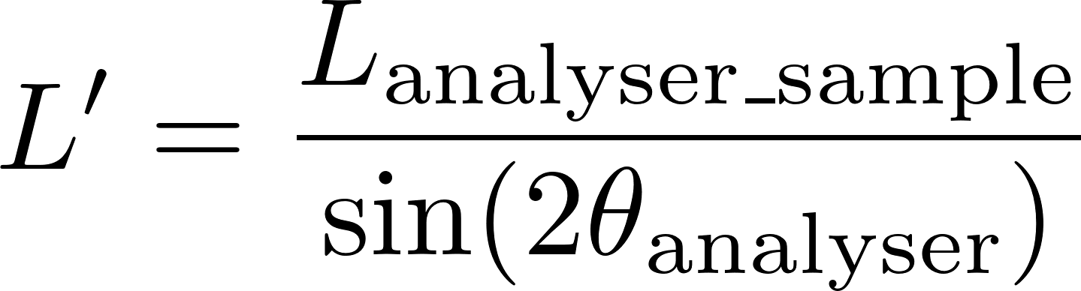

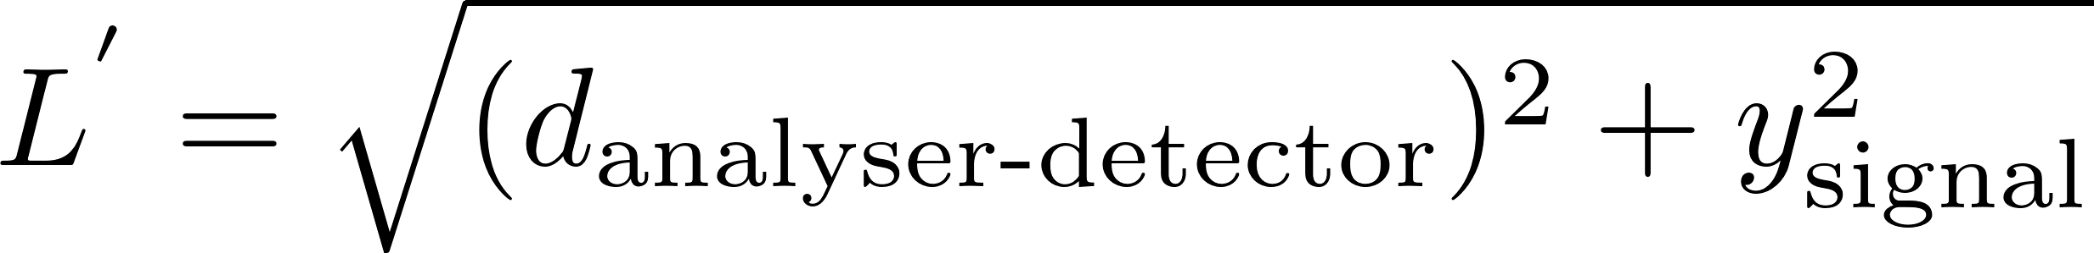







Data treatment : Energy transfer
$$TOF$$
$$L_{i}$$
$λ_{i}$ , $E_{i}$ , $k_{i}$
$$hw$$
$$L_{f}$$
$$θ_{analyser}$$
$λ_{f}$ , $E_{f}$ , $k_{f}$
OR
Notes:
Now I will talk a bit about the data treatment
So , we know the time of flight , the distance from the moderator to sample and the distance from the sample to the detector.
From these three we can compute the incident energy.
From the analyser angle we can compute the final energy and correct the travel distance after the analyser because.
And at the end , the energy tranfer

Slide 28














Data treatment: Momentum transfer
x
Top view
kf
ki
z
$$\vec{Q}=\left({Q_{x} \atop \begin{aligned}Q_{y} \\ Q_{z}\end{aligned}}\right)$$
y
$$k_{i}$$
$$d_{tube}$$
$$k_{f}$$
Analyzer/Detector position
$${2θ}_{center}$$
Tube index
$${2θ}_{corrected}$$
analyzer
$$θ^{′}$$
0
sample
1
$$L_{f}$$
Notes:
Now , to compute the momentum tranfer , for each analyser channel , we know the incident the final wavector.
Based on the position of the analyser we know the two theta , scattering angle
Because each analyser correspond to two tube detector , we need to correct the angle based on the tube index.
At last we compute the Q vector.

Slide 29



Data treatment: Inelastic powder sample
Input file for Isotropic_Sqw
Virtual experiment - McStas
Accessible Q-hw region for λ_f =4.2 AA
Notes:
To validate that and instrument and the data reduction routines are working properly, we have used the Isotropic_sqw component of mcstas which is an inelastic powder sample.
Using this sample someone can use an input file of a predefined dispersion curve.
So, here we can see how the dispersion is suppose to look like and which region of it can we theoretically covered by our instrument.
And this is what we have obtained by performing a visual experiment with McStas.
As you can see, it closely matches the input file.

Slide 30





Single crystal
$$\vec{Q_{l}}=\left({Q_{x} \atop \begin{aligned}0 \\ Q_{z}\end{aligned}}\right)$$
Lattice Parameters
$$\vec{hkl}=\left({h \atop \begin{aligned}k \\ l\end{aligned}}\right)$$
UB matrix
$$\vec{Q_{l}}=2πR⋅UB\left({h \atop \begin{aligned}0 \\ l\end{aligned}}\right)$$
Sample Rotation $\left(ν,ω,μ\right)$, only $ω=Rot_{y}=A3$
R matrix
MJOLNIR: A software package for multiplexing neutron spectrometers, Jakob Lass
Notes:
To use a single crystal there are additional data reduction steps to account for the sample rotation.
We know the Q_vector in the lab frame.
From the lattice parameters , we compute the UB matrix.
Form the sample angles of rotation , we compute rotation matrix, no this case we only rotate around the y axis.
At last we compute the Miller indices hkl

Slide 31


Data treatment :Single crystal – Phonon_simple
Parameters for Lead – Pb:
a = 4.95 AA
b = 9.4 fm
M = 207.2 amu
c = 10 meV*AA
Notes:
For a single crystal, we used the phonon simple component of mcstas which simulates one acoustic branch with the default parameters for Lead.
After performing a full 360 rotation and reducing the data, we have obtained these plots.
Here you can see constant energy cuts , and here constant –l cuts.
If we cut at a highly symmetric point, we observe that the dispersion optained using the instrument closely matches the theoretical form dispersion.

Slide 32
Performance comparisons
BIFROST , CAMEA , IN8

Slide 33
Accessible S(q,hw) region

Slide 34


Comparison with simulations of BIFROST@ESS
FANTASTIC
 | FANTASTIC | BIFROST | BIFROST gains
Flux | 2x10⁷ n/s/cm² | 6x10⁹ n/s/cm² | 300
@ 4meV | 6.5x10⁻⁴ n/s | 0.12 n/s | 184
Total analyser area | 0.147 m² | 0.192 m² | 1.31
@ 4meV normalized | 44.2 x10⁻⁴ n/s/m² | 0.625 n/s/m² | 141
Phonon simple – same configuration on both digital twins
Notes:
We also want to compare the performance of the fantastic with bifrost. The bifrost digital twin and the scripts for the data treatment are readily available, so we have used the same exact sample with the same configuration on the two instruments. Firstly the flux at sample position of bifrost is 300 times higher than fantastic as you can see the for fanstiastic of the the order of magnitude 10 to the 9th and for fantastic 10 to the 7th . And this is the main parameter that impacts the performance of the instrument. So, for a cut at 4 meV and having performed the same bining in energy ,qx and qy between and normalizing by the total analyser area, bifrost is 240 times more powerfull.

Slide 35


Comparison with experimental measurements CAMEA@PSI
FANTASTIC
CAMEA
MnF2 experimental measurements on CAMEA (Jakob Lass)
SpinWave_BCO sample
(Accurate simulations of magnetic excitations in the
neutron simulation package McStas - Silas B. Schack)
Ring at hw=3,5 meV on CAMEA: 1.68 n/sec
Ring at hw=3,5 meV on FANTASTIC: 0.79 n/sec
CAMEA 53% more flux

Slide 36


Comparison with experimental measurements IN8@ILL
IN8
Calibrated sample component
Virtual experiment
+ comparisons
+
FANTASTIC
IN8
Phonon anomaly in Tb2Ti2O7 pyrochlore : a fingerprint of magneto-elastic coupling
Sylvain PETIT , Victor BALEDENT
Phonon_simple_mosaic.comp
Phonon_simple.comp
Mortified component to account for sample mosaicity.
Randomly rotating each scattered neutron’s velocity vector by a small Gaussian-distributed angle.
mosaicity=?=adjust the fwhm of the peak
Tb2Ti2O7
a=10.06
b=;=adjust intensity of the peak (scattering length)
M=525.58
c=;=adjust the position of the peak (speed of sound)
T=273.15+1.5 K
radius=2.5mm
height=2.5cm
Notes:
We also want to compare fantastic with experimental measurements
So we performed an experiment on IN8 at ILLL measuring a phonon
Ww have used the McStas digital twin of IN8 to calibrate the Phonon_simple sample , and used the calibrated sample on fantastic
To calibrate the sample we need to adjust 3 parameters , the scattering length which changes the intensity of the peak
The speed of sound which changes the possiosion of the peak and the mosaicity.
The phonon simple component does not support any mosaic spread , so we had to modify it, so that it rotates the velocity vector of the scattered neutron

Slide 37



Calibration
Phonon at 440,
IN8 measurement
Instrument configuration:
Monochromator: Si 111
Analyser: Cu 111
Kf = 2.66 1/AA
Ki = 3.16 1/AA
Calibrated sample with IN8 digital twin
Parameters:
c=21.8498 meV/AA^(-1)
b=824.245 fm
Mosaic=48.683 arcmin
Notes:
So, here you can see the phonon 440 as measured on IN8 and here with blue the peak from the calibrated sample

Slide 38




Comparison with experimental measurements
At [440] cutting at hw = 6meV, IN8 peak is ~200 times higher than FANTASTIC.
FANTASTIC can cover a wide HKL-hw space.
With FANTASTIC we have access to more information.
Taking advantage of the symmetry ,the total intensity of the at hw =6meV is 5.92 n/sec , same order of magnitude as IN8.
Since we also have access to different energy transfers, at 440-hw, the total intensity is 34.5 n/sec.
Total intensity from FANTASTIC : 185.4 n/sec.
Notes:
So , we have used the calibrated sample on fantastic and permomed a 40 degree roation of the sample every ¼ of a degree which is a 5min measurement
If we cut the 440 peak at 6 meV, we have a 200 lower intensity than IN8
But the strength of fantastic is that it can cover a wide HKL-hw space ,so a lot more information
If we take advantage of the symmetery and sum the toal intensity of the ring at 6 mev , the intisity 6.5 n/sec which is the sample order of magnitude as in8
If we sum at different energy transfers the total intensity is 3 times higher than IN8
If we some everything it’s 50 times higher than IN8
This first comparison shows the efficiency of an indirect geometry ToF spectrometer for (Q, ω) space exploration and coverage while a conventional triple-axis instrument on a continuous source is the optimal setup for specific (Q, ΔE) energy scans.
H=100
K=0
L=100
E=37

Slide 39






Signal to background ratio
Investigate the interaction of neutrons with the instrument’s structural materials and determine the origin of the background – characterize the background.
Determine the source of the background and shield from it.
A model of the instrument was developed in OpenMC
The model includes:
Sample – Cryostat
Collimator
Be-filter
Analyzers
He3 tubes
Beam stop
Concrete walls
Notes:
We also want to eastimate the signal to background ration of the instrument. To do this we have to investicate the interaction of the neutron with the stactural material of the instrument and determine the origin of the background. Basically how much each component of the instrument contributes to the background and improve the shielding of the component.
Do do this we have developed a model of the instrument in OpenMC monte carlo partical transport code. The model incudes the sampe and cryostat , the collimato , the Be-filter , the ana;ysers , the He3 tubes , the beamstop and the concrete walls .
Moving on to OpenMC, even though it is not a code tailored for neutron scattering experiments, it is a more well-rounded and versatile code, offering more capabilities than McStas. Since, in the course of this thesis, we want to study the gamma and neutron background generated by the interaction of the neutron with the machine's structural materials (something not feasible with McStas) we choose to compare these two codes by creating a simple instrument.
A simple diffractometer consisting of a monochromatic neutron source, a graphite sample, a beam stop, and a plane detector was created using the two codes. Graphite was chosen because of the availability of TSL-S(α,β) cross-sections in the nuclear data library. However, since both codes can be integrated with NCrystal, different samples can be used, including single crystals. The same diffraction pattern was obtained with the two codes. Scipp, a scientific data analysis library developed by the European Spallation Source (ESS), was used to identify the diffraction peaks (Figure 2), the position of the peaks is identical between mcstas and OpenMC.

Slide 40




Background quantification
Based on the angle of the analyser we know where on the length of the tube the scattered neutrons will be detected.
On the rest of the tube the signal will be background.
Log scale
Notes:
Now I will talk a bit about how we quantify the background. Firstly from the angle of the analyzer we know exactly where on the length of the tube the scattered neutron will be detected , The signal the we are going to have n the rest of the tube an the be considered as backgroung.
Here you can see the signal that we obtain on all the tubes ,we then sum radially and obtain this peak here. We then sum the signal on the entire tube , exlcuting the region of the peak.

Slide 41


How much each component contributes to the background
Key observations:
Full model: S/B ~ 10
The most significant contributor is the concrete wall, 18 times higher background
Be filter: 30 % reduction
Cryostat : 15 % increase
Air scattering : 44 % increase
Notes:
We have performed many simulations , each time removing one component of the interument . By doing this we will be able to know how much each component contributed to the background.
So from this we can observe that for the full model including all the components of the instrument , the signal to background ratio is equal to 10. The most significant contributor to the background is the concrete walls. When including the the Be filter the backgound is reduced by 30 %, the cryostal contributes 15 % to the background and the airscattering 40 %

Slide 42

Thank you for your attention

Slide 43


