Slide 1
Beamline diagnostics for tracking
neutron beam performance at the
Spallation Neutron Source
E. B. Iverson, M. J. Frost
Oak Ridge National Laboratory
ICANS-XXV
13-19 April 2026

Slide 2
Outline
So you’ve got a neutron beam – now what?
Characterization of EACH beamline as early as possible is essential; verifying shielding, KPI, and performance – AND as the starting point of a long term monitoring process...
How can we characterize a neutron beam
Energy (wavelength / velocity) spectral distribution
Energy-dependent time distribution
Transverse extent (i.e., beam footprint)
“other stuff” – background / contamination, etc.
All sounds like commissioning – but we have exactly the same set of questions all along...
Moderator Test Station
First Target Station
Second Target Station
Notes:
In building the MDF at SNS, we do not have to focus on flux as much as we would on a stand-alone facility:
SNS doesn't need another beamline - this is for source technology demonstration - dedicated, single-use optimization
A small source would never begin to compete on flux; just don't worry about it
Prototypical nature is more important than flux anyway

Slide 3
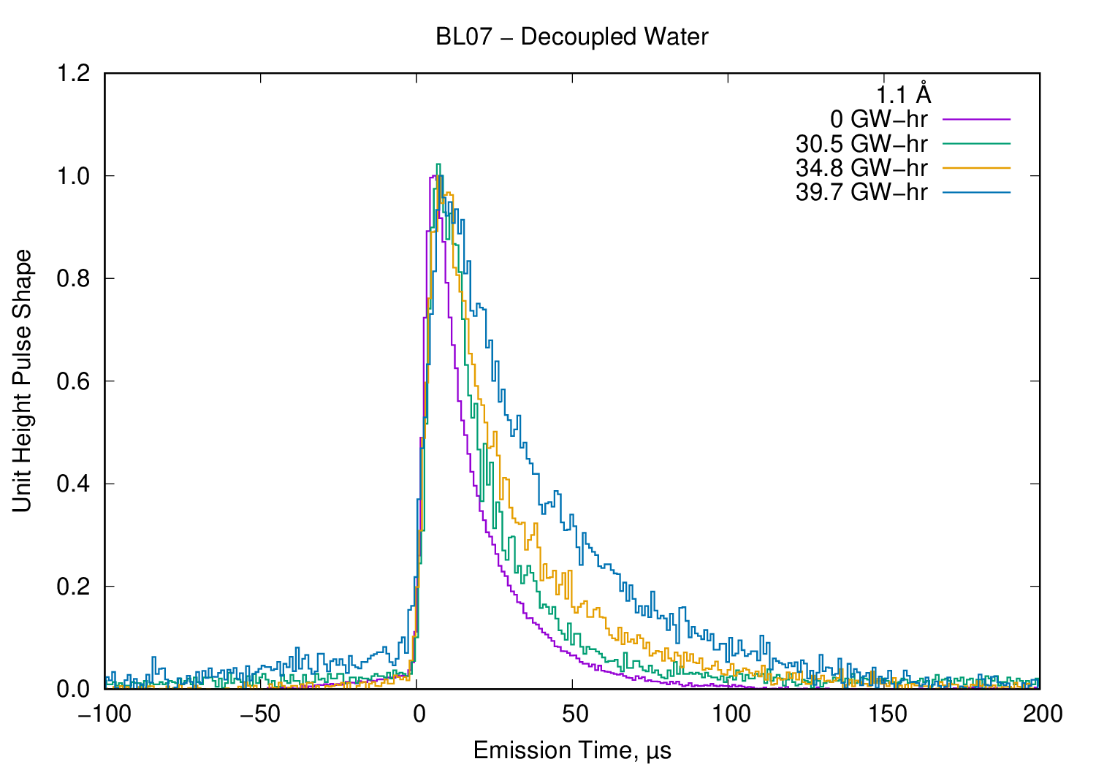
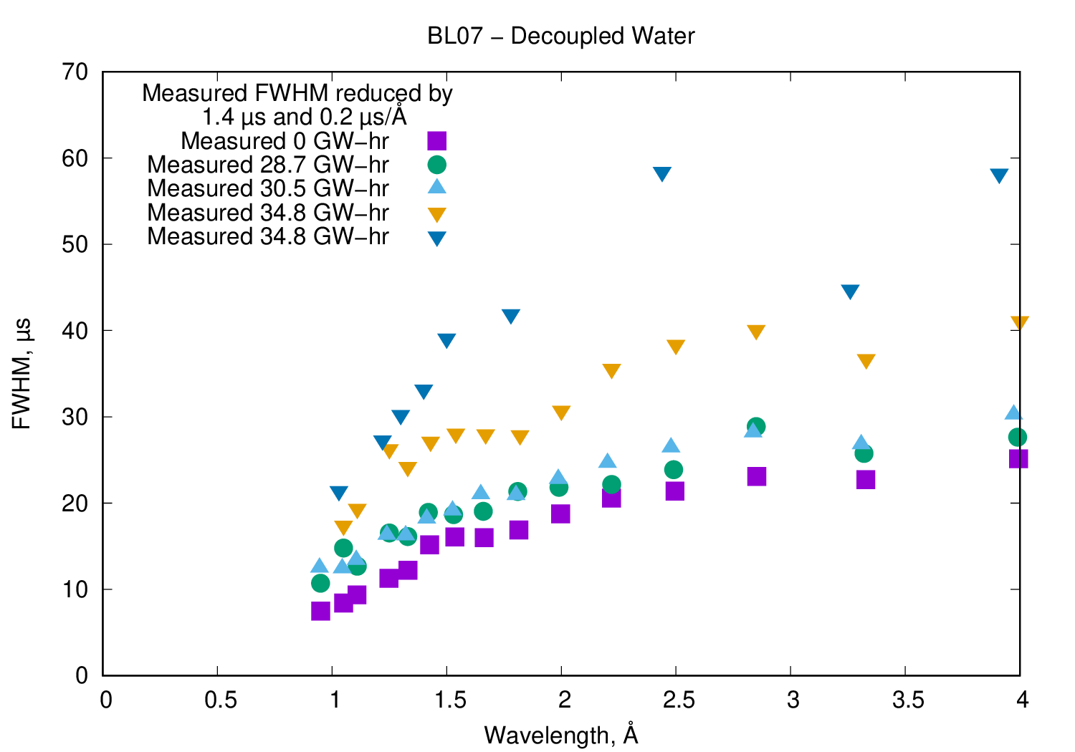
Example: VULCAN pulse shape changes over IRP life
VULCAN instrument (an engineering diffractometer on the decoupled poisoned water moderator) sees enormous changes in the beam over the life of the Inner Reflector Plug (IRP2 replaced with IRP3 in Dec)
IRP2 was designed for around 30 GW-hr of beam operation against poison and decoupler burnup – it ended up staying in service through 40 GW-hr of operation
Dedicated pulse shape measurements indicate change at nominal end of life, rapidly worsening, despite subtle changes in routine instrument calibration
Notes:
With the SNS front-end copy that makes up the BTF, we get “forced” into a different source configuration than we might choose if we started from scratch. This changes our optimization process, which at least for exploration purposes offers the chance at significantly different features and gains.

Slide 4
Fast, Comprehensive Before / After Comparisons
Measured count-rate at variety of incident energies for direct geometry spectrometers (ARCS, SEQUOIA, HYSPEC, CNCS)
Measured neutron spectral distributions for white-beam instruments (BASIS, SNAP, EQ-SANS, VULCAN, VENUS, VISION)
Used both in situ beam monitors and a dedicated beam monitor in the sample position
Not a complete comparison – didn’t look at pulse shape / resolution, just at raw intensity numbers
Before and after (IRP replacement) comparison prompts immediate followup with instrument teams and justification for further examination
Some instrument monitor problems were even identified during the “before” comparisons, permitting significant improvement in instrument operations

Slide 5
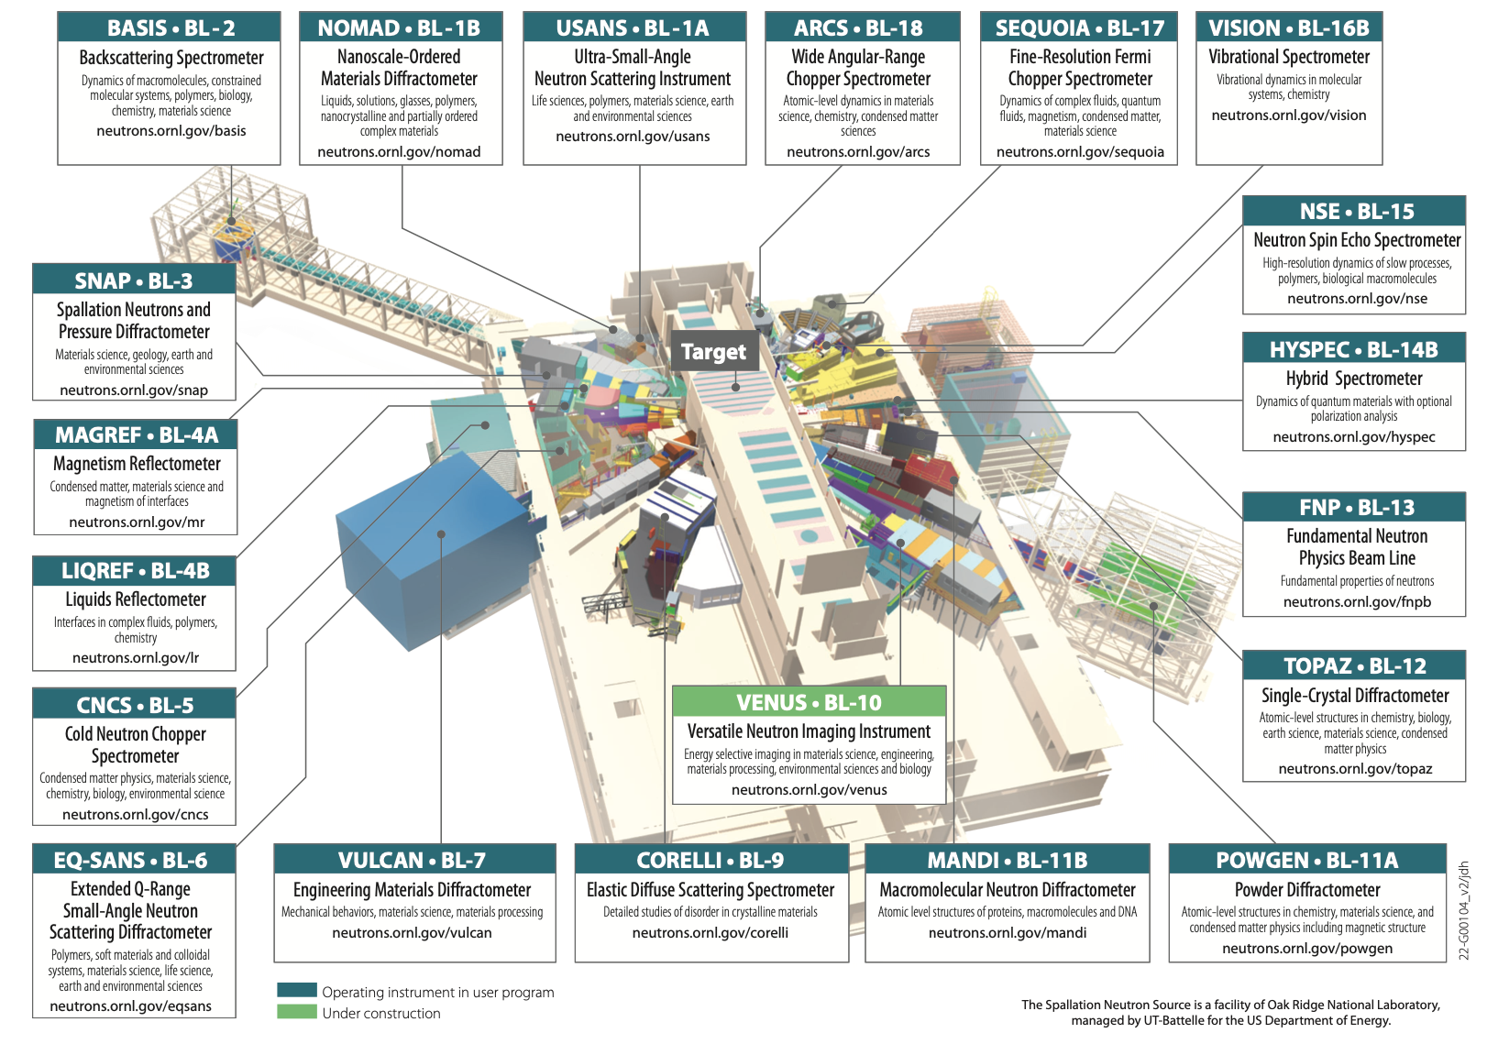
Instruments Measured: BASIS, SNAP, CNCS, EQ-SANS, VULCAN, POWGEN, HYSPEC, VISION, SEQUIOA & ARCS
Decoupled
Water
Moderator
(thick side)
Decoupled
Hydrogen
Moderator
Bottom
Coupled
Hydrogen
Moderator
Top
Coupled
Hydrogen
Moderator
Decoupled
Hydrogen
Moderator
Decoupled Water Moderator (thin side)
Notes:
<number>

Slide 6
Summary of design changes from IRP-2 to IRP-3
“Basically” the same – not identical, with “minor changes”
The poison thickness (gadolinium) in the decoupled water moderator was increased from 1 mm to 1.3 mm to match the lifetime of the decoupled hydrogen moderator and increase the IRP 3 lifetime to 38 GW-hr, with a +3% / +8% performance impact (thick/thin side)
Aluminum flow baffle removed from decoupled water moderator vessel (thin side, now 17 not 15 mm thick) with 10% expected performance increase (pulse-integrated)
Coupled hydrogen moderator has improved wrapping of pre-moderator medium and reduced aluminum thickness at emission face enhancing cold neutron flux by ~8%.
Increased penetration of stinger feeding decoupled hydrogen moderator as a first measure countering the power non-linearity.
All these changes described apply to a comparison at beginning-of-life for both IRPs, but that’s not what we have – we have IRP 2 EOL to IRP 3 BOL, which adds PPU
1.0 GeV to 1.3 GeV
Hydrogen catalyst
Notes:
With the SNS front-end copy that makes up the BTF, we get “forced” into a different source configuration than we might choose if we started from scratch. This changes our optimization process, which at least for exploration purposes offers the chance at significantly different features and gains.

Slide 7
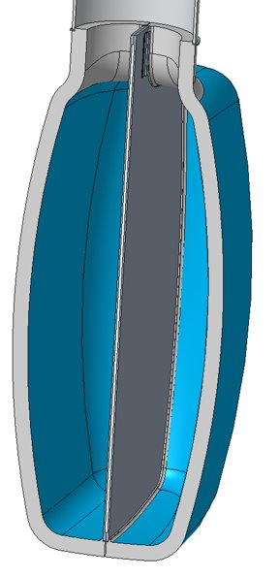
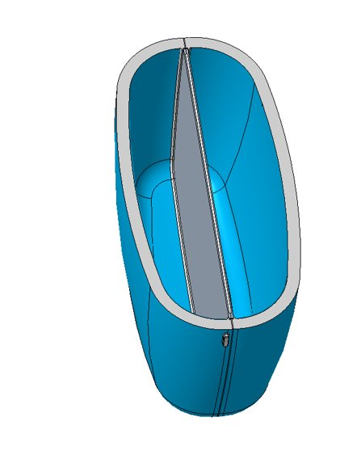
Nominal Moderator Geometry (at room temperature)​
* Inlet pipe not shown
Inside portion 3.8 inch (97 mm) wide
11 inch (280 mm) spherical radius internal surface of moderator
0.813 inch
(20.7 mm) space nominally
1.139 inch
(28.9 mm) space nominally
1.139 inch
(28.9 mm) space nominally
The hydrogen thickness of the moderator varies across the face due to the shape of the moderator​
Inside portion 5.3 inch (135 mm) tall at center

Slide 8
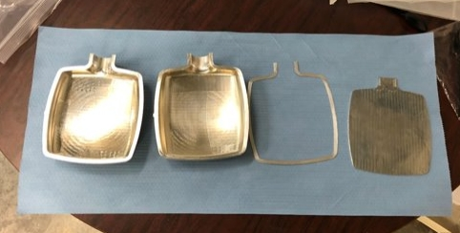
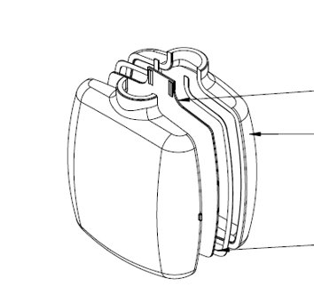
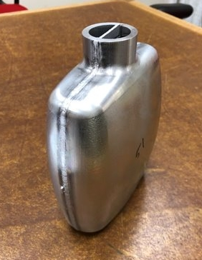
IRP-3 Moderator component manufacture and processing are unchanged from IPR-2
Moderator vessels consist of four pieces
Aluminum fabrications, except for gadolinium inside the poison plate
Vessel is electron beam welded to reduce distortion
Poison plate
Vessel halves
Shim

Slide 9
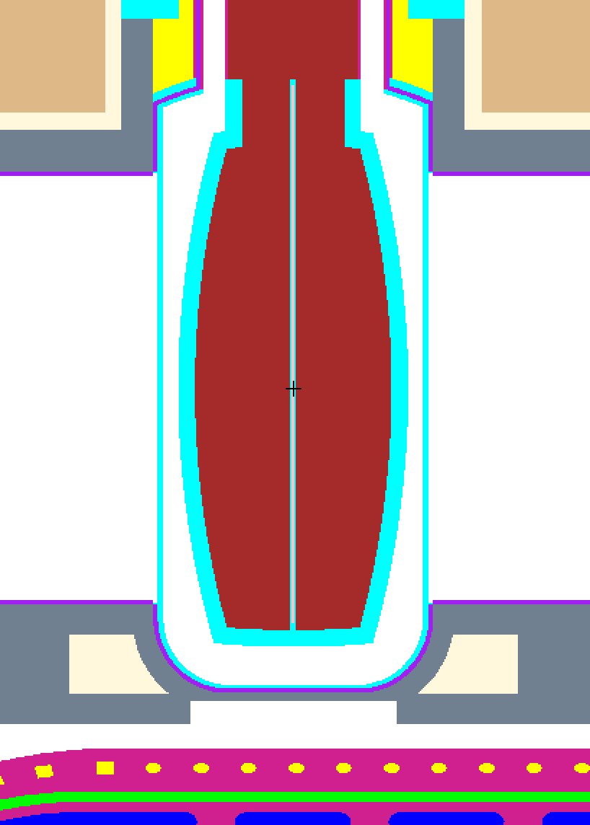
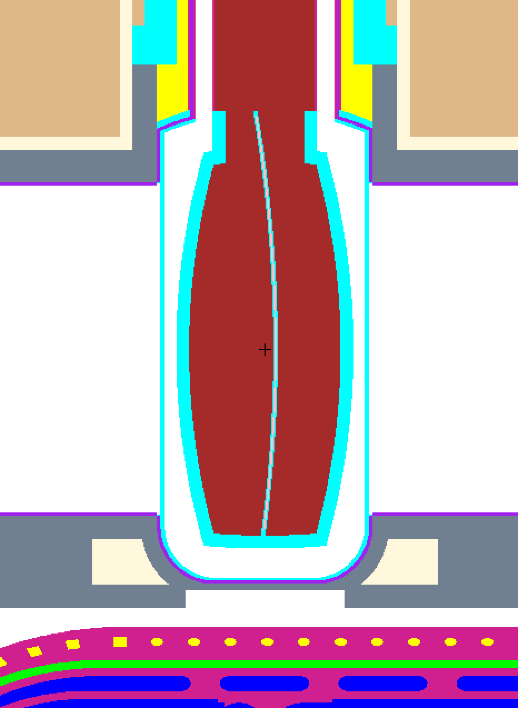

Effects due to distortion of the Gd poison plate in the decoupled hydrogen moderator for IRP-2
BLs 1-3
BLs 10-12
4.2 mm
Bulged
Plate buckled toward POWGEN for IRP-2; flipped for IRP-3
-25% for “thin” side, +35% for “thick” side
Notes:
Slides Poison_plate_bulge referenced in non-conformance 106020200-DR0005-R00 (imply convex side faces BL 10-12???
<number>

Slide 10
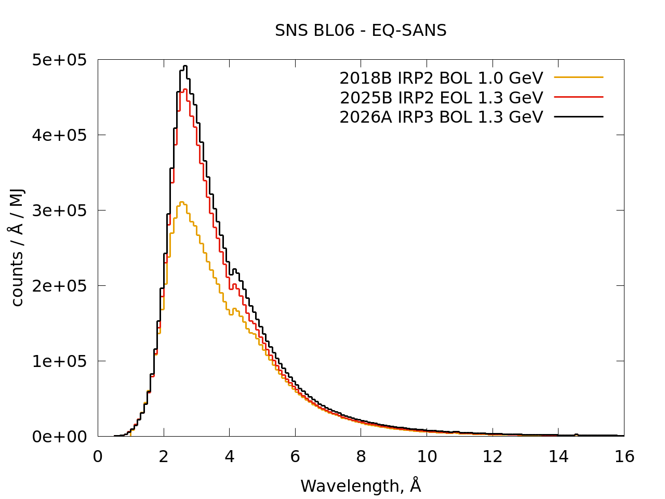
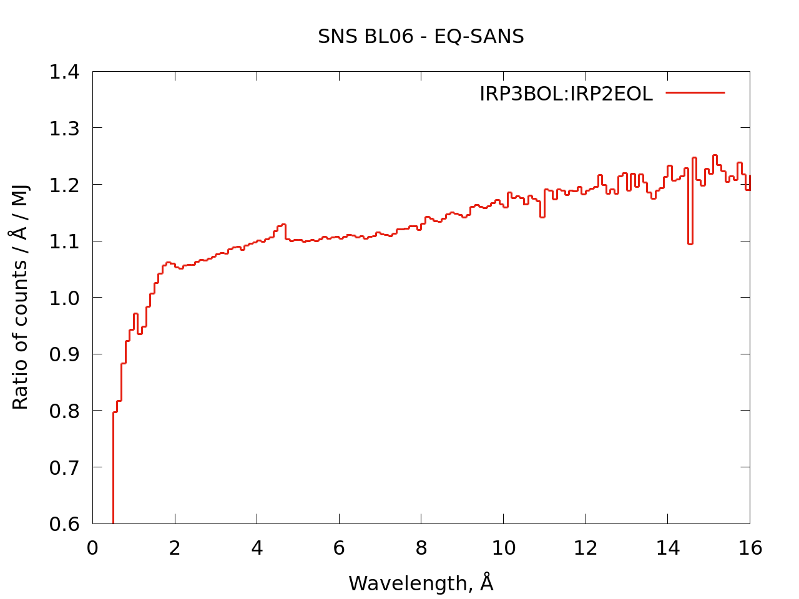
Coupled Hydrogen Shows Flux Gain (BL-05 / EQ-SANS)
Expected Changes
Decoupler and poison burnup are largely irrelevant for the coupled, unpoisoned moderators
Installation of orthohydrogen converter during PPU changes spectrum, boosting peak and very long wavelengths
Increase in energy during PPU boosts intensity slightly by moving neutron production peak toward coupled moderators, which also happen to be the downstream moderators
Expansion of premoderator coverage in IRP3 boosts intensity
Preliminary Observations
Small GAIN in intensity relative to IRP2 EOL – around 10% average, more at long wavelengths
Attribute to increased premoderator coverage on coupled moderator
Significant GAIN in intensity relative to IRP1 BOL – around 60% at peak
Attribute to PPU changes
Further work
Planned measurements at CNCS, HYSPEC will confirm effects
Notes:
Would be good to also include IRP-2 BOL baseline but complicated by ortho/para catalyst introduction
<number>

Slide 11
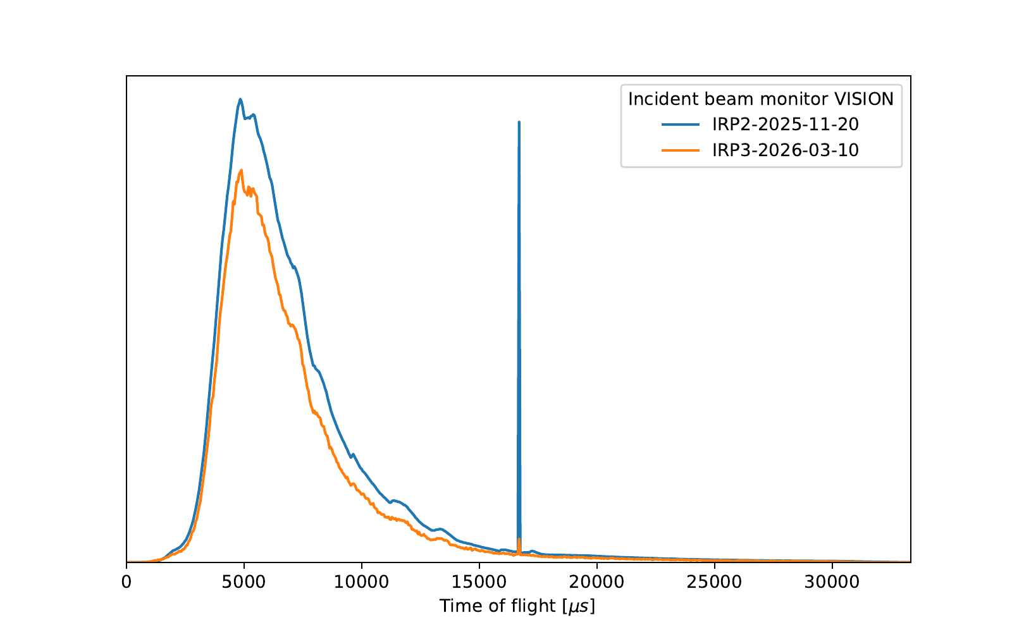
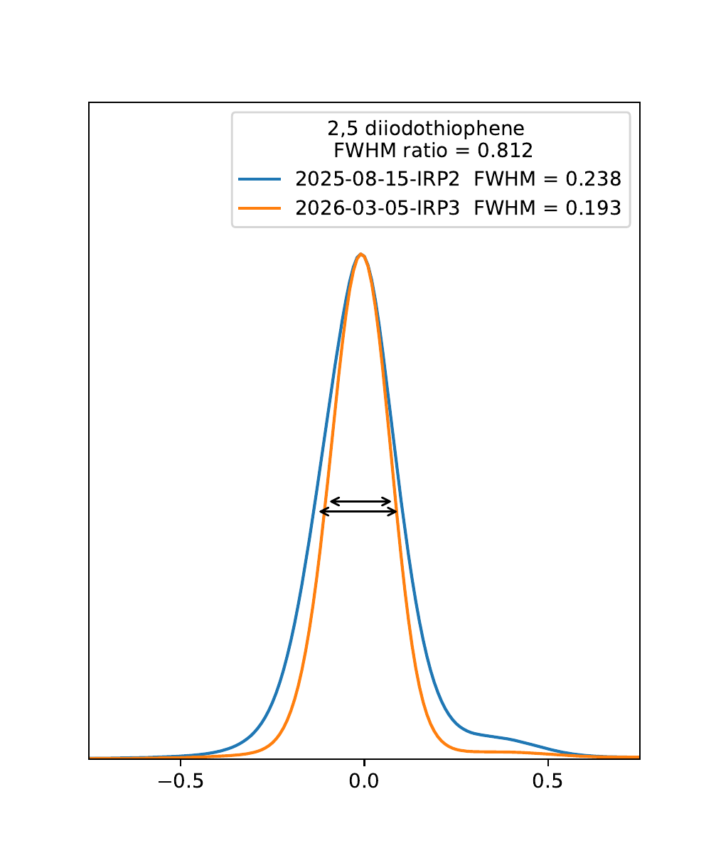
Decoupled Water (thick) Shows Expected Flux Loss (BL-16b / VISION)
Expected Changes
Decoupler and poison are new, and will suppress overall intensity by about 20% relative to “burned up” IRP2
Poison thickness increase (to support longer IRP life) will suppress overall intensity by about 3% relative to IRP2 BOL
Poison plate repositioning and removal of flow baffle will increase intensity by about 3%
All reductions in intensity should be accompanied by reductions in pulse width (that is, improvement in resolution)
Preliminary Observations
IRP3 BOL to IRP2 EOL monitor countrate ratio reflects 20% loss in intensity across wavelength range for VISION
Resolution has improved by 15-20%
Inconsistent results from ARCS & SEQUOIA suggesting 5-10% GAIN in intensity
Further work
Additional confirmatory measurements on VISION
Additional detailed measurements on ARCS and SEQUOIA
Reconciliation of VISION (flux loss) and ARCS & SEQUOIA (flux gain) observations
Assessment of resolution effects on ARCS & SEQUOIA using standard samples and downstream beam monitors
Notes:
Would be good to also include IRP-2 BOL baseline but complicated by ortho/para catalyst introduction
<number>

Slide 12
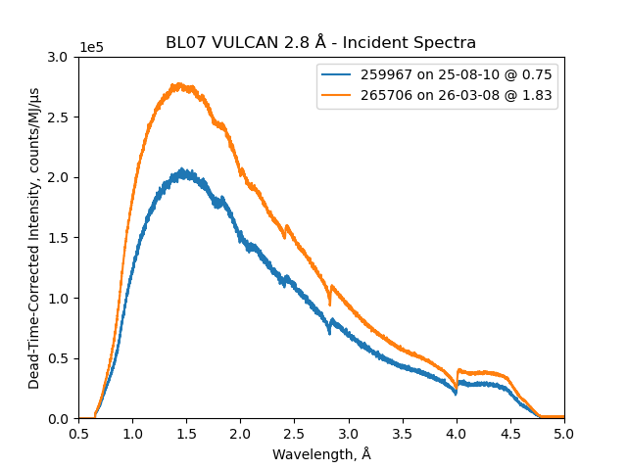
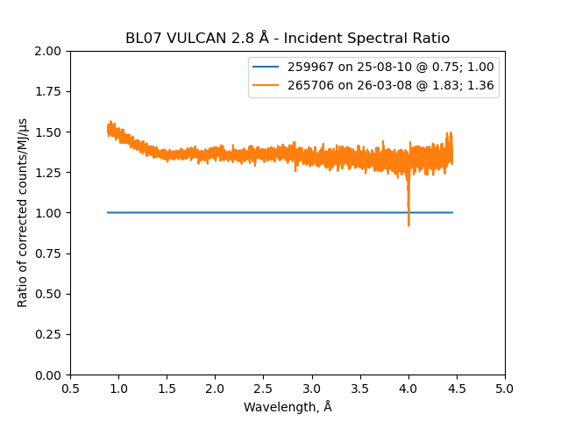
Decoupled Water (thin) Shows Unexpected Flux Gain (BL-07 / VULCAN)
Expected Changes
Decoupler and poison are new, and should suppress overall intensity by about 35% relative to “burned up” IRP2
Poison thickness increase (to support longer IRP life) will suppress overall intensity by about 8% relative to IRP2 BOL
Poison plate repositioning and removal of flow baffle will increase intensity by about 8%
Overall, expect net 35-40% loss
All reductions in intensity should be accompanied by reductions in pulse width (that is, improvement in potential resolution)
Preliminary Observations
IRP3 BOL to IRP2 EOL monitor countrate ratio reflects 35% GAIN in intensity across wavelength range
Instrument calibration data (vanadium), not shown, suggests 25% GAIN in intensity across wavelength range relative to IRP2 EOL
No apparent change in resolution observed, data not shown (suggesting instrument resolution is not dominated by moderator, but by instrument geometry)
Further work
Additional confirmatory measurements on VULCAN, including powder standards for line shape, position and resolution
Confirmation with monitor and scattering measurements on CORELLI
Notes:
Would be good to also include IRP-2 BOL baseline but complicated by ortho/para catalyst introduction
<number>

Slide 13
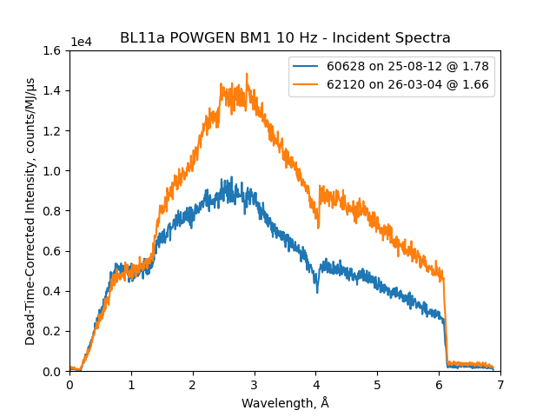
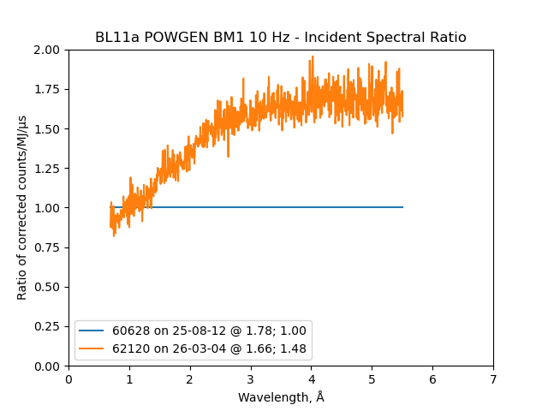
Decoupled H2 (forward) Shows >Expected Flux Gain (BL-11a / POWGEN)
Expected Changes
Decoupler and poison are new, and should suppress overall intensity by about 17% relative to “burned up” IRP2
Changes in moderator design intended to improve flow patterns, reducing non-linearity in performance with power by reducing potential flow stagnation. Non-linearity reduced intensity at full power by 10-20% depending on wavelength
Known non-conformances resulted in a bulged poison plate, shifting intensity from POWGEN side to BASIS side, in IRP2. Facility choice to reverse that bulge for IRP3, favoring flux at POWGEN and resolution at BASIS
Net ~ 25% increase in flux on VENUS, POWGEN, MANDI, and TOPAZ
All increases in intensity should be accompanied by increases in pulse width (that is, poorer potential resolution)
Preliminary Observations
IRP3 BOL to IRP2 EOL POWGEN monitor countrate ratio reflects 30 to 70% GAIN in intensity depending on wavelength (larger than anticipated)
Consistent change in incident beam intensity on VENUS (not shown)
No apparent change in resolution observed, data not shown (suggesting instrument resolution is not dominated by moderator, but by instrument geometry)
Power dependence reduced; 8%, wavelength independent (next page)
Further work
Confirmation measurements on all instruments, w/ standards for line shape
Improved statistics and coverage during upcoming power ramp for non-linearity
Notes:
Would be good to also include IRP-2 BOL baseline but complicated by ortho/para catalyst introduction
<number>

Slide 14
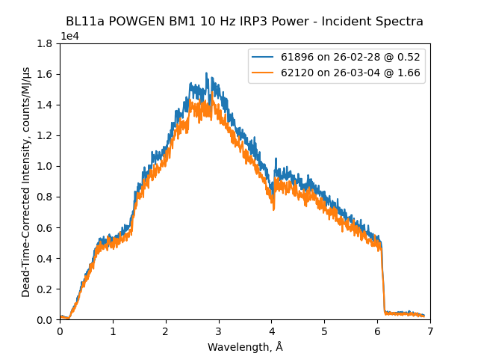
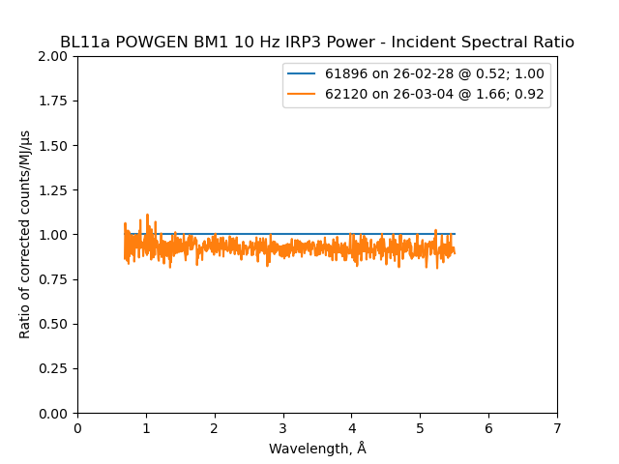
Decoupled H2 (forward): Less Power Non-Linearity (BL-11a / POWGEN)
Expected Changes
Changes in moderator design intended to improve flow patterns, reducing non-linearity in performance with power by reducing potential flow stagnation. Non-linearity reduced intensity at full power by 10-20% depending on wavelength
All increases in intensity should be accompanied by increases in pulse width (that is, poorer potential resolution)
Preliminary Observations
Power dependence reduced; about -8%, wavelength independent; very different than before
Further work
Repeat during power ramp, so we get multiple points along curve, and so that everything is continuous, rather than separated by a week
Notes:
Would be good to also include IRP-2 BOL baseline but complicated by ortho/para catalyst introduction
<number>

Slide 15
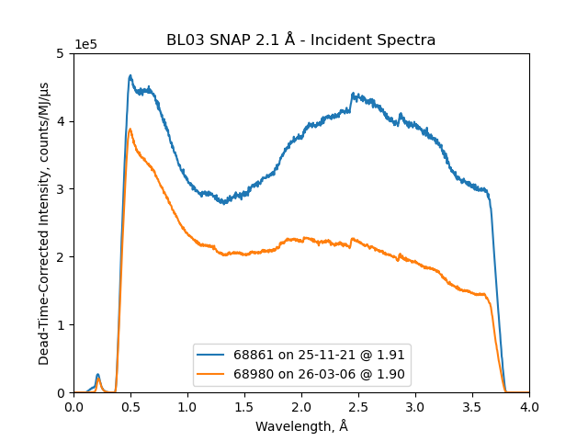
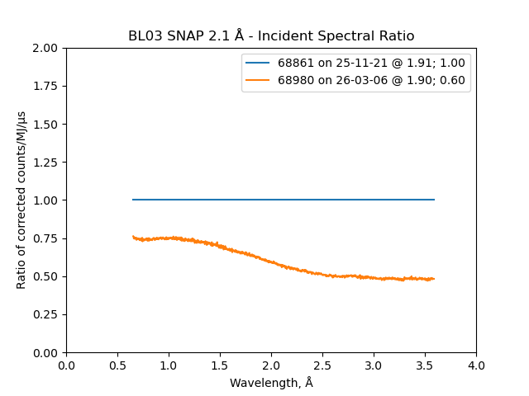
Decoupled H2 (backward) - Flux Reduction (>expected) (BL-03 / SNAP)
Expected Changes
Decoupler and poison are new, and should suppress overall intensity by about 17% relative to “burned up” IRP2
Changes in moderator design intended to improve flow patterns, reducing non-linearity in performance with power by reducing potential flow stagnation. Non-linearity reduced intensity at full power by 10-20% depending on wavelength
Manufacturing issues resulted in a bulged poison plate, shifting intensity from POWGEN side to BASIS side, in IRP2. Facility choice to reverse that bulge for IRP3, favoring flux at POWGEN and resolution at BASIS
Net effect: 35% reduction on flux for USANS ,NOMAD, BASIS, and SNAP
All reductions in intensity should be accompanied by reductions in pulse width (that is, improvement in potential resolution)
Preliminary Observations
IRP3 BOL to IRP2 EOL SNAP monitor countrate ratio reflects 50 to 70% LOSS in intensity depending on wavelength (larger than anticipated)
Consistent change in incident beam intensity on NOMAD and USANS (not shown)
No apparent change in SNAP resolution observed, data not shown (suggesting instrument resolution is not dominated by moderator, but by instrument geometry)
Further work
Additional confirmatory measurements on NOMAD and BASIS, including standards for line shape and resolution
Notes:
Would be good to also include IRP-2 BOL baseline but complicated by ortho/para catalyst introduction
<number>

Slide 16
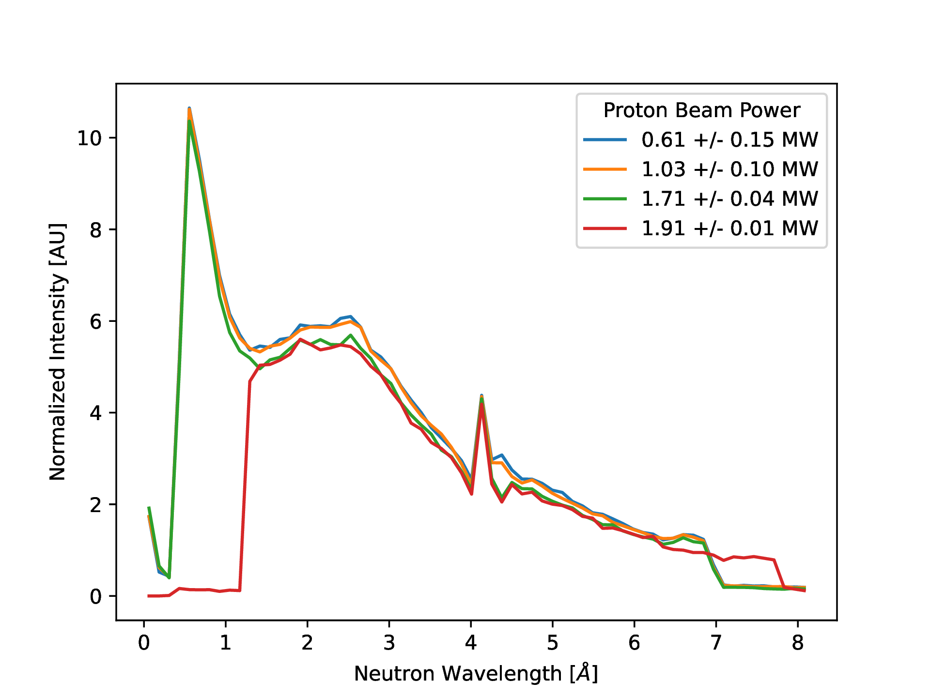
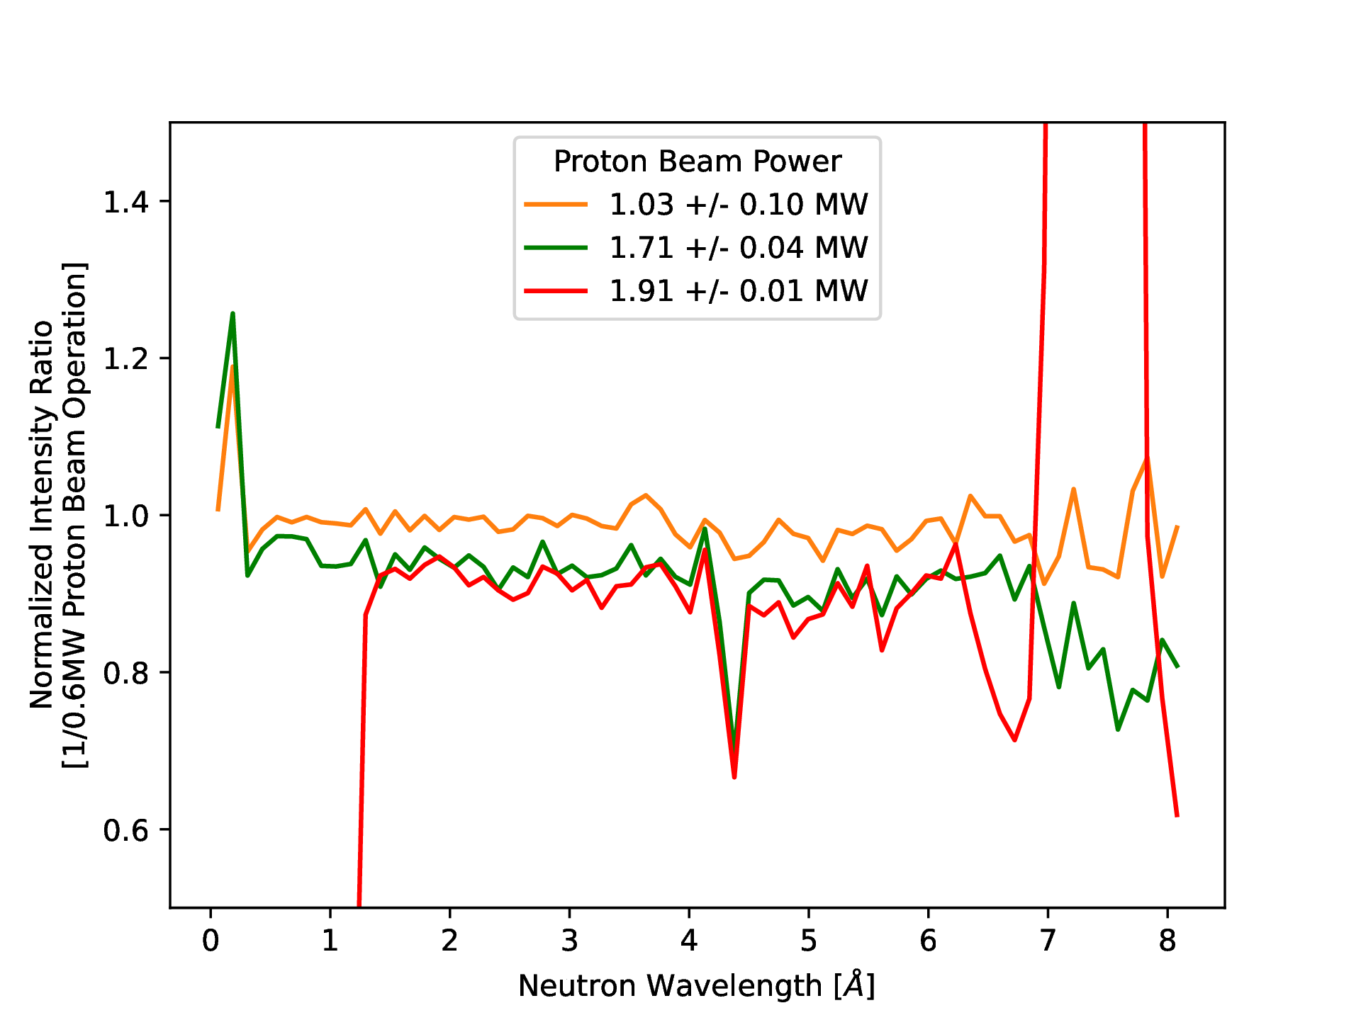
Decoupled H2 (backward) - Reduced Power Non-Linearity (BL-03 / SNAP)
Expected Changes
Changes in moderator design intended to improve flow patterns, reducing non-linearity in performance with power by reducing potential flow stagnation. Non-linearity reduced intensity at full power by 10-20% depending on wavelength
All increases in intensity should be accompanied by increases in pulse width (that is, poorer potential resolution)
Preliminary Observations
Power dependence is reduced; about -5-10%, seems wavelength independent; very different than before
Loss is same on both sides – despite apparent significant bulge – shouldn’t that impact a stagnation zone differently?
Further work
Repeat during power ramp, so we get multiple points along curve, and not separated by some days (start-up power ramp was...rough, and included chopper problems, as evident)
Better statistics
Notes:
Would be good to also include IRP-2 BOL baseline but complicated by ortho/para catalyst introduction
<number>

Slide 17
Expected performance change from IRP-2 EOL to IRP-3 BOL
Modification | IRP2 EOL vs. IRP3 BOL analysis | IRP2 EOL vs. IRP3 BOL reality?
DWM poison plate repositioning | 1.03 peak DWM thick side 1.08 peak DWM thin side +8% wider pulse widths
DWM poison thickness increase | 0.97 DWM thick side 0.92 DWM thin side
Beryllium height reduction (15 cm) | 0.99
Poison burnup (fresh vs 40 GWh) | 0.80 DWM thick 0.63 DWM thin 0.83 DHM
DHM Power nonlinearity | 1.10 DHM | Reduced, but still present
DHM poison plate bulge expected | 1.35 DHM forward 0.74 DHM backward
CHM modifications | 1.08
Summary | CHM 1.08 DWM thick 0.79 DWM thin 0.62 DHM forward 1.22 DHM backward 0.67 | CHM 1.10 (EQSANS) DWM thick 0.80 (VISION) DWM thin 1.35 (VULCAN) DHM forward 1.48 (POWGEN) DHM backward 0.60 (SNAP)
Notes:
Would be good to also include IRP-2 BOL baseline but complicated by ortho/para catalyst introduction
<number>

Slide 18
Summary
Six viewed moderator faces:
Coupled hydrogen (2) – changed exactly as predicted for IRP-2 to IRP-3 swap
Decoupled water (thick and thin) – sort of not quite but maybe okay…?
VISION (thick side) lost flux and improved resolution exactly as expected, but other beams viewing the same face seem initially to have gone up. Need to keep looking
VULCAN (thin side) should have gone down quite a bit – instead went up quite a bit. There is a known optics issue with the instrument (currently under study). Important note – modern instruments have a lot going on. Changes in the source (moderators) during outages are going to be simultaneous with changes on instrument (maintenance and upgrades). We rarely get to look at one change at a time! Need to keep looking
Decoupled hydrogen (2 faces) – changed as expected, but more sharply – expected +20/-30, got +50/-40. Power-dependent performance changed, but still present.
Note – it changed as expected, but not everyone (i.e., instrument teams) really heard that expectation. Communicate and manage expectations on repeat!
Moderator Test Station
First Target Station
Second Target Station
Notes:
In building the MDF at SNS, we do not have to focus on flux as much as we would on a stand-alone facility:
SNS doesn't need another beamline - this is for source technology demonstration - dedicated, single-use optimization
A small source would never begin to compete on flux; just don't worry about it
Prototypical nature is more important than flux anyway

