Slide 1
Design and Commissioning of the Reflectivity Measurement Terminal of NTDS
Qing zhang
Institute of High Energy Physics, Chinese Academy of Sciences
China Spallation Neutron Source Center
Notes:
Good morning, everyone. My name is XX from the Institute of High Energy Physics, Today, I'm honored to present our work on the "Design and Commissioning of the Reflectivity Measurement Terminal of NTDS."

Slide 2
CONTENT
A brief introduction of NTDS
Design and Construction of the Reflectivity Measurement Terminal
Commissioning
Plans for the future
Notes:
In this presentation, I will cover four main topics. First, I'll give you a brief introduction to NTDS. Second, I'll walk you through the design and construction of our reflectivity measurement terminal. Third, I'll share the commissioning results we've achieved so far. Finally, I'll discuss our plans for the future.

Slide 3
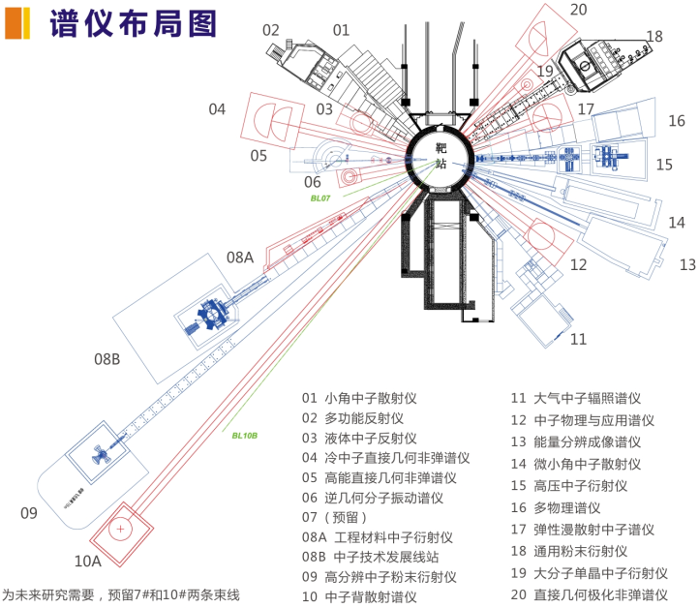

A brief introduction of NTDS
NTDS: A multifunctional test beamline of CSNS
TOF Cold/Hot Neutron Technology Test and Research Platform
Support the construction and operation of the neutron instruments
Promote neutron technology development
Term
Testing of neutron devices
Orientation services of single crystals
Novel Instrumental Demonstration for TOF Neutron
Notes:
Let me begin by introducing NTDS. Since my group leader already introduced NTDS in the previous presentation, I will not go into too much detail here.NTDS stands for Neutron Technology Development Station, which is a multifunctional test beamline at CSNS. It is built to support instrument R&D, neutron device testing, and new technology demonstration.

Slide 4
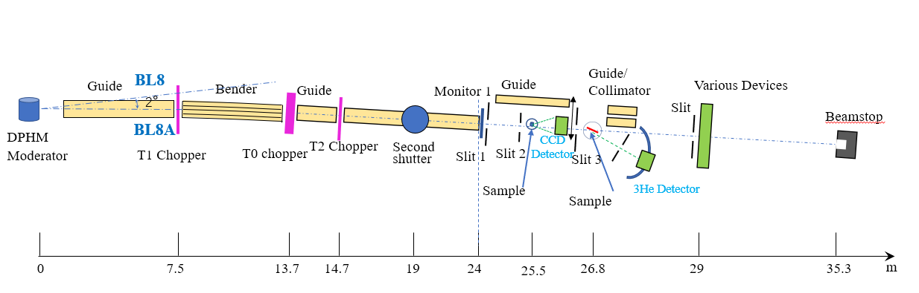
Overview
Beamline and moderator: BL8A, Decoupled Poisoned Hydrogen Moderator
Neutron wavelength and bandwidth: 1~10Å, 4.5Å~6.5Å
Beam size and Neutron intensity @24.2m: max 25mm*50mm, ~1.2×10⁷ n/s/cm²@500KW
Terminal 2
Neutron reflectivity measurement
Terminal 3 Device testing
Terminal 1
Orientation of single crystals
Notes:
This slide shows the physical layout and key design parameters of the NTDS beamline.
NTDS is located at Beamline 8A (BL8A) of CSNS. The neutron wavelength covers 1–10 Å. the maximum beam size is 25 mm × 50 mm, and the neutron intensity reaches approximately 1.2×10⁷ n/s/cm² at 500 kW.
The facility features three terminals: Terminal 1 for single crystal orientation, Terminal 2—which is our focus today—for neutron reflectivity measurement, and Terminal 3 for general device testing.

Slide 5
CONTENT
A brief introduction of NTDS
Design and Construction of the Reflectivity Measurement Terminal
Commissioning
Plans for the future
Notes:
Now let's move to the second part of my presentation—the design and construction of the reflectivity measurement terminal.

Slide 6
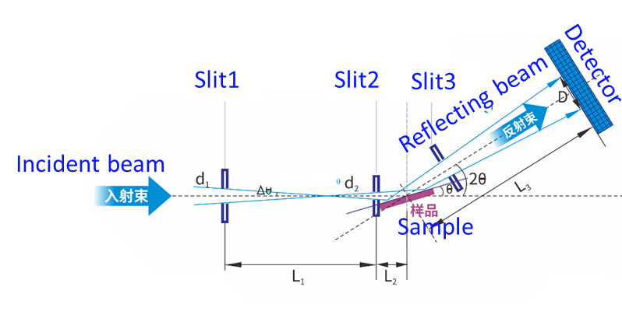
Design
The Reflectivity Measurement System is a dedicated platform built for testing neutron guide supermirrors.
Guide
S1
S3
BEAM
Guide
Beamstop
Monitor
Sample
He3 Detector
S2
CCD
Sample
1880
570
2000
Wavelength：1~10 Å
Bandwidth: 5.4 Å /10 Å
Beam size: 0.1×0.1mm²~25×50mm²
Q range: 0.005~0.22Å-1（m=0.2~10）
Best Resolution DQ/Q：~1%
Detector: 4*He3 tube,8mm×300mm
Neutron flux at sample: ~10⁶n/s/cm²@180kW
Notes:
The Reflectance Measurement System is specifically designed as a dedicated platform for testing neutron guide supermirrors—a critical component in neutron scattering instruments. Looking at the picher, the neutron beam travels from left to right through the system. It passes through slits S1 and S3, then reaches the sample position. The reflected neutrons are captured by the helium-3 detector mounted on a reflection arm. the Q range covers 0.005 to 0.22, corresponding to m-values from 0.2 to 10. At the sample position, we achieve a neutron flux of about 10 to the power of 6 neutrons per second per square centimeter at 180 kilowatts.

Slide 7
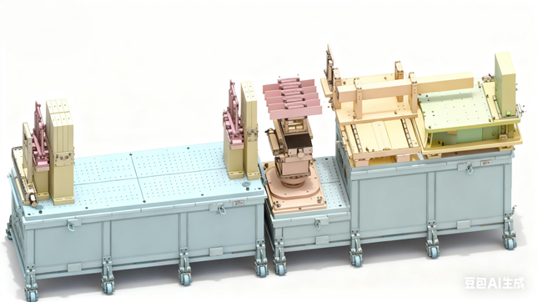
Design
The main components of the Reflectivity Measurement Terminal :
1）Monitor
2) Slit *2
range: ~60×60max
repeat accuracy: ±10um
3) Sample stage
Rz range and accuracy:±180° 0.001°
Ry range and accuracy:±10° 0.001°
X/Y range and accuracy:±20mm ±10um
Z and accuracy ：±25mm ±10um
4) Reflection arm
range: -2~10°
repeat accuracy: 0.001°
5) Detector
helium‑3 tube detectors
4* 8 mm(W) × 300 mm(H), arranged vertically
5) Collimator (to be installed)
6) Automatic sample changer
max 5 samples for switching
repeat accuracy: ±10um
Notes:
Let me detail the main components of the reflectivity measurement terminal. First, a monitor is used for beam monitoring. Second, there are two slit systems that allow precise adjustment of the beam size from 0.01 to 60 mm in both width and height.
The sample stage is a 5‑axis motion platform comprising three translational axes and two rotational axes, enabling precise sample positioning.
The reflection arm has a range of -2 degrees to 10 degrees. The helium-3 tube detectors are arranged vertically, four tubes each measuring 8 mm × 300 mm. During reflectivity measurements, we use only one of these tubes to detect neutrons and another tube serves as background. We also have a collimator planned for future installation and an automatic sample changer that can handle up to 5 samples.

Slide 8
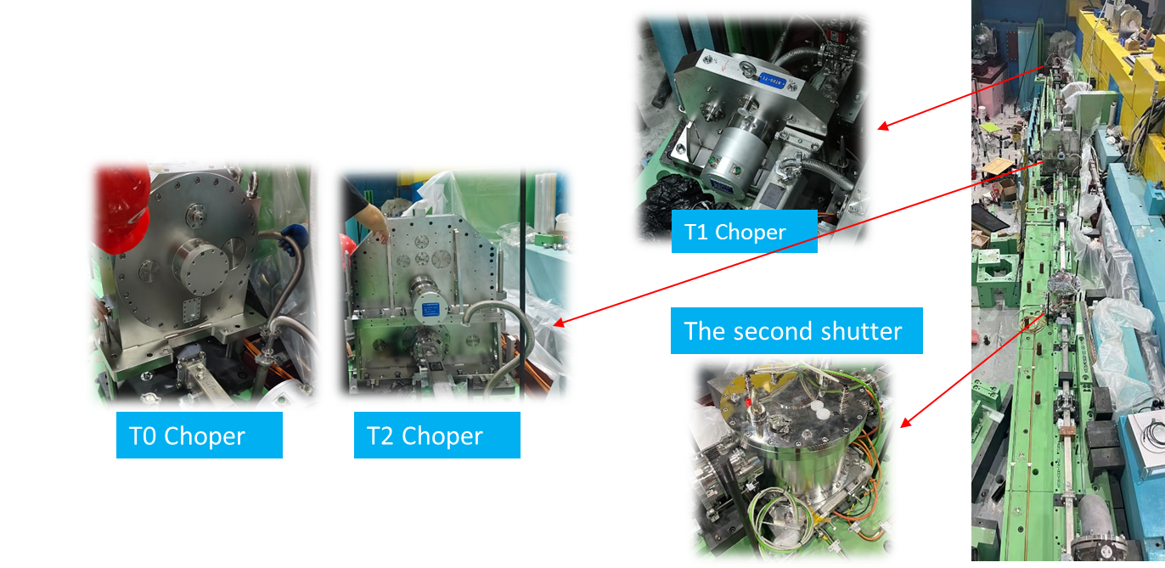
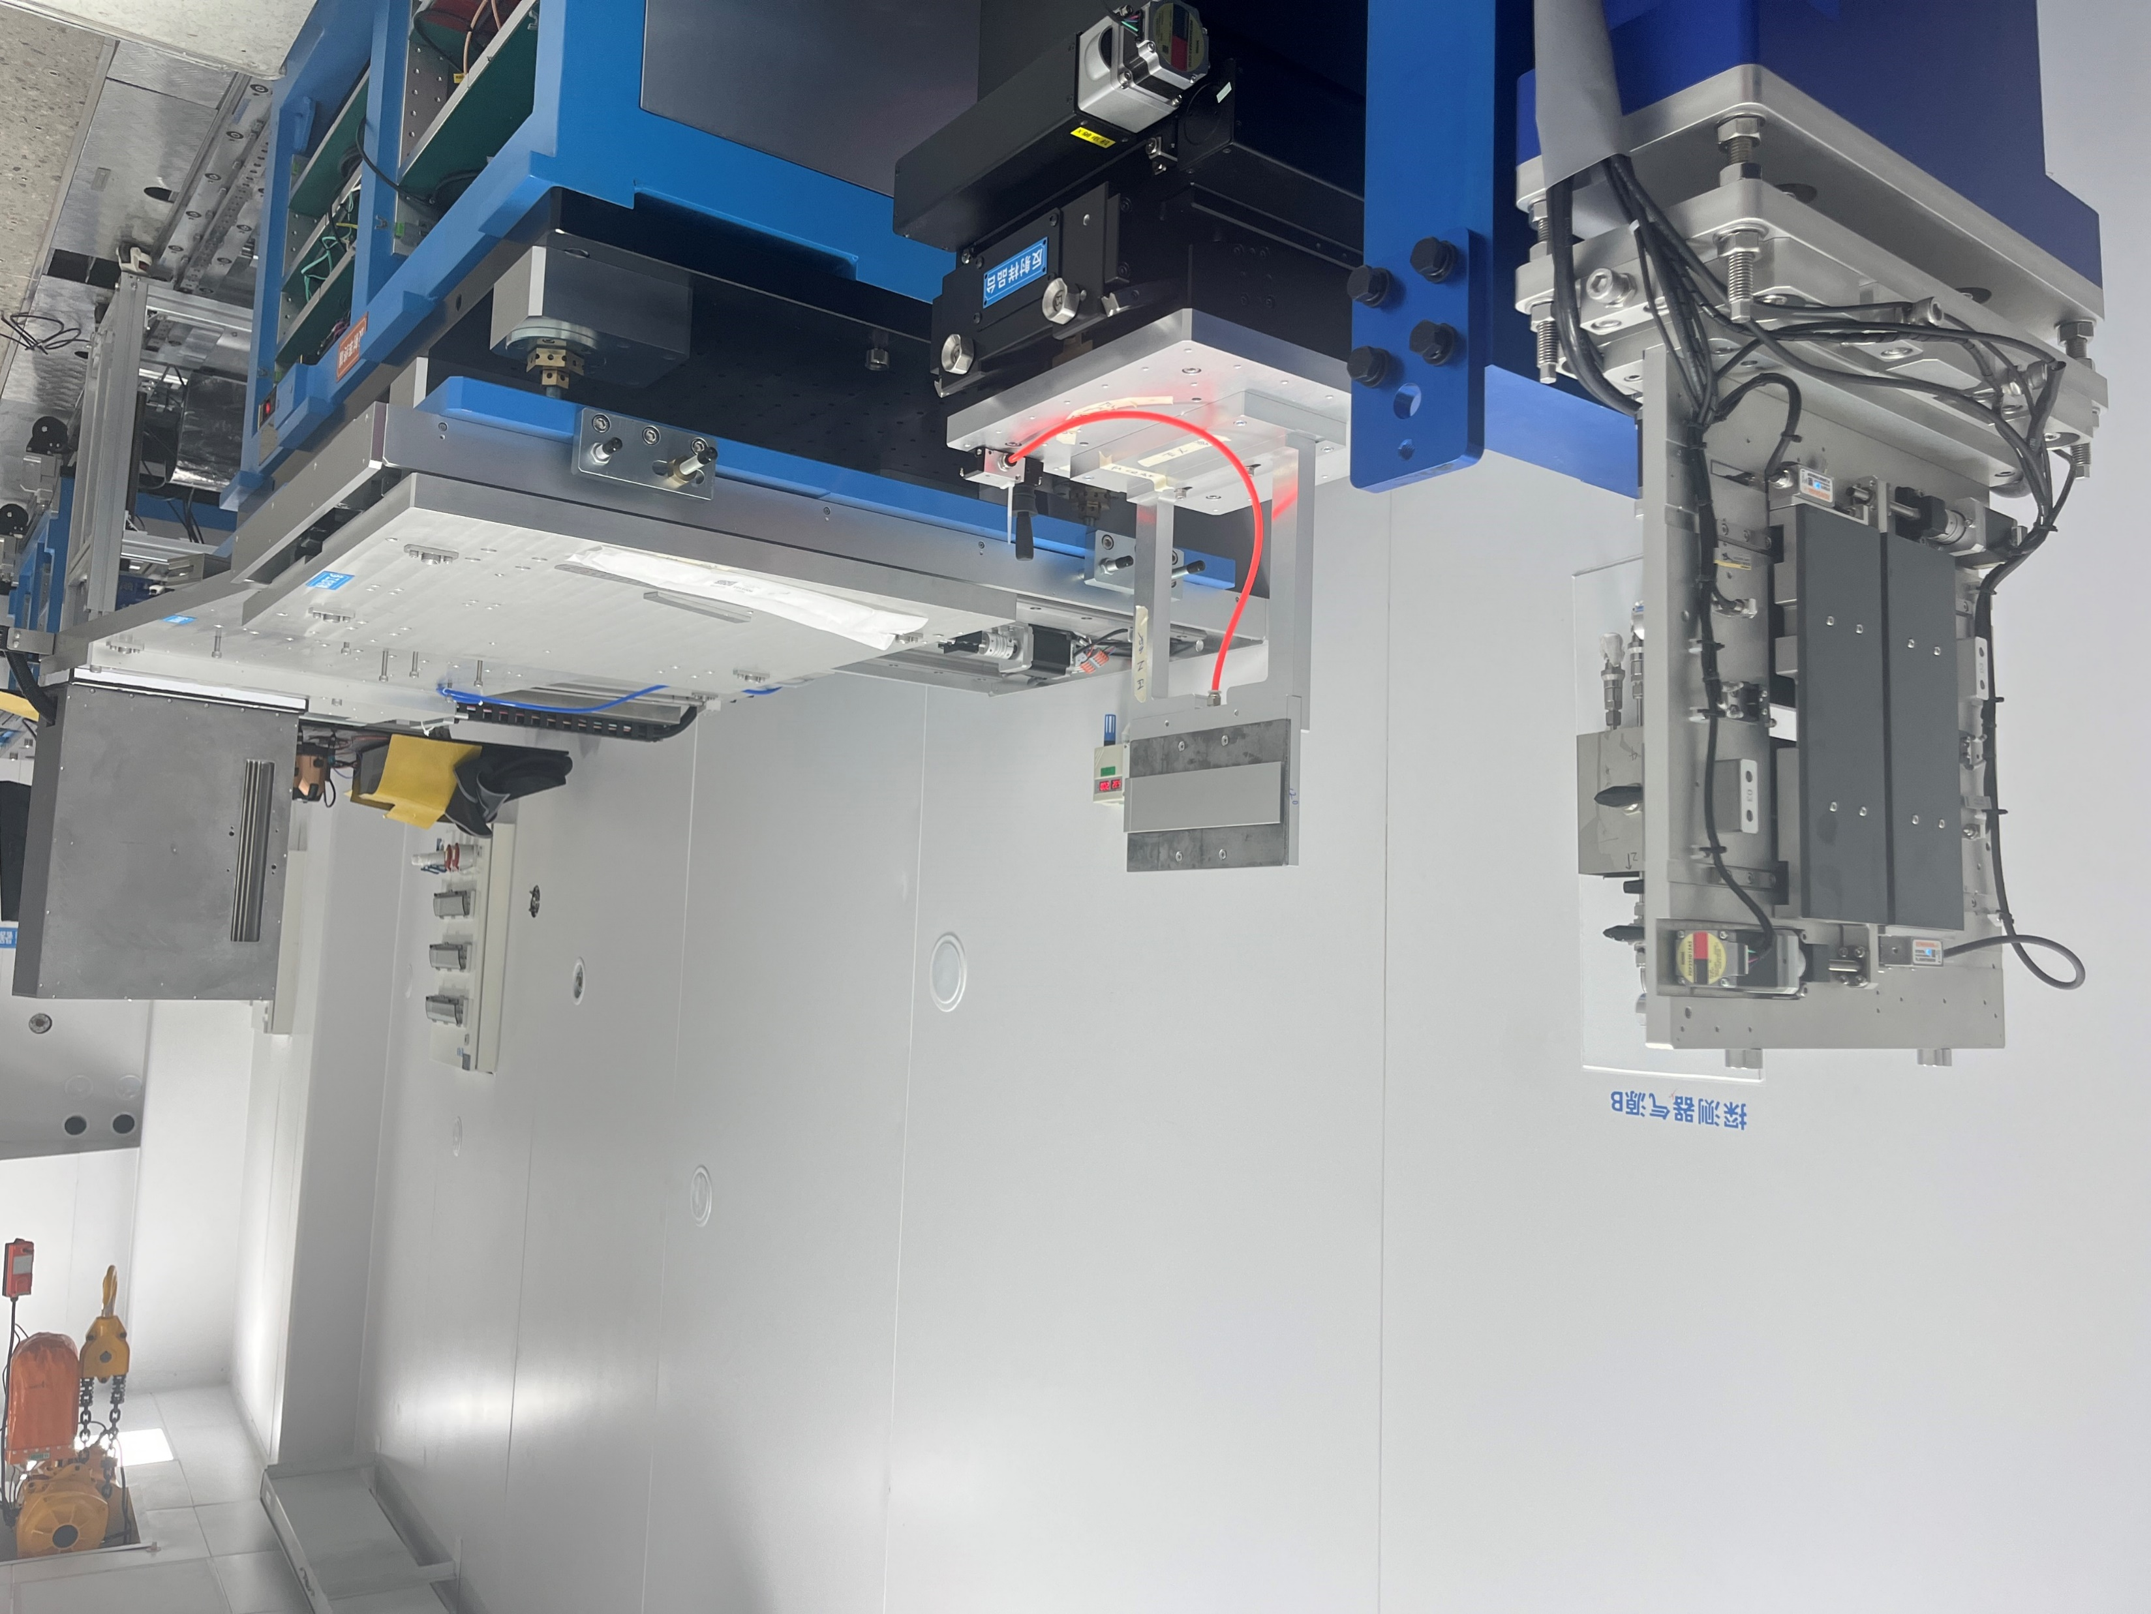
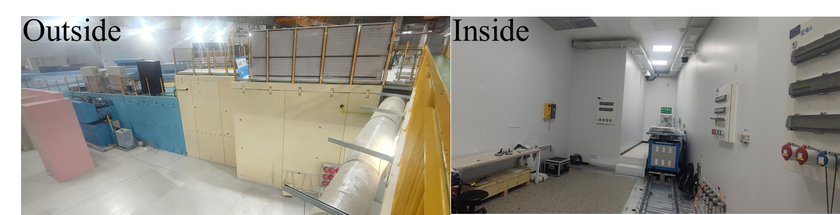
Construction
2024.07-2024.09
Guides and shielding assembly
2025.08
Choppers and shutter assembly
2025.10
Equipment inside the scattering chamber assembly
2026.03.05
First beam come out
now
Commissioning
Notes:
We began installing the first components in the summer of 2024. All front-end beamline equipment had been installed by the summer of 2025. on March 5th, 2026, we achieved first beam—a major milestone for our project. Currently, we are in the commissioning phase, testing and optimizing all systems. These photos show various stages of the entire construction process.

Slide 9
CONTENT
A brief introduction of NTDS
Design and Construction of the Reflectivity Measurement Terminal
Commissioning
Plans for the future
Notes:
Let's now move to the third part—commissioning results. This is where we validate our design through actual measurements.

Slide 10
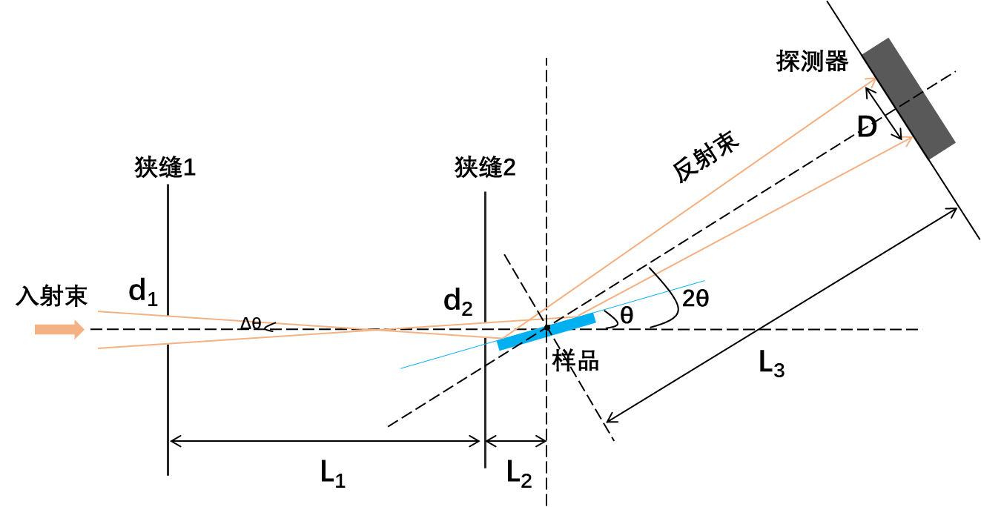


Commissioning
Reflectivity measurement
Sample positioning
Configuration
Direct beam
Reflected beam
Data analysis
Output results
Calibration
How to accurately measure the reflectivity of a neutron supermirror?
Reduce stray neutron counts
Precisely measure the incident angle
A reliable data processing workflow
R = $\frac{I(Q)}{I_{0}}$
$Q(m)=\frac{4π}{λ}∙\sin{θ}≈4π\text{α}∙$m
Notes:
This page shows our reflectivity measurement procedure.
To get accurate results, we must address three challenges: reduce stray neutrons, precisely controlling the incident angle (as reflectivity is highly sensitive to alignment), and use a reliable data processing workflow to extract meaningful results from raw data. These are critical for reliable supermirror characterization.
A major difference exists between reactor and spallation neutron sources for reflectivity measurements.
Reactor sources use a fixed wavelength and vary the incident angle. spallation source employs time-of-flight technique: the mirror is fixed, and wavelength is varied to obtain the full reflectivity curve. only 1–2 angles need to be measured.

Slide 11
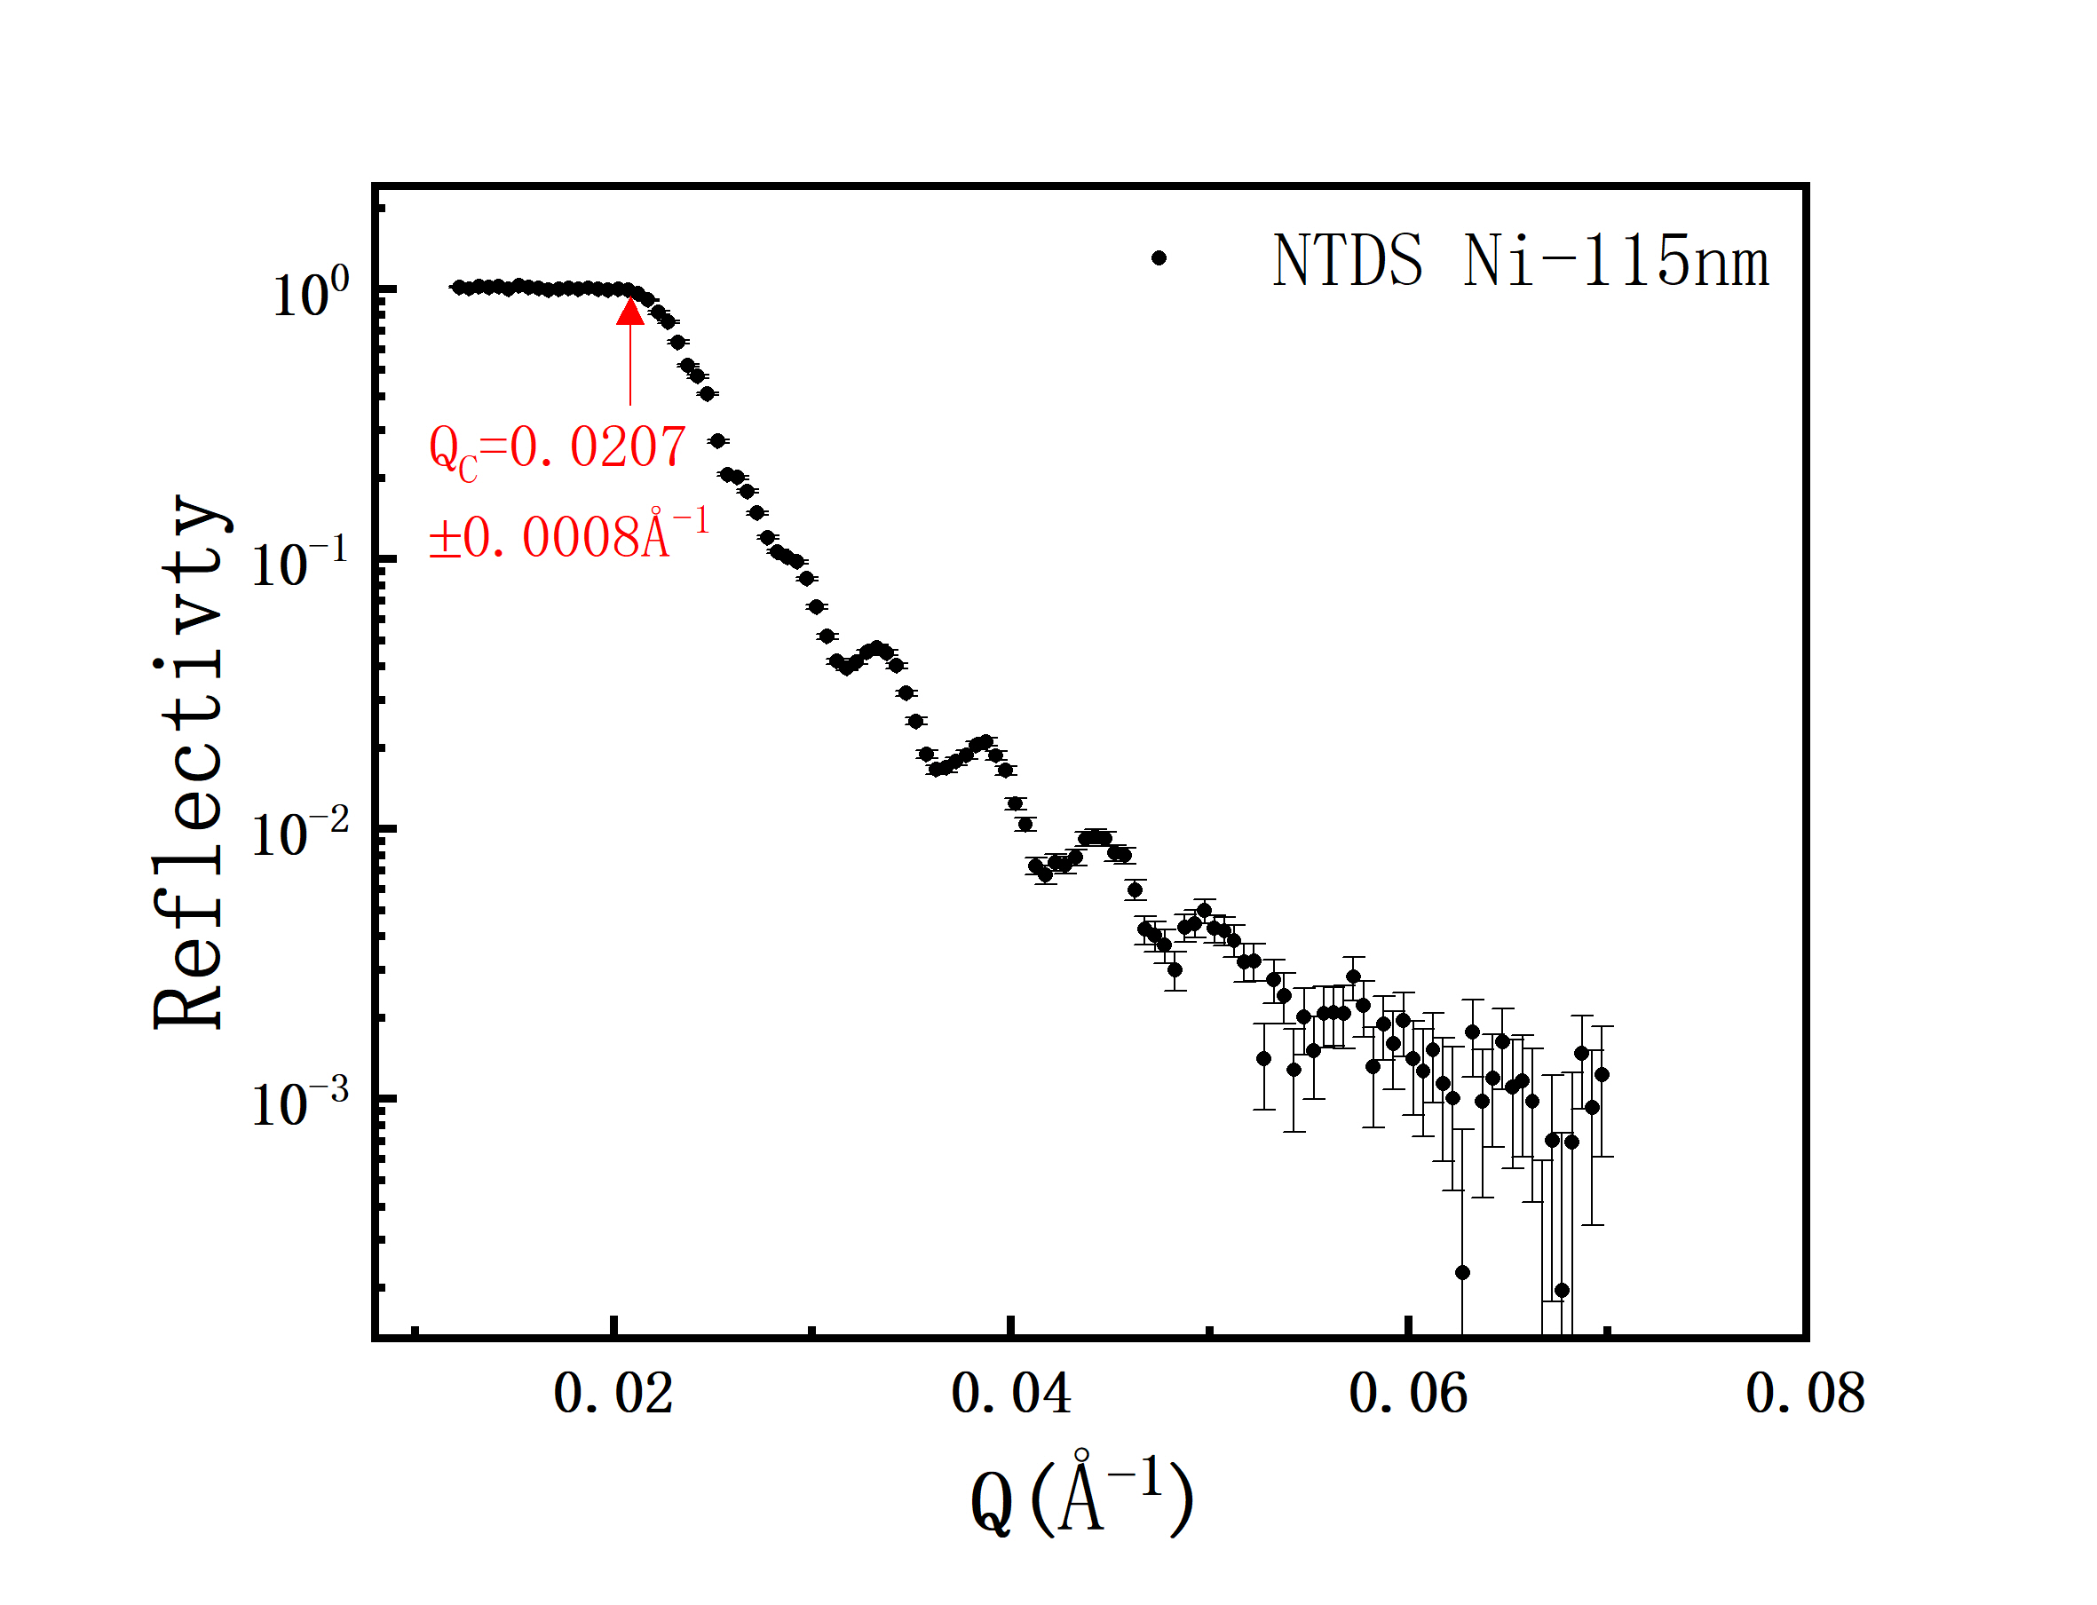
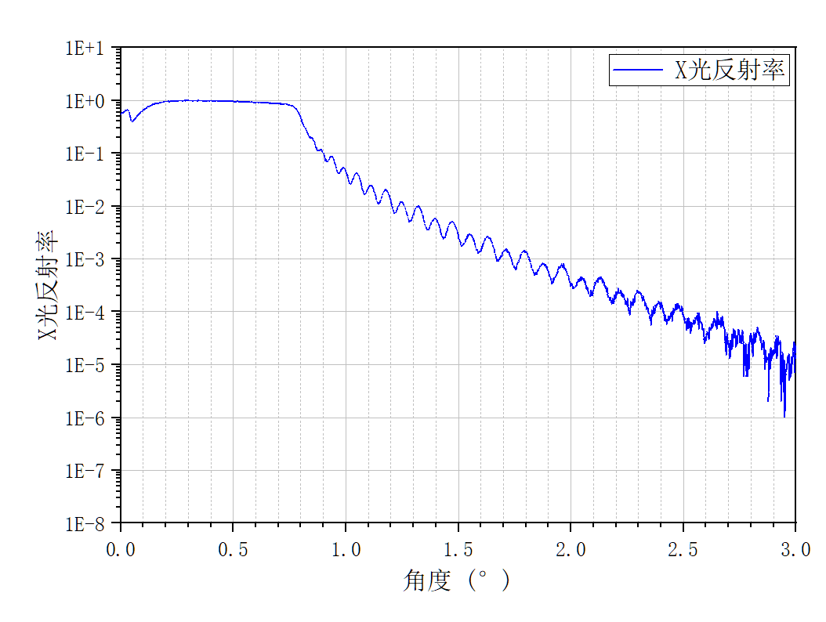
Commissioning
Test of a Standard Ni Film Sample
Sample：Single Ni film, 100 × 40 × 1.5 mm3
Conditions: wavelength 1–6.4 Å, reflection angles 0.3°, 0.4°, 0.5°
Results of NTDS:
Total reflection critical Q-value-0.0207±0.0008Å⁻¹
The film thickness measured by neutron testing shows a deviation of less than 5% from the XRR results.
XRR
NTDS
Notes:
To validate our system, we first tested a standard sample—a single nickel film . We used wavelengths from 1 to 6.4 Angstroms Our results show excellent agreement with established methods. The total reflection critical Q-value was measured at 0.0207 per Angstrom., the film thickness measured by our neutron testing shows a deviation of less than 5 percent from X-ray results. This validates both our instrument and our data analysis procedures.

Slide 12
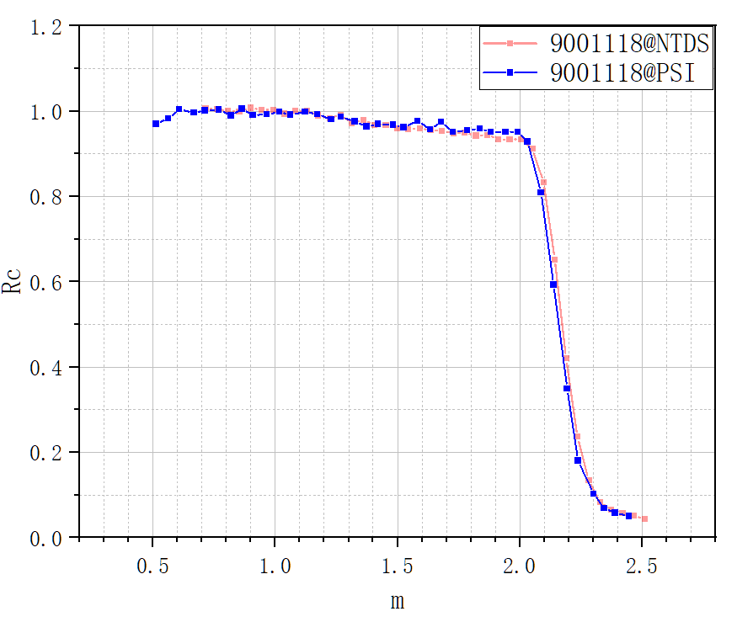
Commissioning
Supermirror sample test
PSI：m=2.17，Rc=93%
NTDS：m=2.18，Rc=92%
Sample: m=2 from Swiss
9001118#, 200×100×5
Conditions
Wavelength ： 2–7.4 Å
Slit: 0.6×20/0.4×20
Reflection angle ： 0.5°
Footprint: 81×32mm²
m range : 0.68-2.52
Notes:
Next, we tested a real supermirror sample. Sample 1 is an m=2 supermirror provided by SWISS. We would like to thank them for their support.
The test condition is simple: the beam footprint is smaller than the sample. Under these conditions, we got an m-range from 0.68 to 2.52.
We obtained a full reflectivity curve with only one angle, so no multi-angle stitching was needed. The figure on the right shows our results ,which agree well with the PSI data. The differences between NTDS and PSI are all within 1%,

Slide 13
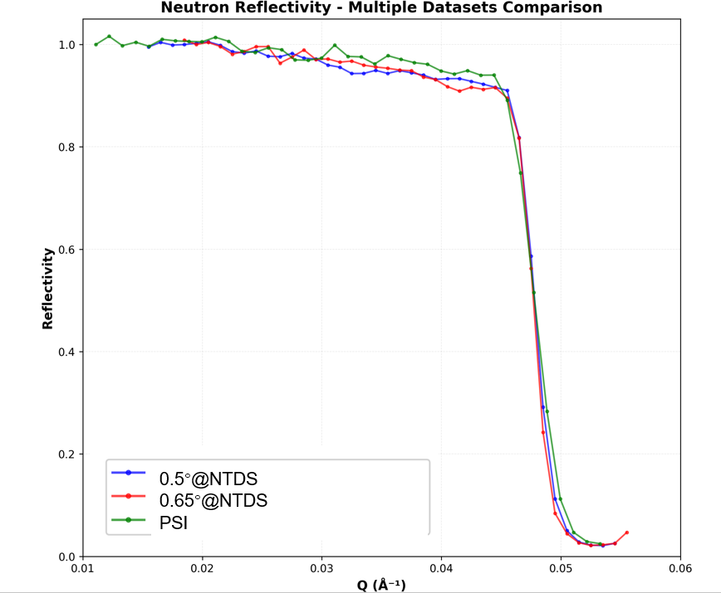
Commissioning
Supermirror sample test
PSI：m=2.21，Rc=91%
NTDS：m=2.21，Rc=93%
Sample: m=2 from CSNS
A2# 400×60×5
Conditions
Wavelength/Å | reflection angle | Slit /mm | Footprint /mm | m range
2~7.4 | 0.5° | 0.6×20 0.4×20 | 81×32 | 0.68~2.52
2.5~7.9 | 0.65° |  | 81×40 | 0.83~2.6
Notes:
We also tested a supermirror sample developed by CSNS, which was also measured at PSI. Two sets of parameters were used, with the first set being the same as in the previous test. The results show that the difference between the two sets of measurements is small. Compared with the PSI data, the m‑value is essentially the same, while the Rc value is 2% lower.

Slide 14
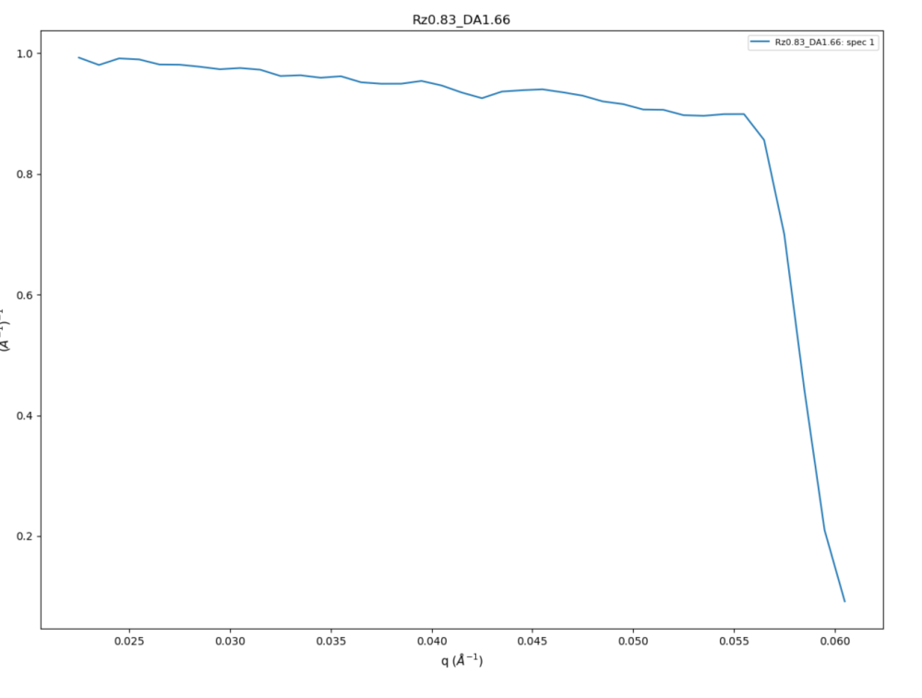
Commissioning
Supermirror sample test
PSI：m=2.71，Rc=92%
NTDS：m=2.70，Rc=91%
Sample: m=2.5 from CSNS
9000509# 420×45×2.75
Conditions
Wavelength ： 3–8.4 Å
Slit: 0.6×20/0.4×20
Reflection angle ： 0.83°
m range : 0.997-2.791
Notes:
Next, we tested another supermirror sample: an m=2.5 mirror from CSNS. The test conditions are listed on the left:
Again, we compared our NTDS results with PSI data.
The differences are all within 1%, showing excellent agreement between the two methods.

Slide 15
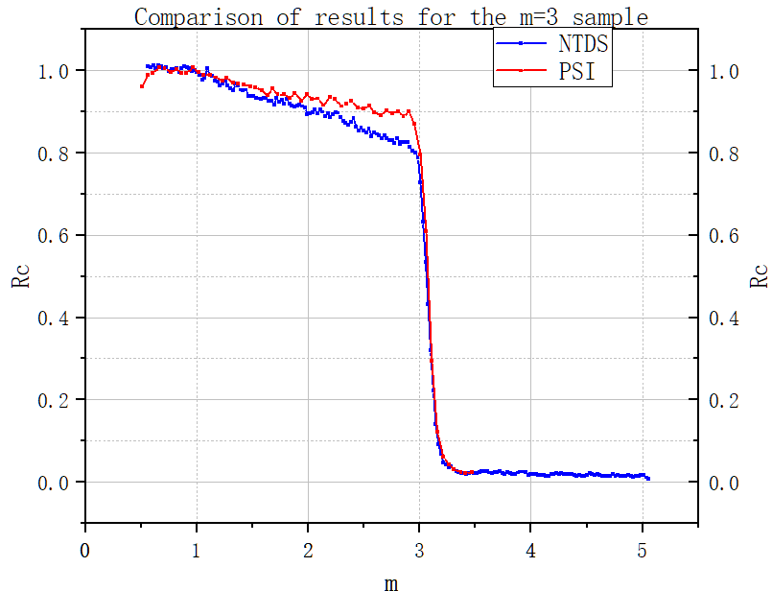
Commissioning
Supermirror sample test
Sample: Ni/Ti m=3 borofloat from Swiss 200×50×5mm³
Conditions
Wavelength ： 1–6.4 Å
Slit: 0.6×25/0.4×25
Reflection angle ： 0.4°/0.5°
m range : 0.63-5.09
PSI：m=3.09，Rc=90%
NTDS：m=3.076，Rc=80.42%
Notes:
Then, we try m =3 sample. We used wavelengths from 1 to 6.4 Angstroms.
let's compare our results with reference measurements from PSI. However, compared with the PSI results, the curve drops faster in the region where m is less than 3, which leads to our measured Rc being around 80%, showing a discrepancy from the PSI results. While the m-value matches very well, there was a difference in the critical reflectivity. This prompted us to investigate further and optimize our measurement conditions.

Slide 16
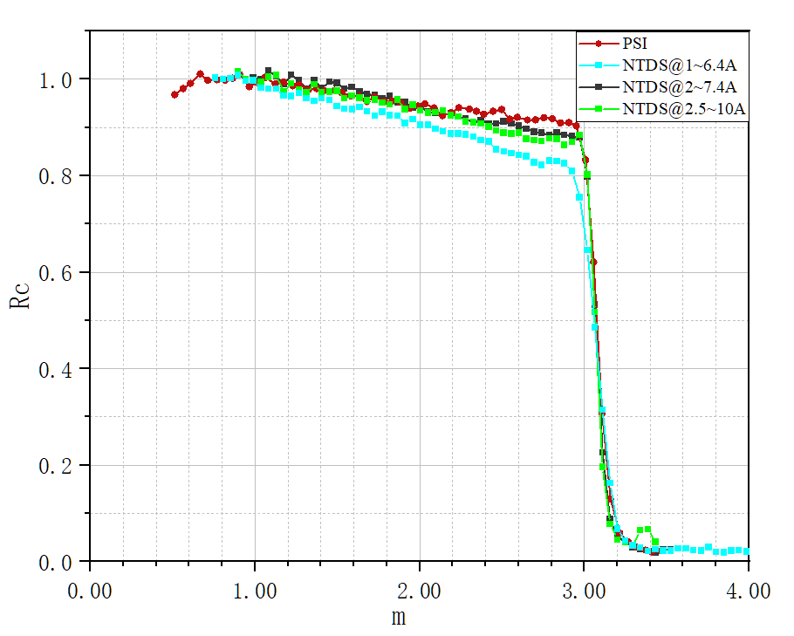

Commissioning
Supermirror sample test
PSI：m=3.09，Rc=90%
NTDS：m=3.08，Rc=88%(NTDS@2~7.4Å)
Test using longer wavelengths
Wavelength
2–7.4Å
2.5~10Å
Notes:
We tried other test conditions, such as narrower slits, different angles, and different wavelengths. Then we found that the results improved when testing with longer wavelengths. Such as from 2 to 7.4 Angstroms and 2.5 to 10 Angstroms. We now achieve m equals 3.08 with critical reflectivity of 88 percent, which is much closer to the PSI reference value of 90 percent. This demonstrates that proper wavelength selection is crucial for accurate supermirror characterization. But the reason needs to be found.

Slide 17
Plans for the future
Test multiple samples
Perform tests under various different conditions
Explore data analysis methods
Take measures to reduce neutron background
Notes:
Looking ahead, we have several plans to further improve our facility. First, we will test multiple samples to build a comprehensive database. Second, we'll perform tests under various different conditions to fully characterize the instrument capabilities. Third, we'll continue exploring data analysis methods to improve accuracy. Fourth, we'll take measures to reduce neutron background even further. Finally, we'll automate processes to improve experimental efficiency and user experience.

Slide 18
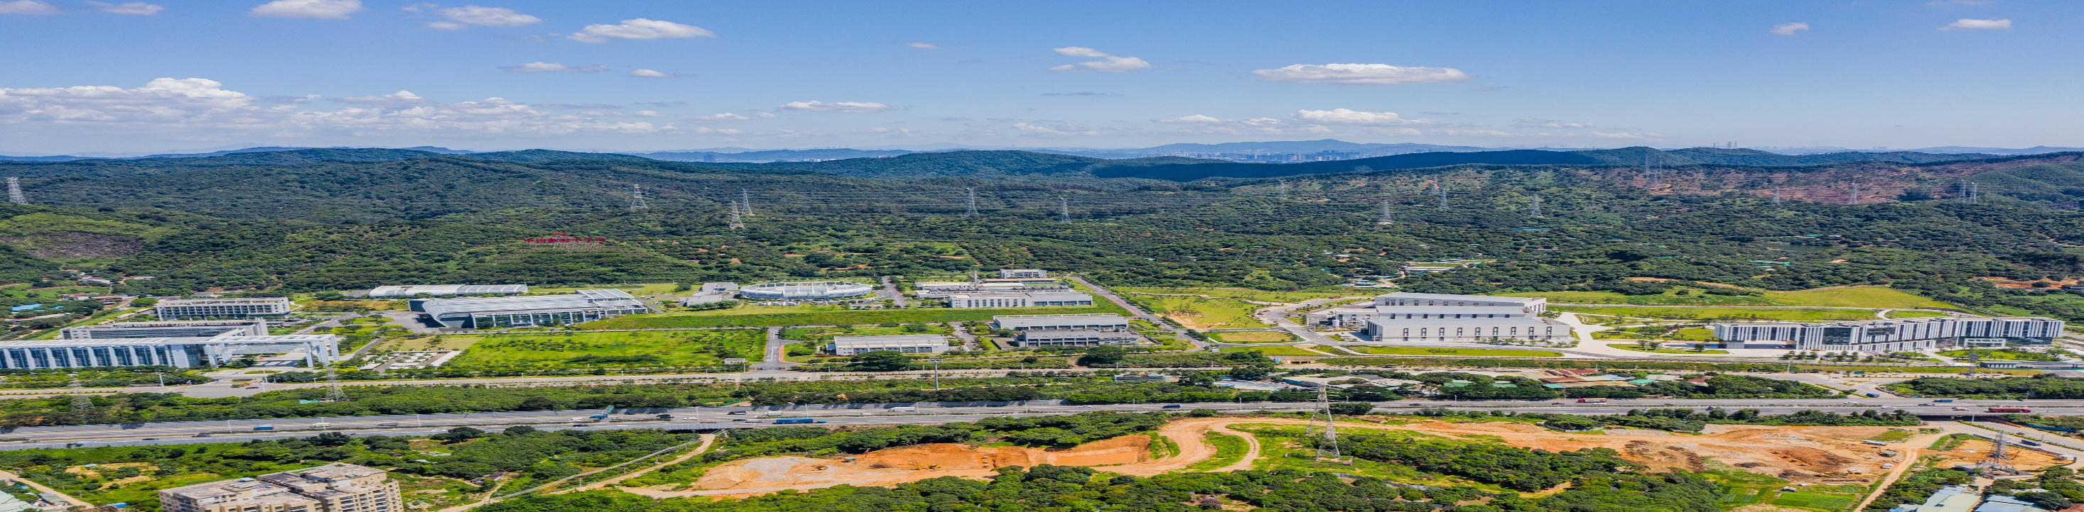
Thank you for your attention!
Any questions and advices are expected!
Notes:
Thank you very much for your attention. I hope this presentation has given you a good overview of our work on the reflectivity measurement terminal at NTDS. We welcome users who need supermirror or other reflectivity tests to come and test at our facility. THANK YOU!

