Slide 1



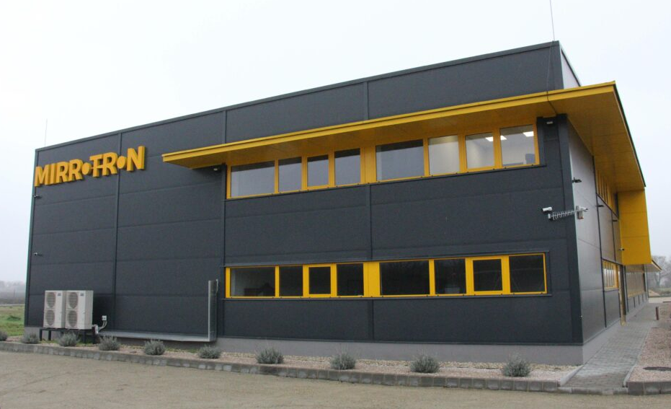
Future 8 MeV Upgrade for the LvB Compact Accelerator-driven Neutron Source
Mina Akhyani, Ha Shuai, Ferenc Mezei

Slide 2
AGENDA
LvB project history and now
LvB upgrade plan
Performance estimate in the upgrade
Brightify implementation
Conclusions

Slide 3
LvB compact source project
BNCT
Upgrade area
70º beam line
RFQ 3 m
DTL 5.5 m
ECR
TMR
35 keV
8 MeV
2.5 MeV
Started at 2018
Purpose of the LvB project
Meet the neutron demand of Mirrotron Ltd for supermirror and other instrument testing
Provide neutron beam time for other industrial companies

Slide 4
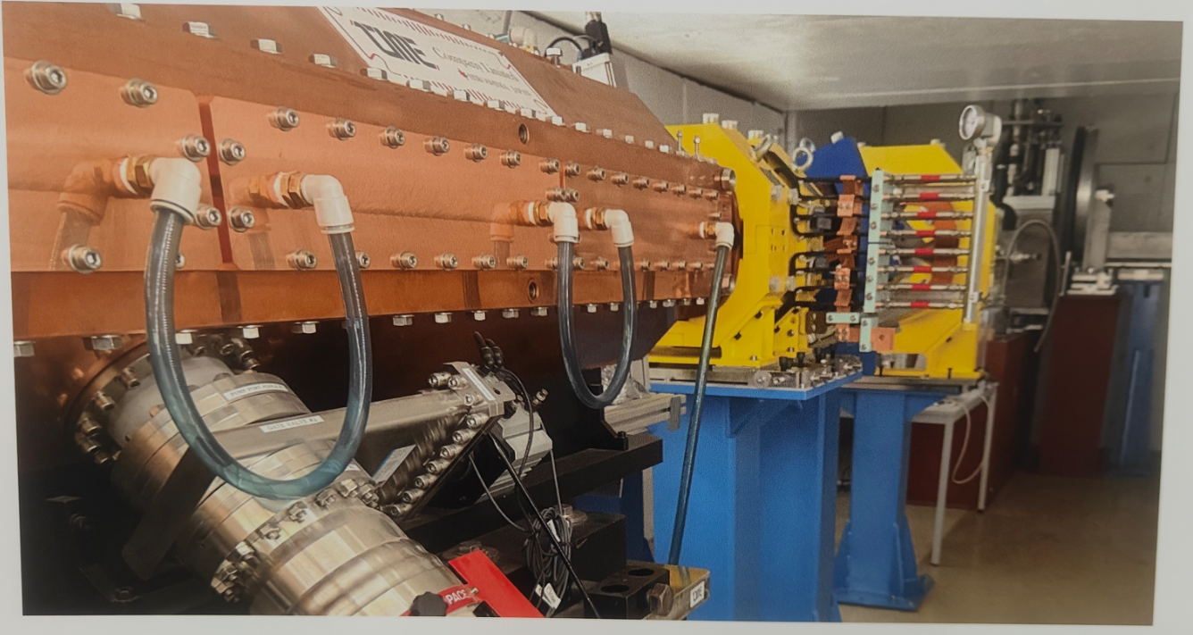
LvB Accelerator
Accelerator Parameters
Ion Source | Mode | Pulsed beam
 | Pulse width | 1.25 ms
 | Output energy | 35 keV
 | Pulse frequency | 40 Hz
 | Peak current | 20 mA
RFQ | Output energy | 2.5 MeV
 | RF frequency | 200 MHz
 | Duty factor | 5%

Slide 5
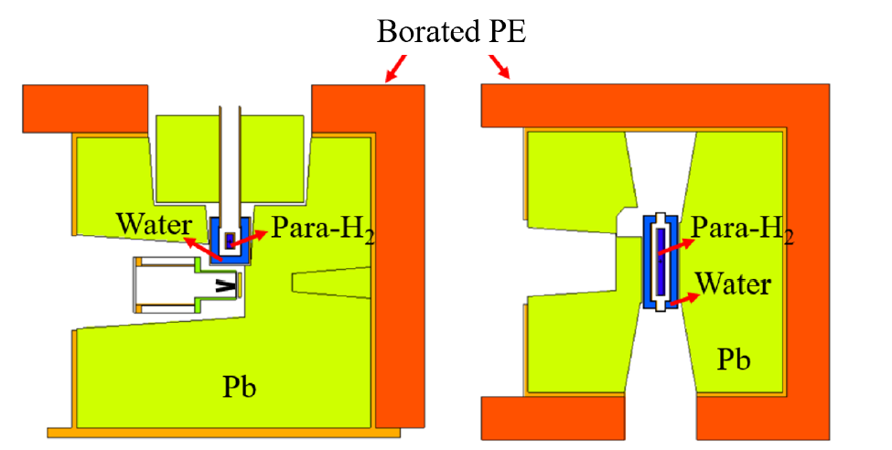
Lvb current tmr assembly
TMR specifications
Target | Material | Lithium
 | Geometry | V-shaped 15 deg wrt beam
 | Dimensions | 3,5*3,5 cm2
 | Thickness | 50 µm
Pre- Moderator | Material | Water (300 K)
 | Wall Thickness | 1.5 cm
 | Length | 21 cm
 | External Cross-section | 8,2*9,9 cm2
Cold Moderator | Material | Para-H2 (20 K)
 | Cross-section dimensions | 1,5*3 cm2
 | Length | 15 cm
Reflector | Material | Lead
 | External Dimensions | 60*60*60 cm3
Side view
top view

Slide 6
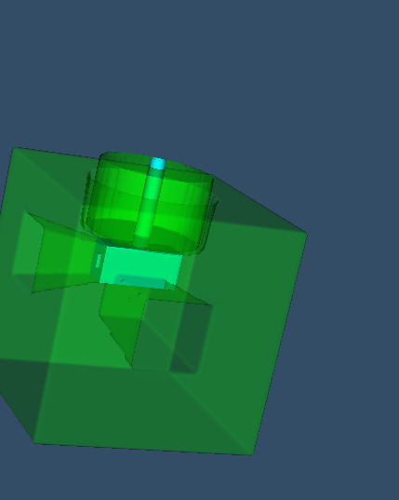
Upgrade plan: which parts of TMR must/could be modified?
Target (MUST)
Replace existing solid Li target
Goal: enable high neutron yield and long target lifetime at 8 MeV proton energy (blistering, heat load)
Moderator (COULD)
Adjust dimensions
Optimize location
Reflector (COULD)
Adjust dimensions

Slide 7
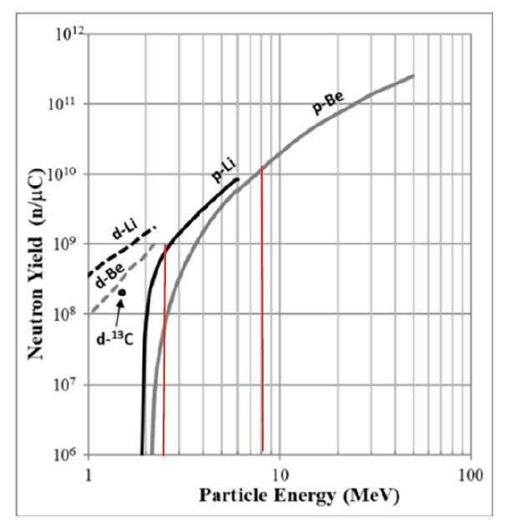
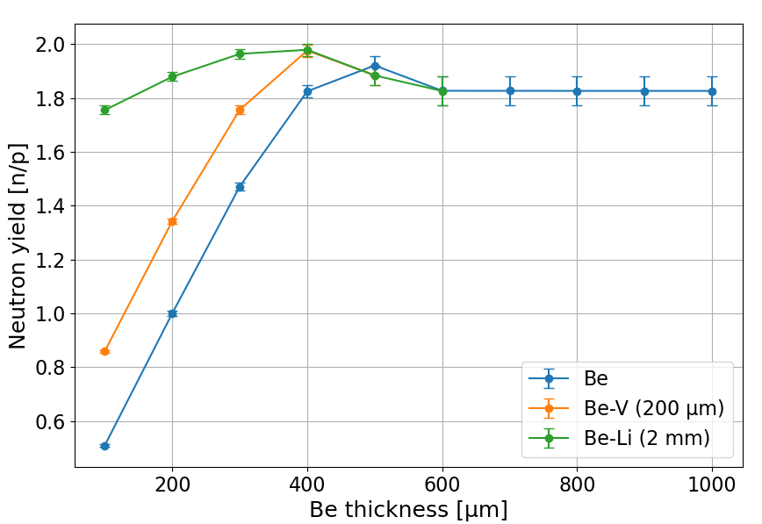
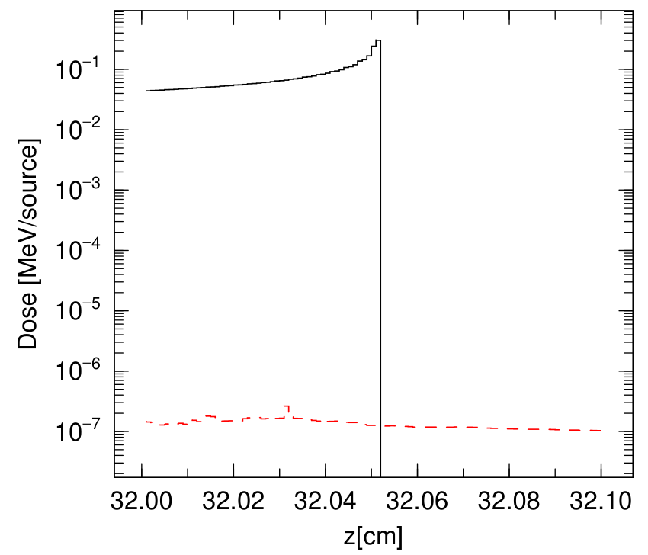
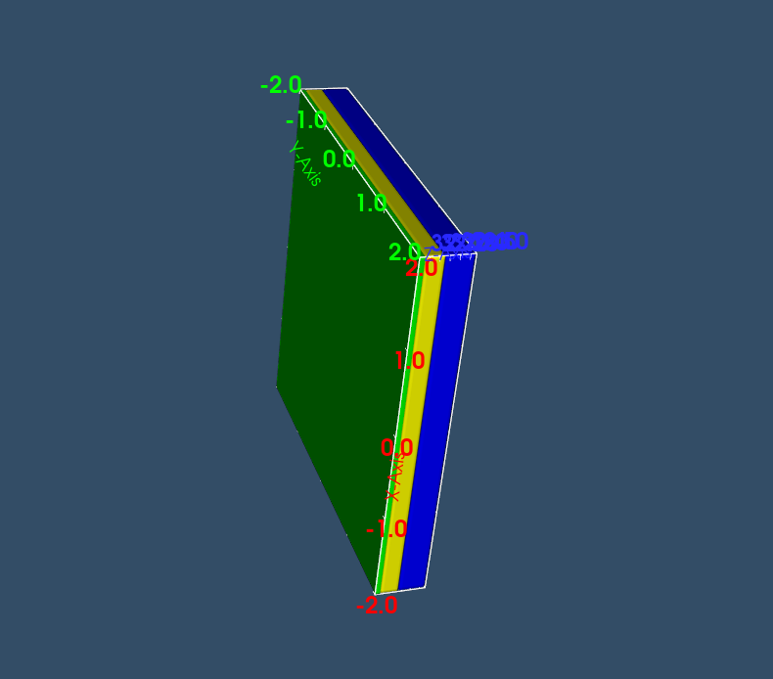
Target optimization
~530 µm
*IAEA, 2023. Advances in boron neutron capture therapy. IAEAL 23-01601.
Heat load requirement:
~500 W/cm² -> Cross-section: 4 × 4 cm²

Slide 8
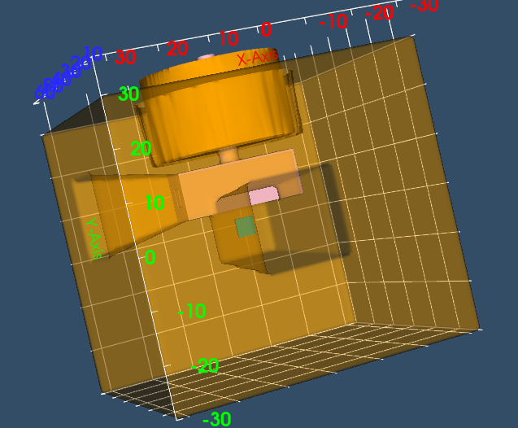
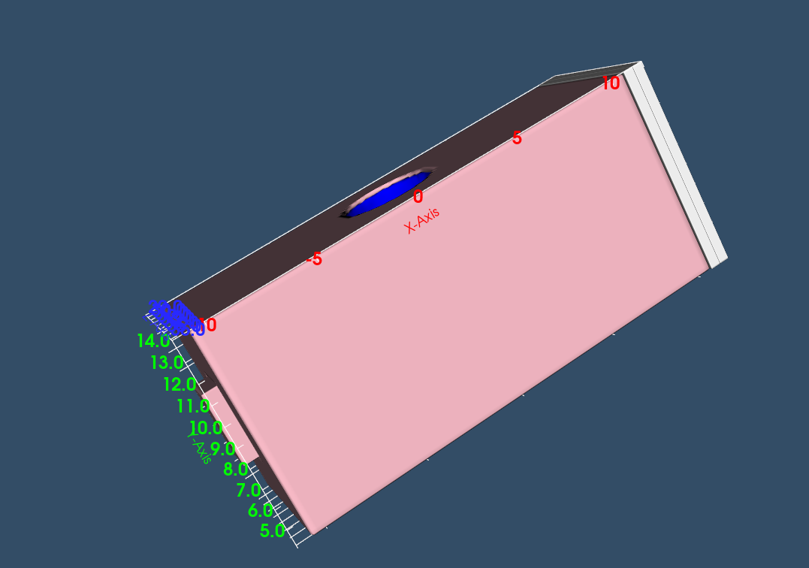

TMR performance
Brightness: Figure-of-Merit
Phase-space density
Brightness is calculated by T-cross, using angular current within 2 degrees.
Void cell is added to the exit surface of the moderator (9.9 cm * 8.2 cm)
Energy range : 2-80 meV (1-6 Å)
T-cross tally
Exit surface of the moderator

Slide 9
TMR performance
Target | Proton energy [MeV] | Be layer thickness [µm] | Moderator length [cm] | Reflector length [cm] | Brightness*1e-8 [1/cm2/sr/source] | Relative error
Li | 2.5 | - | 15 | 60 | 0.4 | 0.04
Be-Li | 8 | 400 | 15 | 60 | 3.8 | 0.03
Proton energy: 2.5 → 8 MeV
Li target → Be-Li target
9X better brightness

Slide 10
Upgrade plan: which parts of TMR must/could be modified?
Target (MUST)
Moderator (COULD)
Adjust dimensions
Reflector (COULD)
Adjust dimensions
Moderator Length
Reflector Length

Slide 11
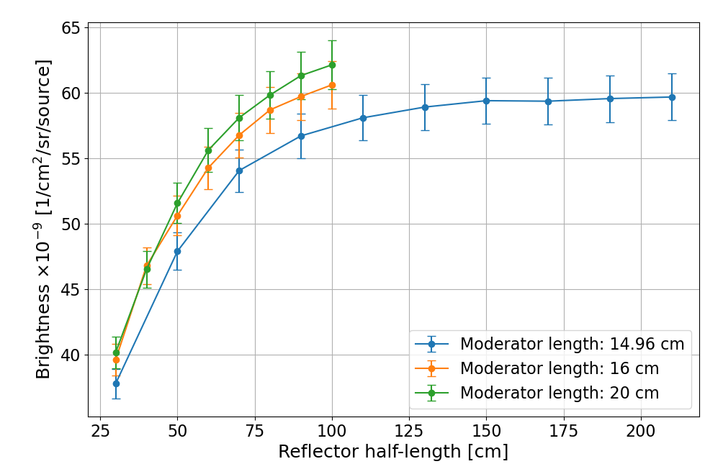
Reflector optimization
opt
max
Highest brightness: 2*2*2 m3 lead
BUT:
Weight: 100t → Too heavy for CANS
Optimal economical choice:
1,2*1,2*1,2 m3

Slide 12
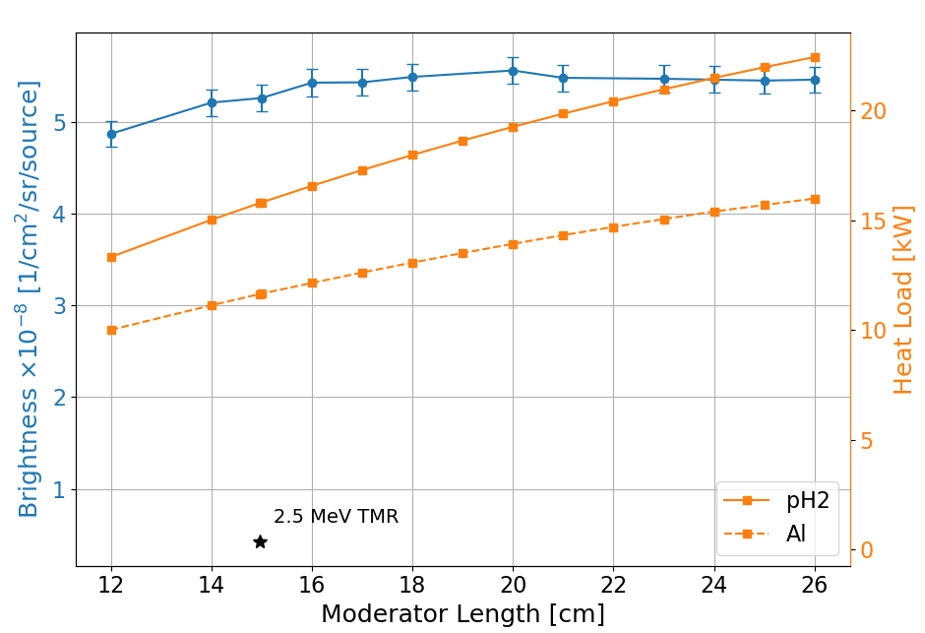
Moderator optimization
Due to cryogenic costs, smaller moderator would be a better choice.
3X more cryostat power is required compared to the current TMR.
Optimal moderator length choice:
15-16 cm

Slide 13
TMR performance
Target | Proton energy [MeV] | Be layer thickness [µm] | Moderator length [cm] | Reflector length [cm] | Brightness*1e-8 [1/cm2/sr/source] | Relative error
Li | 2.5 | - | 15 | 60 | 0.4 | 0.04
Be-Li | 8 | 400 | 15 | 60 | 3.8 | 0.03
Be-Li | 8 | 400 | 15 | 120 | 5.2 | 0.03
Proton energy: 2.5 → 8 MeV
Li target → Be-Li target
Reflector size increased by 8X
13X better brightness

Slide 14
Is brightness calculation accurate?

Slide 15
Is brightness calculation accurate?
Current Method
Caveat
Integrates over the entire moderator exit surface
Uses same phase-space volume for both instruments
Assumes normal direction for brightness calculation
Guides accept only part of the moderator exit surface
Each instrument has its own requirements
Both instruments cannot simultaneously access the normal direction
9 degrees

Slide 16
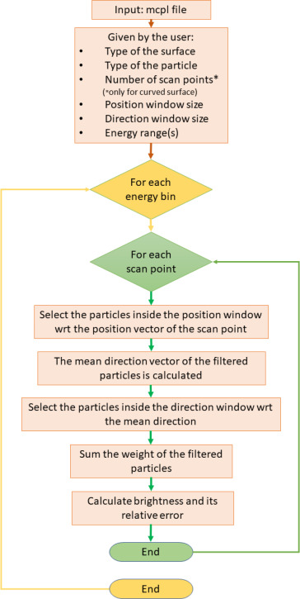
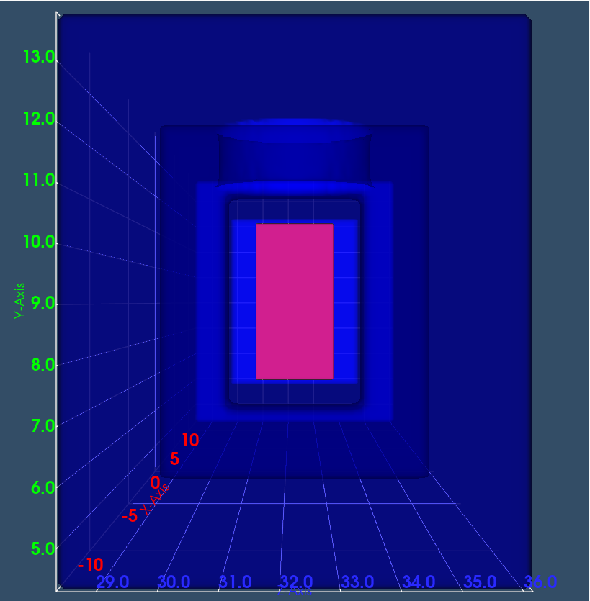
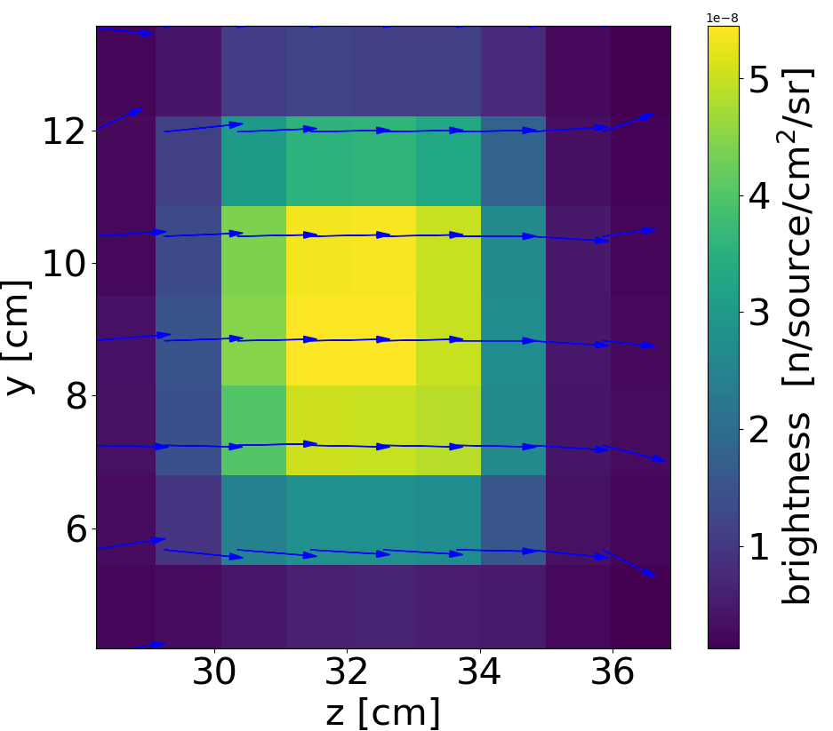
Improving the Brightness Calculation: Brightify*
Enables flexible selection of phase space volume
Allows brightness evaluation for arbitrary emission directions, not limited to the surface normal
Introduces an additional dimension –direction- into the brightness map.
Impact:
Supports optimized guide design and placement
* https://doi.org/10.1016/j.nima.2025.171037

Slide 17
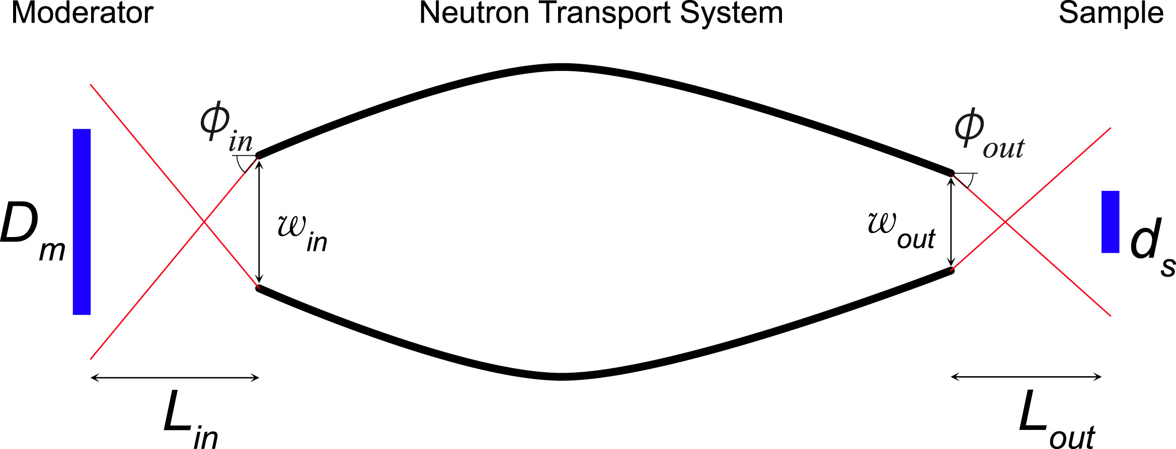
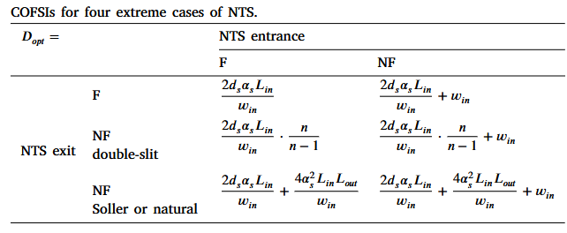
Brightify Implementation: step-by-step
1. Phase space definition
Calculate the phase space volume on the moderator surface analytically (using COFSI*)
This defines the resolution of the brightness map
2. Directional optimization
Use brightify to identify optimal emission direction for cold brightness (highly directional)
3. Consistent direction application
Apply the same optimized direction to: Thermal and bi-spectral brightness maps
*https://doi.org/10.1016/j.nima.2023.168643

Slide 18
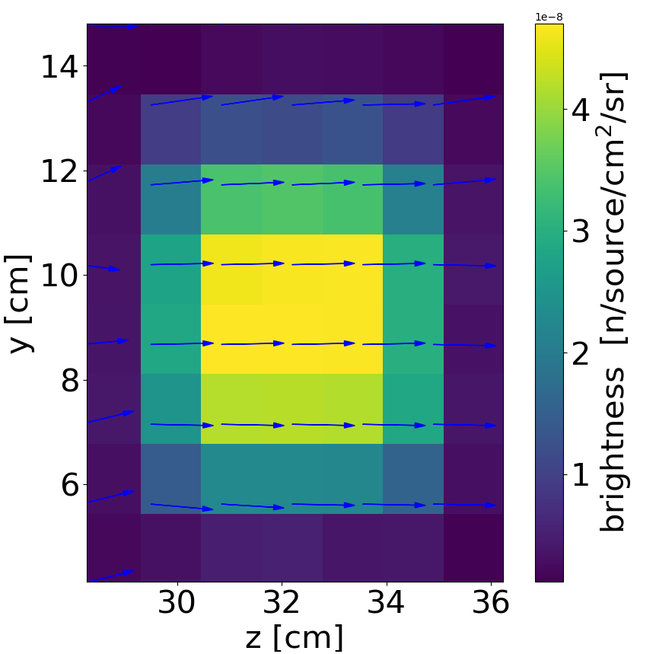
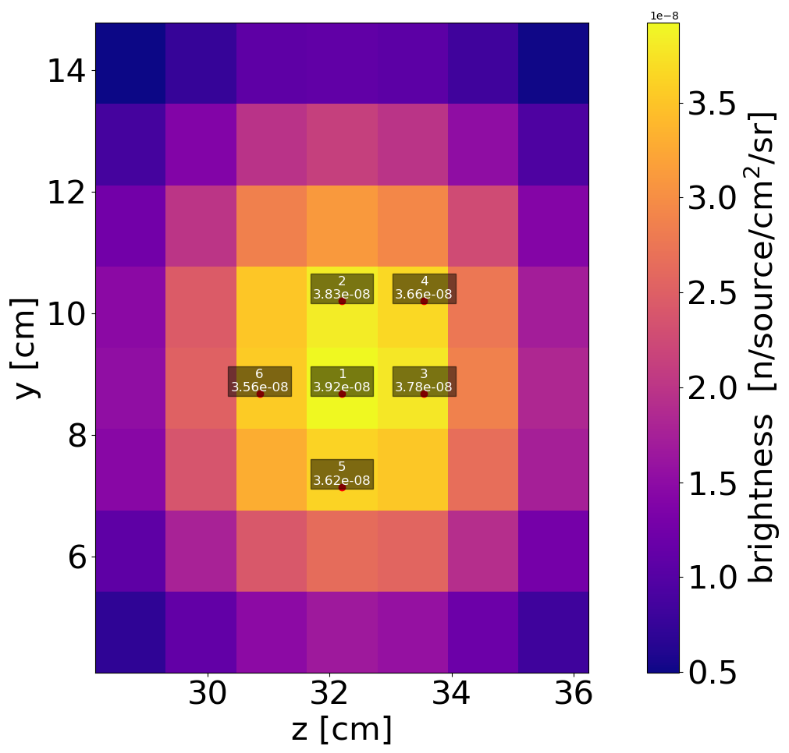
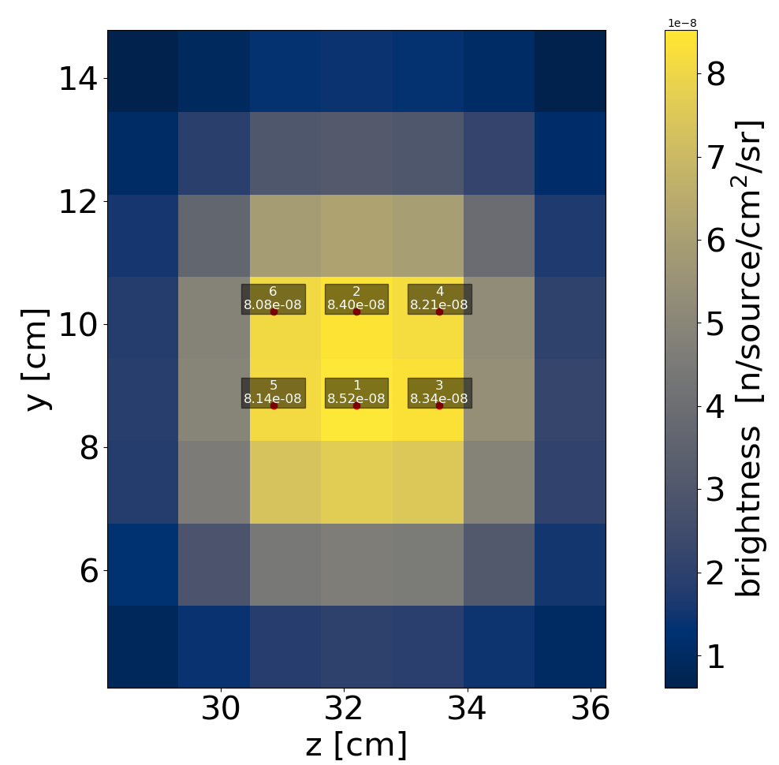
Instrument-specific brightness
Instrument | Phase-space volume | (1) Cold Brightness 2-20 meV [n/cm2/source/sr] *1e-8 | (2) Thermal 20-80 meV [n/cm2/source/sr] *1e-8 | (3) Bispectral 2-80 meV [n/cm2/source/sr] *1e-8
Reflectometer | 5.4*6.1 cm2 2 degrees | 4.7 | 3.9 | 8.5
Diffractometer | 4.4*6.3 cm2 2 degrees | 5.45 | 4.0 | 9.5
1
2
3

Slide 19
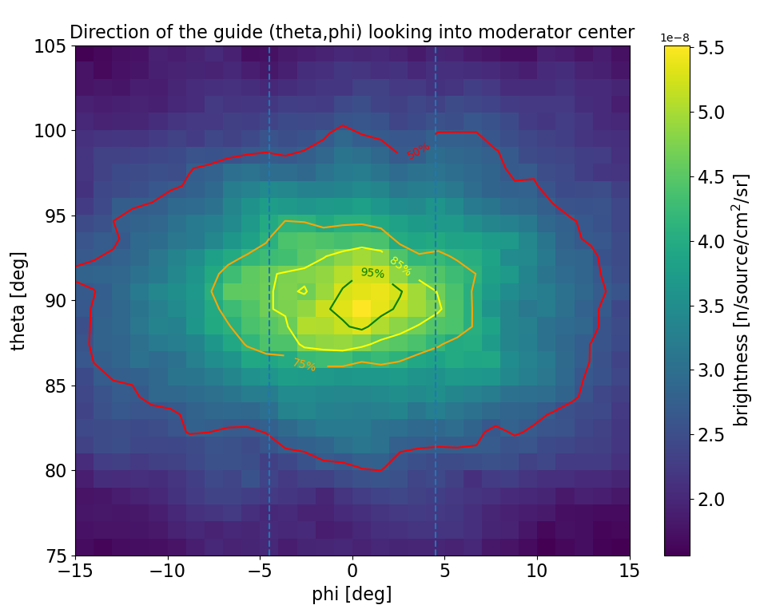

What if the instrument is not in the normal direction to the moderator surface?
guides
$$φ$$
Moderator exit surface
Top view

Slide 20
Final tips & takeaways
LvB upgrade
Improved brightness evaluation
~13X performance gain by:
Proton energy increased:
2.5 MeV → 8 MeV
Target design improved:
Li → Li-Be
Reflector volume increased by a factor of 8
Brightify implemented for more realistic, instrument-relevant brightness estimation.
Deviation from optimal direction results in:
~15% loss at 4.5°
Up to 50% loss at 15°
How can we better arrange the guides around a single moderator to without sacrificing this hard-won brightness?

Slide 21
THANK YOU
Mina Akhyani
m.Akhyani@fz-Juelich.de
https://github.com/BrightnessTools/Brightify

